Slide 1
Rounding & Estimation
Rounding
SAM
1H Q11
May 2017 1H Q15
Edexcel
Spec 1
1H Q8
Nov 2017 2H Q8
AQA
Spec 2
1H Q8
Nov 2018 3H Q1
OCR
Spec 2
2H Q16
May 2019 1H Q8

Slide 2
Rounding & Estimation
Rounding
Nov 2017
1H Q8
Edexcel
Nov 2017
1H Q12
AQA
SAM
3H Q8
1 Marker
Nov 2017
1H Q4
OCR
Nov 2018
1H Q16

Slide 3
Rounding & Estimation
Rounding
Edexcel
June 2018
3H Q3
AQA
Practice
2H Q17
Nov 2018
2H Q2
OCR

Slide 4
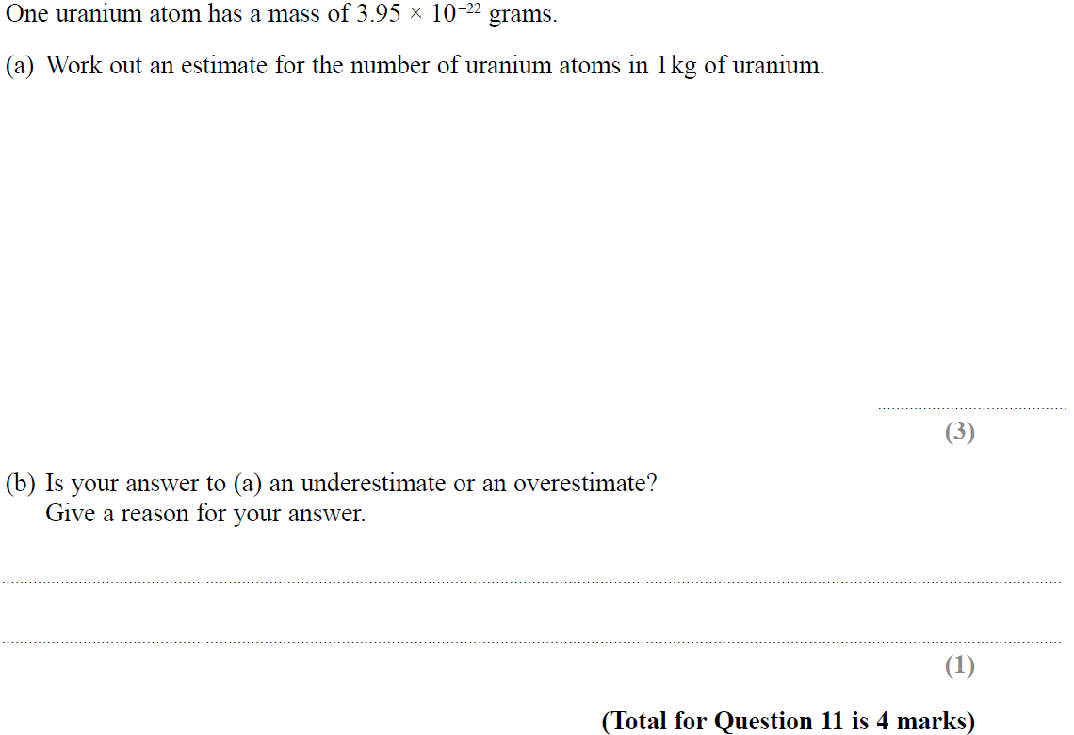
Rounding
SAM 1H Q11

Slide 5
Rounding
SAM 1H Q11
A
B

Slide 6
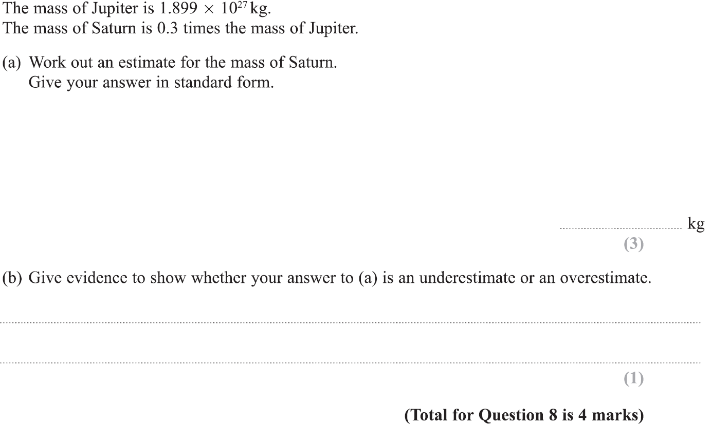
Rounding
Specimen Set 1 1H Q8

Slide 7
Rounding
Specimen Set 1 1H Q8
A
B

Slide 8
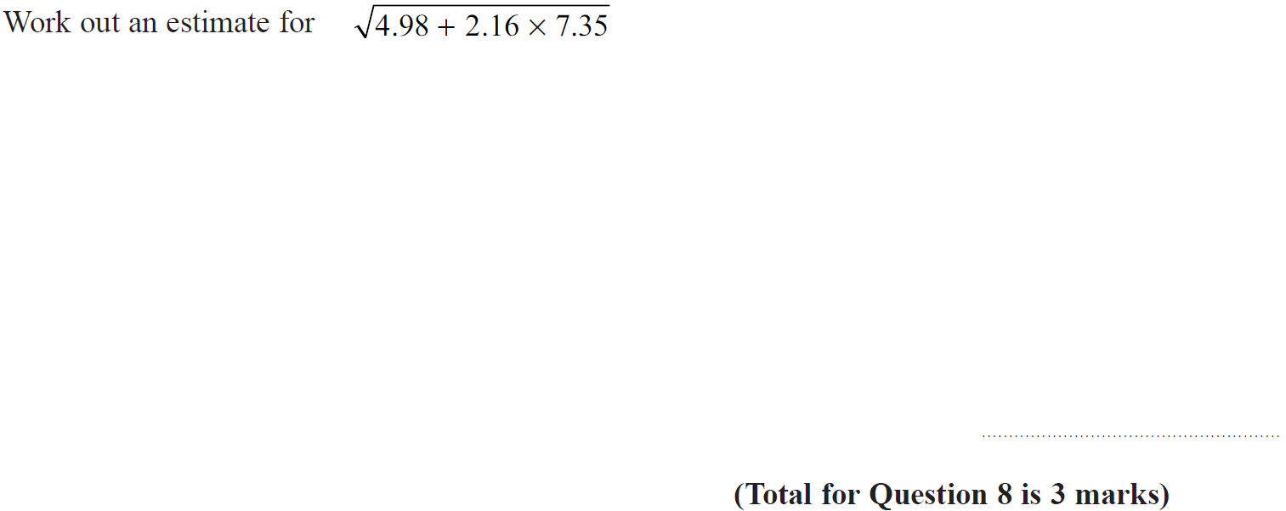
Rounding
Specimen Set 2 1H Q8

Slide 9
Rounding
Specimen Set 2 1H Q8
A

Slide 10
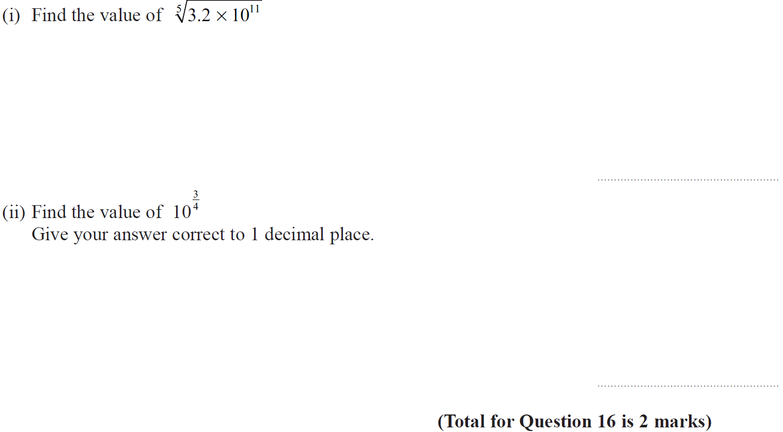
Rounding
Specimen Set 2 2H Q16

Slide 11
Rounding
Specimen Set 2 2H Q16
(i)
(ii)

Slide 12
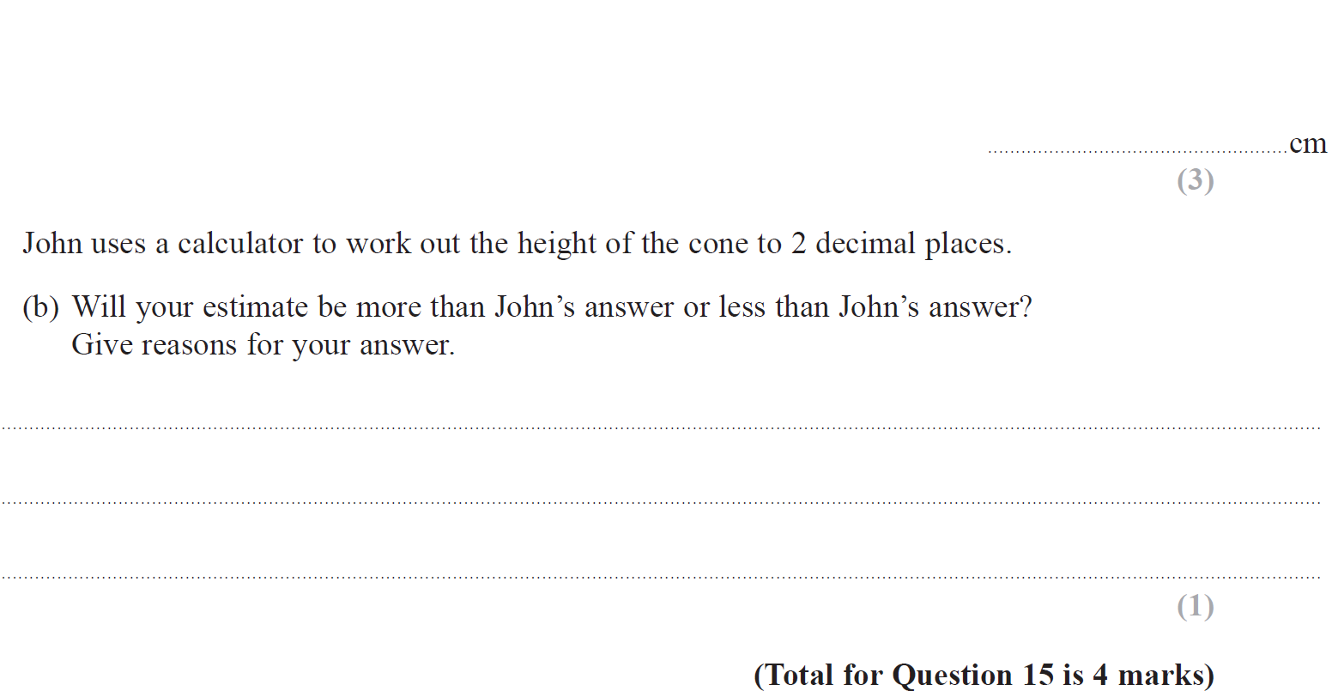
Rounding
May 2017 1H Q15

Slide 13
Rounding
May 2017 1H Q15
A
B

Slide 14
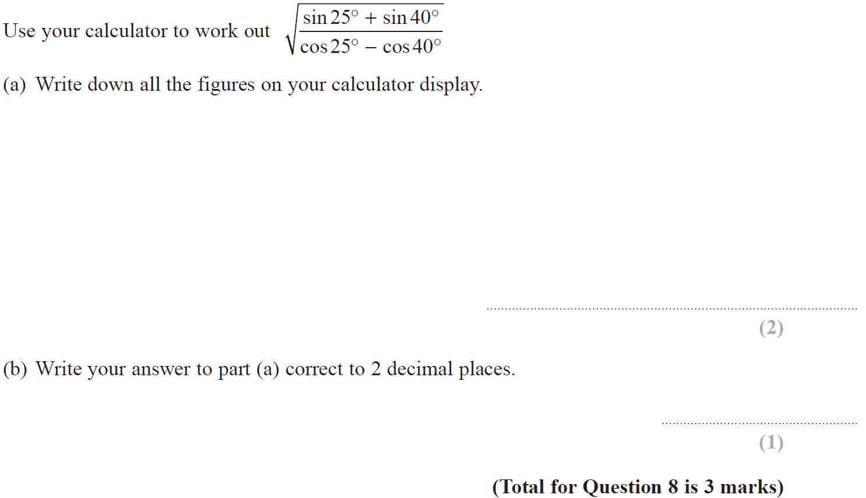
Rounding
Nov 2017 2H Q8

Slide 15
Rounding
Nov 2017 2H Q8
A
B

Slide 16
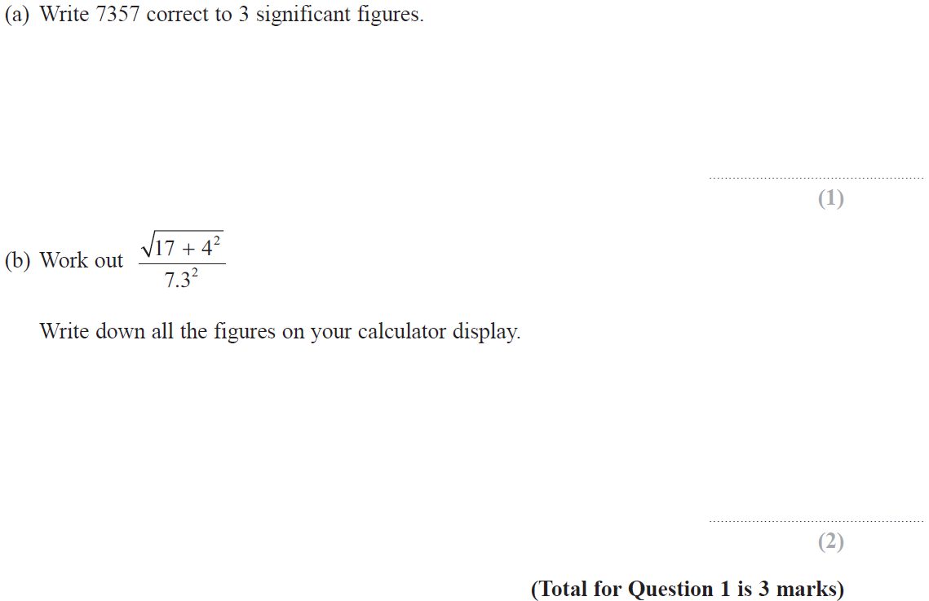
Rounding
Nov 2018 3H Q1

Slide 17
Rounding
Nov 2018 3H Q1
A
B

Slide 18
Rounding
May 2019 1H Q8

Slide 19
Rounding
May 2019 1H Q8
A
B
C
A SF
B SF
C SF

Slide 20
Rounding
SAM 3H Q8

Slide 21
Rounding
SAM 3H Q8
A
B

Slide 22
Rounding
Nov 2017 1H Q8

Slide 23
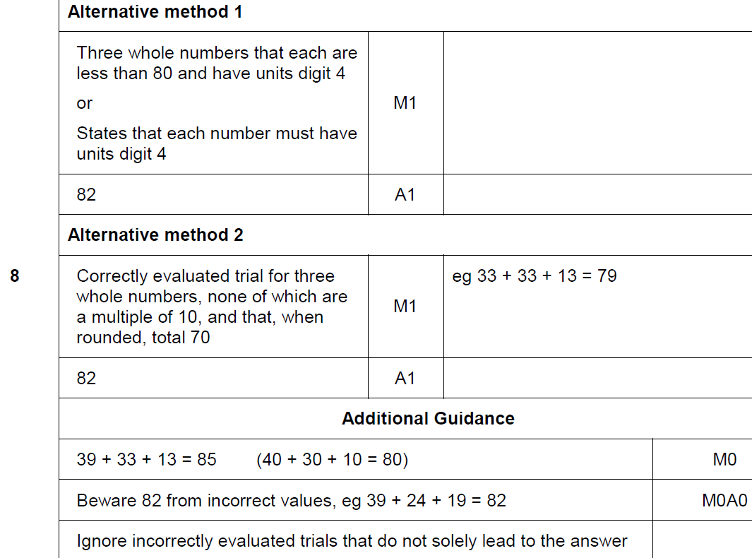
Rounding
Nov 2017 1H Q8
A

Slide 24
Rounding
Nov 2017 1H Q12

Slide 25
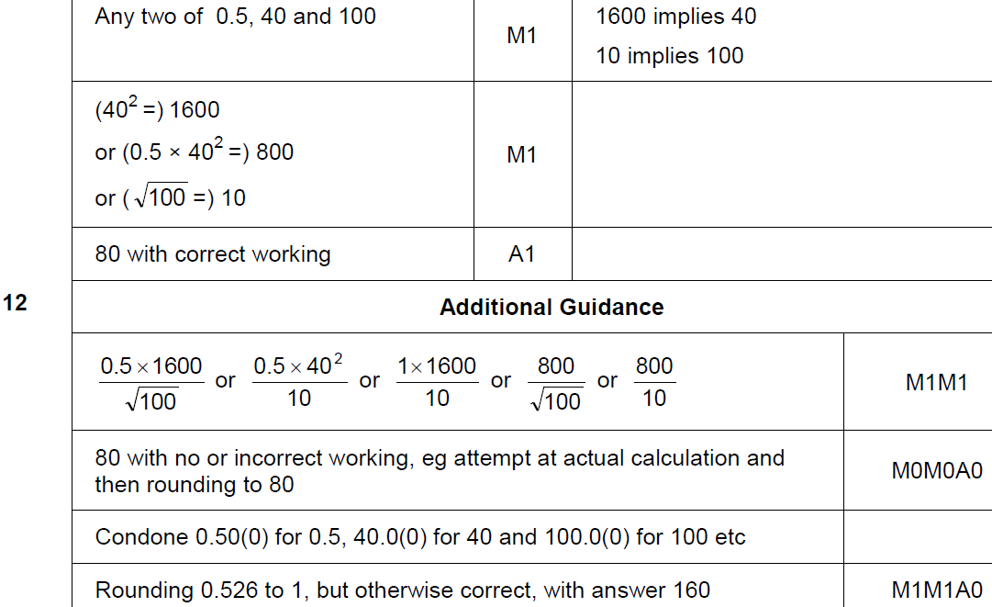
Rounding
Nov 2017 1H Q12
A

Slide 26
Rounding
May 2018 1H Q4

Slide 27
Rounding
May 2018 1H Q4
A

Slide 28
Rounding
Nov 2018 1H Q16

Slide 29
Rounding
Nov 2018 1H Q16
A

Slide 30
Rounding
Practice 2H Q17

Slide 31
Rounding
Practice 2H Q17
A

Slide 32
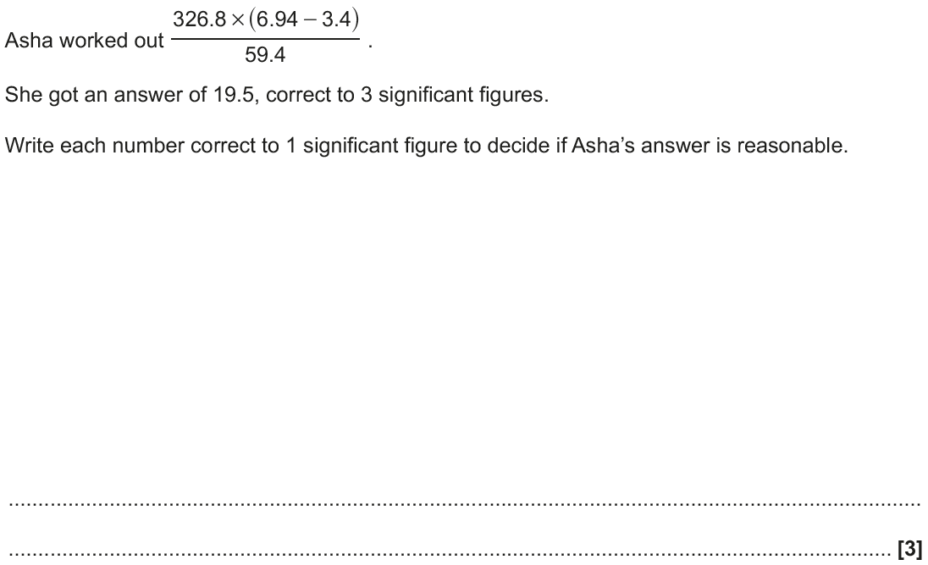
Rounding
June 2018 3H Q3

Slide 33
Rounding
June 2018 3H Q3
A

Slide 34
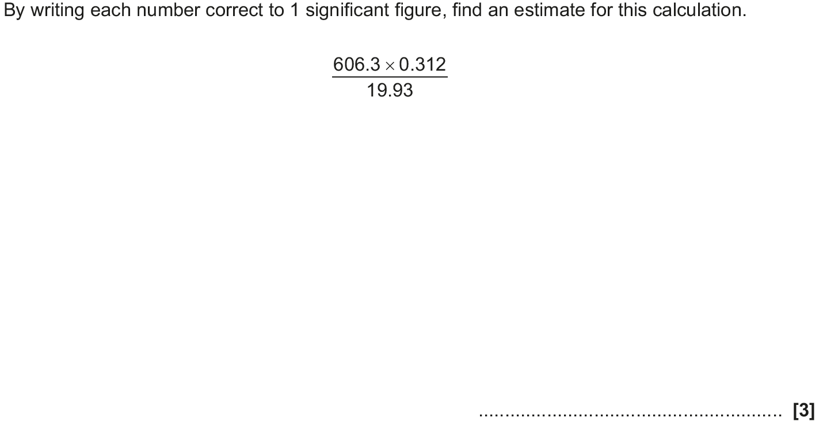
Rounding
Nov 2018 2H Q2

Slide 35
Rounding
Nov 2018 2H Q2
A

