Slide 1
Rounding & Estimation
Rounding
June 2018
3H Q3
Practice
2H Q17
Nov 2018
2H Q2

Slide 2
Rounding
Practice 2H Q17

Slide 3
Rounding
Practice 2H Q17
A

Slide 4
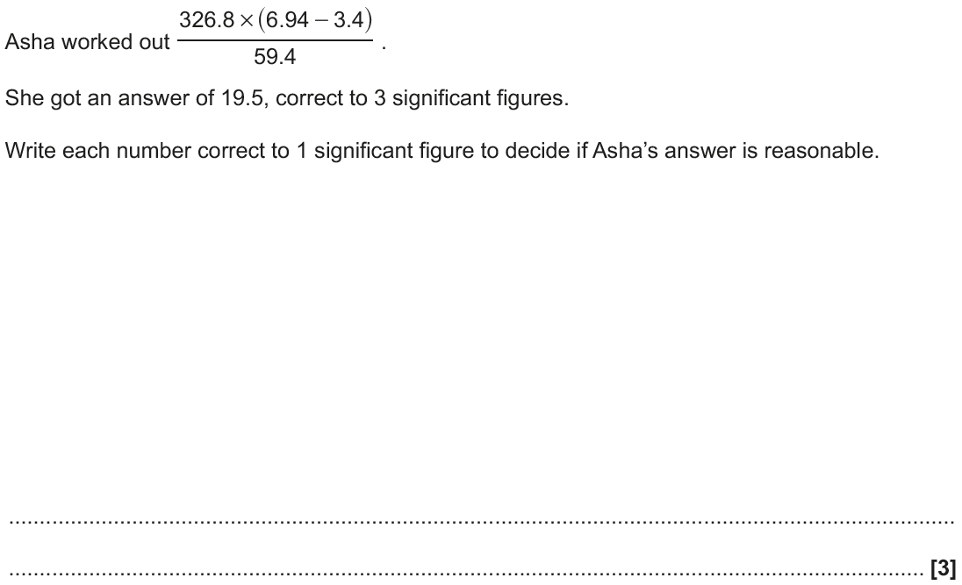
Rounding
June 2018 3H Q3

Slide 5
Rounding
June 2018 3H Q3
A

Slide 6
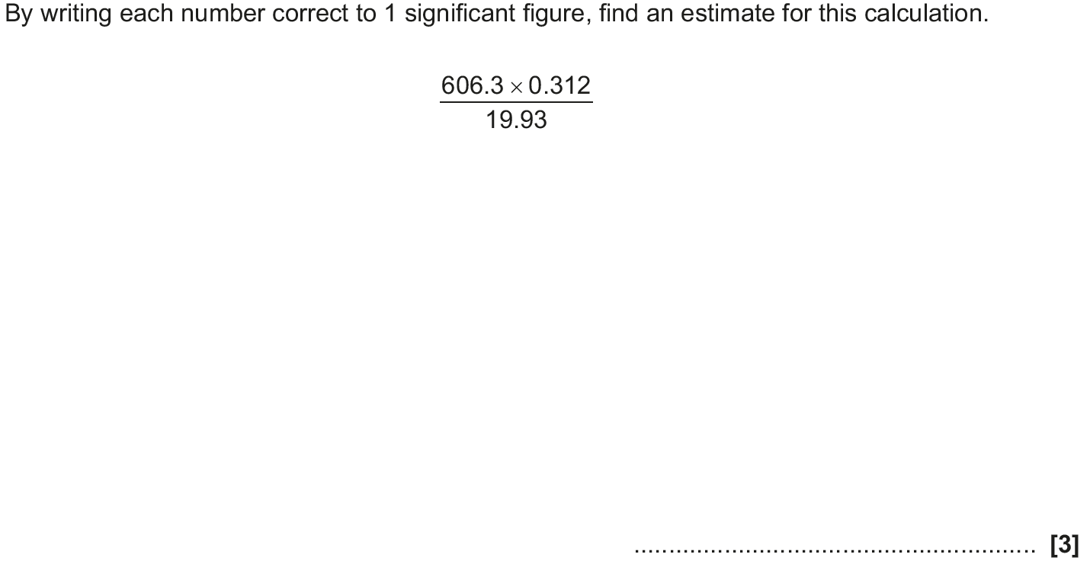
Rounding
Nov 2018 2H Q2

Slide 7
Rounding
Nov 2018 2H Q2
A

