Slide 1
Recurring Decimals
Recurring Decimals
May 2017
1H Q15
Nov 2017
1H Q26
SAM
1H Q27
1 Marker
June 2018
2H Q27
June 2018
3H Q3

Slide 2
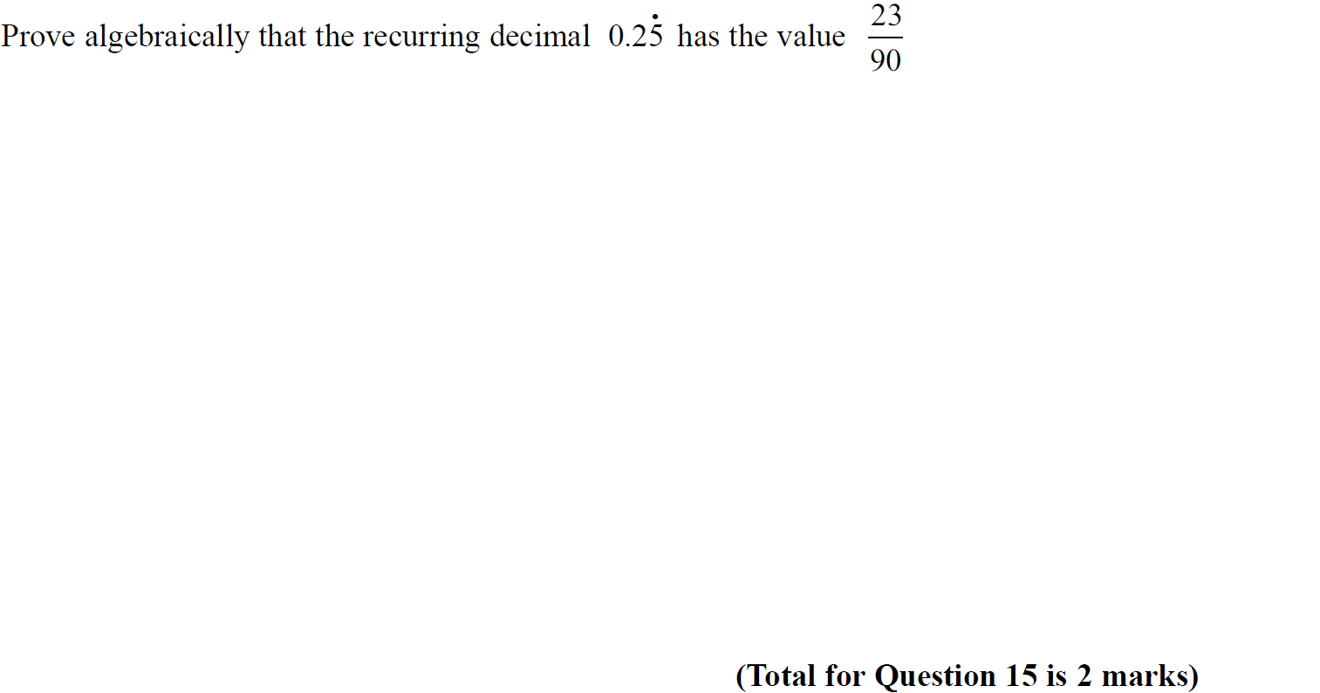
Recurring Decimals
SAM 2H Q15

Slide 3
Recurring Decimals
SAM 2H Q15
A

Slide 4
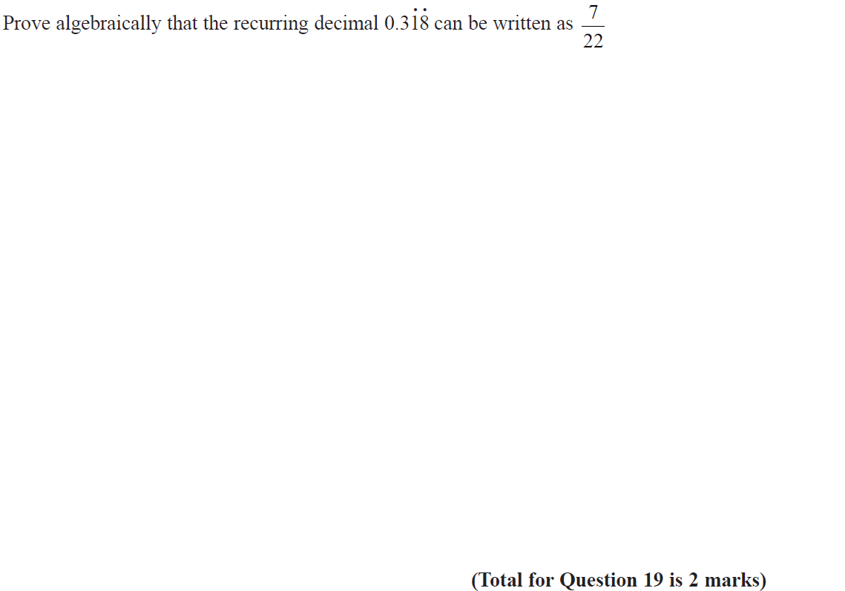
Recurring Decimals
Specimen Set 2 3H Q19

Slide 5
Recurring Decimals
Specimen Set 2 3H Q19
A

Slide 6
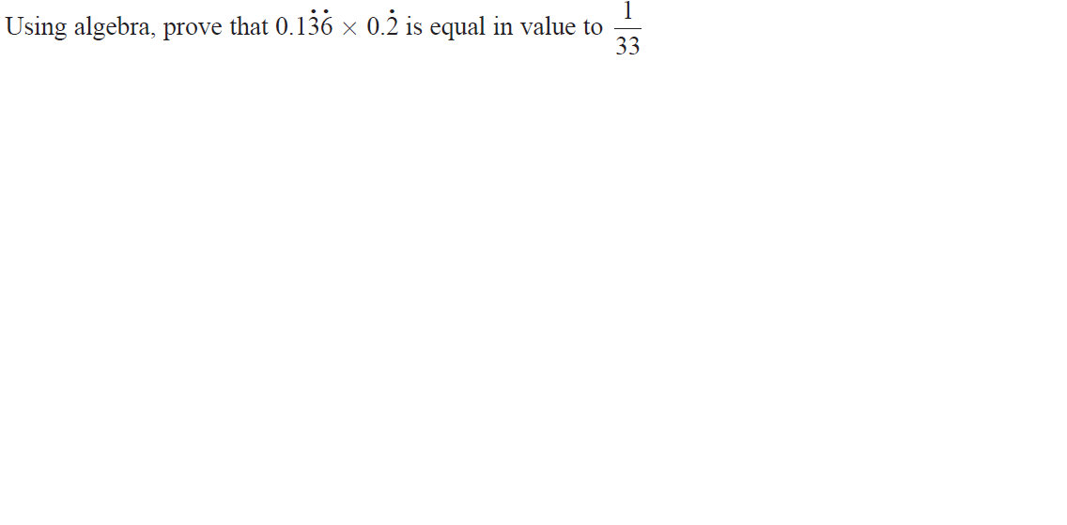
Recurring Decimals
June 2017 2H Q16

Slide 7
Recurring Decimals
June 2017 2H Q16
A

Slide 8
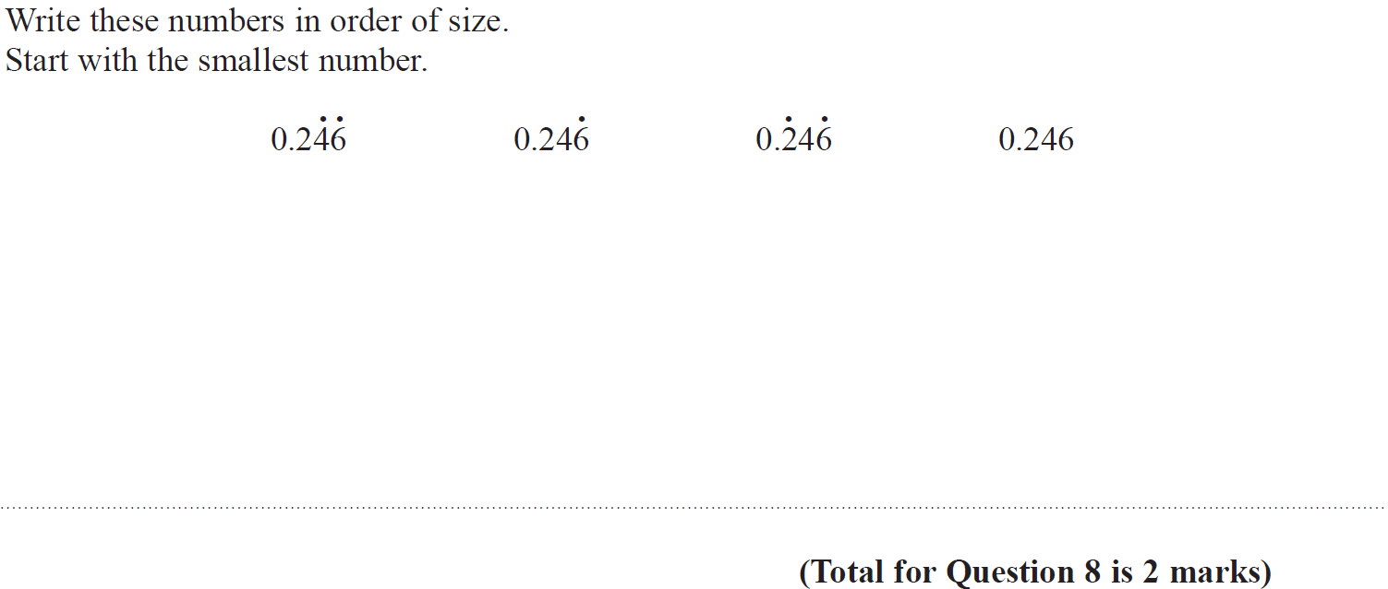
Recurring Decimals
Nov 2017 1H Q8

Slide 9
Recurring Decimals
Nov 2017 1H Q8
A

Slide 10
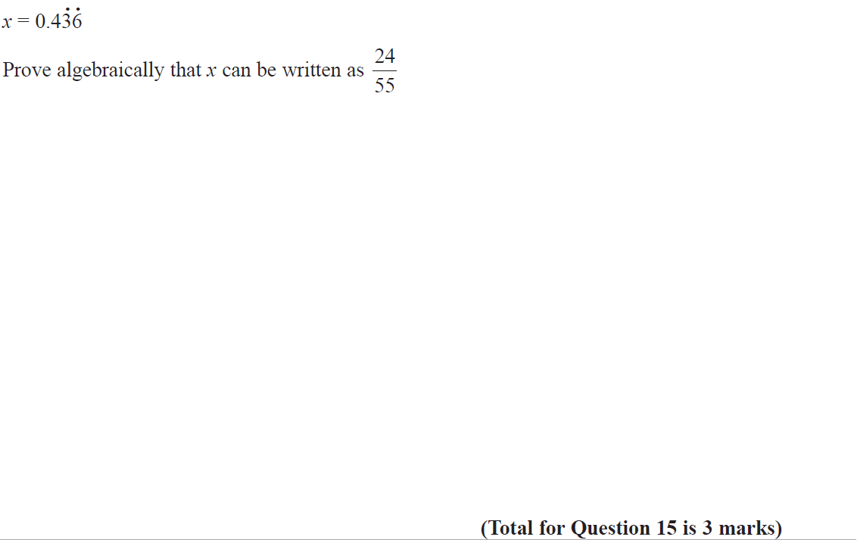
Recurring Decimals
Nov 2017 1H Q15

Slide 11
Recurring Decimals
Nov 2017 1H Q15
A

Slide 12
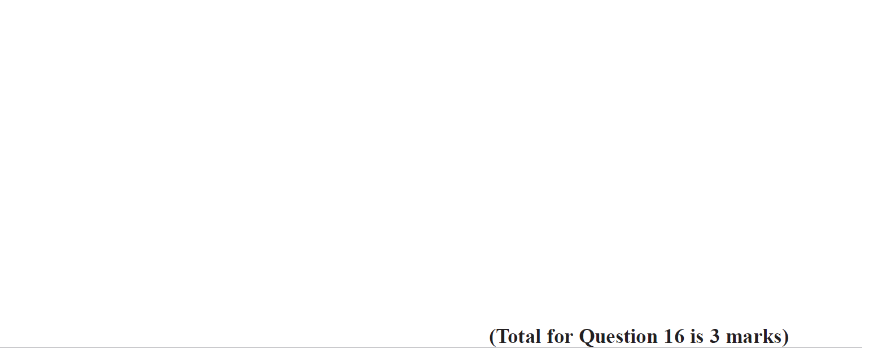
Recurring Decimals
Nov 2018 1H Q16

Slide 13
Recurring Decimals
Nov 2018 1H Q16
A

Slide 14
Recurring Decimals
SAM 1H Q27

Slide 15
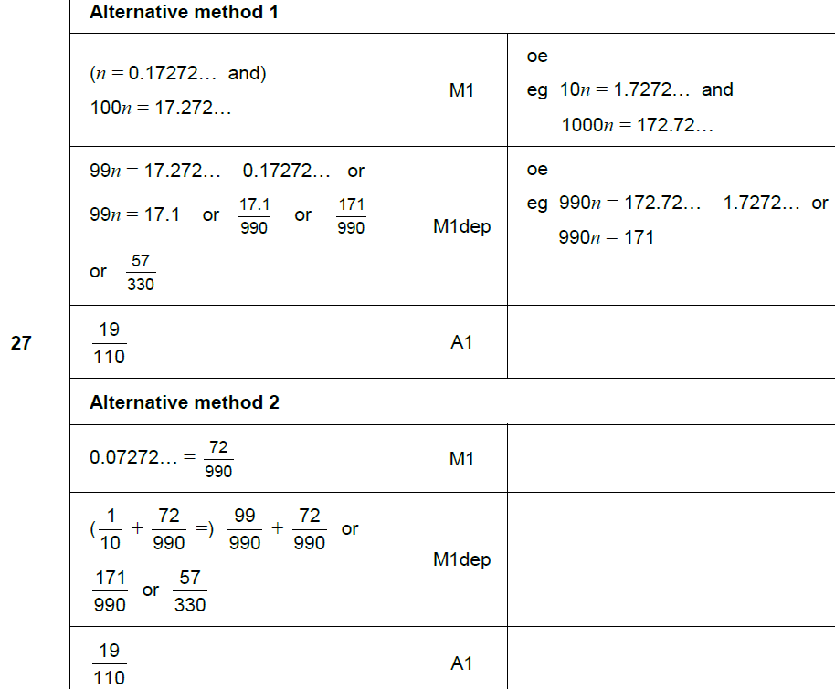
Recurring Decimals
SAM 1H Q27
A

Slide 16
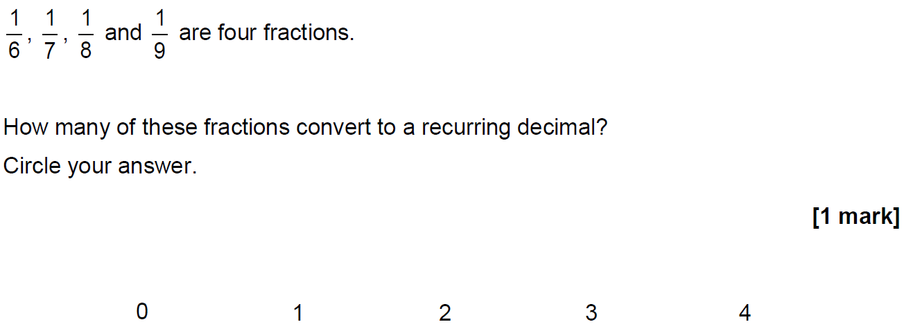
Recurring Decimals
May 2017 1H Q15

Slide 17
Recurring Decimals
May 2017 1H Q15
A

Slide 18
Recurring Decimals
Nov 2017 1H Q26

Slide 19
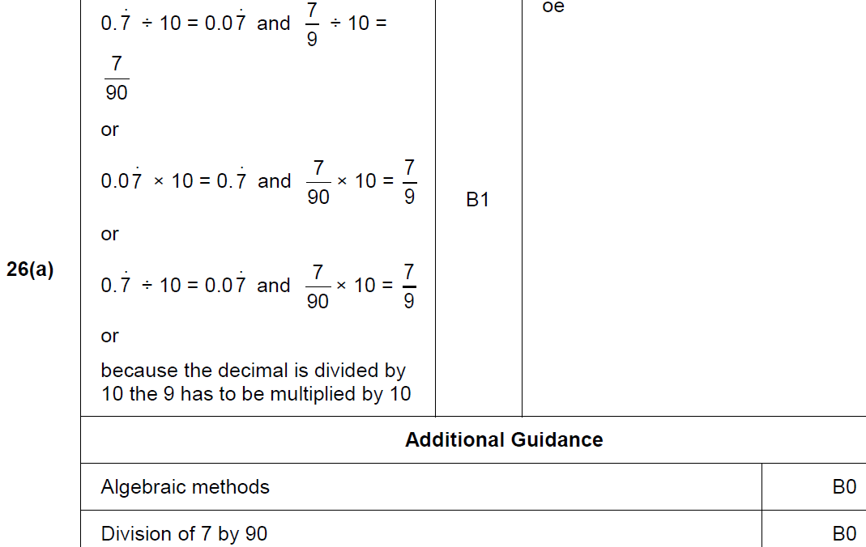
Recurring Decimals
Nov 2017 1H Q26
A

Slide 20
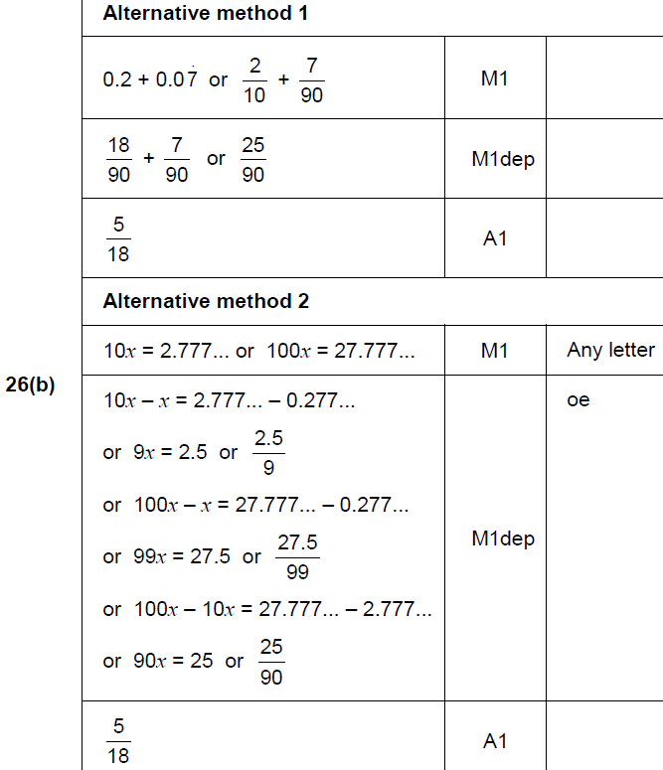
Recurring Decimals
Nov 2017 1H Q26
B

Slide 21
Recurring Decimals
June 2018 2H Q27

Slide 22
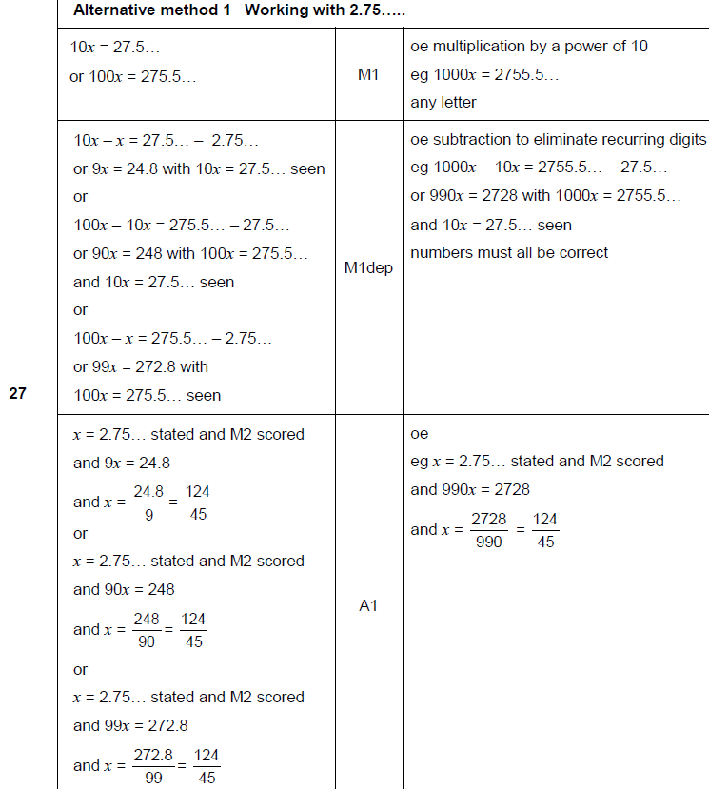
Recurring Decimals
June 2018 2H Q27
A

Slide 23
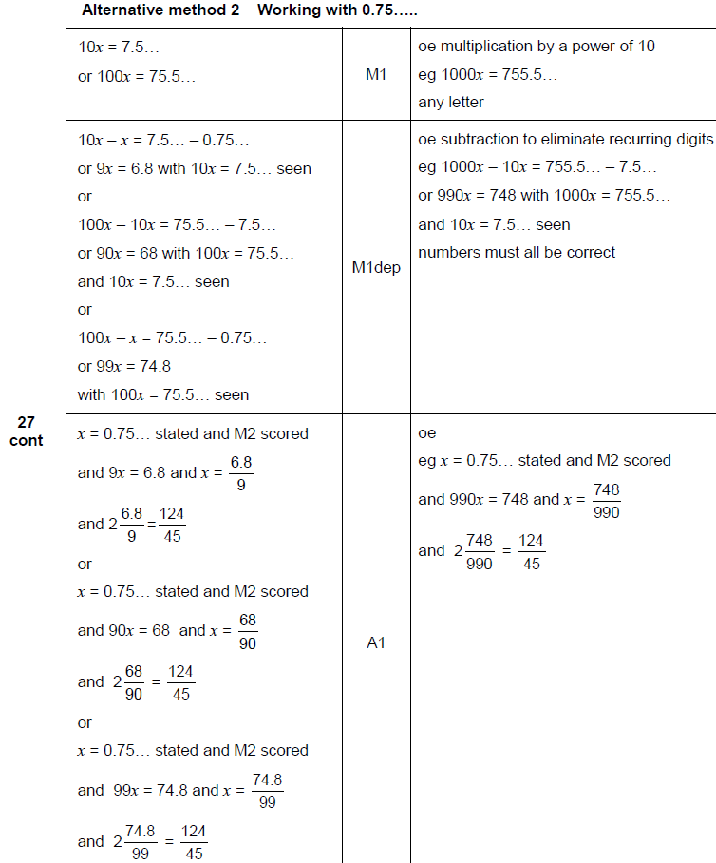
Recurring Decimals
June 2018 2H Q27
A Alternative 1

Slide 24
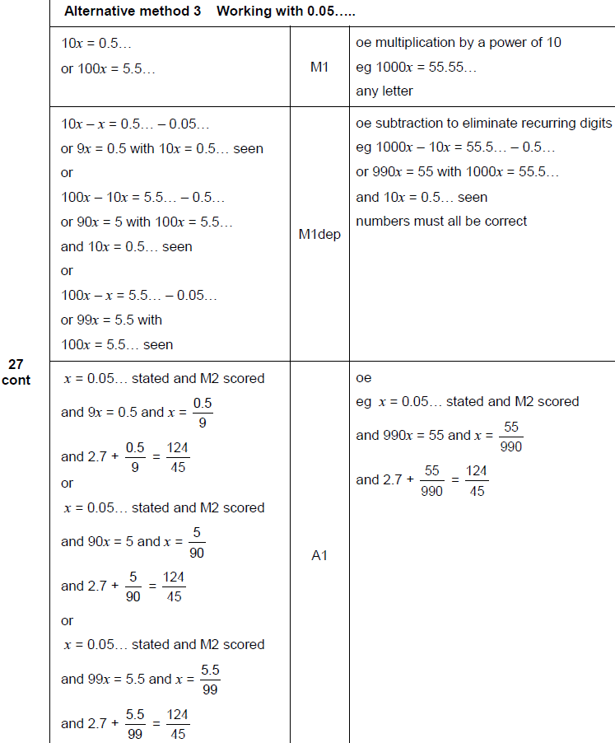
Recurring Decimals
June 2018 2H Q27
A Alternative 2

Slide 25
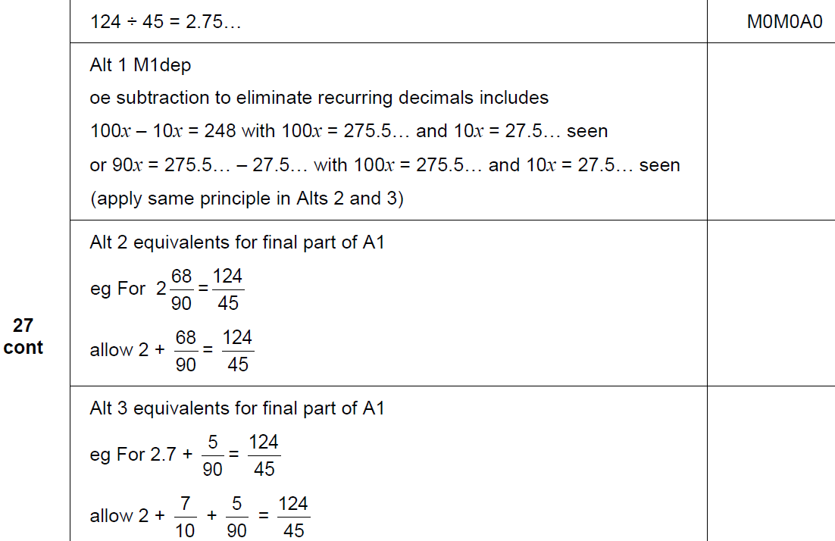
Recurring Decimals
June 2018 2H Q27
B

Slide 26
Recurring Decimals
June 2018 3H Q3

Slide 27
Recurring Decimals
June 2018 3H Q3
A

