Slide 1
Recurring Decimals
Recurring Decimals
Edexcel
June 2017 2H Q16
SAM
2H Q15
AQA
Nov 2017 1H Q8
Spec 2
3H Q19
OCR
Nov 2017 1H Q15

Slide 2
Recurring Decimals
Recurring Decimals
May 2017
1H Q15
Edexcel
Nov 2017
1H Q26
AQA
SAM
1H Q27
1 Marker
June 2018
2H Q27
OCR
June 2018
3H Q3

Slide 3
Recurring Decimals
Recurring Decimals
June 2017
2H Q13
Edexcel
Nov 2017
2H Q12
AQA
Practice
2H Q9
June 2018
2H Q13
OCR
Nov 2018
3H Q14

Slide 4
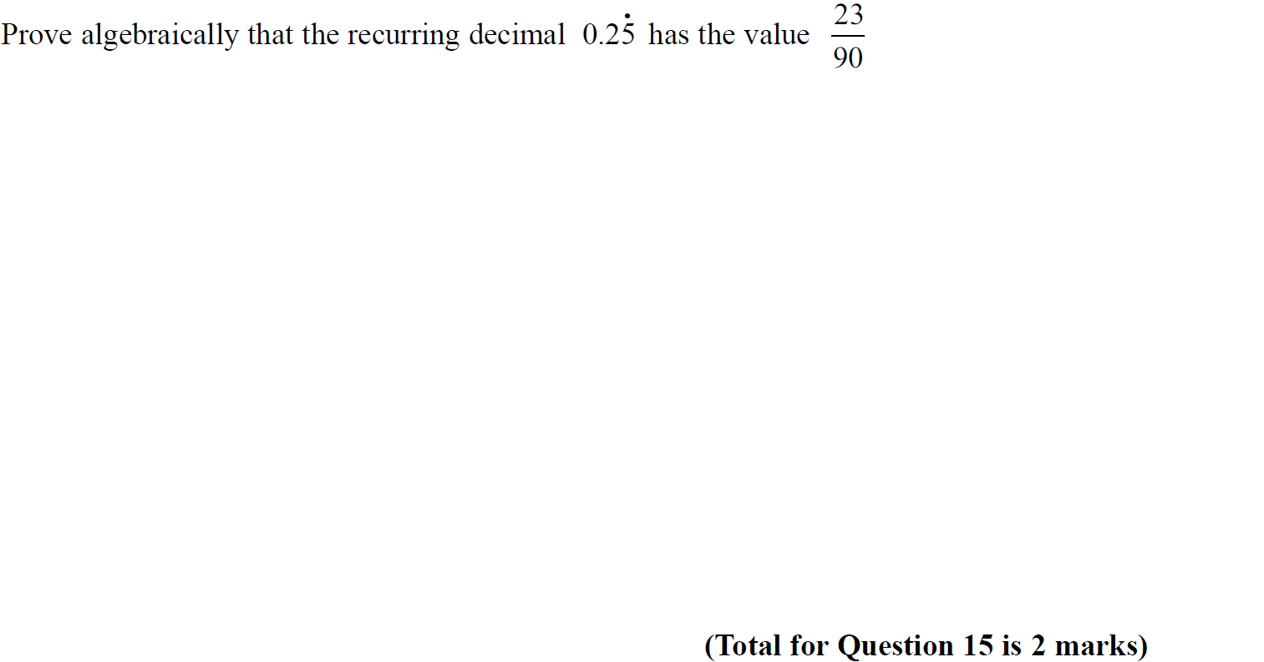
Recurring Decimals
SAM 2H Q15

Slide 5
Recurring Decimals
SAM 2H Q15
A

Slide 6
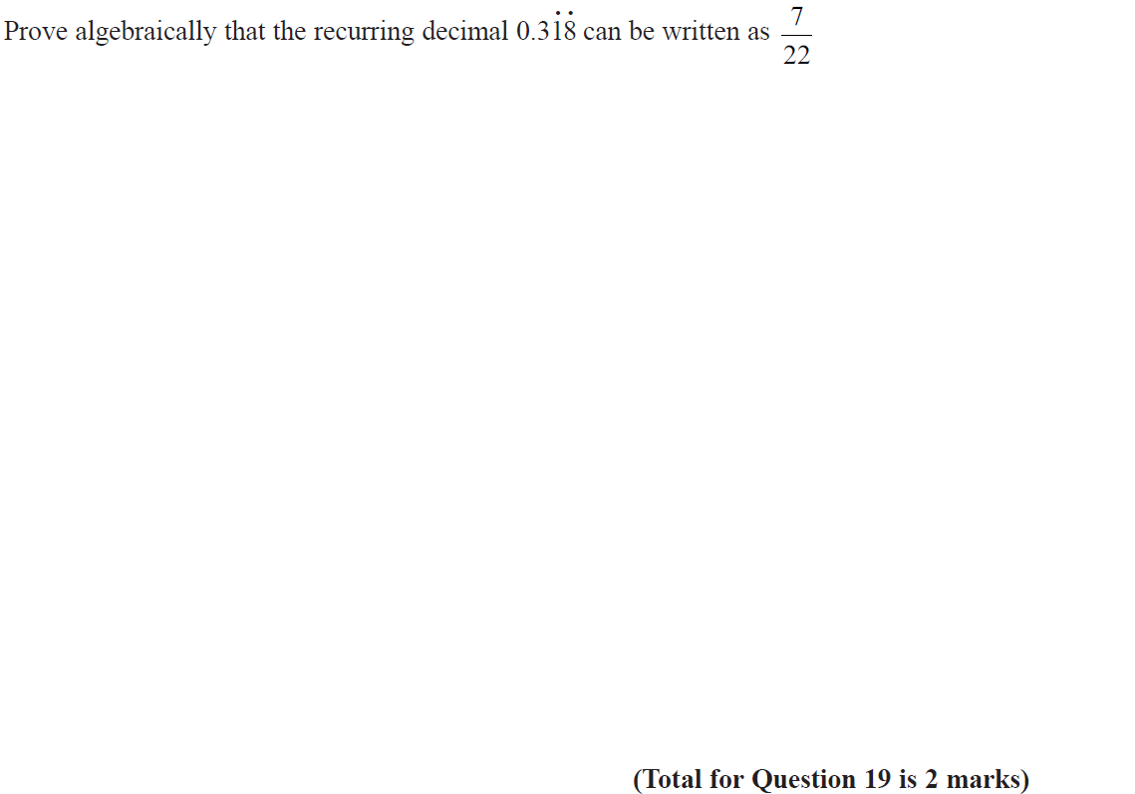
Recurring Decimals
Specimen Set 2 3H Q19

Slide 7
Recurring Decimals
Specimen Set 2 3H Q19
A

Slide 8
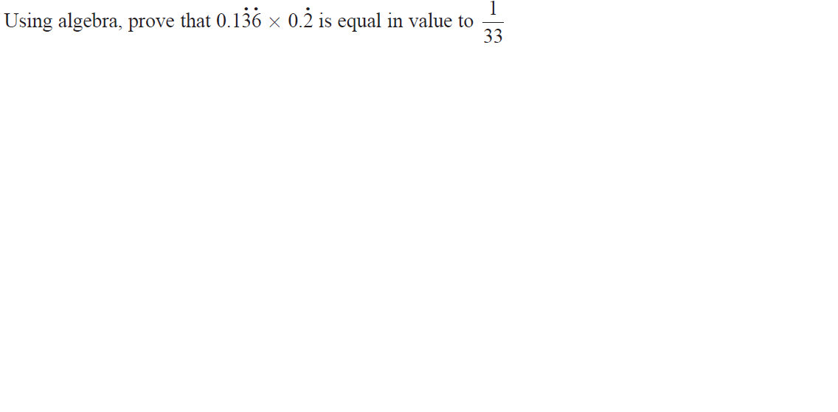
Recurring Decimals
June 2017 2H Q16

Slide 9
Recurring Decimals
June 2017 2H Q16
A

Slide 10
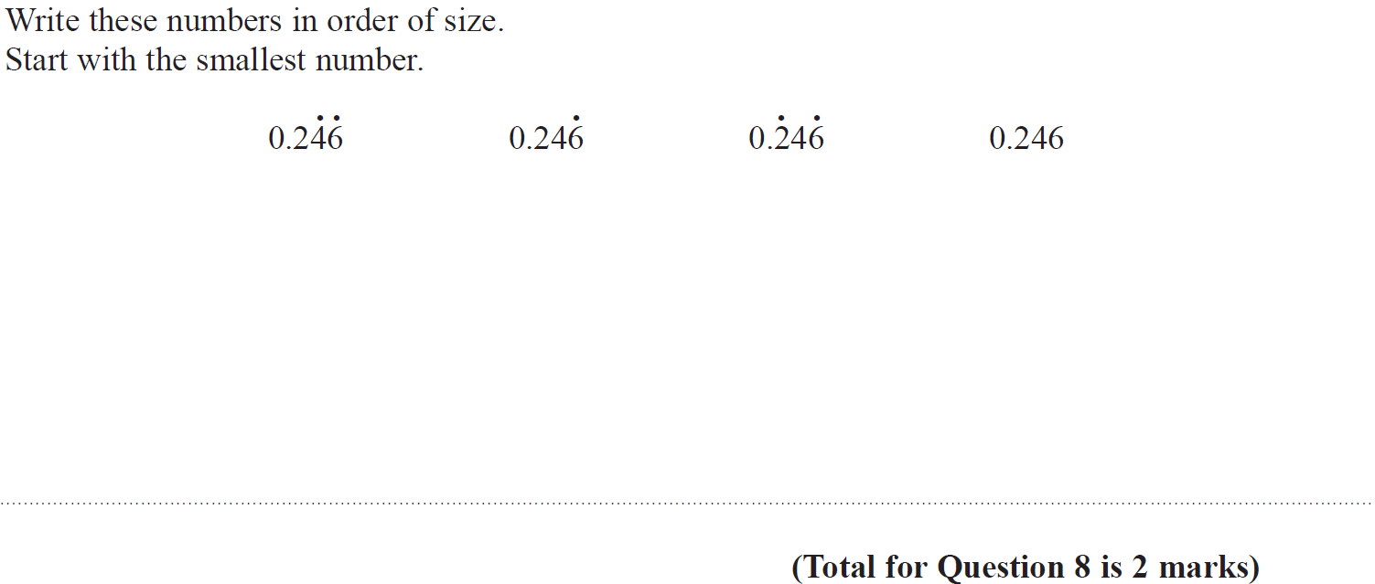
Recurring Decimals
Nov 2017 1H Q8

Slide 11
Recurring Decimals
Nov 2017 1H Q8
A

Slide 12
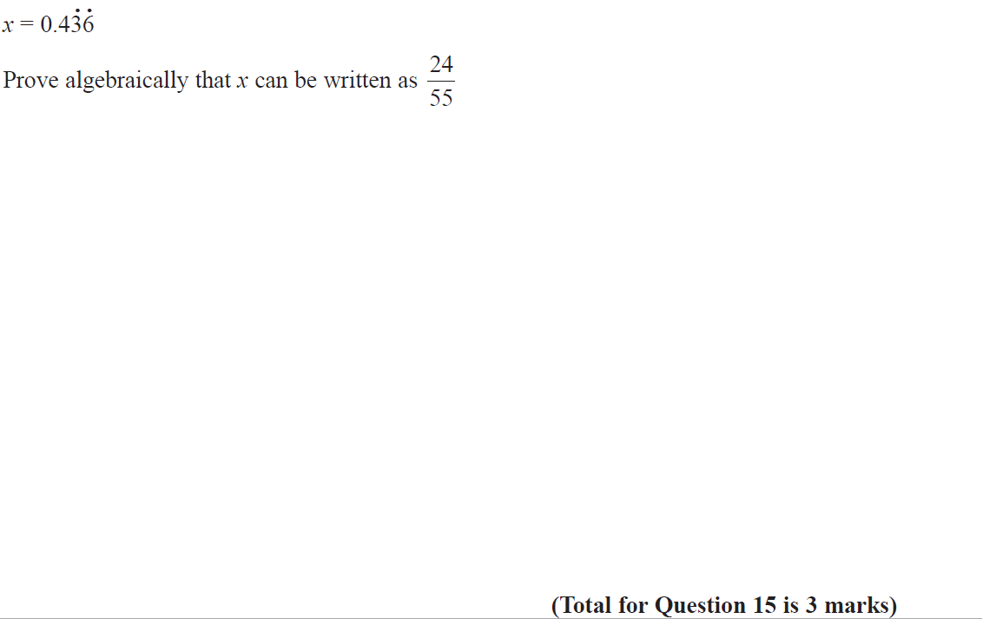
Recurring Decimals
Nov 2017 1H Q15

Slide 13
Recurring Decimals
Nov 2017 1H Q15
A

Slide 14
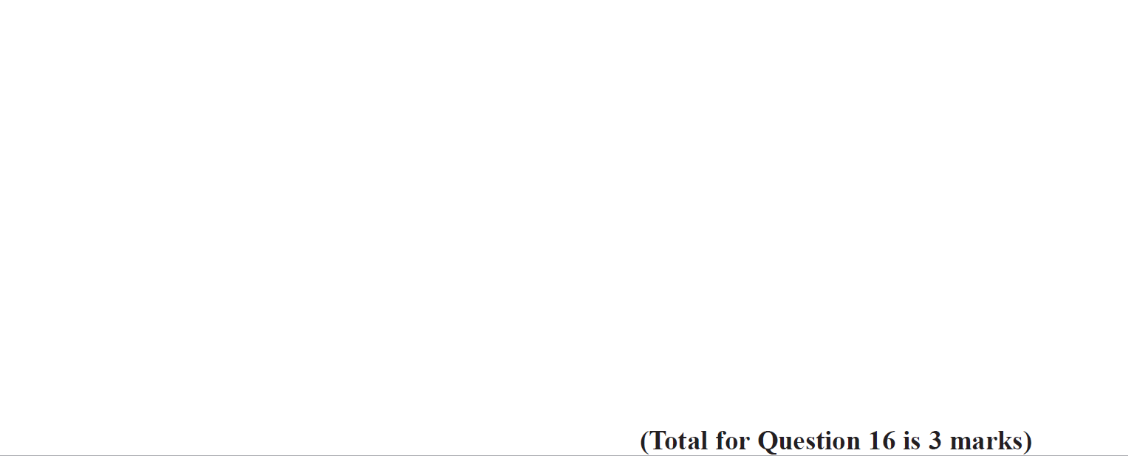
Recurring Decimals
Nov 2018 1H Q16

Slide 15
Recurring Decimals
Nov 2018 1H Q16
A

Slide 16
Recurring Decimals
SAM 1H Q27

Slide 17
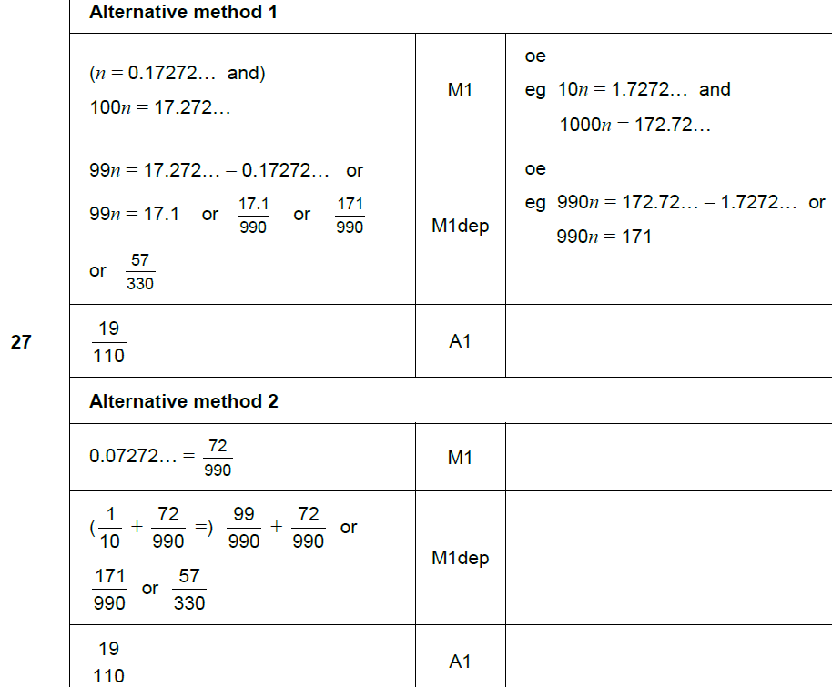
Recurring Decimals
SAM 1H Q27
A

Slide 18
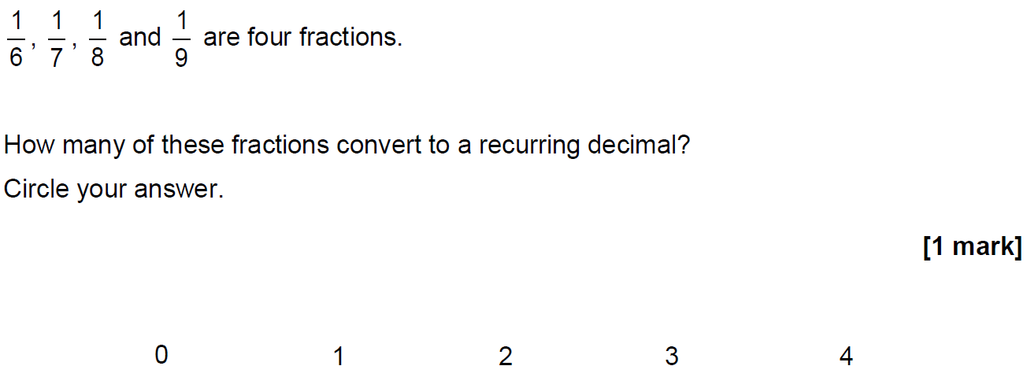
Recurring Decimals
May 2017 1H Q15

Slide 19
Recurring Decimals
May 2017 1H Q15
A

Slide 20
Recurring Decimals
Nov 2017 1H Q26

Slide 21
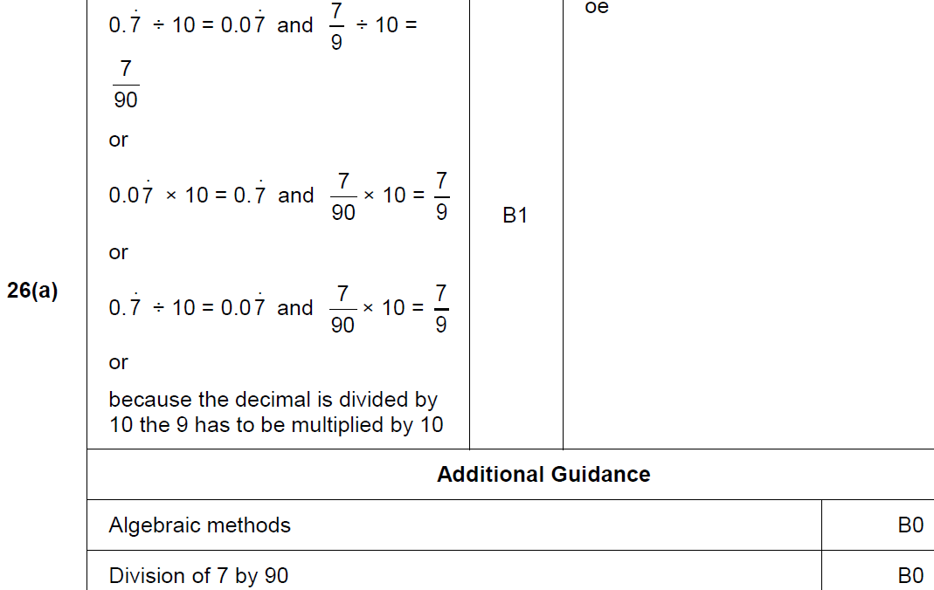
Recurring Decimals
Nov 2017 1H Q26
A

Slide 22
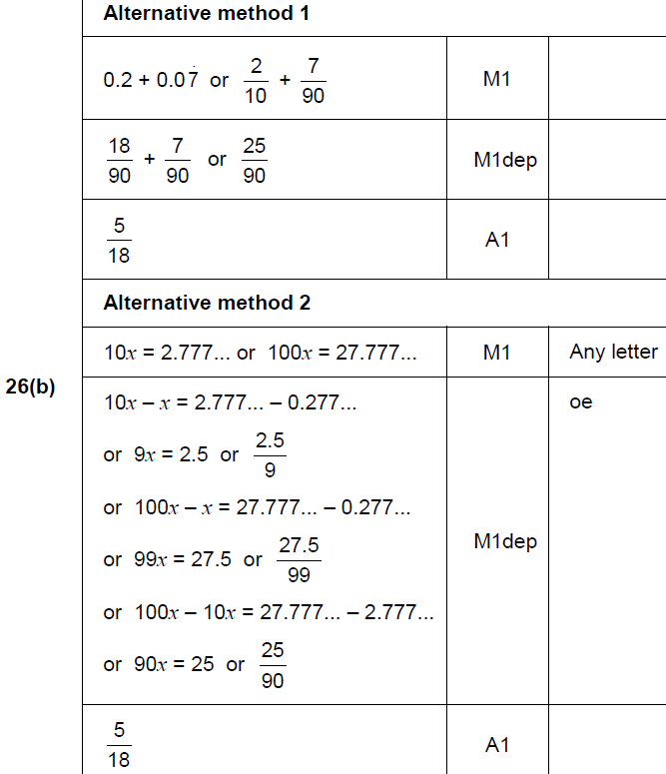
Recurring Decimals
Nov 2017 1H Q26
B

Slide 23
Recurring Decimals
June 2018 2H Q27

Slide 24
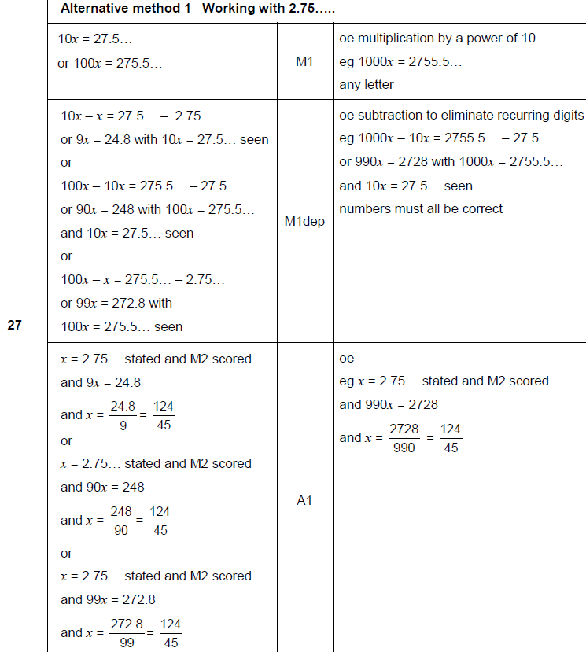
Recurring Decimals
June 2018 2H Q27
A

Slide 25
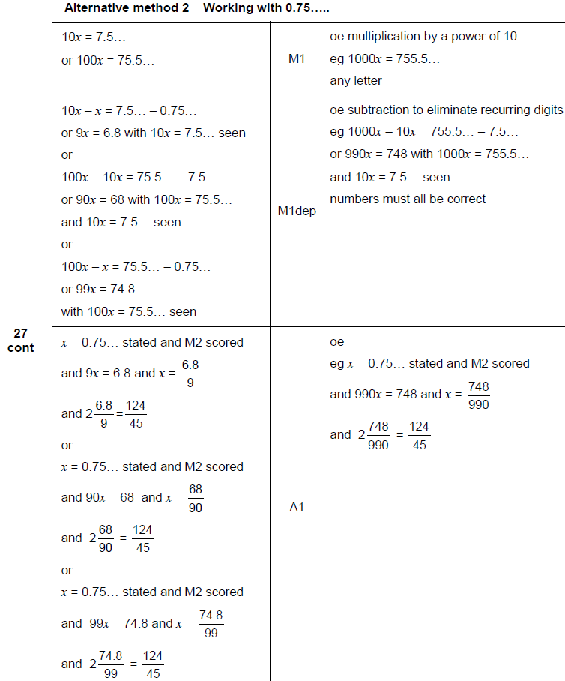
Recurring Decimals
June 2018 2H Q27
A Alternative 1

Slide 26
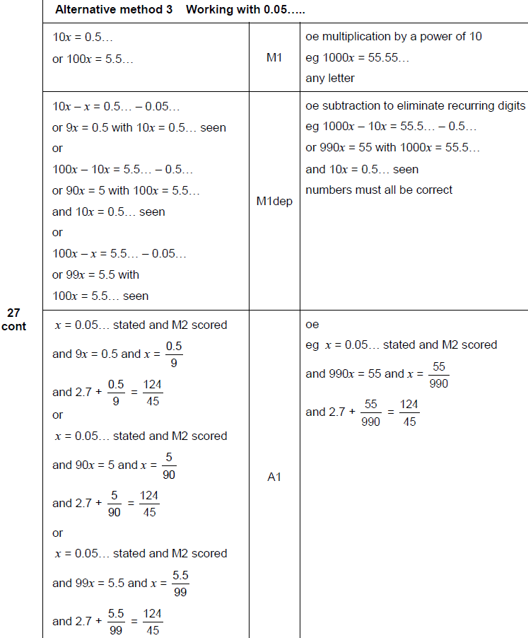
Recurring Decimals
June 2018 2H Q27
A Alternative 2

Slide 27
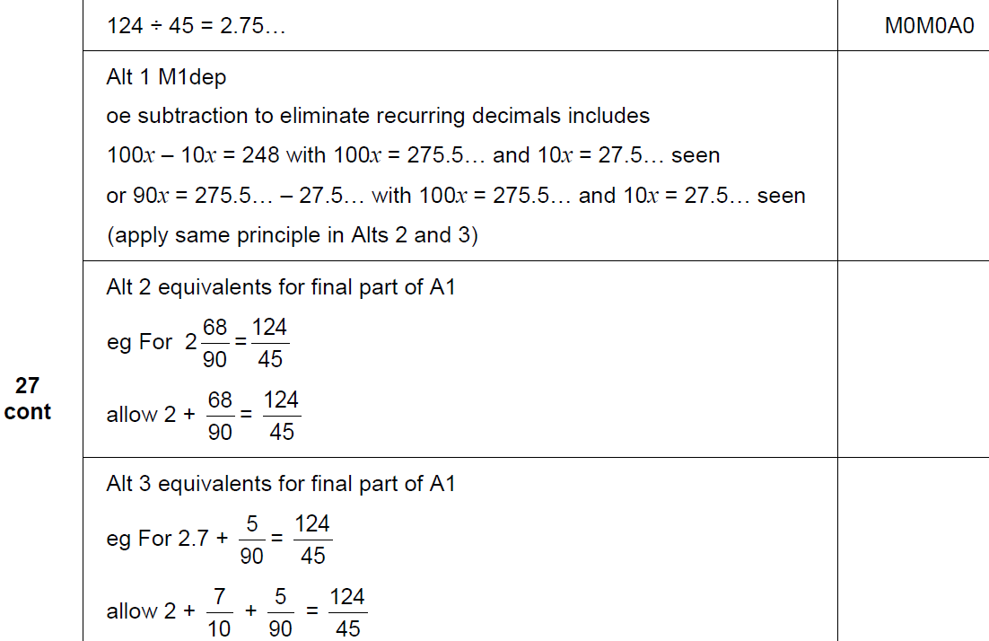
Recurring Decimals
June 2018 2H Q27
B

Slide 28
Recurring Decimals
June 2018 3H Q3

Slide 29
Recurring Decimals
June 2018 3H Q3
A

Slide 30
Recurring Decimals
Practice 2H Q9

Slide 31
Recurring Decimals
Practice 2H Q9
A
B
C

Slide 32
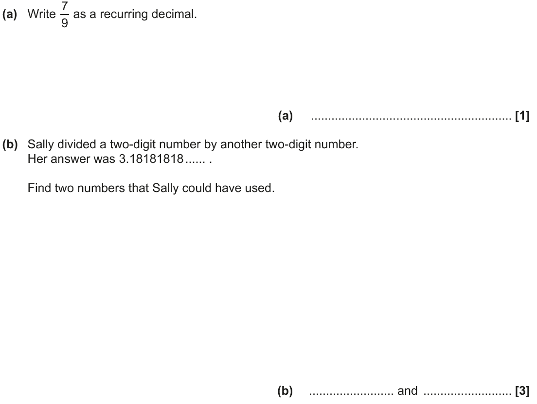
Recurring Decimals
June 2017 2H Q13

Slide 33
Recurring Decimals
June 2017 2H Q13
A
B

Slide 34
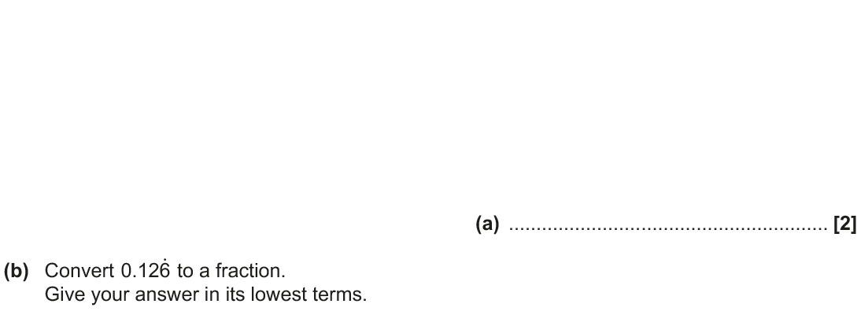
Recurring Decimals
Nov 2017 2H Q12

Slide 35
Recurring Decimals
Nov 2017 2H Q12
A
B

Slide 36
Recurring Decimals
June 2018 2H Q13

Slide 37
Recurring Decimals
June 2018 2H Q13
A
B

Slide 38
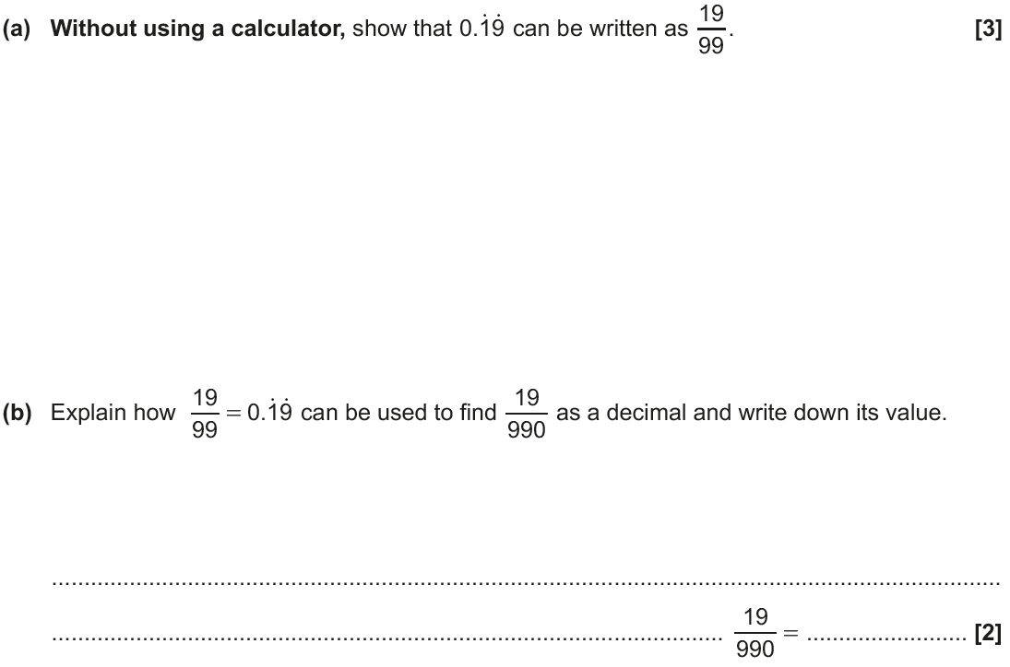
Recurring Decimals
Nov 2018 3H Q14

Slide 39
Recurring Decimals
Nov 2018 3H Q14
A
B

