Slide 1
Ratio & Basic Proportion
Ratio & Basic Proportion
SAM
2H Q1
Spec 1
2H Q7
June 2017 3H Q12
Nov 2017 3H Q4
Nov 2018 2H Q17
SAM
2H Q8
Spec 2
1H Q5
Nov 2017 1H Q2
May 2018 1H Q2
Nov 2018 3H Q6
SAM
3H Q2
Spec 2
2H Q6
Nov 2017 1H Q13
May 2018 1H Q8
May 2019 1H Q2
June 2019 2H Q17
Spec 1
1H Q10
Spec 2
2H Q21
Nov 2017 1H Q14
June 2018 2H Q12
May 2019 1H Q6
June 2019 3H Q9
Spec 1
1H Q16
Spec 2
3H Q1
Nov 2017 2H Q9
Nov 2018 1H Q4
May 2019 1H Q17
Spec 1
2H Q2
Spec 2
3H Q6
Nov 2017 3H Q2
Nov 2018 2H Q10
June 2019 2H Q7
Inverse Proportion in context
Proportion Graphs

Slide 2
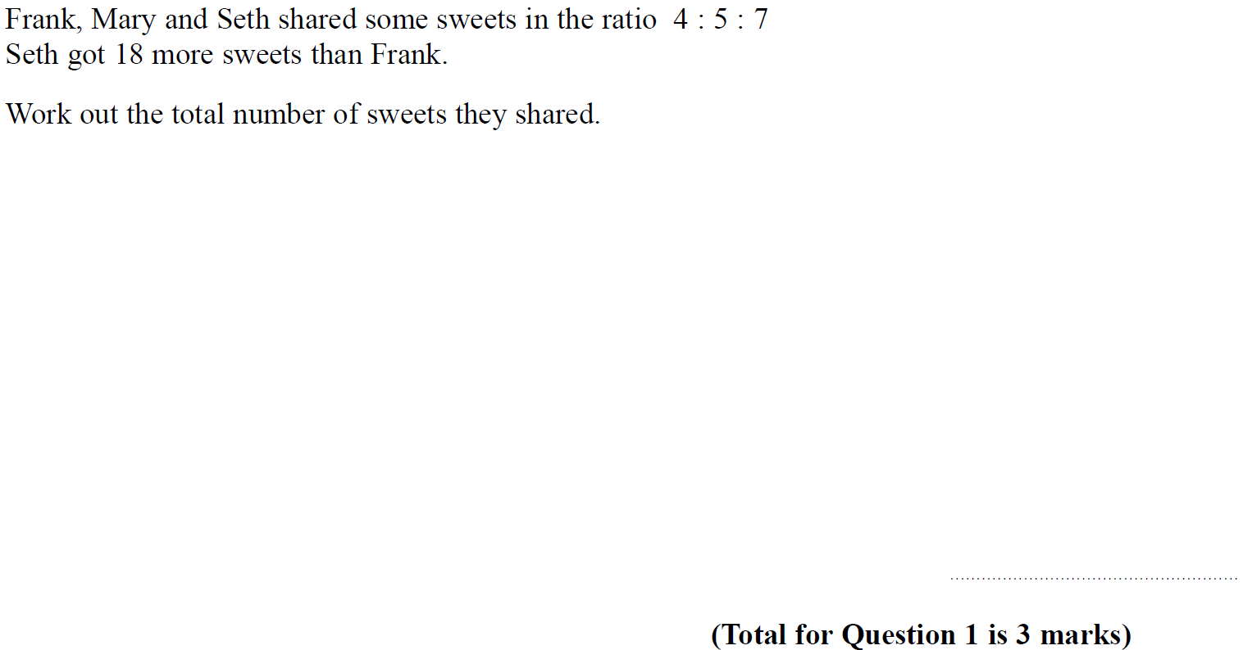
Ratio & Basic Proportion
SAM 2H Q1

Slide 3
Ratio & Basic Proportion
SAM 2H Q1
A

Slide 4
Ratio & Basic Proportion
SAM 2H Q8

Slide 5
Ratio & Basic Proportion
SAM 2H Q8
A

Slide 6
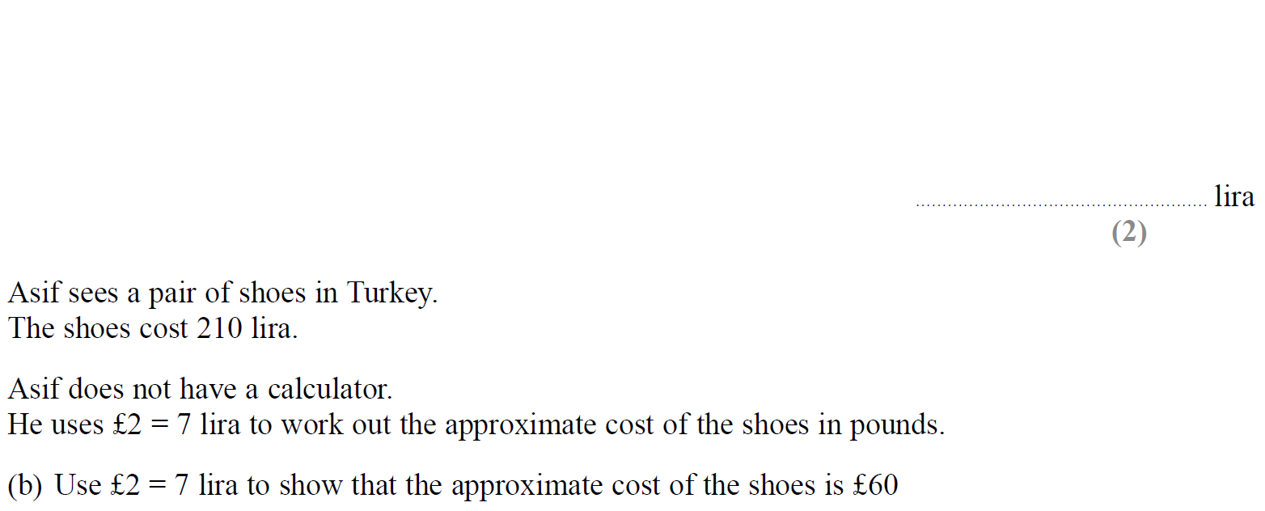
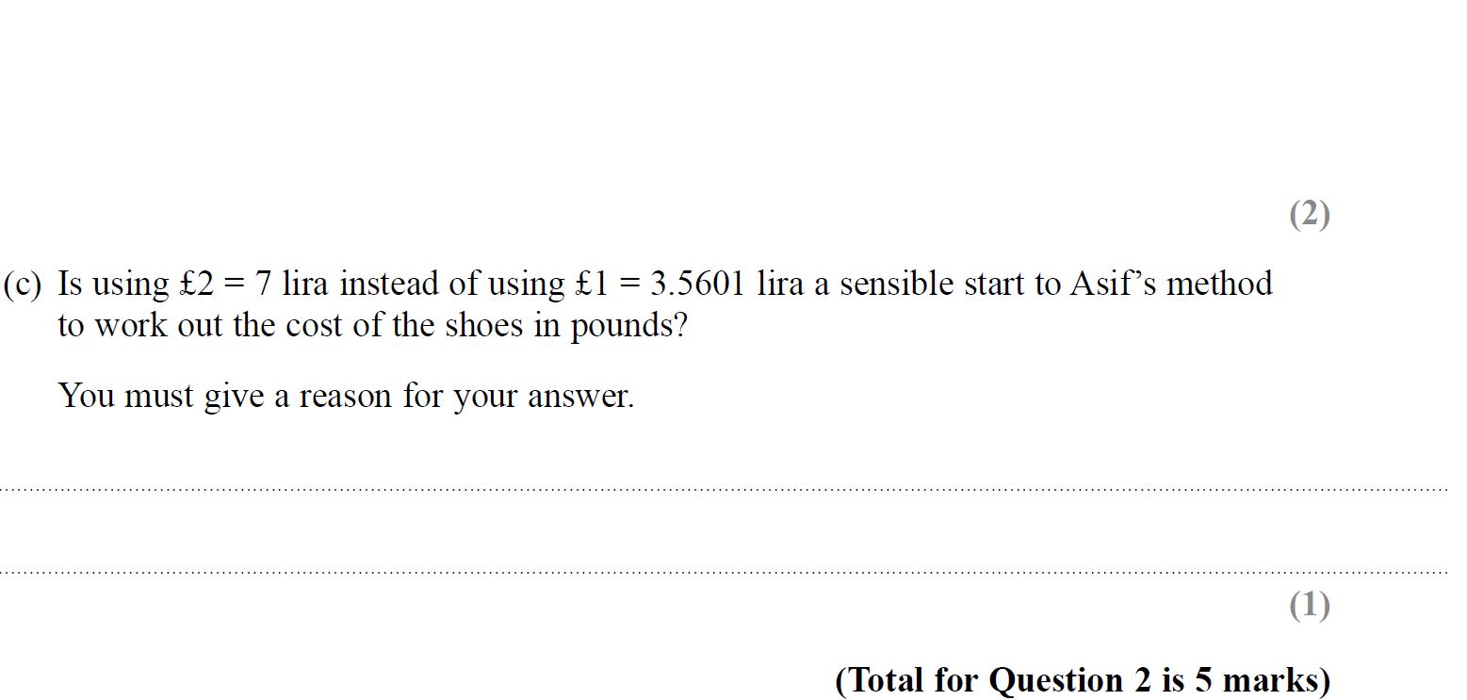
Ratio & Basic Proportion
SAM 3H Q2

Slide 7
Ratio & Basic Proportion
SAM 3H Q2
A
B
C

Slide 8
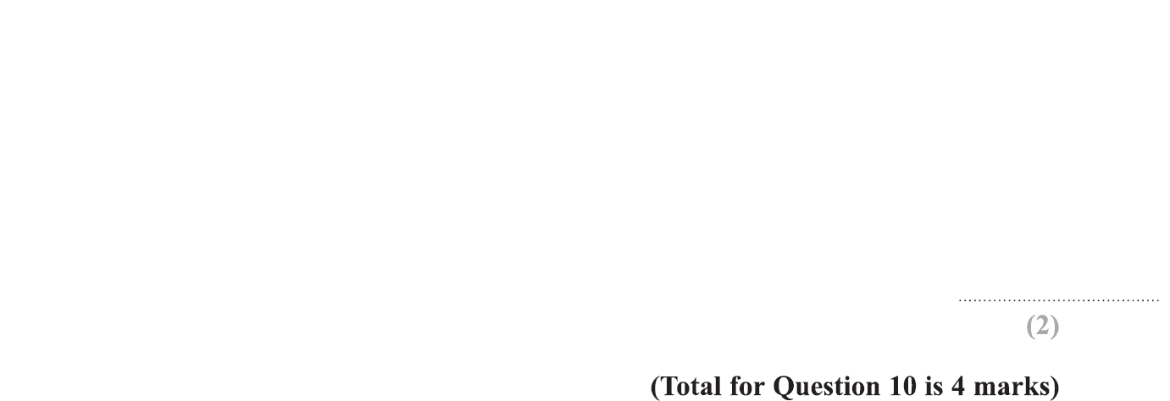
Ratio & Basic Proportion
Specimen Set 1 1H Q10

Slide 9
Ratio & Basic Proportion
Specimen Set 1 1H Q10
A
B

Slide 10
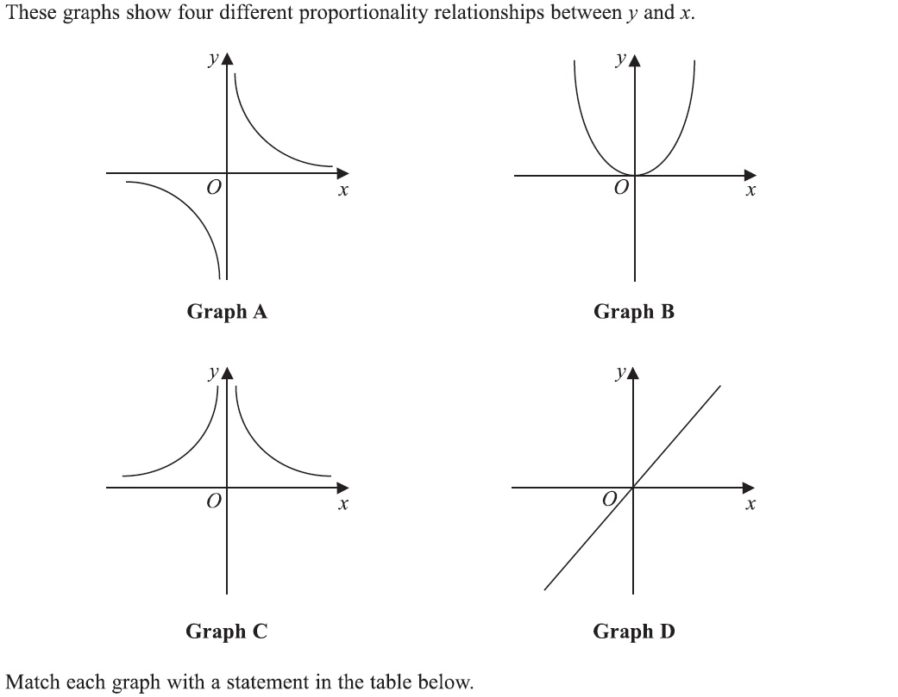
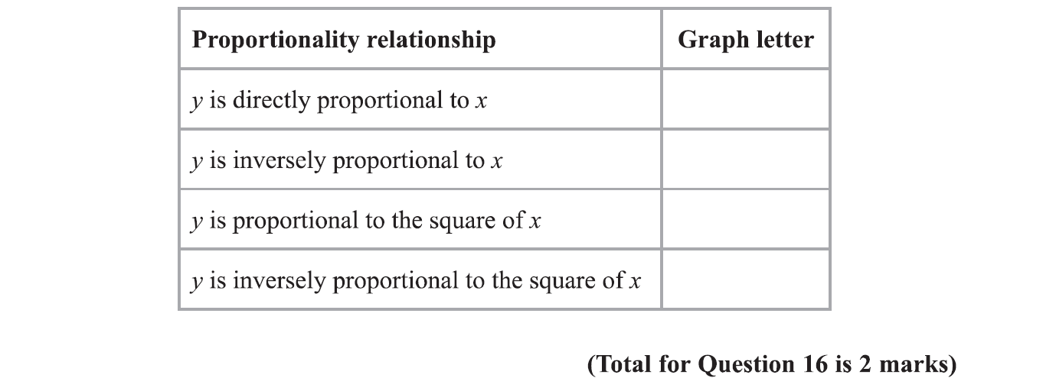
Ratio & Basic Proportion
Specimen Set 1 1H Q16

Slide 11
Ratio & Basic Proportion
Specimen Set 1 1H Q16
A

Slide 12
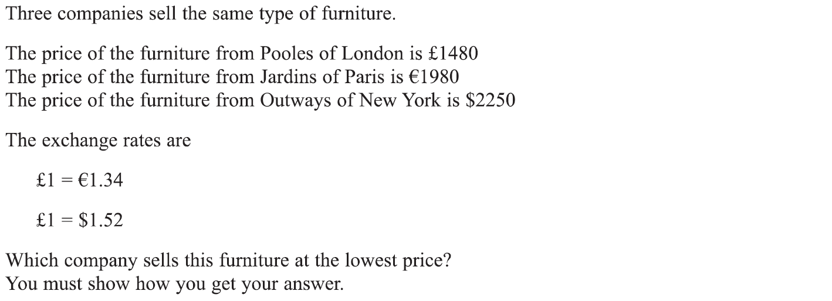
Ratio & Basic Proportion
Specimen Set 1 2H Q2

Slide 13
Ratio & Basic Proportion
Specimen Set 1 2H Q2
A

Slide 14
Ratio & Basic Proportion
Specimen Set 1 2H Q7

Slide 15
Ratio & Basic Proportion
Specimen Set 1 2H Q7
A

Slide 16
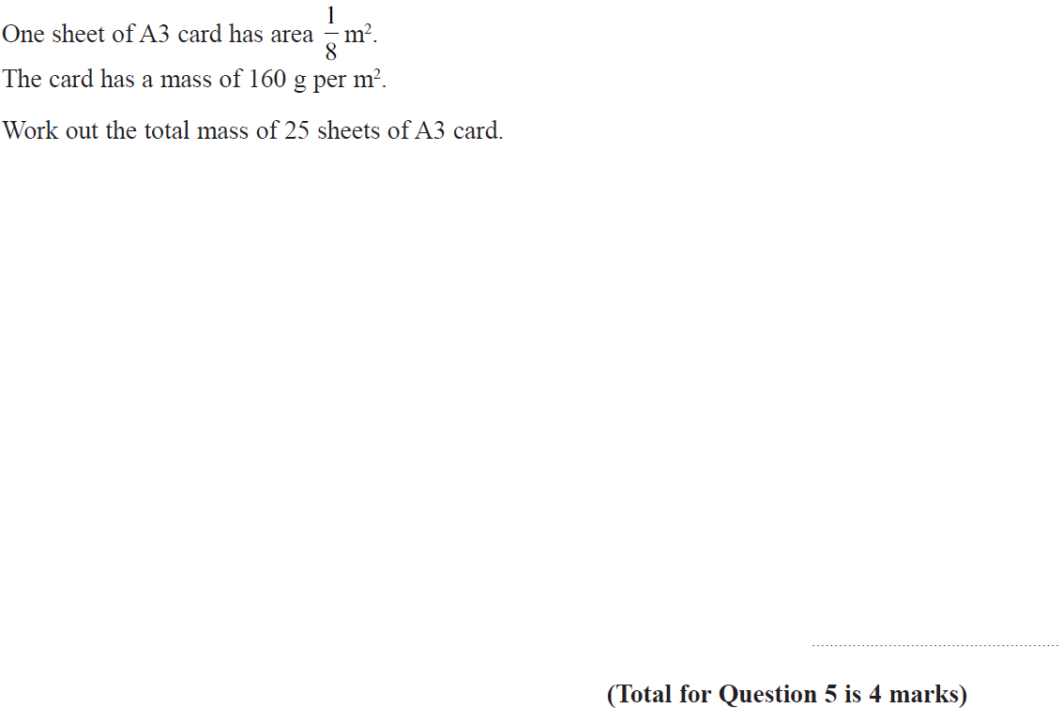
Ratio & Basic Proportion
Specimen Set 2 1H Q5

Slide 17
Ratio & Basic Proportion
Specimen Set 2 1H Q5
A

Slide 18
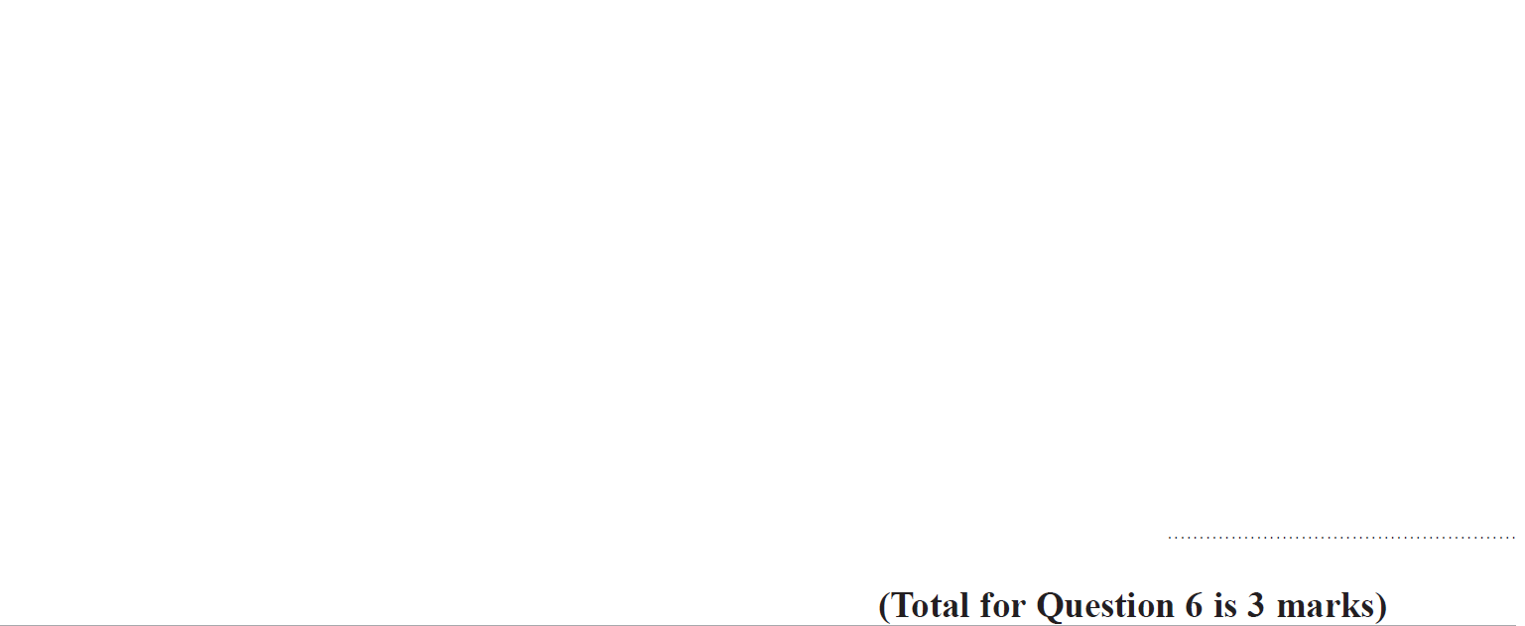
Ratio & Basic Proportion
Specimen Set 2 2H Q6

Slide 19
Ratio & Basic Proportion
Specimen Set 2 2H Q6
A

Slide 20
Ratio & Basic Proportion
Specimen Set 2 2H Q21

Slide 21
Ratio & Basic Proportion
Specimen Set 2 2H Q21
A

Slide 22
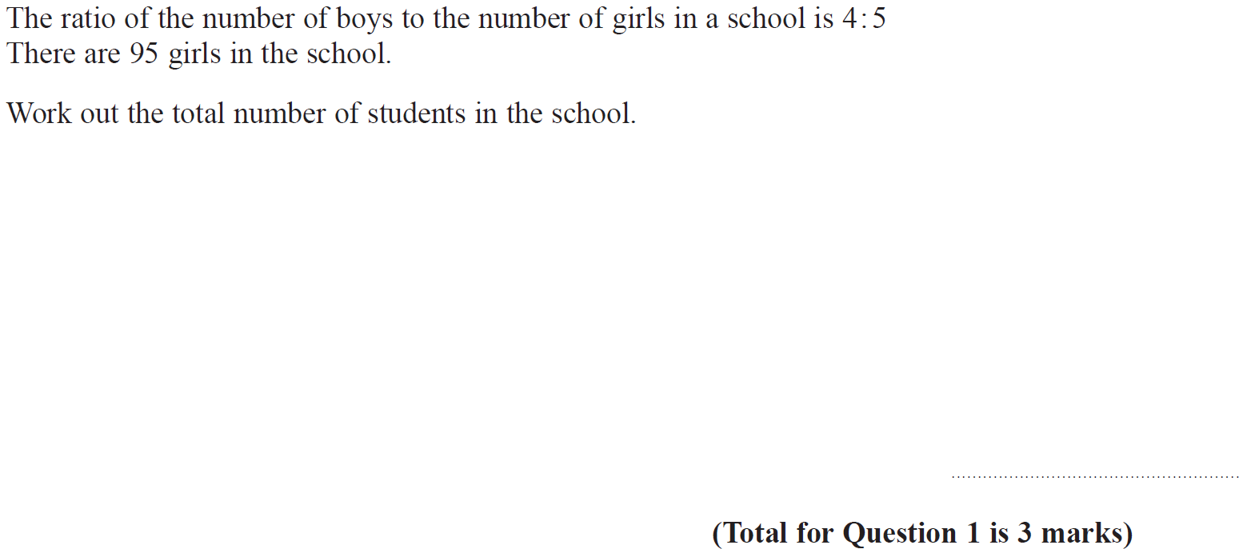
Ratio & Basic Proportion
Specimen Set 2 3H Q1

Slide 23
Ratio & Basic Proportion
Specimen Set 2 3H Q1
A

Slide 24
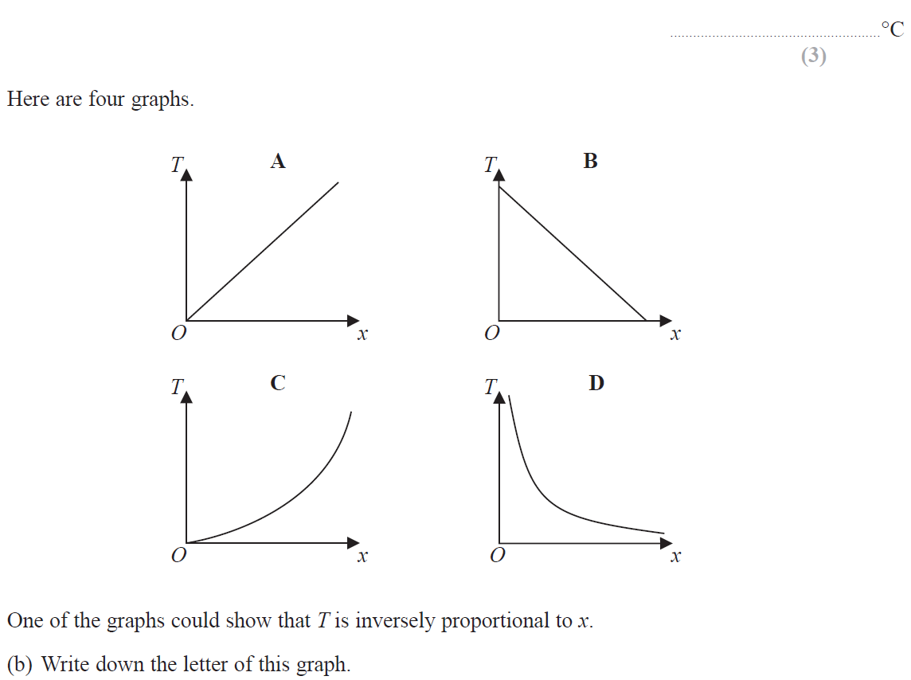
Ratio & Basic Proportion
Specimen Set 2 3H Q6

Slide 25
Ratio & Basic Proportion
Specimen Set 2 3H Q6
A
B

Slide 26
Ratio & Basic Proportion
June 2017 3H Q12

Slide 27
Ratio & Basic Proportion
June 2017 3H Q12
A

Slide 28
Ratio & Basic Proportion
Nov 2017 1H Q2

Slide 29
Ratio & Basic Proportion
Nov 2017 1H Q2
A

Slide 30
Ratio & Basic Proportion
Nov 2017 1H Q13

Slide 31
Ratio & Basic Proportion
Nov 2017 1H Q13
A

Slide 32
Ratio & Basic Proportion
Nov 2017 1H Q14

Slide 33
Ratio & Basic Proportion
Nov 2017 1H Q14
A

Slide 34
Ratio & Basic Proportion
Nov 2017 2H Q9

Slide 35
Ratio & Basic Proportion
Nov 2017 2H Q9
A

Slide 36
Ratio & Basic Proportion
Nov 2017 3H Q2

Slide 37
Ratio & Basic Proportion
Nov 2017 3H Q2
A

Slide 38
Ratio & Basic Proportion
Nov 2017 3H Q4

Slide 39
Ratio & Basic Proportion
Nov 2017 3H Q4
A

Slide 40
Ratio & Basic Proportion
May 2018 1H Q2

Slide 41
Ratio & Basic Proportion
May 2018 1H Q2
A

Slide 42
Ratio & Basic Proportion
May 2018 1H Q8

Slide 43
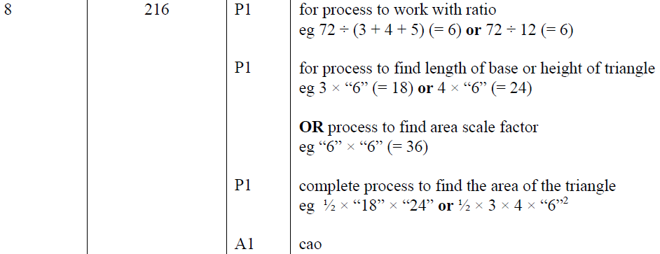
Ratio & Basic Proportion
May 2018 1H Q8
A

Slide 44
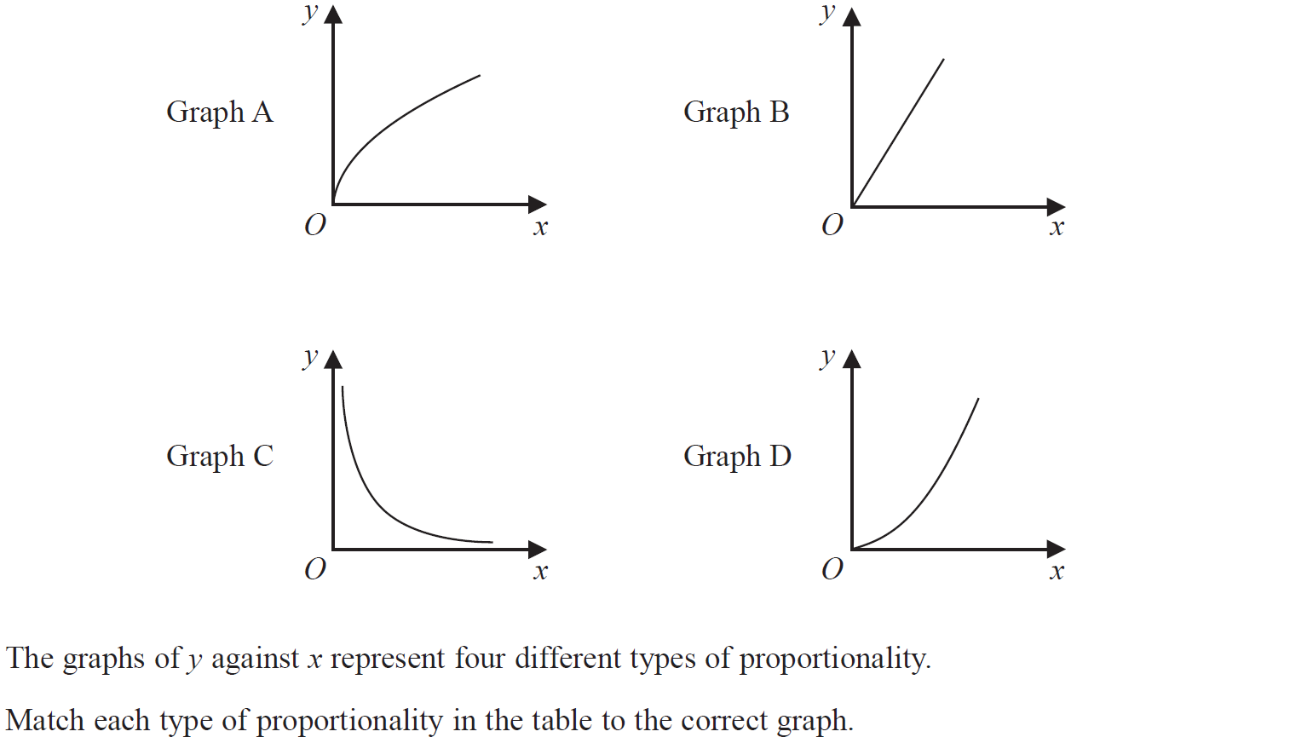
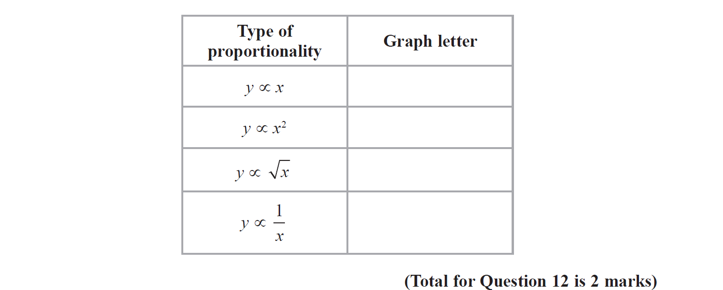
Ratio & Basic Proportion
June 2018 2H Q12

Slide 45
Ratio & Basic Proportion
June 2018 2H Q12
A

Slide 46
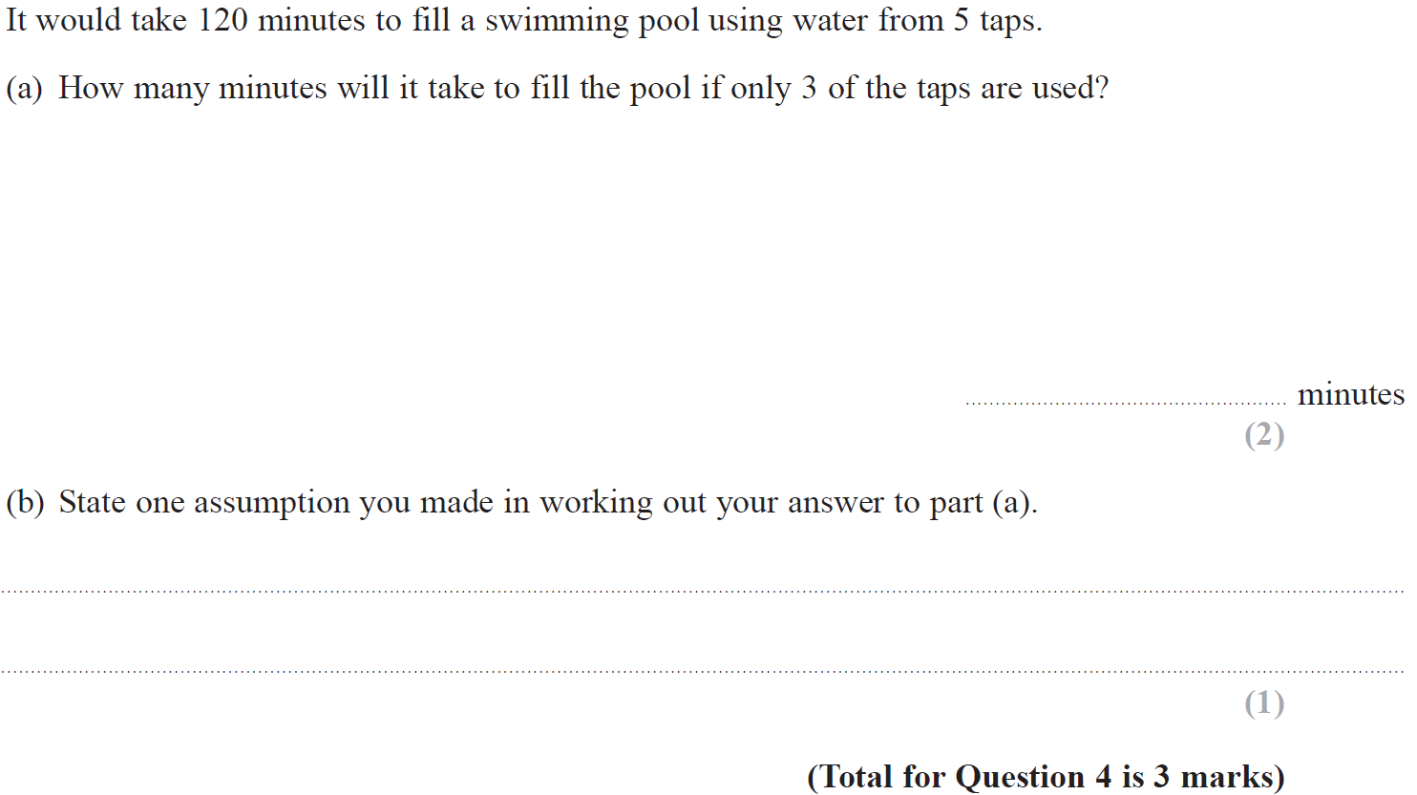
Ratio & Basic Proportion
Nov 2018 1H Q4

Slide 47
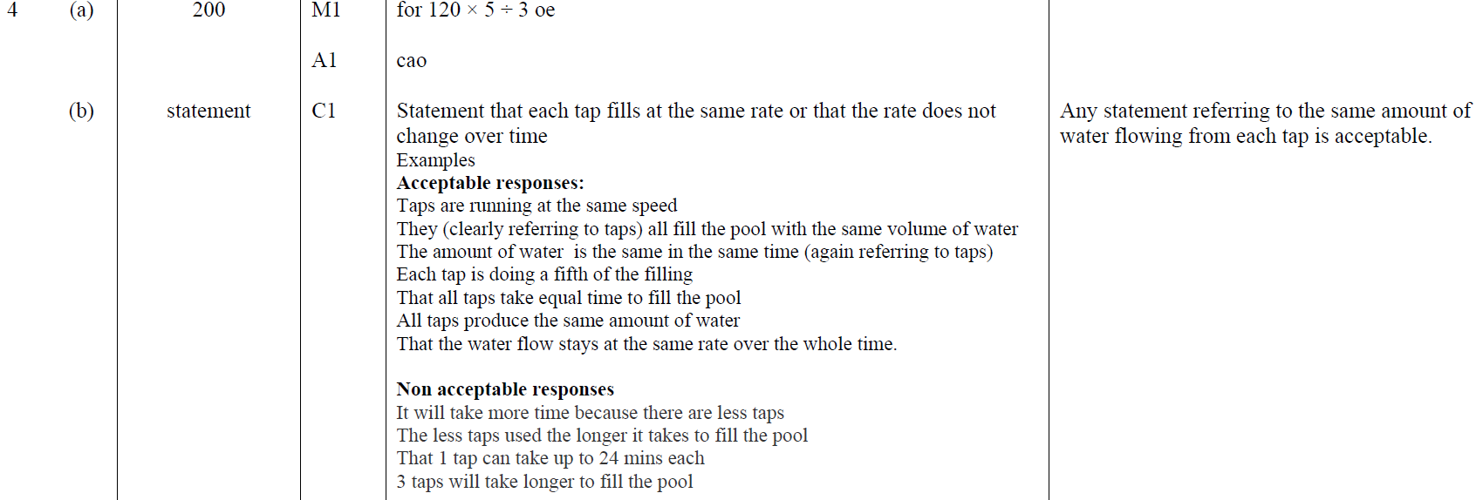
Ratio & Basic Proportion
Nov 2018 1H Q4
A
B

Slide 48
Ratio & Basic Proportion
Nov 2018 2H Q10

Slide 49
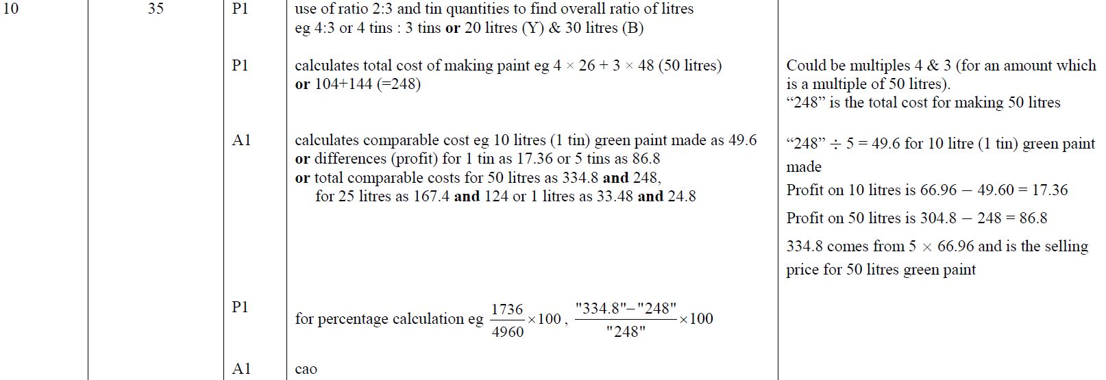
Ratio & Basic Proportion
Nov 2018 2H Q10
A

Slide 50
Ratio & Basic Proportion
Nov 2018 2H Q17

Slide 51
Ratio & Basic Proportion
Nov 2018 2H Q17
A

Slide 52
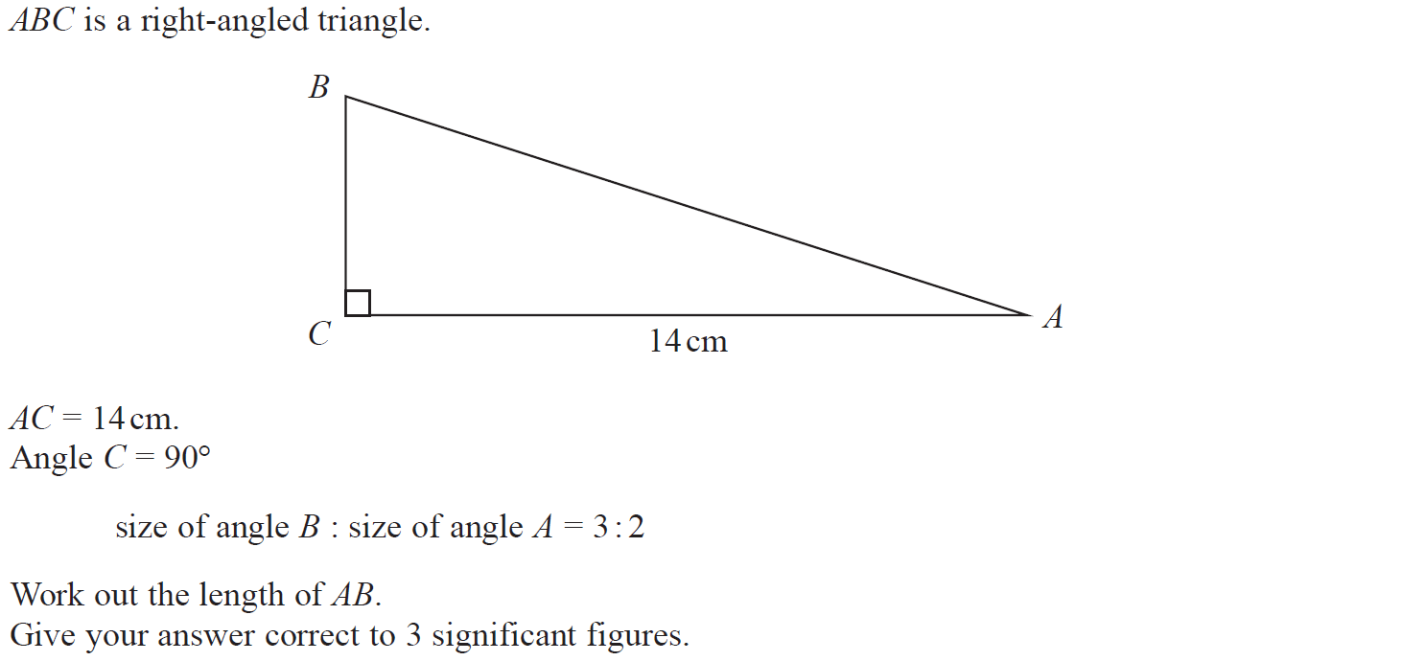
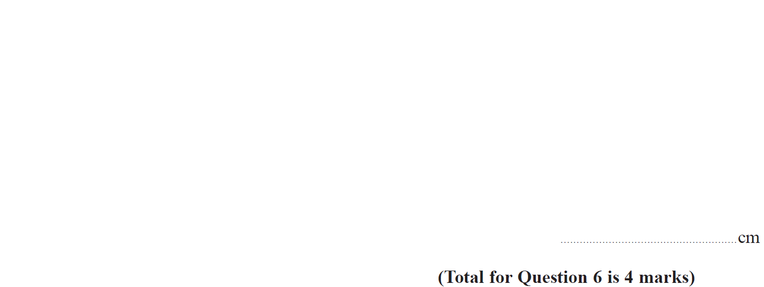
Ratio & Basic Proportion
Nov 2018 3H Q6

Slide 53
Ratio & Basic Proportion
Nov 2018 3H Q6
A

Slide 54
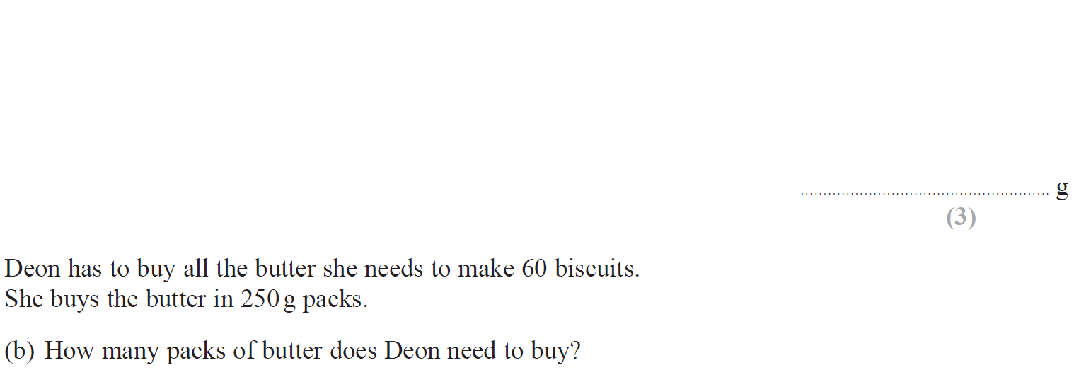
Ratio & Basic Proportion
May 2019 1H Q2

Slide 55
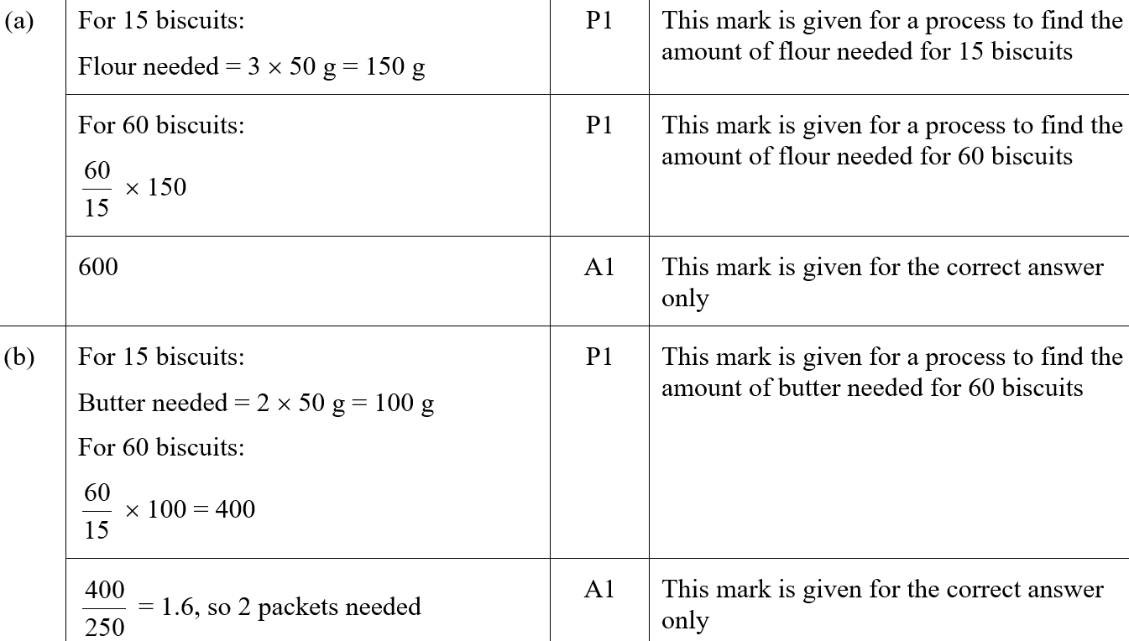
Ratio & Basic Proportion
May 2019 1H Q2
A
B
A SF
B SF

Slide 56
Ratio & Basic Proportion
May 2019 1H Q6

Slide 57
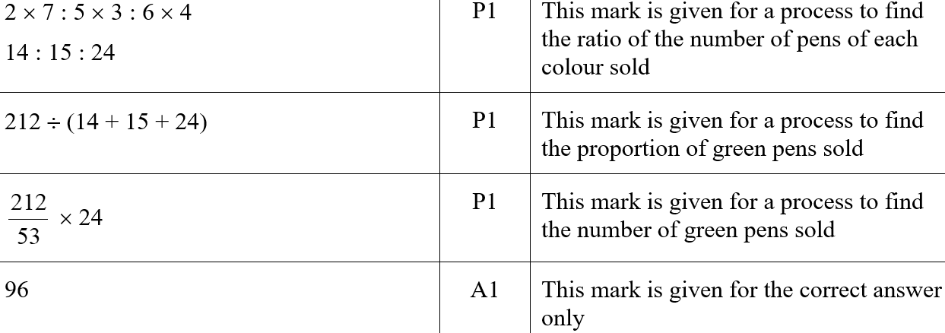
Ratio & Basic Proportion
May 2019 1H Q6
A
A SF

Slide 58
Ratio & Basic Proportion
May 2019 1H Q17

Slide 59
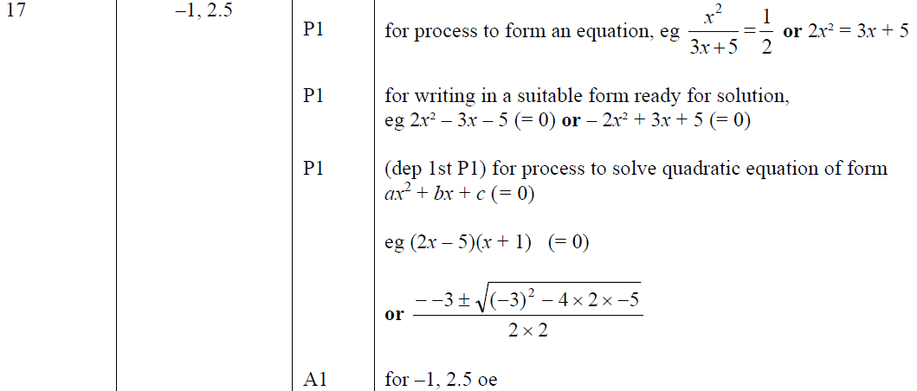
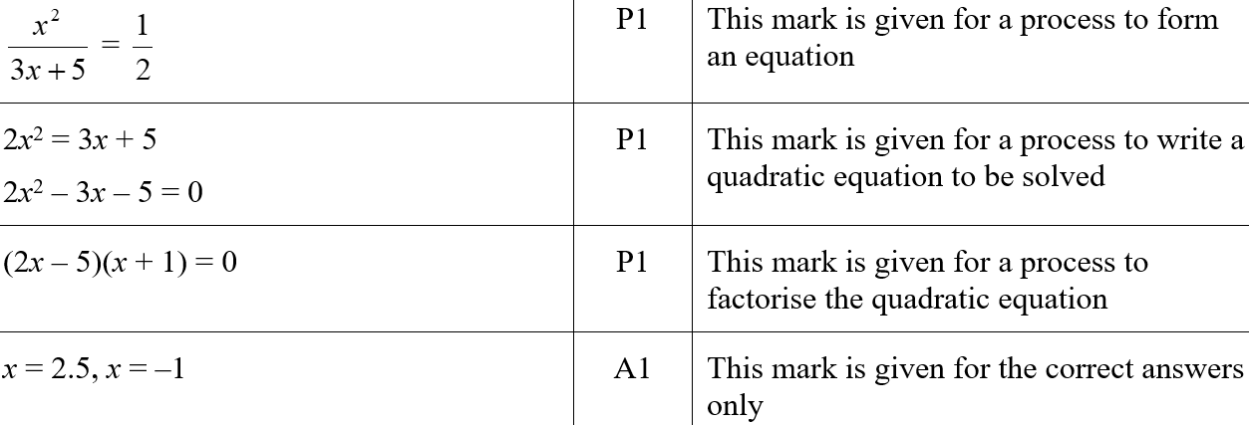
Ratio & Basic Proportion
May 2019 1H Q17
A
A SF

Slide 60
Ratio & Basic Proportion
June 2019 2H Q7

Slide 61
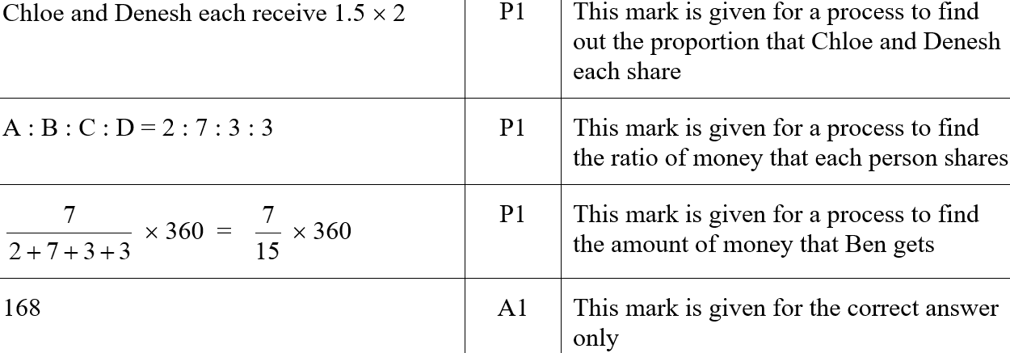
Ratio & Basic Proportion
June 2019 2H Q7
A
A SF

Slide 62
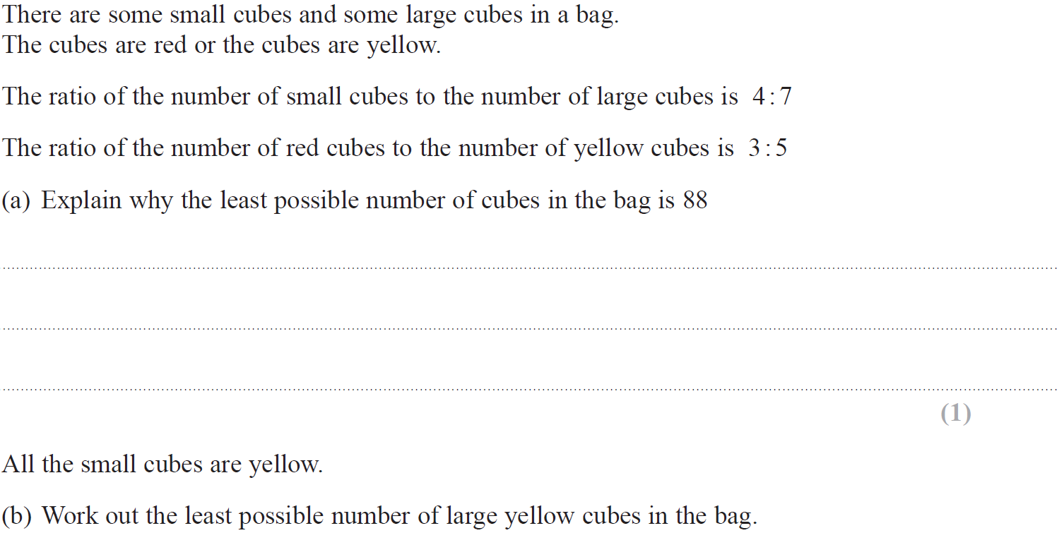
Ratio & Basic Proportion
June 2019 2H Q17

Slide 63
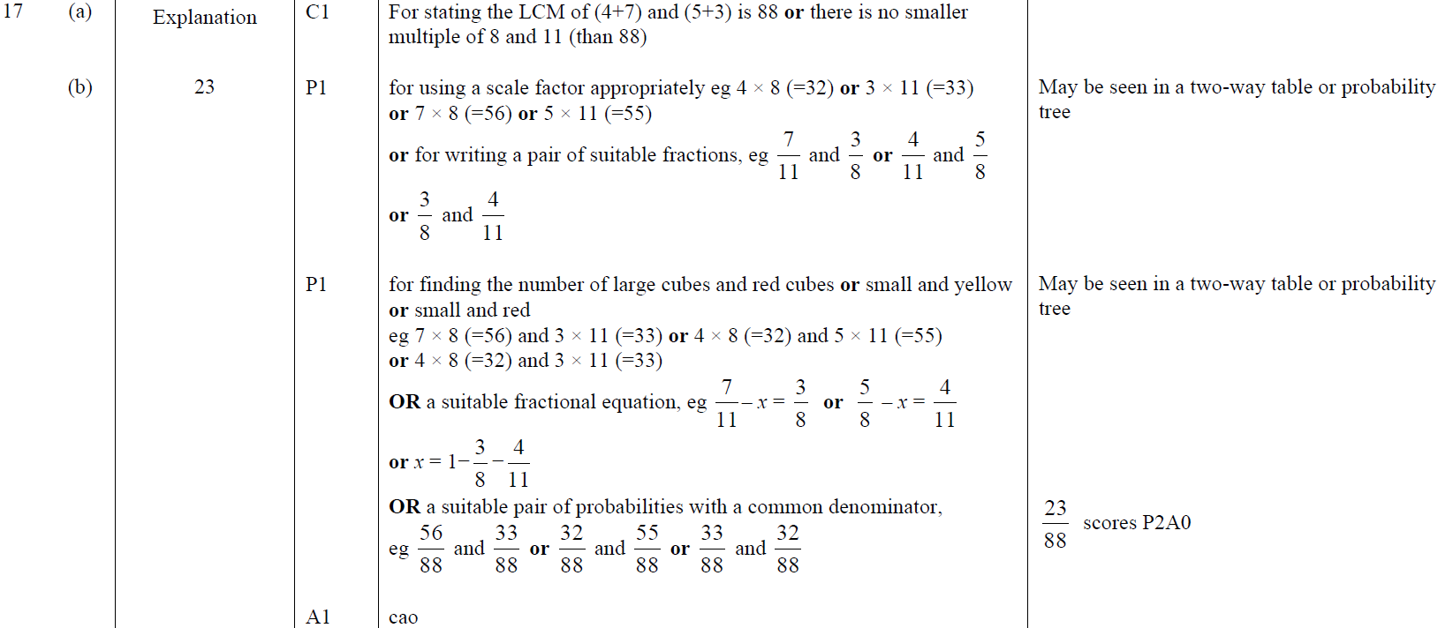
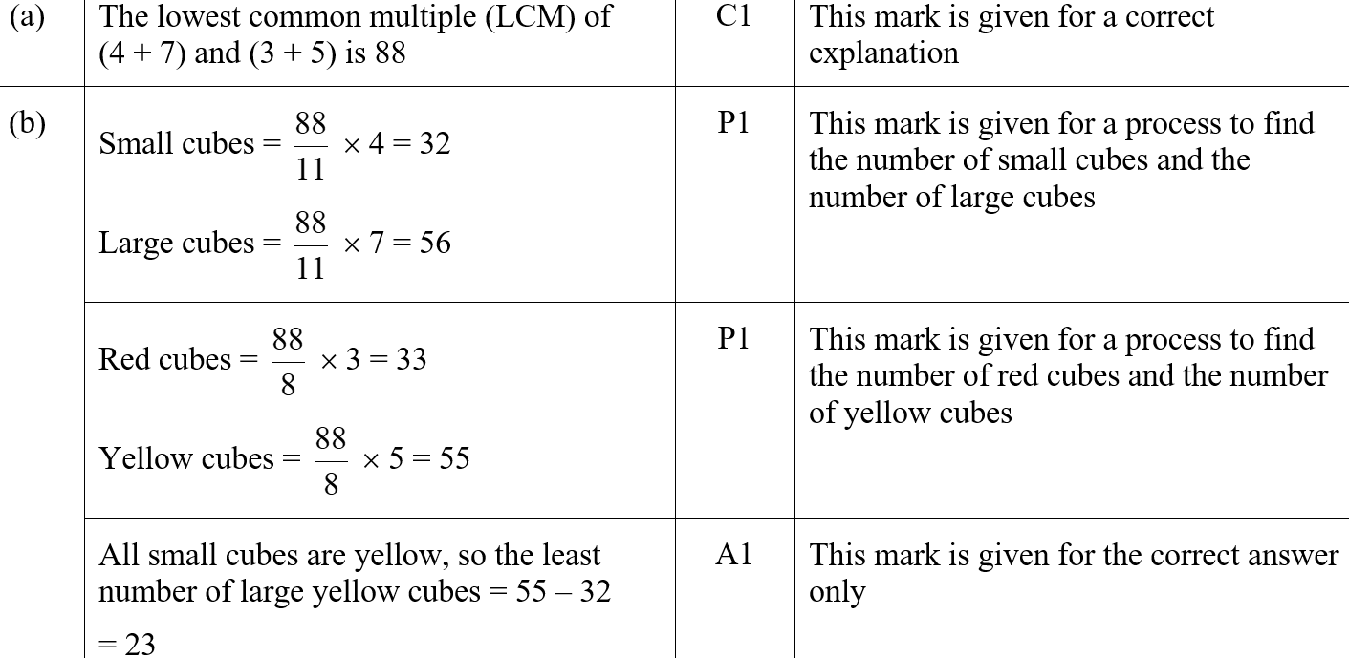
Ratio & Basic Proportion
June 2019 2H Q17
A
B
A SF
B SF

Slide 64
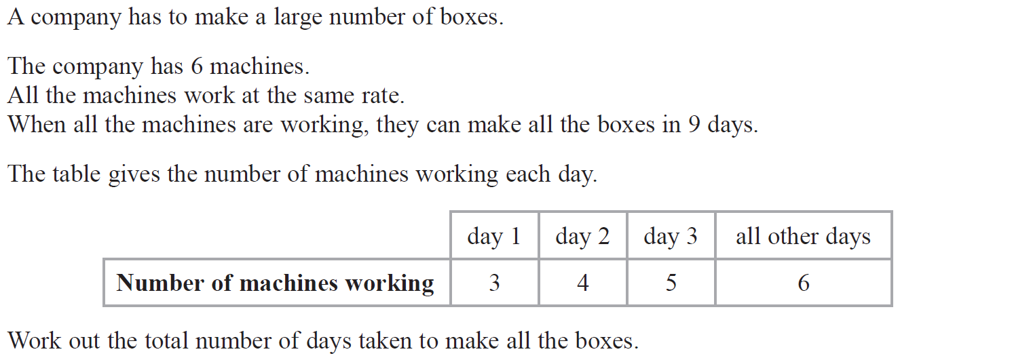
Ratio & Basic Proportion
June 2019 3H Q9

Slide 65
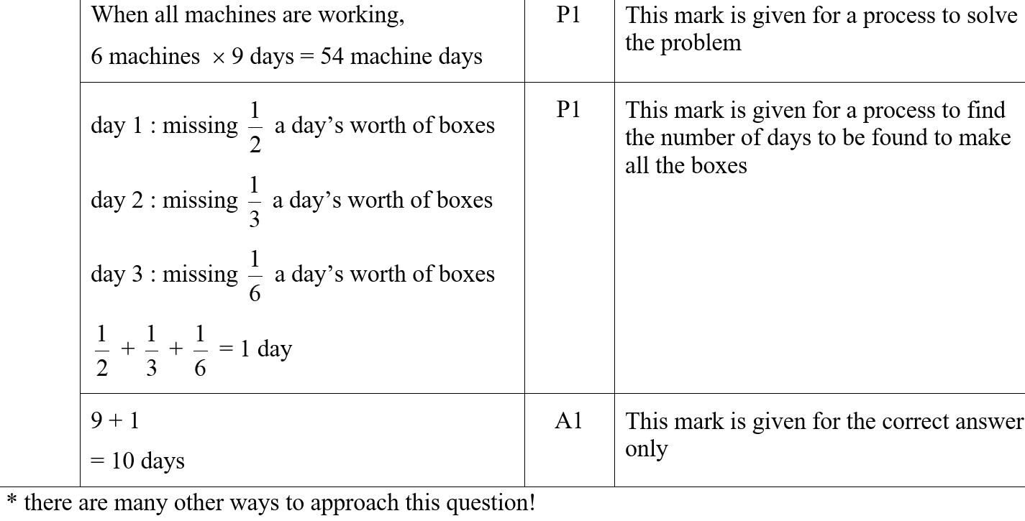
Ratio & Basic Proportion
June 2019 3H Q9
A
A SF

