Slide 1
Ratio & Basic Proportion
Ratio & Basic Proportion
May 2017
1H Q4
Nov 2017
1H Q13
SAM
1H Q10
May 2017
1H Q8
Nov 2017
1H Q25
June 2018
2H Q3
SAM
1H Q17
June 2017
2H Q13
Nov 2017
3H Q17
June 2018
2H Q8
1 Marker
SAM
2H Q10
June 2017
2H Q19
Nov 2017
3H Q24
Nov 2018
1H Q13
SAM
3H Q4
June 2017
3H Q11
May 2018
1H Q14
Nov 2018
1H Q18
SAM
3H Q16
June 2017
3H Q14
May 2018
1H Q26
Inverse Proportion in context
Proportion Graphs

Slide 2
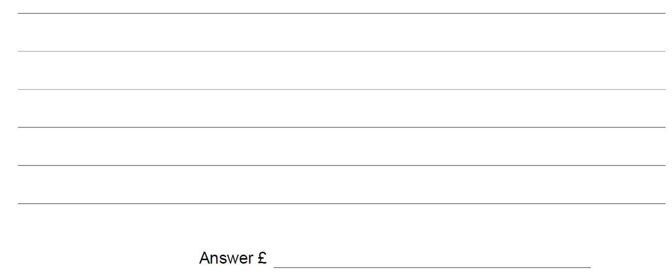
Ratio & Basic Proportion
SAM 1H Q10

Slide 3
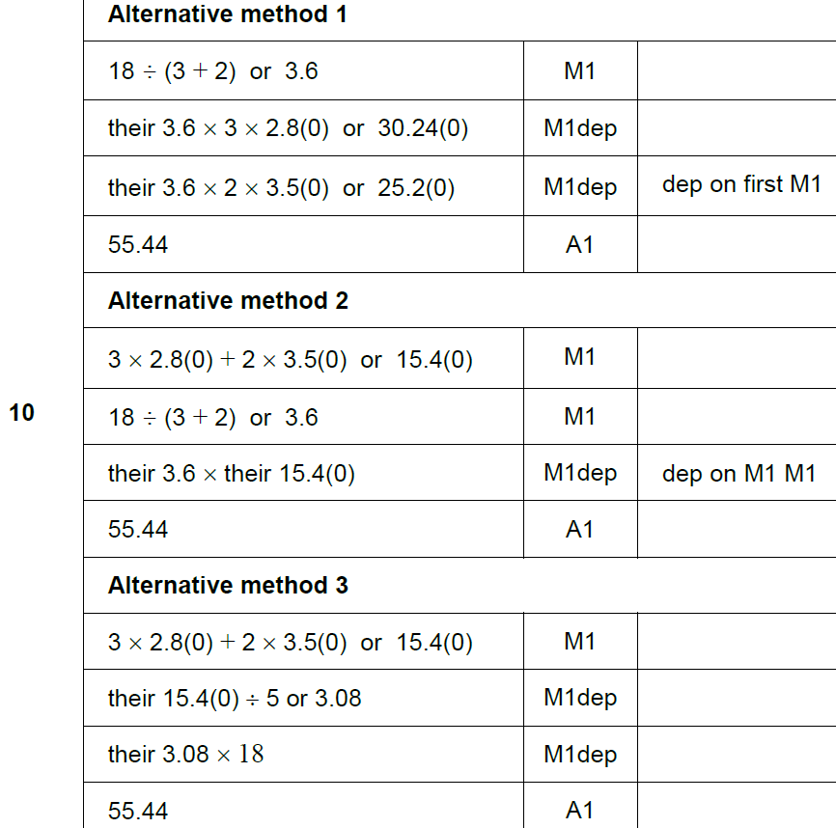
Ratio & Basic Proportion
SAM 1H Q10
A

Slide 4
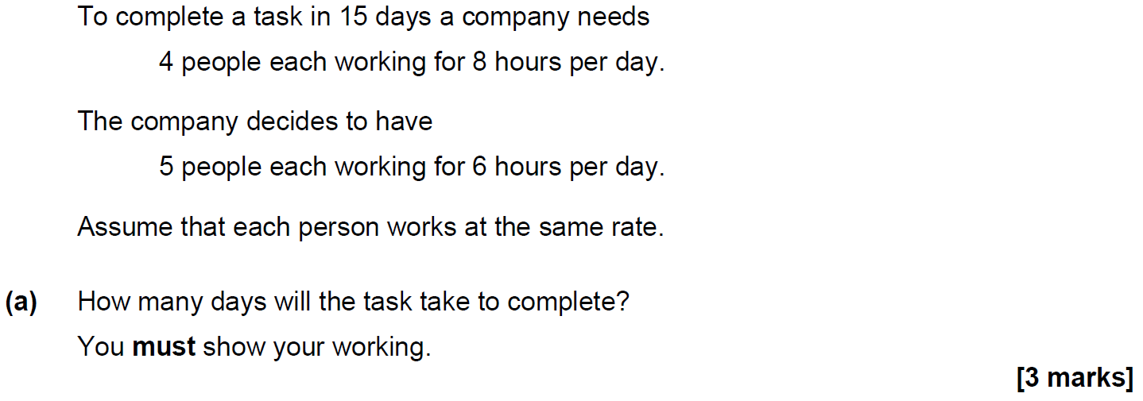
Ratio & Basic Proportion
SAM 1H Q17

Slide 5
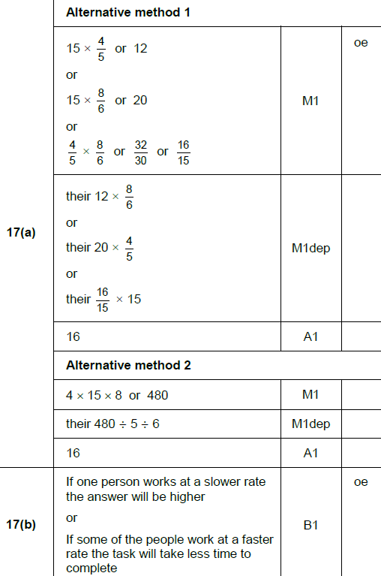
Ratio & Basic Proportion
SAM 1H Q17
A
B

Slide 6
Ratio & Basic Proportion
SAM 2H Q10

Slide 7
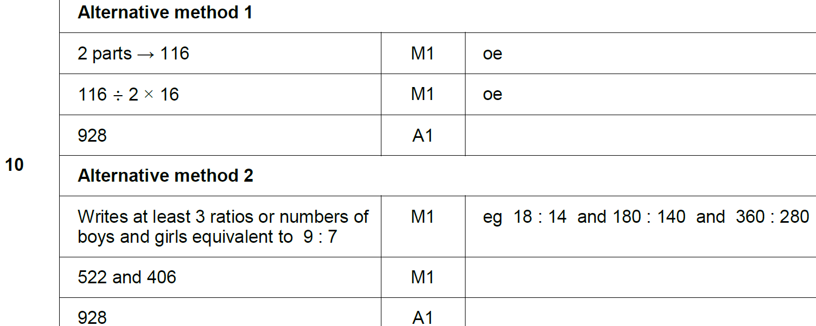
Ratio & Basic Proportion
SAM 2H Q10
A

Slide 8
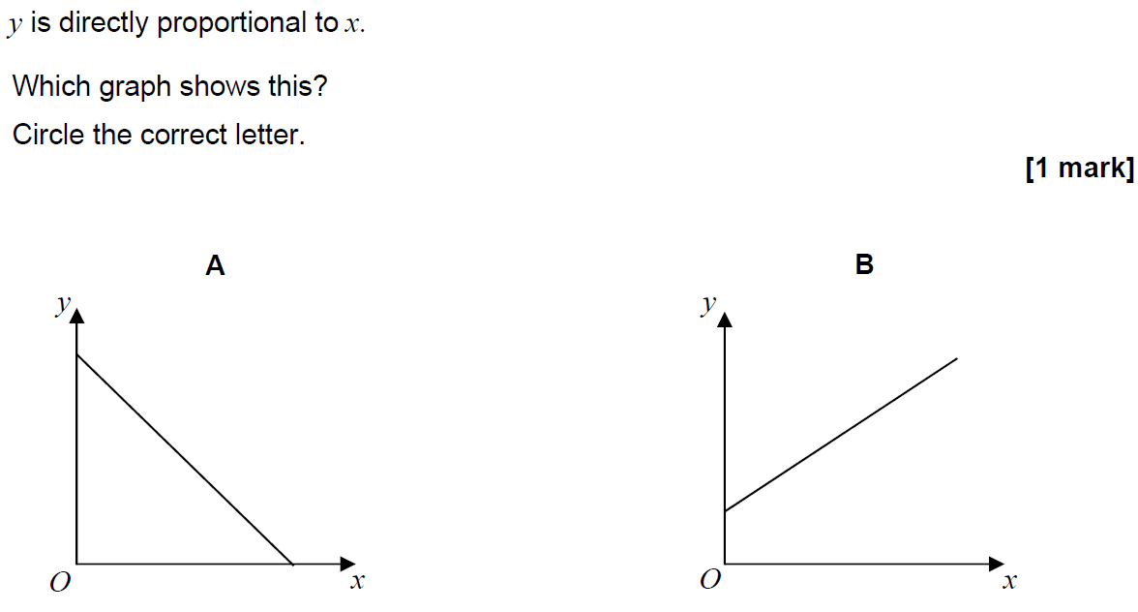
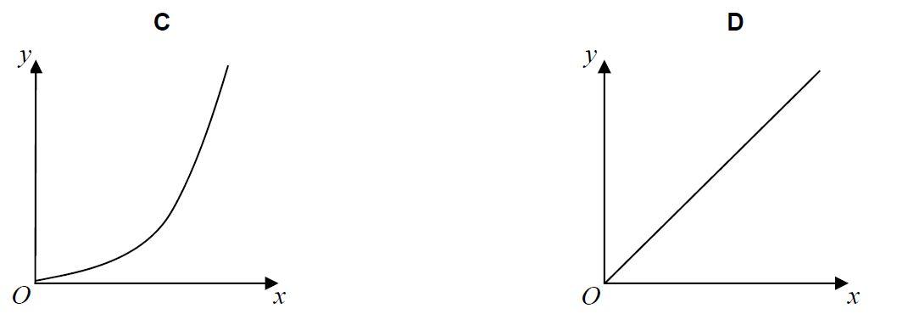
Ratio & Basic Proportion
SAM 3H Q4

Slide 9
Ratio & Basic Proportion
SAM 3H Q4
A

Slide 10
Ratio & Basic Proportion
SAM 3H Q16

Slide 11
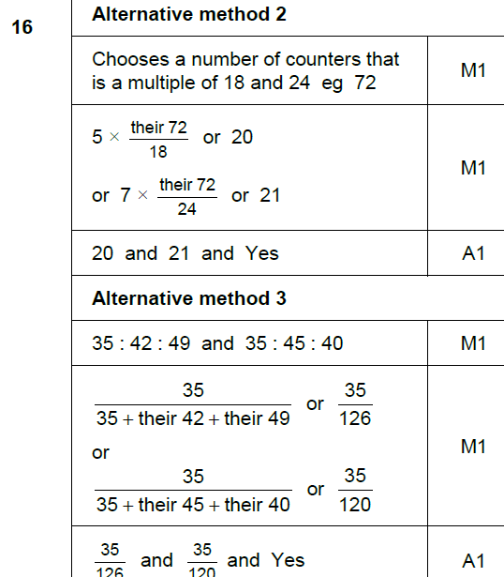
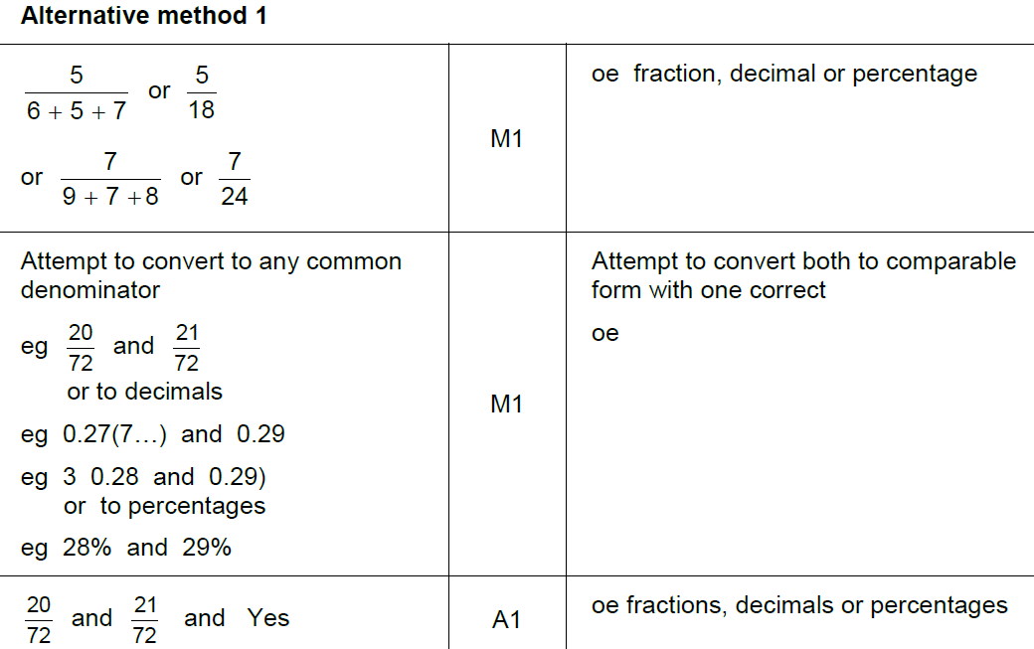
Ratio & Basic Proportion
SAM 3H Q16
A

Slide 12
Ratio & Basic Proportion
May 2017 1H Q4

Slide 13
Ratio & Basic Proportion
May 2017 1H Q4
A

Slide 14
Ratio & Basic Proportion
May 2017 1H Q8

Slide 15
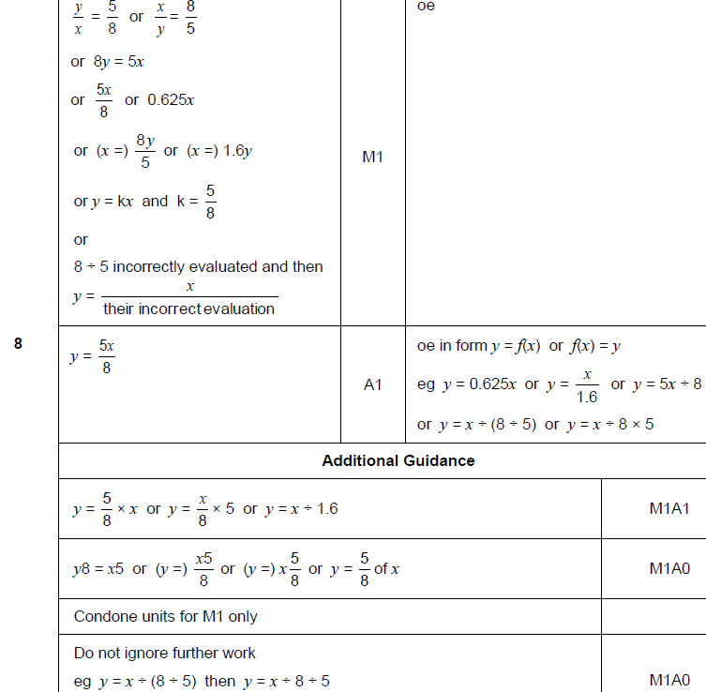
Ratio & Basic Proportion
May 2017 1H Q8
A

Slide 16
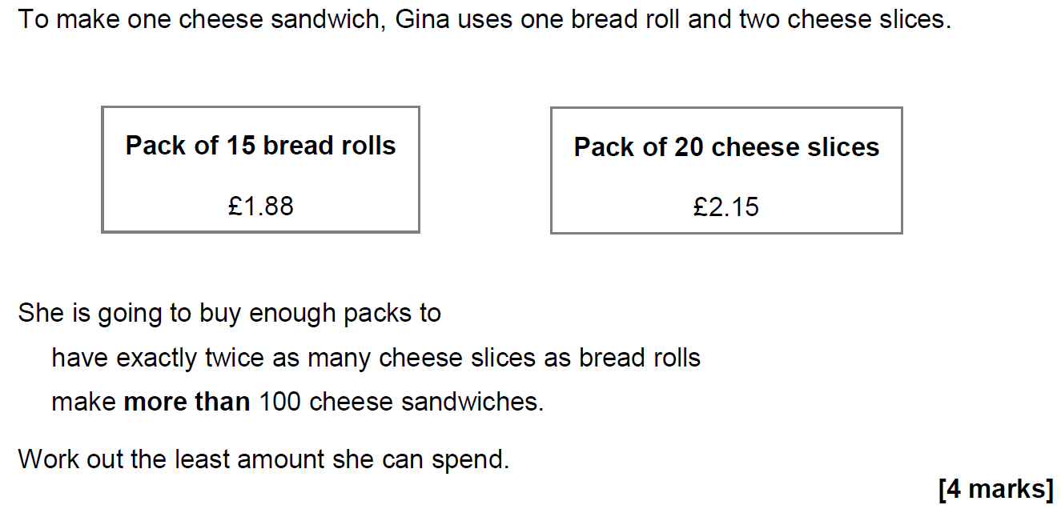
Ratio & Basic Proportion
June 2017 2H Q13

Slide 17
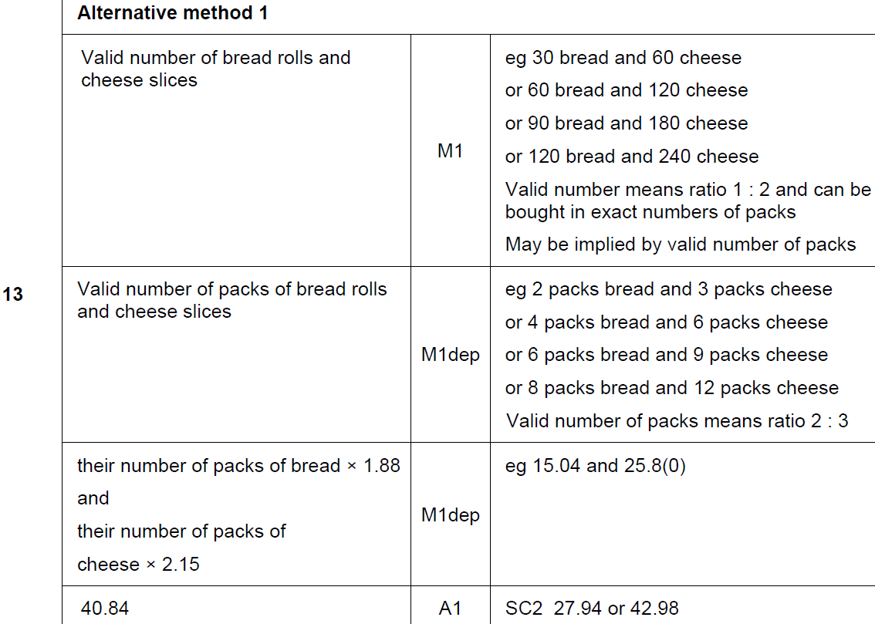
Ratio & Basic Proportion
June 2017 2H Q13
A

Slide 18
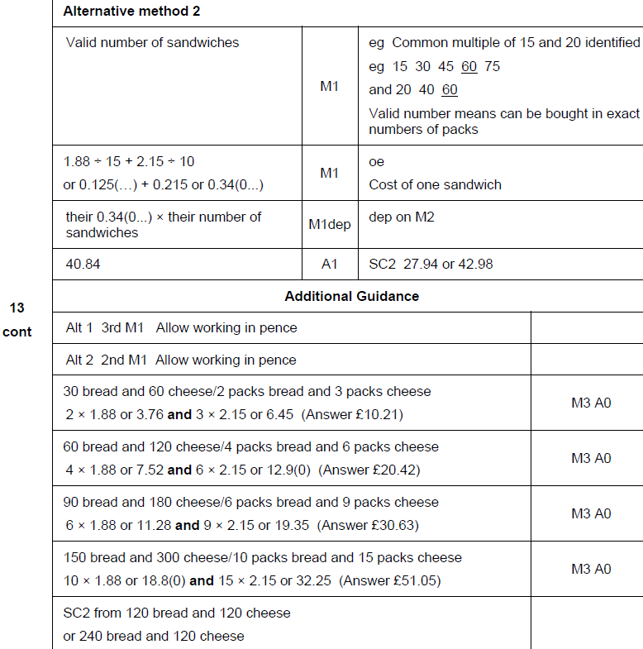
Ratio & Basic Proportion
June 2017 2H Q13
A Alternative & notes

Slide 19
Ratio & Basic Proportion
June 2017 2H Q19

Slide 20
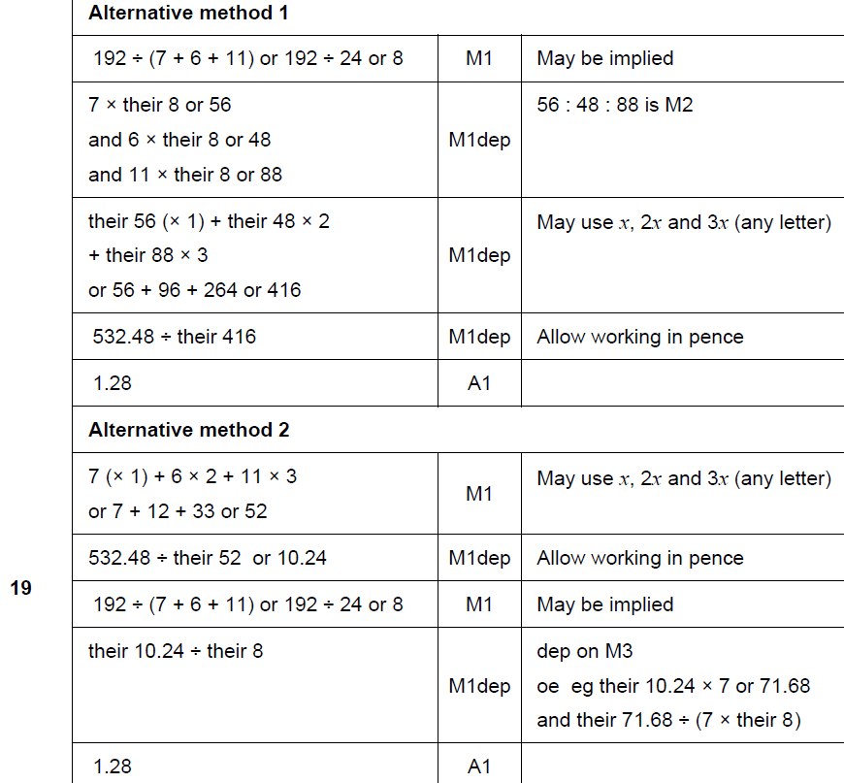
Ratio & Basic Proportion
June 2017 2H Q19
A

Slide 21
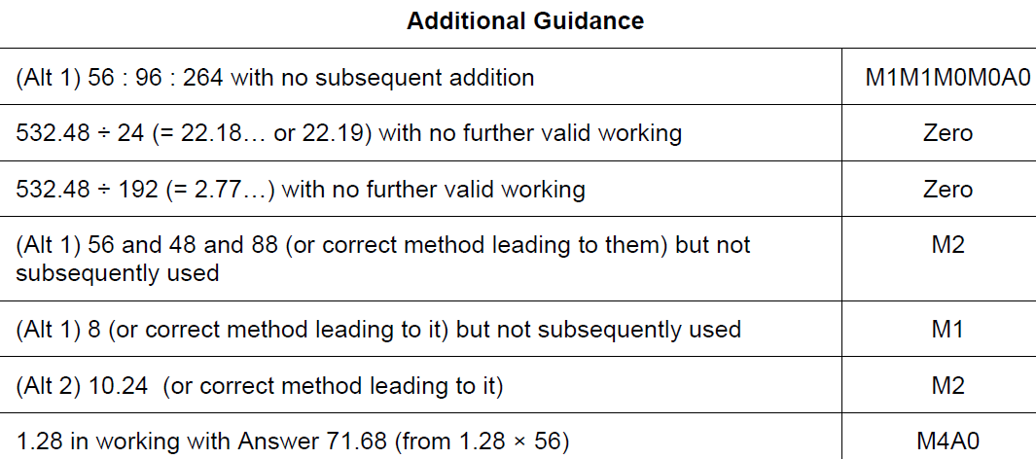
Ratio & Basic Proportion
June 2017 2H Q19
A notes

Slide 22
Ratio & Basic Proportion
June 2017 3H Q11

Slide 23
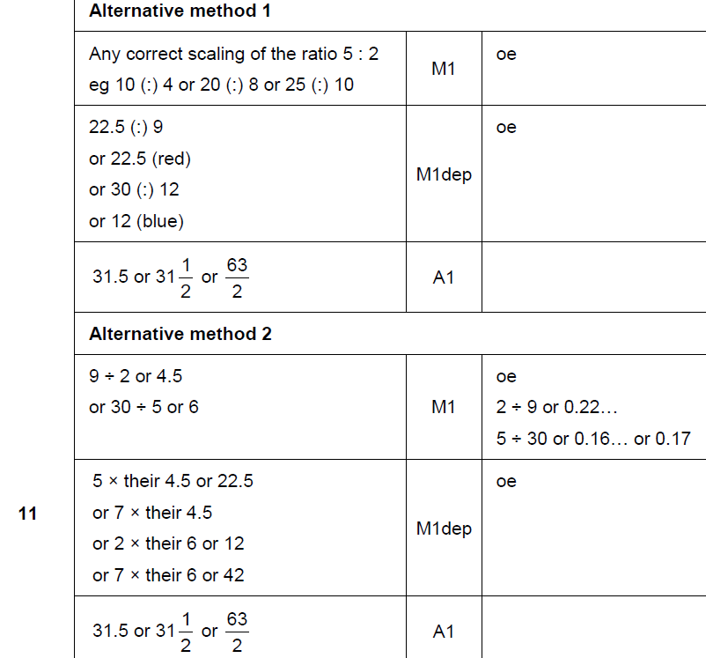
Ratio & Basic Proportion
June 2017 3H Q11
A

Slide 24
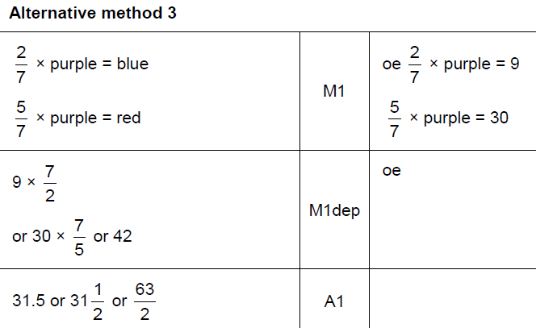
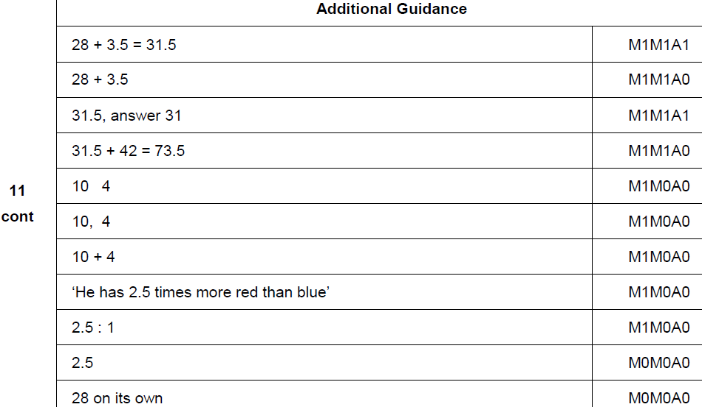
Ratio & Basic Proportion
June 2017 3H Q11
A Alternative & notes

Slide 25
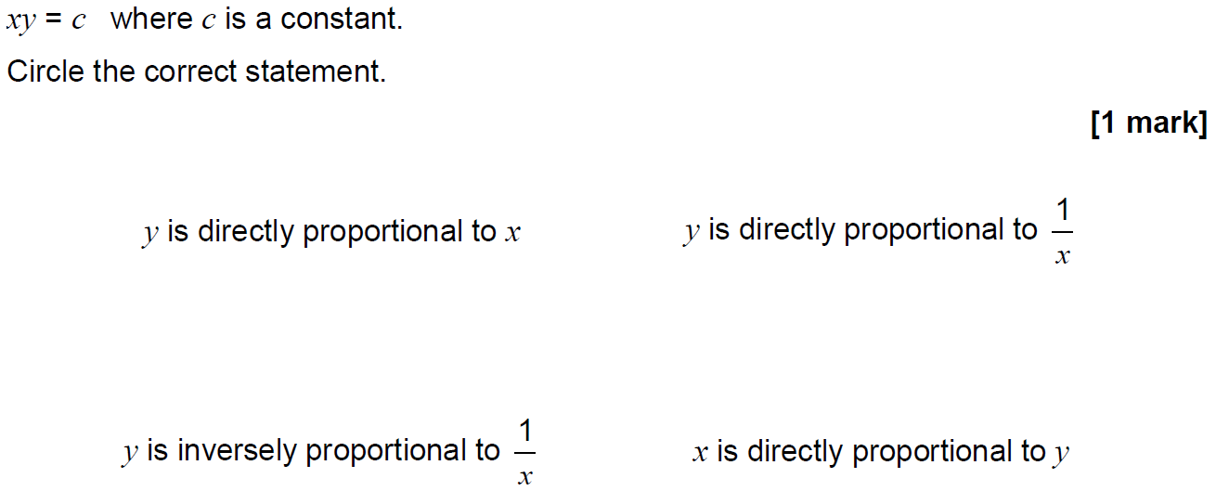
Ratio & Basic Proportion
June 2017 3H Q14

Slide 26
Ratio & Basic Proportion
June 2017 3H Q14
A

Slide 27
Ratio & Basic Proportion
Nov 2017 1H Q13

Slide 28
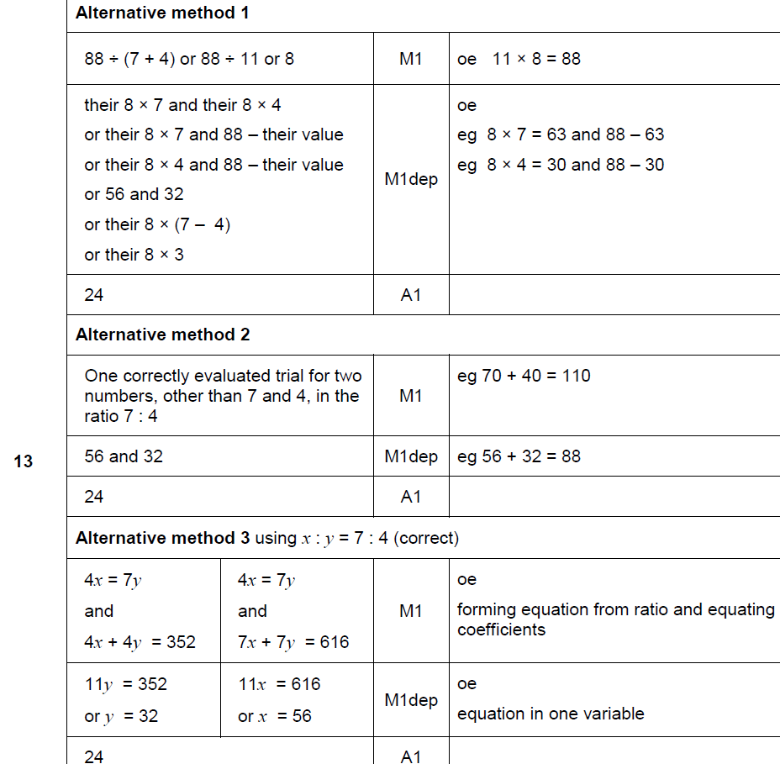
Ratio & Basic Proportion
Nov 2017 1H Q13
A

Slide 29
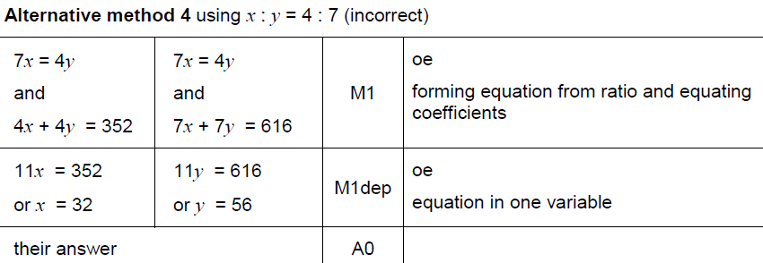
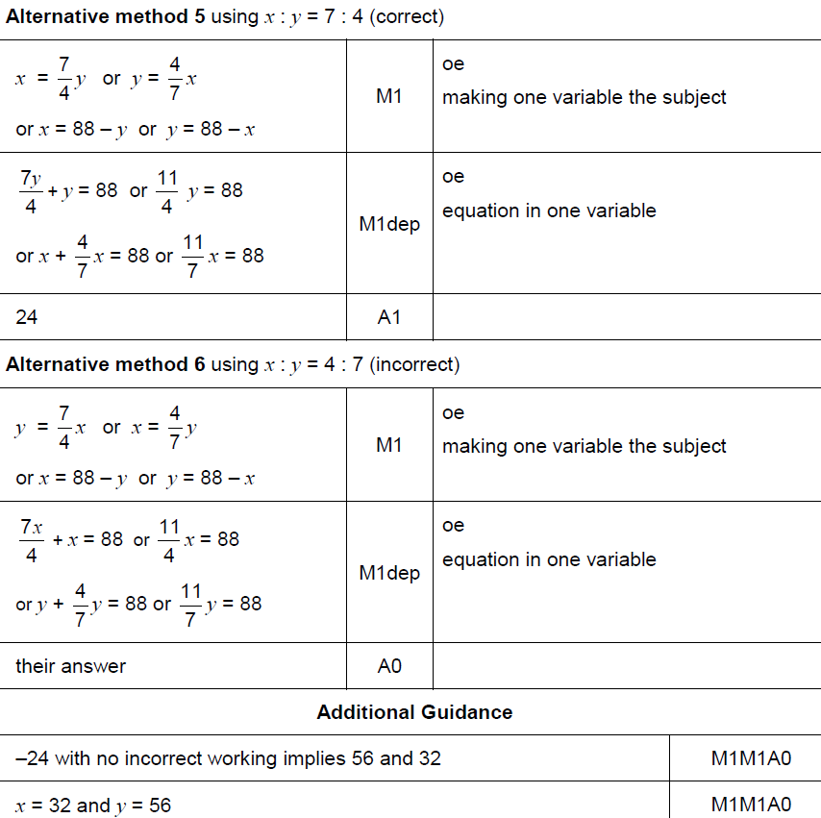
Ratio & Basic Proportion
Nov 2017 1H Q13
A Alternative & notes

Slide 30
Ratio & Basic Proportion
Nov 2017 1H Q25

Slide 31
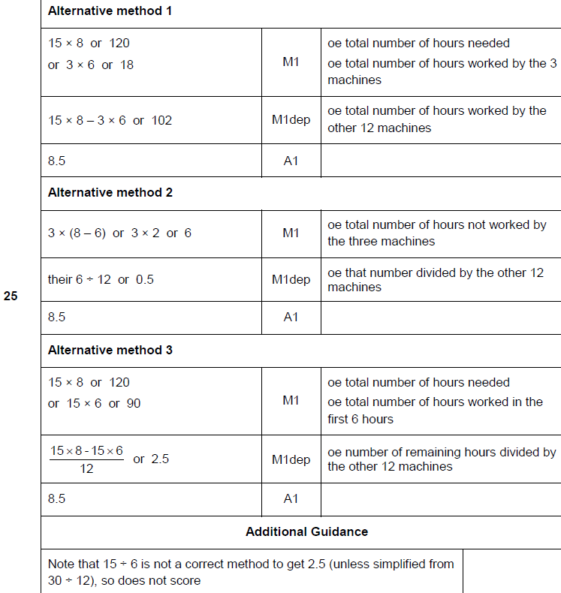
Ratio & Basic Proportion
Nov 2017 1H Q25
A

Slide 32
Ratio & Basic Proportion
Nov 2017 3H Q17
At a football game
number of men : number of women : number of children = 13 : 5 : 7
There are 4152 more men than women.
Work out the number of children at the game.
[3 marks]

Slide 33
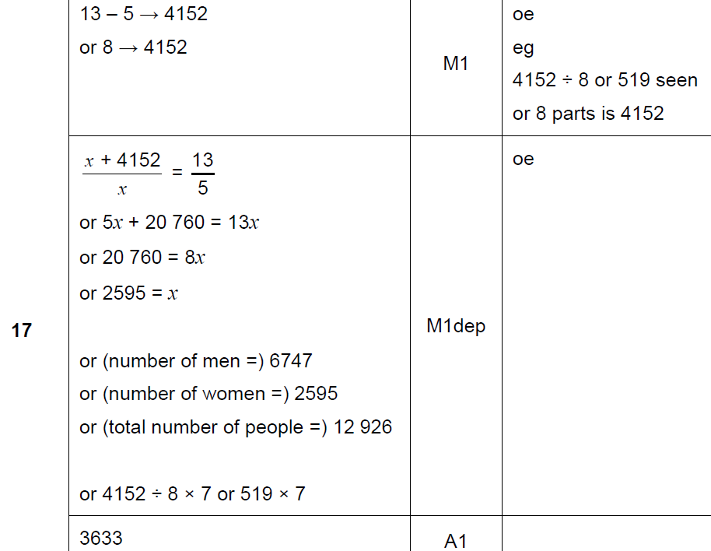
Ratio & Basic Proportion
Nov 2017 3H Q17
A

Slide 34
Ratio & Basic Proportion
Nov 2017 3H Q24
a : b = 9 : 4 and 10b = 7c
Work out a : c in its simplest form.
[3 marks]

Slide 35
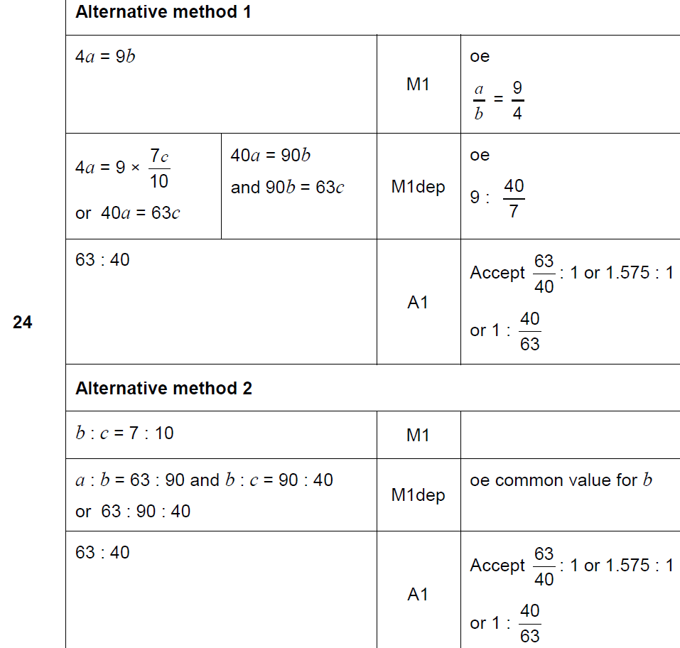
Ratio & Basic Proportion
Nov 2017 3H Q24
A

Slide 36
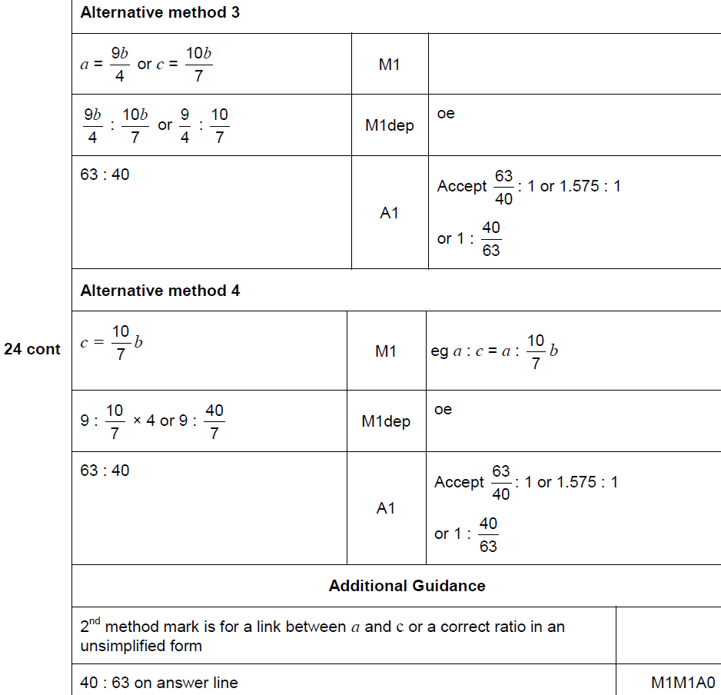
Ratio & Basic Proportion
Nov 2017 3H Q24
A Alternative & notes

Slide 37
Ratio & Basic Proportion
May 2018 1H Q14

Slide 38
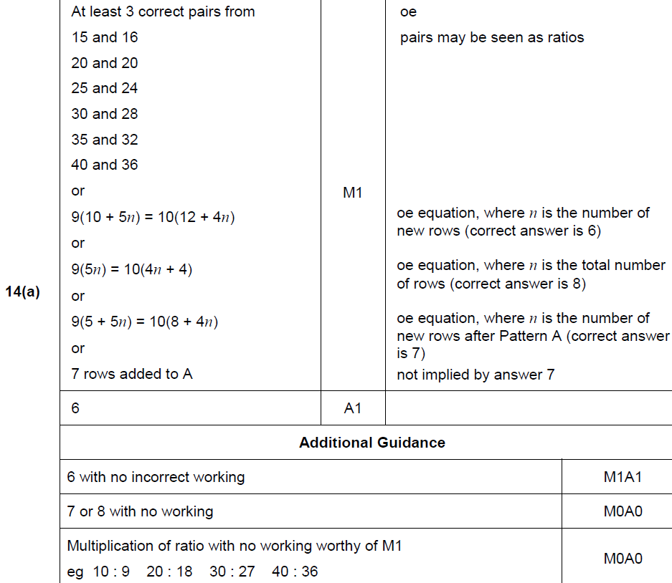
Ratio & Basic Proportion
May 2018 1H Q14
A

Slide 39
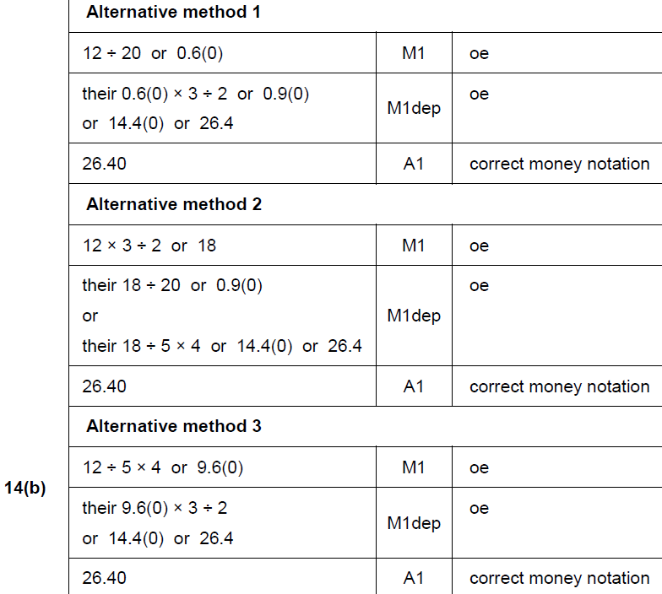
Ratio & Basic Proportion
May 2018 1H Q14
B

Slide 40
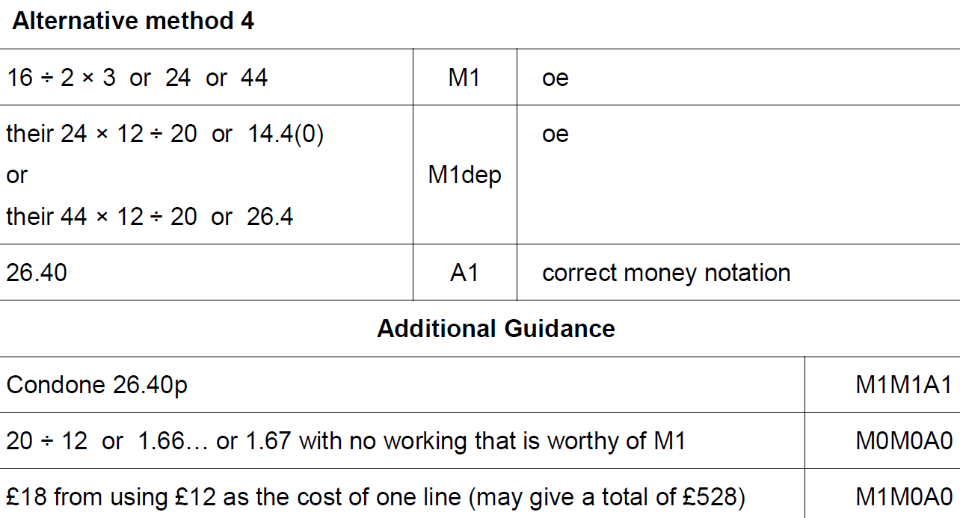
Ratio & Basic Proportion
May 2018 1H Q14
B Alternative 3 & notes

Slide 41
Ratio & Basic Proportion
May 2018 1H Q26
b is two thirds of c.
5a = 4c
Work out the ratio a : b : c
Give your answer in its simplest form where a, b and c are integers.
[3 marks]

Slide 42
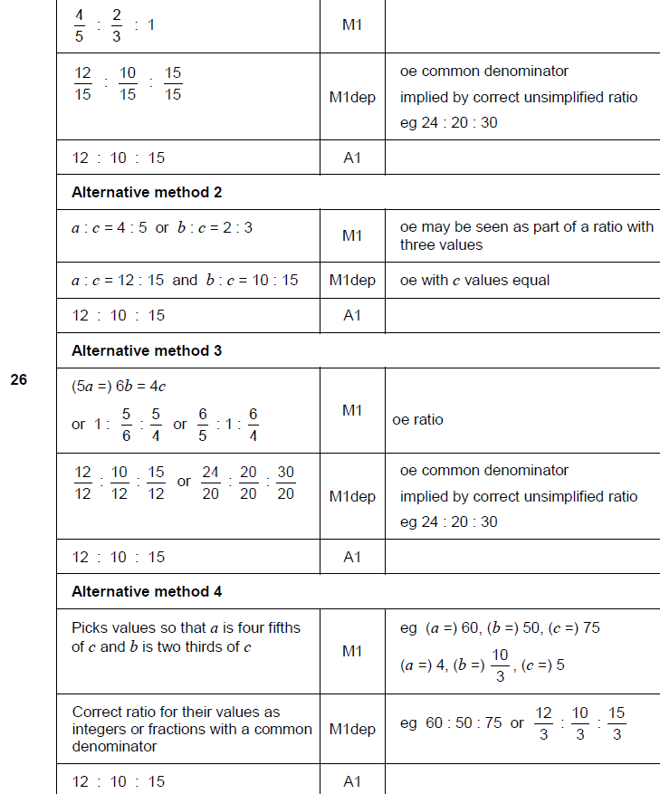
Ratio & Basic Proportion
May 2018 1H Q26
A

Slide 43
Ratio & Basic Proportion
June 2018 2H Q3

Slide 44
Ratio & Basic Proportion
June 2018 2H Q3
A

Slide 45
Ratio & Basic Proportion
June 2018 2H Q8
Theo starts with savings of £18
James starts with no savings.
Each week from now,
Theo will save £4.50 and James will save £4
In how many weeks will Theo and James have savings in the ratio 15 : 8 ?
[3 marks]

Slide 46
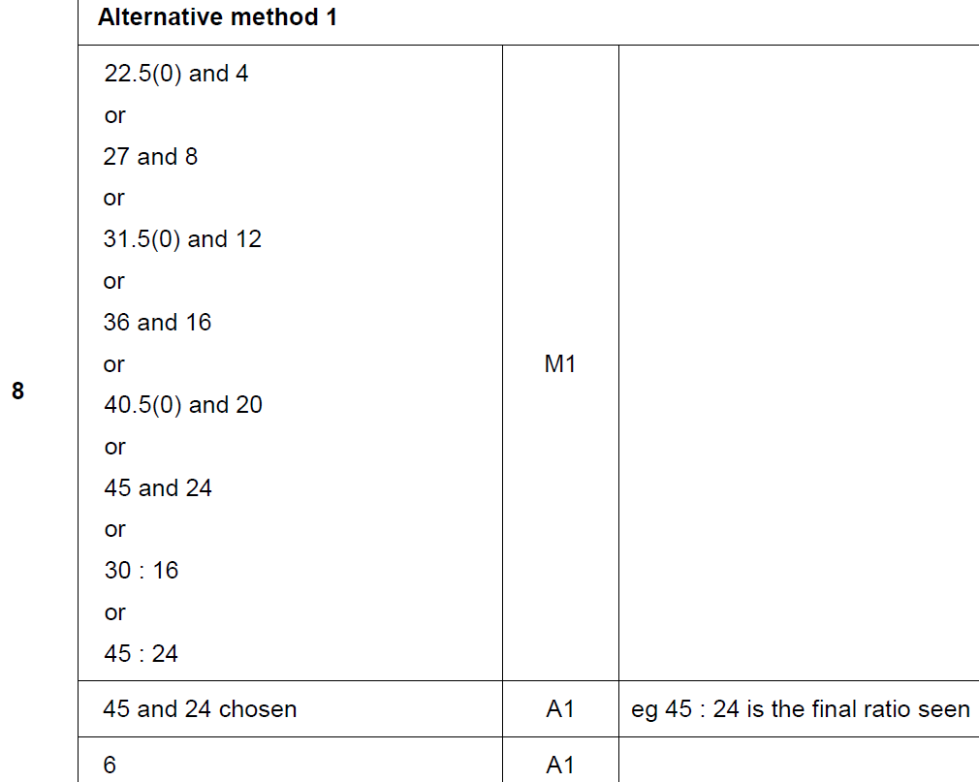
Ratio & Basic Proportion
June 2018 2H Q8
A

Slide 47
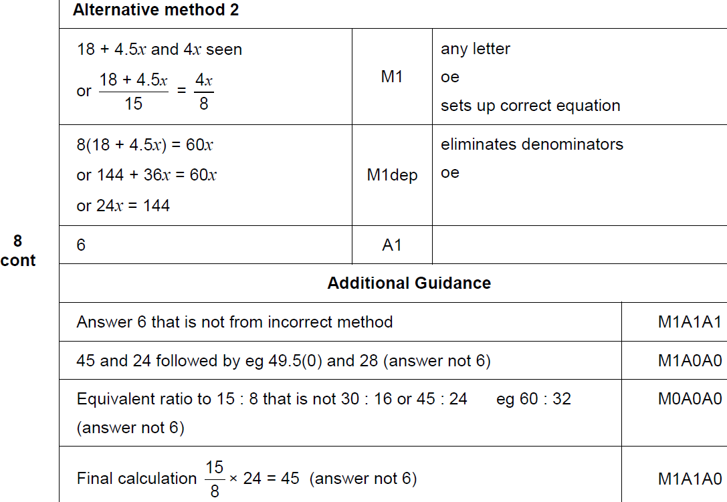
Ratio & Basic Proportion
June 2018 2H Q8
A Alternative & notes

Slide 48
Ratio & Basic Proportion
Nov 2018 1H Q13
e : f = 2 : 3 and f : g = 5 : 4
Work out e : g
Give your answer in its simplest form.
[3 marks]

Slide 49
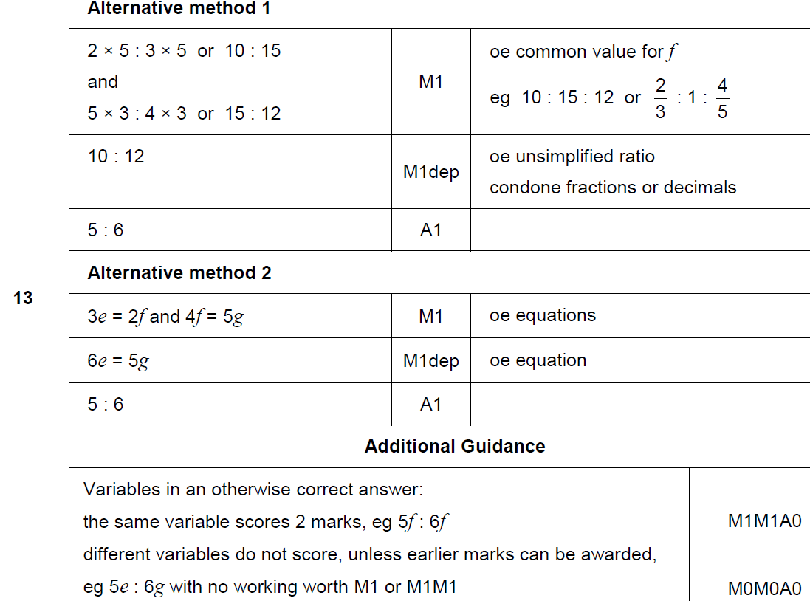
Ratio & Basic Proportion
Nov 2018 1H Q13
A

Slide 50
Ratio & Basic Proportion
Nov 2018 1H Q18
Beth and Mia translate documents from Spanish into English.
A set of documents that would take Beth 8 days would take Mia 10 days.
Beth starts to translate the documents.
After 2 days Beth and Mia both work on translating the documents.
How many more days will it take to complete the work?
You must show your working.
[4 marks]

Slide 51
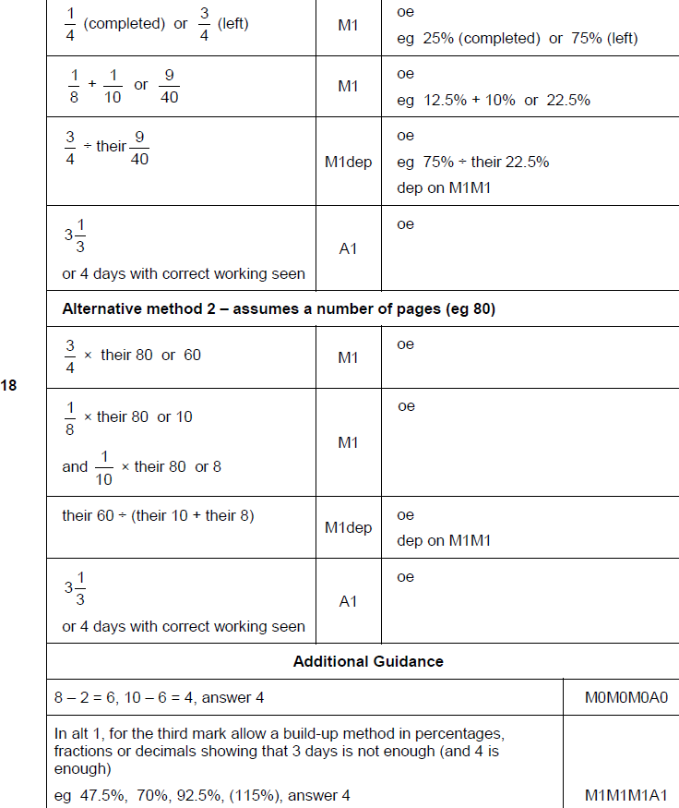
Ratio & Basic Proportion
Nov 2018 1H Q18
A

