Slide 1
Ratio & Basic Proportion
Ratio & Basic Proportion
SAM
2H Q1
Spec 1
2H Q7
June 2017 3H Q12
Nov 2017 3H Q4
Nov 2018 2H Q17
SAM
2H Q8
Spec 2
1H Q5
Nov 2017 1H Q2
May 2018 1H Q2
Nov 2018 3H Q6
Edexcel
SAM
3H Q2
Spec 2
2H Q6
Nov 2017 1H Q13
May 2018 1H Q8
May 2019 1H Q2
June 2019 2H Q17
AQA
Spec 1
1H Q10
Spec 2
2H Q21
Nov 2017 1H Q14
June 2018 2H Q12
May 2019 1H Q6
June 2019 3H Q9
OCR
Spec 1
1H Q16
Spec 2
3H Q1
Nov 2017 2H Q9
Nov 2018 1H Q4
May 2019 1H Q17
Spec 1
2H Q2
Spec 2
3H Q6
Nov 2017 3H Q2
Nov 2018 2H Q10
June 2019 2H Q7
Inverse Proportion in context
Proportion Graphs

Slide 2
Ratio & Basic Proportion
Ratio & Basic Proportion
May 2017
1H Q4
Nov 2017
1H Q13
SAM
1H Q10
May 2017
1H Q8
Nov 2017
1H Q25
June 2018
2H Q3
Edexcel
SAM
1H Q17
June 2017
2H Q13
Nov 2017
3H Q17
June 2018
2H Q8
AQA
SAM
2H Q10
1 Marker
June 2017
2H Q19
Nov 2017
3H Q24
Nov 2018
1H Q13
OCR
SAM
3H Q4
June 2017
3H Q11
May 2018
1H Q14
Nov 2018
1H Q18
SAM
3H Q16
June 2017
3H Q14
May 2018
1H Q26
Inverse Proportion in context
Proportion Graphs

Slide 3
Ratio & Basic Proportion
Ratio & Basic Proportion
June 2017
2H Q3
May 2017
1H Q1
SAM
1H Q1
June 2017
2H Q7
SAM
2H Q19
June 2018
2H Q10
Edexcel
SAM
1H Q4
June 2017
3H Q2
Practice
2H Q2
Nov 2018
3H Q5
AQA
SAM
1H Q6
Nov 2017
1H Q6
Practice
2H Q4*
Nov 2018
3H Q6
OCR
SAM
2H Q2
Nov 2017
2H Q8
Practice
3H Q1
Nov 2018
3H Q9
SAM
2H Q4
Nov 2017
2H Q9
Nov 2018
3H Q10
Nov 2017
3H Q13
Inverse Proportion in context
Proportion Graphs
*Conversion Graphs

Slide 4
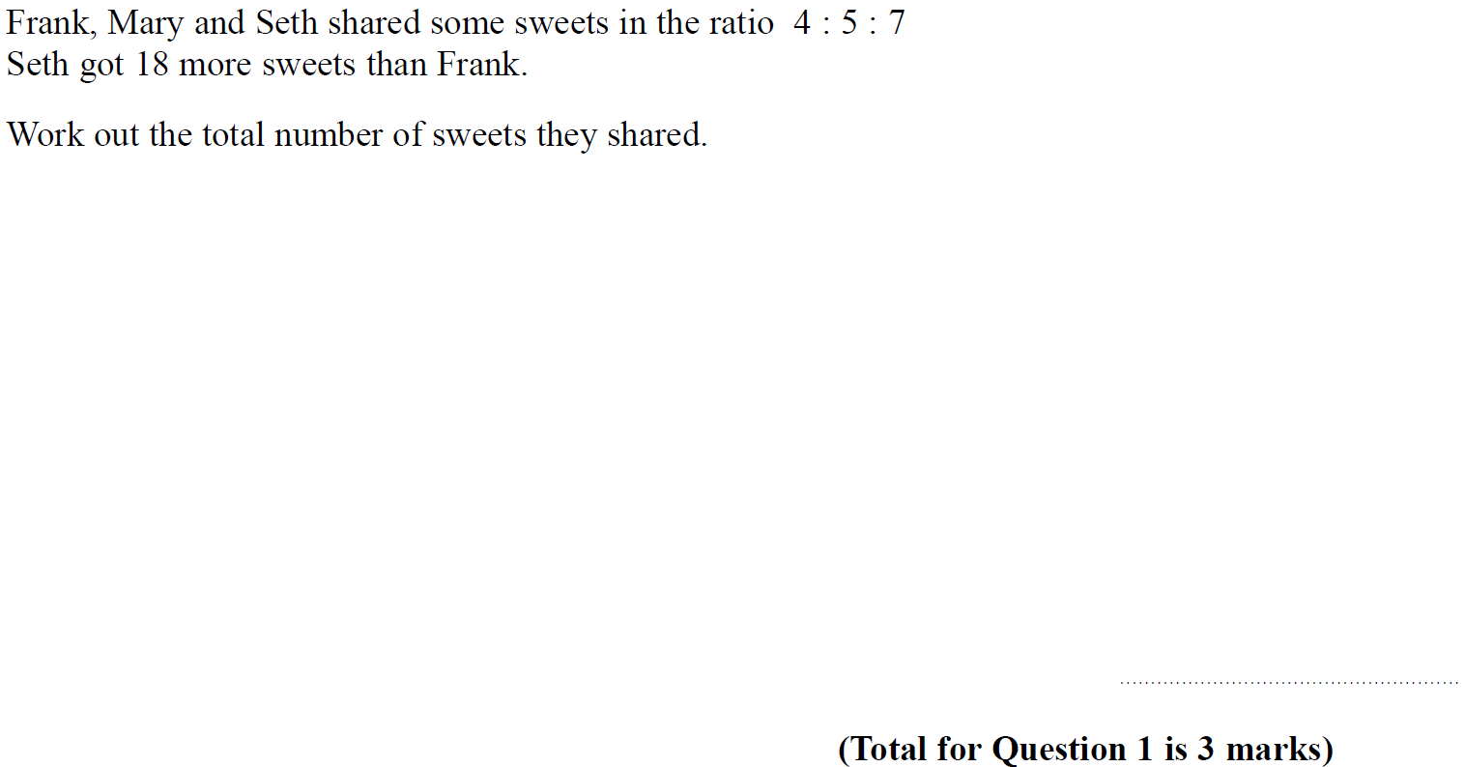
Ratio & Basic Proportion
SAM 2H Q1

Slide 5
Ratio & Basic Proportion
SAM 2H Q1
A

Slide 6
Ratio & Basic Proportion
SAM 2H Q8

Slide 7
Ratio & Basic Proportion
SAM 2H Q8
A

Slide 8
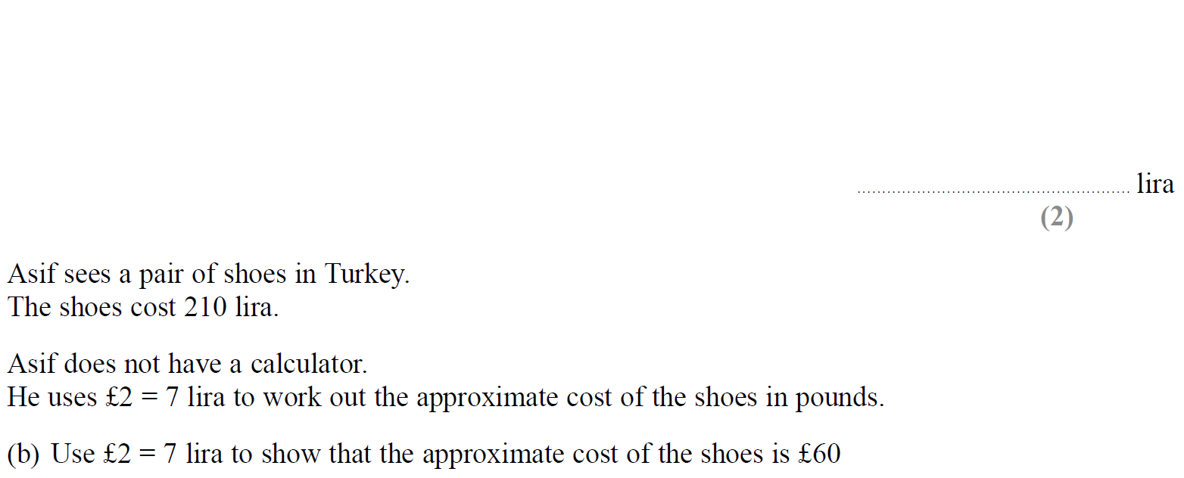
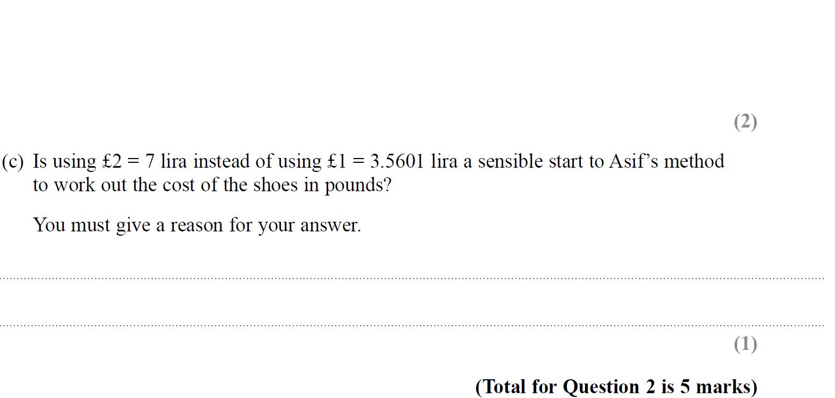
Ratio & Basic Proportion
SAM 3H Q2

Slide 9
Ratio & Basic Proportion
SAM 3H Q2
A
B
C

Slide 10
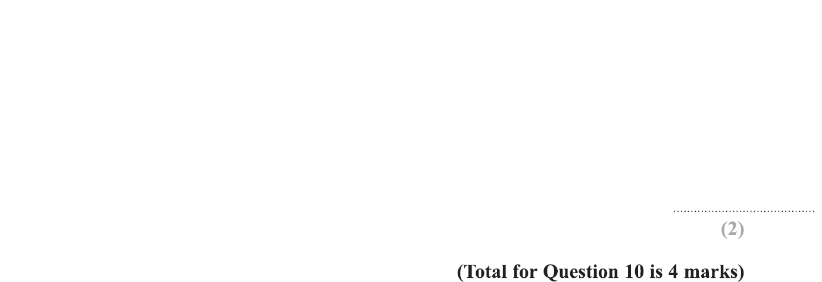
Ratio & Basic Proportion
Specimen Set 1 1H Q10

Slide 11
Ratio & Basic Proportion
Specimen Set 1 1H Q10
A
B

Slide 12
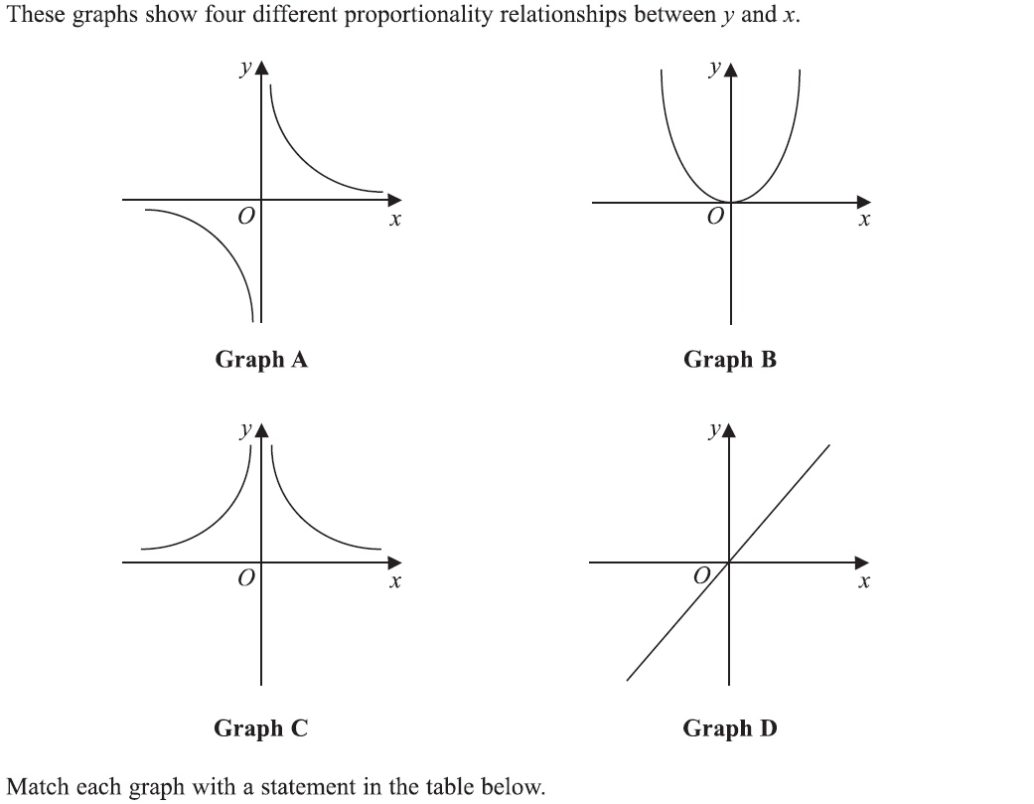
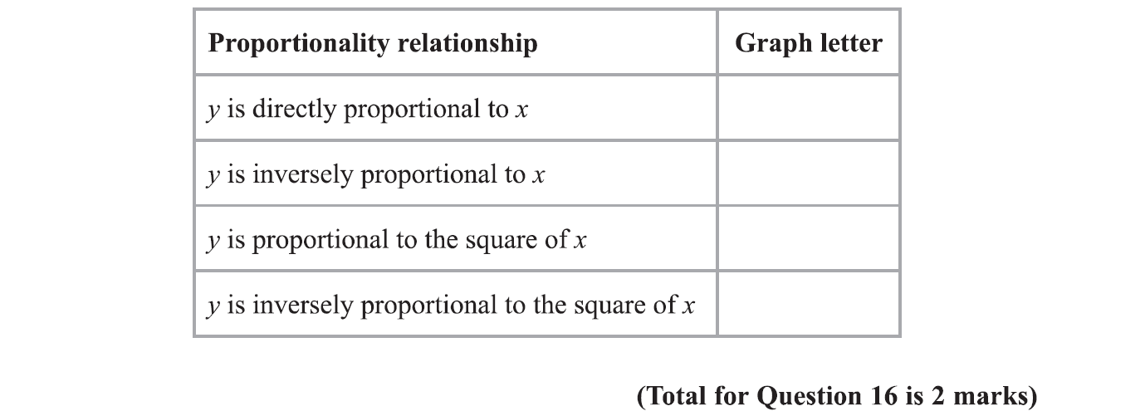
Ratio & Basic Proportion
Specimen Set 1 1H Q16

Slide 13
Ratio & Basic Proportion
Specimen Set 1 1H Q16
A

Slide 14
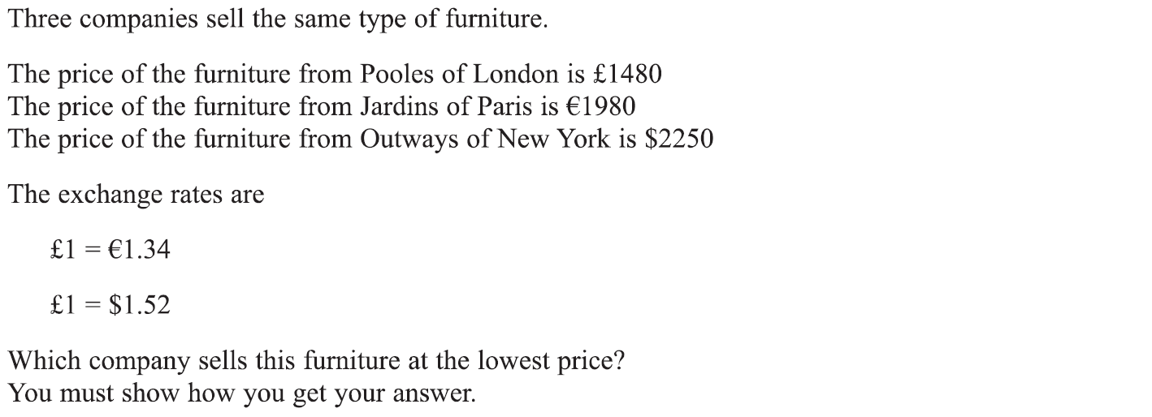
Ratio & Basic Proportion
Specimen Set 1 2H Q2

Slide 15
Ratio & Basic Proportion
Specimen Set 1 2H Q2
A

Slide 16
Ratio & Basic Proportion
Specimen Set 1 2H Q7

Slide 17
Ratio & Basic Proportion
Specimen Set 1 2H Q7
A

Slide 18
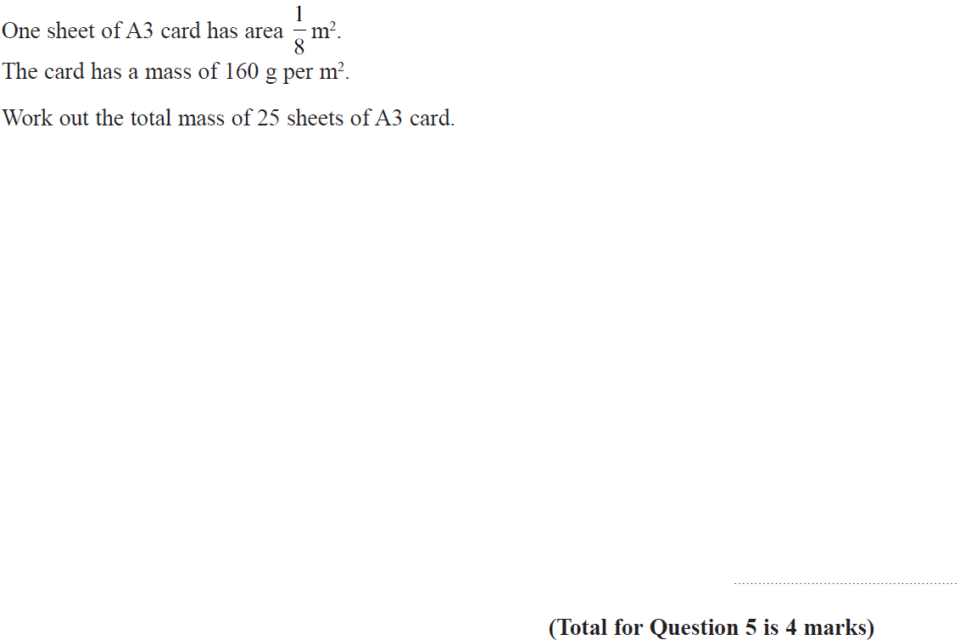
Ratio & Basic Proportion
Specimen Set 2 1H Q5

Slide 19
Ratio & Basic Proportion
Specimen Set 2 1H Q5
A

Slide 20
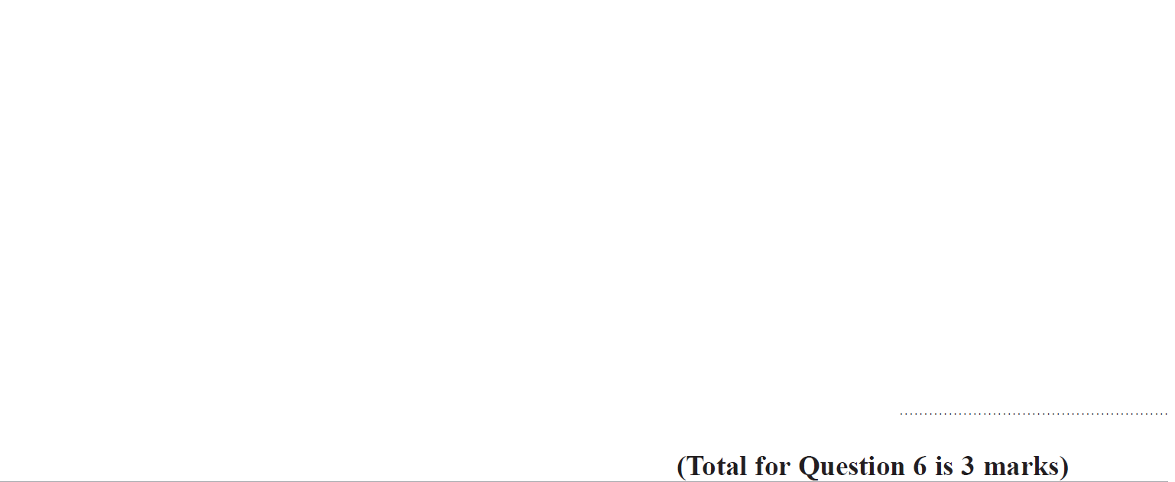
Ratio & Basic Proportion
Specimen Set 2 2H Q6

Slide 21
Ratio & Basic Proportion
Specimen Set 2 2H Q6
A

Slide 22
Ratio & Basic Proportion
Specimen Set 2 2H Q21

Slide 23
Ratio & Basic Proportion
Specimen Set 2 2H Q21
A

Slide 24
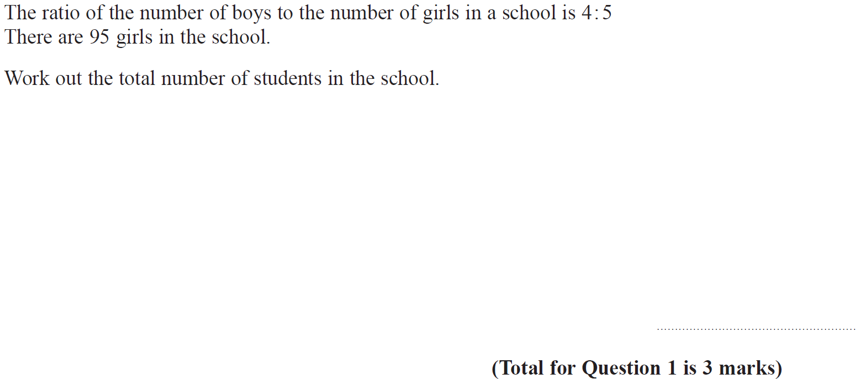
Ratio & Basic Proportion
Specimen Set 2 3H Q1

Slide 25
Ratio & Basic Proportion
Specimen Set 2 3H Q1
A

Slide 26
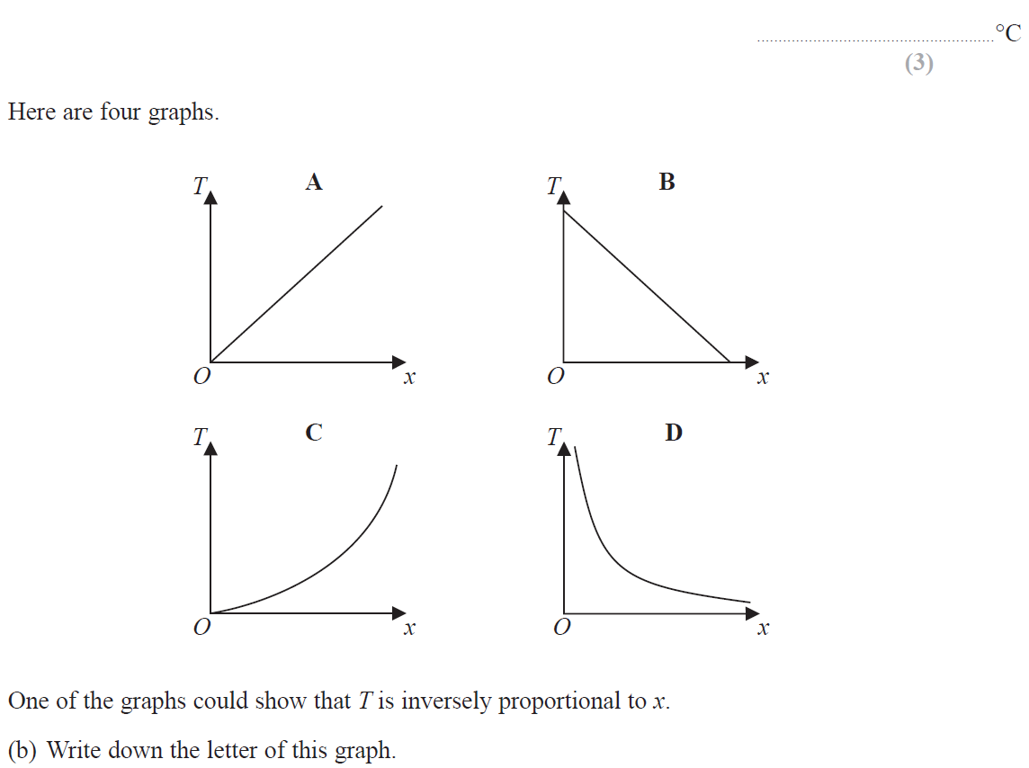
Ratio & Basic Proportion
Specimen Set 2 3H Q6

Slide 27
Ratio & Basic Proportion
Specimen Set 2 3H Q6
A
B

Slide 28
Ratio & Basic Proportion
June 2017 3H Q12

Slide 29
Ratio & Basic Proportion
June 2017 3H Q12
A

Slide 30
Ratio & Basic Proportion
Nov 2017 1H Q2

Slide 31
Ratio & Basic Proportion
Nov 2017 1H Q2
A

Slide 32
Ratio & Basic Proportion
Nov 2017 1H Q13

Slide 33
Ratio & Basic Proportion
Nov 2017 1H Q13
A

Slide 34
Ratio & Basic Proportion
Nov 2017 1H Q14

Slide 35
Ratio & Basic Proportion
Nov 2017 1H Q14
A

Slide 36
Ratio & Basic Proportion
Nov 2017 2H Q9

Slide 37
Ratio & Basic Proportion
Nov 2017 2H Q9
A

Slide 38
Ratio & Basic Proportion
Nov 2017 3H Q2

Slide 39
Ratio & Basic Proportion
Nov 2017 3H Q2
A

Slide 40
Ratio & Basic Proportion
Nov 2017 3H Q4

Slide 41
Ratio & Basic Proportion
Nov 2017 3H Q4
A

Slide 42
Ratio & Basic Proportion
May 2018 1H Q2

Slide 43
Ratio & Basic Proportion
May 2018 1H Q2
A

Slide 44
Ratio & Basic Proportion
May 2018 1H Q8

Slide 45
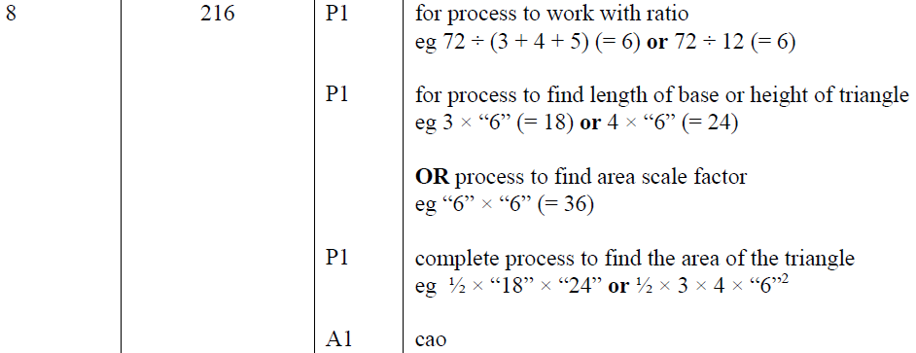
Ratio & Basic Proportion
May 2018 1H Q8
A

Slide 46
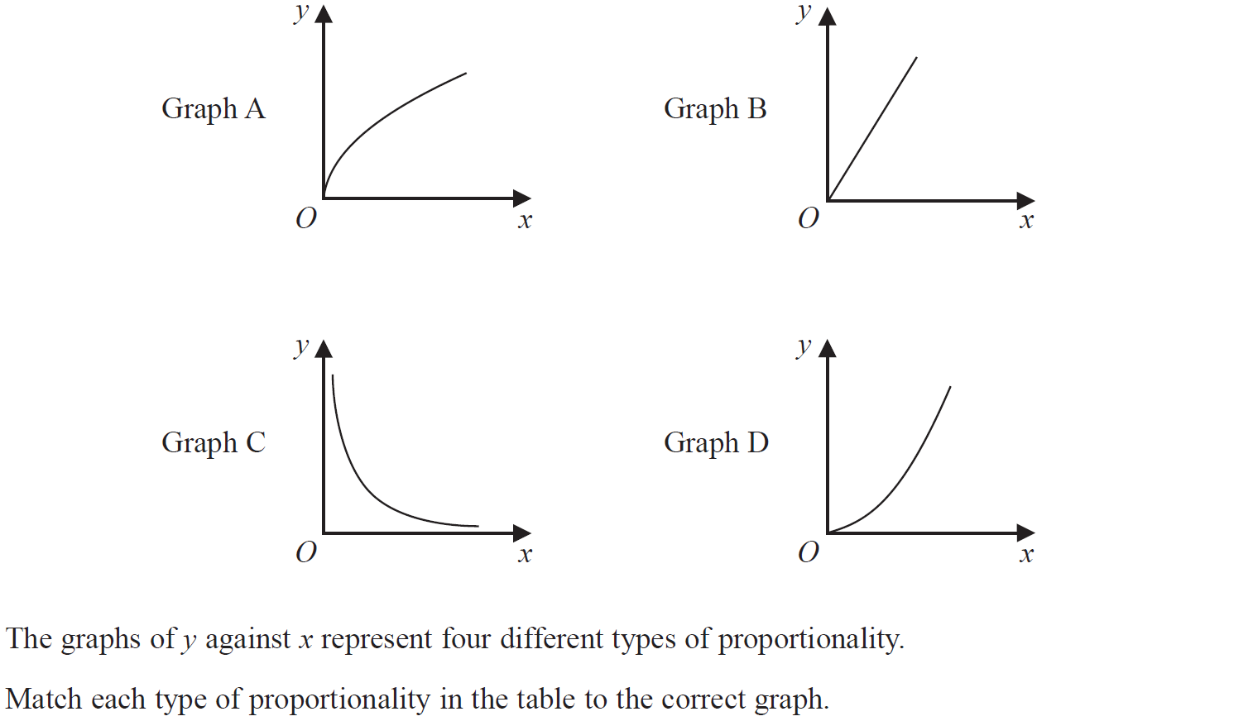
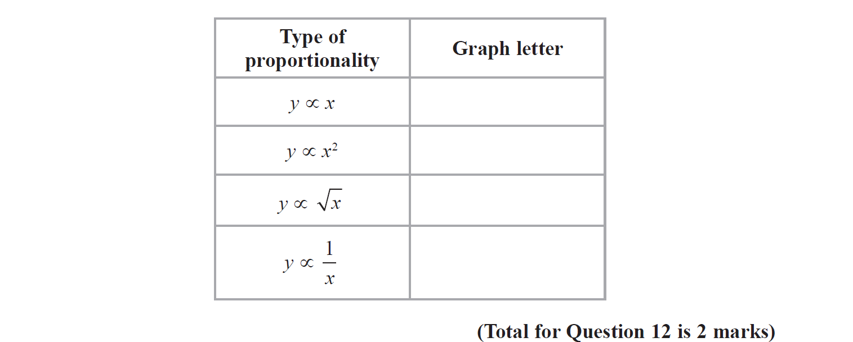
Ratio & Basic Proportion
June 2018 2H Q12

Slide 47
Ratio & Basic Proportion
June 2018 2H Q12
A

Slide 48
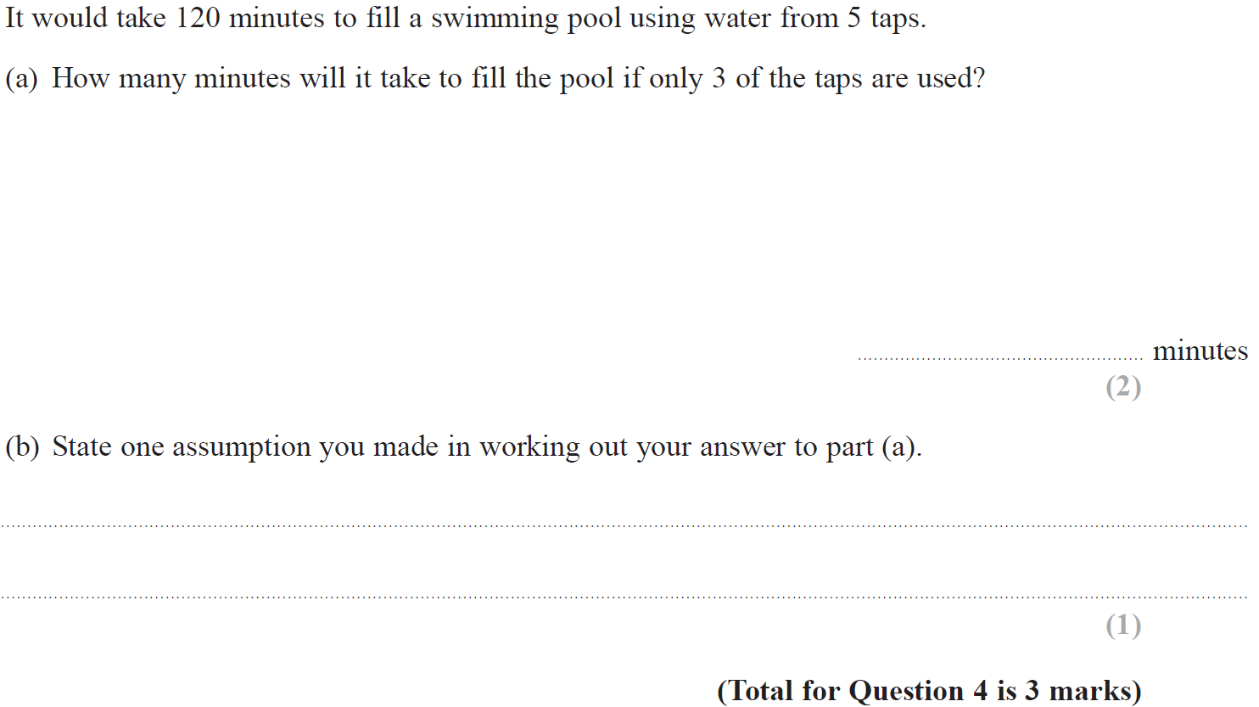
Ratio & Basic Proportion
Nov 2018 1H Q4

Slide 49
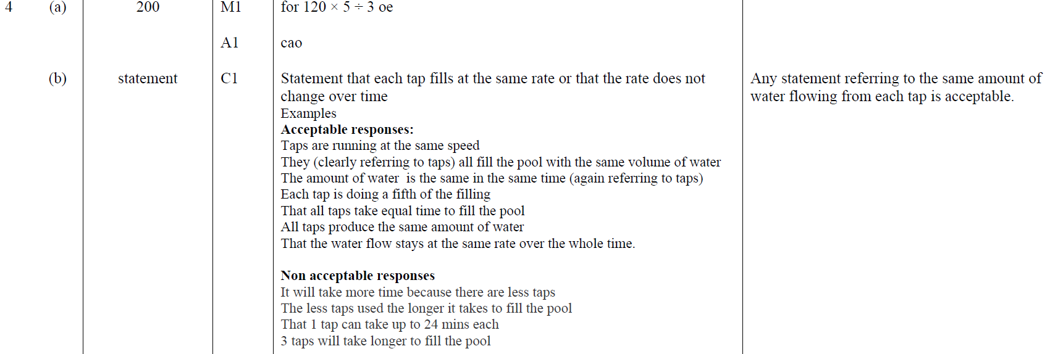
Ratio & Basic Proportion
Nov 2018 1H Q4
A
B

Slide 50
Ratio & Basic Proportion
Nov 2018 2H Q10

Slide 51
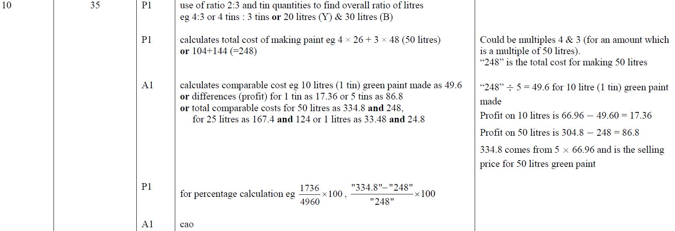
Ratio & Basic Proportion
Nov 2018 2H Q10
A

Slide 52
Ratio & Basic Proportion
Nov 2018 2H Q17

Slide 53
Ratio & Basic Proportion
Nov 2018 2H Q17
A

Slide 54
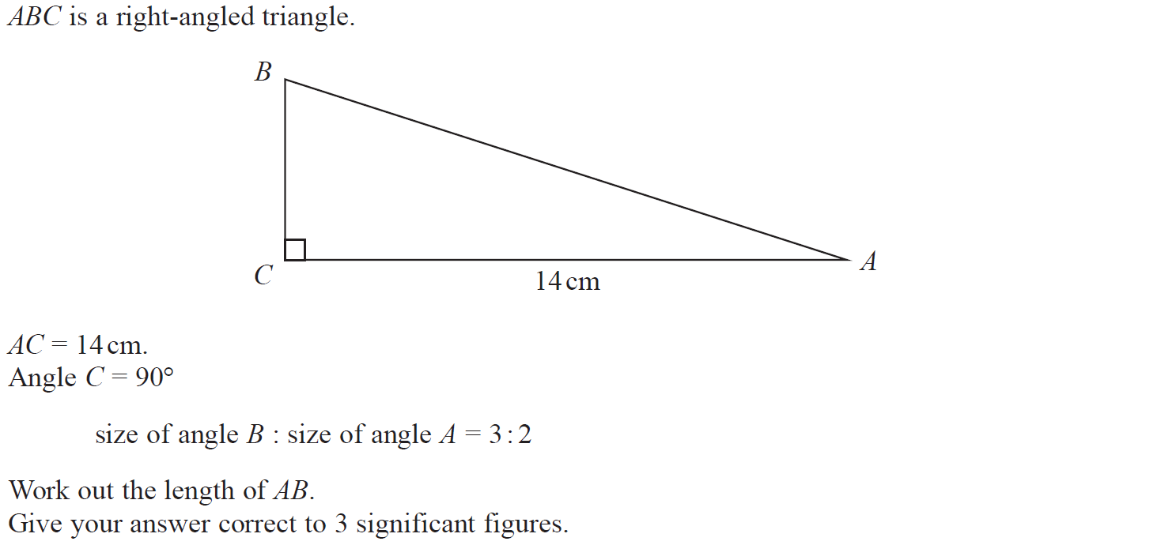
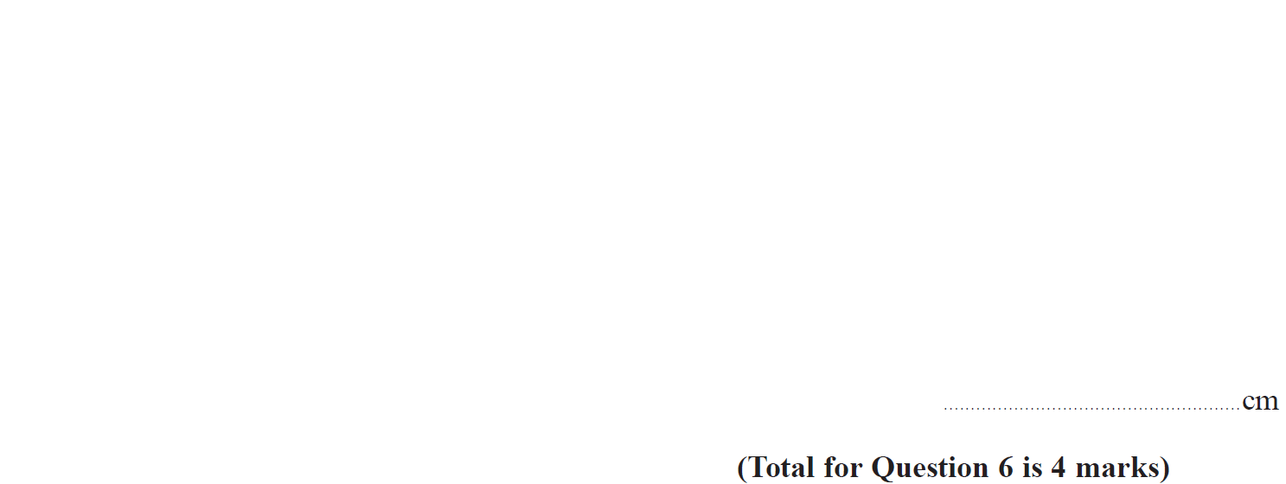
Ratio & Basic Proportion
Nov 2018 3H Q6

Slide 55
Ratio & Basic Proportion
Nov 2018 3H Q6
A

Slide 56
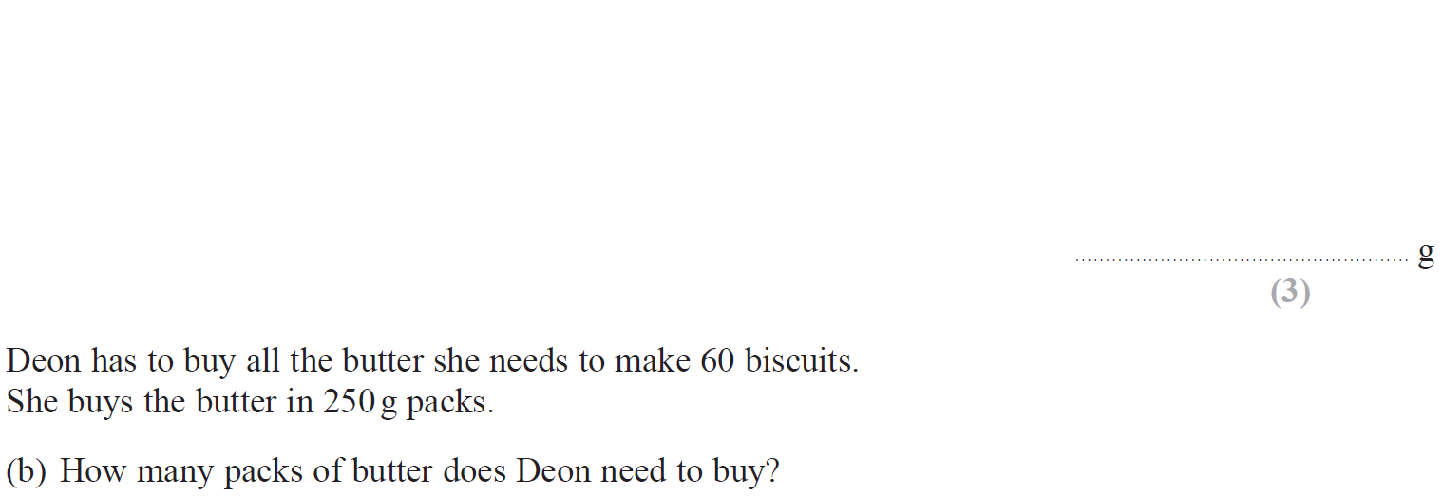
Ratio & Basic Proportion
May 2019 1H Q2

Slide 57
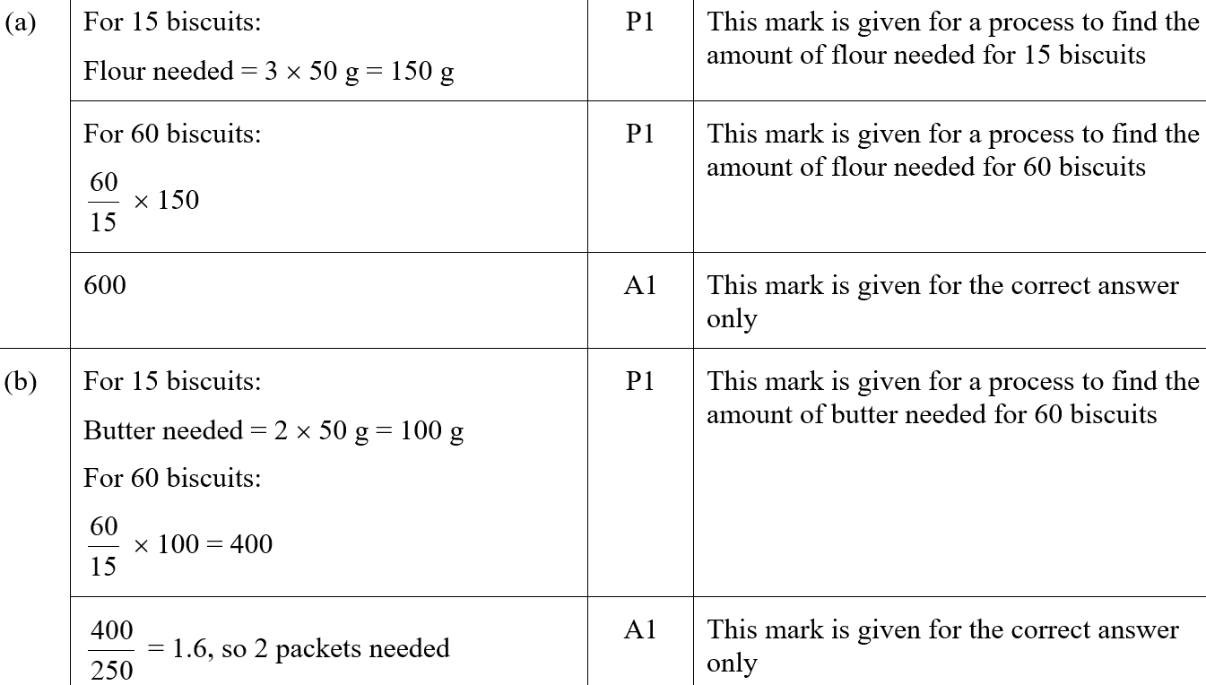
Ratio & Basic Proportion
May 2019 1H Q2
A
B
A SF
B SF

Slide 58
Ratio & Basic Proportion
May 2019 1H Q6

Slide 59
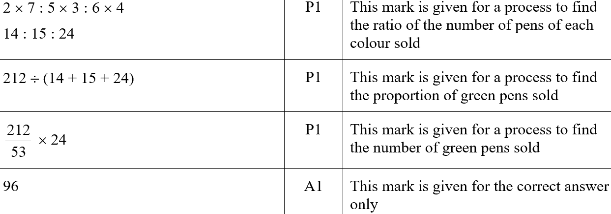
Ratio & Basic Proportion
May 2019 1H Q6
A
A SF

Slide 60
Ratio & Basic Proportion
May 2019 1H Q17

Slide 61
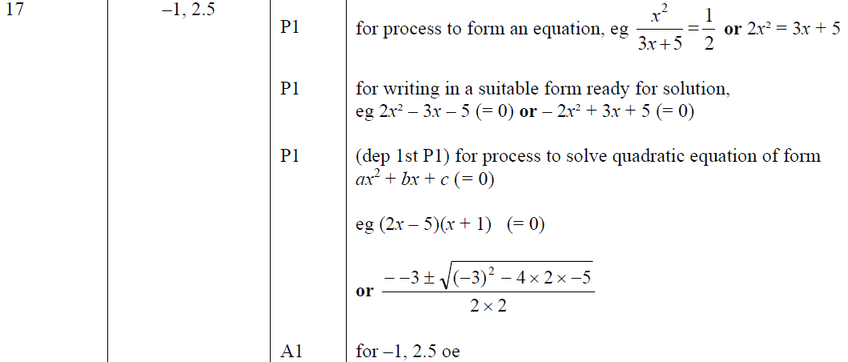
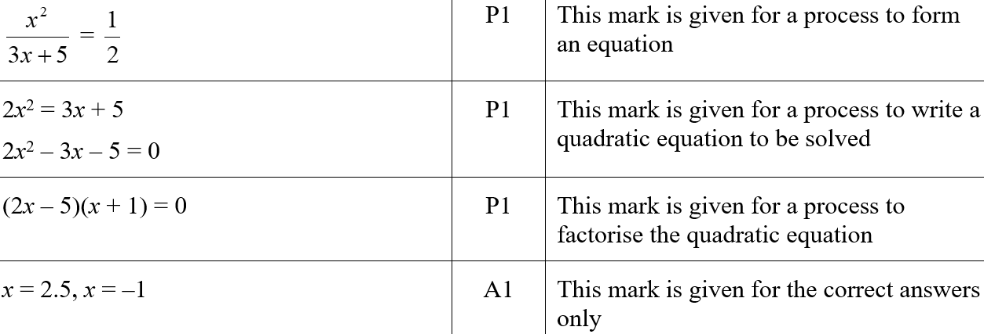
Ratio & Basic Proportion
May 2019 1H Q17
A
A SF

Slide 62
Ratio & Basic Proportion
June 2019 2H Q7

Slide 63
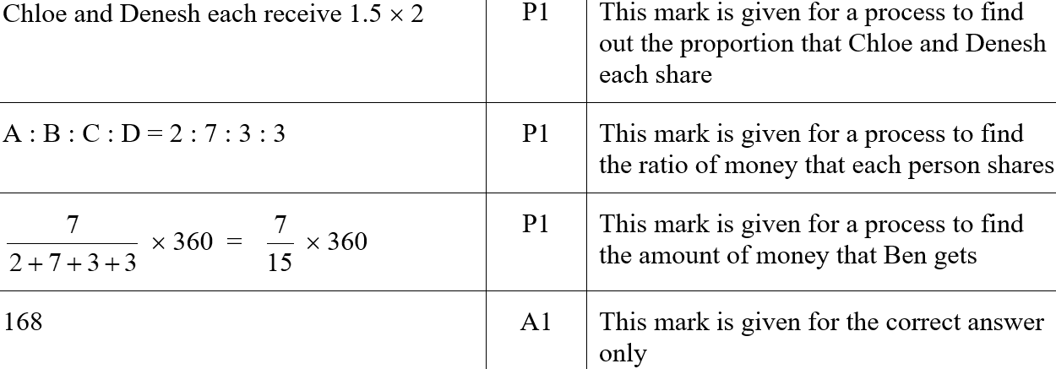
Ratio & Basic Proportion
June 2019 2H Q7
A
A SF

Slide 64
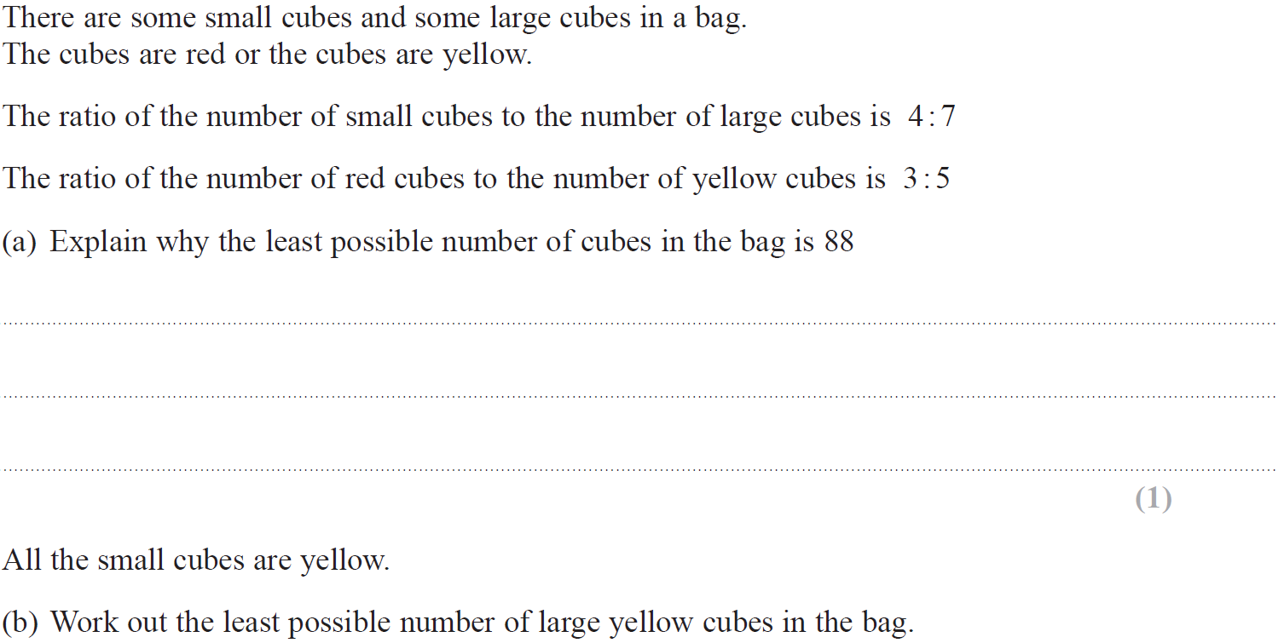
Ratio & Basic Proportion
June 2019 2H Q17

Slide 65
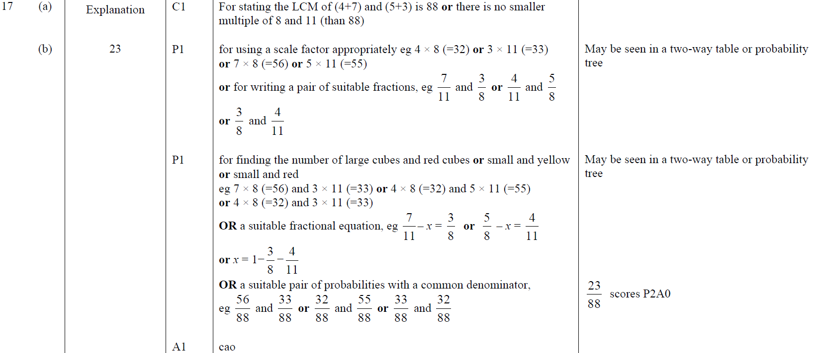
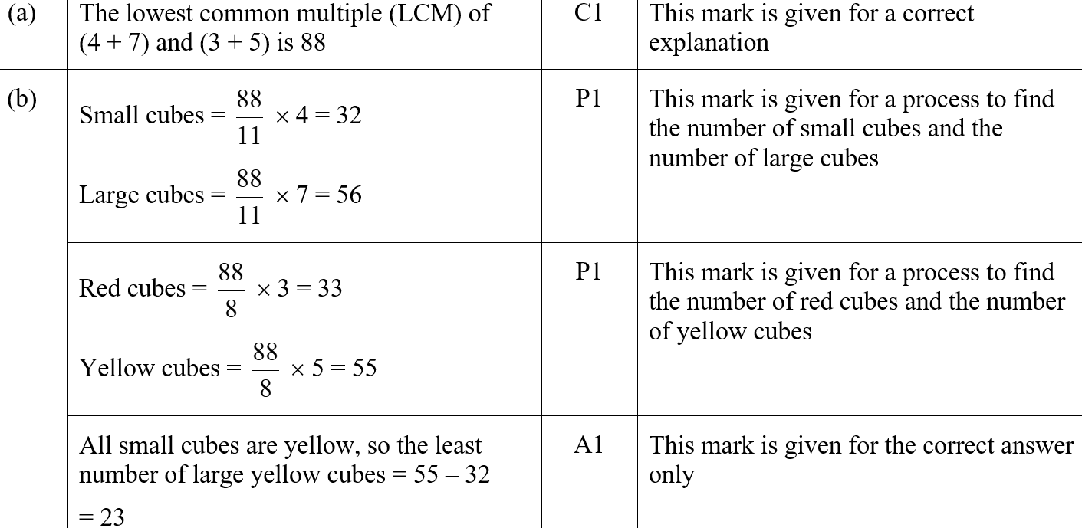
Ratio & Basic Proportion
June 2019 2H Q17
A
B
A SF
B SF

Slide 66
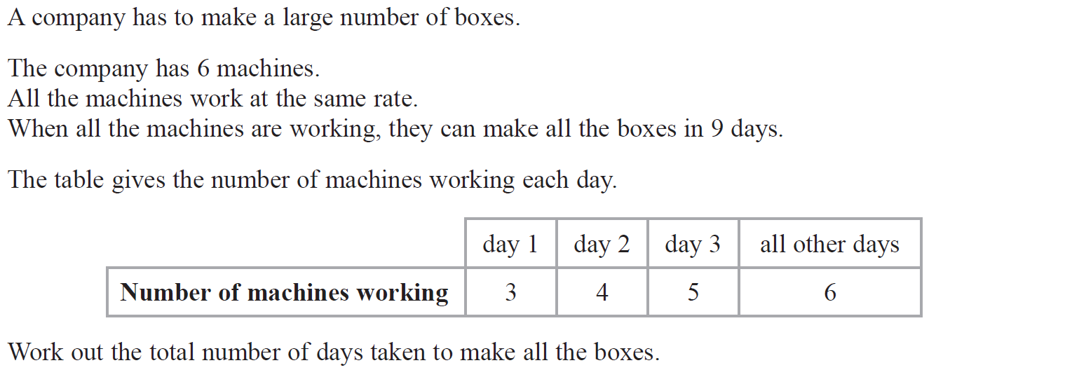
Ratio & Basic Proportion
June 2019 3H Q9

Slide 67
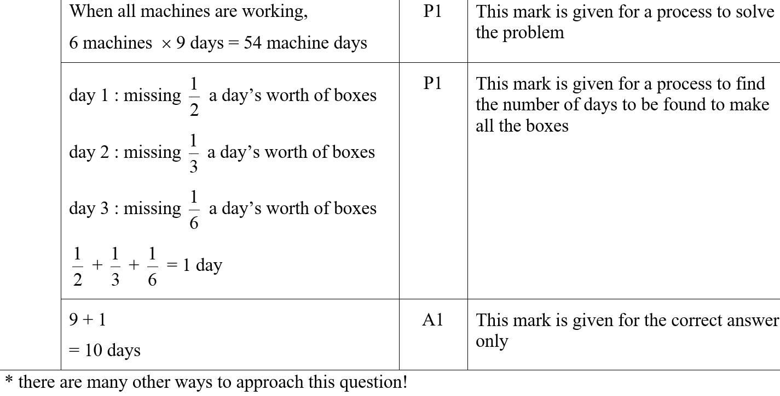
Ratio & Basic Proportion
June 2019 3H Q9
A
A SF

Slide 68
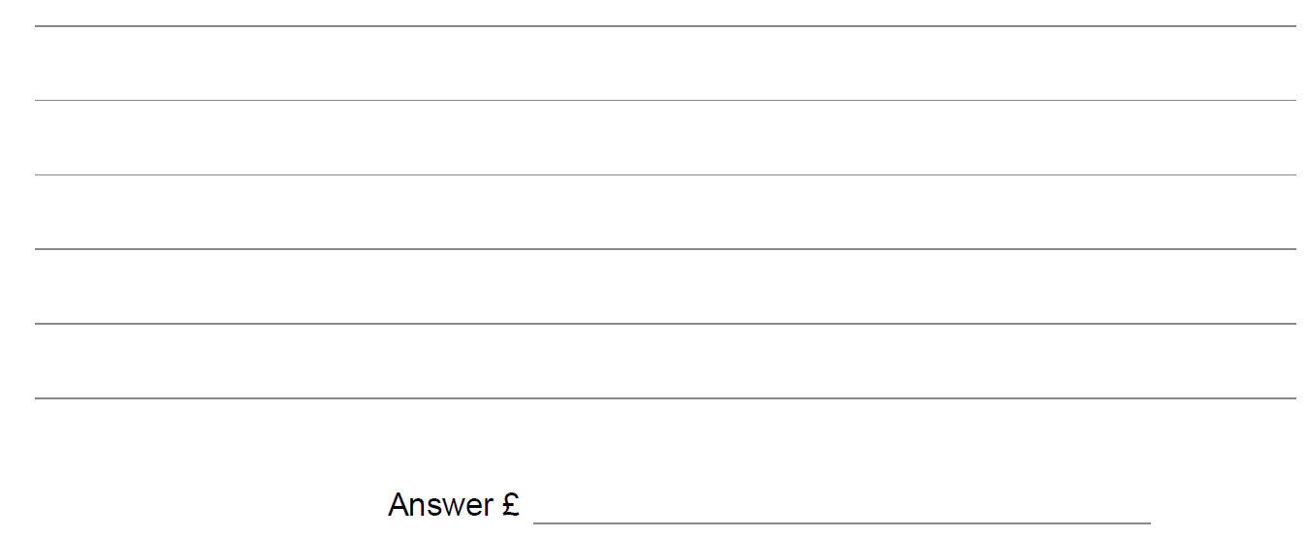
Ratio & Basic Proportion
SAM 1H Q10

Slide 69
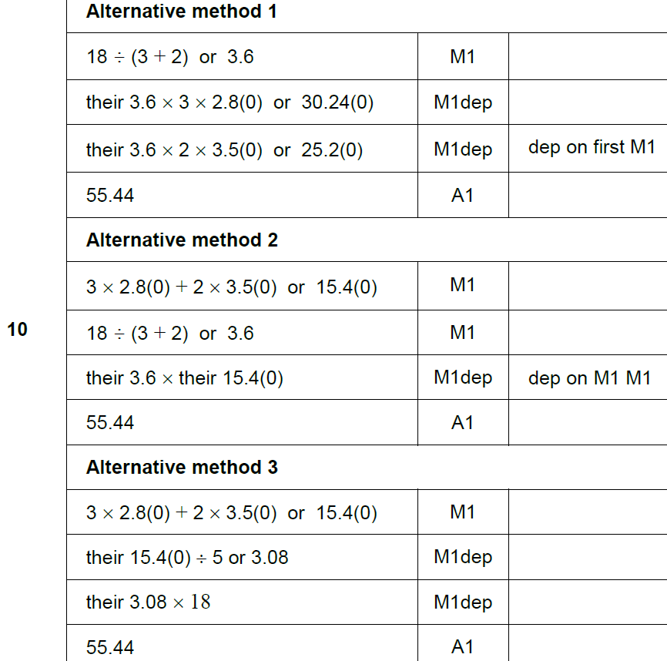
Ratio & Basic Proportion
SAM 1H Q10
A

Slide 70
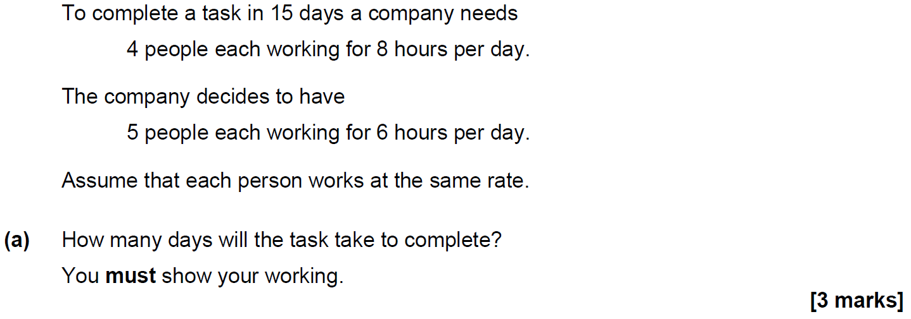
Ratio & Basic Proportion
SAM 1H Q17

Slide 71
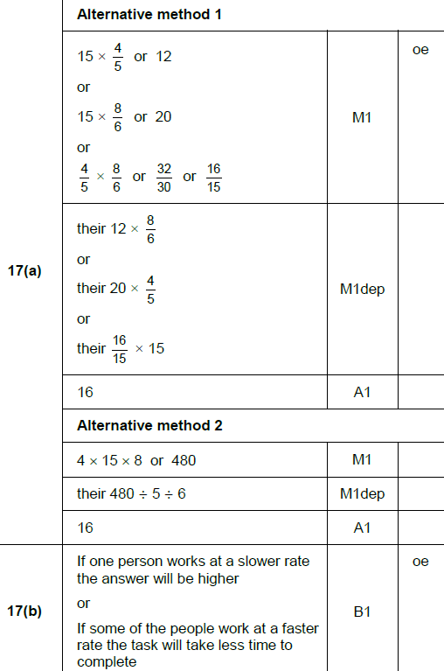
Ratio & Basic Proportion
SAM 1H Q17
A
B

Slide 72
Ratio & Basic Proportion
SAM 2H Q10

Slide 73
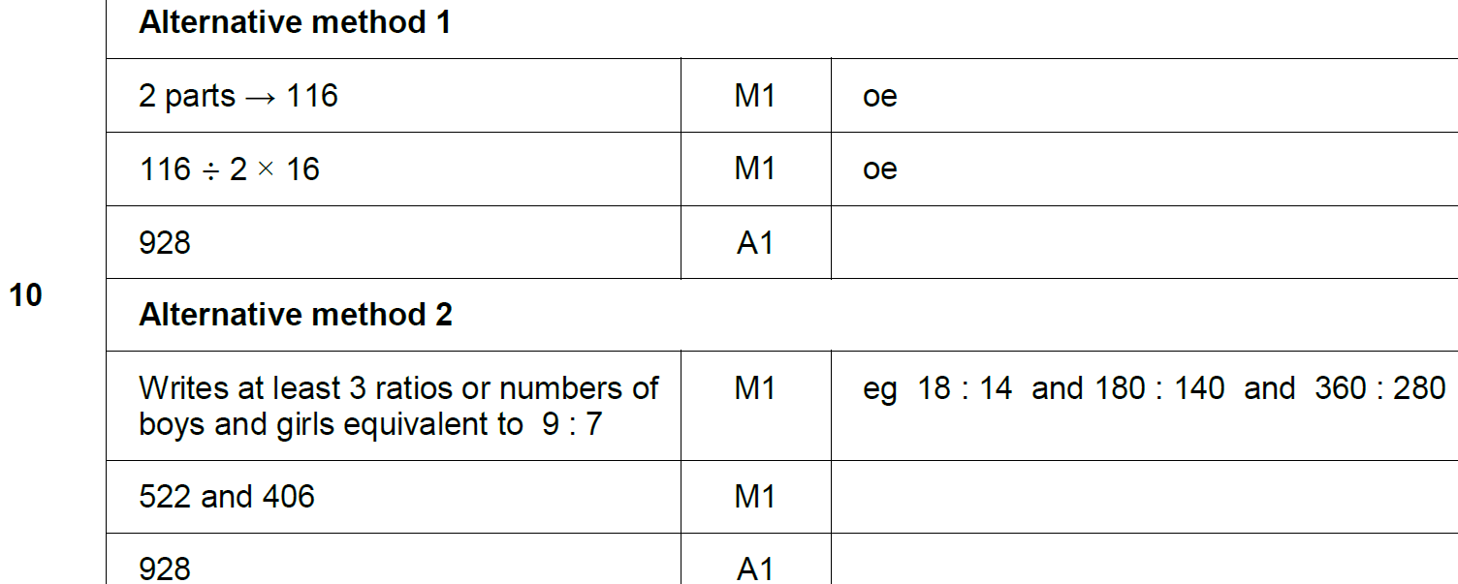
Ratio & Basic Proportion
SAM 2H Q10
A

Slide 74
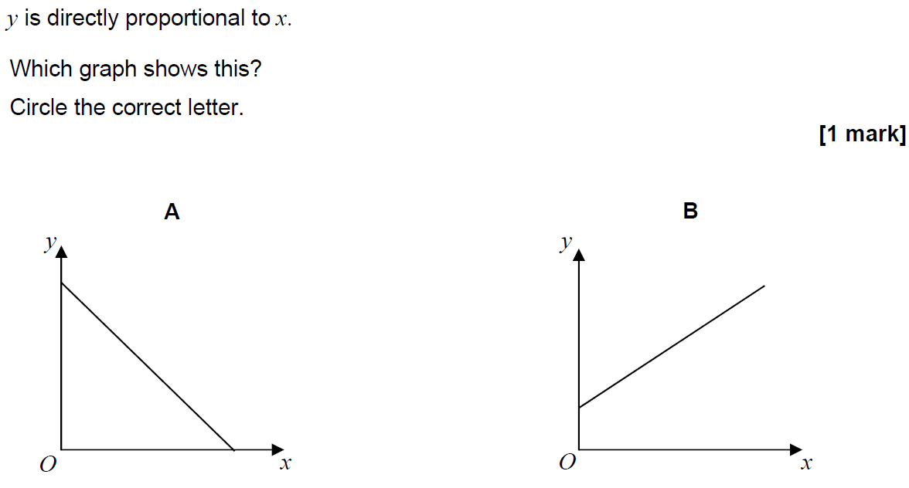
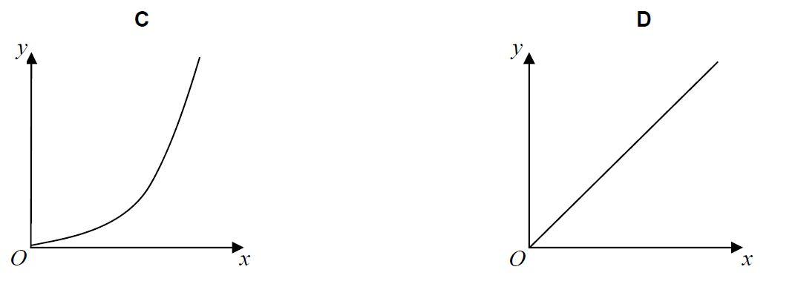
Ratio & Basic Proportion
SAM 3H Q4

Slide 75
Ratio & Basic Proportion
SAM 3H Q4
A

Slide 76
Ratio & Basic Proportion
SAM 3H Q16

Slide 77
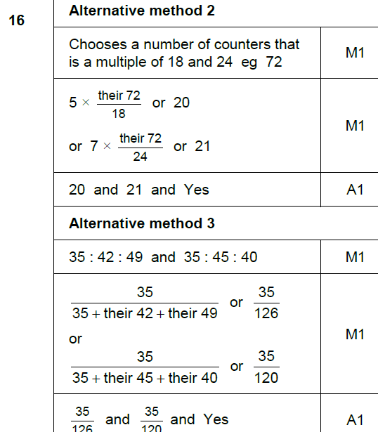
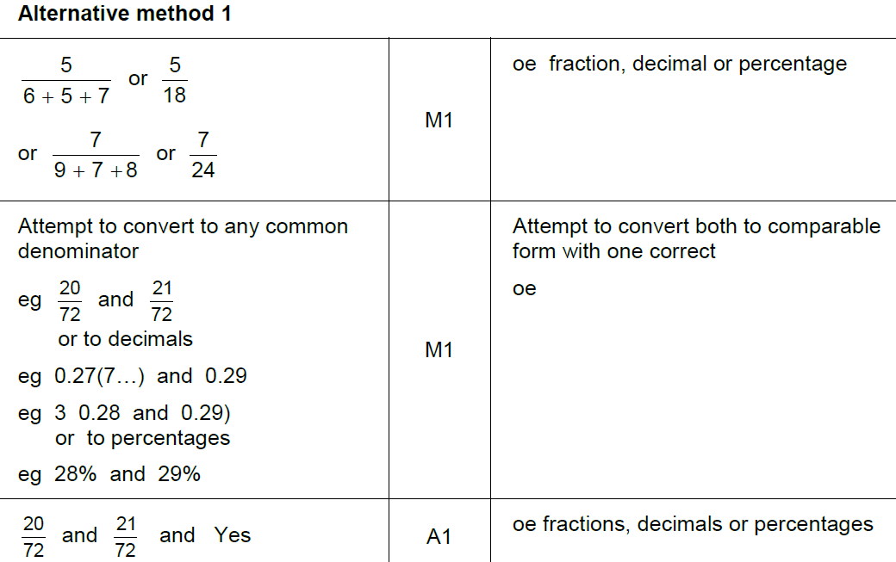
Ratio & Basic Proportion
SAM 3H Q16
A

Slide 78
Ratio & Basic Proportion
May 2017 1H Q4

Slide 79
Ratio & Basic Proportion
May 2017 1H Q4
A

Slide 80
Ratio & Basic Proportion
May 2017 1H Q8

Slide 81
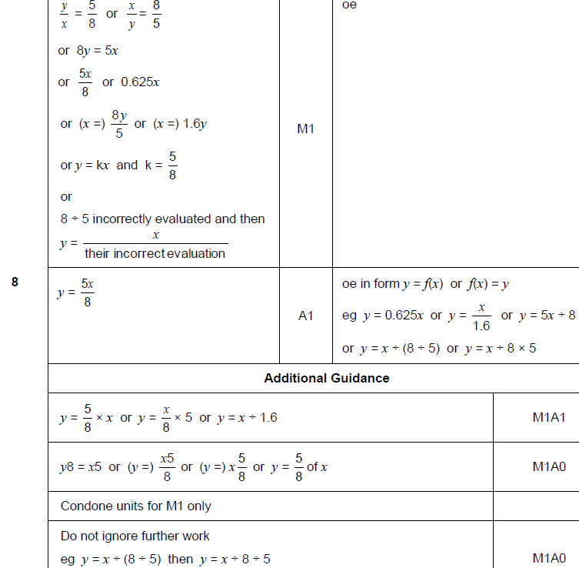
Ratio & Basic Proportion
May 2017 1H Q8
A

Slide 82
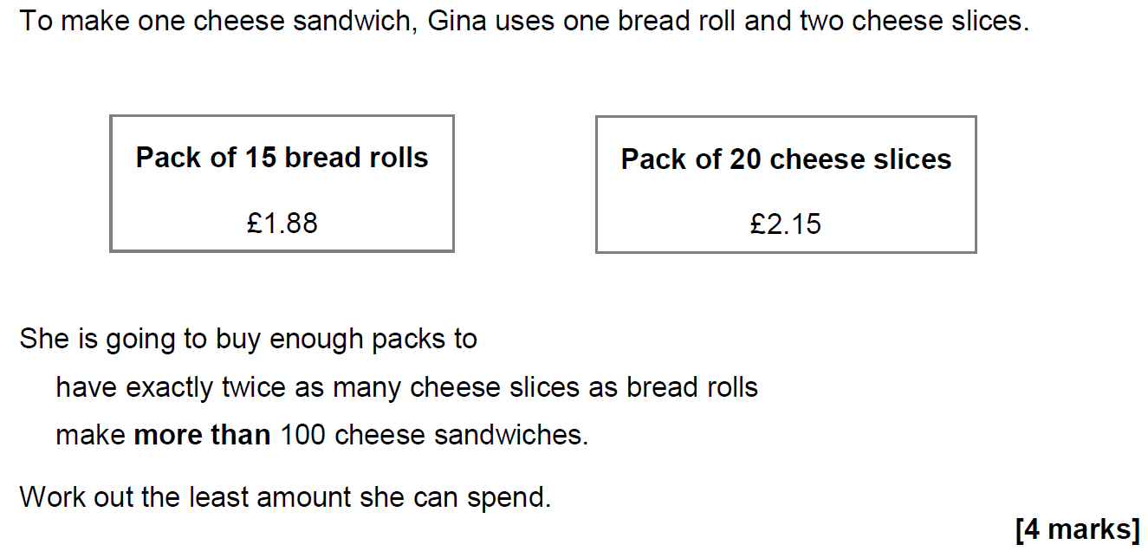
Ratio & Basic Proportion
June 2017 2H Q13

Slide 83
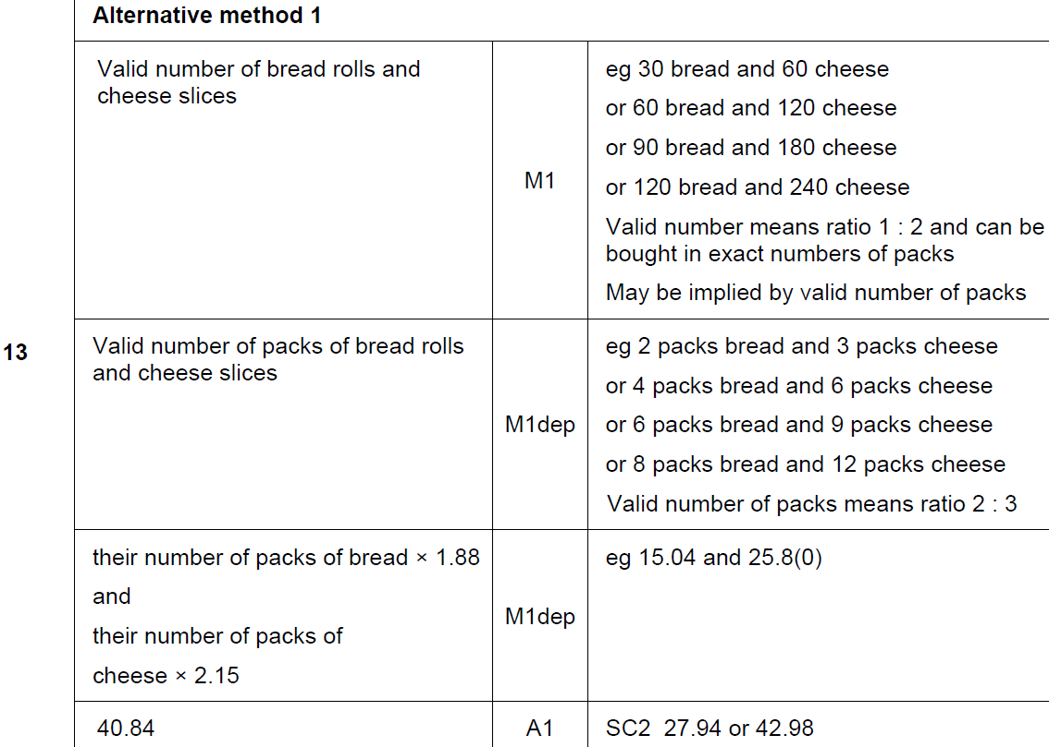
Ratio & Basic Proportion
June 2017 2H Q13
A

Slide 84
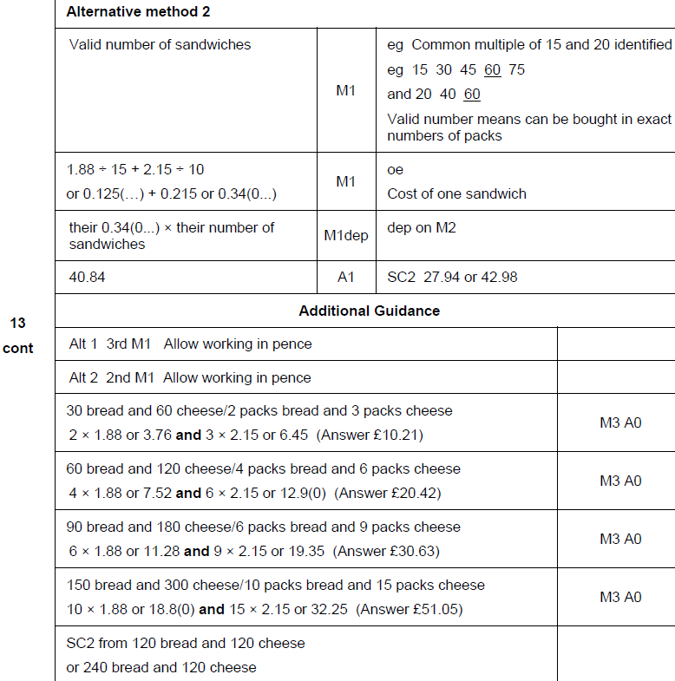
Ratio & Basic Proportion
June 2017 2H Q13
A Alternative & notes

Slide 85
Ratio & Basic Proportion
June 2017 2H Q19

Slide 86
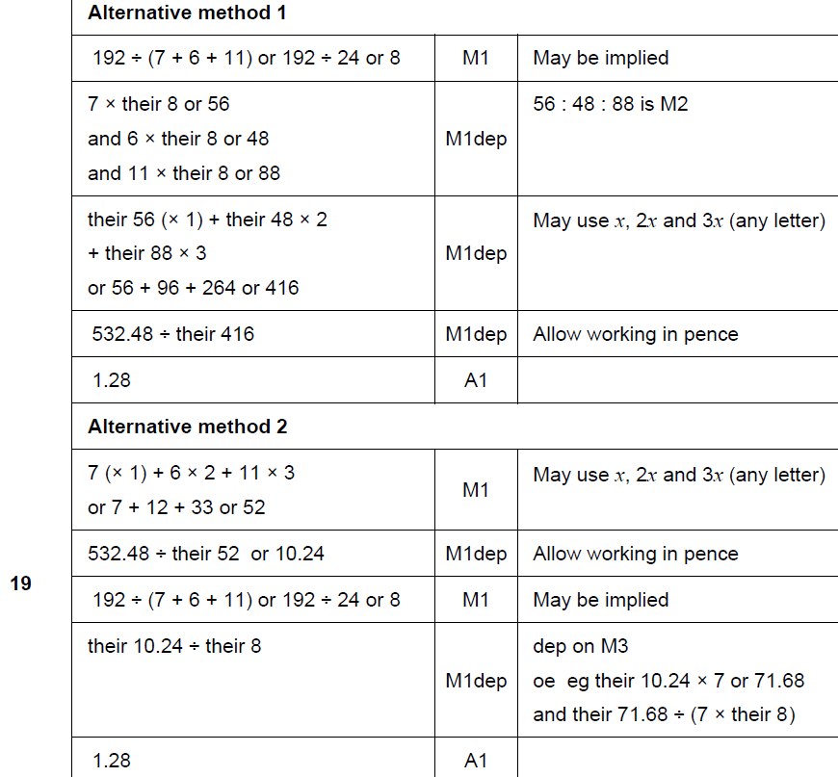
Ratio & Basic Proportion
June 2017 2H Q19
A

Slide 87
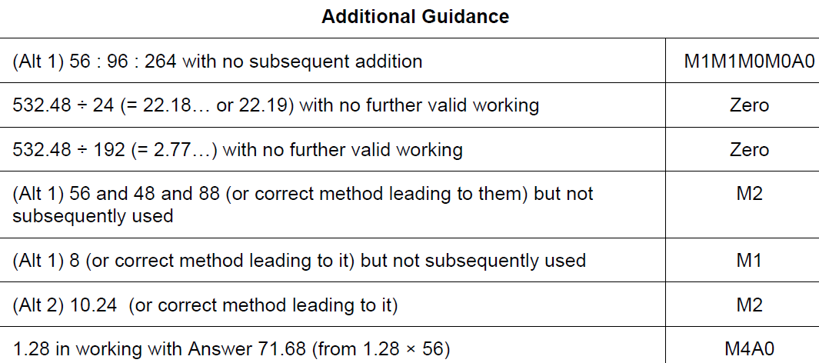
Ratio & Basic Proportion
June 2017 2H Q19
A notes

Slide 88
Ratio & Basic Proportion
June 2017 3H Q11

Slide 89
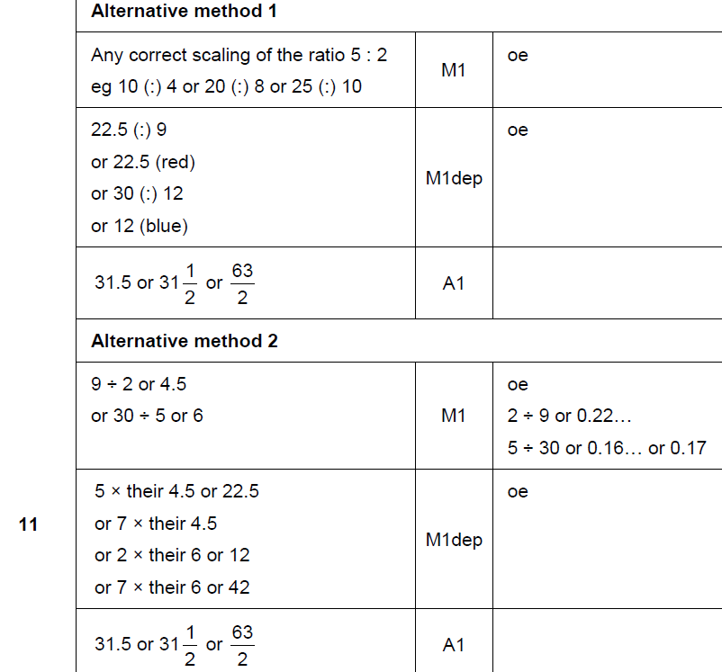
Ratio & Basic Proportion
June 2017 3H Q11
A

Slide 90
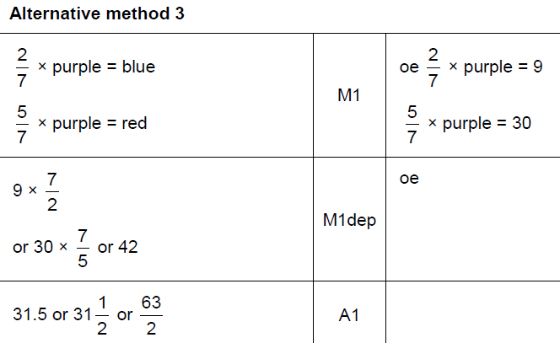
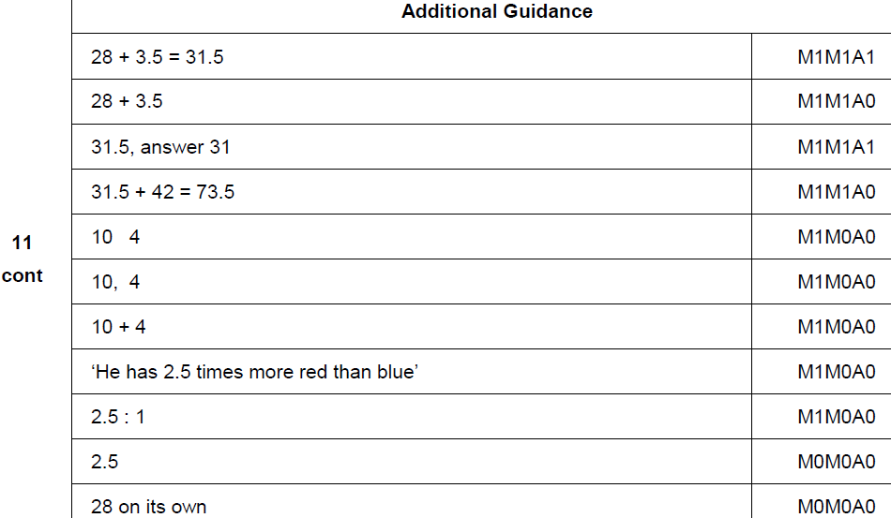
Ratio & Basic Proportion
June 2017 3H Q11
A Alternative & notes

Slide 91
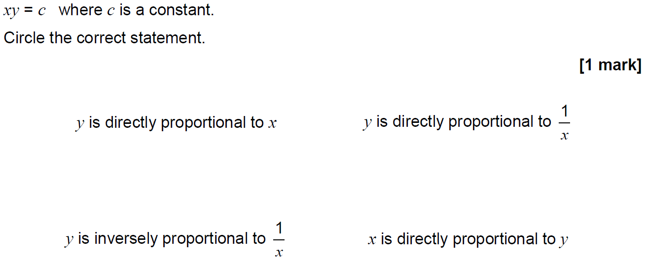
Ratio & Basic Proportion
June 2017 3H Q14

Slide 92
Ratio & Basic Proportion
June 2017 3H Q14
A

Slide 93
Ratio & Basic Proportion
Nov 2017 1H Q13

Slide 94
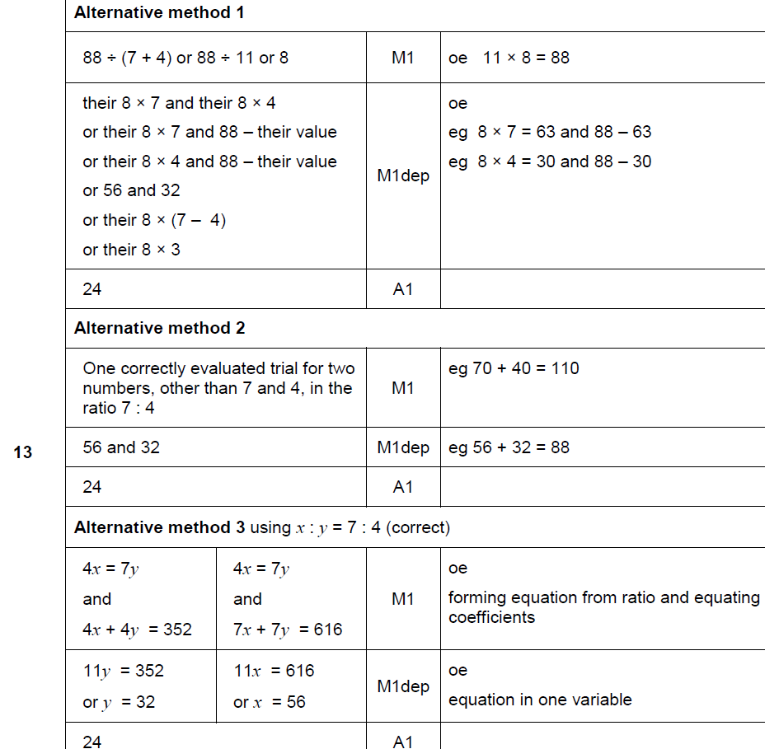
Ratio & Basic Proportion
Nov 2017 1H Q13
A

Slide 95
Ratio & Basic Proportion
Nov 2017 1H Q13
A Alternative & notes

Slide 96
Ratio & Basic Proportion
Nov 2017 1H Q25

Slide 97
Ratio & Basic Proportion
Nov 2017 1H Q25
A

Slide 98
Ratio & Basic Proportion
Nov 2017 3H Q17
At a football game
number of men : number of women : number of children = 13 : 5 : 7
There are 4152 more men than women.
Work out the number of children at the game.
[3 marks]

Slide 99
Ratio & Basic Proportion
Nov 2017 3H Q17
A

Slide 100
Ratio & Basic Proportion
Nov 2017 3H Q24
a : b = 9 : 4 and 10b = 7c
Work out a : c in its simplest form.
[3 marks]

Slide 101
Ratio & Basic Proportion
Nov 2017 3H Q24
A

Slide 102
Ratio & Basic Proportion
Nov 2017 3H Q24
A Alternative & notes

Slide 103
Ratio & Basic Proportion
May 2018 1H Q14

Slide 104
Ratio & Basic Proportion
May 2018 1H Q14
A

Slide 105
Ratio & Basic Proportion
May 2018 1H Q14
B

Slide 106
Ratio & Basic Proportion
May 2018 1H Q14
B Alternative 3 & notes

Slide 107
Ratio & Basic Proportion
May 2018 1H Q26
b is two thirds of c.
5a = 4c
Work out the ratio a : b : c
Give your answer in its simplest form where a, b and c are integers.
[3 marks]

Slide 108
Ratio & Basic Proportion
May 2018 1H Q26
A

Slide 109
Ratio & Basic Proportion
June 2018 2H Q3

Slide 110
Ratio & Basic Proportion
June 2018 2H Q3
A

Slide 111
Ratio & Basic Proportion
June 2018 2H Q8
Theo starts with savings of £18
James starts with no savings.
Each week from now,
Theo will save £4.50 and James will save £4
In how many weeks will Theo and James have savings in the ratio 15 : 8 ?
[3 marks]

Slide 112
Ratio & Basic Proportion
June 2018 2H Q8
A

Slide 113
Ratio & Basic Proportion
June 2018 2H Q8
A Alternative & notes

Slide 114
Ratio & Basic Proportion
Nov 2018 1H Q13
e : f = 2 : 3 and f : g = 5 : 4
Work out e : g
Give your answer in its simplest form.
[3 marks]

Slide 115
Ratio & Basic Proportion
Nov 2018 1H Q13
A

Slide 116
Ratio & Basic Proportion
Nov 2018 1H Q18
Beth and Mia translate documents from Spanish into English.
A set of documents that would take Beth 8 days would take Mia 10 days.
Beth starts to translate the documents.
After 2 days Beth and Mia both work on translating the documents.
How many more days will it take to complete the work?
You must show your working.
[4 marks]

Slide 117
Ratio & Basic Proportion
Nov 2018 1H Q18
A

Slide 118
Ratio & Basic Proportion
SAM 1H Q1

Slide 119
Ratio & Basic Proportion
SAM 1H Q1
A

Slide 120
Ratio & Basic Proportion
SAM 1H Q4

Slide 121
Ratio & Basic Proportion
SAM 1H Q4
A (i)
A (ii)
B (i)
B (ii)

Slide 122
Ratio & Basic Proportion
SAM 1H Q6

Slide 123
Ratio & Basic Proportion
SAM 1H Q6
A

Slide 124
Ratio & Basic Proportion
SAM 2H Q2

Slide 125
Ratio & Basic Proportion
SAM 2H Q2
A
B
C

Slide 126
Ratio & Basic Proportion
SAM 2H Q4

Slide 127
Ratio & Basic Proportion
SAM 2H Q4
A
B

Slide 128
Ratio & Basic Proportion
SAM 2H Q19

Slide 129
Ratio & Basic Proportion
SAM 2H Q19
A

Slide 130
Ratio & Basic Proportion
Practice 2H Q2

Slide 131
Ratio & Basic Proportion
Practice 2H Q2
A

Slide 132
Ratio & Basic Proportion
Practice 2H Q4

Slide 133
Ratio & Basic Proportion
Practice 2H Q4
A
B (i)
B (ii)
C

Slide 134
Ratio & Basic Proportion
Practice 3H Q1

Slide 135
Ratio & Basic Proportion
Practice 3H Q1
A
B

Slide 136
Ratio & Basic Proportion
June 2017 2H Q3

Slide 137
Ratio & Basic Proportion
June 2017 2H Q3
A

Slide 138
Ratio & Basic Proportion
June 2017 2H Q3
A Exemplar responses

Slide 139
Ratio & Basic Proportion
June 2017 2H Q7

Slide 140
Ratio & Basic Proportion
June 2017 2H Q7
A
B

Slide 141
Ratio & Basic Proportion
June 2017 3H Q2
Construction line 1
Construction line 2
Construction line 3
note: AD = 12cm
Construction line 4
Construction line 5
Shaded region

Slide 142
Ratio & Basic Proportion
June 2017 3H Q2
A (i)
A (ii)
B

Slide 143
Ratio & Basic Proportion
Nov 2017 1H Q6

Slide 144
Ratio & Basic Proportion
Nov 2017 1H Q6
A

Slide 145
Ratio & Basic Proportion
Nov 2017 2H Q8

Slide 146
Ratio & Basic Proportion
Nov 2017 2H Q8
A
B

Slide 147
Ratio & Basic Proportion
Nov 2017 2H Q9

Slide 148
Ratio & Basic Proportion
Nov 2017 2H Q9
A

Slide 149
Ratio & Basic Proportion
Nov 2017 3H Q13

Slide 150
Ratio & Basic Proportion
Nov 2017 3H Q13
A
B

Slide 151
Ratio & Basic Proportion
May 2018 1H Q1

Slide 152
Ratio & Basic Proportion
May 2018 1H Q1
A
B

Slide 153
Ratio & Basic Proportion
June 2018 2H Q10

Slide 154
Ratio & Basic Proportion
June 2018 2H Q10
A
B

Slide 155
Ratio & Basic Proportion
June 2018 2H Q10
B Exemplar responses

Slide 156
Ratio & Basic Proportion
Nov 2018 3H Q5

Slide 157
Ratio & Basic Proportion
Nov 2018 3H Q5
A
B
C

Slide 158
Ratio & Basic Proportion
Nov 2018 3H Q6

Slide 159
Ratio & Basic Proportion
Nov 2018 3H Q6
A

Slide 160
Ratio & Basic Proportion
Nov 2018 3H Q9

Slide 161
Ratio & Basic Proportion
Nov 2018 3H Q9
A
B

Slide 162
Ratio & Basic Proportion
Nov 2018 3H Q10

Slide 163
Ratio & Basic Proportion
Nov 2018 3H Q10
A

