Slide 1
Quadratic Inequalities
Quadratic Inequalities
June 2017 3H Q21
1 Marker
Nov 2017 3H Q29

Slide 2
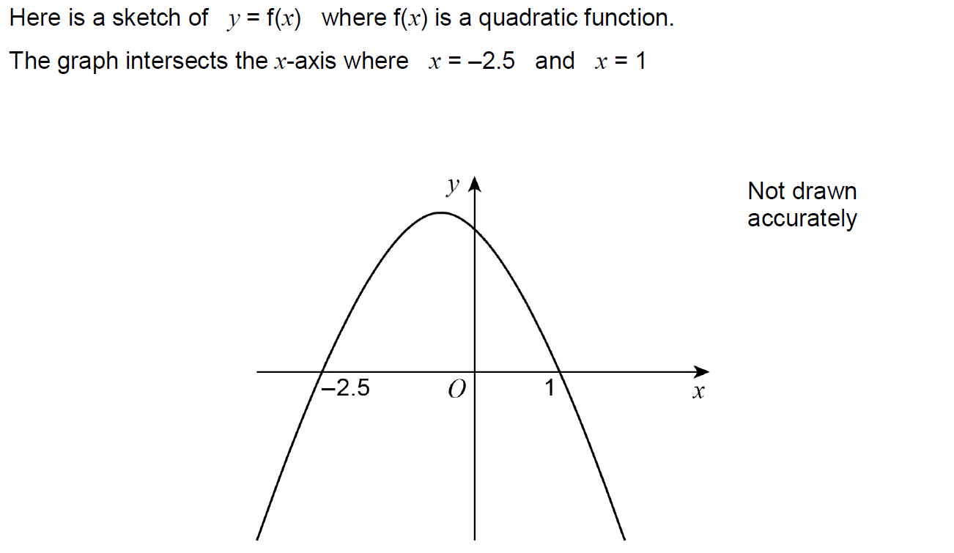
Quadratic Inequalities
June 2017 3H Q21

Slide 3
Quadratic Inequalities
June 2017 3H Q21
A

Slide 4
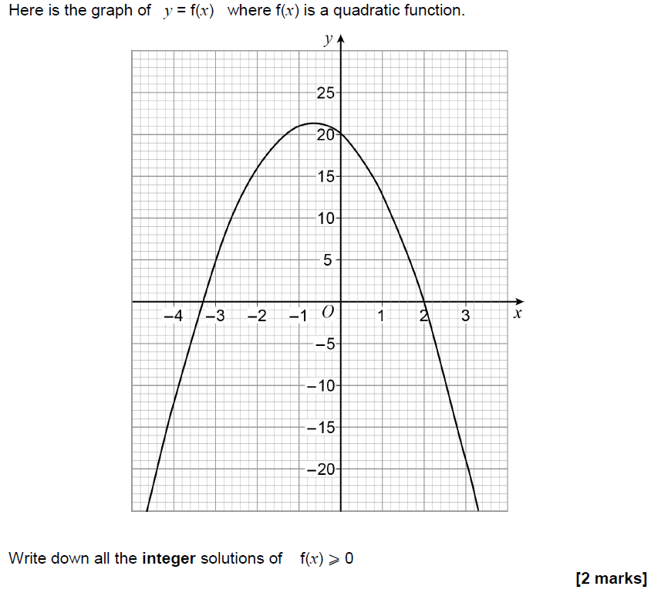
Quadratic Inequalities
Nov 2017 3H Q29

Slide 5
Quadratic Inequalities
Nov 2017 3H Q29
A

