Slide 1
Quadratic Inequalities
Quadratic Inequalities
June 2017
3H Q19
Edexcel
Nov 2017
1H Q23
SAM
1H Q19
AQA
May 2018
1H Q20
Spec 2
1H Q21
OCR
Nov 2018
2H Q19
June 2019
3H Q18

Slide 2
Quadratic Inequalities
Quadratic Inequalities
Edexcel
June 2017 3H Q21
AQA
1 Marker
Nov 2017 3H Q29
OCR

Slide 3
Quadratic Inequalities
Quadratic Inequalities
Edexcel
SAM
2H Q16
AQA
Nov 2017
2H Q17
SAM
2H Q20
OCR

Slide 4
Quadratic Inequalities
SAM 1H Q19

Slide 5
Quadratic Inequalities
SAM 1H Q19
A

Slide 6
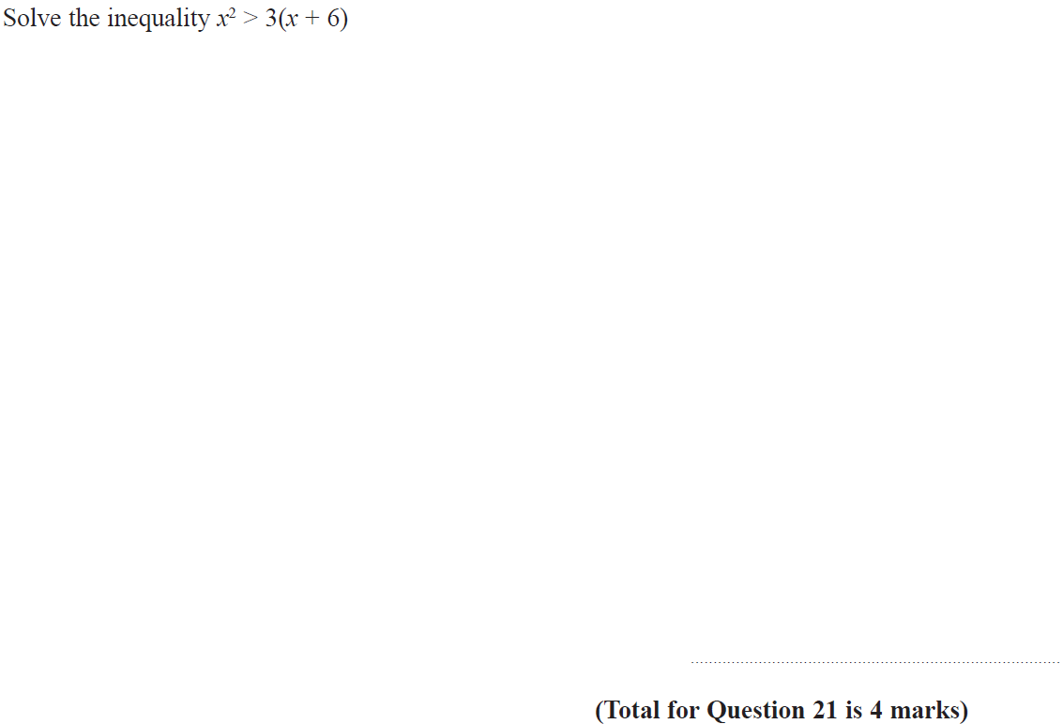
Quadratic Inequalities
Specimen Set 2 1H Q21

Slide 7
Quadratic Inequalities
Specimen Set 2 1H Q21
A

Slide 8
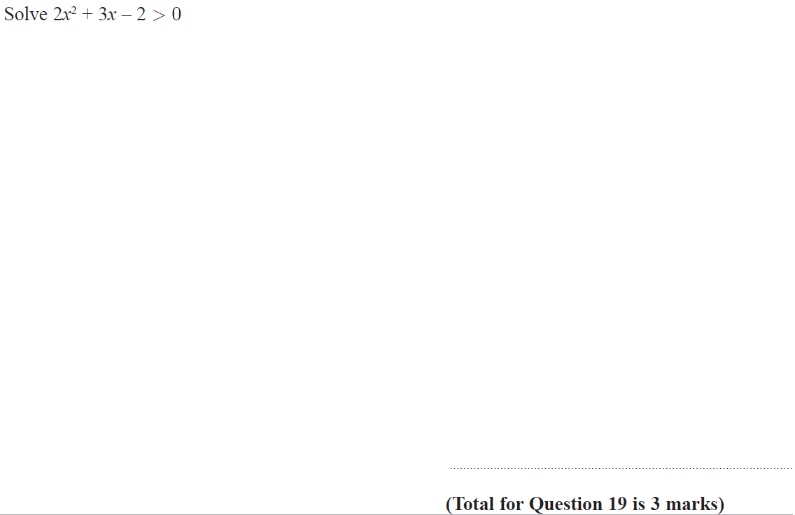
Quadratic Inequalities
June 2017 3H Q19

Slide 9
Quadratic Inequalities
June 2017 3H Q19
A

Slide 10
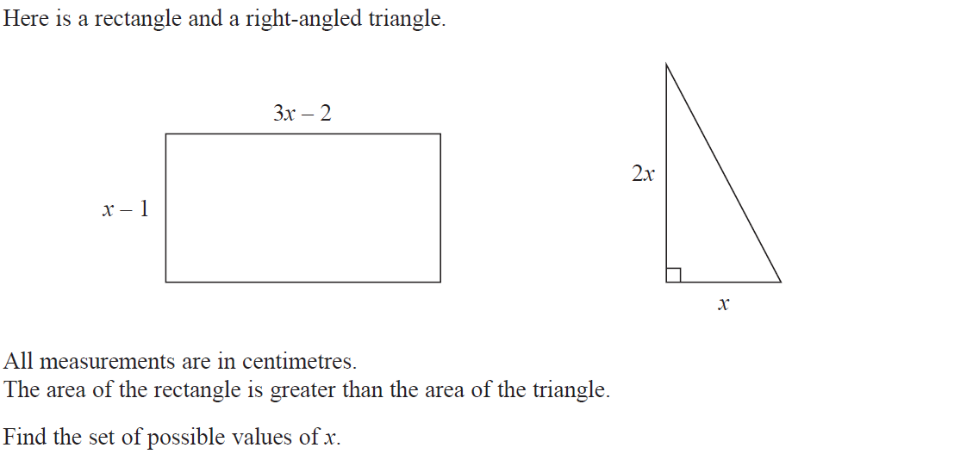
Quadratic Inequalities
Nov 2017 1H Q23

Slide 11
Quadratic Inequalities
Nov 2017 1H Q23
A

Slide 12
Quadratic Inequalities
May 2018 1H Q20

Slide 13
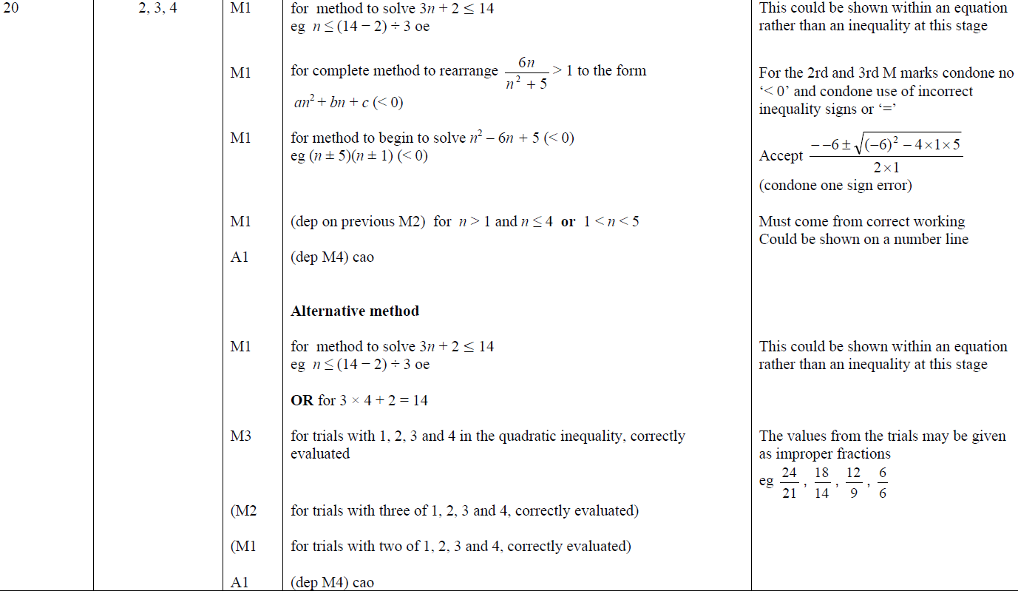
Quadratic Inequalities
May 2018 1H Q20
A

Slide 14
Quadratic Inequalities
Nov 2018 2H Q19

Slide 15
Quadratic Inequalities
Nov 2018 2H Q19
A

Slide 16
Quadratic Inequalities
June 2019 3H Q18

Slide 17
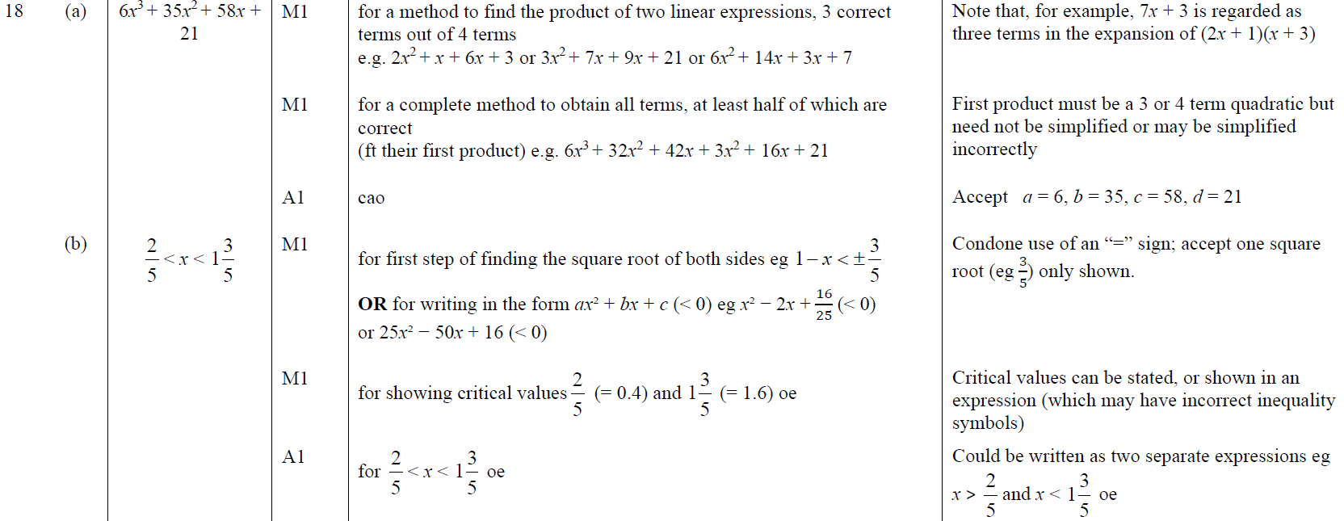
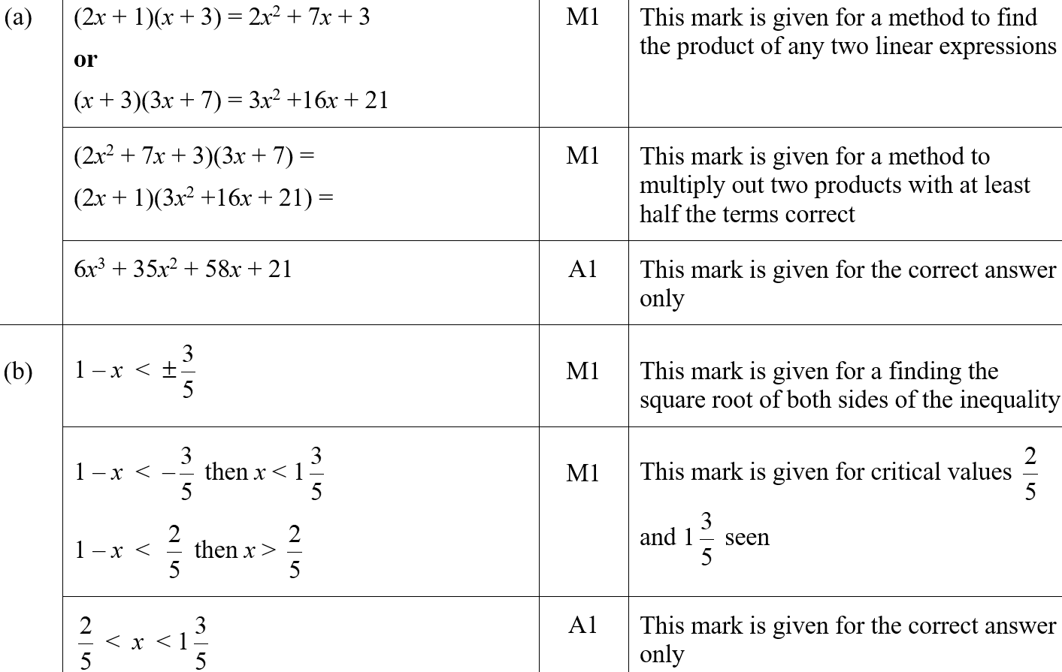
Quadratic Inequalities
June 2019 3H Q18
A
B
A SF
B SF

Slide 18
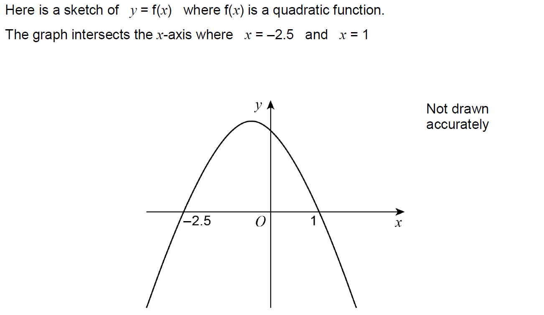
Quadratic Inequalities
June 2017 3H Q21

Slide 19
Quadratic Inequalities
June 2017 3H Q21
A

Slide 20
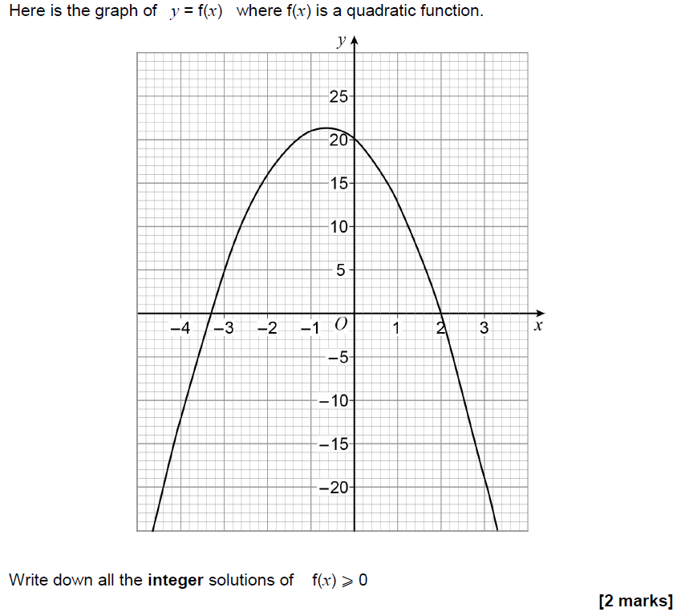
Quadratic Inequalities
Nov 2017 3H Q29

Slide 21
Quadratic Inequalities
Nov 2017 3H Q29
A

Slide 22
Quadratic Inequalities
SAM 2H Q16

Slide 23
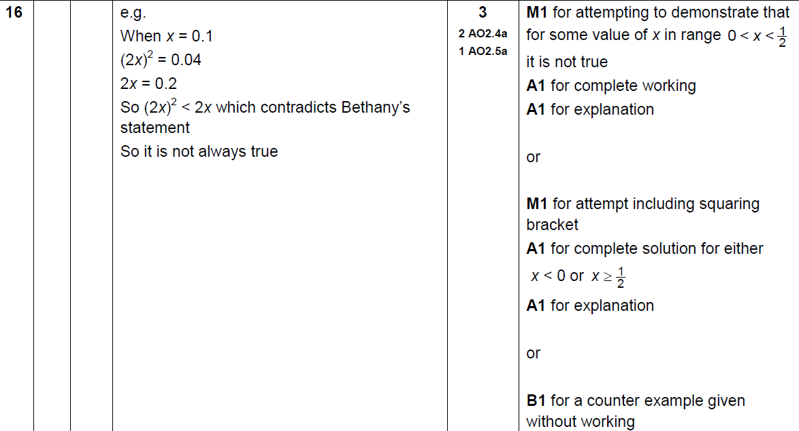
Quadratic Inequalities
SAM 2H Q16
A

Slide 24
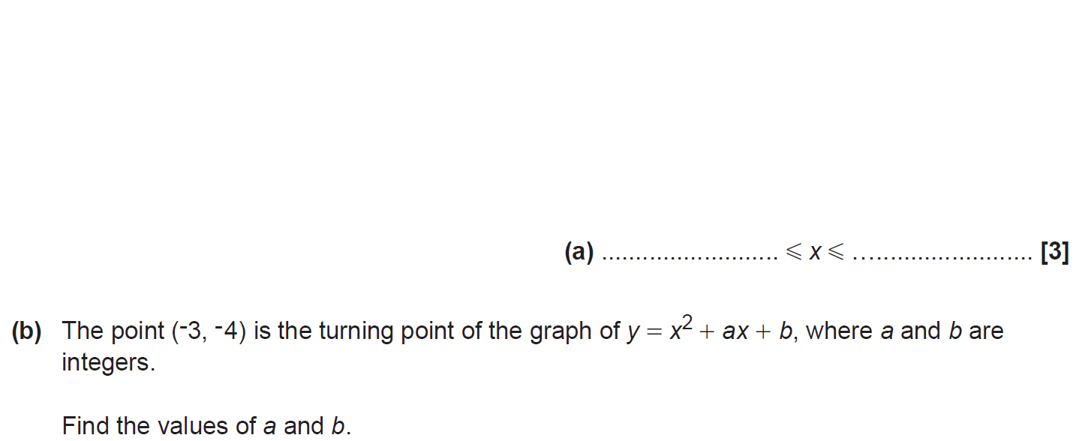
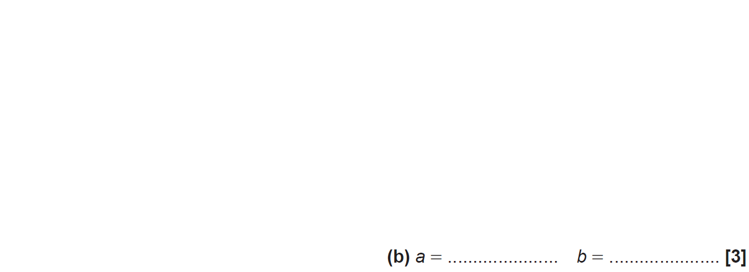
Quadratic Inequalities
SAM 2H Q20

Slide 25
Quadratic Inequalities
SAM 2H Q20
A
B

Slide 26
Quadratic Inequalities
Nov 2017 2H Q17

Slide 27
Quadratic Inequalities
Nov 2017 2H Q17
A

