Slide 1
Quadratic Inequalities
Quadratic Inequalities
SAM
2H Q16
Nov 2017
2H Q17
SAM
2H Q20

Slide 2
Quadratic Inequalities
SAM 2H Q16

Slide 3
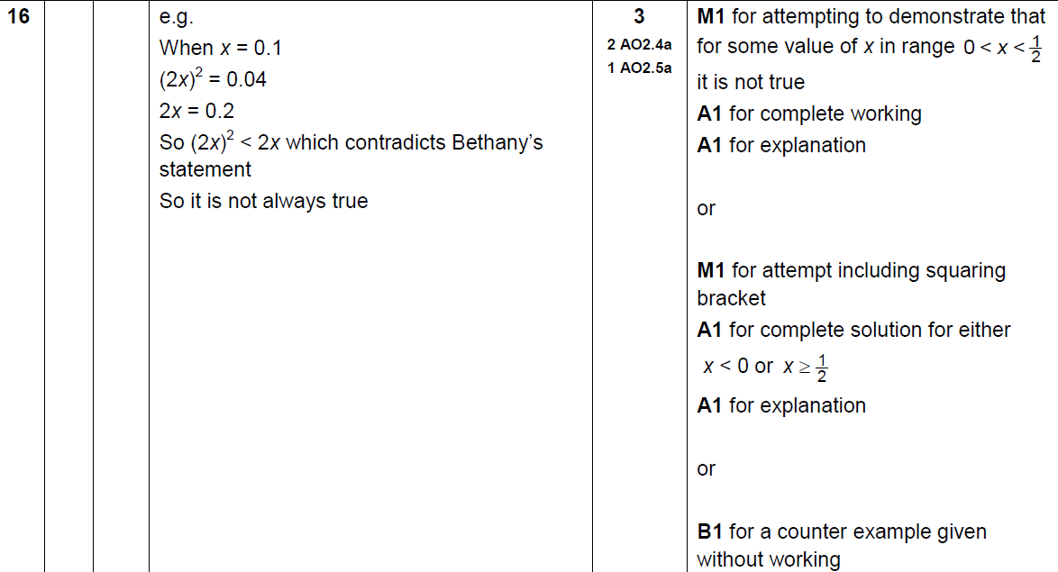
Quadratic Inequalities
SAM 2H Q16
A

Slide 4
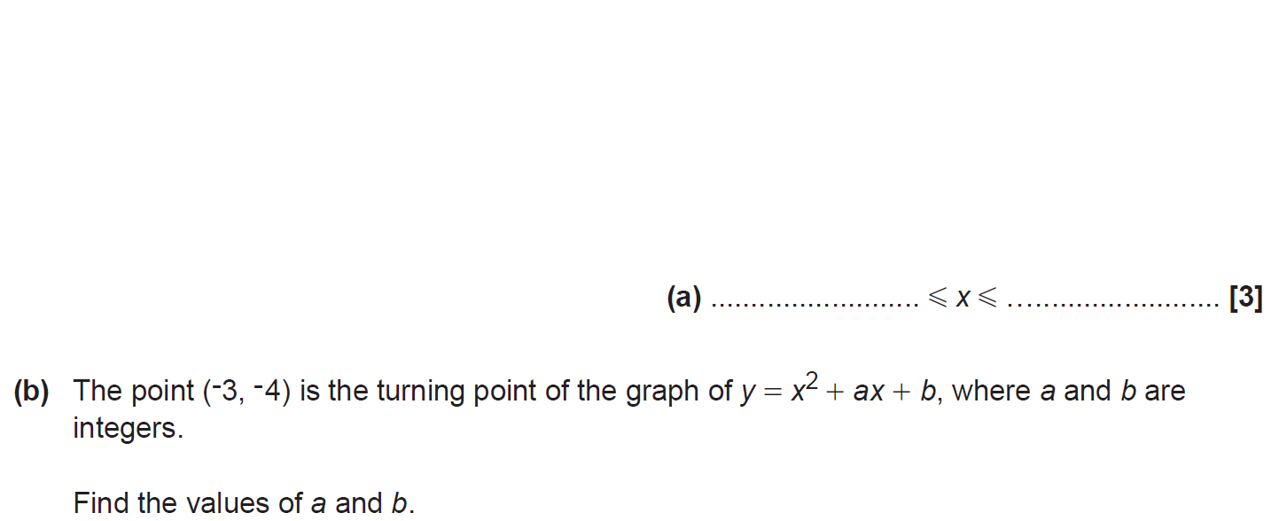
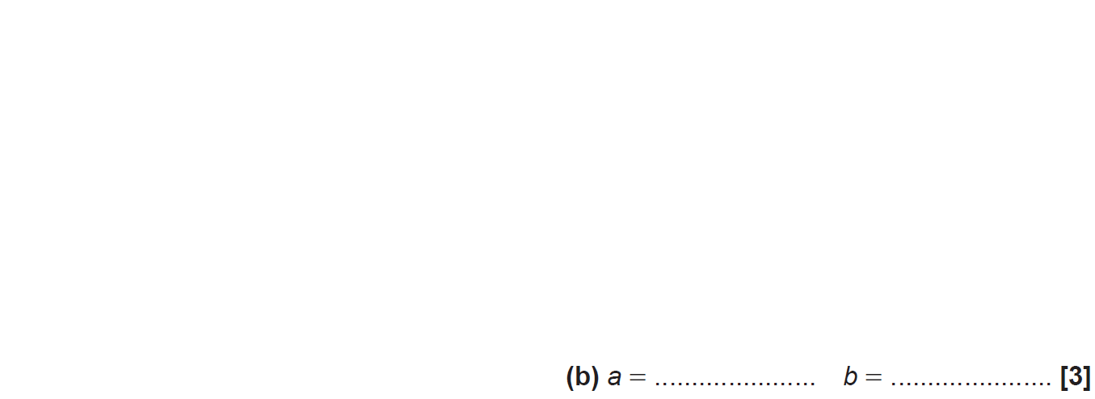
Quadratic Inequalities
SAM 2H Q20

Slide 5
Quadratic Inequalities
SAM 2H Q20
A
B

Slide 6
Quadratic Inequalities
Nov 2017 2H Q17

Slide 7
Quadratic Inequalities
Nov 2017 2H Q17
A

