Slide 1
Quadratic Inequalities
Quadratic Inequalities
June 2017
3H Q19
Nov 2017
1H Q23
SAM
1H Q19
May 2018
1H Q20
Spec 2
1H Q21
Nov 2018
2H Q19
June 2019
3H Q18

Slide 2
Quadratic Inequalities
SAM 1H Q19

Slide 3
Quadratic Inequalities
SAM 1H Q19
A

Slide 4
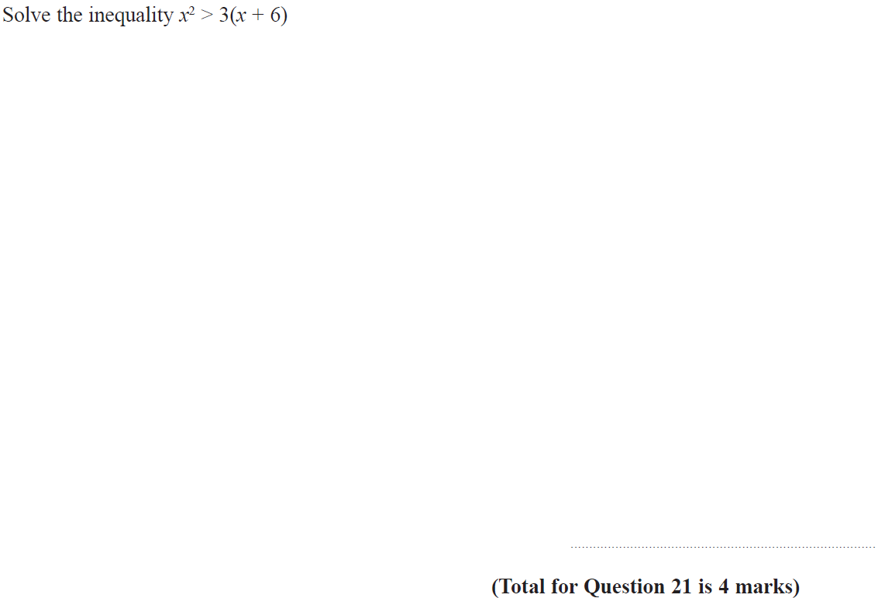
Quadratic Inequalities
Specimen Set 2 1H Q21

Slide 5
Quadratic Inequalities
Specimen Set 2 1H Q21
A

Slide 6
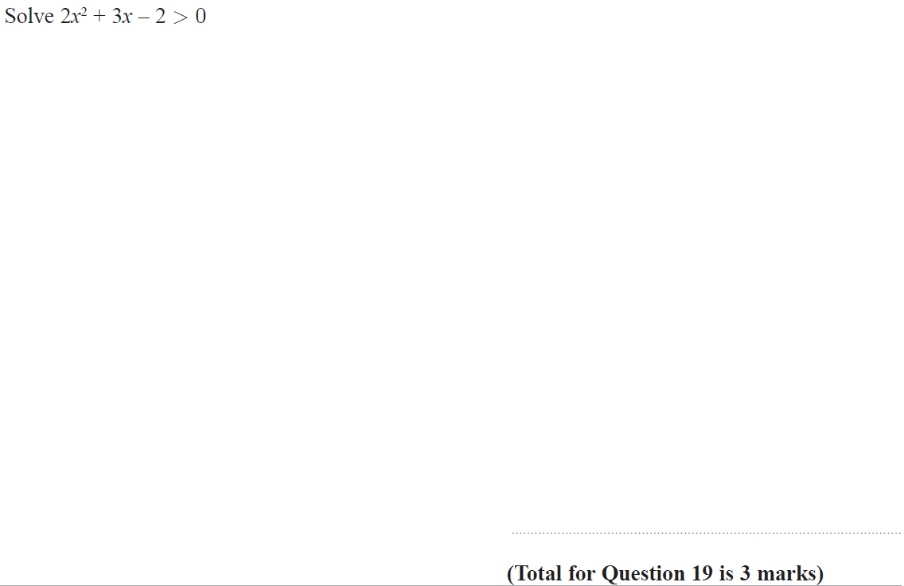
Quadratic Inequalities
June 2017 3H Q19

Slide 7
Quadratic Inequalities
June 2017 3H Q19
A

Slide 8
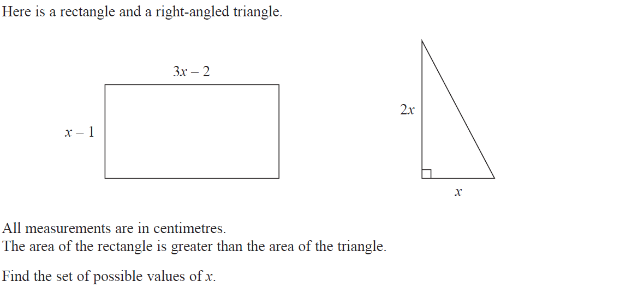
Quadratic Inequalities
Nov 2017 1H Q23

Slide 9
Quadratic Inequalities
Nov 2017 1H Q23
A

Slide 10
Quadratic Inequalities
May 2018 1H Q20

Slide 11
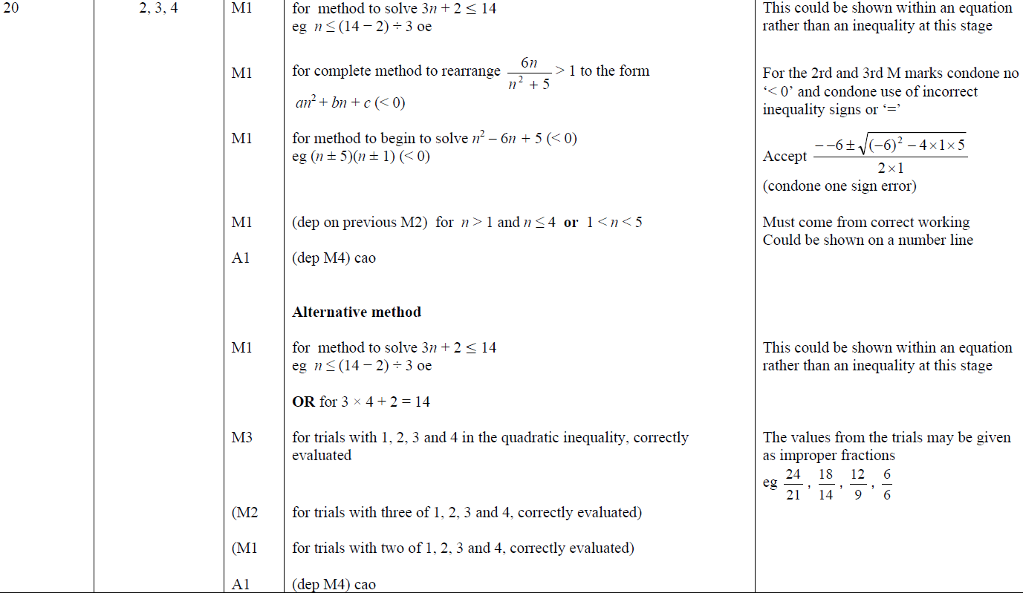
Quadratic Inequalities
May 2018 1H Q20
A

Slide 12
Quadratic Inequalities
Nov 2018 2H Q19

Slide 13
Quadratic Inequalities
Nov 2018 2H Q19
A

Slide 14
Quadratic Inequalities
June 2019 3H Q18

Slide 15
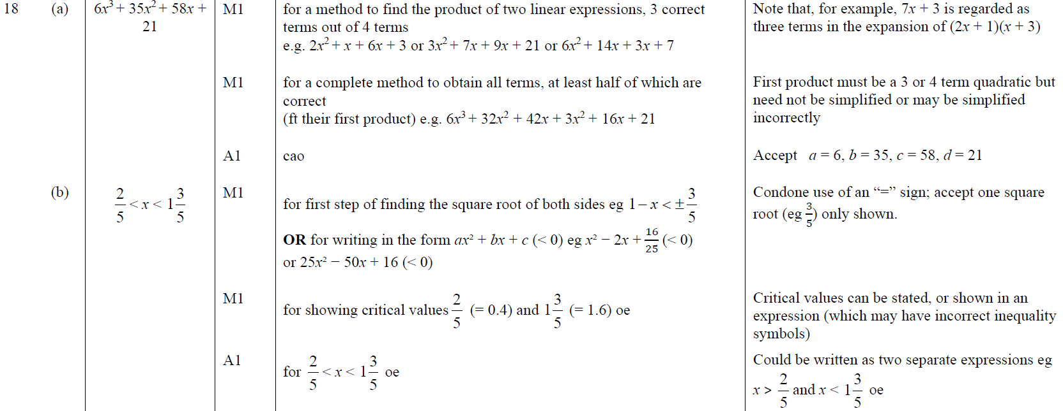
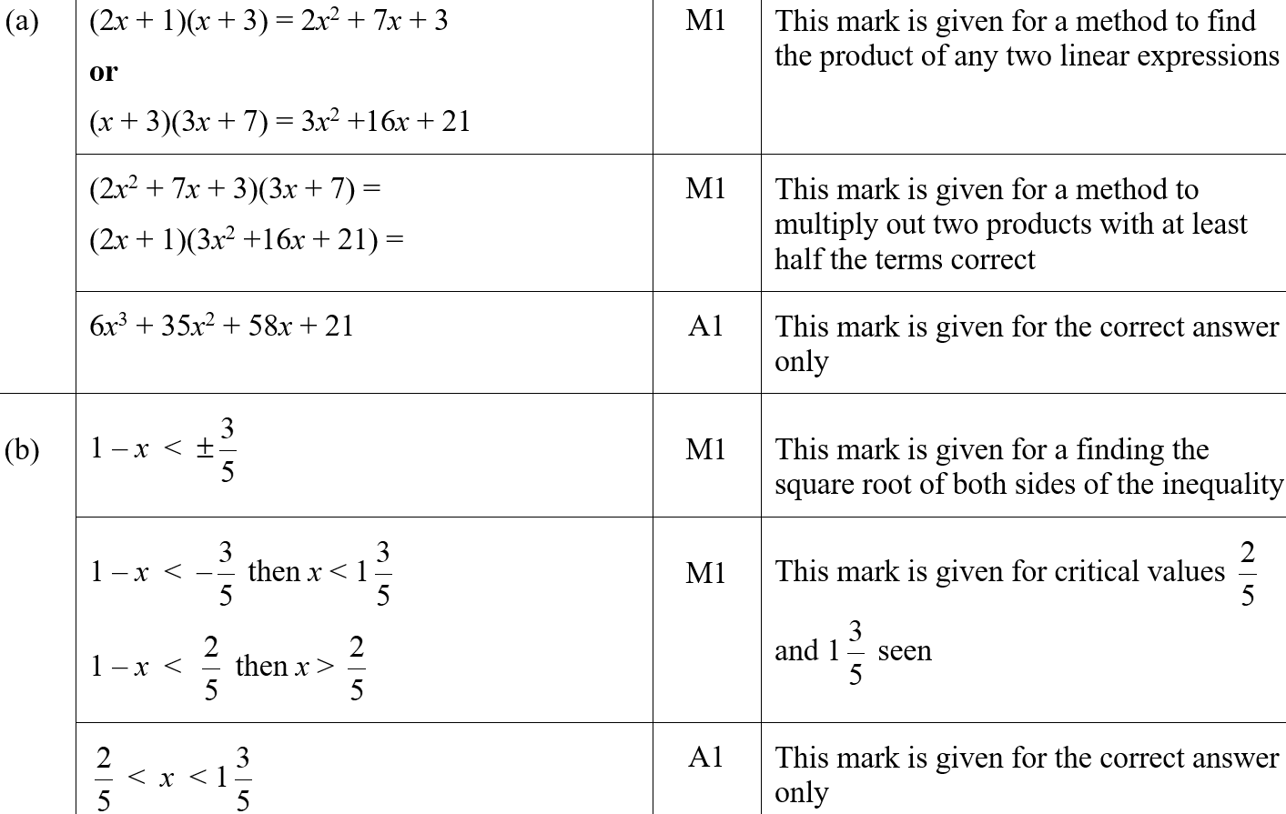
Quadratic Inequalities
June 2019 3H Q18
A
B
A SF
B SF

