Slide 1
Pythagoras
Pythagoras
June 2017
2H Q15
June 2018
3H Q20
1 Marker
SAM
3H Q28
June 2017
3H Q25
June 2018
3H Q25
June 2017
3H Q27
Nov 2018
3H Q23
3D
*May use Trigonometry instead

Slide 2
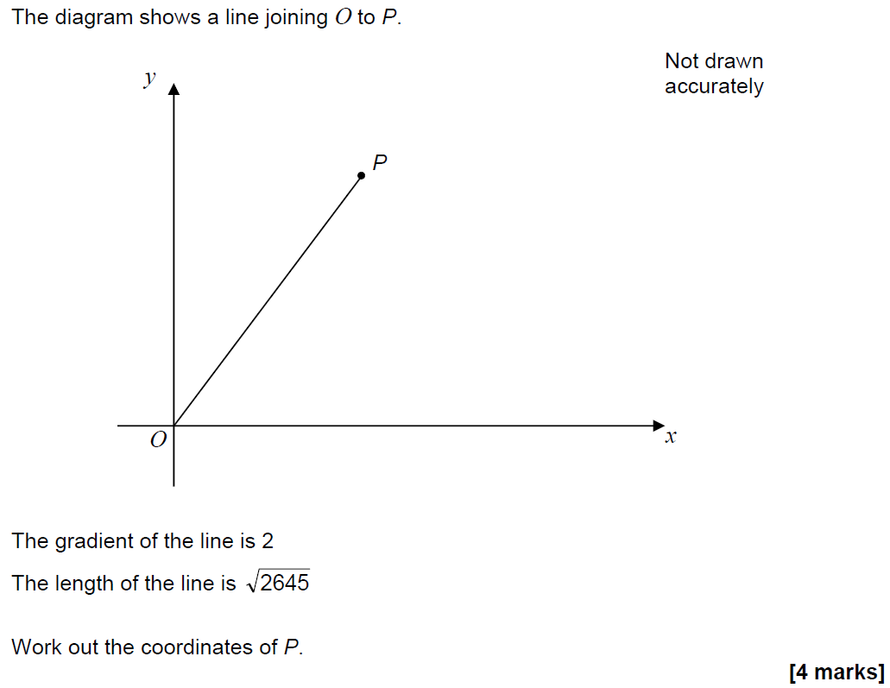
Pythagoras
SAM 3H Q28

Slide 3
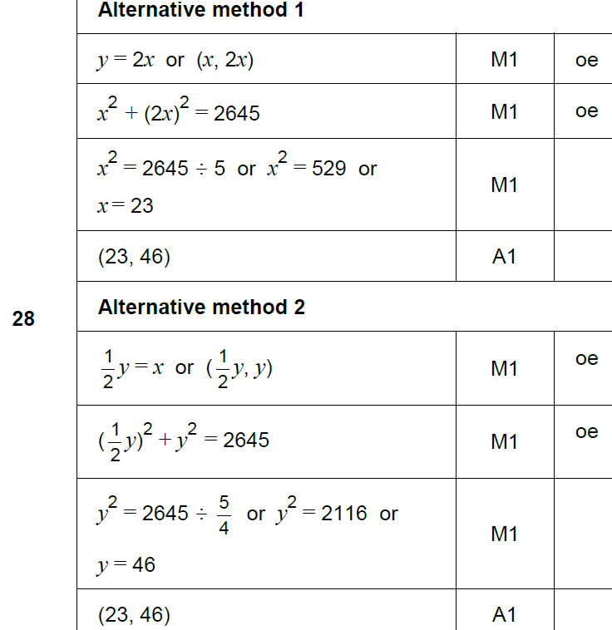
Pythagoras
SAM 3H Q28
A

Slide 4
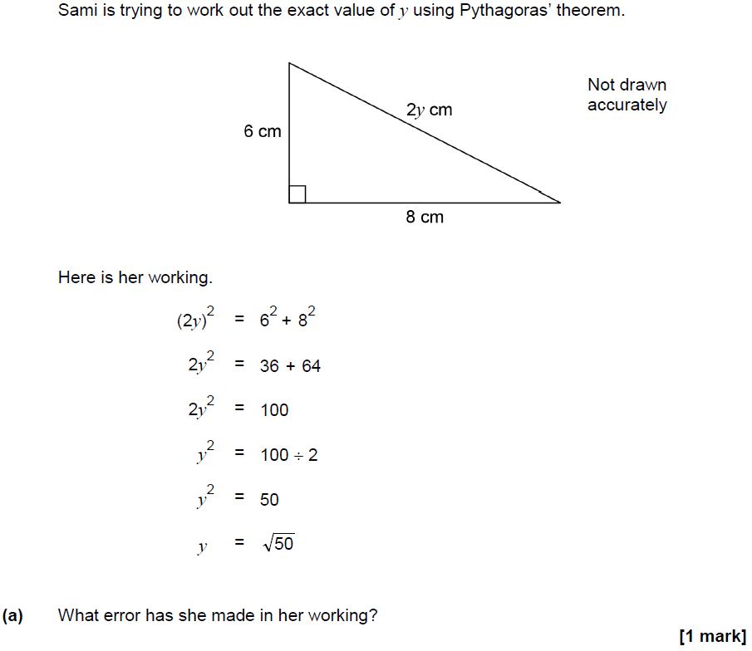
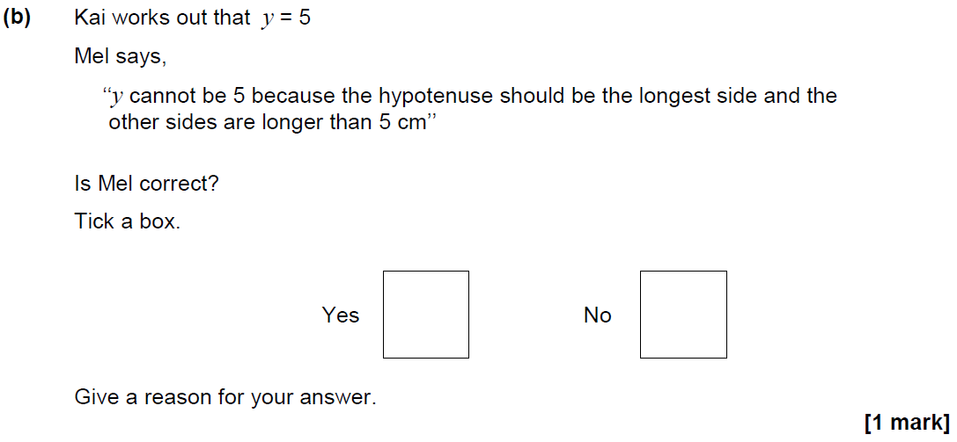
Pythagoras
June 2017 2H Q15

Slide 5
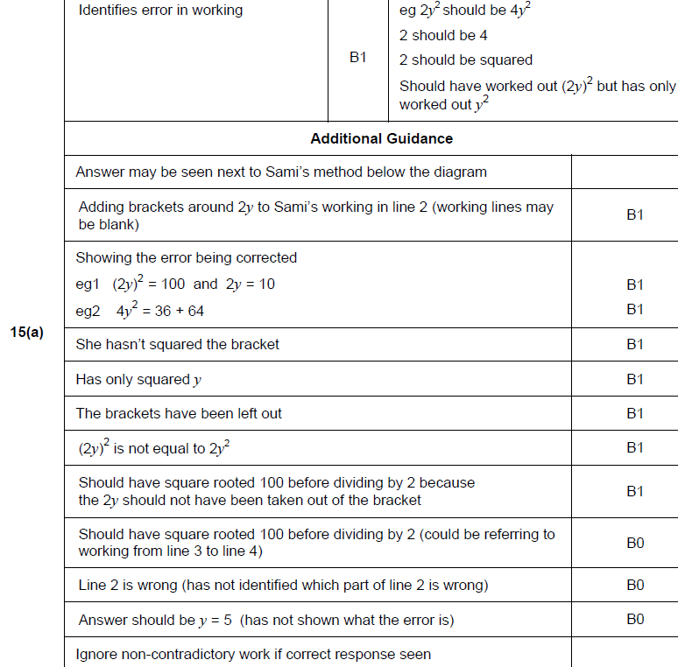
Pythagoras
June 2017 2H Q15
A

Slide 6
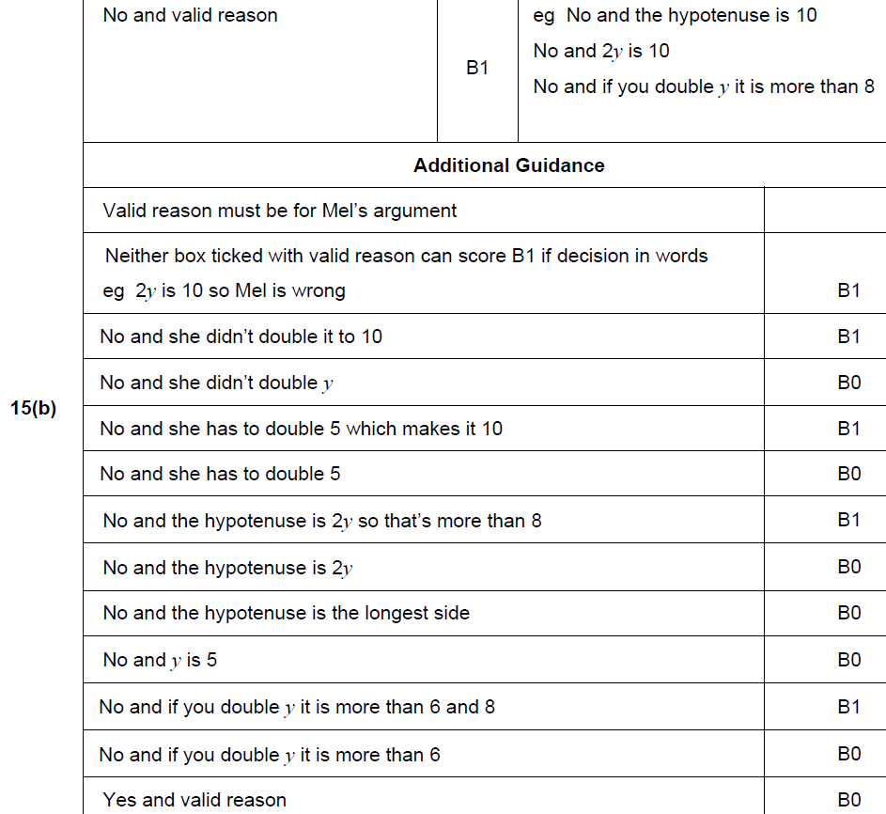
Pythagoras
June 2017 2H Q15
B

Slide 7
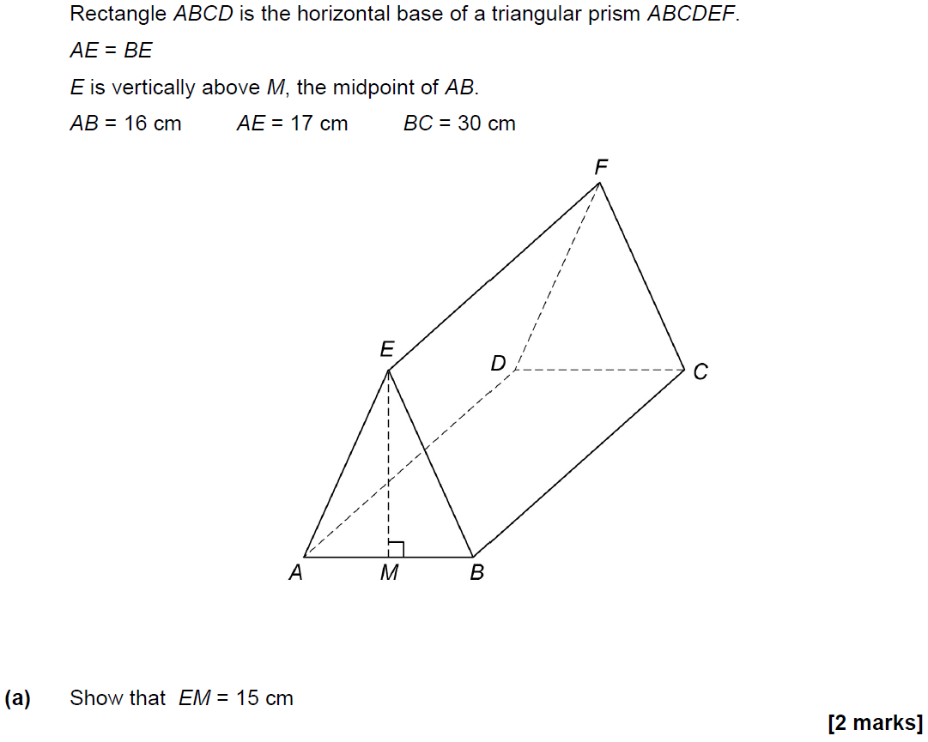
Pythagoras
June 2017 3H Q25

Slide 8
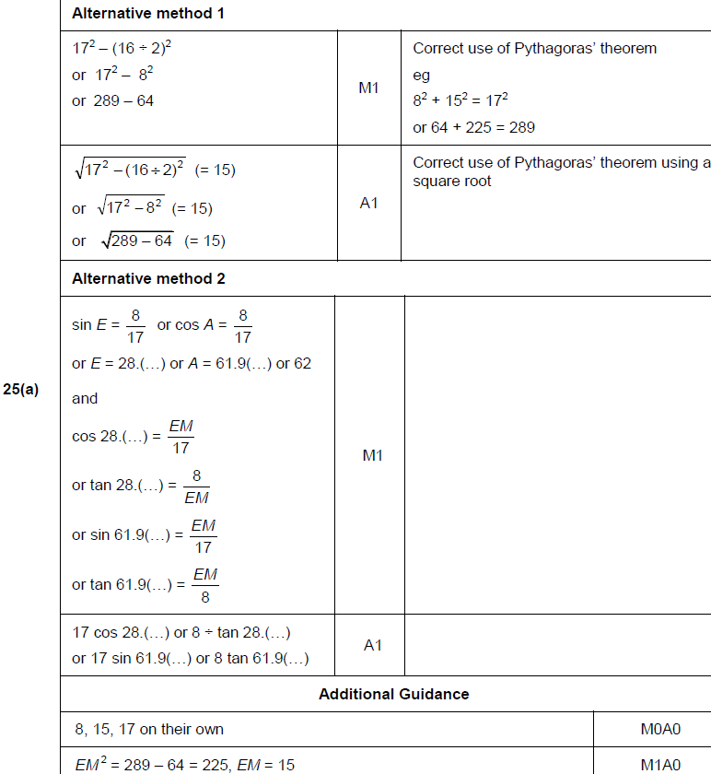
Pythagoras
June 2017 3H Q25
A

Slide 9
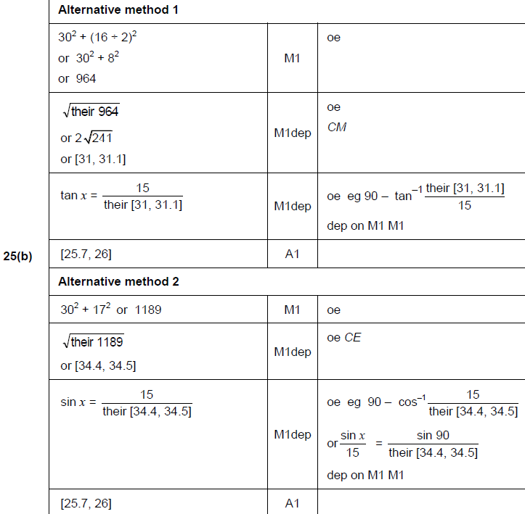
Pythagoras
June 2017 3H Q25
B

Slide 10
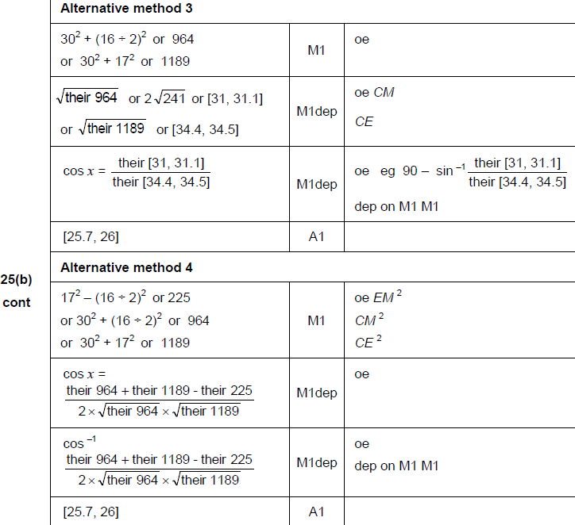
Pythagoras
June 2017 3H Q25
B Alternatives

Slide 11
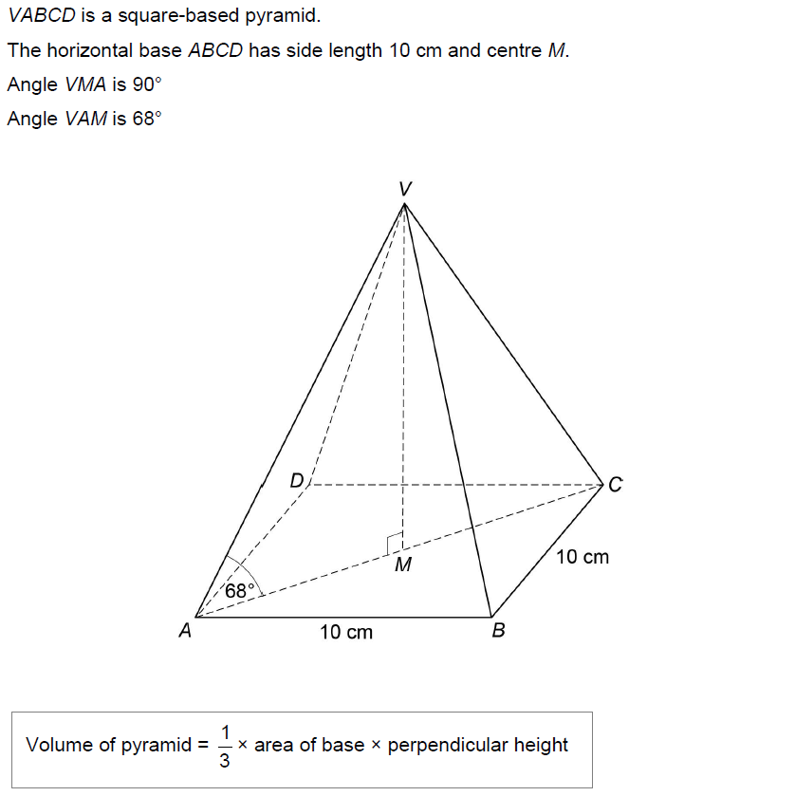
Pythagoras
Nov 2017 3H Q27
Work out the volume of the pyramid.
[6 marks]

Slide 12
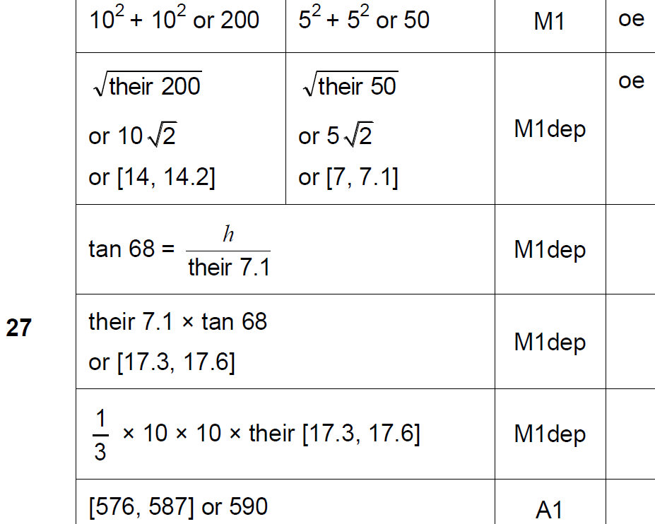
Pythagoras
Nov 2017 3H Q27
A

Slide 13
Pythagoras
June 2018 3H Q20

Slide 14
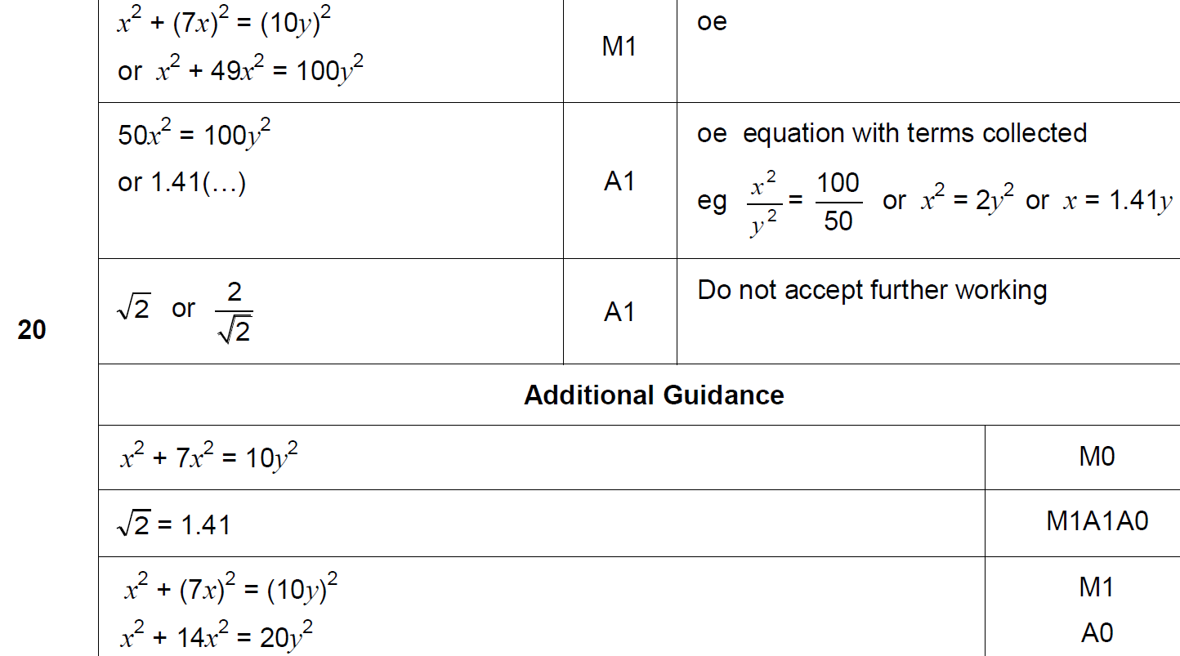
Pythagoras
June 2018 3H Q20
A

Slide 15
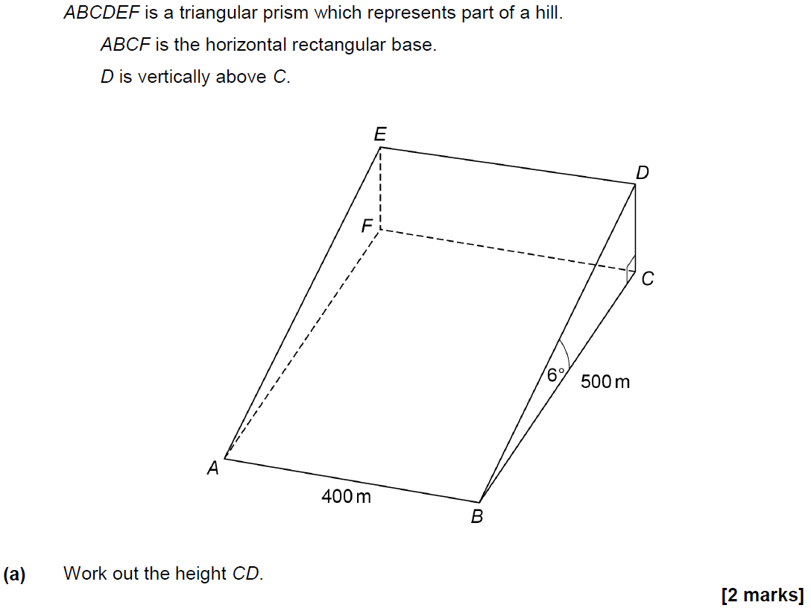
Pythagoras
June 2018 3H Q25

Slide 16
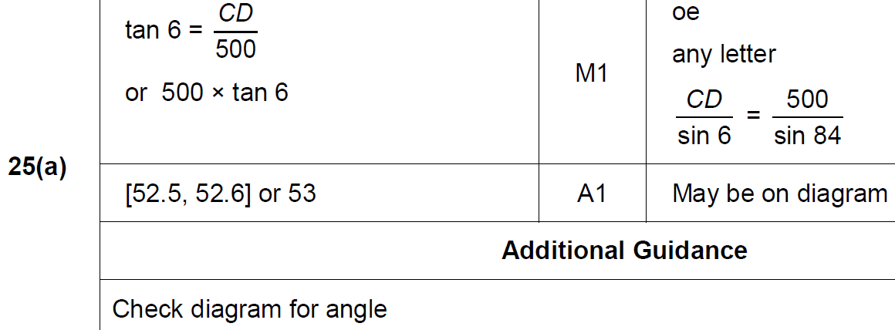
Pythagoras
June 2018 3H Q25
A

Slide 17
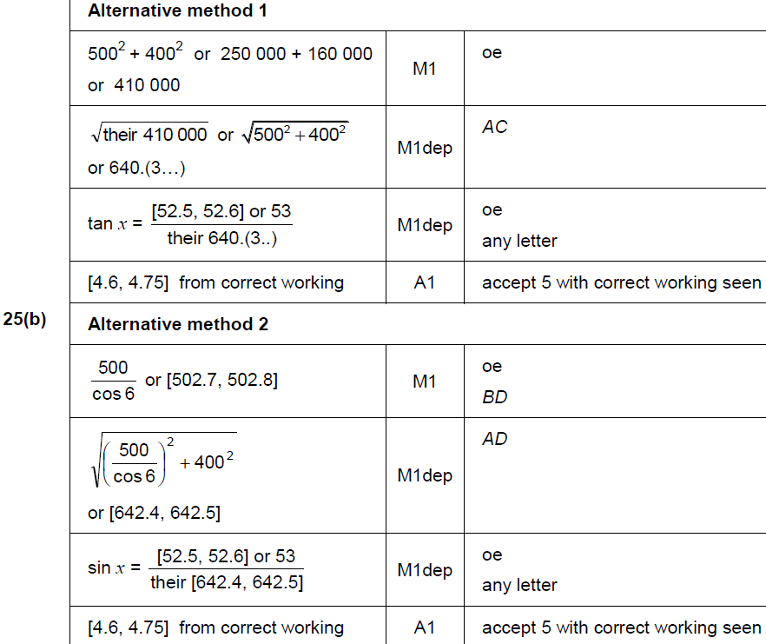
Pythagoras
June 2018 3H Q25
B

Slide 18
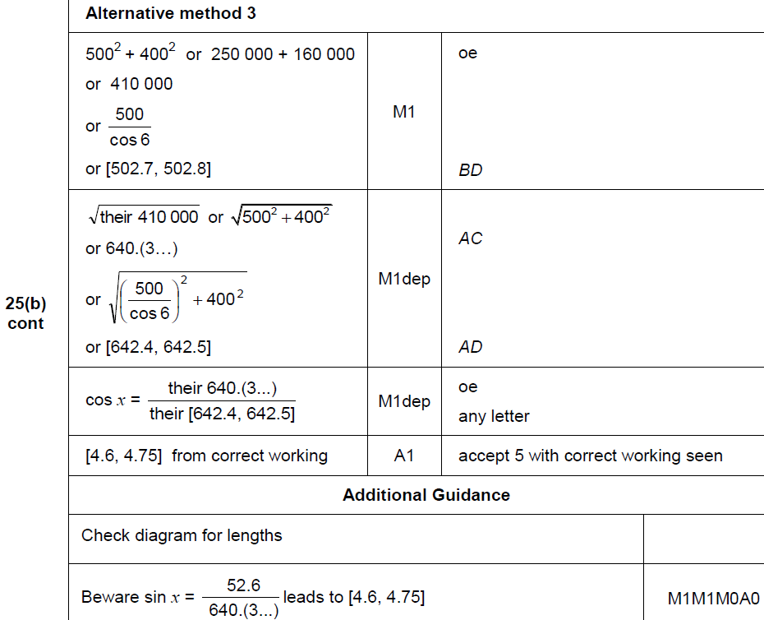
Pythagoras
June 2018 3H Q25
B Alternative

Slide 19
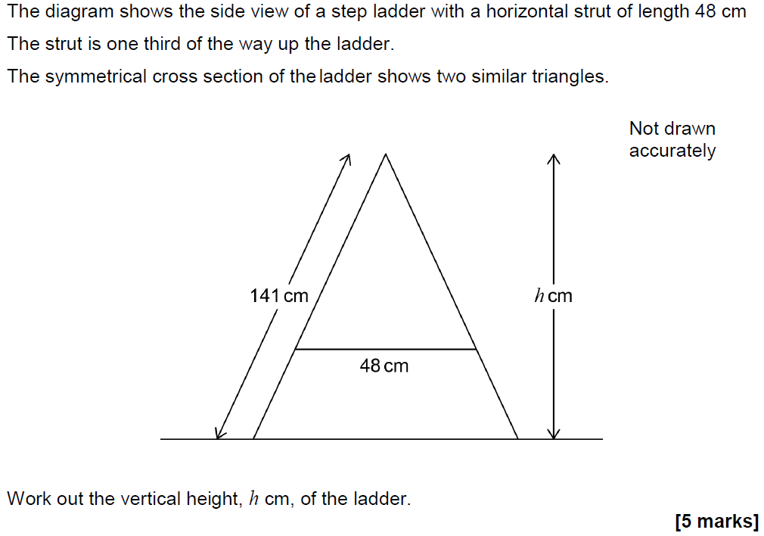
Pythagoras
Nov 2018 3H Q23

Slide 20
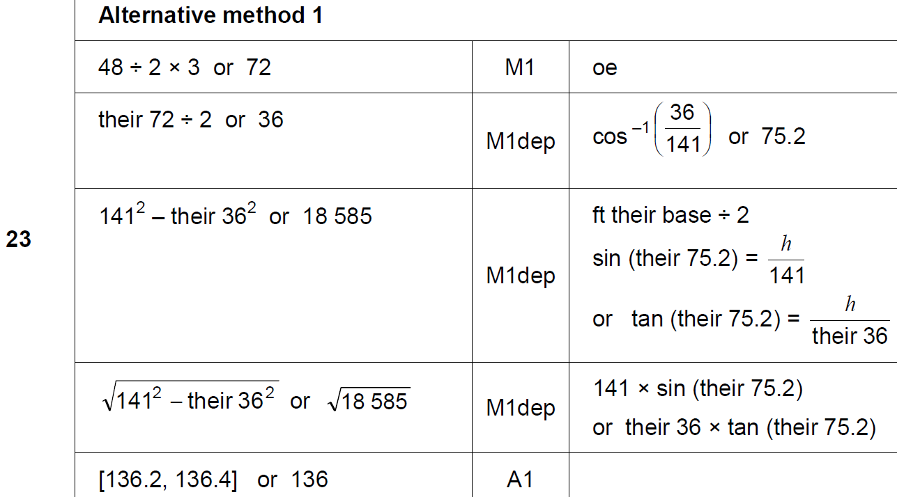
Pythagoras
Nov 2018 3H Q23
A

Slide 21
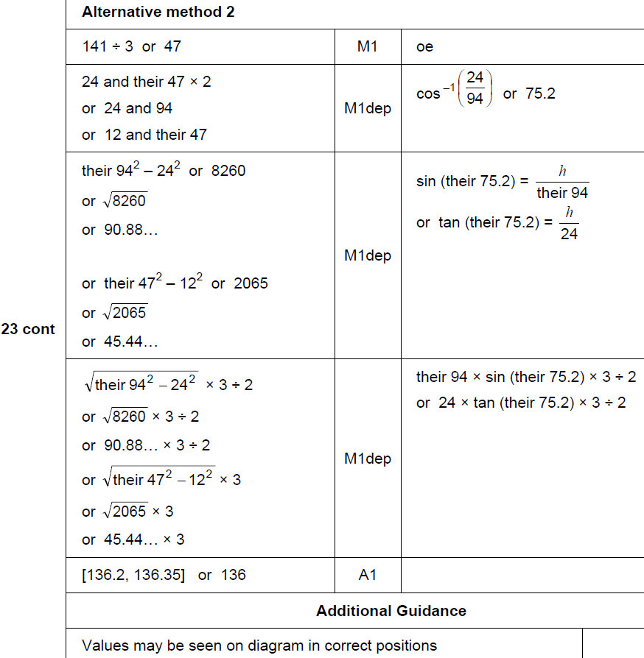
Pythagoras
Nov 2018 3H Q23
A Alternative & notes

