Slide 1
Pythagoras
Pythagoras
June 2017
2H Q20
SAM
1H Q11
June 2017
3H Q18
SAM
1H Q12
Nov 2017
1H Q14
Practice
1H Q7
June 2018
2H Q11
Practice
2H Q3
June 2018
3H Q12
Practice
3H Q2*
Nov 2018
1H Q3
Nov 2018
1H Q20
3D
*May use Trigonometry instead

Slide 2
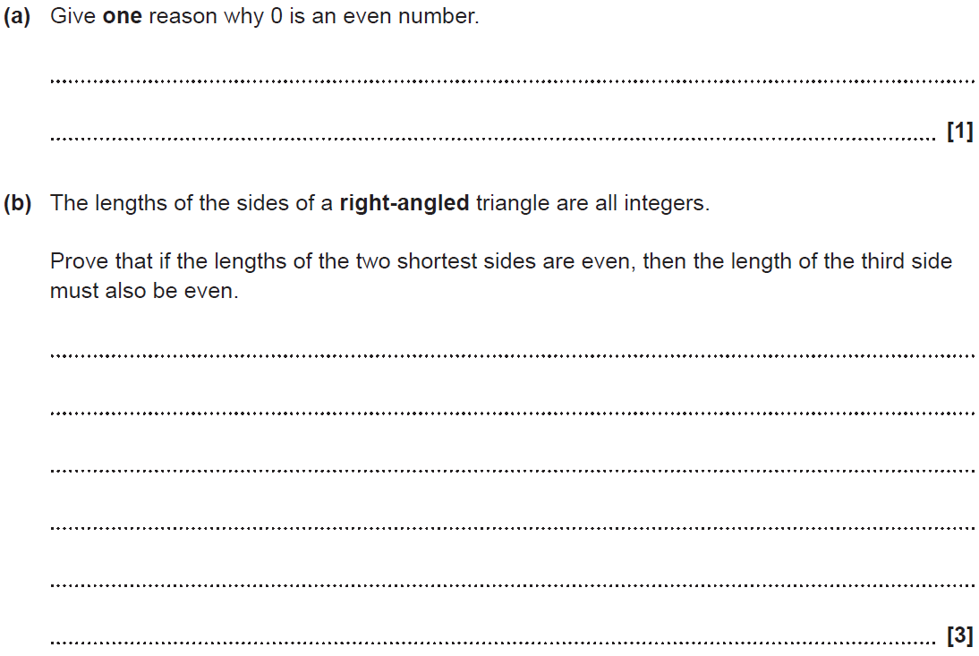
Pythagoras
SAM 1H Q11

Slide 3
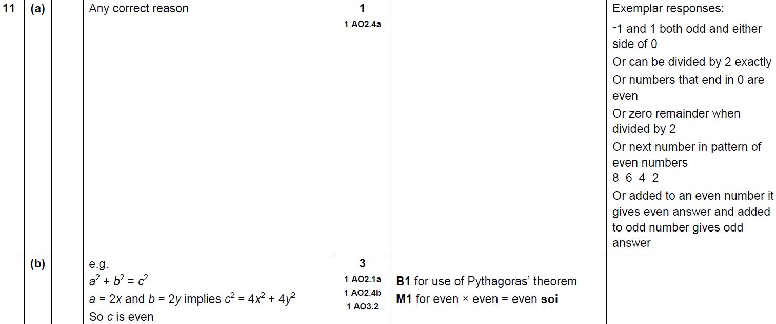
Pythagoras
SAM 1H Q11
A
B

Slide 4
Pythagoras
SAM 1H Q12

Slide 5
Pythagoras
SAM 1H Q12
A

Slide 6
Pythagoras
Practice 1H Q7

Slide 7
Pythagoras
Practice 1H Q7
A

Slide 8
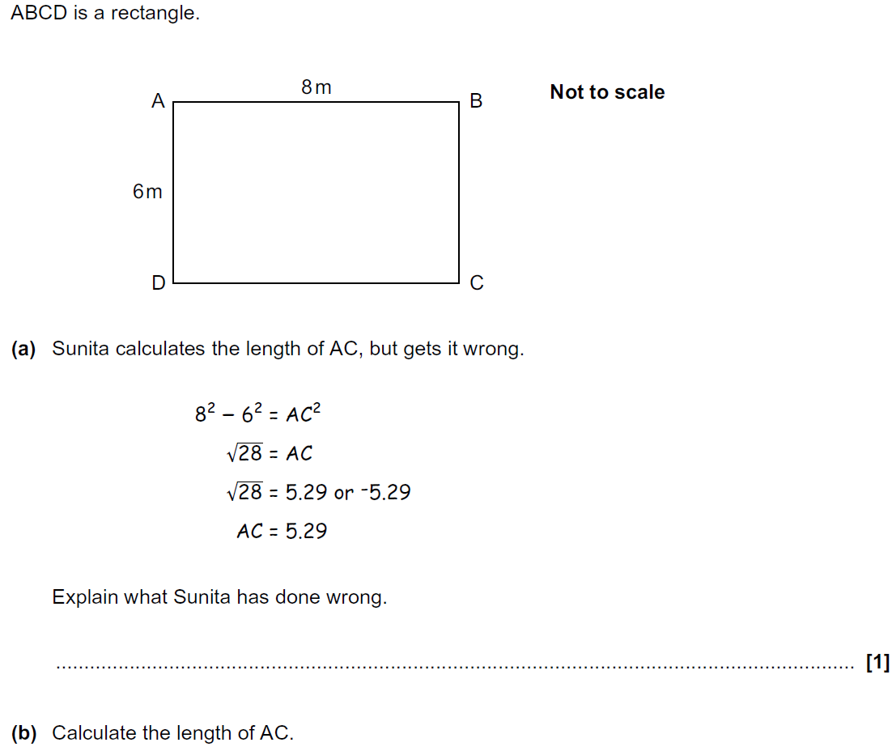
Pythagoras
Practice 2H Q3

Slide 9
Pythagoras
Practice 2H Q3
A
B

Slide 10
Pythagoras
Practice 3H Q2

Slide 11
Pythagoras
Practice 3H Q2
A

Slide 12
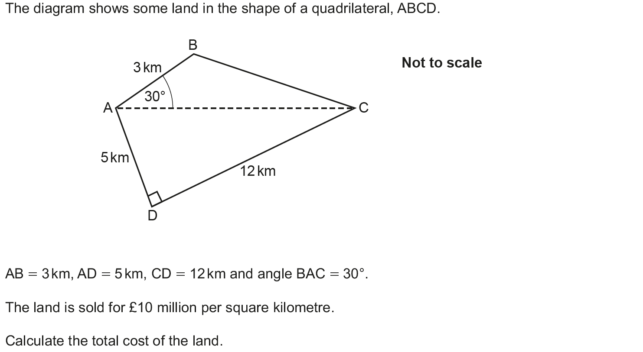
Pythagoras
June 2017 2H Q20

Slide 13
Pythagoras
June 2017 2H Q20
A

Slide 14
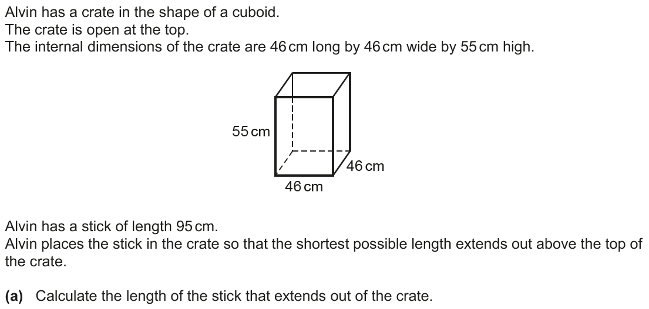
Pythagoras
June 2017 3H Q18

Slide 15
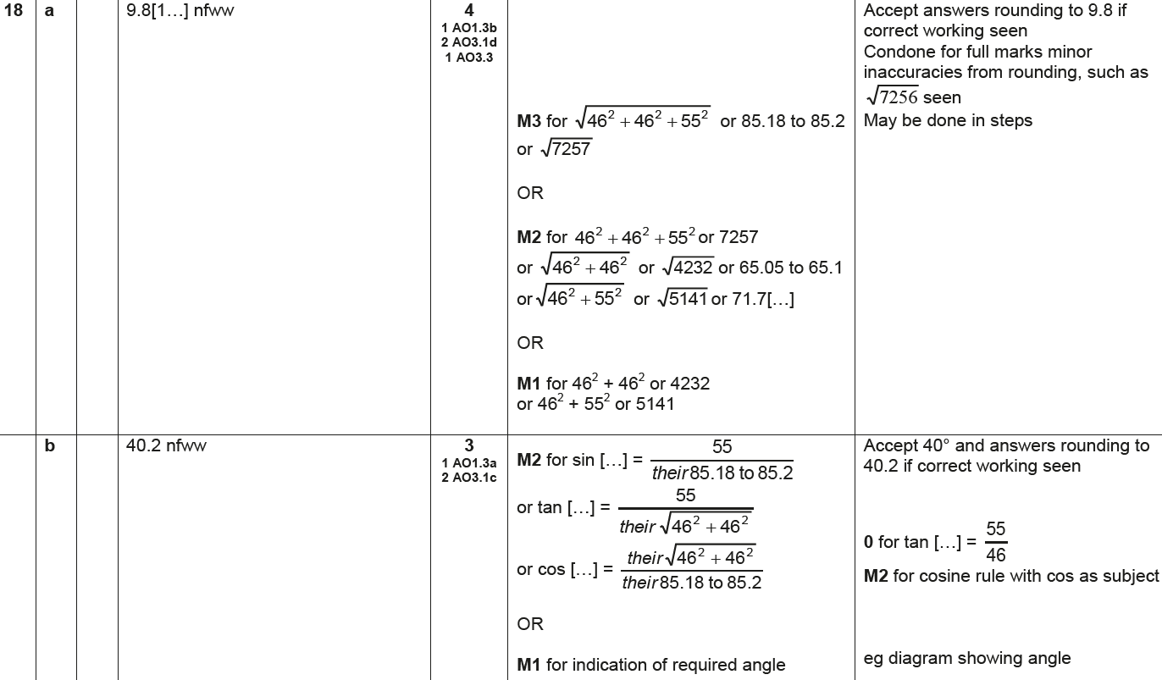
Pythagoras
June 2017 3H Q18
A
B

Slide 16
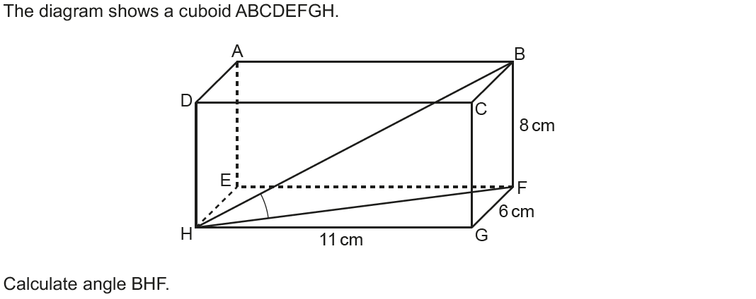
Pythagoras
Nov 2017 1H Q14

Slide 17
Pythagoras
Nov 2017 1H Q14
A

Slide 18
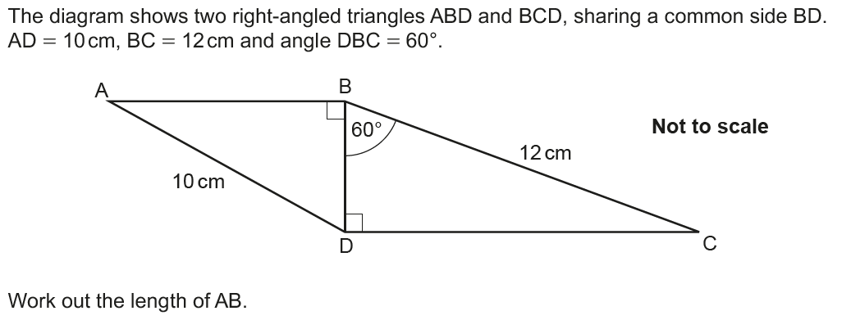
Pythagoras
June 2018 2H Q11

Slide 19
Pythagoras
June 2018 2H Q11
A

Slide 20
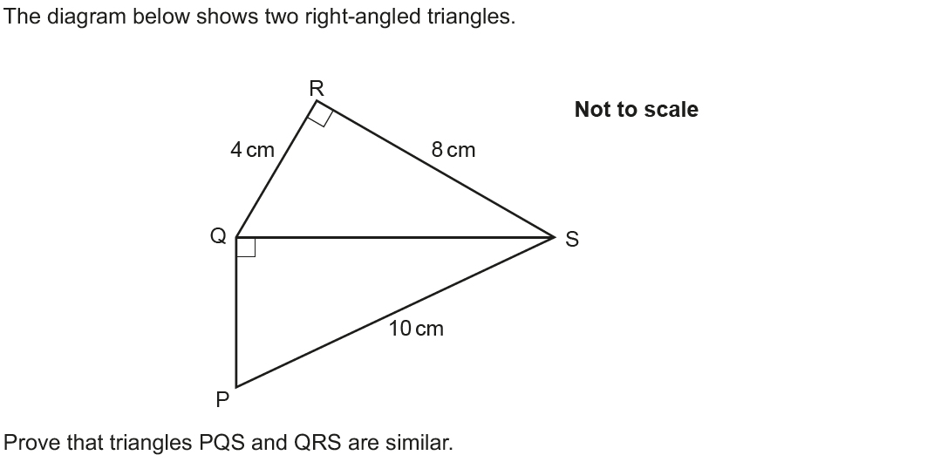
Pythagoras
June 2018 3H Q12

Slide 21
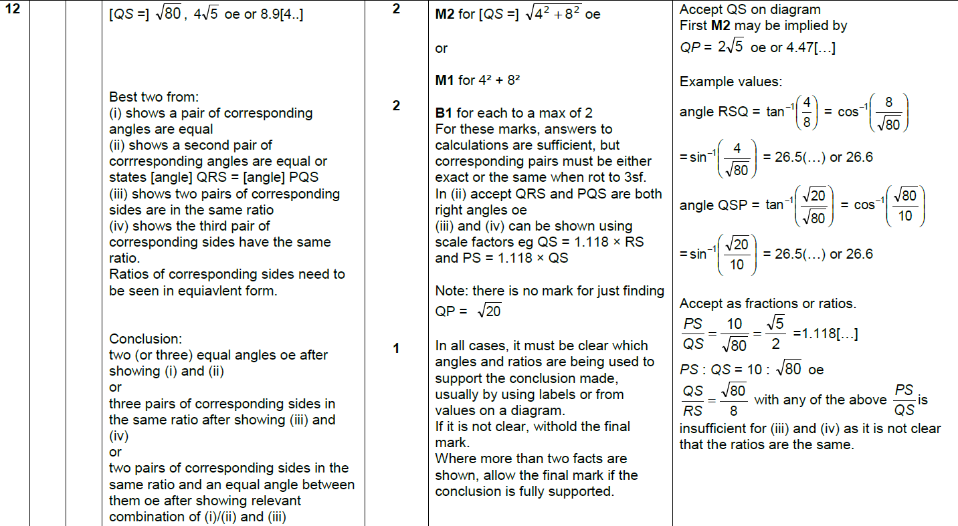
Pythagoras
June 2018 3H Q12
A

Slide 22
Pythagoras
Nov 2018 1H Q3

Slide 23
Pythagoras
Nov 2018 1H Q3
A

Slide 24
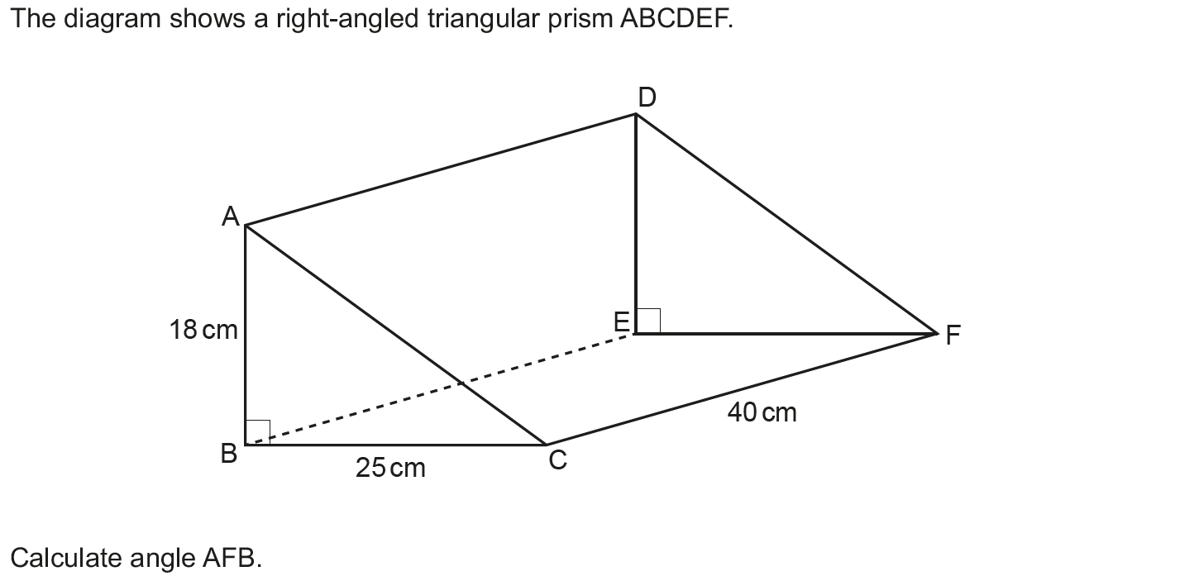
Pythagoras
Nov 2018 1H Q20

Slide 25
Pythagoras
Nov 2018 1H Q20
A

