Slide 1
Pythagoras
Pythagoras
May 2017
1H Q5
SAM
2H Q6
June 2017
2H Q21*
SAM
3H Q16
June 2017
3H Q8
Spec 1
2H Q19
Nov 2017
2H Q7
Spec 1
3H Q12
Nov 2018
2H Q13*
Spec 2
1H Q4
Nov 2018
3H Q12
Spec 2
2H Q17
June 2019
2H Q19
Spec 2
3H Q7**
June 2019
3H Q8
3D
*May use Trigonometry instead
**Proof of Pythagoras with areas

Slide 2
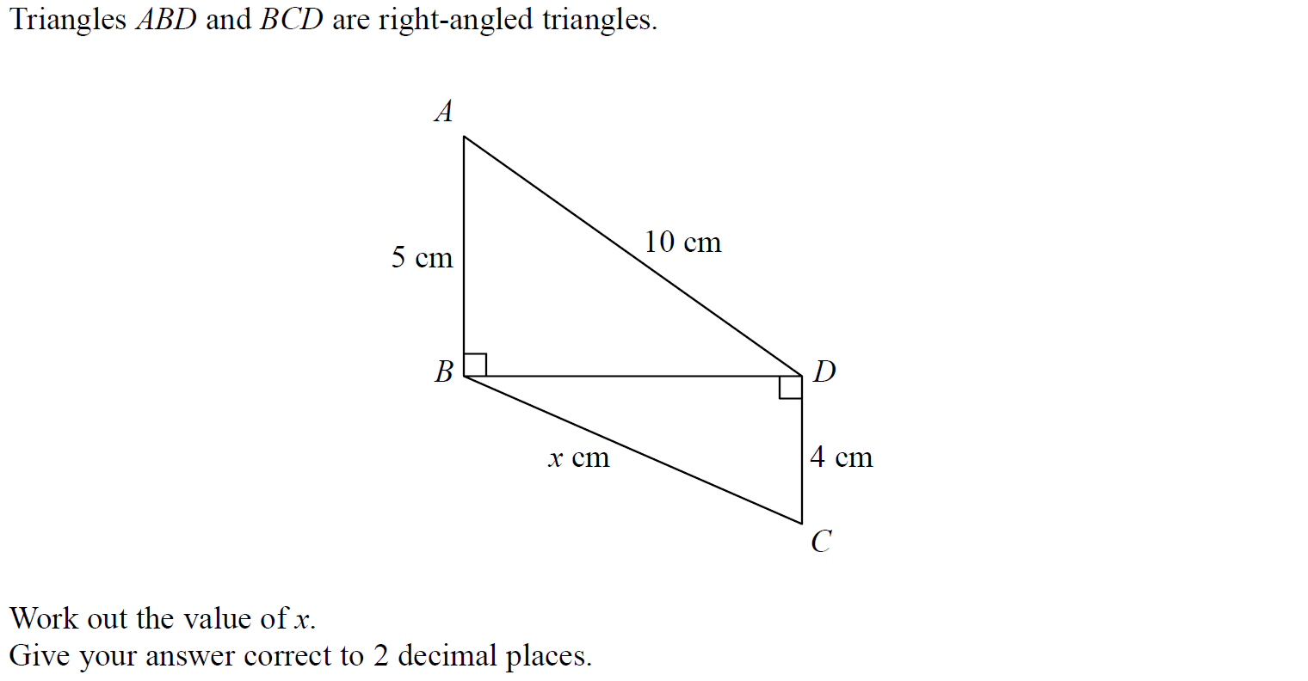
Pythagoras
SAM 2H Q6

Slide 3
Pythagoras
SAM 2H Q6
A

Slide 4
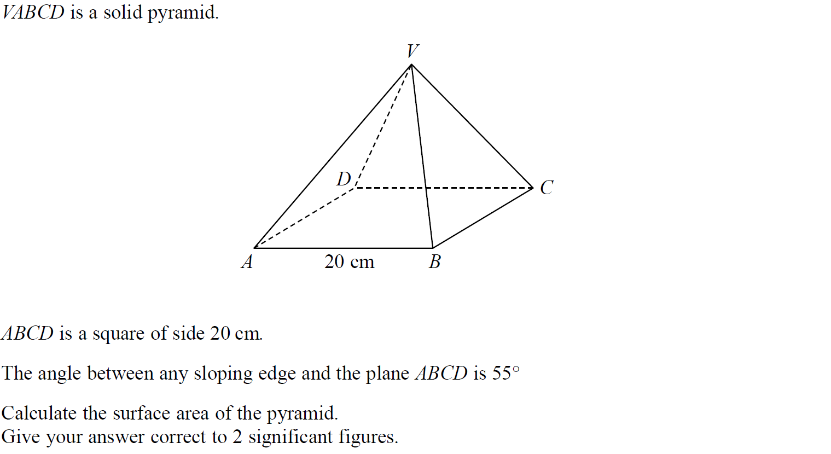
Pythagoras
SAM 3H Q16

Slide 5
Pythagoras
SAM 3H Q16
A

Slide 6
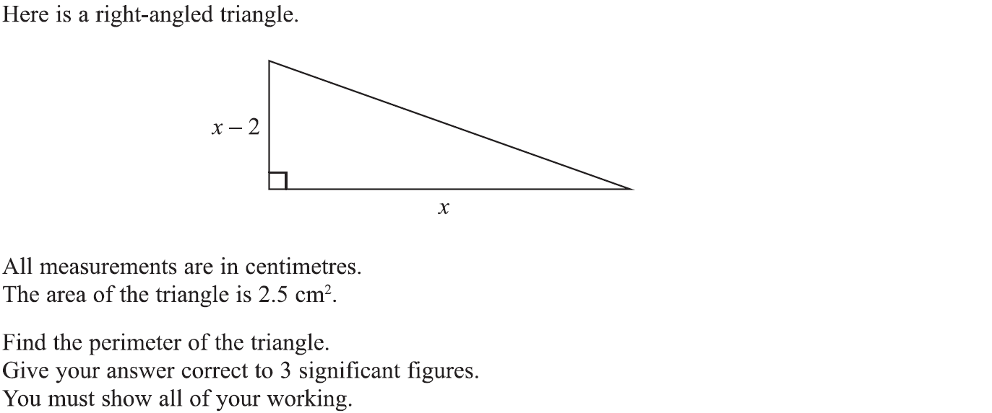
Pythagoras
Specimen Set 1 2H Q19

Slide 7
Pythagoras
Specimen Set 1 2H Q19
A

Slide 8
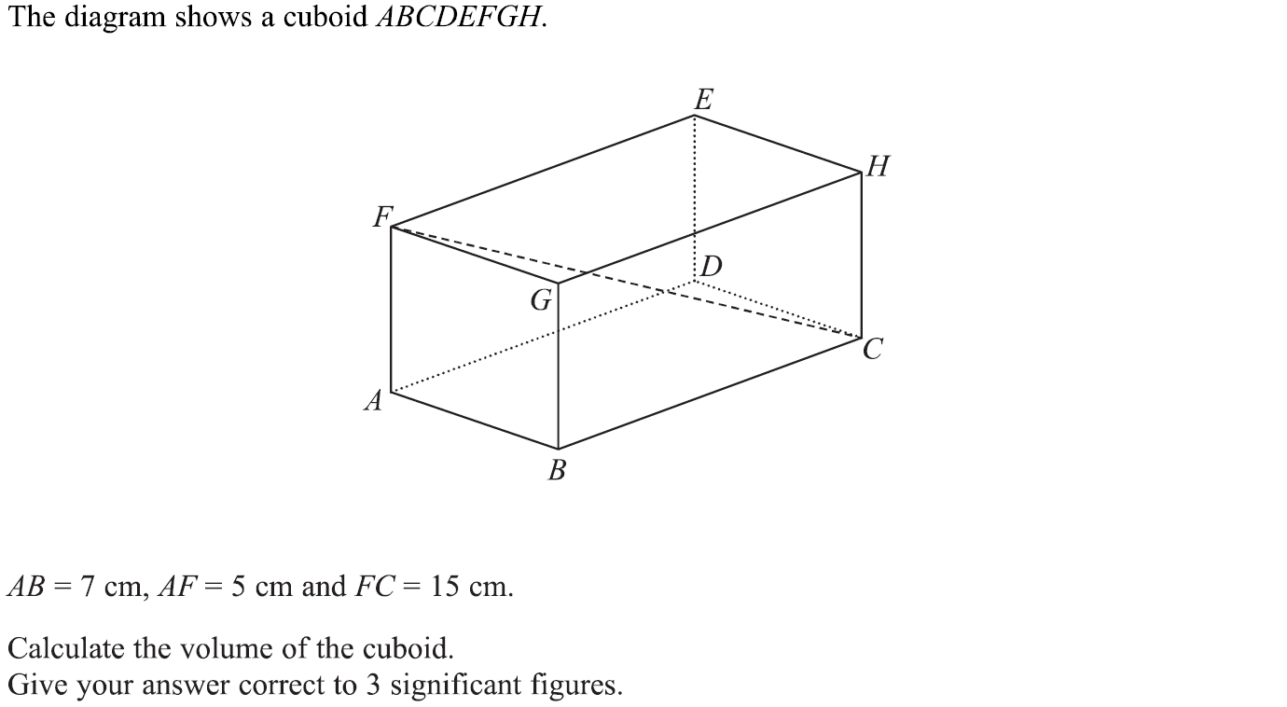
Pythagoras
Specimen Set 1 3H Q12

Slide 9
Pythagoras
Specimen Set 1 3H Q12
A

Slide 10
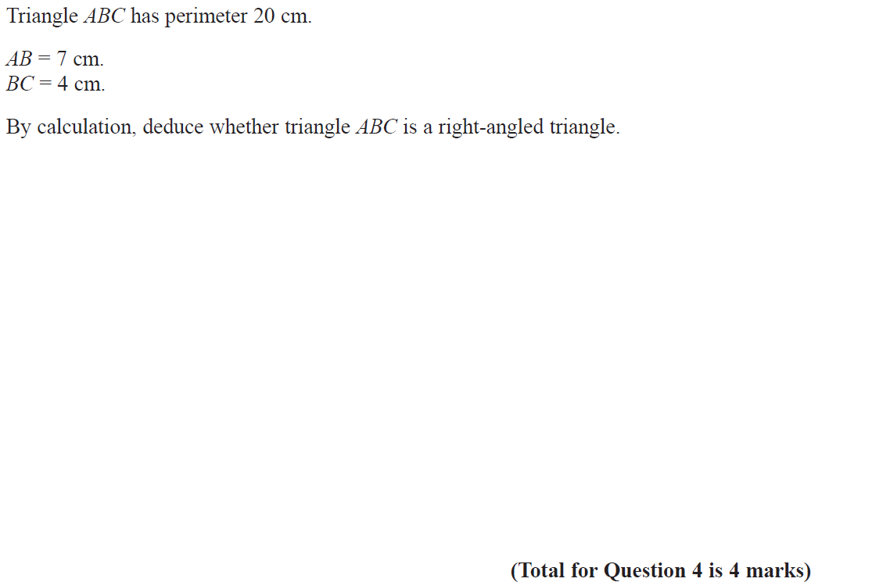
Pythagoras
Specimen Set 2 1H Q4

Slide 11
Pythagoras
Specimen Set 2 1H Q4
A

Slide 12
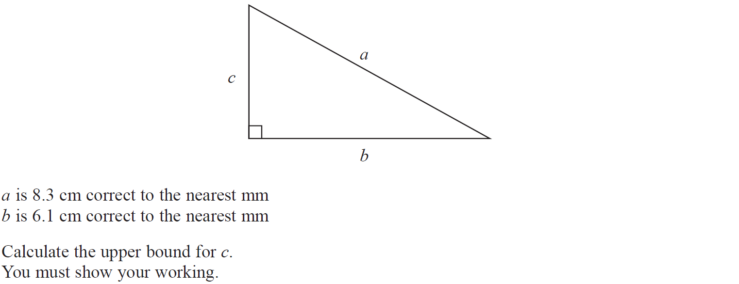
Pythagoras
Specimen Set 2 2H Q17

Slide 13
Pythagoras
Specimen Set 2 2H Q17
A

Slide 14
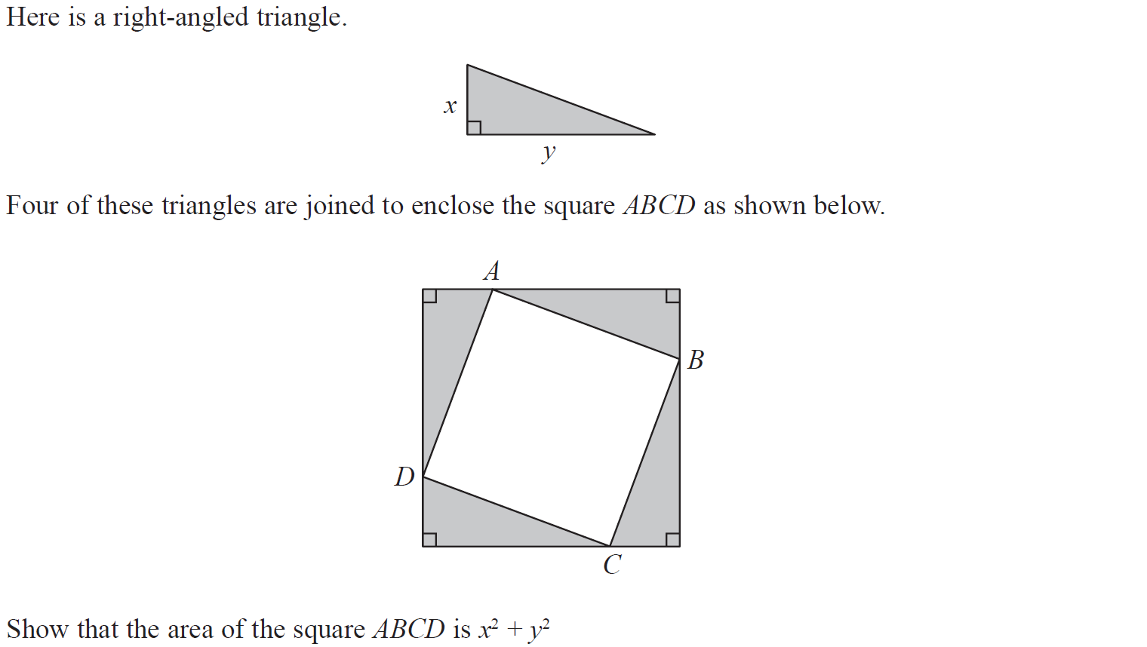
Pythagoras
Specimen Set 2 3H Q7

Slide 15
Pythagoras
Specimen Set 2 3H Q7
A

Slide 16
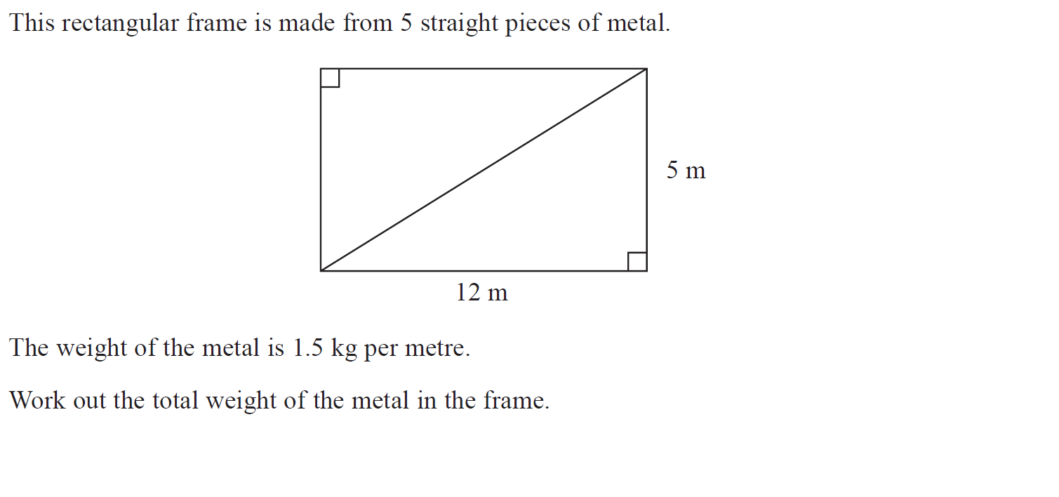
Pythagoras
May 2017 1H Q5

Slide 17
Pythagoras
May 2017 1H Q5
A

Slide 18
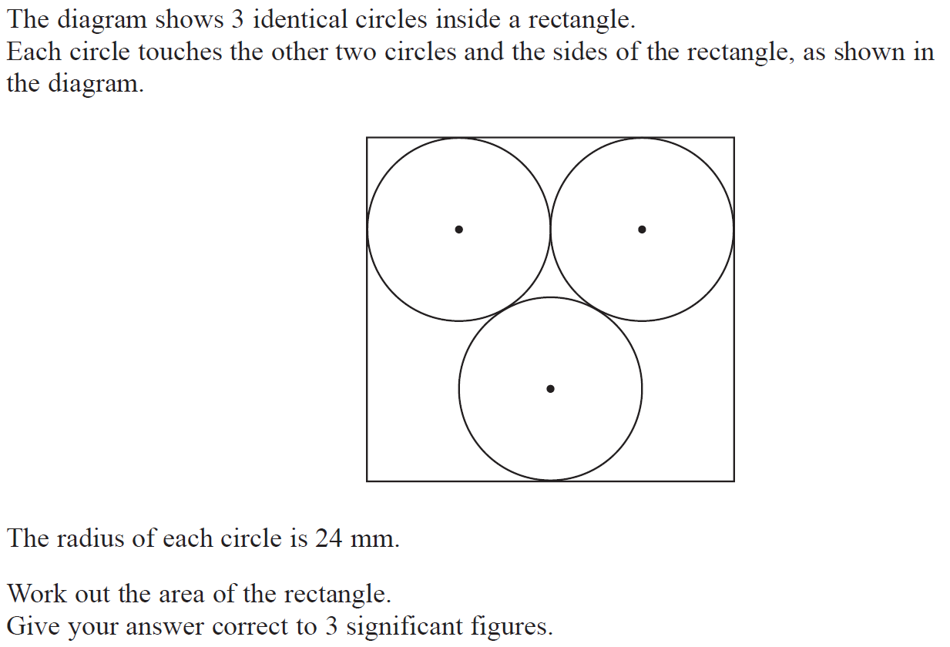
Pythagoras
June 2017 2H Q21

Slide 19
Pythagoras
June 2017 2H Q21
A

Slide 20
Pythagoras
June 2017 3H Q8

Slide 21
Pythagoras
June 2017 3H Q8
A

Slide 22
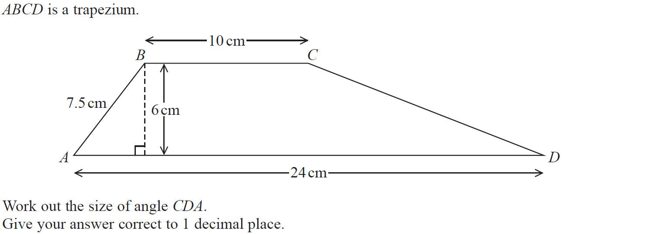
Pythagoras
Nov 2017 2H Q7

Slide 23
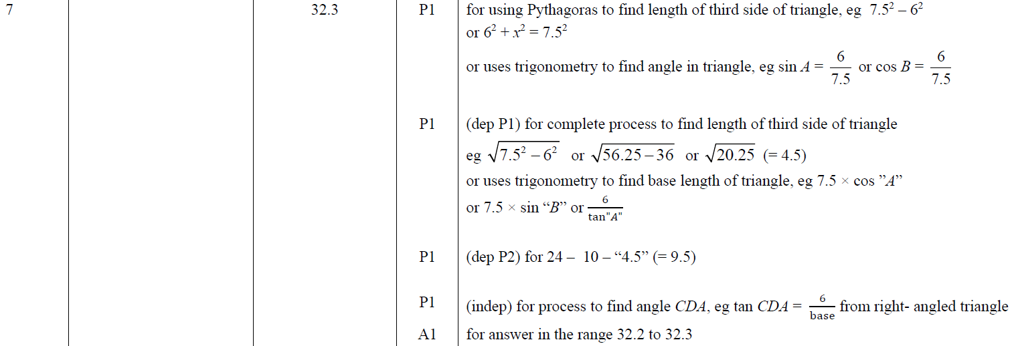
Pythagoras
Nov 2017 2H Q7
A

Slide 24
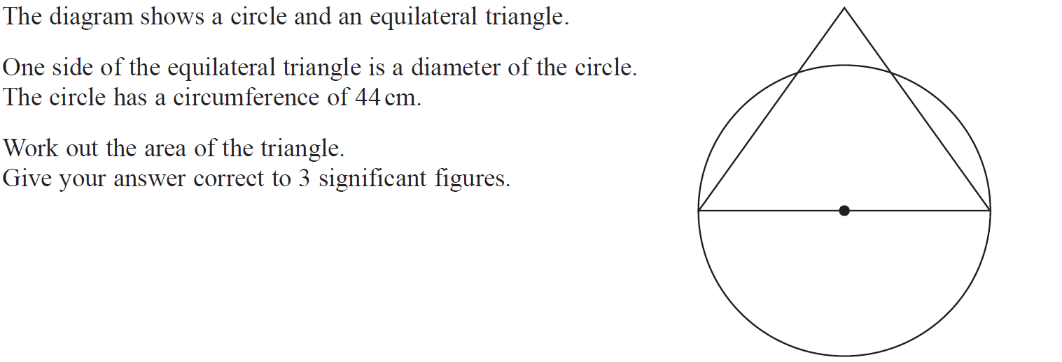
Pythagoras
Nov 2018 2H Q13

Slide 25
Pythagoras
Nov 2018 2H Q13
A

Slide 26
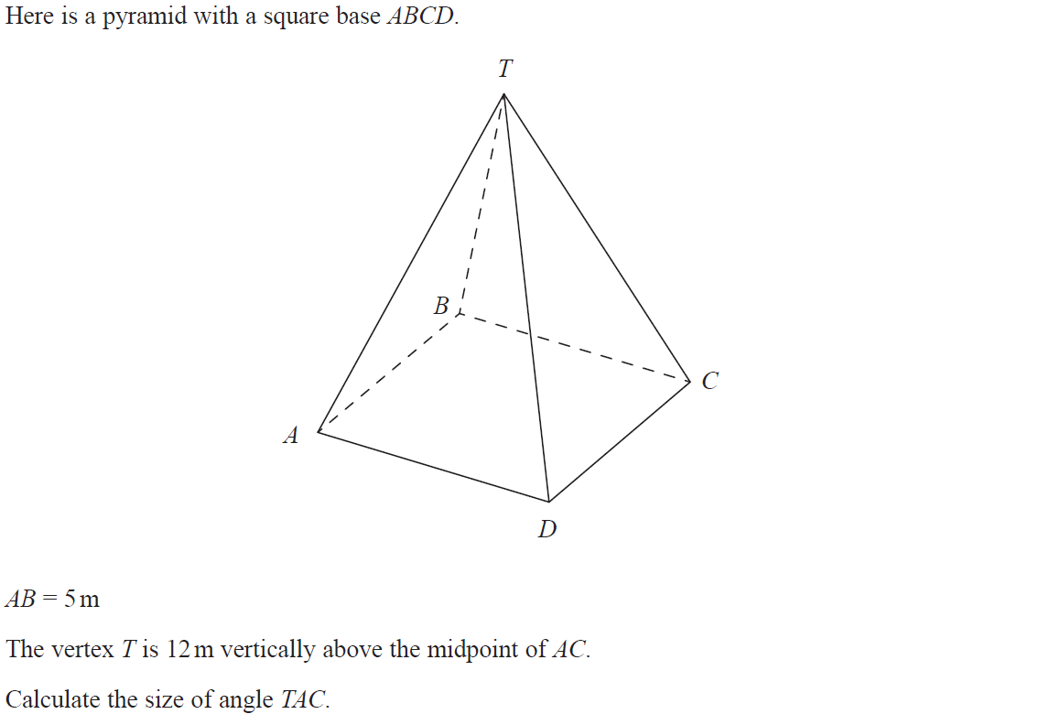
Pythagoras
Nov 2018 3H Q12

Slide 27
Pythagoras
Nov 2018 3H Q12
A

Slide 28
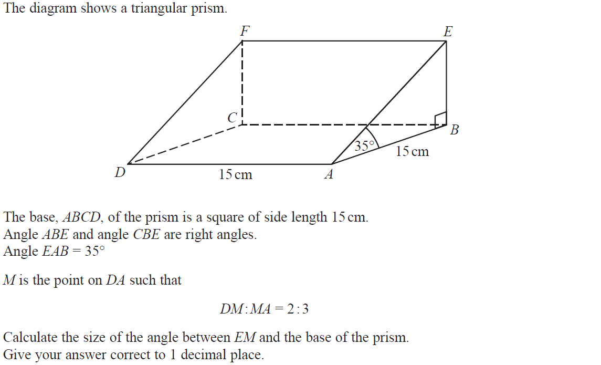
Pythagoras
June 2019 2H Q19

Slide 29
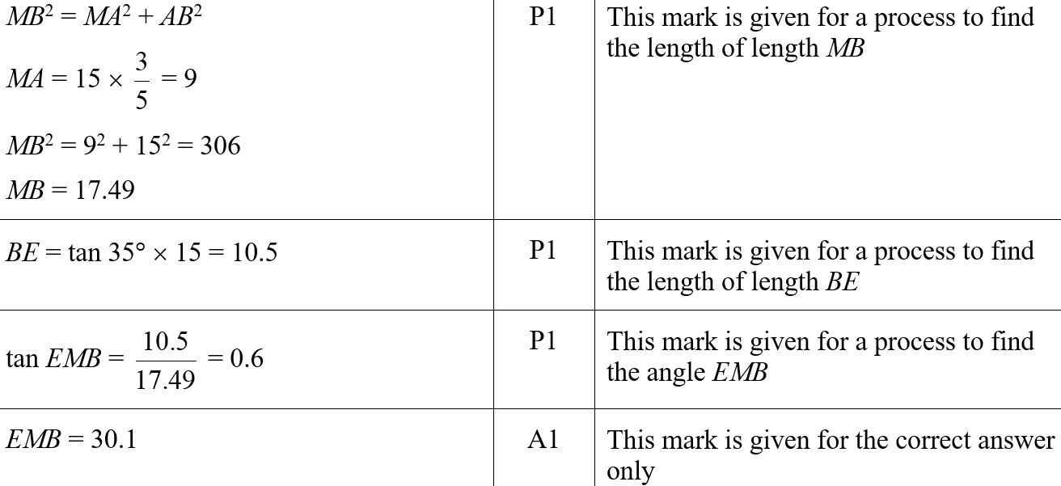
Pythagoras
June 2019 2H Q19
A
A SF

Slide 30
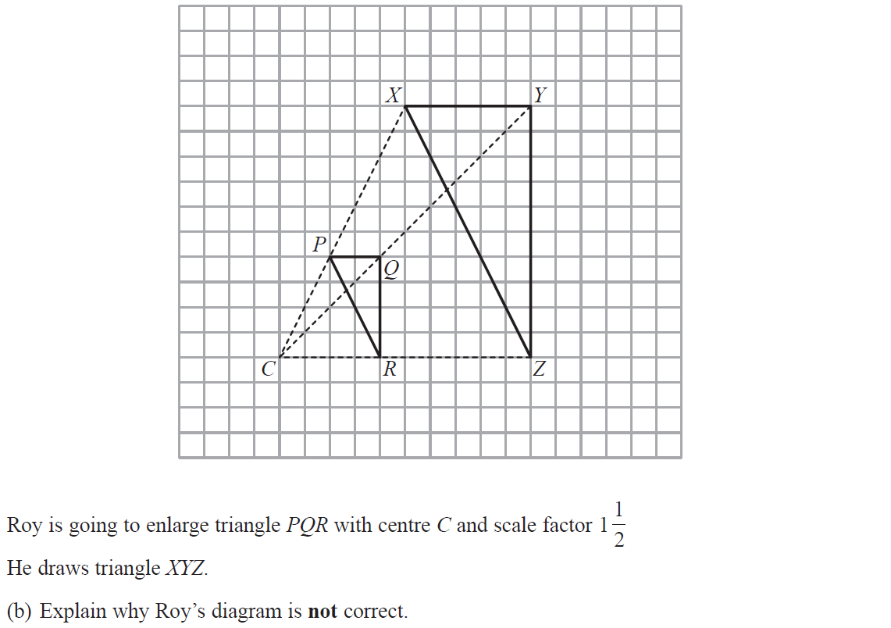
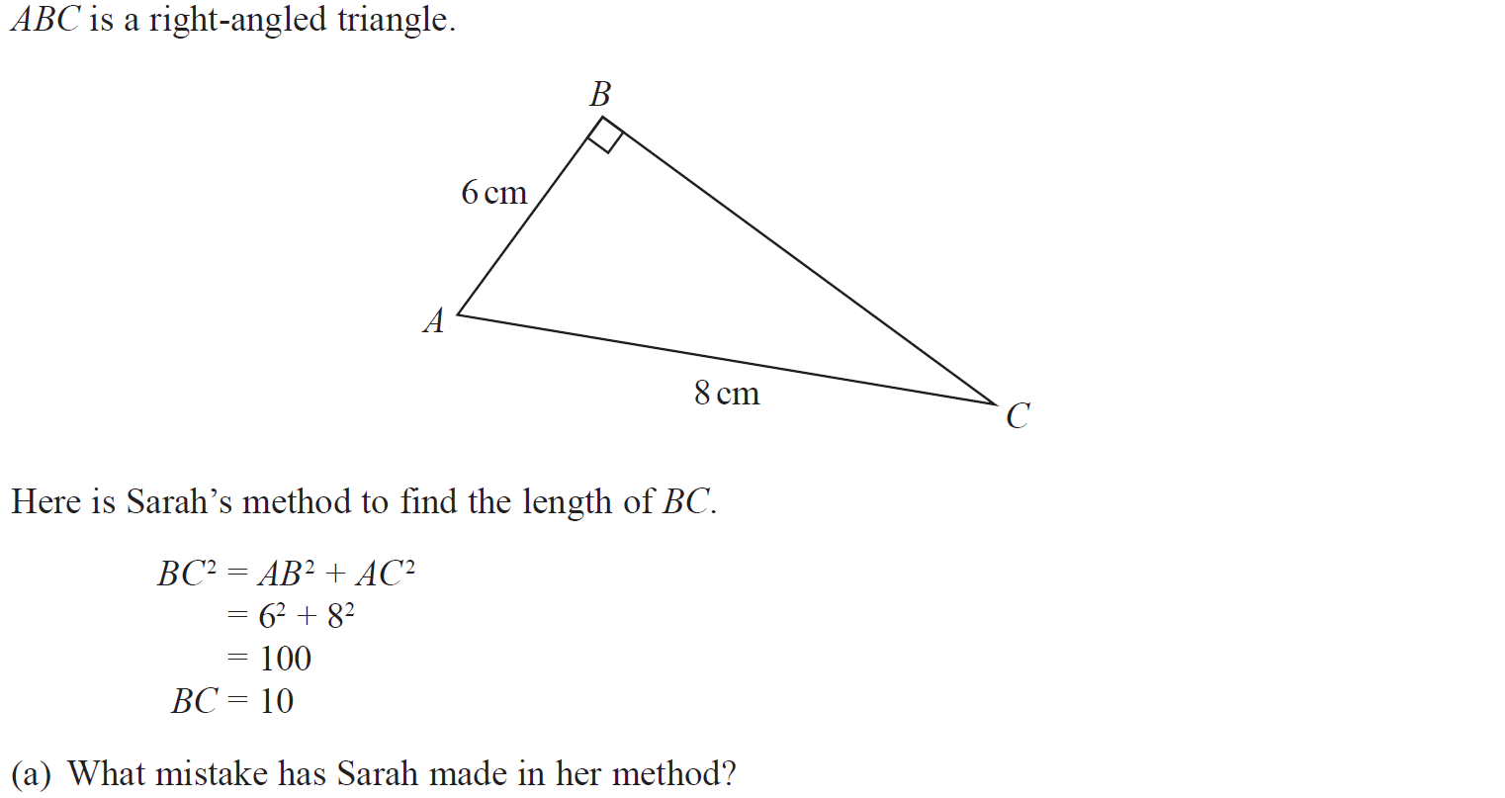
Pythagoras
June 2019 3H Q8

Slide 31
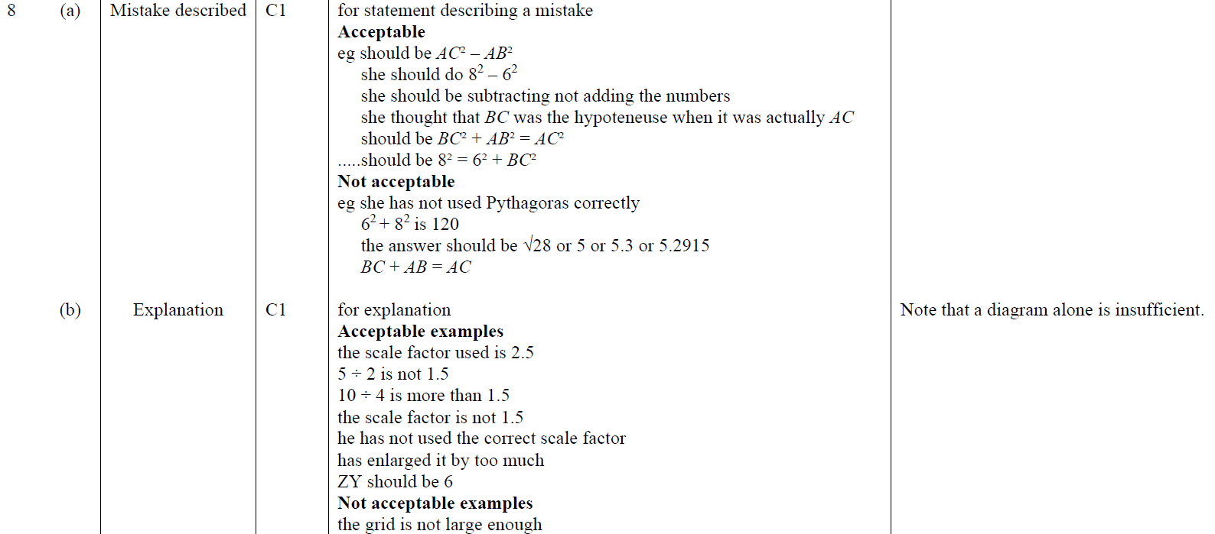
Pythagoras
June 2019 3H Q8
A
B
A SF
B SF

