Slide 1
Properties of Numbers
Properties of Numbers
May 2017
1H Q2
Nov 2017
1H Q1
June 2018
2H Q2
SAM
3H Q6
June 2018
3H Q10
May 2019
1H Q3
June 2019
2H Q17
Prime factors/ HCF/ LCM

Slide 2
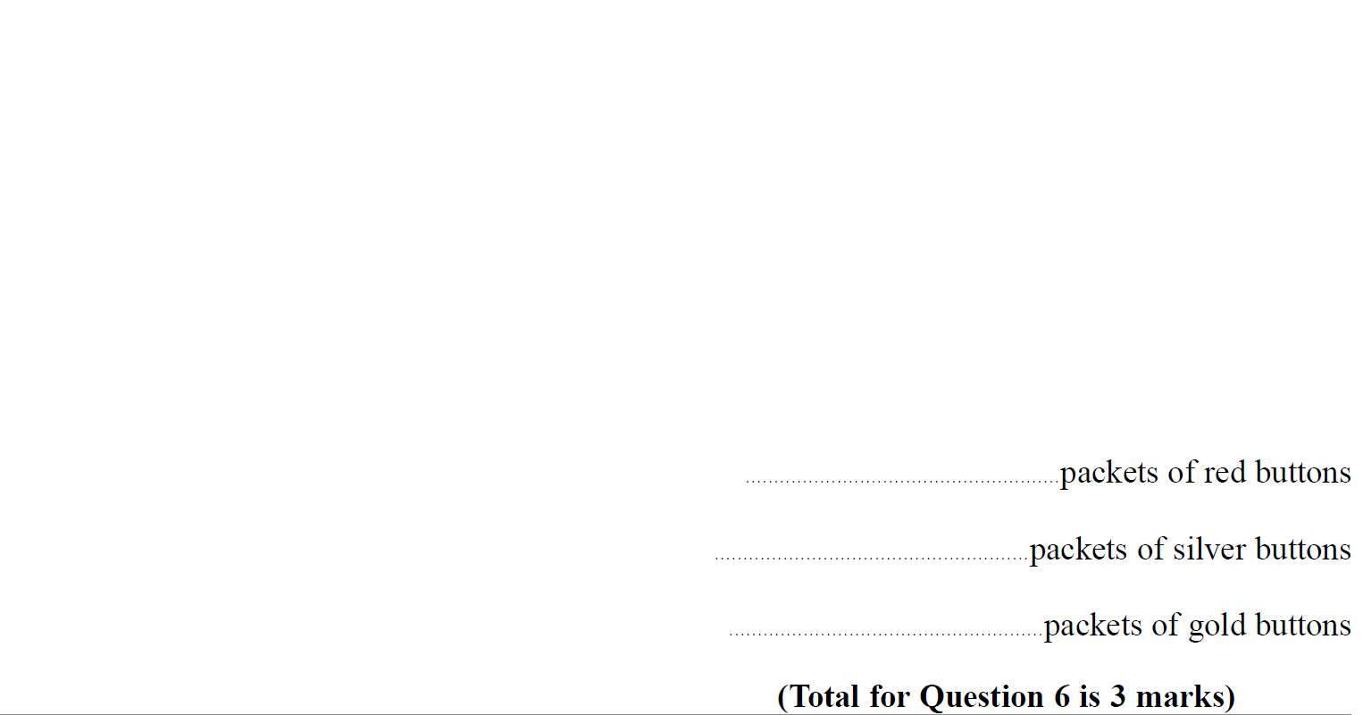
Properties of Numbers
SAM 3H Q6

Slide 3
Properties of Numbers
SAM 3H Q6
A

Slide 4
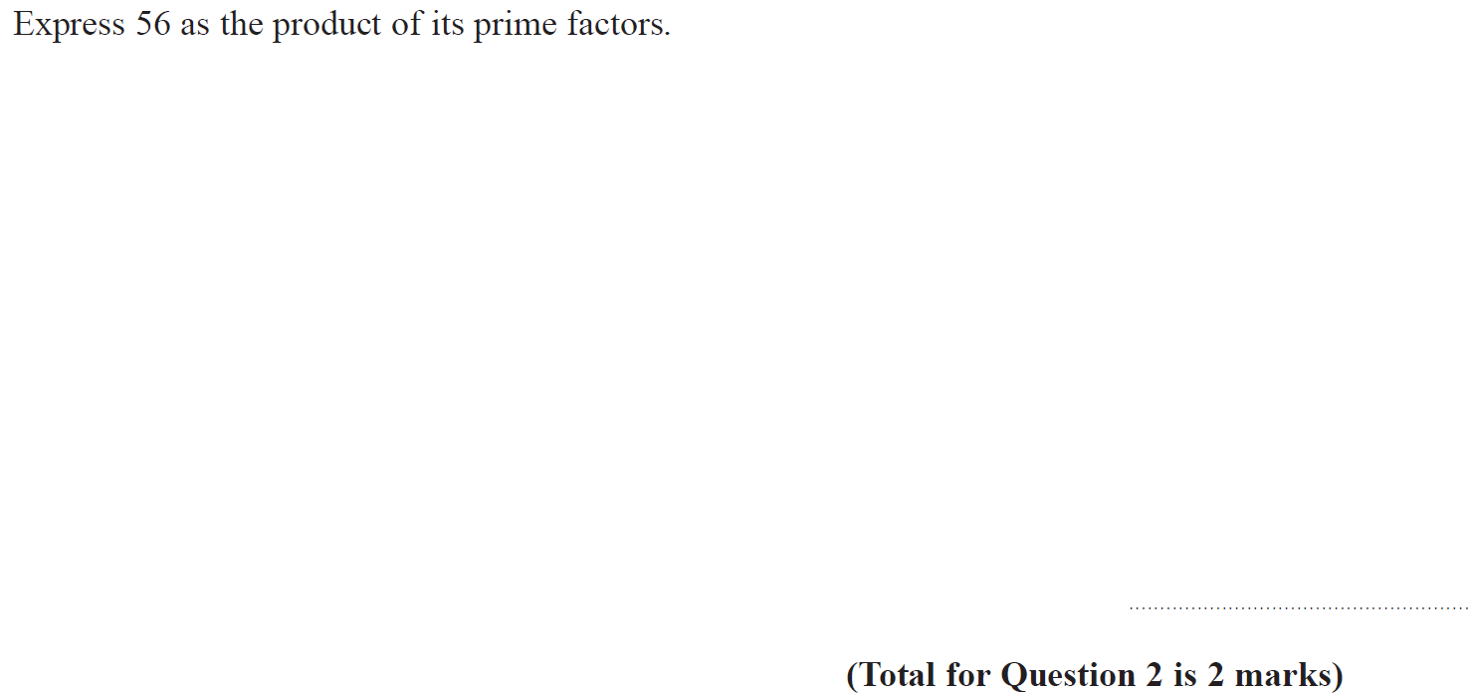
Properties of Numbers
May 2017 1H Q2

Slide 5
Properties of Numbers
May 2017 1H Q2
A

Slide 6
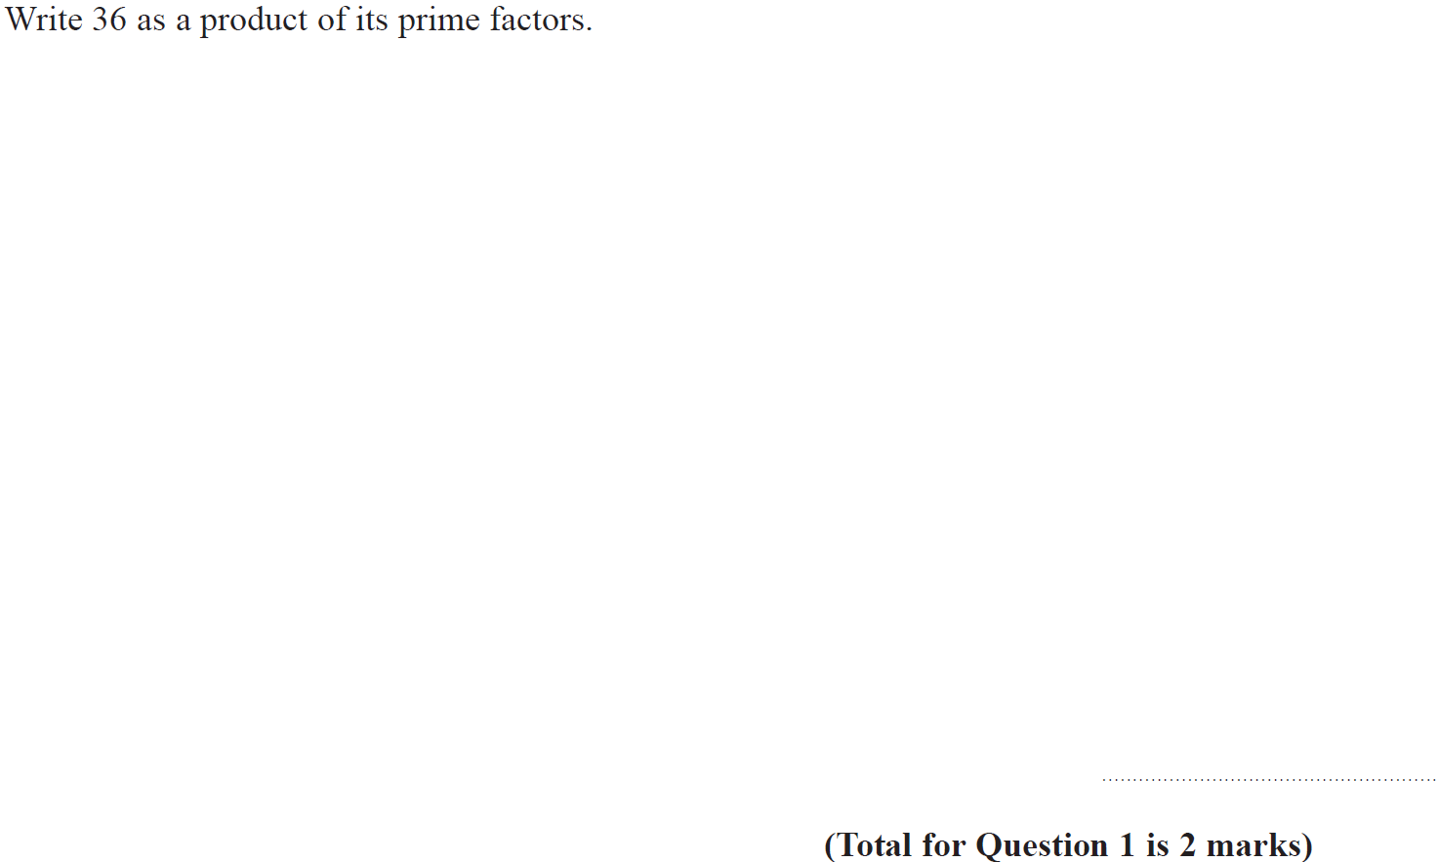
Properties of Numbers
Nov 2017 1H Q1

Slide 7
Properties of Numbers
Nov 2017 1H Q1
A

Slide 8
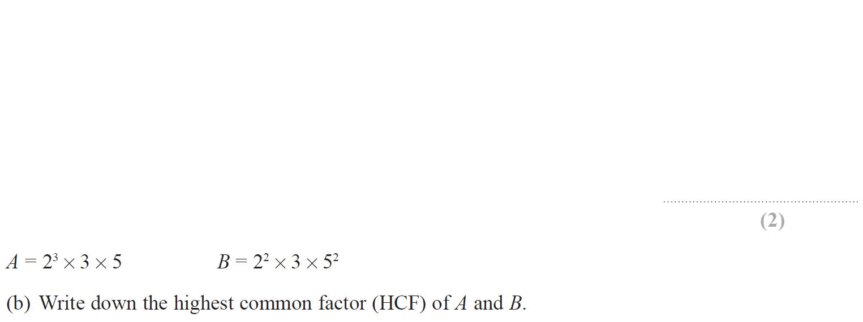
Properties of Numbers
June 2018 2H Q2

Slide 9
Properties of Numbers
June 2018 2H Q2
A
B

Slide 10
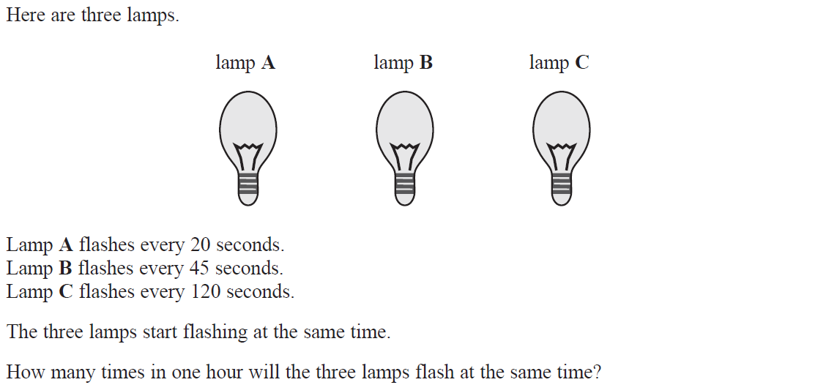
Properties of Numbers
June 2018 3H Q10

Slide 11
Properties of Numbers
June 2018 3H Q10
A

Slide 12
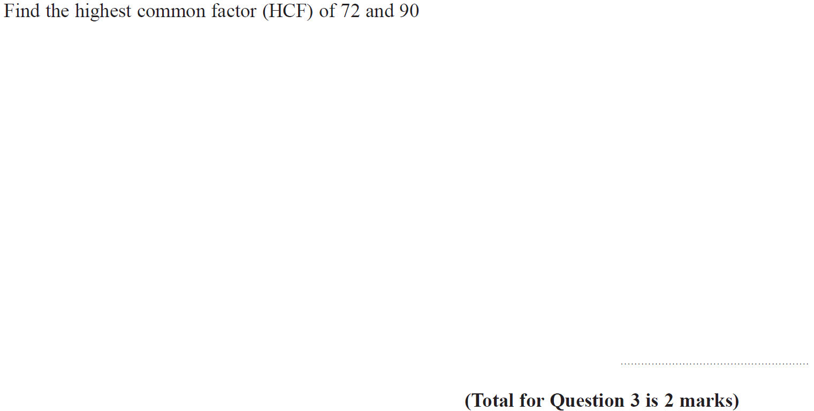
Properties of Numbers
May 2019 1H Q3

Slide 13
Properties of Numbers
May 2019 1H Q3
A
A SF

Slide 14
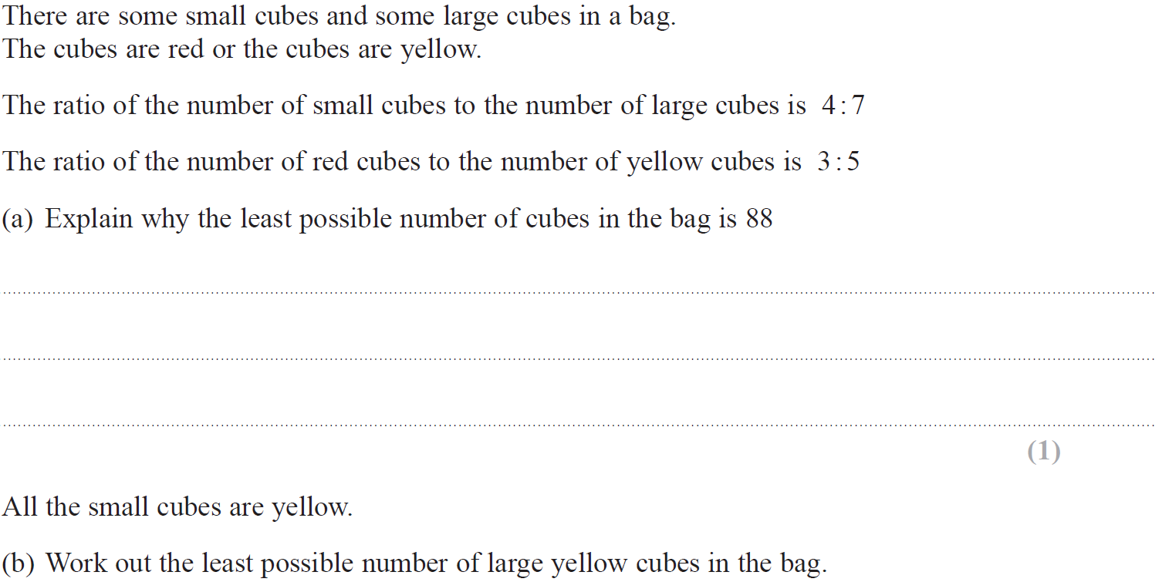
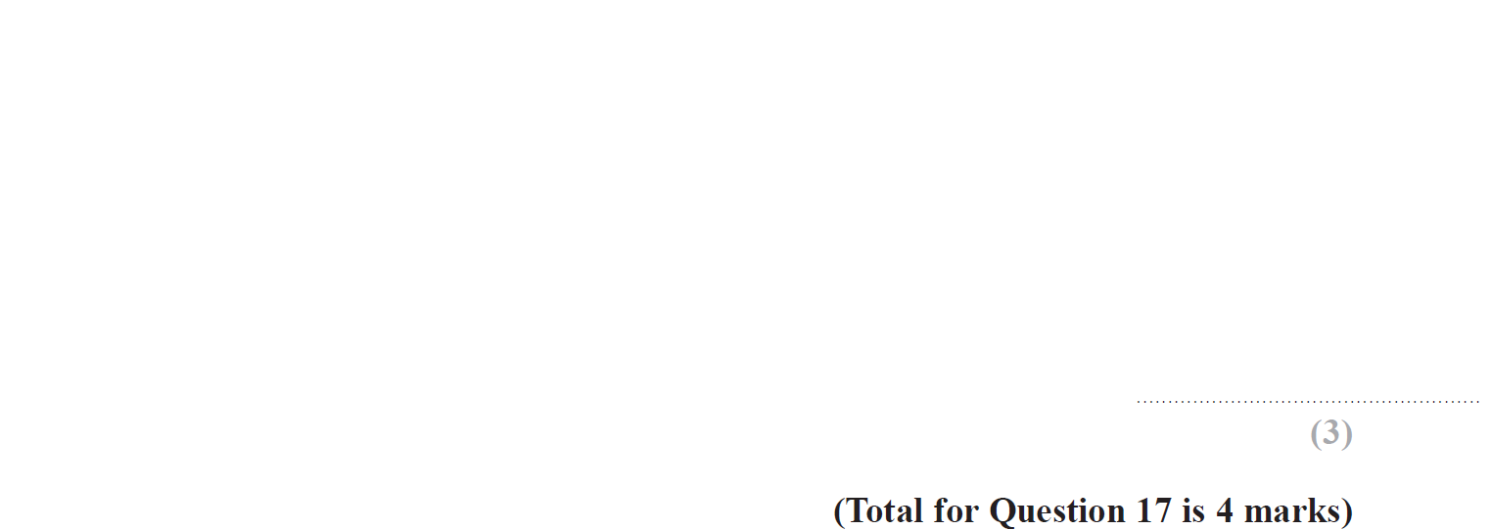
Properties of Numbers
June 2019 2H Q17

Slide 15
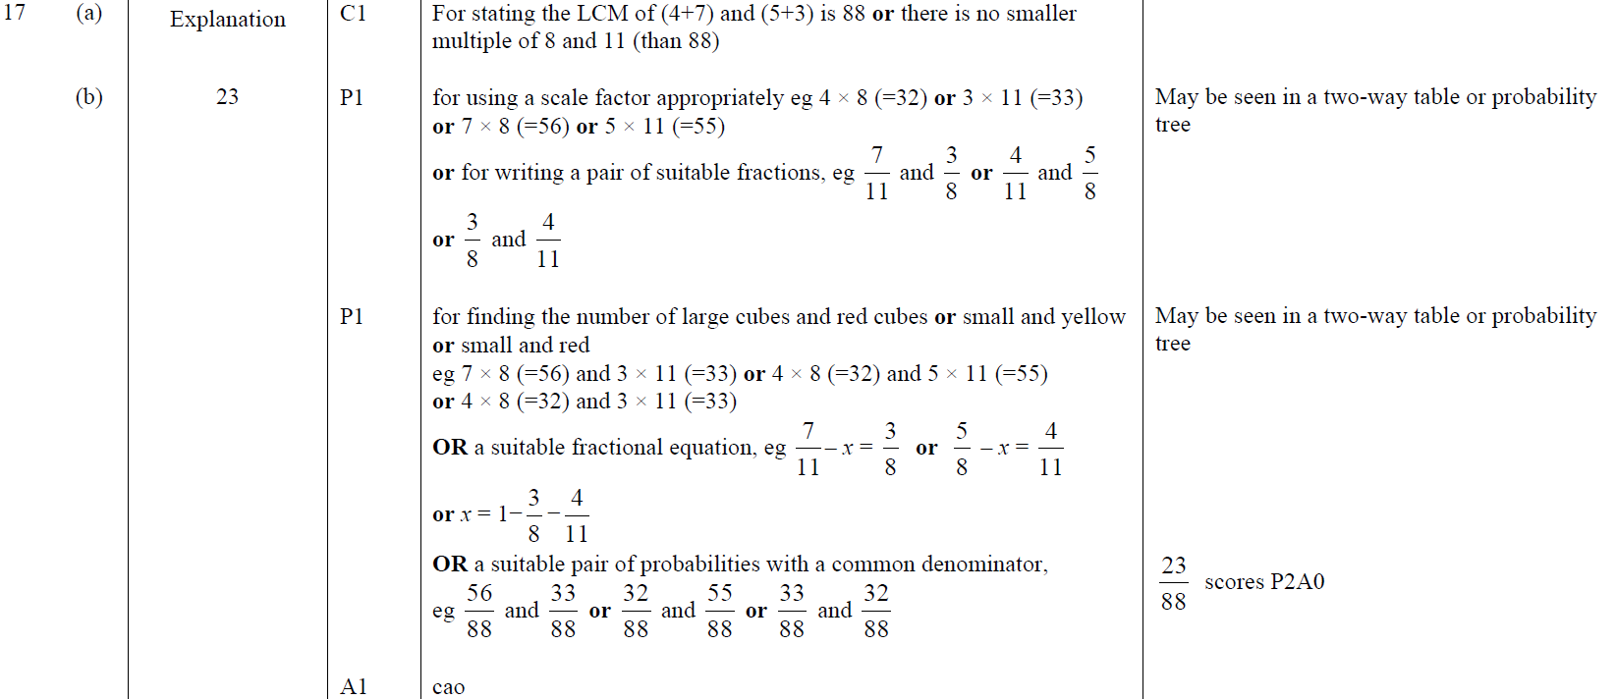
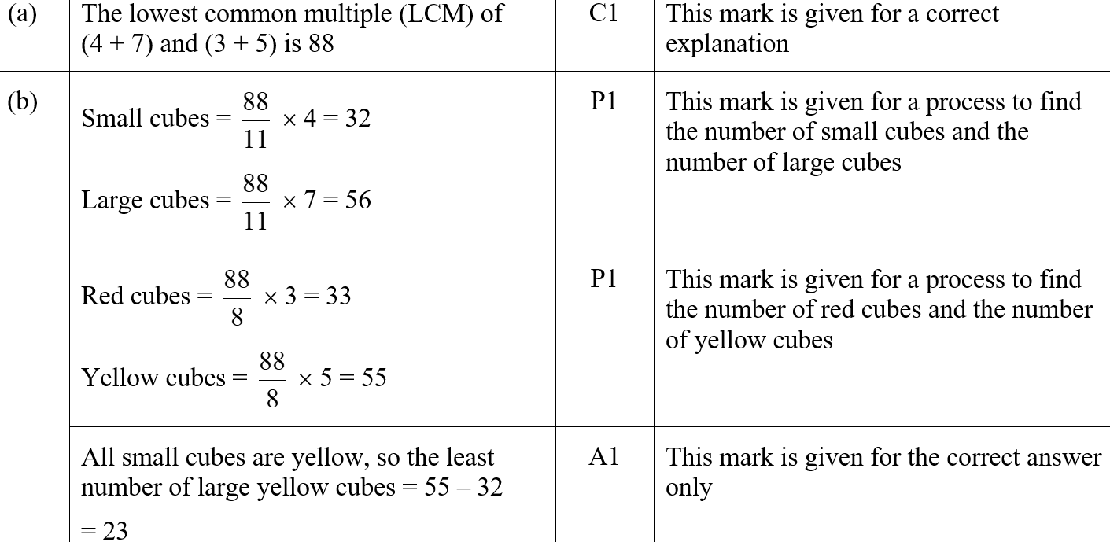
Properties of Numbers
June 2019 2H Q17
A
B
A SF
B SF

