Slide 1
Properties of Numbers
Properties of Numbers
May 2017
1H Q2
Nov 2017
1H Q1
Edexcel
June 2018
2H Q2
AQA
SAM
3H Q6
June 2018
3H Q10
OCR
May 2019
1H Q3
June 2019
2H Q17
Prime factors/ HCF/ LCM

Slide 2
Properties of Numbers
Properties of Numbers
May 2017
1H Q5
June 2018
3H Q5
Edexcel
SAM
2H Q9
June 2017
2H Q13
Nov 2018
2H Q17
AQA
SAM
2H Q18
Nov 2017
3H Q6
1 Marker
Nov 2018
3H Q4
OCR
SAM
3H Q12
Nov 2017
3H Q15
Nov 2018
3H Q7
Nov 2017
3H Q26
Prime factors/ HCF/ LCM

Slide 3
Properties of Numbers
Properties of Numbers
May 2017
1H Q3
SAM
1H Q11
Edexcel
Nov 2017
2H Q3
SAM
2H Q7
AQA
Nov 2017
3H Q2
SAM
2H Q16
OCR
May 2018
1H Q3
SAM
3H Q3
Nov 2018
1H Q8
Prime factors/ HCF/ LCM

Slide 4
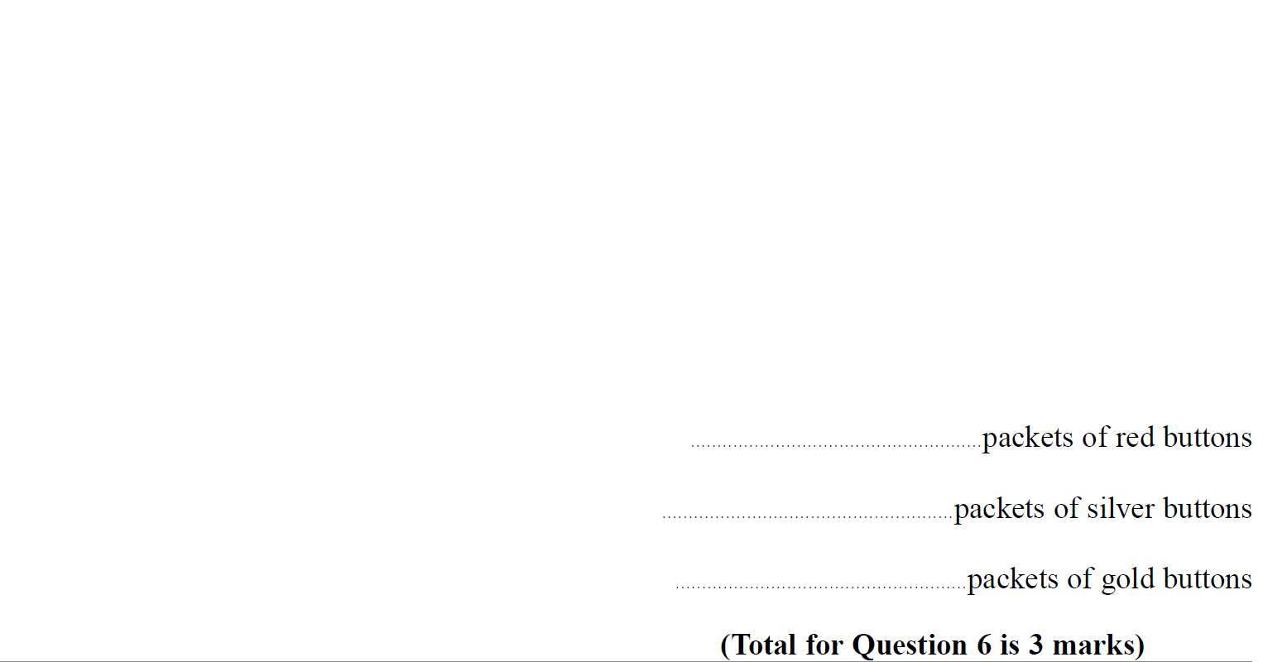
Properties of Numbers
SAM 3H Q6

Slide 5
Properties of Numbers
SAM 3H Q6
A

Slide 6
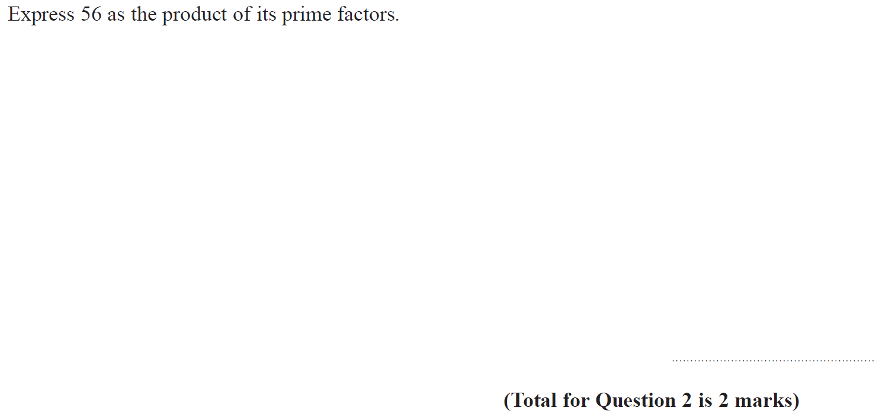
Properties of Numbers
May 2017 1H Q2

Slide 7
Properties of Numbers
May 2017 1H Q2
A

Slide 8
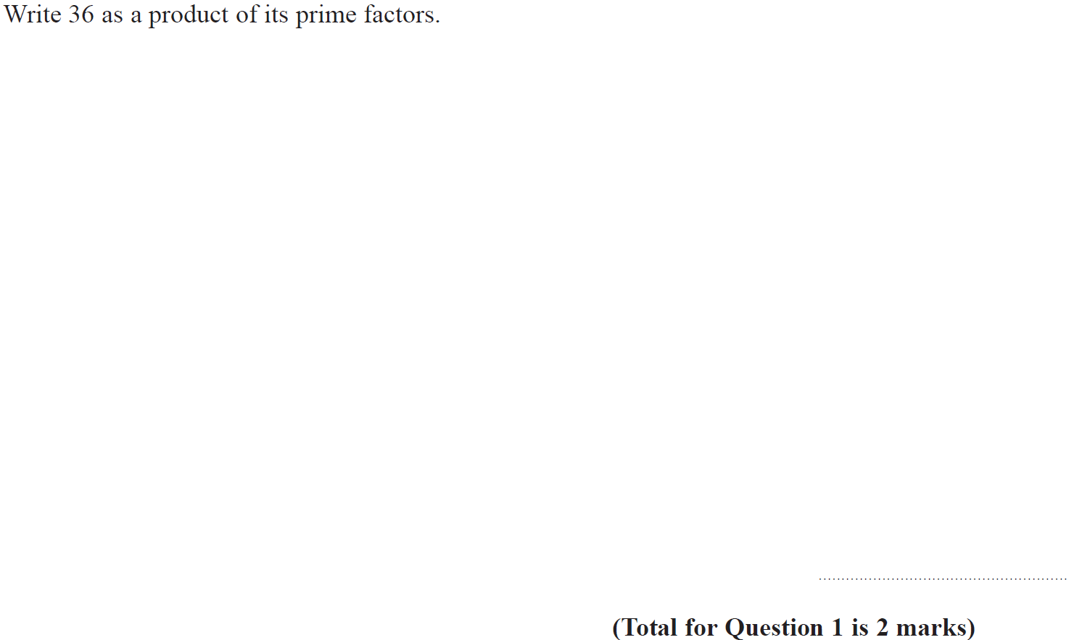
Properties of Numbers
Nov 2017 1H Q1

Slide 9
Properties of Numbers
Nov 2017 1H Q1
A

Slide 10
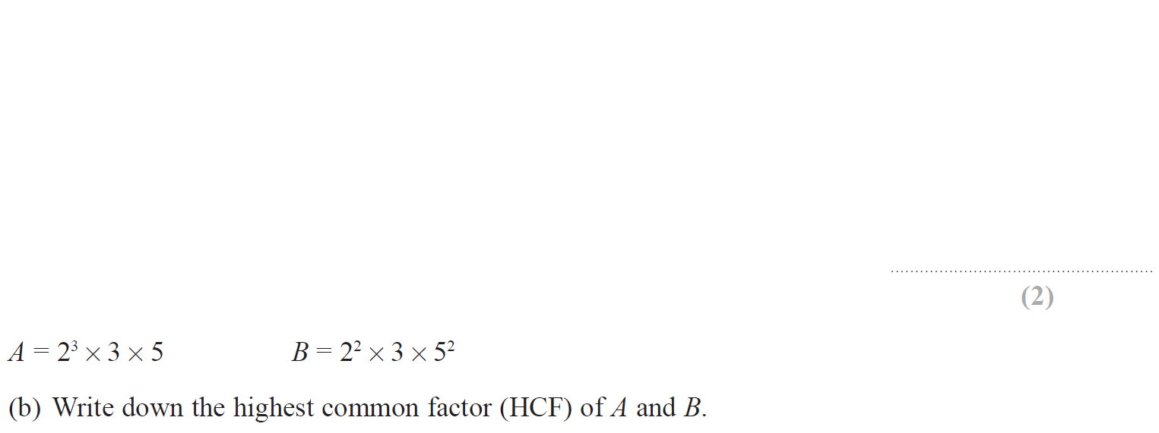
Properties of Numbers
June 2018 2H Q2

Slide 11
Properties of Numbers
June 2018 2H Q2
A
B

Slide 12
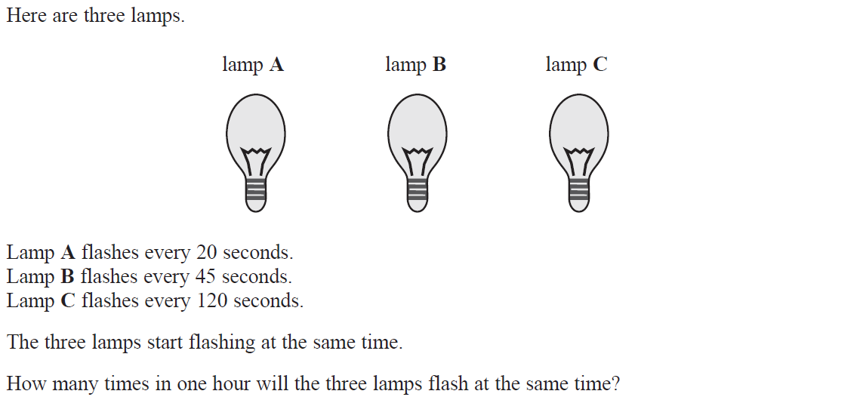
Properties of Numbers
June 2018 3H Q10

Slide 13
Properties of Numbers
June 2018 3H Q10
A

Slide 14
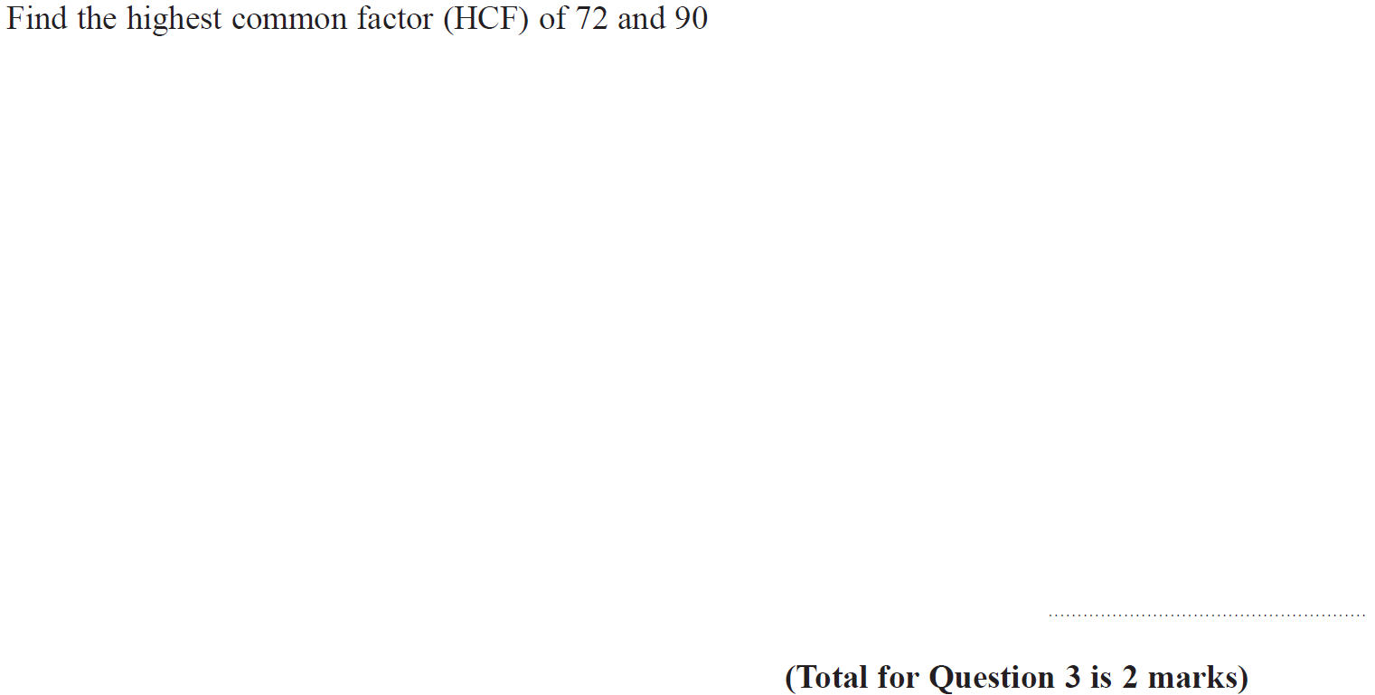
Properties of Numbers
May 2019 1H Q3

Slide 15
Properties of Numbers
May 2019 1H Q3
A
A SF

Slide 16
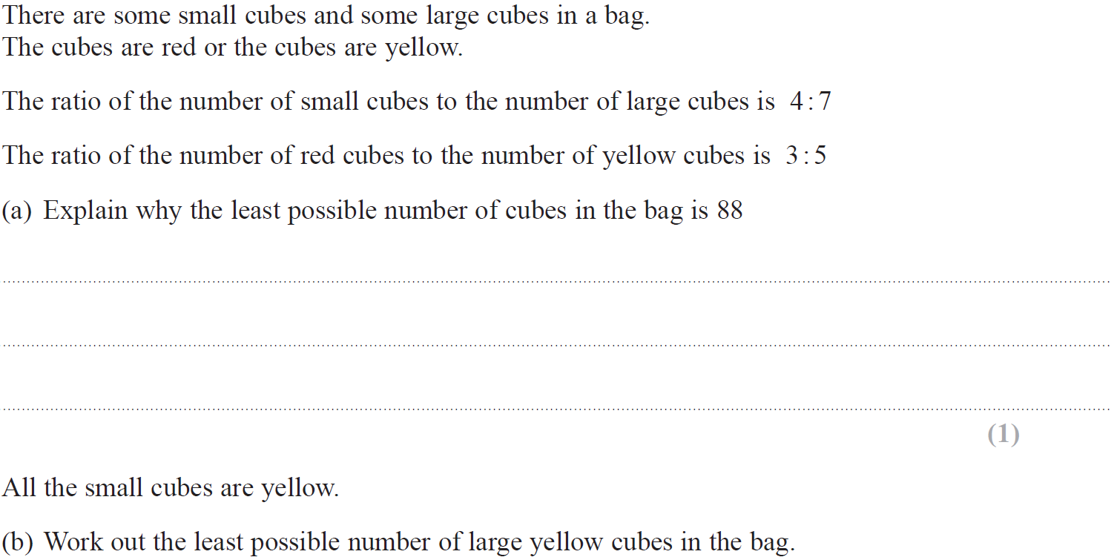
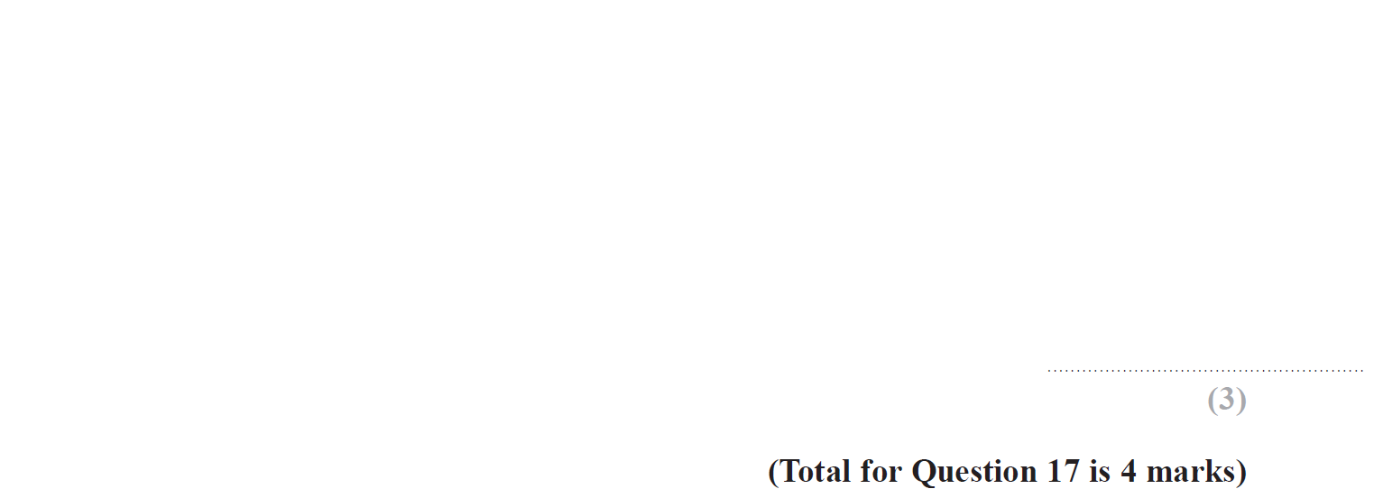
Properties of Numbers
June 2019 2H Q17

Slide 17
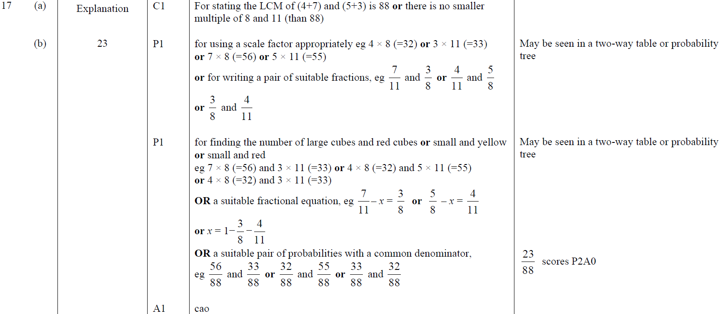
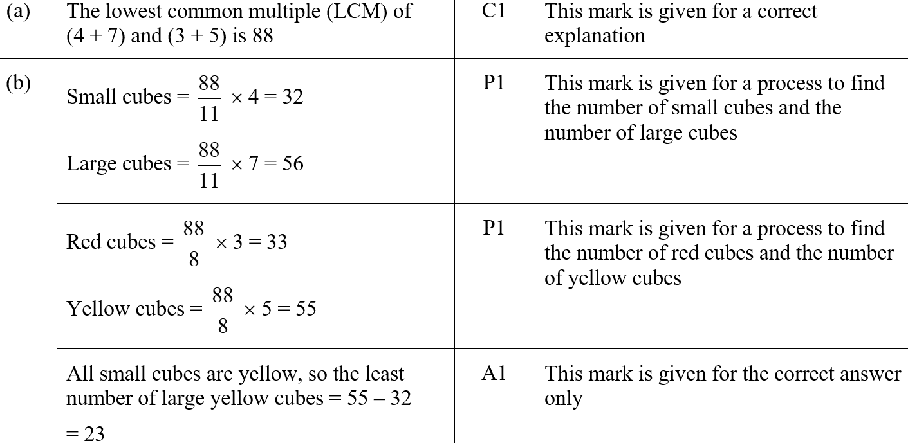
Properties of Numbers
June 2019 2H Q17
A
B
A SF
B SF

Slide 18
Properties of Numbers
SAM 2H Q9

Slide 19
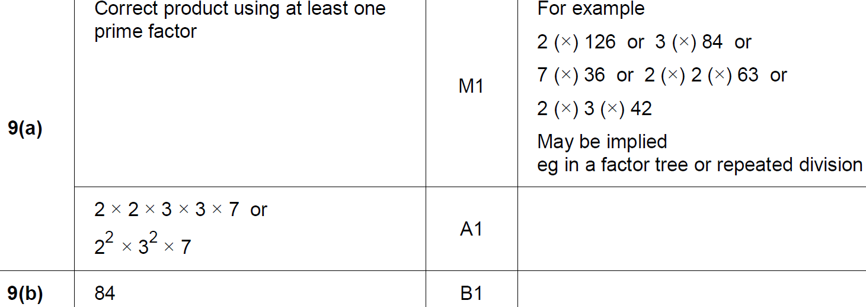
Properties of Numbers
SAM 2H Q9
A
B

Slide 20
Properties of Numbers
SAM 2H Q18

Slide 21
Properties of Numbers
SAM 2H Q18
A
B

Slide 22
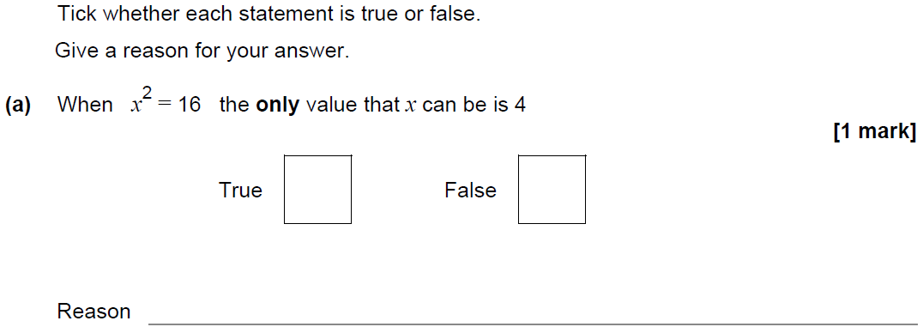
Properties of Numbers
SAM 3H Q12

Slide 23
Properties of Numbers
SAM 3H Q12
A
B
C

Slide 24
Properties of Numbers
May 2017 1H Q5

Slide 25
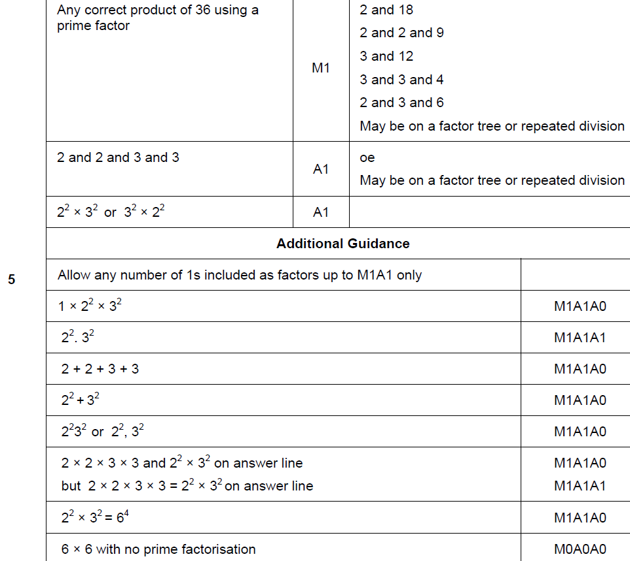
Properties of Numbers
May 2017 1H Q5
A

Slide 26
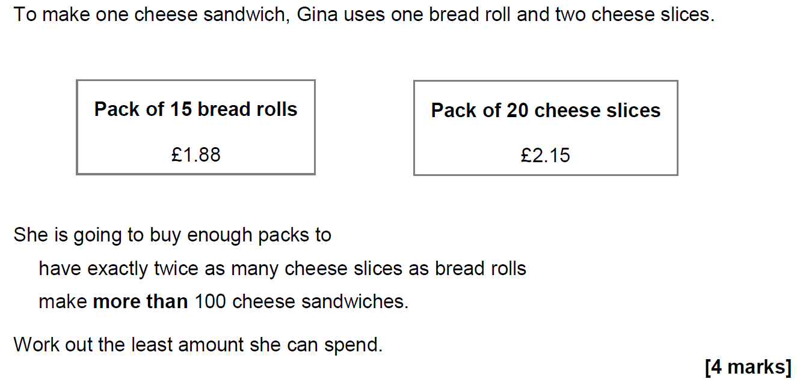
Properties of Numbers
June 2017 2H Q13

Slide 27
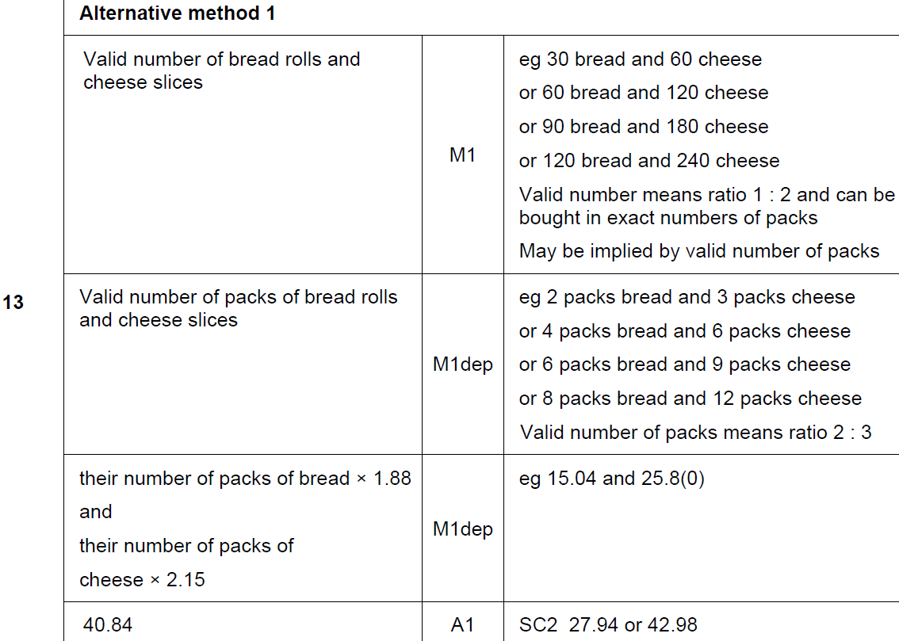
Properties of Numbers
June 2017 2H Q13
A

Slide 28
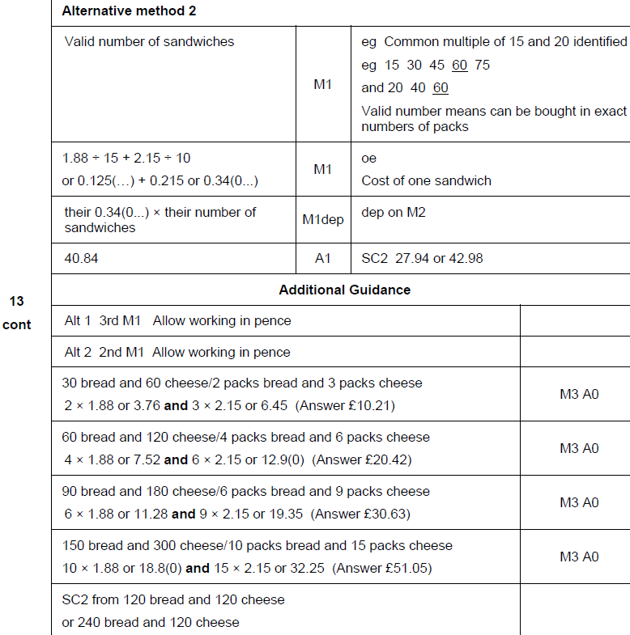
Properties of Numbers
June 2017 2H Q13
A Alternative & notes

Slide 29
Properties of Numbers
Nov 2017 3H Q6

Slide 30
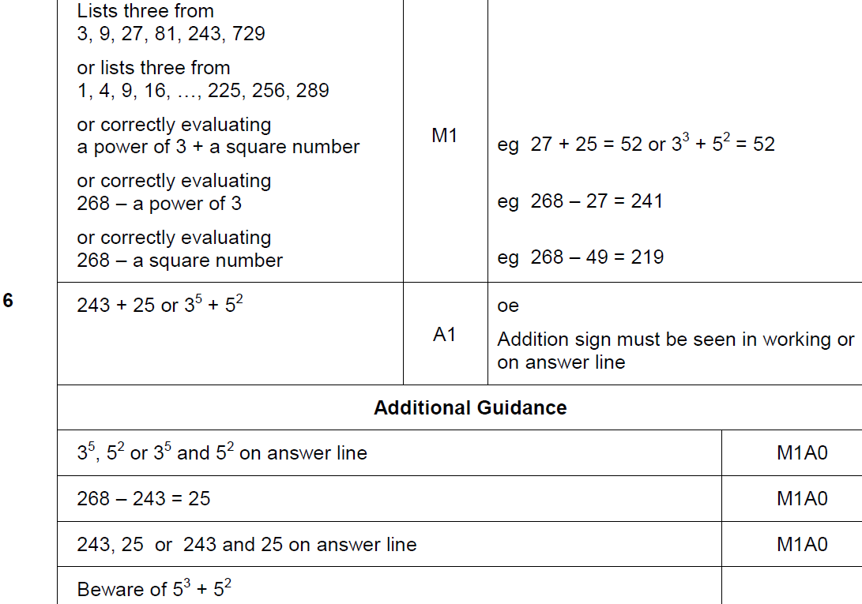
Properties of Numbers
Nov 2017 3H Q6
A

Slide 31
Properties of Numbers
Nov 2017 3H Q15

Slide 32
Properties of Numbers
Nov 2017 3H Q15
A

Slide 33
Properties of Numbers
Nov 2017 3H Q26

Slide 34
Properties of Numbers
Nov 2017 3H Q26
A

Slide 35
Properties of Numbers
June 2018 3H Q5

Slide 36
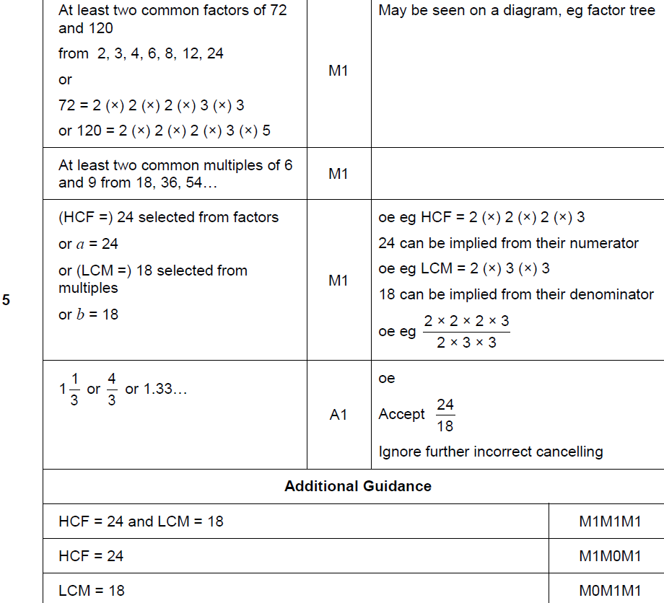
Properties of Numbers
June 2018 3H Q5
A

Slide 37
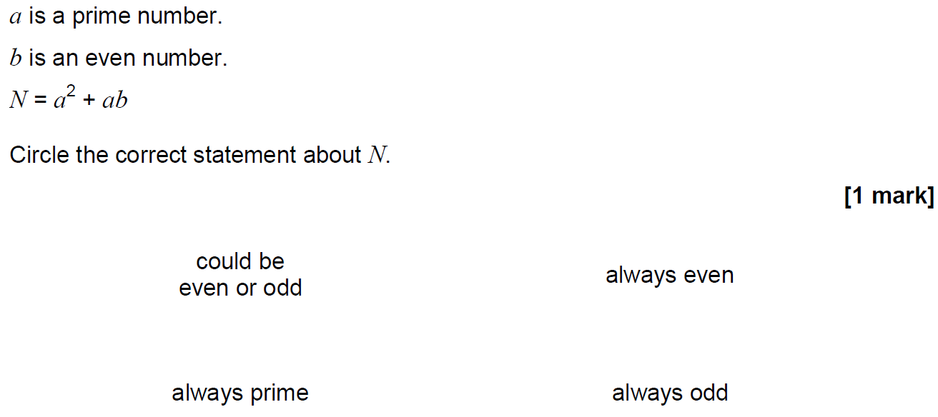
Properties of Numbers
Nov 2018 2H Q17

Slide 38
Properties of Numbers
Nov 2018 2H Q17
A

Slide 39
Properties of Numbers
Nov 2018 3H Q4

Slide 40
Properties of Numbers
Nov 2018 3H Q4
A

Slide 41
Properties of Numbers
Nov 2018 3H Q7

Slide 42
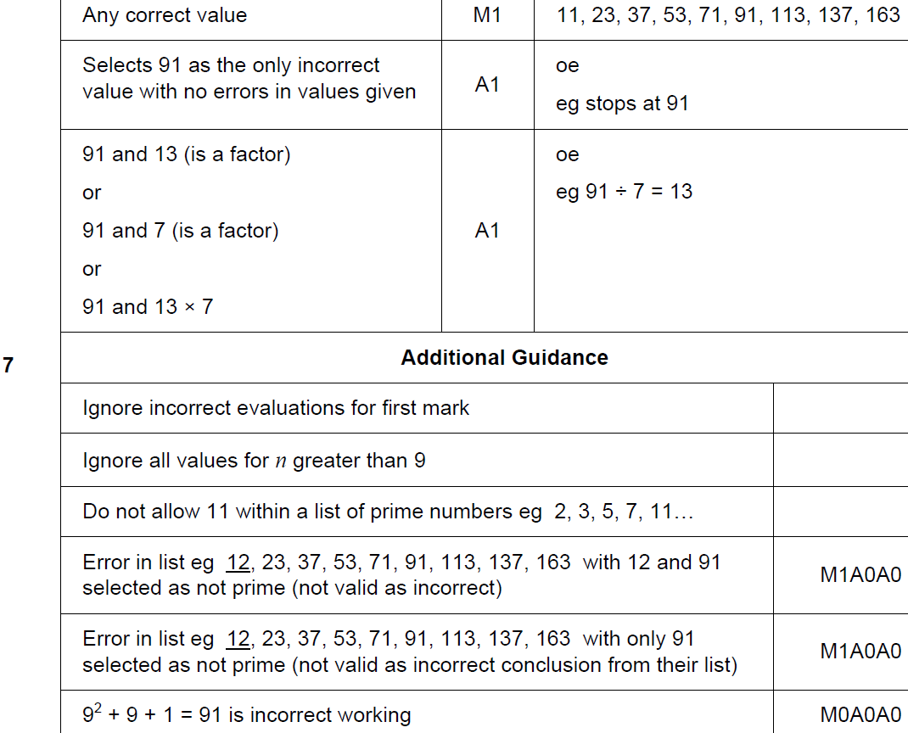
Properties of Numbers
Nov 2018 3H Q7
A

Slide 43
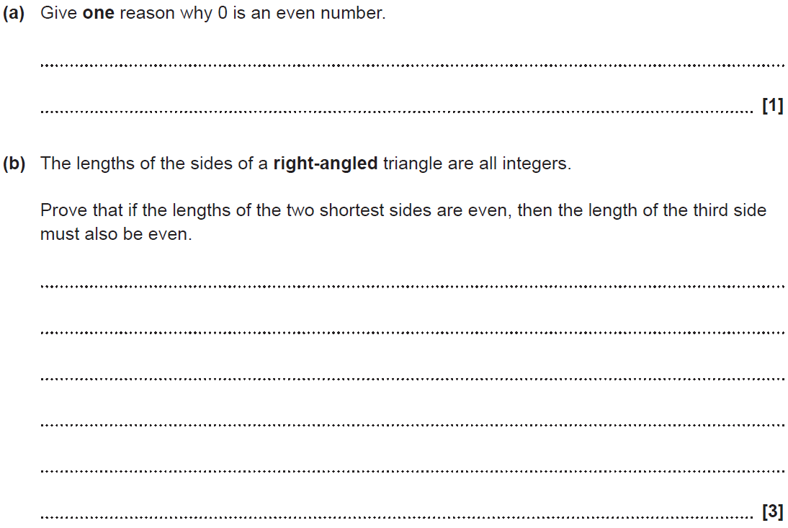
Properties of Numbers
SAM 1H Q11

Slide 44
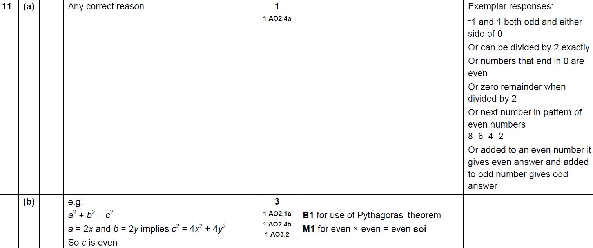
Properties of Numbers
SAM 1H Q11
A
B

Slide 45
Properties of Numbers
SAM 2H Q7

Slide 46
Properties of Numbers
SAM 2H Q7
A

Slide 47
Properties of Numbers
SAM 2H Q16

Slide 48
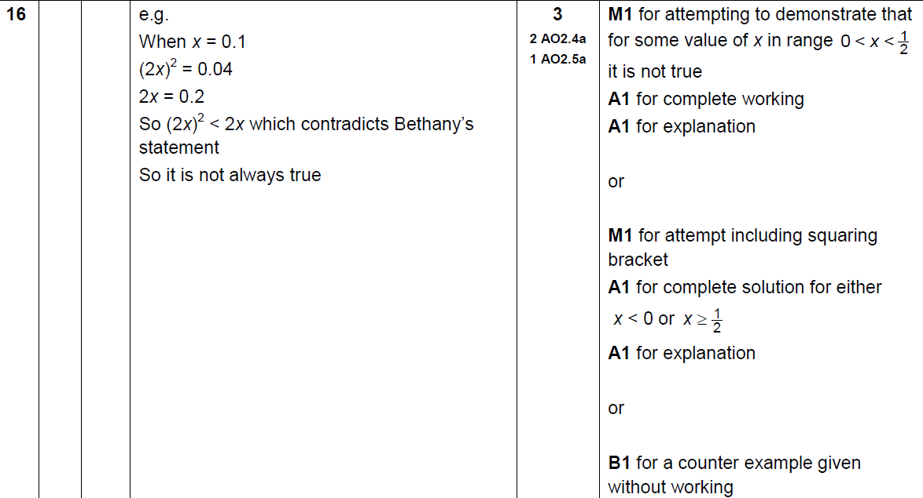
Properties of Numbers
SAM 2H Q16
A

Slide 49
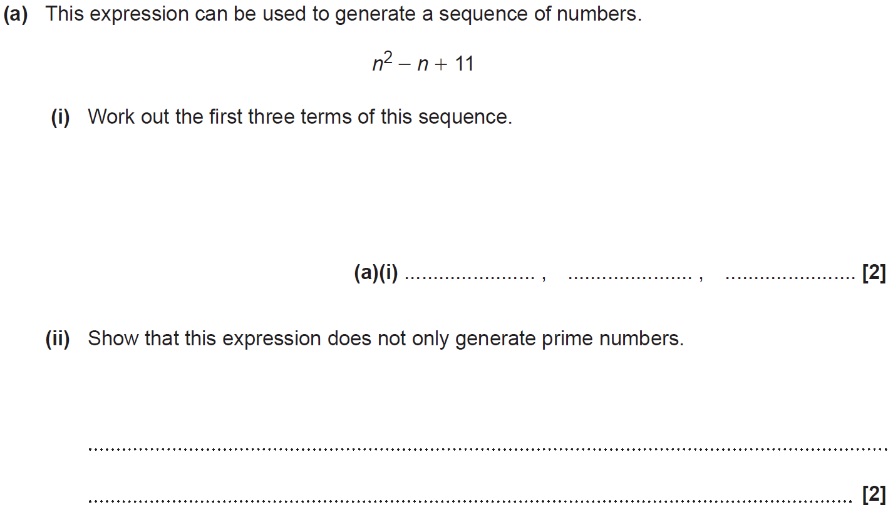
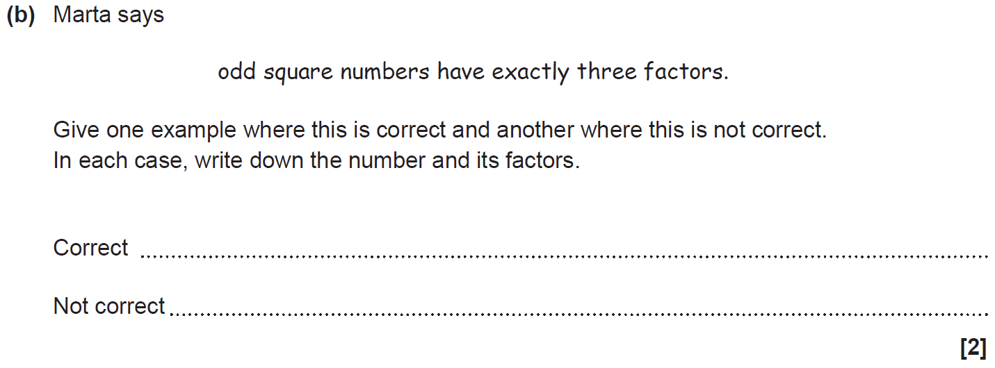
Properties of Numbers
SAM 3H Q3

Slide 50
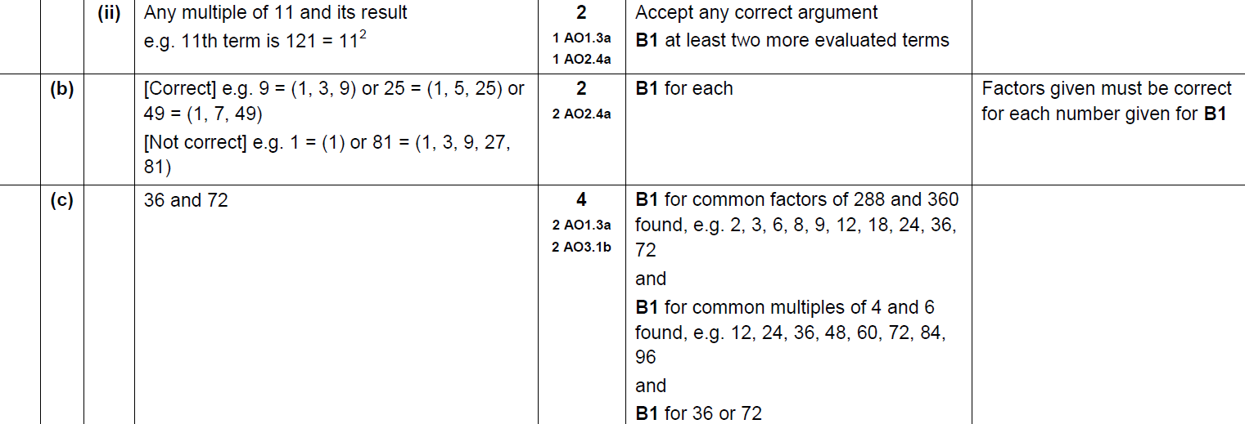
Properties of Numbers
SAM 3H Q3
A (i)
A (ii)
B
C

Slide 51
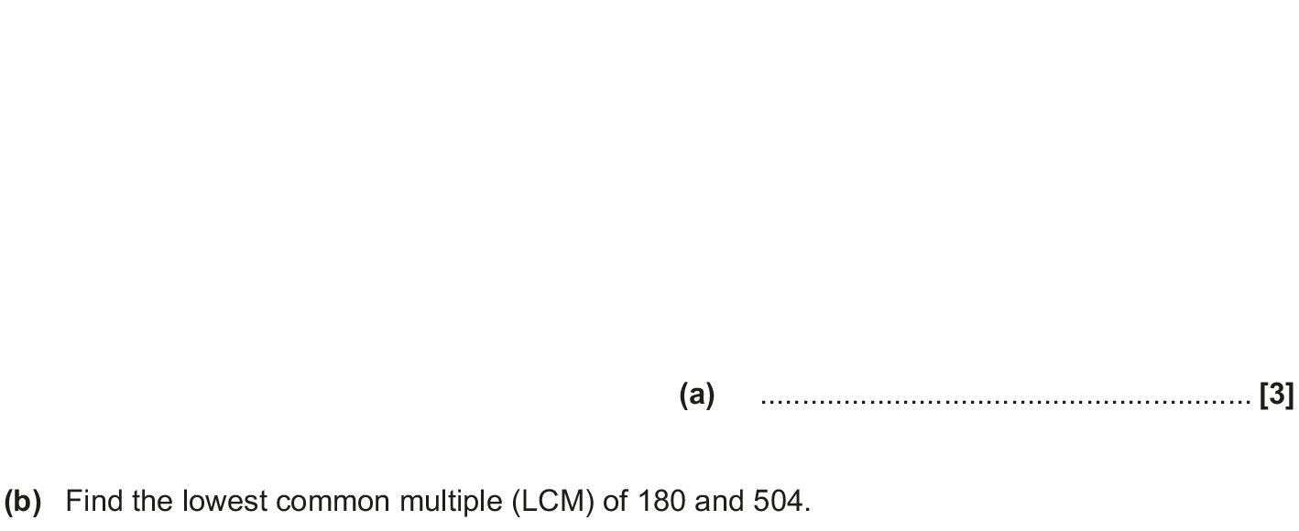
Properties of Numbers
May 2017 1H Q3

Slide 52
Properties of Numbers
May 2017 1H Q3
A
B

Slide 53
Properties of Numbers
Nov 2017 2H Q3

Slide 54
Properties of Numbers
Nov 2017 2H Q3
A

Slide 55
Properties of Numbers
Nov 2017 3H Q2

Slide 56
Properties of Numbers
Nov 2017 3H Q2
A

Slide 57
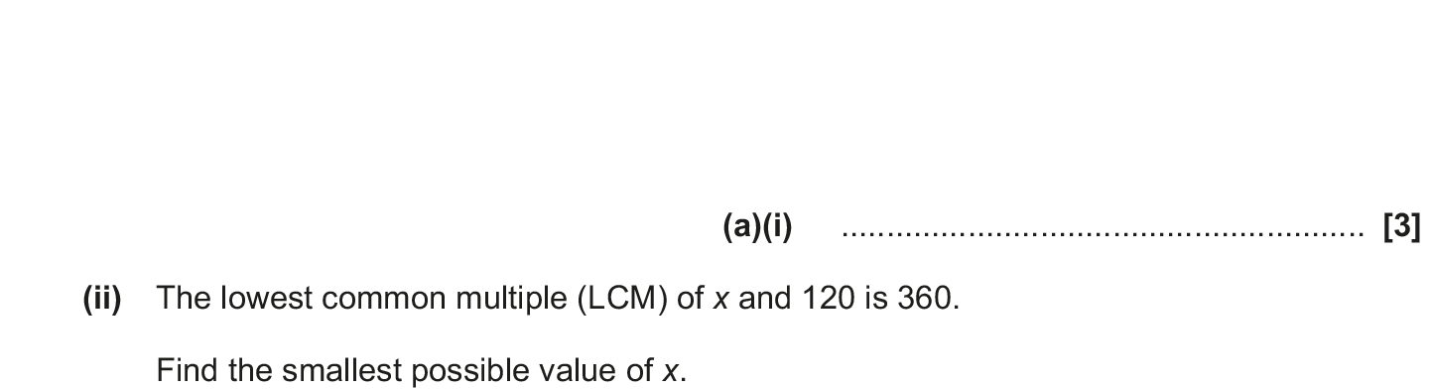
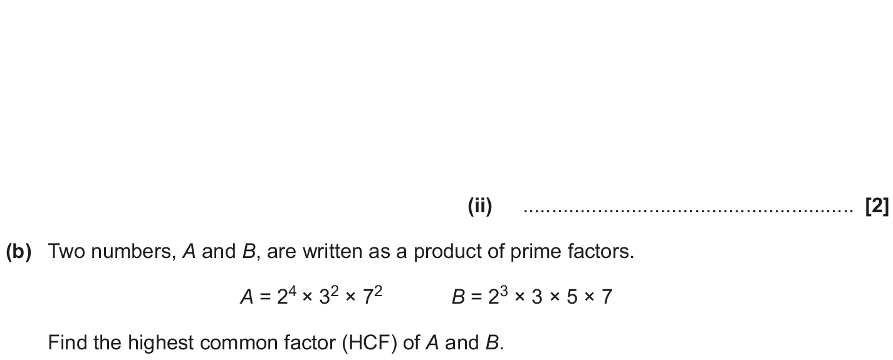
Properties of Numbers
May 2018 1H Q3

Slide 58
Properties of Numbers
May 2018 1H Q3
A (i)
A (ii)
B

Slide 59
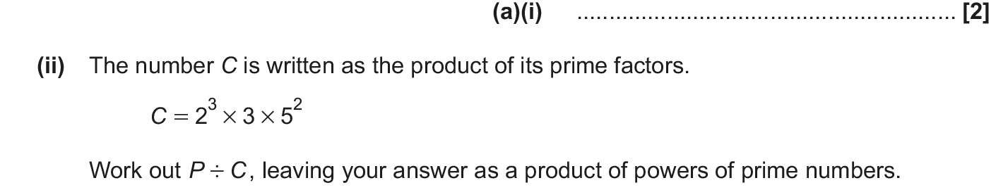
Properties of Numbers
Nov 2018 1H Q8

Slide 60
Properties of Numbers
Nov 2018 1H Q8
A (i)
A (ii)
B (i)
B (ii)

