Slide 1
Properties of Numbers
Properties of Numbers
May 2017
1H Q3
SAM
1H Q11
Nov 2017
2H Q3
SAM
2H Q7
Nov 2017
3H Q2
SAM
2H Q16
May 2018
1H Q3
SAM
3H Q3
Nov 2018
1H Q8
Prime factors/ HCF/ LCM

Slide 2
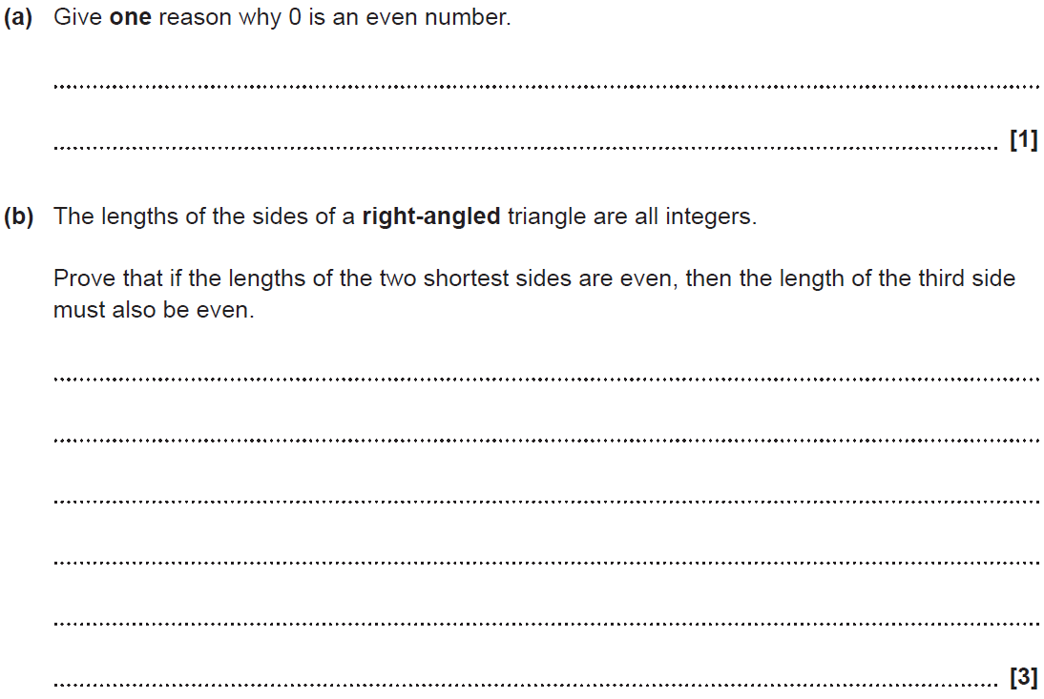
Properties of Numbers
SAM 1H Q11

Slide 3
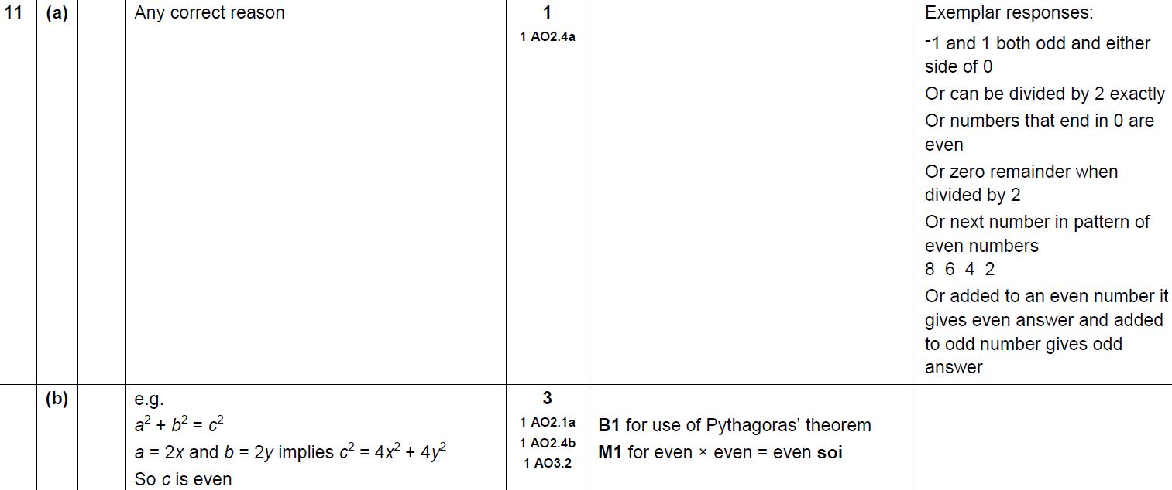
Properties of Numbers
SAM 1H Q11
A
B

Slide 4
Properties of Numbers
SAM 2H Q7

Slide 5
Properties of Numbers
SAM 2H Q7
A

Slide 6
Properties of Numbers
SAM 2H Q16

Slide 7
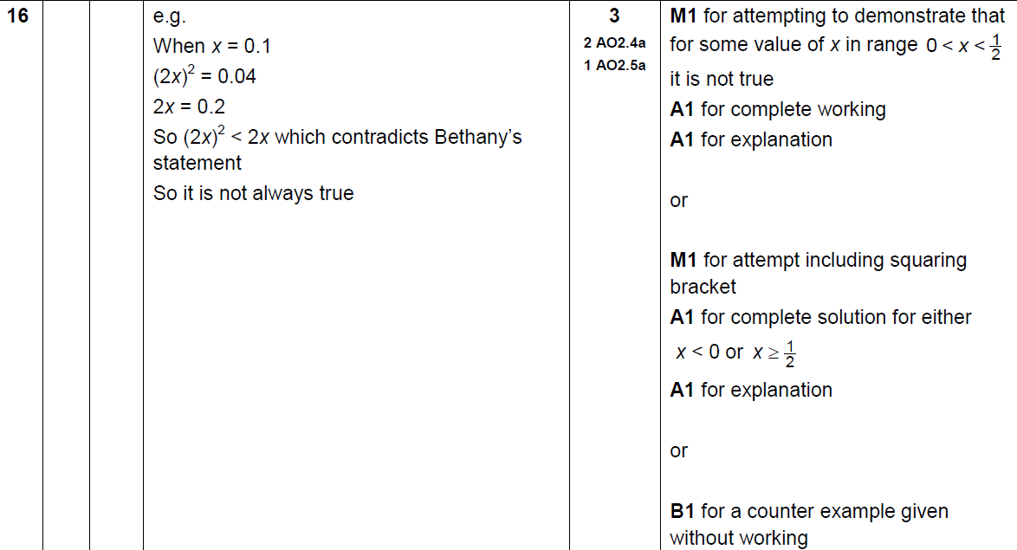
Properties of Numbers
SAM 2H Q16
A

Slide 8
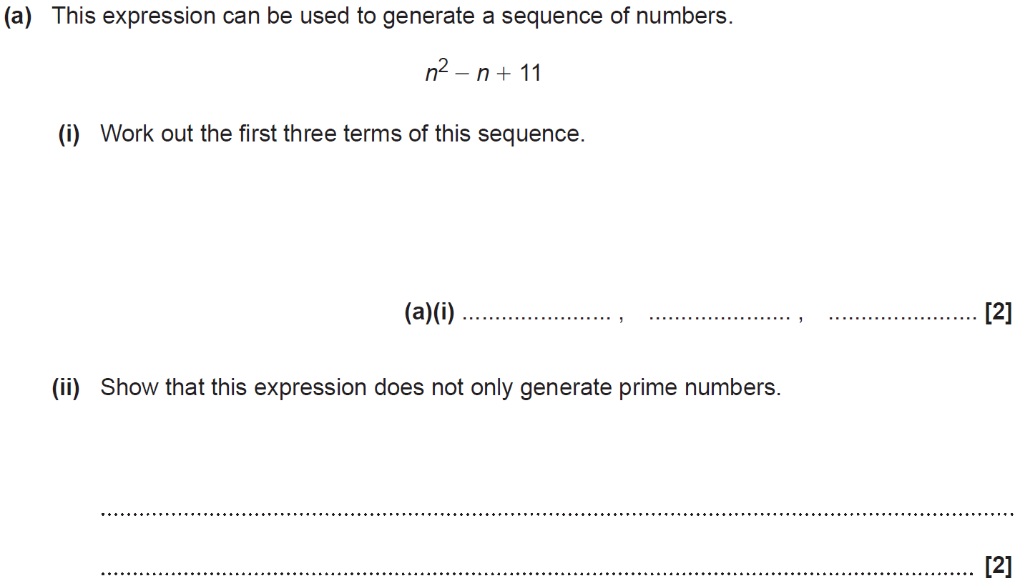
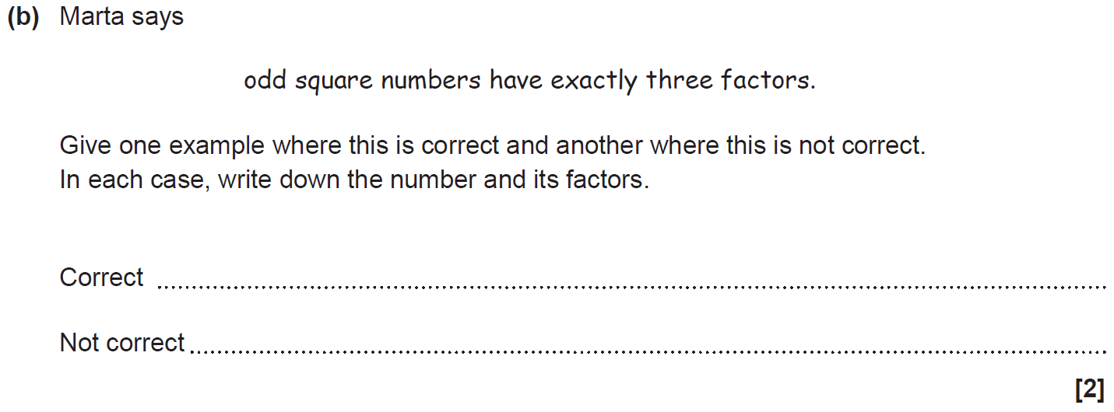
Properties of Numbers
SAM 3H Q3

Slide 9
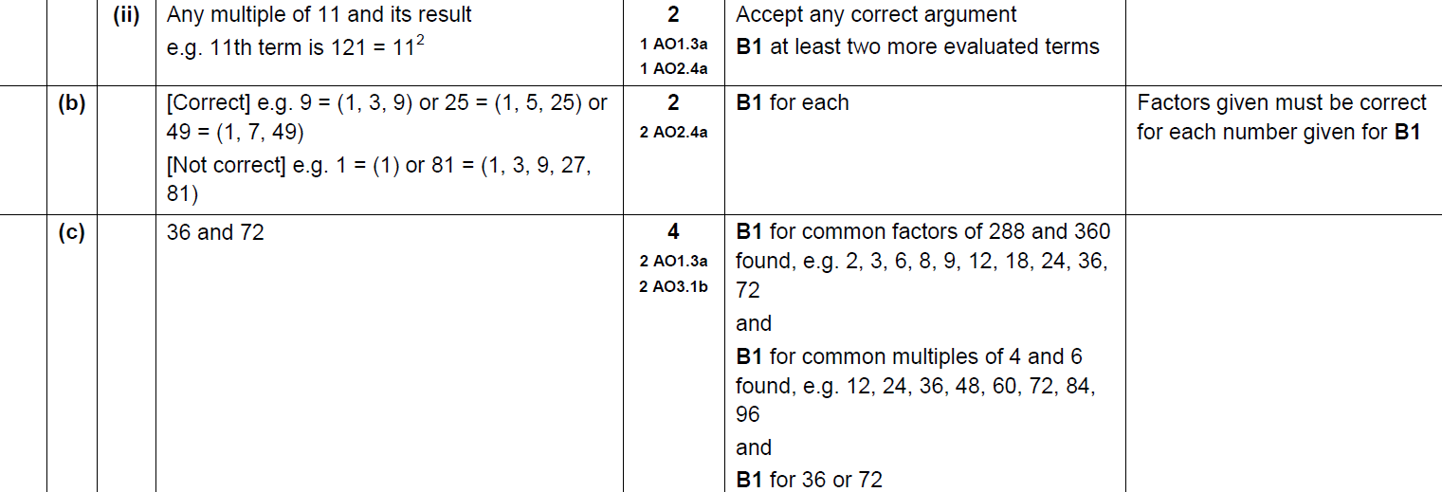
Properties of Numbers
SAM 3H Q3
A (i)
A (ii)
B
C

Slide 10
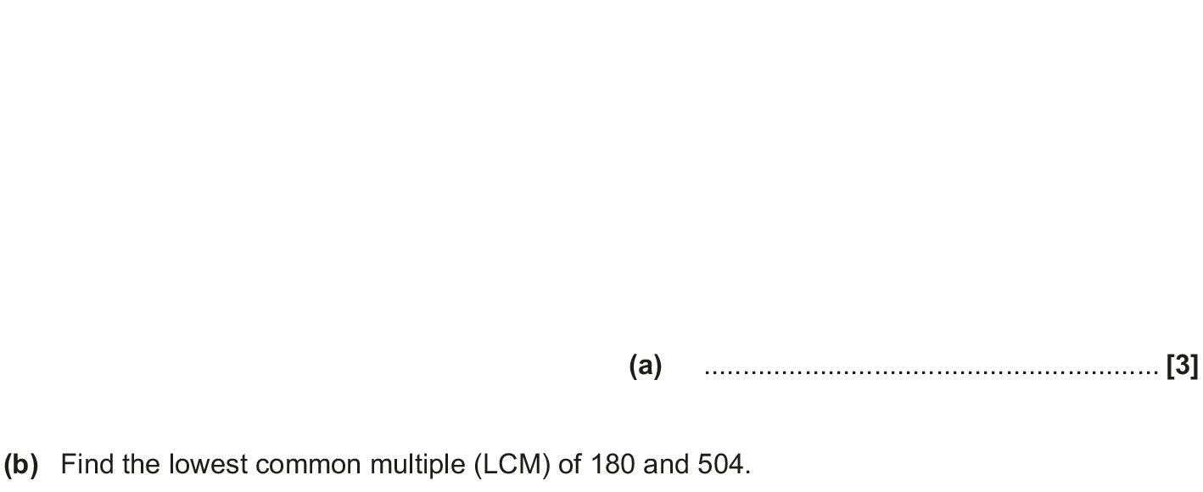
Properties of Numbers
May 2017 1H Q3

Slide 11
Properties of Numbers
May 2017 1H Q3
A
B

Slide 12
Properties of Numbers
Nov 2017 2H Q3

Slide 13
Properties of Numbers
Nov 2017 2H Q3
A

Slide 14
Properties of Numbers
Nov 2017 3H Q2

Slide 15
Properties of Numbers
Nov 2017 3H Q2
A

Slide 16
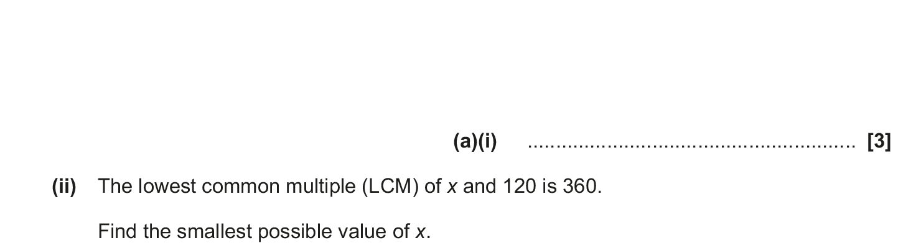
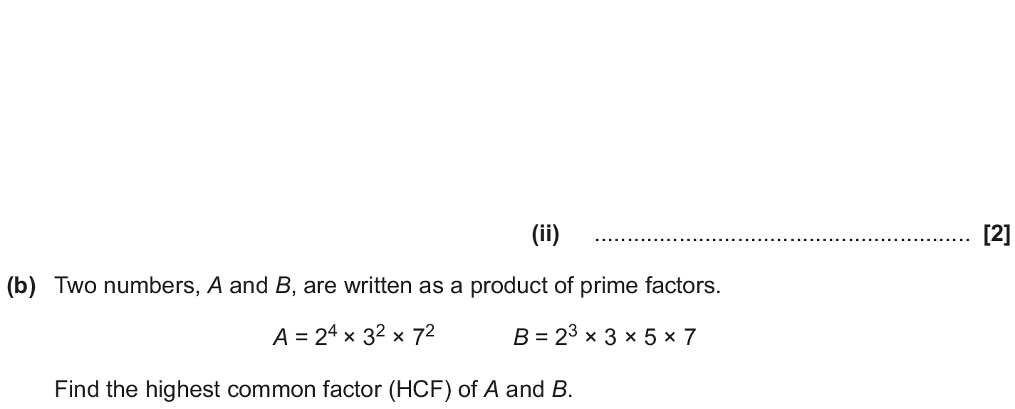
Properties of Numbers
May 2018 1H Q3

Slide 17
Properties of Numbers
May 2018 1H Q3
A (i)
A (ii)
B

Slide 18
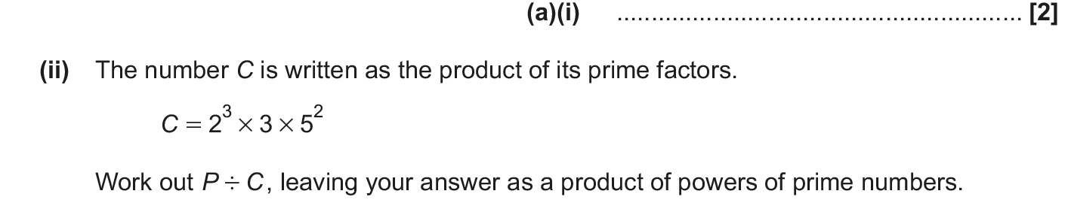
Properties of Numbers
Nov 2018 1H Q8

Slide 19
Properties of Numbers
Nov 2018 1H Q8
A (i)
A (ii)
B (i)
B (ii)

