Slide 1
Show that…/ Proof
Show that…/ Proof
(algebraic)
SAM
1H Q18
Spec 1
2H Q13
May 2017
1H Q4
Nov 2017
1H Q3
Nov 2017
3H Q19
Nov 2018
3H Q14
SAM
2H Q14
Spec 1
3H Q22
May 2017
1H Q6
Nov 2017
1H Q6
May 2018
1H Q12
Edexcel
Nov 2018
3H Q15
SAM
2H Q16
Spec 2
1H Q9
May 2017
1H Q10
Nov 2017
1H Q14
June 2018
2H Q13
AQA
May 2019
1H Q13
SAM
3H Q3
Spec 2
1H Q20
May 2017
1H Q16
Nov 2017
1H Q17
Nov 2018
1H Q7
OCR
May 2019
1H Q21
Spec 1
1H Q15
Spec 2
3H Q7
May 2017
1H Q22
Nov 2017
3H Q11
Nov 2018
2H Q11
June 2019
3H Q18
Spec 1
1H Q20
Spec 2
3H Q17
June 2017
3H Q5
Nov 2017
3H Q14
Nov 2018
3H Q4
Proof of algebraic properties
Proof

Slide 2
Show that…/ Proof
Show that…/ Proof
(algebraic)
May 2017
1H Q17
Nov 2017
1H Q6
Nov 2018
1H Q19
SAM
1H Q12
June 2017
2H Q25
May 2018
1H Q30
Edexcel
Nov 2018
2H Q20
SAM
1H Q16
June 2017
3H Q17
June 2018
2H Q13
AQA
Nov 2018
3H Q7
SAM
2H Q16
June 2017
3H Q25
June 2018
2H Q26
OCR
Nov 2018
3H Q16
SAM
2H Q24
June 2017
3H Q27
June 2018
3H Q8
Nov 2018
3H Q27
Nov 2017
1H Q19
June 2018
3H Q18
Proof of algebraic properties
Proof

Slide 3
Show that…/ Proof
Show that…/ Proof
(algebraic)
SAM
1H Q11
Practice
1H Q12
May 2017
1H Q10
Nov 2017
2H Q11
June 2018
2H Q15
SAM
1H Q17
Practice
1H Q13
June 2017
2H Q8
Nov 2017
2H Q18
June 2018
3H Q4
Nov 2018
2H Q13
Edexcel
SAM
1H Q20
Practice
2H Q15
June 2017
2H Q14
Nov 2017
3H Q14
June 2018
3H Q9
Nov 2018
2H Q20
AQA
SAM
2H Q14
Practice
2H Q17
June 2017
2H Q21
Nov 2017
3H Q17
June 2018
3H Q14
Nov 2018
3H Q5
OCR
SAM
2H Q16*
Practice
3H Q11
June 2017
3H Q17
May 2018
1H Q12
June 2018
3H Q19
Nov 2018
3H Q16
*By counter-example
SAM
3H Q7
Practice
3H Q15
Nov 2017
1H Q17
May 2018
1H Q13
Nov 2018
1H Q2
Nov 2018
3H Q21
Proof of algebraic properties
SAM
3H Q8
Practice
3H Q17
Nov 2017
2H Q8
June 2018
2H Q8
Nov 2018
1H Q22
Proof

Slide 4
Show that…/ Proof
SAM 1H Q18

Slide 5
Show that…/ Proof
SAM 1H Q18
A

Slide 6
Show that…/ Proof
SAM 2H Q14

Slide 7
Show that…/ Proof
SAM 2H Q14
A

Slide 8
Show that…/ Proof
SAM 2H Q16

Slide 9
Show that…/ Proof
SAM 2H Q16
A

Slide 10
Show that…/ Proof
SAM 3H Q3

Slide 11
Show that…/ Proof
SAM 3H Q3
A
B
c

Slide 12
Show that…/ Proof
Specimen Set 1 1H Q15

Slide 13
Show that…/ Proof
Specimen Set 1 1H Q15
A

Slide 14
Show that…/ Proof
Specimen Set 1 1H Q20

Slide 15
Show that…/ Proof
Specimen Set 1 1H Q20
A

Slide 16
Show that…/ Proof
Specimen Set 1 2H Q13

Slide 17
Show that…/ Proof
Specimen Set 1 2H Q13
A

Slide 18
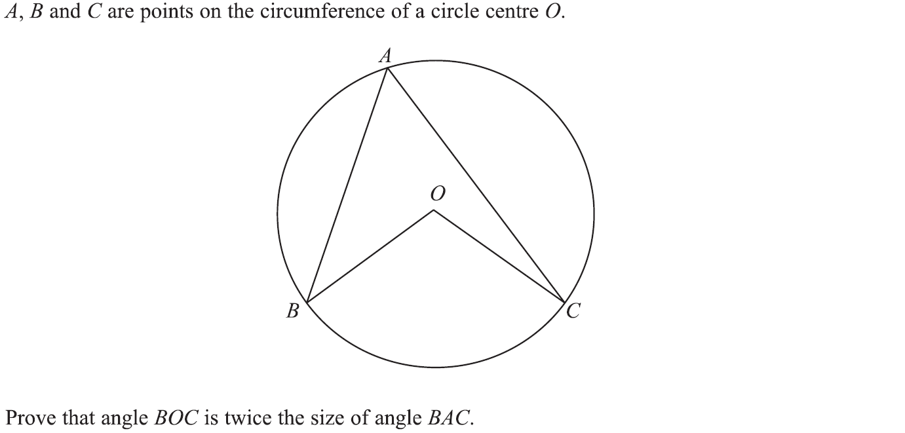
Show that…/ Proof
Specimen Set 1 2H Q24

Slide 19
Show that…/ Proof
Specimen Set 1 2H Q24
A

Slide 20
Show that…/ Proof
Specimen Set 1 3H Q22

Slide 21
Show that…/ Proof
Specimen Set 1 3H Q22
A

Slide 22
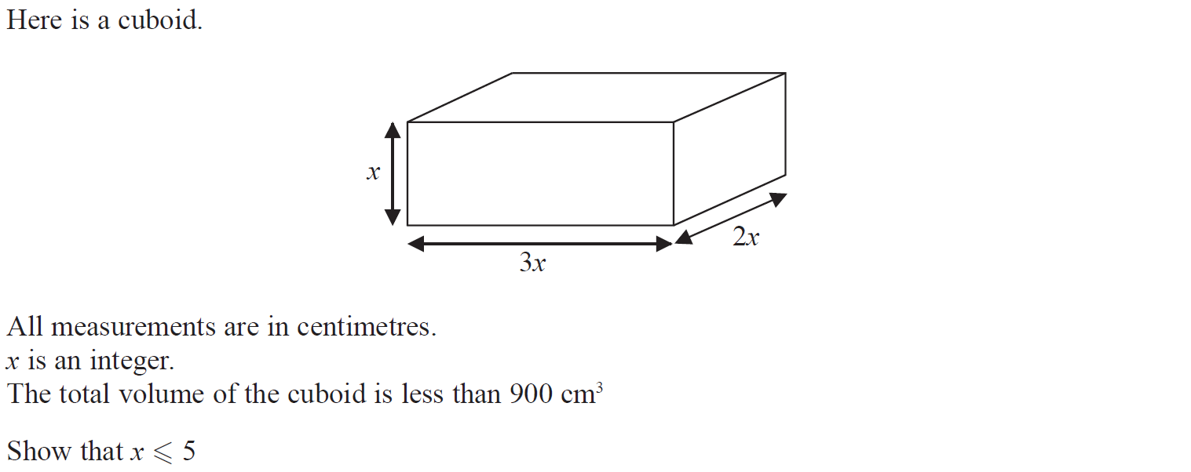
Show that…/ Proof
Specimen Set 2 1H Q9

Slide 23
Show that…/ Proof
Specimen Set 2 1H Q9
A

Slide 24
Show that…/ Proof
Specimen Set 2 1H Q20

Slide 25
Show that…/ Proof
Specimen Set 2 1H Q20
A

Slide 26
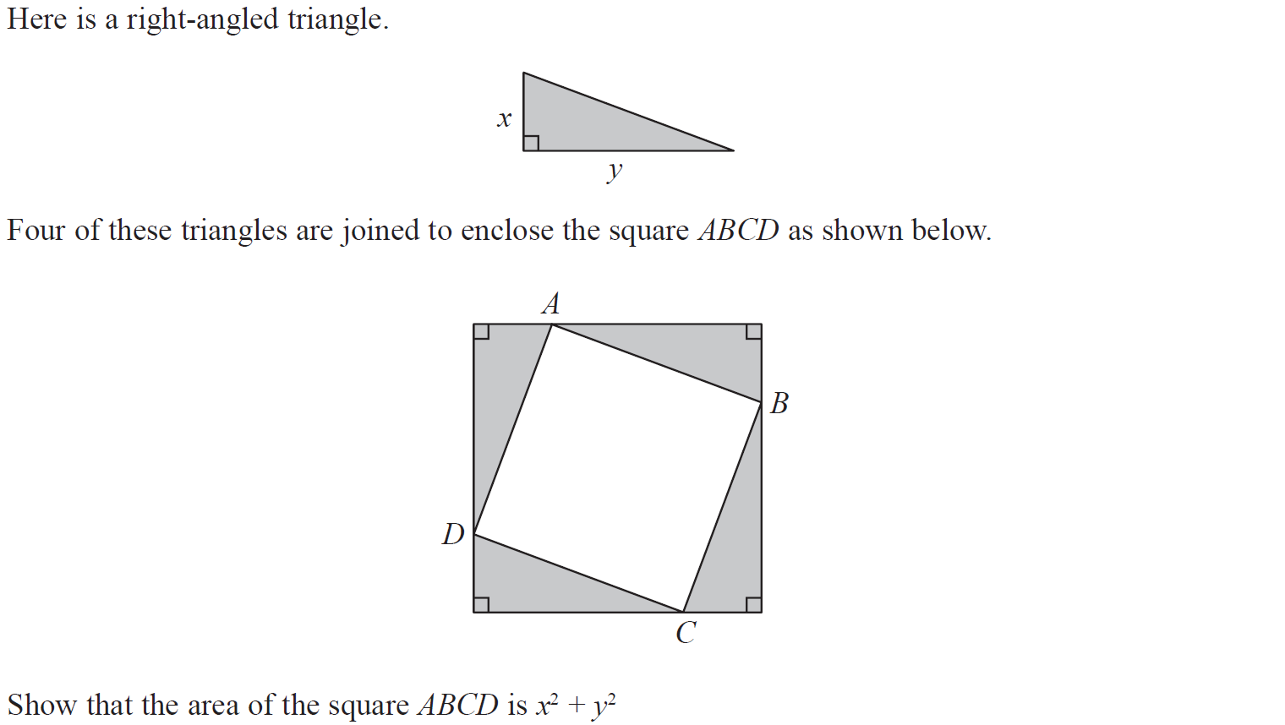
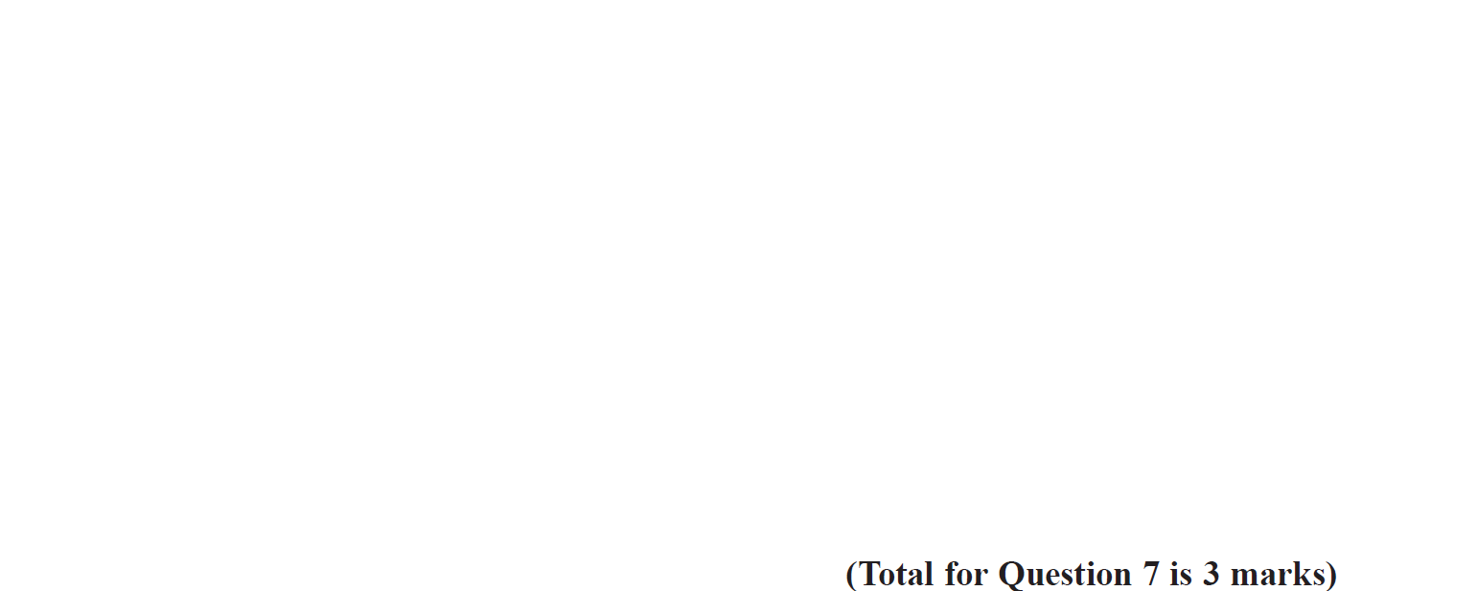
Show that…/ Proof
Specimen Set 2 3H Q7

Slide 27
Show that…/ Proof
Specimen Set 2 3H Q7
A

Slide 28
Show that…/ Proof
Specimen Set 2 3H Q17

Slide 29
Show that…/ Proof
Specimen Set 2 3H Q17
A

Slide 30
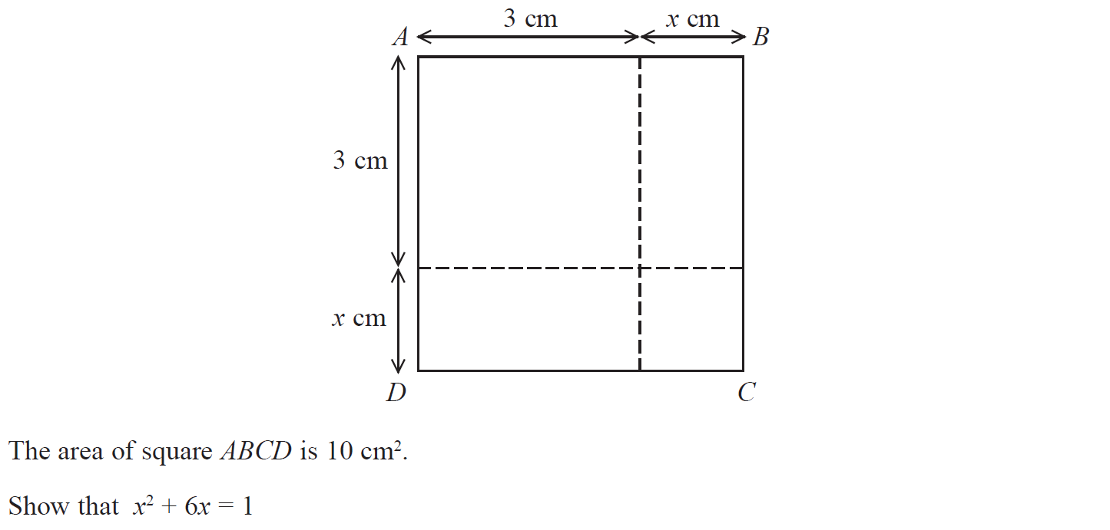
Show that…/ Proof
May 2017 1H Q4

Slide 31
Show that…/ Proof
May 2017 1H Q4
A

Slide 32
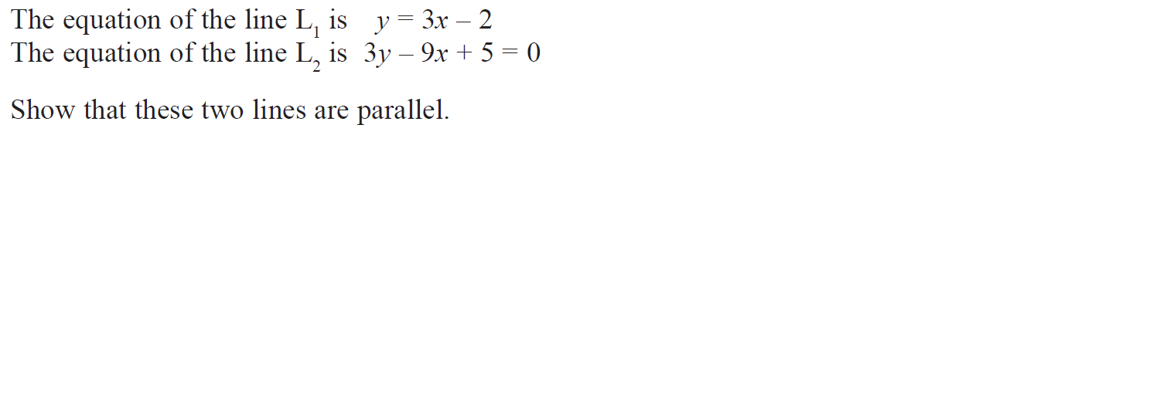
Show that…/ Proof
May 2017 1H Q6

Slide 33
Show that…/ Proof
May 2017 1H Q6
A

Slide 34
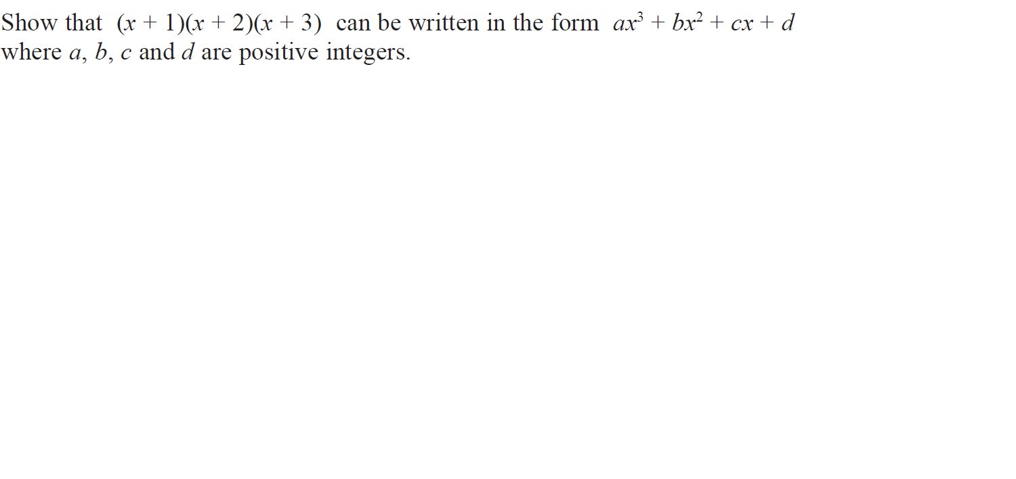
Show that…/ Proof
May 2017 1H Q10

Slide 35
Show that…/ Proof
May 2017 1H Q10
A

Slide 36
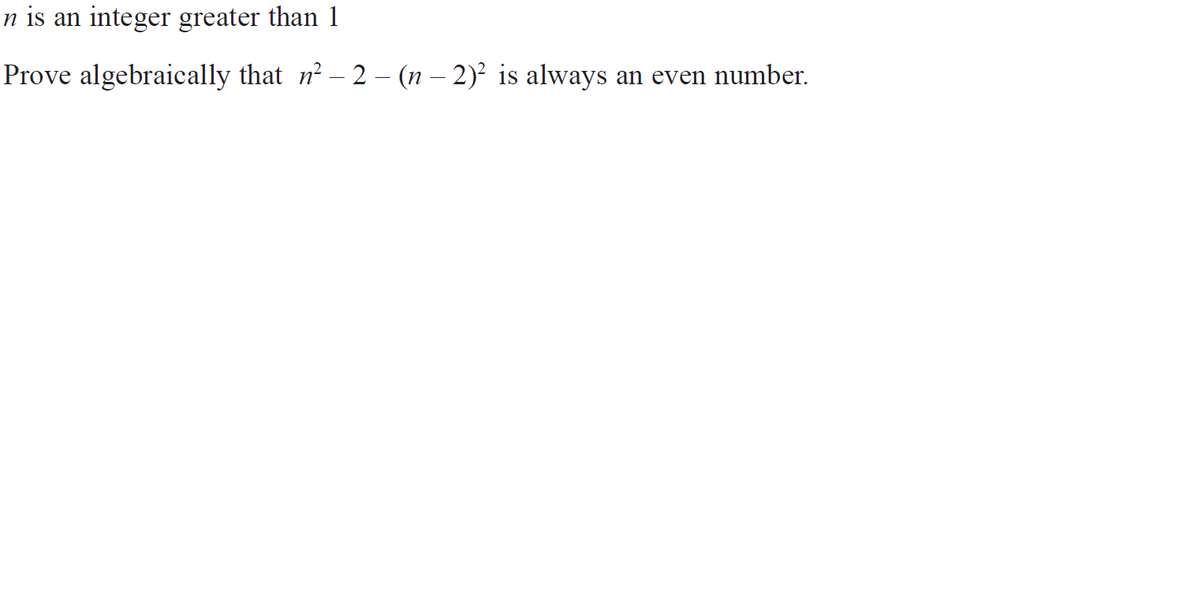
Show that…/ Proof
May 2017 1H Q16

Slide 37
Show that…/ Proof
May 2017 1H Q16
A

Slide 38
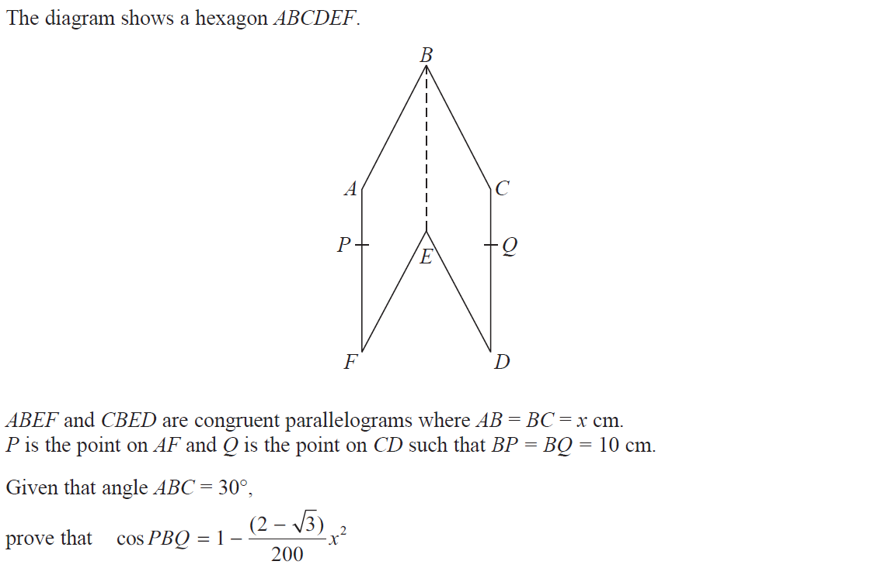
Show that…/ Proof
May 2017 1H Q22

Slide 39
Show that…/ Proof
May 2017 1H Q22
A

Slide 40
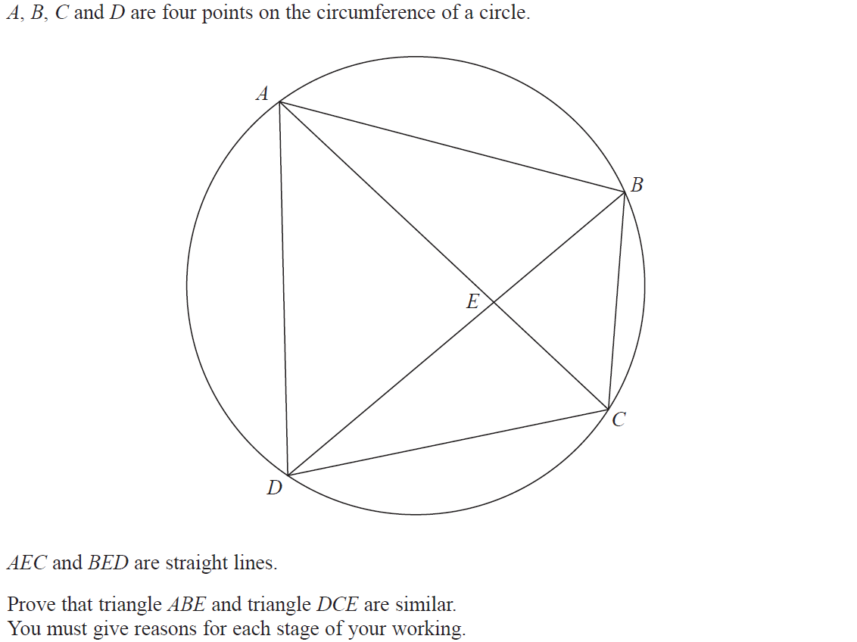
Show that…/ Proof
June 2017 2H Q15

Slide 41
Show that…/ Proof
June 2017 2H Q15
A

Slide 42
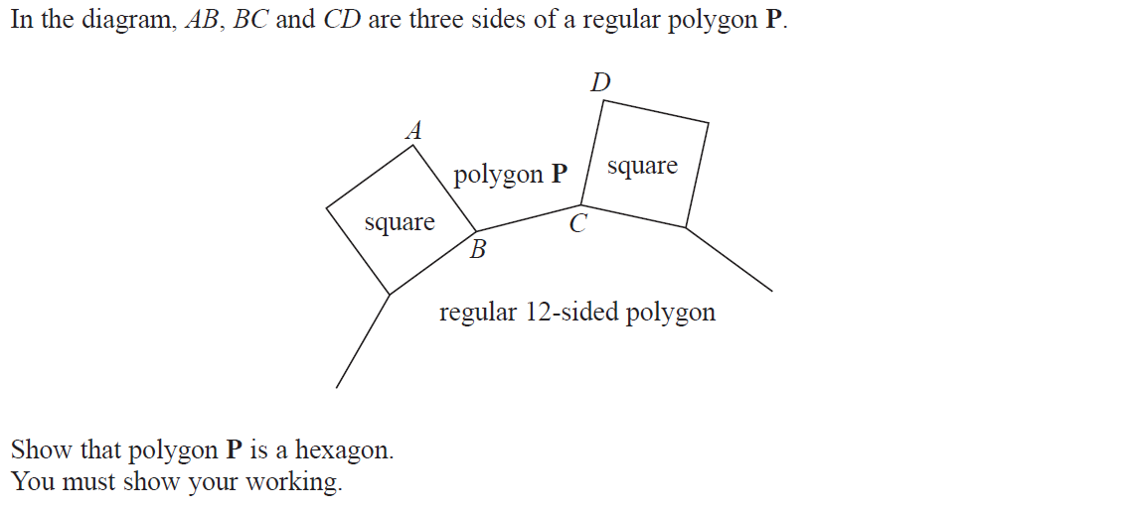
Show that…/ Proof
June 2017 3H Q5

Slide 43
Show that…/ Proof
June 2017 3H Q5
A

Slide 44
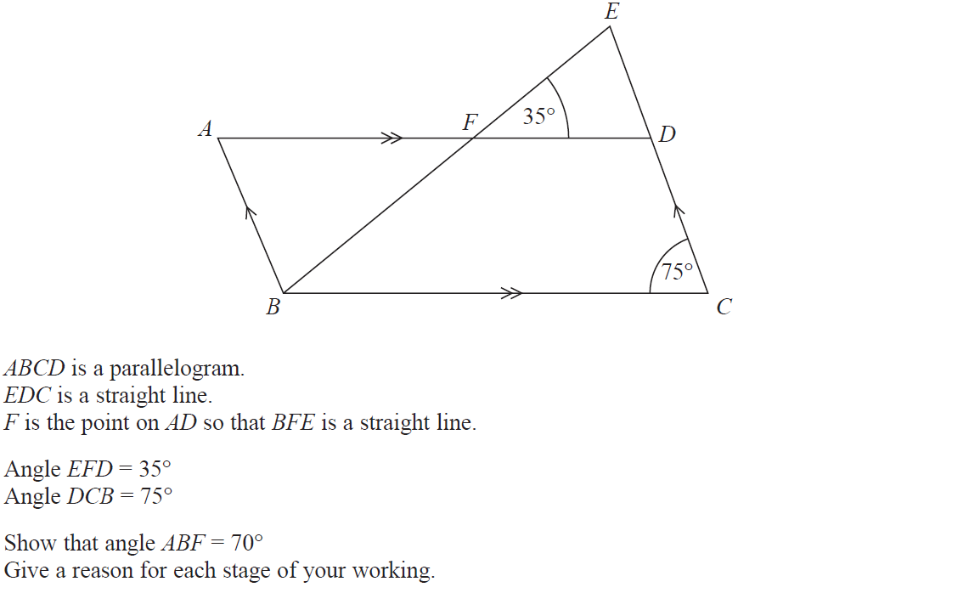
Show that…/ Proof
Nov 2017 1H Q3

Slide 45
Show that…/ Proof
Nov 2017 1H Q3
A

Slide 46
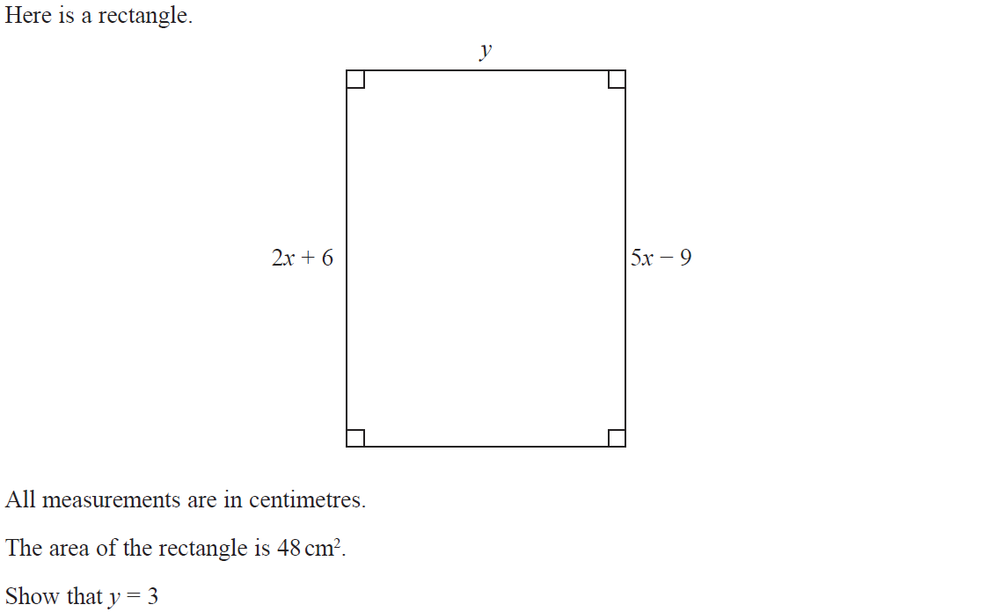
Show that…/ Proof
Nov 2017 1H Q6

Slide 47
Show that…/ Proof
Nov 2017 1H Q6
A

Slide 48
Show that…/ Proof
Nov 2017 1H Q14

Slide 49
Show that…/ Proof
Nov 2017 1H Q14
A

Slide 50
Show that…/ Proof
Nov 2017 1H Q17

Slide 51
Show that…/ Proof
Nov 2017 1H Q17
A

Slide 52
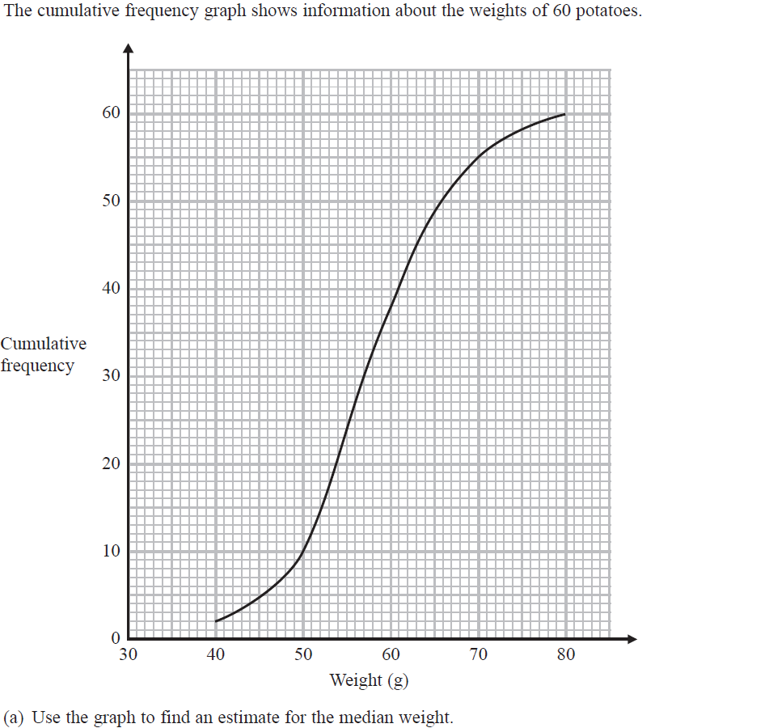
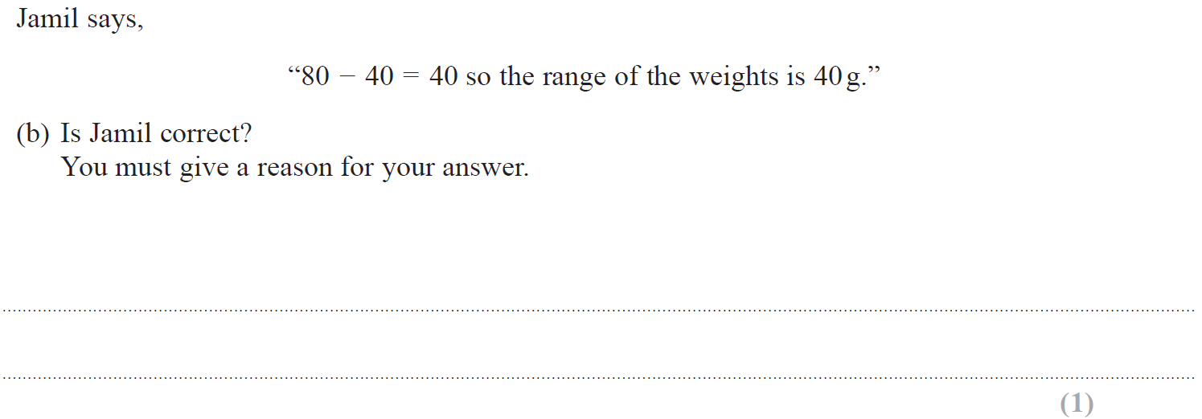
Show that…/ Proof
Nov 2017 3H Q11

Slide 53
Show that…/ Proof
Nov 2017 3H Q11
A
B
C

Slide 54
Show that…/ Proof
Nov 2017 3H Q14

Slide 55
Show that…/ Proof
Nov 2017 3H Q14
A

Slide 56
Show that…/ Proof
Nov 2017 3H Q19

Slide 57
Show that…/ Proof
Nov 2017 3H Q19
A

Slide 58
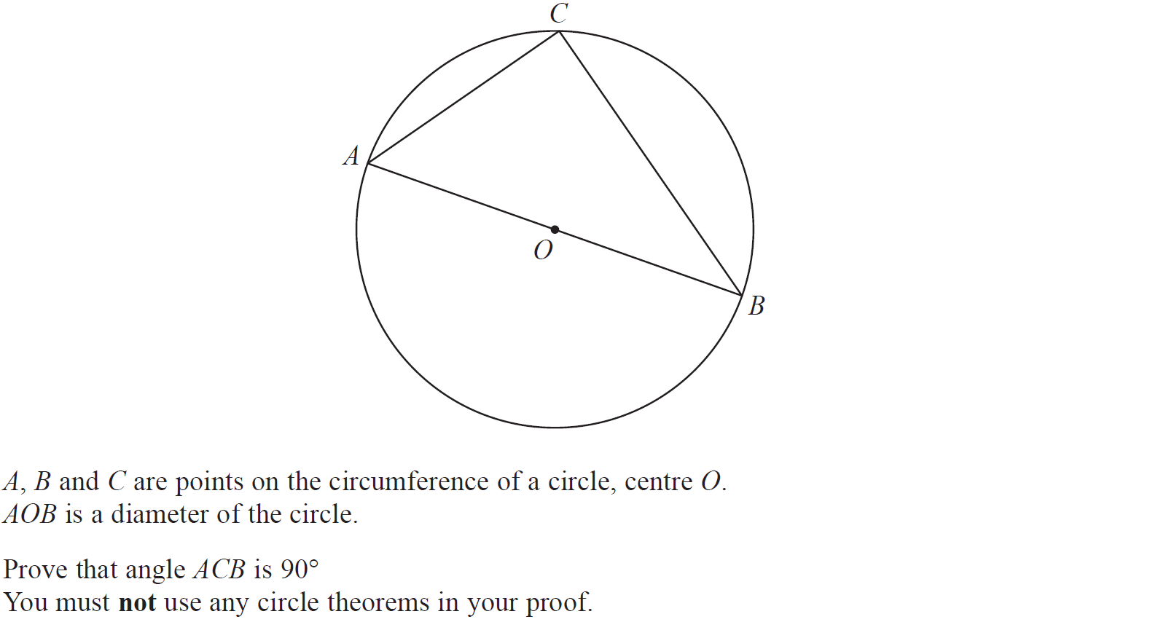
Show that…/ Proof
Nov 2017 3H Q20

Slide 59
Show that…/ Proof
Nov 2017 3H Q20
A

Slide 60
Show that…/ Proof
May 2018 1H Q12

Slide 61
Show that…/ Proof
May 2018 1H Q12
A

Slide 62
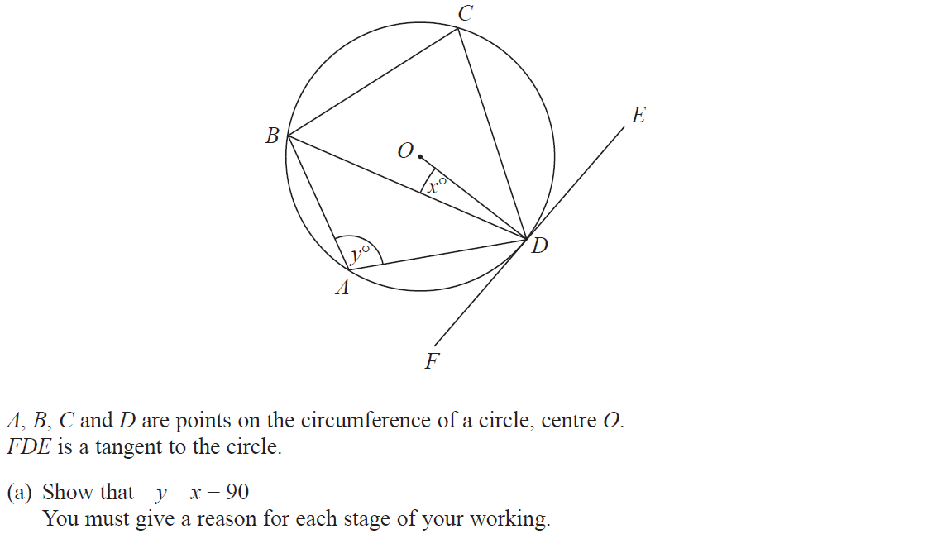
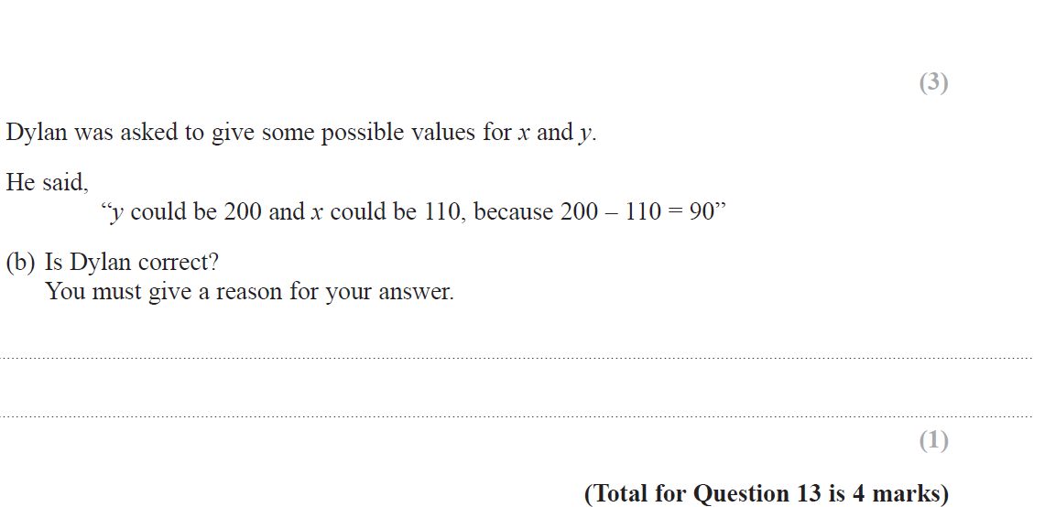
Show that…/ Proof
June 2018 2H Q13

Slide 63
Show that…/ Proof
June 2018 2H Q13
A
B

Slide 64
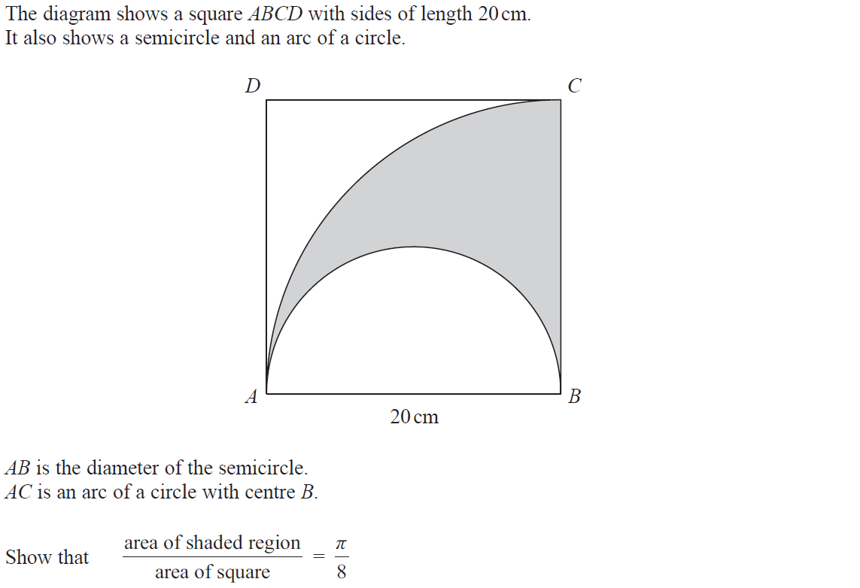
Show that…/ Proof
Nov 2018 1H Q7

Slide 65
Show that…/ Proof
Nov 2018 1H Q7
A

Slide 66
Show that…/ Proof
Nov 2018 2H Q11

Slide 67
Show that…/ Proof
Nov 2018 2H Q11
A

Slide 68
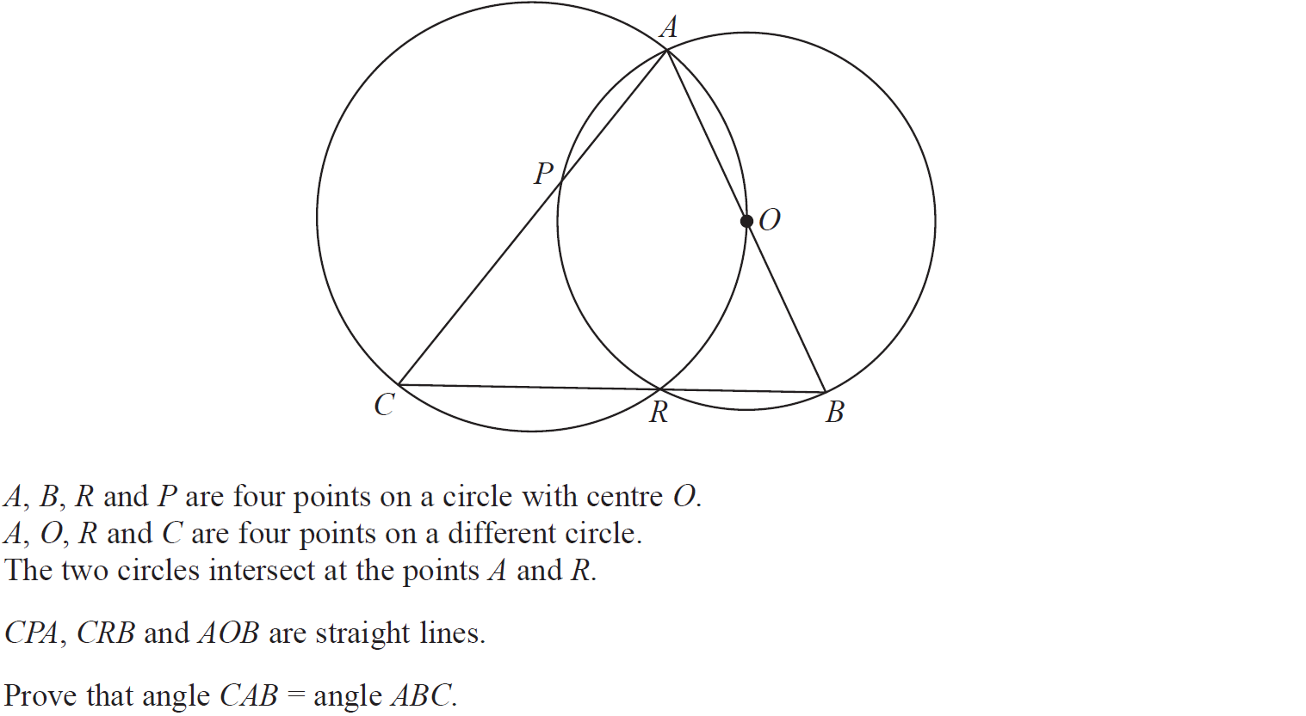
Show that…/ Proof
Nov 2018 2H Q21

Slide 69
Show that…/ Proof
Nov 2018 2H Q21
A

Slide 70
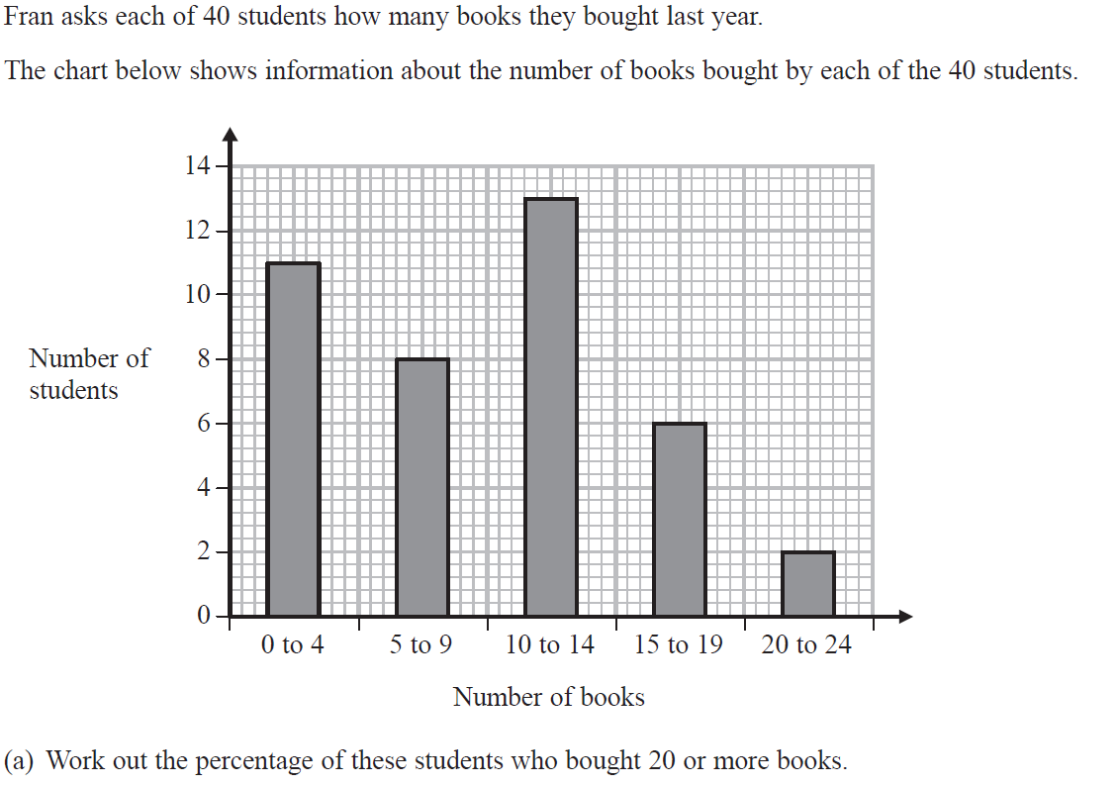
Show that…/ Proof
Nov 2018 3H Q4

Slide 71
Show that…/ Proof
Nov 2018 3H Q4
A
B

Slide 72
Show that…/ Proof
Nov 2018 3H Q14

Slide 73
Show that…/ Proof
Nov 2018 3H Q14
A

Slide 74
Show that…/ Proof
Nov 2018 3H Q15

Slide 75
Show that…/ Proof
Nov 2018 3H Q15
A

Slide 76
Show that…/ Proof
May 2019 1H Q13

Slide 77
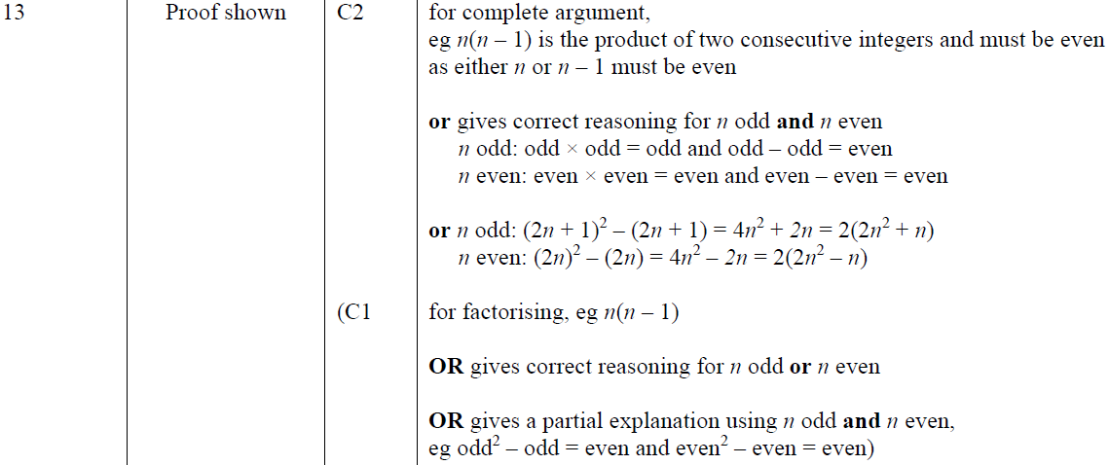
Show that…/ Proof
Nov 2018 3H Q15
A
A SF

Slide 78
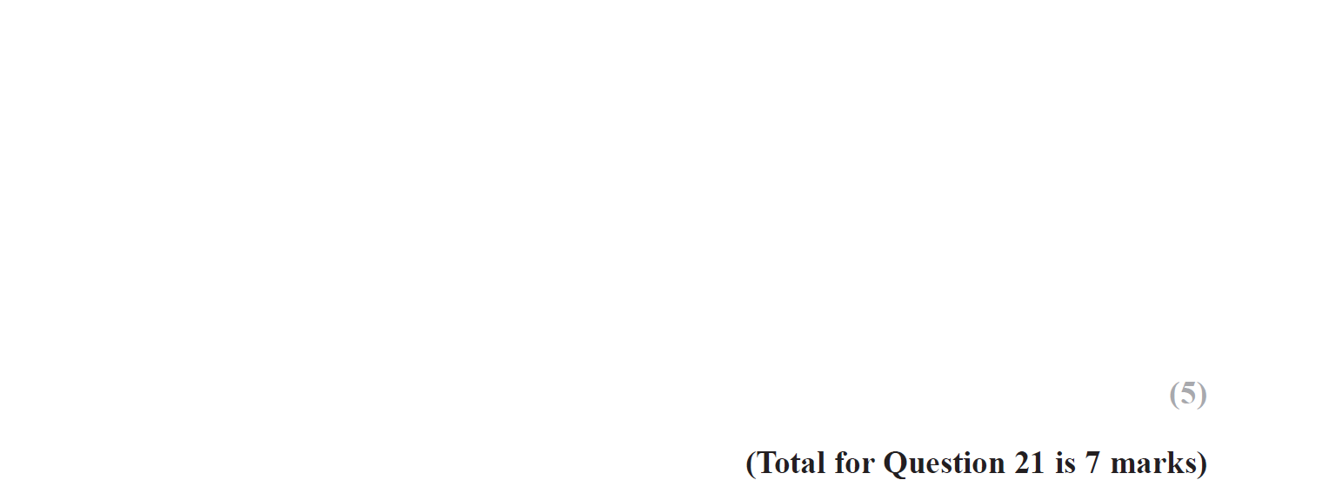
Show that…/ Proof
May 2019 1H Q21

Slide 79
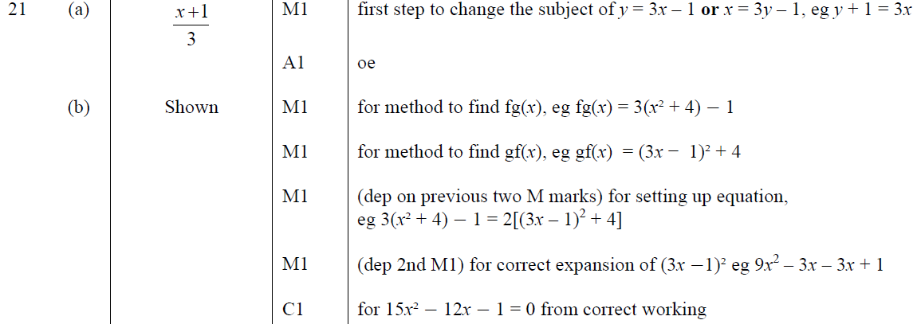
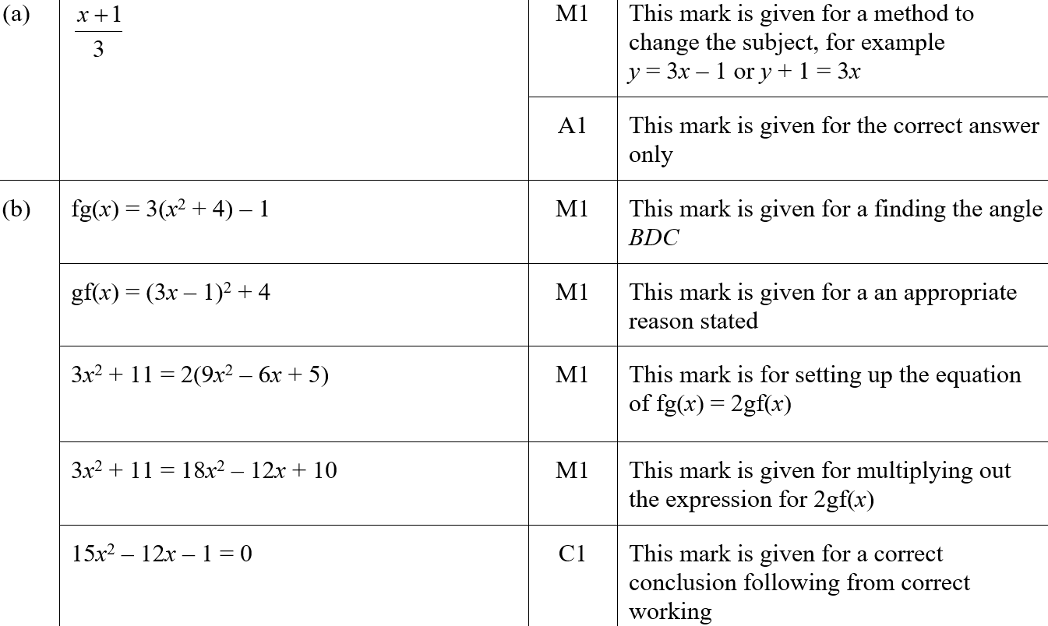
Show that…/ Proof
May 2019 1H Q21
A
B
A SF
B SF

Slide 80
Show that…/ Proof
June 2019 3H Q18

Slide 81
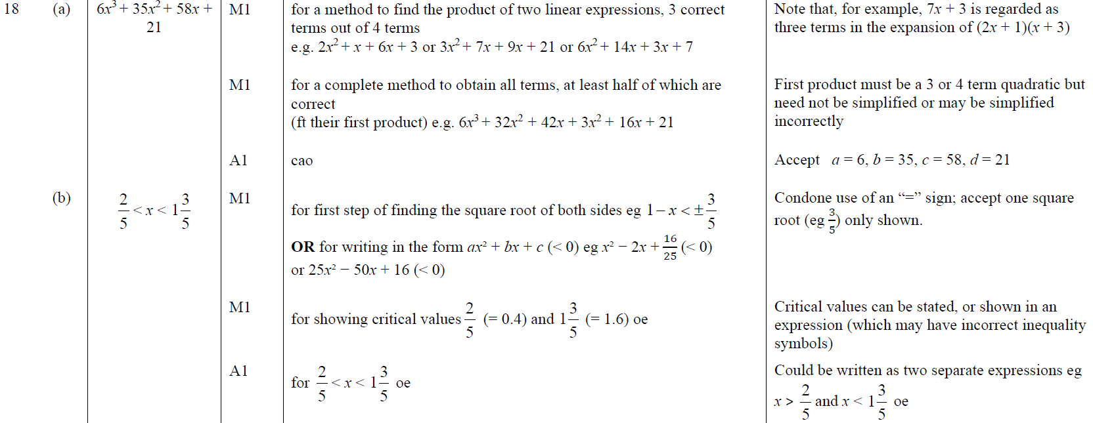
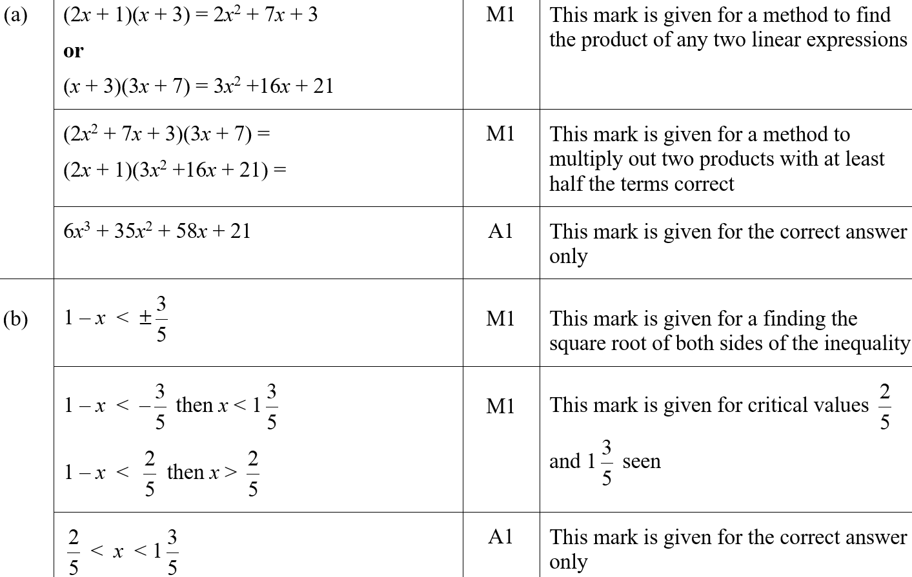
Show that…/ Proof
June 2019 3H Q18
A
B
A SF
B SF

Slide 82
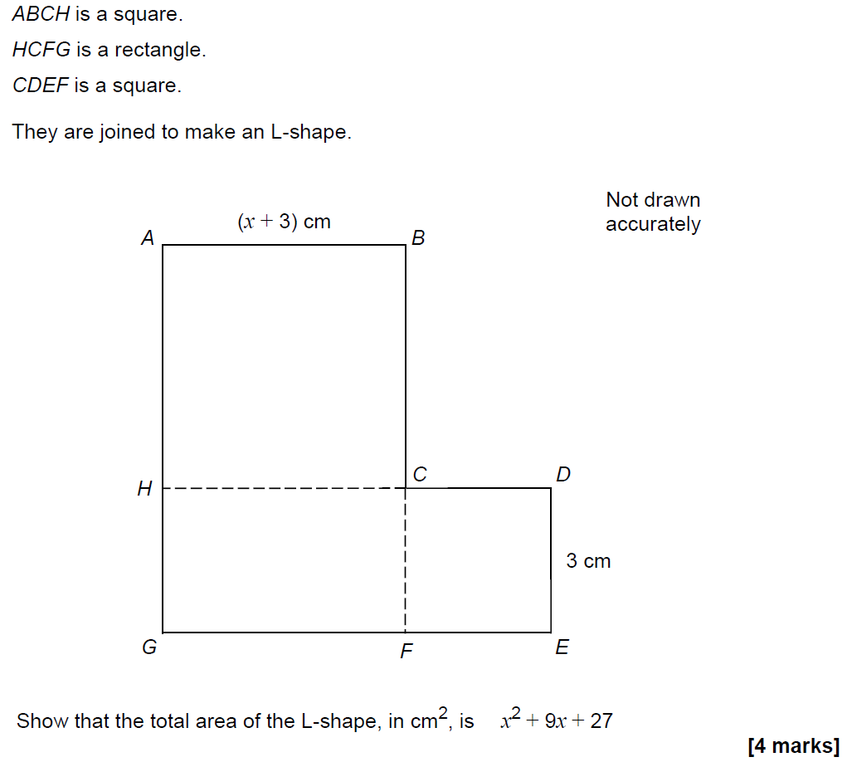
Show that…
SAM 1H Q12

Slide 83
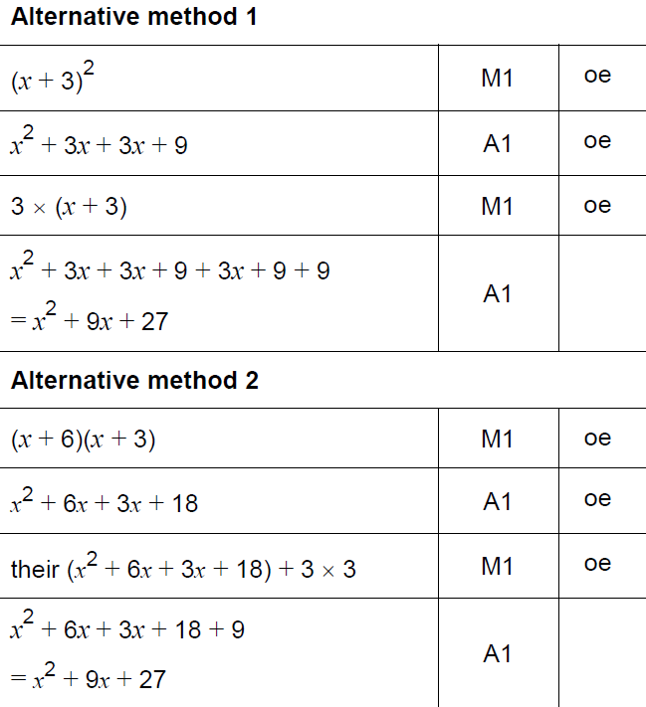
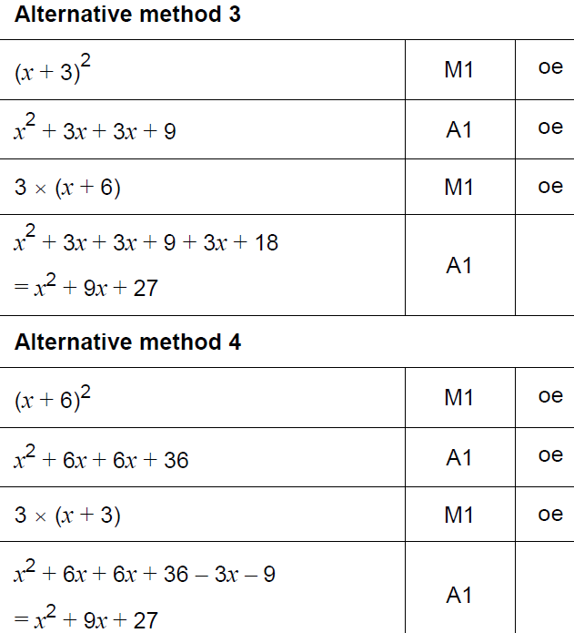
Show that…
SAM 1H Q12
A

Slide 84
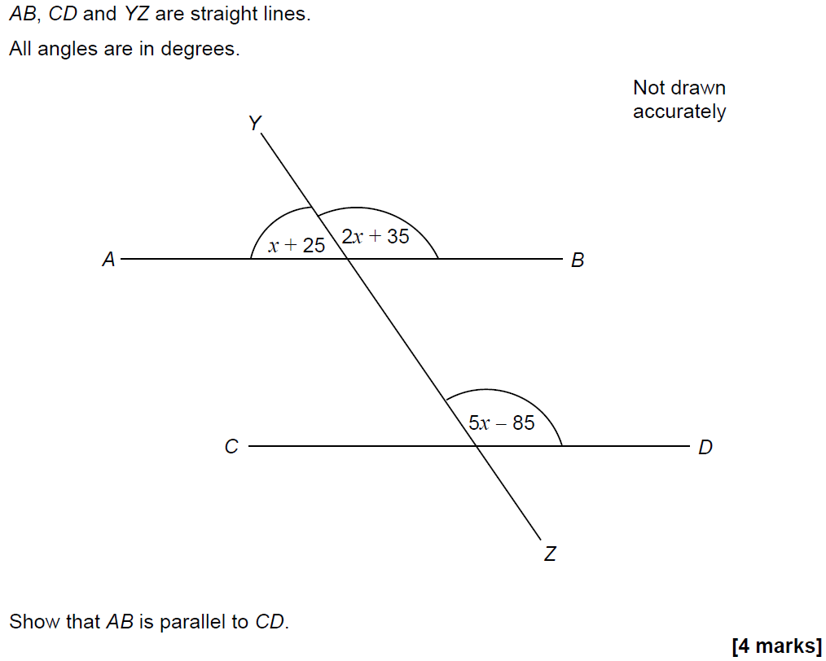
Show that…
SAM 1H Q16

Slide 85
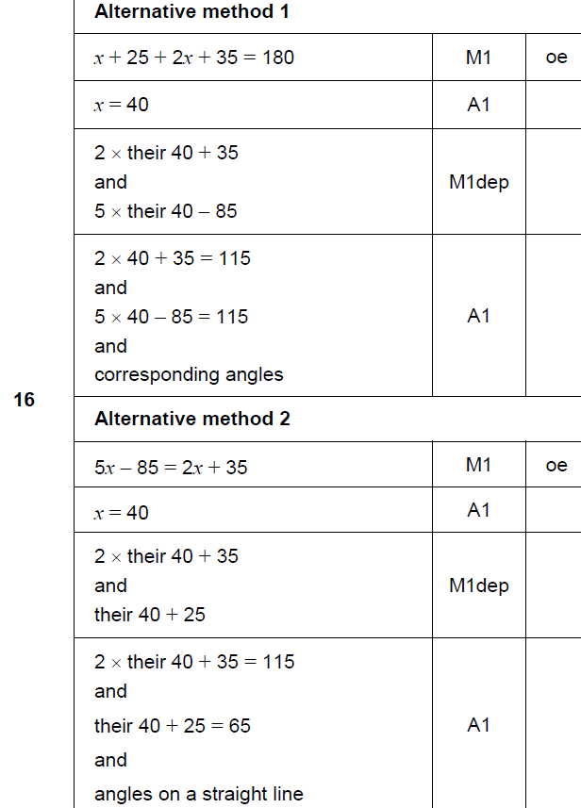
Show that…
SAM 1H Q16
A

Slide 86
Show that…
SAM 2H Q16

Slide 87
Show that…
SAM 2H Q16
A

Slide 88
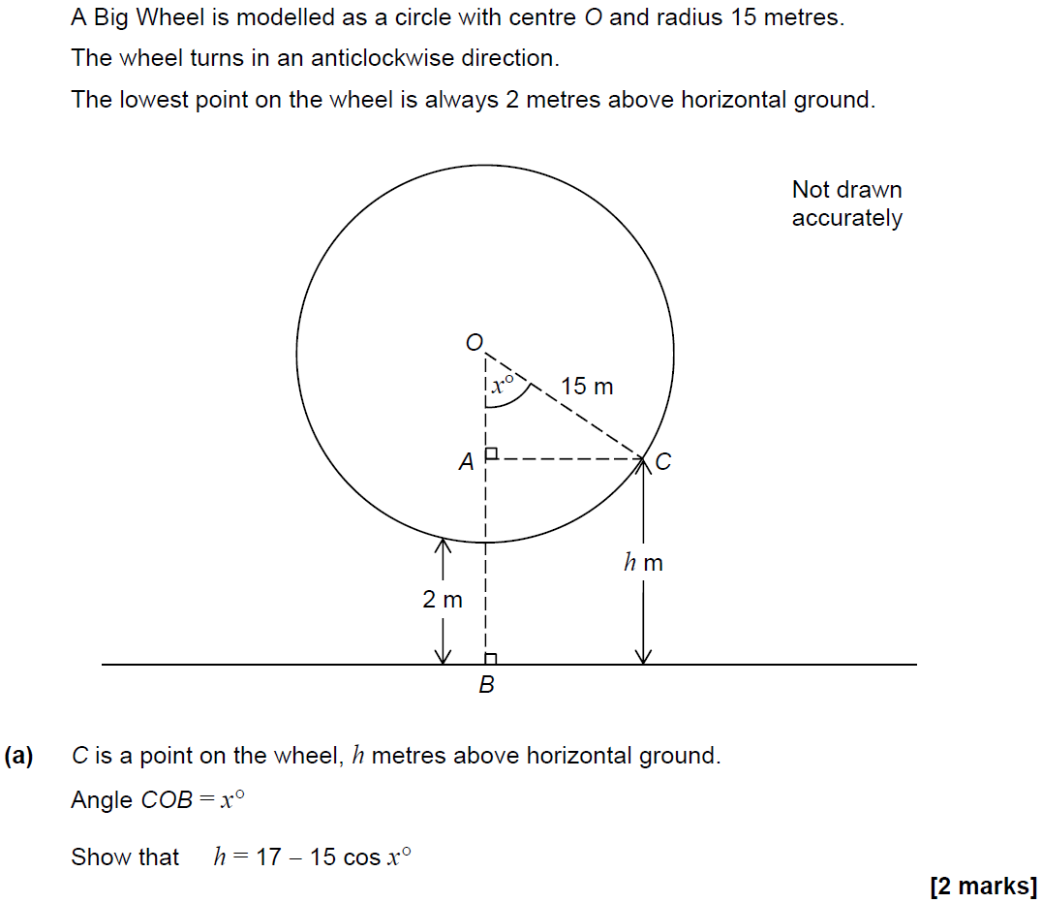
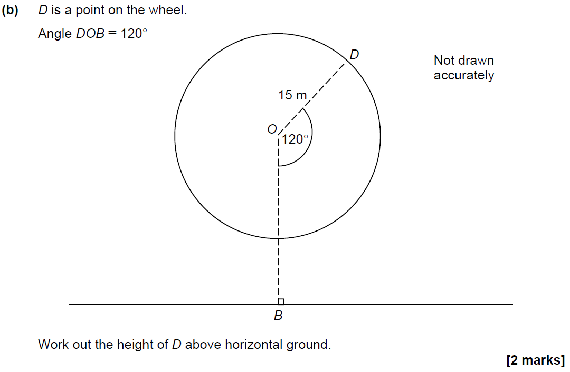
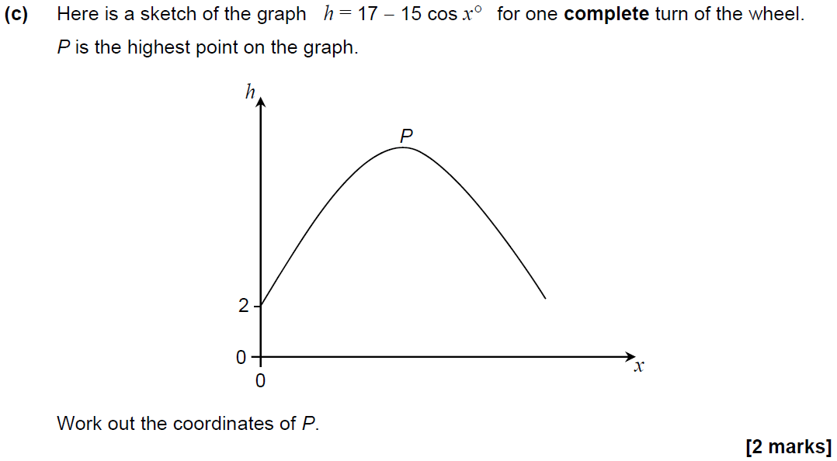
Show that…
SAM 2H Q24

Slide 89
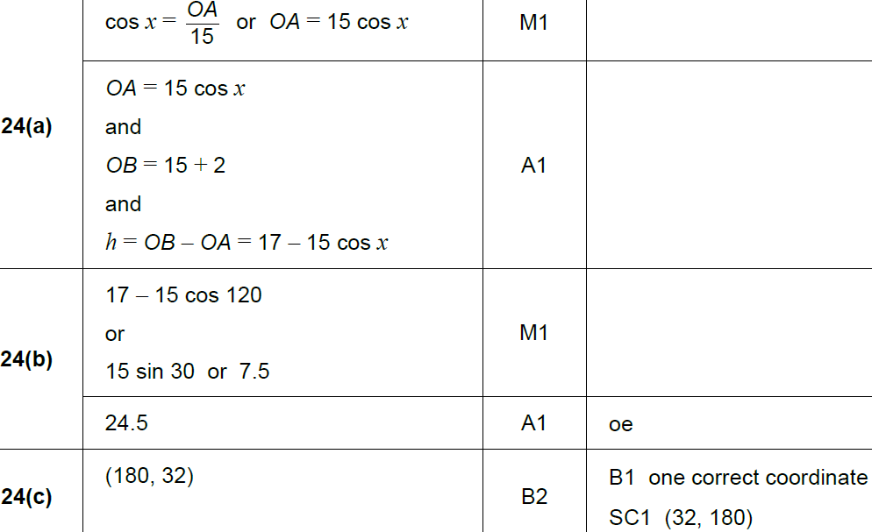
Show that…
SAM 2H Q24
A
B
C

Slide 90
Show that…
May 2017 1H Q17

Slide 91
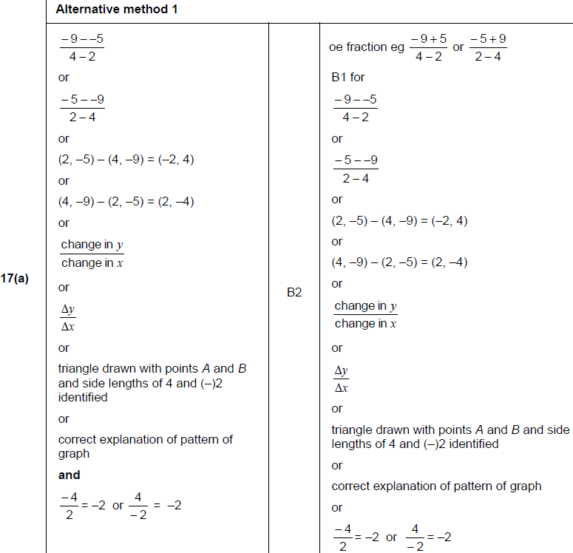
Show that…
May 2017 1H Q17
A

Slide 92
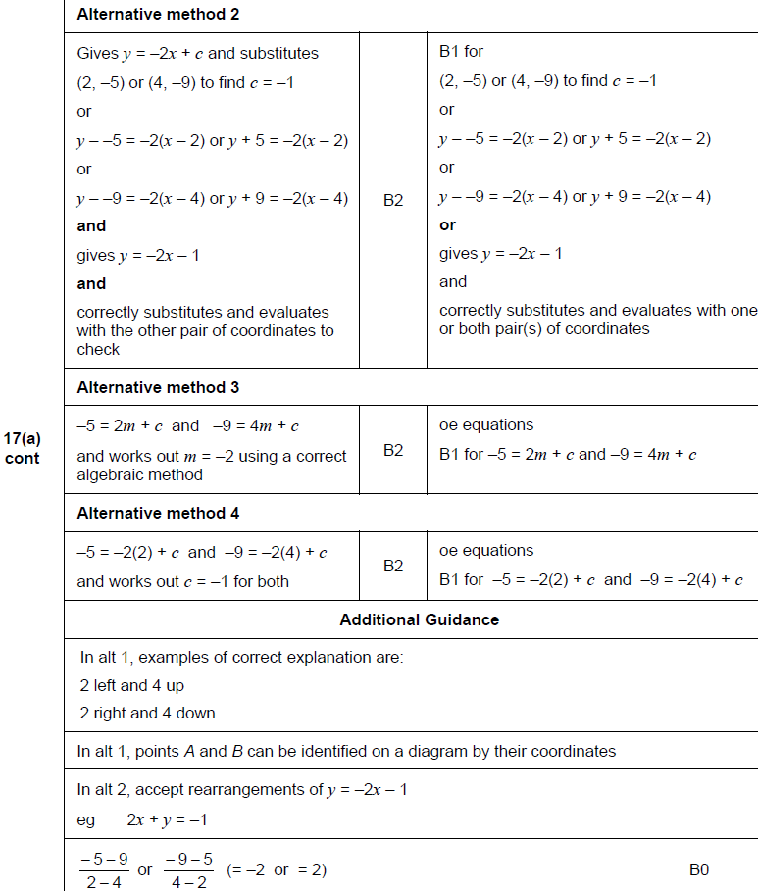
Show that…
May 2017 1H Q17
A Alternatives

Slide 93
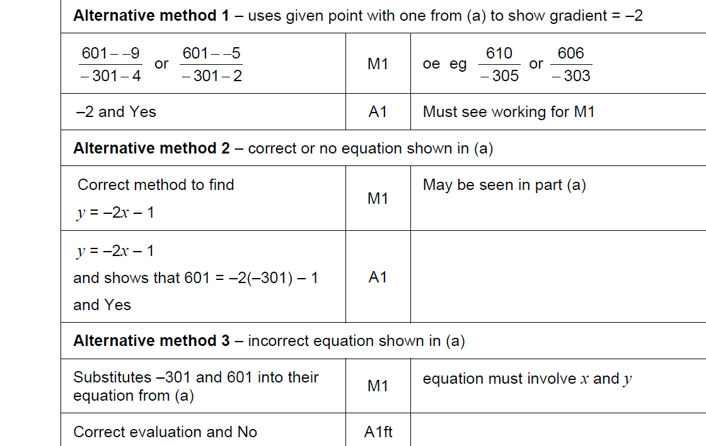
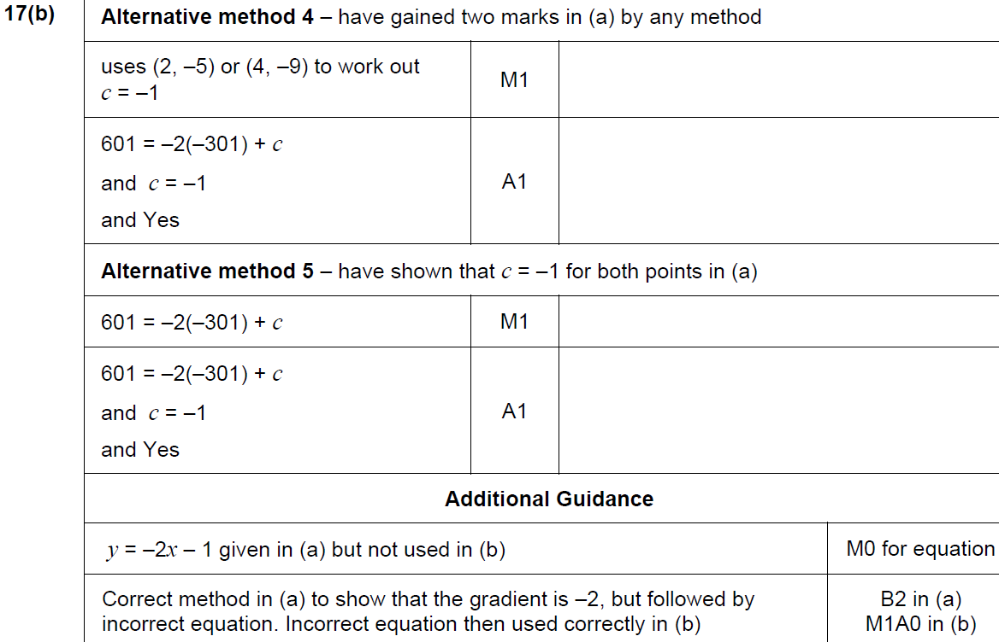
Show that…
May 2017 1H Q17
B

Slide 94
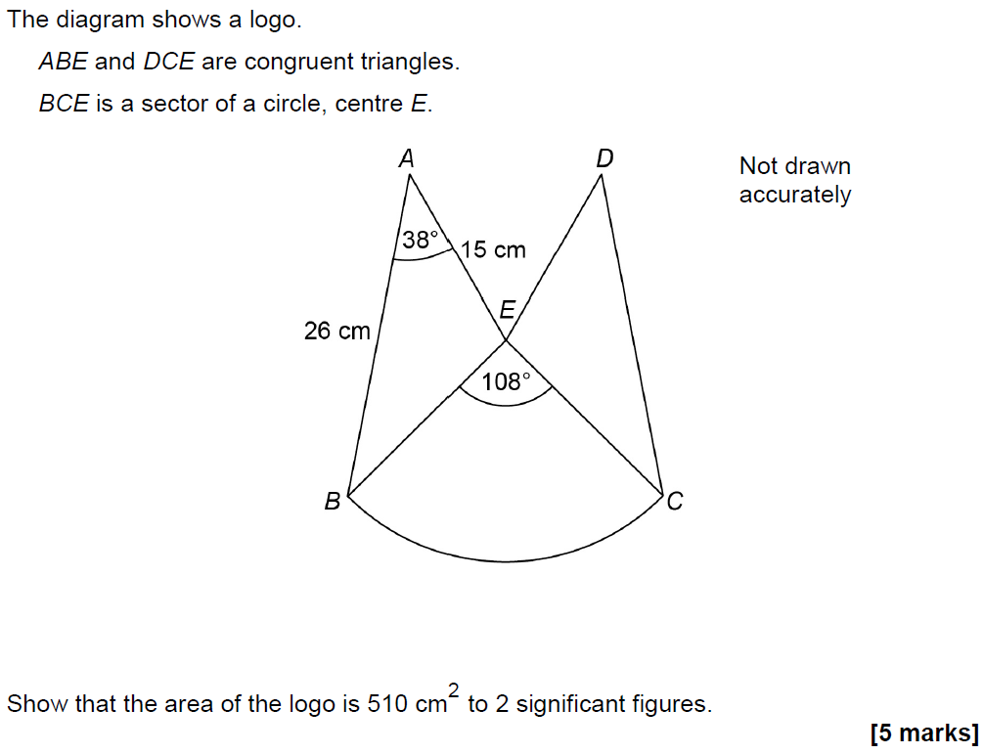
Show that…
June 2017 2H Q25

Slide 95
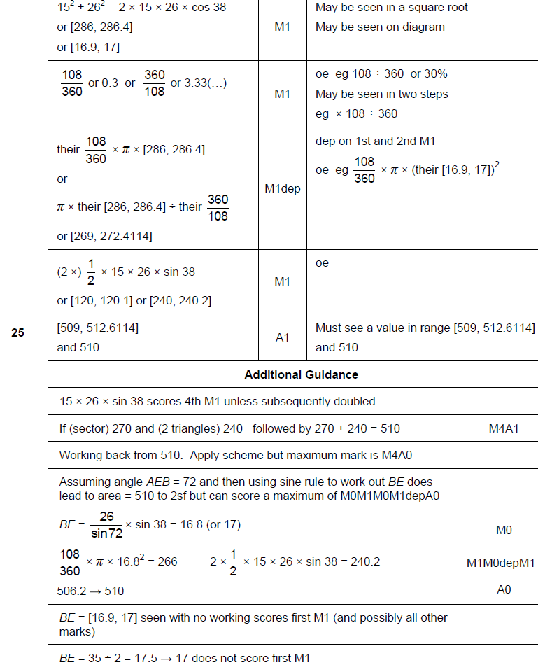
Show that…
June 2017 2H Q25
A

Slide 96
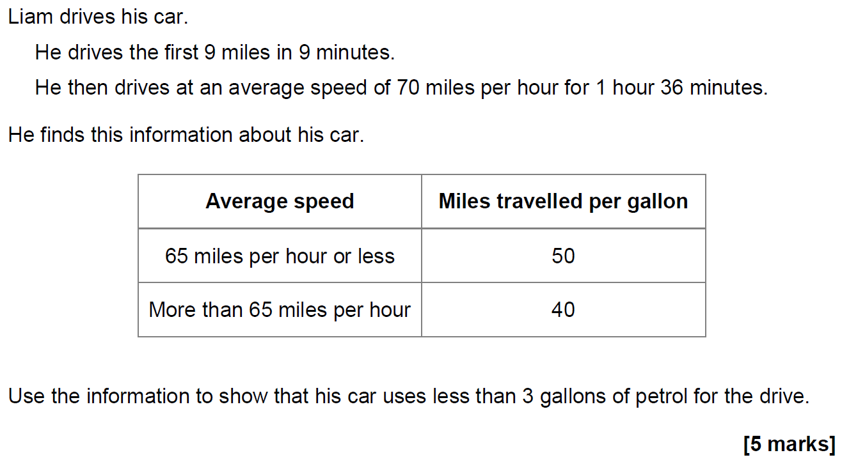
Show that…
June 2017 3H Q17

Slide 97
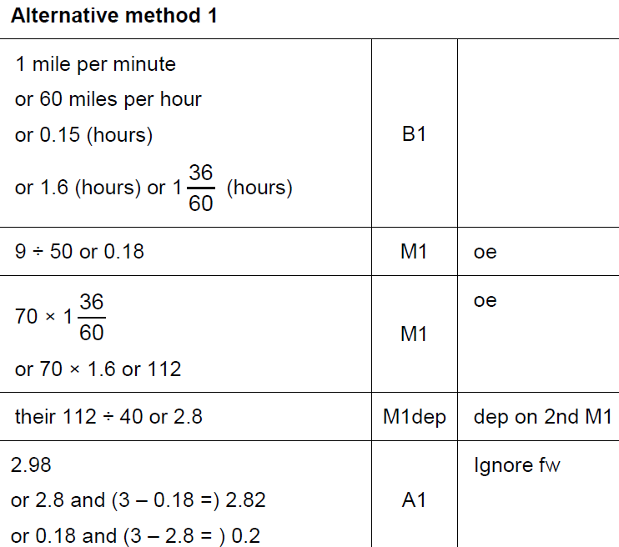
Show that…
June 2017 3H Q17
A

Slide 98
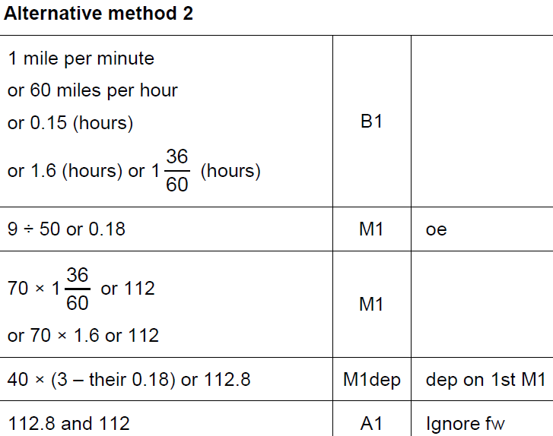
Show that…
June 2017 3H Q17
A Alternative 1

Slide 99
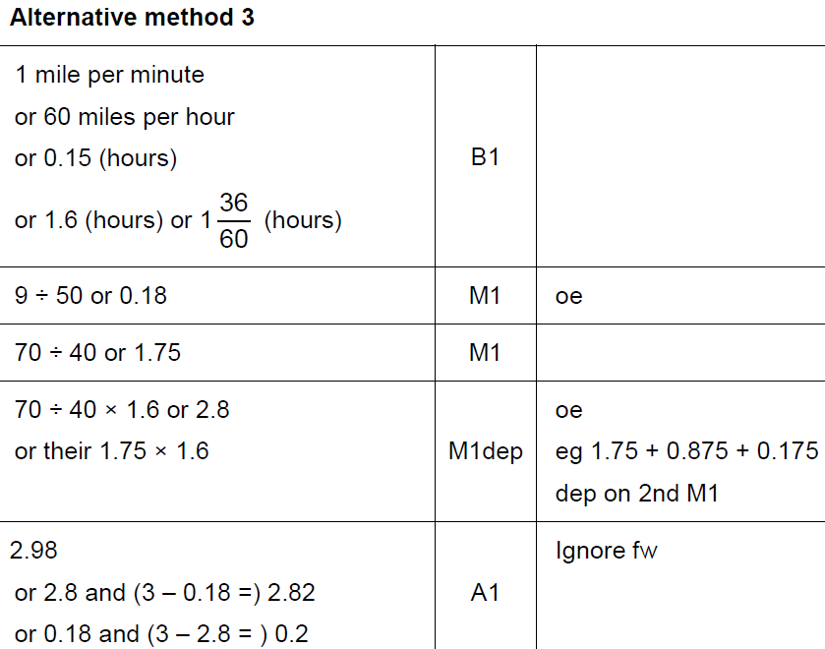
Show that…
June 2017 3H Q17
A Alternative 2

Slide 100
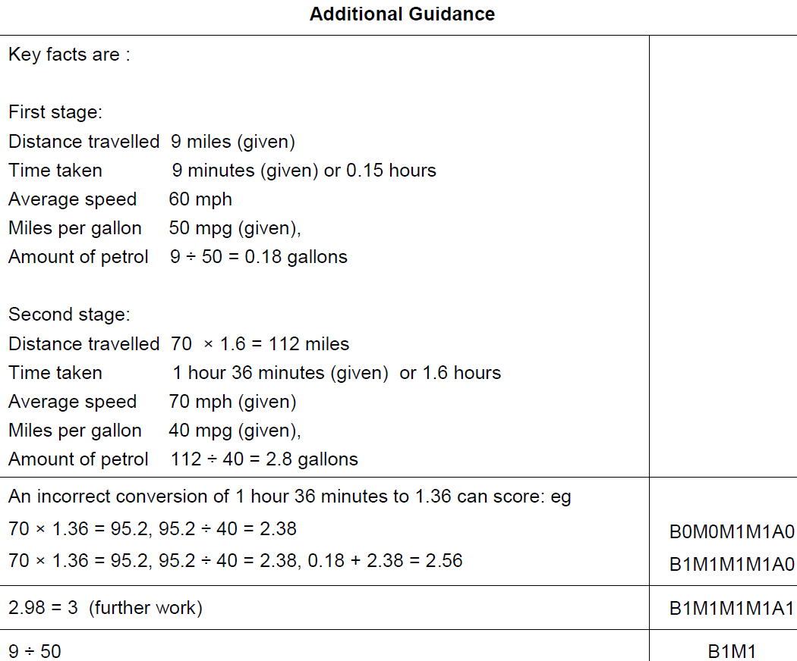
Show that…
June 2017 3H Q17
A notes

Slide 101
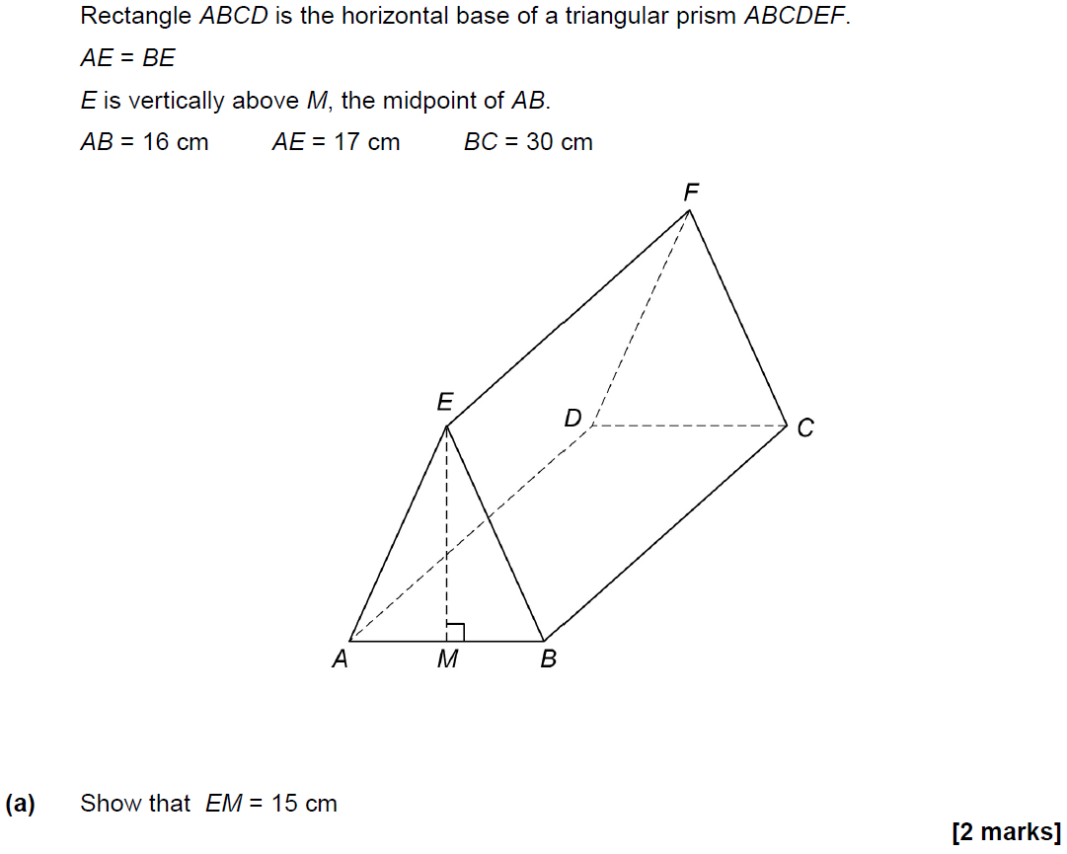
Show that…
June 2017 3H Q25

Slide 102
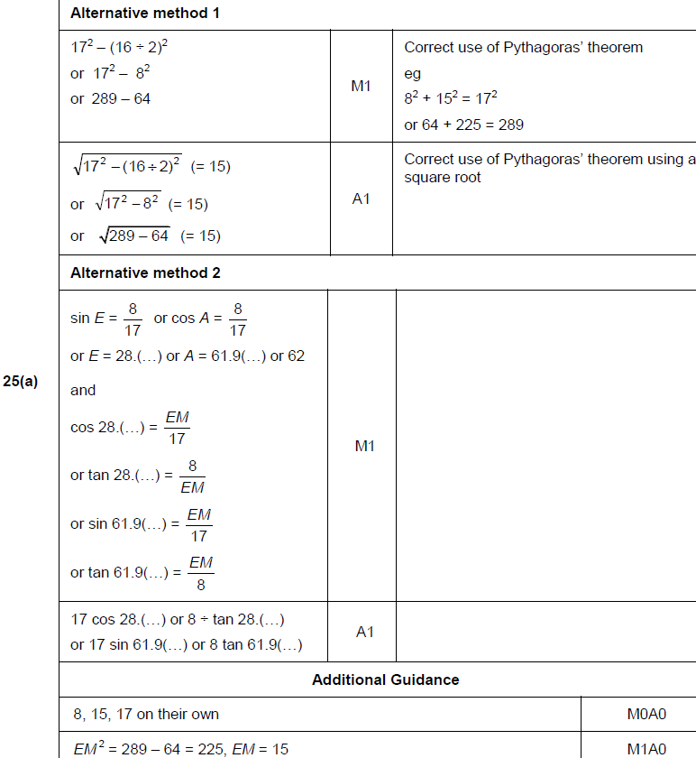
Show that…
June 2017 3H Q25
A

Slide 103
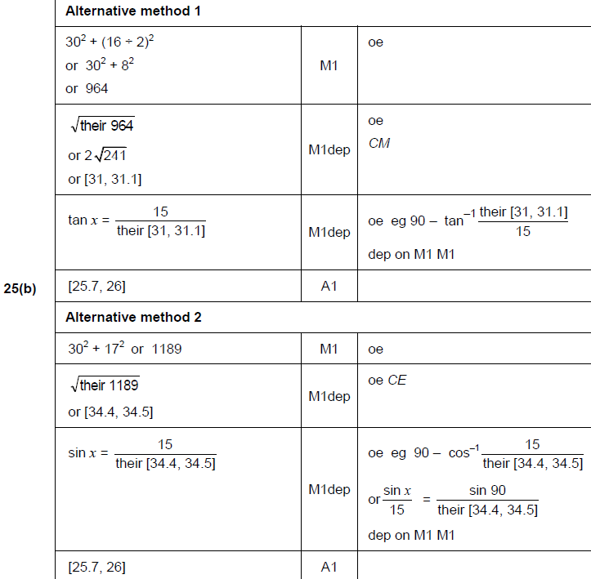
Show that…
June 2017 3H Q25
B

Slide 104
Show that…
June 2017 3H Q25
B Alternatives

Slide 105
Show that…
June 2017 3H Q27

Slide 106
Show that…
June 2017 3H Q27
A

Slide 107
Show that…
June 2017 3H Q27
A Alternatives & notes

Slide 108
Show that…
Nov 2017 1H Q19

Slide 109
Show that…
Nov 2017 1H Q19
A

Slide 110
Show that…
Nov 2017 3H Q6

Slide 111
Show that…
Nov 2017 3H Q6
A

Slide 112
Show that…
May 2018 1H Q30
Show that the value of cos 30° × tan 60° + sin 30° is an integer.
[3 marks]

Slide 113
Show that…
May 2018 1H Q30
A

Slide 114
Show that…
June 2018 2H Q13

Slide 115
Show that…
June 2018 2H Q13
A

Slide 116
Show that…
June 2018 2H Q13
A Alternative & notes

Slide 117
Show that…
June 2018 2H Q26

Slide 118
Show that…
June 2018 2H Q26
A

Slide 119
Show that…
June 2018 2H Q26
A Alternative

Slide 120
Show that…
June 2018 2H Q26
A notes

Slide 121
Show that…
June 2018 3H Q8

Slide 122
Show that…
June 2018 3H Q8
A

Slide 123
Show that…
June 2018 3H Q8
A Alternative & notes

Slide 124
Show that…
June 2018 3H Q8
B

Slide 125
Show that…
June 2018 3H Q18

Slide 126
Show that…
June 2018 3H Q18
A

Slide 127
Show that…
June 2018 3H Q18
A Alternative

Slide 128
Show that…
June 2018 3H Q18
A notes

Slide 129
Show that…
Nov 2018 1H Q19
In a chess club, there are x boys and y girls.
(a) If 5 more boys and 8 more girls join, there would be half as many boys as girls.
Show that y = 2x + 2
[2 marks]
(b) If instead,
10 more boys and 1 more girl join, there would be the same number of boys and girls.
Work out x and y.
[3 marks]

Slide 130
Show that…
Nov 2018 1H Q19
A
B

Slide 131
Show that…
Nov 2018 2H Q20

Slide 132
Show that…
Nov 2018 2H Q20
A

Slide 133
Show that…
Nov 2018 3H Q7

Slide 134
Show that…
Nov 2018 3H Q7
A

Slide 135
Show that…
Nov 2018 3H Q16
In a running club there are 50 females and 80 males.
If a female is chosen at random, the probability she has blue eyes is 0.38
If a male is chosen at random, the probability he has blue eyes is 0.6
One person is chosen at random.
Show that the probability the person has blue eyes is more than 0.5
[4 marks]

Slide 136
Show that…
Nov 2018 3H Q16
A

Slide 137
Show that…
Nov 2018 3H Q16
A Alternative 3 & 4

Slide 138
Show that…
Nov 2018 3H Q27

Slide 139
Show that…
Nov 2018 3H Q27
A

Slide 140
Show that…
Nov 2018 3H Q27
B

Slide 141
Show that…
Nov 2018 3H Q27
B notes

Slide 142
Show that…
SAM 1H Q11

Slide 143
Show that…
SAM 1H Q11
A
B

Slide 144
Show that…
SAM 1H Q17

Slide 145
Show that…
SAM 1H Q17
A

Slide 146
Show that…
SAM 1H Q17

Slide 147
Show that…
SAM 1H Q17
A

Slide 148
Show that…
SAM 1H Q20

Slide 149
Show that…
SAM 1H Q20
A
B

Slide 150
Show that…
SAM 2H Q14

Slide 151
Show that…
SAM 2H Q14
A

Slide 152
Show that…
SAM 2H Q16

Slide 153
Show that…
SAM 2H Q16
A

Slide 154
Show that…
SAM 3H Q7

Slide 155
Show that…
SAM 3H Q7
A

Slide 156
Show that…
SAM 3H Q8

Slide 157
Show that…
SAM 3H Q8
A
B

Slide 158
Show that…
Practice 1H Q12

Slide 159
Show that…
Practice 1H Q12
A

Slide 160
Show that…
Practice 1H Q13

Slide 161
Show that…
Practice 1H Q13
A
B

Slide 162
Show that…
Practice 2H Q15

Slide 163
Show that…
Practice 2H Q15
A
B

Slide 164
Show that…
Practice 2H Q15

Slide 165
Show that…
Practice 2H Q15
A
B

Slide 166
Show that…
Practice 2H Q17

Slide 167
Show that…
Practice 2H Q17
A

Slide 168
Show that…
Practice 3H Q11

Slide 169
Show that…
Practice 3H Q11
A
B (i)
B (ii)
C

Slide 170
Show that…
Practice 3H Q15

Slide 171
Show that…
Practice 3H Q15
A

Slide 172
Show that…
Practice 3H Q17

Slide 173
Show that…
Practice 3H Q17
A
B

Slide 174
Show that…
May 2017 1H Q10

Slide 175
Show that…
May 2017 1H Q10
A
B
C

Slide 176
Show that…
June 2017 2H Q8

Slide 177
Show that…
June 2017 2H Q8
A
B

Slide 178
Show that…
June 2017 2H Q14

Slide 179
Show that…
June 2017 2H Q14
A
B

Slide 180
Show that…
June 2017 2H Q21

Slide 181
Show that…
June 2017 2H Q21
A
B

Slide 182
Show that…
June 2017 3H Q17

Slide 183
Show that…
June 2017 3H Q17
A

Slide 184
Show that…
Nov 2017 1H Q17

Slide 185
Show that…
Nov 2017 1H Q17
A
B

Slide 186
Show that…
Nov 2017 2H Q8

Slide 187
Show that…
Nov 2017 2H Q8
A
B

Slide 188
Show that…
Nov 2017 2H Q11

Slide 189
Show that…
Nov 2017 2H Q11
A (i)
A (ii)
A (iii)
B

Slide 190
Show that…
Nov 2017 2H Q18

Slide 191
Show that…
Nov 2017 2H Q18
A

Slide 192
Show that…
Nov 2017 3H Q14

Slide 193
Show that…
Nov 2017 3H Q14
A
B

Slide 194
Show that…
Nov 2017 3H Q17

Slide 195
Show that…
Nov 2017 3H Q17
A
B
C

Slide 196
Show that…
May 2018 1H Q12

Slide 197
Show that…
May 2018 1H Q12
A
B
C

Slide 198
Show that…
May 2018 1H Q13

Slide 199
Show that…
May 2018 1H Q13
A
B

Slide 200
Show that…
June 2018 2H Q8

Slide 201
Show that…
June 2018 2H Q8
A
B (i)
B (ii)

Slide 202
Show that…
June 2018 2H Q15

Slide 203
Show that…
June 2018 2H Q15
A

Slide 204
Show that…
June 2018 3H Q4

Slide 205
Show that…
June 2018 3H Q4
A
B

Slide 206
Show that…
June 2018 3H Q9

Slide 207
Show that…
June 2018 3H Q9
A
B
C

Slide 208
Show that…
June 2018 3H Q14

Slide 209
Show that…
June 2018 3H Q14
A
B (i)
B (ii)

Slide 210
Show that…
June 2018 3H Q19

Slide 211
Show that…
June 2018 3H Q19
A

Slide 212
Show that…
Nov 2018 1H Q2

Slide 213
Show that…
Nov 2018 1H Q2
A
B

Slide 214
Show that…
Nov 2018 1H Q22

Slide 215
Show that…
Nov 2018 1H Q22
A

Slide 216
Show that…
Nov 2018 2H Q13

Slide 217
Show that…
Nov 2018 2H Q13
A
B

Slide 218
Show that…
Nov 2018 2H Q20

Slide 219
Show that…
Nov 2018 2H Q20
A
B

Slide 220
Show that…
Nov 2018 3H Q5

Slide 221
Show that…
Nov 2018 3H Q5
A
B
C

Slide 222
Show that…
Nov 2018 3H Q16

Slide 223
Show that…
Nov 2018 3H Q16
A

Slide 224
Show that…
Nov 2018 3H Q21

Slide 225
Show that…
Nov 2018 3H Q21
A

