Slide 1
Prisms
Prisms
Edexcel
Spec 1
1H Q5
Nov 2018
3H Q8
AQA
Spec 2
1H Q9
June 2019
2H Q4
OCR
Spec 2
3H Q8
June 2019
3H Q9
Cylinders

Slide 2
Prisms
Prisms
Nov 2017
2H Q6
May 2018
1H Q18
Edexcel
June 2018
2H Q16
AQA
SAM
1H Q18
1 Marker
Nov 2018
1H Q2
OCR
Nov 2018
2H Q13
Nov 2018
2H Q14
Cylinders

Slide 3
Prisms
Prisms
Edexcel
SAM
1H Q2
AQA
Practice
3H Q17
OCR
Cylinders

Slide 4
Prisms
Specimen Set 1 1H Q5

Slide 5
Prisms
Specimen Set 1 1H Q5
A

Slide 6
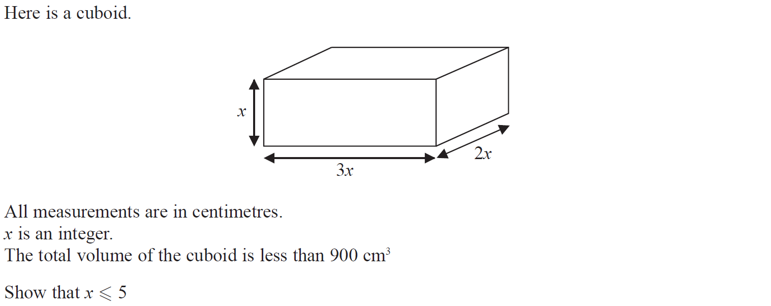
Prisms
Specimen Set 2 1H Q9

Slide 7
Prisms
Specimen Set 2 1H Q9
A

Slide 8
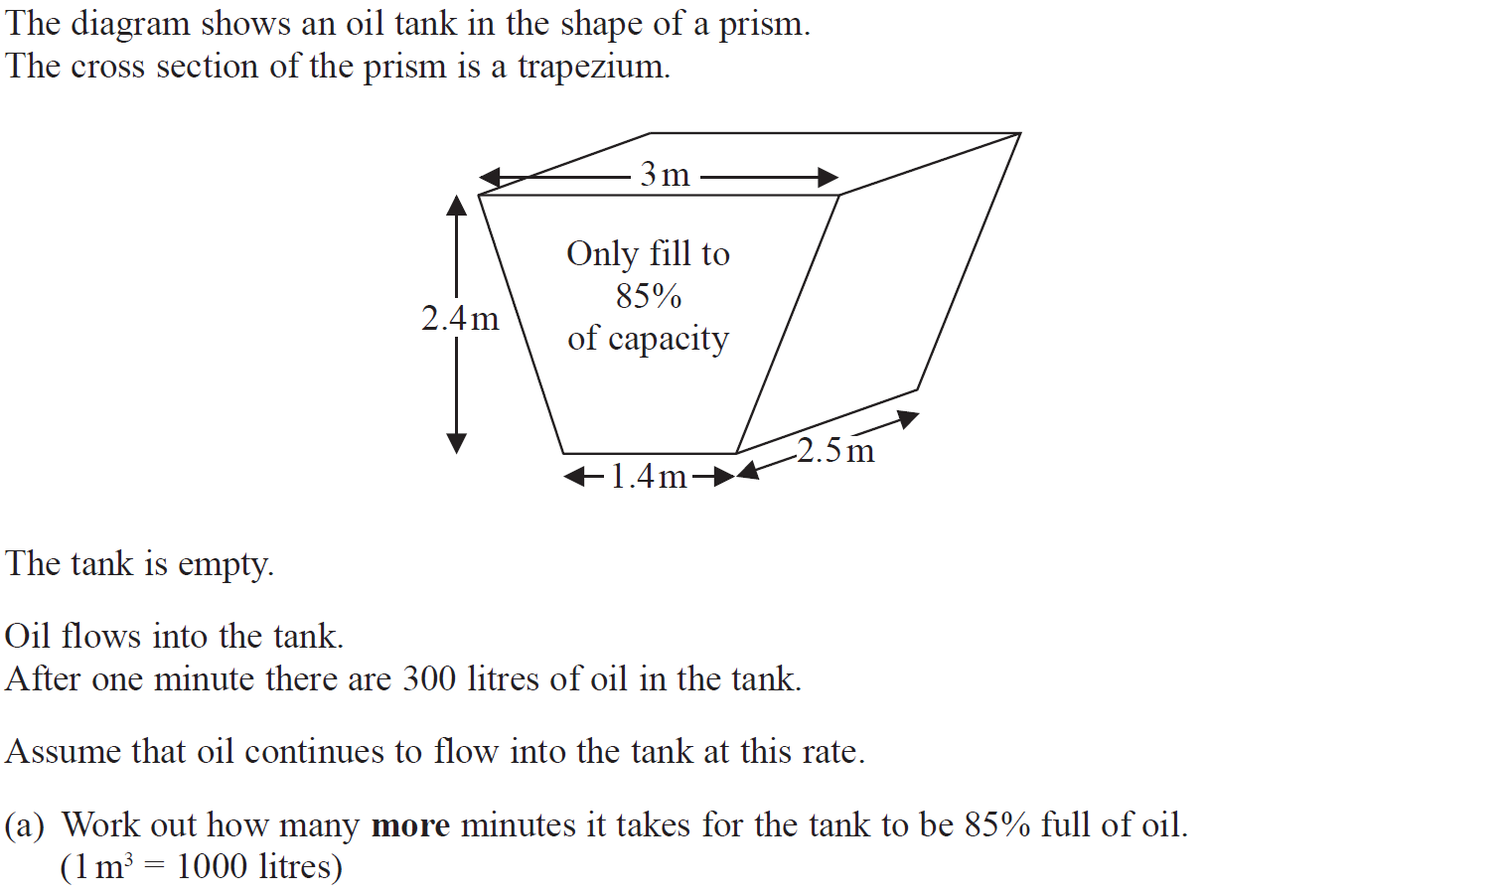
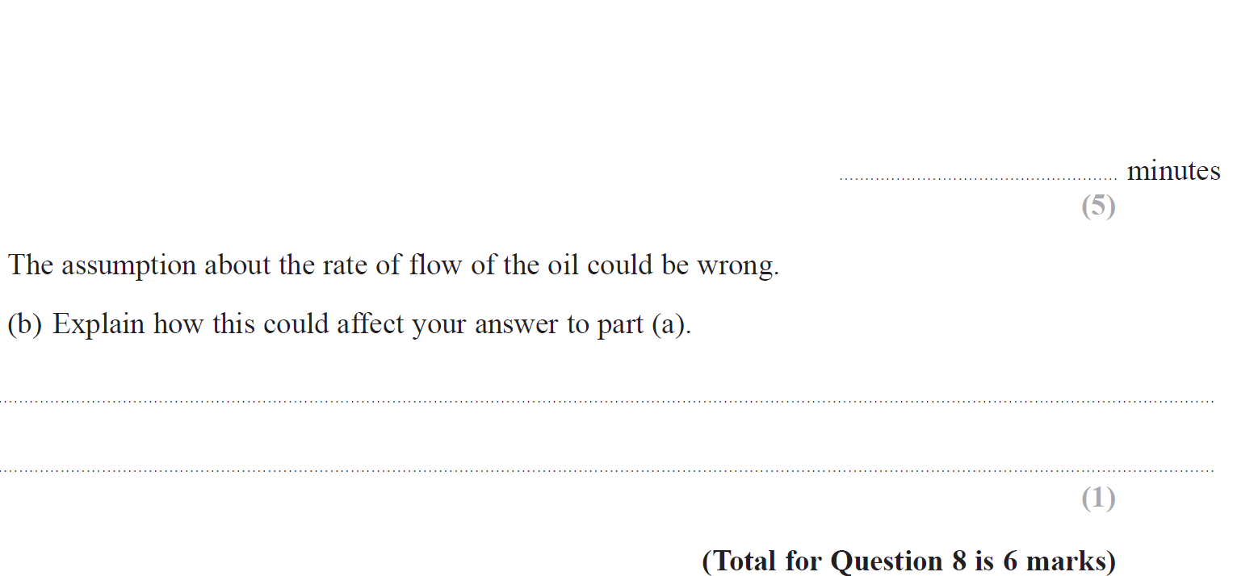
Prisms
Specimen Set 2 3H Q8

Slide 9
Prisms
Specimen Set 2 3H Q8
A
B

Slide 10
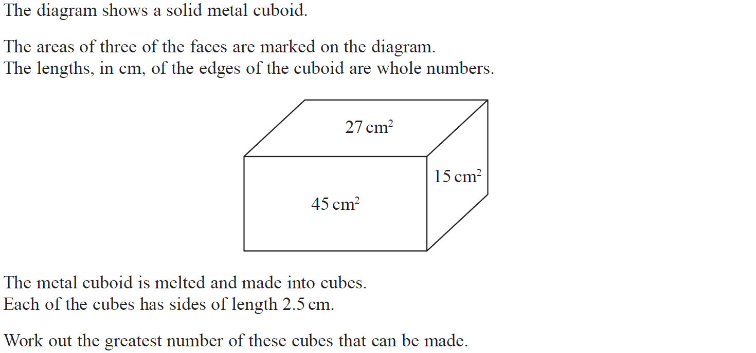
Prisms
Nov 2018 3H Q8

Slide 11
Prisms
Nov 2018 3H Q8
A

Slide 12
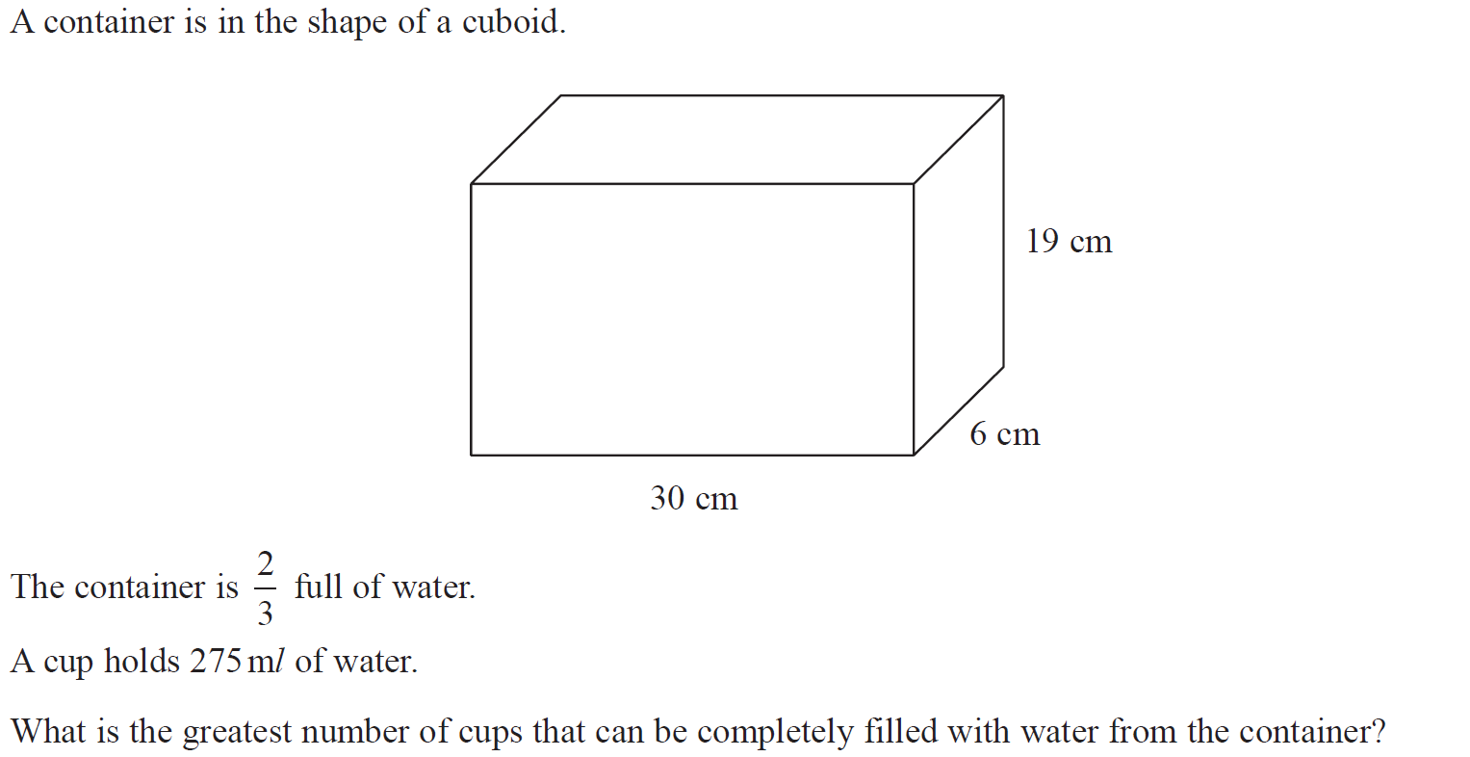
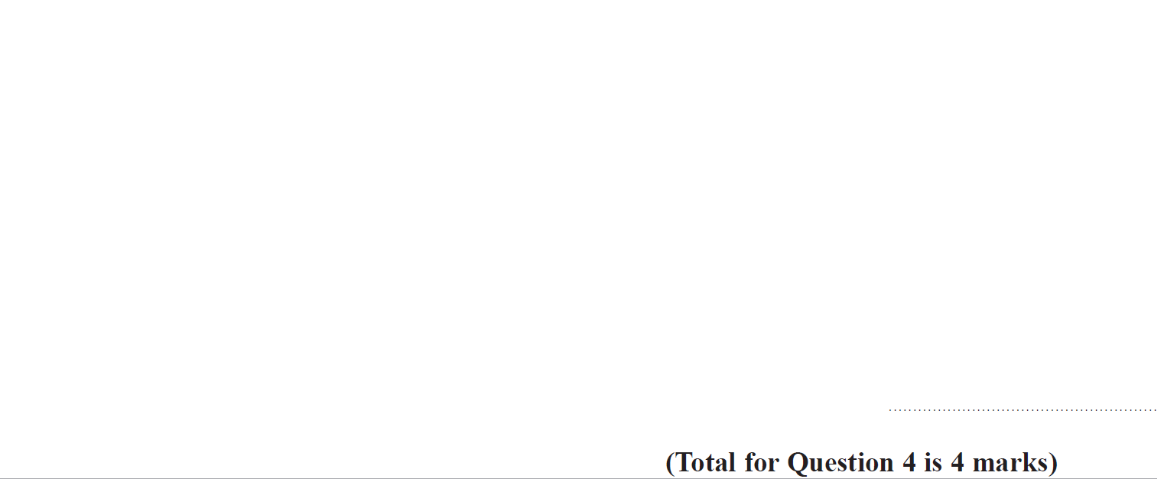
Prisms
June 2019 2H Q4

Slide 13
Prisms
June 2019 2H Q4
A
A SF

Slide 14
Prisms
June 2019 3H Q6

Slide 15
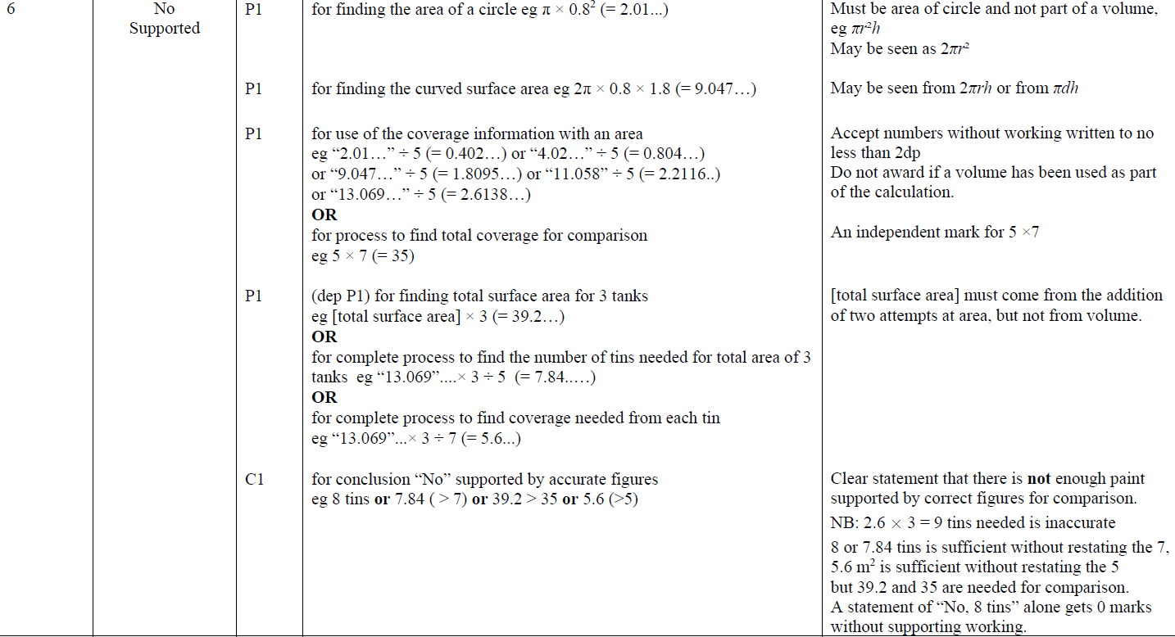
Prisms
June 2019 3H Q6
A

Slide 16
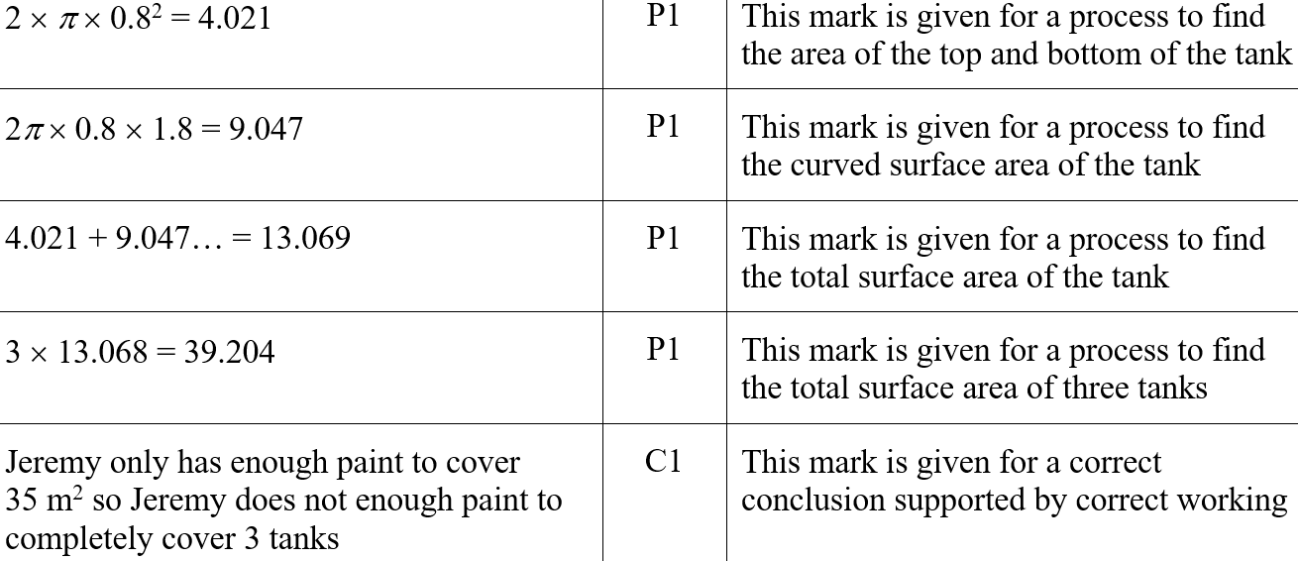
Prisms
June 2019 3H Q6
A SF

Slide 17
Prisms
SAM 1H Q18

Slide 18
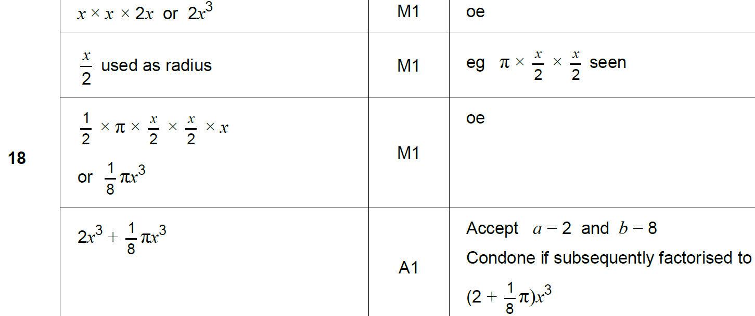
Prisms
SAM 1H Q18
A

Slide 19
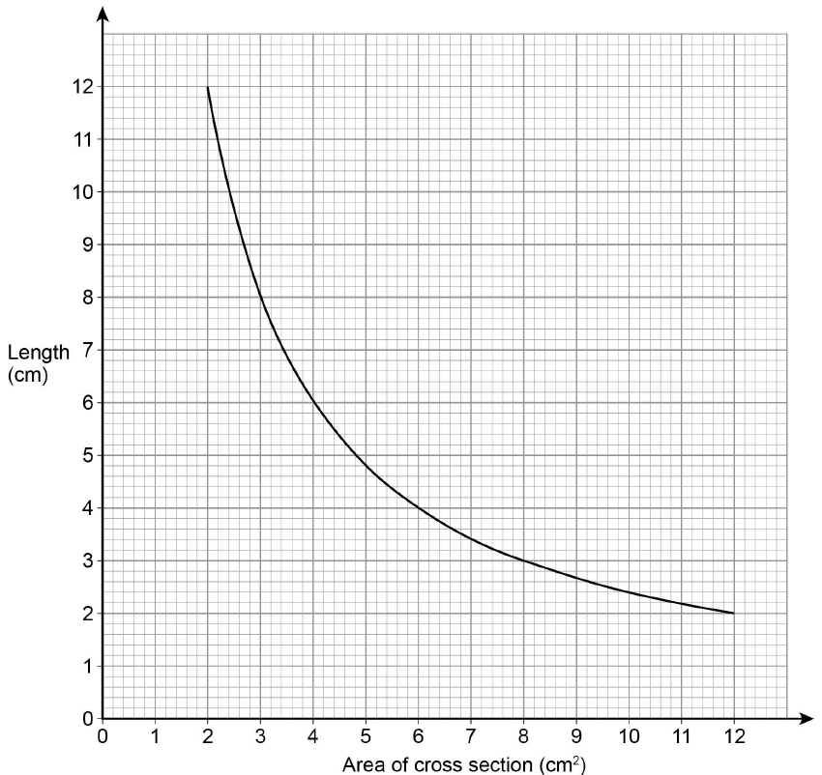
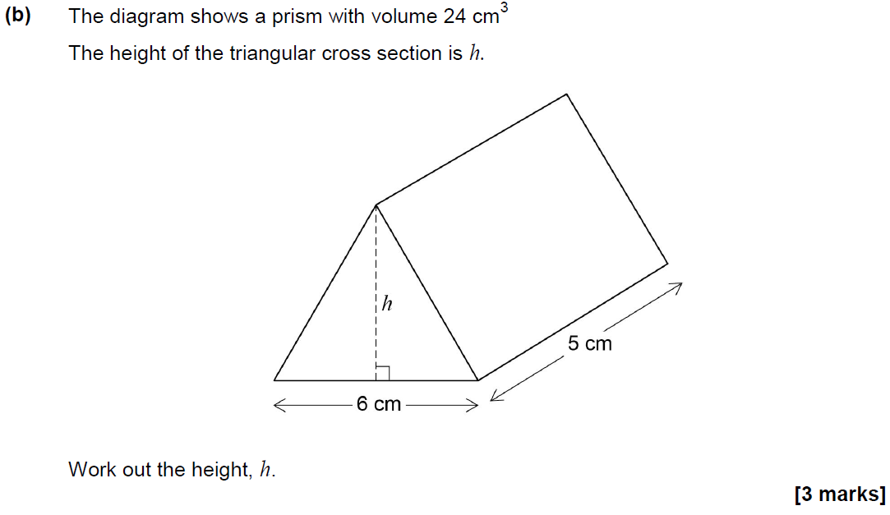
Prisms
Nov 2017 2H Q6

Slide 20
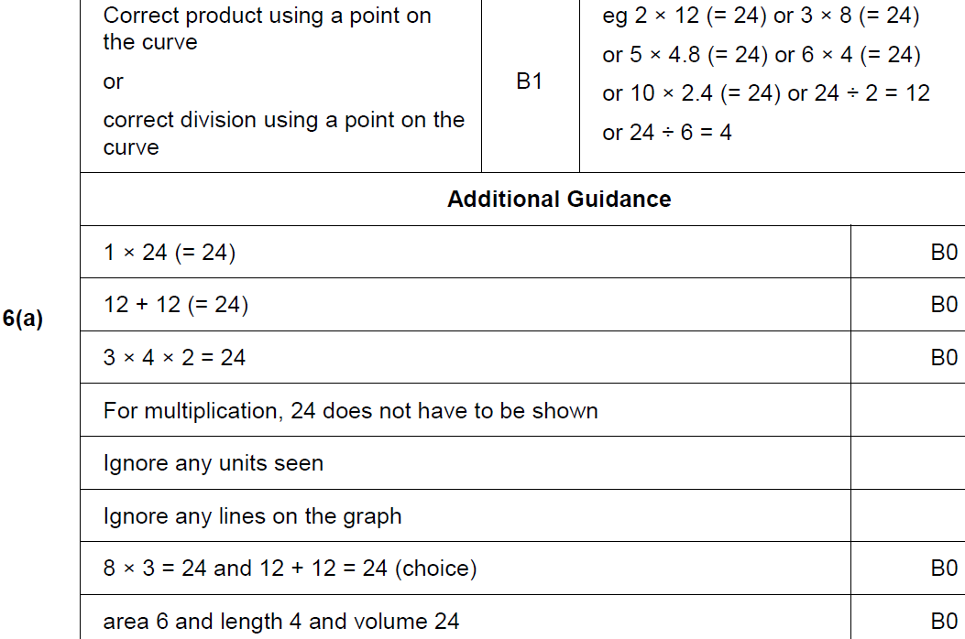
Prisms
Nov 2017 2H Q6
A

Slide 21
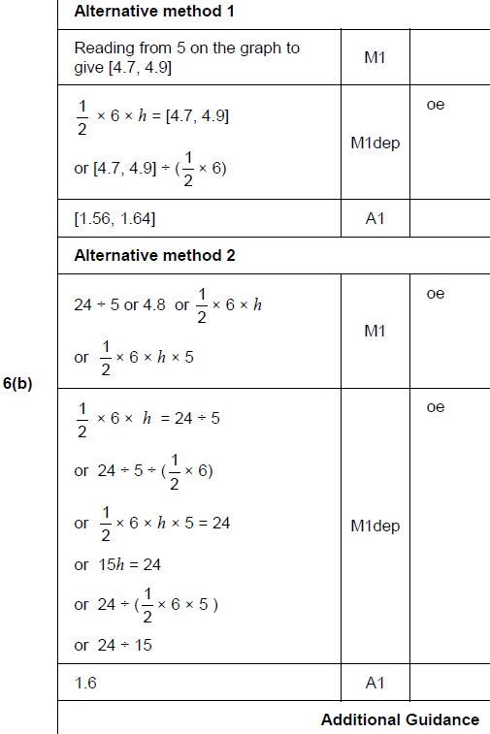
Prisms
Nov 2017 2H Q6
B

Slide 22
Prisms
May 2018 1H Q18

Slide 23
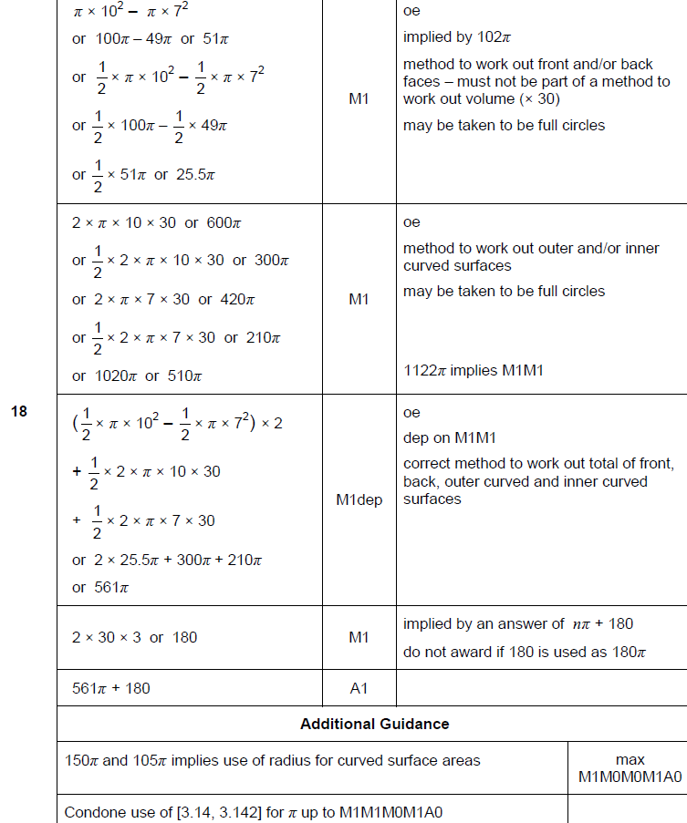
Prisms
May 2018 1H Q18
A

Slide 24
Prisms
June 2018 2H Q16

Slide 25
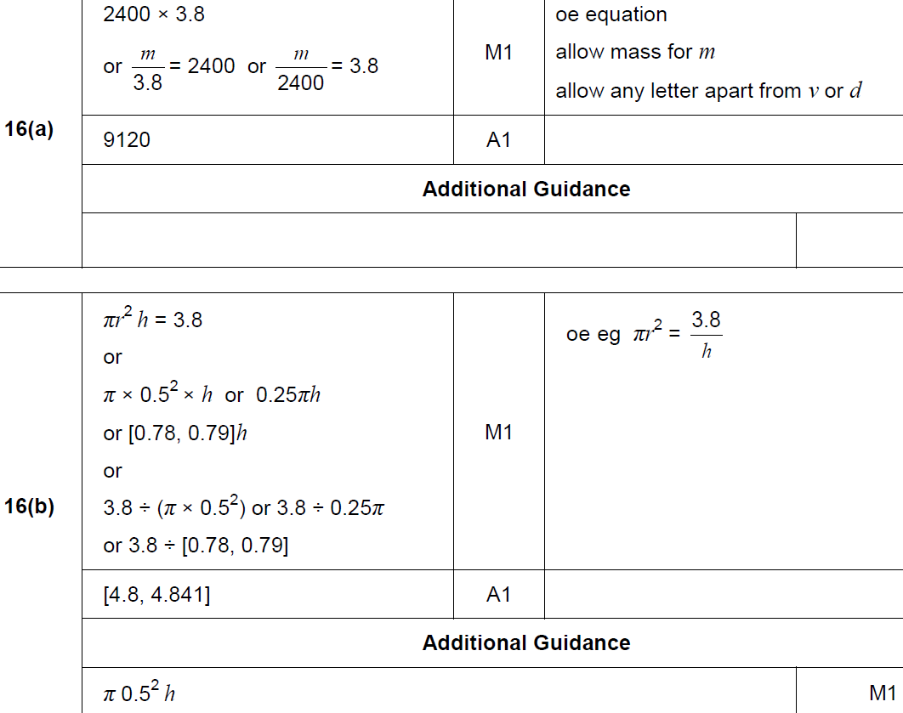
Prisms
June 2018 2H Q16
A
B

Slide 26
Prisms
Nov 2018 1H Q2

Slide 27
Prisms
Nov 2018 1H Q2
A

Slide 28
Prisms
Nov 2018 2H Q13

Slide 29
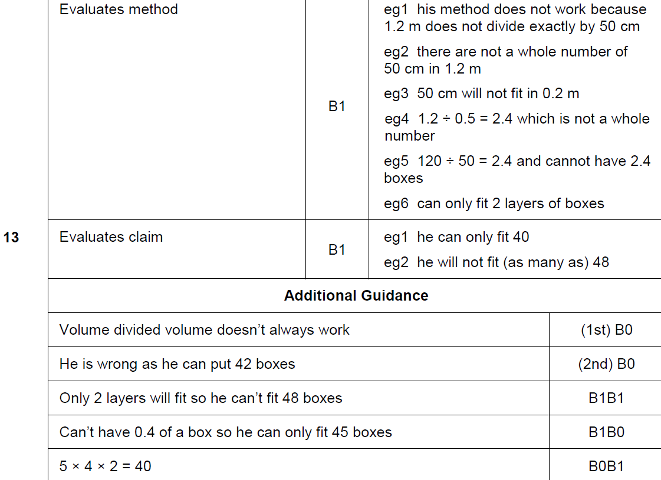
Prisms
Nov 2018 2H Q13
A

Slide 30
Prisms
Nov 2018 2H Q14

Slide 31
Prisms
Nov 2018 2H Q14
A

Slide 32
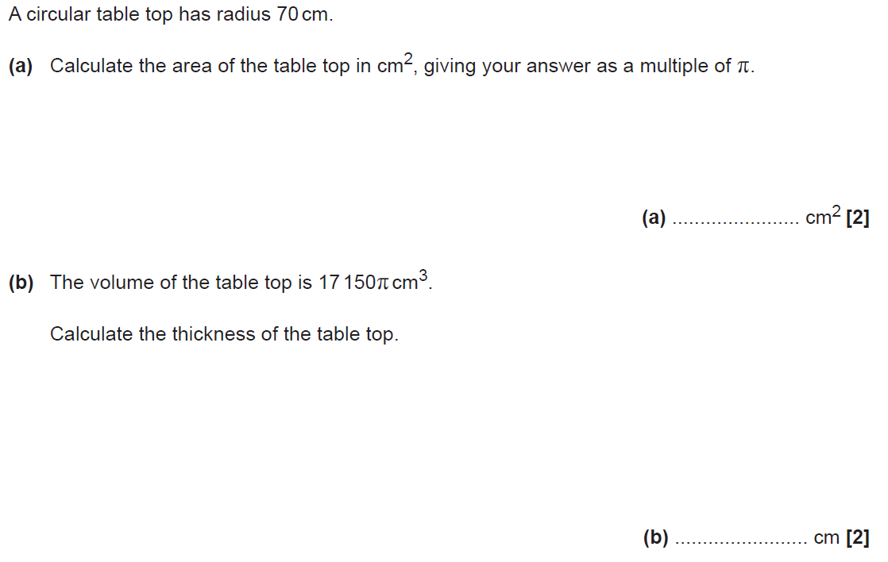
Prisms
SAM 1H Q2

Slide 33
Prisms
SAM 1H Q2
A

Slide 34
Prisms
Practice 3H Q17

Slide 35
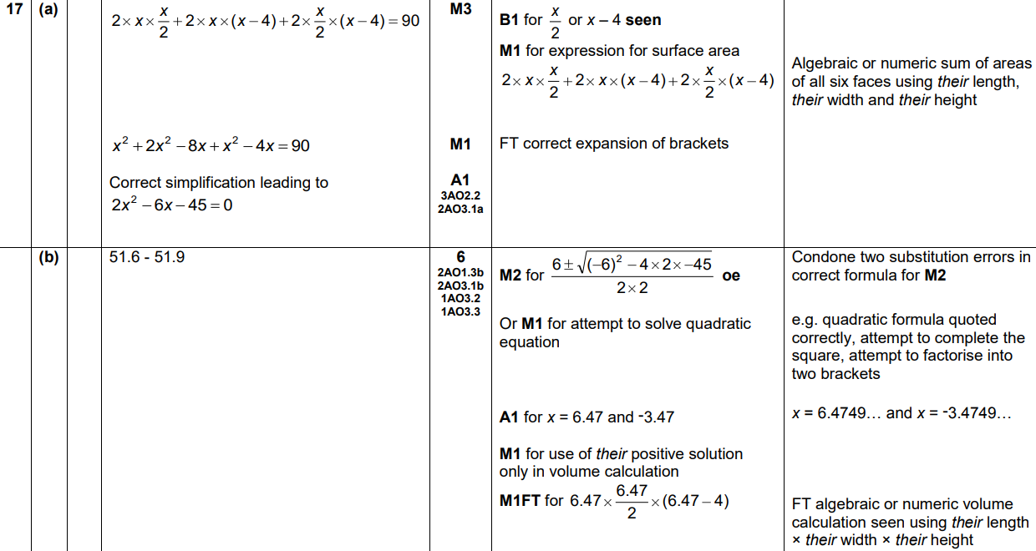
Prisms
Practice 3H Q17
A
B

