Slide 1
Prisms
Prisms
Old Spec Q’s
NTSQ
Q4
Jan 2019
2HR Q2
NTSQ
Q9
May 2019
1H Q6
NTSQ
Q16
May 2019
1H Q21
SAM
2H Q3
June 2019
2H Q4
June 2018
2H Q6
May 2018
1HR Q9
Jan 2019
1H Q15
Jan 2019
1HR Q17
Cylinders

Slide 2
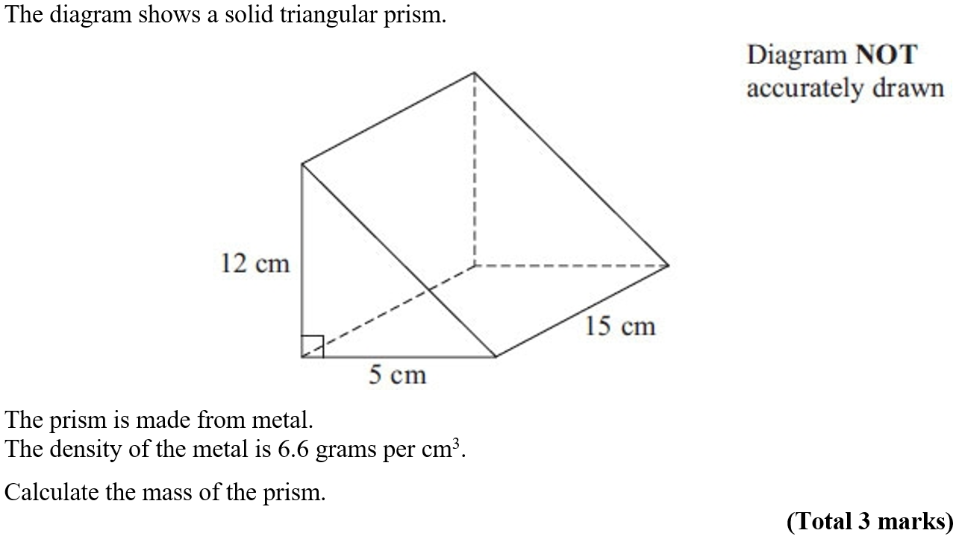
Prisms
NTSQ Q4

Slide 3
Prisms
NTSQ Q4
A

Slide 4
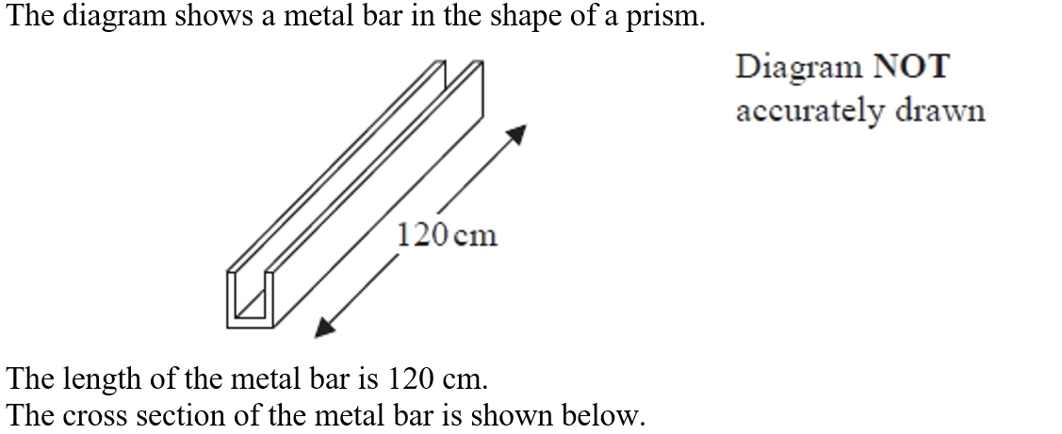
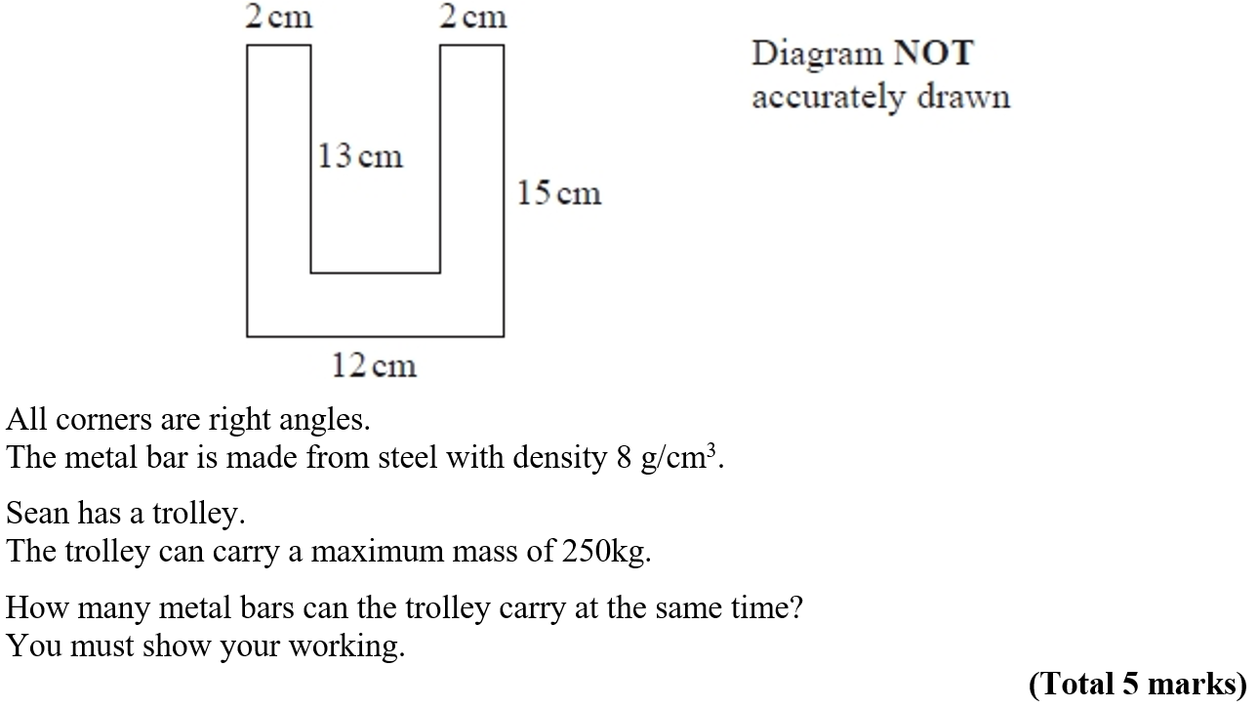
Prisms
NTSQ Q9

Slide 5
Prisms
NTSQ Q9
A

Slide 6
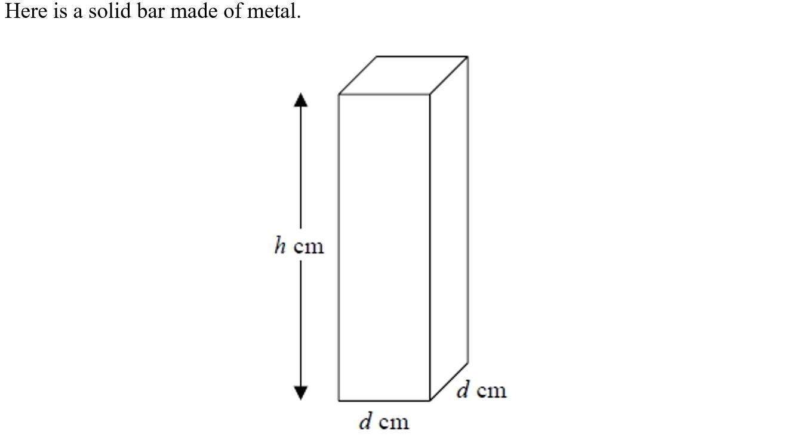
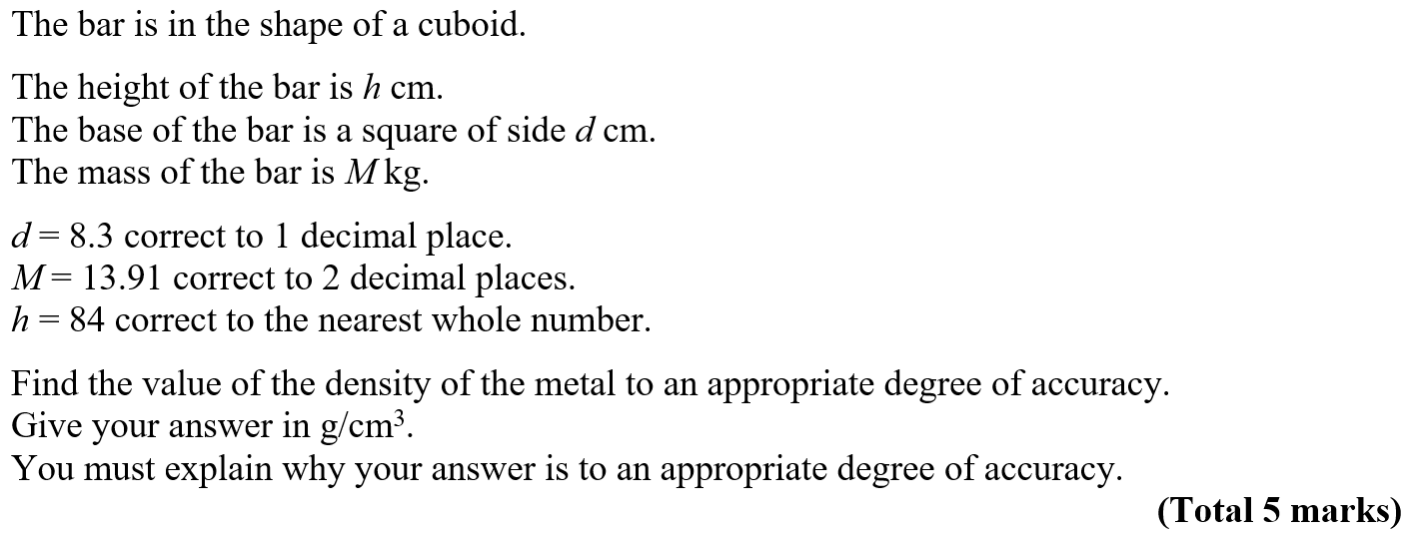
Prisms
NTSQ Q16

Slide 7
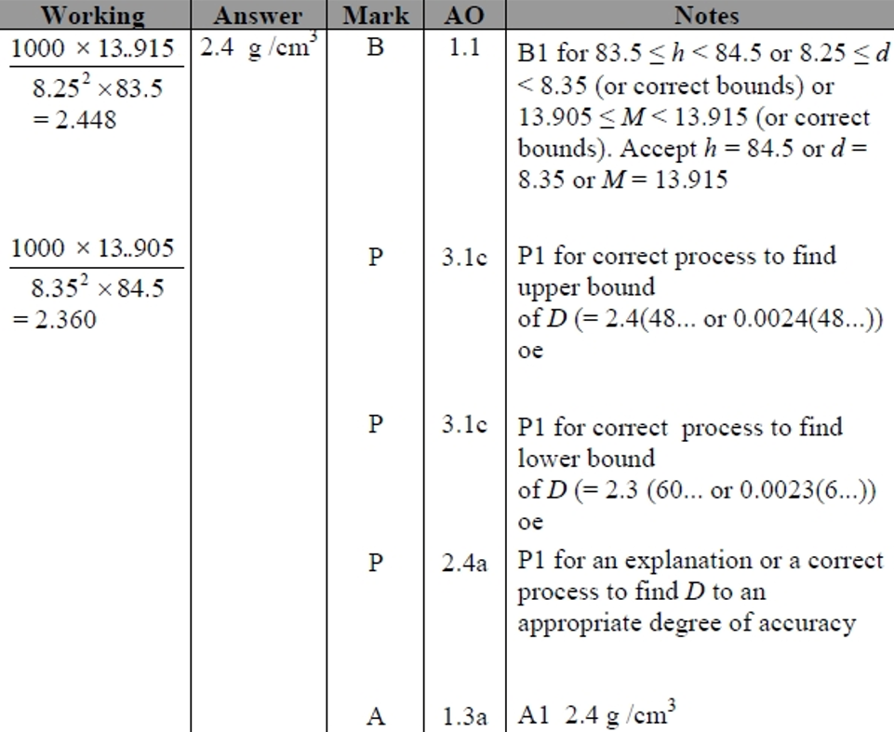
Prisms
NTSQ Q16
A

Slide 8
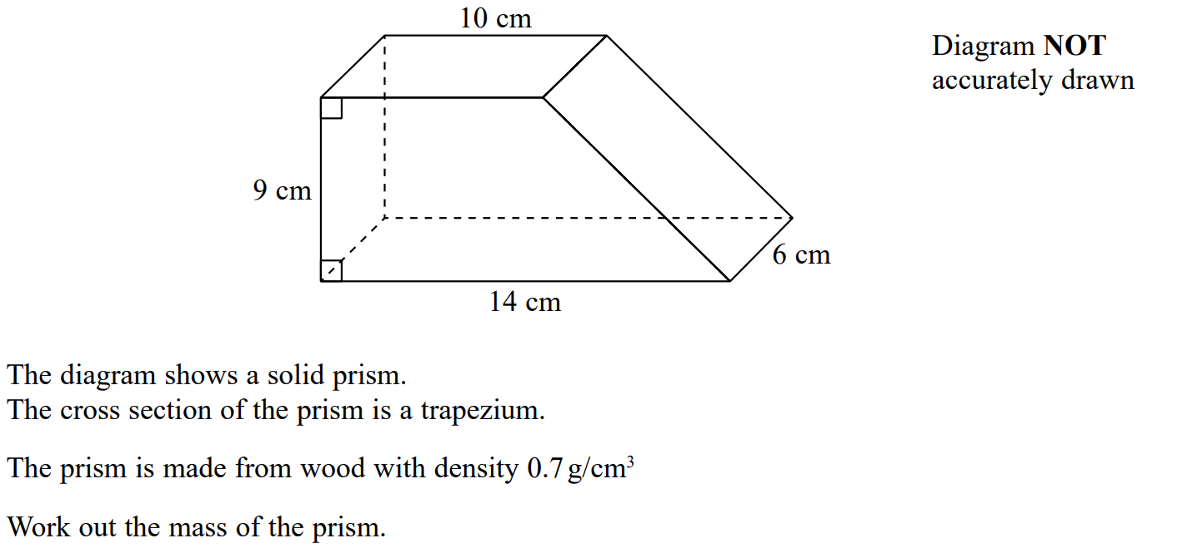
Prisms
SAM 2H Q3

Slide 9
Prisms
SAM 2H Q3
A

Slide 10
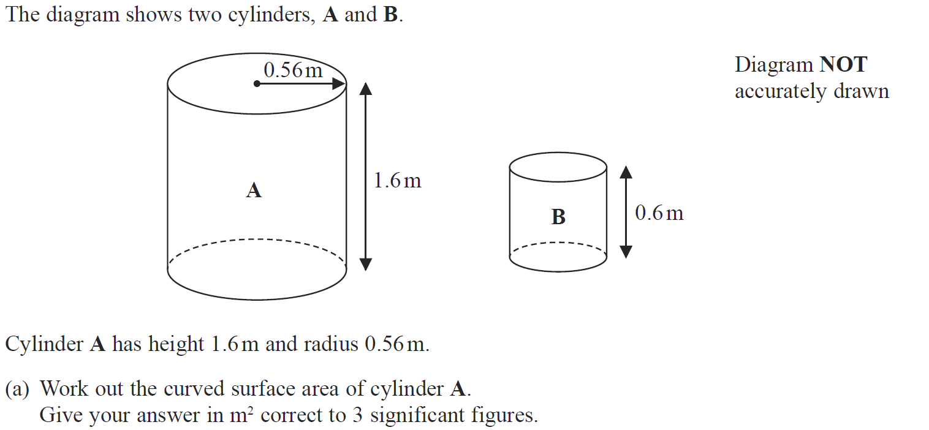
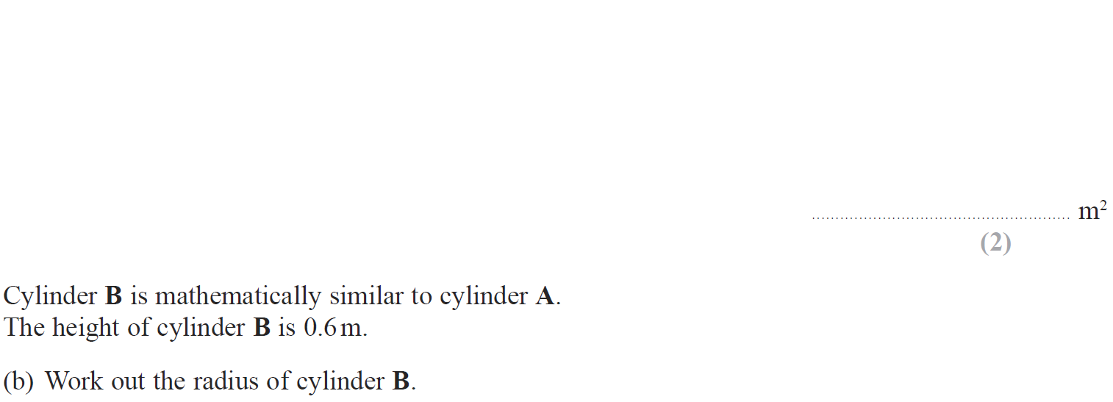
Prisms
June 2018 2H Q6

Slide 11
Prisms
June 2018 2H Q6
A
B

Slide 12
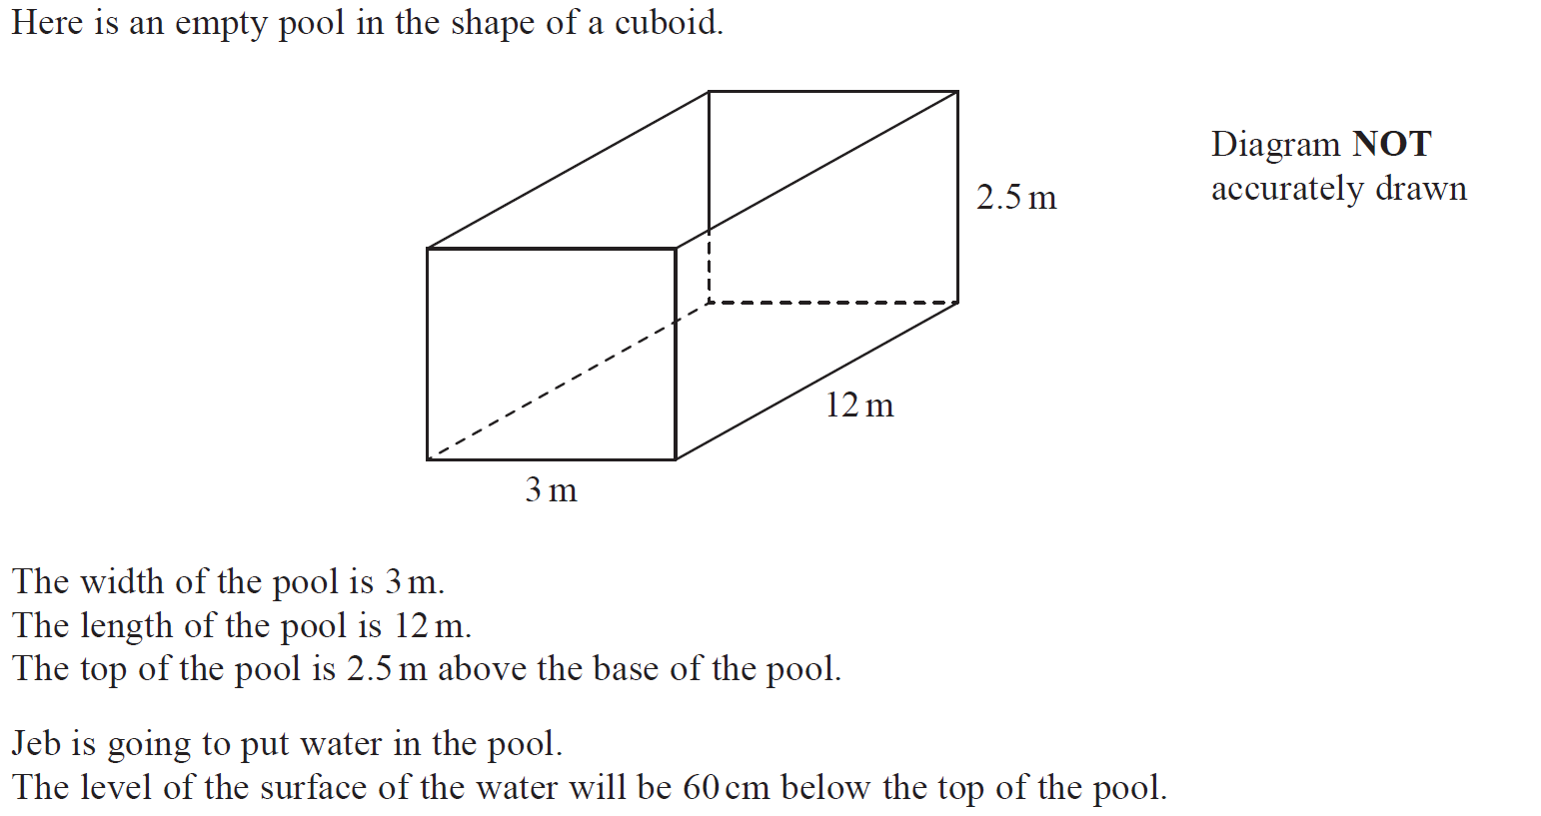
Prisms
May 2018 1HR Q9

Slide 13
Prisms
May 2018 1HR Q9
A

Slide 14
Prisms
Jan 2019 1H Q15

Slide 15
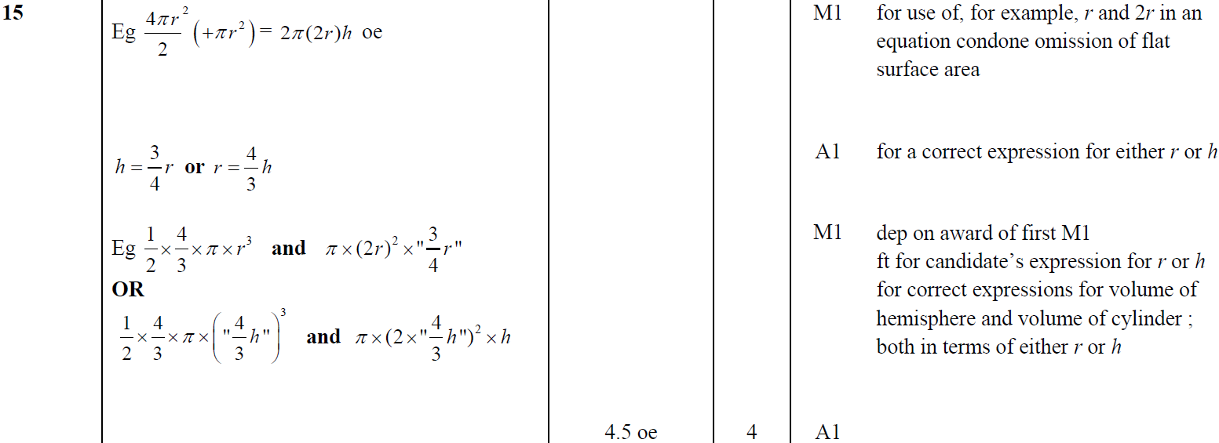
Prisms
Jan 2019 1H Q15
A

Slide 16
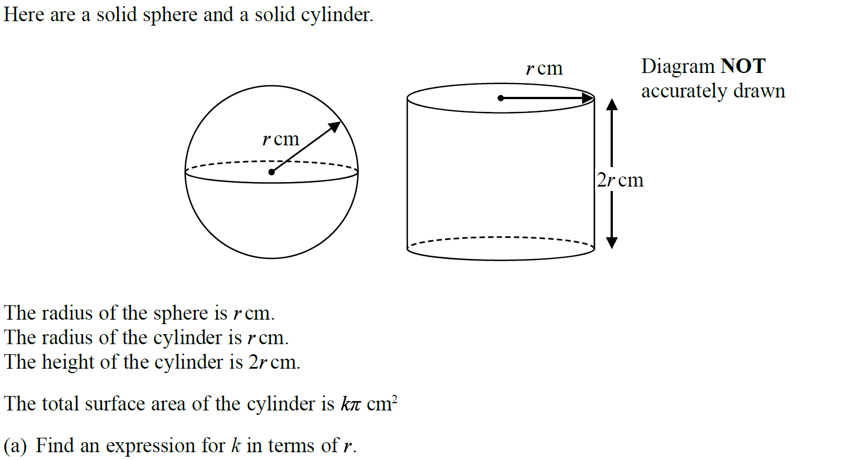
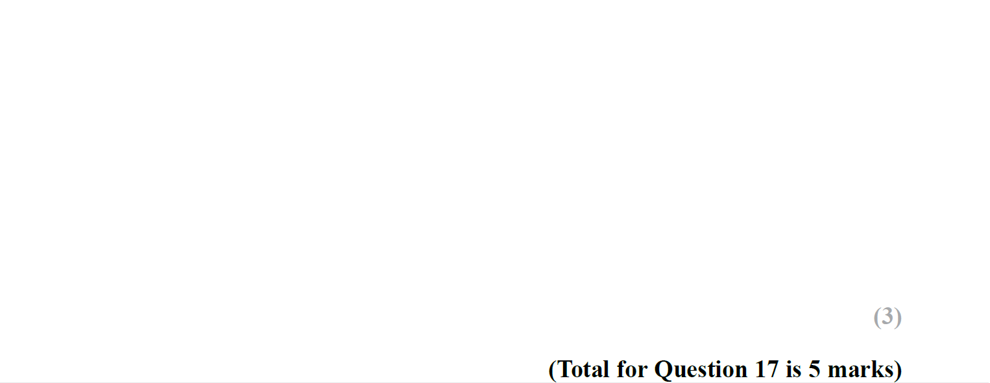
Prisms
Jan 2019 1HR Q17

Slide 17
Prisms
Jan 2019 1HR Q17
A
B

Slide 18
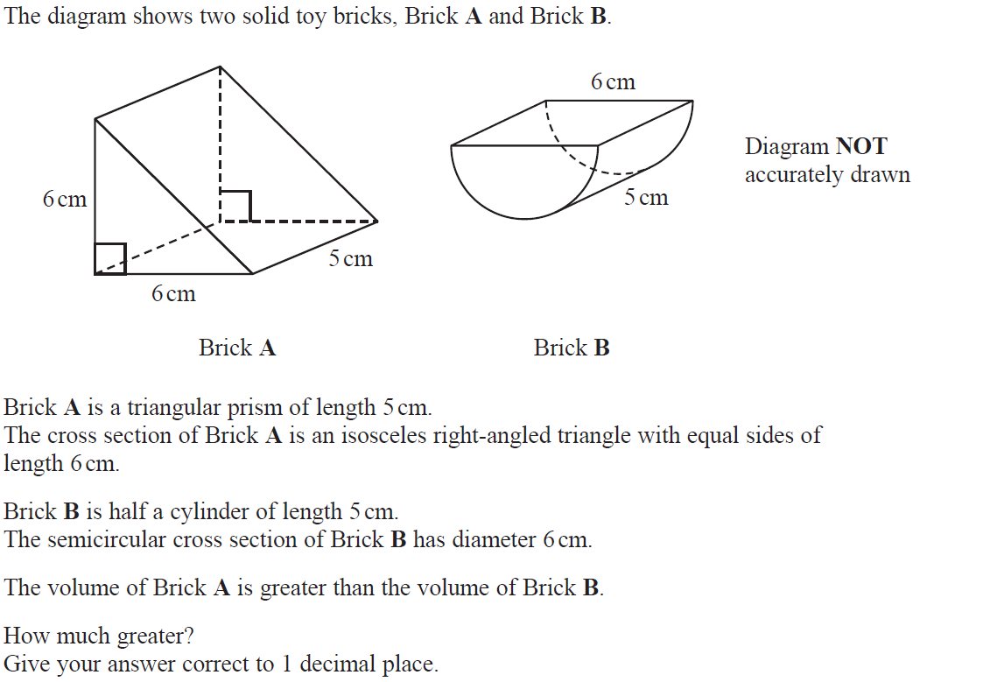
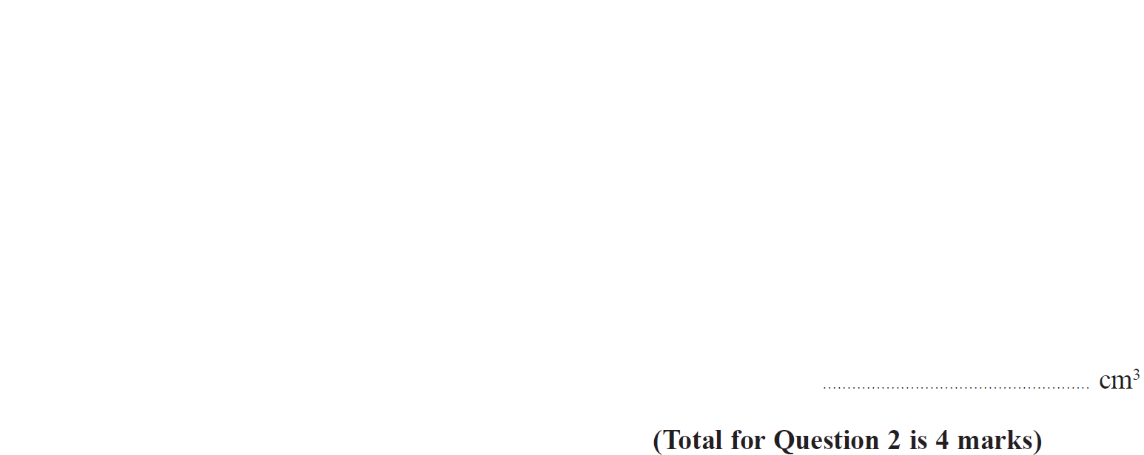
Prisms
Jan 2019 2HR Q2

Slide 19
Prisms
Jan 2019 2HR Q2
A

Slide 20
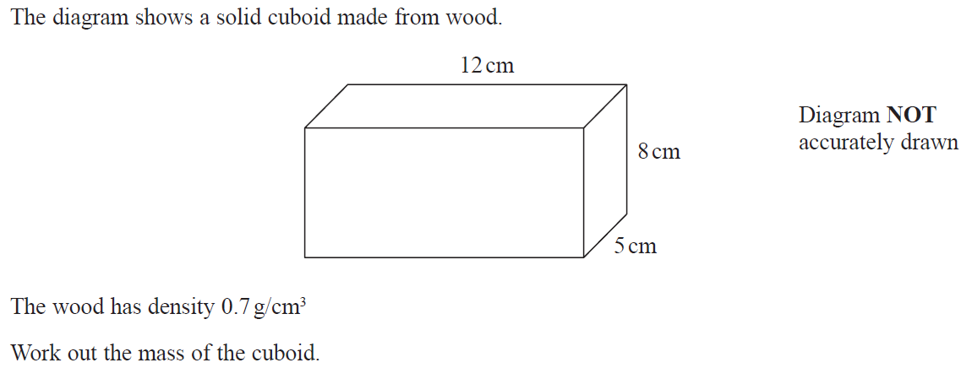
Prisms
May 2019 1H Q6

Slide 21
Prisms
May 2019 1H Q6
A

Slide 22
Prisms
May 2019 1H Q21

Slide 23
Prisms
May 2019 1H Q21
A

Slide 24
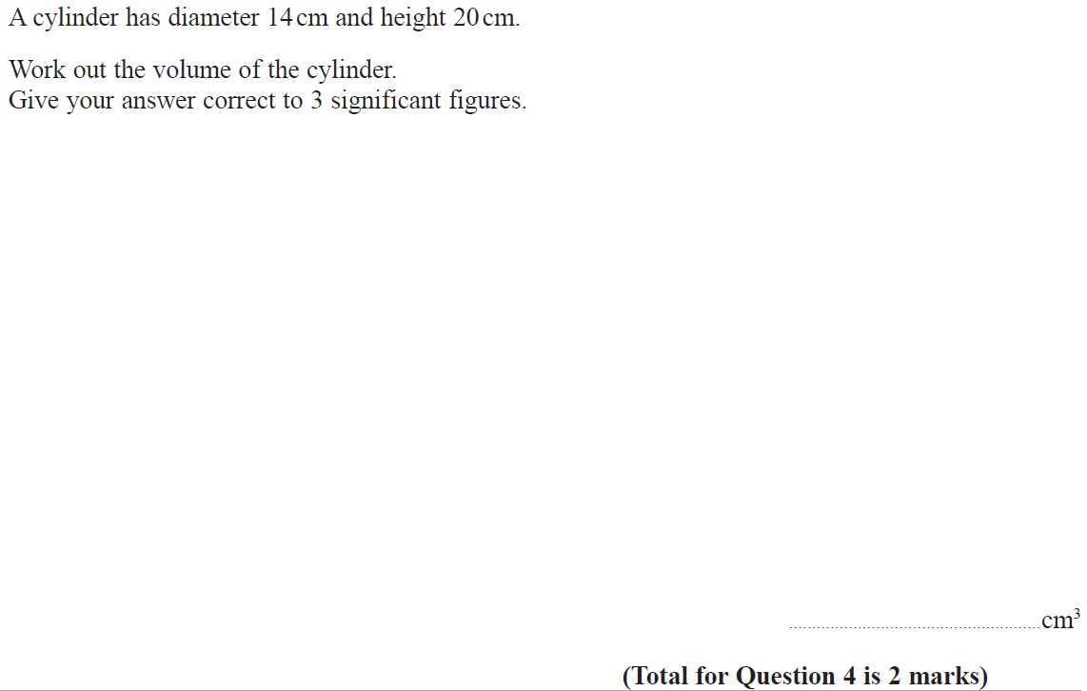
Prisms
June 2019 2H Q4

Slide 25
Prisms
June 2019 2H Q4
A

Slide 26
Prisms
Prisms
New Spec Q’s
Nov 2004
4H Q9
Nov 2010
3H Q15
Jan 2014 3HR Q14
June 2015 4HR Q11
Jan 2018 4HR Q2
May 2005
3H Q7
June 2011 3H Q23
Jan 2014 4HR Q19
Jan 2016 3H Q9
May 2018 3H Q19
Nov 2006
4H Q7
Jan 2012 3H Q3
May 2014 3H Q9
Jan 2016 4H Q23
June 2018 4H Q1
May 2007
3H Q7
May 2012 3H Q20
May 2014 3HR Q9
Jan 2016 3HR Q15
June 2018 4H Q11
Nov 2007
4H Q26
May 2012 4H Q22
Jan 2015 4H Q21
June 2016 4H Q20
May 2018 3HR Q15
May 2008
4H Q8
May 2013 3H Q8
Jan 2015 3HR Q10
Jan 2017 4H Q21
June 2018 4HR Q25
Nov 2008
3H Q6
May 2013 4HR Q19
Jan 2015 3HR Q17
May 2017 3HR Q19
Nov 2009
3H Q10
Jan 2014 4H Q2
May 2015 3H Q11
June 2017 4HR Q4
Cylinders

Slide 27
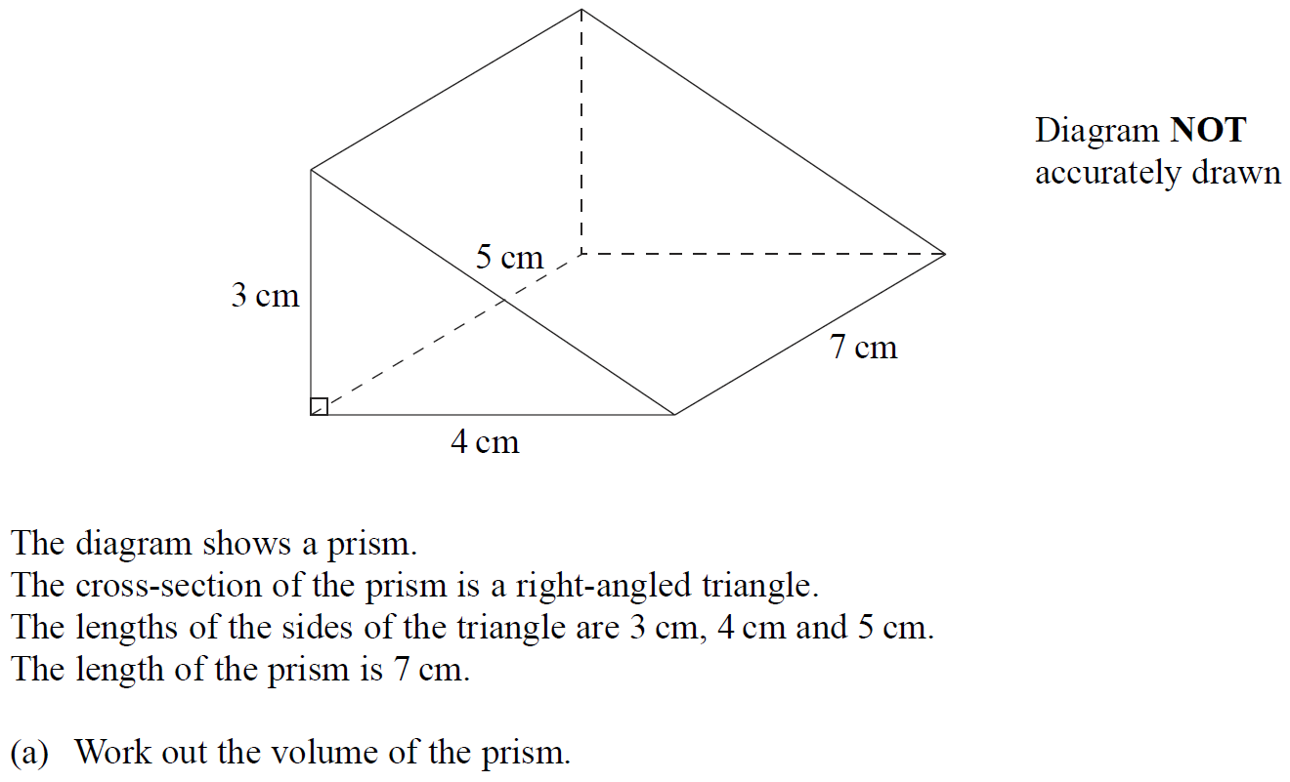
Prisms
Nov 2004 4H Q9

Slide 28
Prisms
Nov 2004 4H Q9
A
B

Slide 29
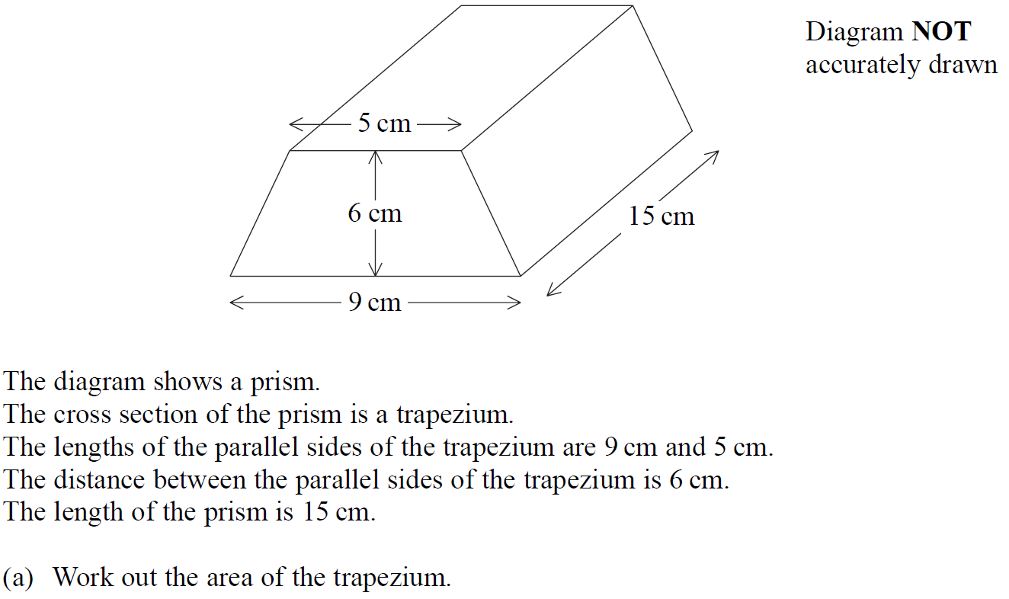
Prisms
May 2005 3H Q7

Slide 30
Prisms
May 2005 3H Q7
A
B

Slide 31
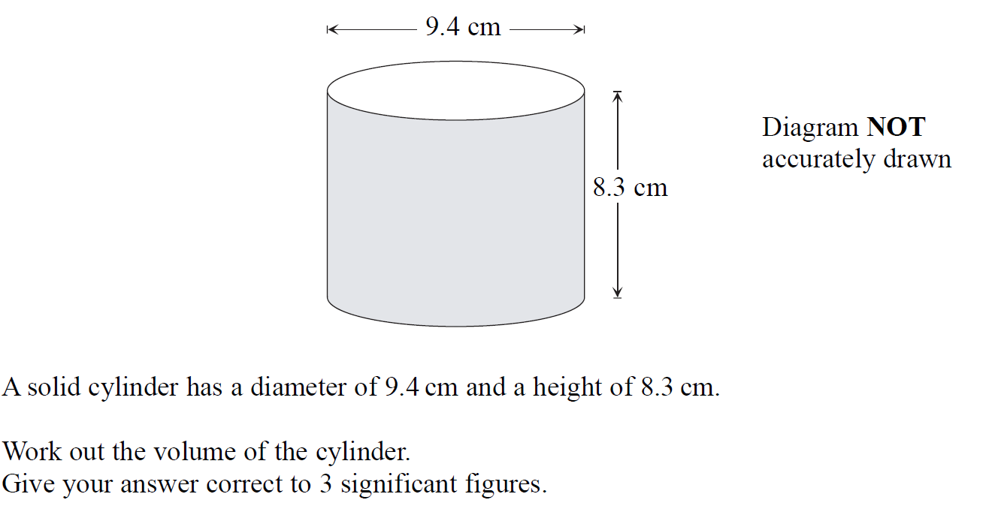
Prisms
Nov 2006 4H Q7

Slide 32
Prisms
Nov 2006 4H Q7
A

Slide 33
Prisms
May 2007 3H Q7

Slide 34
Prisms
May 2007 3H Q7
A
B

Slide 35
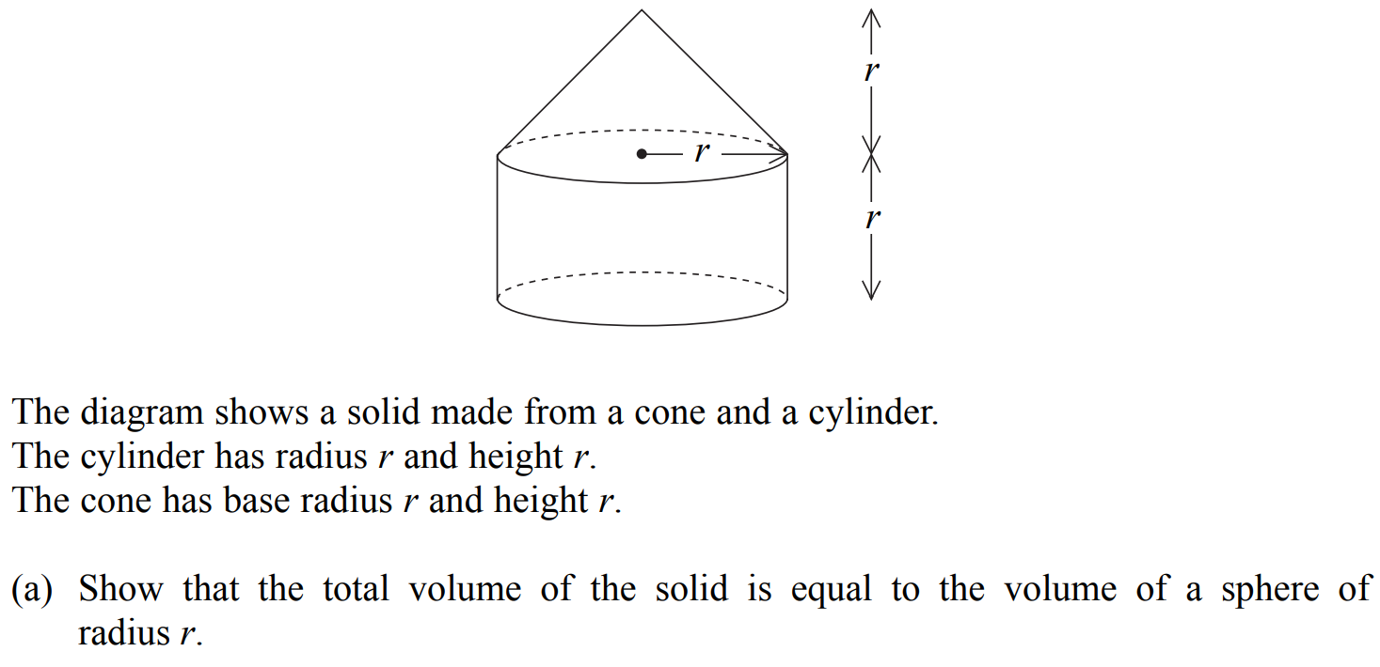
Prisms
Nov 2007 4H Q26

Slide 36
Prisms
Nov 2007 4H Q26
A
B

Slide 37
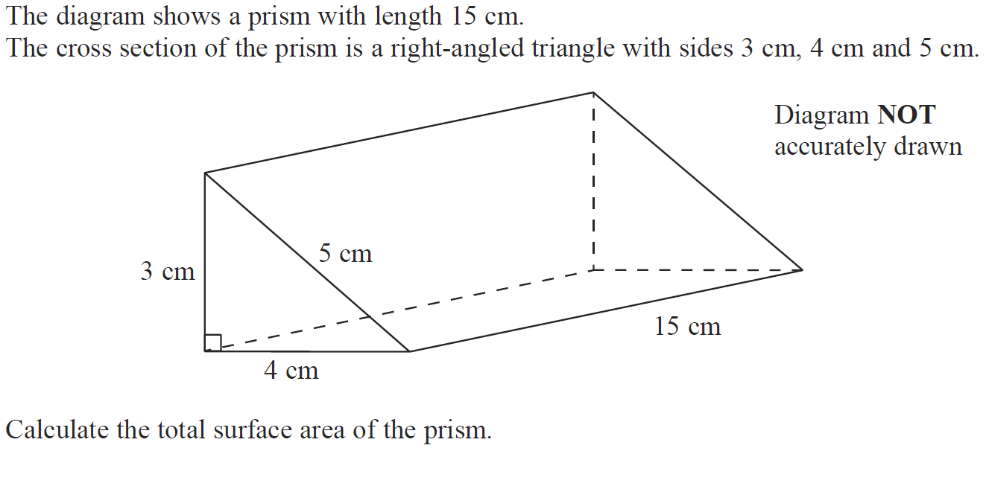
Prisms
May 2008 4H Q8

Slide 38
Prisms
May 2008 4H Q8
A

Slide 39
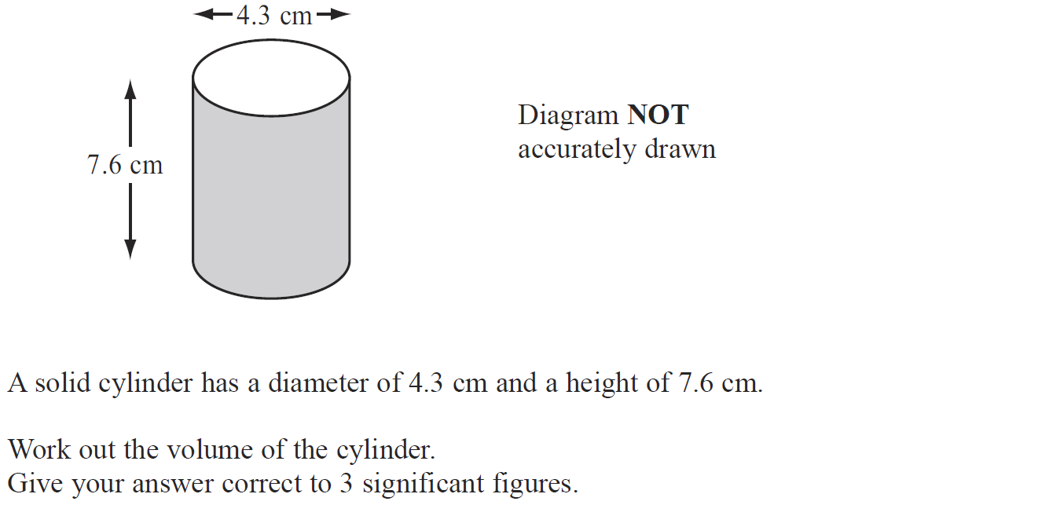
Prisms
Nov 2008 3H Q6

Slide 40
Prisms
Nov 2008 3H Q6
A

Slide 41
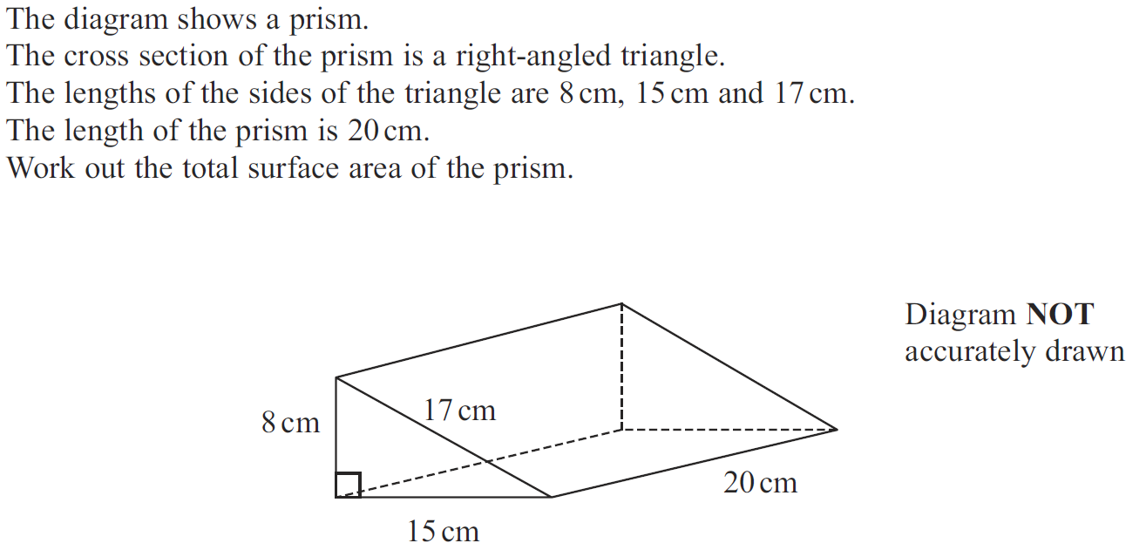
Prisms
Nov 2009 3H Q10

Slide 42
Prisms
Nov 2009 3H Q10
A

Slide 43
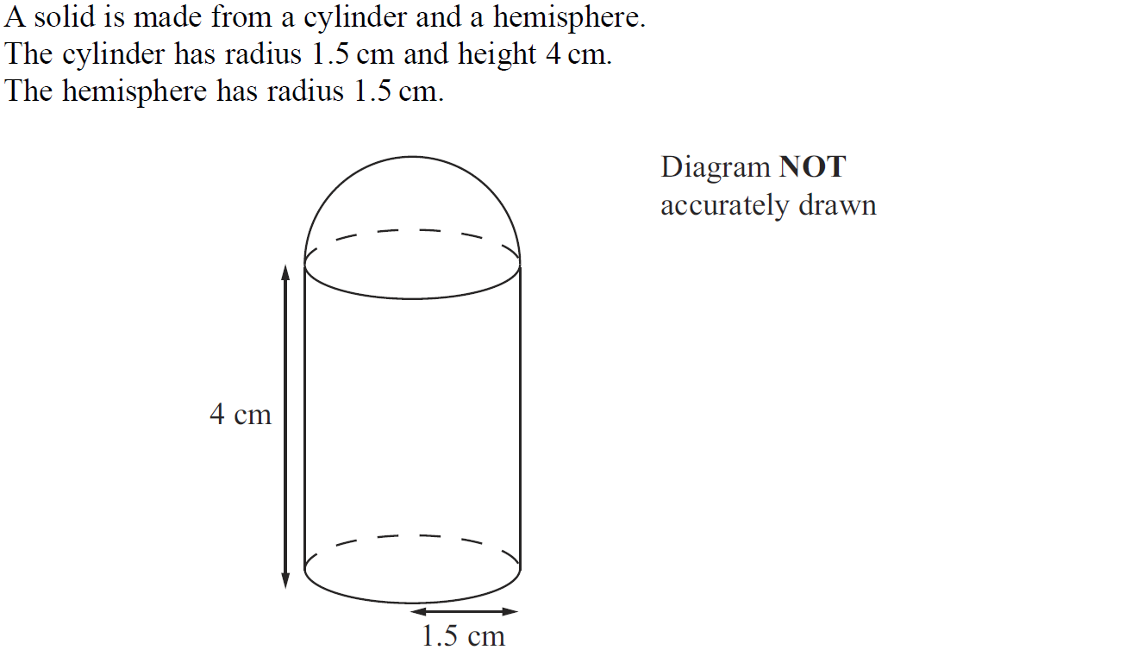
Prisms
Nov 2010 3H Q15

Slide 44
Prisms
Nov 2010 3H Q15
A

Slide 45
Prisms
June 2011 3H Q23

Slide 46
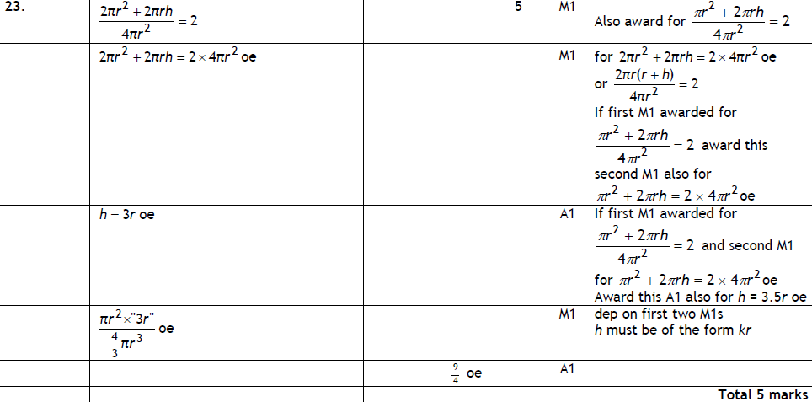
Prisms
June 2011 3H Q23
A

Slide 47
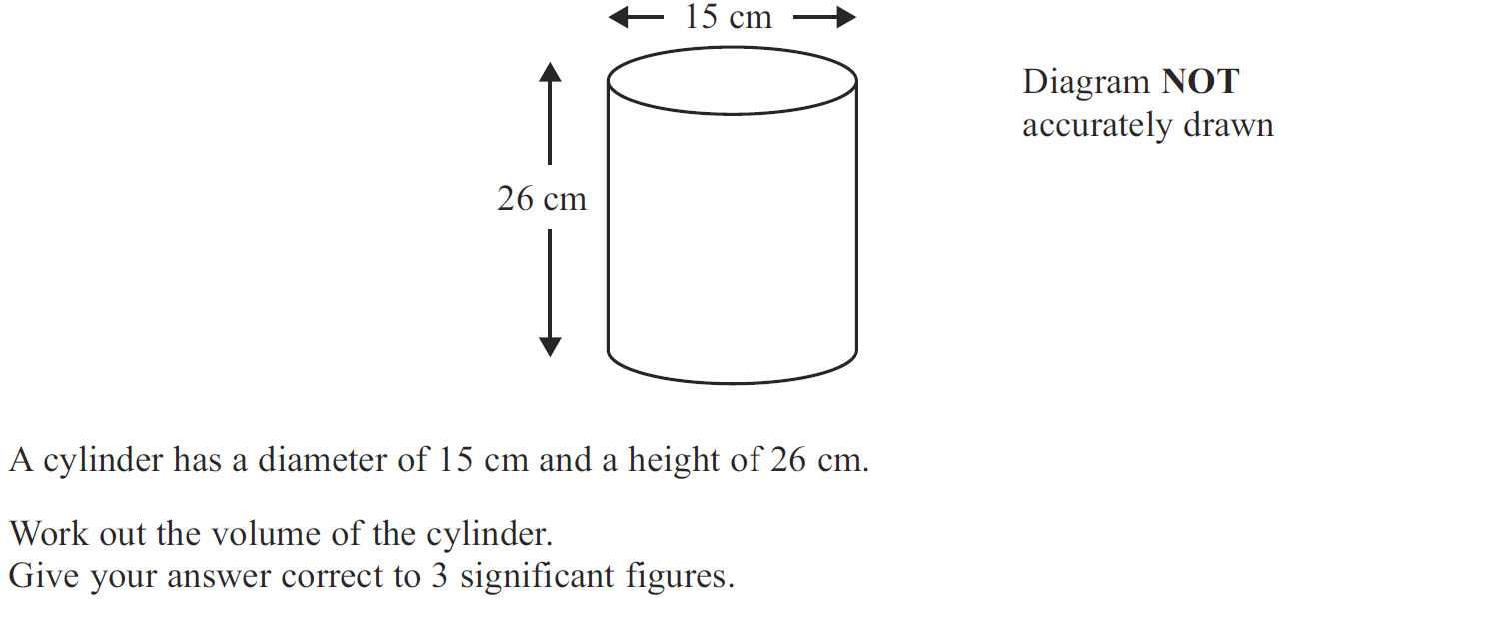
Prisms
Jan 2012 3H Q3

Slide 48
Prisms
Jan 2012 3H Q3
A

Slide 49
Prisms
May 2012 3H Q20

Slide 50
Prisms
May 2012 3H Q20
A

Slide 51
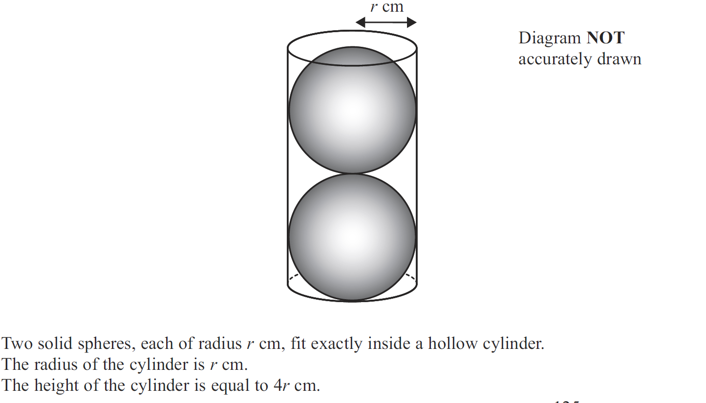
Prisms
May 2012 4H Q22

Slide 52
Prisms
May 2012 4H Q22
A

Slide 53
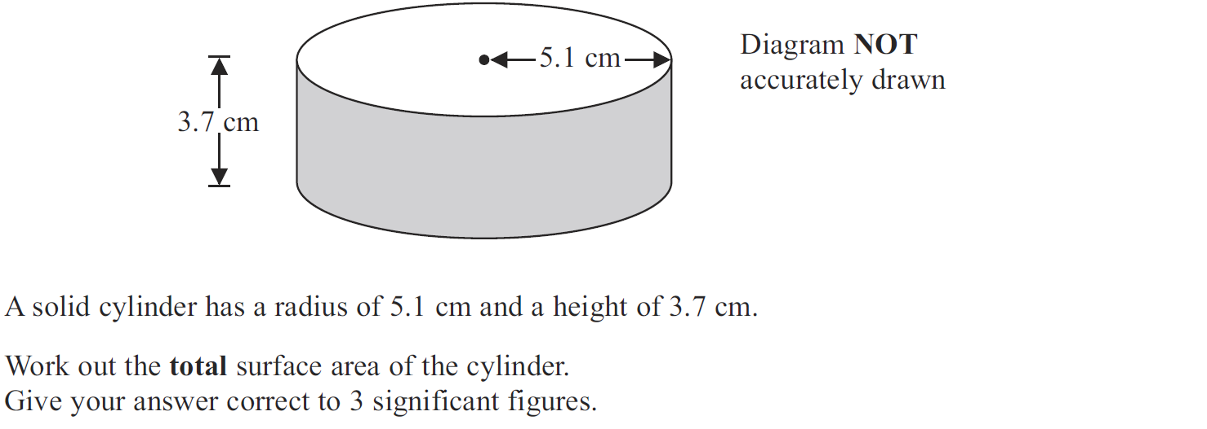
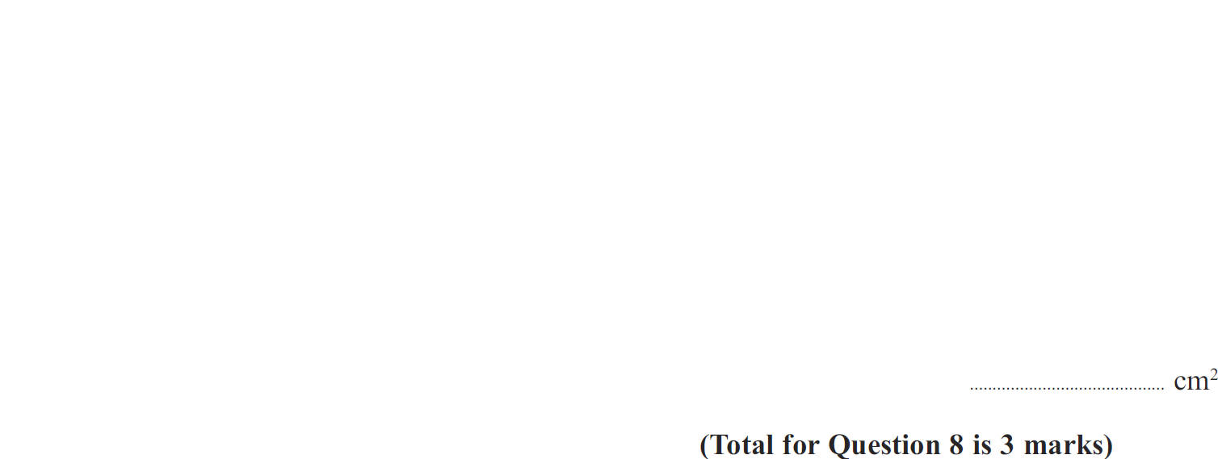
Prisms
May 2013 3H Q8

Slide 54
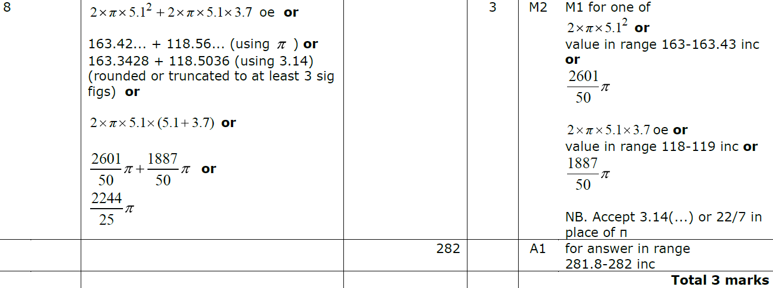
Prisms
May 2013 3H Q8
A

Slide 55
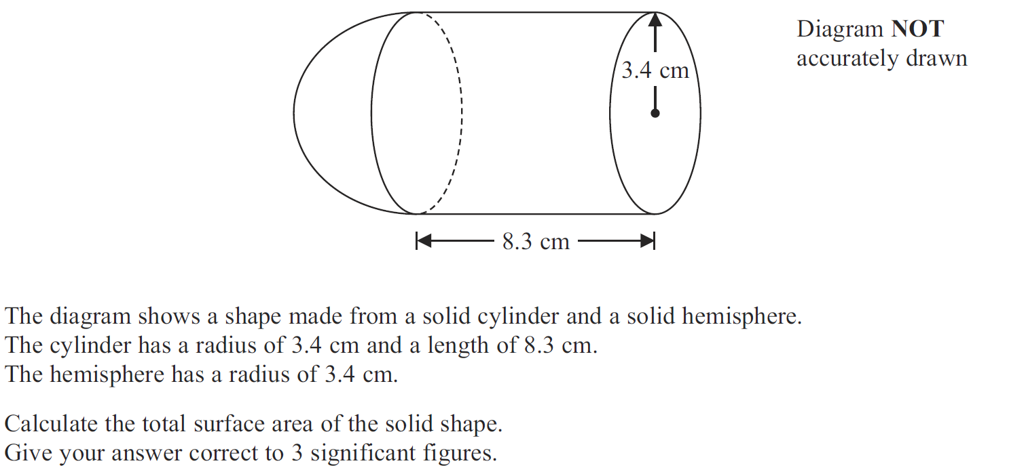
Prisms
May 2013 4HR Q19

Slide 56
Prisms
May 2013 4HR Q19
A

Slide 57
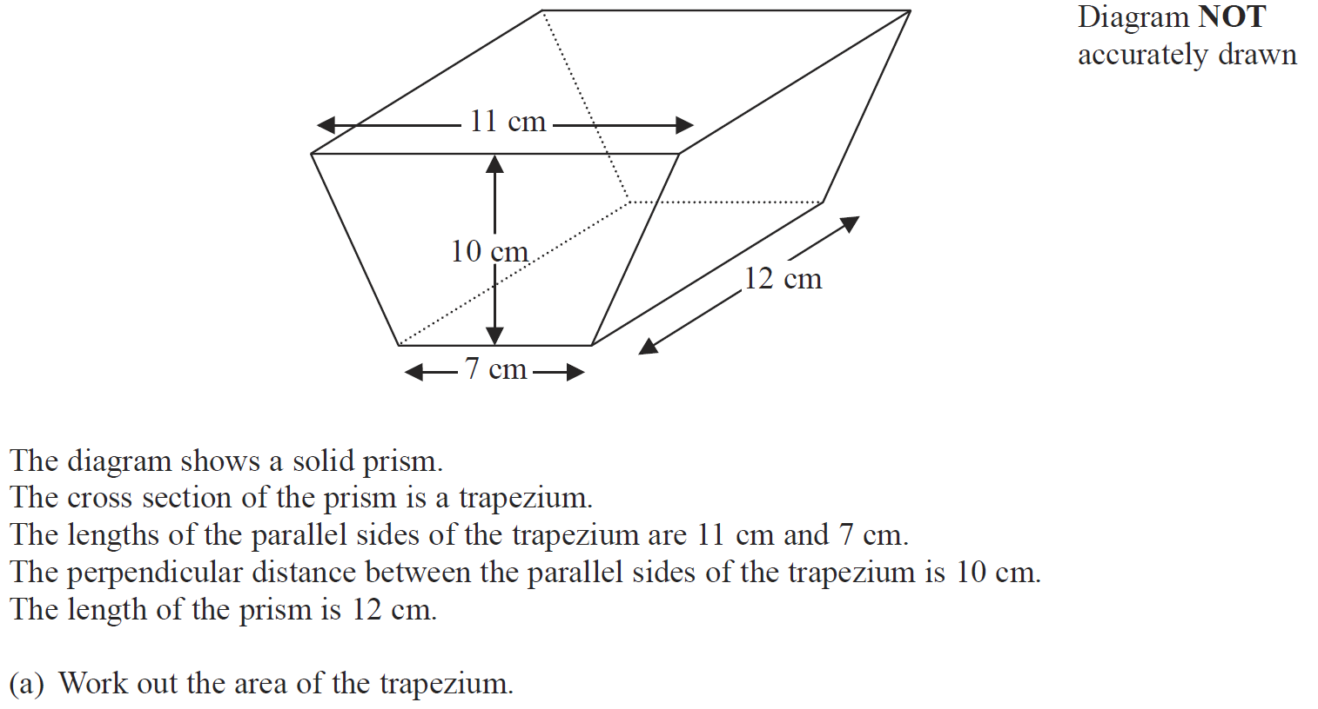
Prisms
Jan 2014 4H Q2

Slide 58
Prisms
Jan 2014 4H Q2
A
B

Slide 59
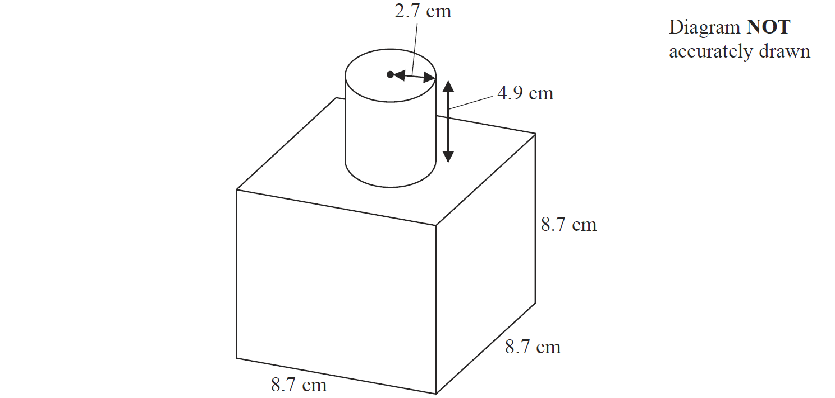
Prisms
Jan 2014 3HR Q14

Slide 60
Prisms
Jan 2014 3HR Q14
A

Slide 61
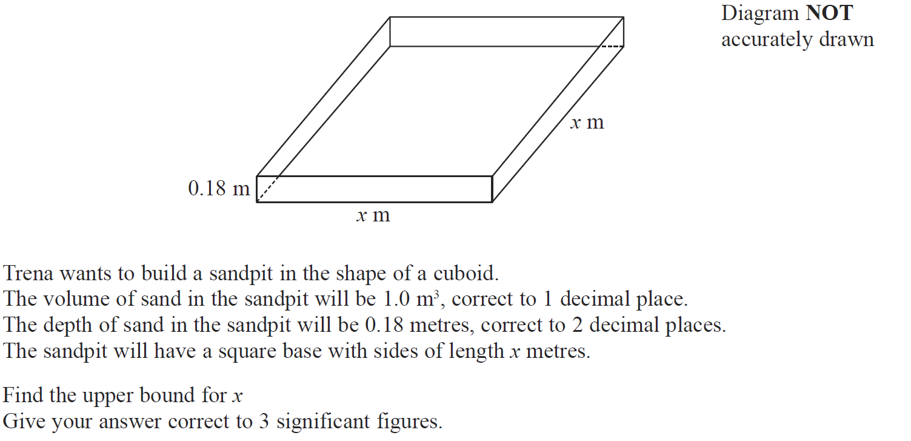
Prisms
Jan 2014 4HR Q19

Slide 62
Prisms
Jan 2014 4HR Q19
A

Slide 63
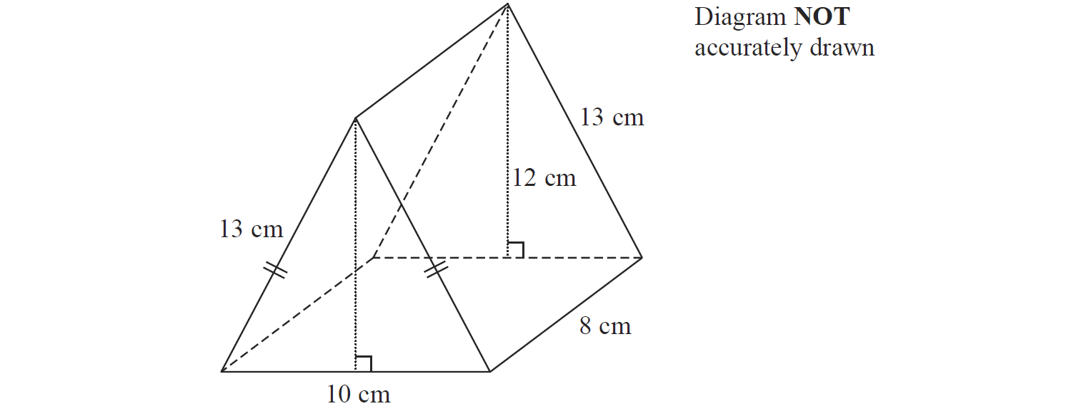
Prisms
May 2014 3H Q9

Slide 64
Prisms
May 2014 3H Q9
A

Slide 65
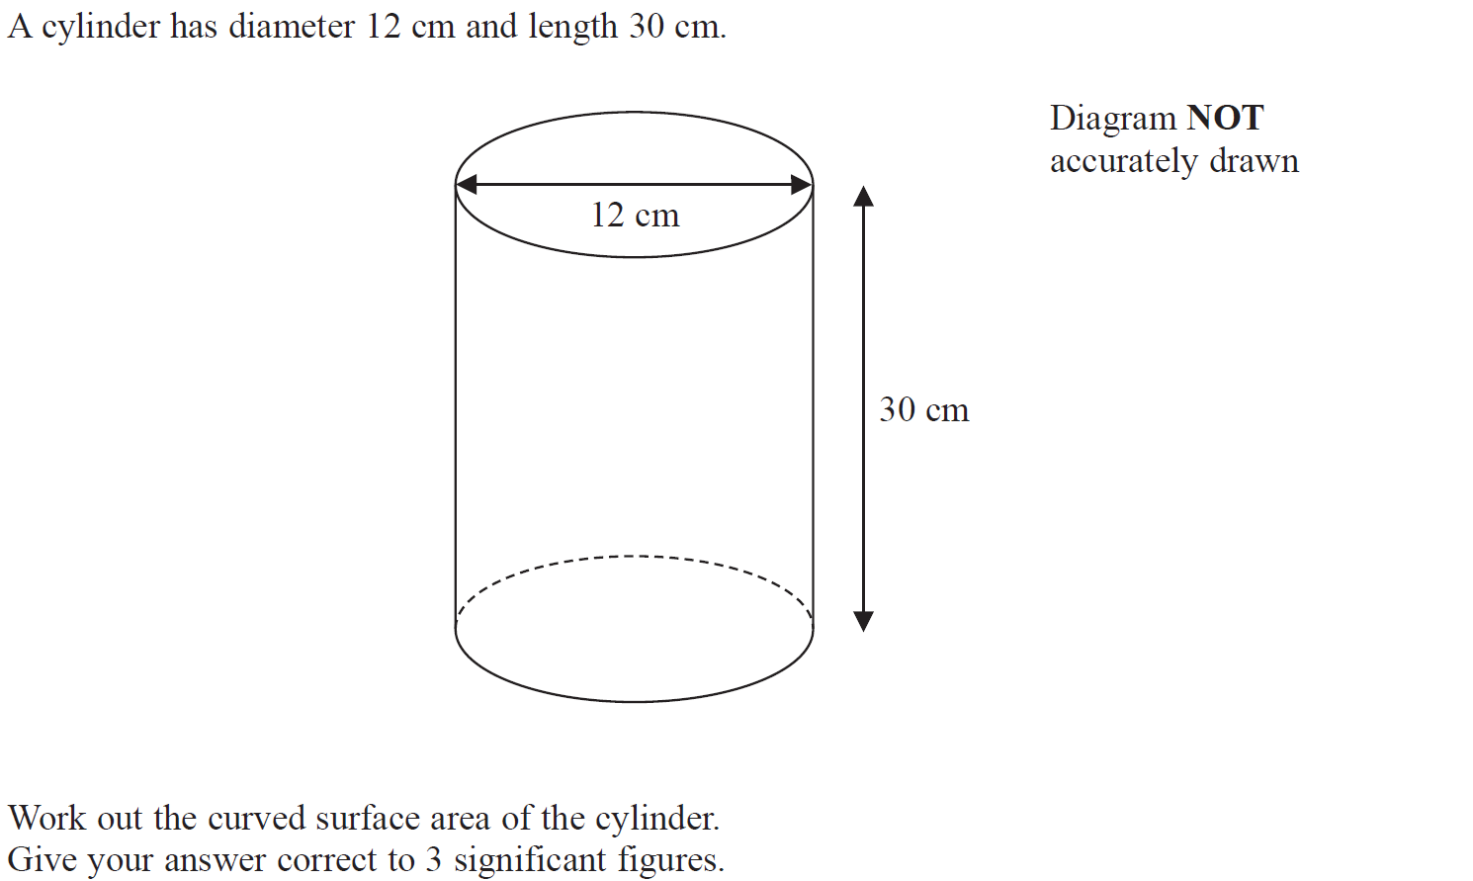
Prisms
May 2014 3HR Q9

Slide 66
Prisms
May 2014 3HR Q9
A

Slide 67
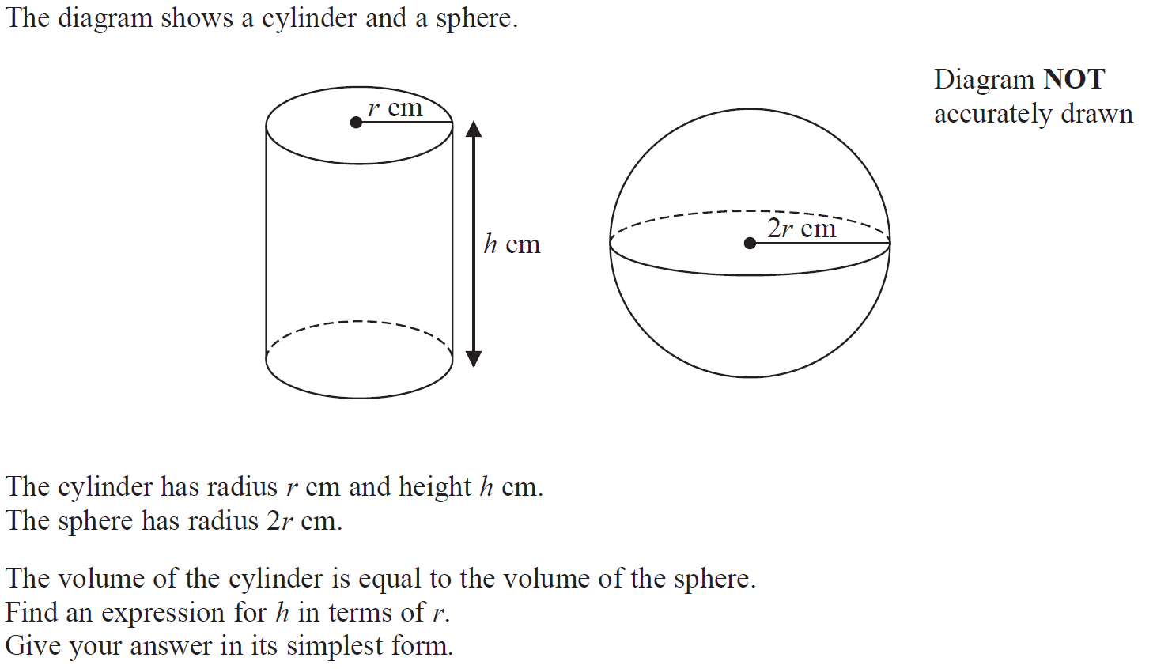
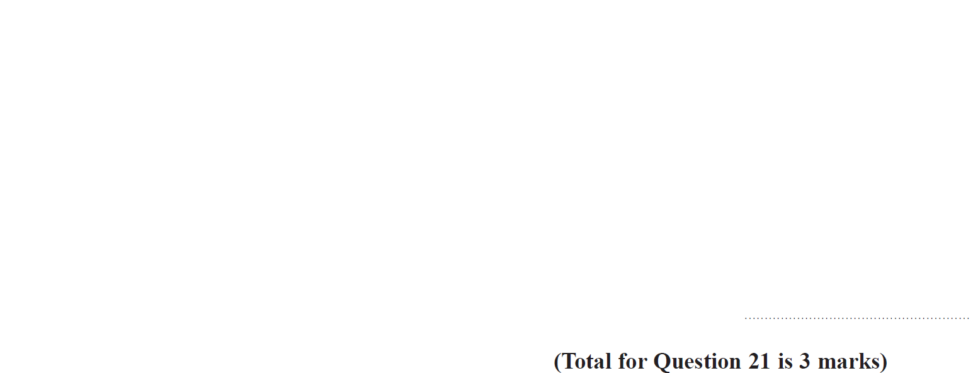
Prisms
Jan 2015 4H Q21

Slide 68
Prisms
Jan 2015 4H Q21
A

Slide 69
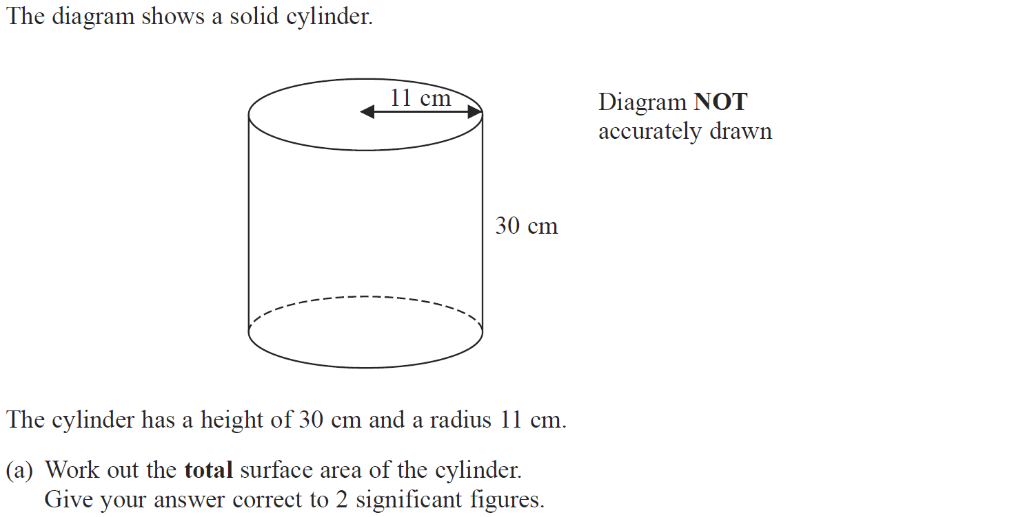
Prisms
Jan 2015 3HR Q10

Slide 70
Prisms
Jan 2015 3HR Q10
A
B (i)
B (ii)

Slide 71
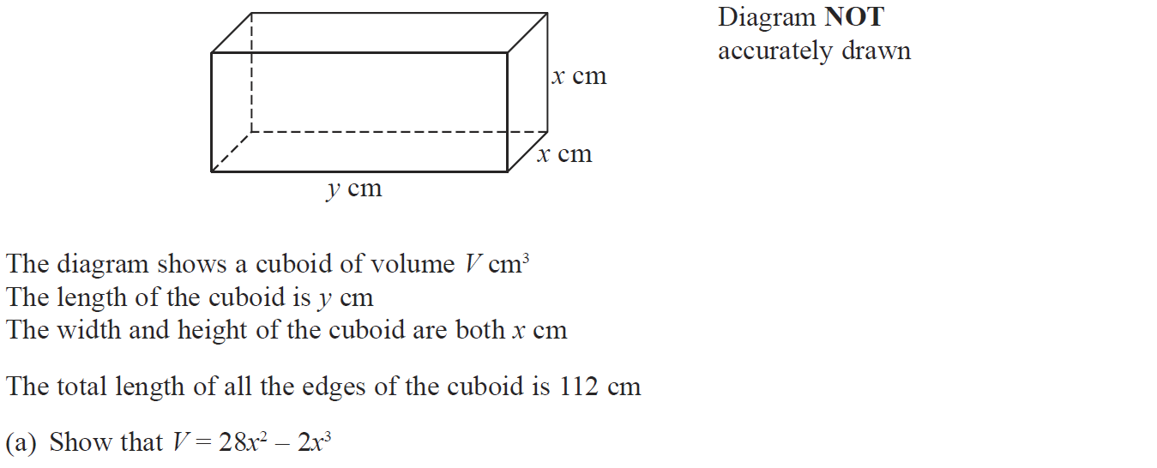
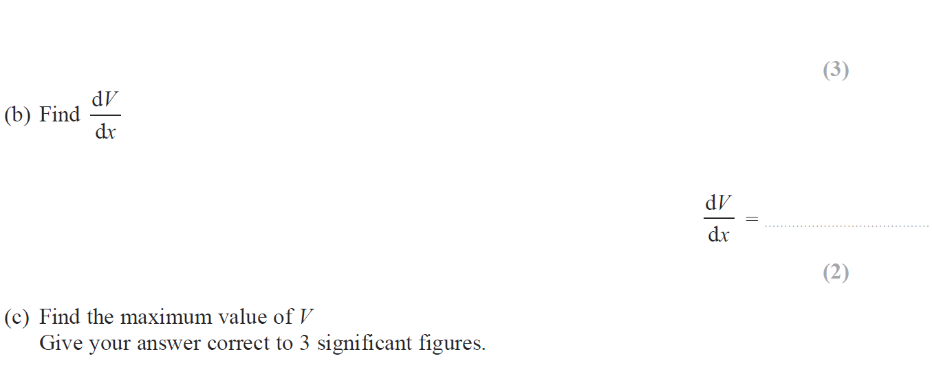
Prisms
Jan 2015 3HR Q17

Slide 72
Prisms
Jan 2015 3HR Q17
A
B
C

Slide 73
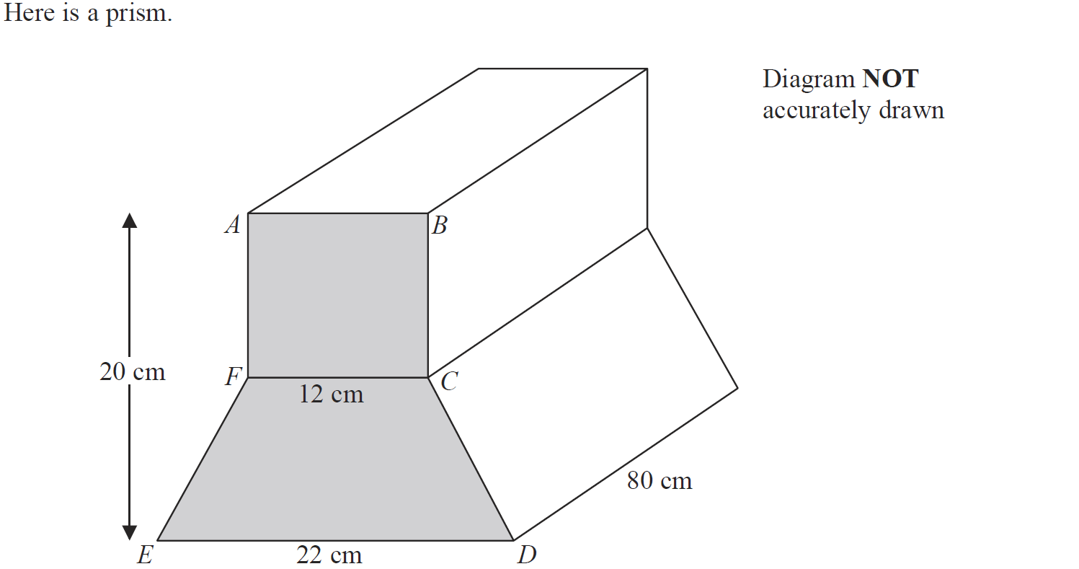
Prisms
May 2015 3H Q11

Slide 74
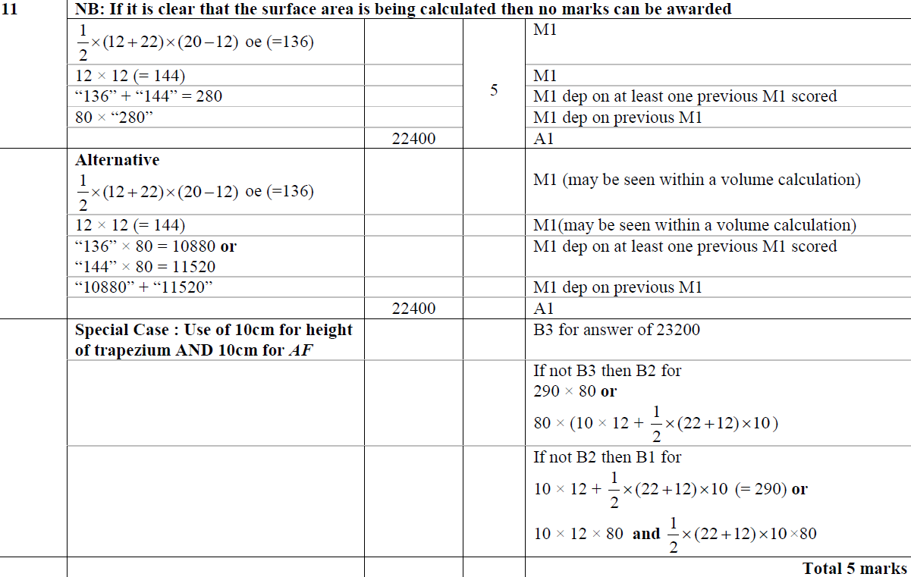
Prisms
May 2015 3H Q11
A

Slide 75
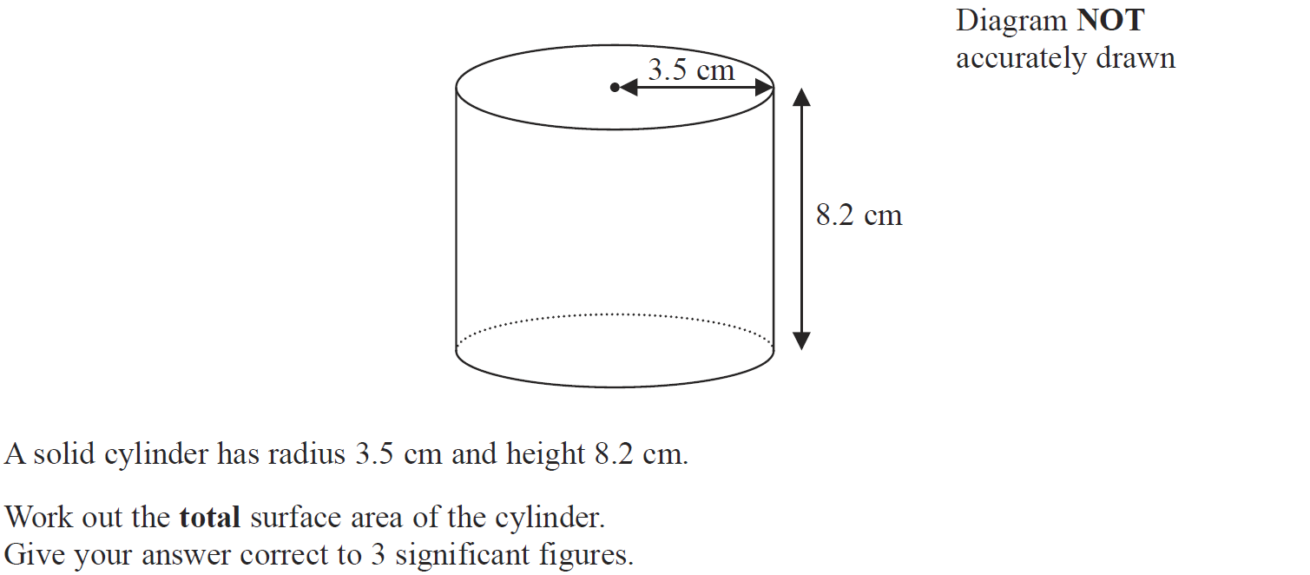
Prisms
June 2015 4H Q11

Slide 76
Prisms
June 2015 4H Q11
A

Slide 77
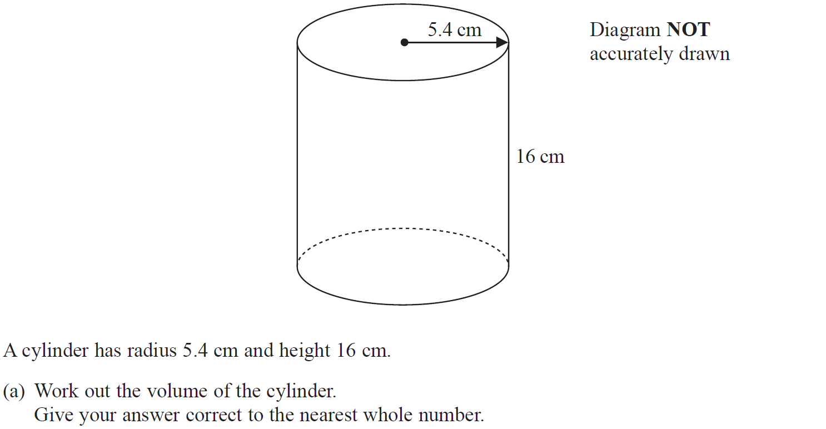
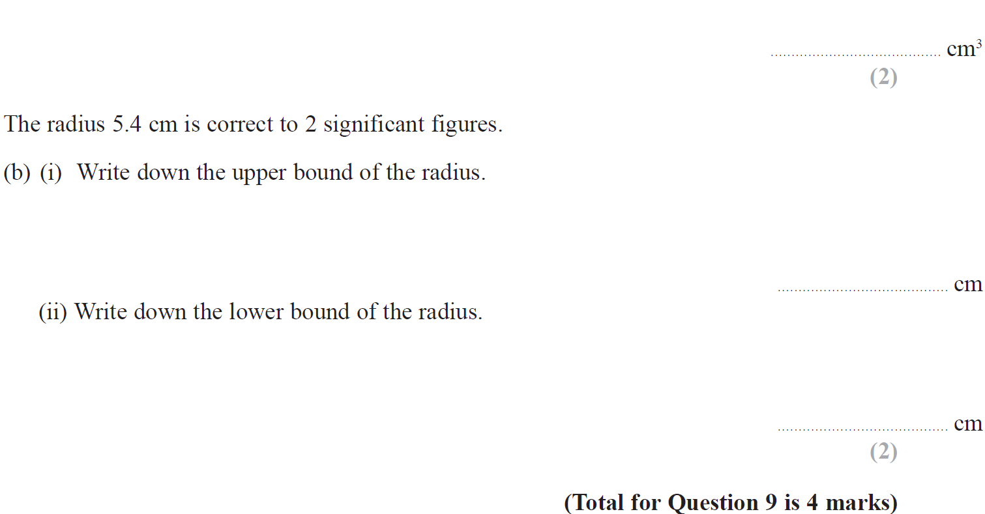
Prisms
Jan 2016 3H Q9

Slide 78
Prisms
Jan 2016 3H Q9
A
B (i)
B (ii)

Slide 79
Prisms
Jan 2016 4H Q23

Slide 80
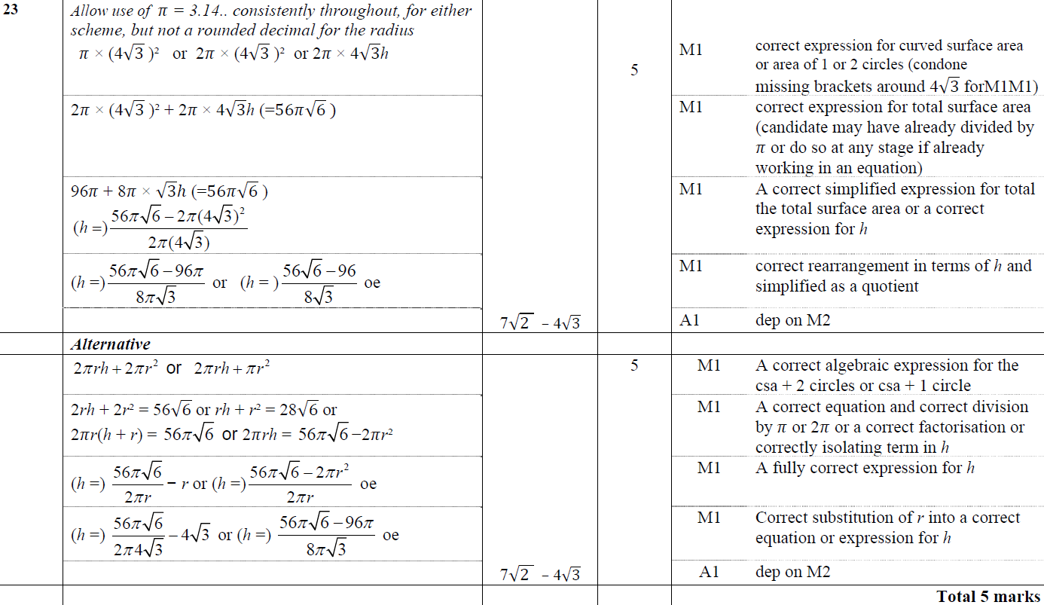
Prisms
Jan 2016 4H Q23
A

Slide 81
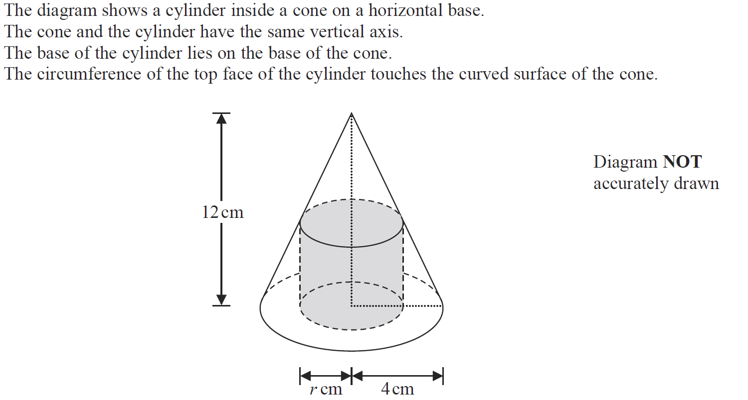
Prisms
Jan 2016 3HR Q15

Slide 82
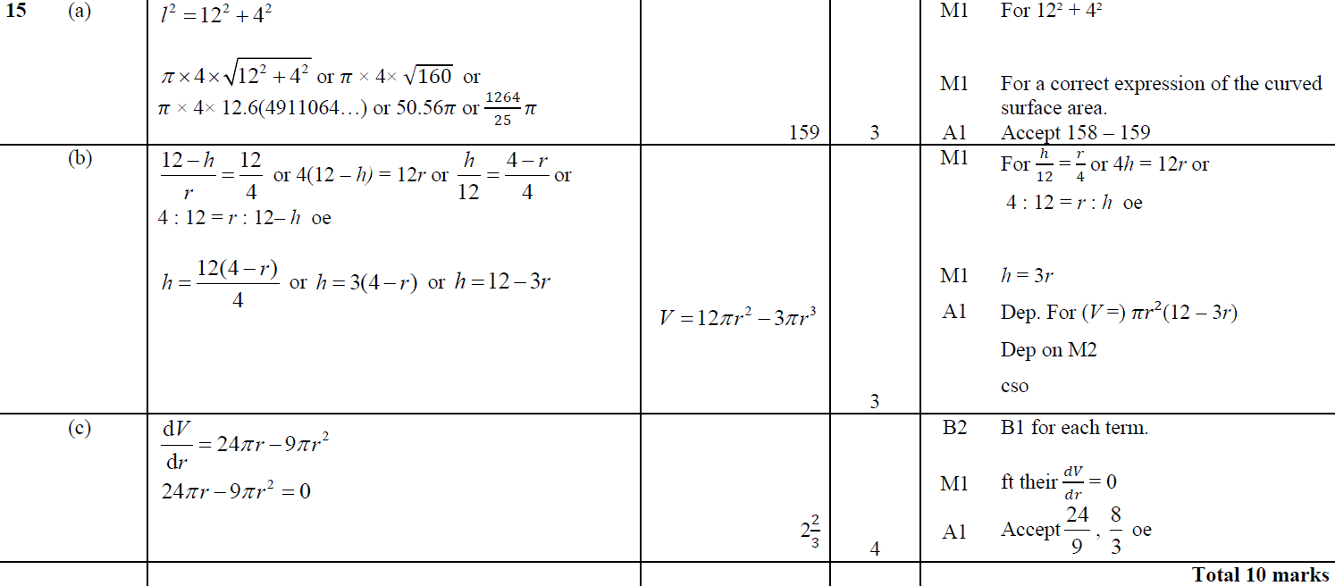
Prisms
Jan 2016 3HR Q15
A
B
C

Slide 83
Prisms
June 2016 4H Q20

Slide 84
Prisms
June 2016 4H Q20
A

Slide 85
Prisms
Jan 2017 4HR Q21

Slide 86
Prisms
Jan 2017 4HR Q21
A
B

Slide 87
Prisms
May 2017 3HR Q19

Slide 88
Prisms
May 2017 3HR Q19
A

Slide 89
Prisms
June 2017 4HR Q4

Slide 90
Prisms
June 2017 4HR Q4
A

Slide 91
Prisms
Jan 2018 4HR Q2

Slide 92
Prisms
Jan 2018 4HR Q2
A
B

Slide 93
Prisms
May 2018 3H Q19

Slide 94
Prisms
May 2018 3H Q19
A

Slide 95
Prisms
June 2018 4H Q1

Slide 96
Prisms
June 2018 4H Q1
A

Slide 97
Prisms
June 2018 4H Q11

Slide 98
Prisms
June 2018 4H Q11
A
B

Slide 99
Prisms
May 2018 3HR Q15

Slide 100
Prisms
May 2018 3HR Q15
A
B
C

Slide 101
Prisms
June 2018 4HR Q25

Slide 102
Prisms
June 2018 4HR Q25
A

