Slide 1
Prisms
Prisms
Spec 1
1H Q5
Nov 2018
3H Q8
Spec 2
1H Q9
June 2019
2H Q4
Spec 2
3H Q8
June 2019
3H Q9
Cylinders

Slide 2
Prisms
Specimen Set 1 1H Q5

Slide 3
Prisms
Specimen Set 1 1H Q5
A

Slide 4
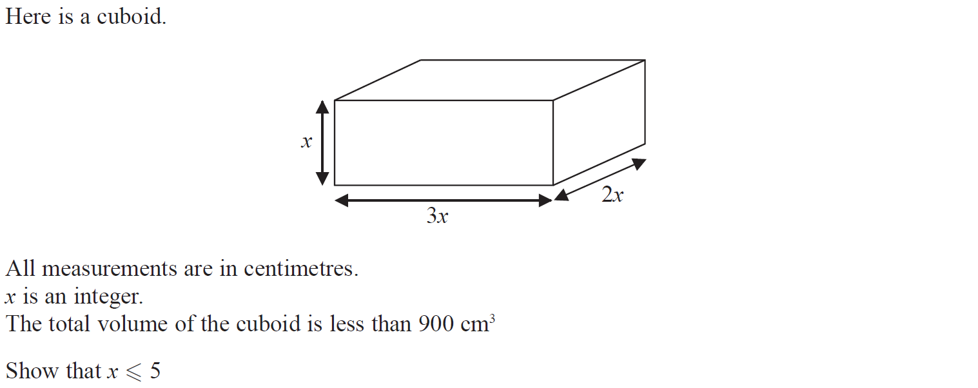
Prisms
Specimen Set 2 1H Q9

Slide 5
Prisms
Specimen Set 2 1H Q9
A

Slide 6
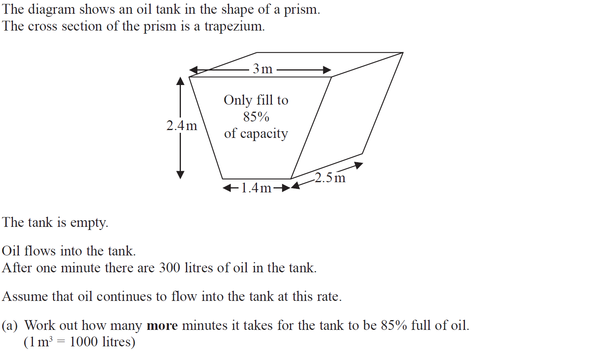
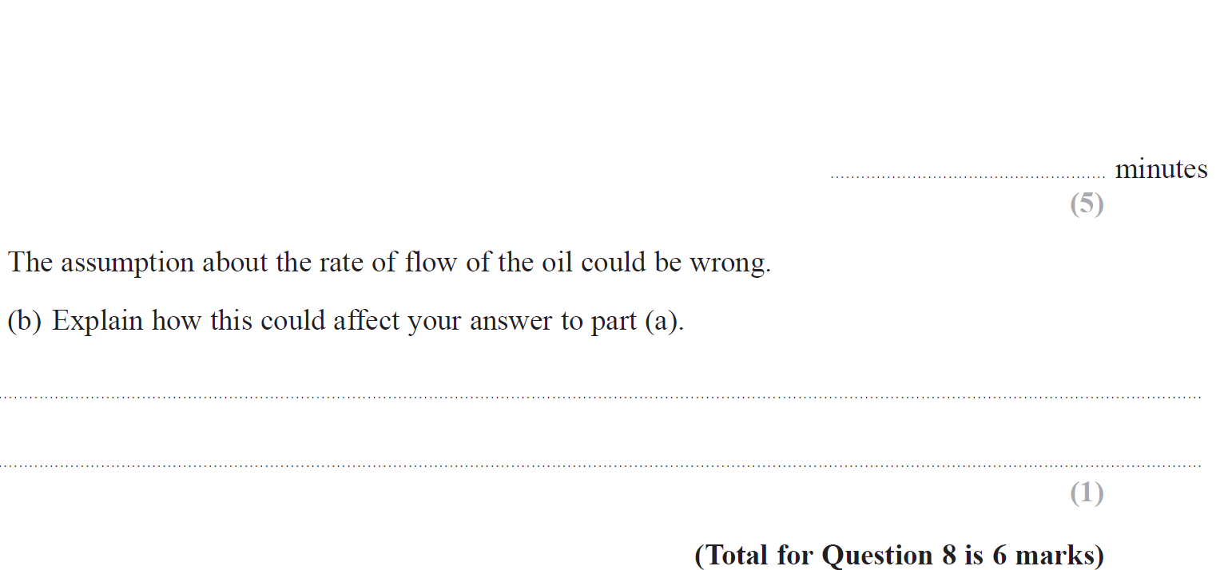
Prisms
Specimen Set 2 3H Q8

Slide 7
Prisms
Specimen Set 2 3H Q8
A
B

Slide 8
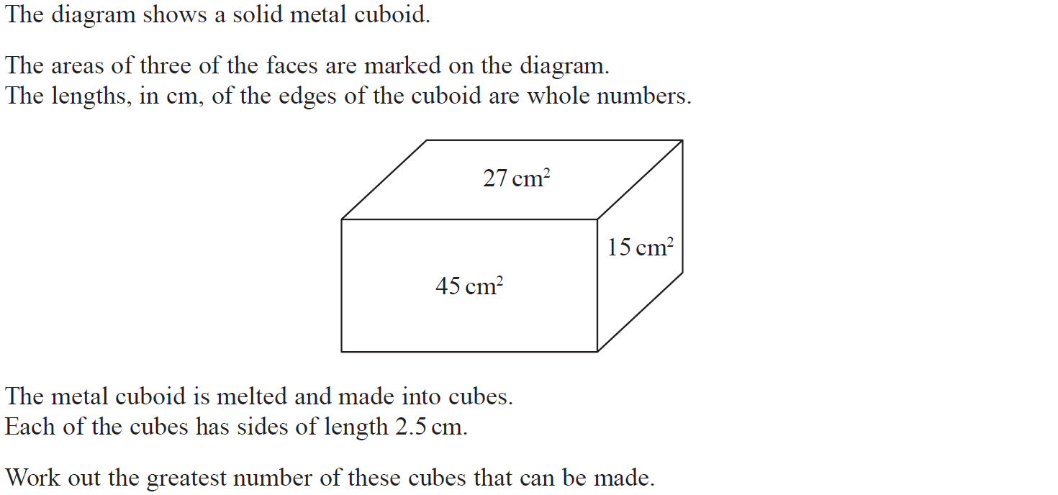
Prisms
Nov 2018 3H Q8

Slide 9
Prisms
Nov 2018 3H Q8
A

Slide 10
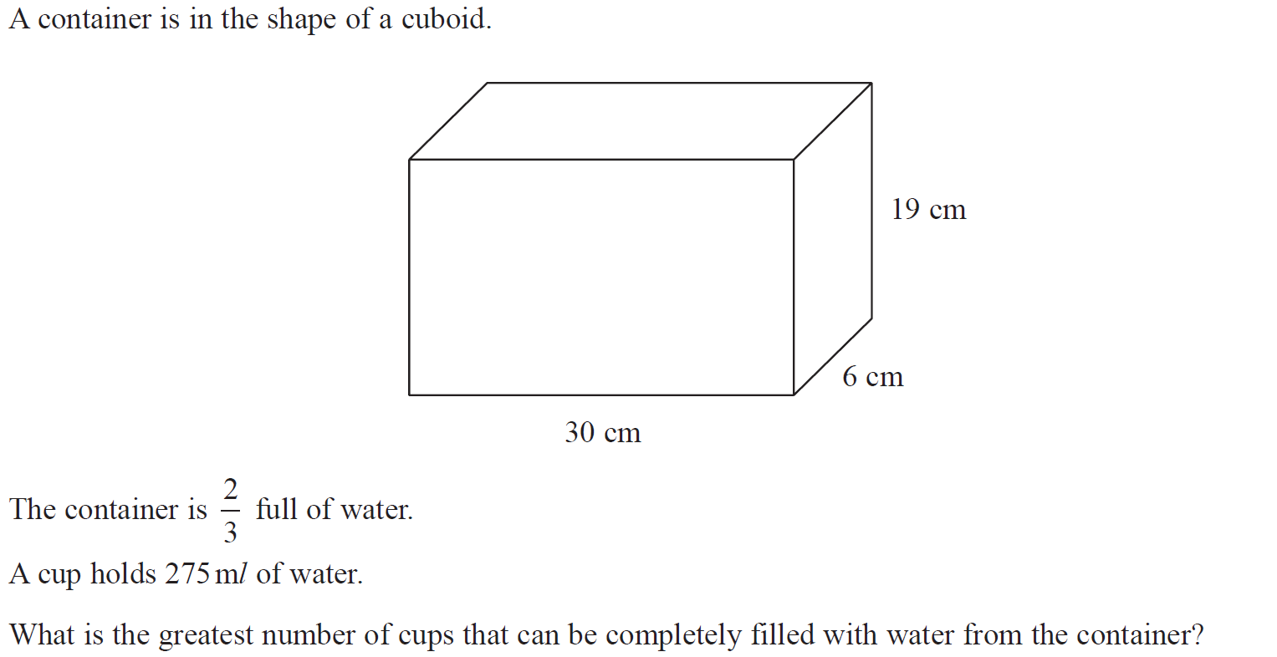
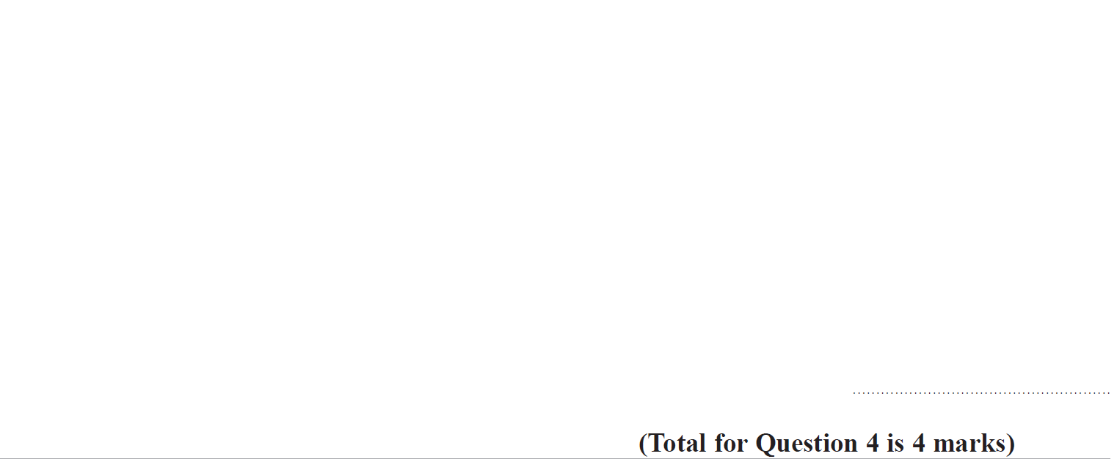
Prisms
June 2019 2H Q4

Slide 11
Prisms
June 2019 2H Q4
A
A SF

Slide 12
Prisms
June 2019 3H Q6

Slide 13
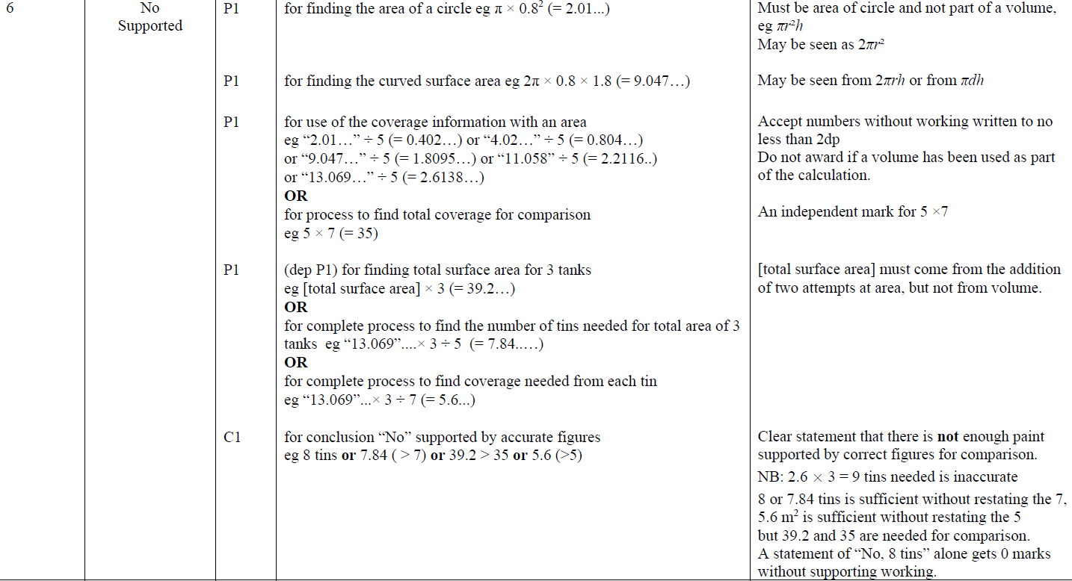
Prisms
June 2019 3H Q6
A

Slide 14
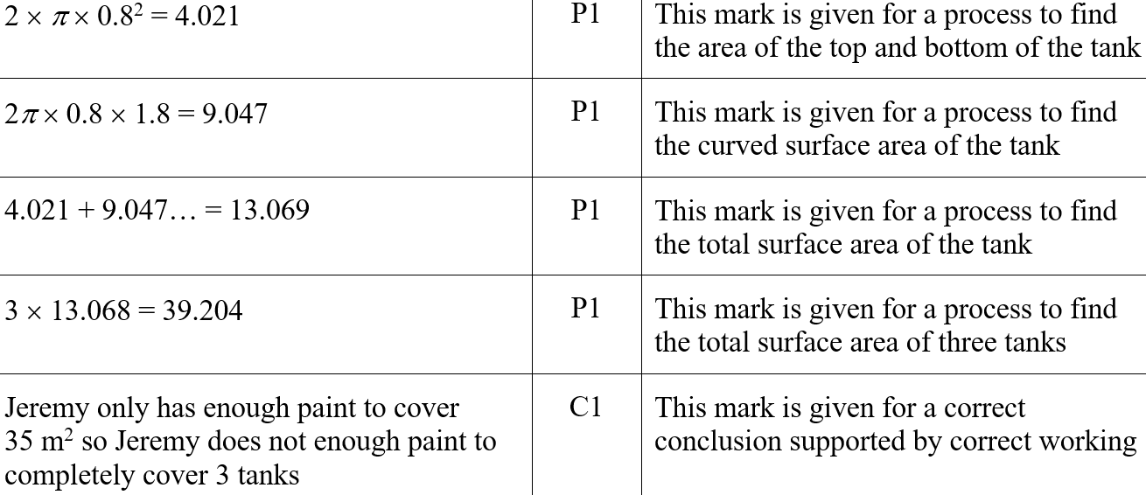
Prisms
June 2019 3H Q6
A SF

