Slide 1
Old Spec Q’s
Power
SAM
SAM
2018
2019
2019

Slide 2
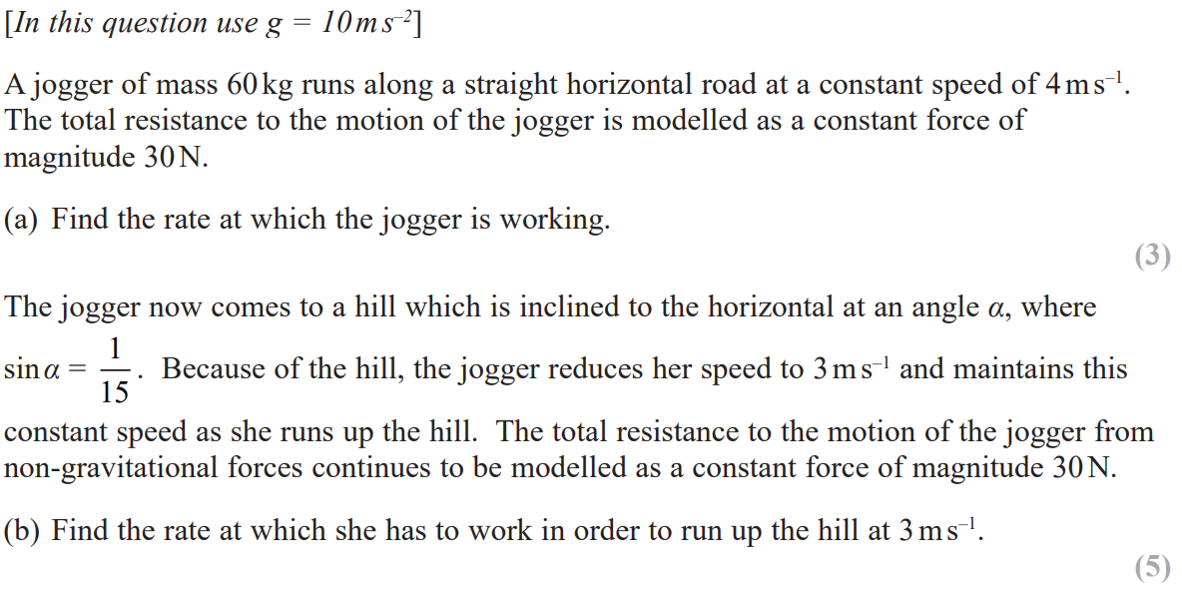
SAM

Slide 3
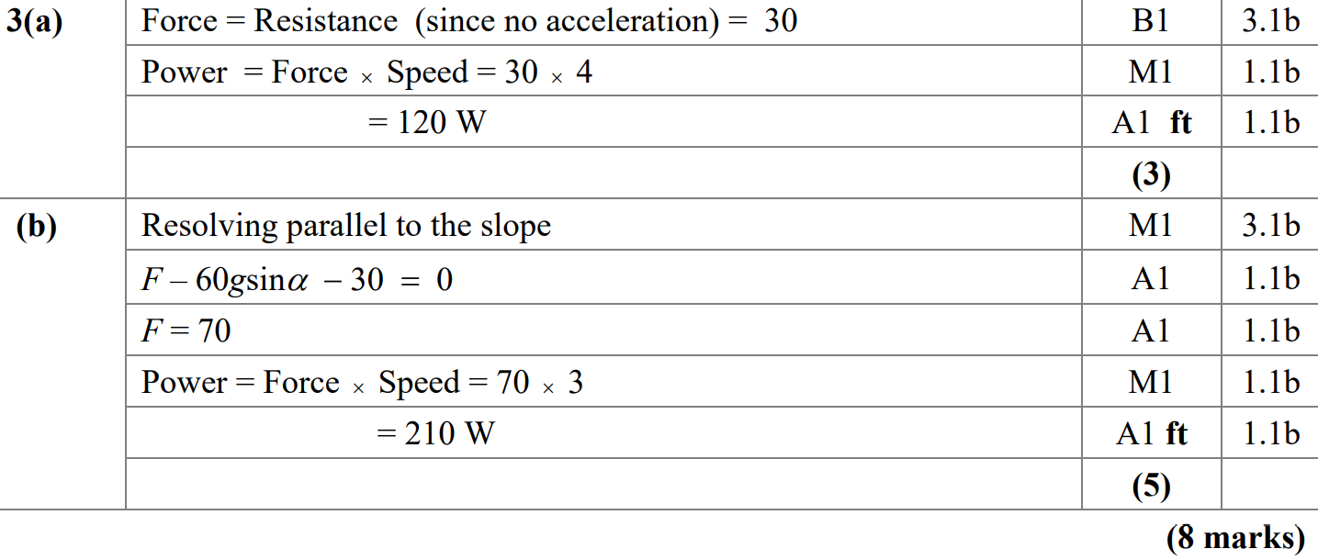
SAM
A
B

Slide 4
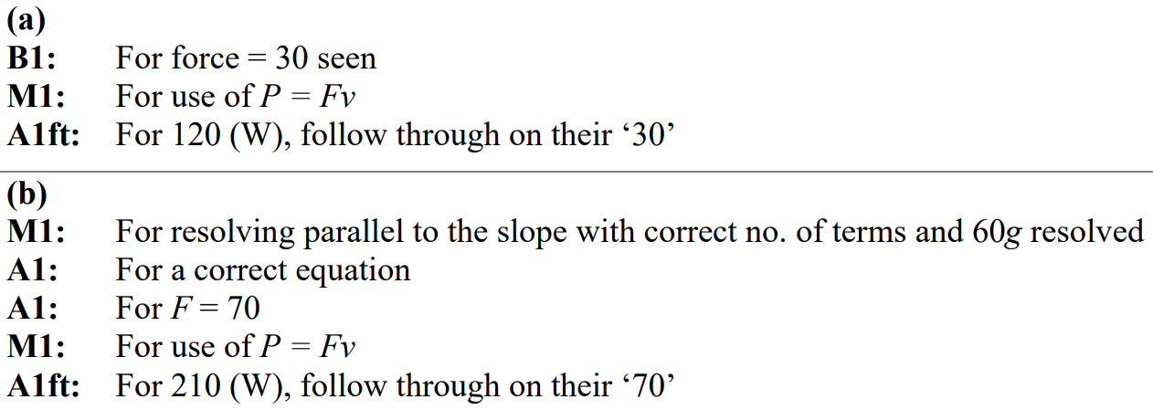
SAM
A notes
B notes

Slide 5
2018

Slide 6
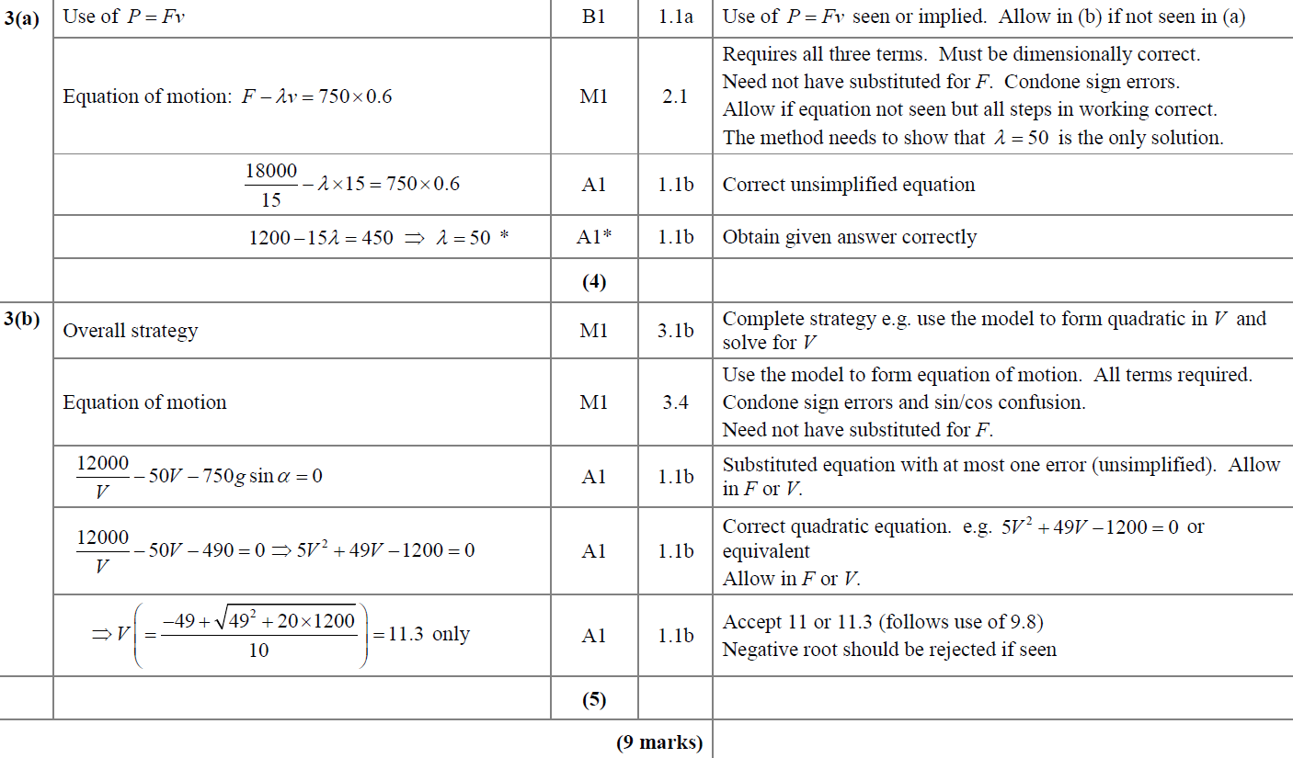
2018
A
B

Slide 7
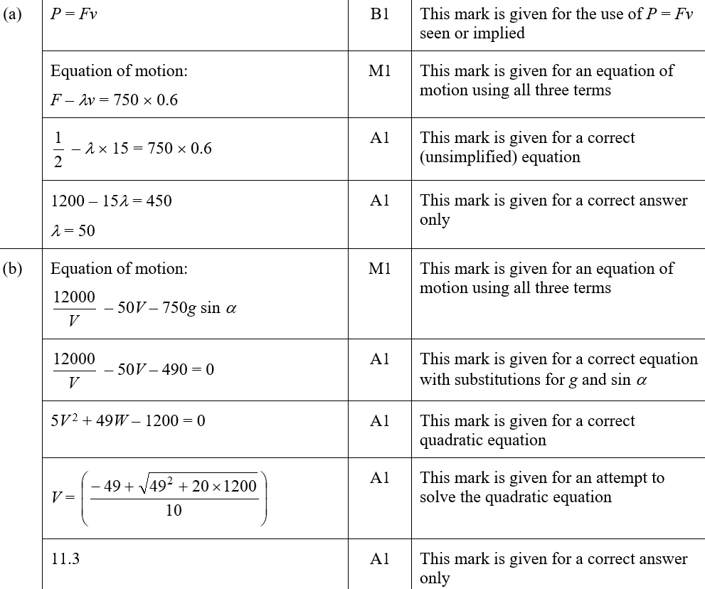
2018
A (SF)
B (SF)

Slide 8
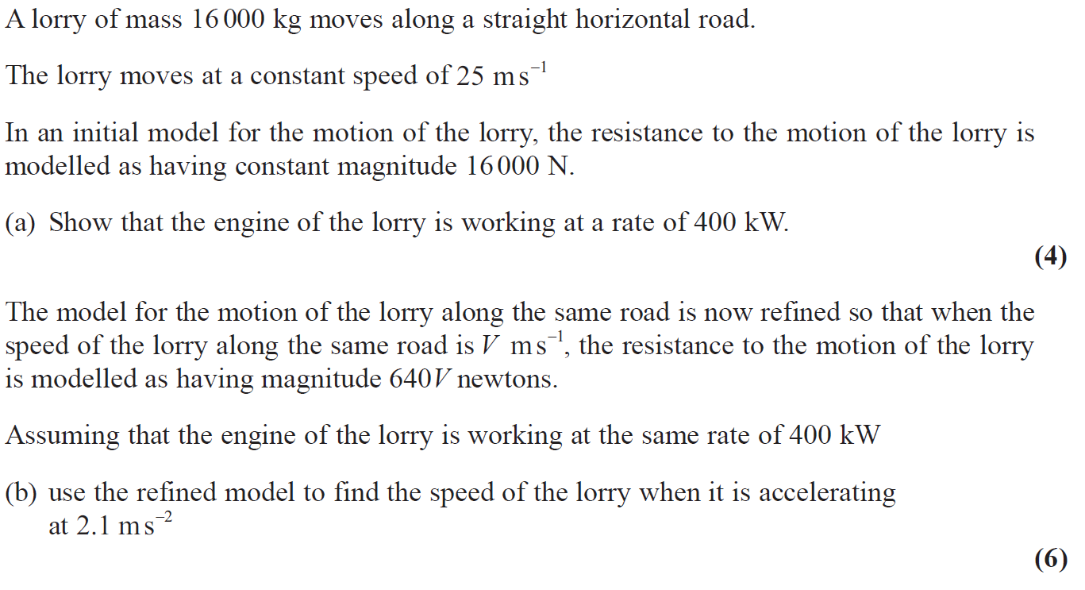
2019

Slide 9
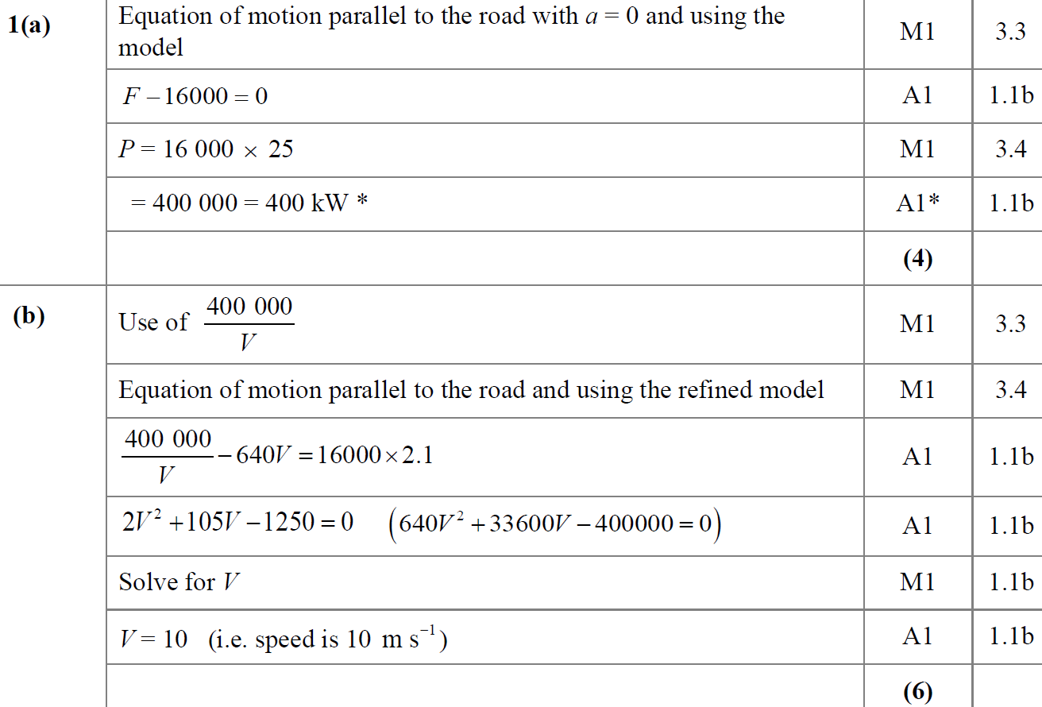
2019
A
B

Slide 10
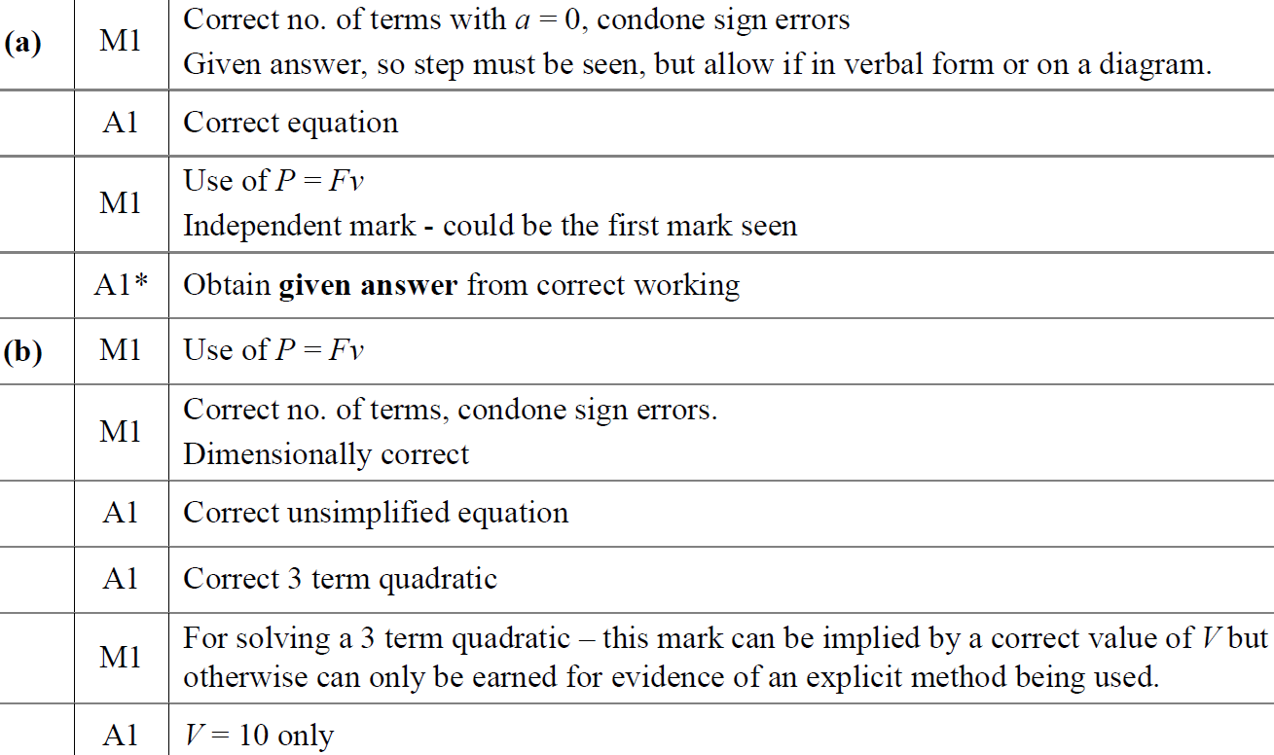
2019
A notes
B notes

Slide 11
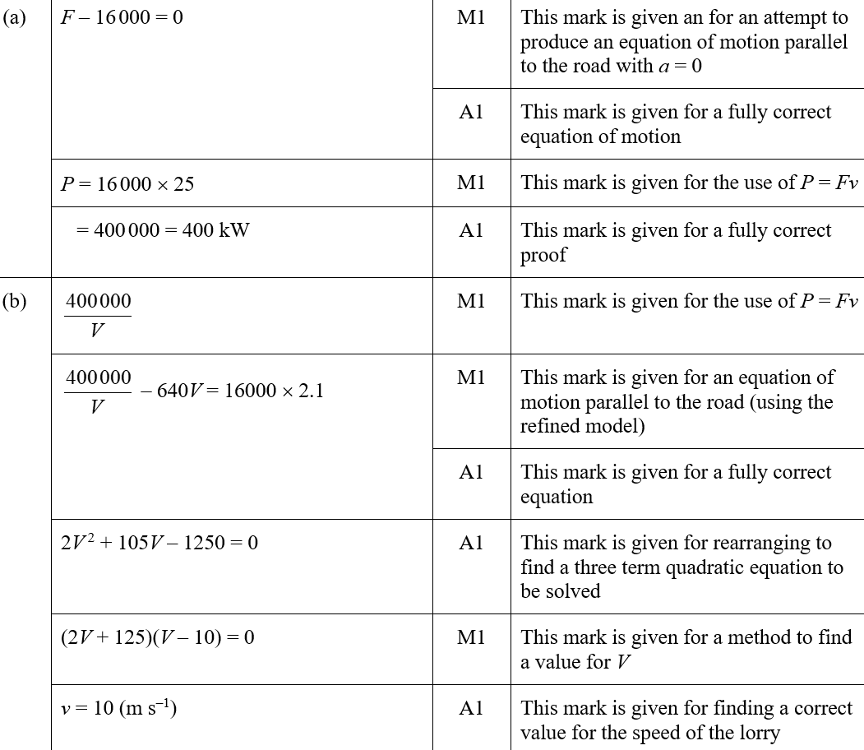
2019
A (SF)
B (SF)

Slide 12
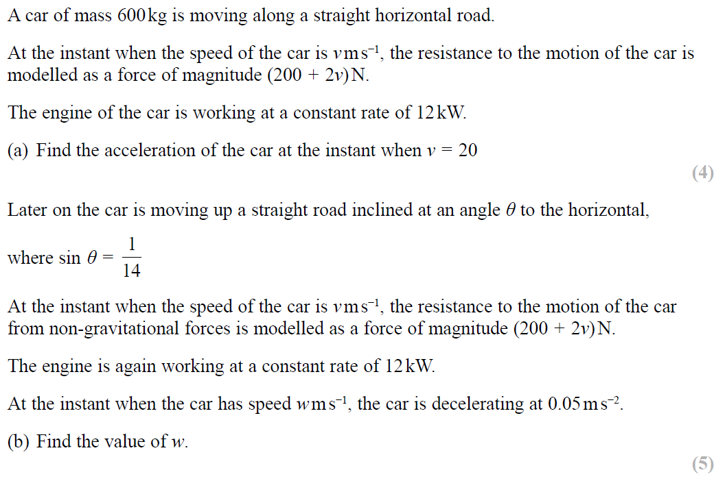
SAM

Slide 13
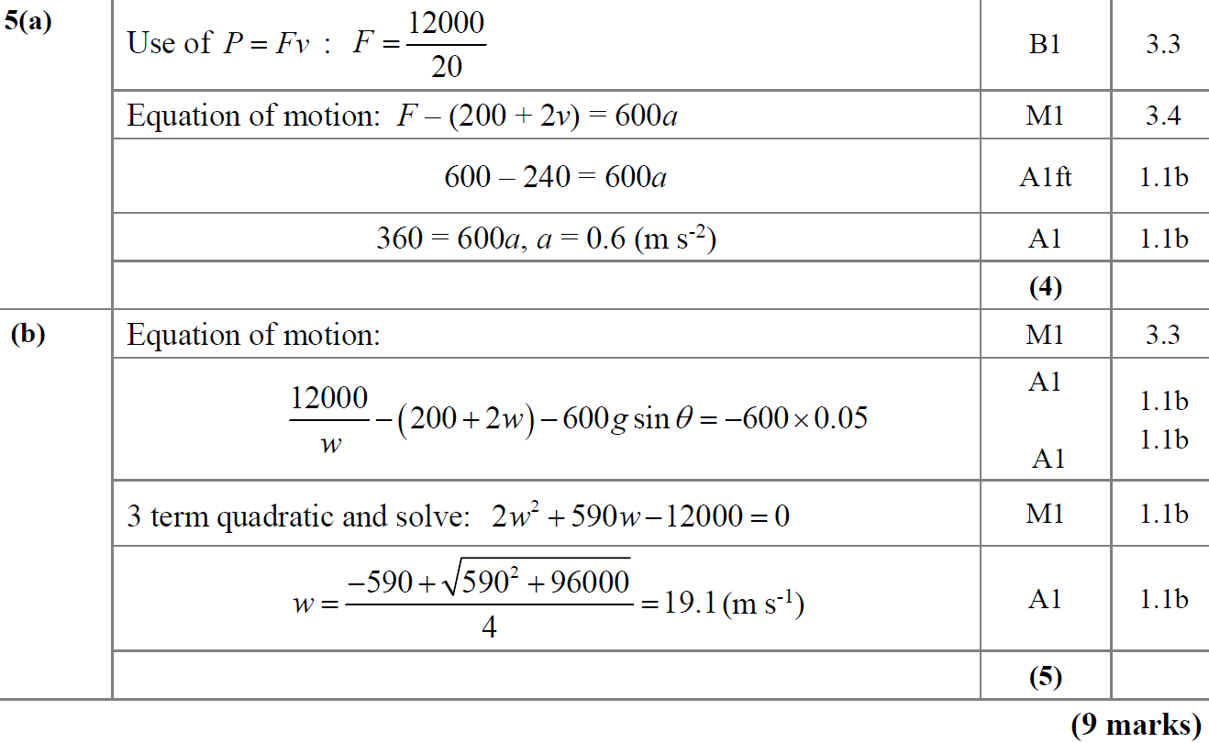
SAM
A
B

Slide 14
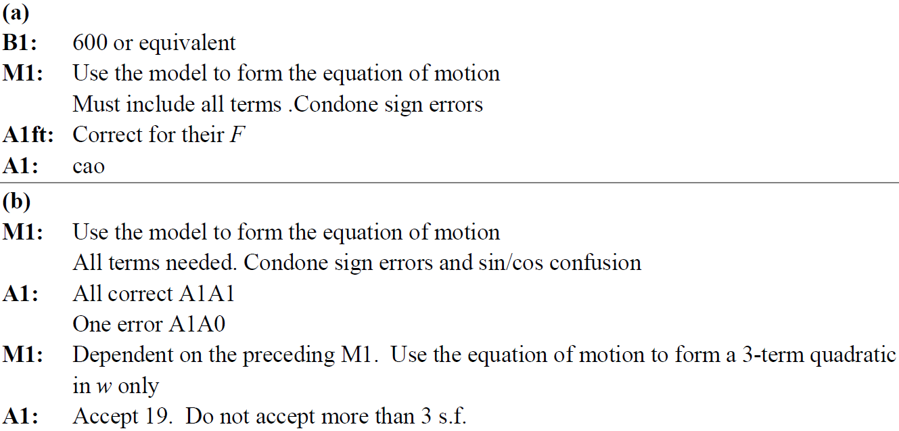
SAM
A notes
B notes

Slide 15
2019

Slide 16
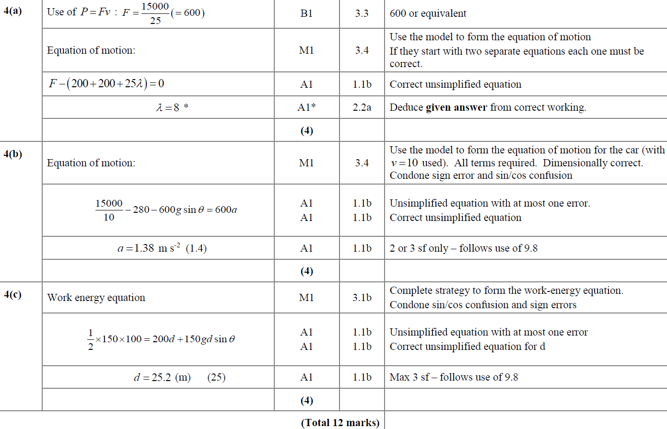
2019
A
B
C

Slide 17
New Spec Q’s
Old Spec Power
Jan 2002
June 2005
Jan 2009
Jan 2013
June 2018
June 2002
Jan 2006
May 2009
June 2013 (R)
June 2019
Jan 2003
June 2006
Jan 2010
June 2014
June 2003
Jan 2007
June 2010
June 2014 (R)
Jan 2004
June 2007
Jan 2011
June 2015
June 2004
Jan 2008
June 2011
June 2016
Jan 2005
May 2008
May 2012
June 2017

Slide 18
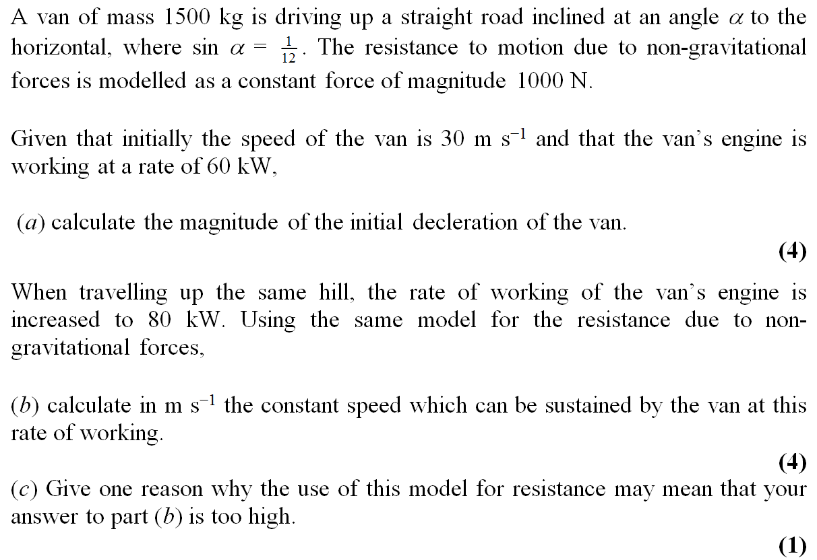
Jan 2002

Slide 19
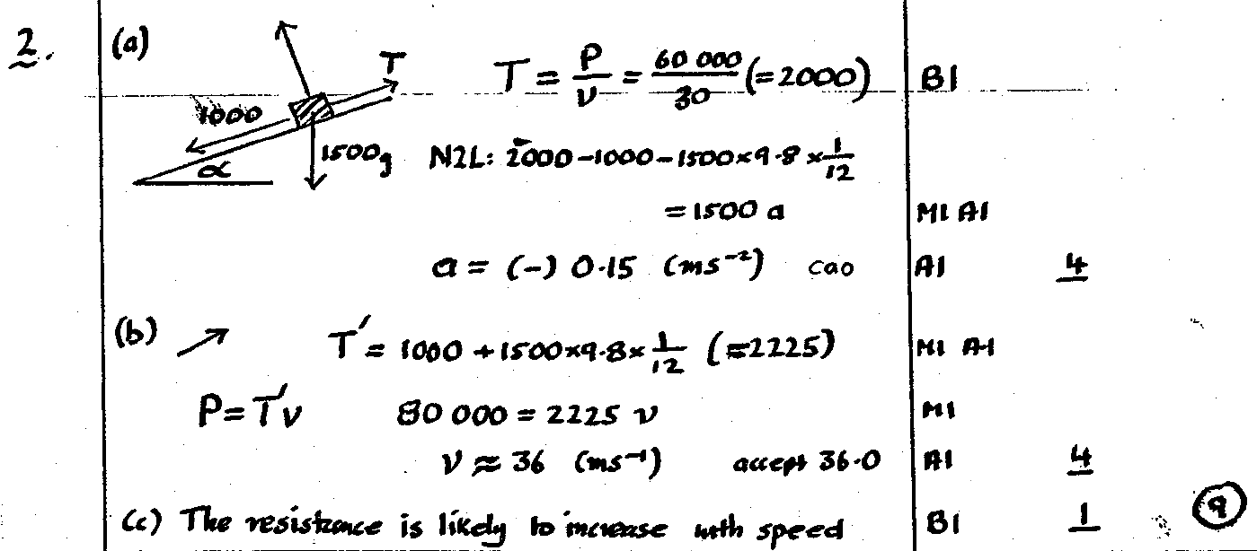
Jan 2002
A
B
C

Slide 20
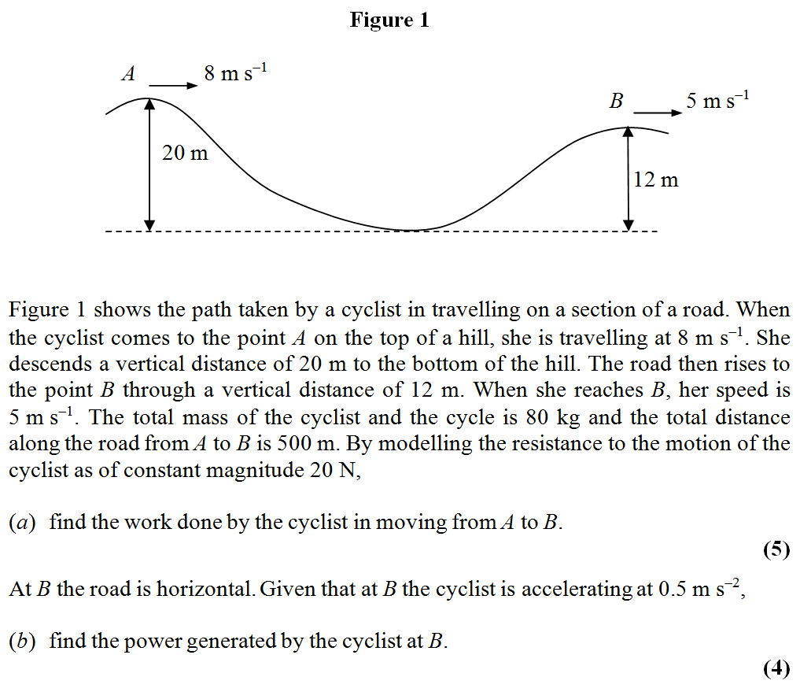
June 2002

Slide 21
June 2002
A
B

Slide 22
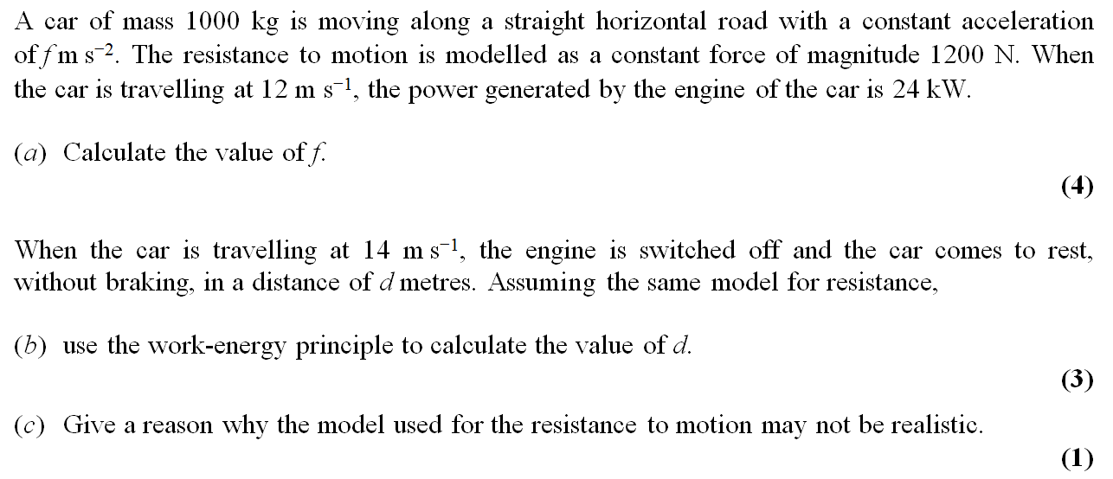
Jan 2003

Slide 23
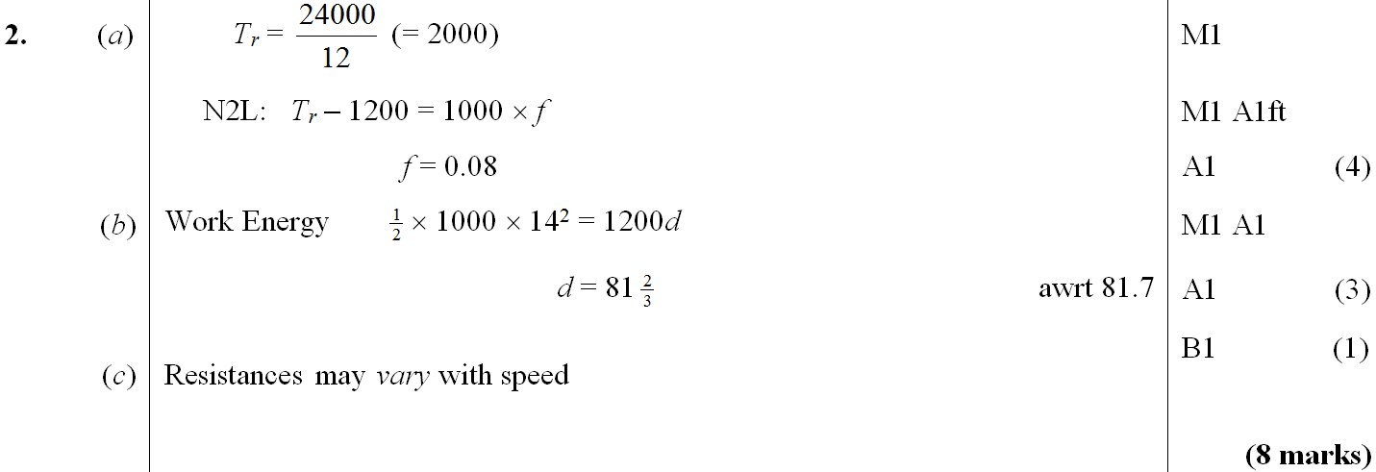
Jan 2003
A
B
C

Slide 24
June 2003

Slide 25
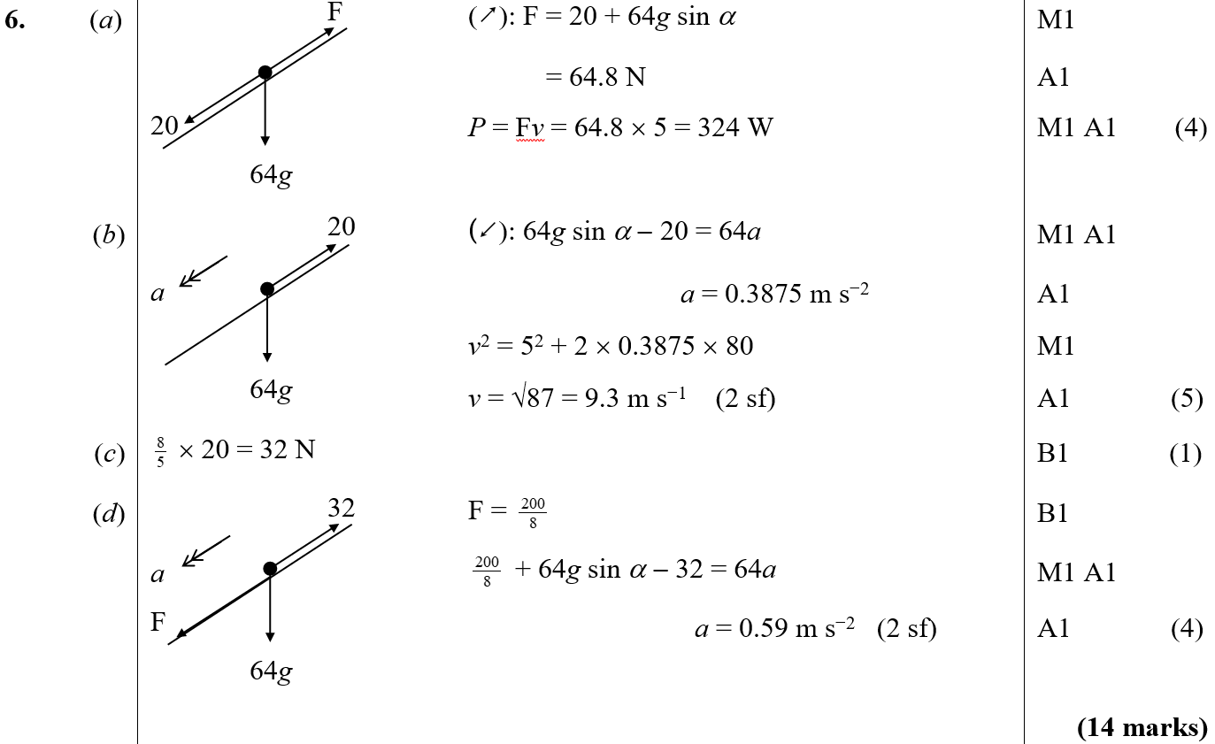
June 2003
A
B
C
D

Slide 26
Jan 2004

Slide 27
Jan 2004
A

Slide 28
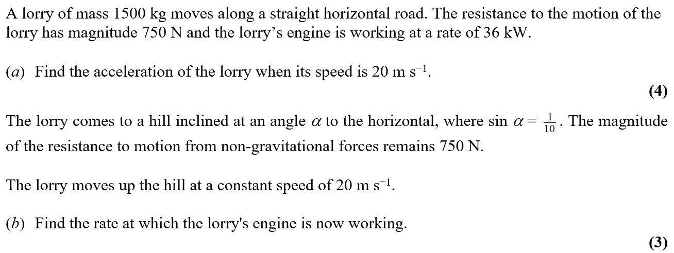
June 2004

Slide 29
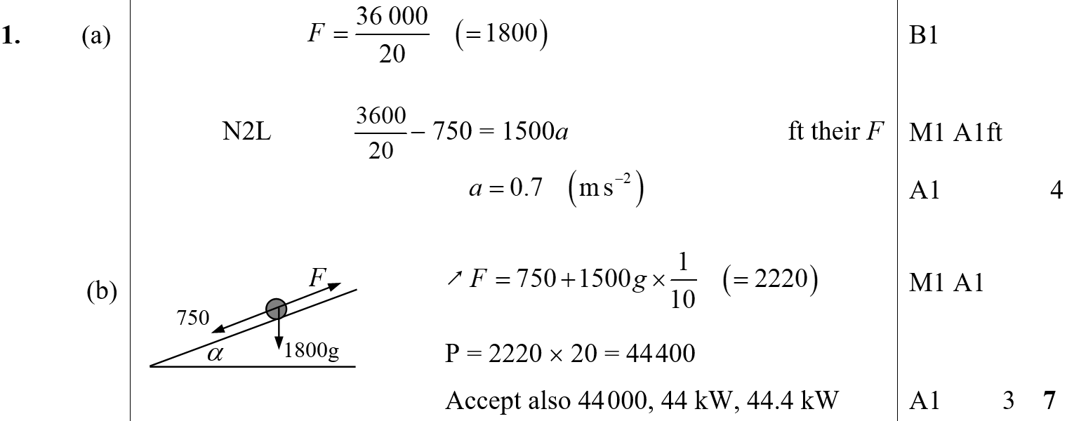
June 2004
A
B

Slide 30
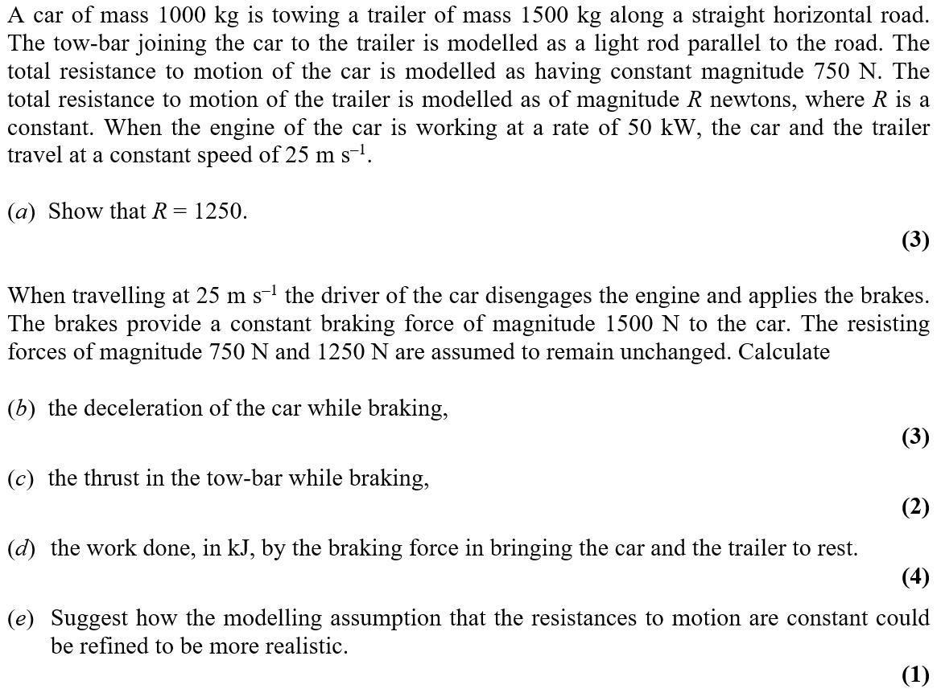
Jan 2005

Slide 31
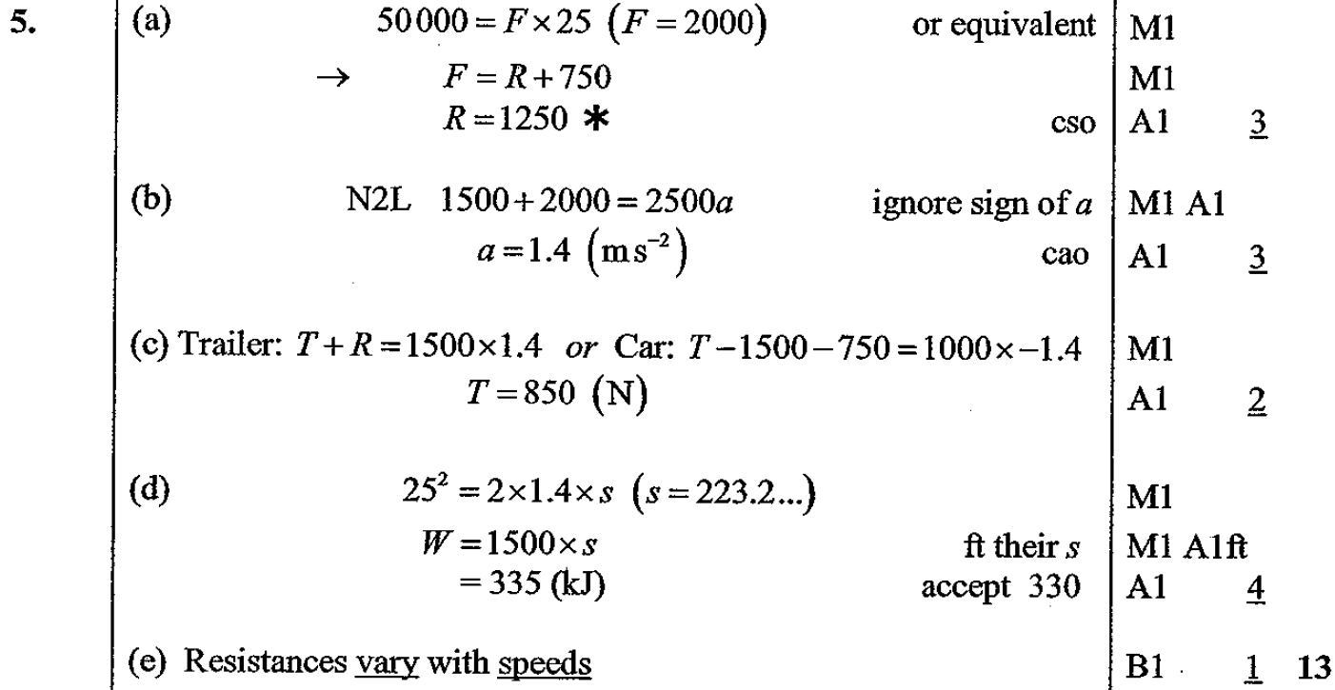
Jan 2005
A
B
C
D
E

Slide 32
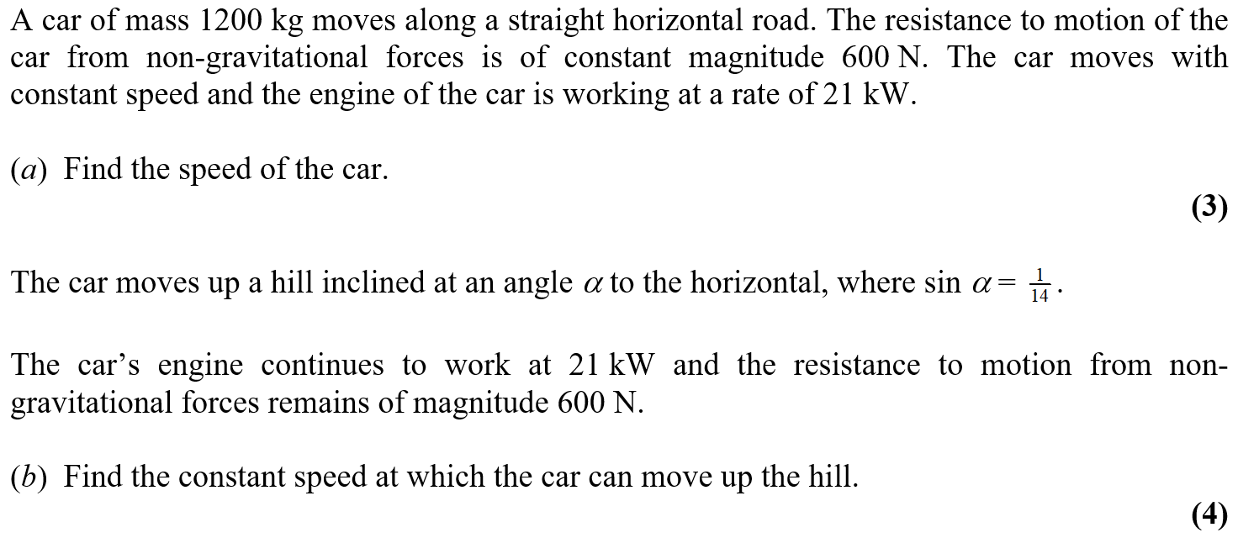
June 2005

Slide 33
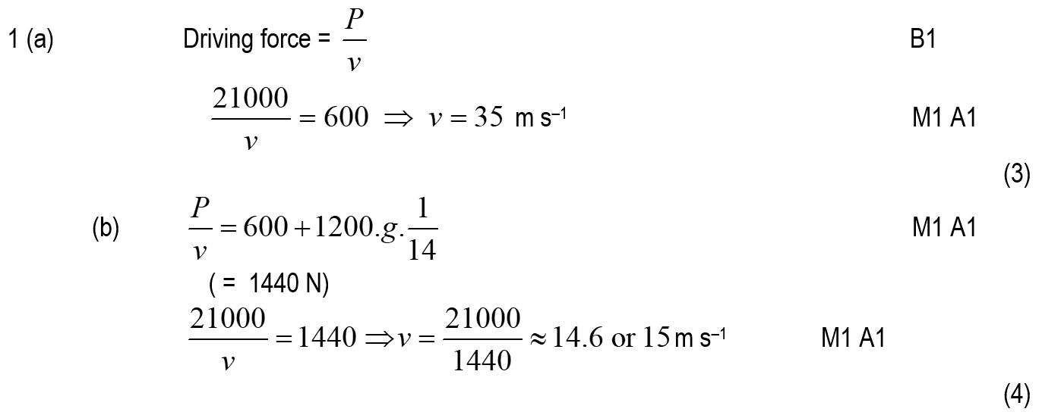
June 2005
A
B

Slide 34
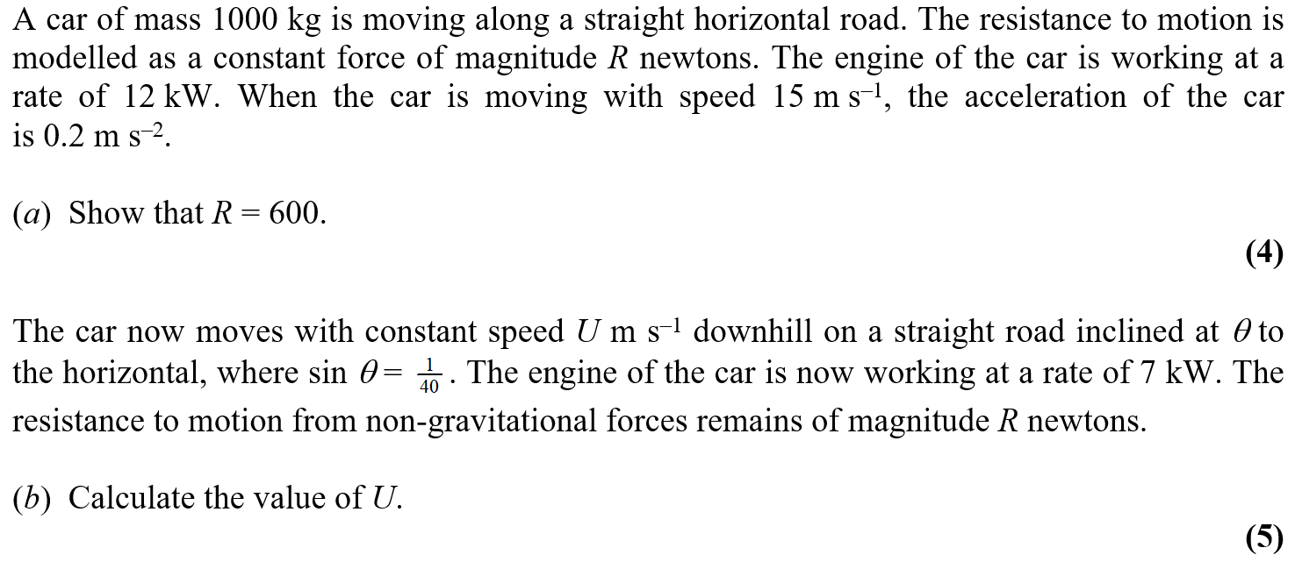
Jan 2006

Slide 35
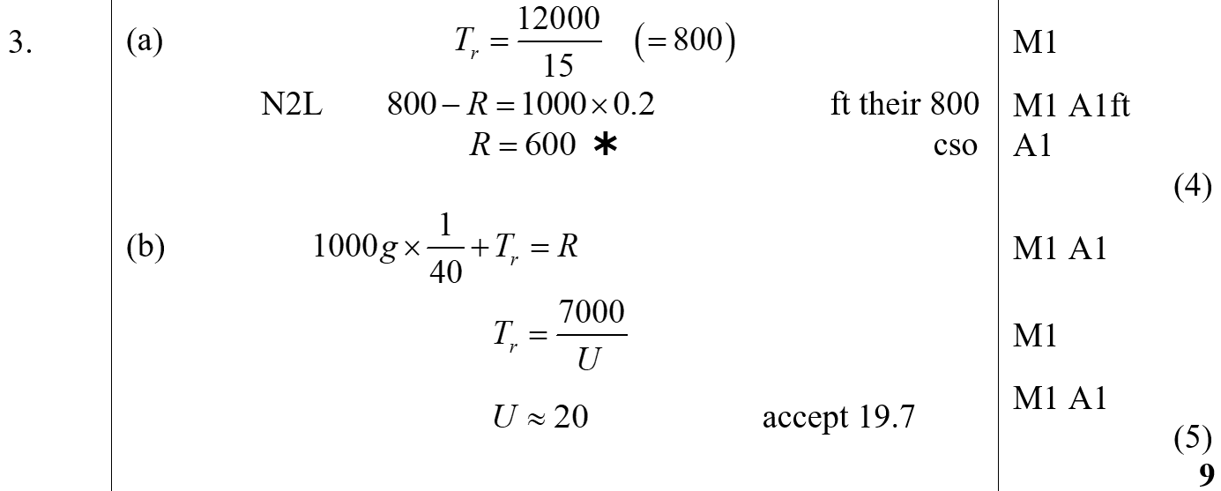
Jan 2006
A
B

Slide 36
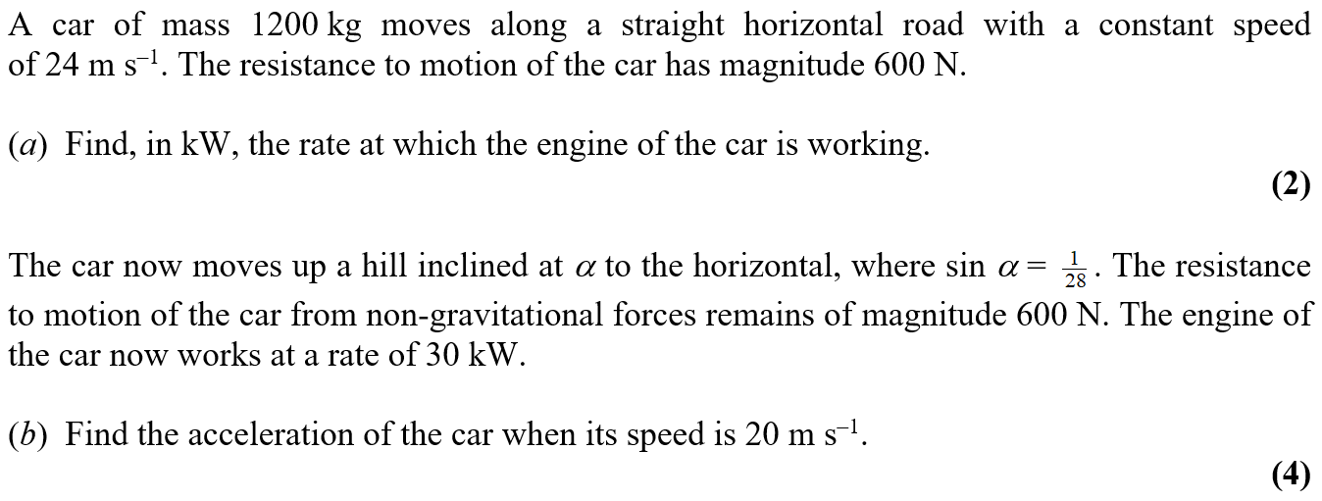
June 2006

Slide 37
June 2006
A
B

Slide 38
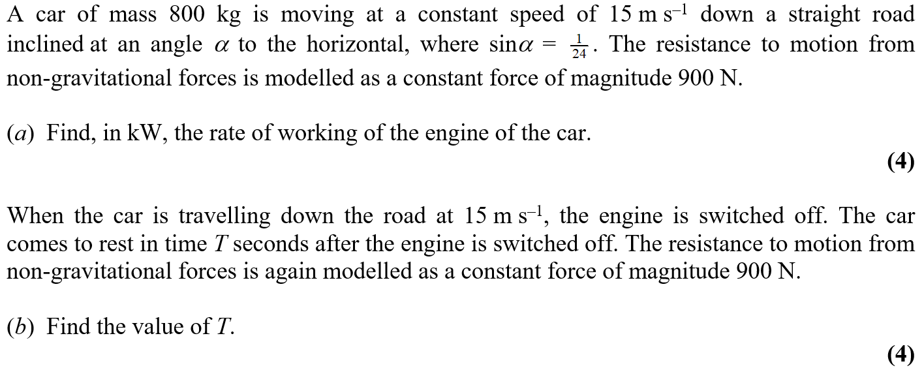
Jan 2007

Slide 39
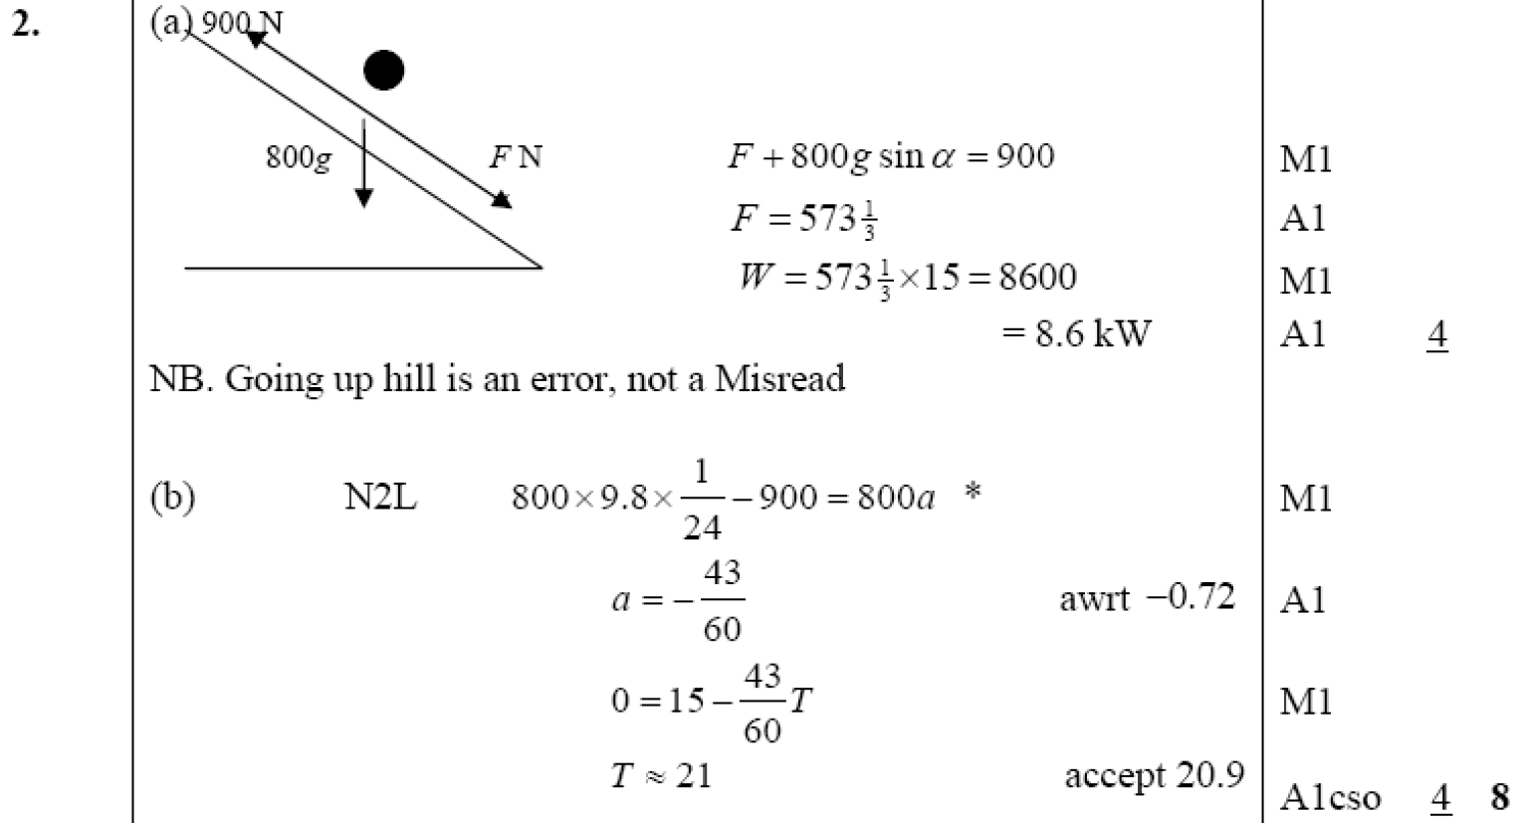
Jan 2007
A
B

Slide 40
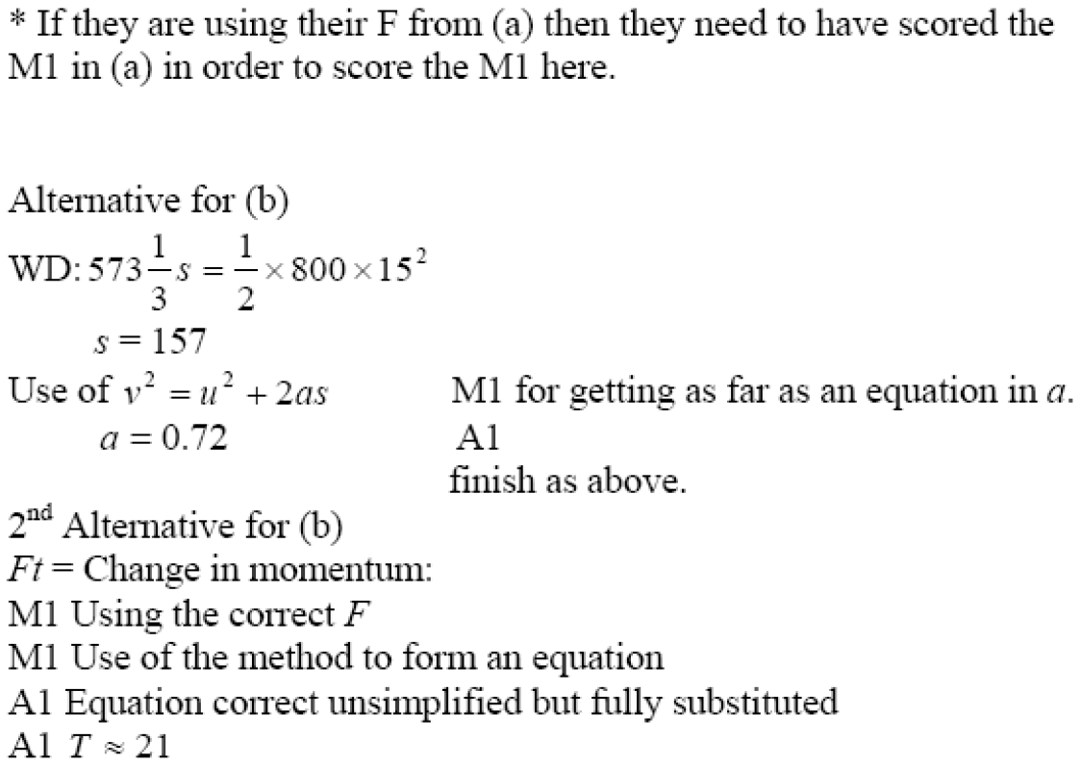
Jan 2007
General notes and Alternatives for B

Slide 41
June 2007

Slide 42
June 2007
A
notes

Slide 43
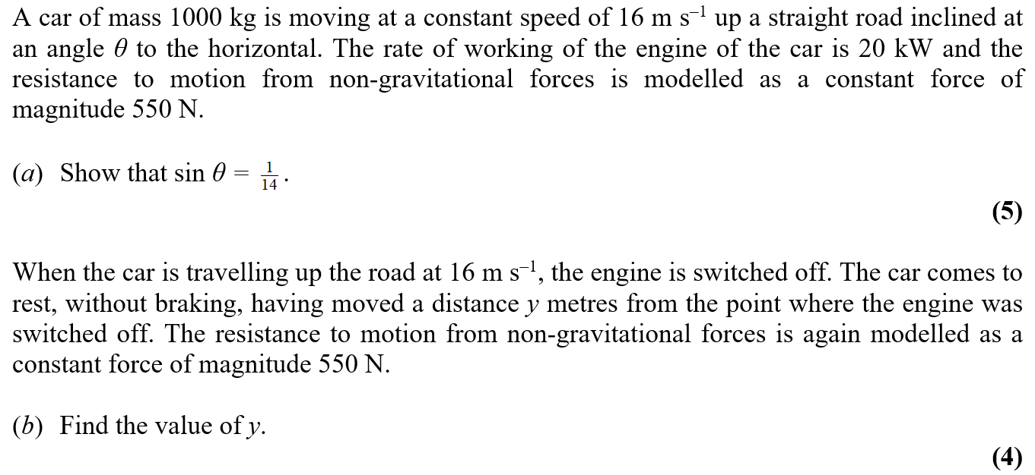
Jan 2008

Slide 44
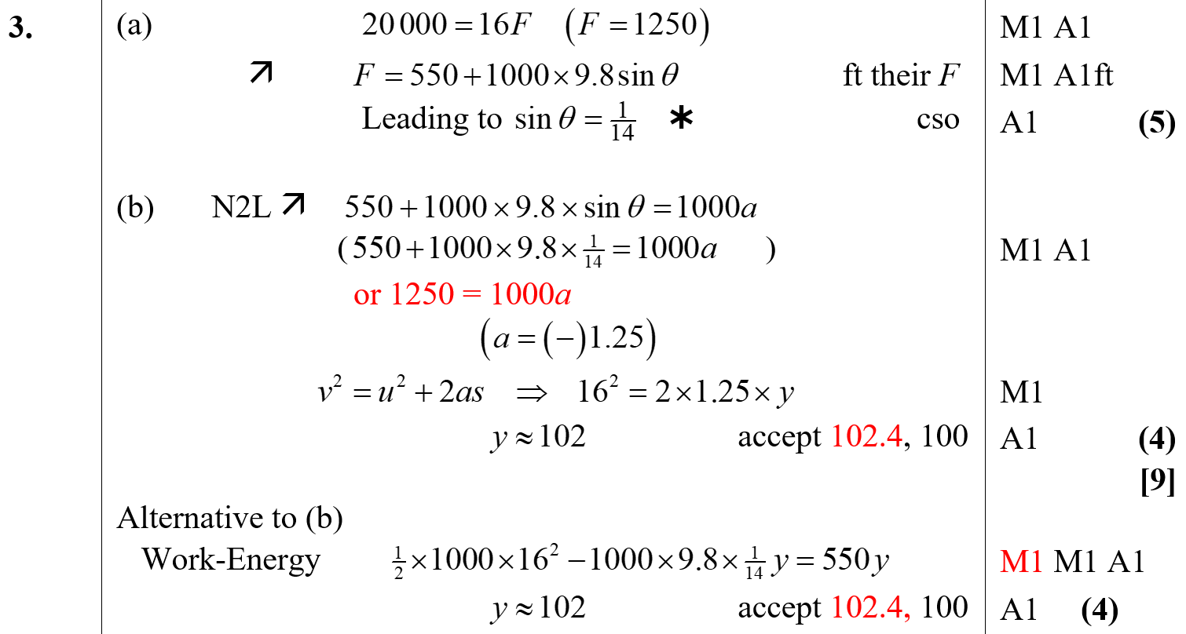
Jan 2008
A
B

Slide 45
May 2008

Slide 46
May 2008
A

Slide 47
Jan 2009

Slide 48
Jan 2009
A

Slide 49
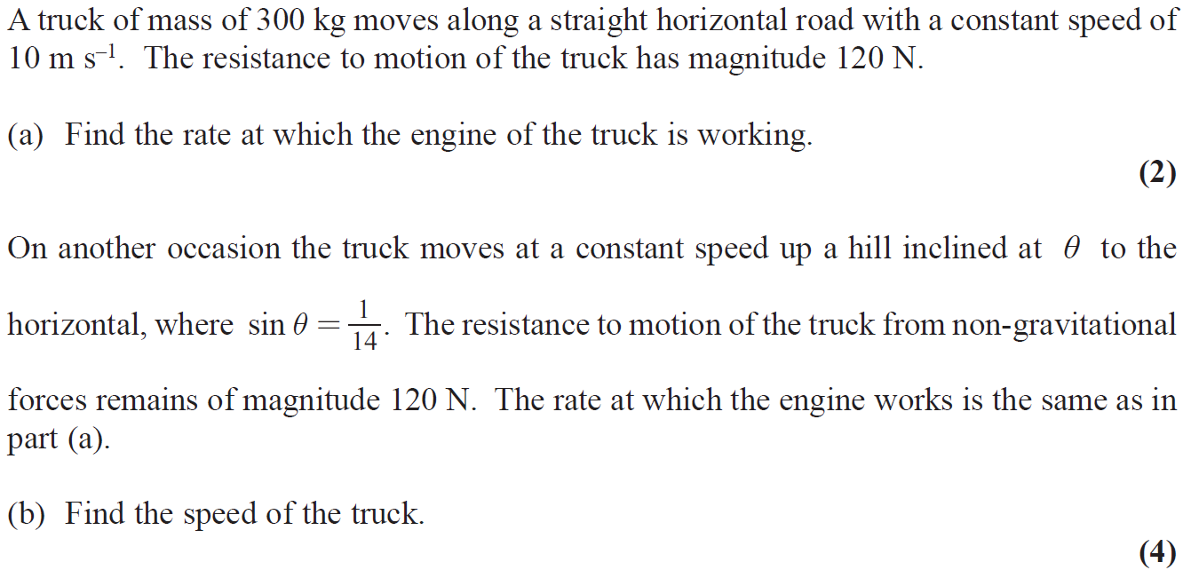
May 2009

Slide 50
May 2009
A
B

Slide 51
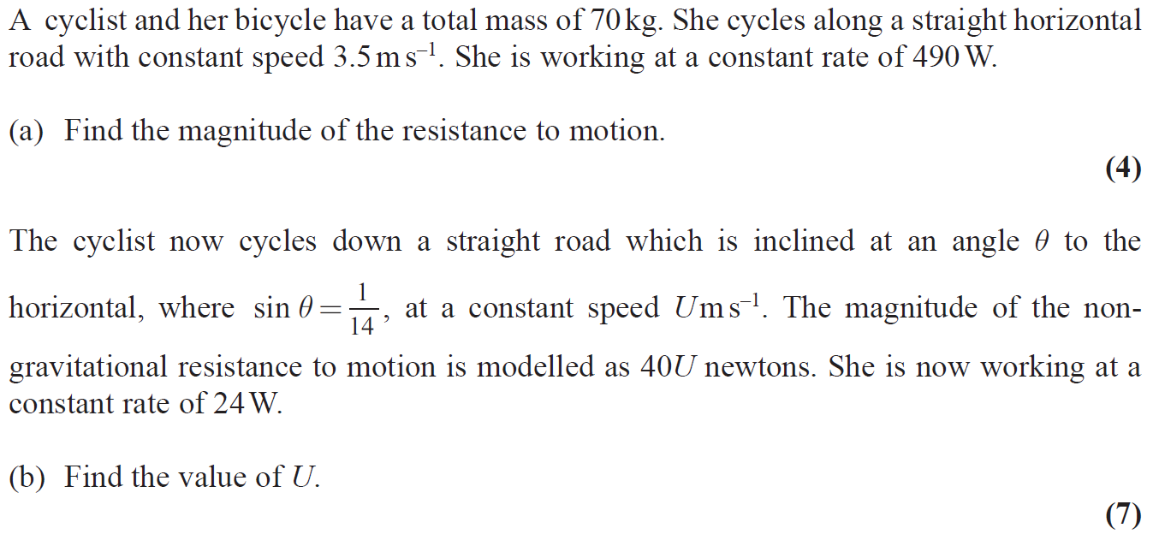
Jan 2010

Slide 52
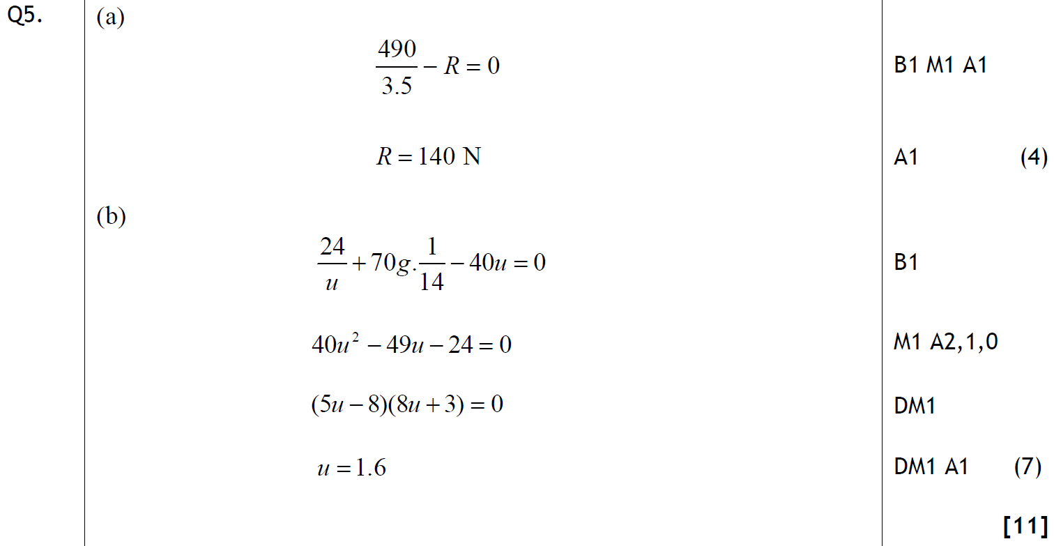
Jan 2010
A
B

Slide 53
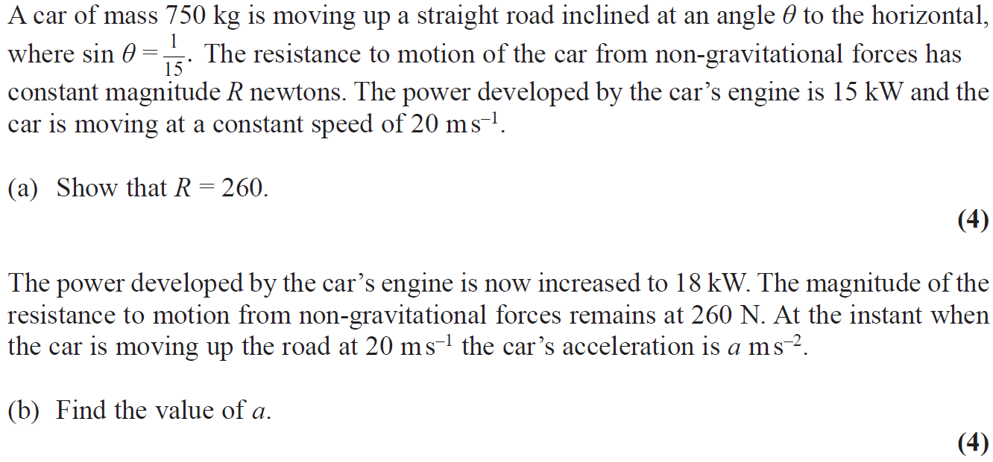
June 2010

Slide 54
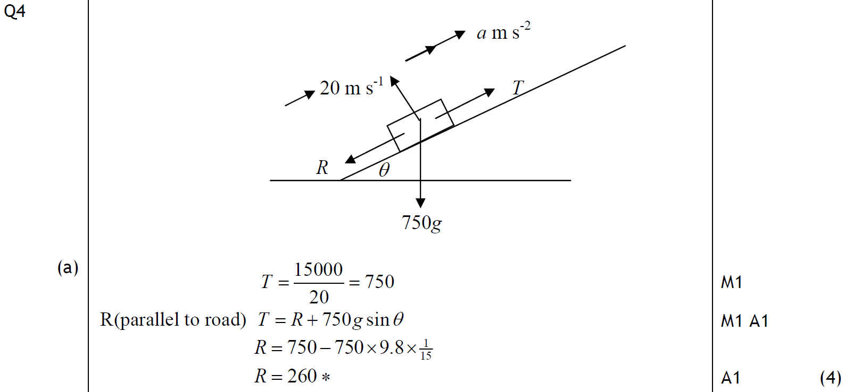
June 2010
A

Slide 55
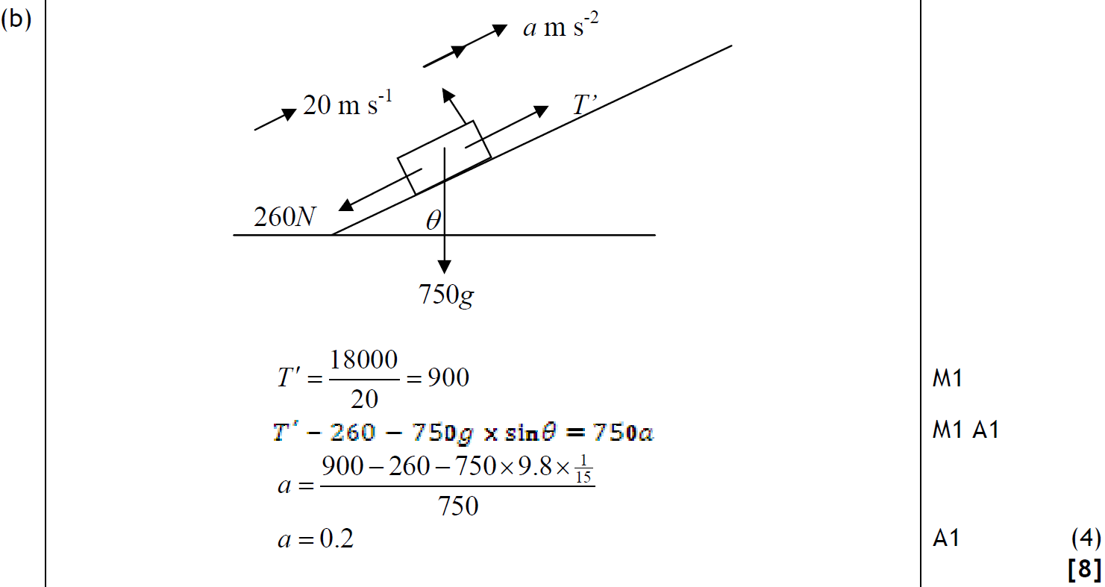
June 2010
B

Slide 56
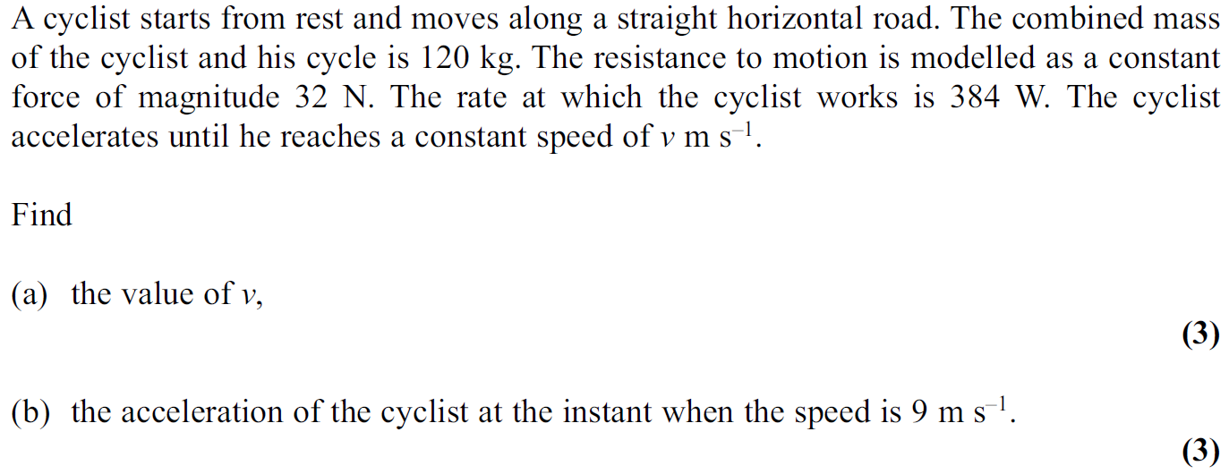
Jan 2011

Slide 57
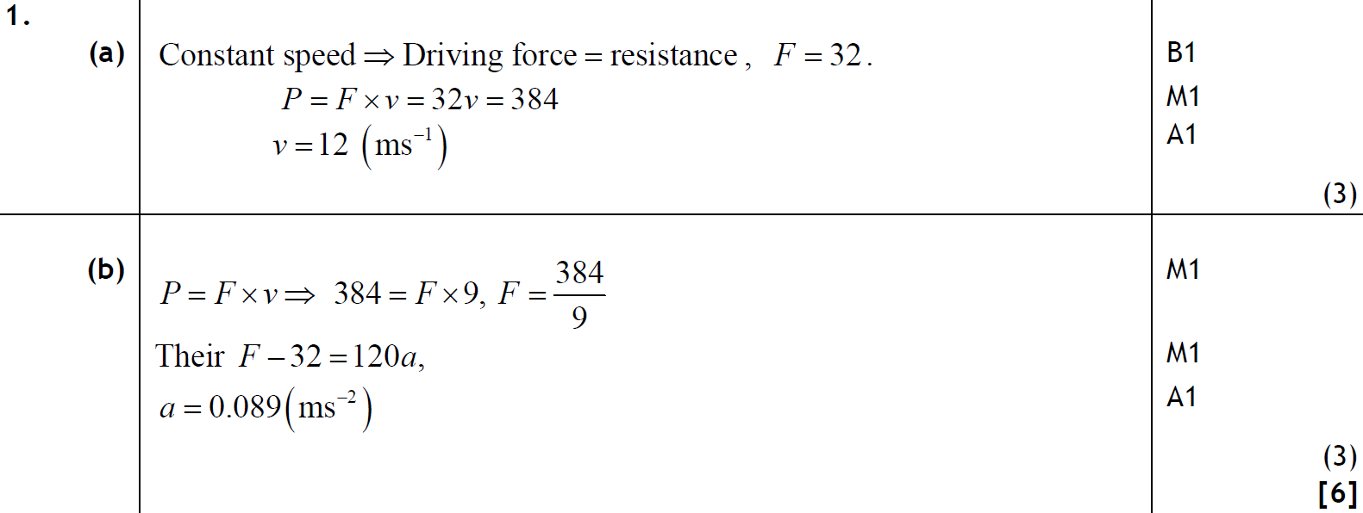
Jan 2011
A
B

Slide 58
June 2011

Slide 59
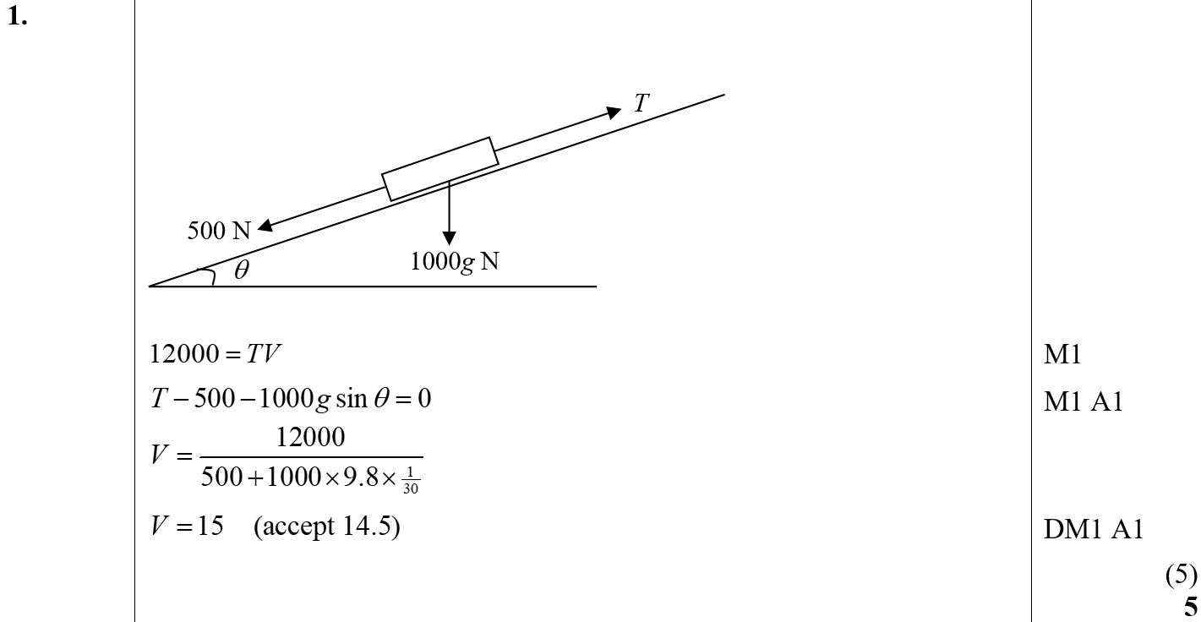
June 2011
A

Slide 60
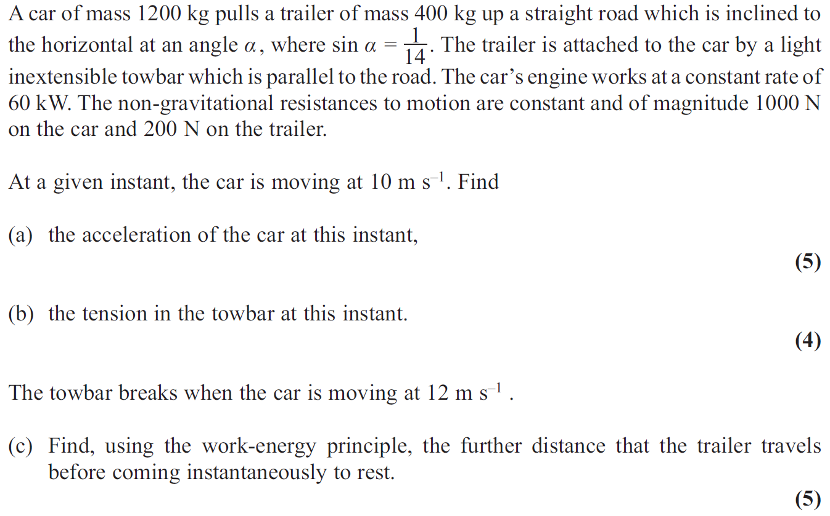
May 2012

Slide 61
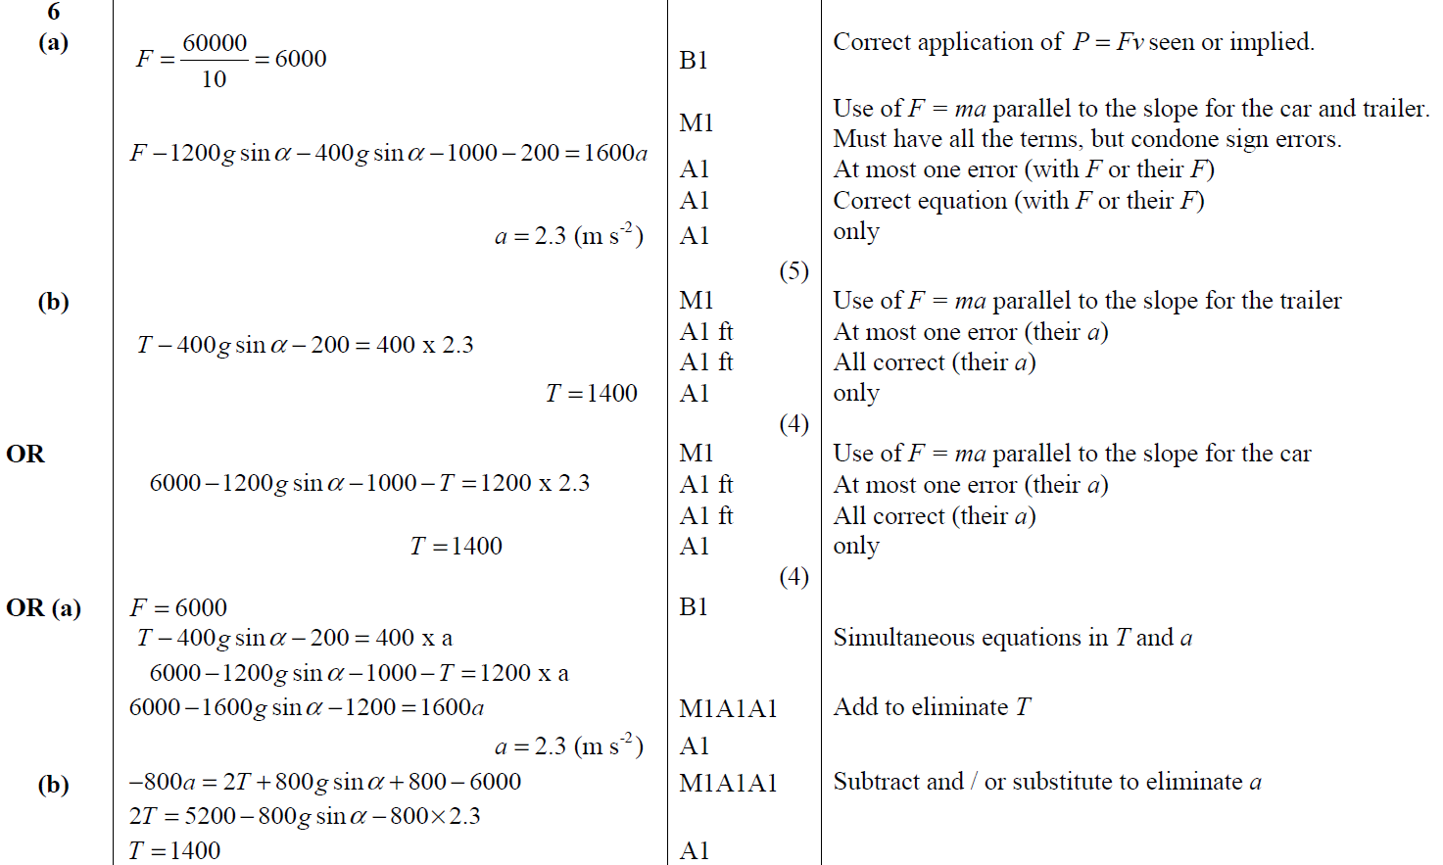
May 2012
A
B
A Alternative
B Alternative

Slide 62
May 2012
C

Slide 63
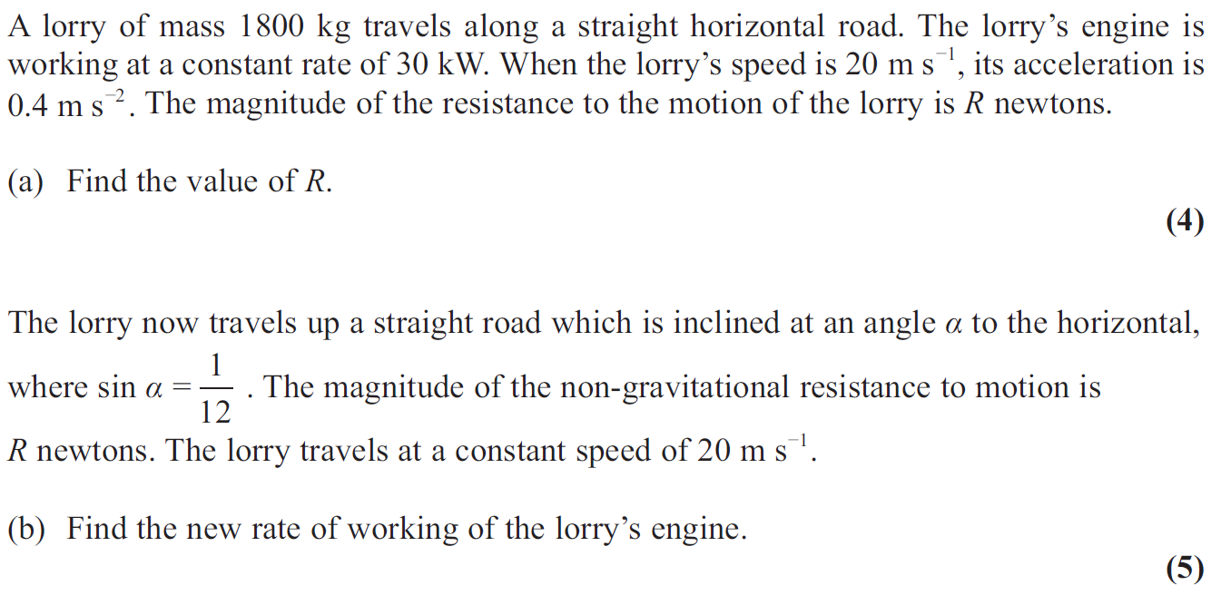
Jan 2013

Slide 64
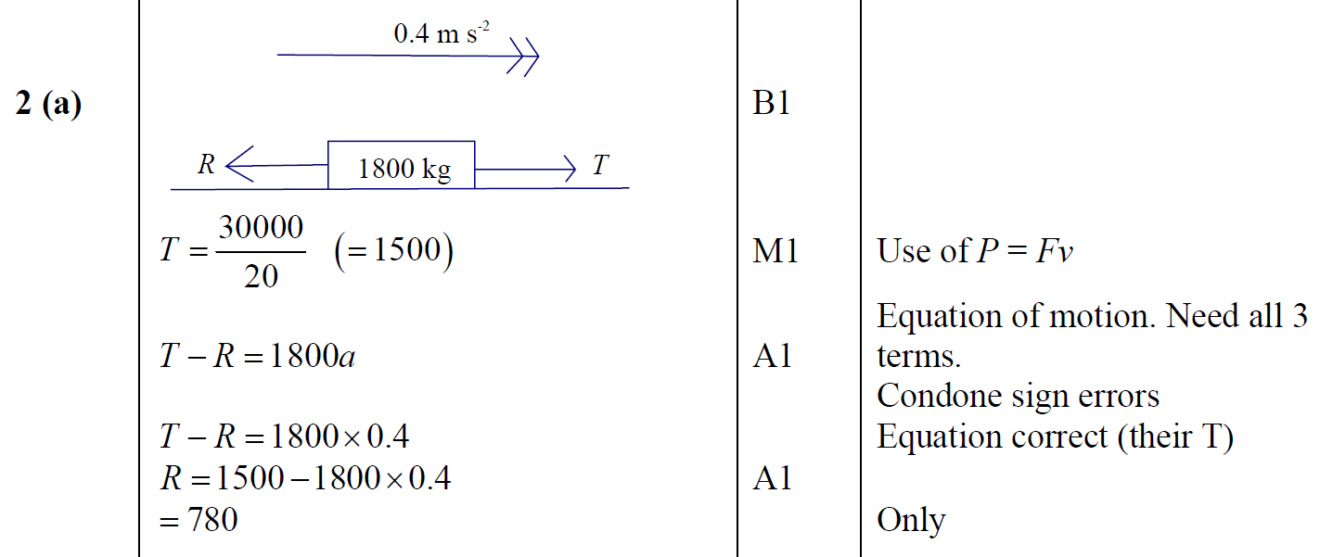
Jan 2013
A

Slide 65
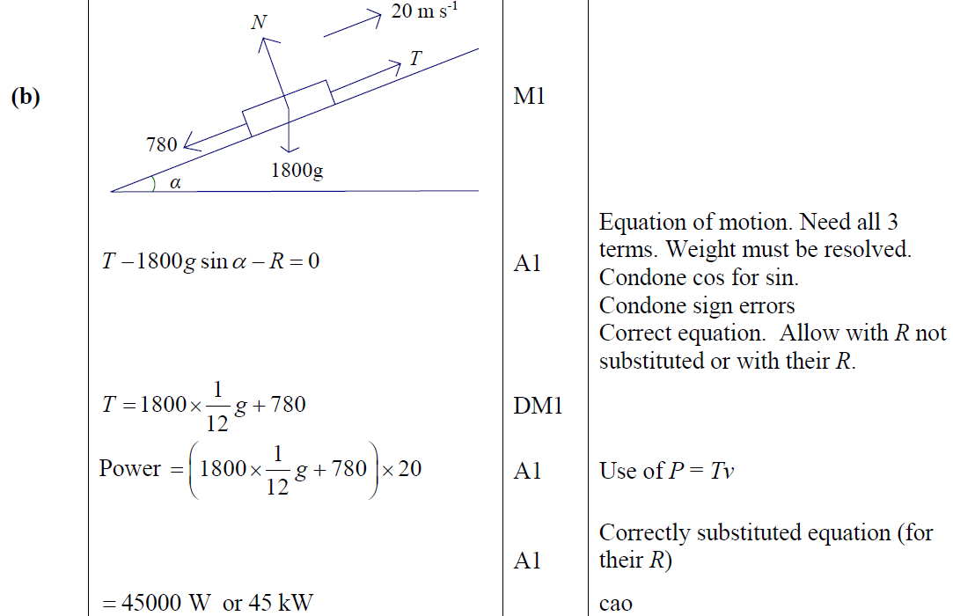
Jan 2013
B

Slide 66
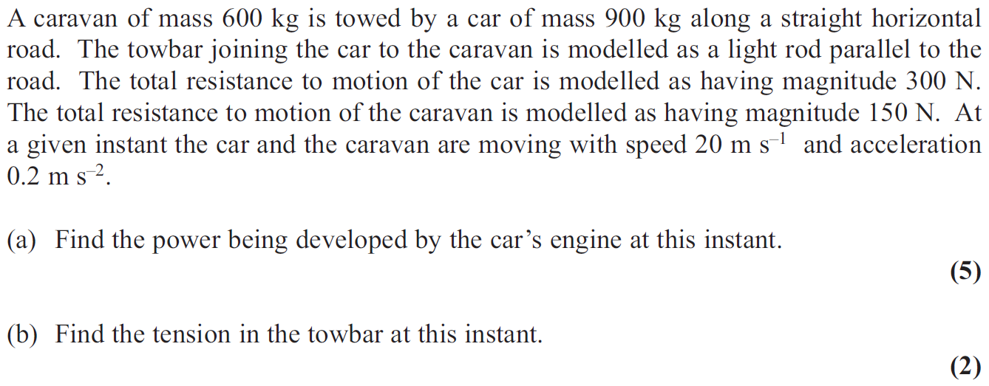
June 2013 (R)

Slide 67
June 2013 (R)
A
B

Slide 68
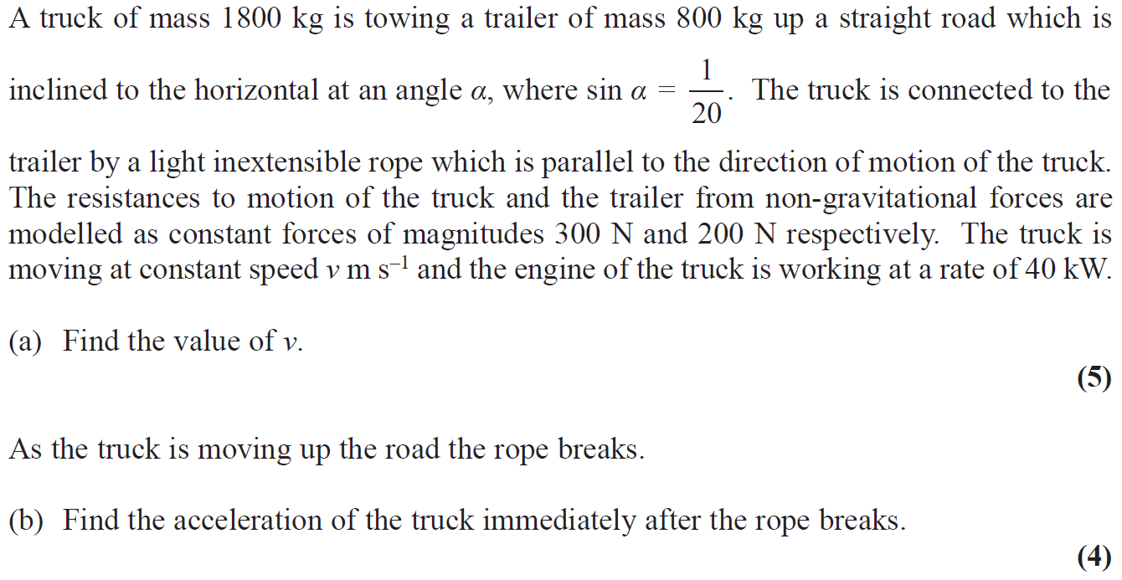
June 2014

Slide 69
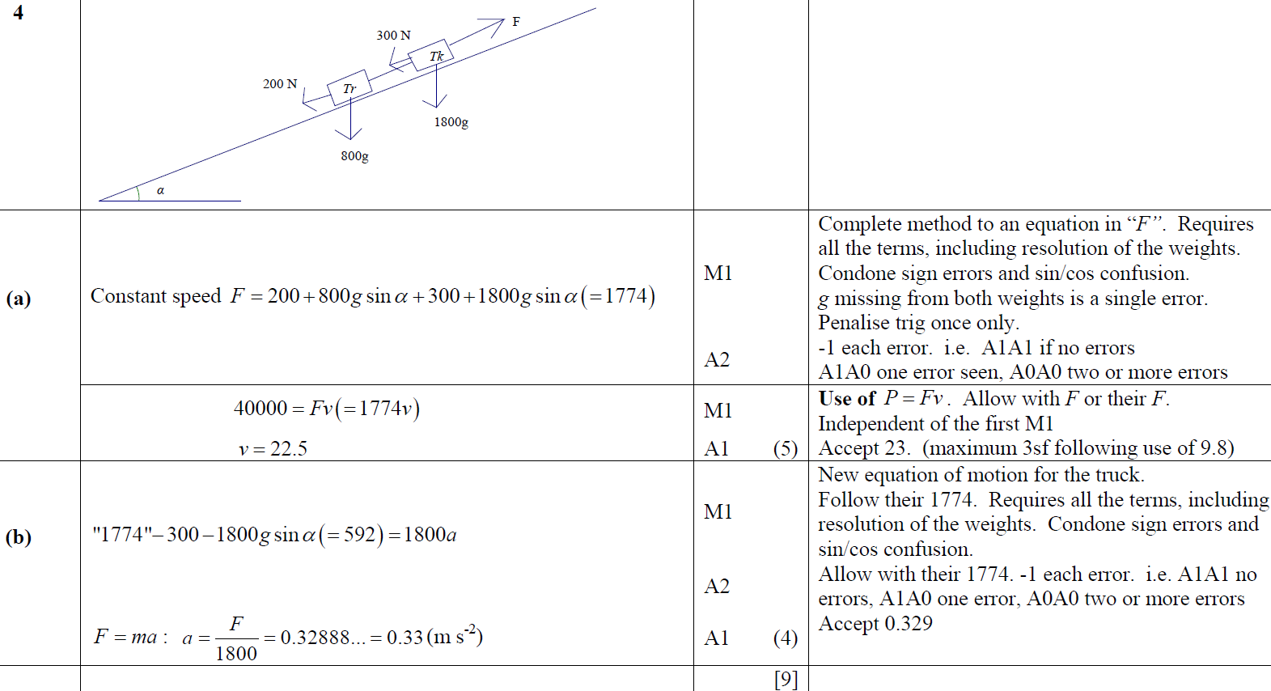
June 2014
A
B

Slide 70
June 2014 (R)

Slide 71
June 2014 (R)
A
B

Slide 72
June 2015

Slide 73
June 2015
A

Slide 74
June 2016

Slide 75
June 2016
A
B

Slide 76
June 2017

Slide 77
June 2017
A

Slide 78
June 2017
B
C

Slide 79
June 2018

Slide 80
June 2018
A

Slide 81
June 2018
B

Slide 82
June 2019

Slide 83
June 2019
A

