Slide 1
Pie Charts
Pie Charts
Edexcel
Nov 2017 2H Q11
AQA
June 2019 3H Q21
OCR

Slide 2
Pie Charts
Pie Charts
Edexcel
June 2017
2H Q10
AQA
1 Marker
Nov 2017
1H Q11
OCR

Slide 3
Pie Charts
Pie Charts
Edexcel
June 2017
3H Q3
AQA
Nov 2018
3H Q1
OCR

Slide 4
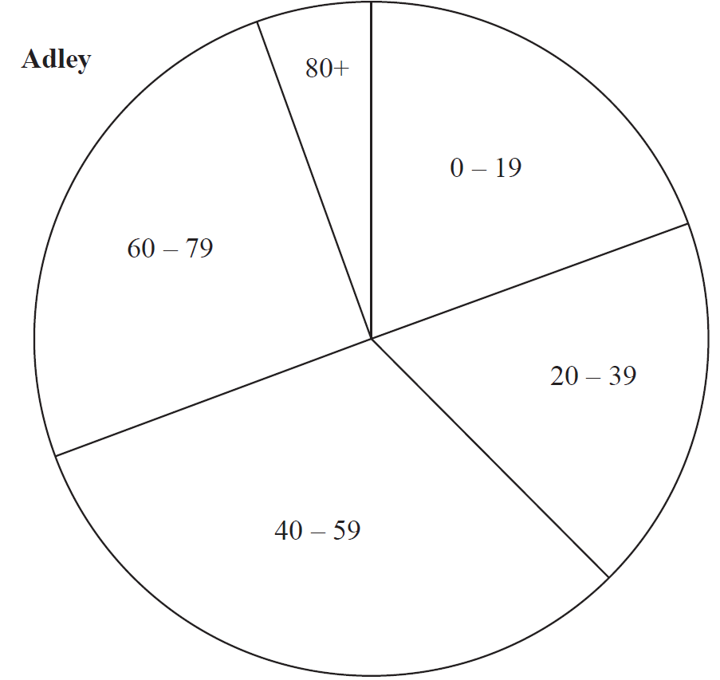
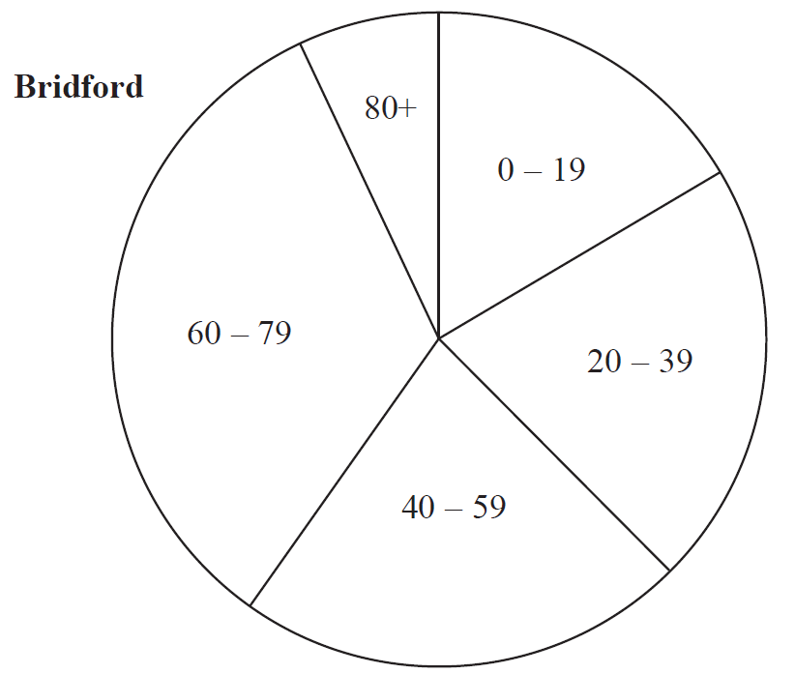
Pie Charts
Nov 2017 2H Q11

Slide 5
Pie Charts
Nov 2017 2H Q11
A

Slide 6
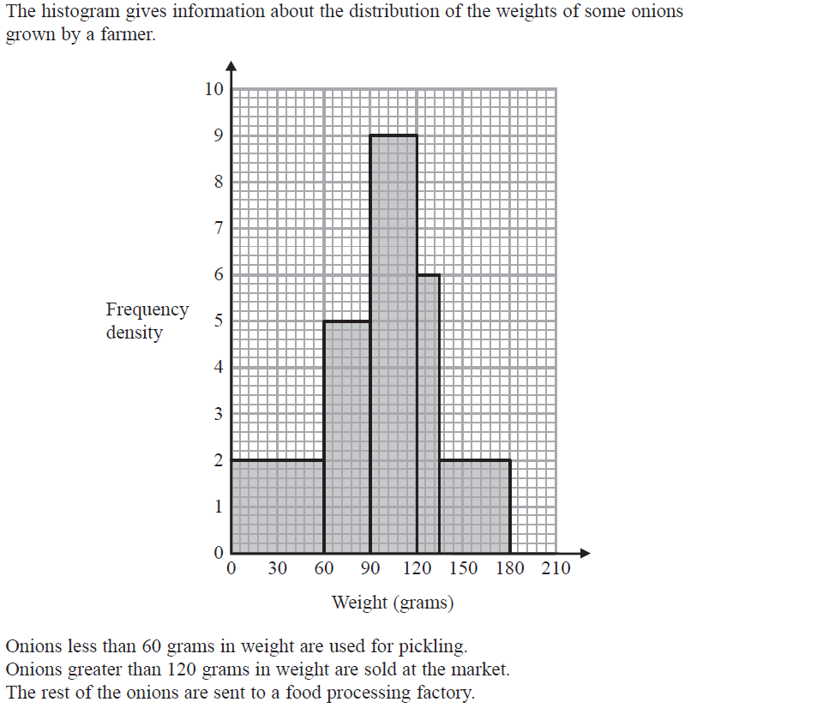
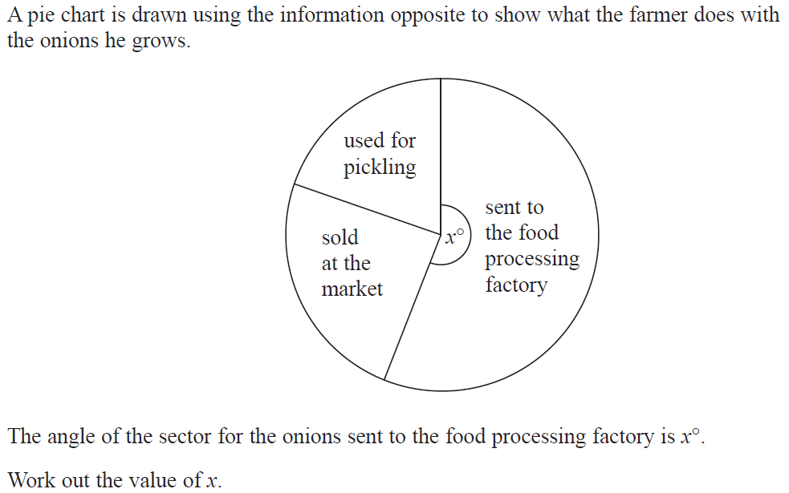
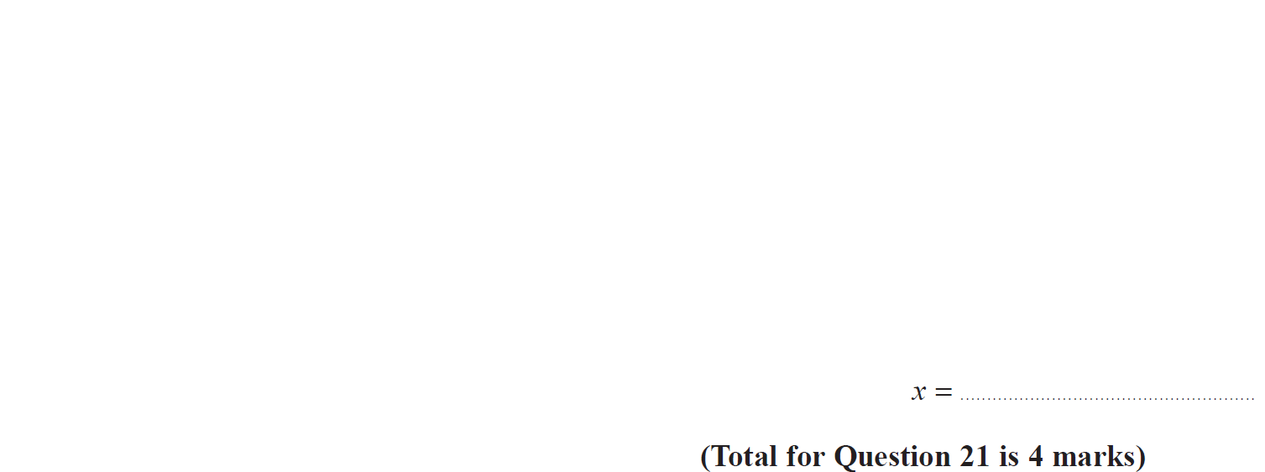
Pie Charts
June 2019 3H Q21

Slide 7
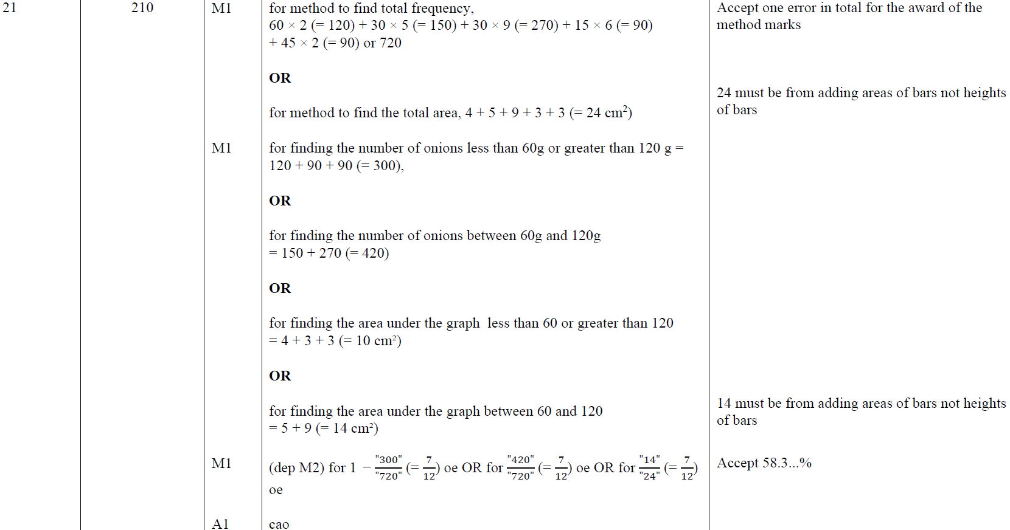
Pie Charts
June 2019 3H Q21
A

Slide 8
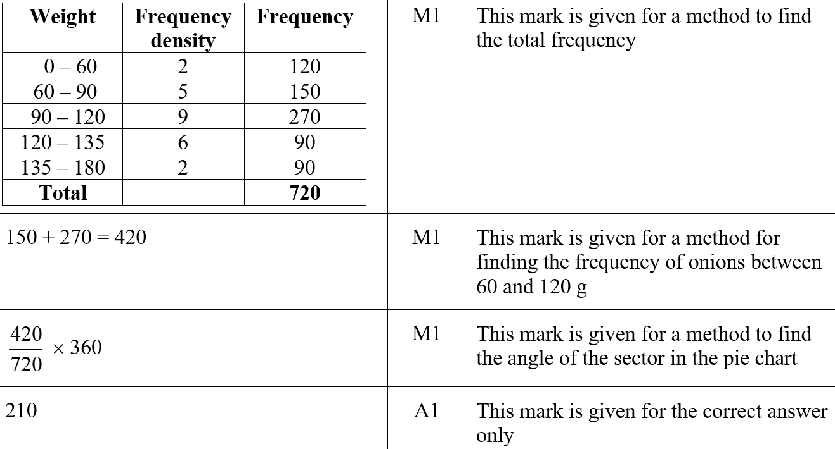
Pie Charts
June 2019 3H Q21
A SF

Slide 9
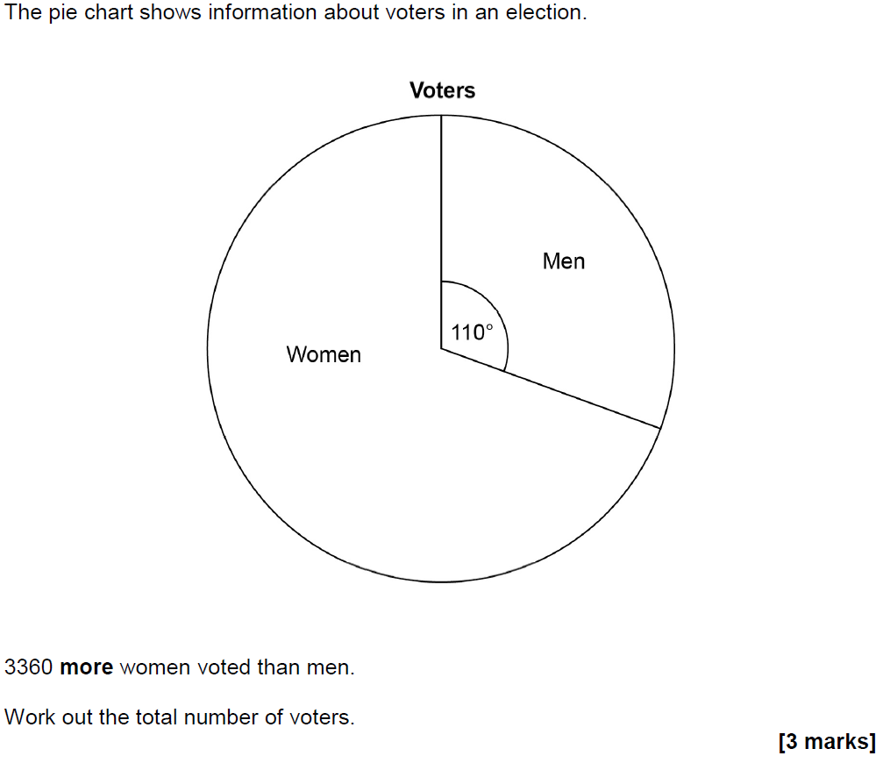
Pie Charts
June 2017 2H Q10

Slide 10
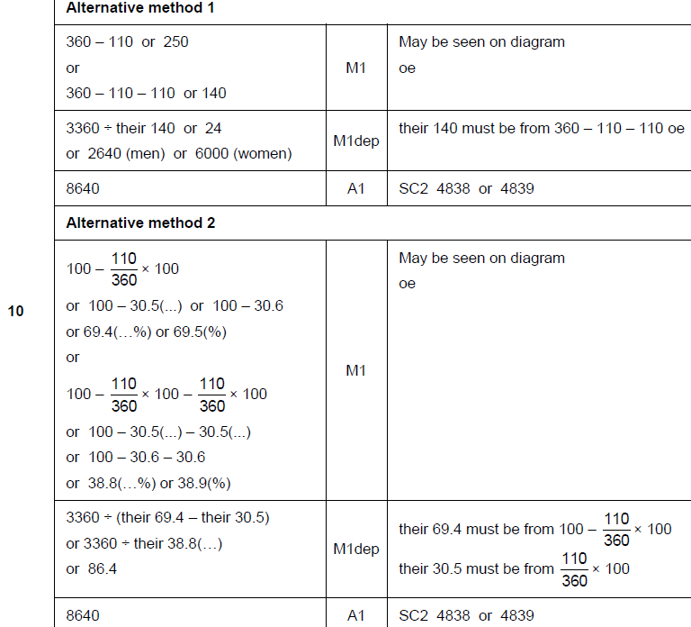
Pie Charts
June 2017 2H Q10
A

Slide 11
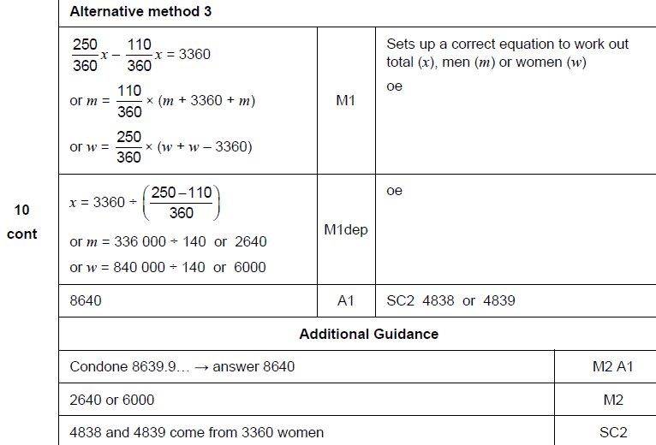
Pie Charts
June 2017 2H Q10
A Alternative & notes

Slide 12
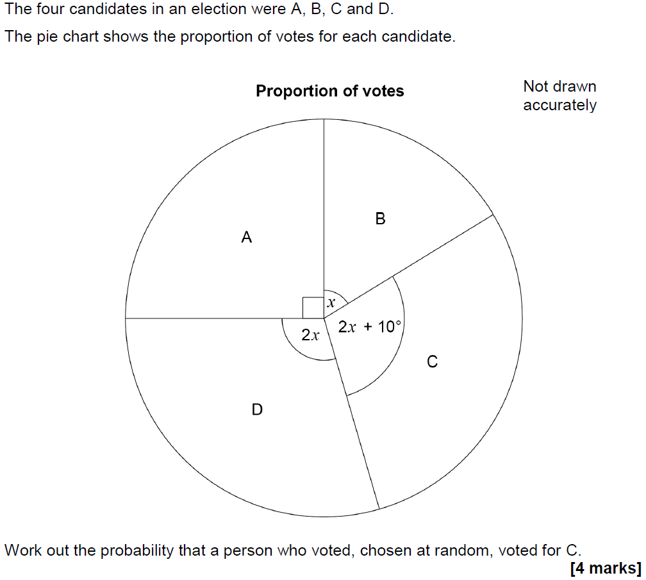
Pie Charts
Nov 2017 1H Q11

Slide 13
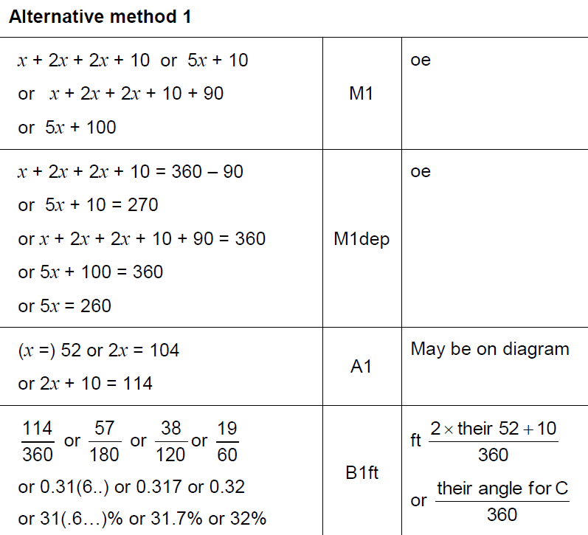
Pie Charts
Nov 2017 1H Q11
A

Slide 14
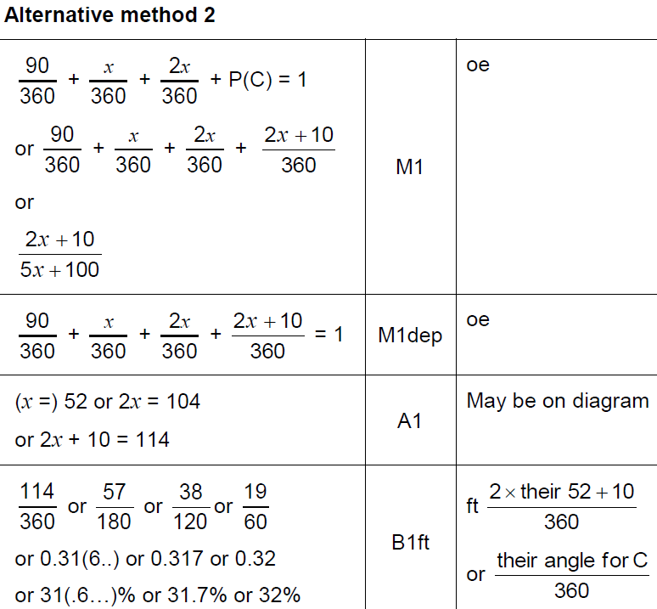
Pie Charts
Nov 2017 1H Q11
A Alternative

Slide 15
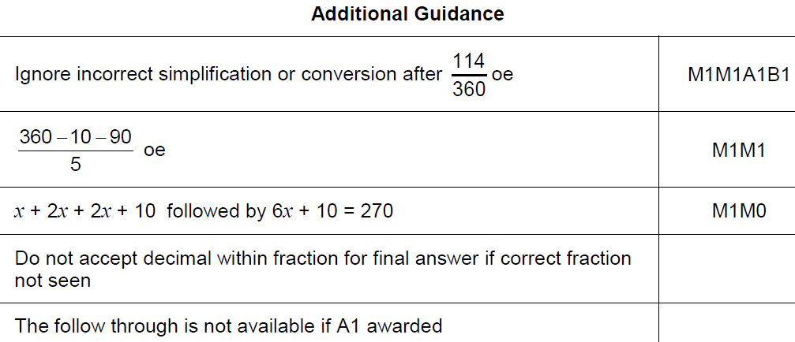
Pie Charts
Nov 2017 1H Q11
A notes

Slide 16
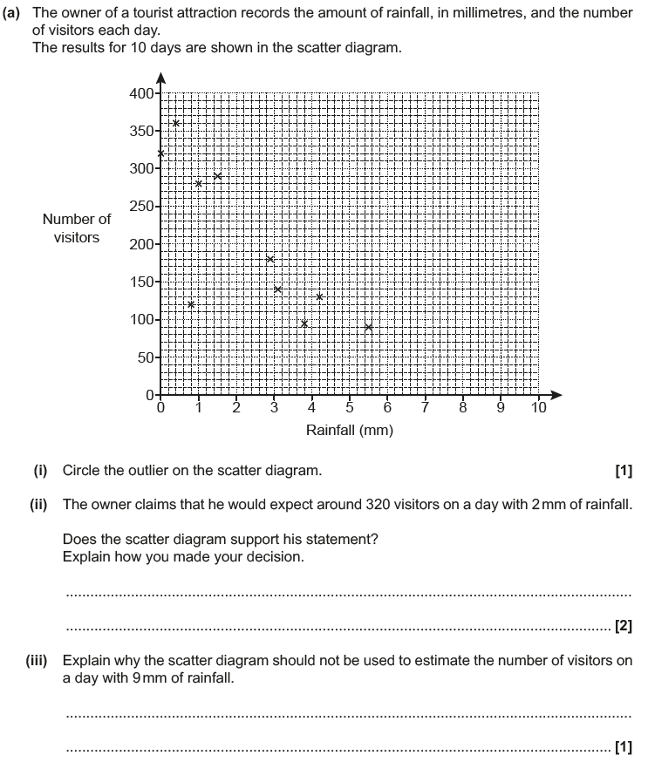
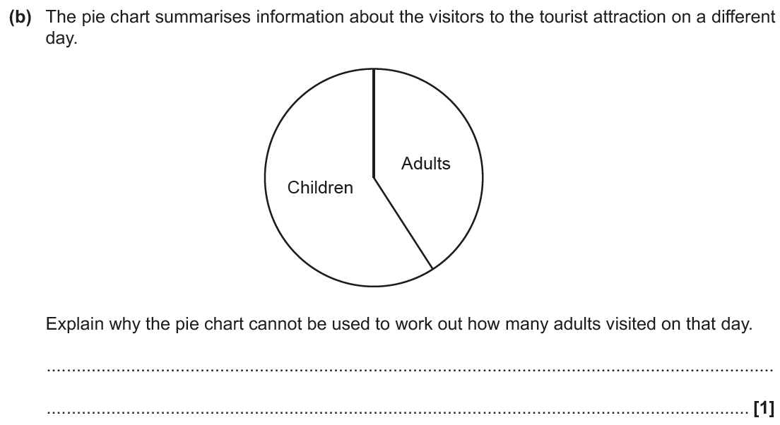
Pie Charts
June 2017 3H Q3

Slide 17
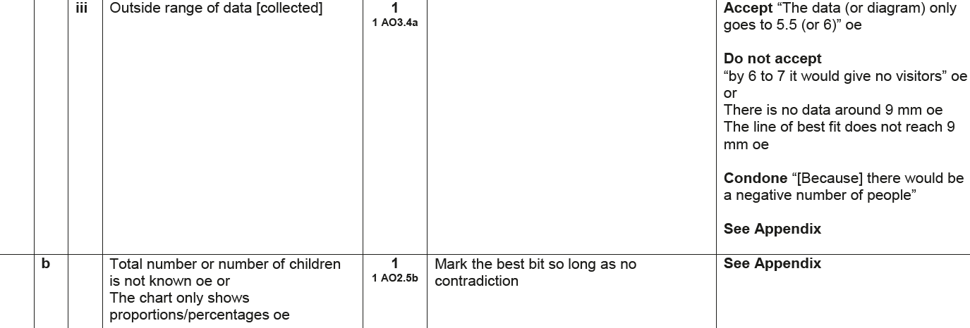
Pie Charts
June 2017 3H Q3
A (i)
A (ii)
A (iii)
B

Slide 18
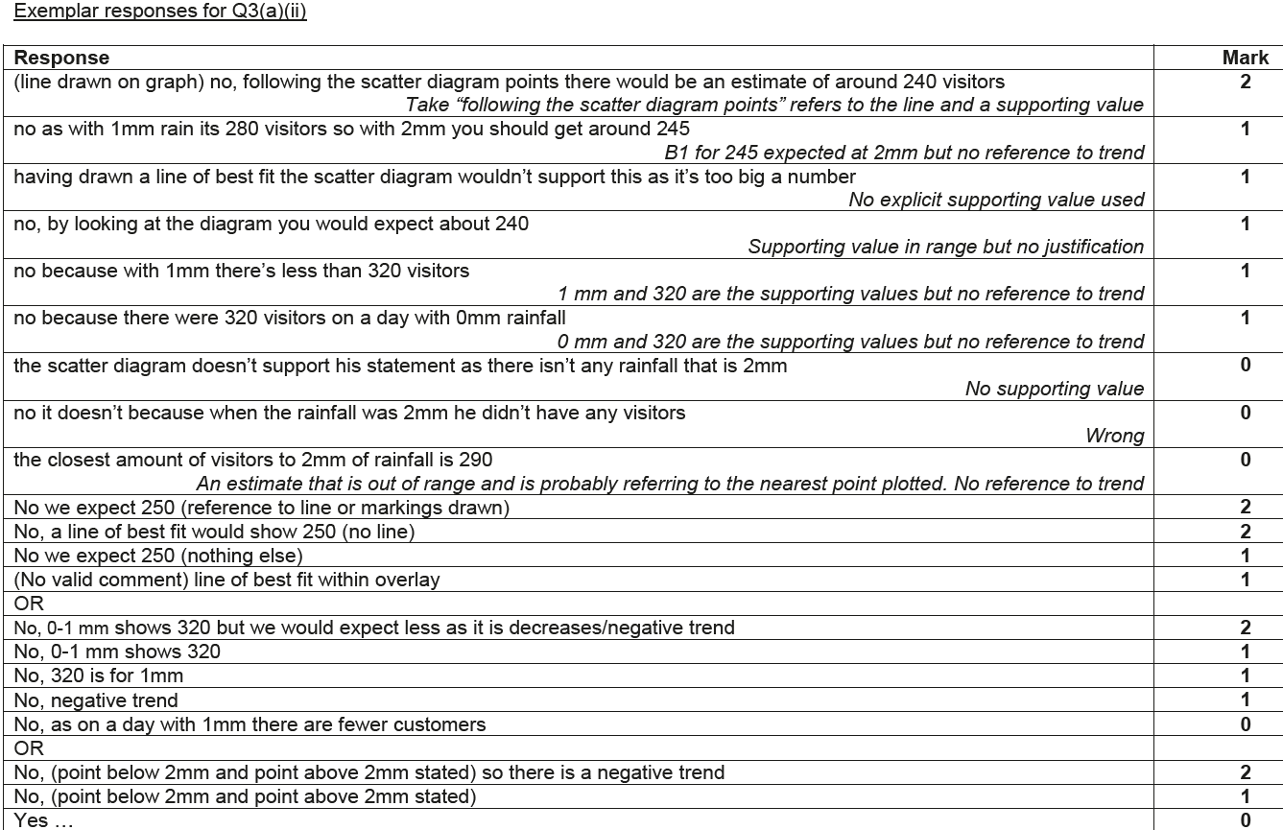
Pie Charts
June 2017 3H Q3
A (ii) Exemplar responses

Slide 19
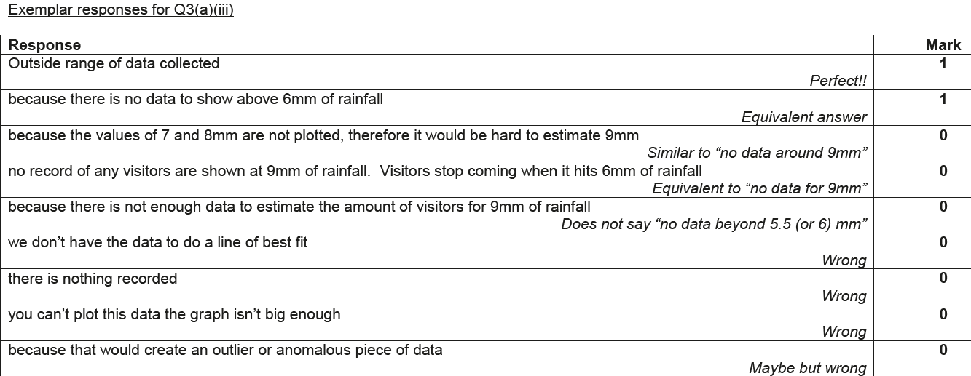
Pie Charts
June 2017 3H Q3
A (iii) Exemplar responses

Slide 20
Pie Charts
June 2017 3H Q3
B Exemplar responses

Slide 21
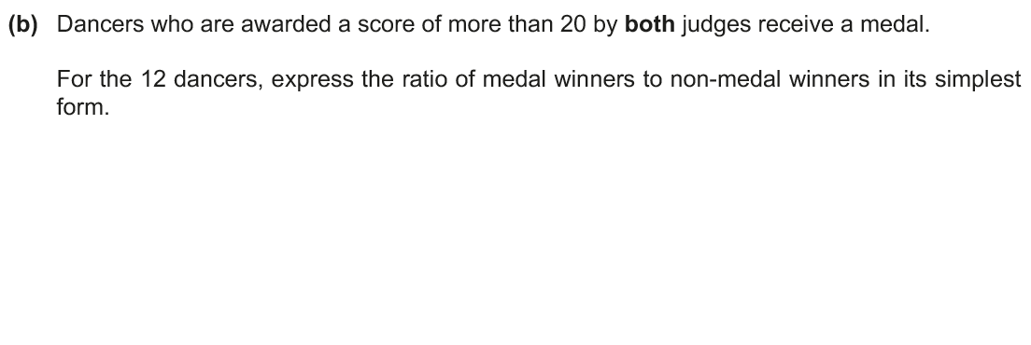
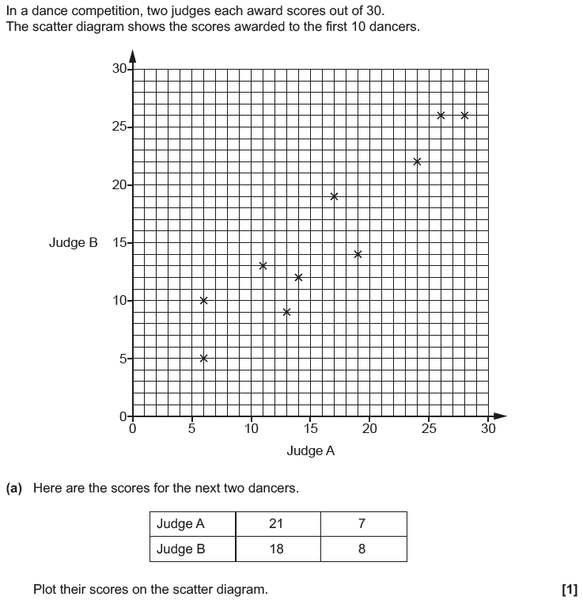
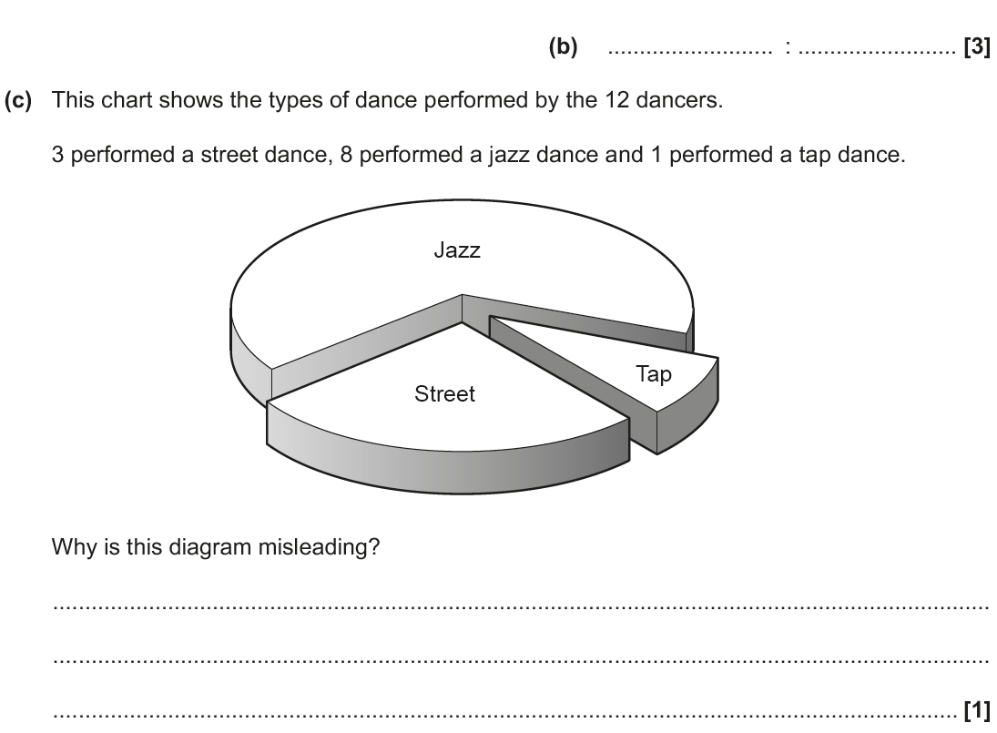
Pie Charts
Nov 2018 3H Q1

Slide 22
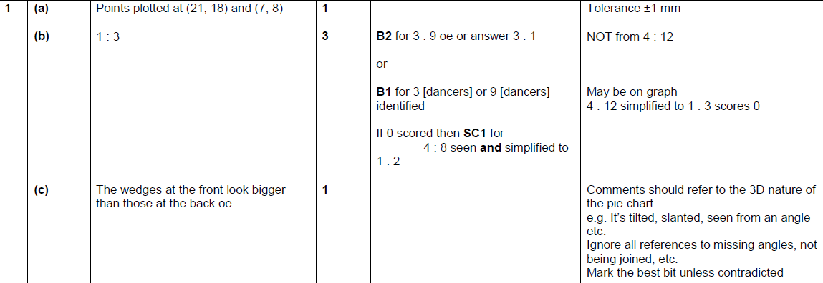
Pie Charts
Nov 2018 3H Q1
A
B
C

