Slide 1
Pie Charts
Pie Charts
June 2017
3H Q3
Nov 2018
3H Q1

Slide 2
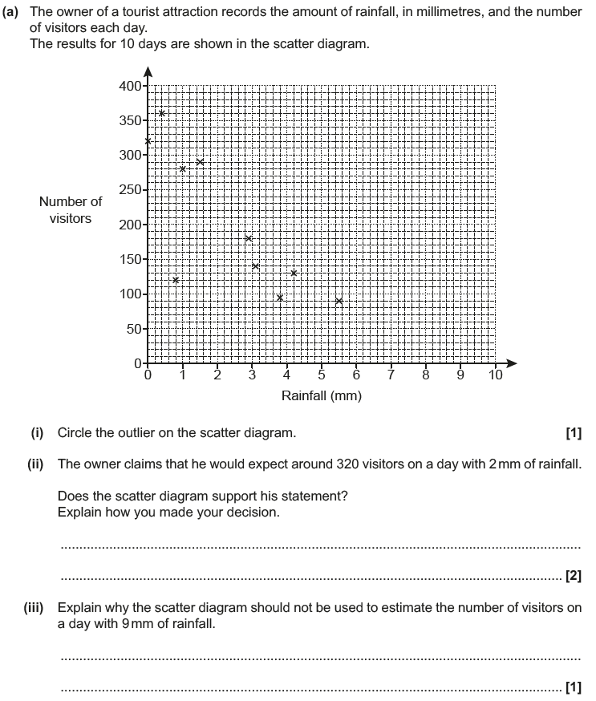
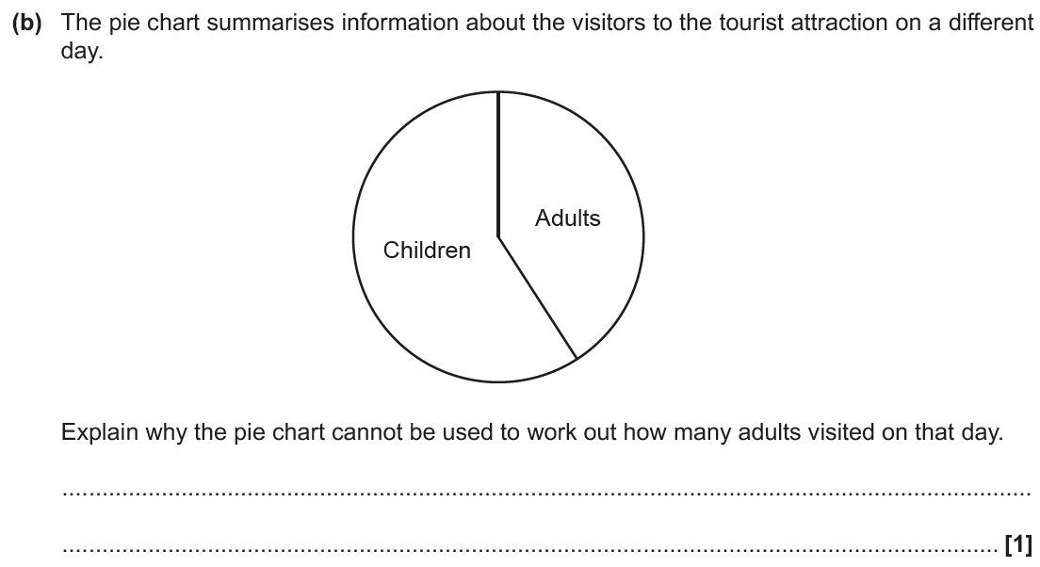
Pie Charts
June 2017 3H Q3

Slide 3
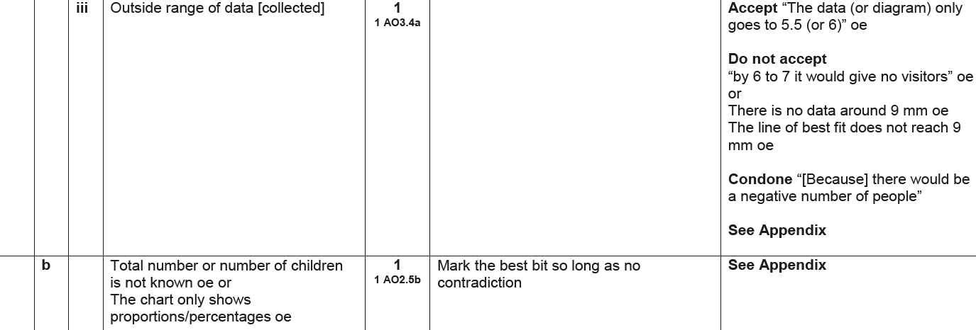
Pie Charts
June 2017 3H Q3
A (i)
A (ii)
A (iii)
B

Slide 4
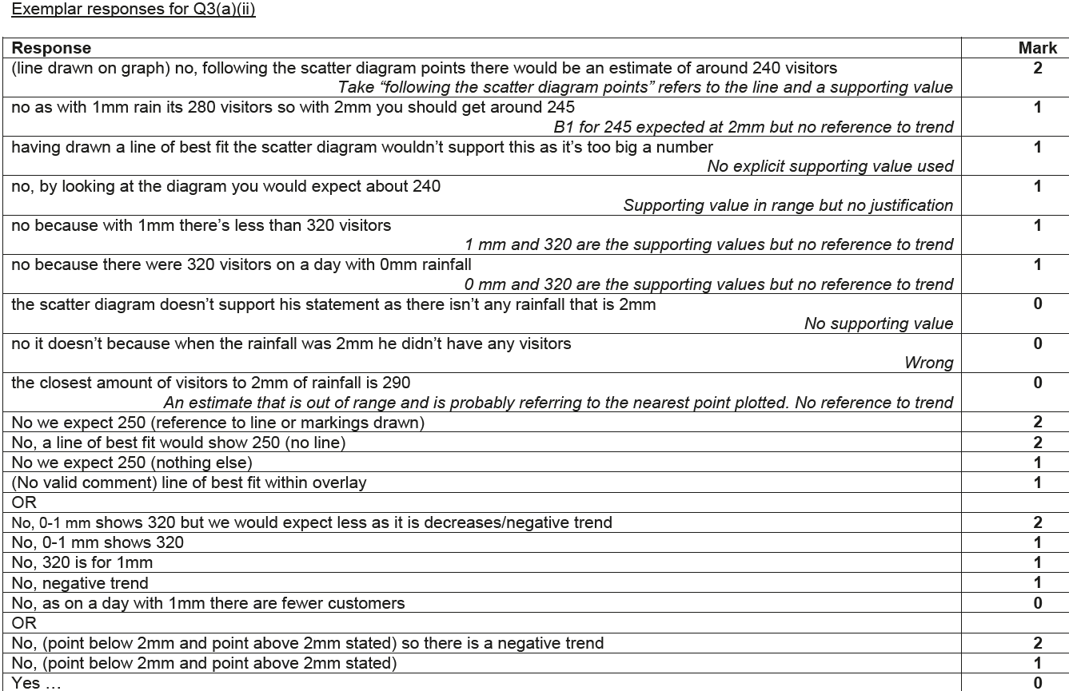
Pie Charts
June 2017 3H Q3
A (ii) Exemplar responses

Slide 5
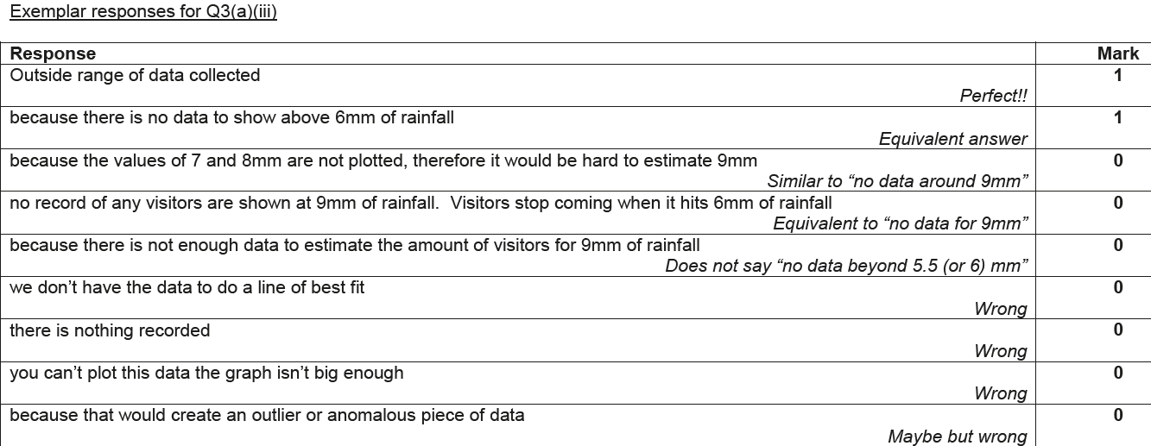
Pie Charts
June 2017 3H Q3
A (iii) Exemplar responses

Slide 6
Pie Charts
June 2017 3H Q3
B Exemplar responses

Slide 7
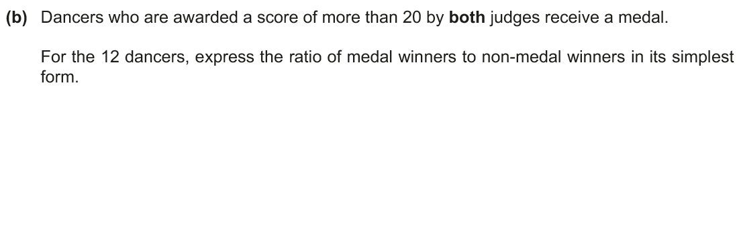
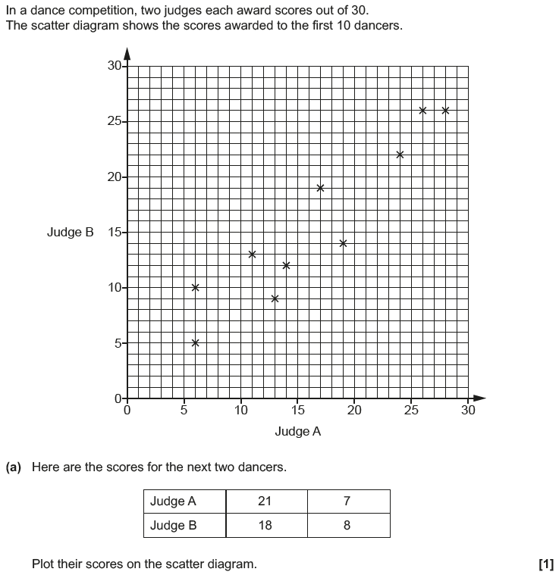
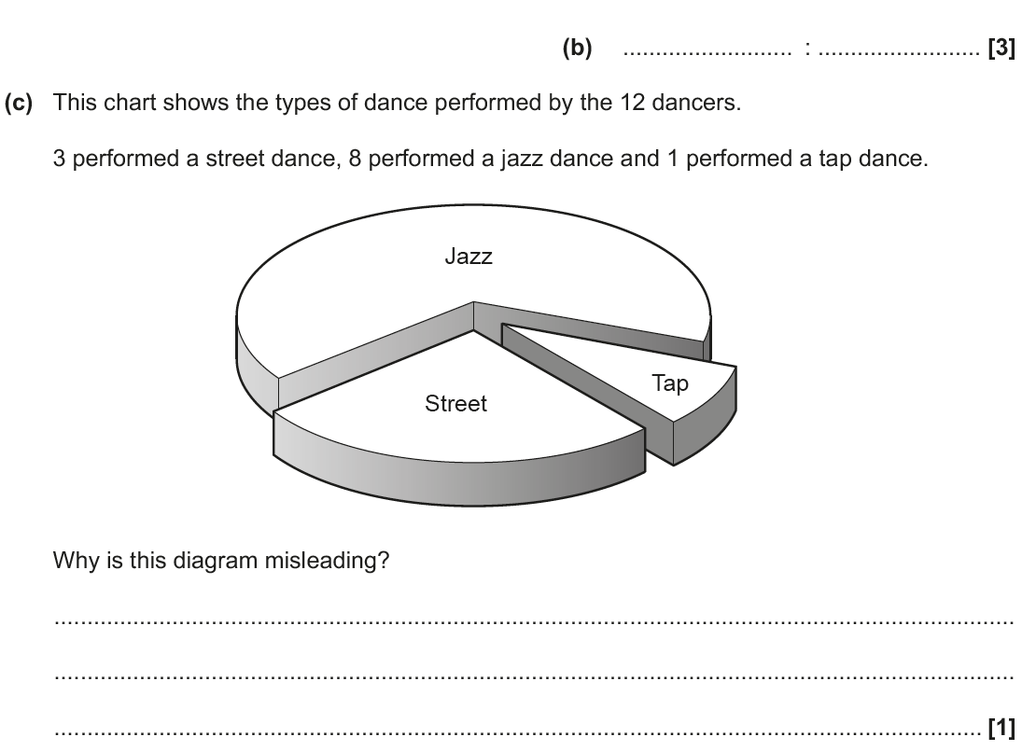
Pie Charts
Nov 2018 3H Q1

Slide 8
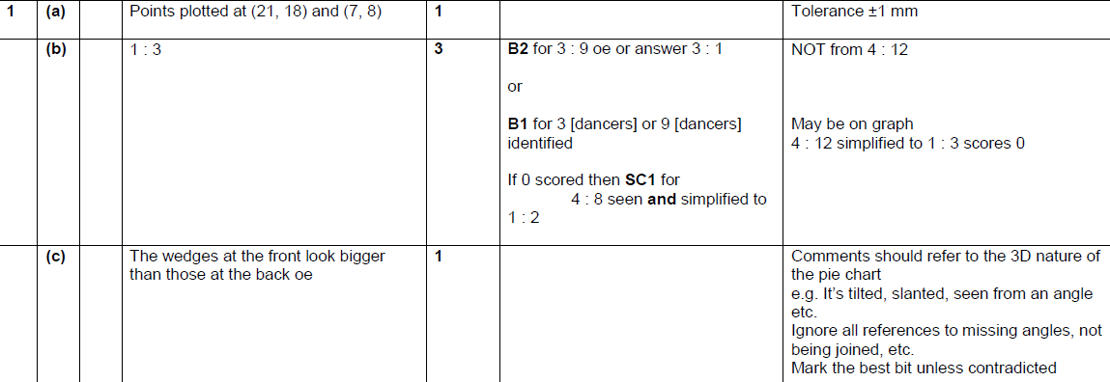
Pie Charts
Nov 2018 3H Q1
A
B
C

