Slide 1
Pie Charts
Pie Charts
Nov 2017 2H Q11
June 2019 3H Q21

Slide 2
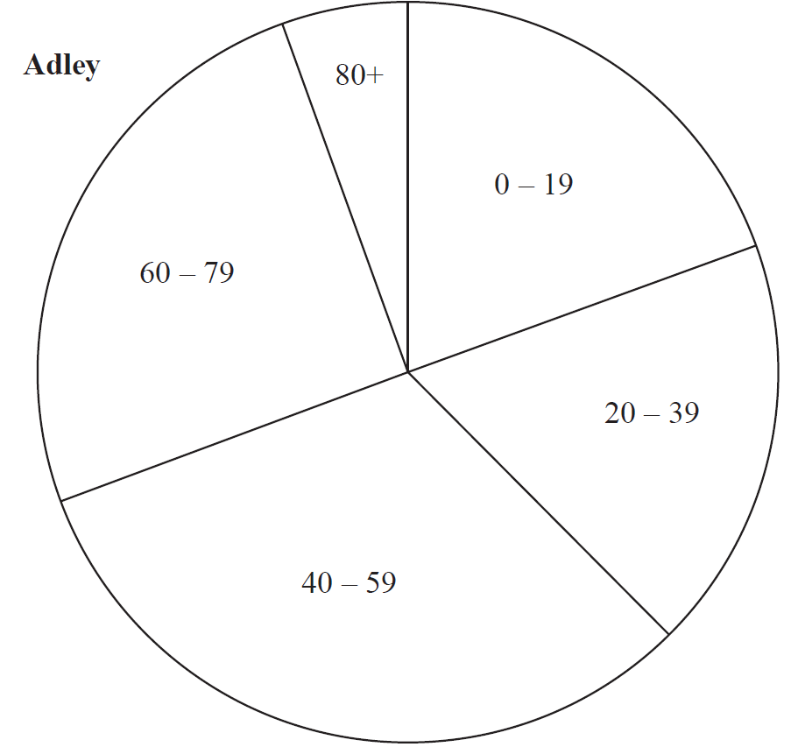
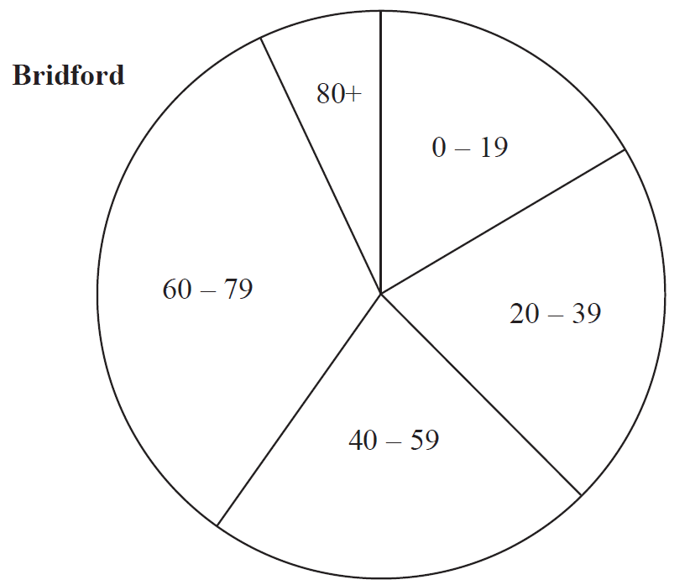
Pie Charts
Nov 2017 2H Q11

Slide 3
Pie Charts
Nov 2017 2H Q11
A

Slide 4
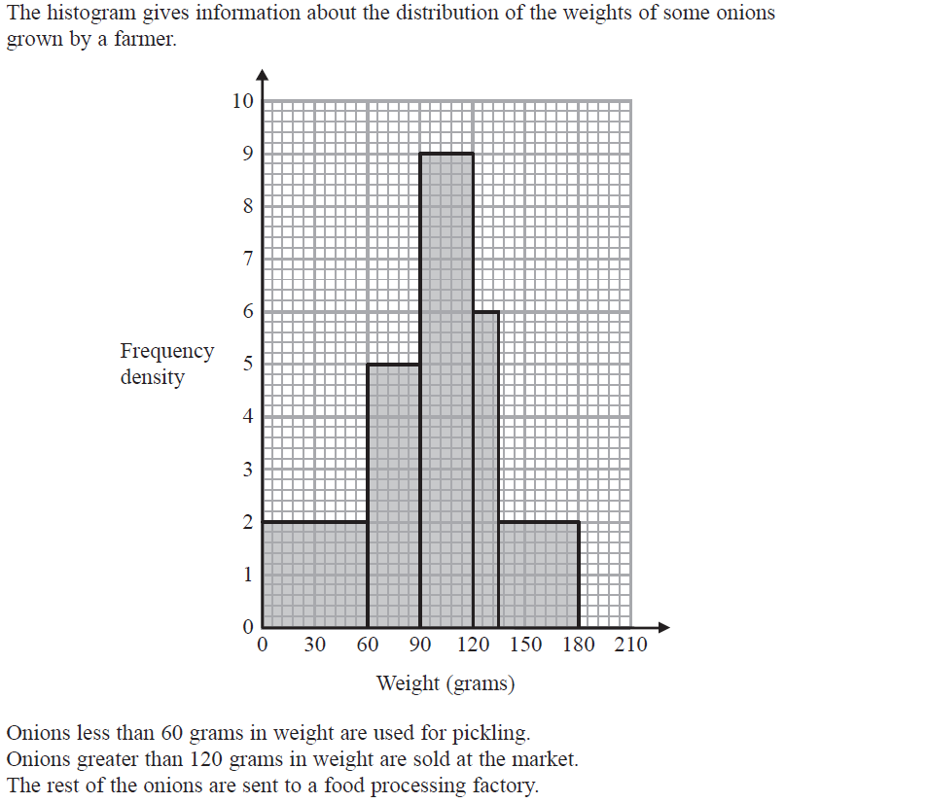
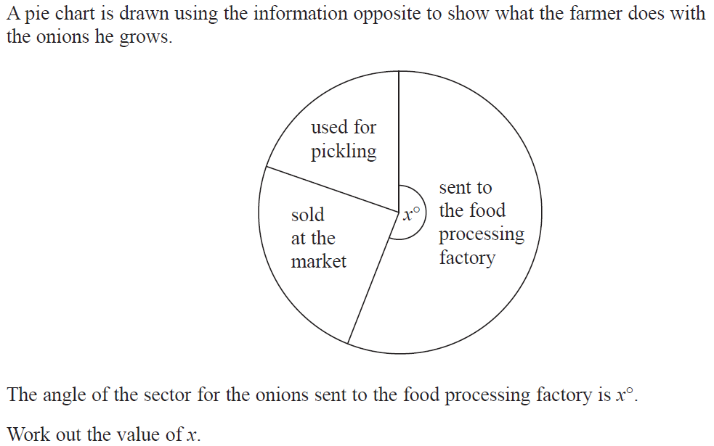
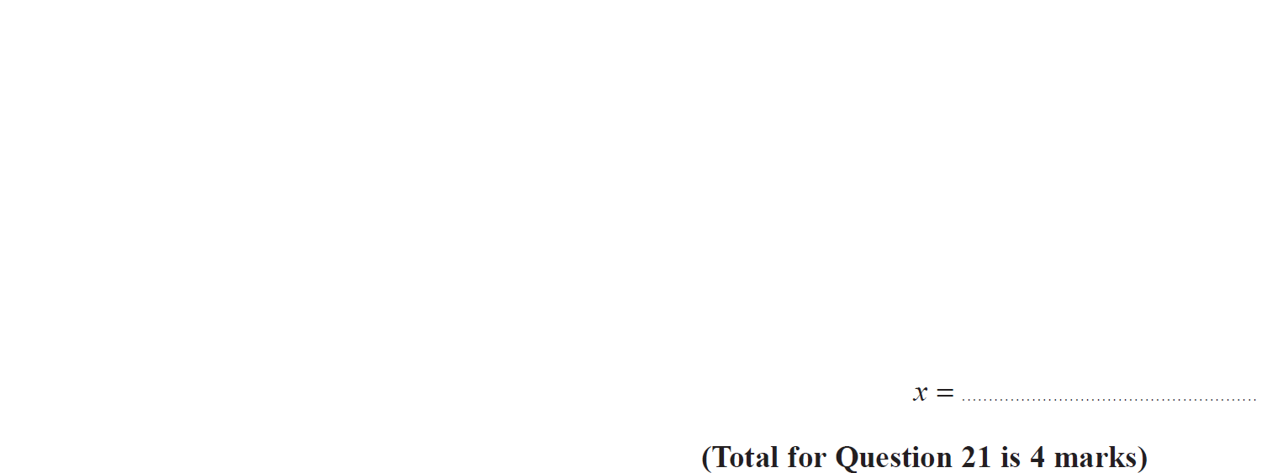
Pie Charts
June 2019 3H Q21

Slide 5
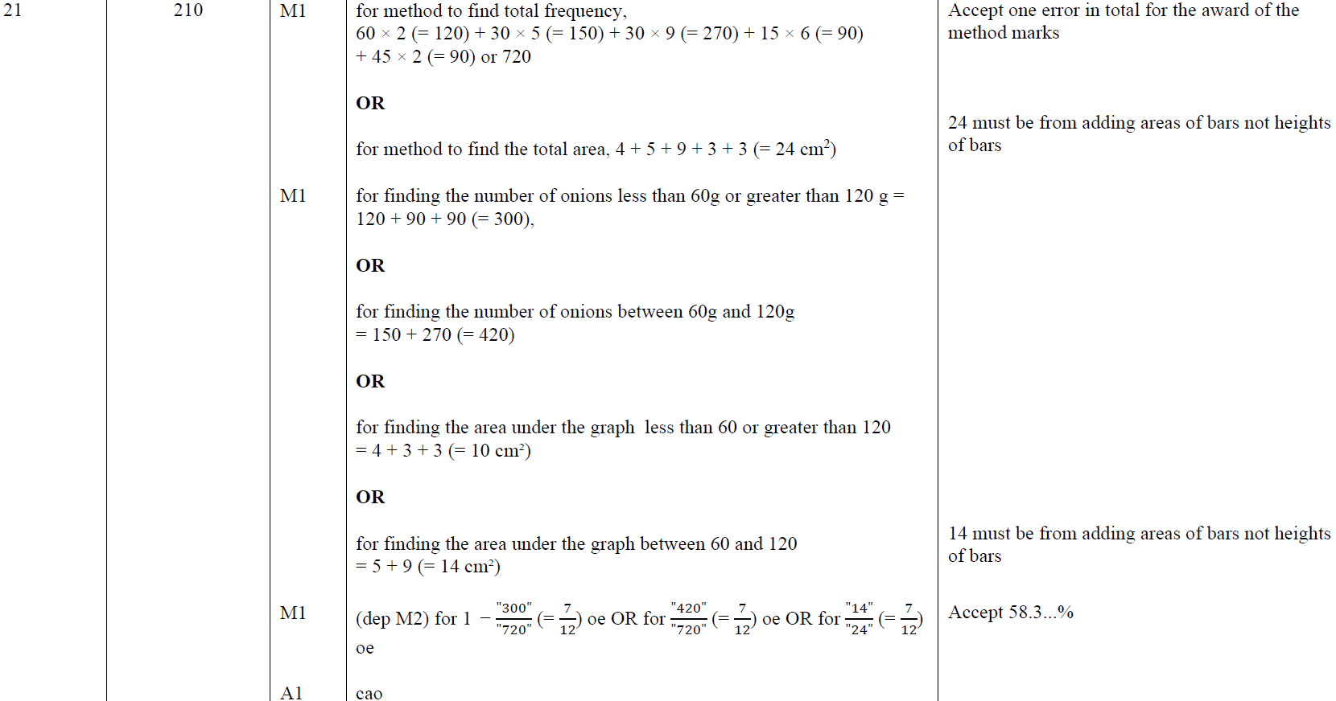
Pie Charts
June 2019 3H Q21
A

Slide 6
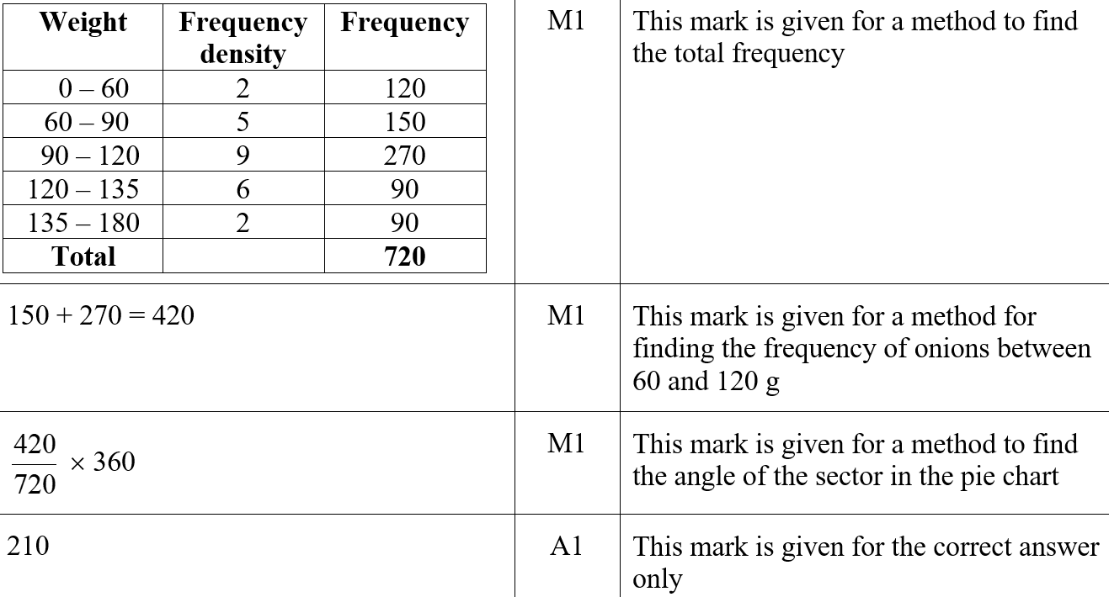
Pie Charts
June 2019 3H Q21
A SF

