Slide 1
Percentages
Percentages
May 2017
1H Q11
June 2018
2H Q4
SAM
1H Q1
May 2017
1H Q18
June 2018
2H Q6
SAM
2H Q5
June 2017
3H Q16
June 2018
3H Q7
SAM
2H Q21
Nov 2017
2H Q2
1 Marker
June 2018
3H Q9
SAM
3H Q5
Nov 2017
2H Q15
Nov 2018
1H Q10
SAM
3H Q11
Nov 2017
3H Q11
Nov 2018
3H Q8
Nov 2017
3H Q20
Best Buys
Compound/ Repeated Change

Slide 2
Percentages
SAM 1H Q1

Slide 3
Percentages
SAM 1H Q1
A

Slide 4
Percentages
SAM 2H Q5

Slide 5
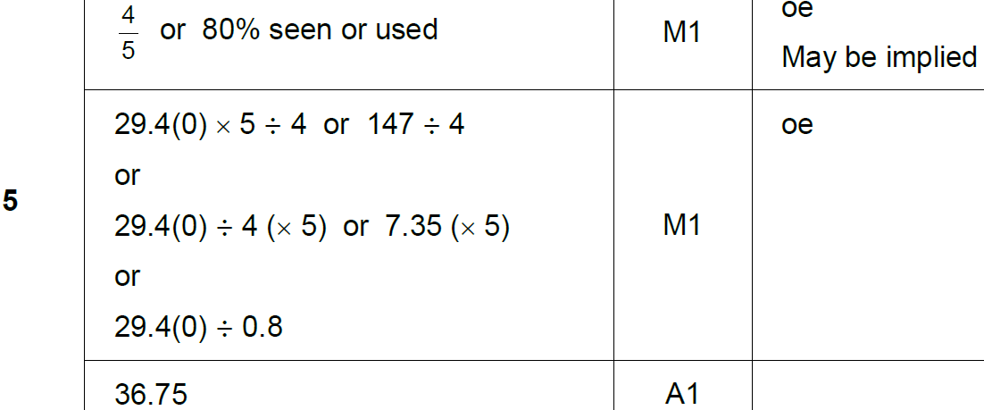
Percentages
SAM 2H Q5
A

Slide 6
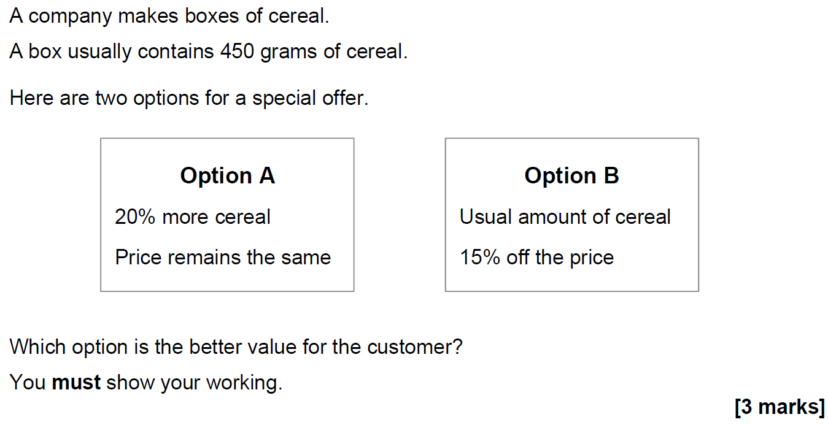
Percentages
SAM 2H Q21

Slide 7
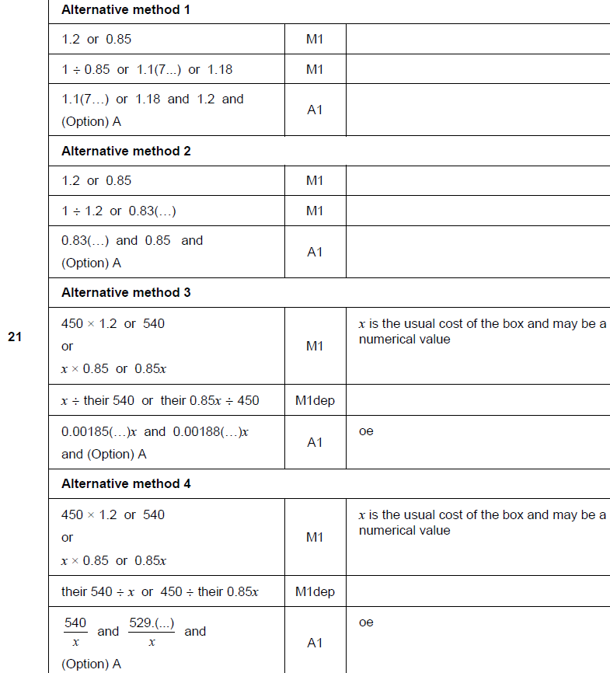
Percentages
SAM 2H Q21
A

Slide 8
Percentages
SAM 3H Q5

Slide 9
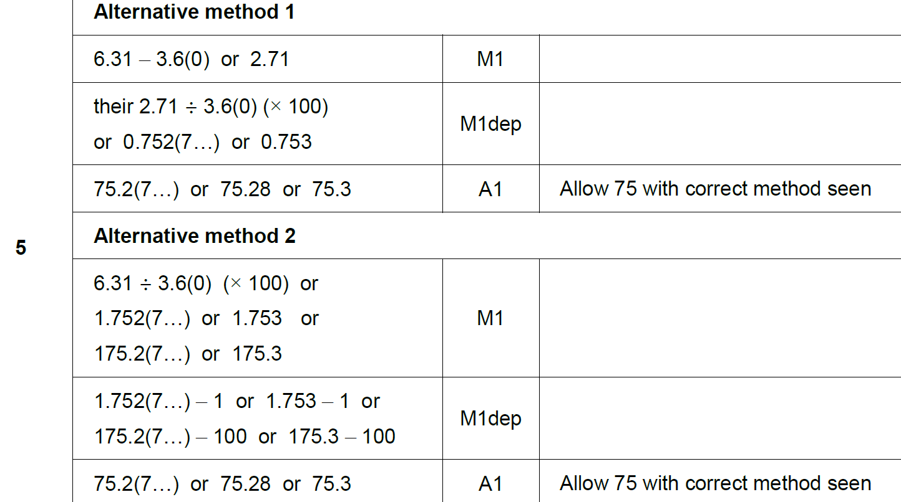
Percentages
SAM 3H Q5
A

Slide 10
Percentages
SAM 3H Q11

Slide 11
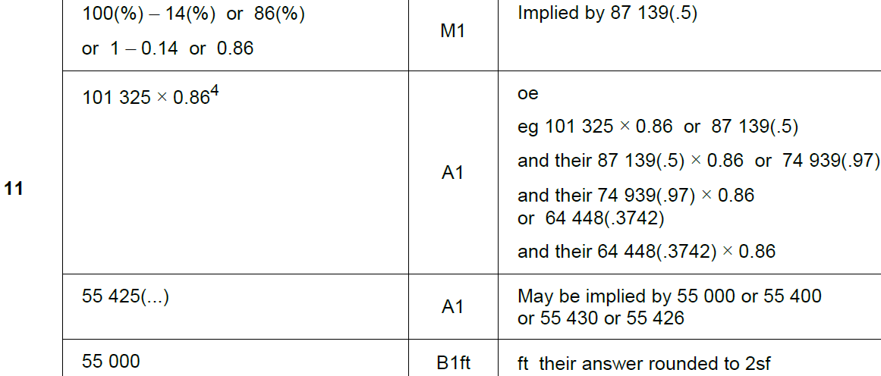
Percentages
SAM 3H Q11
A

Slide 12
Percentages
May 2017 1H Q11

Slide 13
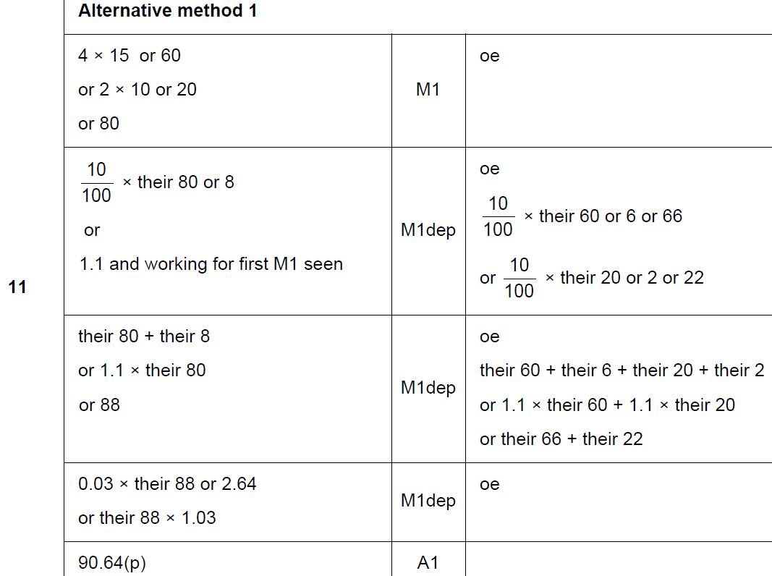
Percentages
May 2017 1H Q11
A

Slide 14
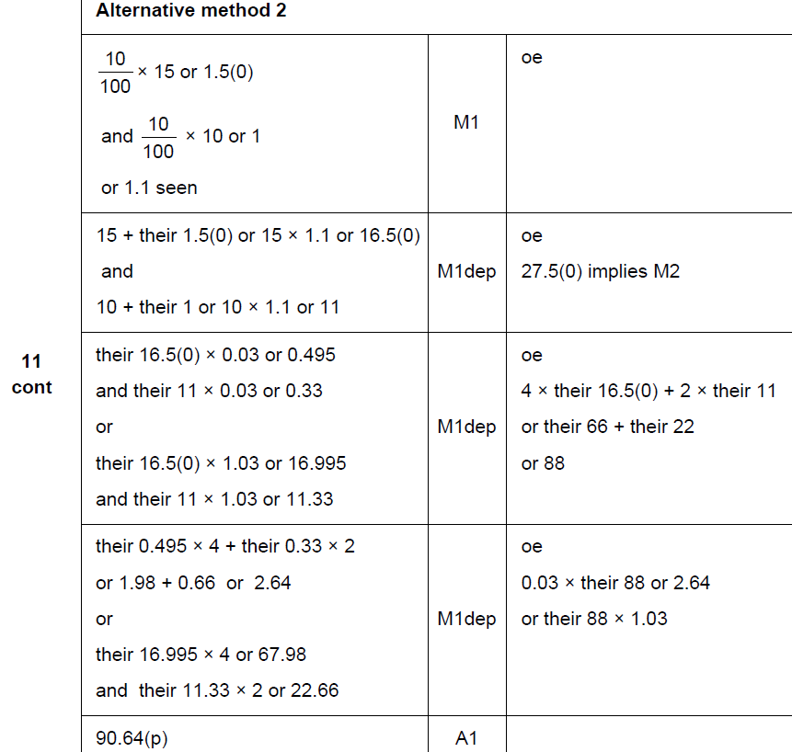
Percentages
May 2017 1H Q11
A Alternative 1

Slide 15
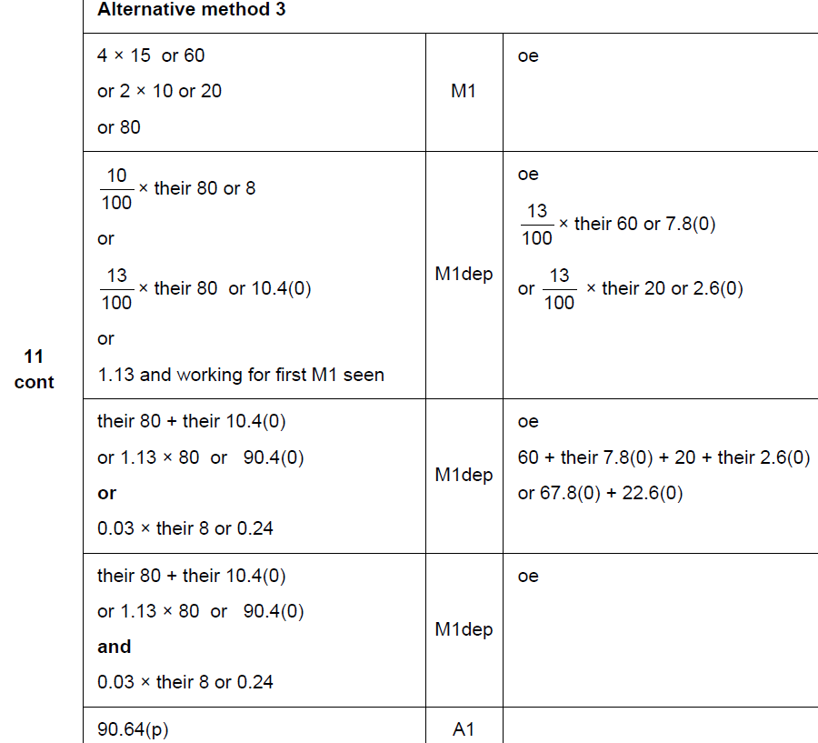
Percentages
May 2017 1H Q11
A

Slide 16
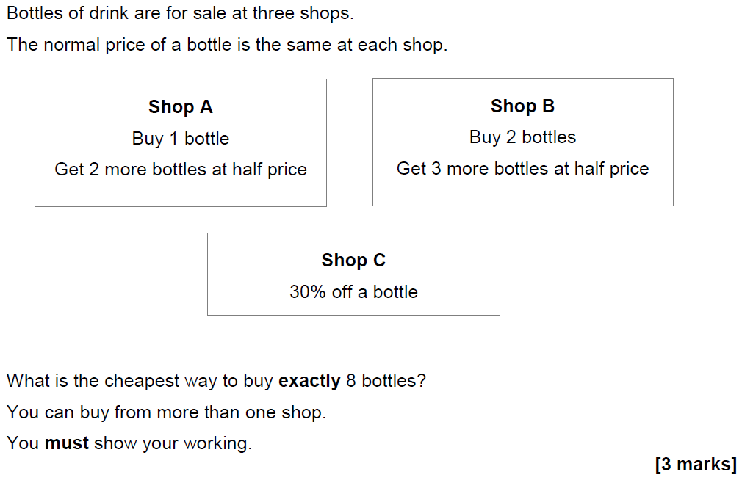
Percentages
May 2017 1H Q18

Slide 17
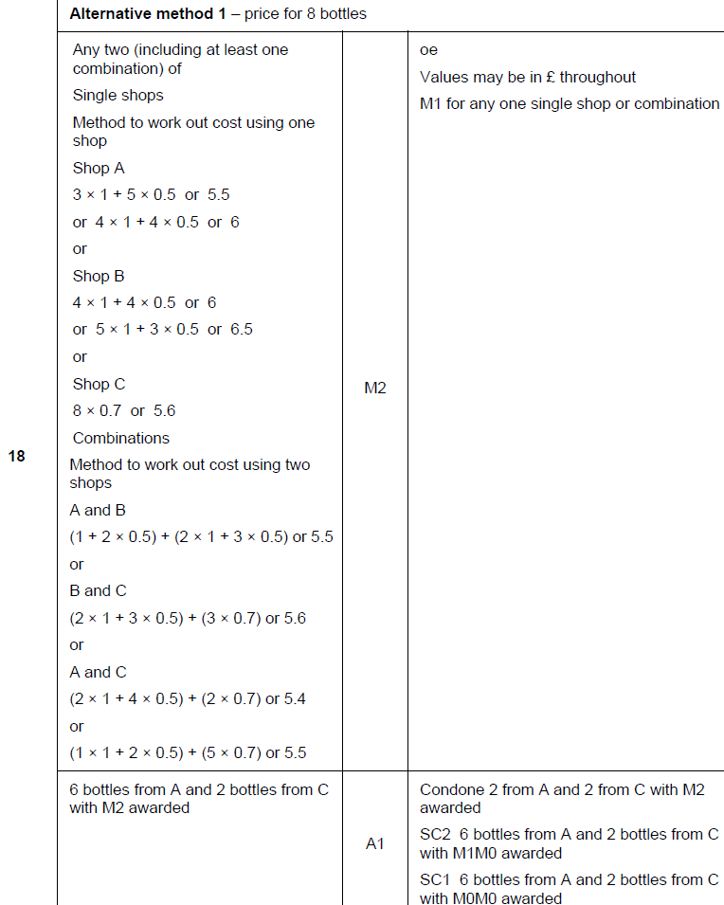
Percentages
May 2017 1H Q18
A

Slide 18
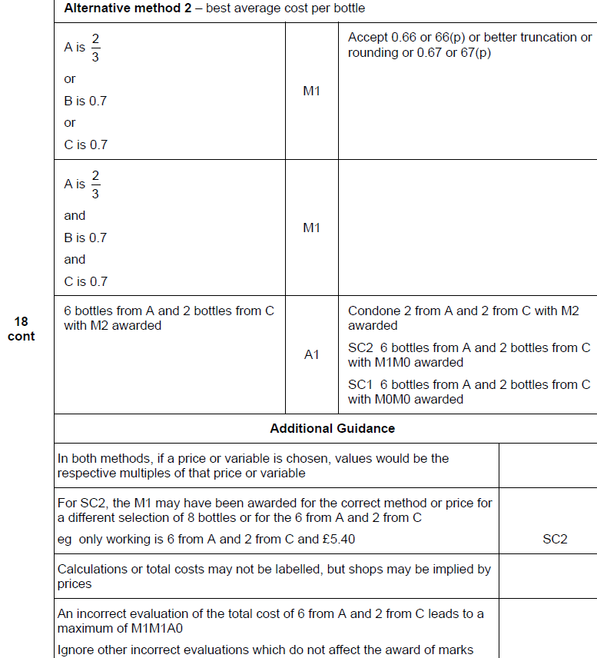
Percentages
May 2017 1H Q18
A Alternative

Slide 19
Percentages
June 2017 3H Q16

Slide 20
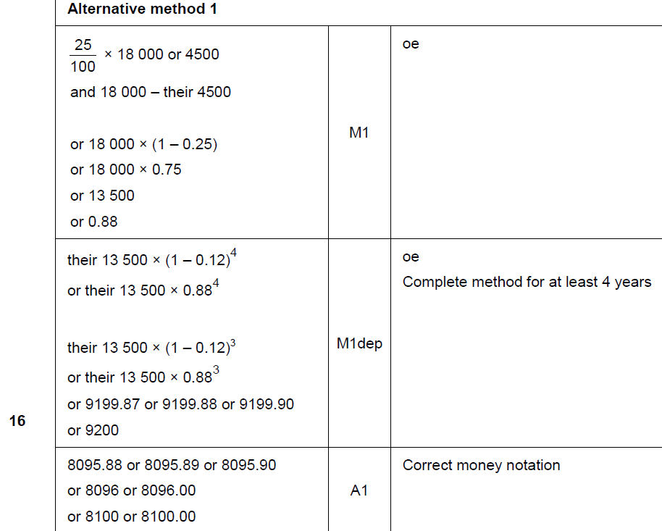
Percentages
June 2017 3H Q16
A

Slide 21
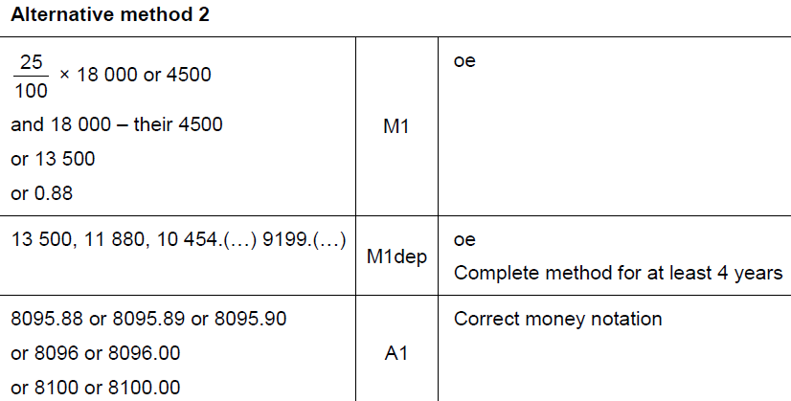
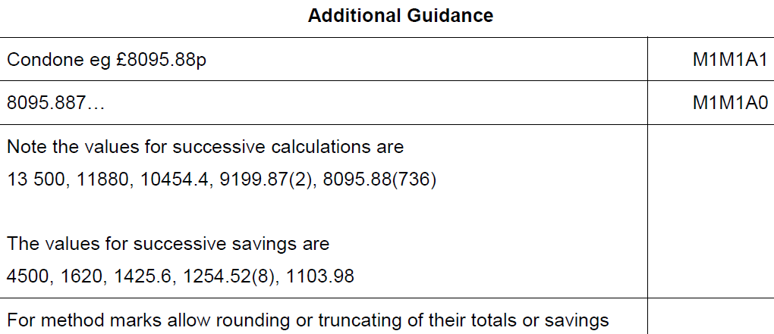
Percentages
June 2017 3H Q16
A Alternative & notes

Slide 22
Percentages
Nov 2017 2H Q2

Slide 23
Percentages
Nov 2017 2H Q2
A

Slide 24
Percentages
Nov 2017 2H Q15
Mirek invests £6000 at a compound interest rate of 1.5% per year.
He wants to earn more than £1000 interest.
Work out the least time, in whole years, that this will take.
[3 marks]

Slide 25
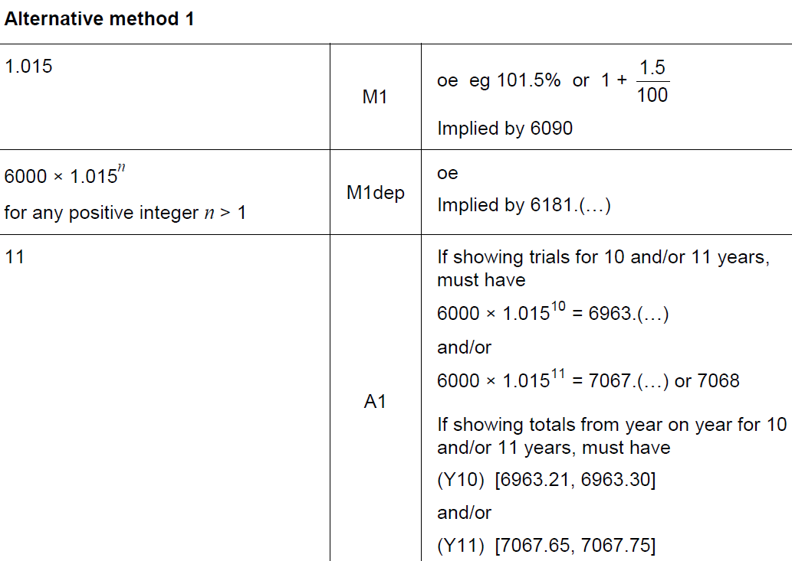
Percentages
Nov 2017 2H Q15
A

Slide 26
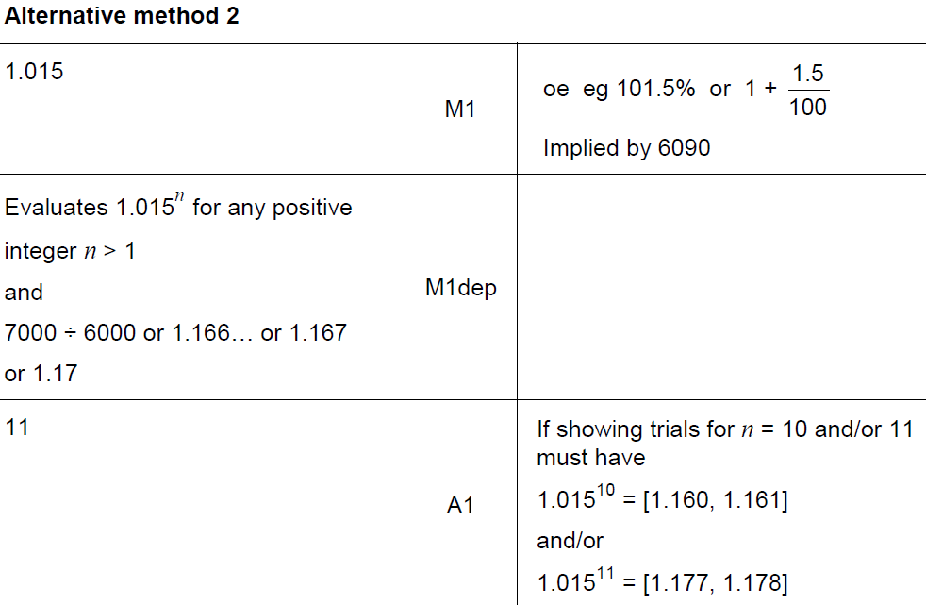
Percentages
Nov 2017 2H Q15
A Alternative

Slide 27
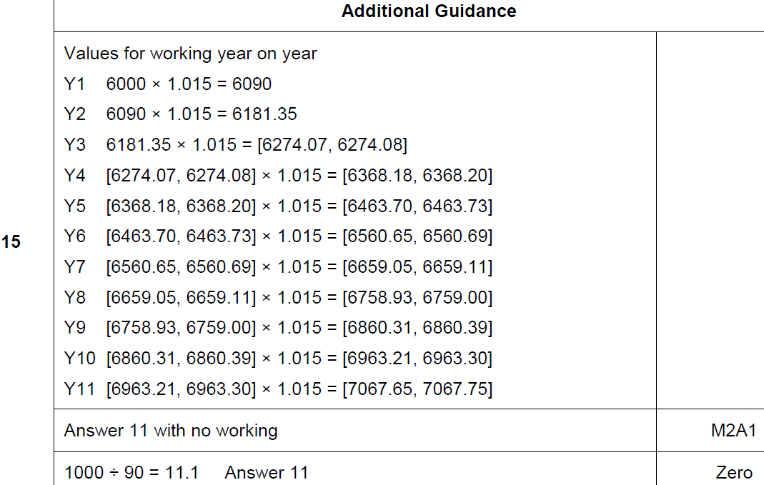
Percentages
Nov 2017 2H Q15
A notes

Slide 28
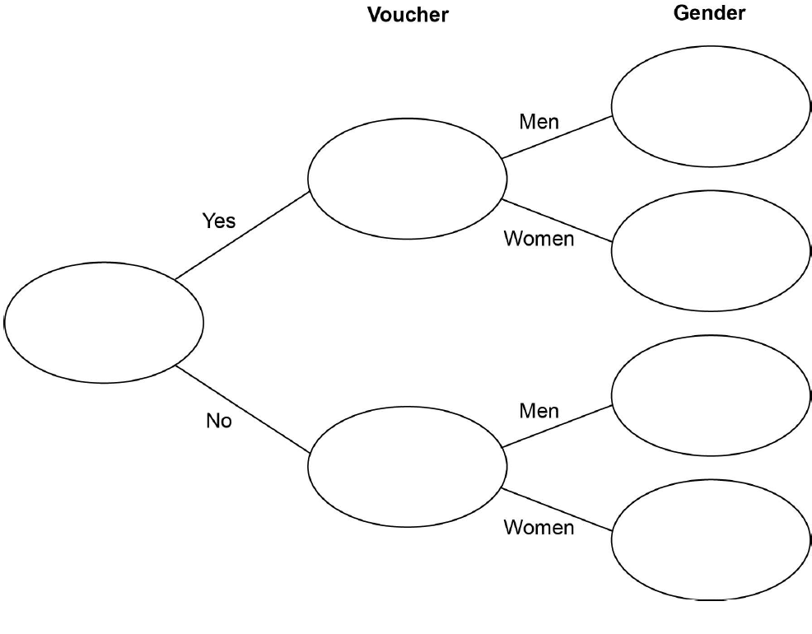
Percentages
Nov 2017 3H Q11

Slide 29
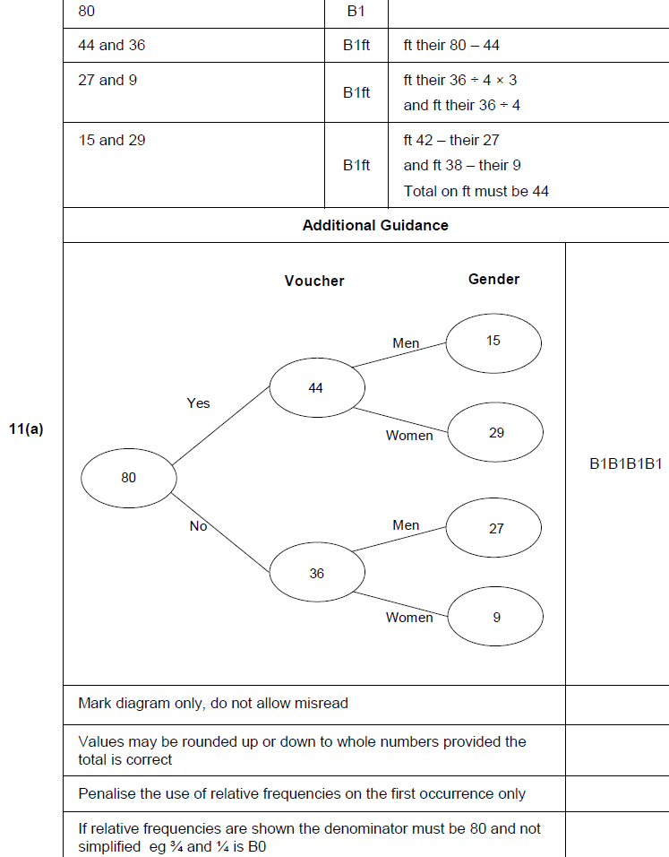
Percentages
Nov 2017 3H Q11
A

Slide 30
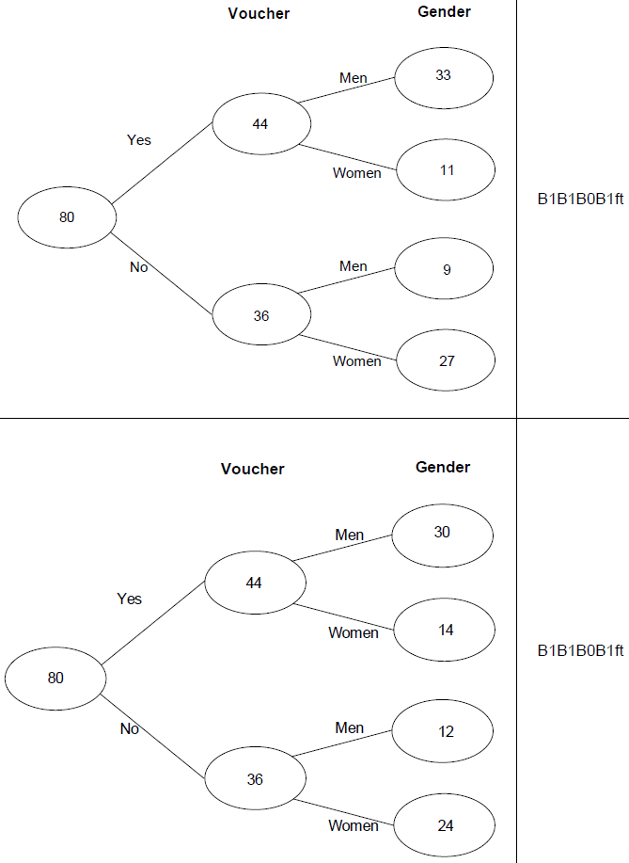
Percentages
Nov 2017 3H Q11
A notes

Slide 31
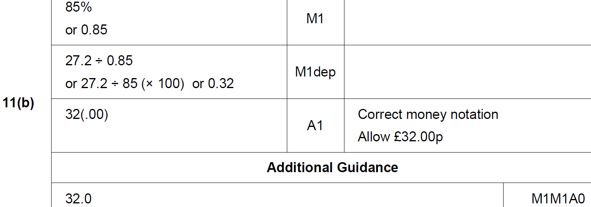
Percentages
Nov 2017 3H Q11
B

Slide 32
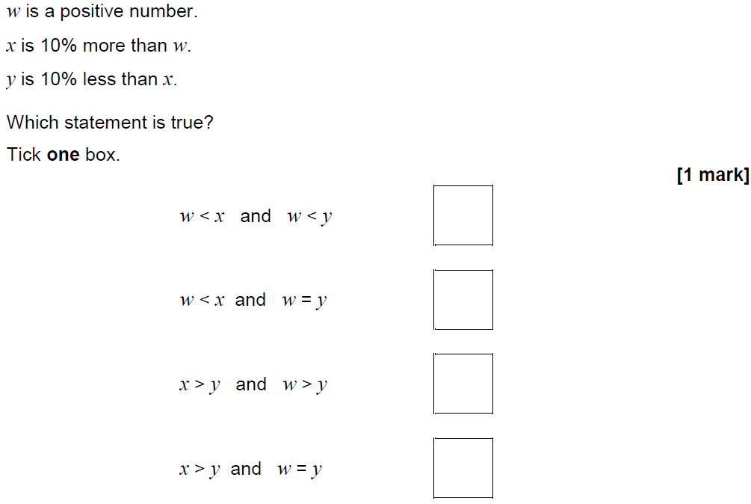
Percentages
Nov 2017 3H Q20

Slide 33
Percentages
Nov 2017 3H Q20
A

Slide 34
Percentages
June 2018 2H Q4

Slide 35
Percentages
June 2018 2H Q4
A

Slide 36
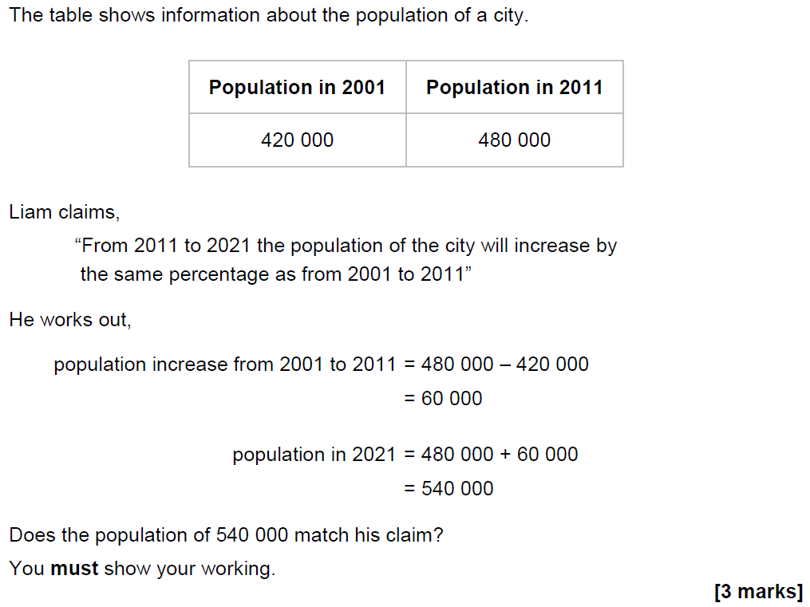
Percentages
June 2018 2H Q6

Slide 37
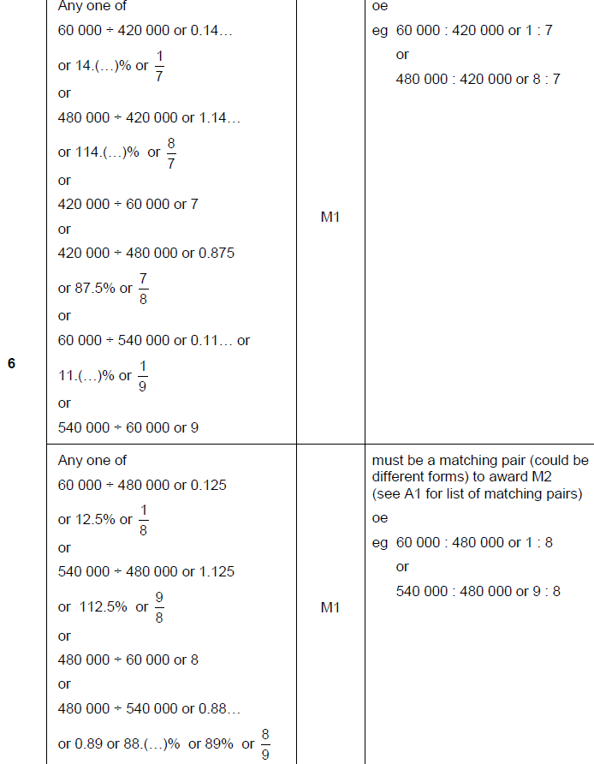
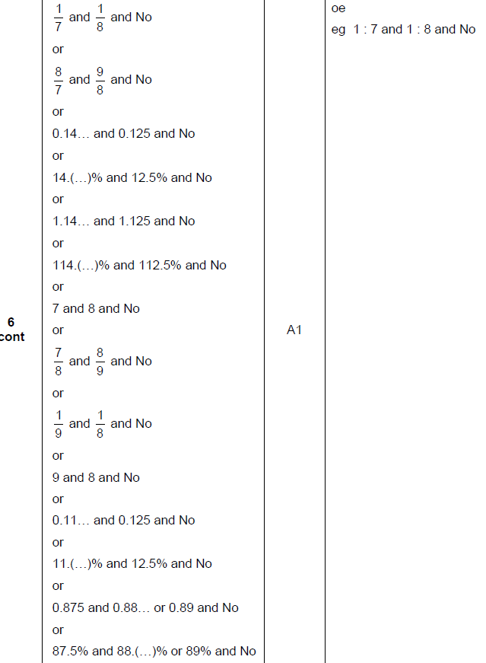
Percentages
June 2018 2H Q6
A

Slide 38
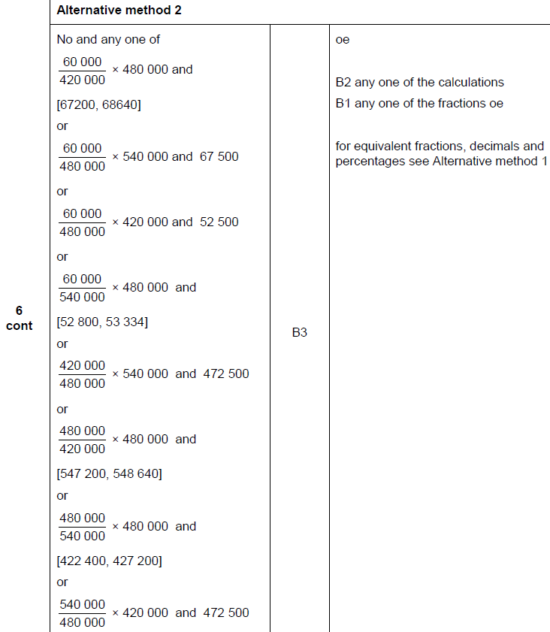
Percentages
June 2018 2H Q6
A Alternative

Slide 39
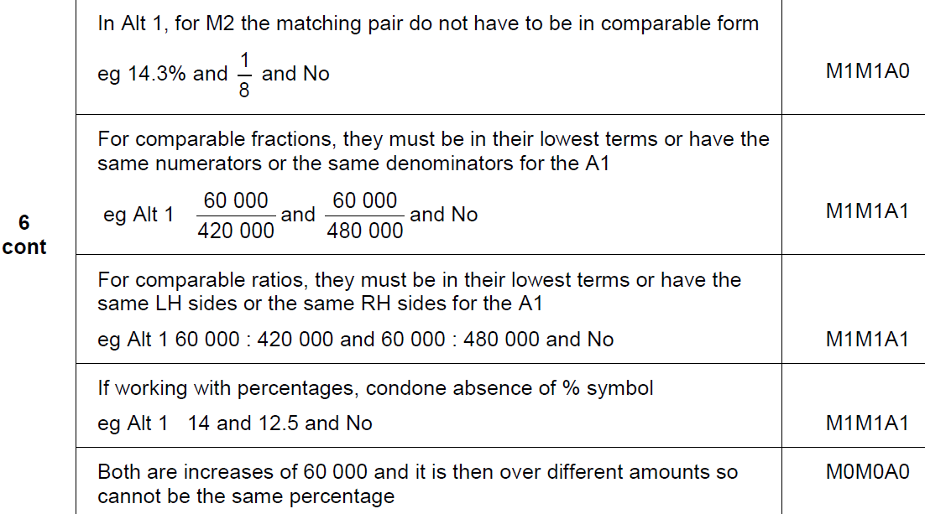
Percentages
June 2018 2H Q6
A notes

Slide 40
Percentages
June 2018 3H Q7
Investment A Save £150 per month for 2 years.
2.5% interest is added to the total amount saved.
Investment B Invest £3500
Compound interest is added at 3% per year.
After 2 years, how much more is investment B worth than investment A?
[4 marks]

Slide 41
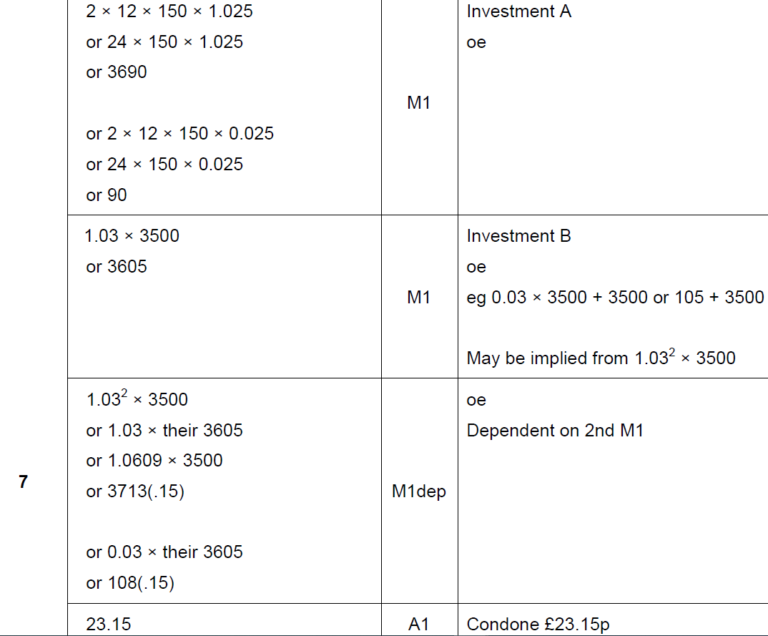
Percentages
June 2018 3H Q7
A

Slide 42
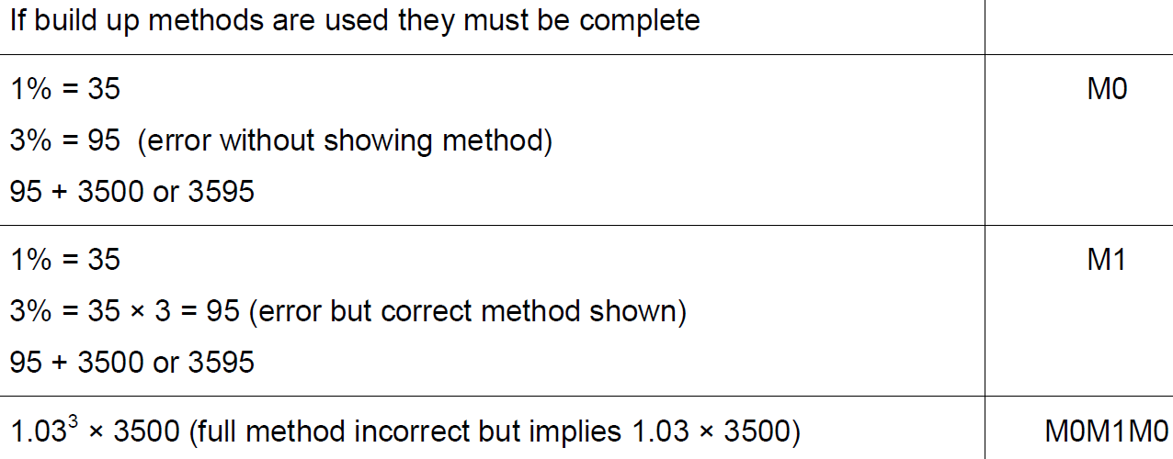
Percentages
June 2018 3H Q7
A notes

Slide 43
Percentages
June 2018 3H Q9
The cost of a ticket increases by 10% to £19.25
Work out the original cost.
[3 marks]

Slide 44
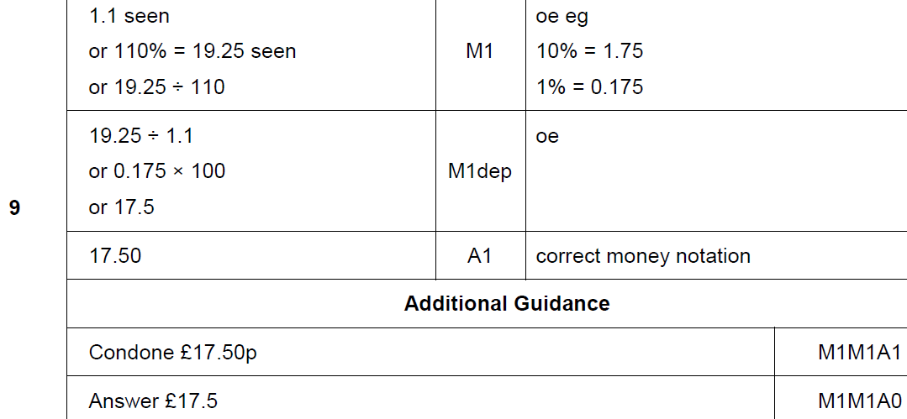
Percentages
June 2018 3H Q9
A

Slide 45
Percentages
Nov 2018 1H Q10
Work out the percentage increase from 80 to 280
[3 marks]

Slide 46
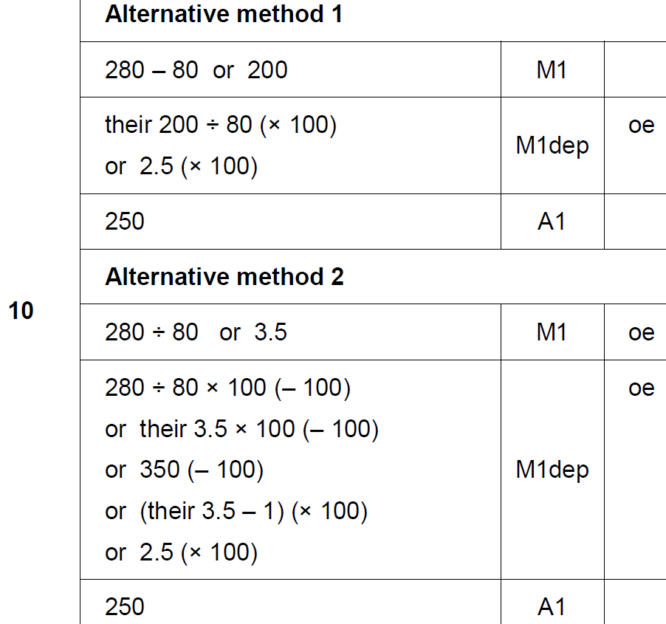
Percentages
Nov 2018 1H Q10
A

Slide 47
Percentages
Nov 2018 3H Q8
Doug owes an amount of £600
He wants to pay off this amount in five months.
He says,
“Each month, I will pay back 20% of the amount I still owe.”
Show working to check if his method is correct.
[3 marks]

Slide 48
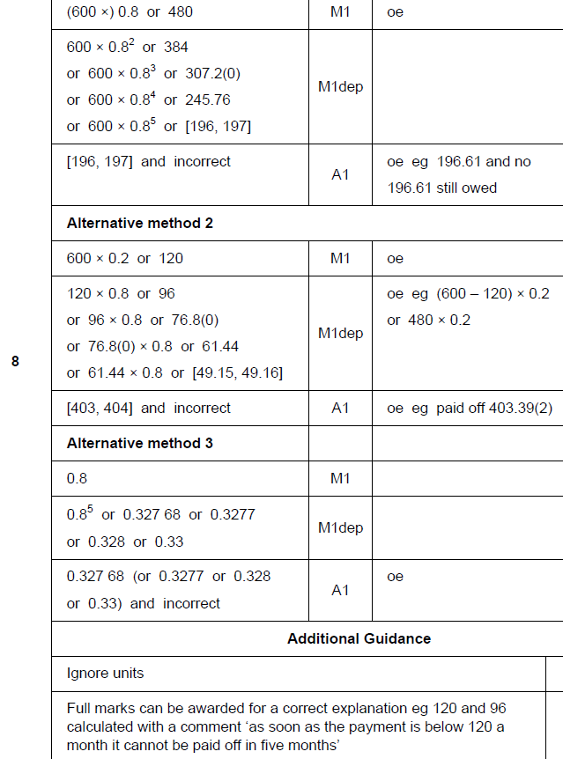
Percentages
Nov 2018 3H Q8
A

