Slide 1
Percentages
Percentages
SAM
1H Q15
May 2017
1H Q9
May 2018
1H Q3
SAM
2H Q10
June 2017
2H Q6
June 2018
2H Q6
Edexcel
Spec 1
2H Q6
June 2017
3H Q10
June 2018
2H Q9
Nov 2018
3H Q2
AQA
Spec 1
2H Q13
Nov 2017
2H Q2
June 2018
3H Q11
June 2019
3H Q2
OCR
Spec 1
3H Q8
Nov 2017
2H Q13
Nov 2018
1H Q3
June 2019
3H Q10
Spec 2
2H Q10
Nov 2017
2H Q18
Nov 2018
1H Q11
Spec 2
3H Q9
Nov 2017
3H Q9
Nov 2018
2H Q4
Best Buys
Compound/ Repeated Change

Slide 2
Percentages
Percentages
May 2017
1H Q11
June 2018
2H Q4
SAM
1H Q1
May 2017
1H Q18
June 2018
2H Q6
Edexcel
SAM
2H Q5
June 2017
3H Q16
June 2018
3H Q7
AQA
SAM
2H Q21
Nov 2017
2H Q2
1 Marker
June 2018
3H Q9
OCR
SAM
3H Q5
Nov 2017
2H Q15
Nov 2018
1H Q10
SAM
3H Q11
Nov 2017
3H Q11
Nov 2018
3H Q8
Nov 2017
3H Q20
Best Buys
Compound/ Repeated Change

Slide 3
Percentages
Percentages
May 2017
1H Q5
May 2018
1H Q11
May 2017
1H Q10*
May 2018
1H Q12*
Practice
1H Q2*
June 2017
2H Q4*
June 2018
2H Q6
Edexcel
SAM
1H Q3*
Practice
1H Q3
June 2017
2H Q12
June 2018
3H Q15
AQA
SAM
1H Q15
Practice
2H Q5
June 2017
3H Q1
Nov 2018
1H Q1
OCR
SAM
3H Q4
Practice
3H Q5
Nov 2017
2H Q7
Nov 2018
1H Q4
Nov 2017
2H Q11*
Nov 2018
2H Q7
Nov 2017
3H Q7
Nov 2018
2H Q11
Best Buys
*Exponential models
Compound/ Repeated Change

Slide 4
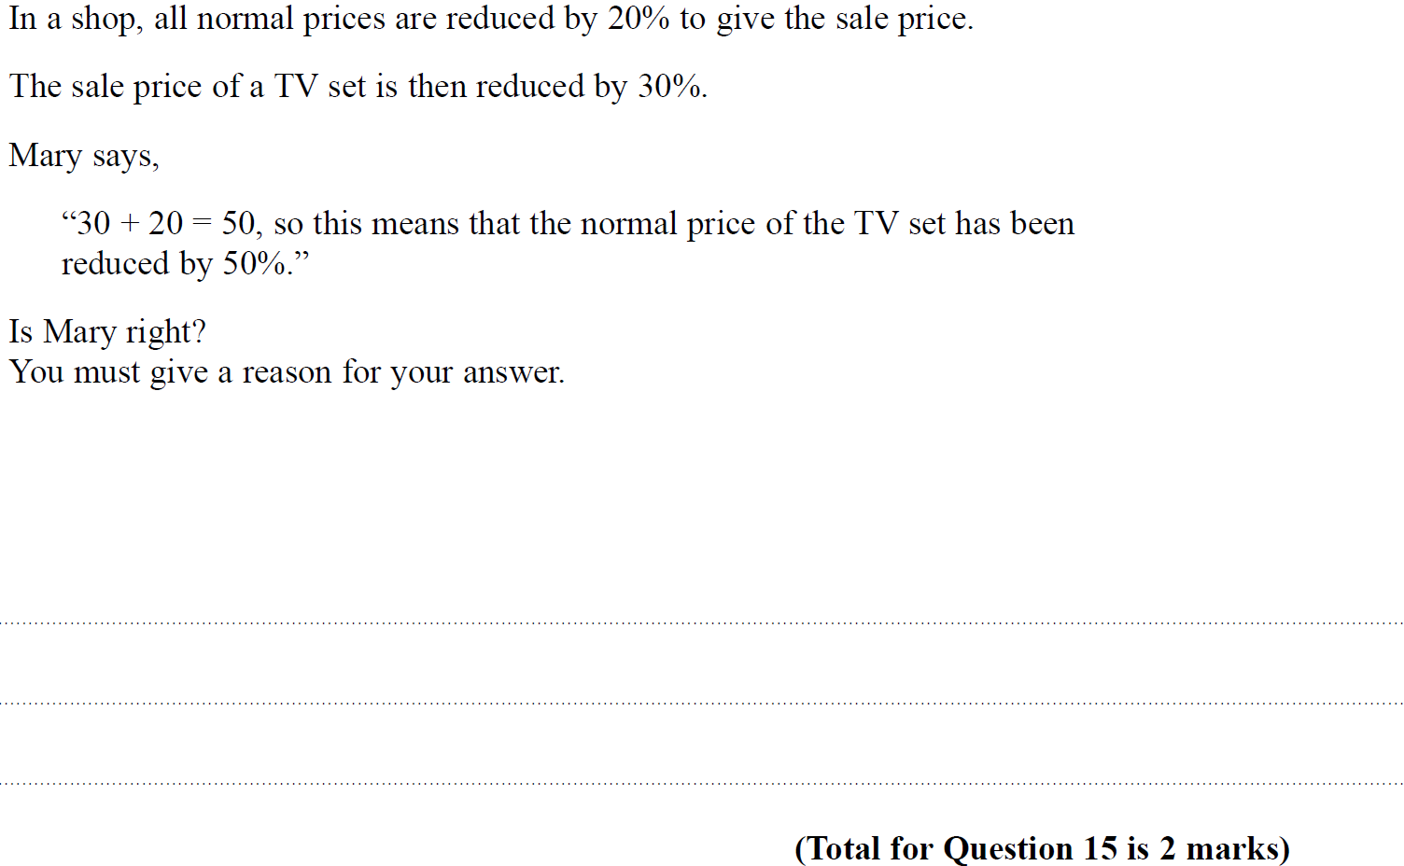
Percentages
SAM 1H Q15

Slide 5
Percentages
SAM 1H Q15
A

Slide 6
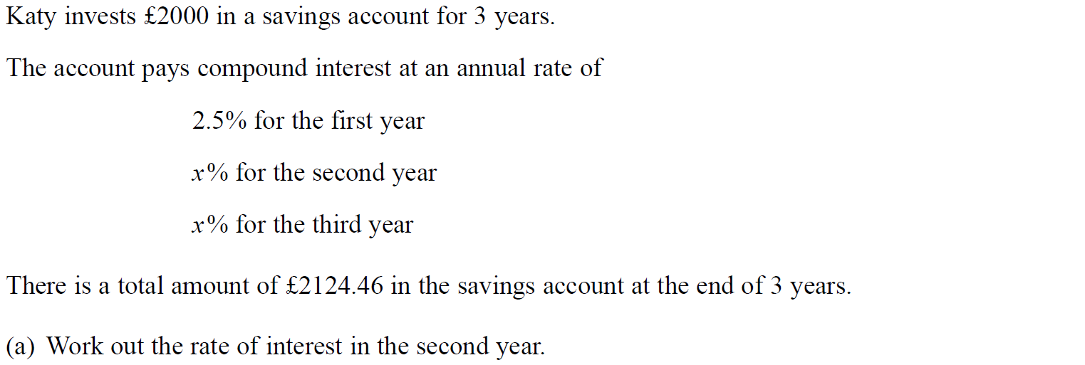
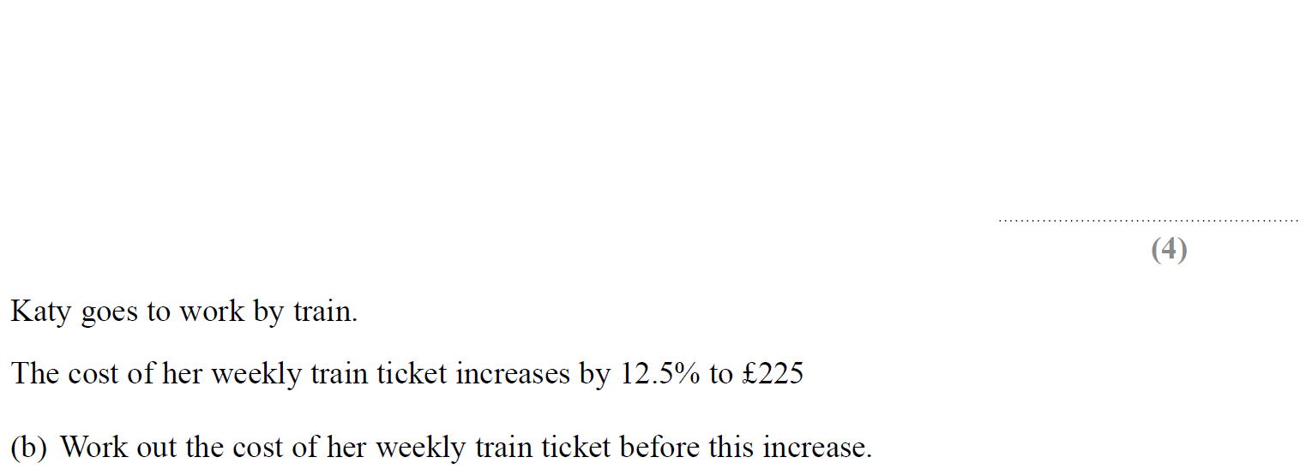
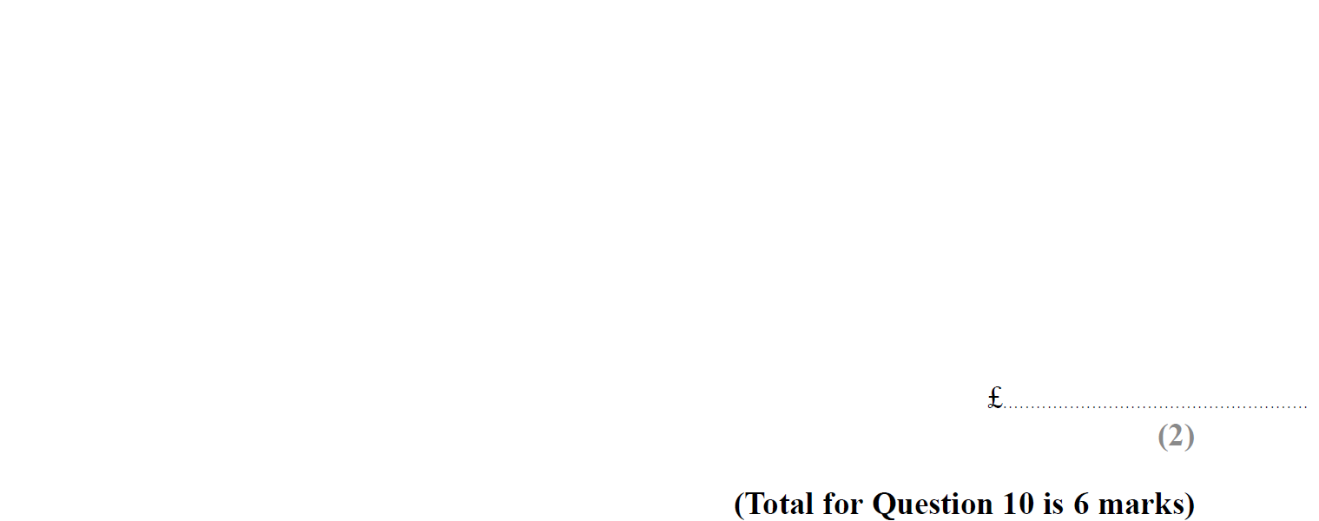
Percentages
SAM 2H Q10

Slide 7
Percentages
SAM 2H Q10
A
B

Slide 8
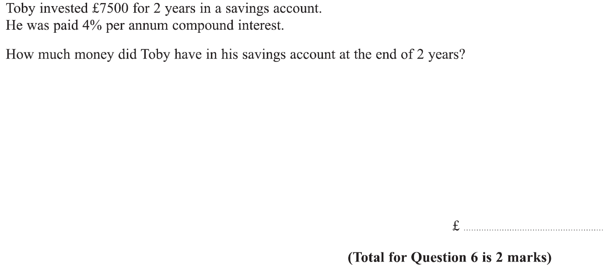
Percentages
Specimen Set 1 2H Q6

Slide 9
Percentages
Specimen Set 1 2H Q6
A

Slide 10
Percentages
Specimen Set 1 2H Q15

Slide 11
Percentages
Specimen Set 1 2H Q15
A

Slide 12
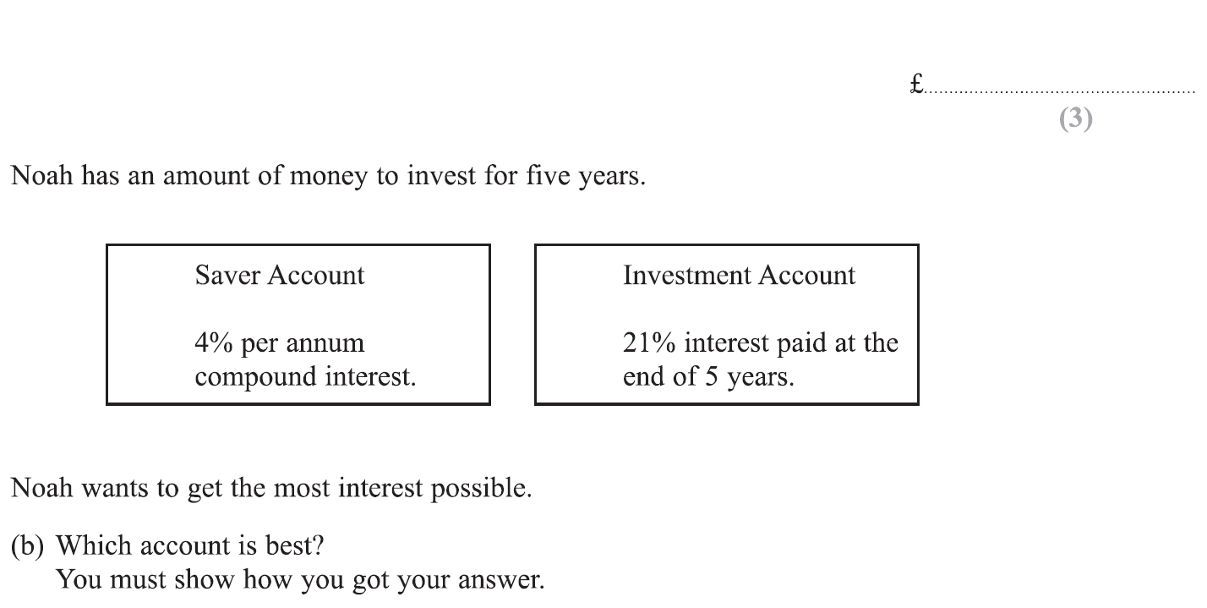
Percentages
Specimen Set 1 3H Q8

Slide 13
Percentages
Specimen Set 1 3H Q8
A
B

Slide 14
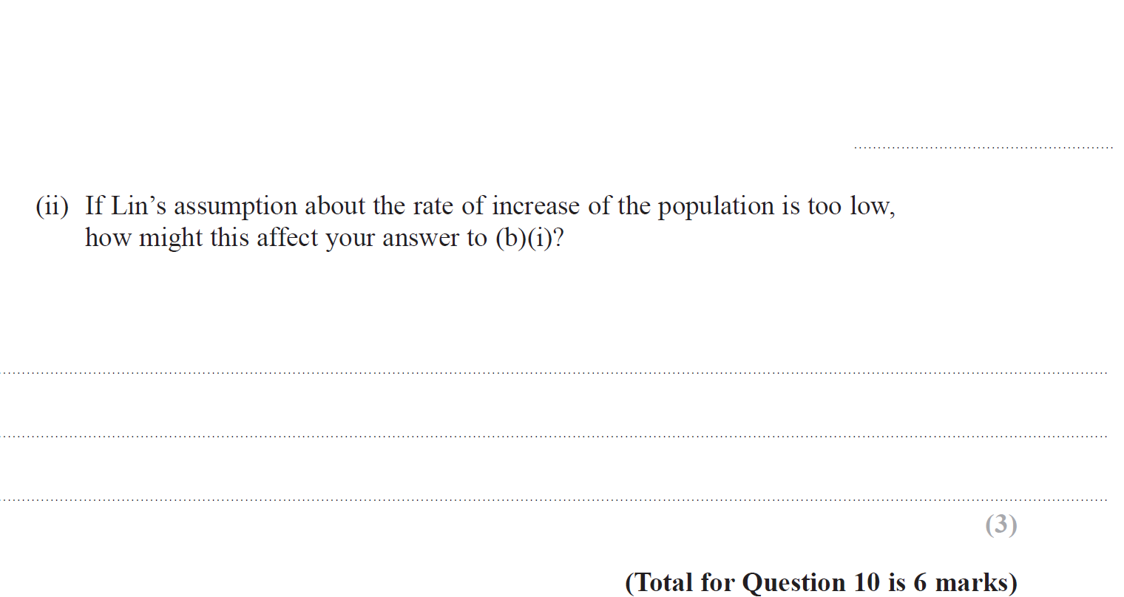
Percentages
Specimen Set 2 2H Q10

Slide 15
Percentages
Specimen Set 2 2H Q10
A
B (i)
B (ii)

Slide 16
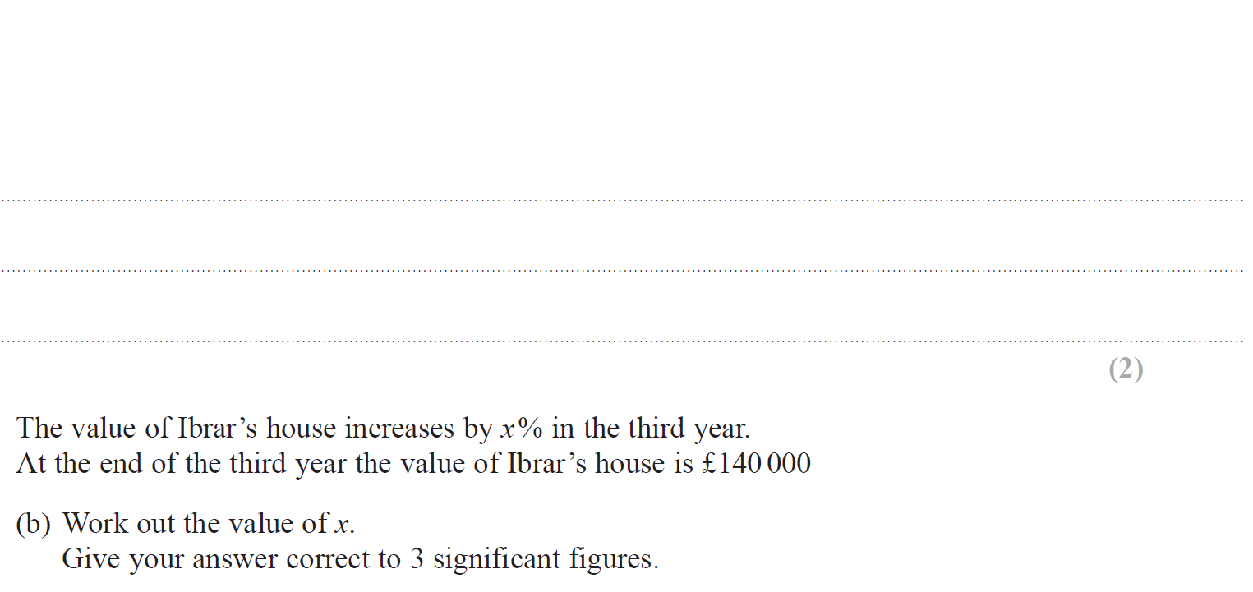
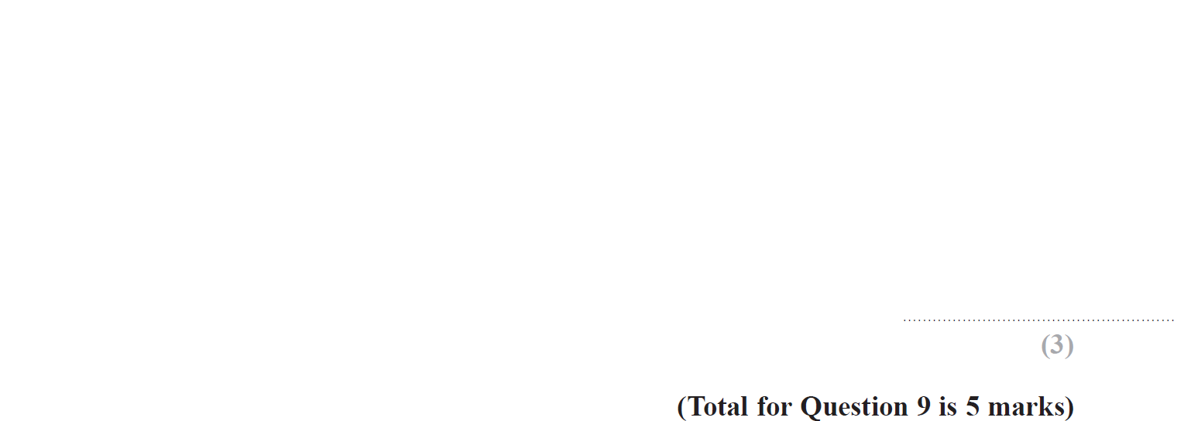
Percentages
Specimen Set 2 3H Q9

Slide 17
Percentages
Specimen Set 2 3H Q9
A
B

Slide 18
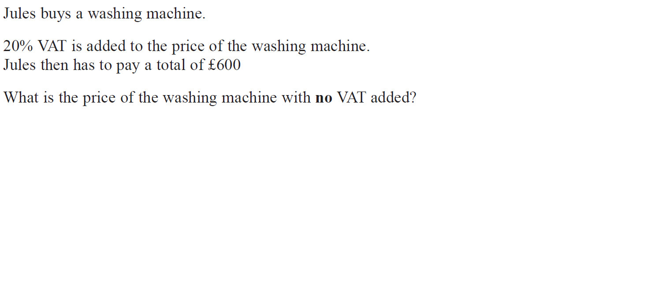
Percentages
May 2017 1H Q9

Slide 19
Percentages
May 2017 1H Q9
A

Slide 20
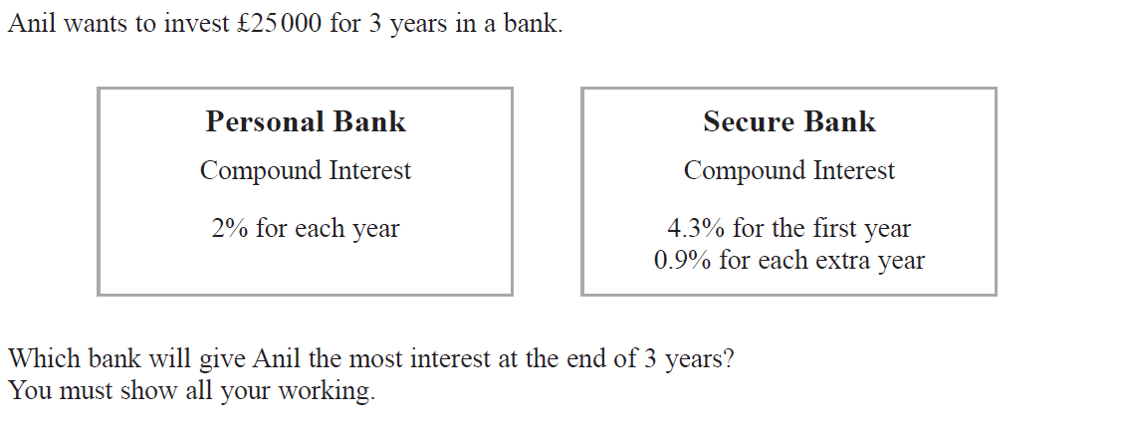
Percentages
June 2017 2H Q6

Slide 21
Percentages
June 2017 2H Q6
A

Slide 22
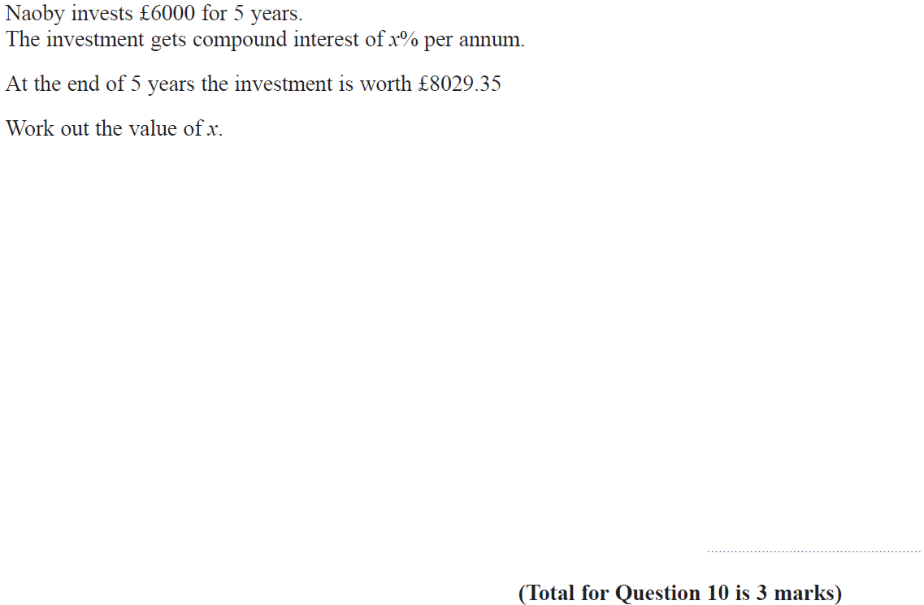
Percentages
June 2017 3H Q10

Slide 23
Percentages
June 2017 3H Q10
A

Slide 24
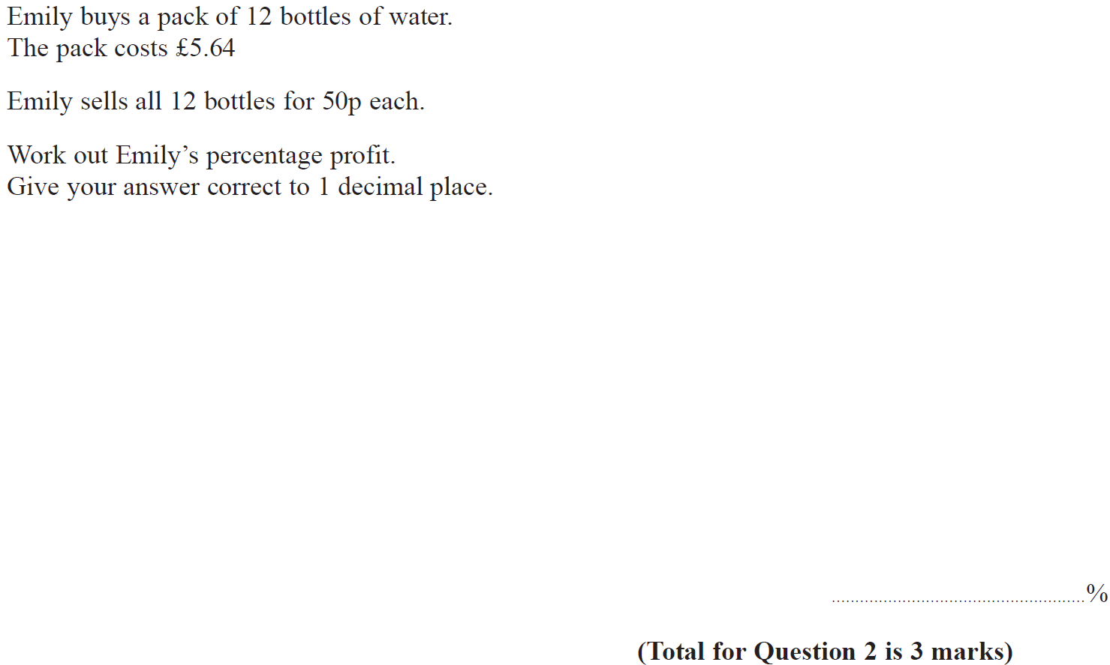
Percentages
Nov 2017 2H Q2

Slide 25
Percentages
Nov 2017 2H Q2
A

Slide 26
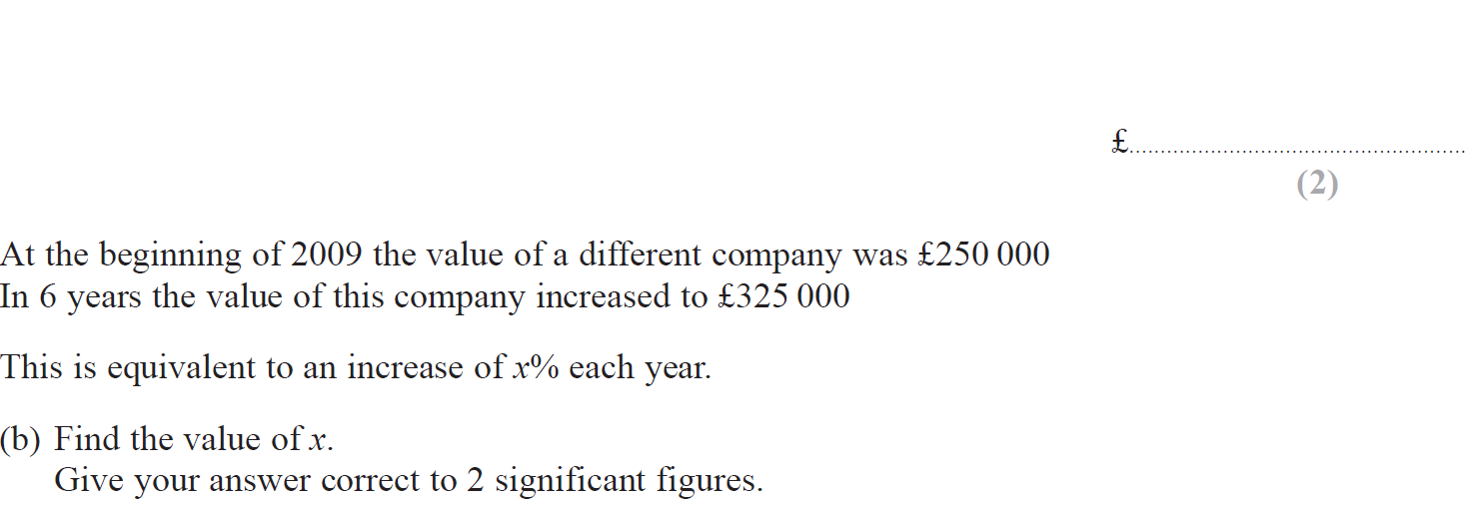
Percentages
Nov 2017 2H Q13

Slide 27
Percentages
Nov 2017 2H Q13
A
B

Slide 28
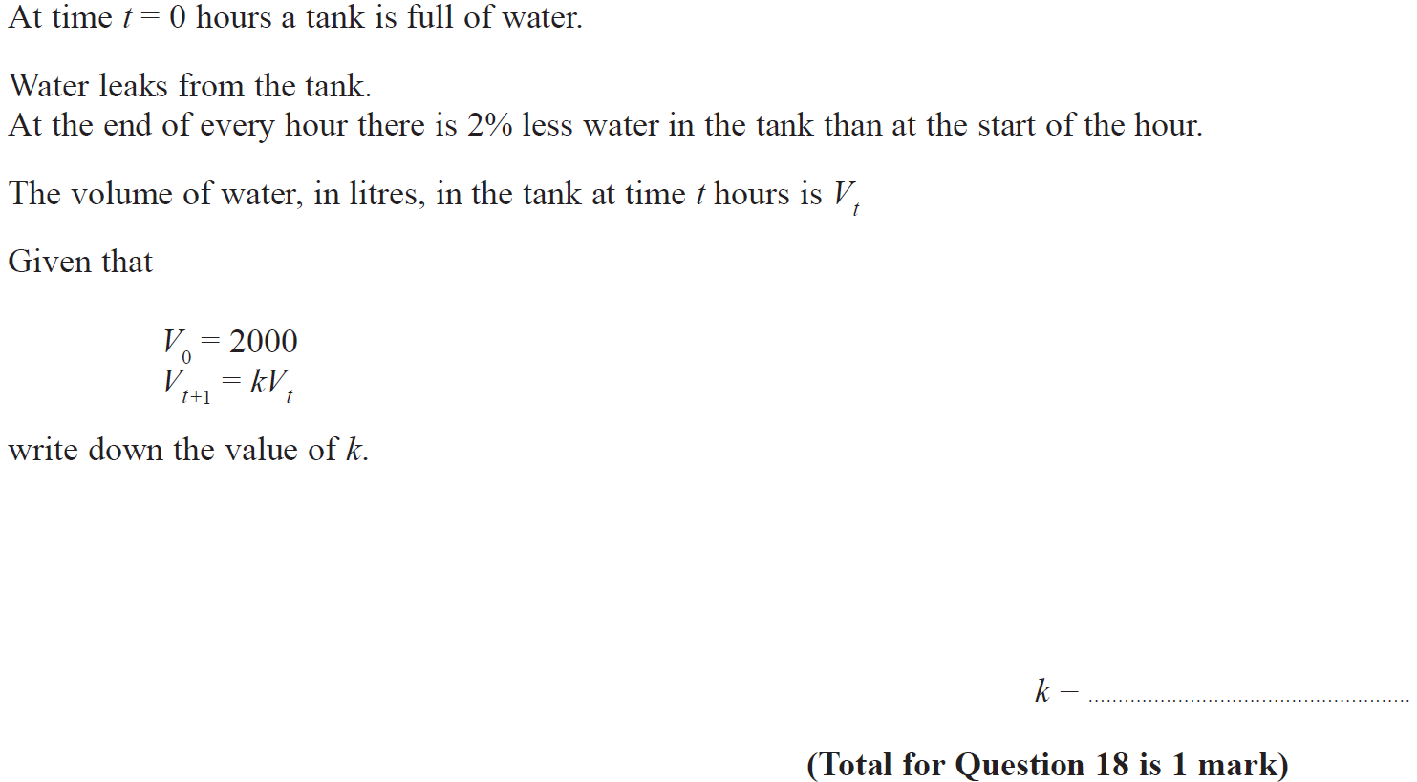
Percentages
Nov 2017 2H Q18

Slide 29
Percentages
Nov 2017 2H Q18
A

Slide 30
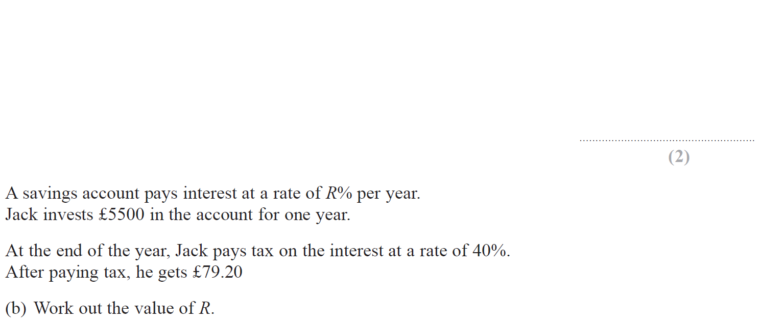
Percentages
Nov 2017 3H Q9

Slide 31
Percentages
Nov 2017 3H Q9
A
B

Slide 32
Percentages
May 2018 1H Q3

Slide 33
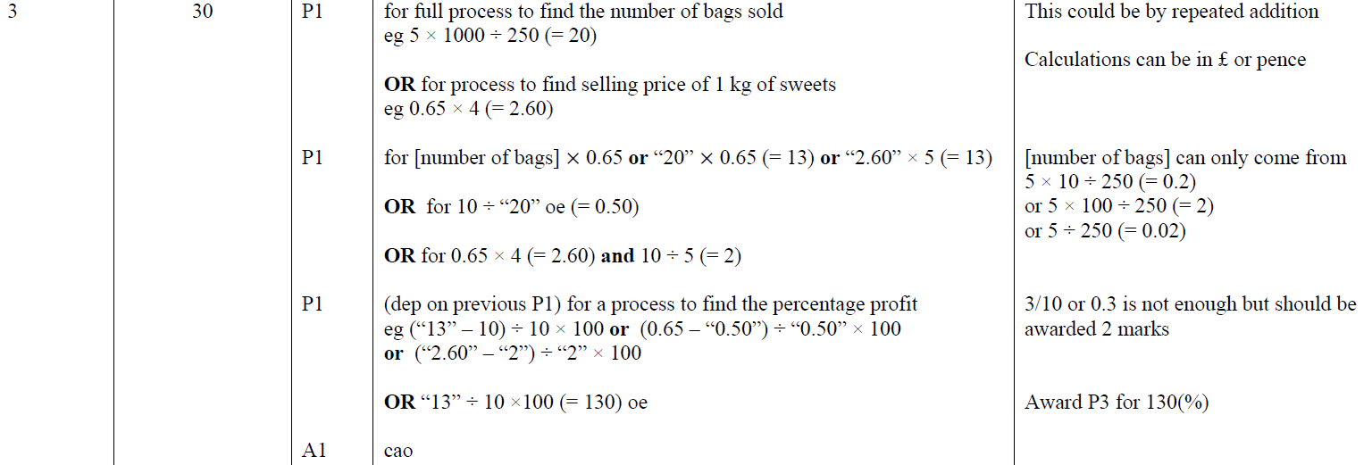
Percentages
May 2018 1H Q3
A

Slide 34
Percentages
June 2018 2H Q6

Slide 35
Percentages
June 2018 2H Q6
A

Slide 36
Percentages
June 2018 2H Q9

Slide 37
Percentages
June 2018 2H Q9
A

Slide 38
Percentages
June 2018 3H Q11

Slide 39
Percentages
June 2018 3H Q11
A

Slide 40
Percentages
Nov 2018 1H Q3

Slide 41
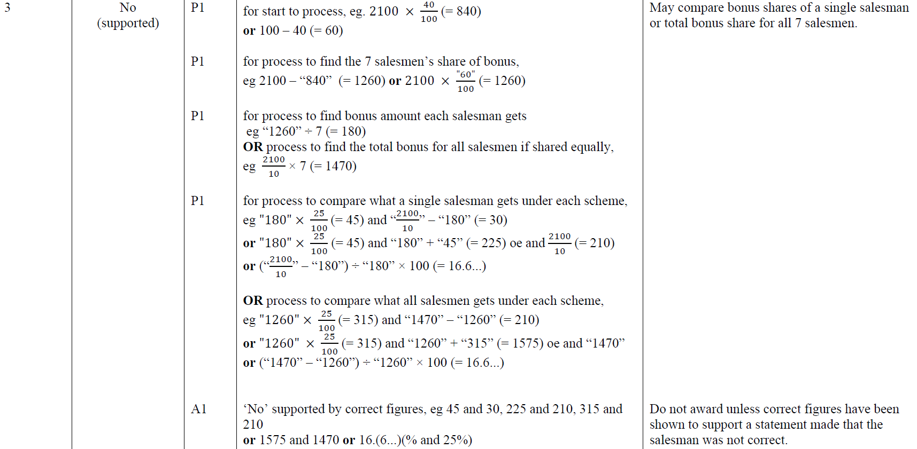
Percentages
Nov 2018 1H Q3
A

Slide 42
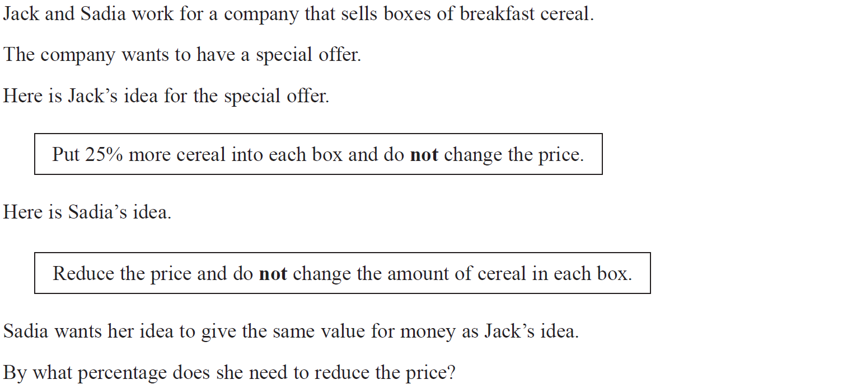
Percentages
Nov 2018 1H Q11

Slide 43
Percentages
Nov 2018 1H Q11
A

Slide 44
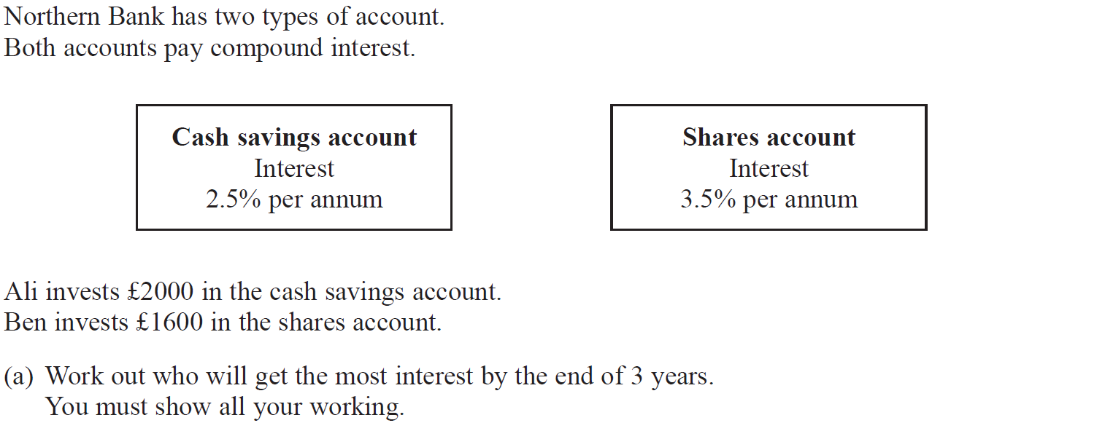
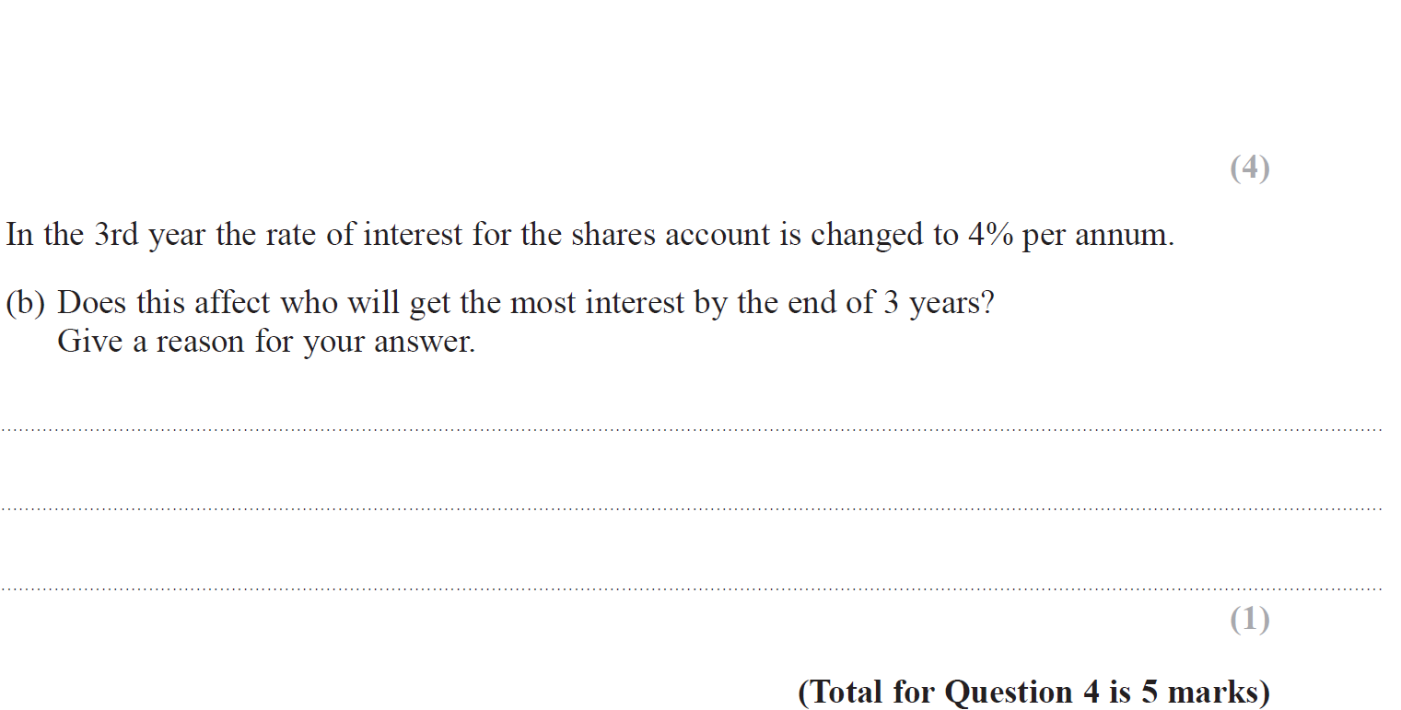
Percentages
Nov 2018 2H Q4

Slide 45
Percentages
Nov 2018 2H Q4
A
B

Slide 46
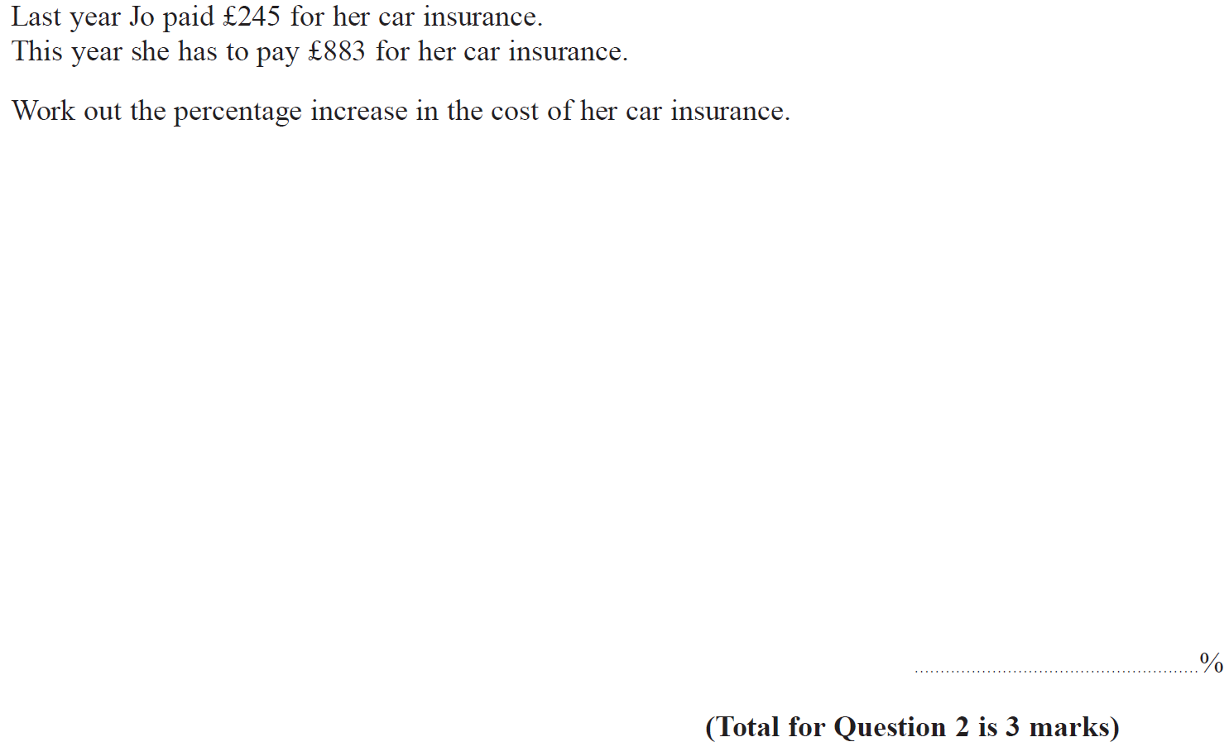
Percentages
Nov 2018 3H Q2

Slide 47
Percentages
Nov 2018 3H Q2
A

Slide 48
Percentages
June 2019 3H Q2

Slide 49
Percentages
June 2019 3H Q2
A
A SF

Slide 50
Percentages
June 2019 3H Q10

Slide 51
Percentages
June 2019 3H Q10
A
A SF

Slide 52
Percentages
SAM 1H Q1

Slide 53
Percentages
SAM 1H Q1
A

Slide 54
Percentages
SAM 2H Q5

Slide 55
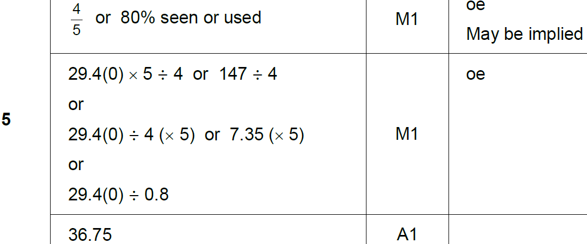
Percentages
SAM 2H Q5
A

Slide 56
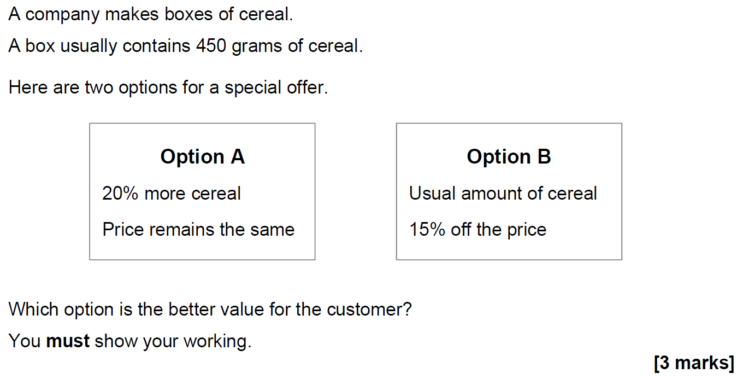
Percentages
SAM 2H Q21

Slide 57
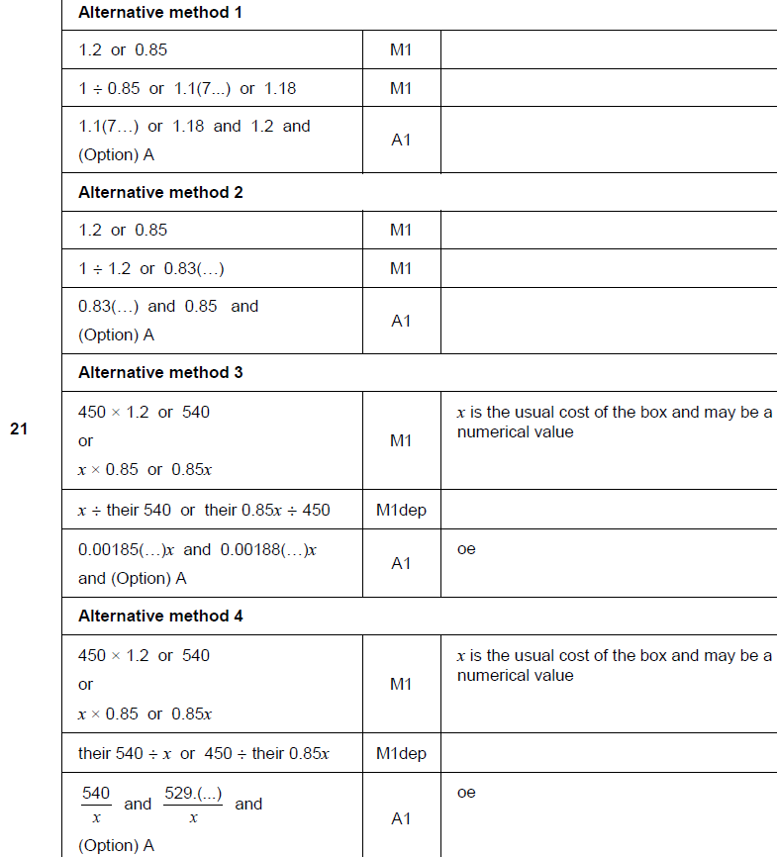
Percentages
SAM 2H Q21
A

Slide 58
Percentages
SAM 3H Q5

Slide 59
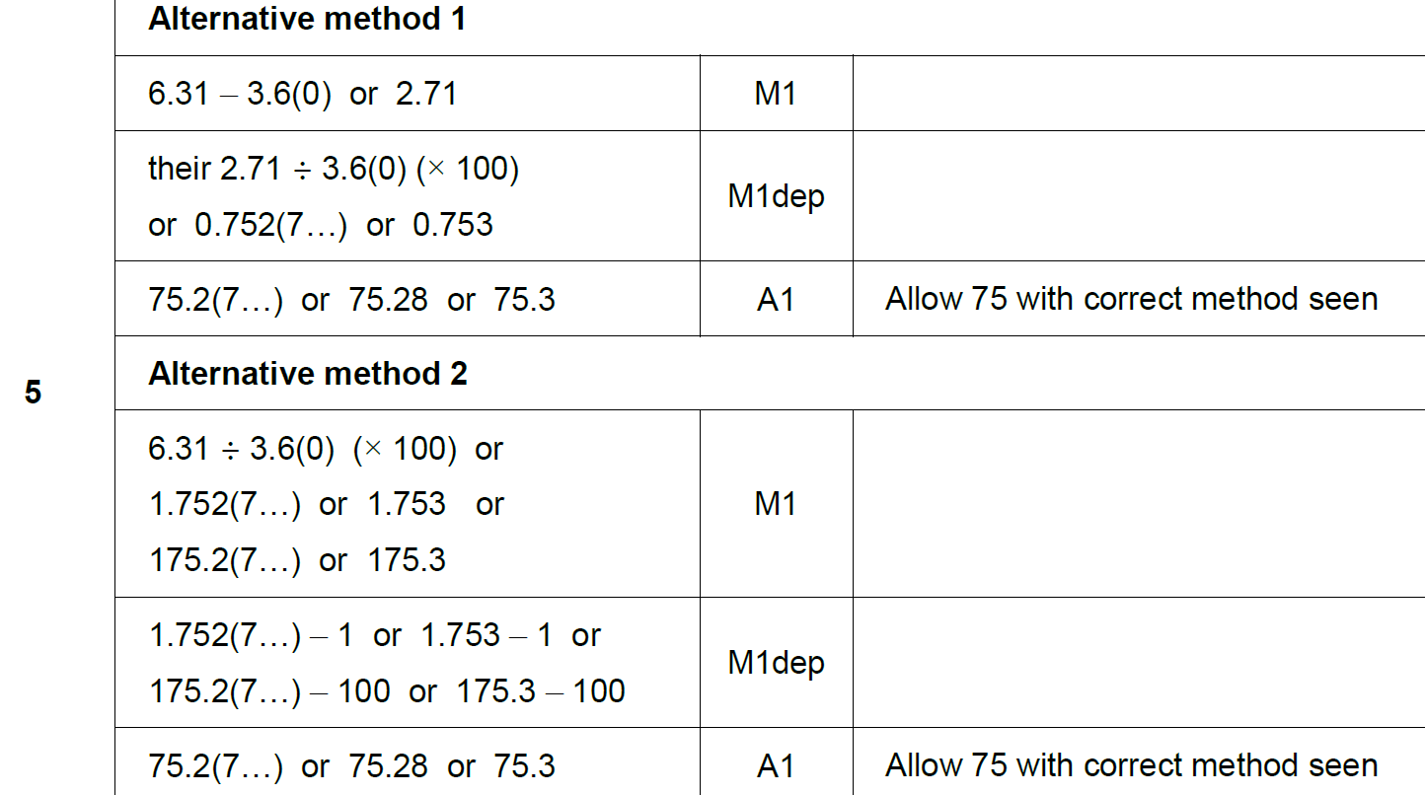
Percentages
SAM 3H Q5
A

Slide 60
Percentages
SAM 3H Q11

Slide 61
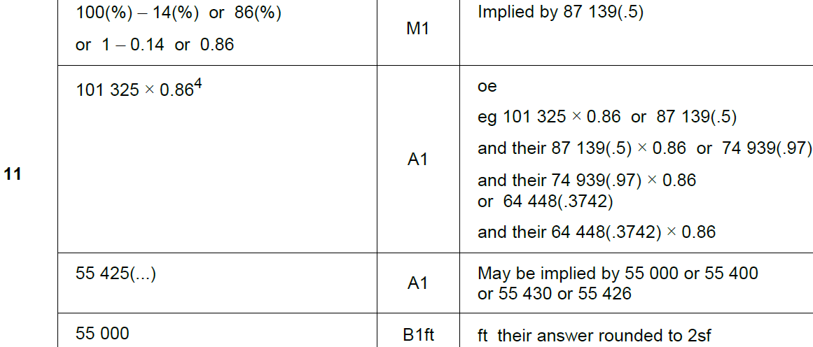
Percentages
SAM 3H Q11
A

Slide 62
Percentages
May 2017 1H Q11

Slide 63
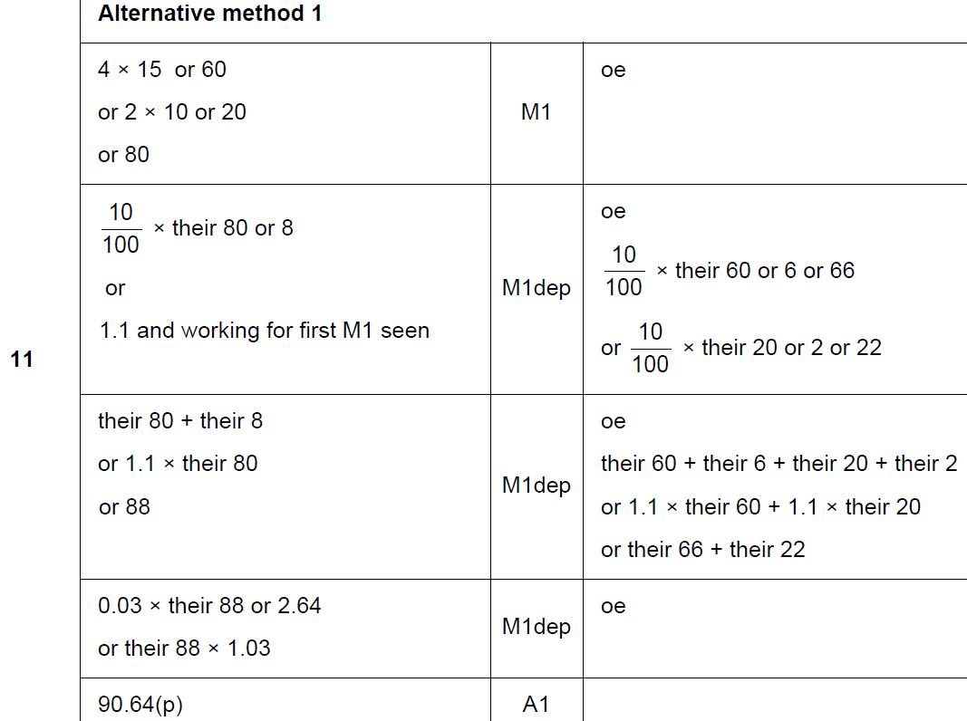
Percentages
May 2017 1H Q11
A

Slide 64
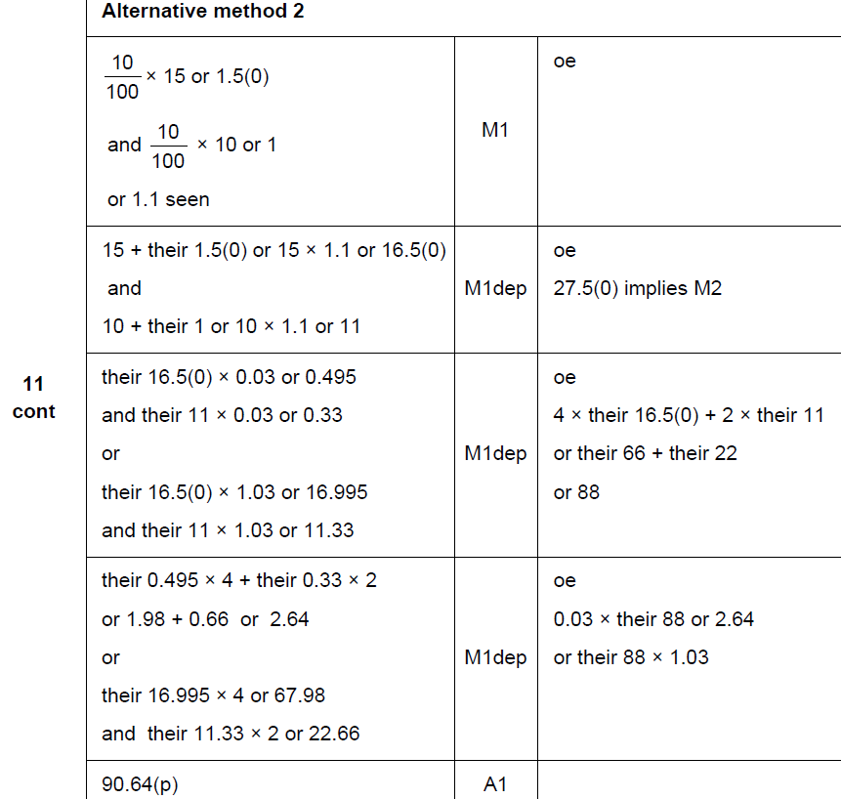
Percentages
May 2017 1H Q11
A Alternative 1

Slide 65
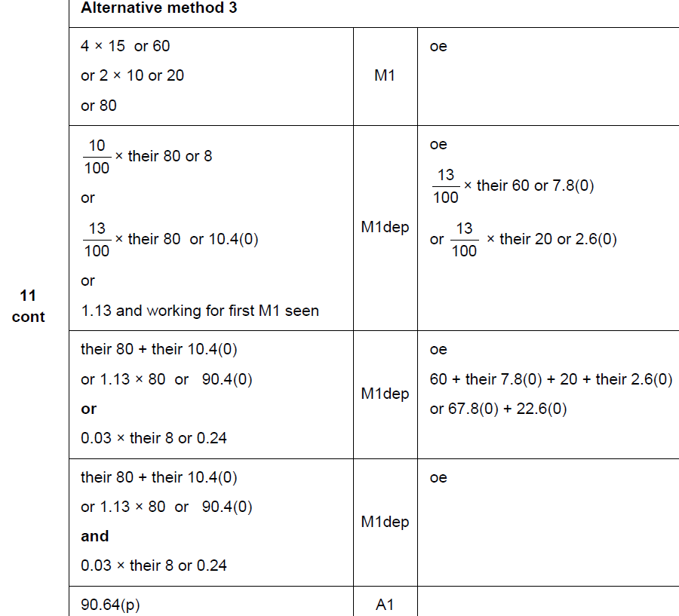
Percentages
May 2017 1H Q11
A

Slide 66
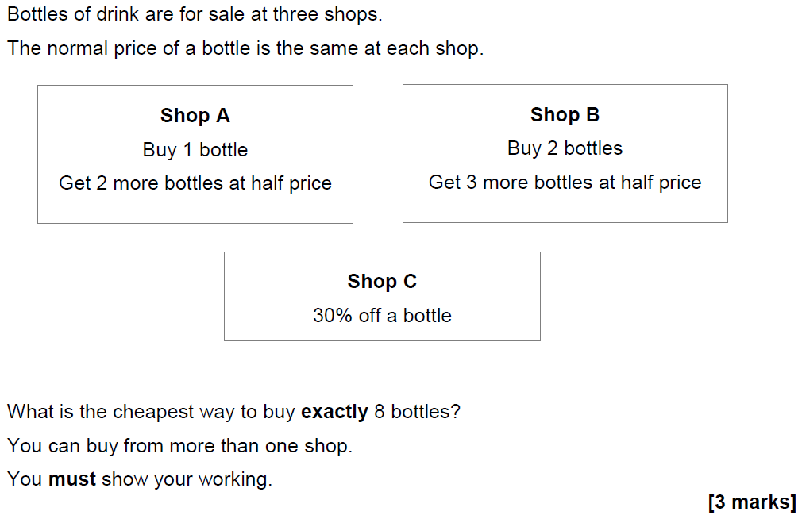
Percentages
May 2017 1H Q18

Slide 67
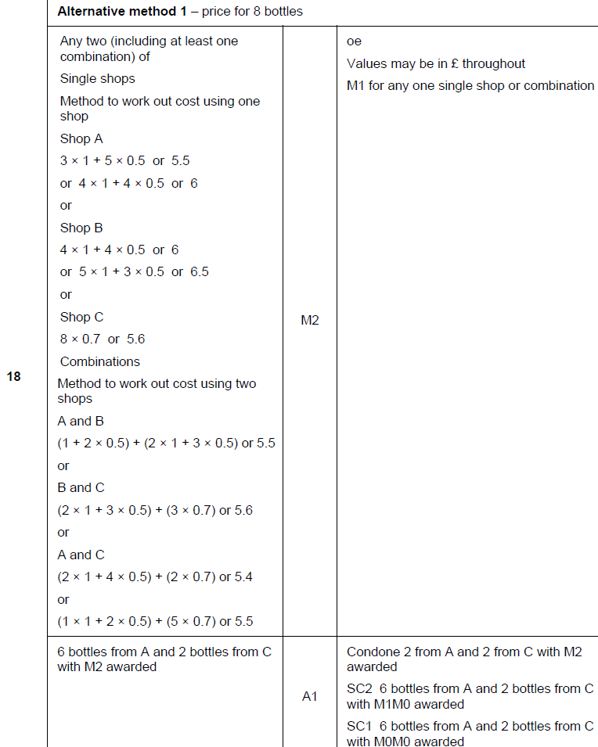
Percentages
May 2017 1H Q18
A

Slide 68
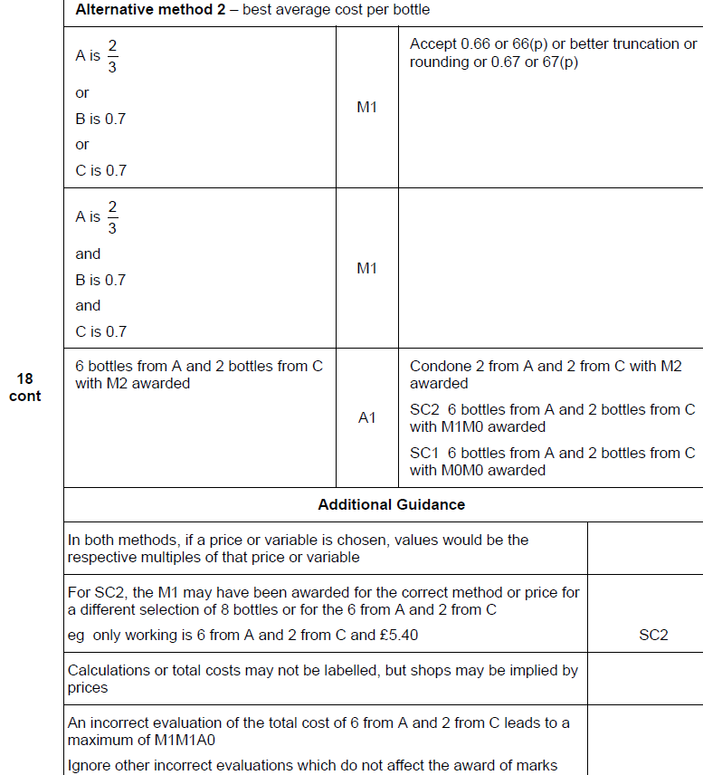
Percentages
May 2017 1H Q18
A Alternative

Slide 69
Percentages
June 2017 3H Q16

Slide 70
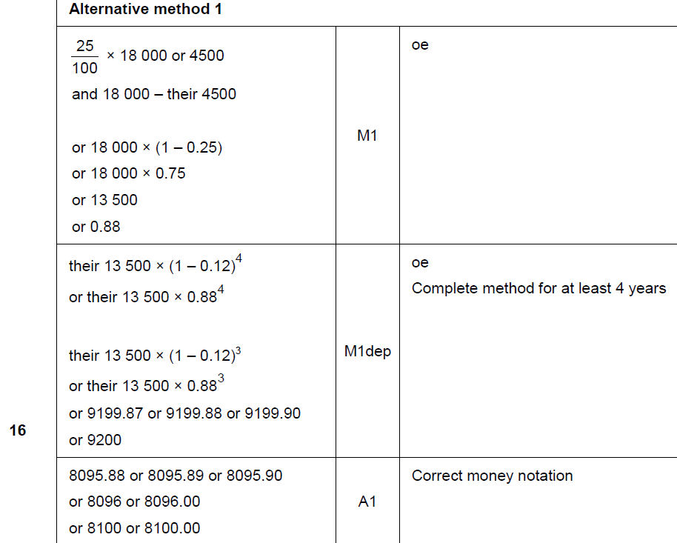
Percentages
June 2017 3H Q16
A

Slide 71
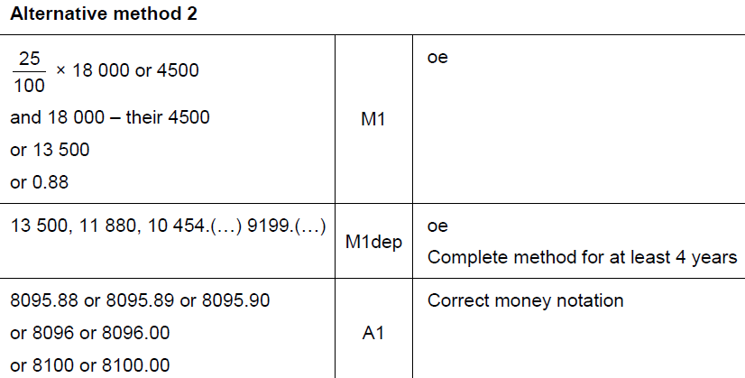
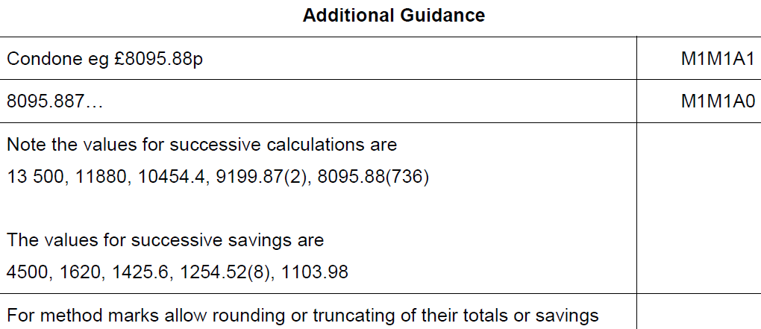
Percentages
June 2017 3H Q16
A Alternative & notes

Slide 72
Percentages
Nov 2017 2H Q2

Slide 73
Percentages
Nov 2017 2H Q2
A

Slide 74
Percentages
Nov 2017 2H Q15
Mirek invests £6000 at a compound interest rate of 1.5% per year.
He wants to earn more than £1000 interest.
Work out the least time, in whole years, that this will take.
[3 marks]

Slide 75
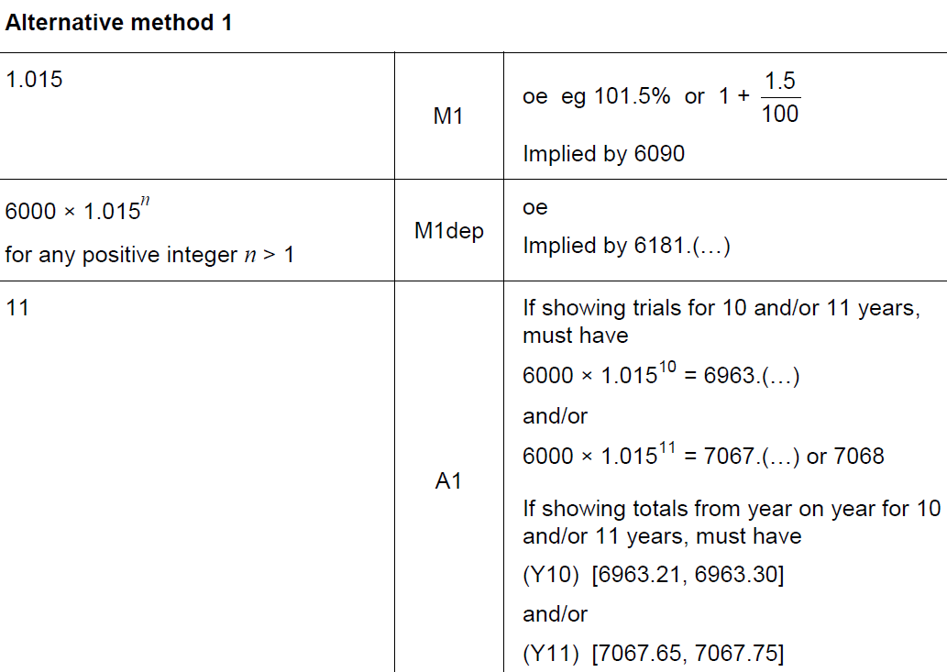
Percentages
Nov 2017 2H Q15
A

Slide 76
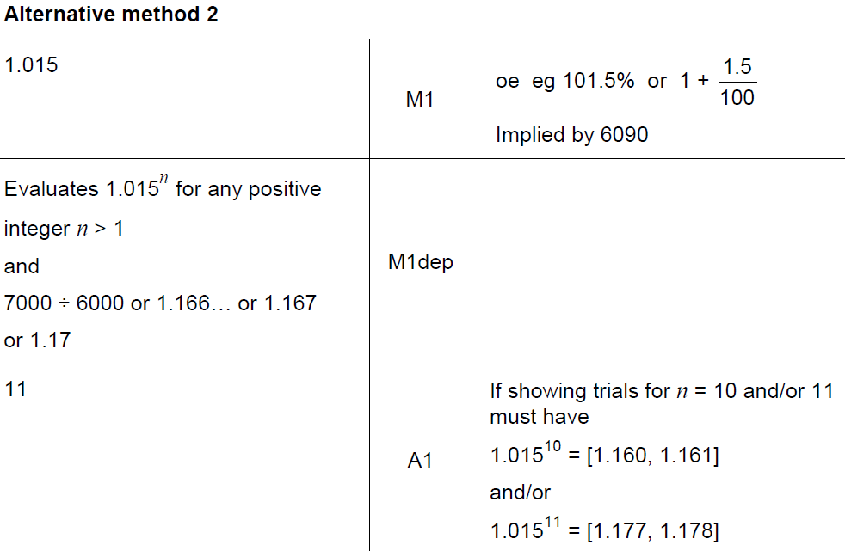
Percentages
Nov 2017 2H Q15
A Alternative

Slide 77
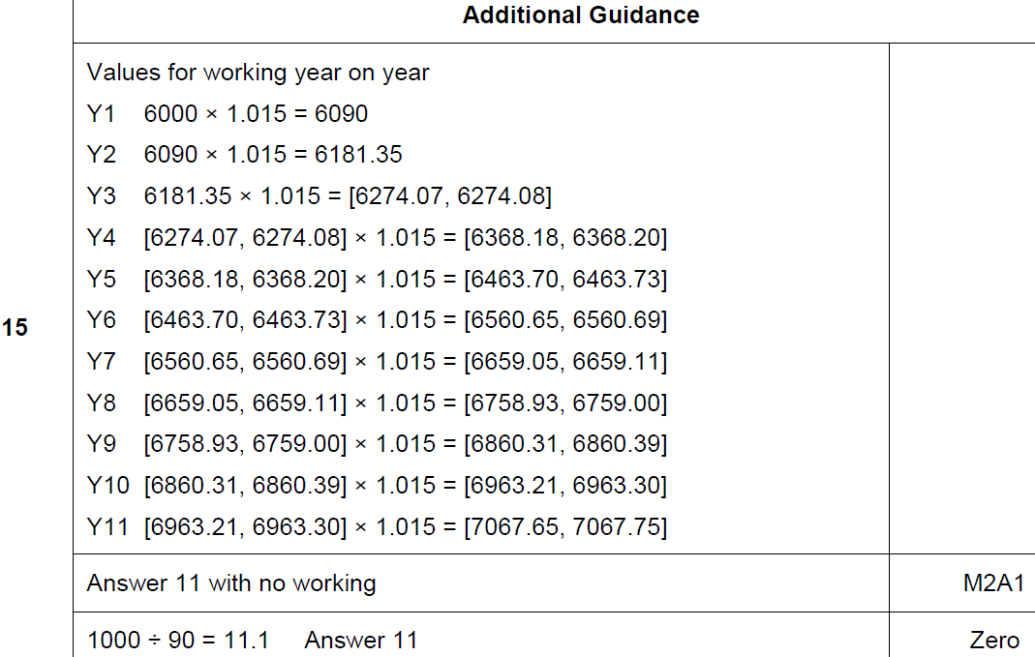
Percentages
Nov 2017 2H Q15
A notes

Slide 78
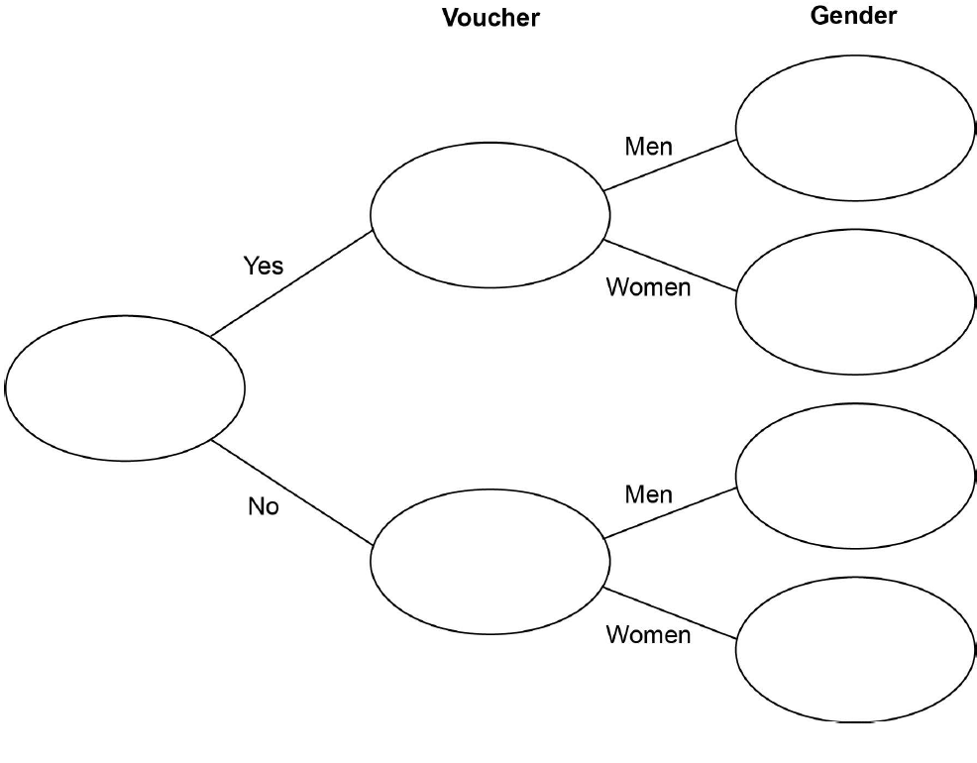
Percentages
Nov 2017 3H Q11

Slide 79
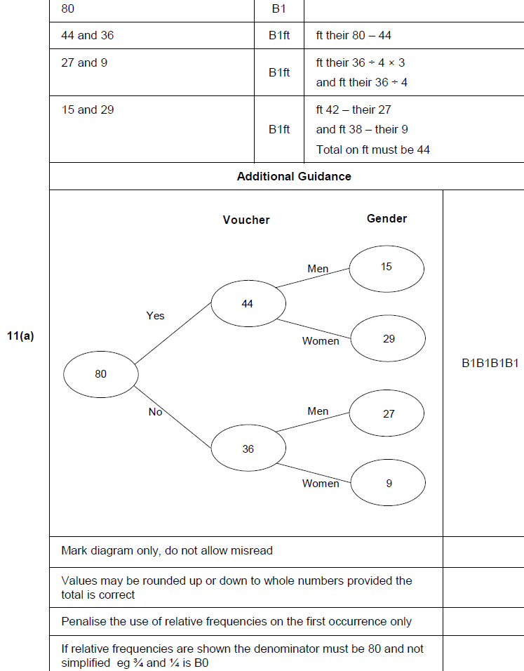
Percentages
Nov 2017 3H Q11
A

Slide 80
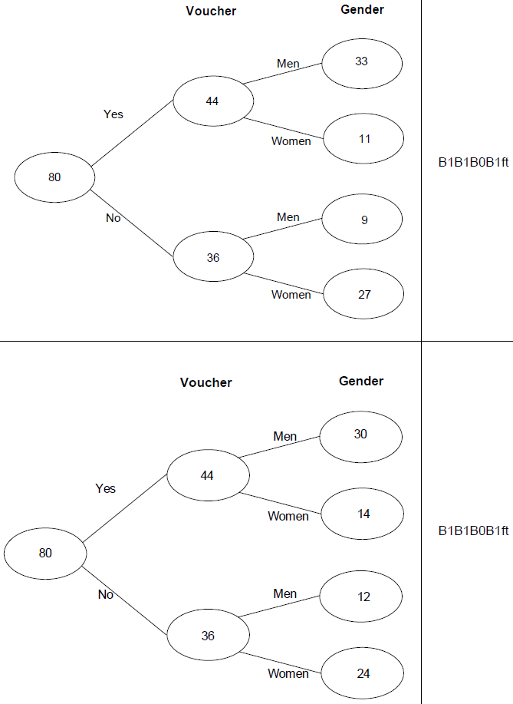
Percentages
Nov 2017 3H Q11
A notes

Slide 81
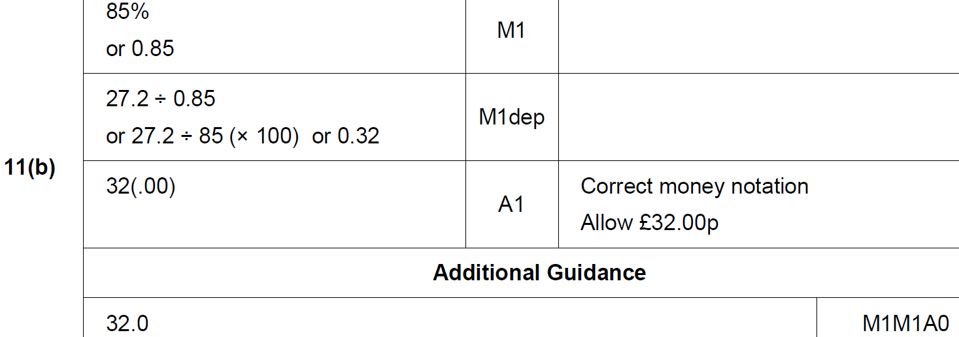
Percentages
Nov 2017 3H Q11
B

Slide 82
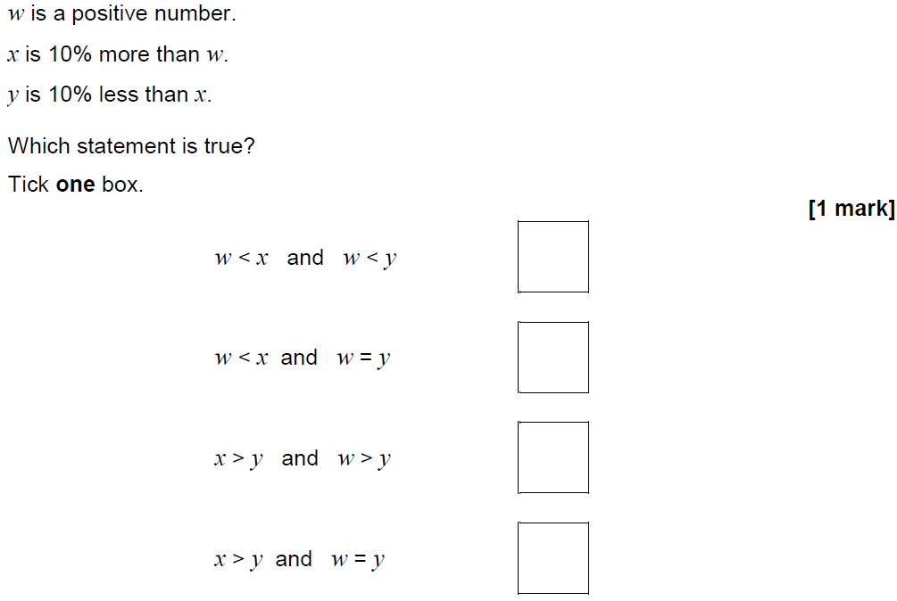
Percentages
Nov 2017 3H Q20

Slide 83
Percentages
Nov 2017 3H Q20
A

Slide 84
Percentages
June 2018 2H Q4

Slide 85
Percentages
June 2018 2H Q4
A

Slide 86
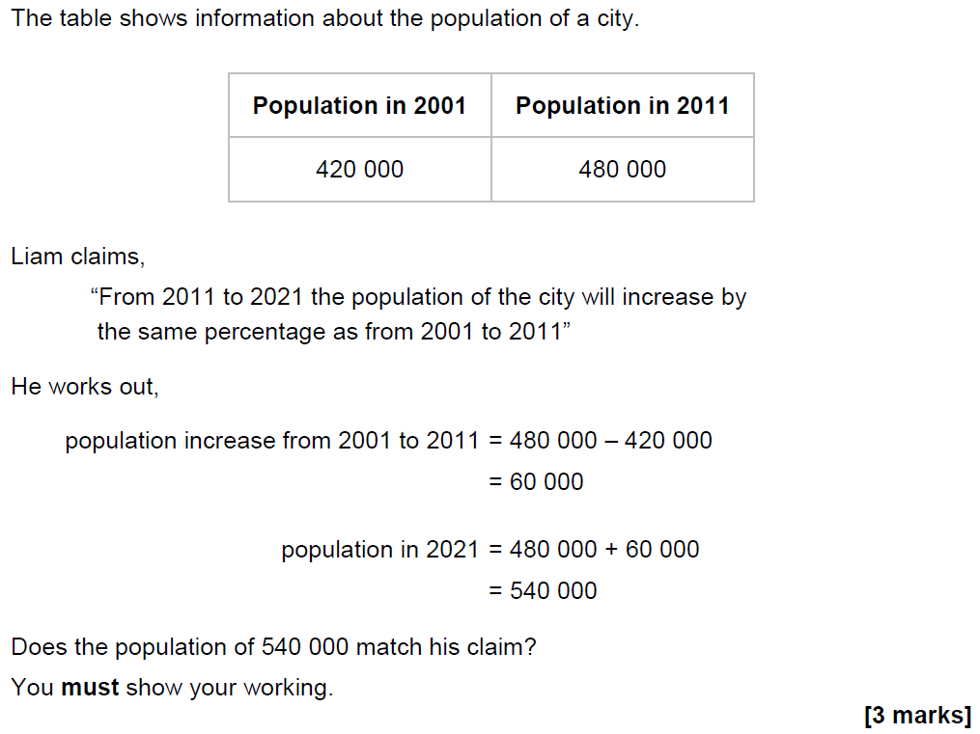
Percentages
June 2018 2H Q6

Slide 87
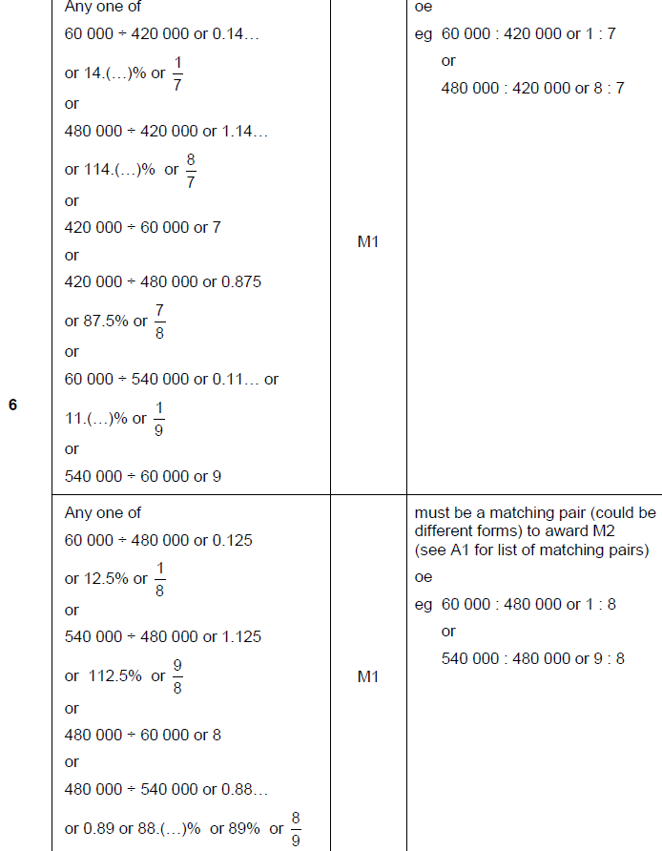
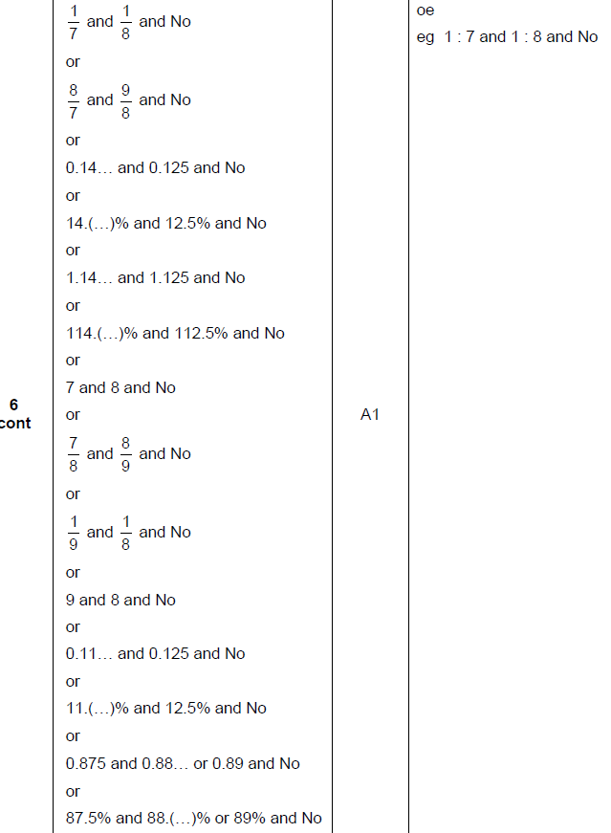
Percentages
June 2018 2H Q6
A

Slide 88
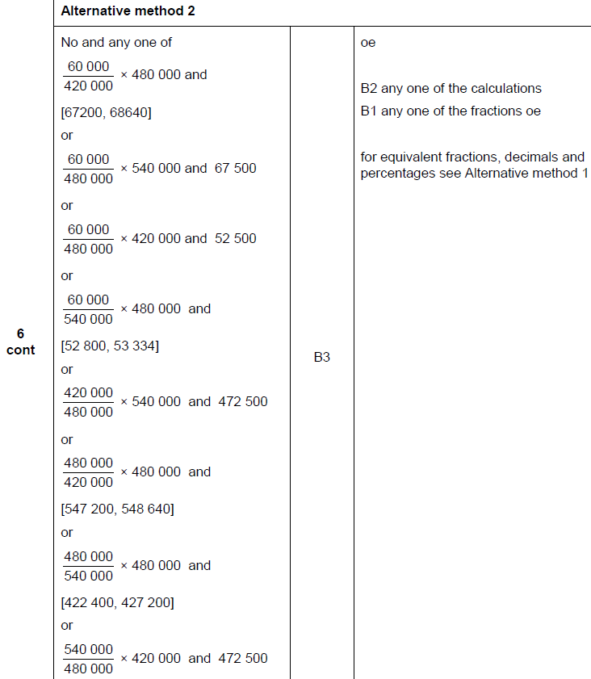
Percentages
June 2018 2H Q6
A Alternative

Slide 89
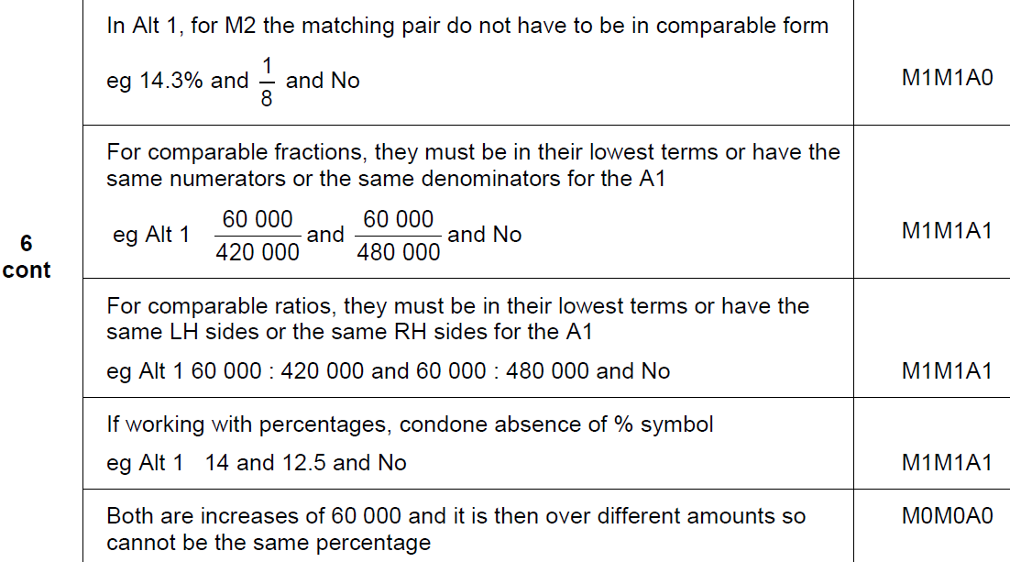
Percentages
June 2018 2H Q6
A notes

Slide 90
Percentages
June 2018 3H Q7
Investment A Save £150 per month for 2 years.
2.5% interest is added to the total amount saved.
Investment B Invest £3500
Compound interest is added at 3% per year.
After 2 years, how much more is investment B worth than investment A?
[4 marks]

Slide 91
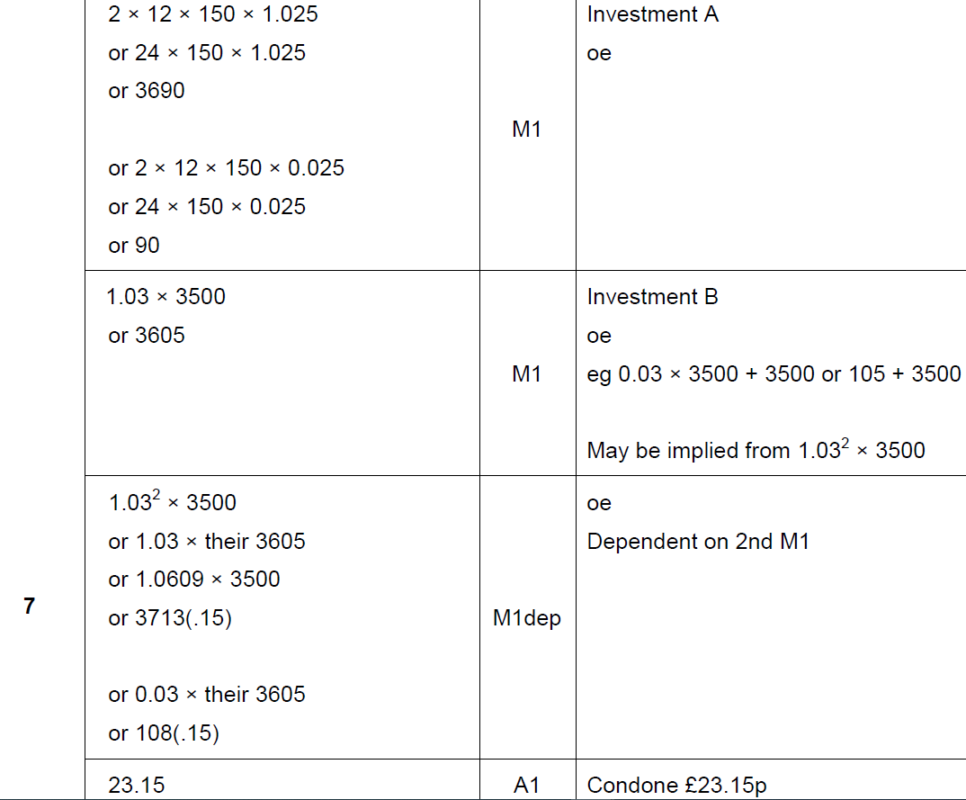
Percentages
June 2018 3H Q7
A

Slide 92
Percentages
June 2018 3H Q7
A notes

Slide 93
Percentages
June 2018 3H Q9
The cost of a ticket increases by 10% to £19.25
Work out the original cost.
[3 marks]

Slide 94
Percentages
June 2018 3H Q9
A

Slide 95
Percentages
Nov 2018 1H Q10
Work out the percentage increase from 80 to 280
[3 marks]

Slide 96
Percentages
Nov 2018 1H Q10
A

Slide 97
Percentages
Nov 2018 3H Q8
Doug owes an amount of £600
He wants to pay off this amount in five months.
He says,
“Each month, I will pay back 20% of the amount I still owe.”
Show working to check if his method is correct.
[3 marks]

Slide 98
Percentages
Nov 2018 3H Q8
A

Slide 99
Percentages
SAM 1H Q3

Slide 100
Percentages
SAM 1H Q3
A
B
C

Slide 101
Percentages
SAM 1H Q15

Slide 102
Percentages
SAM 1H Q15
A

Slide 103
Percentages
SAM 3H Q4

Slide 104
Percentages
SAM 3H Q4
A
B

Slide 105
Percentages
Practice 1H Q2

Slide 106
Percentages
Practice 1H Q2
A
B
C
D

Slide 107
Percentages
Practice 1H Q3

Slide 108
Percentages
Practice 1H Q3
A

Slide 109
Percentages
Practice 2H Q5

Slide 110
Percentages
Practice 2H Q5
A

Slide 111
Percentages
Practice 3H Q5

Slide 112
Percentages
Practice 3H Q5
A

Slide 113
Percentages
May 2017 1H Q5

Slide 114
Percentages
May 2017 1H Q5
A

Slide 115
Percentages
May 2017 1H Q10

Slide 116
Percentages
May 2017 1H Q10
A
B
C

Slide 117
Percentages
June 2017 2H Q4

Slide 118
Percentages
June 2017 2H Q4
A
B
C

Slide 119
Percentages
June 2017 2H Q12

Slide 120
Percentages
June 2017 2H Q12
A

Slide 121
Percentages
June 2017 3H Q1

Slide 122
Percentages
June 2017 3H Q1
A
B
C

Slide 123
Percentages
Nov 2017 2H Q7

Slide 124
Percentages
Nov 2017 2H Q7
A

Slide 125
Percentages
Nov 2017 2H Q11

Slide 126
Percentages
Nov 2017 2H Q11
A (i)
A (ii)
A (iii)
B

Slide 127
Percentages
Nov 2017 3H Q7

Slide 128
Percentages
Nov 2017 3H Q7
A

Slide 129
Percentages
May 2018 1H Q11

Slide 130
Percentages
May 2018 1H Q11
A

Slide 131
Percentages
May 2018 1H Q12

Slide 132
Percentages
May 2018 1H Q12
A
B
C

Slide 133
Percentages
June 2018 2H Q6

Slide 134
Percentages
June 2018 2H Q6
A

Slide 135
Percentages
June 2018 3H Q15

Slide 136
Percentages
June 2018 3H Q15
A

Slide 137
Percentages
Nov 2018 1H Q1

Slide 138
Percentages
Nov 2018 1H Q1
A

Slide 139
Percentages
Nov 2018 1H Q4

Slide 140
Percentages
Nov 2018 1H Q4
A

Slide 141
Percentages
Nov 2018 2H Q7

Slide 142
Percentages
Nov 2018 2H Q7
A

Slide 143
Percentages
Nov 2018 2H Q11

Slide 144
Percentages
Nov 2018 2H Q11
A

