Slide 1
Percentages
Percentages
May 2017
1H Q5
May 2018
1H Q11
May 2017
1H Q10*
May 2018
1H Q12*
Practice
1H Q2*
June 2017
2H Q4*
June 2018
2H Q6
SAM
1H Q3*
Practice
1H Q3
June 2017
2H Q12
June 2018
3H Q15
SAM
1H Q15
Practice
2H Q5
June 2017
3H Q1
Nov 2018
1H Q1
SAM
3H Q4
Practice
3H Q5
Nov 2017
2H Q7
Nov 2018
1H Q4
Nov 2017
2H Q11*
Nov 2018
2H Q7
Nov 2017
3H Q7
Nov 2018
2H Q11
Best Buys
*Exponential models
Compound/ Repeated Change

Slide 2
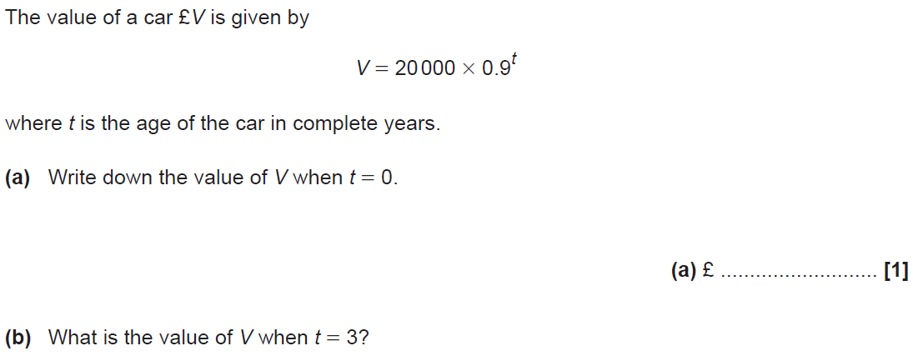
Percentages
SAM 1H Q3

Slide 3
Percentages
SAM 1H Q3
A
B
C

Slide 4
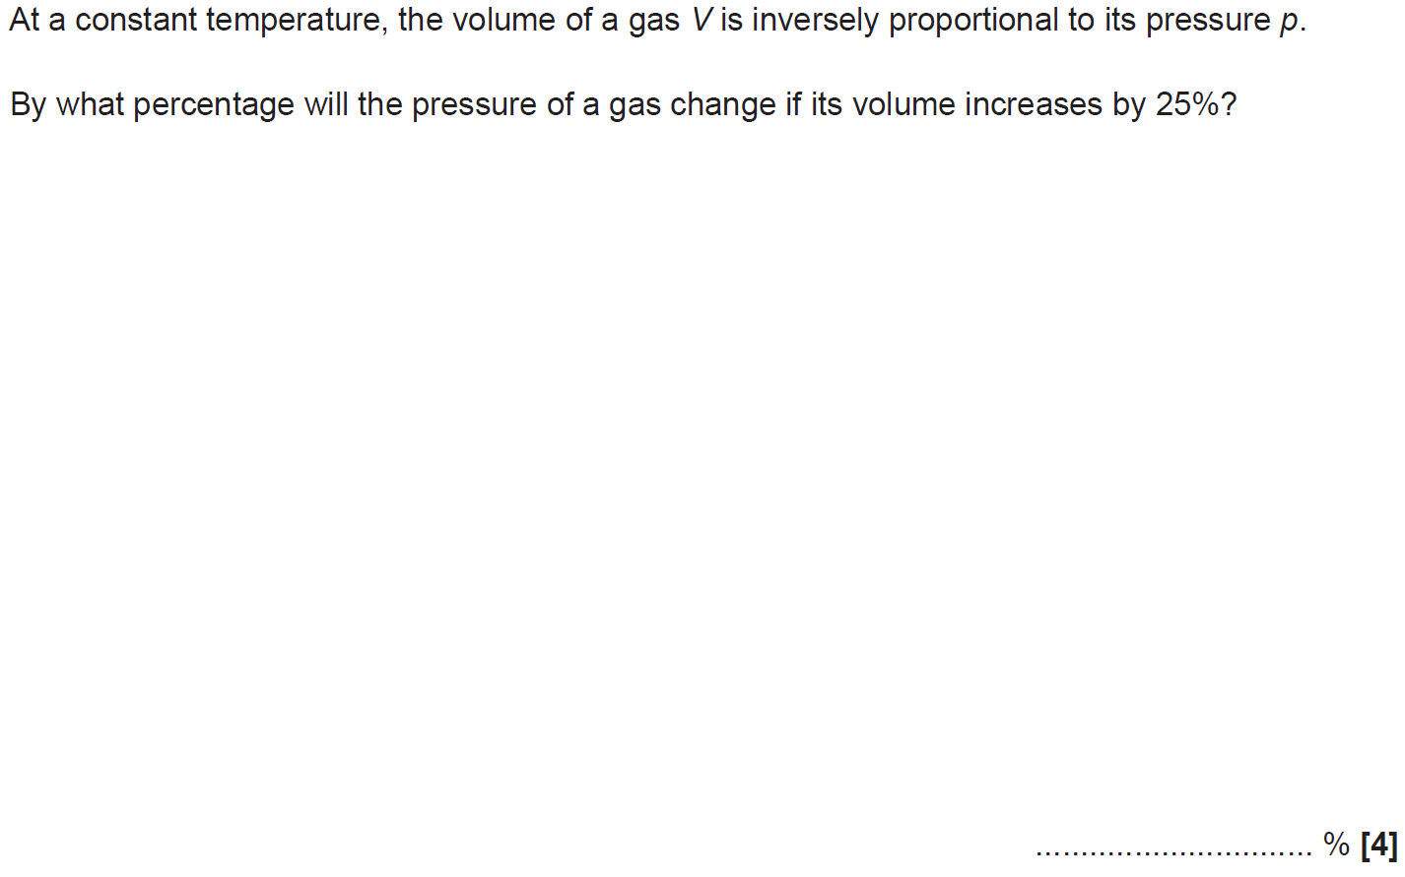
Percentages
SAM 1H Q15

Slide 5
Percentages
SAM 1H Q15
A

Slide 6
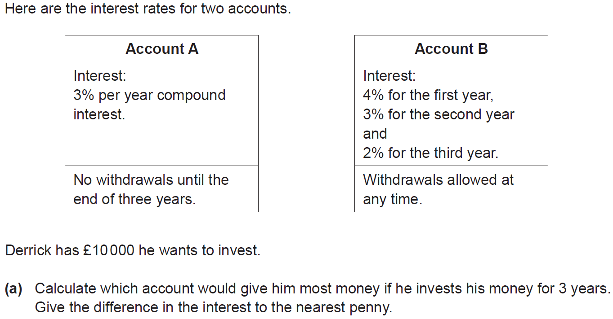
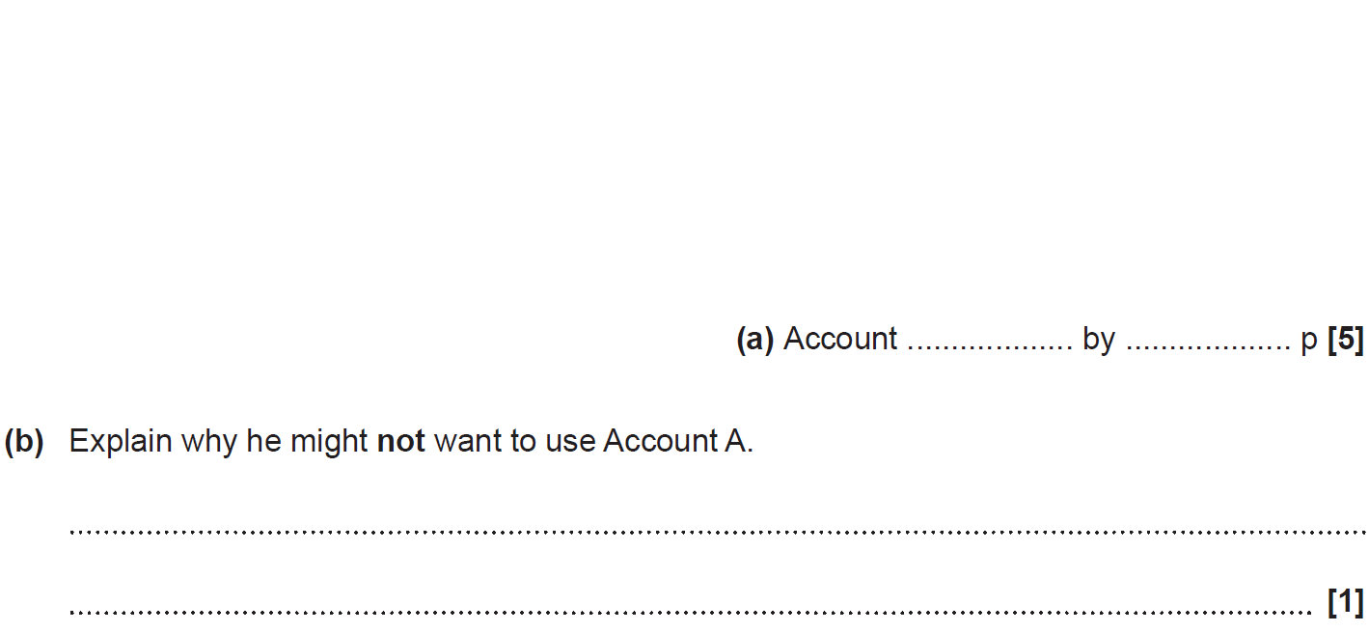
Percentages
SAM 3H Q4

Slide 7
Percentages
SAM 3H Q4
A
B

Slide 8
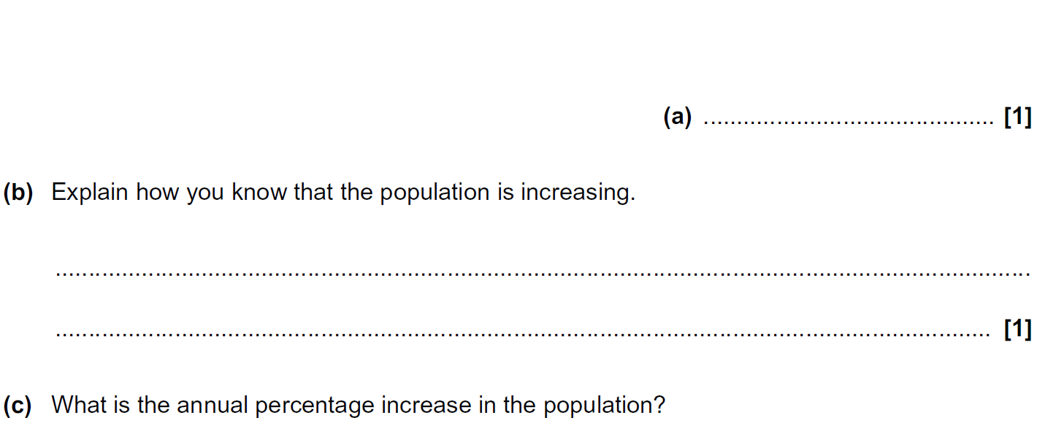
Percentages
Practice 1H Q2

Slide 9
Percentages
Practice 1H Q2
A
B
C
D

Slide 10
Percentages
Practice 1H Q3

Slide 11
Percentages
Practice 1H Q3
A

Slide 12
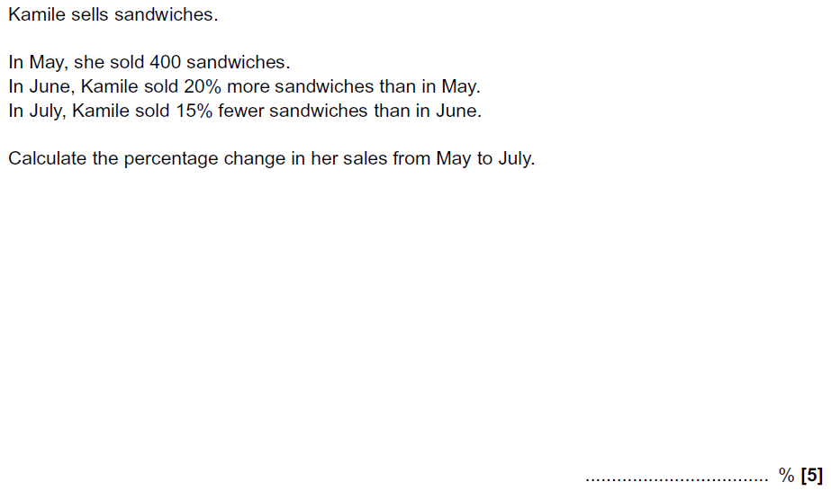
Percentages
Practice 2H Q5

Slide 13
Percentages
Practice 2H Q5
A

Slide 14
Percentages
Practice 3H Q5

Slide 15
Percentages
Practice 3H Q5
A

Slide 16
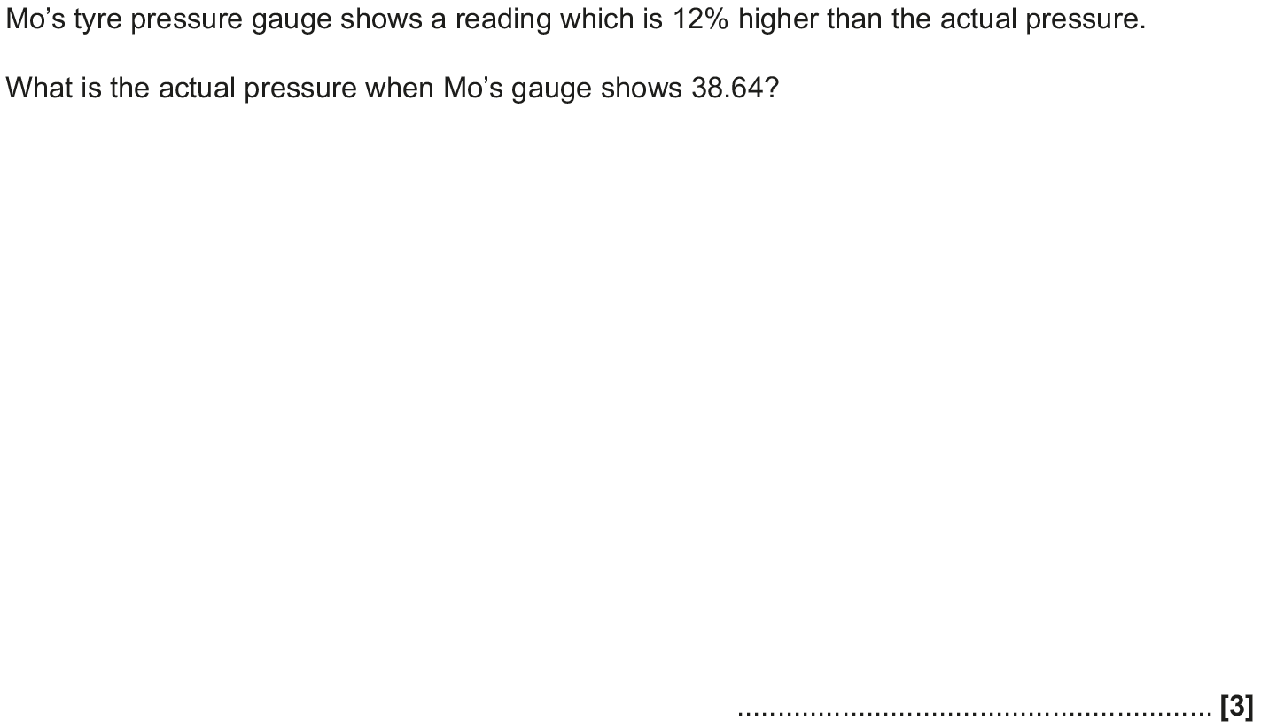
Percentages
May 2017 1H Q5

Slide 17
Percentages
May 2017 1H Q5
A

Slide 18
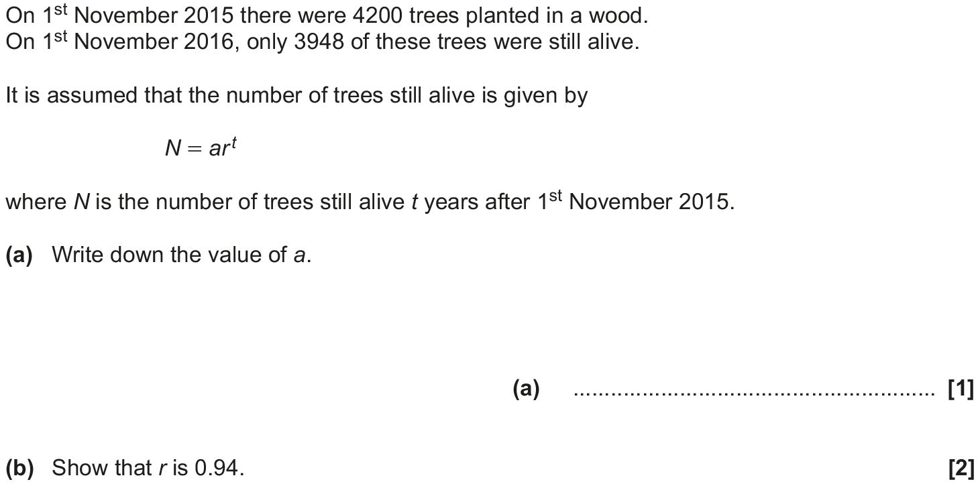
Percentages
May 2017 1H Q10

Slide 19
Percentages
May 2017 1H Q10
A
B
C

Slide 20
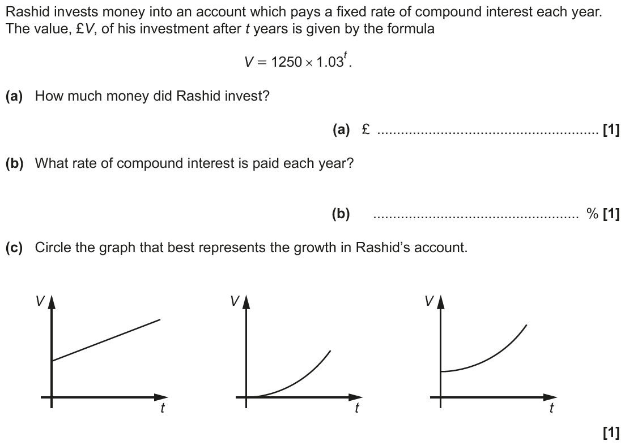
Percentages
June 2017 2H Q4

Slide 21
Percentages
June 2017 2H Q4
A
B
C

Slide 22
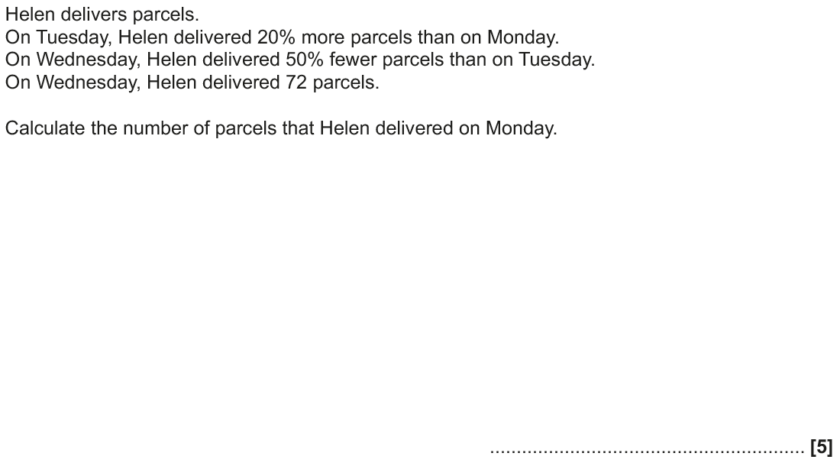
Percentages
June 2017 2H Q12

Slide 23
Percentages
June 2017 2H Q12
A

Slide 24
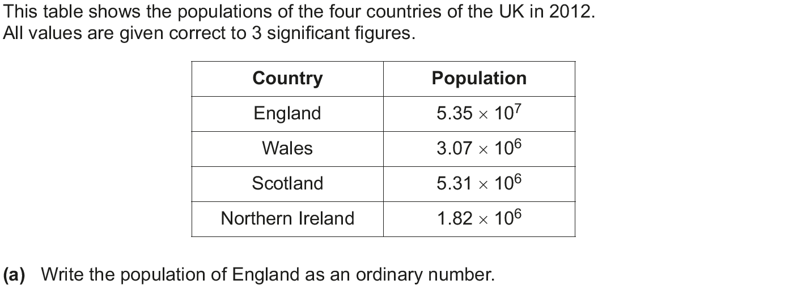
Percentages
June 2017 3H Q1

Slide 25
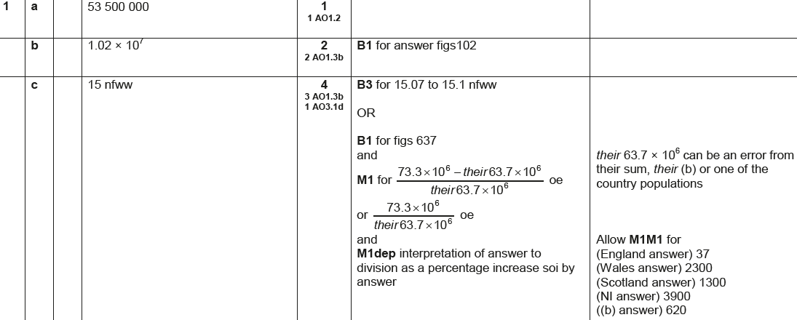
Percentages
June 2017 3H Q1
A
B
C

Slide 26
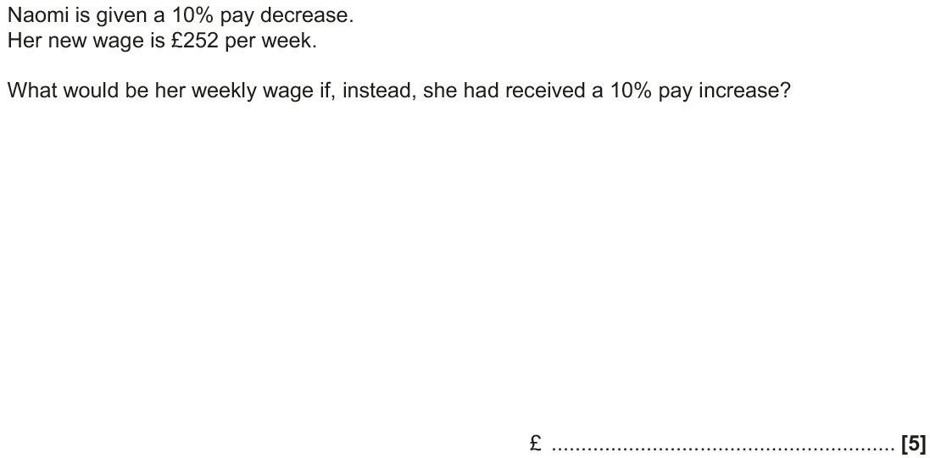
Percentages
Nov 2017 2H Q7

Slide 27
Percentages
Nov 2017 2H Q7
A

Slide 28
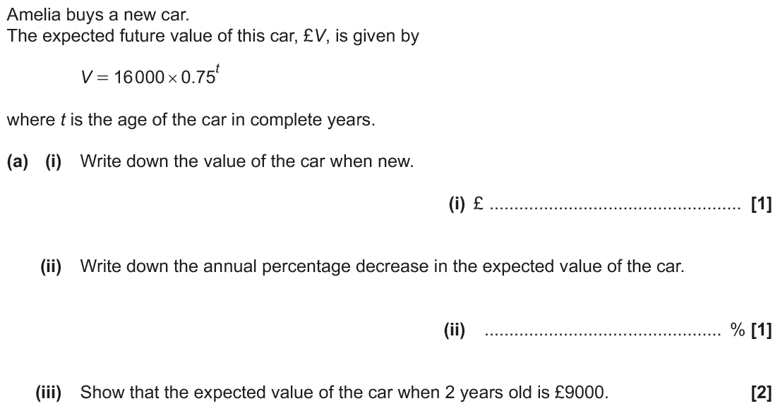
Percentages
Nov 2017 2H Q11

Slide 29
Percentages
Nov 2017 2H Q11
A (i)
A (ii)
A (iii)
B

Slide 30
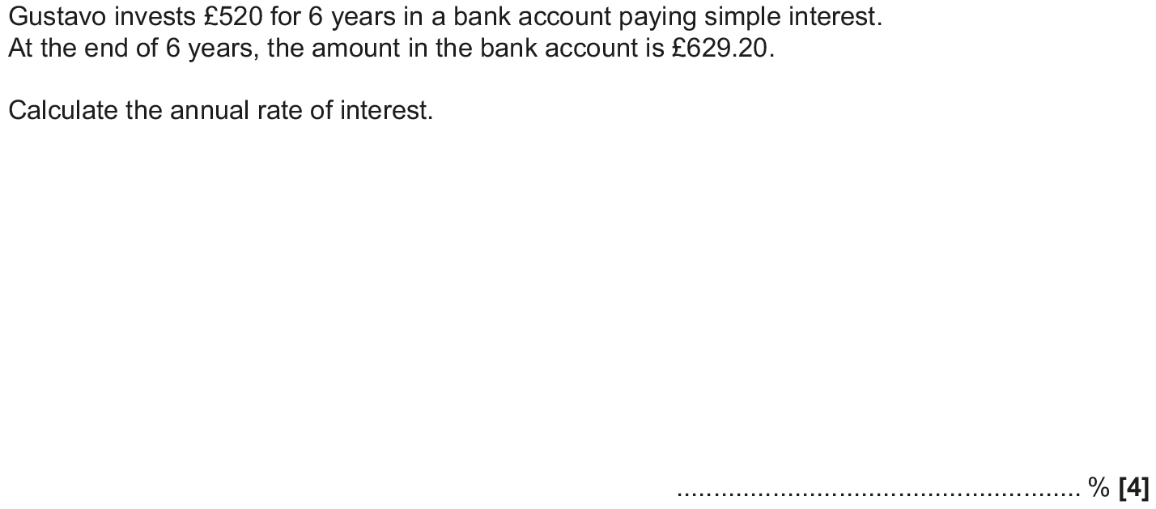
Percentages
Nov 2017 3H Q7

Slide 31
Percentages
Nov 2017 3H Q7
A

Slide 32
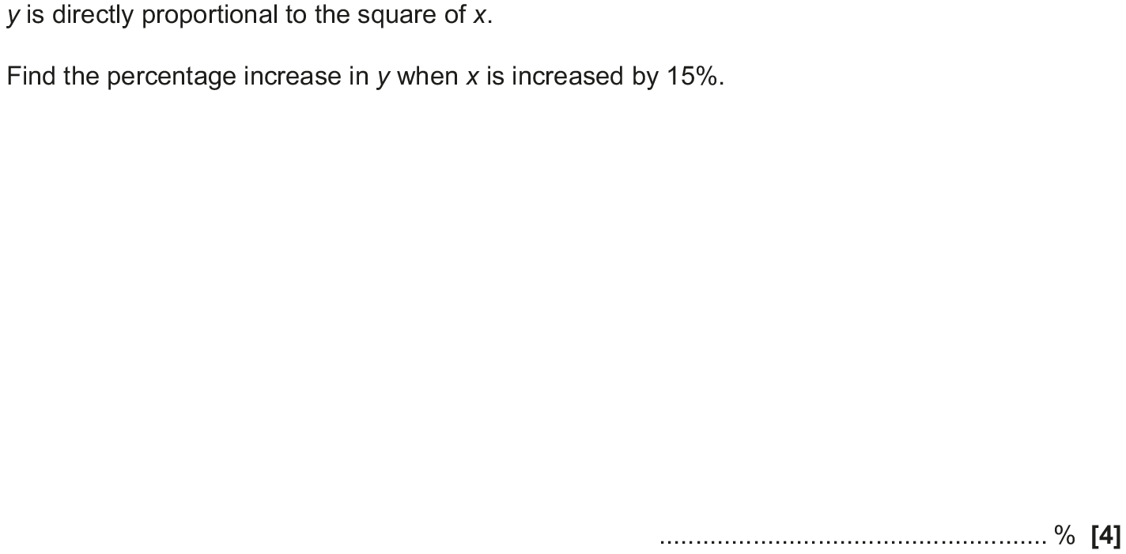
Percentages
May 2018 1H Q11

Slide 33
Percentages
May 2018 1H Q11
A

Slide 34
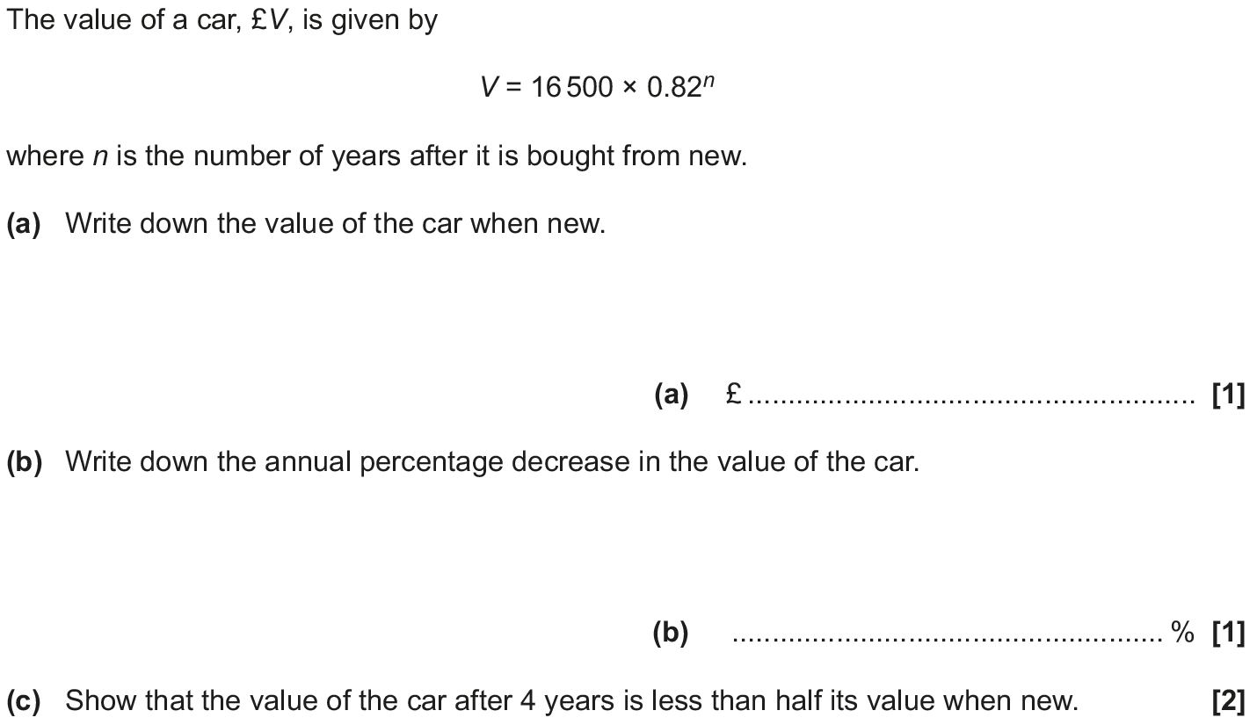
Percentages
May 2018 1H Q12

Slide 35
Percentages
May 2018 1H Q12
A
B
C

Slide 36
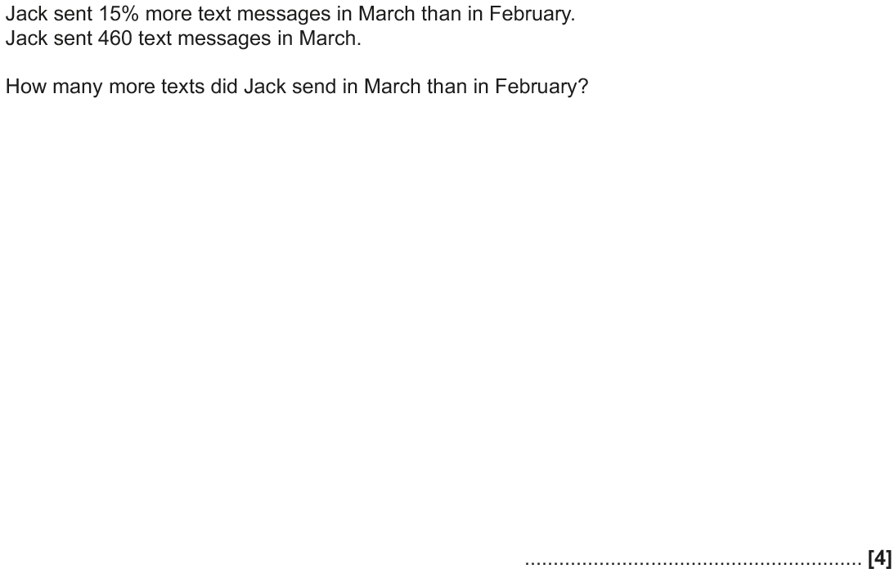
Percentages
June 2018 2H Q6

Slide 37
Percentages
June 2018 2H Q6
A

Slide 38
Percentages
June 2018 3H Q15

Slide 39
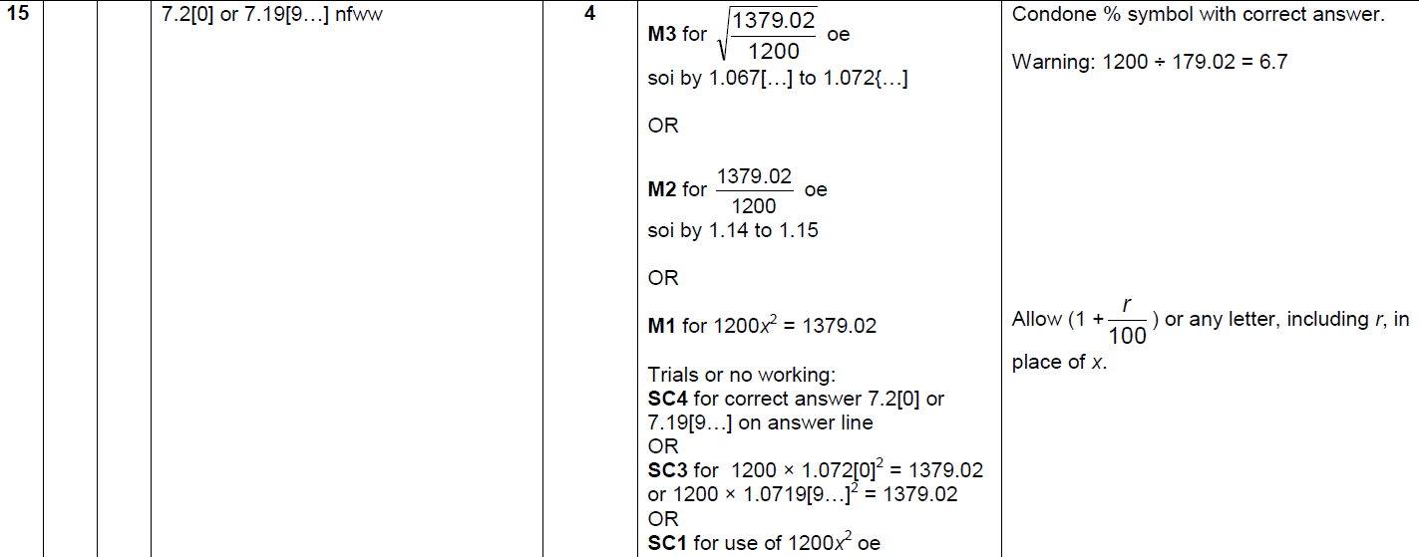
Percentages
June 2018 3H Q15
A

Slide 40
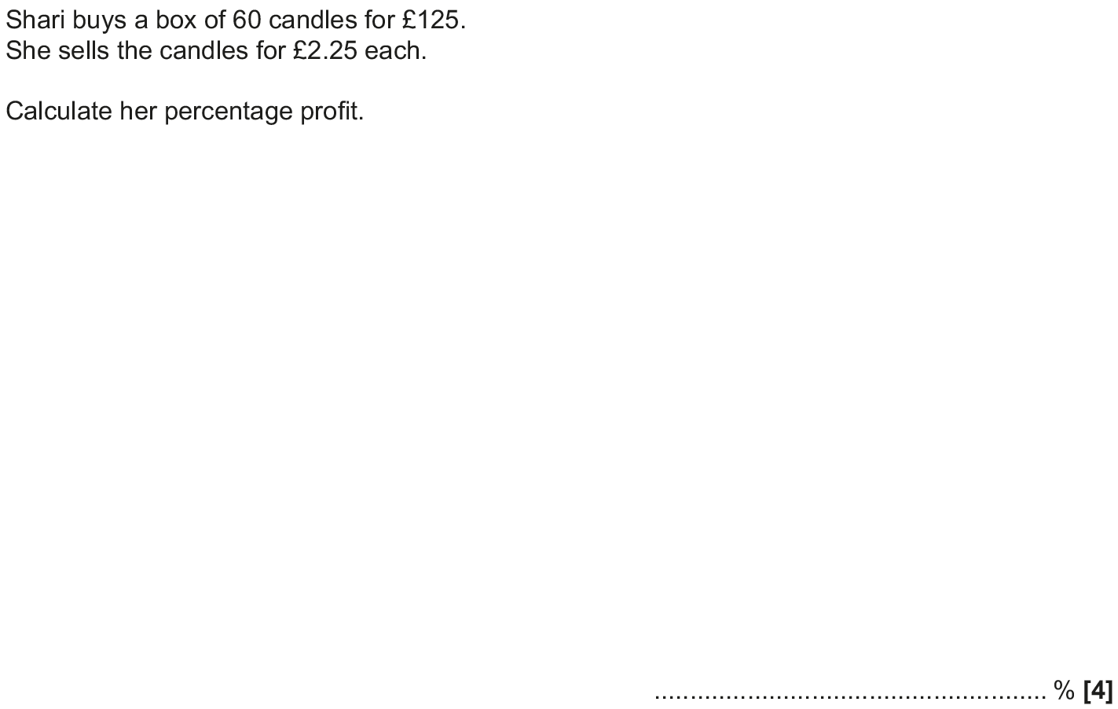
Percentages
Nov 2018 1H Q1

Slide 41
Percentages
Nov 2018 1H Q1
A

Slide 42
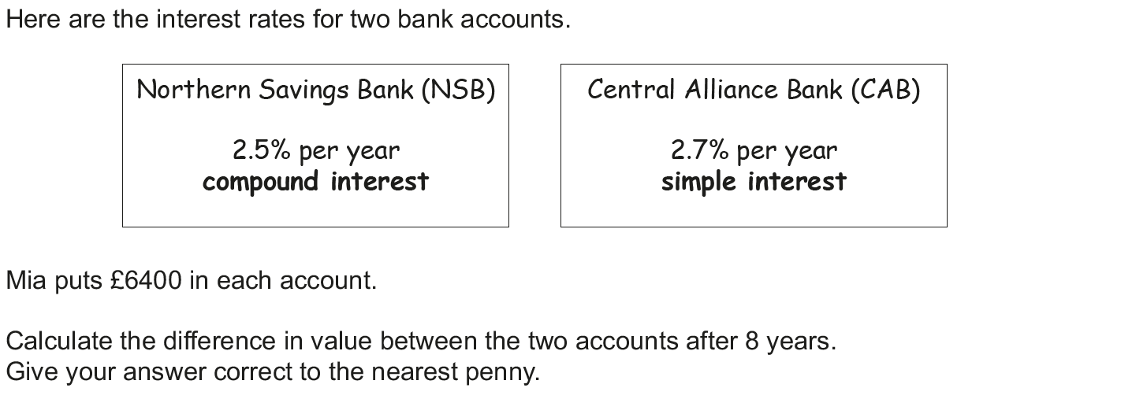
Percentages
Nov 2018 1H Q4

Slide 43
Percentages
Nov 2018 1H Q4
A

Slide 44
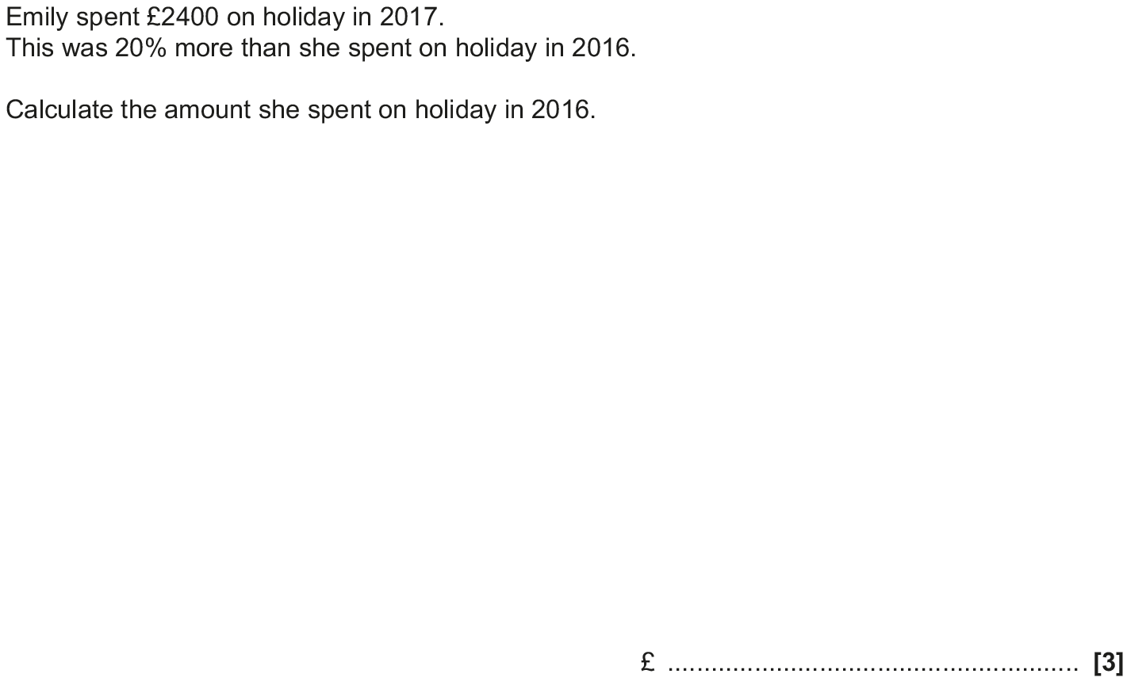
Percentages
Nov 2018 2H Q7

Slide 45
Percentages
Nov 2018 2H Q7
A

Slide 46
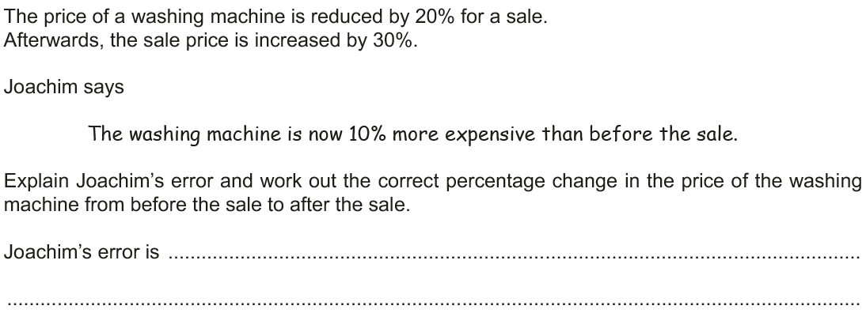
Percentages
Nov 2018 2H Q11

Slide 47
Percentages
Nov 2018 2H Q11
A

