Slide 1
Percentages
Percentages
SAM
1H Q15
May 2017
1H Q9
May 2018
1H Q3
SAM
2H Q10
June 2017
2H Q6
June 2018
2H Q6
Spec 1
2H Q6
June 2017
3H Q10
June 2018
2H Q9
Nov 2018
3H Q2
Spec 1
2H Q13
Nov 2017
2H Q2
June 2018
3H Q11
June 2019
3H Q2
Spec 1
3H Q8
Nov 2017
2H Q13
Nov 2018
1H Q3
June 2019
3H Q10
Spec 2
2H Q10
Nov 2017
2H Q18
Nov 2018
1H Q11
Spec 2
3H Q9
Nov 2017
3H Q9
Nov 2018
2H Q4
Best Buys
Compound/ Repeated Change

Slide 2
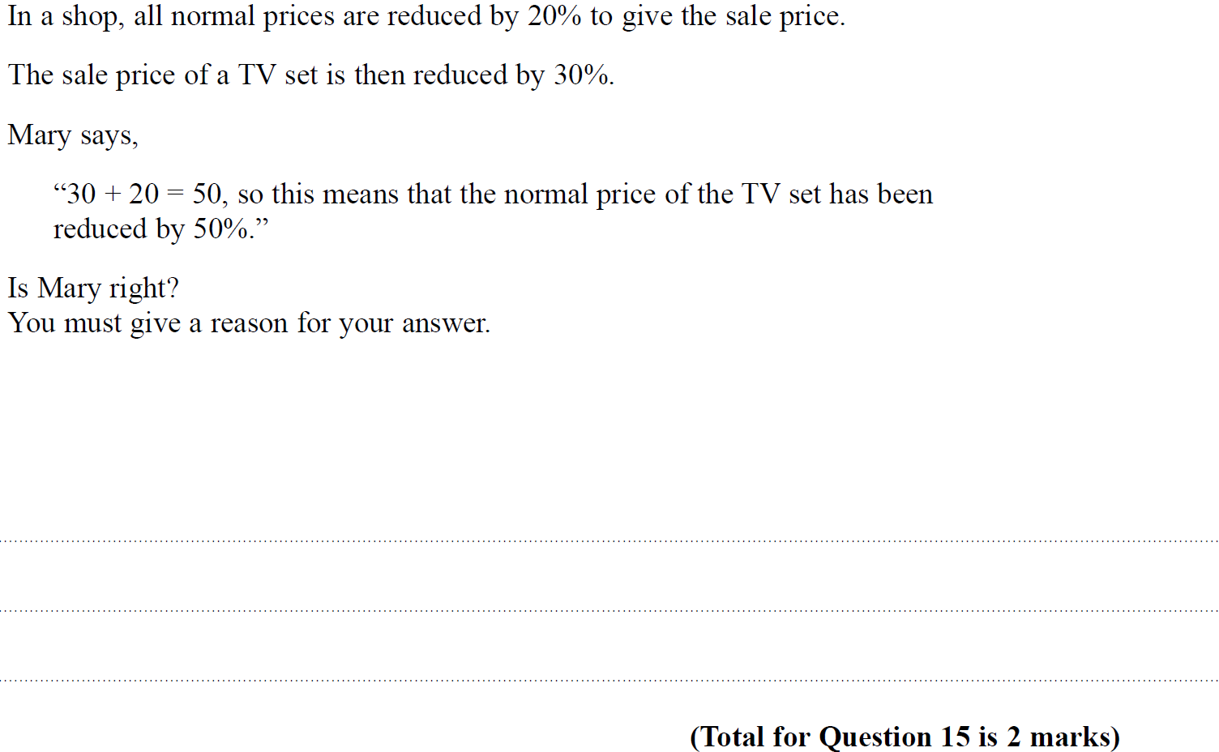
Percentages
SAM 1H Q15

Slide 3
Percentages
SAM 1H Q15
A

Slide 4
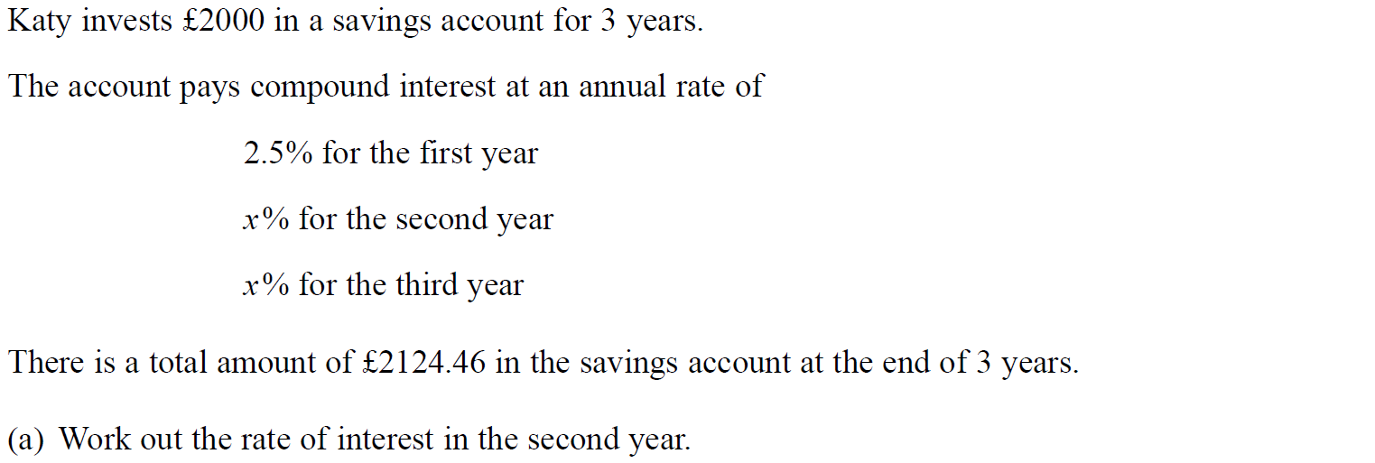
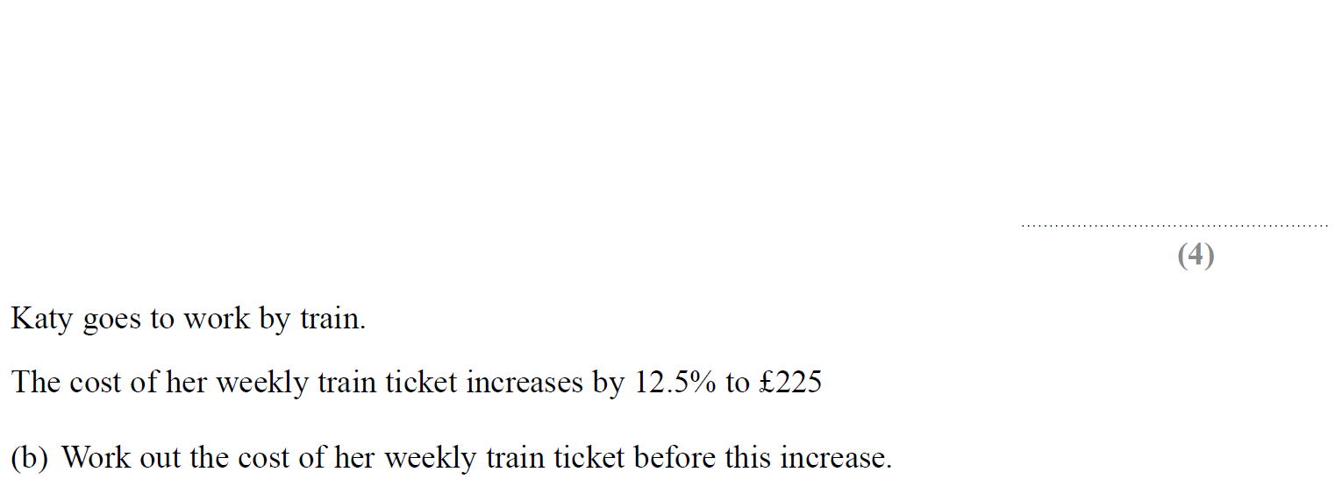
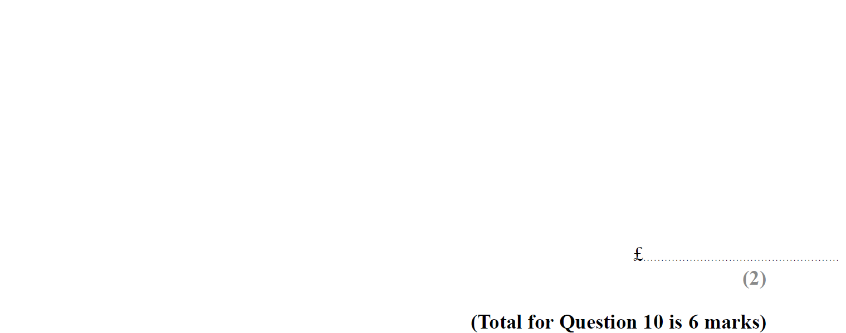
Percentages
SAM 2H Q10

Slide 5
Percentages
SAM 2H Q10
A
B

Slide 6
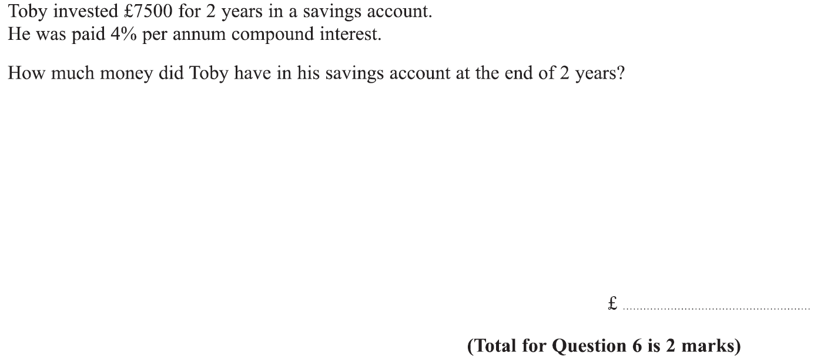
Percentages
Specimen Set 1 2H Q6

Slide 7
Percentages
Specimen Set 1 2H Q6
A

Slide 8
Percentages
Specimen Set 1 2H Q15

Slide 9
Percentages
Specimen Set 1 2H Q15
A

Slide 10
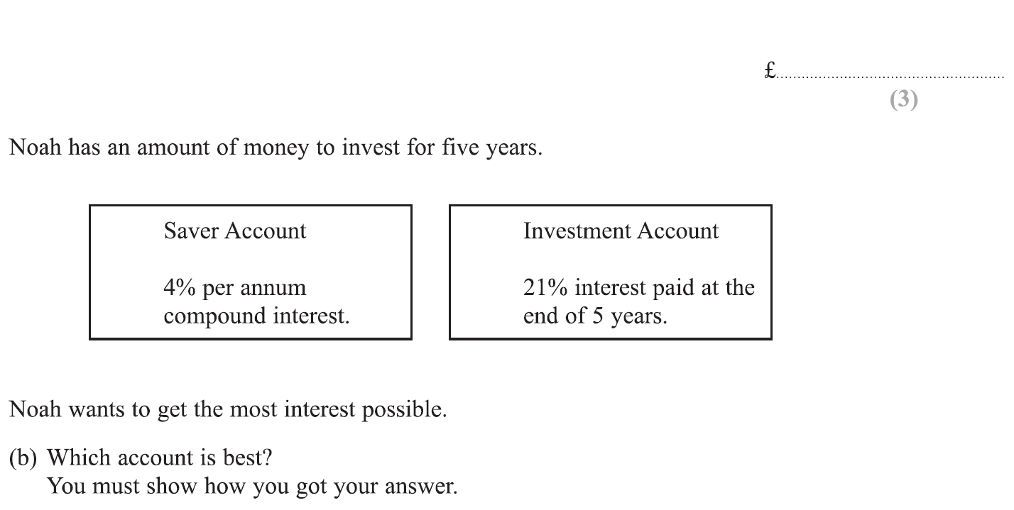
Percentages
Specimen Set 1 3H Q8

Slide 11
Percentages
Specimen Set 1 3H Q8
A
B

Slide 12
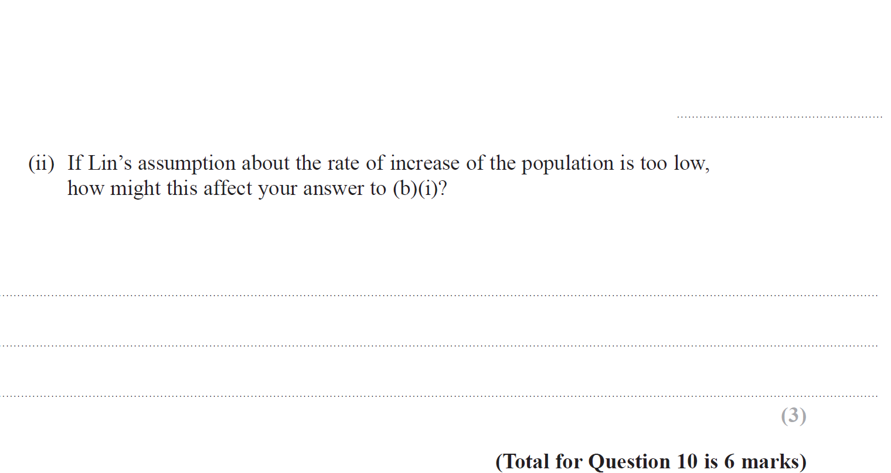
Percentages
Specimen Set 2 2H Q10

Slide 13
Percentages
Specimen Set 2 2H Q10
A
B (i)
B (ii)

Slide 14
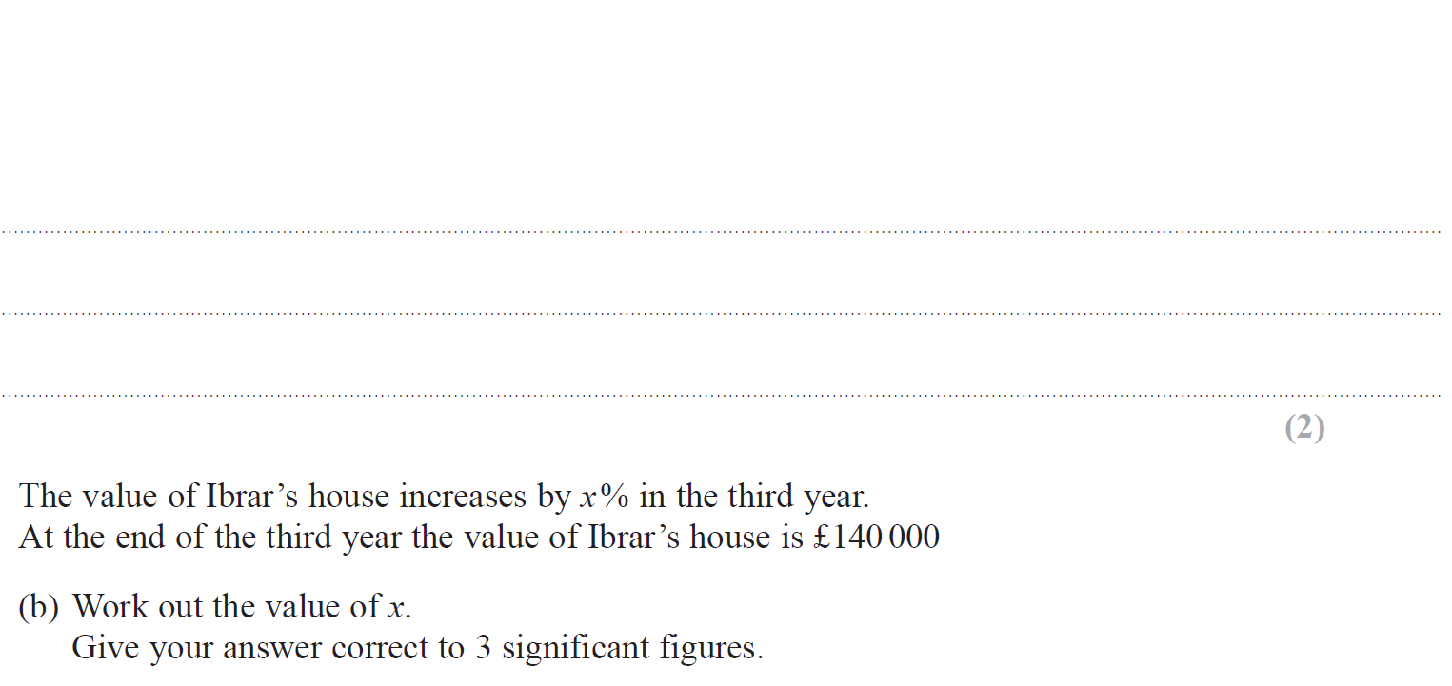
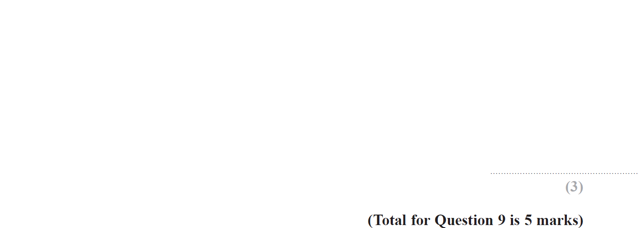
Percentages
Specimen Set 2 3H Q9

Slide 15
Percentages
Specimen Set 2 3H Q9
A
B

Slide 16
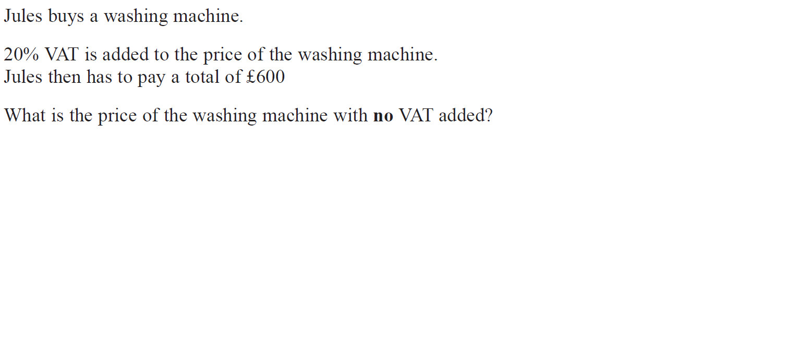
Percentages
May 2017 1H Q9

Slide 17
Percentages
May 2017 1H Q9
A

Slide 18
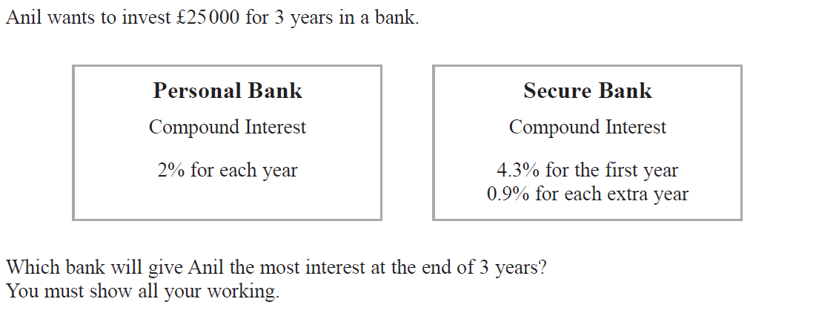
Percentages
June 2017 2H Q6

Slide 19
Percentages
June 2017 2H Q6
A

Slide 20
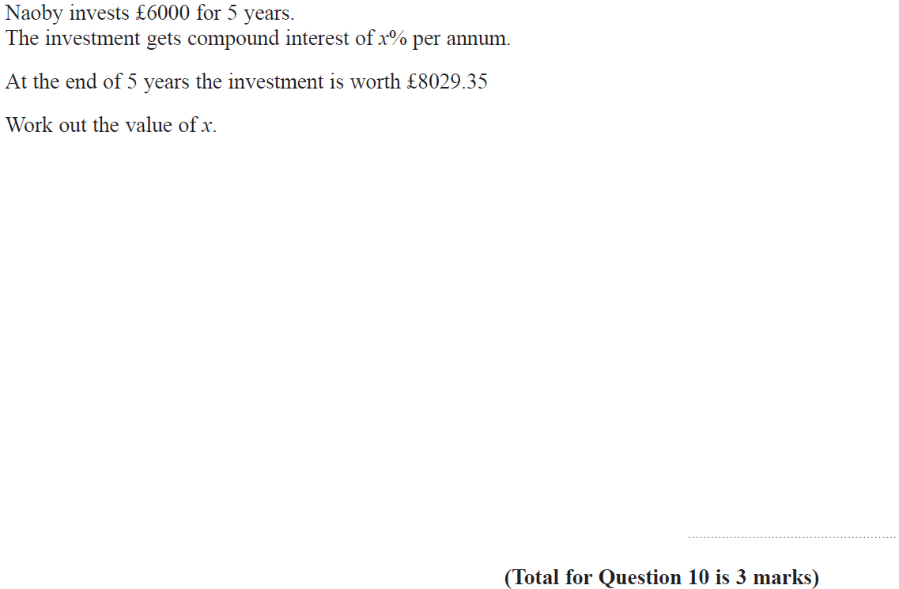
Percentages
June 2017 3H Q10

Slide 21
Percentages
June 2017 3H Q10
A

Slide 22
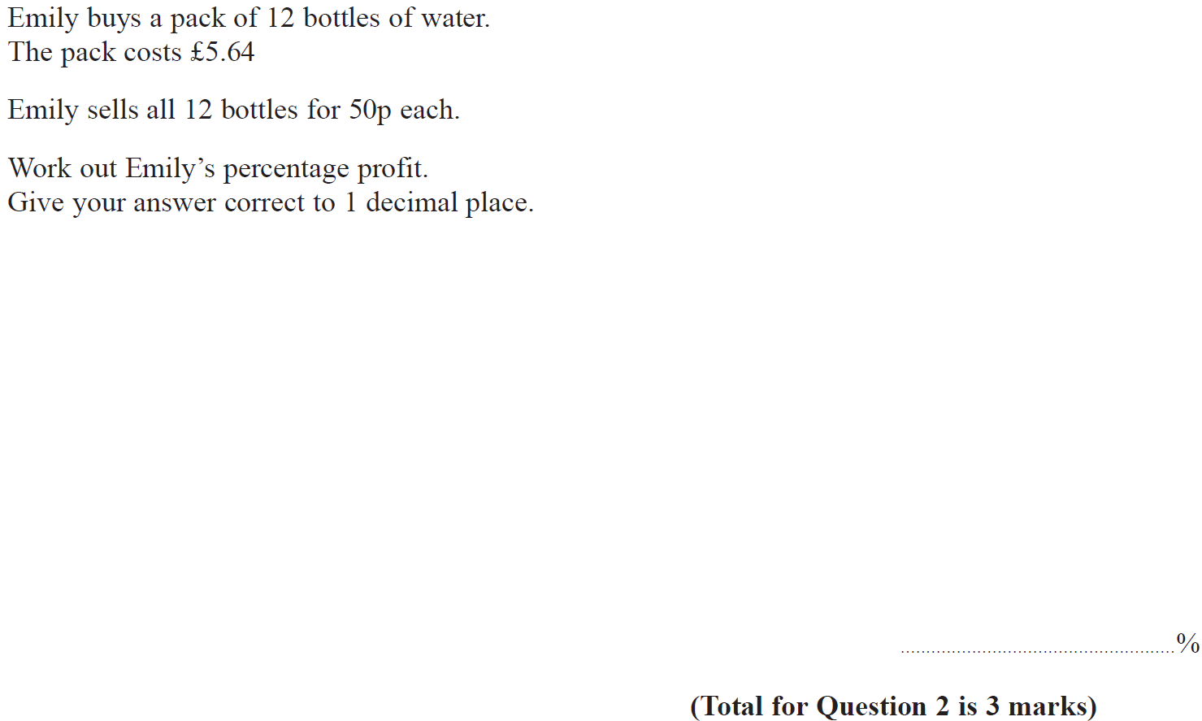
Percentages
Nov 2017 2H Q2

Slide 23
Percentages
Nov 2017 2H Q2
A

Slide 24
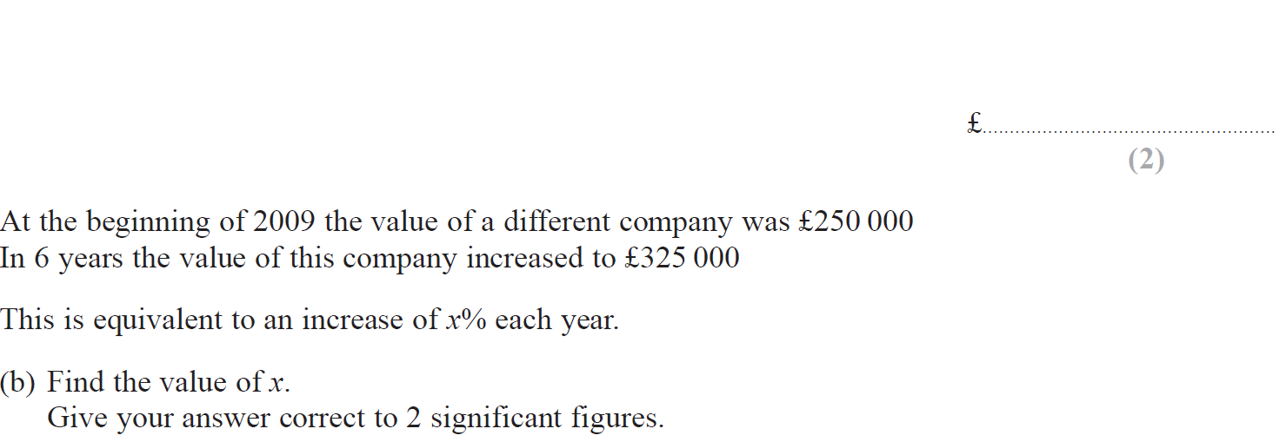
Percentages
Nov 2017 2H Q13

Slide 25
Percentages
Nov 2017 2H Q13
A
B

Slide 26
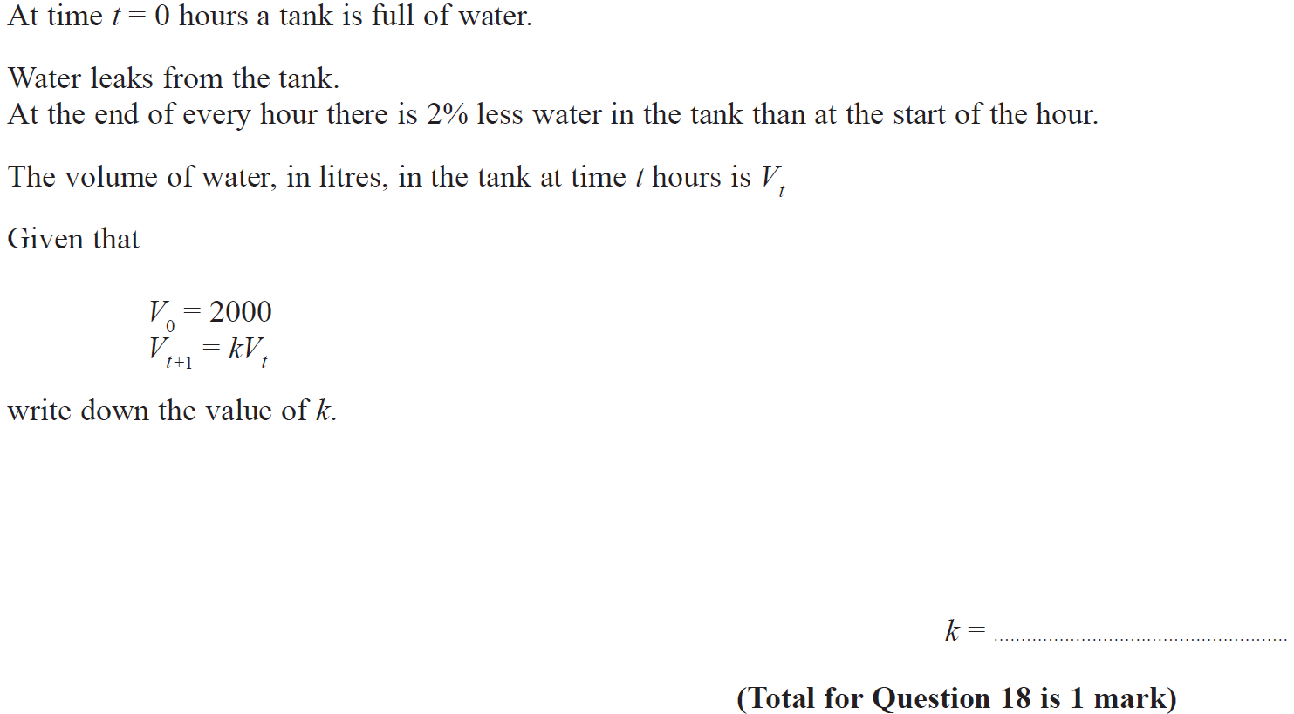
Percentages
Nov 2017 2H Q18

Slide 27
Percentages
Nov 2017 2H Q18
A

Slide 28
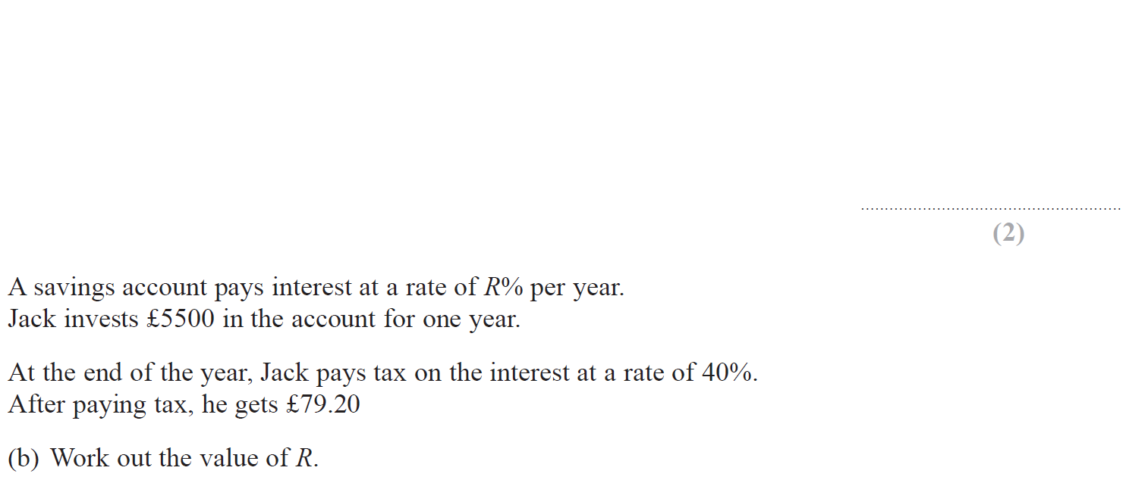
Percentages
Nov 2017 3H Q9

Slide 29
Percentages
Nov 2017 3H Q9
A
B

Slide 30
Percentages
May 2018 1H Q3

Slide 31
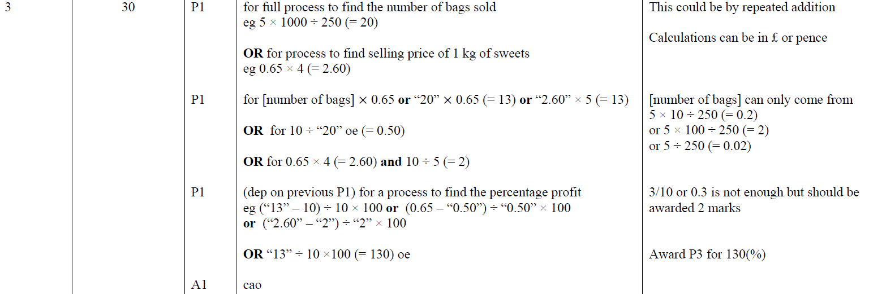
Percentages
May 2018 1H Q3
A

Slide 32
Percentages
June 2018 2H Q6

Slide 33
Percentages
June 2018 2H Q6
A

Slide 34
Percentages
June 2018 2H Q9

Slide 35
Percentages
June 2018 2H Q9
A

Slide 36
Percentages
June 2018 3H Q11

Slide 37
Percentages
June 2018 3H Q11
A

Slide 38
Percentages
Nov 2018 1H Q3

Slide 39
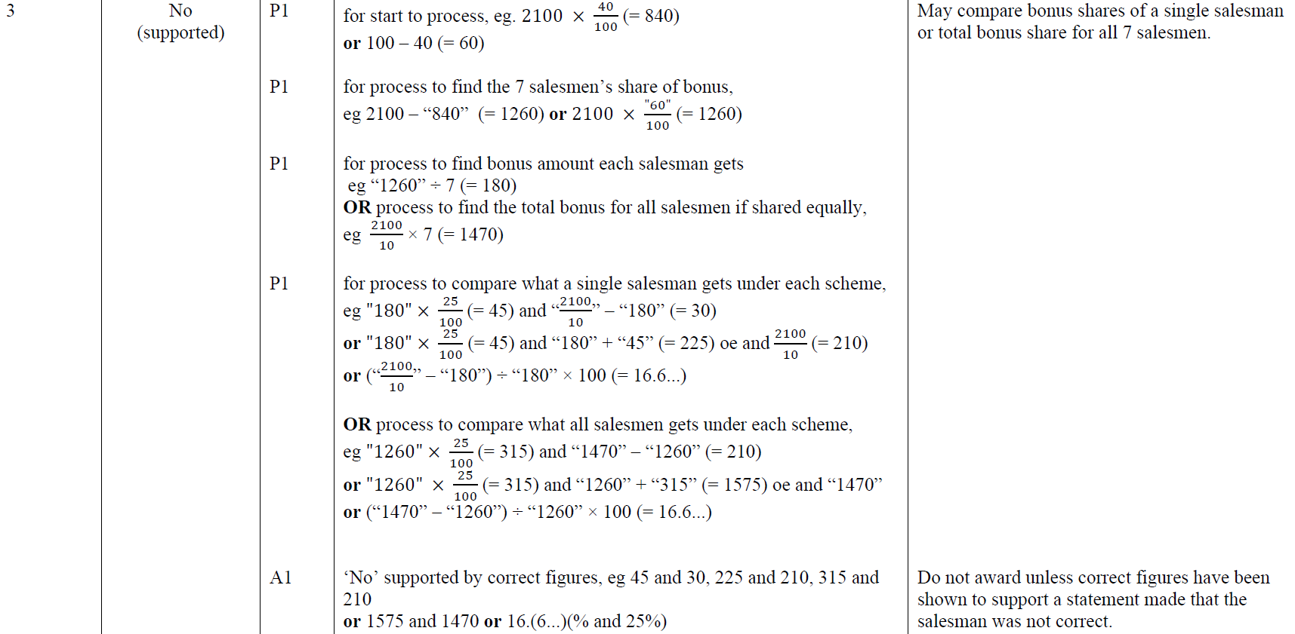
Percentages
Nov 2018 1H Q3
A

Slide 40
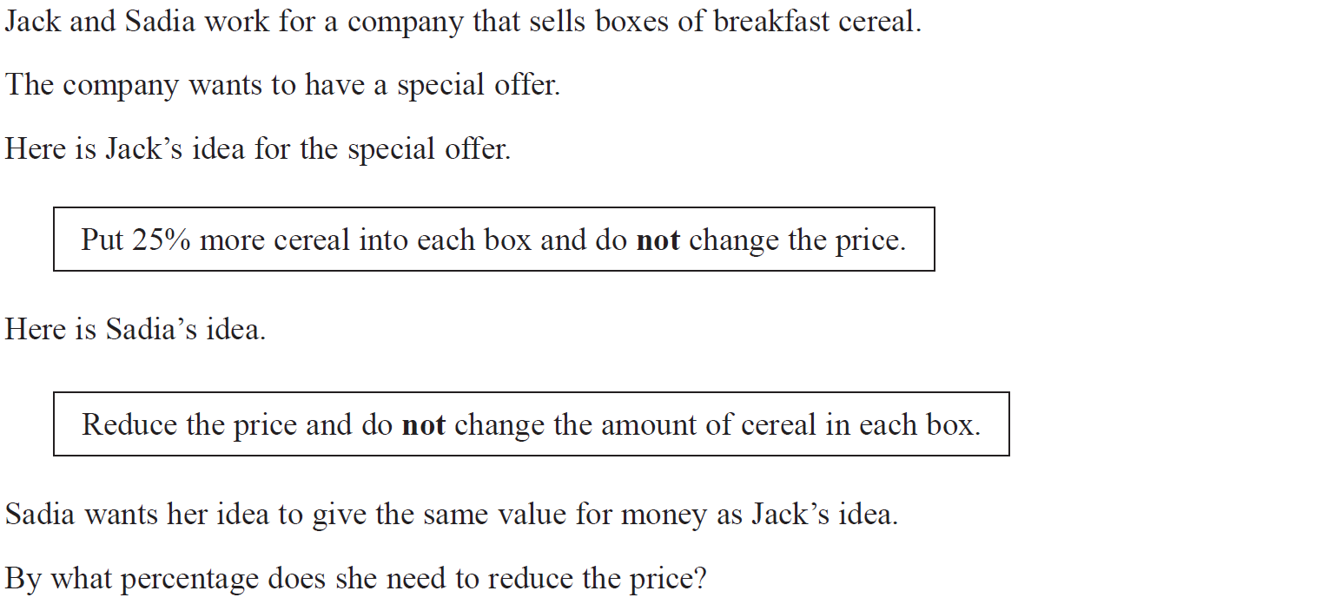
Percentages
Nov 2018 1H Q11

Slide 41
Percentages
Nov 2018 1H Q11
A

Slide 42
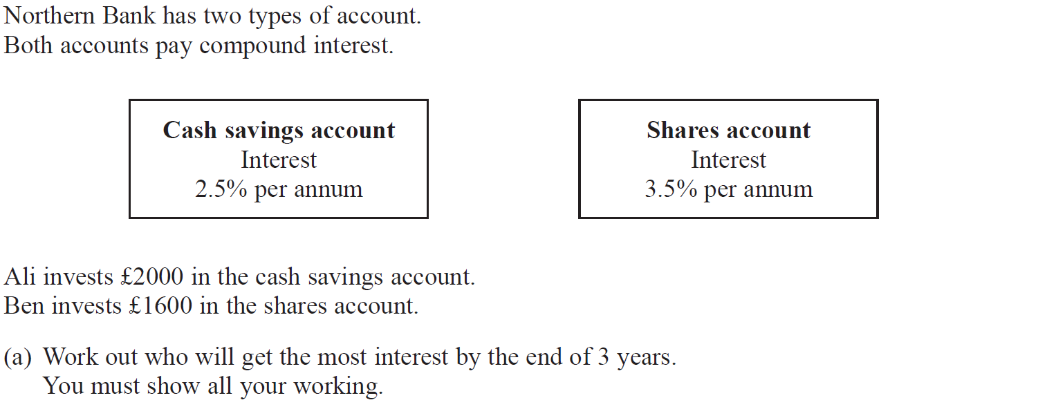
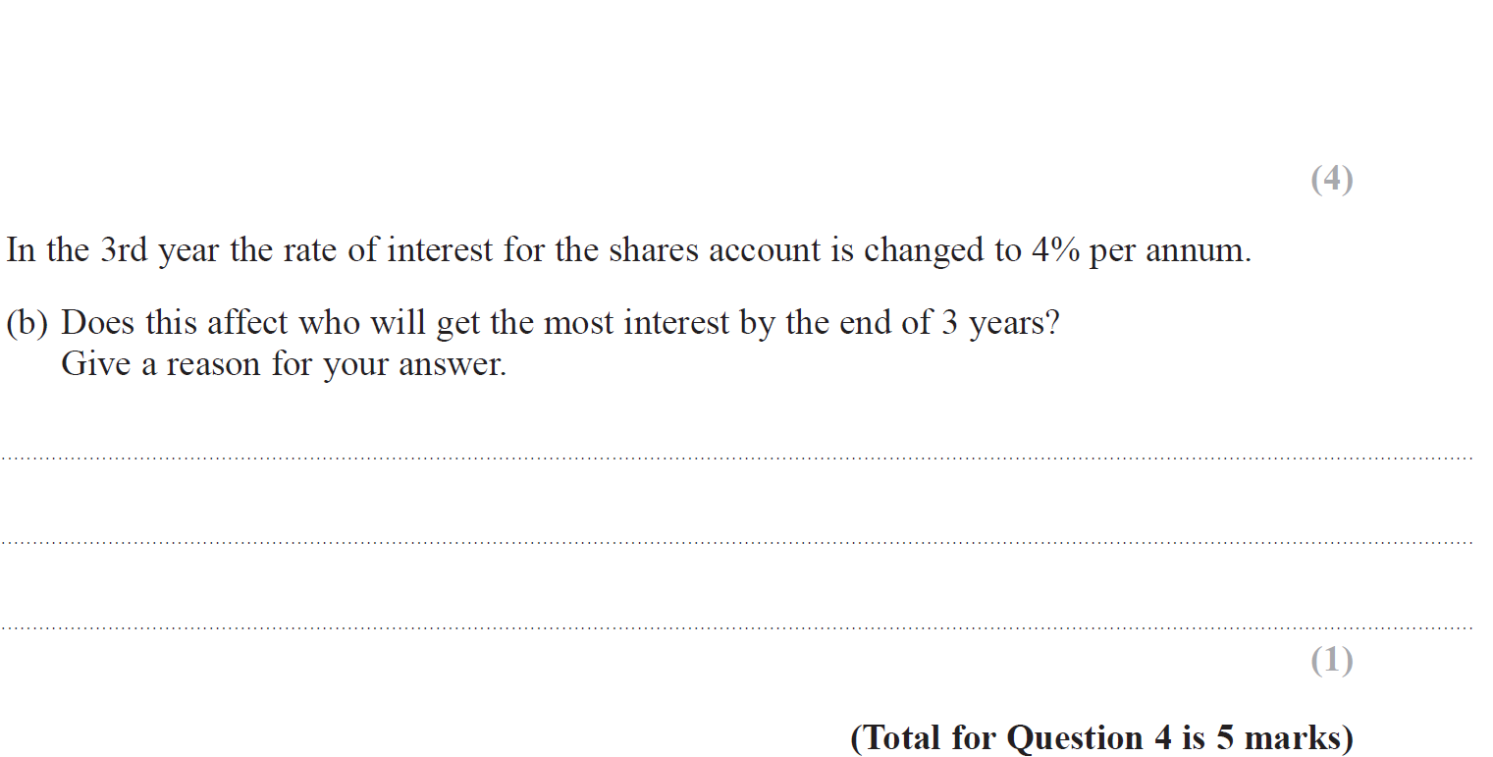
Percentages
Nov 2018 2H Q4

Slide 43
Percentages
Nov 2018 2H Q4
A
B

Slide 44
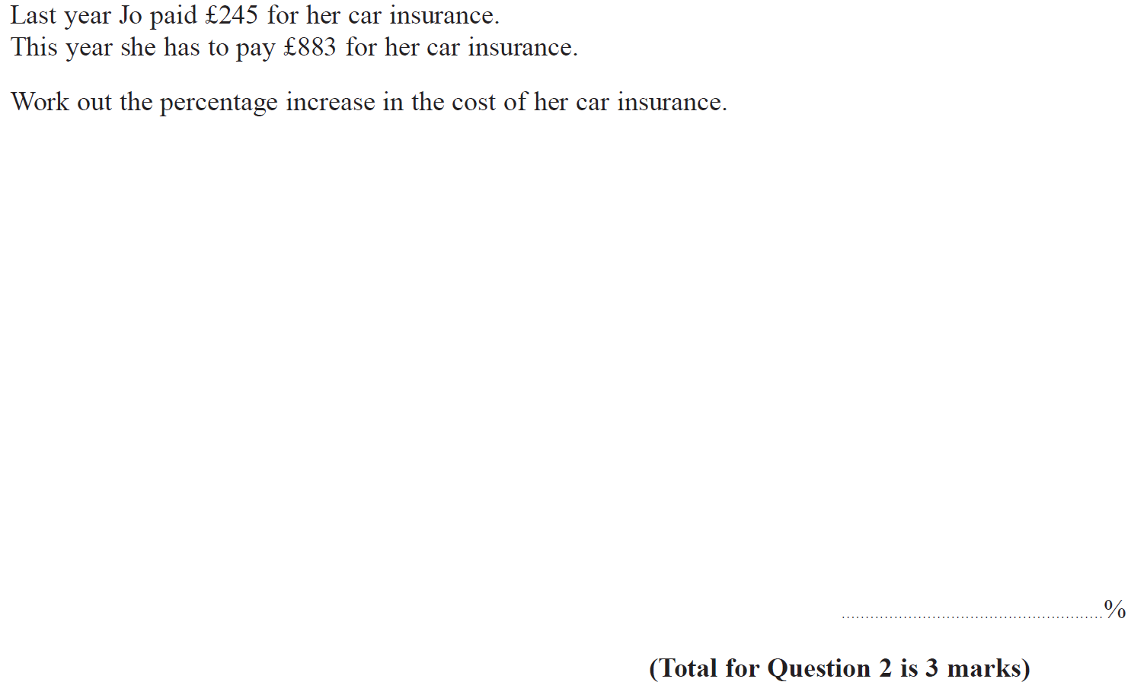
Percentages
Nov 2018 3H Q2

Slide 45
Percentages
Nov 2018 3H Q2
A

Slide 46
Percentages
June 2019 3H Q2

Slide 47
Percentages
June 2019 3H Q2
A
A SF

Slide 48
Percentages
June 2019 3H Q10

Slide 49
Percentages
June 2019 3H Q10
A
A SF

