Slide 1
Multiple Events
Multiple Events
Nov 2017
1H Q27
June 2018
3H Q27
SAM
3H Q22
1 Marker
Nov 2018
2H Q18
Nov 2018
3H Q16
Algebraic modelling

Slide 2
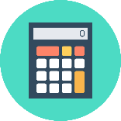
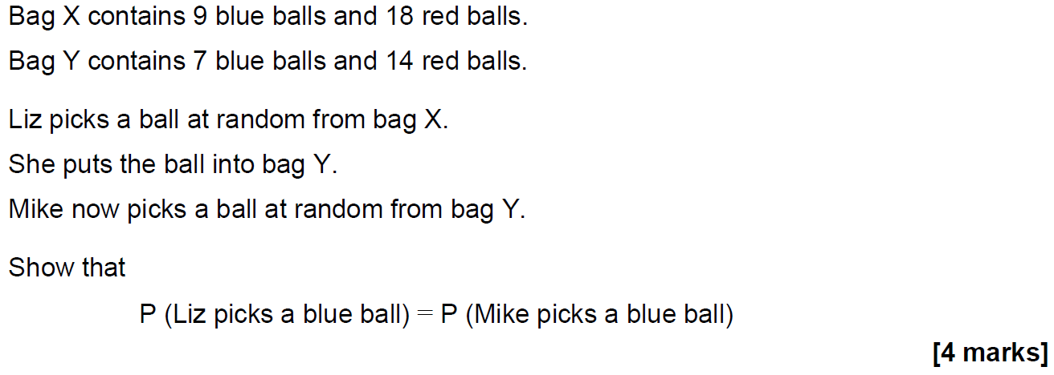
Multiple Events
SAM 3H Q22

Slide 3
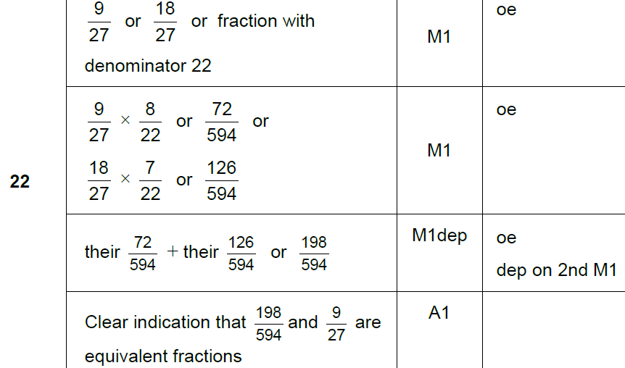
Multiple Events
SAM 3H Q22
A

Slide 4
Multiple Events
Nov 2017 1H Q27

Slide 5
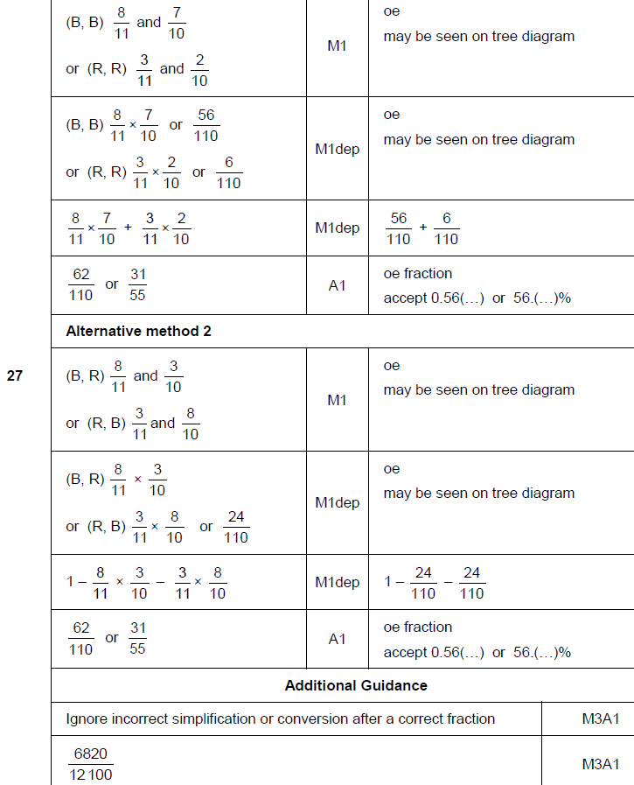
Multiple Events
Nov 2017 1H Q27
A

Slide 6
Multiple Events
June 2018 3H Q27
A bag contains 30 discs.
10 are red and 20 are blue.
One disc is taken out at random and replaced by two of the other colour.
Another disc is then taken out at random and replaced by two of the other colour.
Another disc is then taken out at random.
Work out the probability that all three discs taken out are red.
[3 marks]

Slide 7
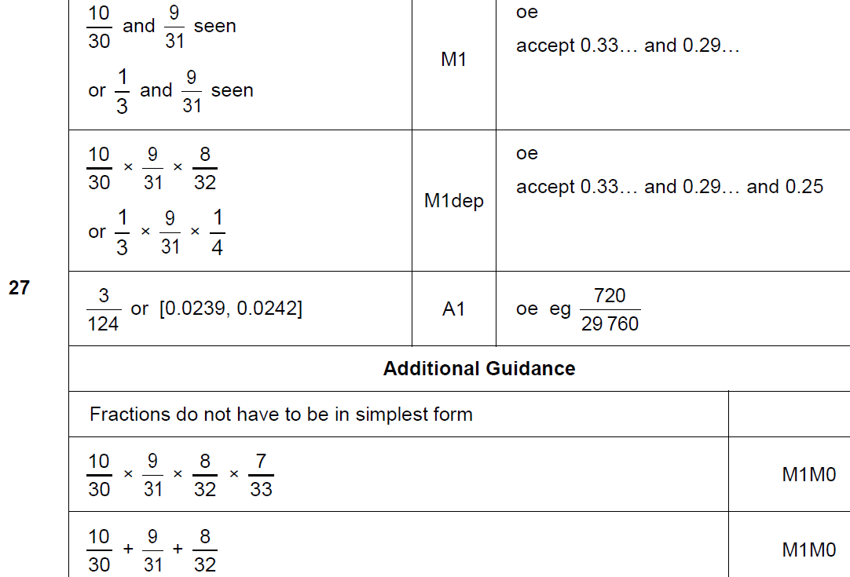
Multiple Events
June 2018 3H Q27
A

Slide 8
Multiple Events
Nov 2018 2H Q18
A bag contains 20 discs.
10 are red, 7 are blue and 3 are green.
(a) Marnie takes a disc at random before putting it back in the bag.
Nick then takes a disc at random before putting it back in the bag.
Olly then takes a disc at random.
Work out the probability that they all take a red disc.
[2 marks]
(b) All 20 discs are in the bag.
Reggie takes three discs at random, one after the other.
After he takes a disc he does not put it back in the bag.
Reggie’s first disc is blue.
Work out the probability that all three discs are different colours.
[3 marks]

Slide 9
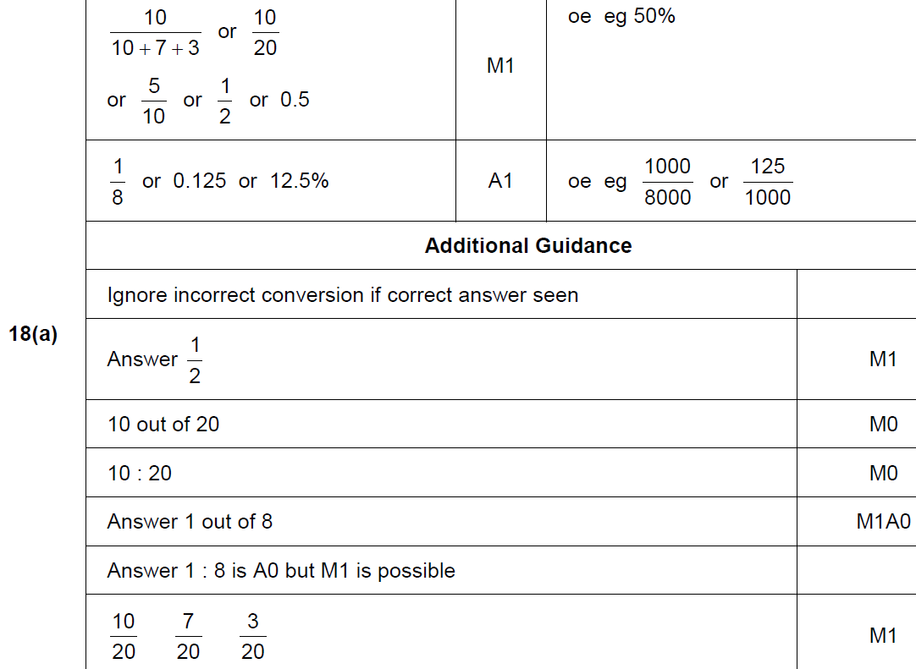
Multiple Events
Nov 2018 2H Q18
A

Slide 10
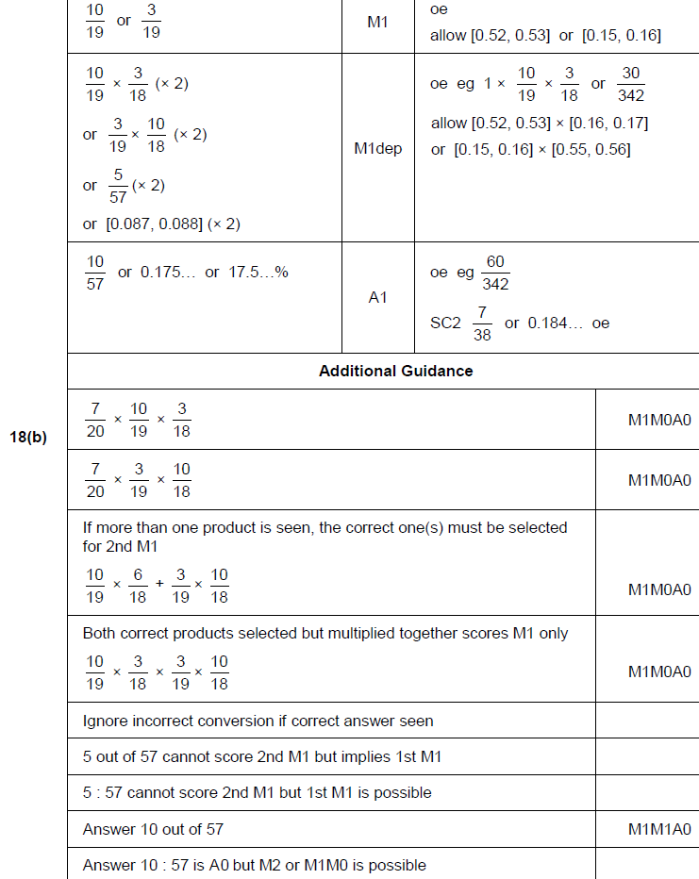
Multiple Events
Nov 2018 2H Q18
B

Slide 11
Multiple Events
Nov 2018 3H Q16
In a running club there are 50 females and 80 males.
If a female is chosen at random, the probability she has blue eyes is 0.38
If a male is chosen at random, the probability he has blue eyes is 0.6
One person is chosen at random.
Show that the probability the person has blue eyes is more than 0.5
[4 marks]

Slide 12
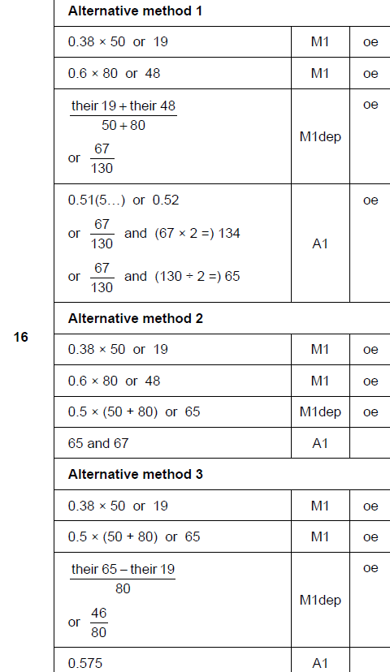
Multiple Events
Nov 2018 3H Q16
A

Slide 13
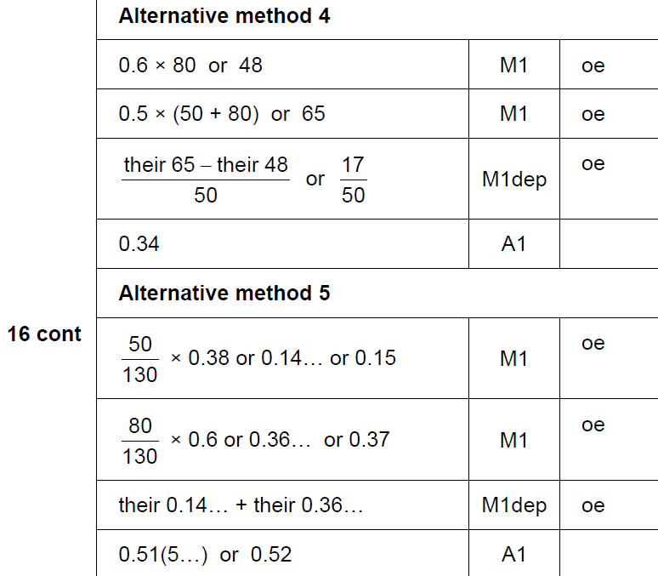
Multiple Events
Nov 2018 3H Q16
A Alternative 3 & 4

