Slide 1
Multiple Events
Multiple Events
SAM
1H Q24
May 2017
1H Q17
Spec 1
1H Q21
Edexcel
May 2017
2H Q21
Spec 1
3H Q18
AQA
Nov 2017
3H Q8
Spec 2
1H Q3
OCR
Nov 2018
1H Q22
Spec 2
1H Q16
Nov 2018
2H Q16
Spec 2
3H Q21
Algebraic modelling
See also:
Tree Diagrams

Slide 2
Multiple Events
Multiple Events
Nov 2017
1H Q27
Edexcel
June 2018
3H Q27
AQA
SAM
3H Q22
1 Marker
Nov 2018
2H Q18
OCR
Nov 2018
3H Q16
Algebraic modelling
See also:
Tree Diagrams

Slide 3
Multiple Events
Multiple Events
June 2017
3H Q6
Edexcel
SAM
2H Q3
June 2018
3H Q7
Nov 2017
2H Q14
AQA
Practice
1H Q6*
Nov 2018
1H Q22*
May 2018
1H Q10
OCR
Practice
2H Q8
Nov 2018
2H Q3
June 2018
2H Q8
Probability Space
*Mark Scheme suggests tree diagram
Algebraic modelling
See also:
Tree Diagrams

Slide 4
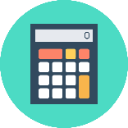
Multiple Events
SAM 1H Q24

Slide 5
Multiple Events
SAM 1H Q24
A

Slide 6
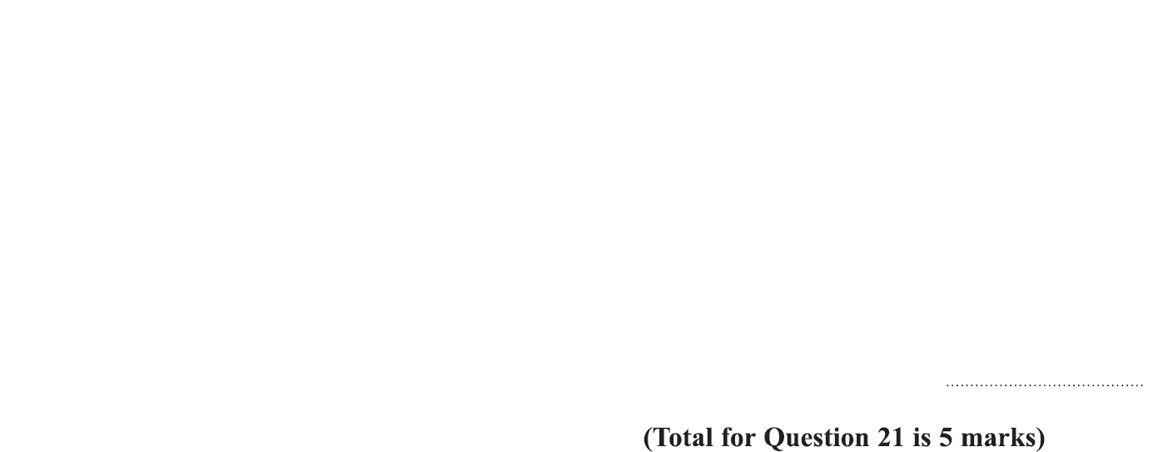
Multiple Events
Specimen Set 1 1H Q21

Slide 7
Multiple Events
Specimen Set 1 1H Q21
A

Slide 8
Multiple Events
Specimen Set 1 3H Q18

Slide 9
Multiple Events
Specimen Set 1 3H Q18
A

Slide 10
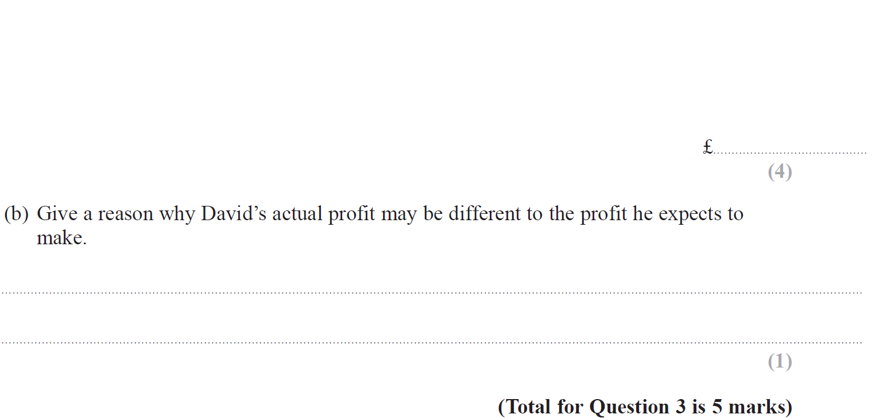
Multiple Events
Specimen Set 2 1H Q3

Slide 11
Multiple Events
Specimen Set 2 1H Q3
A
B

Slide 12
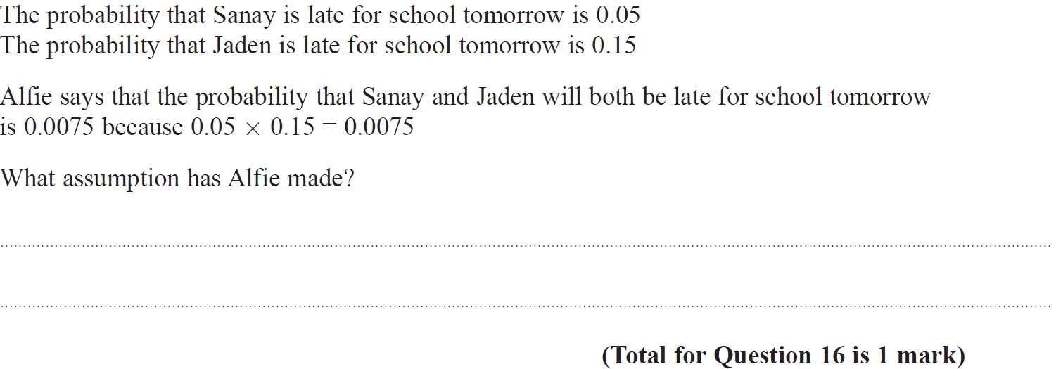
Multiple Events
Specimen Set 2 1H Q16

Slide 13
Multiple Events
Specimen Set 2 1H Q16
A

Slide 14
Multiple Events
Specimen Set 2 3H Q22

Slide 15
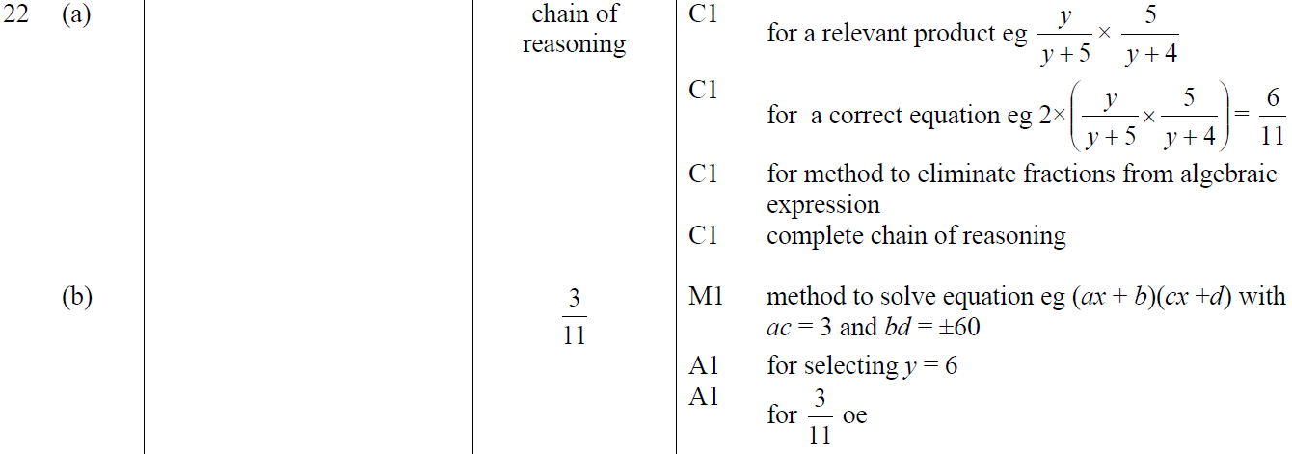
Multiple Events
Specimen Set 2 3H Q22
A
B

Slide 16
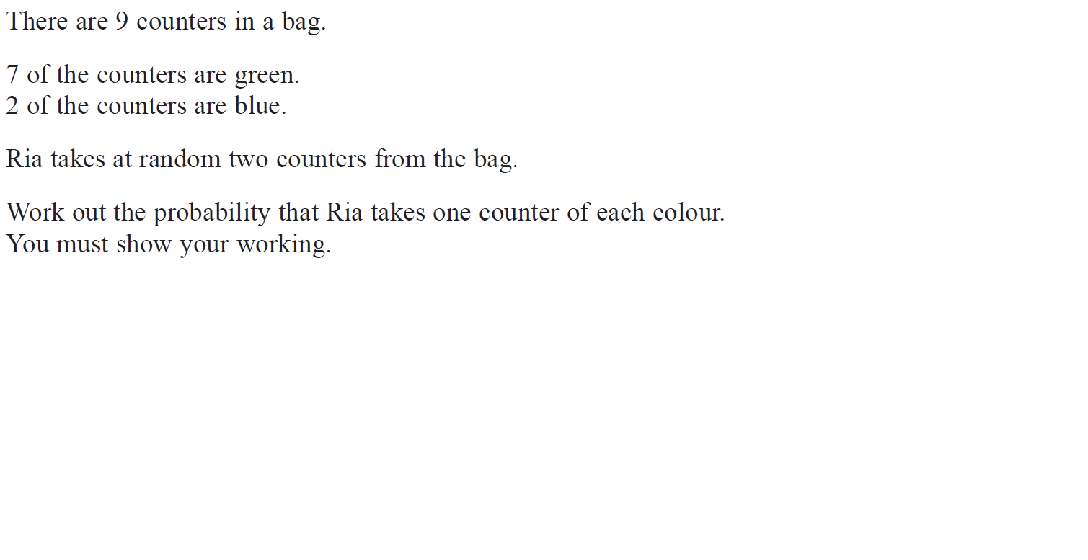
Multiple Events
May 2017 1H Q17

Slide 17
Multiple Events
May 2017 1H Q17
A

Slide 18
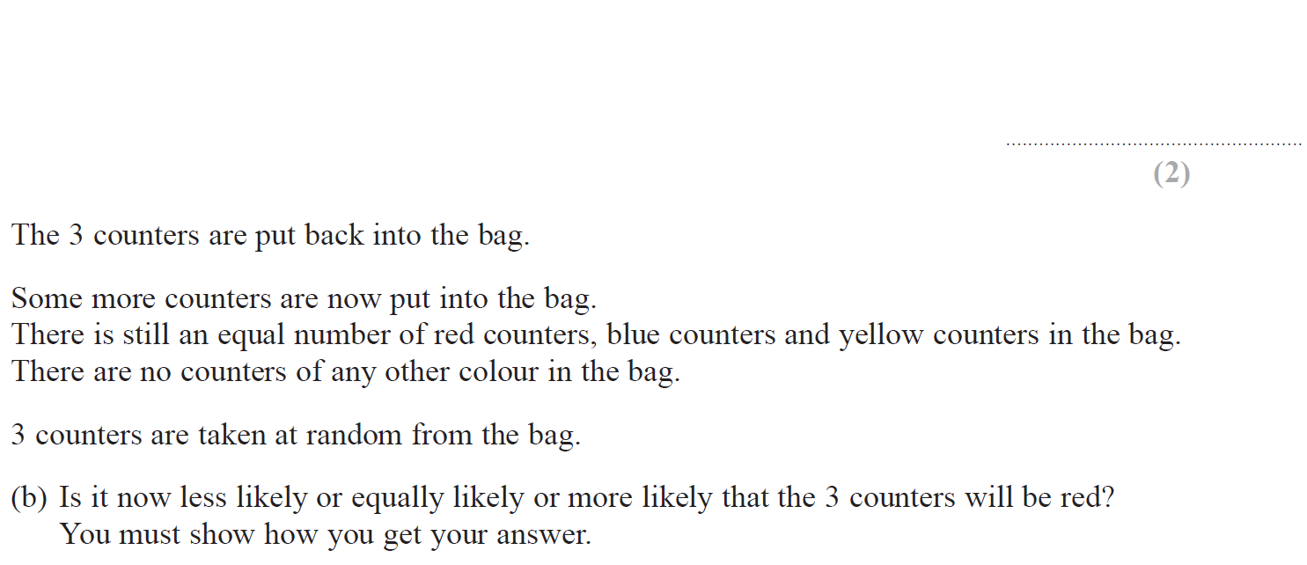
Multiple Events
Nov 2017 2H Q21

Slide 19
Multiple Events
Nov 2017 2H Q21
A
B

Slide 20
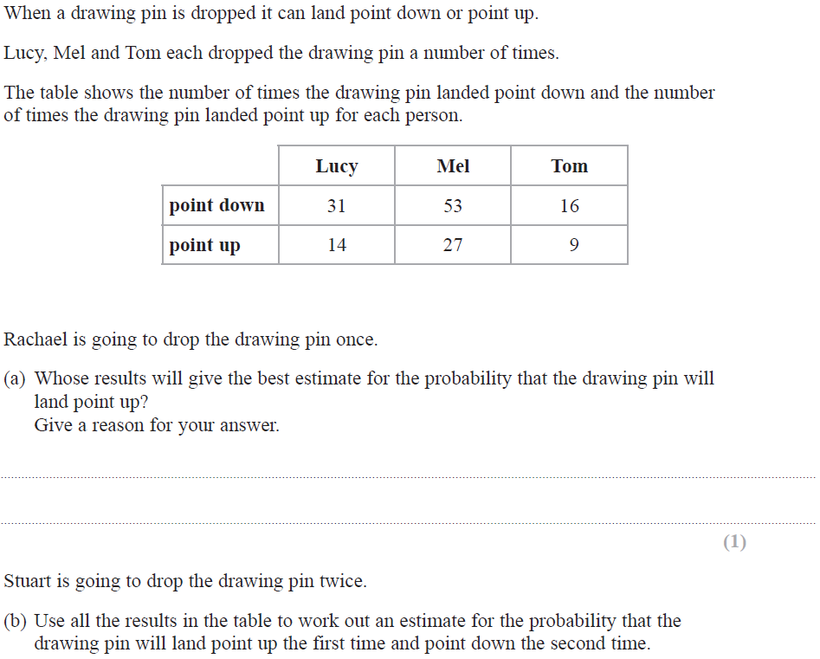
Multiple Events
Nov 2017 3H Q8

Slide 21
Multiple Events
Nov 2017 3H Q8
A
B

Slide 22
Multiple Events
Nov 2018 1H Q22

Slide 23
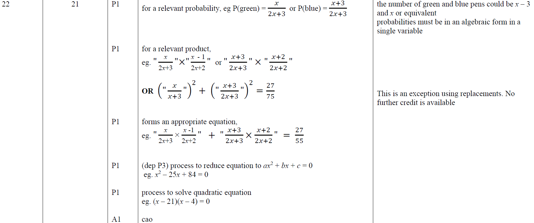
Multiple Events
Nov 2018 1H Q22
A

Slide 24
Multiple Events
Nov 2018 2H Q16

Slide 25
Multiple Events
Nov 2018 2H Q16
A
B

Slide 26
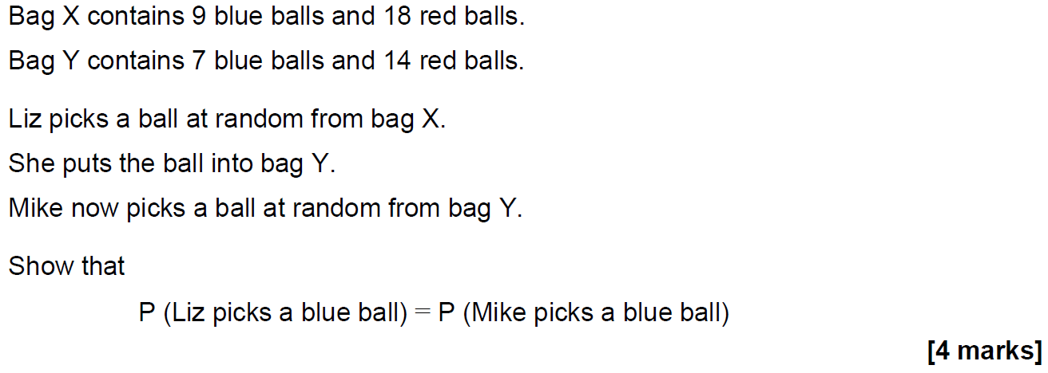
Multiple Events
SAM 3H Q22

Slide 27
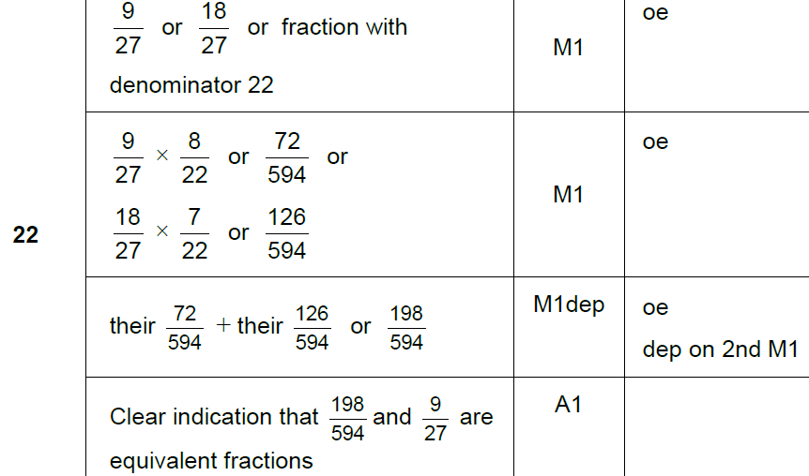
Multiple Events
SAM 3H Q22
A

Slide 28
Multiple Events
Nov 2017 1H Q27

Slide 29
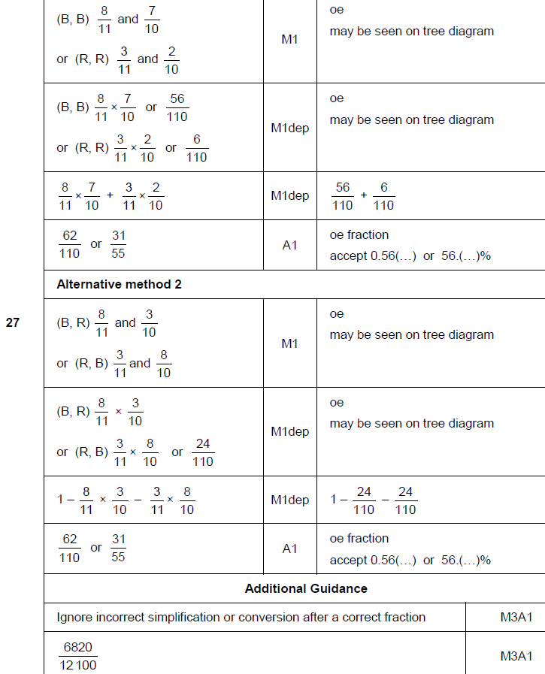
Multiple Events
Nov 2017 1H Q27
A

Slide 30
Multiple Events
June 2018 3H Q27
A bag contains 30 discs.
10 are red and 20 are blue.
One disc is taken out at random and replaced by two of the other colour.
Another disc is then taken out at random and replaced by two of the other colour.
Another disc is then taken out at random.
Work out the probability that all three discs taken out are red.
[3 marks]

Slide 31
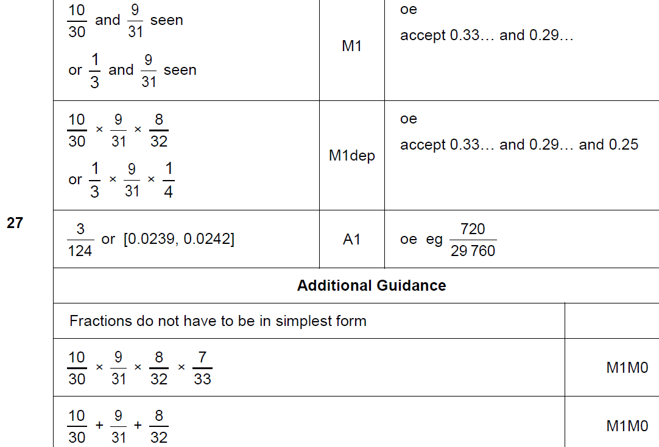
Multiple Events
June 2018 3H Q27
A

Slide 32
Multiple Events
Nov 2018 2H Q18
A bag contains 20 discs.
10 are red, 7 are blue and 3 are green.
(a) Marnie takes a disc at random before putting it back in the bag.
Nick then takes a disc at random before putting it back in the bag.
Olly then takes a disc at random.
Work out the probability that they all take a red disc.
[2 marks]
(b) All 20 discs are in the bag.
Reggie takes three discs at random, one after the other.
After he takes a disc he does not put it back in the bag.
Reggie’s first disc is blue.
Work out the probability that all three discs are different colours.
[3 marks]

Slide 33
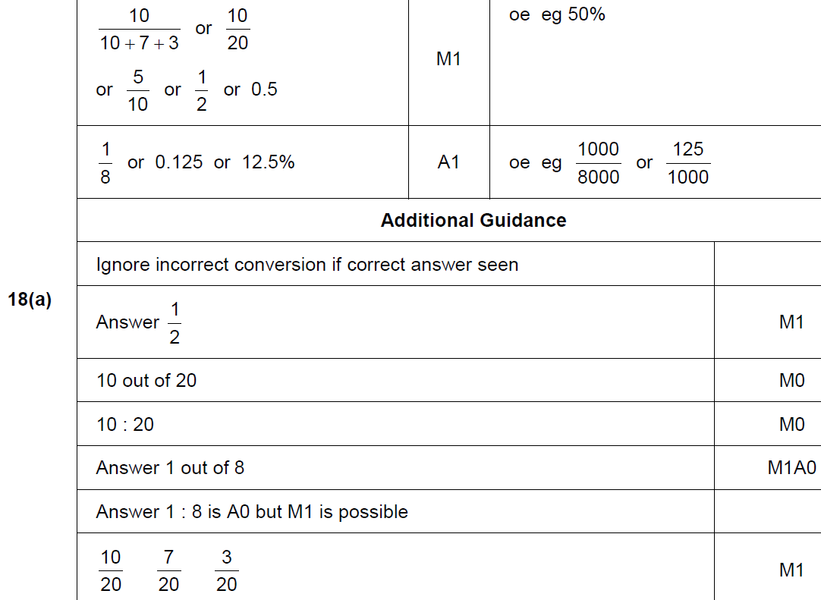
Multiple Events
Nov 2018 2H Q18
A

Slide 34
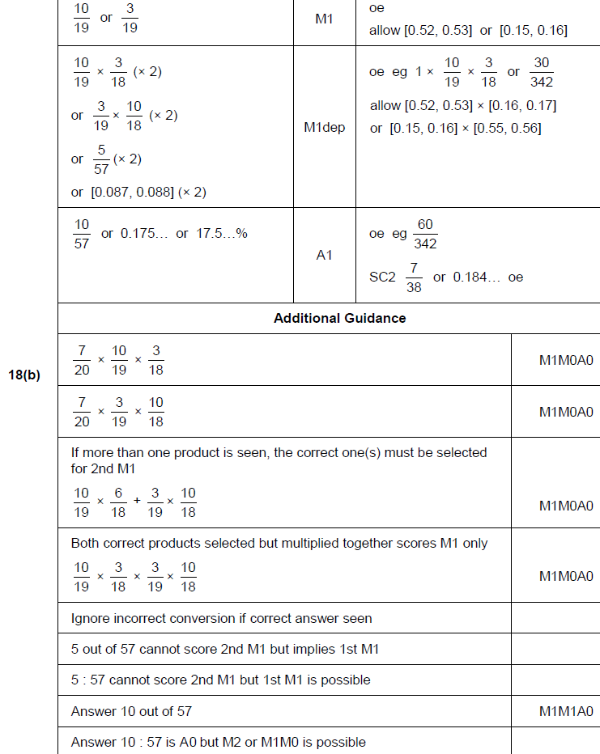
Multiple Events
Nov 2018 2H Q18
B

Slide 35
Multiple Events
Nov 2018 3H Q16
In a running club there are 50 females and 80 males.
If a female is chosen at random, the probability she has blue eyes is 0.38
If a male is chosen at random, the probability he has blue eyes is 0.6
One person is chosen at random.
Show that the probability the person has blue eyes is more than 0.5
[4 marks]

Slide 36
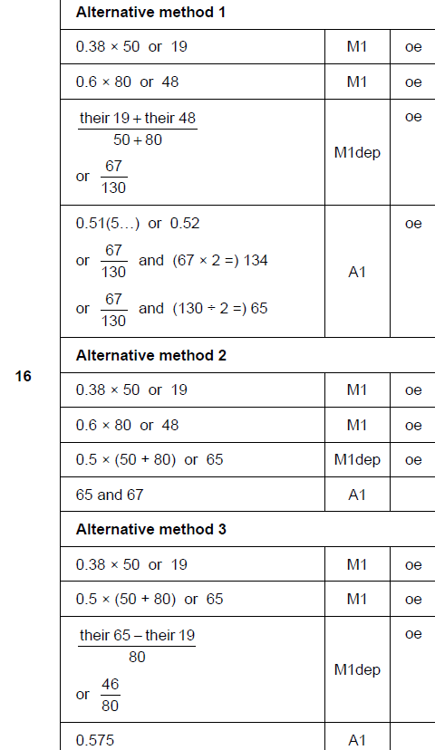
Multiple Events
Nov 2018 3H Q16
A

Slide 37
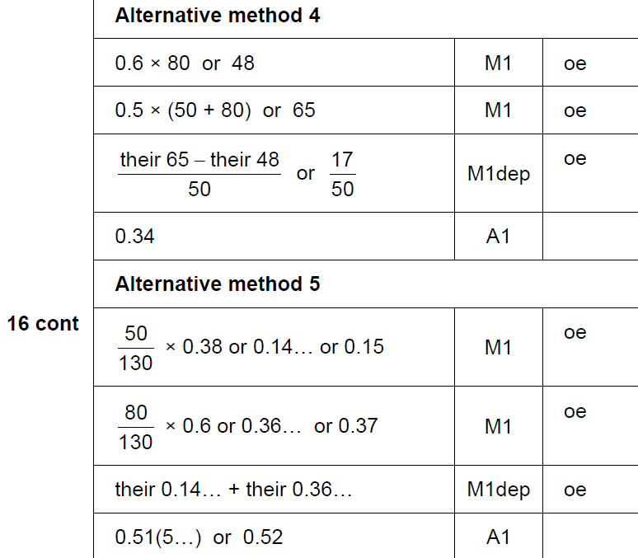
Multiple Events
Nov 2018 3H Q16
A Alternative 3 & 4

Slide 38
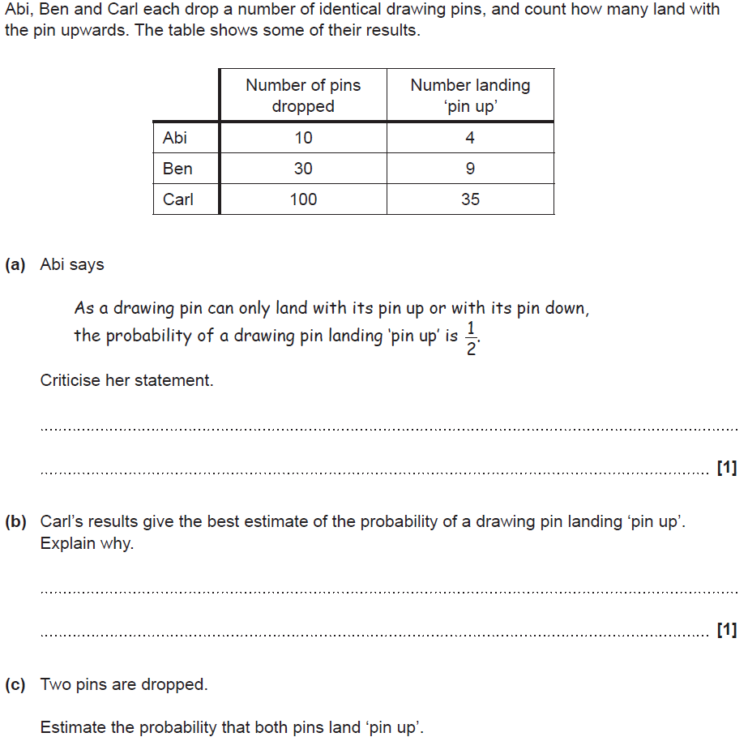
Multiple Events
SAM 2H Q3

Slide 39
Multiple Events
SAM 2H Q3
A
B
C

Slide 40
Multiple Events
Practice 1H Q6

Slide 41
Multiple Events
Practice 1H Q6
A

Slide 42
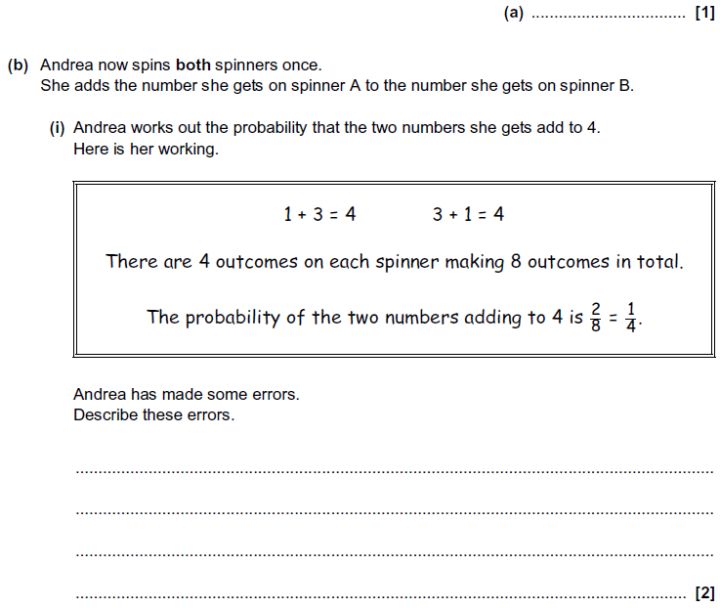
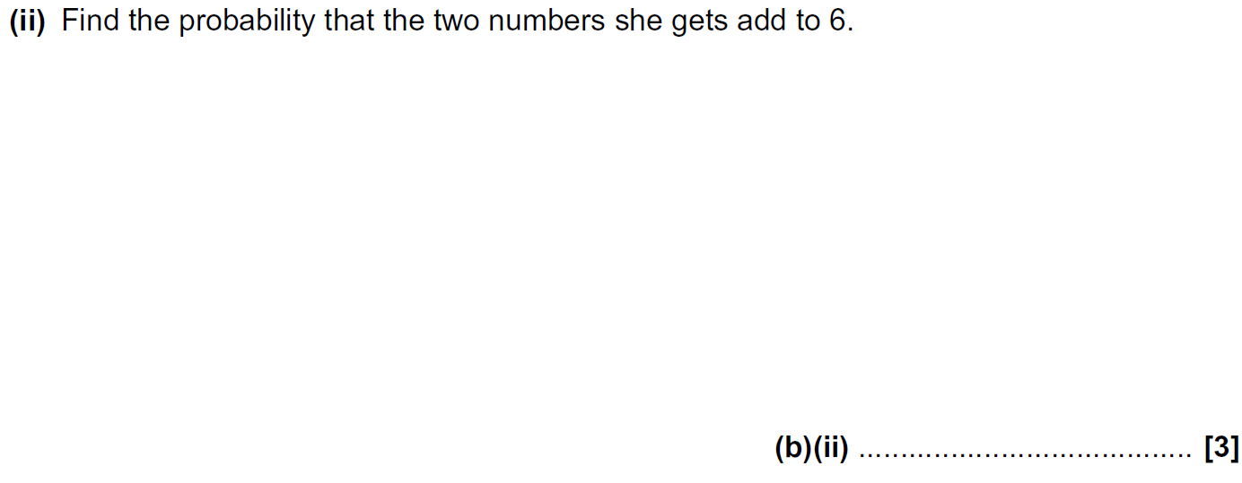
Multiple Events
Practice 2H Q8

Slide 43
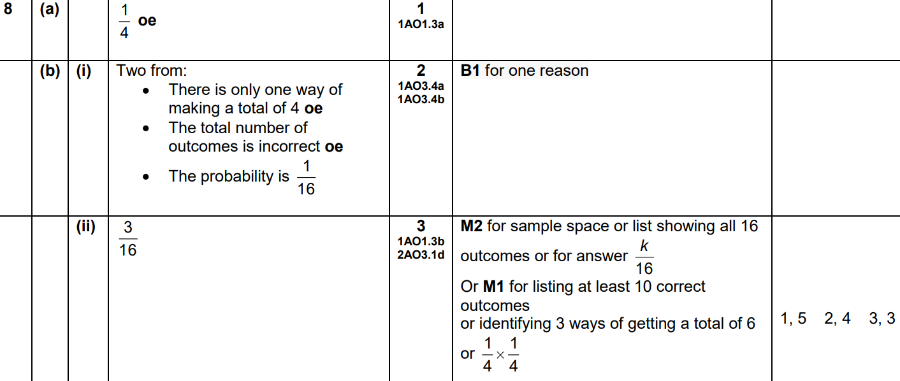
Multiple Events
Practice 2H Q8
A
B (i)
B (ii)

Slide 44
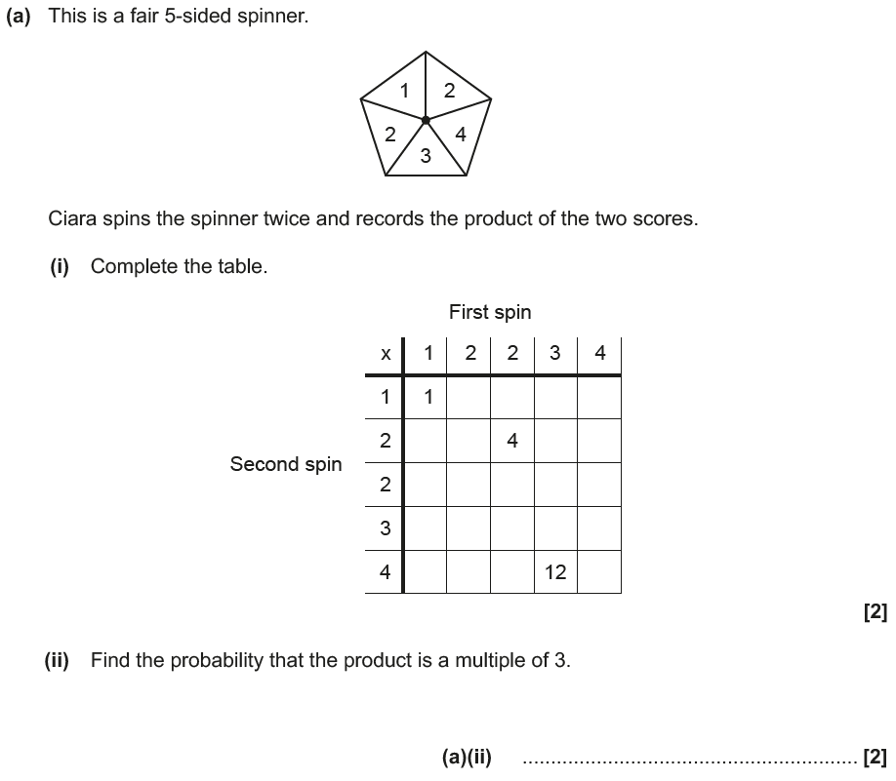
Multiple Events
June 2017 3H Q6

Slide 45
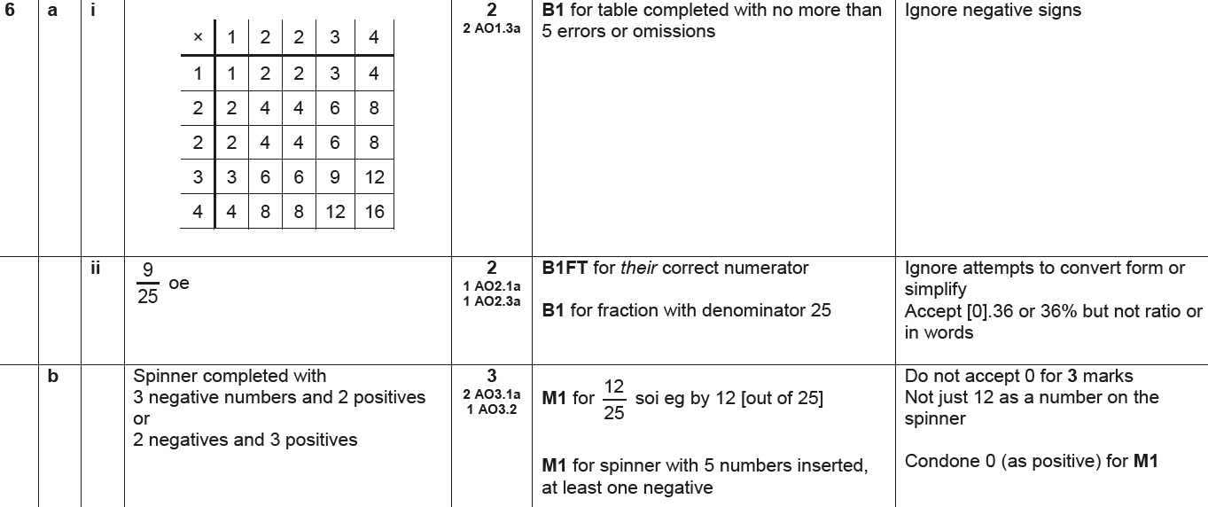
Multiple Events
June 2017 3H Q6
A (i)
A (ii)
B

Slide 46
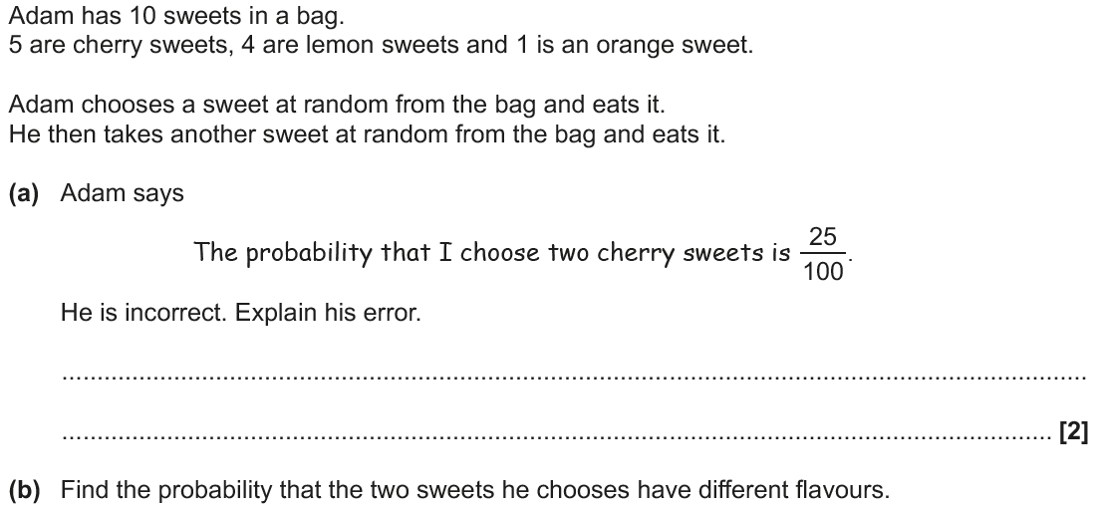
Multiple Events
Nov 2017 2H Q14

Slide 47
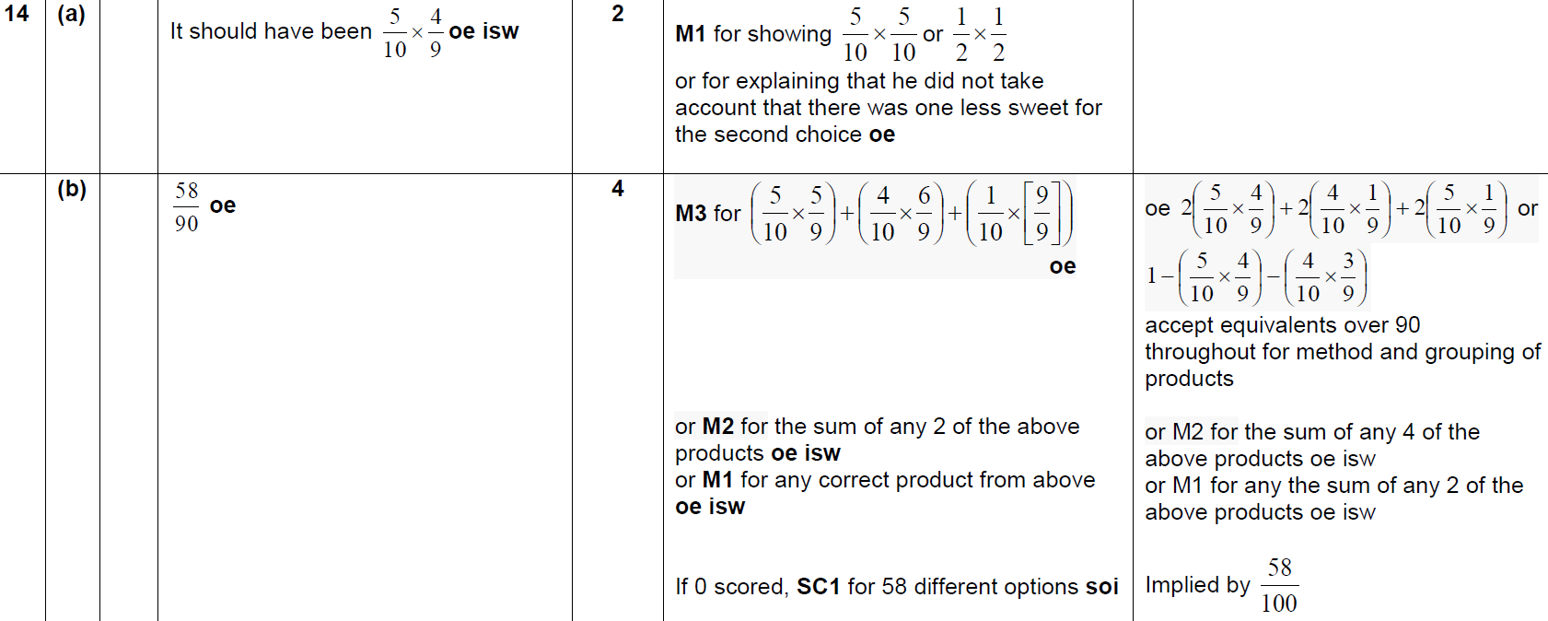
Multiple Events
Nov 2017 2H Q14
A
B

Slide 48
Multiple Events
May 2018 1H Q10

Slide 49
Multiple Events
May 2018 1H Q10
A

Slide 50
Multiple Events
June 2018 2H Q8

Slide 51
Multiple Events
June 2018 2H Q8
A
B (i)
B (ii)

Slide 52
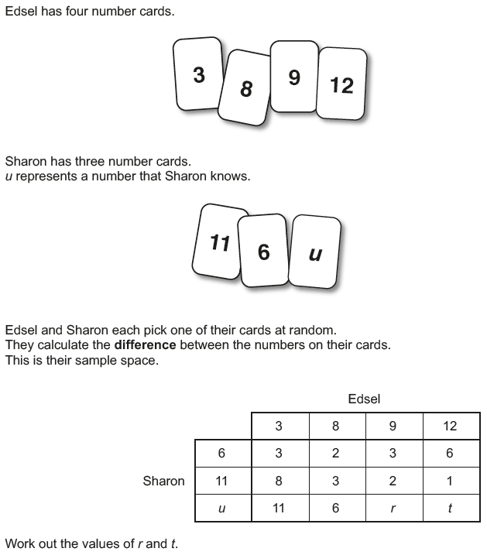
Multiple Events
June 2018 3H Q7

Slide 53
Multiple Events
June 2018 3H Q7
A

Slide 54
Multiple Events
Nov 2018 1H Q22

Slide 55
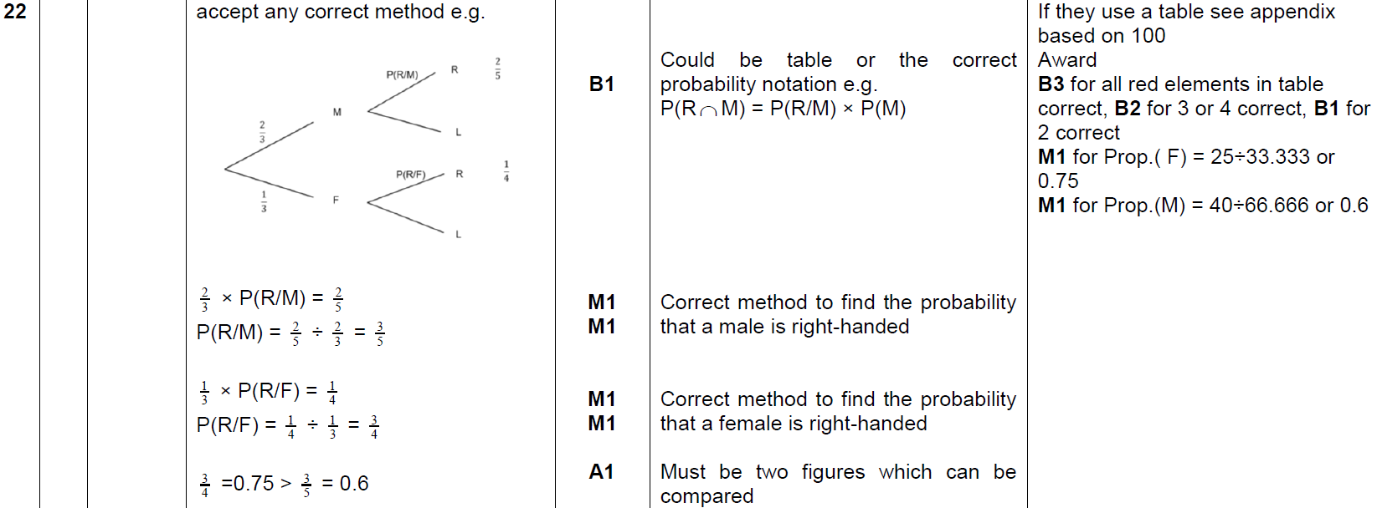
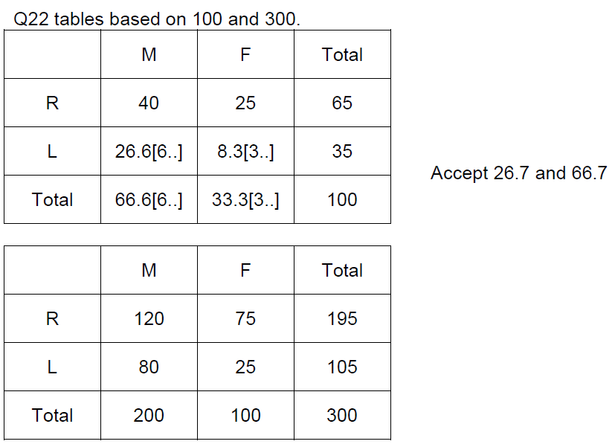
Multiple Events
Nov 2018 1H Q22
A

Slide 56
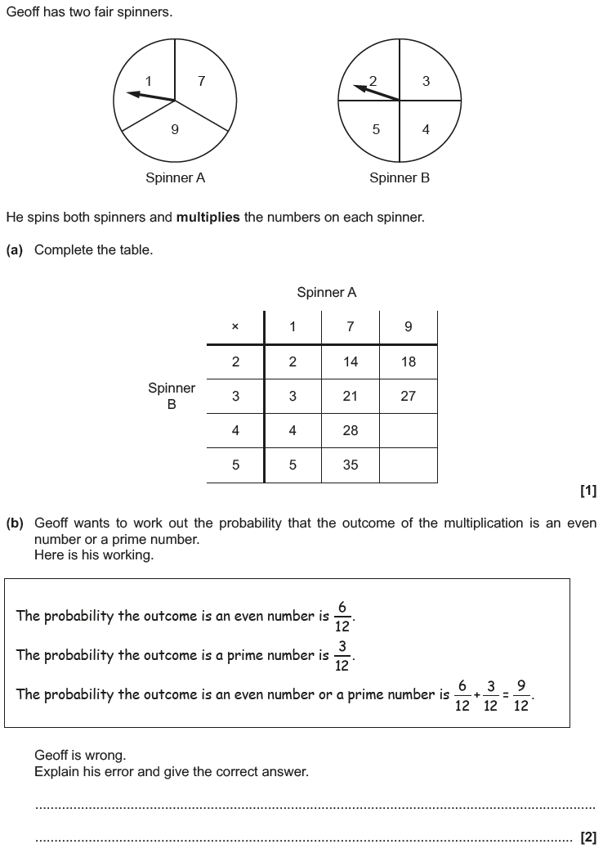
Multiple Events
Nov 2018 2H Q3

Slide 57
Multiple Events
Nov 2018 2H Q3
A
B

