Slide 1
Multiple Events
Multiple Events
June 2017
3H Q6
SAM
2H Q3
June 2018
3H Q7
Nov 2017
2H Q14
Practice
1H Q6*
Nov 2018
1H Q22*
May 2018
1H Q10
Practice
2H Q8
Nov 2018
2H Q3
June 2018
2H Q8
Probability Space
*Mark Scheme suggests tree diagram
Algebraic modelling

Slide 2
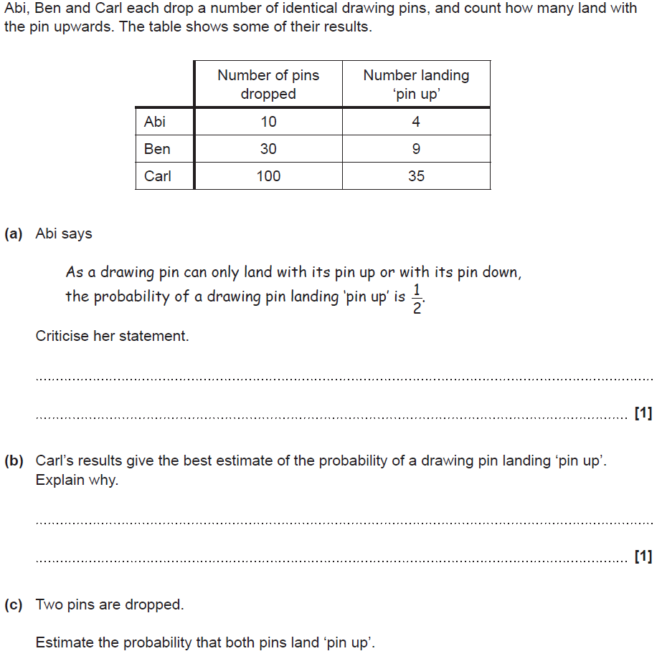
Multiple Events
SAM 2H Q3

Slide 3
Multiple Events
SAM 2H Q3
A
B
C

Slide 4
Multiple Events
Practice 1H Q6

Slide 5
Multiple Events
Practice 1H Q6
A

Slide 6
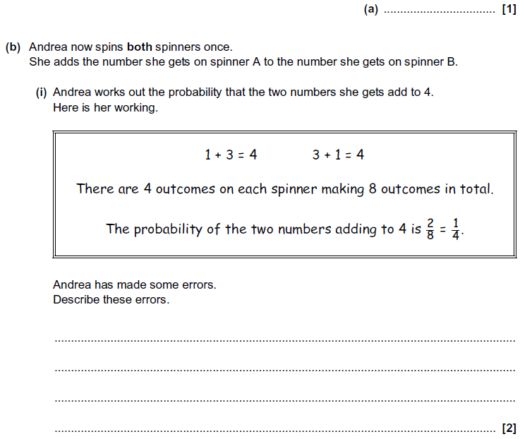
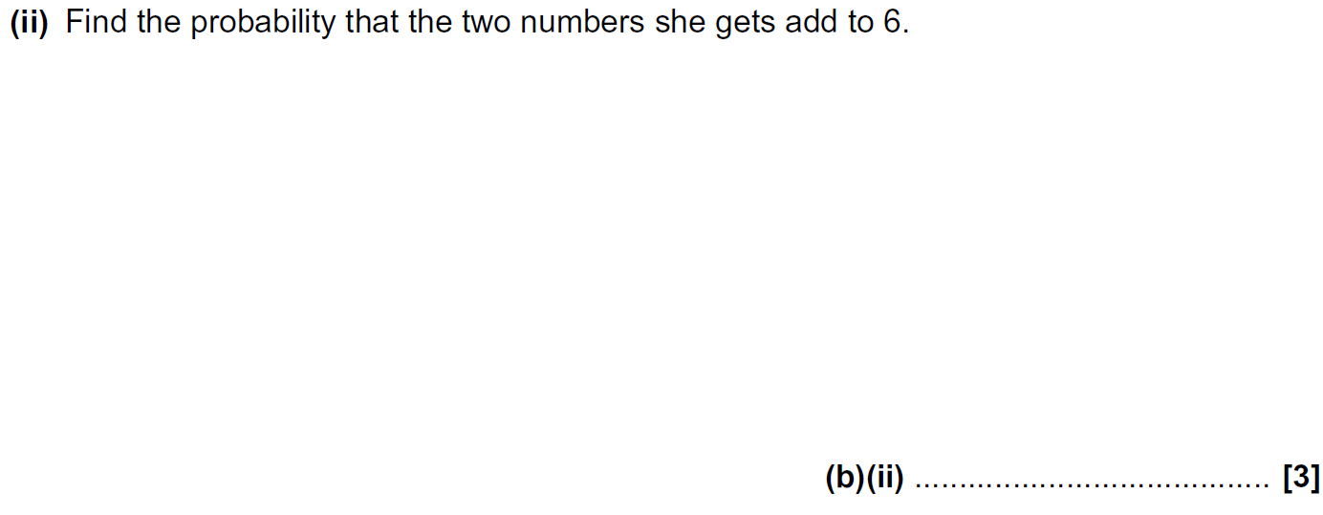
Multiple Events
Practice 2H Q8

Slide 7
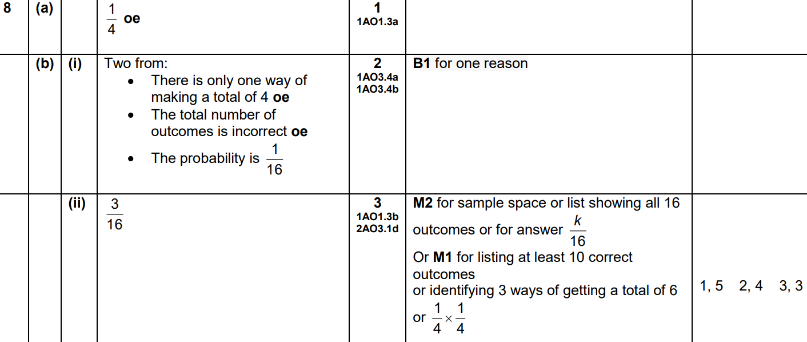
Multiple Events
Practice 2H Q8
A
B (i)
B (ii)

Slide 8
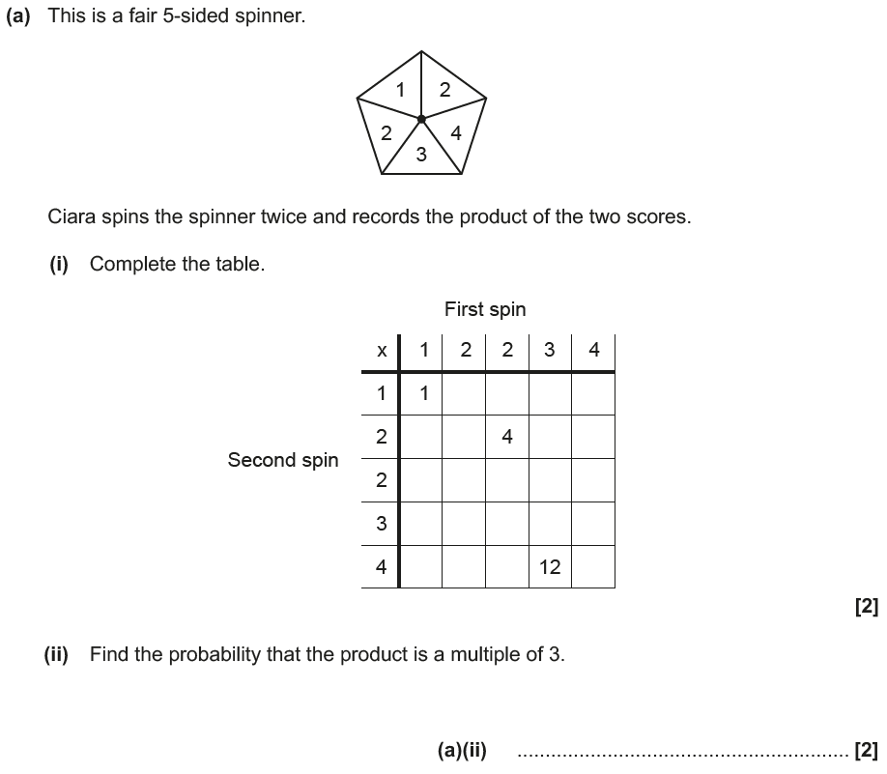
Multiple Events
June 2017 3H Q6

Slide 9
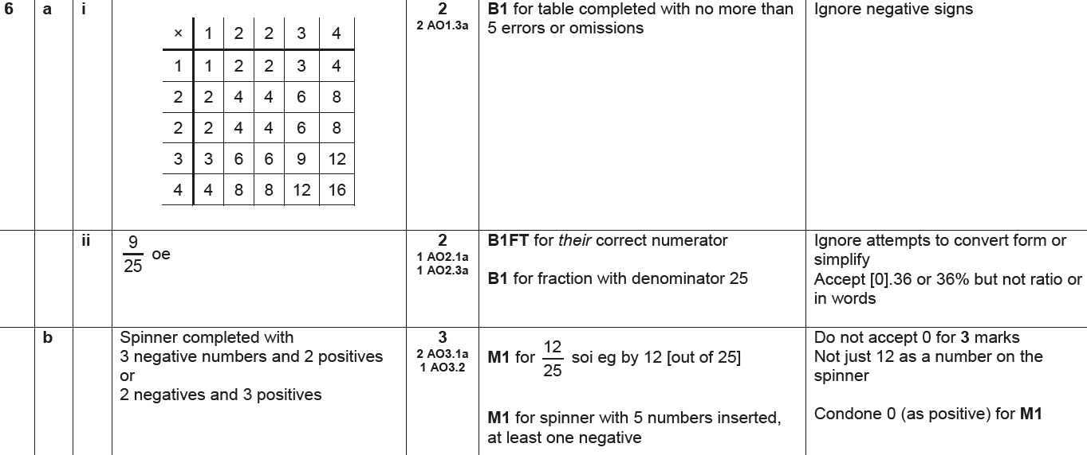
Multiple Events
June 2017 3H Q6
A (i)
A (ii)
B

Slide 10
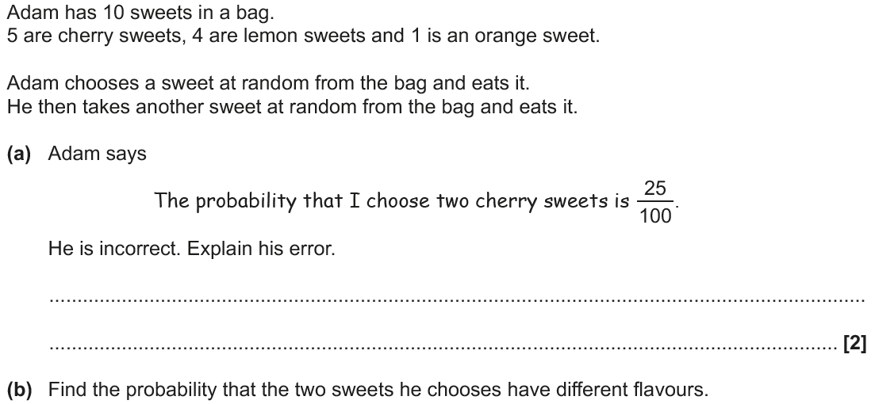
Multiple Events
Nov 2017 2H Q14

Slide 11
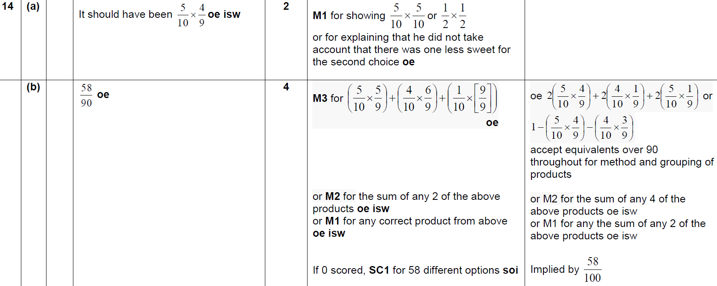
Multiple Events
Nov 2017 2H Q14
A
B

Slide 12
Multiple Events
May 2018 1H Q10

Slide 13
Multiple Events
May 2018 1H Q10
A

Slide 14
Multiple Events
June 2018 2H Q8

Slide 15
Multiple Events
June 2018 2H Q8
A
B (i)
B (ii)

Slide 16
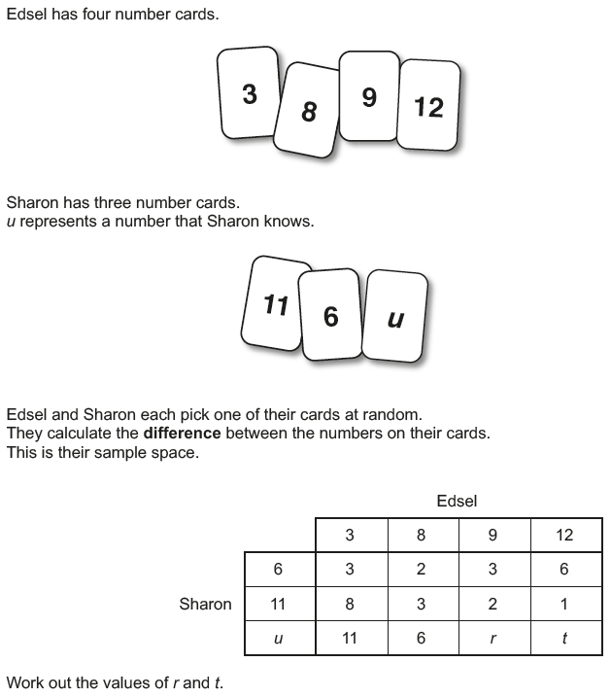
Multiple Events
June 2018 3H Q7

Slide 17
Multiple Events
June 2018 3H Q7
A

Slide 18
Multiple Events
Nov 2018 1H Q22

Slide 19
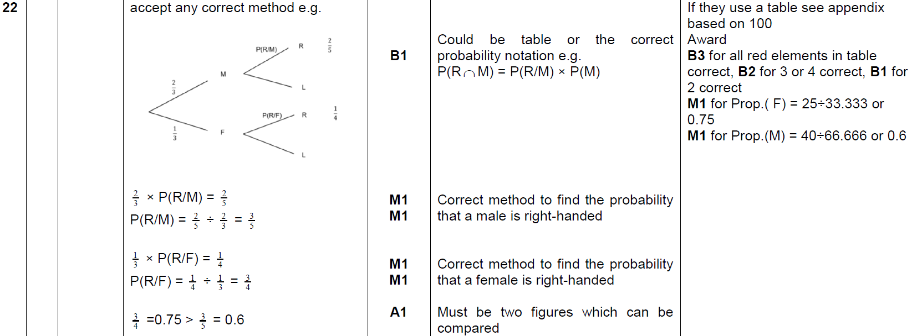
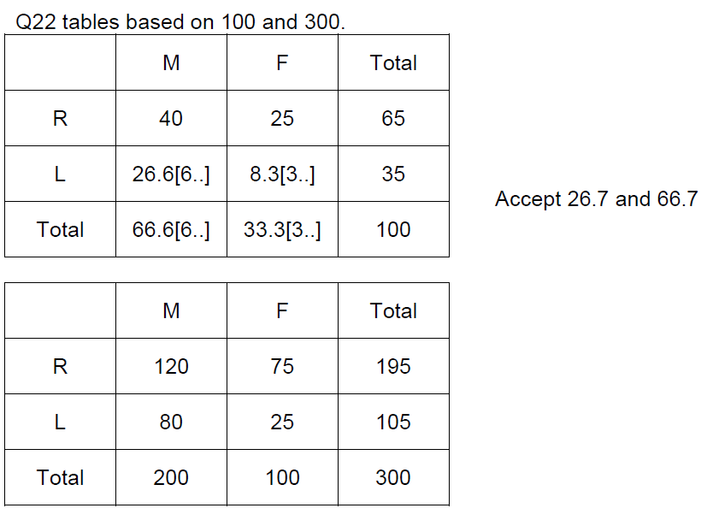
Multiple Events
Nov 2018 1H Q22
A

Slide 20
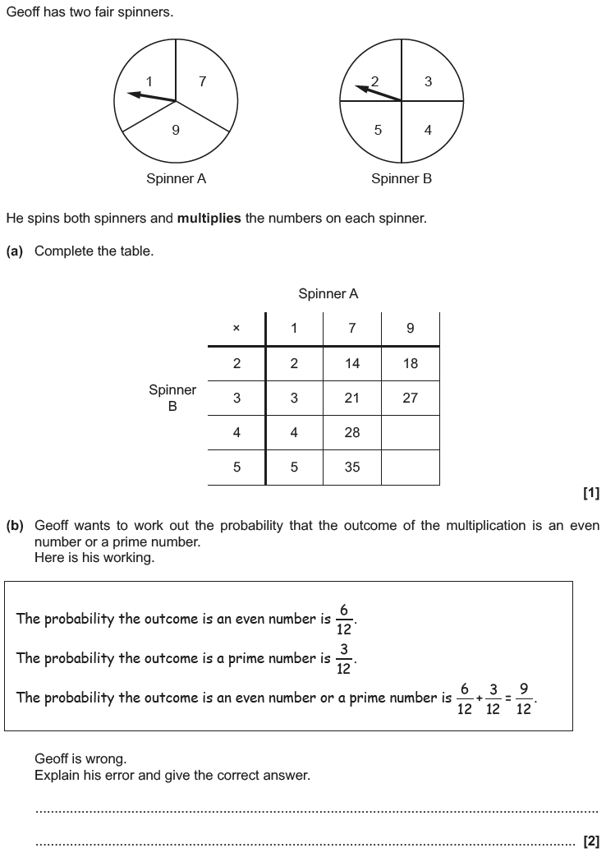
Multiple Events
Nov 2018 2H Q3

Slide 21
Multiple Events
Nov 2018 2H Q3
A
B

