Slide 1
Multiple Events
Multiple Events
SAM
1H Q24
May 2017
1H Q17
Spec 1
1H Q21
May 2017
2H Q21
Spec 1
3H Q18
Nov 2017
3H Q8
Spec 2
1H Q3
Nov 2018
1H Q22
Spec 2
1H Q16
Nov 2018
2H Q16
Spec 2
3H Q21
Algebraic modelling

Slide 2
Multiple Events
SAM 1H Q24

Slide 3
Multiple Events
SAM 1H Q24
A

Slide 4
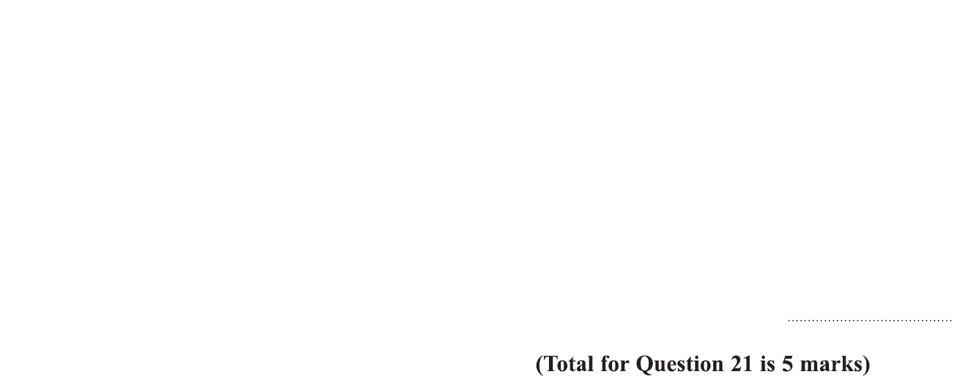
Multiple Events
Specimen Set 1 1H Q21

Slide 5
Multiple Events
Specimen Set 1 1H Q21
A

Slide 6
Multiple Events
Specimen Set 1 3H Q18

Slide 7
Multiple Events
Specimen Set 1 3H Q18
A

Slide 8
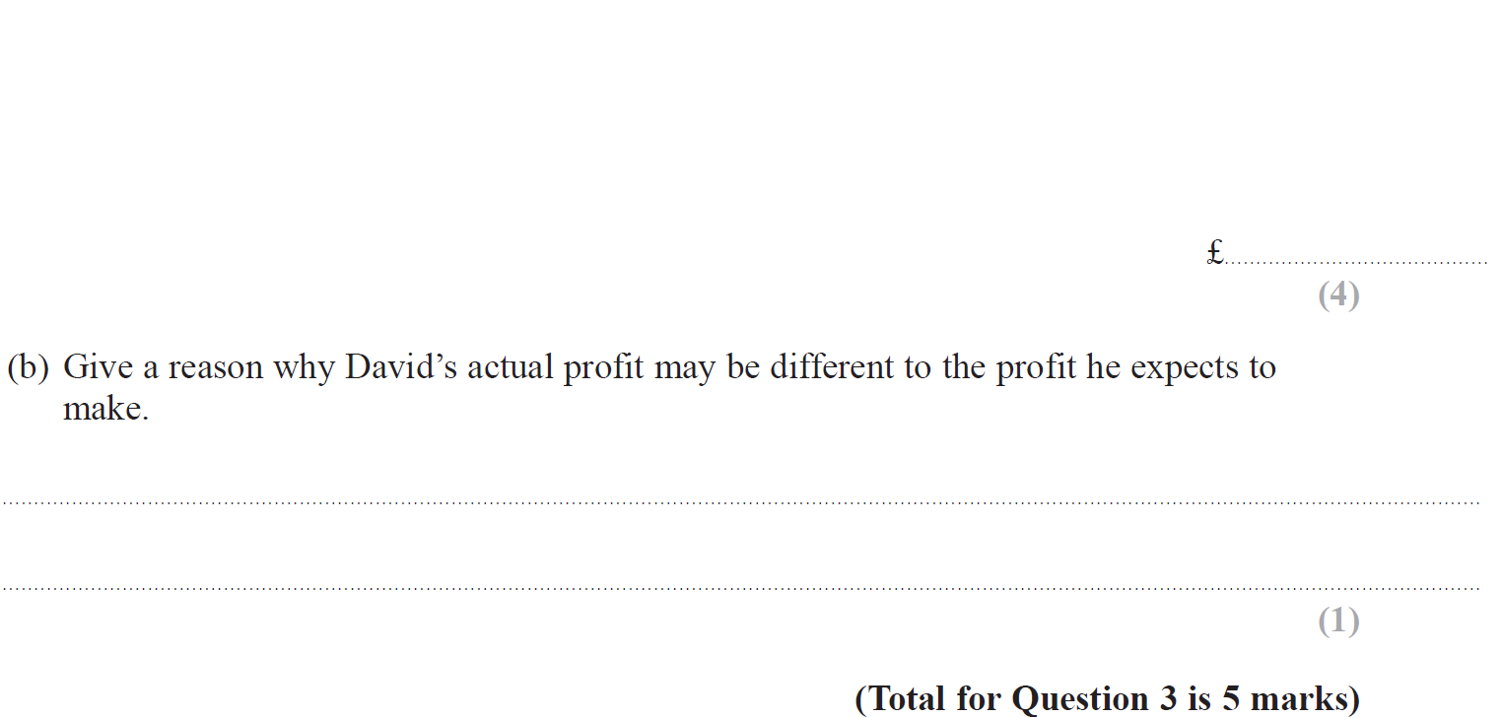
Multiple Events
Specimen Set 2 1H Q3

Slide 9
Multiple Events
Specimen Set 2 1H Q3
A
B

Slide 10
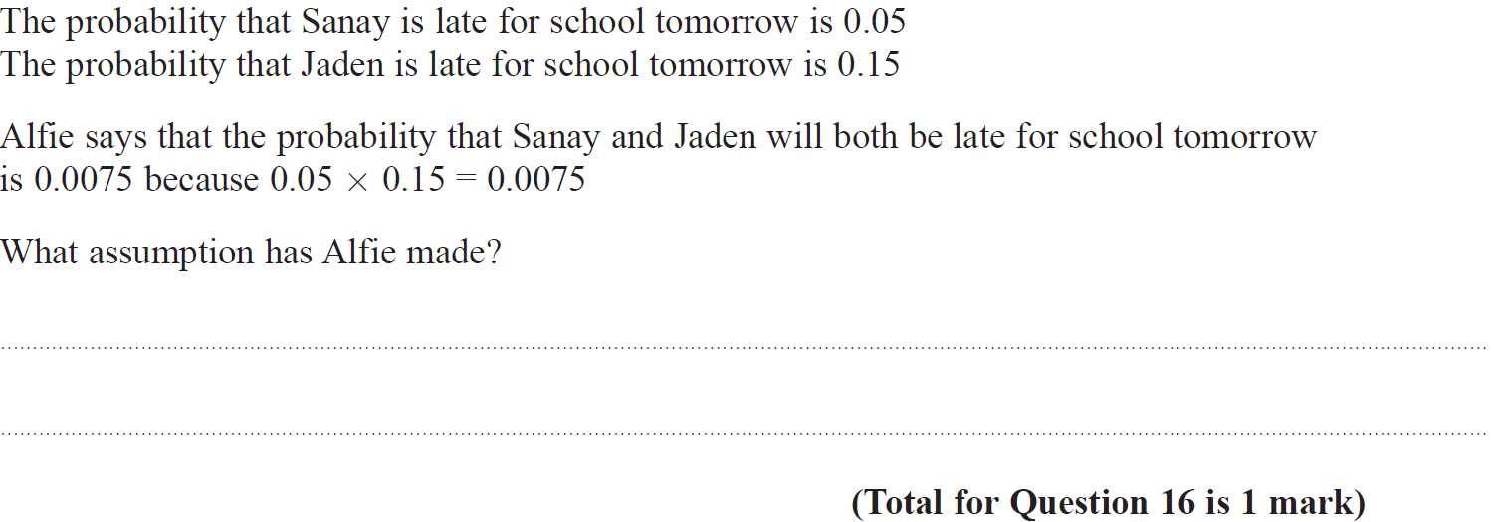
Multiple Events
Specimen Set 2 1H Q16

Slide 11
Multiple Events
Specimen Set 2 1H Q16
A

Slide 12
Multiple Events
Specimen Set 2 3H Q22

Slide 13
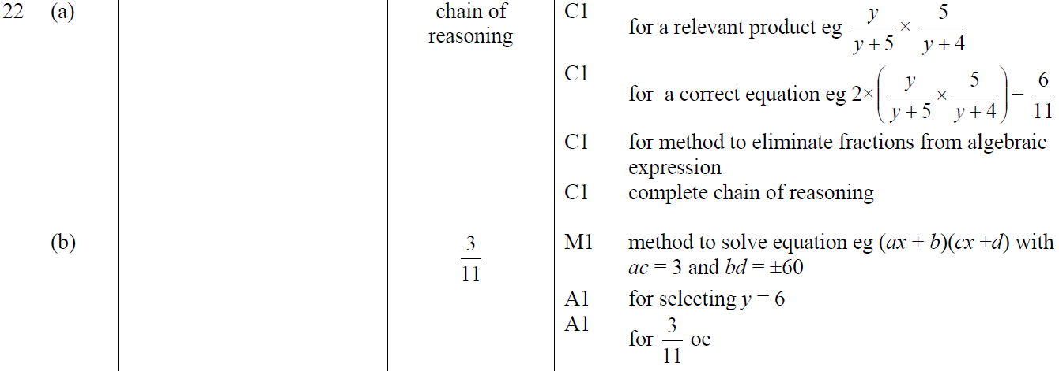
Multiple Events
Specimen Set 2 3H Q22
A
B

Slide 14
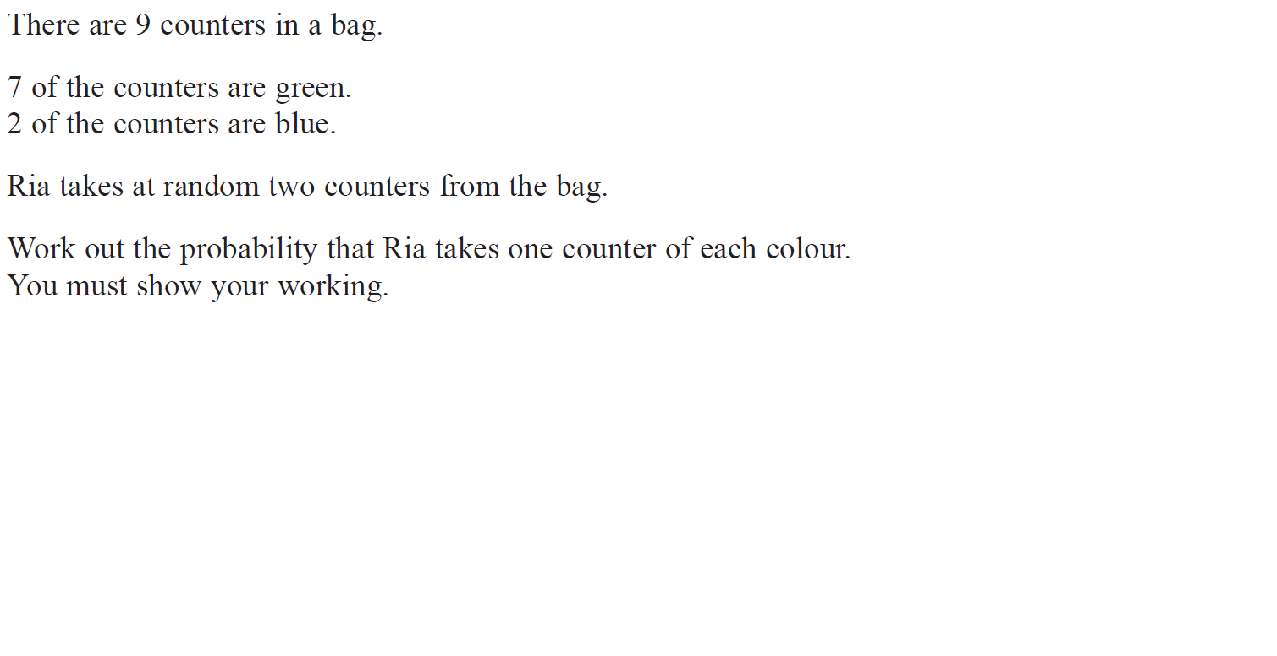
Multiple Events
May 2017 1H Q17

Slide 15
Multiple Events
May 2017 1H Q17
A

Slide 16
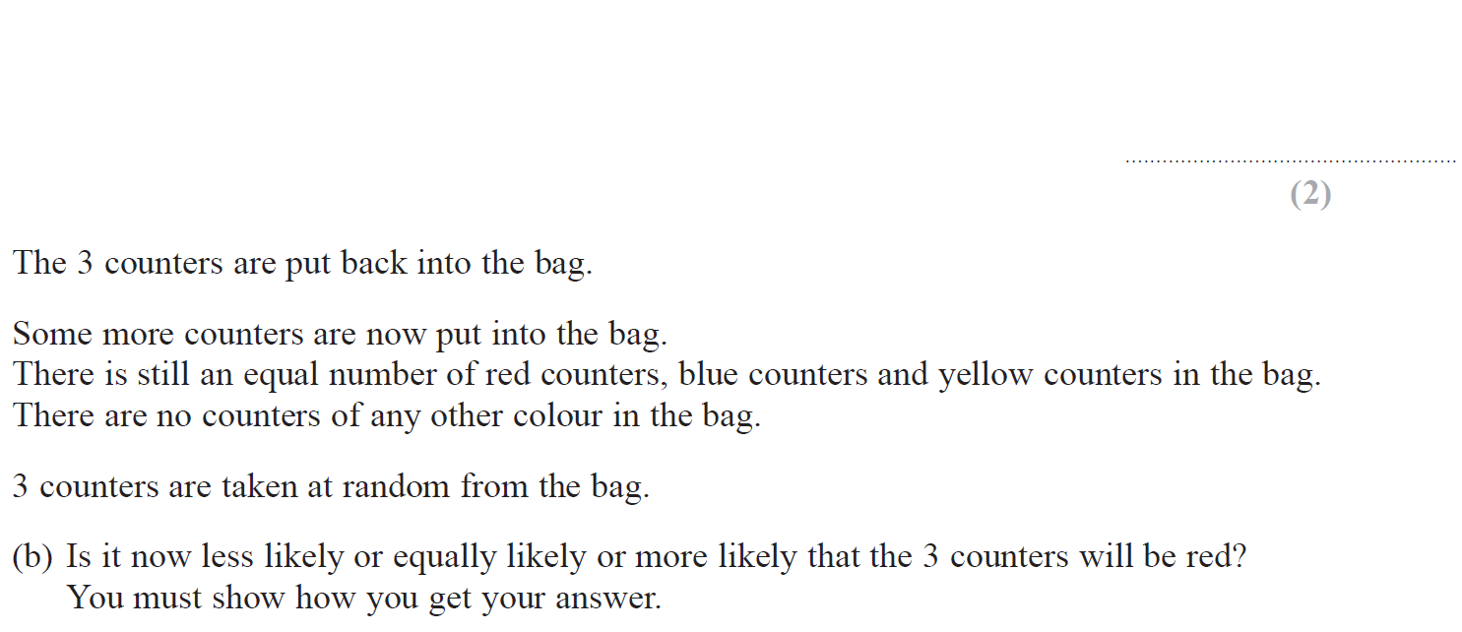
Multiple Events
Nov 2017 2H Q21

Slide 17
Multiple Events
Nov 2017 2H Q21
A
B

Slide 18
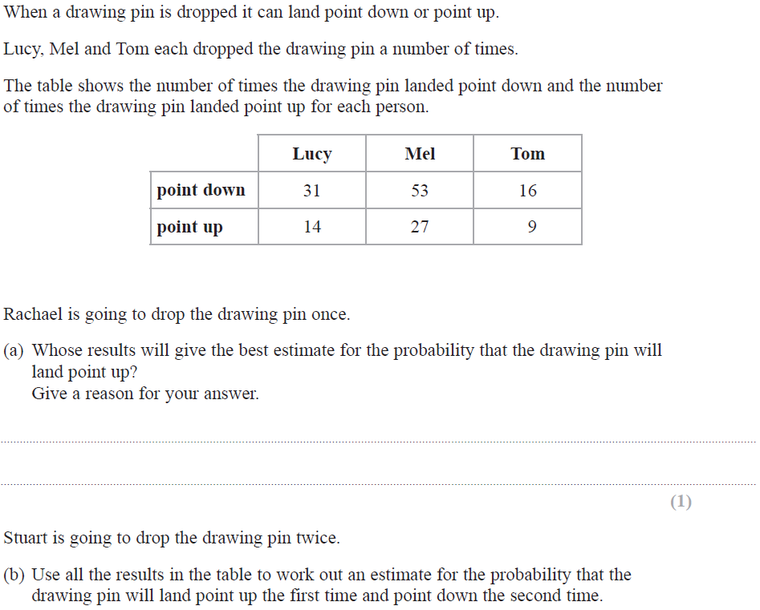
Multiple Events
Nov 2017 3H Q8

Slide 19
Multiple Events
Nov 2017 3H Q8
A
B

Slide 20
Multiple Events
Nov 2018 1H Q22

Slide 21
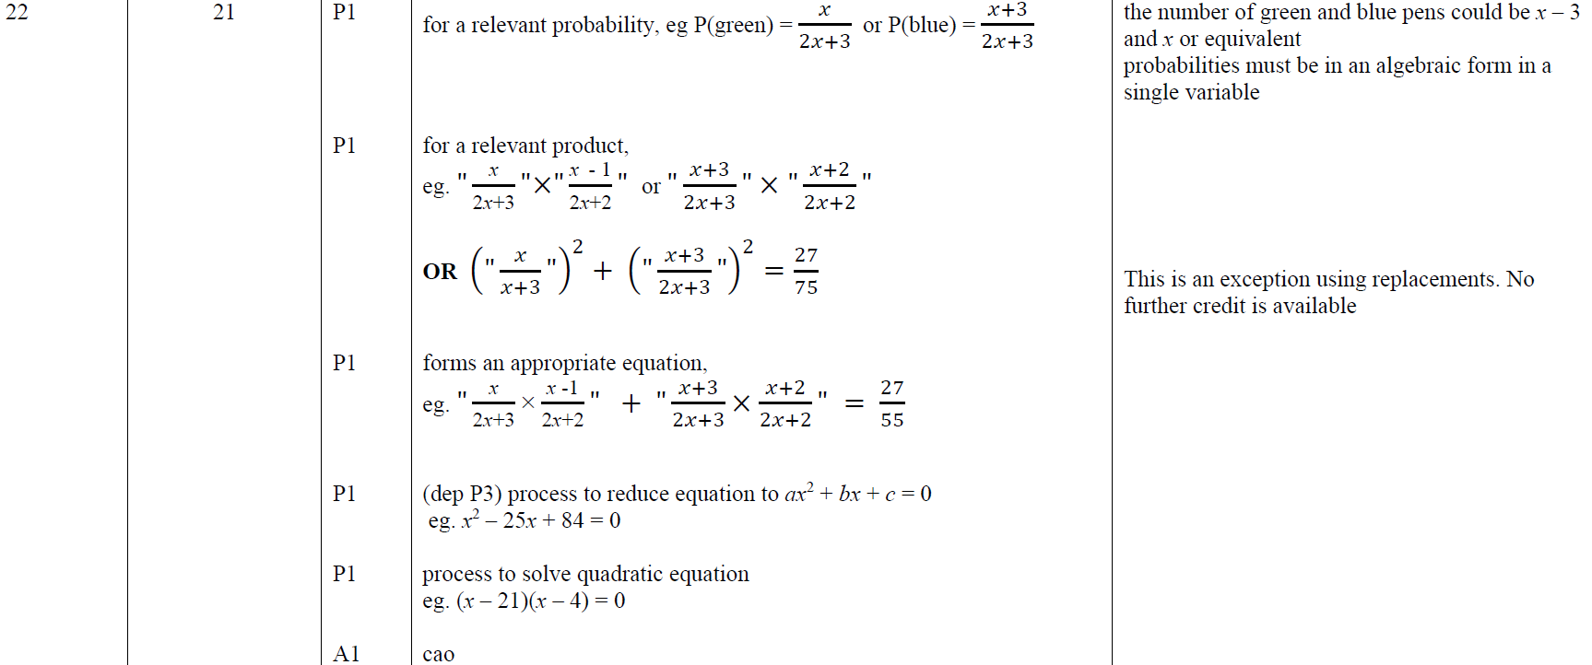
Multiple Events
Nov 2018 1H Q22
A

Slide 22
Multiple Events
Nov 2018 2H Q16

Slide 23
Multiple Events
Nov 2018 2H Q16
A
B

