Slide 1
Manipulating Formulae/ Changing the Subject
Manipulating Formulae/ Changing the Subject
June 2017 3H Q3
Nov 2017 1H Q4
1 Marker
Nov 2017 3H Q9
Nov 2018 3H Q17

Slide 2
Manipulating Formulae/ Changing the Subject
June 2017 3H Q3

Slide 3
Manipulating Formulae/ Changing the Subject
June 2017 3H Q3
A

Slide 4
Manipulating Formulae/ Changing the Subject
Nov 2017 1H Q4

Slide 5
Manipulating Formulae/ Changing the Subject
Nov 2017 1H Q4
A

Slide 6
Manipulating Formulae/ Changing the Subject
Nov 2017 3H Q9

Slide 7
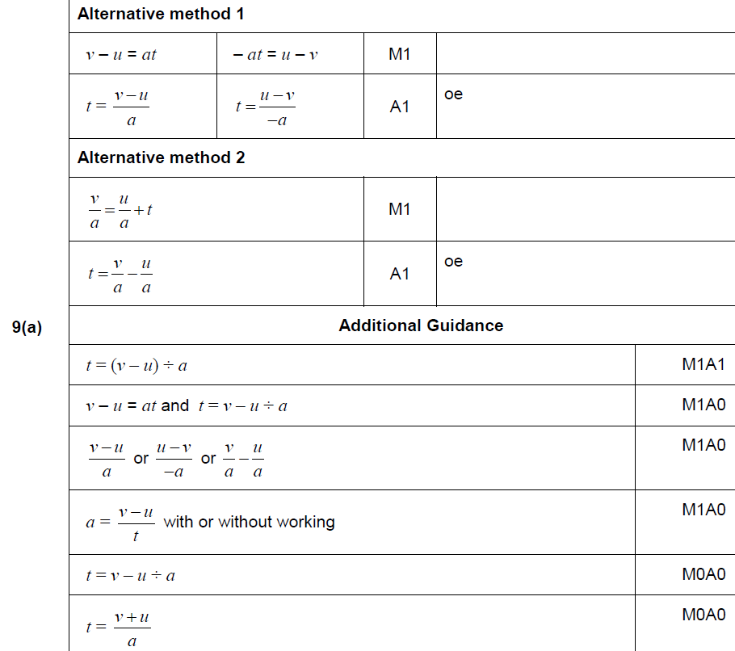
Manipulating Formulae/ Changing the Subject
Nov 2017 3H Q9
A

Slide 8
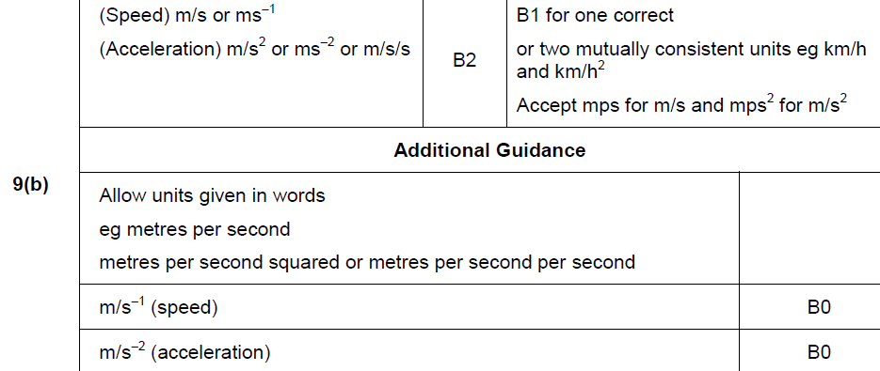
Manipulating Formulae/ Changing the Subject
Nov 2017 3H Q9
B

Slide 9
Manipulating Formulae/ Changing the Subject
Nov 2018 3H Q17

Slide 10
Manipulating Formulae/ Changing the Subject
Nov 2018 3H Q17
A

