Slide 1
Linear Inequalities
Linear Inequalities
Old Spec Q’s
SAM
2H Q14
May 2018
1H Q12
June 2018
2H Q1
Jan 2019
2HR Q8
June 2019
2H Q10
Graphical

Slide 2
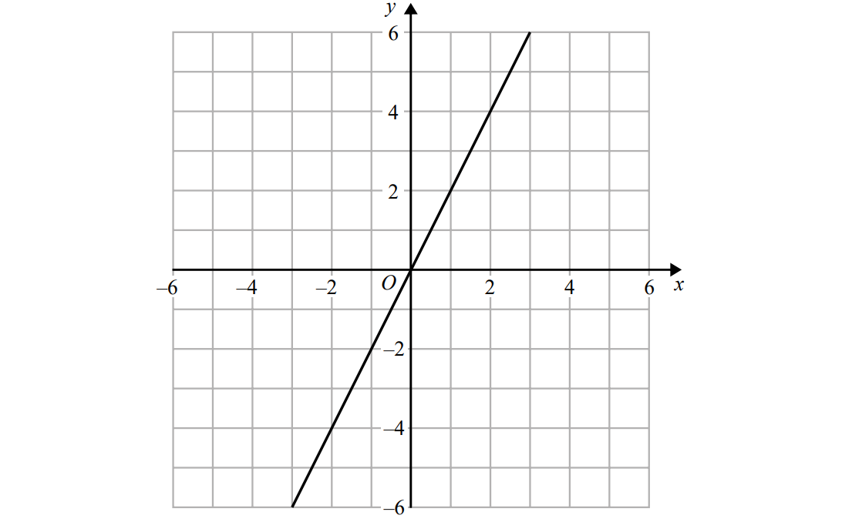
Linear Inequalities
SAM 2H Q14
Show Graph (a)
Hide Graph (a)
Show
Hide
Show
Hide
Show
Hide
Show
Hide

Slide 3
Linear Inequalities
SAM 2H Q14
A
B

Slide 4
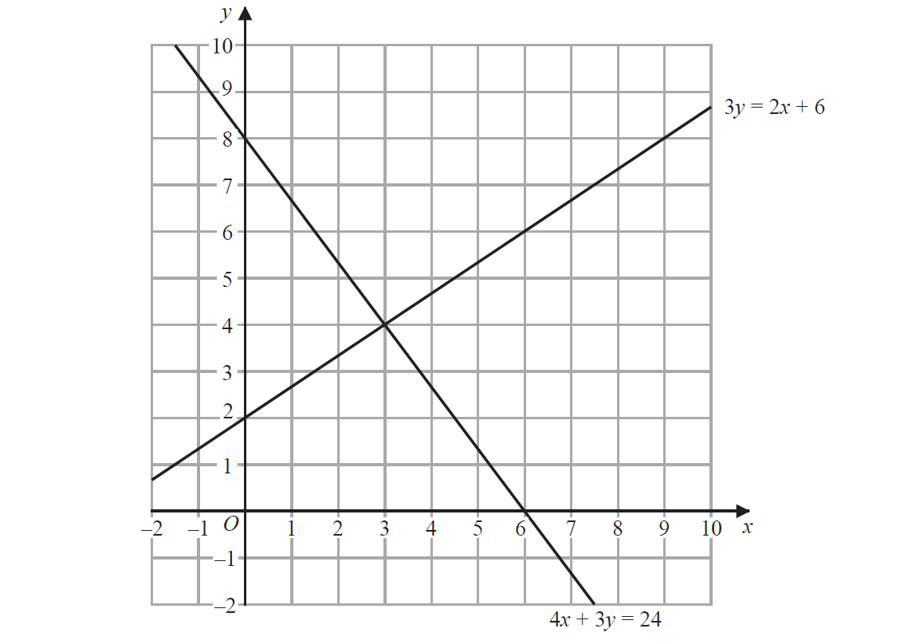
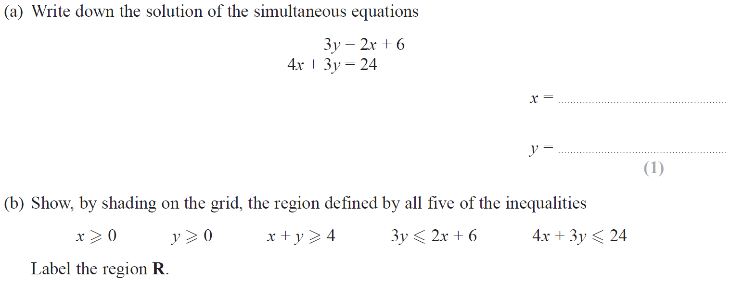
Linear Inequalities
May 2018 1H Q12

Slide 5
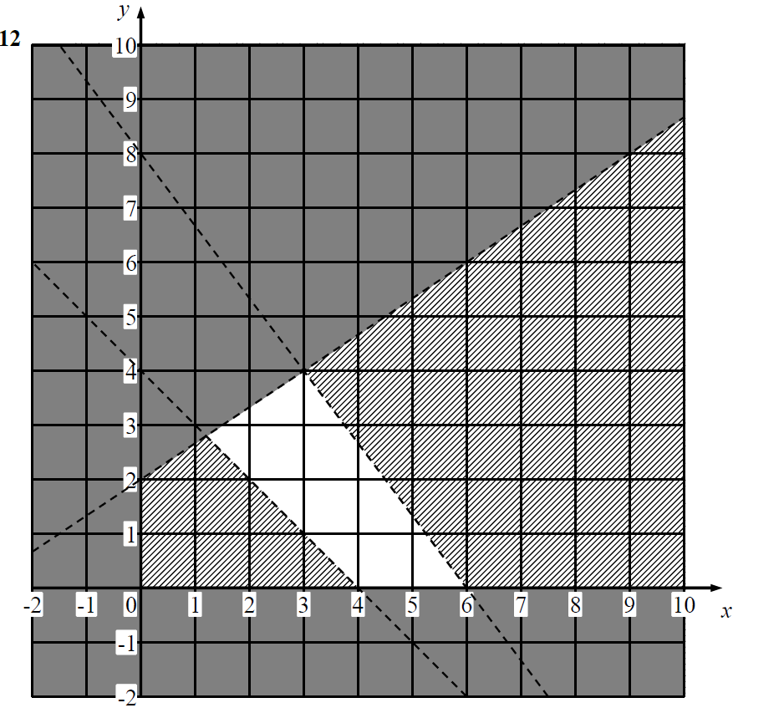
Linear Inequalities
May 2018 1H Q12
A
B

Slide 6
Linear Inequalities
June 2018 2H Q1

Slide 7
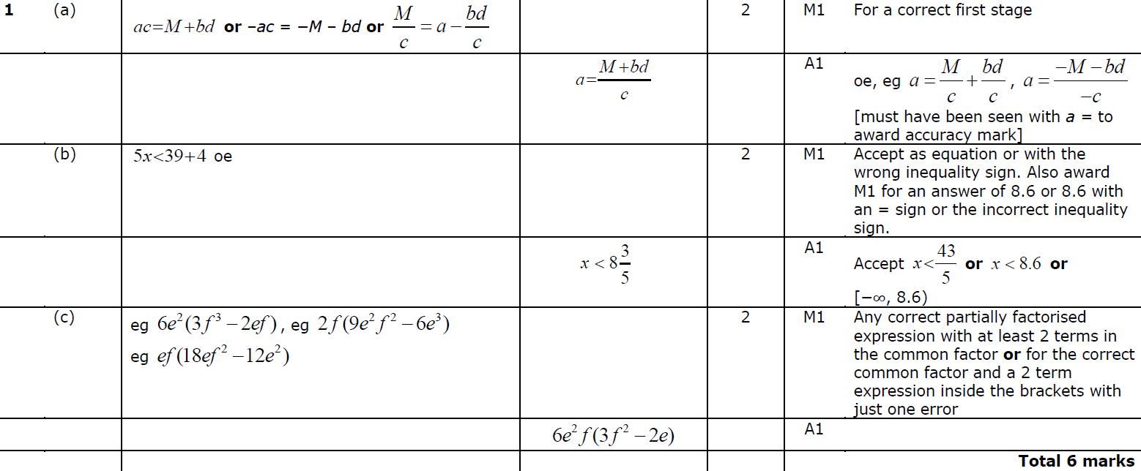
Linear Inequalities
June 2018 2H Q1
A
B
C

Slide 8
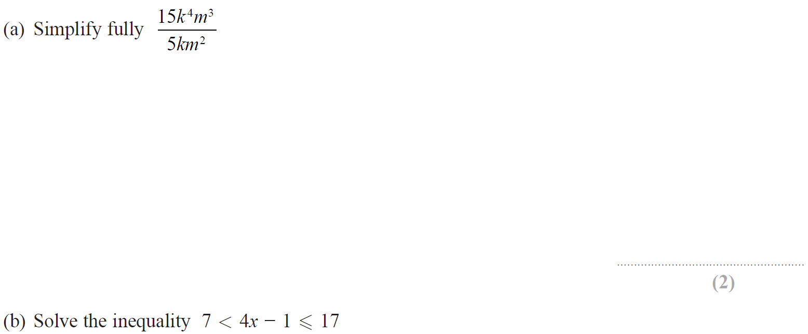
Linear Inequalities
Jan 2019 2HR Q8

Slide 9
Linear Inequalities
Jan 2019 2HR Q8
A
B

Slide 10
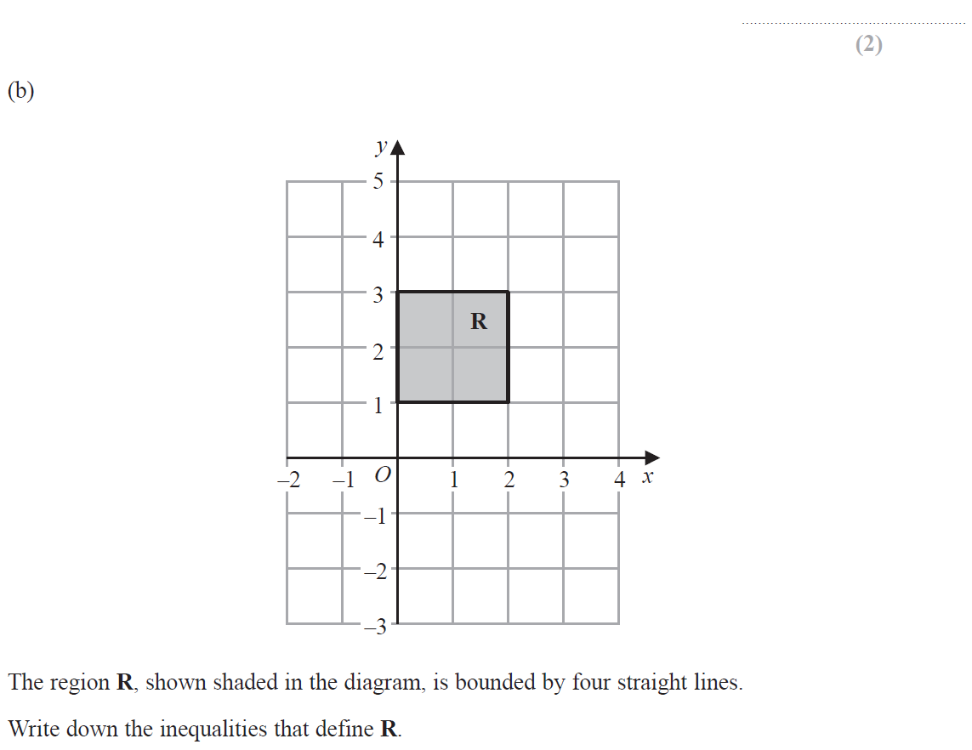
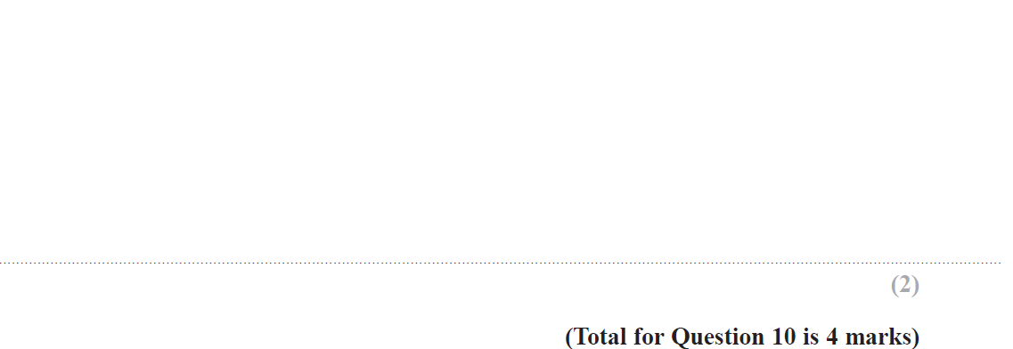
Linear Inequalities
June 2019 2H Q10

Slide 11
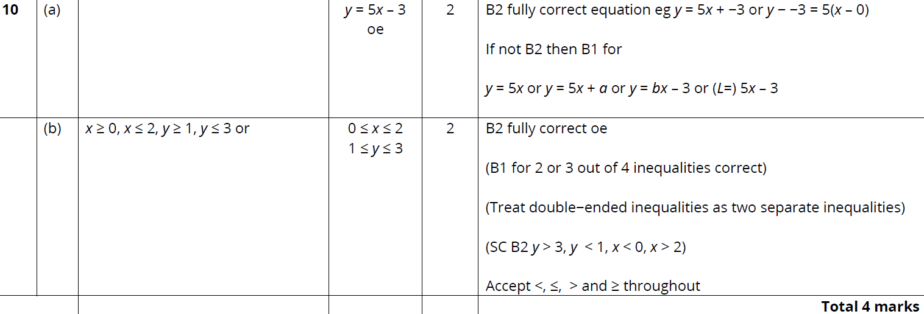
Linear Inequalities
June 2019 2H Q10
A
B

Slide 12
Linear Inequalities
Linear Inequalities
New Spec Q’s
May 2004
3H Q8
Nov 2007
4H Q8
Nov 2010
4H Q9
May 2013 4HR Q7
June 2015 4HR Q9
Jan 2017 4HR Q7
June 2018 4HR Q9
Nov 2004
3H Q6
May 2008
3H Q9
June 2011 4H Q12
Jan 2014 3H Q7
Jan 2016 3H Q10
June 2017 4H Q2
May 2005
3H Q9
May 2008
4H Q14
Jan 2012 4H Q10
Jan 2014 3HR Q9
Jan 2016 4H Q9
May 2017 3HR Q13
Nov 2005
3H Q13
Nov 2008
4H Q6
May 2012 3H Q6
Jan 2014 4HR Q8
Jan 2016 3HR Q7
June 2017 4HR Q7
May 2006
3H Q9
Nov 2009
3H Q9
Jan 2013 3H Q7
May 2014 3H Q8
May 2016 3H Q7
Jan 2018 3H Q5
Nov 2006
3H Q7
Nov 2009
4H Q9
Jan 2013 4H Q13
Jan 2015 4H Q10
May 2016 3HR Q6
Jan 2018 4HR Q7
May 2007
3H Q13
June 2010
3H Q10
May 2013 3H Q15
June 2015 4H Q9
Jan 2017 3H Q5
May 2018 3H Q8
Nov 2007
3H Q9
June 2010
4H Q12
May 2013 4H Q9
June 2015 4HR Q4
Jan 2017 3H Q8
May 2018 3HR Q14
Graphical

Slide 13
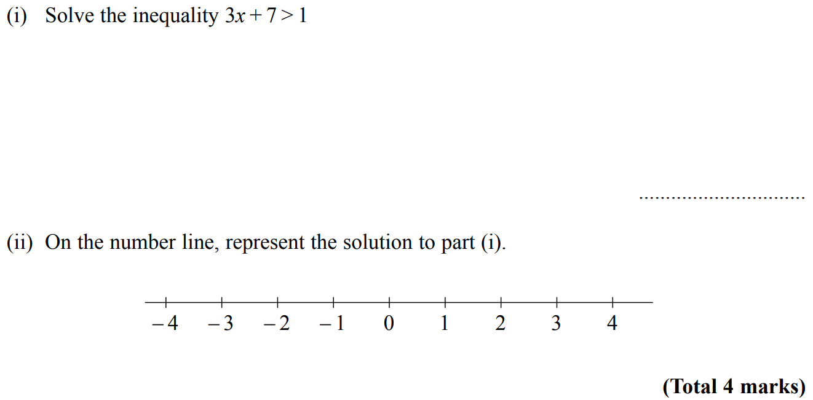
Linear Inequalities
May 2004 3H Q8

Slide 14
Linear Inequalities
May 2004 3H Q8
i
ii

Slide 15
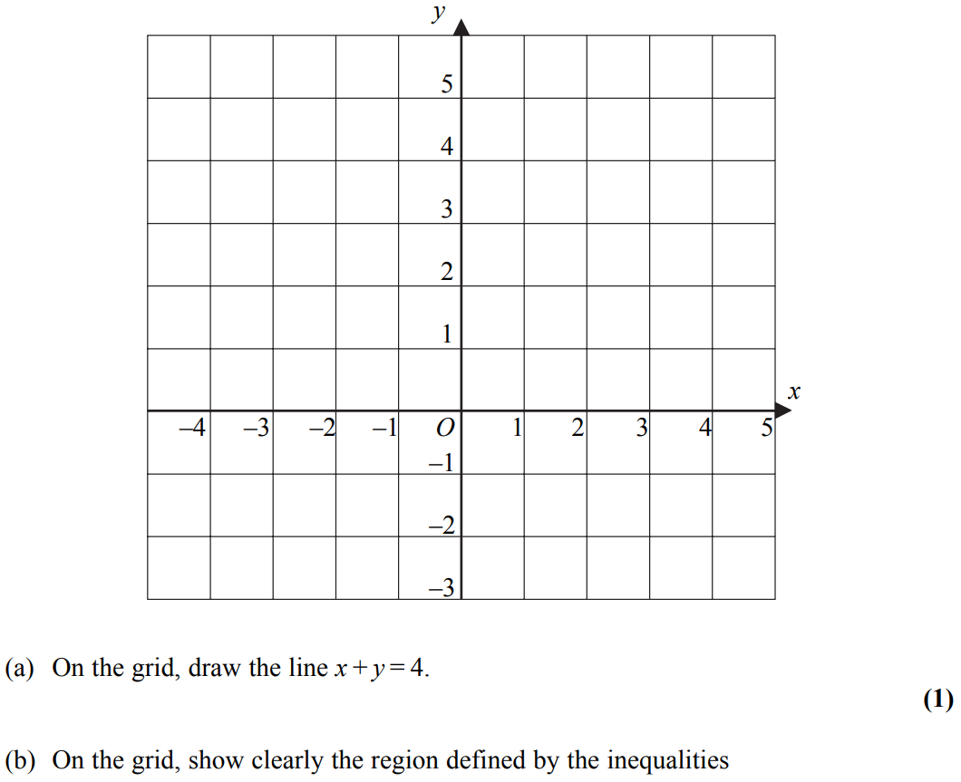
Linear Inequalities
May 2004 3H Q6
Note that in these diagrams I am shading the UNWANTED region
Show
Show
Hide
Show
Hide
Show
Hide

Slide 16
Linear Inequalities
May 2004 3H Q6
A
B

Slide 17
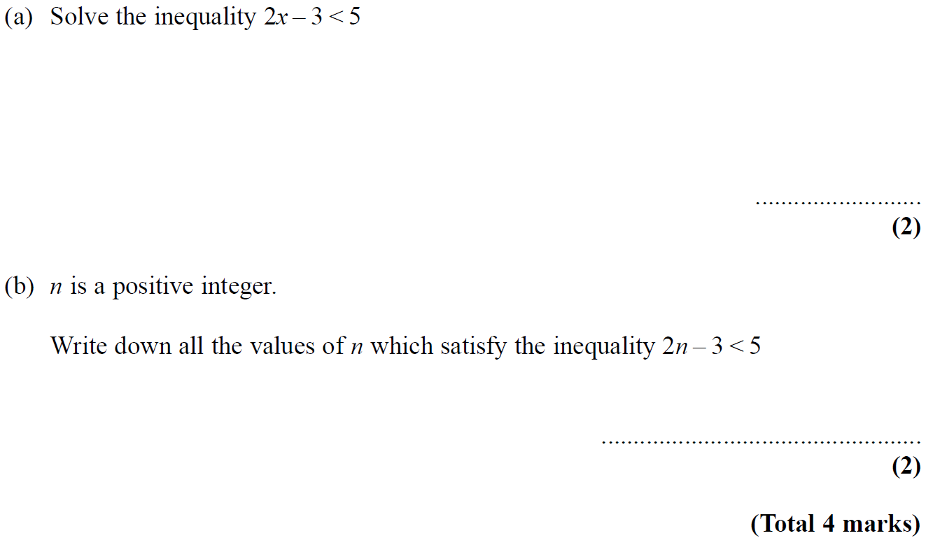
Linear Inequalities
May 2005 3H Q9

Slide 18
Linear Inequalities
May 2005 3H Q9
A
B

Slide 19
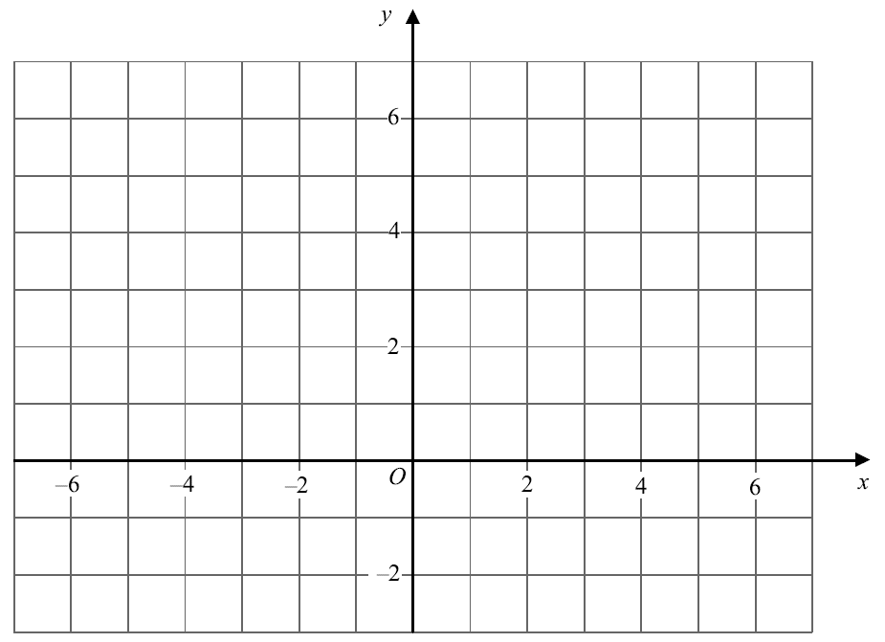
Linear Inequalities
Nov 2005 3H Q13
Show
Show
Show
Hide
Hide
Hide
Show
Hide
Note that in these diagrams I am shading the UNWANTED region
R

Slide 20
Linear Inequalities
Nov 2005 3H Q13
A

Slide 21
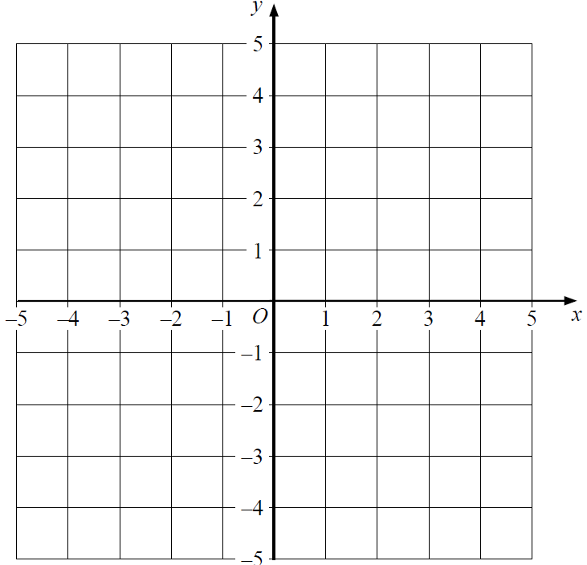
Linear Inequalities
Nov 2005 3H Q9
Show
Show
Hide
Hide
Show
Hide
Note that in these diagrams I am shading the UNWANTED region
R

Slide 22
Linear Inequalities
Nov 2005 3H Q9
A

Slide 23
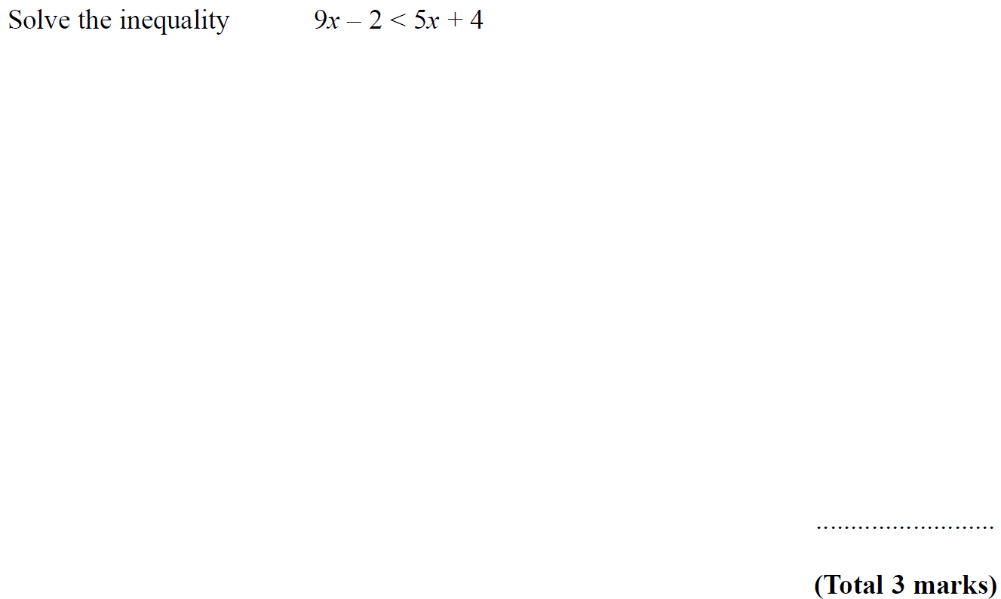
Linear Inequalities
Nov 2006 3H Q7

Slide 24
Linear Inequalities
Nov 2006 3H Q7
A

Slide 25
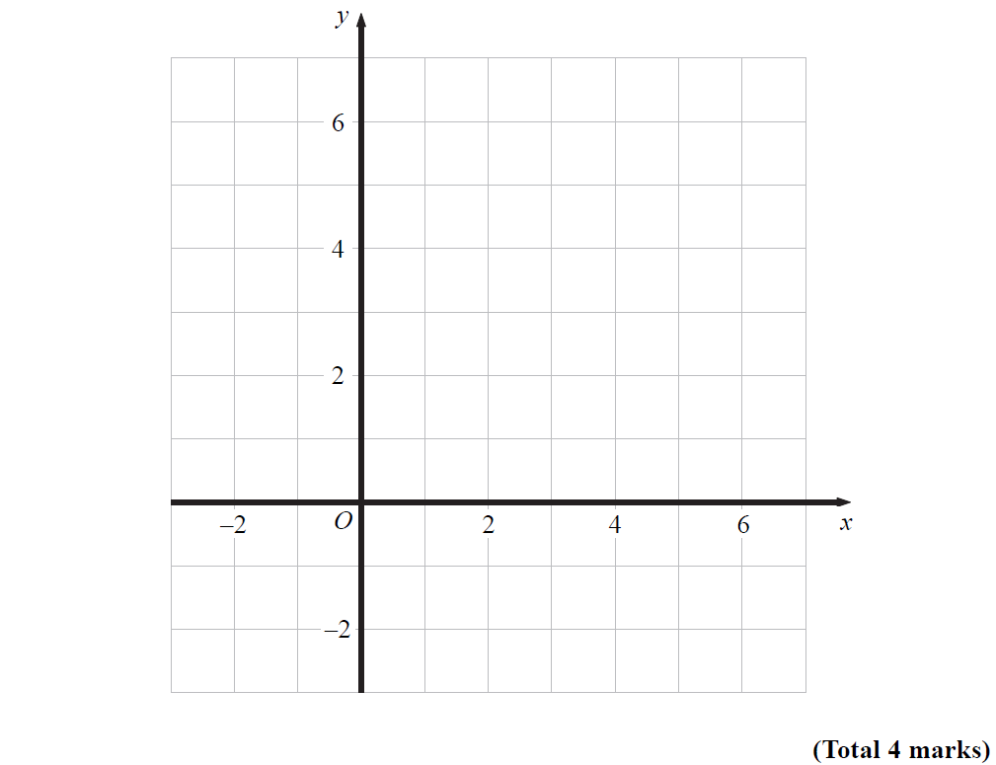
Linear Inequalities
May 2007 3H Q13
Show
Show
Show
Hide
Hide
Hide
Show
Hide
Note that in these diagrams I am shading the UNWANTED region
R

Slide 26
Linear Inequalities
May 2007 3H Q13
A

Slide 27
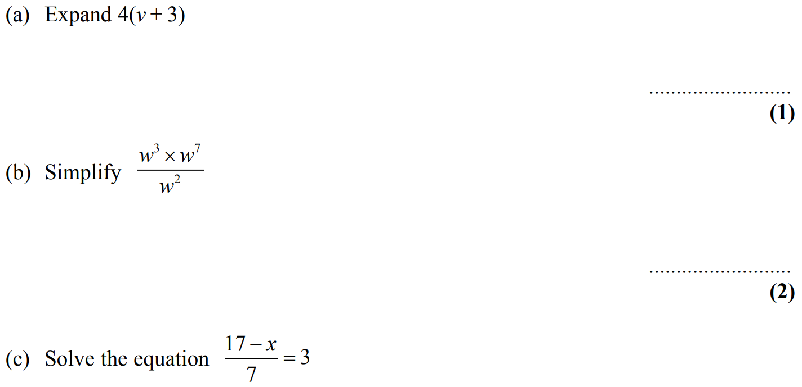
Linear Inequalities
Nov 2007 3H Q9

Slide 28
Linear Inequalities
Nov 2007 3H Q9
A
B
C
D

Slide 29
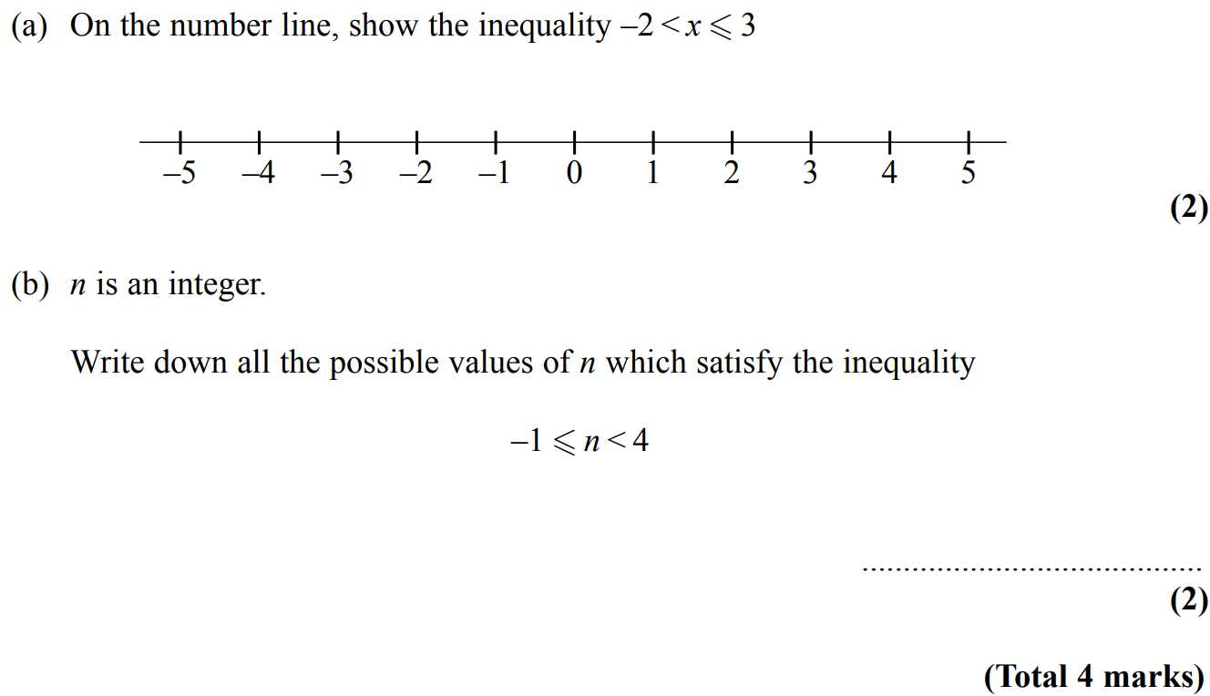
Linear Inequalities
Nov 2007 4H Q8

Slide 30
Linear Inequalities
Nov 2007 4H Q8
A
B

Slide 31
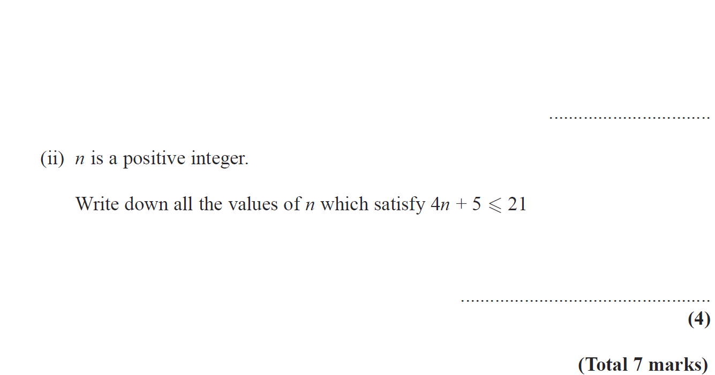
Linear Inequalities
May 2008 3H Q9

Slide 32
Linear Inequalities
May 2008 3H Q9
A
B (i)
B (ii)

Slide 33
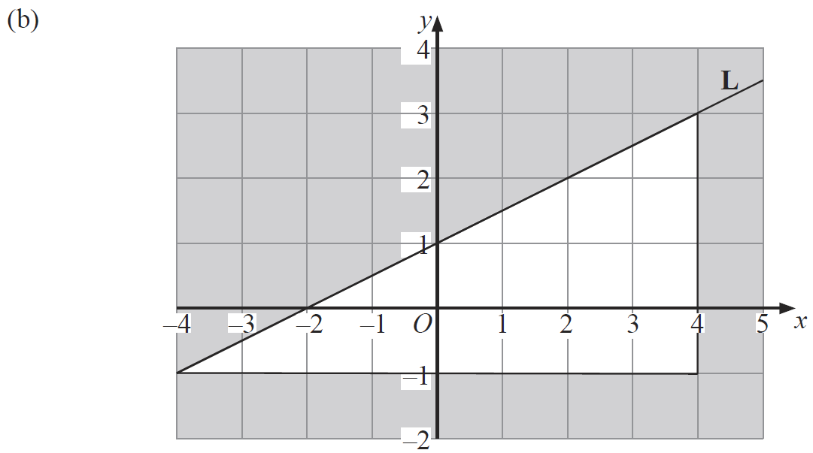
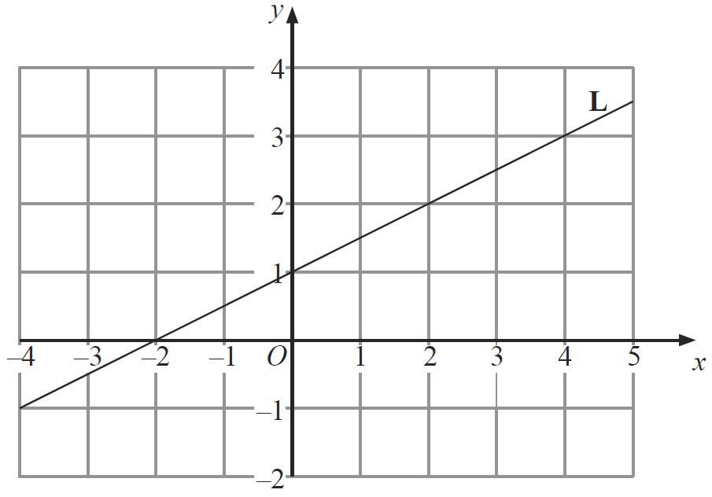
Linear Inequalities
May 2008 4H Q14

Slide 34
Linear Inequalities
May 2008 4H Q14
A (i)
A (ii)
B

Slide 35
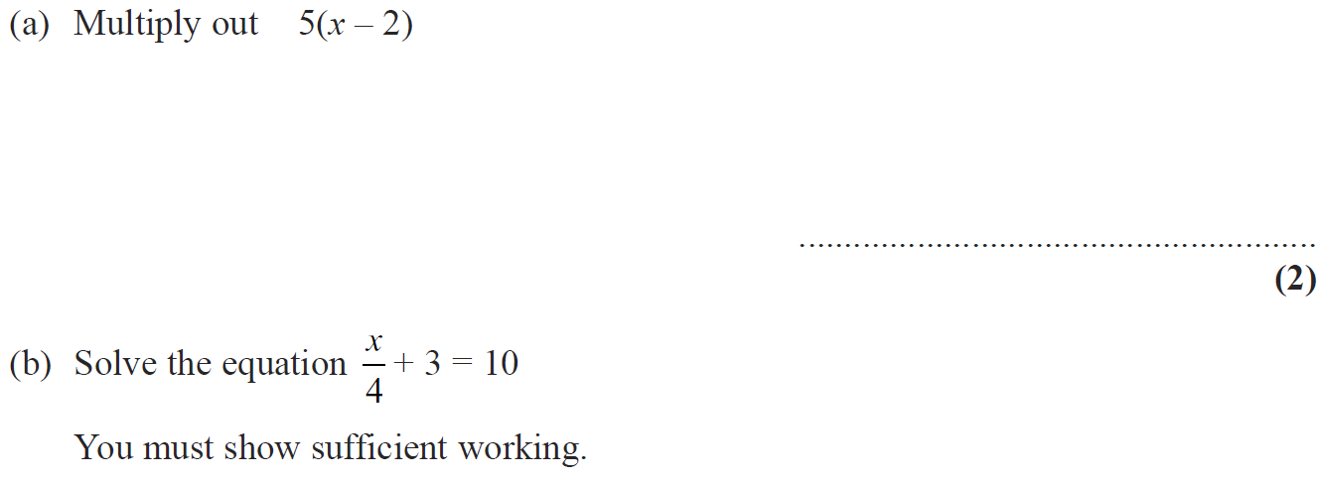
Linear Inequalities
Nov 2008 4H Q6

Slide 36
Linear Inequalities
Nov 2008 4H Q6
A
B
C

Slide 37
Linear Inequalities
Nov 2009 3H Q9

Slide 38
Linear Inequalities
Nov 2009 3H Q9
A
B
C

Slide 39
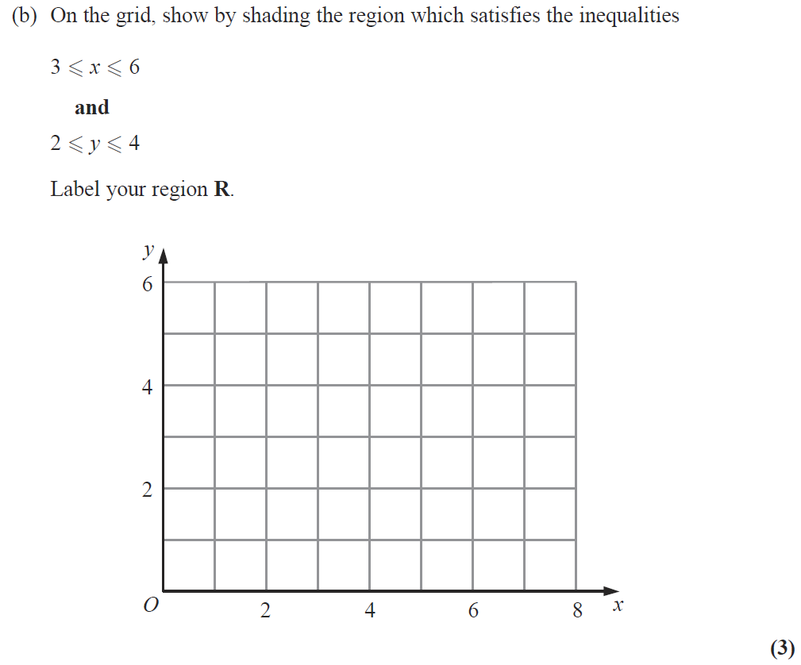
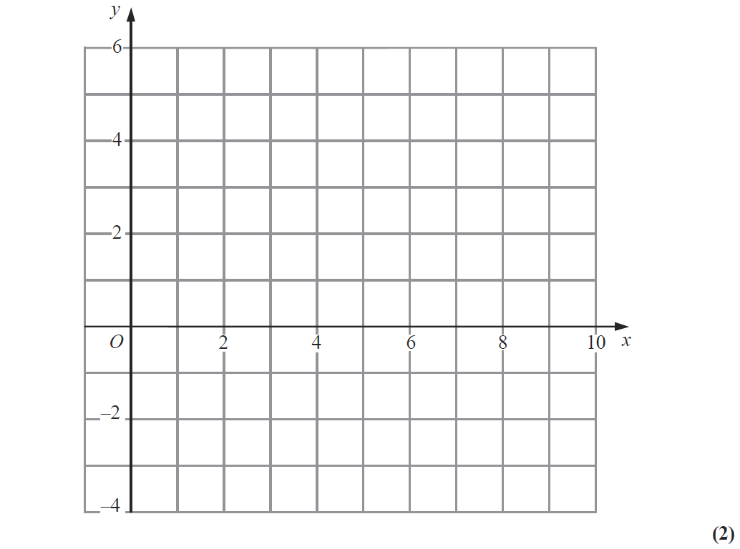
Linear Inequalities
Nov 2009 4H Q9
Show
Hide
Show
Hide
Show
Hide
R
Reveal Graph (a)
Hide Graph (a)
Note that in these diagrams I am shading the UNWANTED region

Slide 40
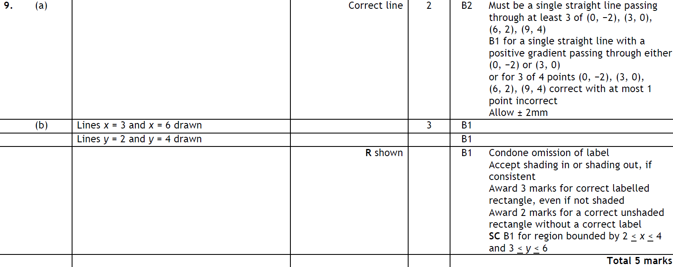
Linear Inequalities
Nov 2009 4H Q9
A
B

Slide 41
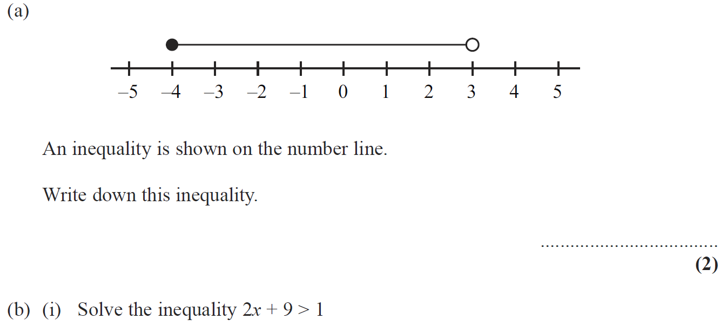
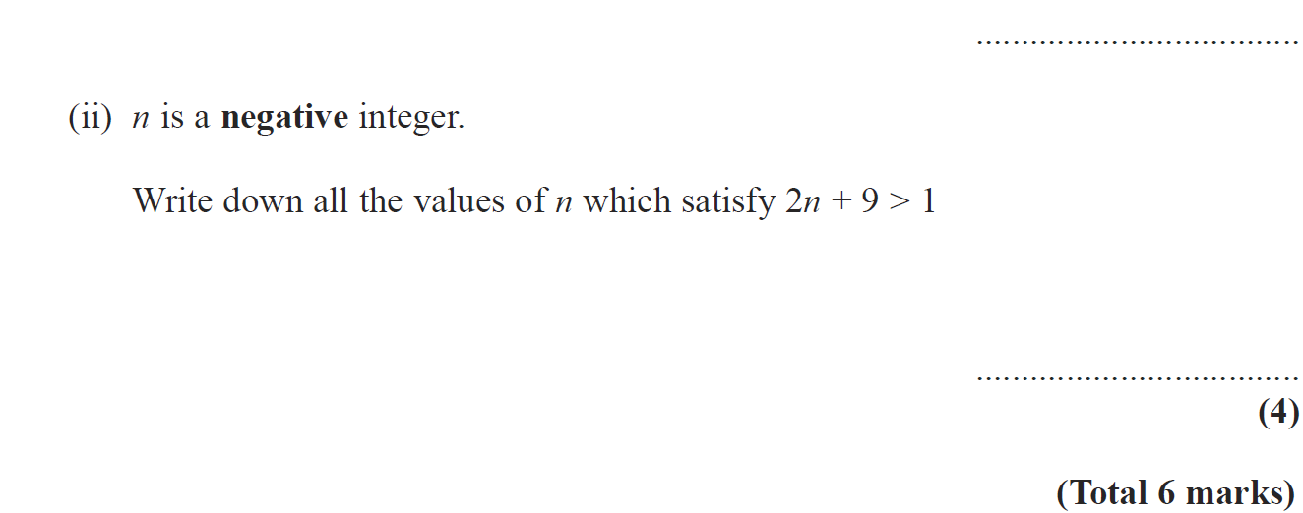
Linear Inequalities
June 2010 3H Q10

Slide 42
Linear Inequalities
June 2010 3H Q10
A
B (i)
B (ii)

Slide 43
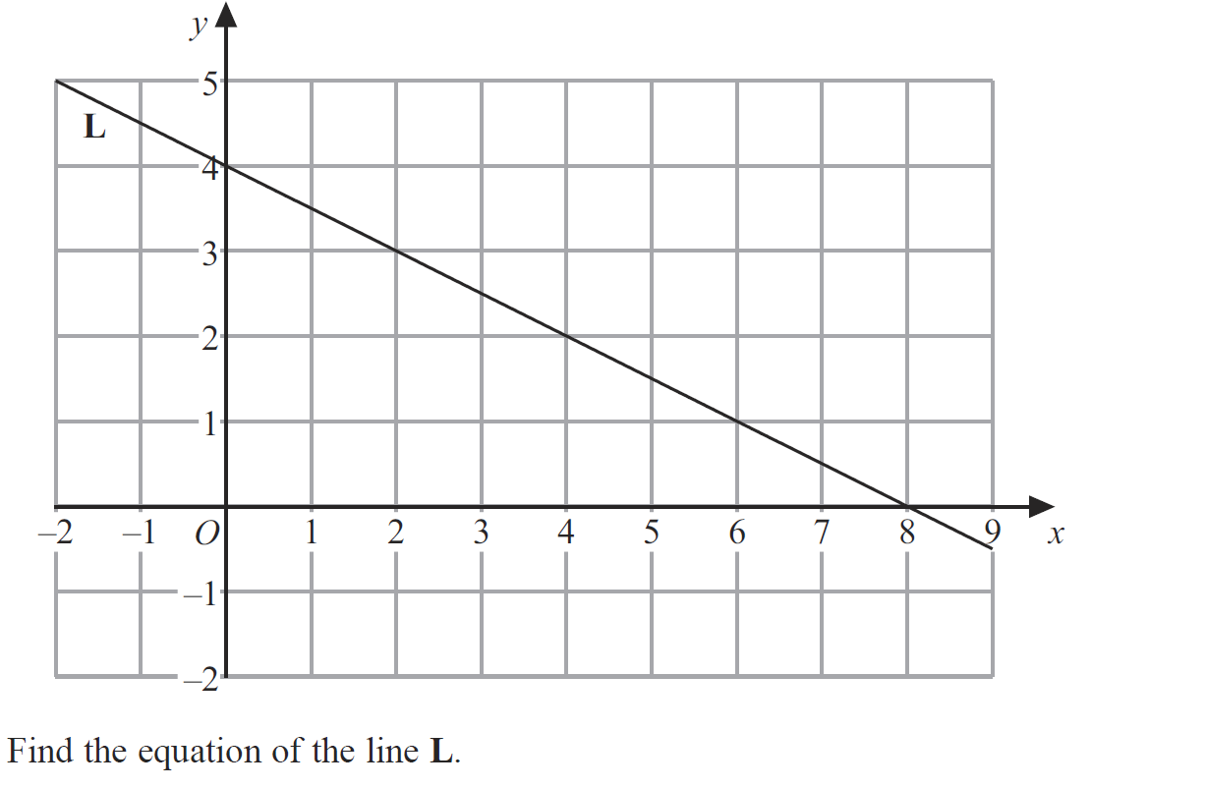
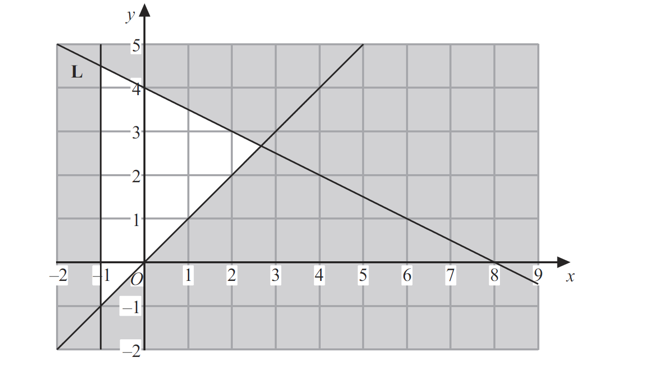
Linear Inequalities
June 2010 4H Q12

Slide 44
Linear Inequalities
June 2010 4H Q12
A
B

Slide 45
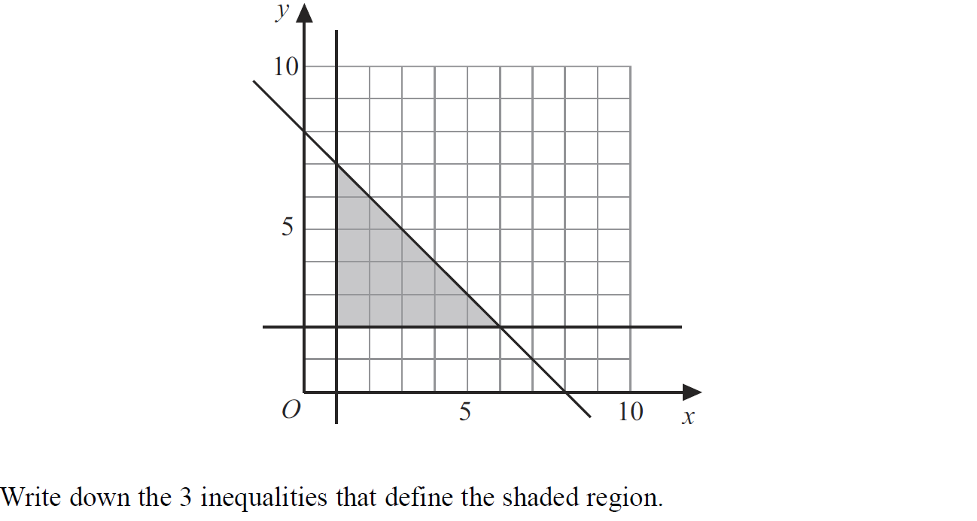
Linear Inequalities
Nov 2010 4H Q9

Slide 46
Linear Inequalities
Nov 2010 4H Q9
A

Slide 47
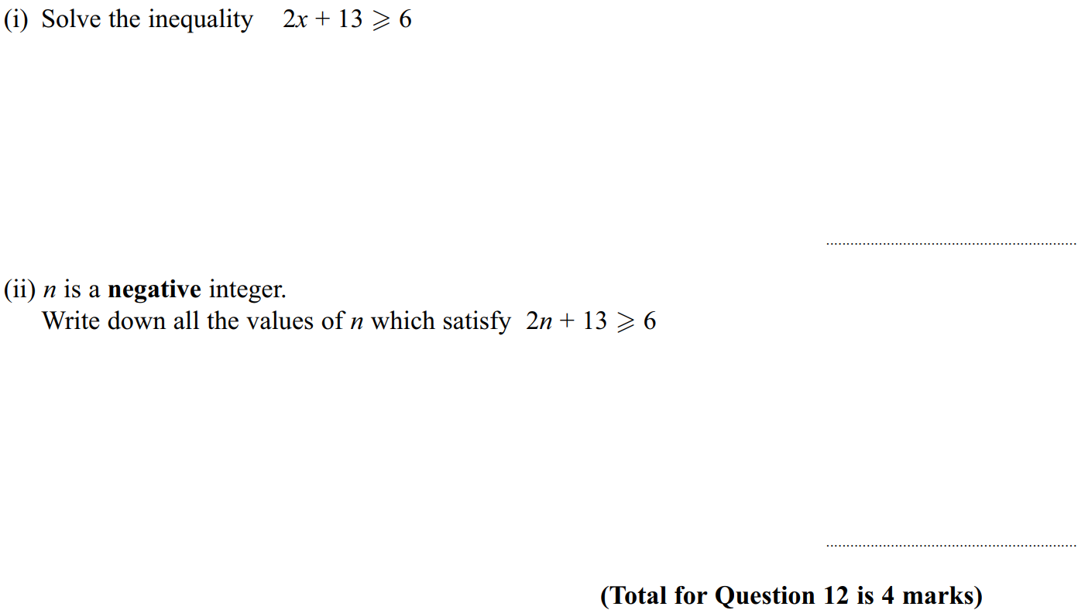
Linear Inequalities
June 2011 4H Q12

Slide 48
Linear Inequalities
June 2011 4H Q12
(i)
(ii)

Slide 49
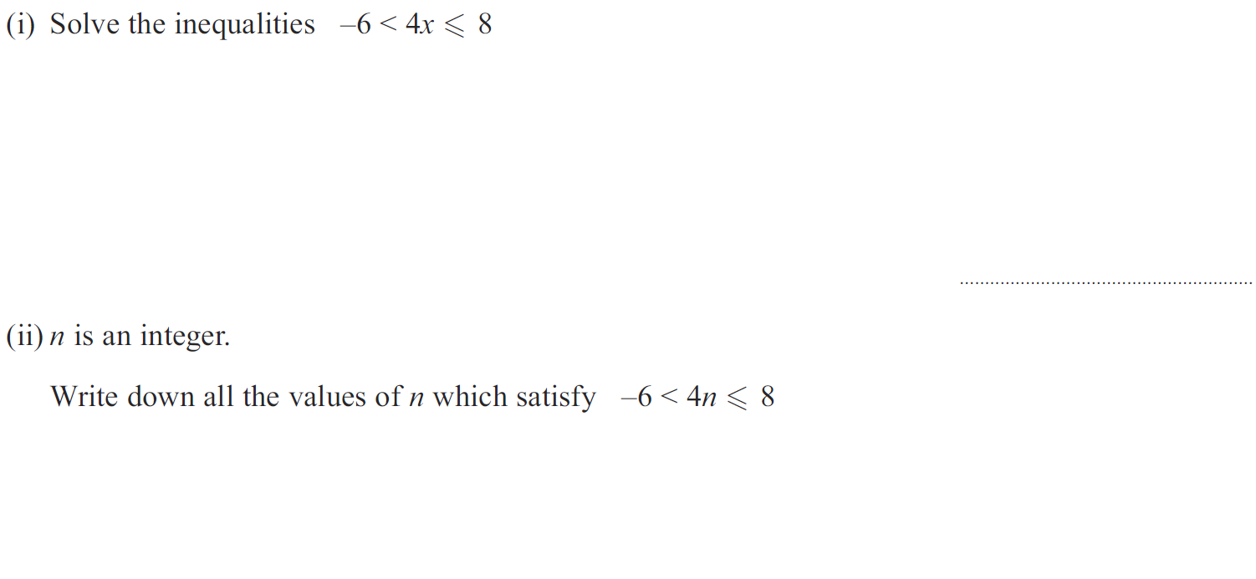
Linear Inequalities
Jan 2012 4H Q10

Slide 50
Linear Inequalities
Jan 2012 4H Q10
(i)
(ii)

Slide 51
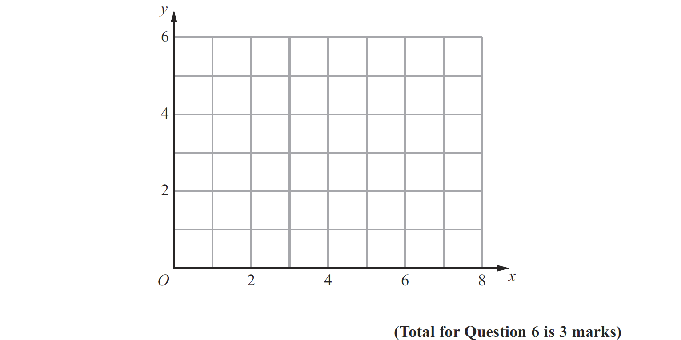
Linear Inequalities
May 2012 3H Q6
Show
Hide
Show
Hide
Show
Hide
Show
Hide
Note that in these diagrams I am shading the UNWANTED region
R

Slide 52
Linear Inequalities
May 2012 3H Q6
A

Slide 53
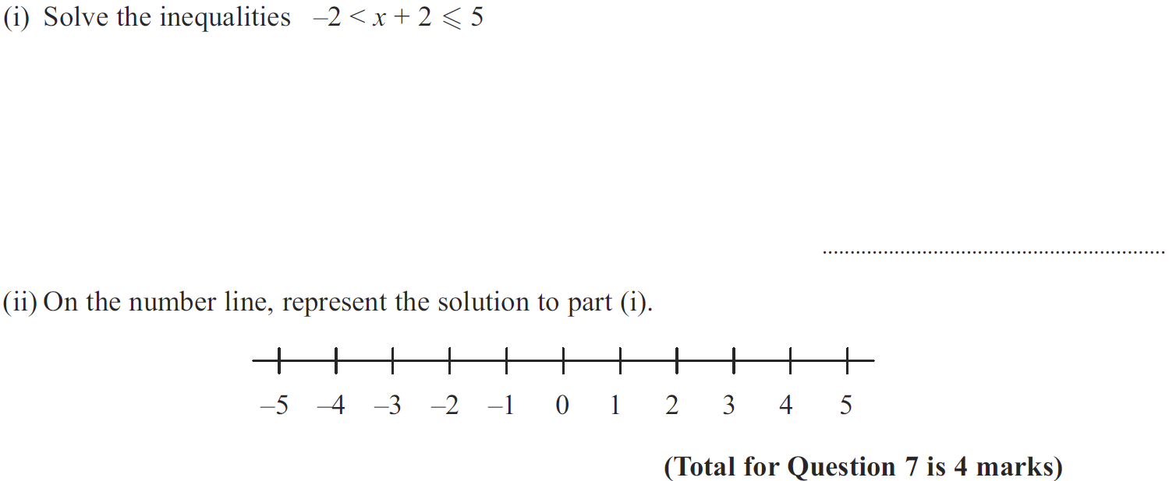
Linear Inequalities
Jan 2013 3H Q7

Slide 54
Linear Inequalities
Jan 2013 3H Q7
(i)
(ii)

Slide 55
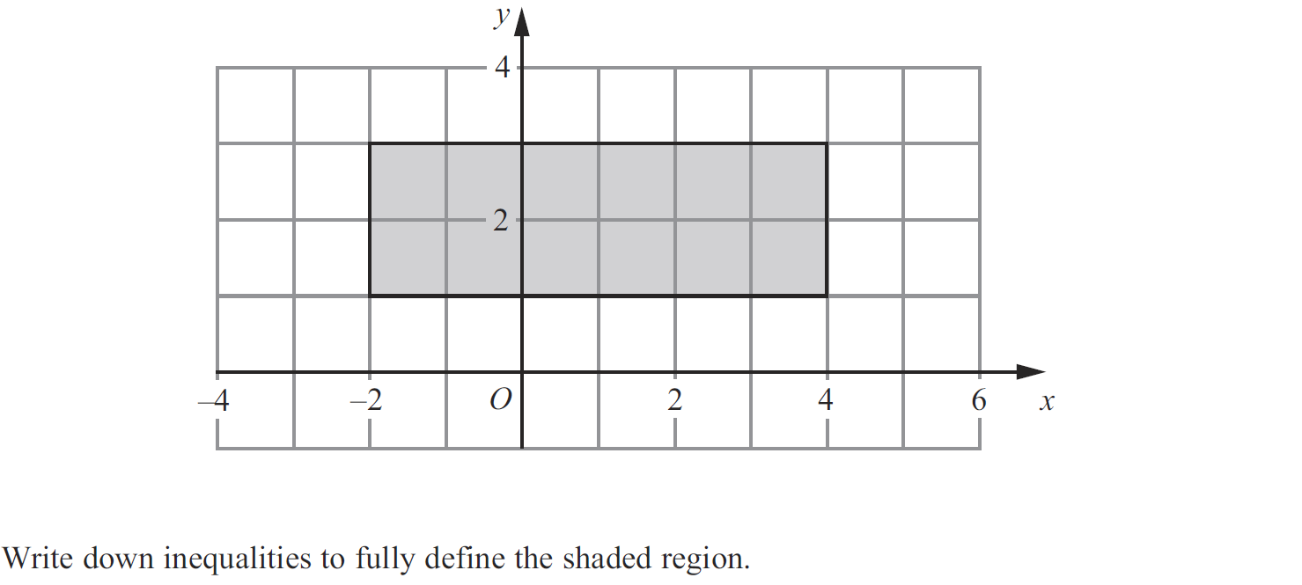
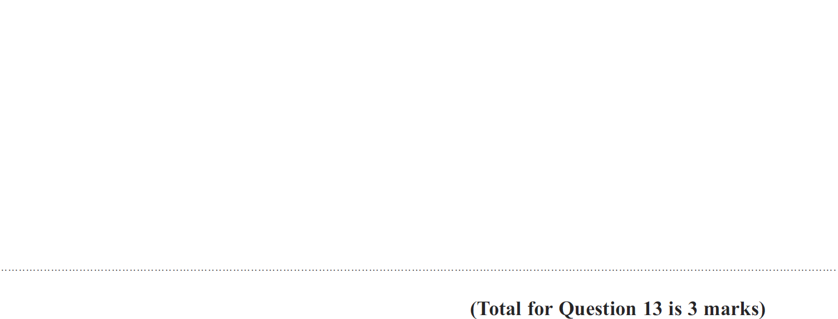
Linear Inequalities
Jan 2013 4H Q13

Slide 56
Linear Inequalities
Jan 2013 4H Q13
A

Slide 57
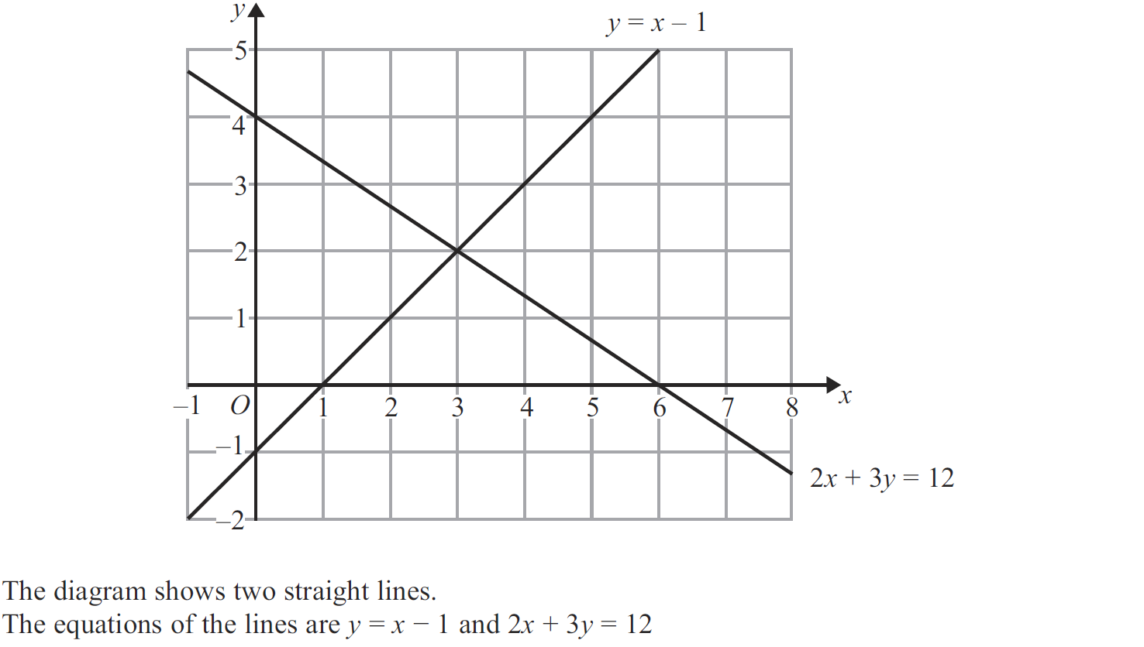
Linear Inequalities
May 2013 3H Q15

Slide 58
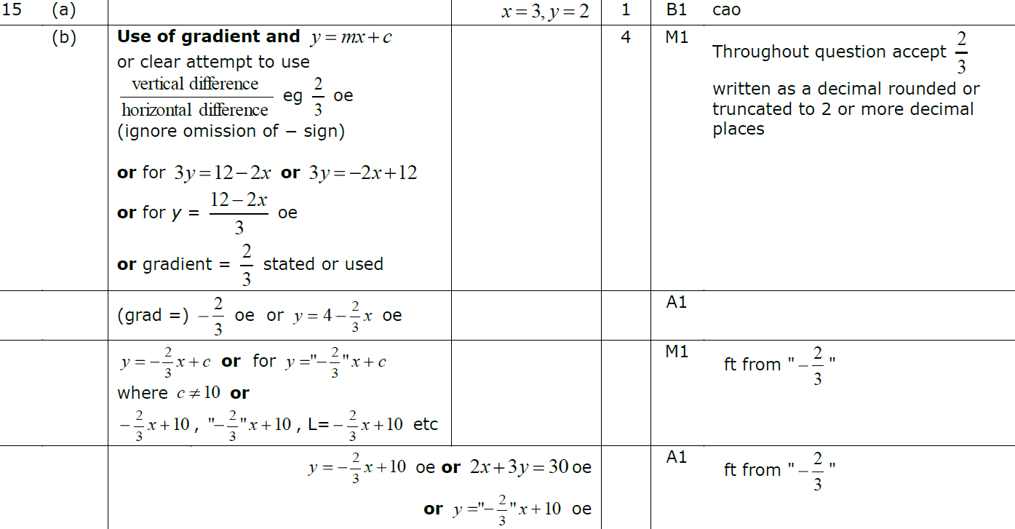
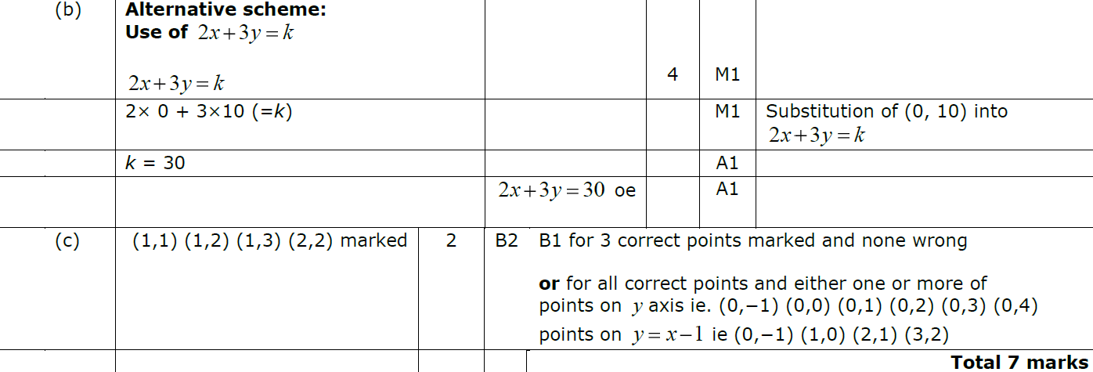
Linear Inequalities
May 2013 3H Q15
A
B
C

Slide 59
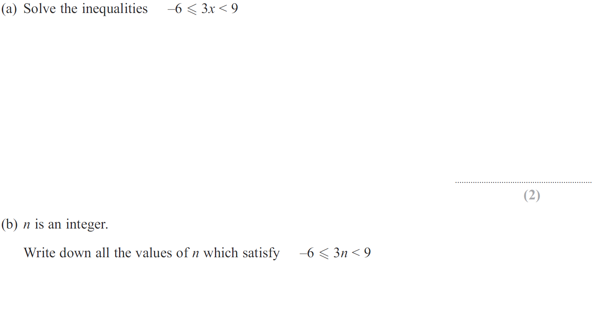
Linear Inequalities
May 2013 4H Q9

Slide 60
Linear Inequalities
May 2013 4H Q9
A
B

Slide 61
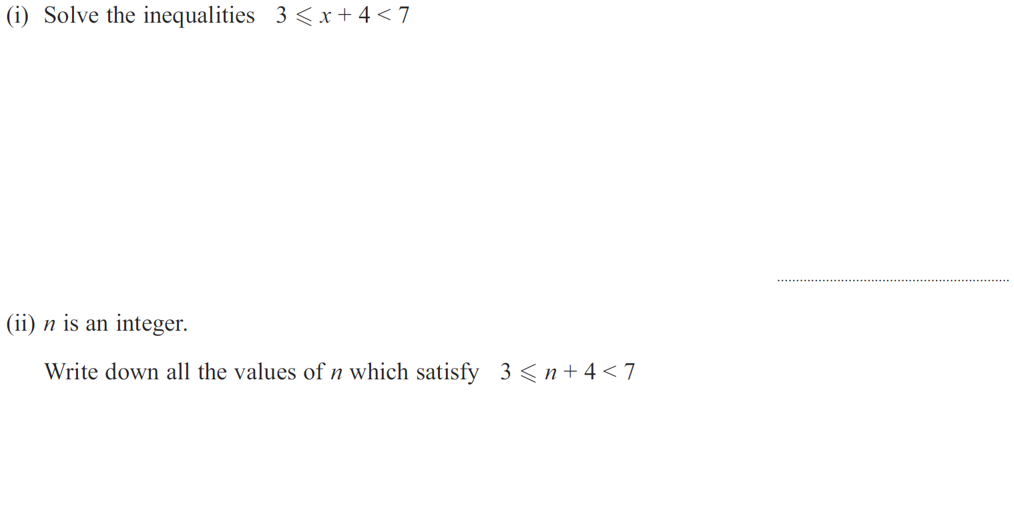
Linear Inequalities
May 2013 4HR Q7

Slide 62
Linear Inequalities
May 2013 4HR Q7
(i)
(ii)

Slide 63
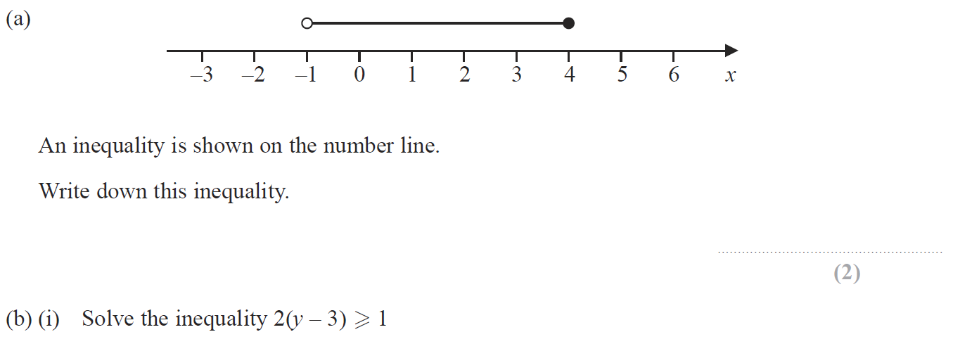
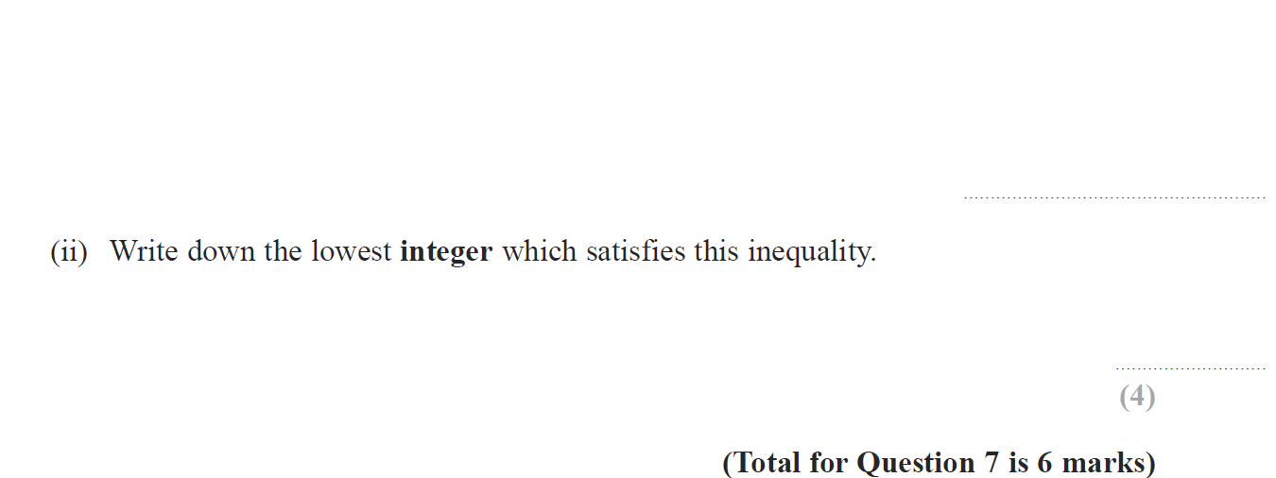
Linear Inequalities
Jan 2014 3H Q7

Slide 64
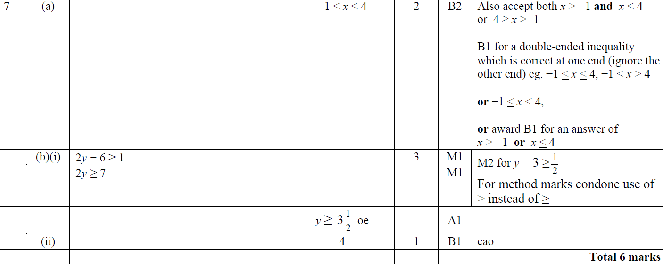
Linear Inequalities
Jan 2014 3H Q7
A
B (i)
B (ii)

Slide 65
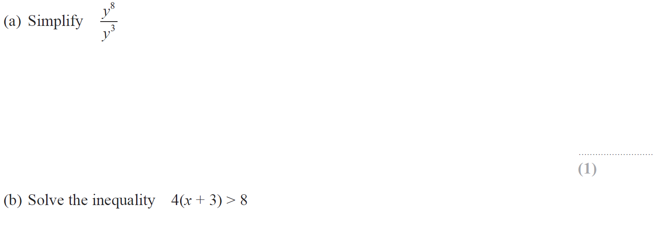
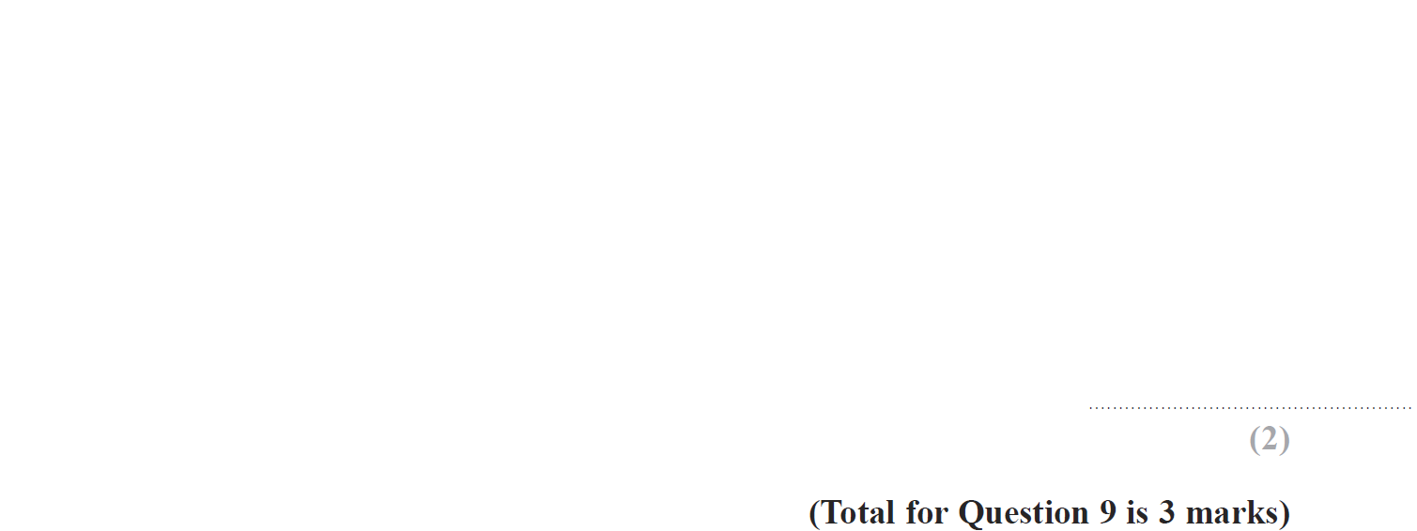
Linear Inequalities
Jan 2014 3HR Q9

Slide 66
Linear Inequalities
Jan 2014 3HR Q9
A
B

Slide 67
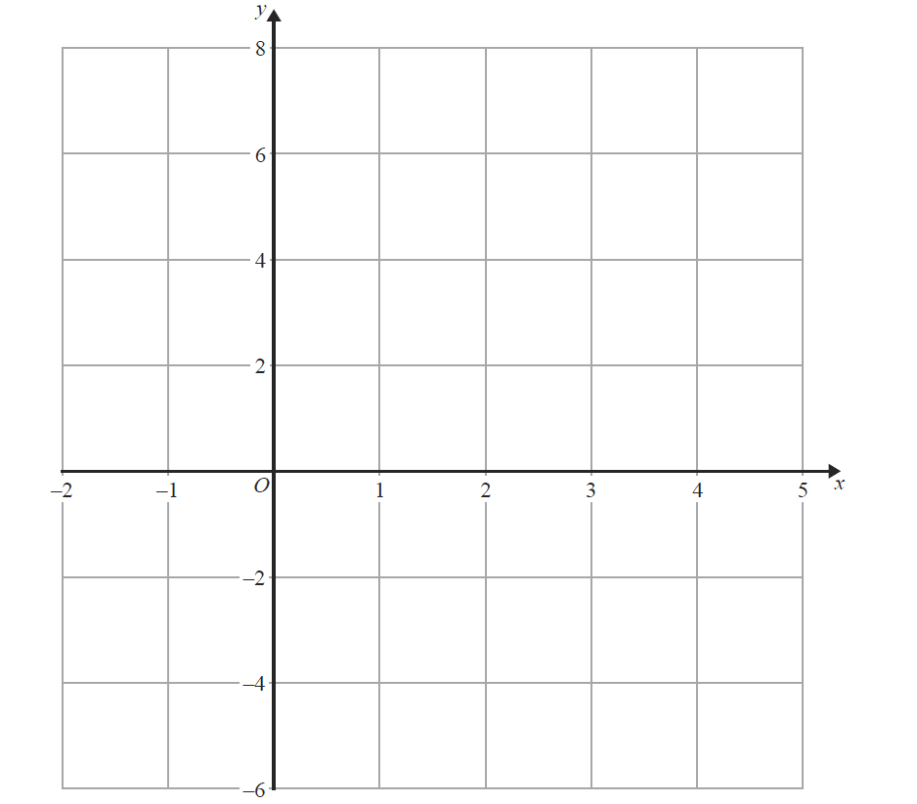
Linear Inequalities
Jan 2014 4HR Q8
Show
R
Note that in these diagrams I am shading the UNWANTED region
Show
Show
Show
Show
Hide
Hide
Hide
Hide

Slide 68
Linear Inequalities
Jan 2014 4HR Q8
A
B
C

Slide 69
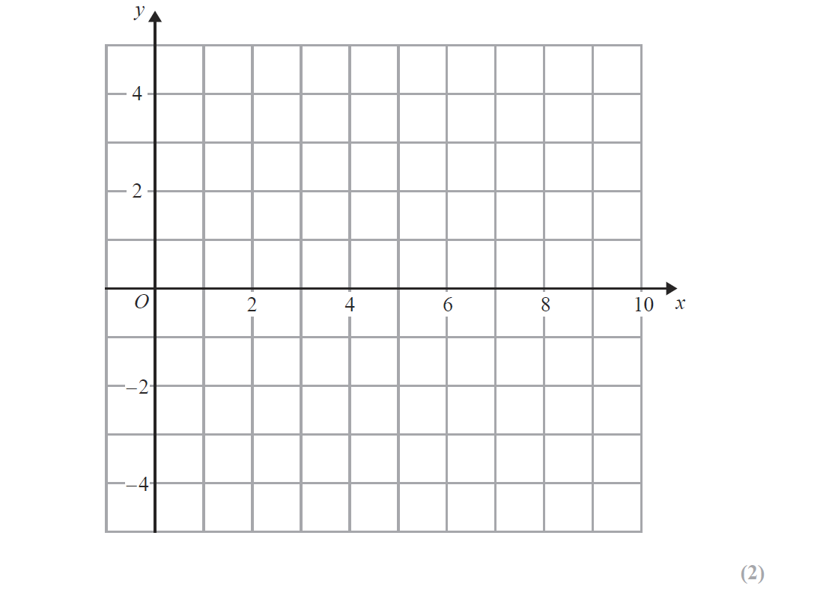
Linear Inequalities
May 2014 3H Q8
Show
R
Note that in these diagrams I am shading the UNWANTED region
Show
Hide
Show
Hide
Show
Hide
Show
Hide

Slide 70
Linear Inequalities
May 2014 3H Q8
A
B

Slide 71
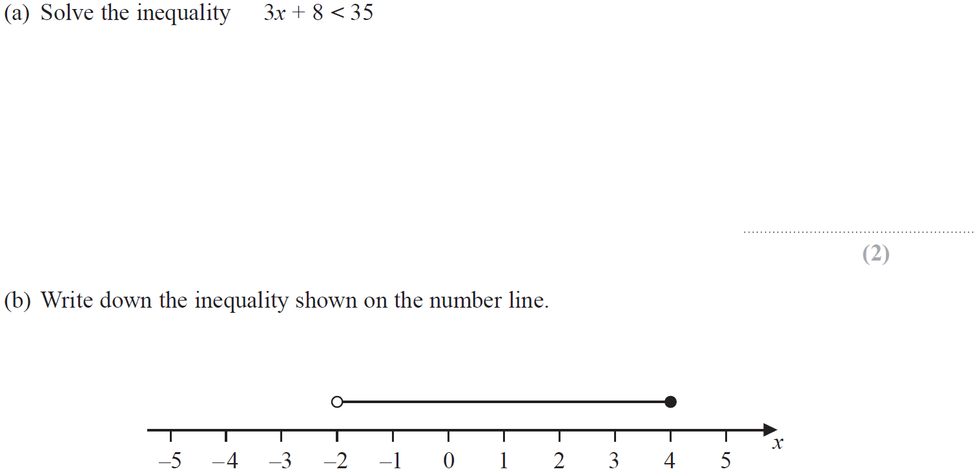
Linear Inequalities
Jan 2015 4H Q10

Slide 72
Linear Inequalities
Jan 2015 4H Q10
A
B

Slide 73
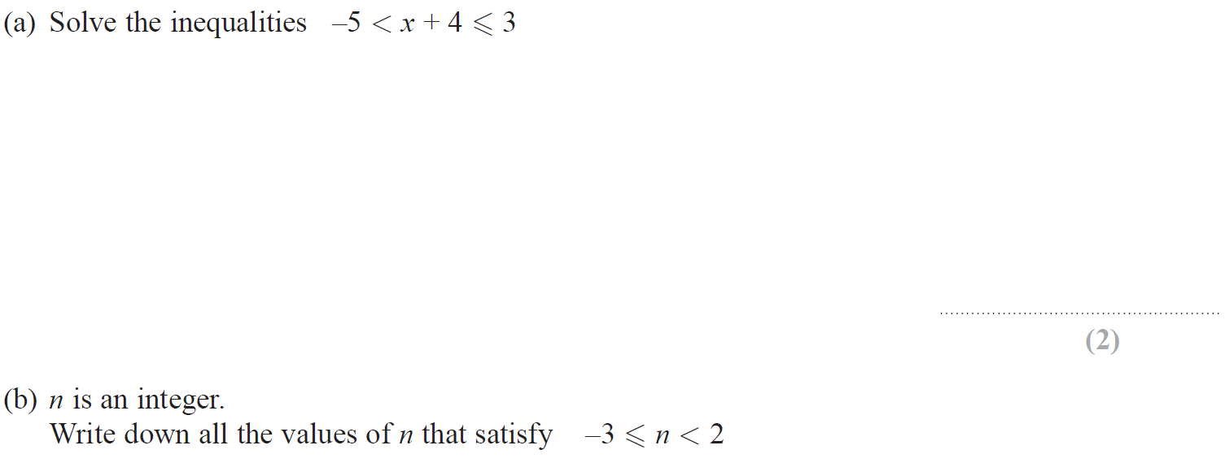
Linear Inequalities
June 2015 4H Q9

Slide 74
Linear Inequalities
June 2015 4H Q9
A
B

Slide 75
Linear Inequalities
June 2015 4HR Q4
Show
Show valid points

Slide 76
Linear Inequalities
June 2015 4HR Q4
A
B

Slide 77
Linear Inequalities
June 2015 4HR Q9

Slide 78
Linear Inequalities
June 2015 4HR Q9
A
B
C
D

Slide 79
Linear Inequalities
Jan 2016 3H Q10
Show
R
Show
Show
Show
Show
Hide
Hide
Hide
Hide
Note that in these diagrams I am shading the UNWANTED region

Slide 80
Linear Inequalities
Jan 2016 3H Q10
A
B

Slide 81
Linear Inequalities
Jan 2016 4H Q9

Slide 82
Linear Inequalities
Jan 2016 4H Q9
A
B
C

Slide 83
Linear Inequalities
Jan 2016 3HR Q7

Slide 84
Linear Inequalities
Jan 2016 3HR Q7
A
B
C

Slide 85
Linear Inequalities
May 2016 3H Q7

Slide 86
Linear Inequalities
May 2016 3H Q7
A
B
C (i)
C (ii)
D

Slide 87
Linear Inequalities
May 2016 3HR Q6

Slide 88
Linear Inequalities
May 2016 3HR Q6
A
B

Slide 89
Linear Inequalities
Jan 2017 3H Q5

Slide 90
Linear Inequalities
Jan 2017 3H Q5
A
B
C
D
E

Slide 91
Linear Inequalities
Jan 2017 3H Q8
Show
R
Show
Hide
Show
Hide
Show
Hide
Show
Hide

Slide 92
Linear Inequalities
Jan 2017 3H Q8
A
B

Slide 93
Linear Inequalities
Jan 2017 4HR Q7

Slide 94
Linear Inequalities
Jan 2017 4HR Q7
A
B
C
D
E

Slide 95
Linear Inequalities
June 2017 4H Q2

Slide 96
Linear Inequalities
June 2017 4H Q2
A
B
C

Slide 97
Linear Inequalities
May 2017 3HR Q13
Show
Hide
Show
Hide
Show
Hide
Show
Hide
R

Slide 98
Linear Inequalities
May 2017 3HR Q13
A

Slide 99
Linear Inequalities
June 2017 4HR Q7

Slide 100
Linear Inequalities
June 2017 4HR Q7
A
B
C

Slide 101
Linear Inequalities
Jan 2018 3H Q5

Slide 102
Linear Inequalities
Jan 2018 3H Q5
A
B
C

Slide 103
Linear Inequalities
Jan 2018 4HR Q7

Slide 104
Linear Inequalities
Jan 2018 4HR Q7
A
B
C
D
E

Slide 105
Linear Inequalities
May 2018 3H Q8

Slide 106
Linear Inequalities
May 2018 3H Q8
A
B

Slide 107
Linear Inequalities
May 2018 3HR Q14

Slide 108
Linear Inequalities
May 2018 3HR Q14
A
B

Slide 109
Linear Inequalities
June 2018 4HR Q9

Slide 110
Linear Inequalities
June 2018 4HR Q9
A
B
C
D

