Slide 1
Linear Inequalities
Linear Inequalities
June 2017
3H Q13
Edexcel
SAM
3H Q9
Nov 2017
2H Q14
AQA
Spec 1
3H Q10
May 2018
1H Q20
OCR
June 2019
2H Q2
Graphical

Slide 2
Linear Inequalities
Linear Inequalities
May 2017
1H Q14
Nov 2017
3H Q23
Edexcel
June 2017
3H Q6
May 2018
1H Q5
AQA
SAM
1H Q8
1 Marker
Nov 2017
1H Q5
June 2018
3H Q2
OCR
Nov 2017
3H Q1
Nov 2018
3H Q10
Graphical

Slide 3
Linear Inequalities
Linear Inequalities
June 2017
2H Q10
Edexcel
SAM
3H Q2
Nov 2017
3H Q18
AQA
Practice
3H Q3
June 2018
2H Q2
OCR
Nov 2018
2H Q14
Graphical

Slide 4
Linear Inequalities
SAM 3H Q9

Slide 5
Linear Inequalities
SAM 3H Q9
A
B
C

Slide 6
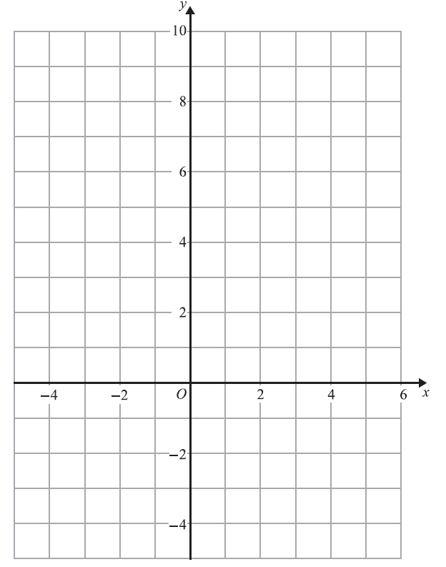
Linear Inequalities
Specimen Set 1 3H Q10
Reverse regions:
Show
Hide
Show
Hide
Show
Hide
Show
Hide
Show
Hide
R

Slide 7
Linear Inequalities
Specimen Set 1 3H Q10
A

Slide 8
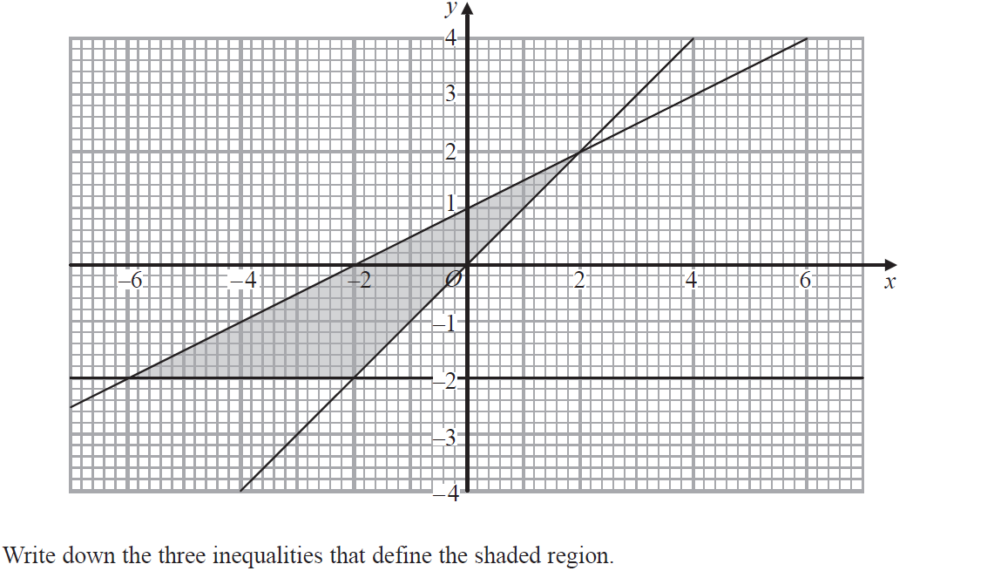
Linear Inequalities
June 2017 3H Q13

Slide 9
Linear Inequalities
June 2017 3H Q13
A

Slide 10
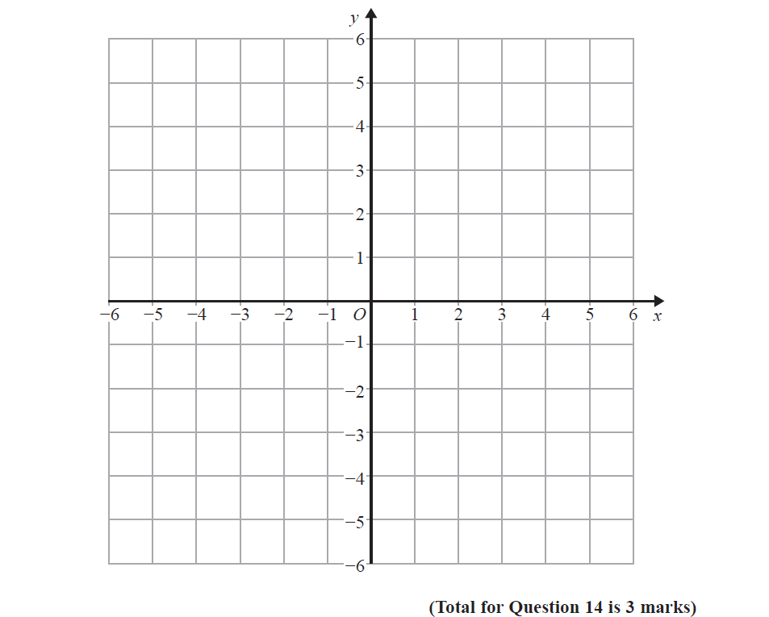
Linear Inequalities
Nov 2017 2H Q14
Reverse regions:
Show
Hide
Show
Hide
Show
Hide
Show
Hide
Show
Hide
R

Slide 11
Linear Inequalities
Nov 2017 2H Q14
A

Slide 12
Linear Inequalities
May 2018 1H Q20

Slide 13
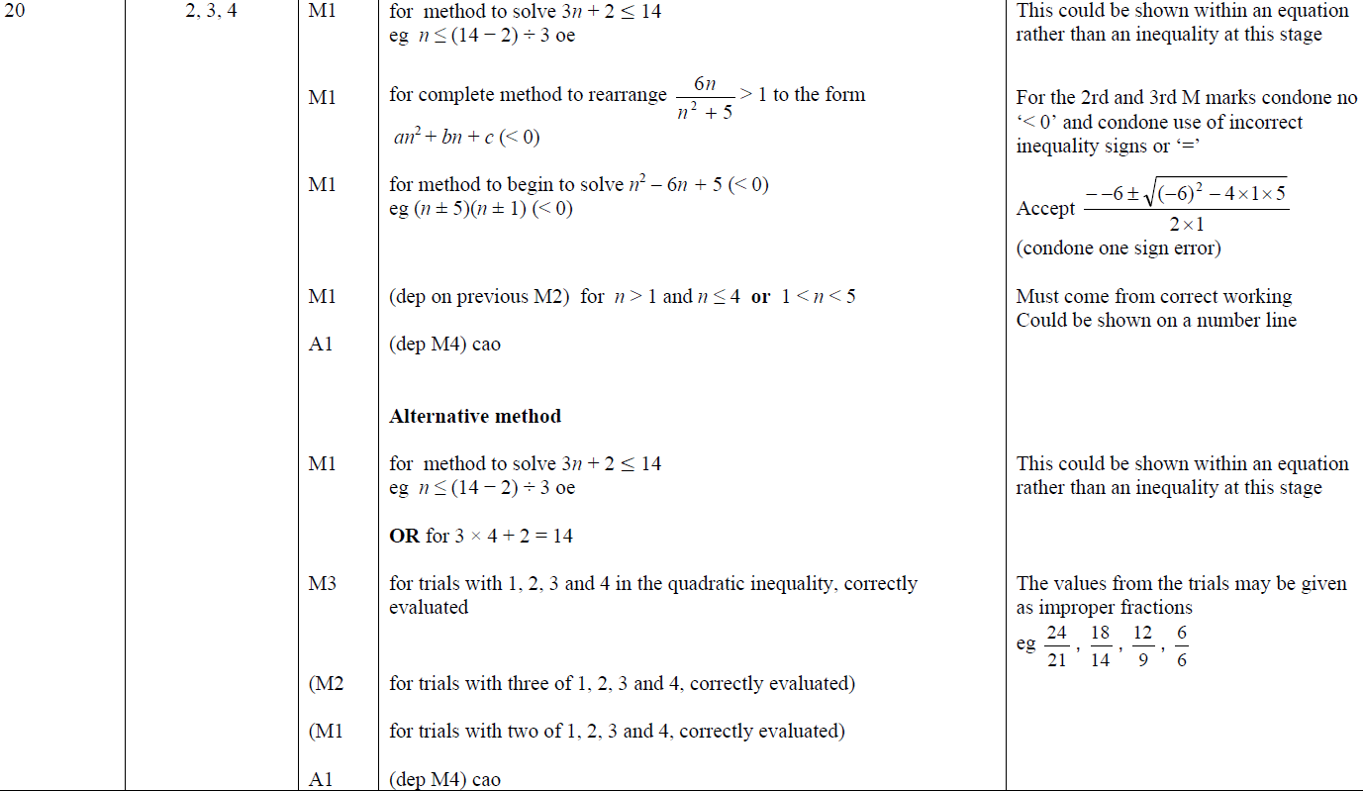
Linear Inequalities
May 2018 1H Q20
A

Slide 14
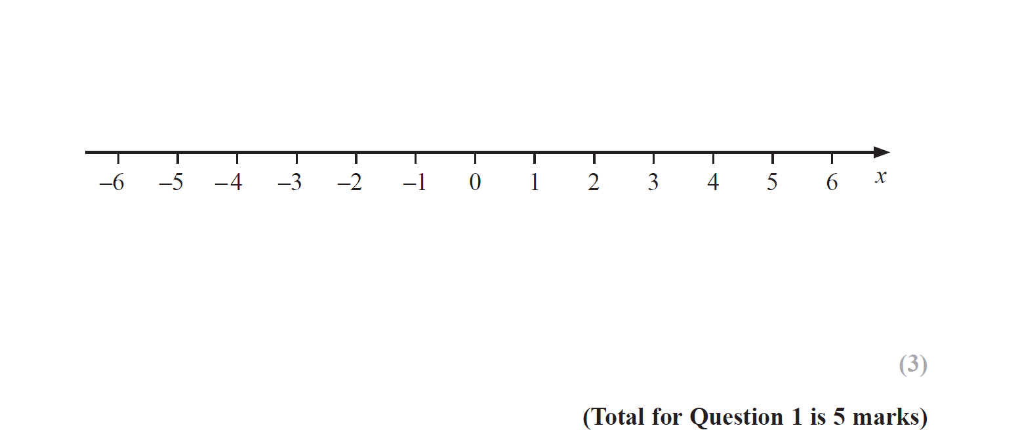
Linear Inequalities
June 2019 2H Q2

Slide 15
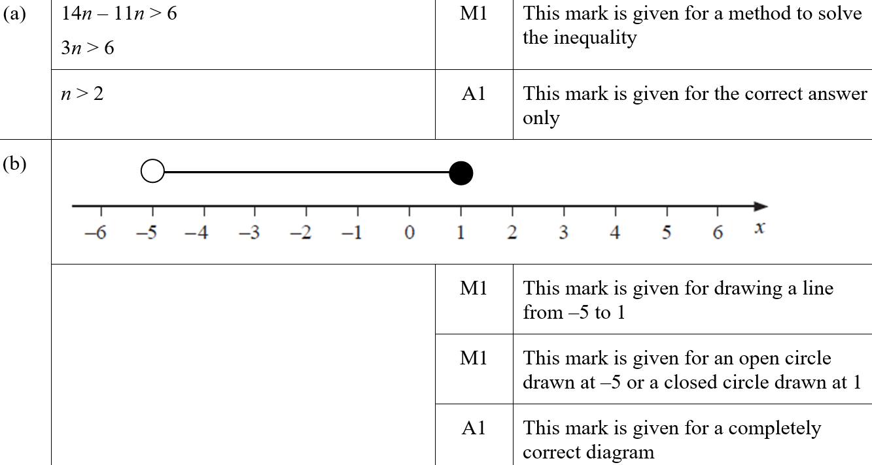
Linear Inequalities
June 2019 2H Q2
A
B
A SF
B SF

Slide 16
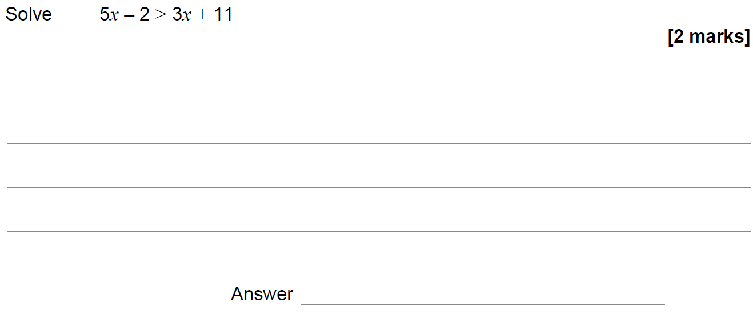
Linear Inequalities
SAM 1H Q8

Slide 17
Linear Inequalities
SAM 1H Q8
A

Slide 18
Linear Inequalities
May 2017 1H Q14

Slide 19
Linear Inequalities
May 2017 1H Q14
A

Slide 20
Linear Inequalities
June 2017 3H Q6

Slide 21
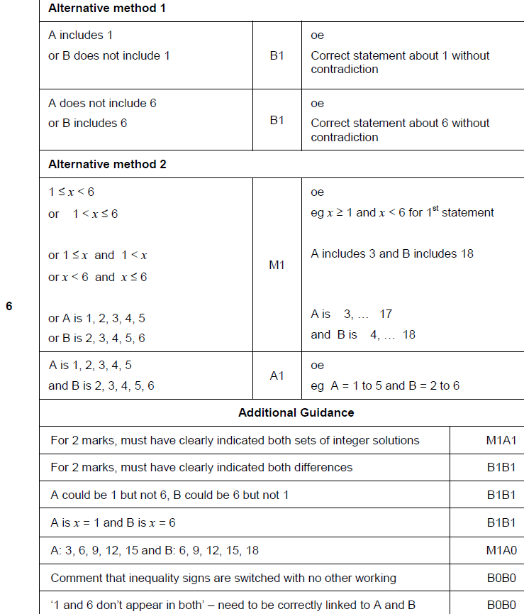
Linear Inequalities
June 2017 3H Q6
A

Slide 22
Linear Inequalities
Nov 2017 1H Q5

Slide 23
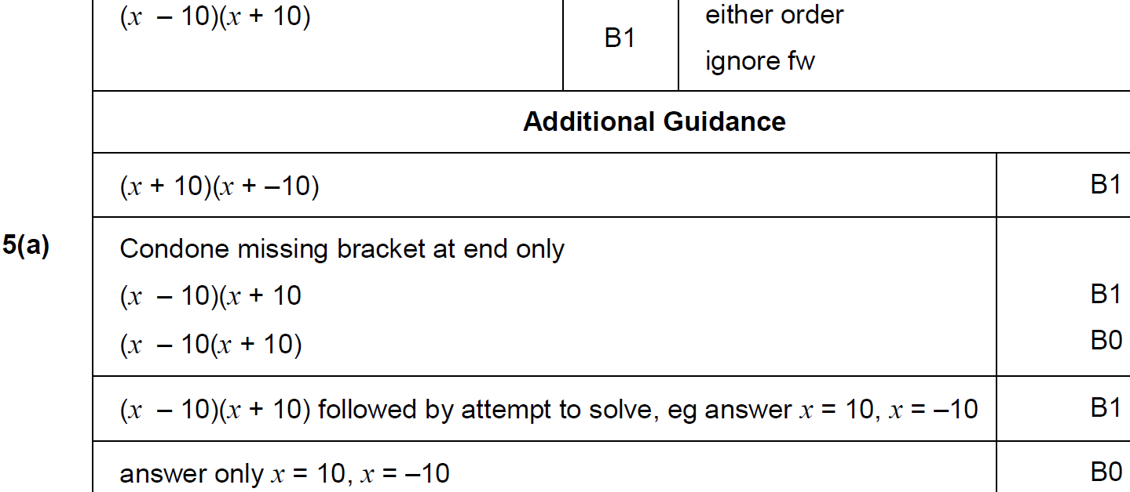
Linear Inequalities
Nov 2017 1H Q5
A

Slide 24
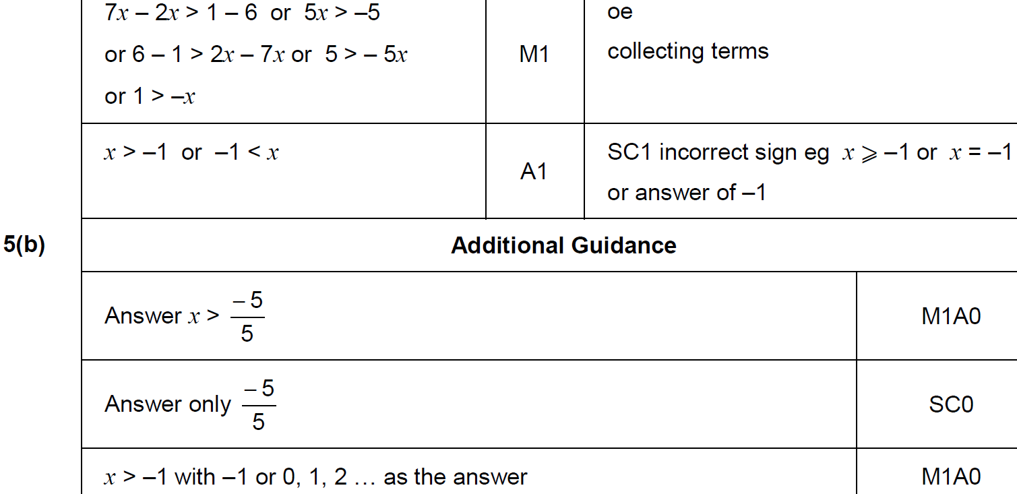
Linear Inequalities
Nov 2017 1H Q5
B

Slide 25
Linear Inequalities
Nov 2017 3H Q1

Slide 26
Linear Inequalities
Nov 2017 3H Q1
A

Slide 27
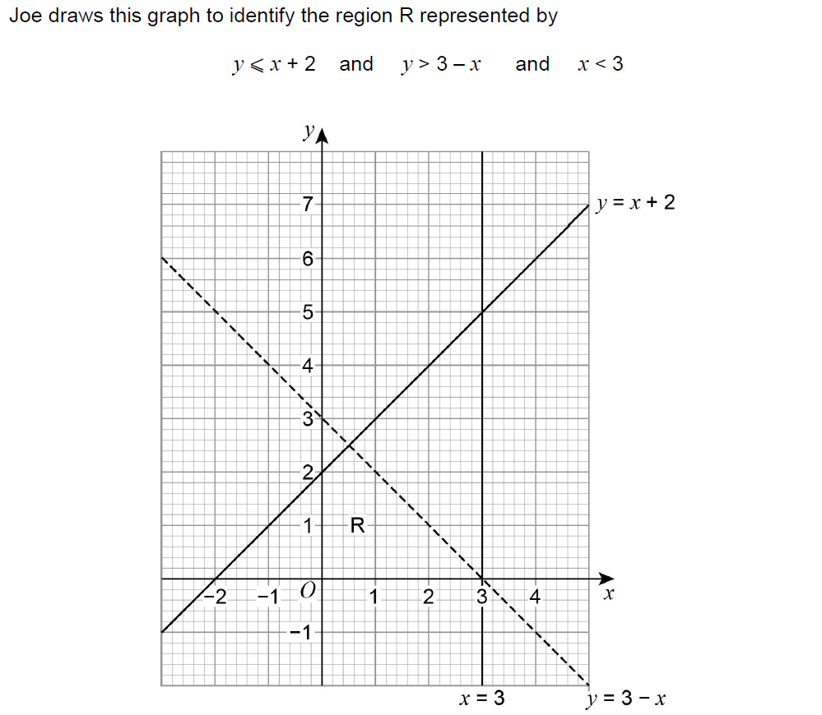
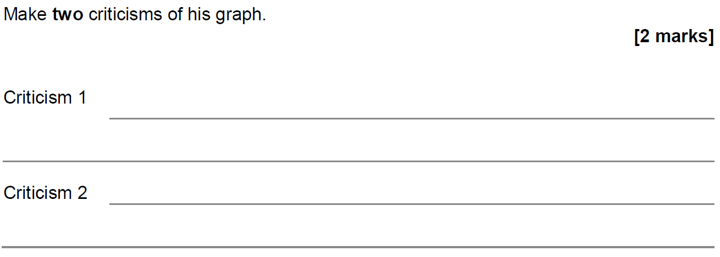
Linear Inequalities
Nov 2017 3H Q23

Slide 28
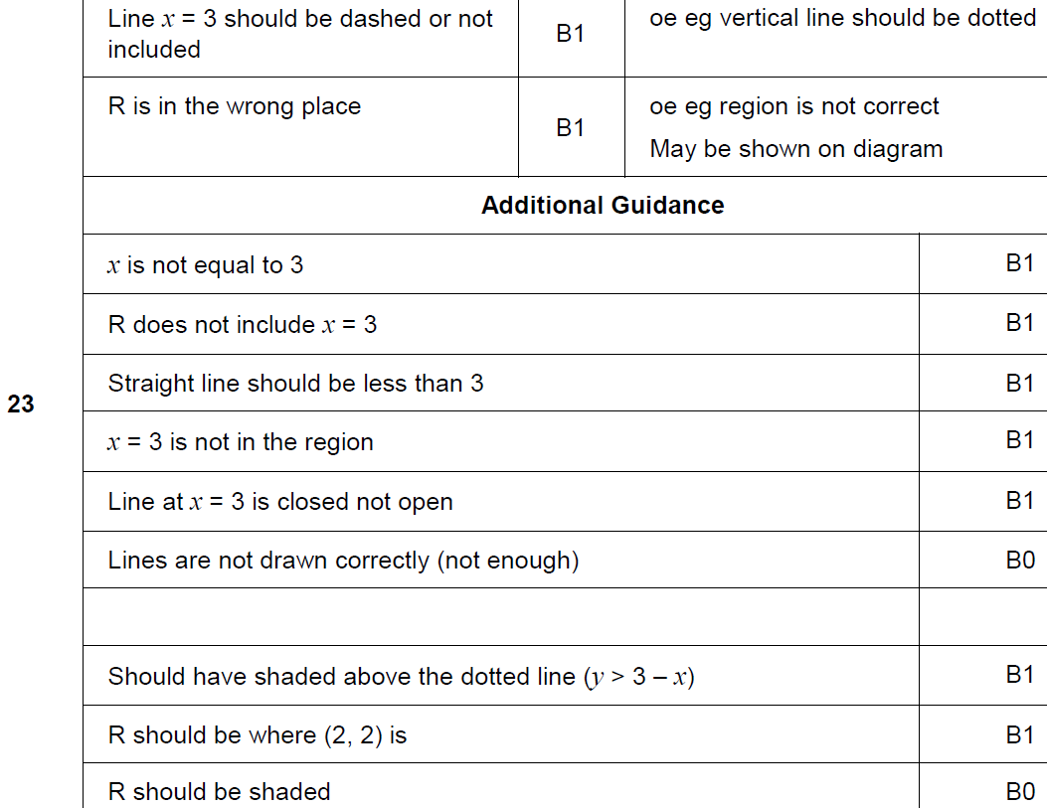
Linear Inequalities
Nov 2017 3H Q23
A

Slide 29
Linear Inequalities
May 2018 1H Q5
Solve 5(x + 3) < 60
[2 marks]

Slide 30
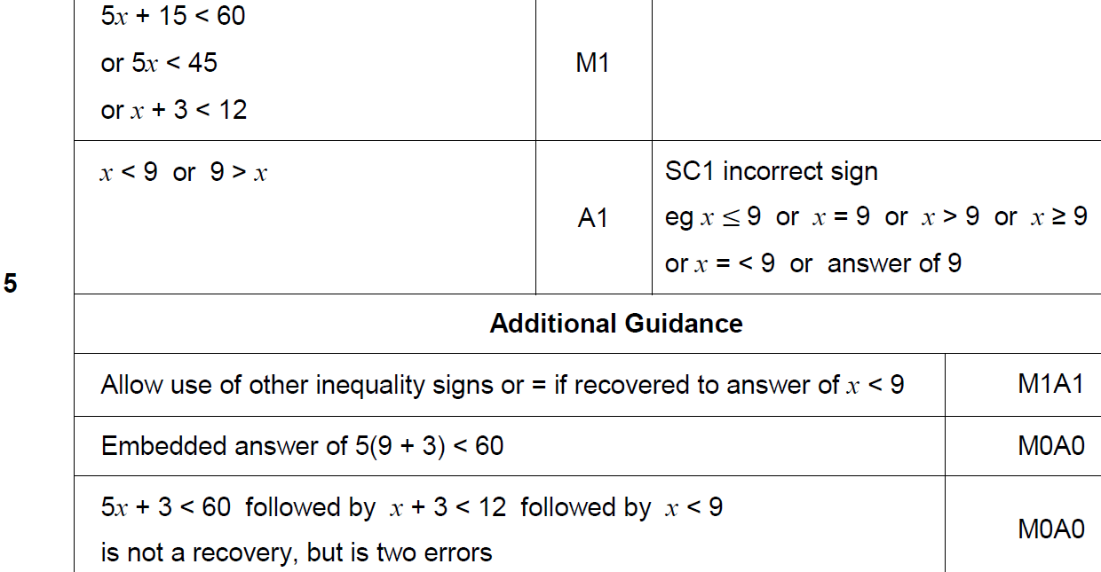
Linear Inequalities
May 2018 1H Q5
A

Slide 31
Linear Inequalities
June 2018 3H Q2

Slide 32
Linear Inequalities
June 2018 3H Q2
A

Slide 33
Linear Inequalities
Nov 2018 3H Q10

Slide 34
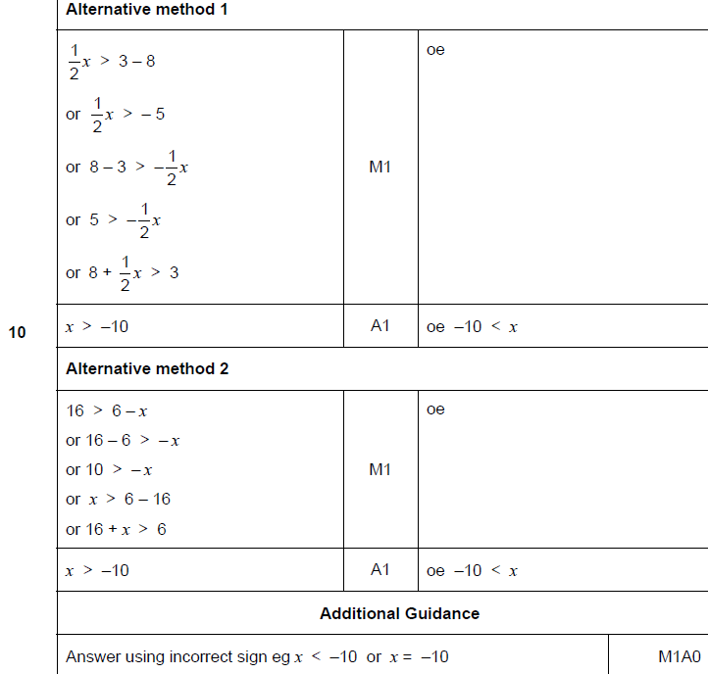
Linear Inequalities
Nov 2018 3H Q10
A

Slide 35
Linear Inequalities
SAM 3H Q2

Slide 36
Linear Inequalities
SAM 3H Q2
A (i)
A (ii)
B
C

Slide 37
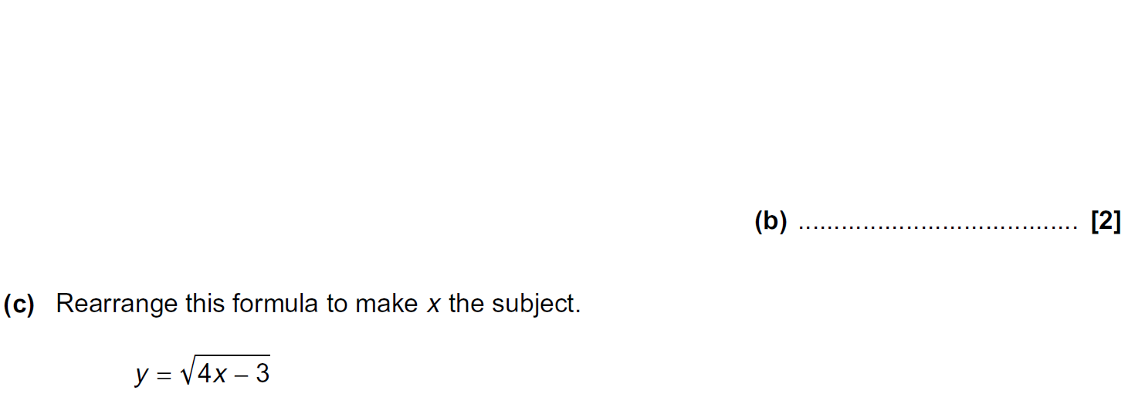
Linear Inequalities
Practice 3H Q3

Slide 38
Linear Inequalities
Practice 3H Q3
A
B
C

Slide 39
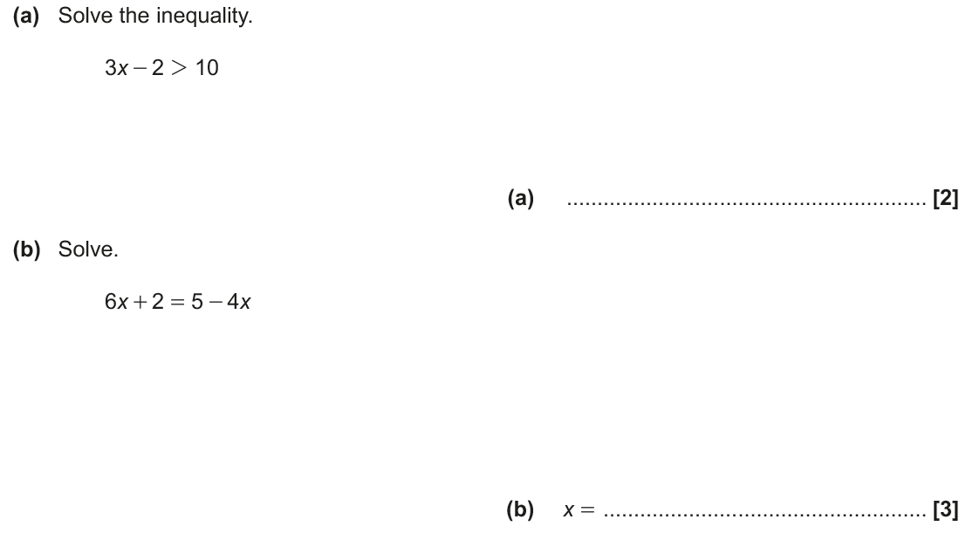
Linear Inequalities
June 2017 2H Q10

Slide 40
Linear Inequalities
June 2017 2H Q10
A
B

Slide 41
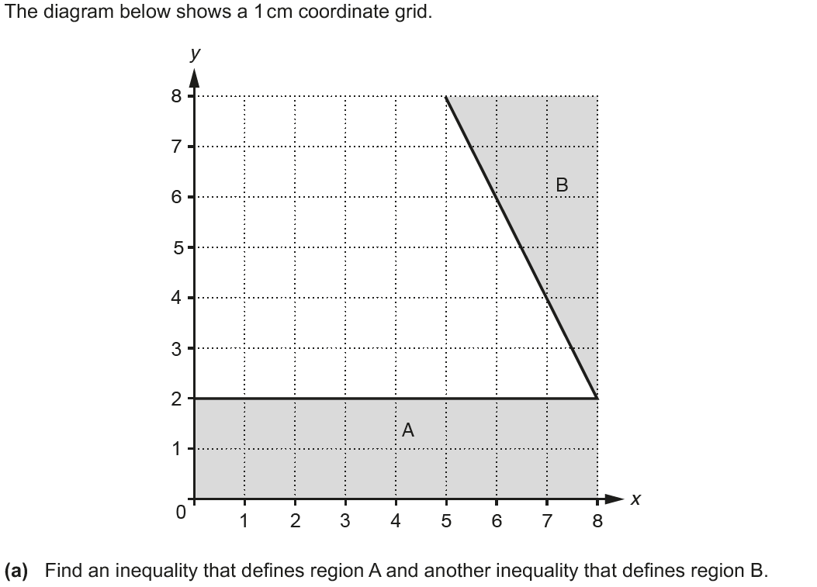
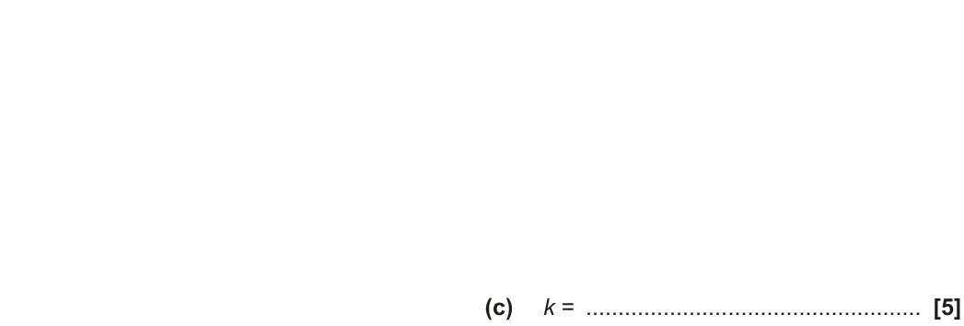
Linear Inequalities
Nov 2017 3H Q18
Show
Hide

Slide 42
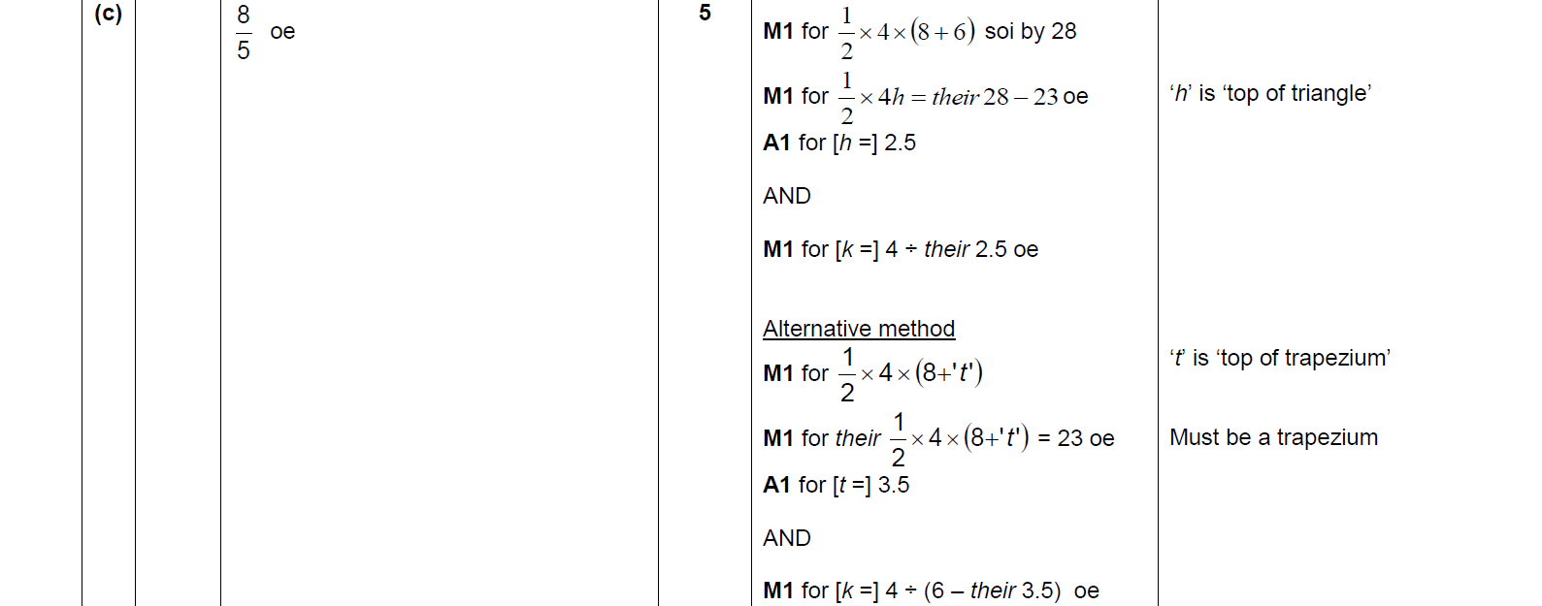
Linear Inequalities
Nov 2017 3H Q18
A
B
C

Slide 43
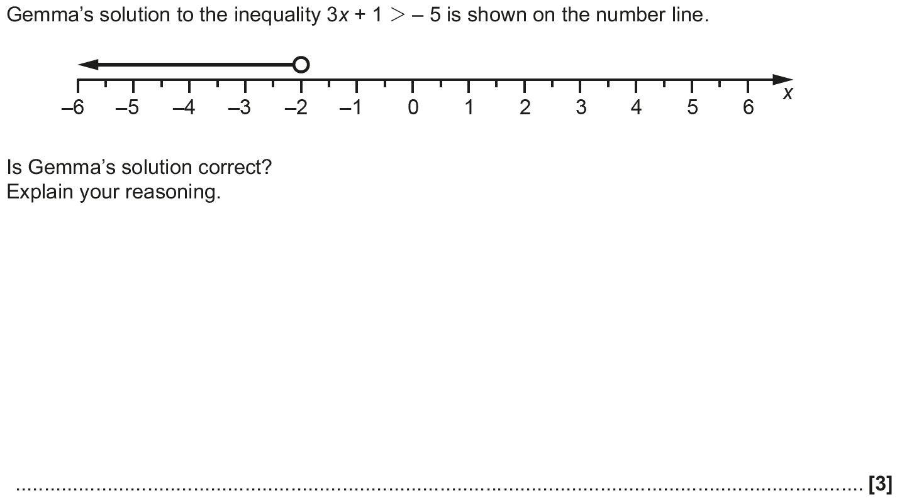
Linear Inequalities
June 2018 2H Q2

Slide 44
Linear Inequalities
June 2018 2H Q2
A

Slide 45
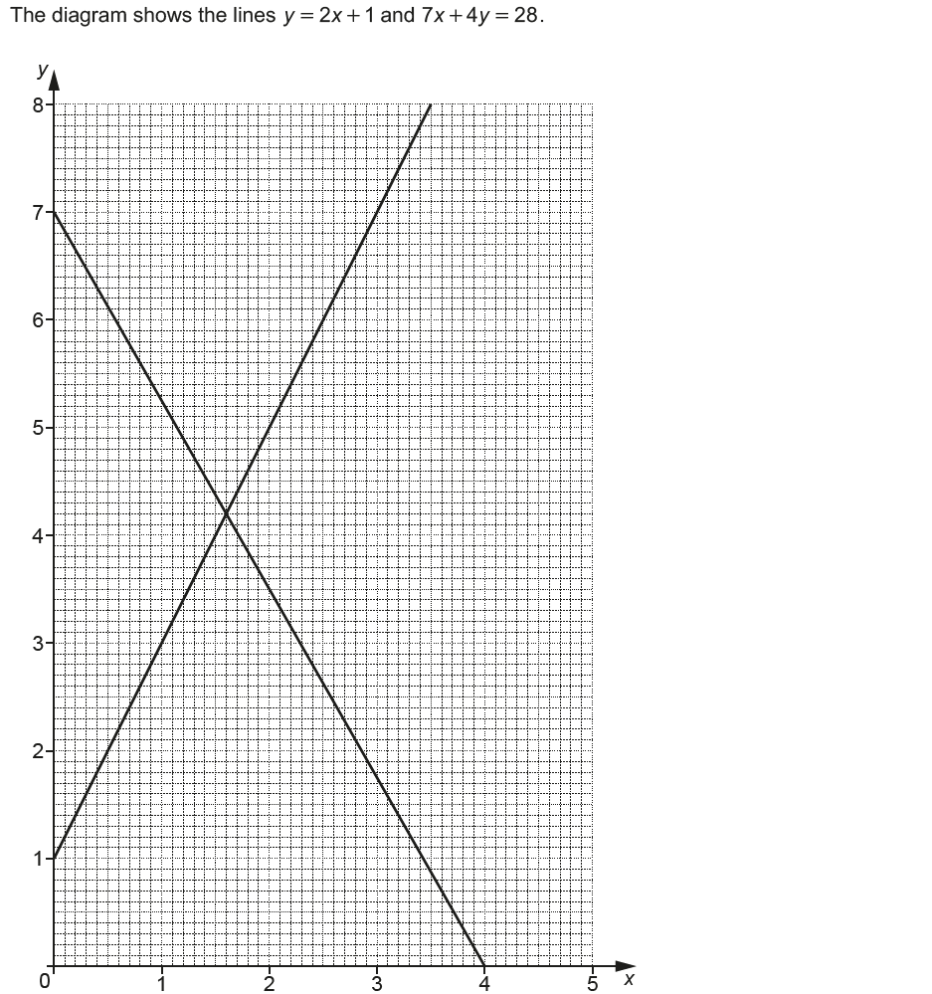
Linear Inequalities
Nov 2018 2H Q14

Slide 46
Linear Inequalities
Nov 2018 2H Q14
A

