Slide 1
Linear Inequalities
Linear Inequalities
June 2017
3H Q13
SAM
3H Q9
Nov 2017
2H Q14
Spec 1
3H Q10
May 2018
1H Q20
June 2019
2H Q2
Graphical

Slide 2
Linear Inequalities
SAM 3H Q9

Slide 3
Linear Inequalities
SAM 3H Q9
A
B
C

Slide 4
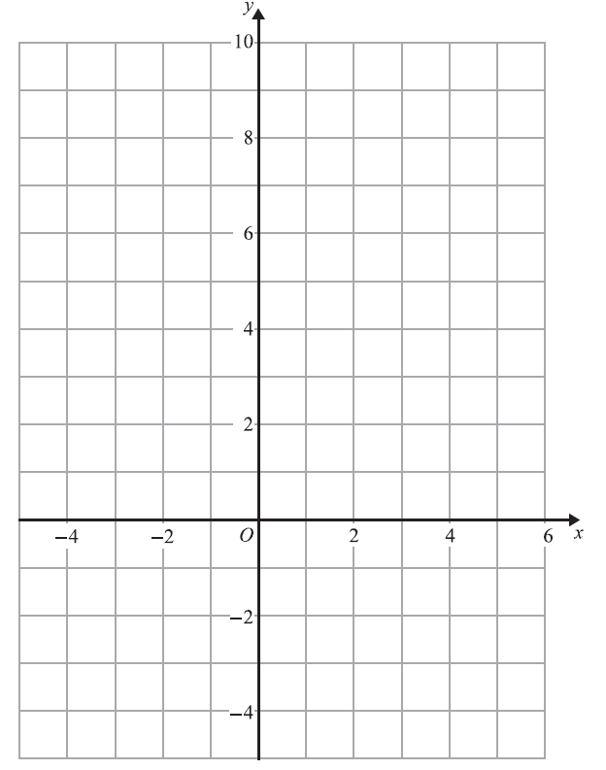
Linear Inequalities
Specimen Set 1 3H Q10
Reverse regions:
Show
Hide
Show
Hide
Show
Hide
Show
Hide
Show
Hide
R

Slide 5
Linear Inequalities
Specimen Set 1 3H Q10
A

Slide 6
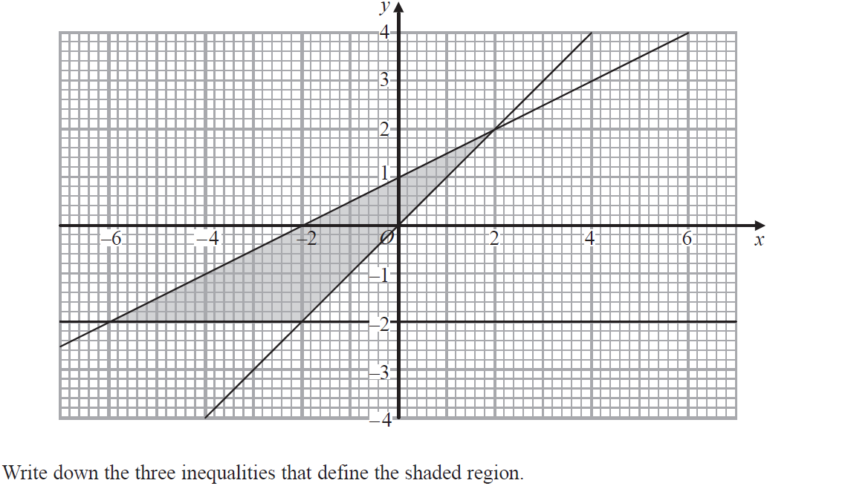
Linear Inequalities
June 2017 3H Q13

Slide 7
Linear Inequalities
June 2017 3H Q13
A

Slide 8
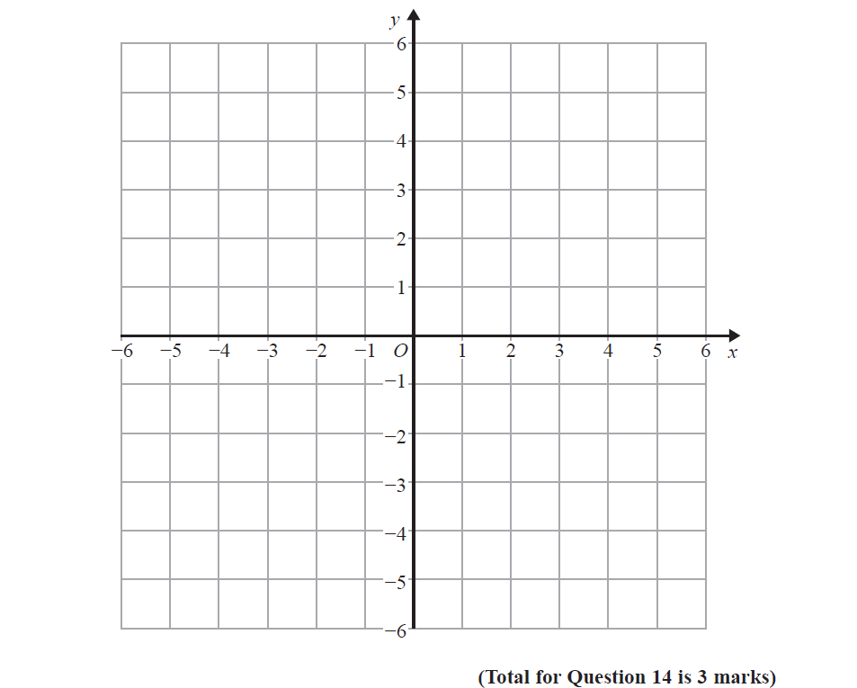
Linear Inequalities
Nov 2017 2H Q14
Reverse regions:
Show
Hide
Show
Hide
Show
Hide
Show
Hide
Show
Hide
R

Slide 9
Linear Inequalities
Nov 2017 2H Q14
A

Slide 10
Linear Inequalities
May 2018 1H Q20

Slide 11
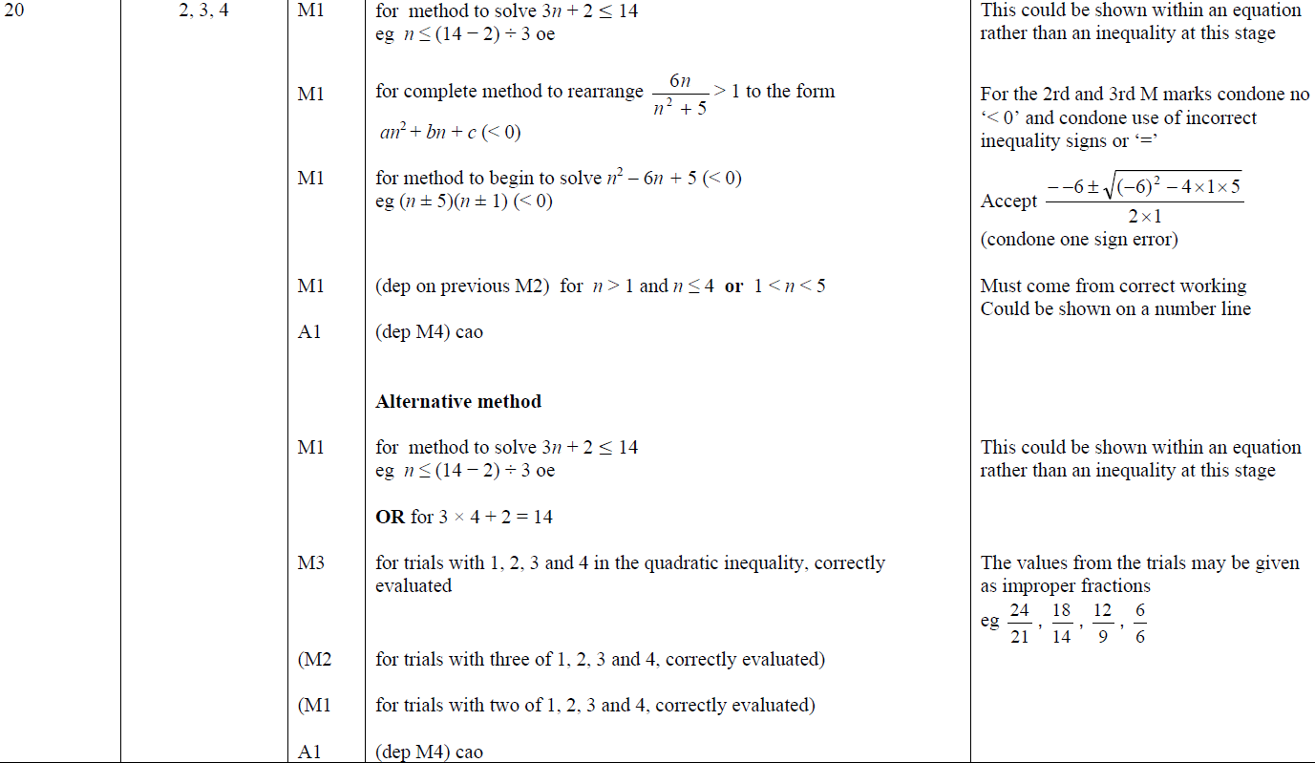
Linear Inequalities
May 2018 1H Q20
A

Slide 12
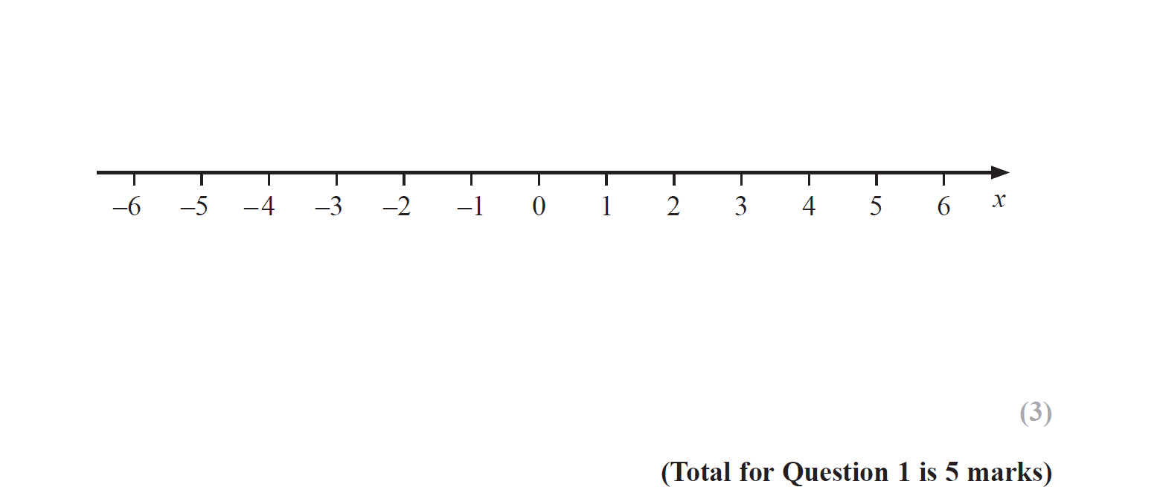
Linear Inequalities
June 2019 2H Q2

Slide 13
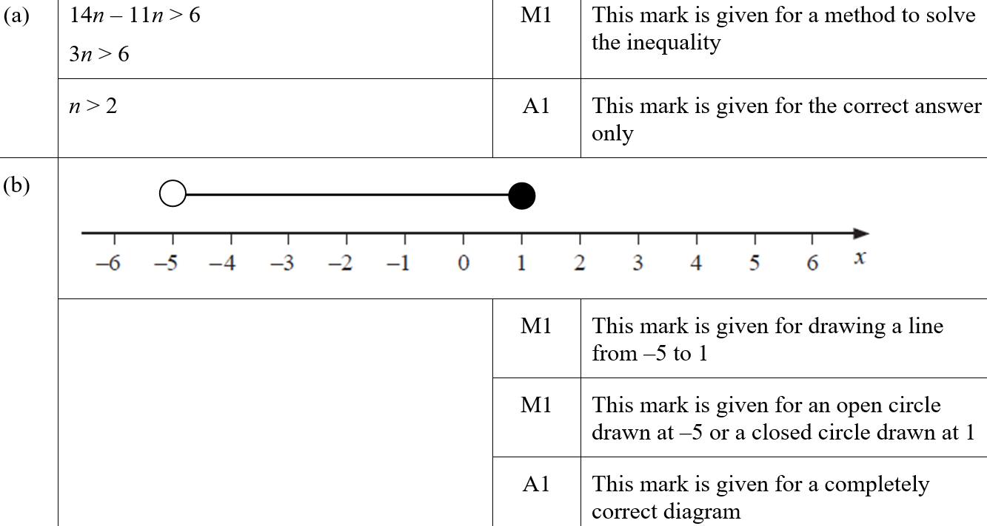
Linear Inequalities
June 2019 2H Q2
A
B
A SF
B SF

