Slide 1
Linear Graphs & Gradients
Linear Graphs & Gradients
June 2017
3H Q5
SAM
1H Q14
Nov 2017
3H Q17
SAM
3H Q14
June 2018
2H Q18
Practice
2H Q18
June 2018
3H Q5
Practice
3H Q10
Nov 2018
1H Q18
Mainly Co-ordinates
With equation of circle and tangents

Slide 2
Linear Graphs & Gradients
SAM 2H Q14

Slide 3
Linear Graphs & Gradients
SAM 2H Q14
A

Slide 4
Linear Graphs & Gradients
SAM 3H Q14

Slide 5
Linear Graphs & Gradients
SAM 3H Q14
A

Slide 6
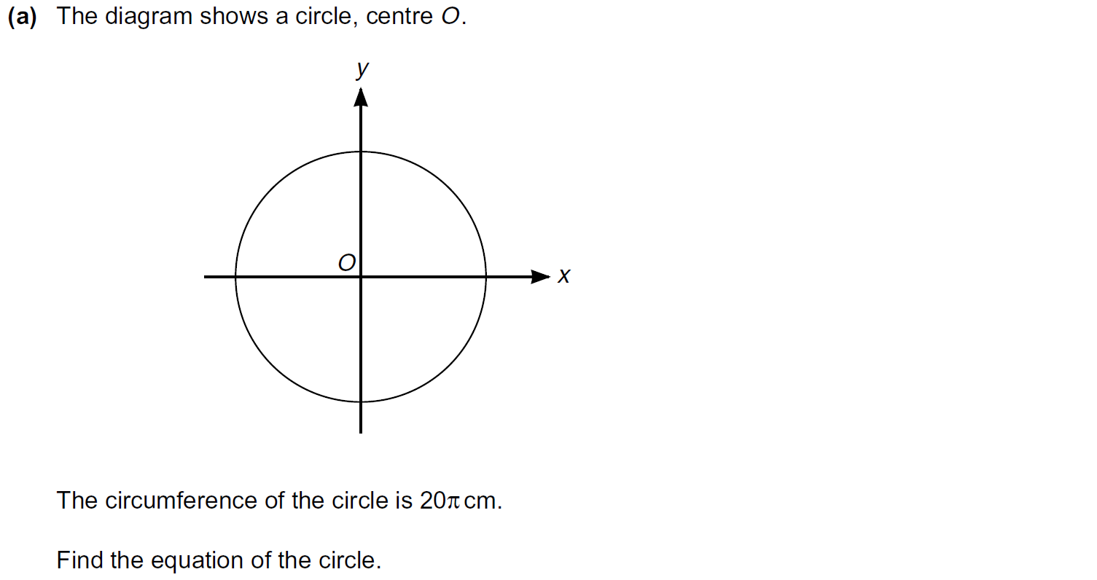
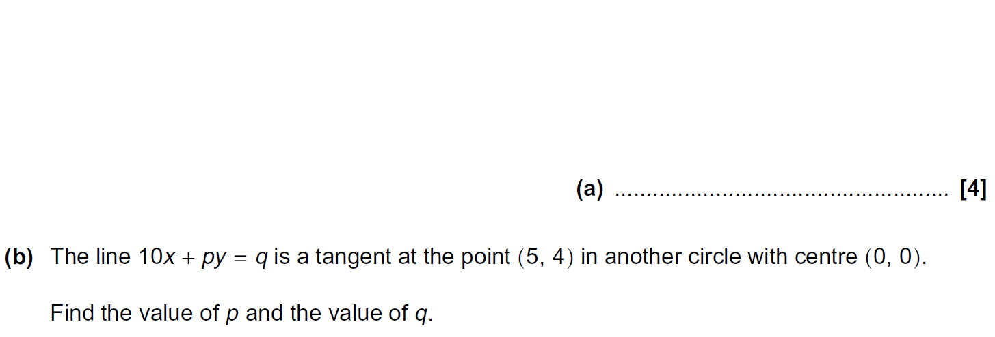
Linear Graphs & Gradients
Practice 2H Q18

Slide 7
Linear Graphs & Gradients
Practice 2H Q18
A
B

Slide 8
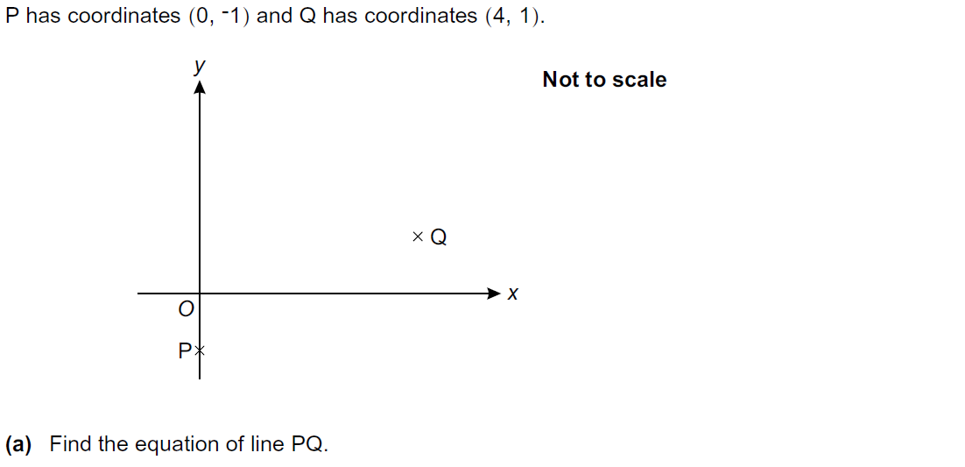
Linear Graphs & Gradients
Practice 3H Q10

Slide 9
Linear Graphs & Gradients
Practice 3H Q10
A
B

Slide 10
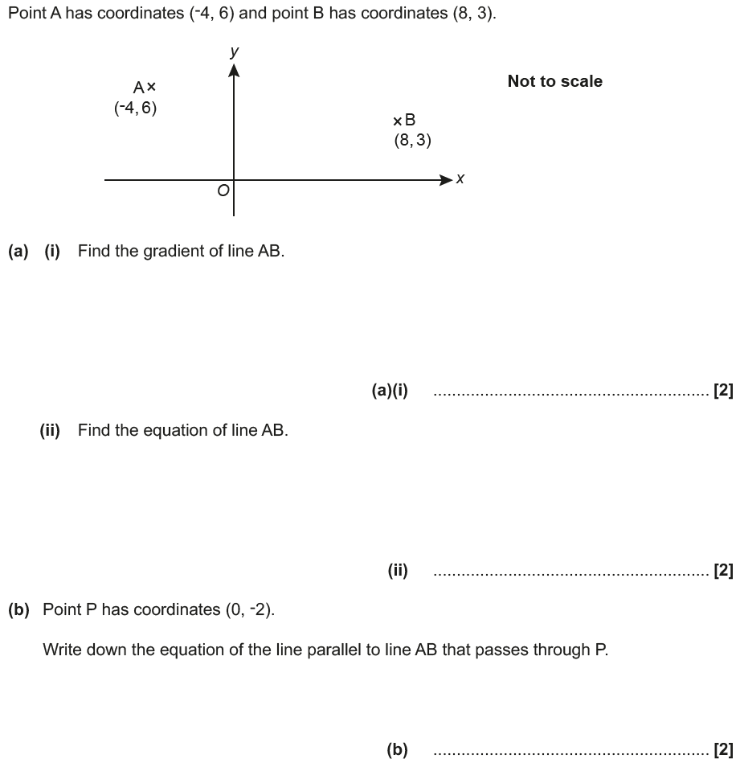
Linear Graphs & Gradients
June 2017 3H Q5

Slide 11
Linear Graphs & Gradients
June 2017 3H Q5
A (i)
A (ii)
B

Slide 12
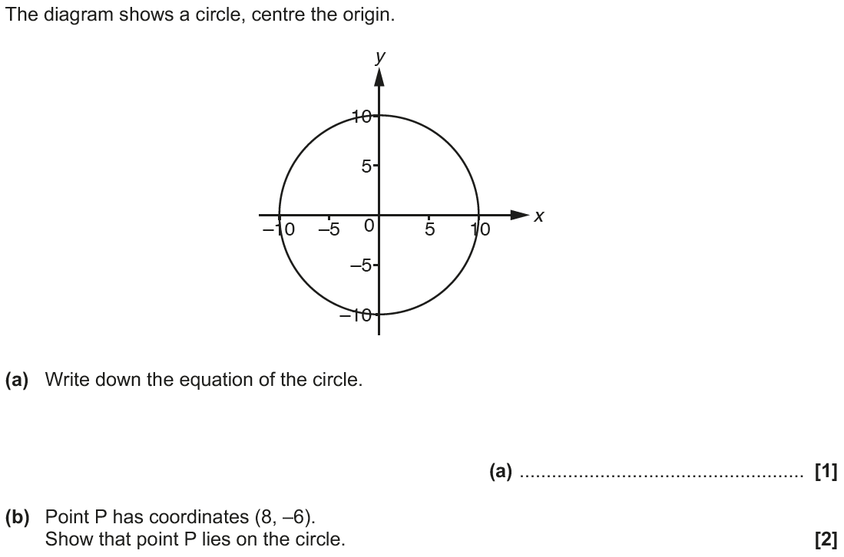
Linear Graphs & Gradients
Nov 2017 3H Q17

Slide 13
Linear Graphs & Gradients
Nov 2017 3H Q17
A
B
C

Slide 14
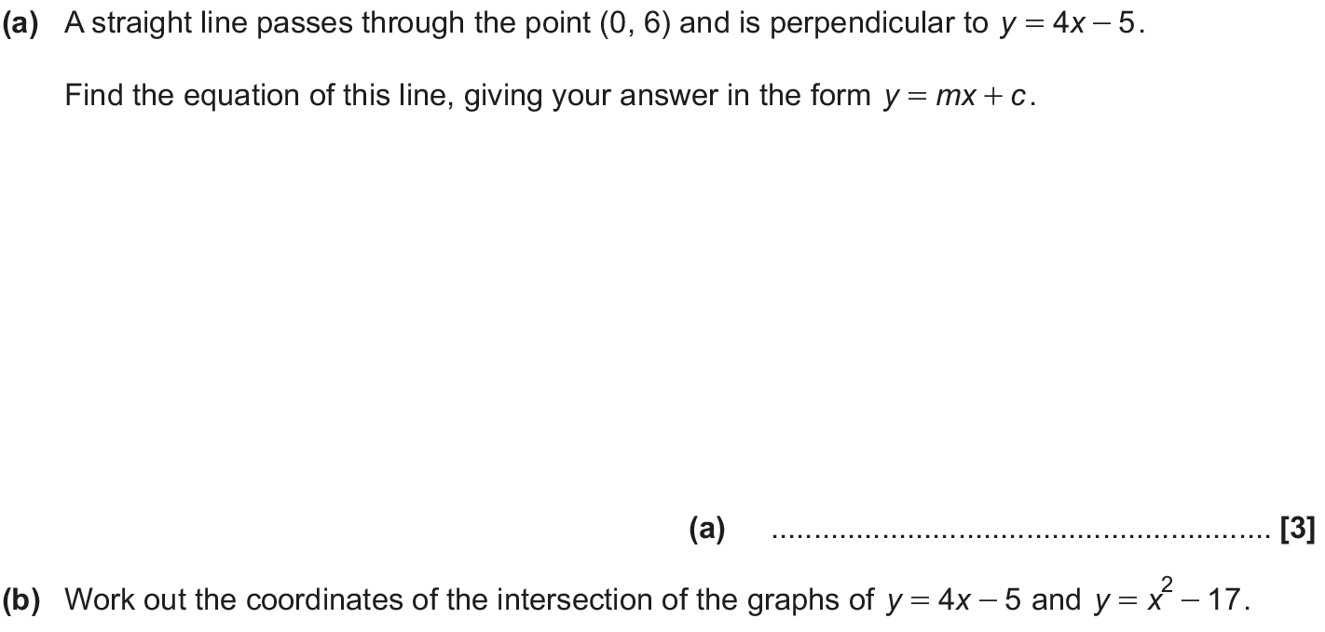
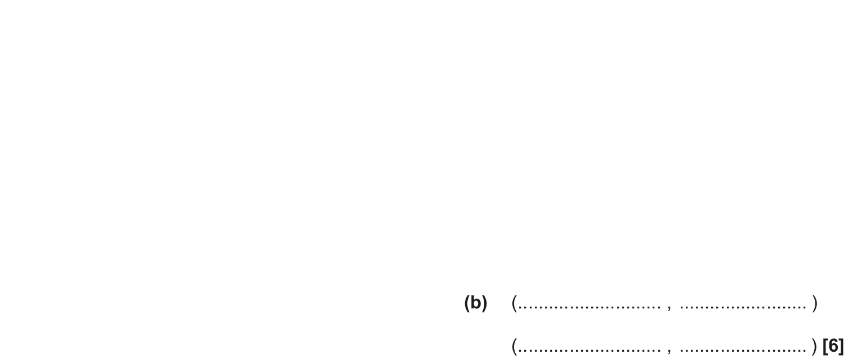
Linear Graphs & Gradients
June 2018 2H Q18

Slide 15
Linear Graphs & Gradients
June 2018 2H Q18
A
B

Slide 16
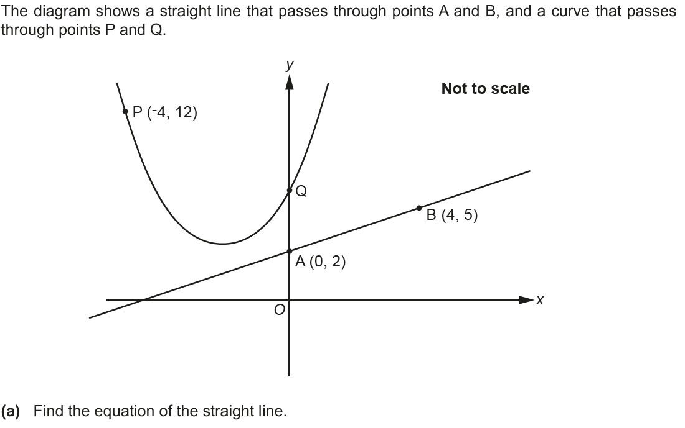
Linear Graphs & Gradients
June 2018 3H Q5

Slide 17
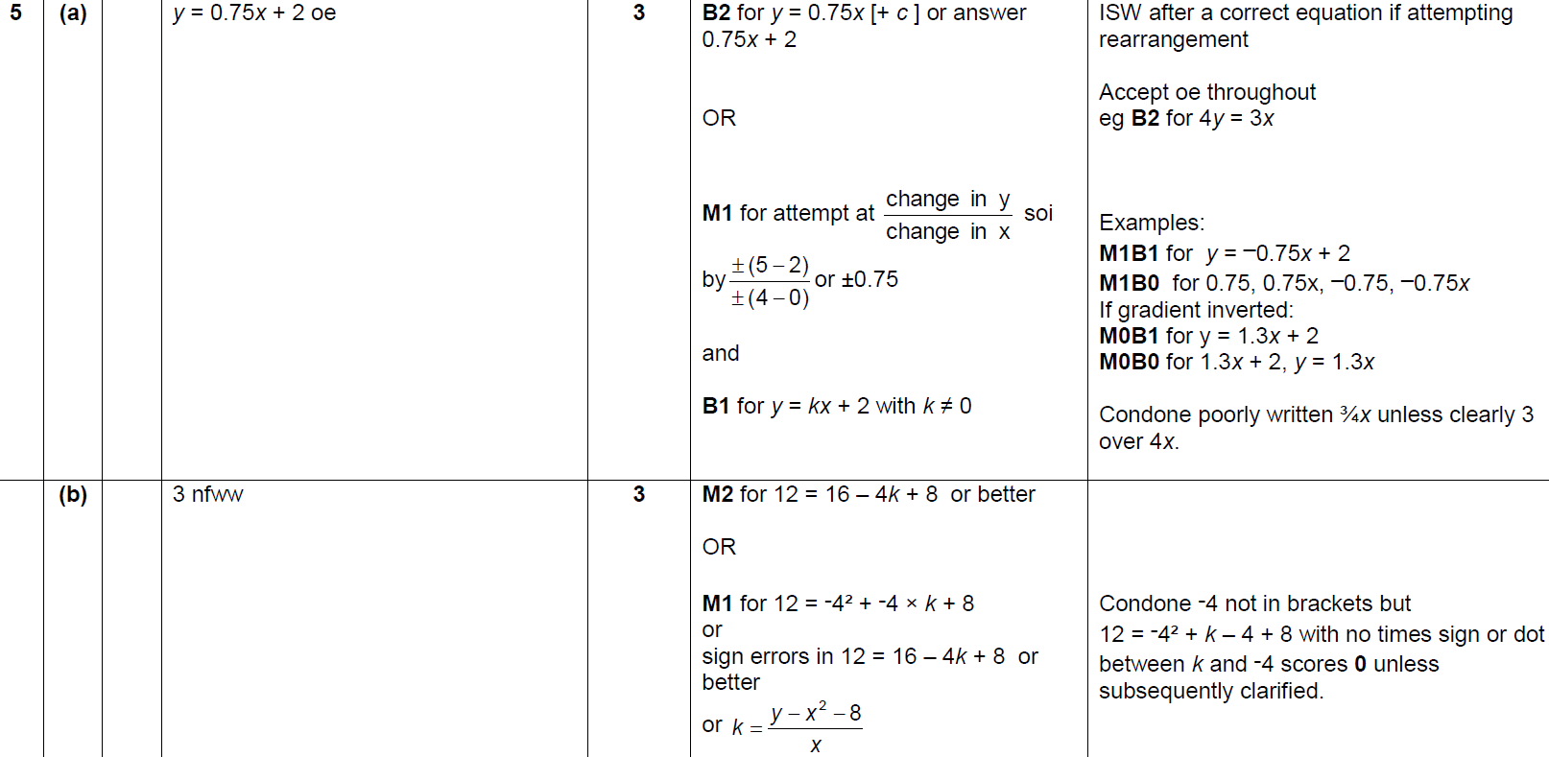
Linear Graphs & Gradients
June 2018 3H Q5
A
B

Slide 18
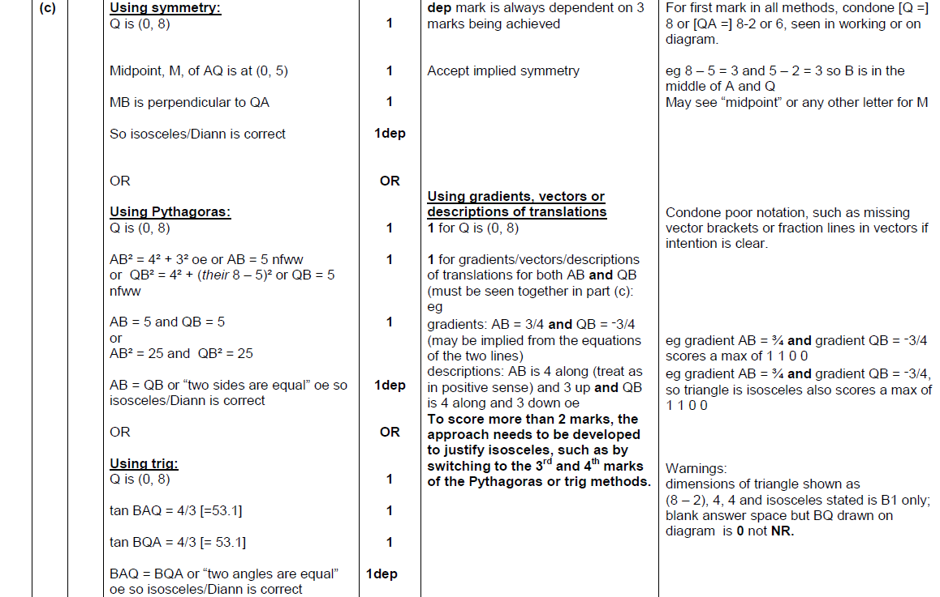
Linear Graphs & Gradients
June 2018 3H Q5
C

Slide 19
Linear Graphs & Gradients
Nov 2018 1H Q18

Slide 20
Linear Graphs & Gradients
Nov 2018 1H Q18
A

