Slide 1
Linear Graphs & Gradients
Linear Graphs & Gradients
May 2017
1H Q17
May 2018
1H Q7
May 2017
1H Q27
SAM
1H Q4
June 2018
2H Q12
June 2017
2H Q3
SAM
1H Q28
June 2018
3H Q8
June 2017
2H Q14
1 Marker
SAM
2H Q4
June 2018
3H Q19
Nov 2017
1H Q21
SAM
3H Q28*
June 2018
3H Q28
Nov 2017
1H Q28
Mainly Pythagoras*
Nov 2018
2H Q2
Nov 2017
3H Q4
Mainly Co-ordinates
With equation of circle and tangents

Slide 2
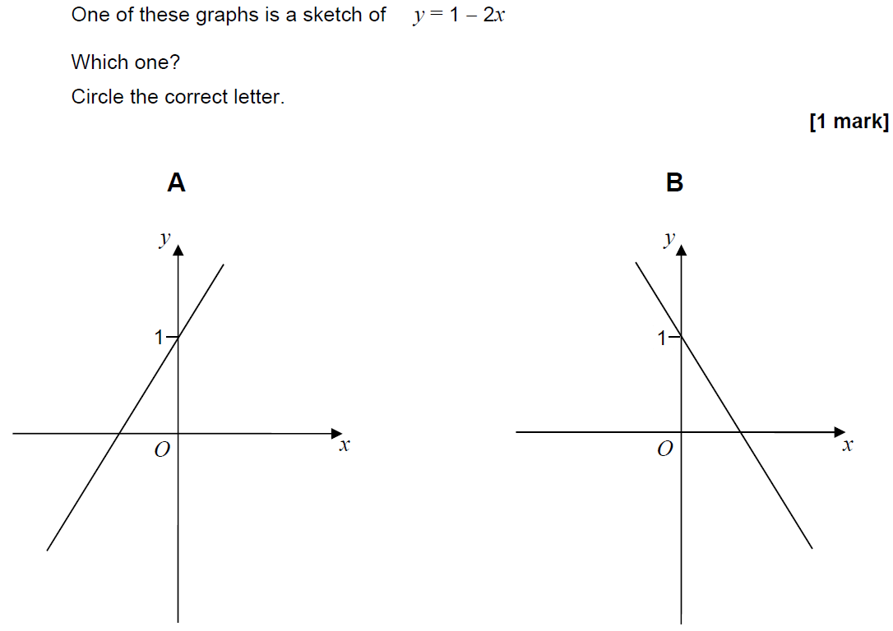
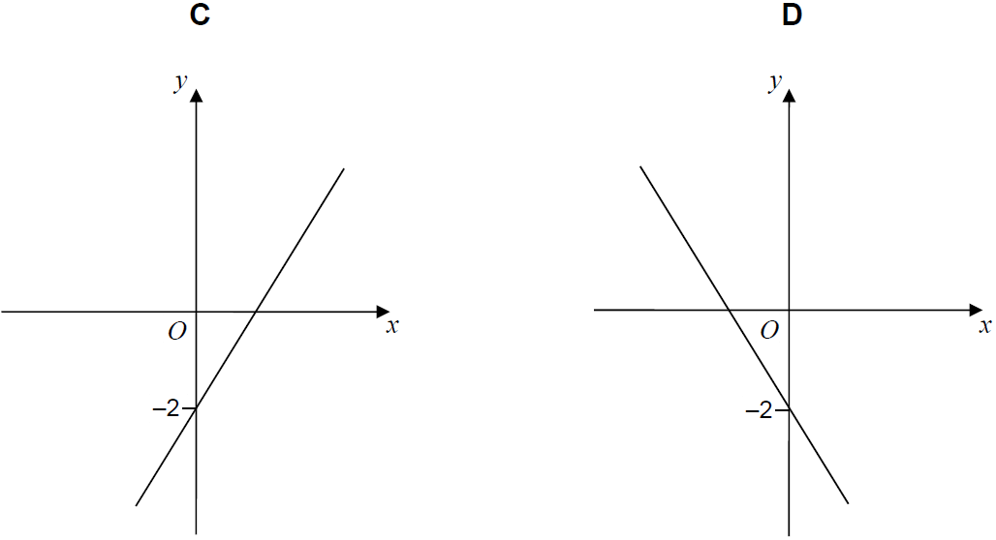
Linear Graphs & Gradients
SAM 1H Q4

Slide 3
Linear Graphs & Gradients
SAM 1H Q4
A

Slide 4
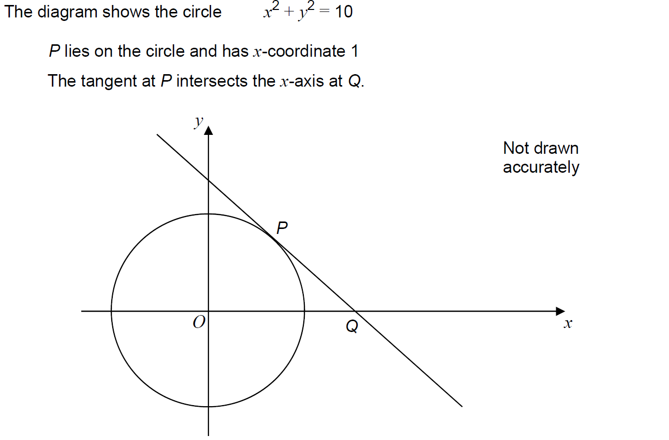
Linear Graphs & Gradients
SAM 1H Q28

Slide 5
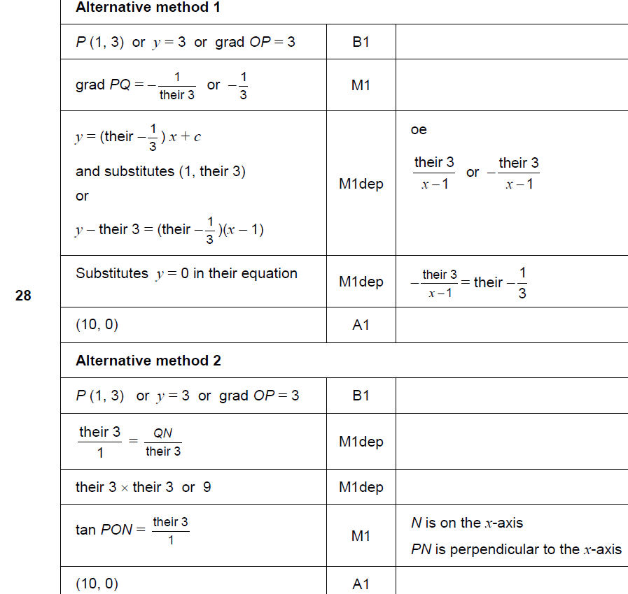
Linear Graphs & Gradients
SAM 1H Q28
A

Slide 6
Linear Graphs & Gradients
SAM 2H Q4

Slide 7
Linear Graphs & Gradients
SAM 2H Q4
A

Slide 8
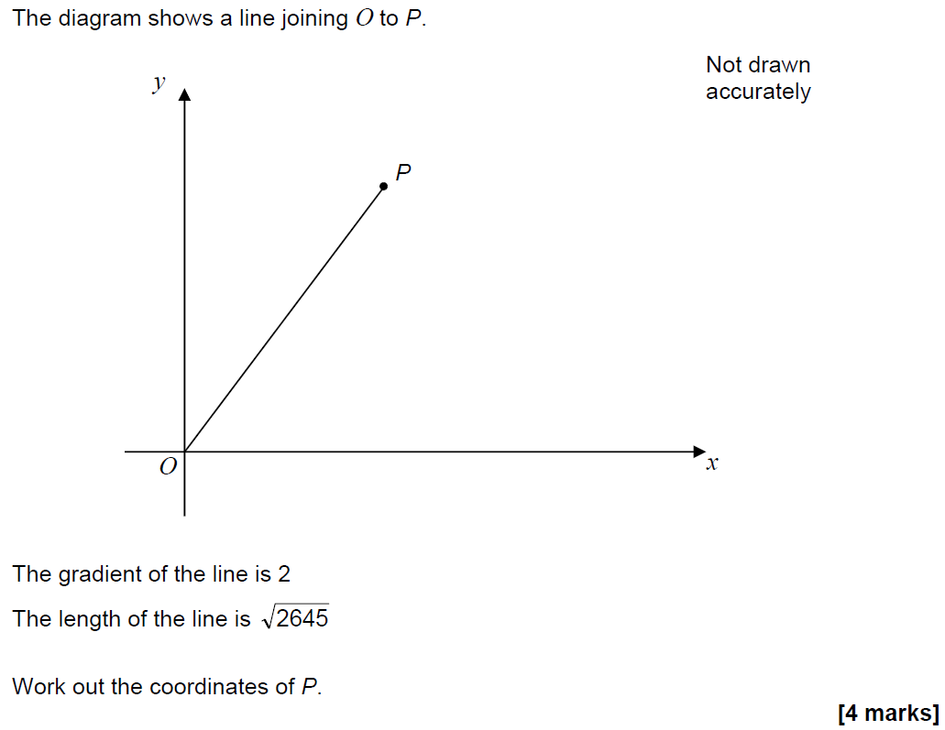
Linear Graphs & Gradients
SAM 3H Q28

Slide 9
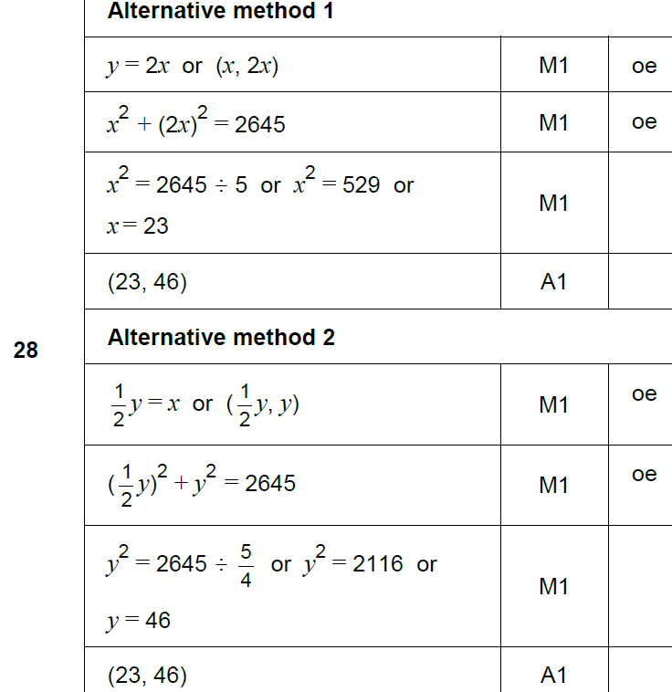
Linear Graphs & Gradients
SAM 3H Q28
A

Slide 10
Linear Graphs & Gradients
May 2017 1H Q17

Slide 11
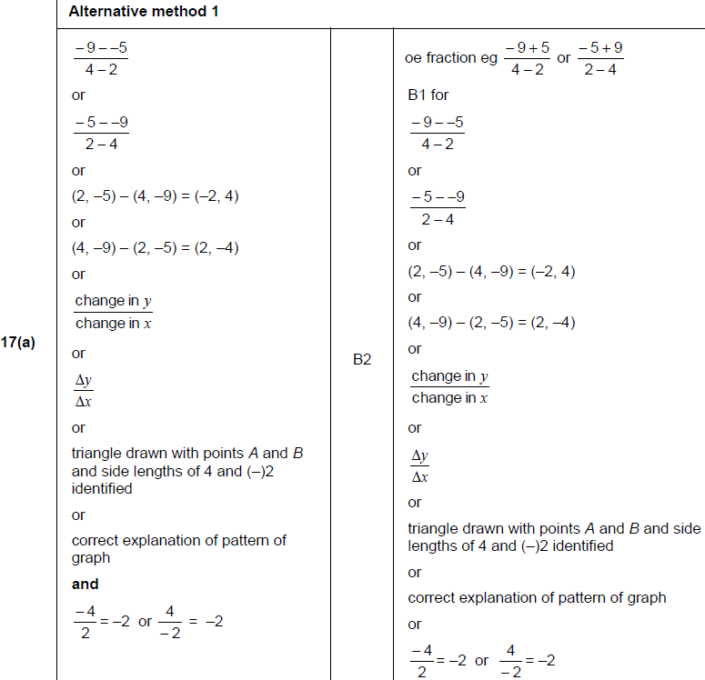
Linear Graphs & Gradients
May 2017 1H Q17
A

Slide 12
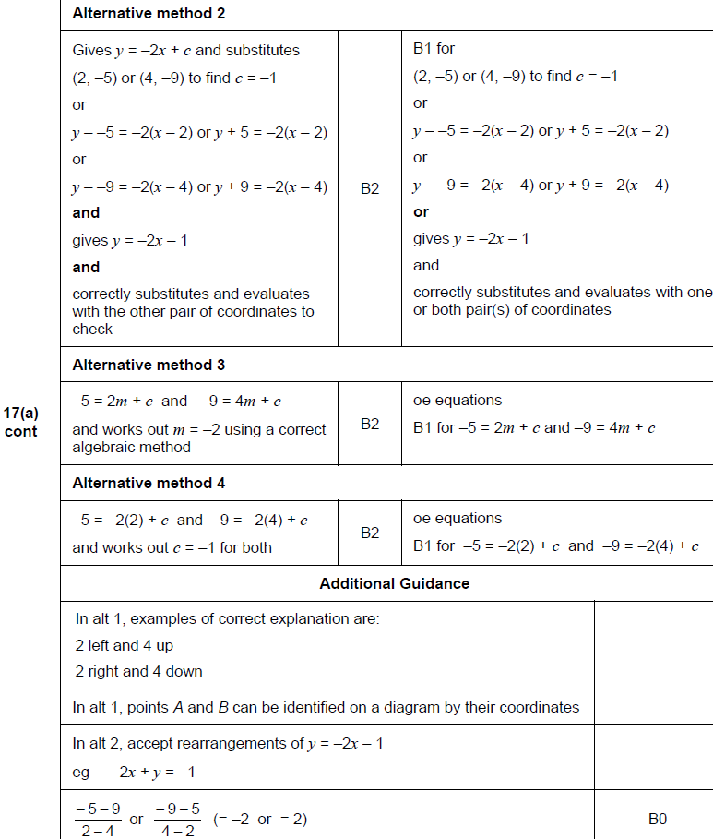
Linear Graphs & Gradients
May 2017 1H Q17
A Alternatives

Slide 13
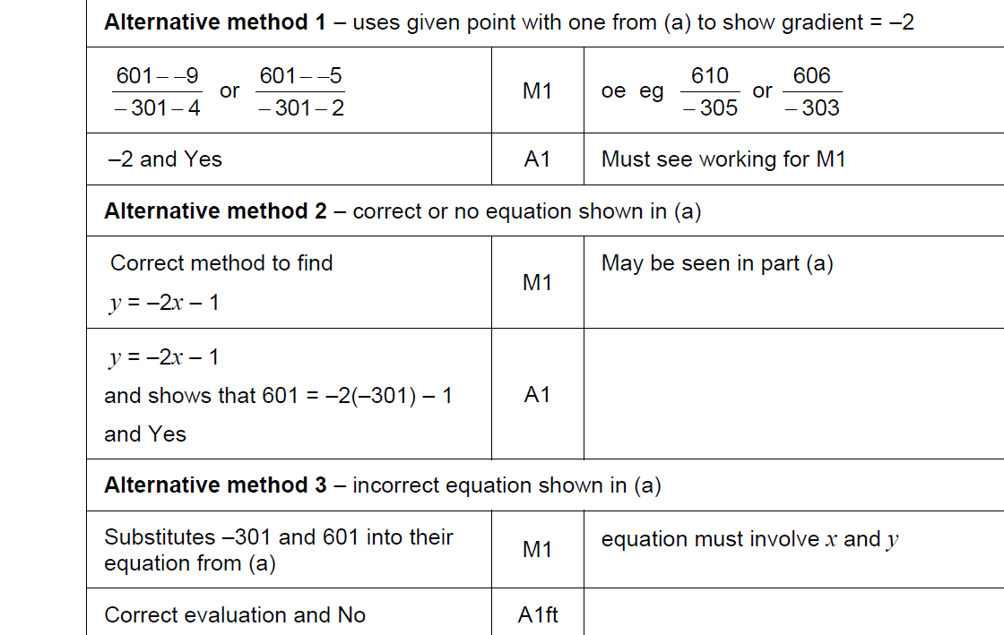
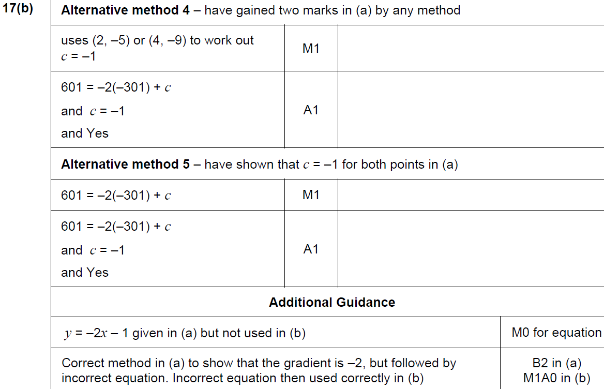
Linear Graphs & Gradients
May 2017 1H Q17
B

Slide 14
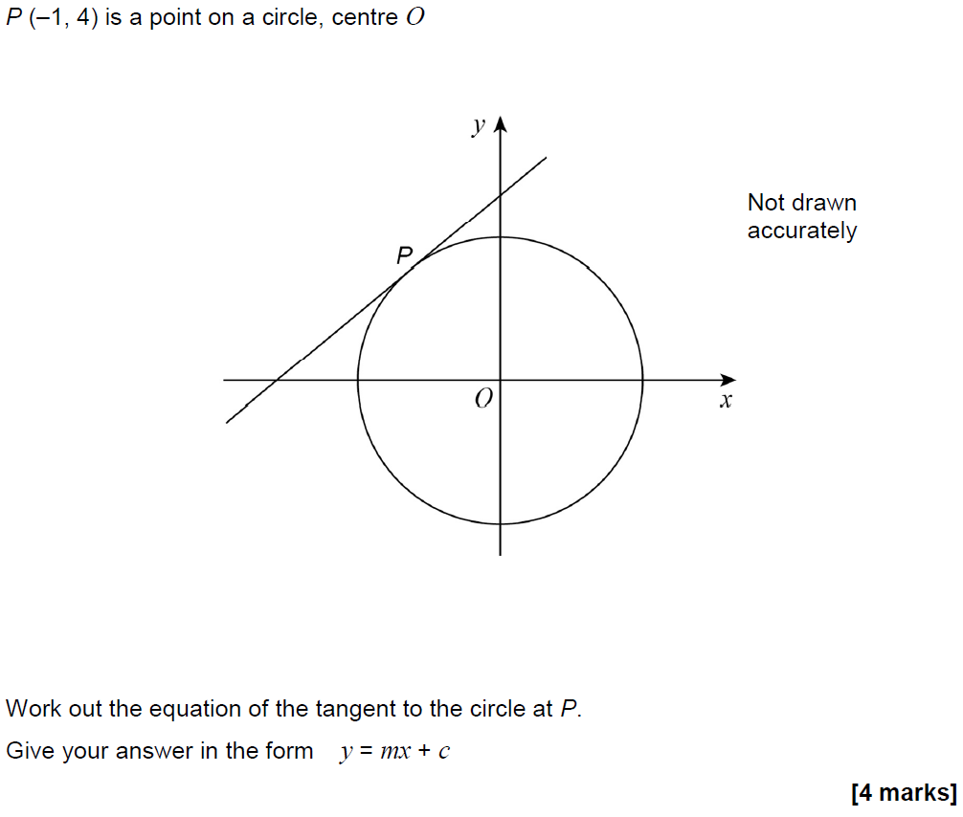
Linear Graphs & Gradients
May 2017 1H Q27

Slide 15
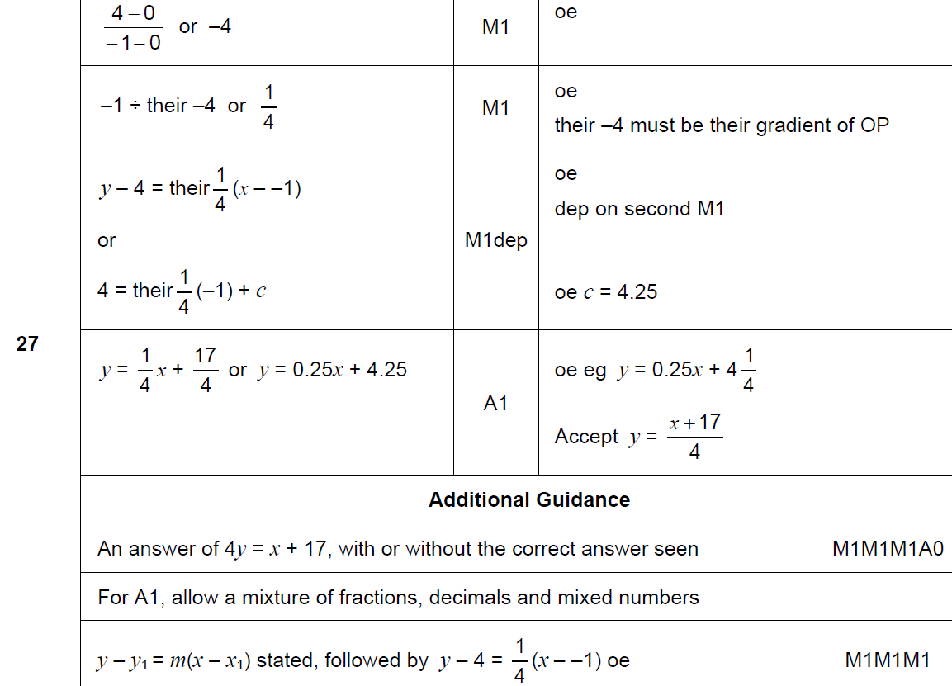
Linear Graphs & Gradients
May 2017 1H Q27
A

Slide 16
Linear Graphs & Gradients
June 2017 2H Q3

Slide 17
Linear Graphs & Gradients
June 2017 2H Q3
A

Slide 18
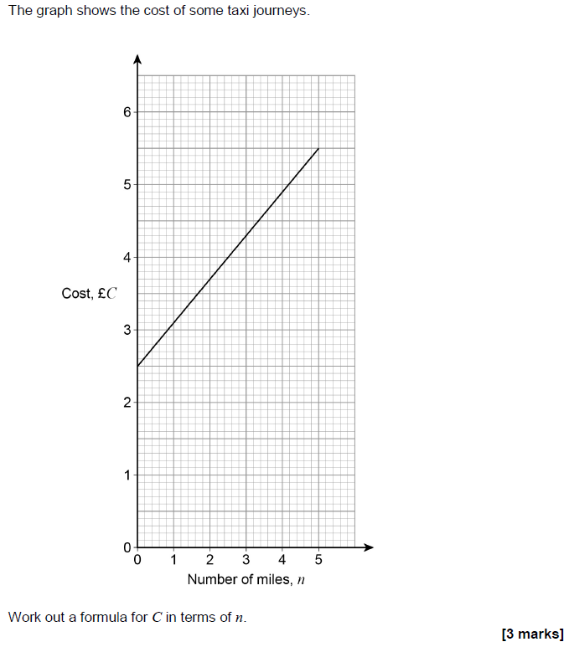
Linear Graphs & Gradients
June 2017 2H Q14

Slide 19
Linear Graphs & Gradients
June 2017 2H Q14
A

Slide 20
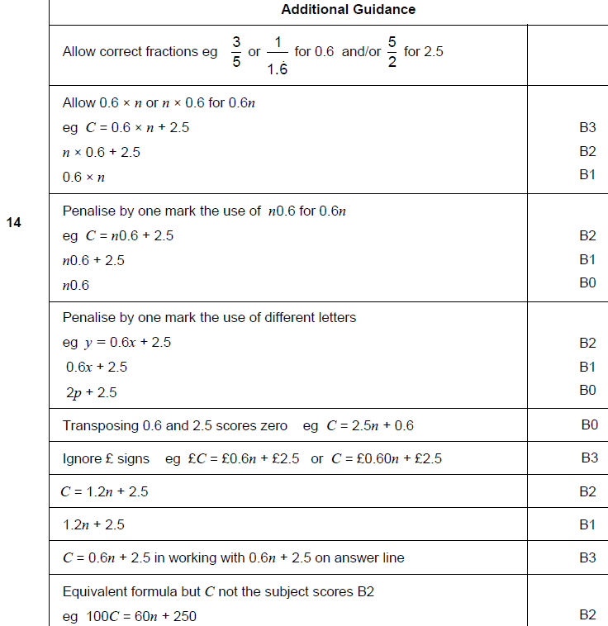
Linear Graphs & Gradients
June 2017 2H Q14
A notes

Slide 21
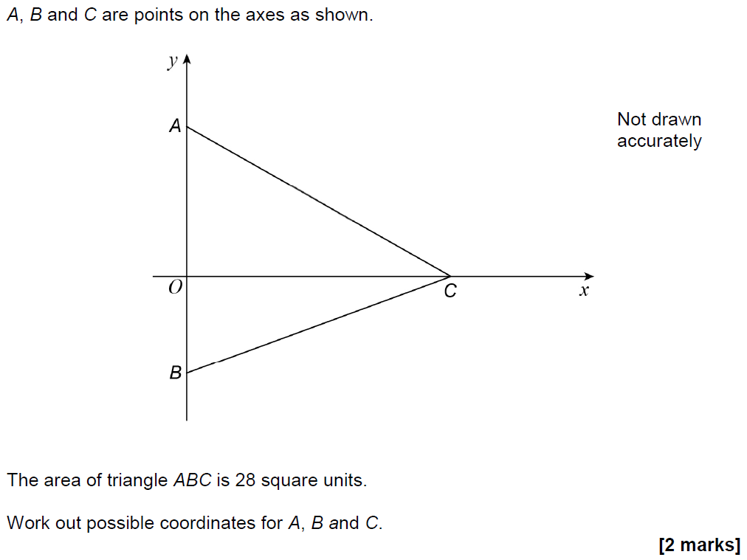
Linear Graphs & Gradients
Nov 2017 1H Q21

Slide 22
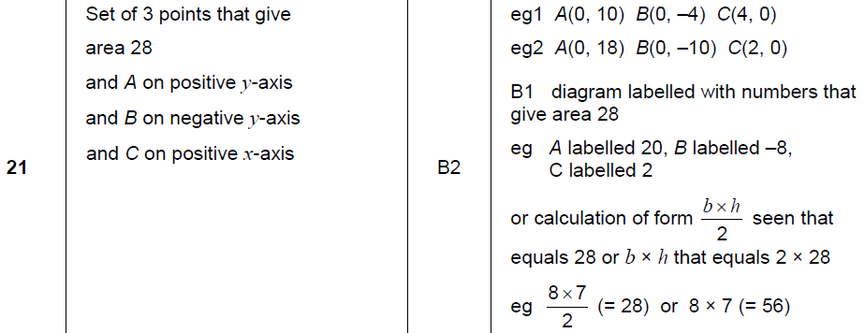
Linear Graphs & Gradients
Nov 2017 1H Q21
A

Slide 23
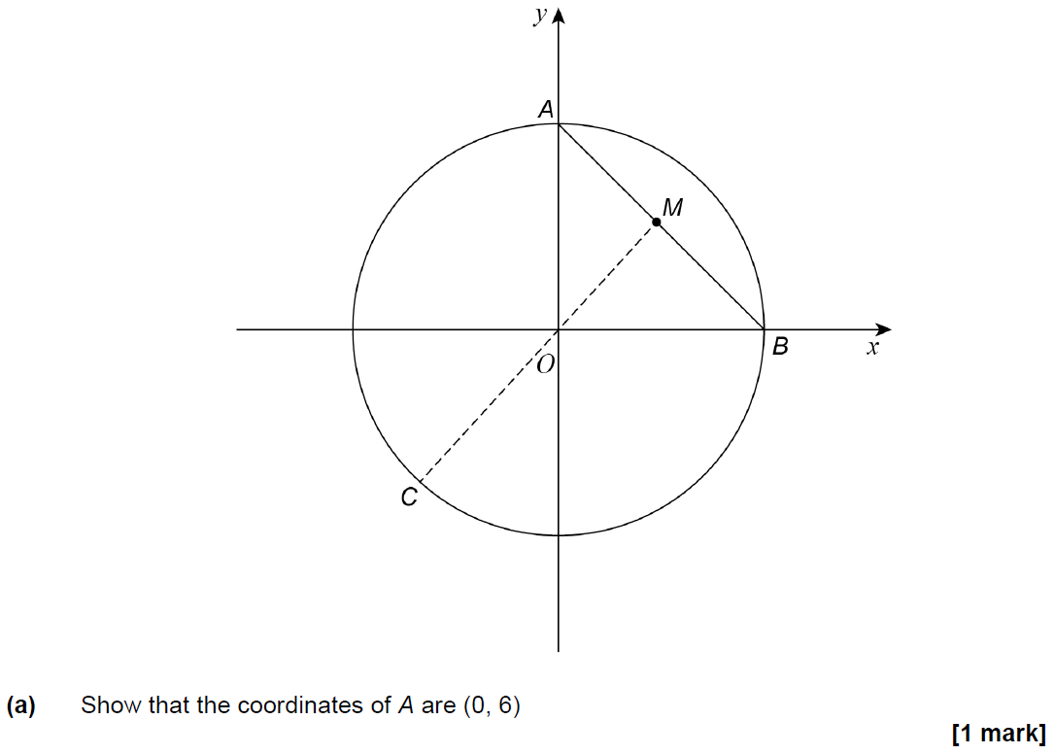
Linear Graphs & Gradients
Nov 2017 1H Q28

Slide 24
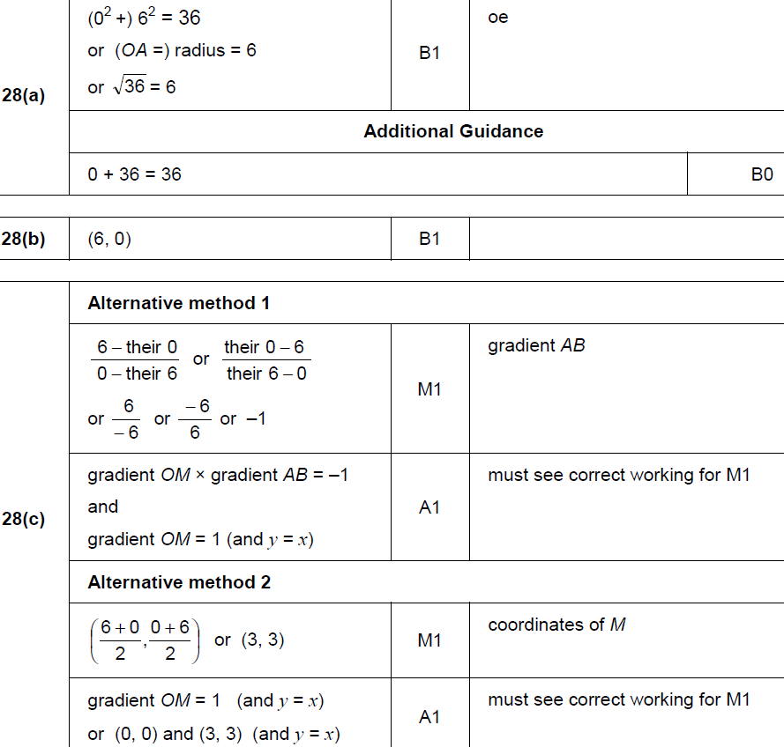
Linear Graphs & Gradients
Nov 2017 1H Q28
A
B
C

Slide 25
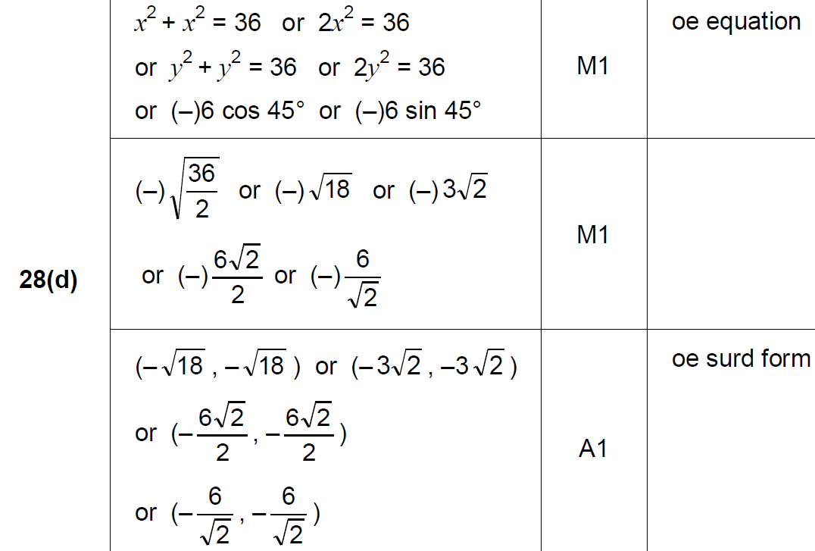
Linear Graphs & Gradients
Nov 2017 1H Q28
D

Slide 26
Linear Graphs & Gradients
Nov 2017 3H Q4

Slide 27
Linear Graphs & Gradients
Nov 2017 3H Q4
A

Slide 28
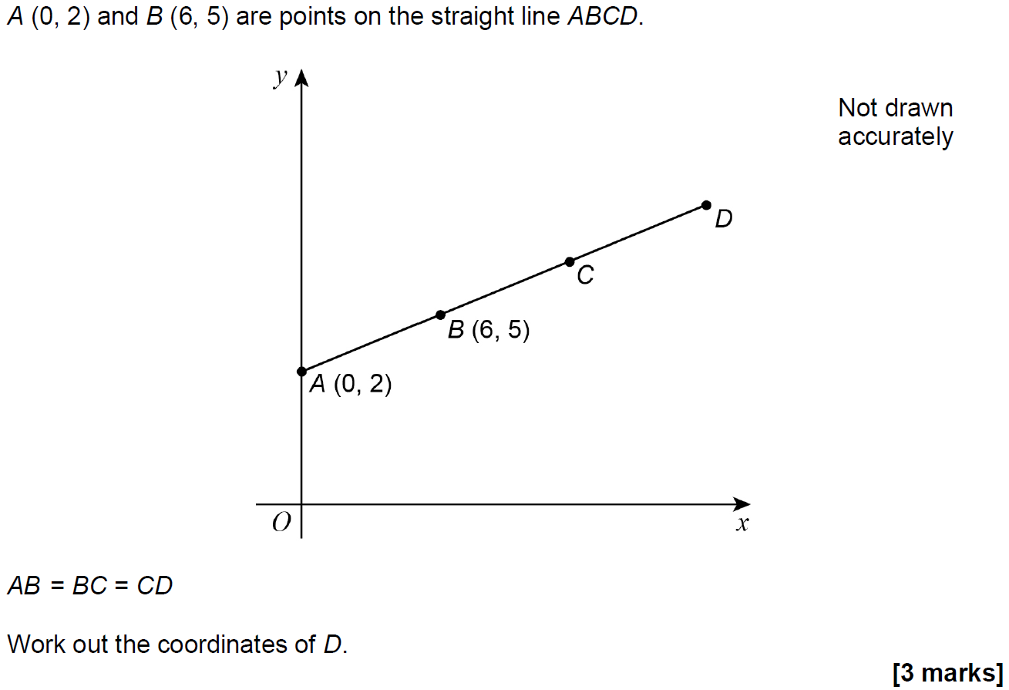
Linear Graphs & Gradients
May 2018 1H Q7

Slide 29
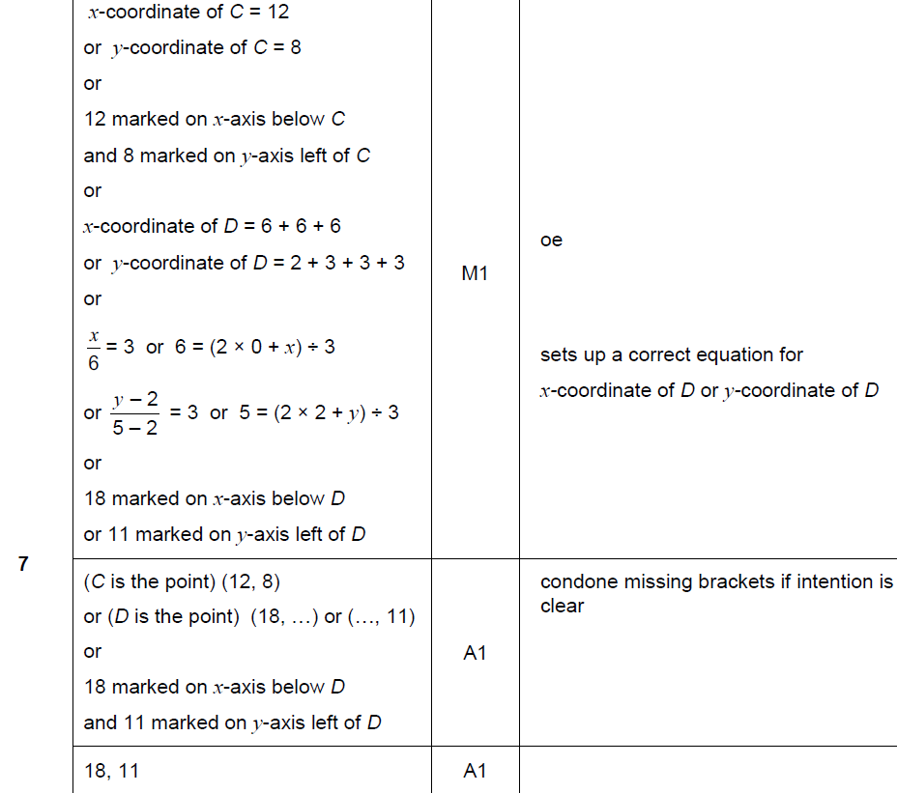
Linear Graphs & Gradients
May 2018 1H Q7
A

Slide 30
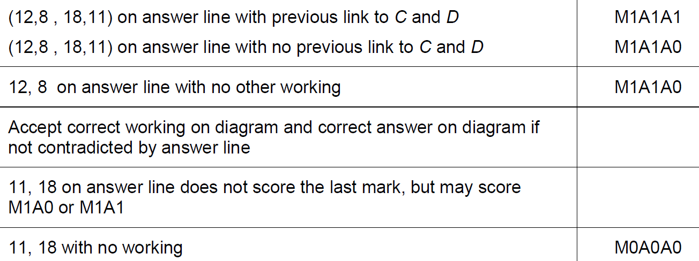
Linear Graphs & Gradients
May 2018 1H Q7
A notes

Slide 31
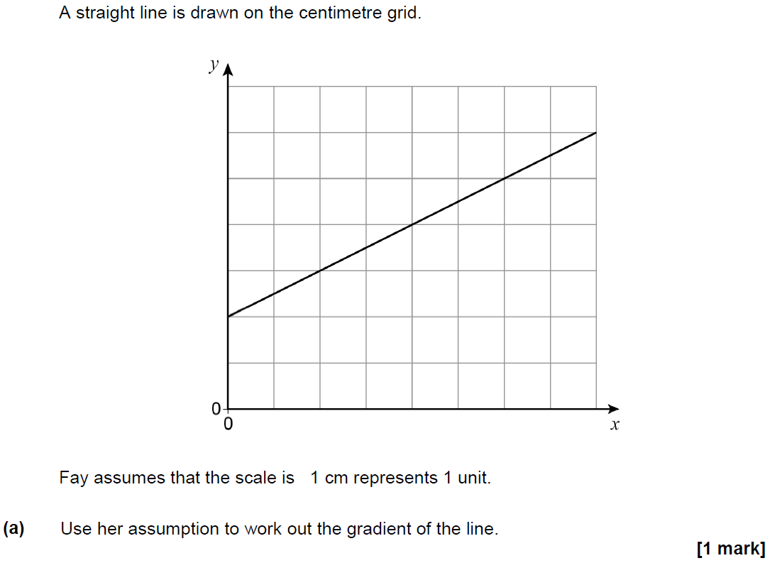
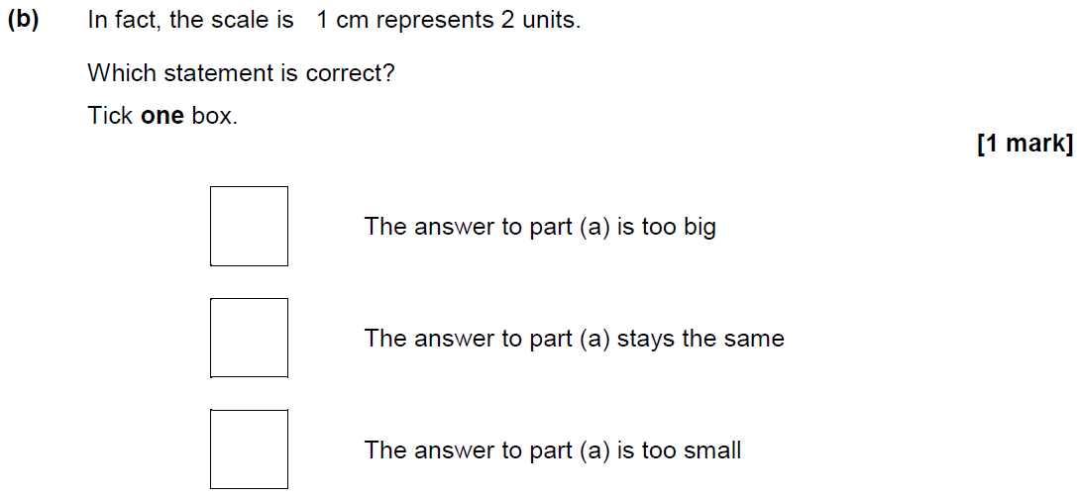
Linear Graphs & Gradients
June 2018 2H Q12

Slide 32
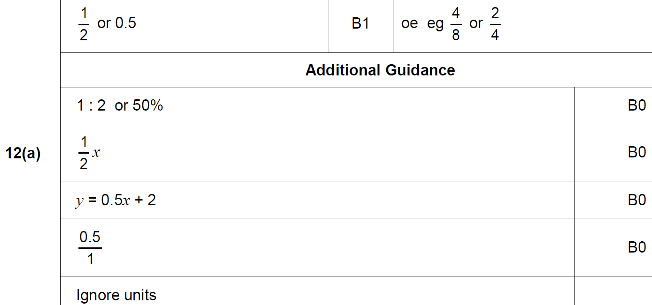
Linear Graphs & Gradients
June 2018 2H Q12
A

Slide 33
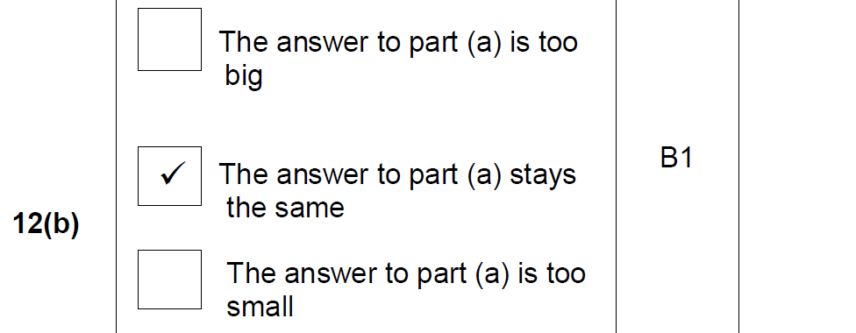
Linear Graphs & Gradients
June 2018 2H Q12
B

Slide 34
Linear Graphs & Gradients
June 2018 3H Q8

Slide 35
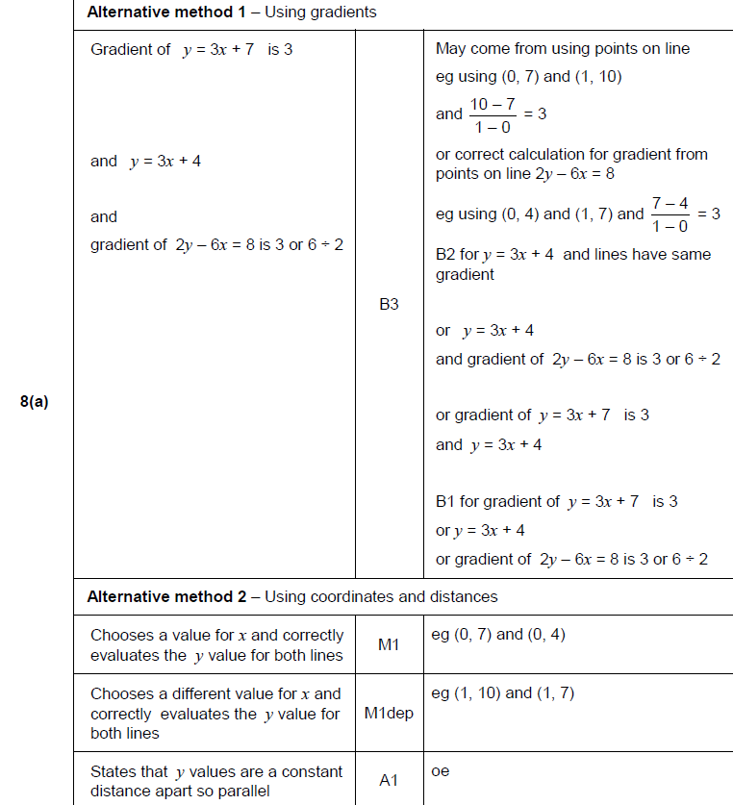
Linear Graphs & Gradients
June 2018 3H Q8
A

Slide 36
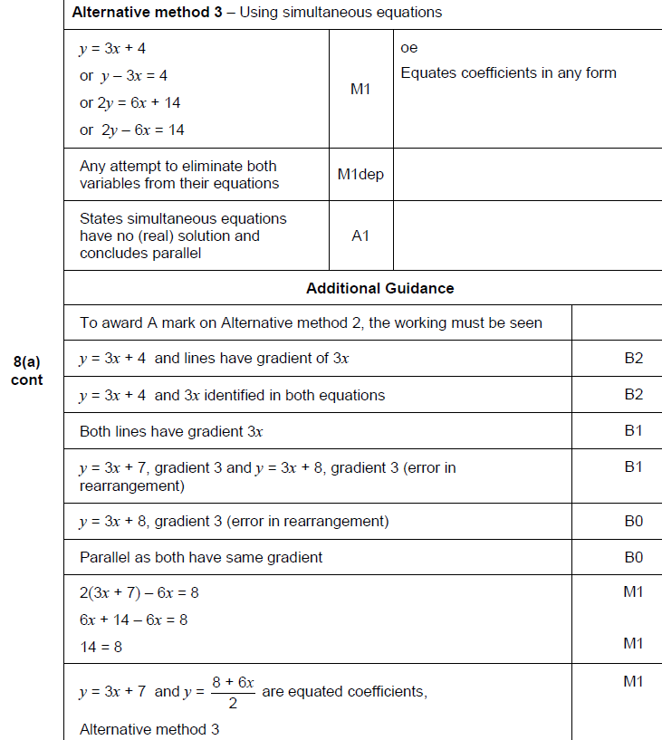
Linear Graphs & Gradients
June 2018 3H Q8
A Alternative & notes

Slide 37
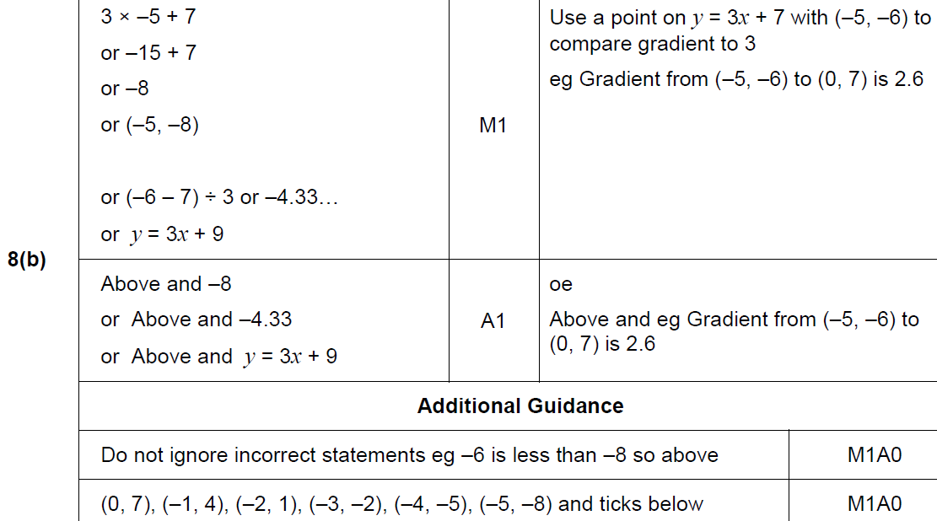
Linear Graphs & Gradients
June 2018 3H Q8
B

Slide 38
Linear Graphs & Gradients
June 2018 3H Q19

Slide 39
Linear Graphs & Gradients
June 2018 3H Q19
A

Slide 40
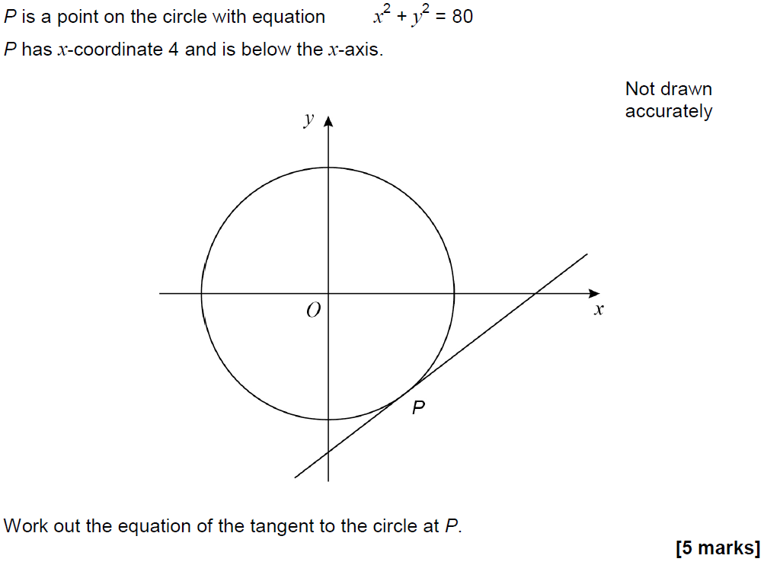
Linear Graphs & Gradients
June 2018 3H Q28

Slide 41
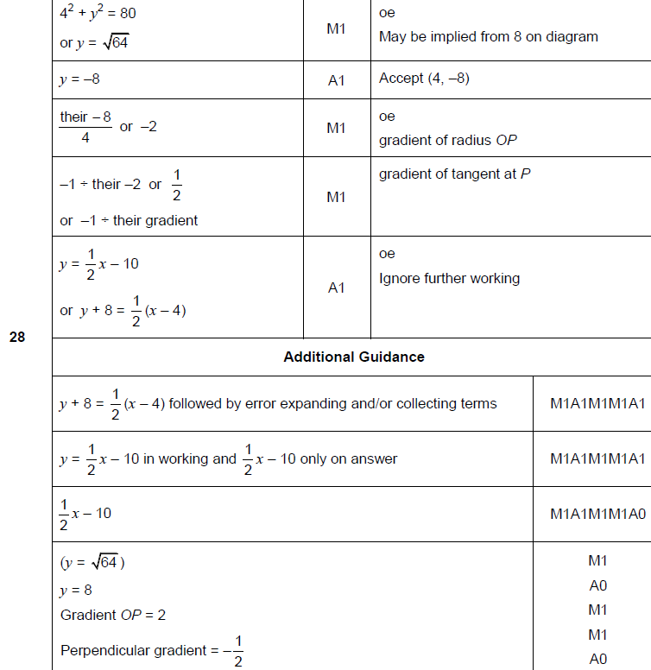
Linear Graphs & Gradients
June 2018 3H Q28
A

Slide 42
Linear Graphs & Gradients
Nov 2018 2H Q2

Slide 43
Linear Graphs & Gradients
Nov 2018 2H Q2
A

