Slide 1
Linear Graphs & Gradients
Linear Graphs & Gradients
SAM
1H Q25
May 2017
1H Q6
May 2018
1H Q19
Spec 1
1H Q23
May 2017
1H Q18
June 2018
2H Q3
Edexcel
Spec 1
2H Q23
June 2017
2H Q23
Nov 2018
2H Q6
AQA
Spec 1
3H Q3
Nov 2017
1H Q19
Nov 2018
2H Q18
OCR
Spec 1
3H Q7
Nov 2017
2H Q19
June 2019
2H Q2
Spec 2
1H Q22
May 2018
1H Q6
June 2019
2H Q16
Mainly Co-ordinates
With equation of circle and tangents

Slide 2
Linear Graphs & Gradients
Linear Graphs & Gradients
May 2017
1H Q17
May 2018
1H Q7
May 2017
1H Q27
SAM
1H Q4
June 2018
2H Q12
Edexcel
June 2017
2H Q3
SAM
1H Q28
June 2018
3H Q8
AQA
June 2017
2H Q14
1 Marker
SAM
2H Q4
June 2018
3H Q19
OCR
Nov 2017
1H Q21
SAM
3H Q28*
June 2018
3H Q28
Nov 2017
1H Q28
Mainly Pythagoras*
Nov 2018
2H Q2
Nov 2017
3H Q4
Mainly Co-ordinates
With equation of circle and tangents

Slide 3
Linear Graphs & Gradients
Linear Graphs & Gradients
June 2017
3H Q5
SAM
1H Q14
Edexcel
Nov 2017
3H Q17
SAM
3H Q14
AQA
June 2018
2H Q18
Practice
2H Q18
OCR
June 2018
3H Q5
Practice
3H Q10
Nov 2018
1H Q18
Mainly Co-ordinates
With equation of circle and tangents

Slide 4
Linear Graphs & Gradients
SAM 1H Q25

Slide 5
Linear Graphs & Gradients
SAM 1H Q25
A

Slide 6
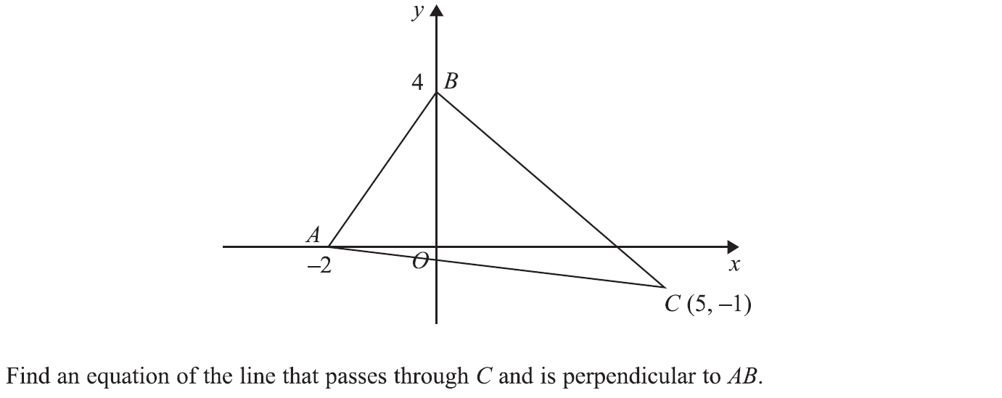
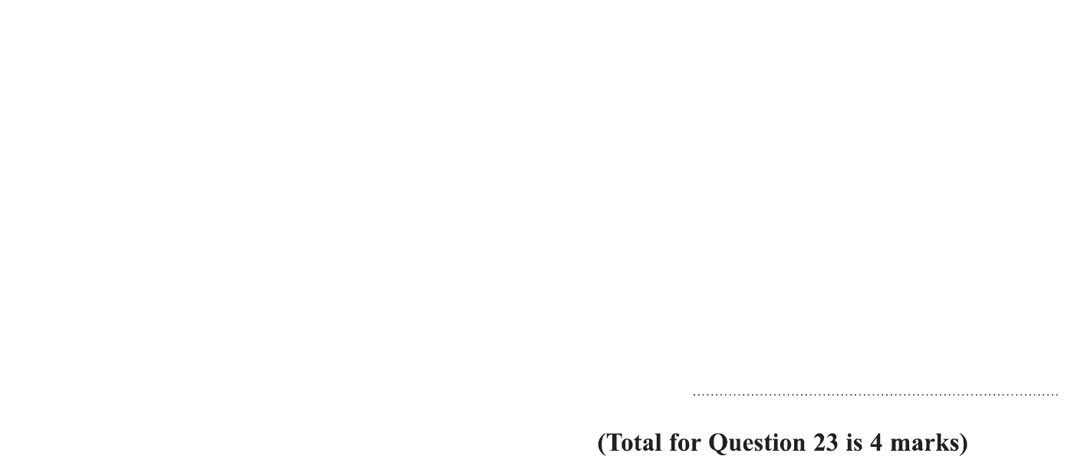
Linear Graphs & Gradients
Specimen Set 1 1H Q23

Slide 7
Linear Graphs & Gradients
Specimen Set 1 1H Q23
A

Slide 8
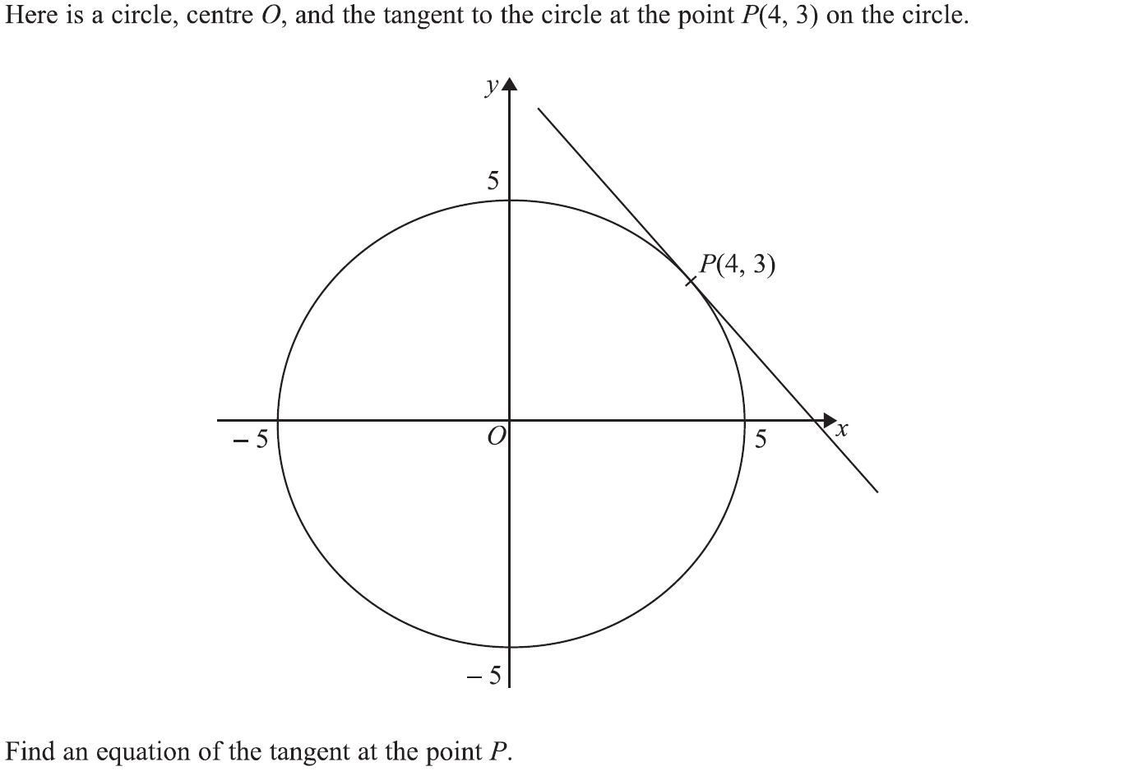
Linear Graphs & Gradients
Specimen Set 1 2H Q23

Slide 9
Linear Graphs & Gradients
Specimen Set 1 2H Q23
A

Slide 10
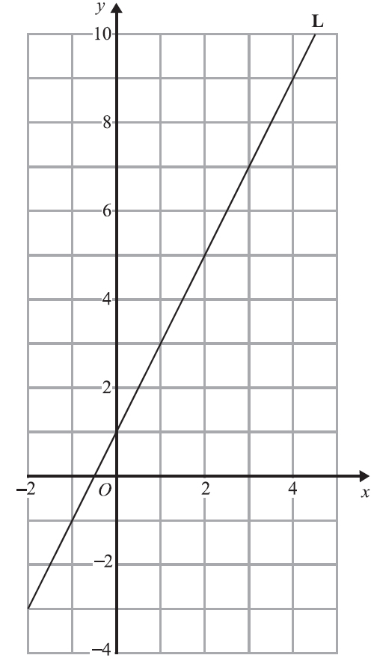
Linear Graphs & Gradients
Specimen Set 1 3H Q3

Slide 11
Linear Graphs & Gradients
Specimen Set 1 3H Q3
A

Slide 12
Linear Graphs & Gradients
Specimen Set 1 3H Q7

Slide 13
Linear Graphs & Gradients
Specimen Set 1 3H Q7
A

Slide 14
Linear Graphs & Gradients
Specimen Set 2 1H Q22

Slide 15
Linear Graphs & Gradients
Specimen Set 2 1H Q22
A

Slide 16
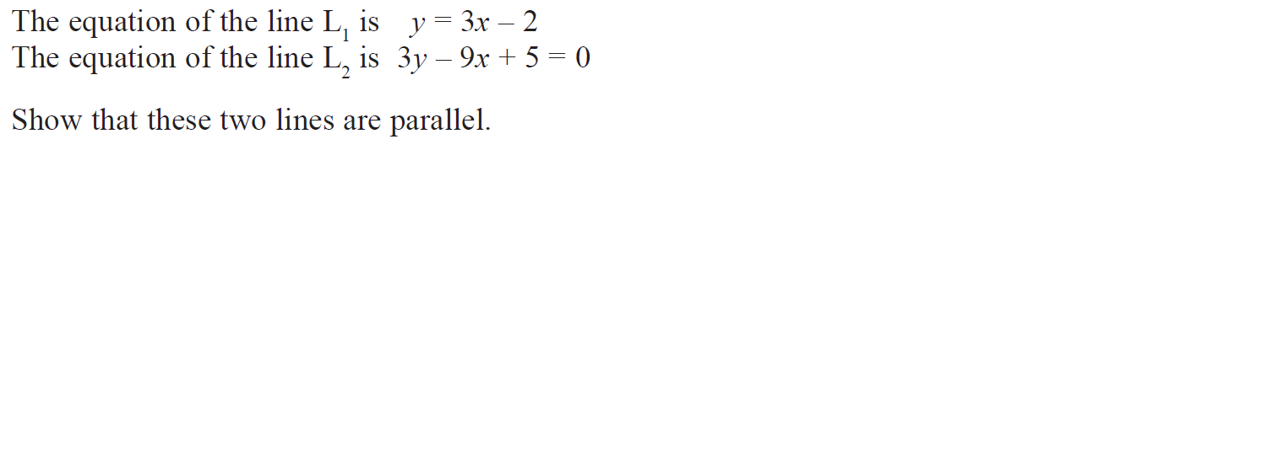
Linear Graphs & Gradients
May 2017 1H Q6

Slide 17
Linear Graphs & Gradients
May 2017 1H Q6
A

Slide 18
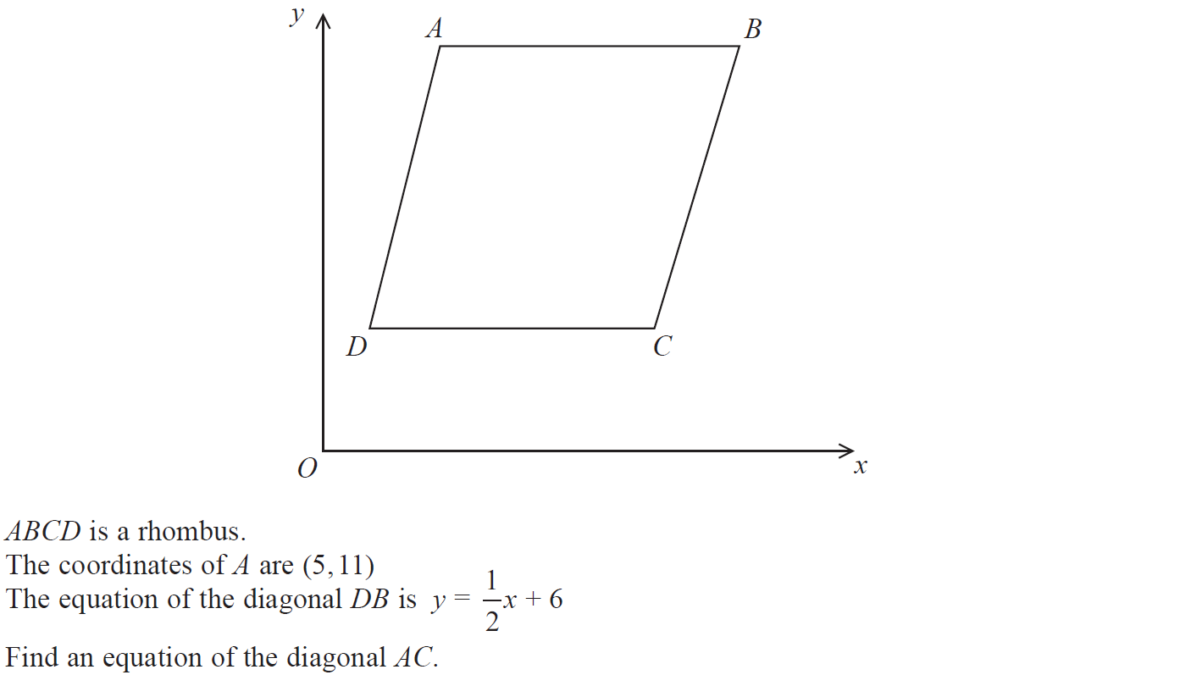
Linear Graphs & Gradients
May 2017 1H Q18

Slide 19
Linear Graphs & Gradients
May 2017 1H Q18
A

Slide 20
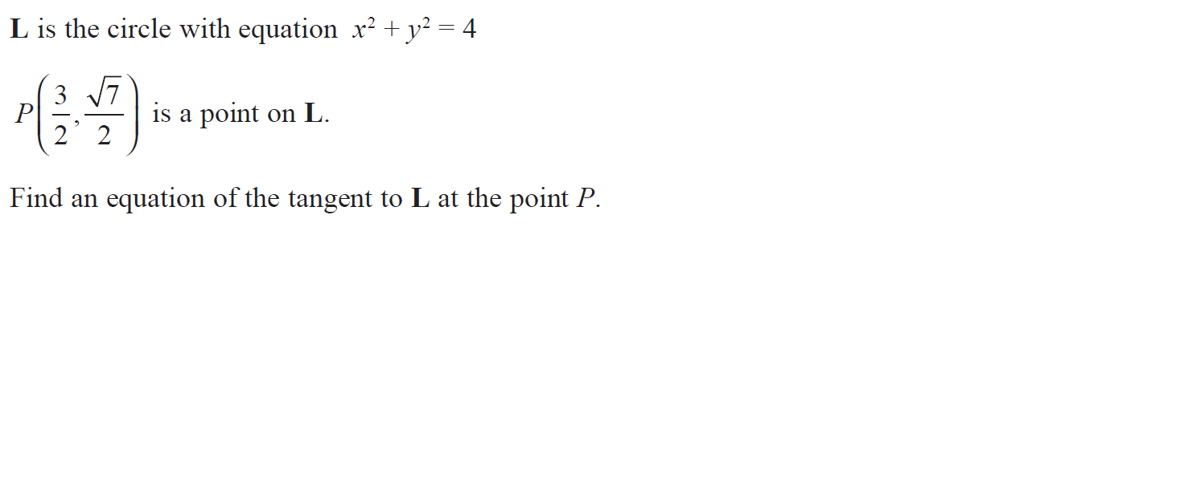
Linear Graphs & Gradients
June 2017 2H Q23

Slide 21
Linear Graphs & Gradients
June 2017 2H Q23
A

Slide 22
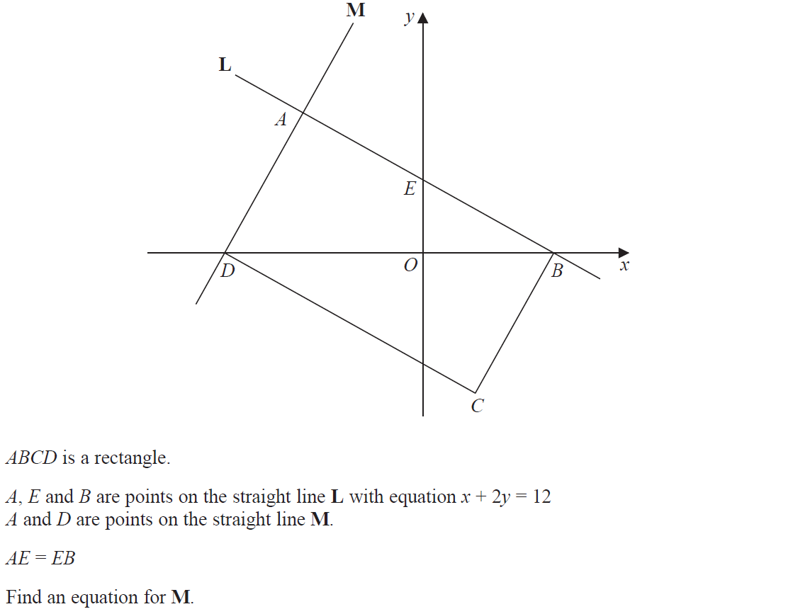
Linear Graphs & Gradients
Nov 2017 1H Q19

Slide 23
Linear Graphs & Gradients
Nov 2017 1H Q19
A

Slide 24
Linear Graphs & Gradients
Nov 2017 2H Q19

Slide 25
Linear Graphs & Gradients
Nov 2017 2H Q19
A

Slide 26
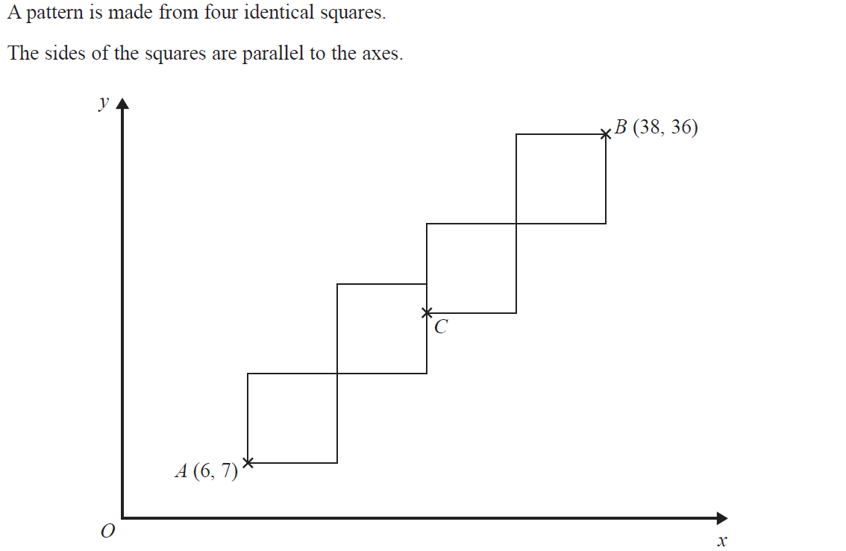
Linear Graphs & Gradients
May 2018 1H Q6

Slide 27
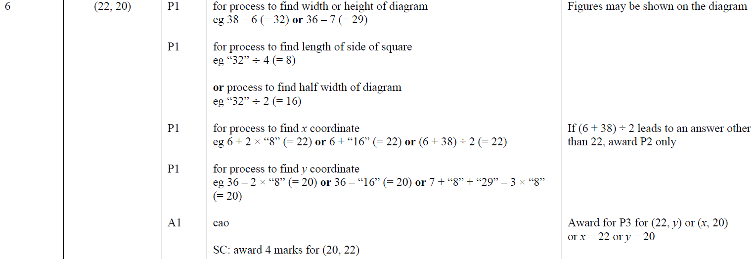
Linear Graphs & Gradients
May 2018 1H Q6
A

Slide 28
Linear Graphs & Gradients
May 2018 1H Q19

Slide 29
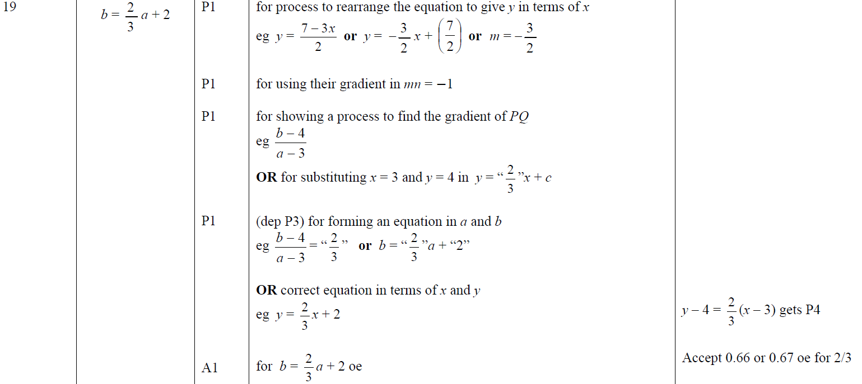
Linear Graphs & Gradients
May 2018 1H Q19
A

Slide 30
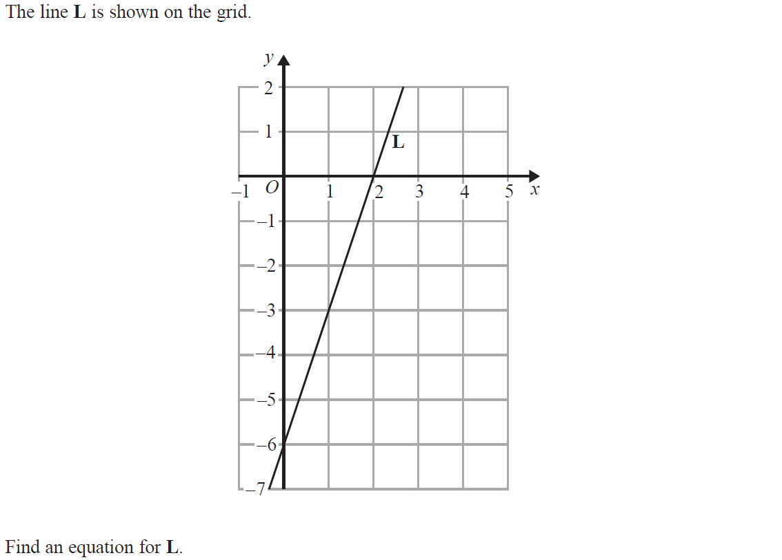
Linear Graphs & Gradients
June 2018 2H Q3

Slide 31
Linear Graphs & Gradients
June 2018 2H Q3
A

Slide 32
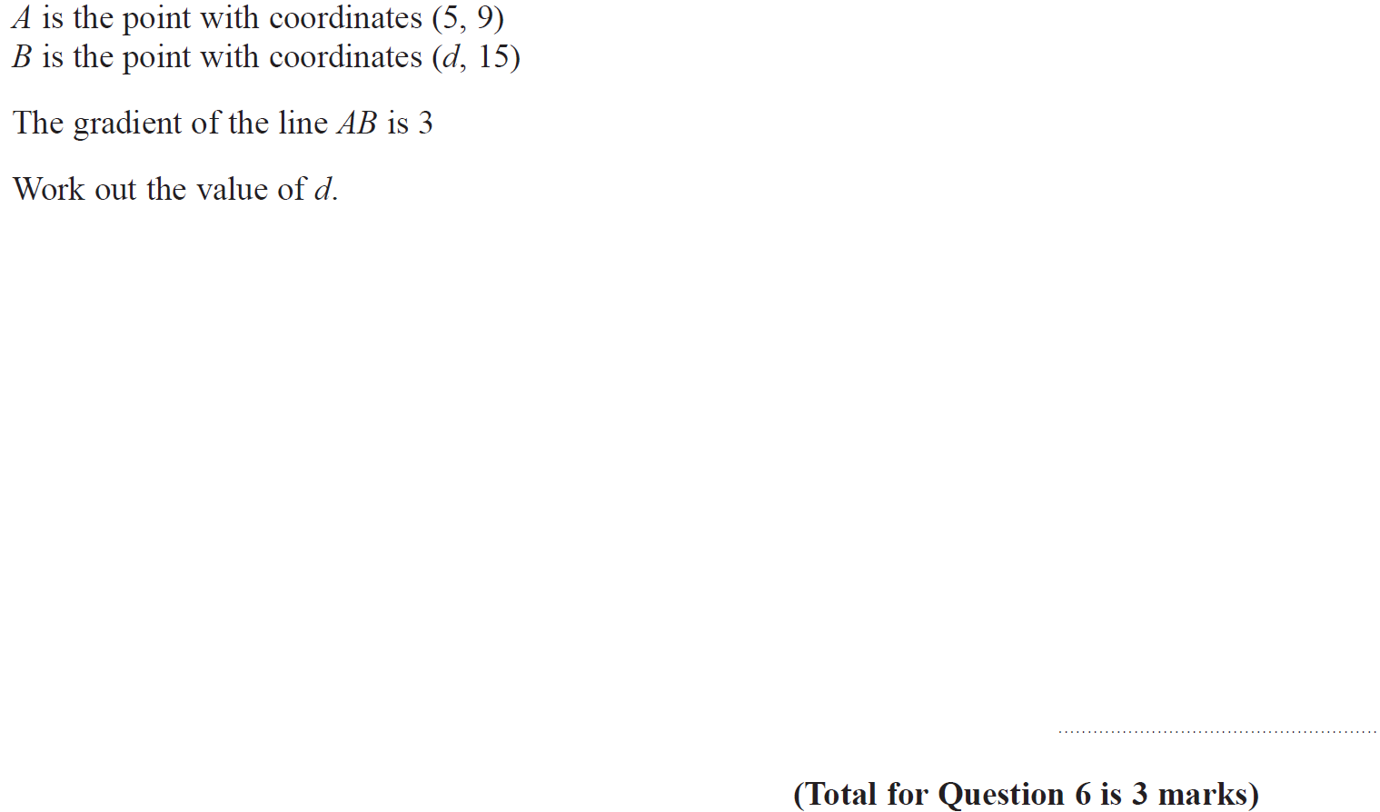
Linear Graphs & Gradients
Nov 2018 2H Q6

Slide 33
Linear Graphs & Gradients
Nov 2018 2H Q6
A

Slide 34
Linear Graphs & Gradients
Nov 2018 2H Q18

Slide 35
Linear Graphs & Gradients
Nov 2018 2H Q18
A

Slide 36
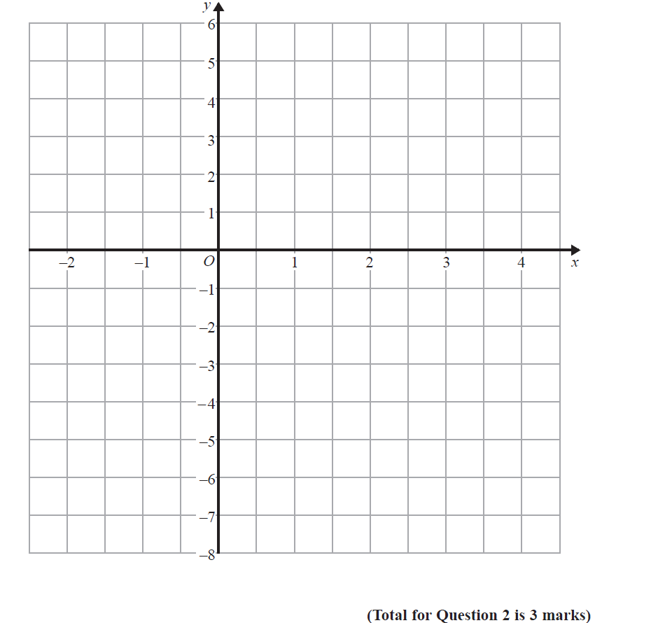
Linear Graphs & Gradients
June 2019 2H Q2

Slide 37
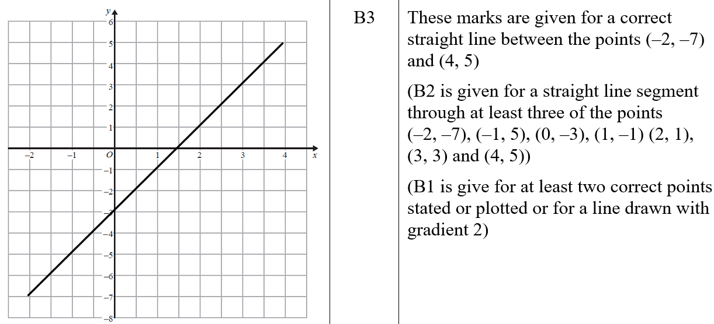
Linear Graphs & Gradients
June 2019 2H Q2
A
A SF

Slide 38
Linear Graphs & Gradients
June 2019 2H Q16

Slide 39
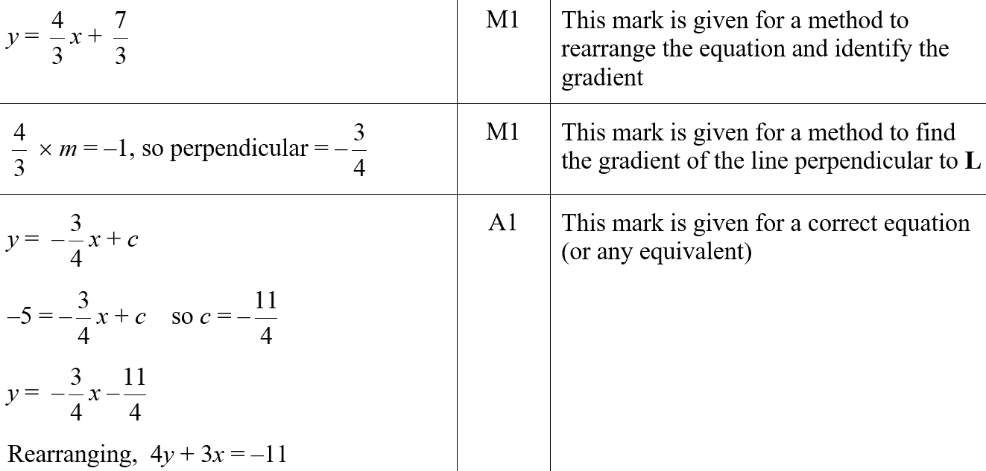
Linear Graphs & Gradients
June 2019 2H Q16
A
A SF

Slide 40
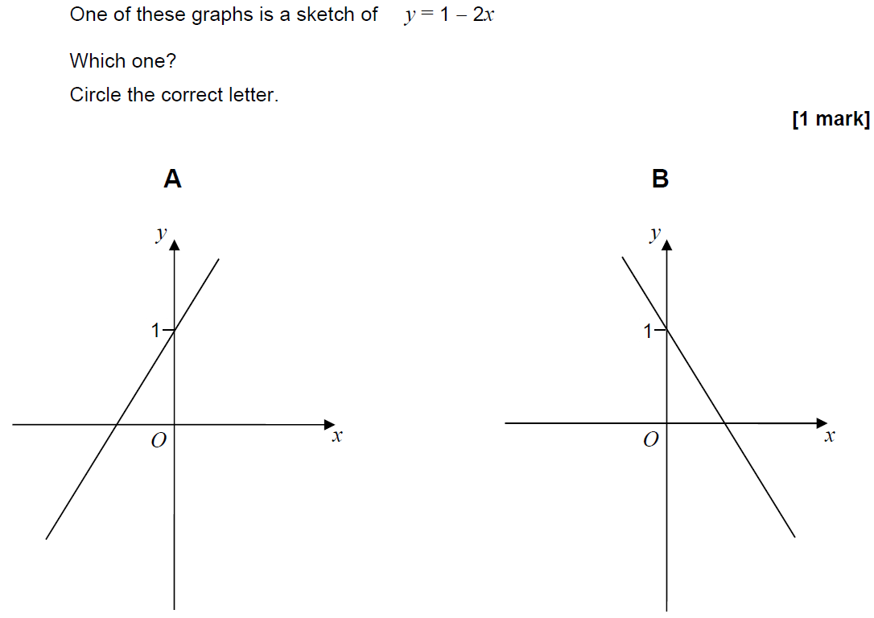
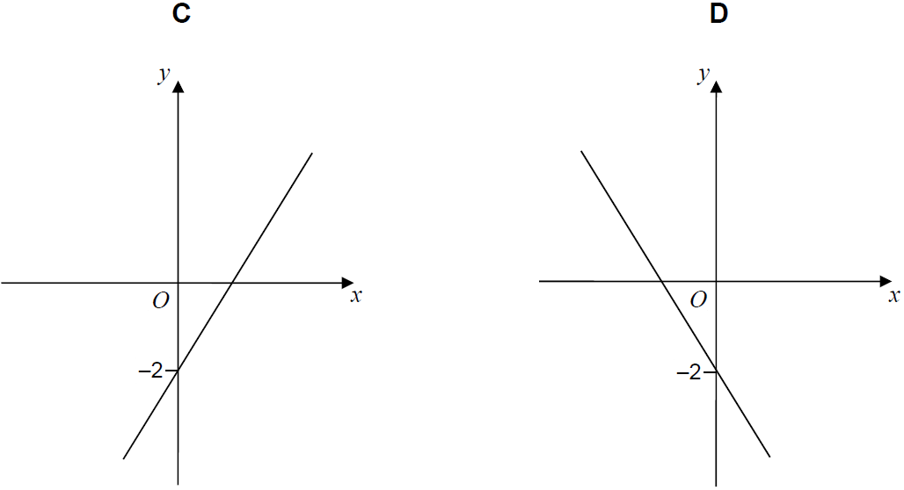
Linear Graphs & Gradients
SAM 1H Q4

Slide 41
Linear Graphs & Gradients
SAM 1H Q4
A

Slide 42
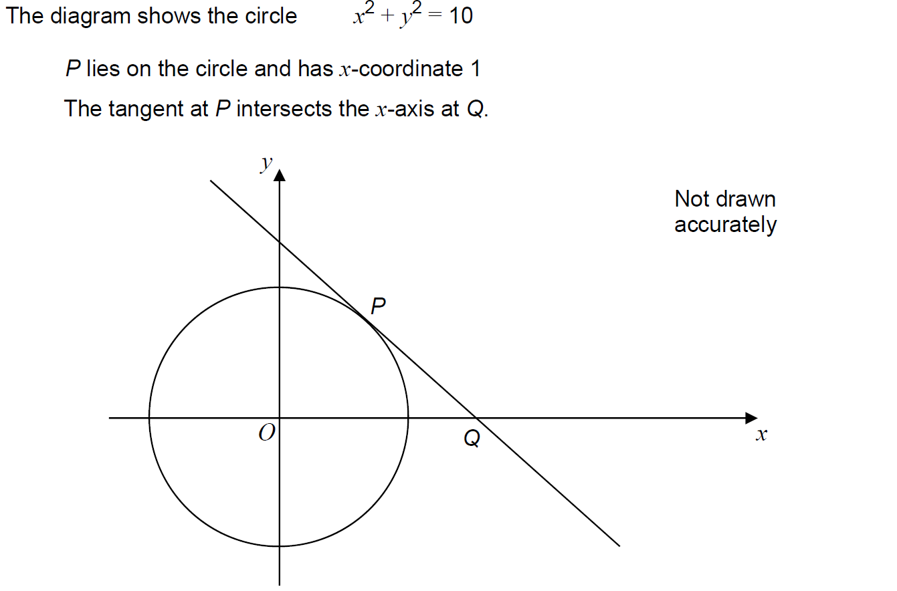
Linear Graphs & Gradients
SAM 1H Q28

Slide 43
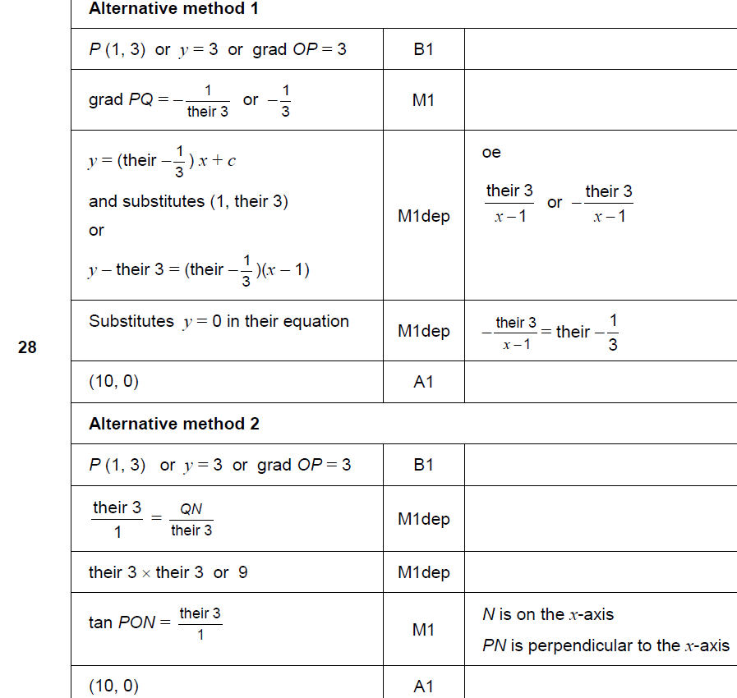
Linear Graphs & Gradients
SAM 1H Q28
A

Slide 44
Linear Graphs & Gradients
SAM 2H Q4

Slide 45
Linear Graphs & Gradients
SAM 2H Q4
A

Slide 46
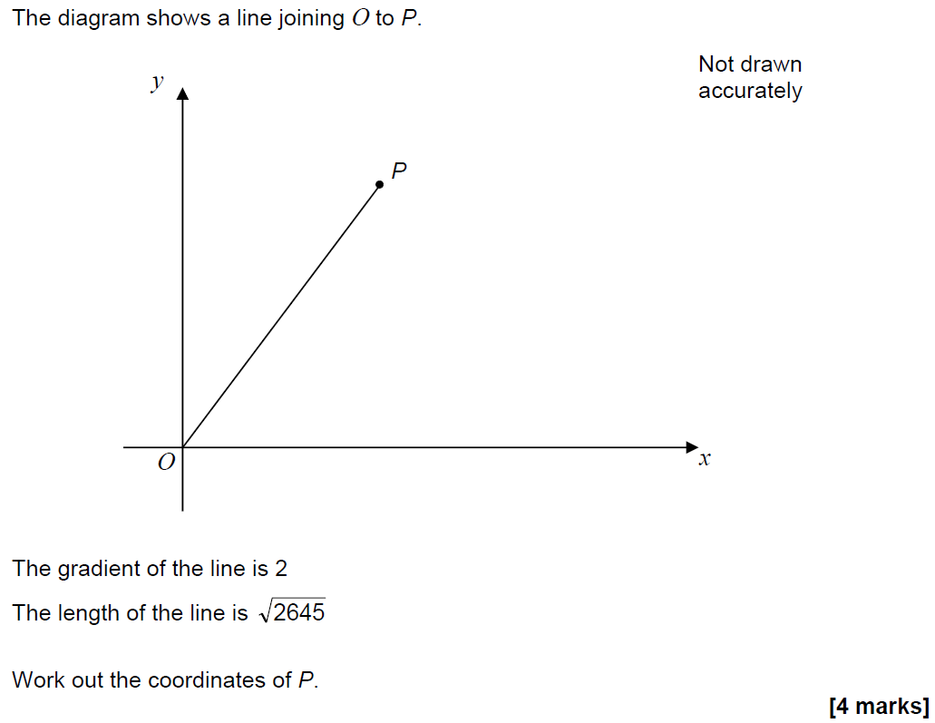
Linear Graphs & Gradients
SAM 3H Q28

Slide 47
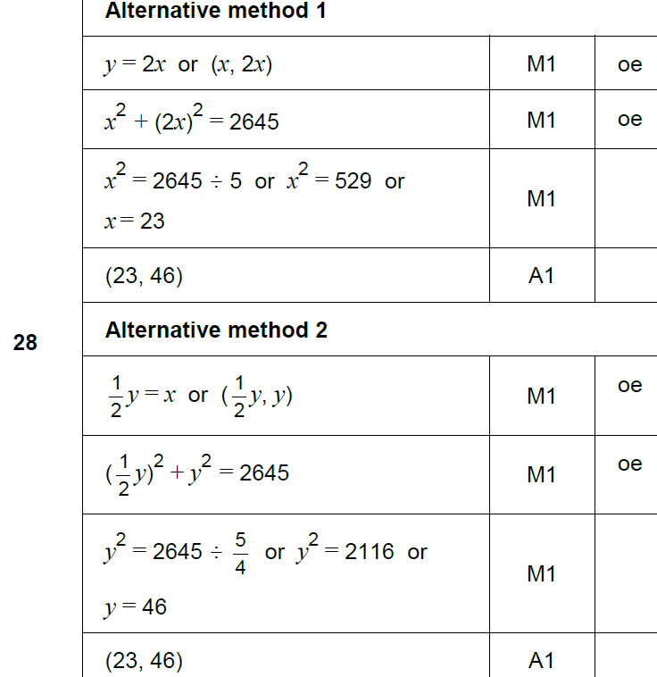
Linear Graphs & Gradients
SAM 3H Q28
A

Slide 48
Linear Graphs & Gradients
May 2017 1H Q17

Slide 49
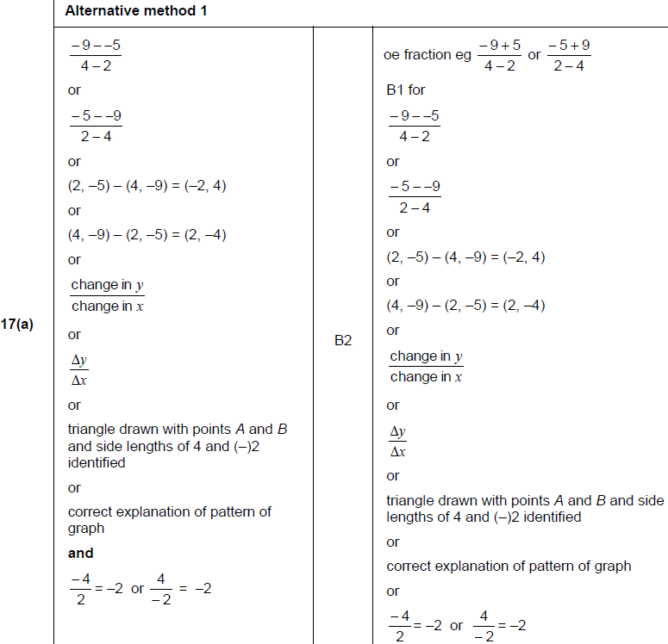
Linear Graphs & Gradients
May 2017 1H Q17
A

Slide 50
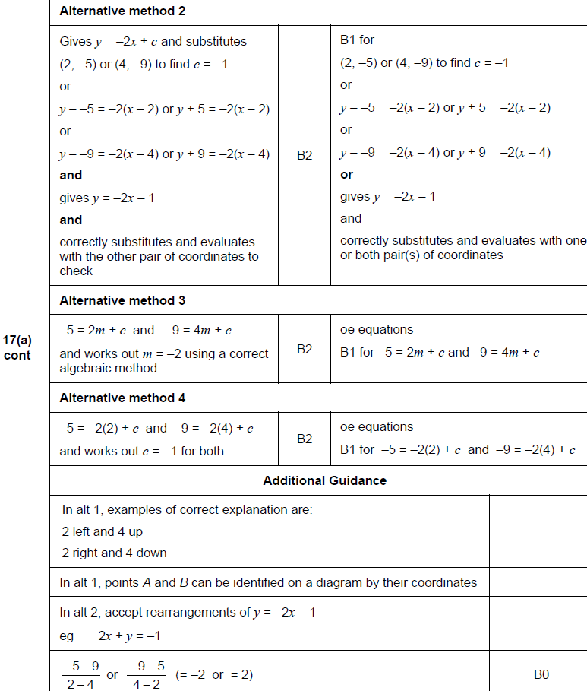
Linear Graphs & Gradients
May 2017 1H Q17
A Alternatives

Slide 51
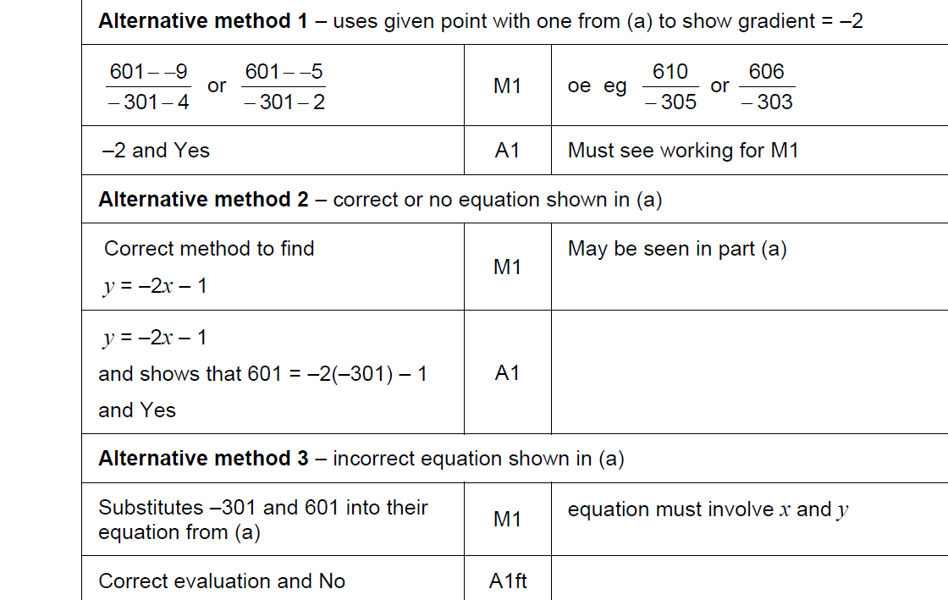
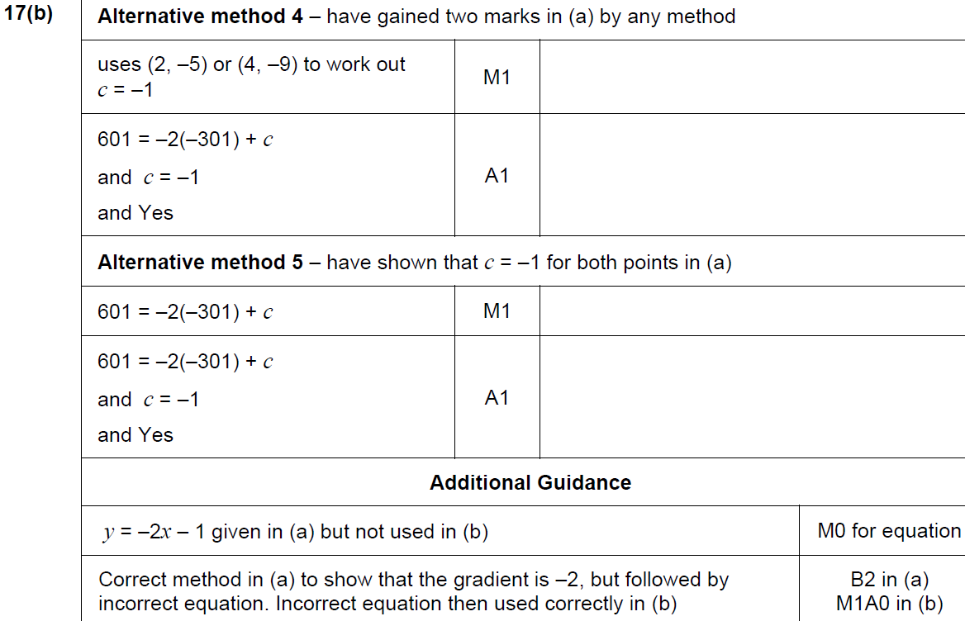
Linear Graphs & Gradients
May 2017 1H Q17
B

Slide 52
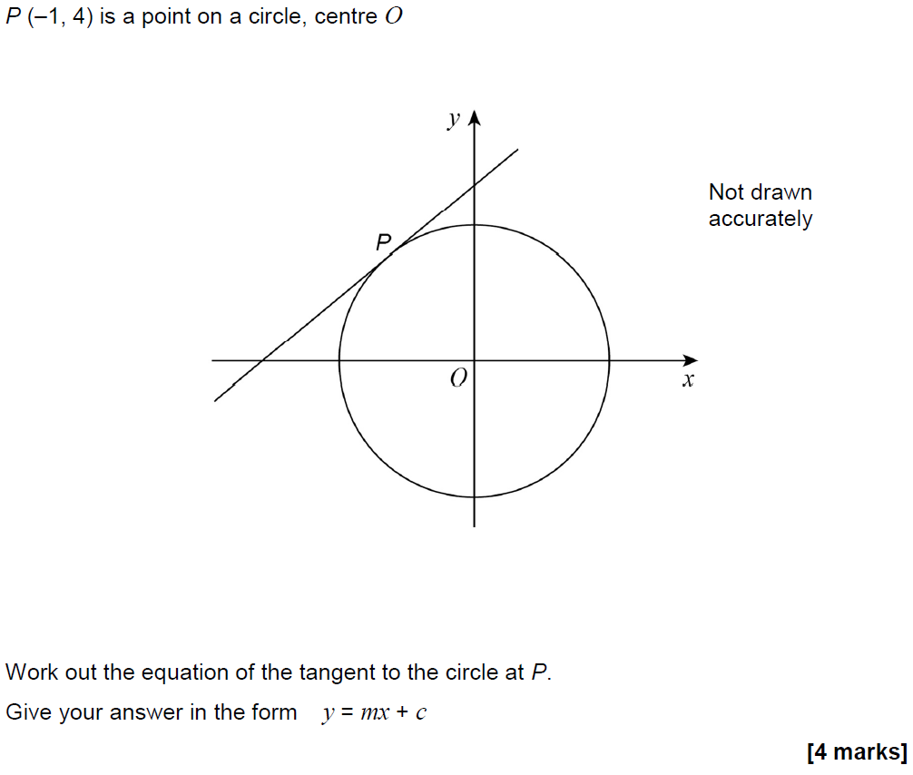
Linear Graphs & Gradients
May 2017 1H Q27

Slide 53
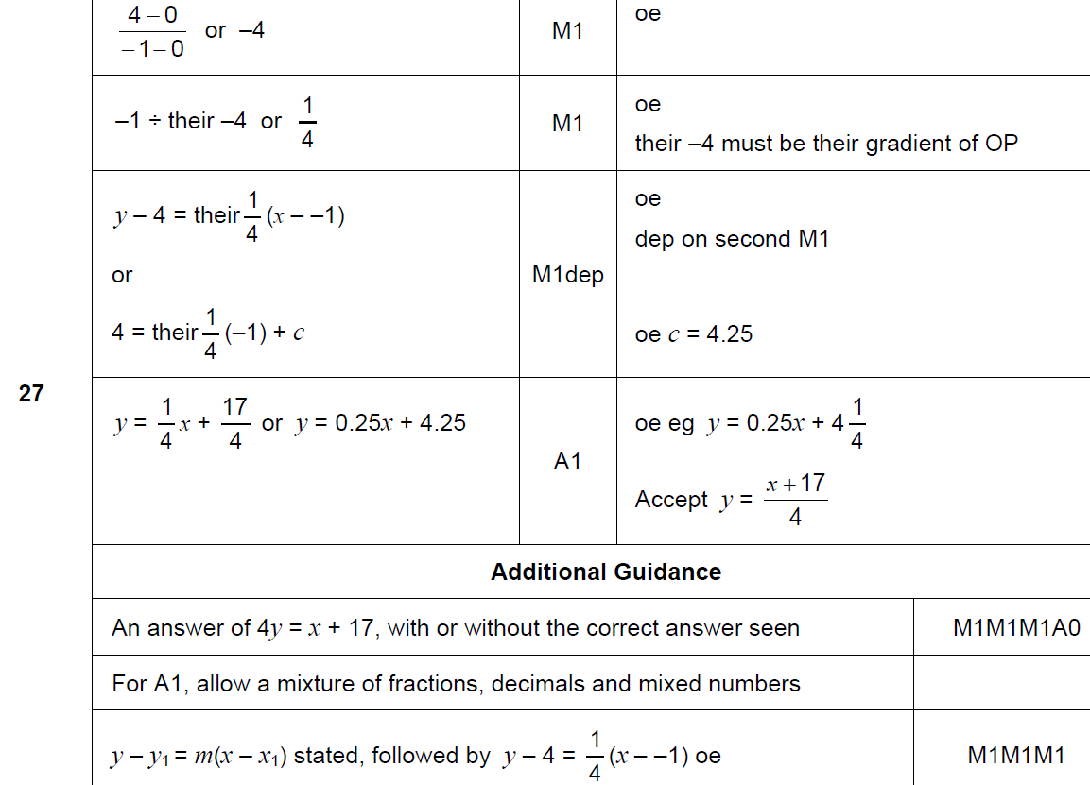
Linear Graphs & Gradients
May 2017 1H Q27
A

Slide 54
Linear Graphs & Gradients
June 2017 2H Q3

Slide 55
Linear Graphs & Gradients
June 2017 2H Q3
A

Slide 56
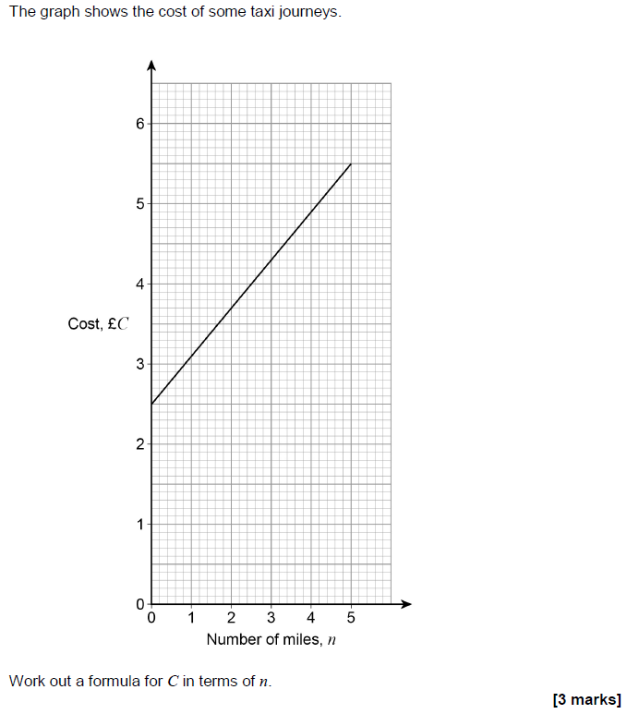
Linear Graphs & Gradients
June 2017 2H Q14

Slide 57
Linear Graphs & Gradients
June 2017 2H Q14
A

Slide 58
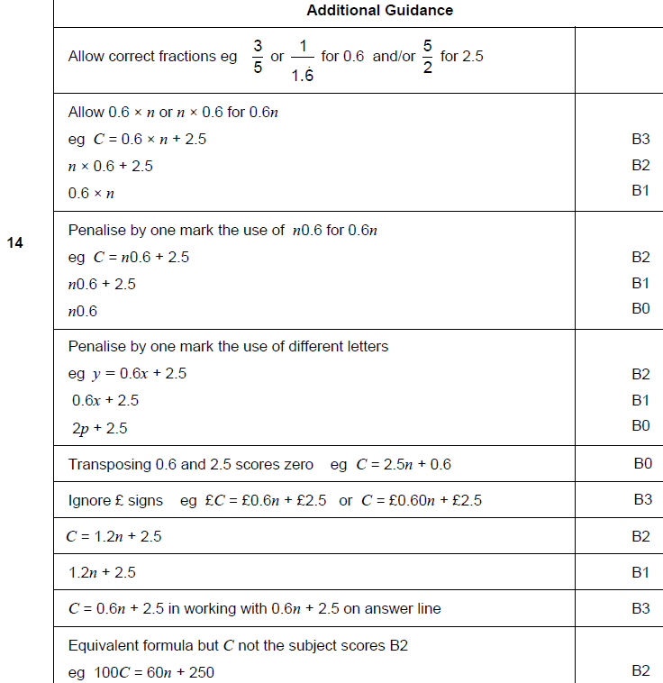
Linear Graphs & Gradients
June 2017 2H Q14
A notes

Slide 59
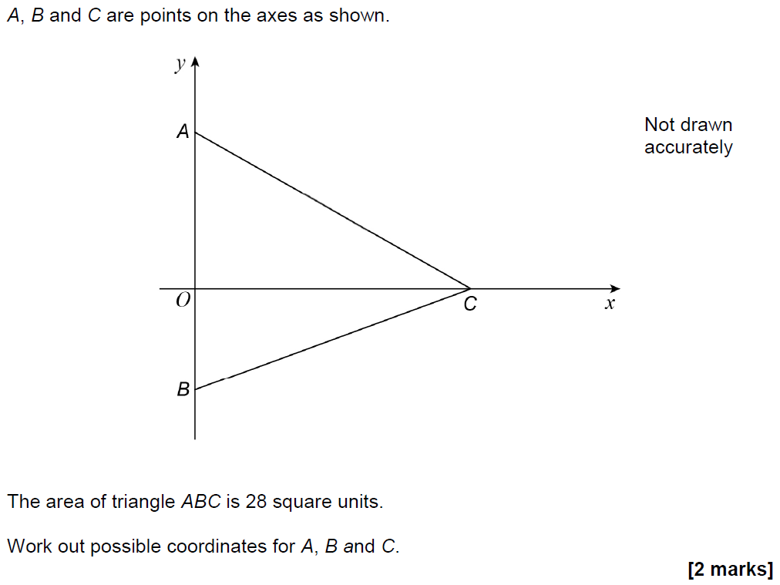
Linear Graphs & Gradients
Nov 2017 1H Q21

Slide 60
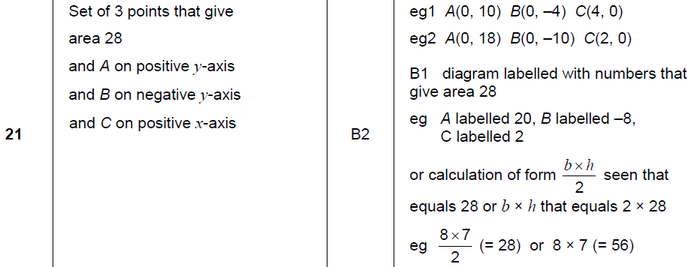
Linear Graphs & Gradients
Nov 2017 1H Q21
A

Slide 61
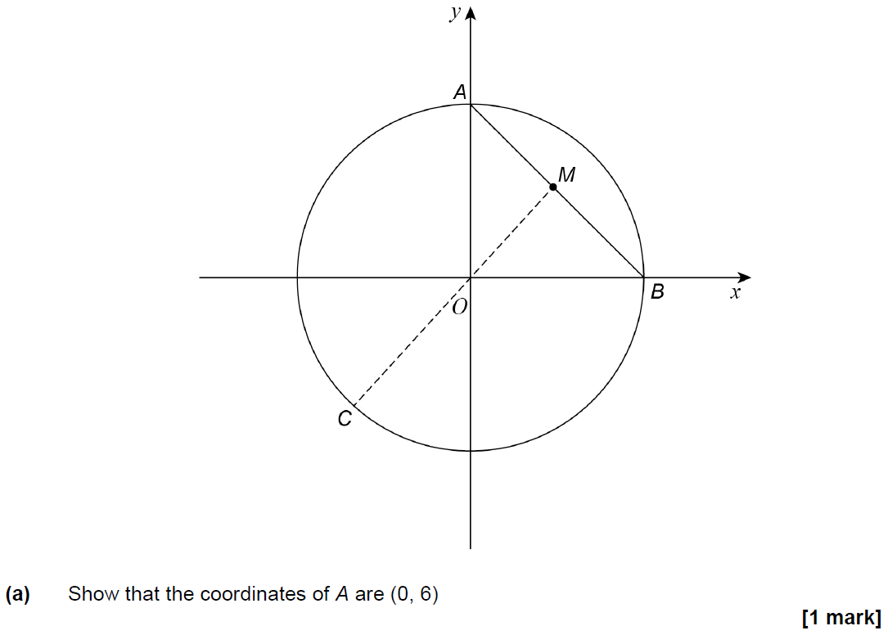
Linear Graphs & Gradients
Nov 2017 1H Q28

Slide 62
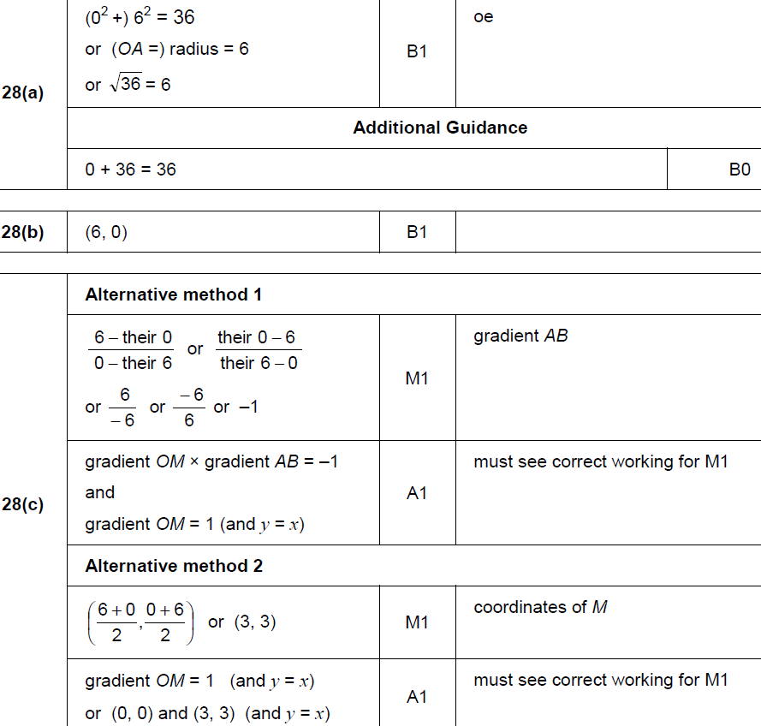
Linear Graphs & Gradients
Nov 2017 1H Q28
A
B
C

Slide 63
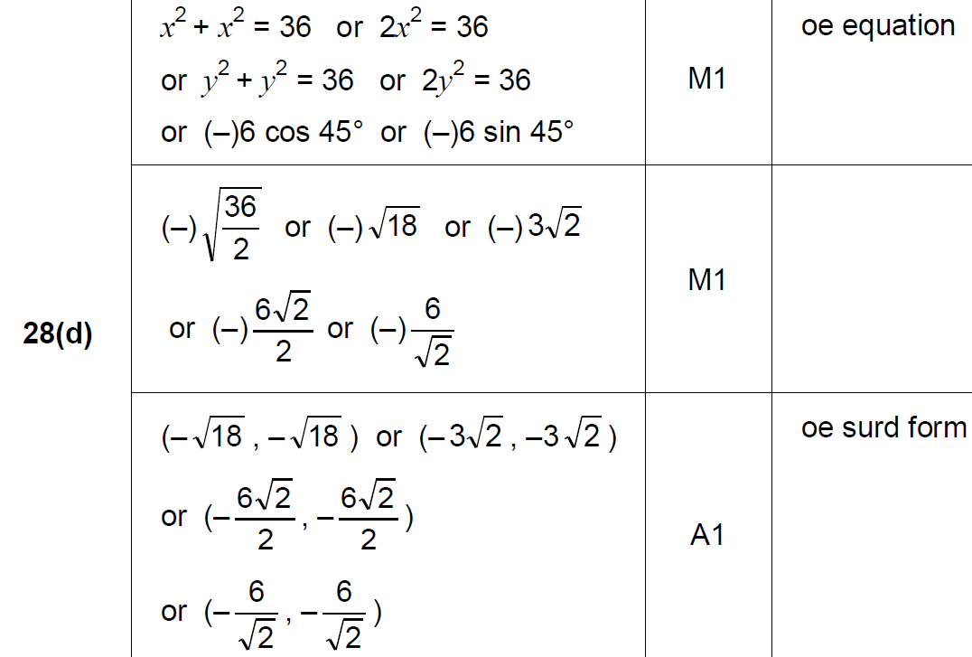
Linear Graphs & Gradients
Nov 2017 1H Q28
D

Slide 64
Linear Graphs & Gradients
Nov 2017 3H Q4

Slide 65
Linear Graphs & Gradients
Nov 2017 3H Q4
A

Slide 66
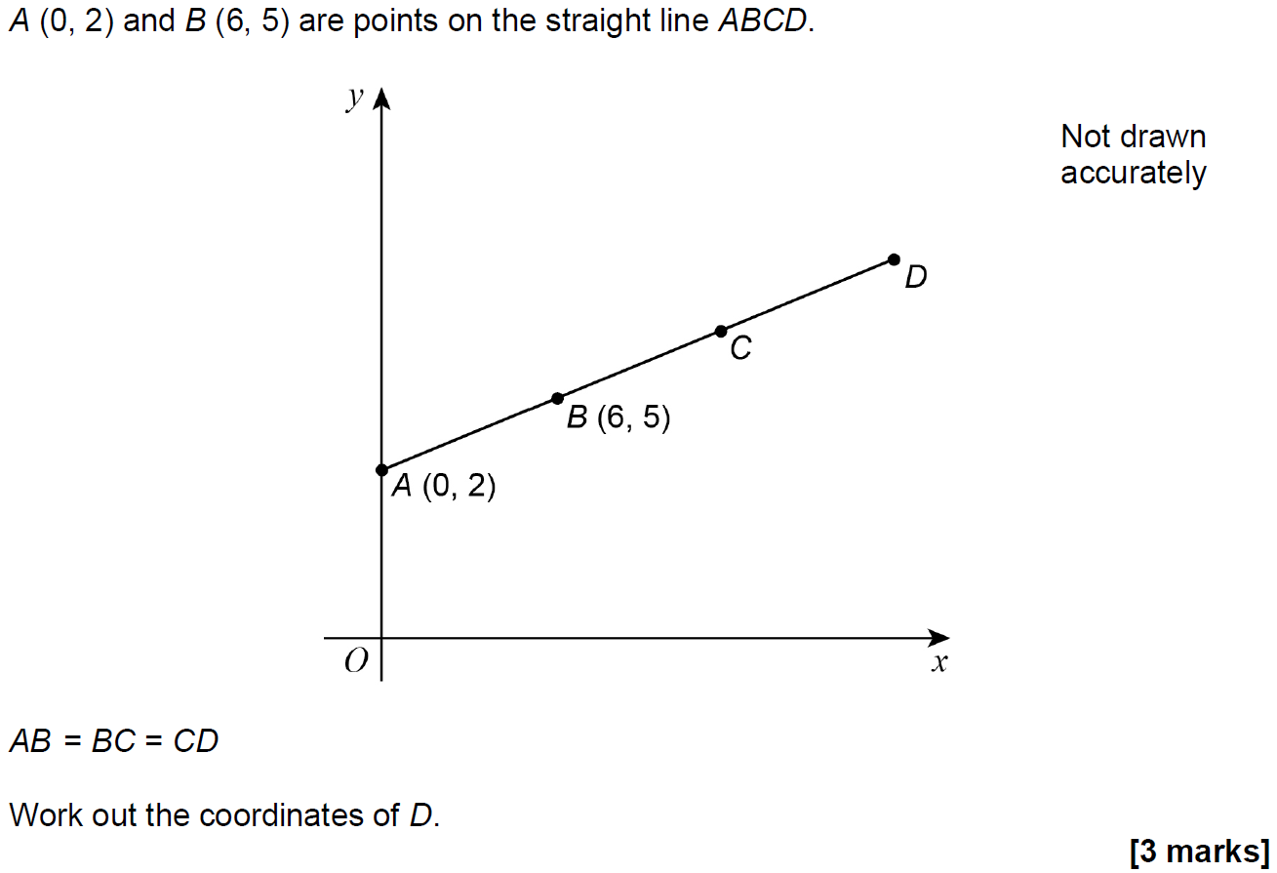
Linear Graphs & Gradients
May 2018 1H Q7

Slide 67
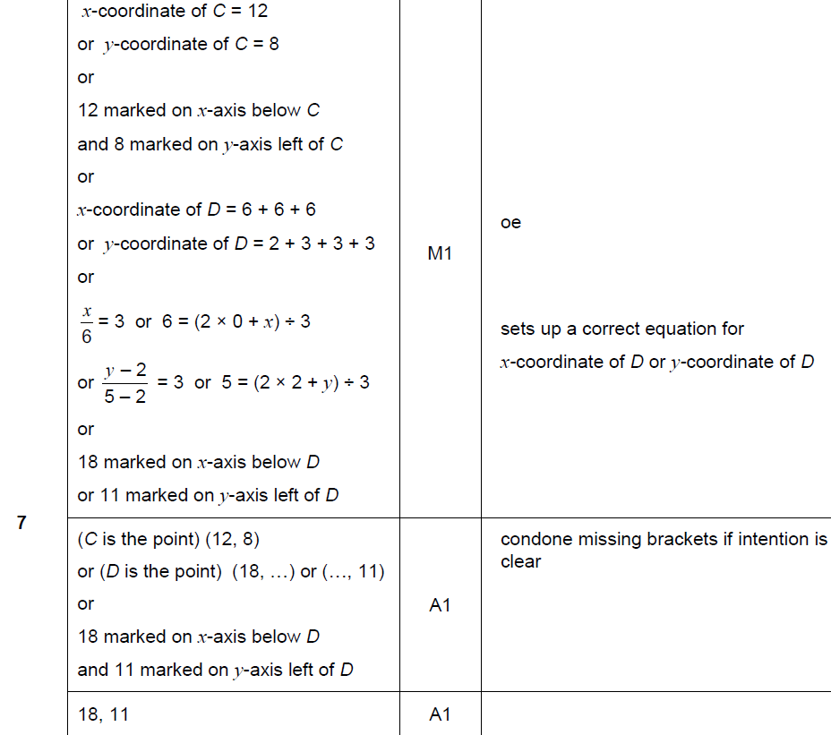
Linear Graphs & Gradients
May 2018 1H Q7
A

Slide 68
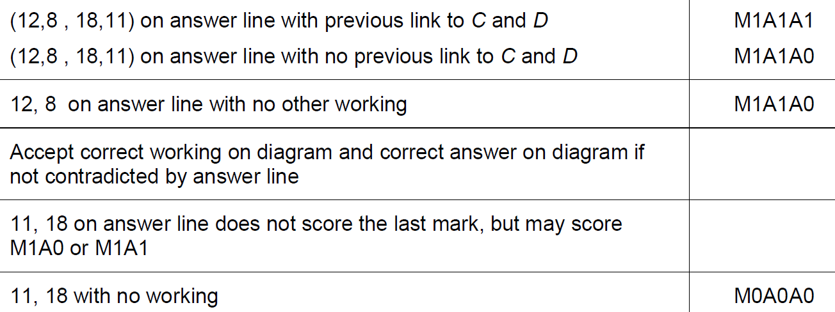
Linear Graphs & Gradients
May 2018 1H Q7
A notes

Slide 69
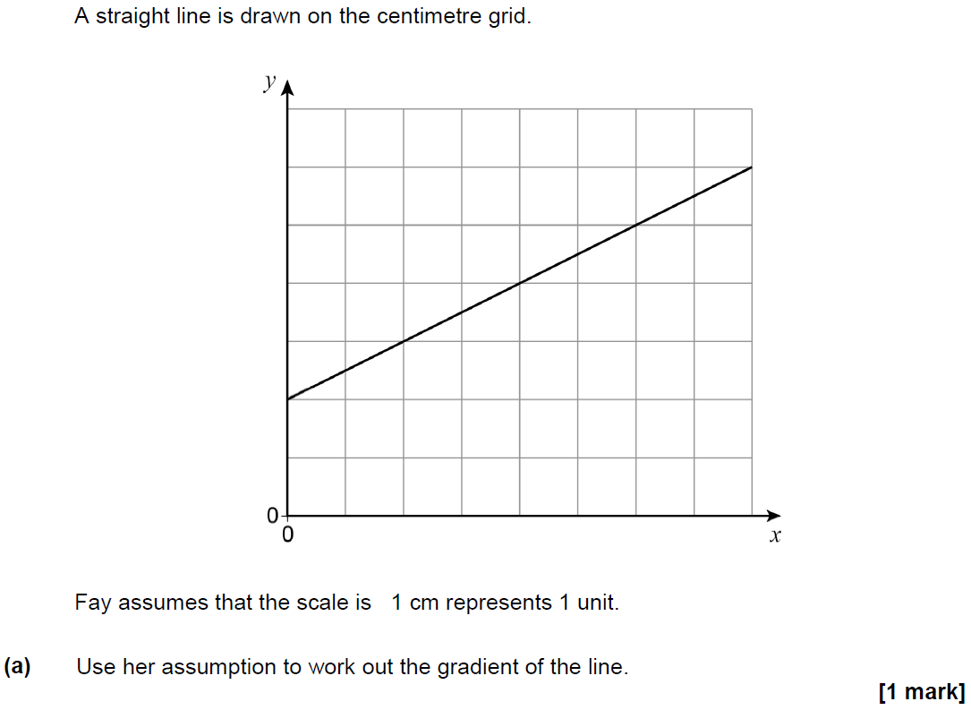
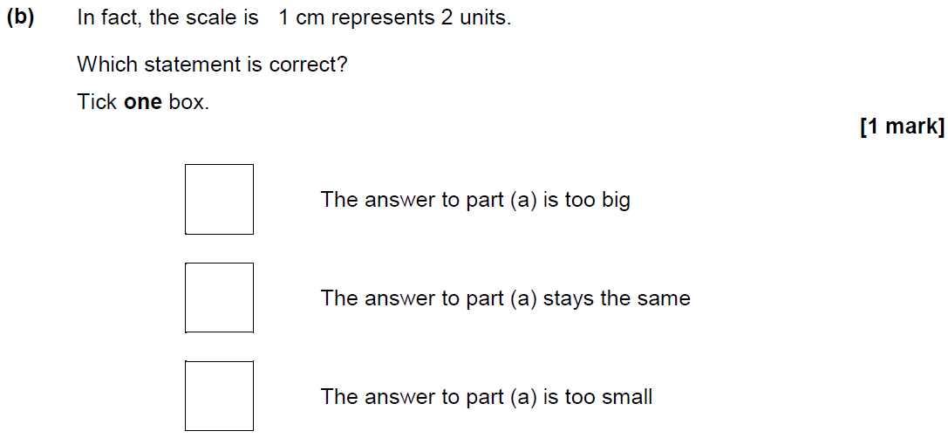
Linear Graphs & Gradients
June 2018 2H Q12

Slide 70
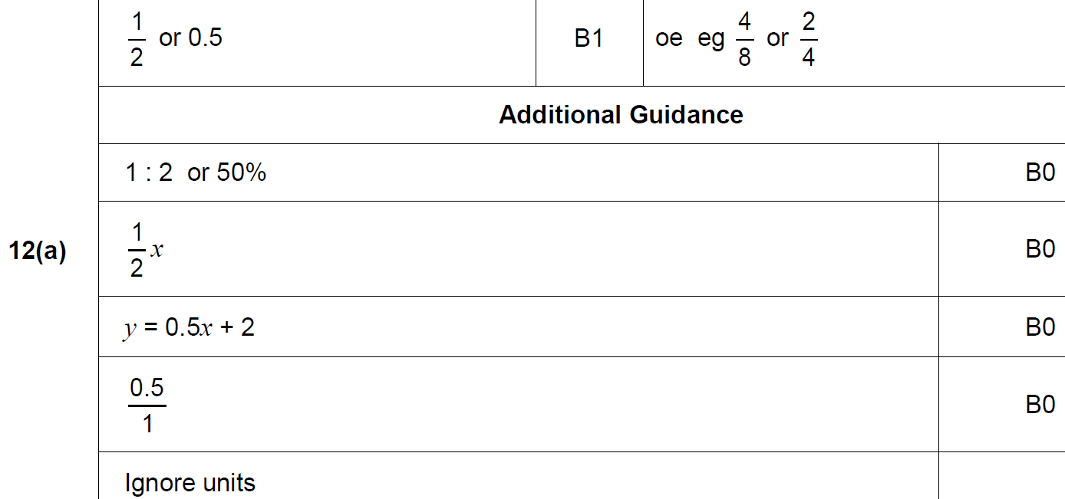
Linear Graphs & Gradients
June 2018 2H Q12
A

Slide 71
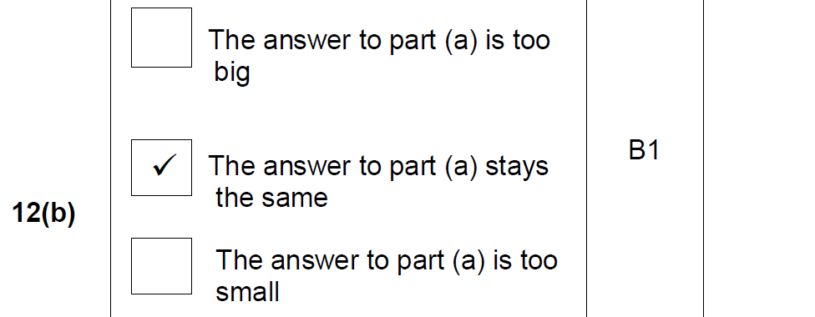
Linear Graphs & Gradients
June 2018 2H Q12
B

Slide 72
Linear Graphs & Gradients
June 2018 3H Q8

Slide 73
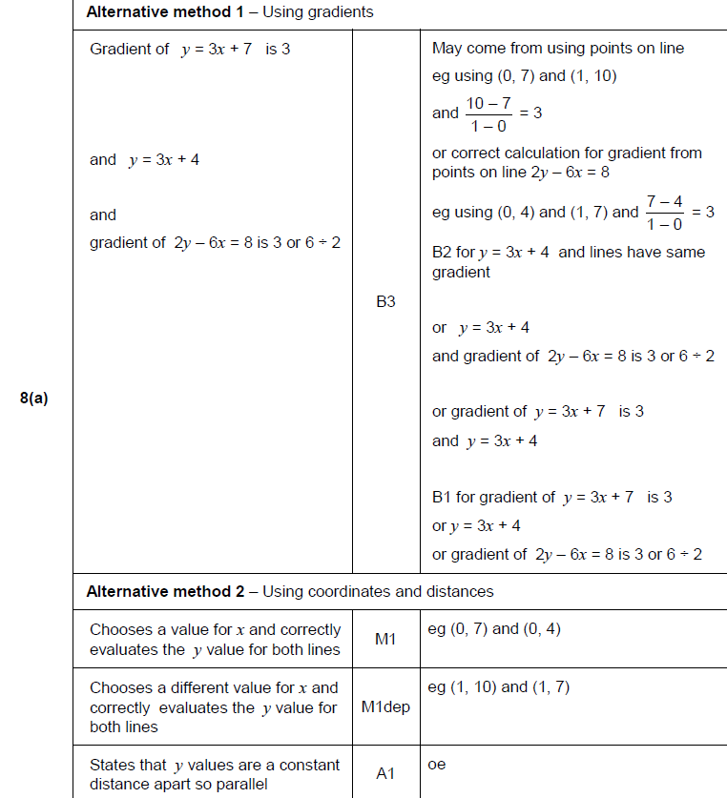
Linear Graphs & Gradients
June 2018 3H Q8
A

Slide 74
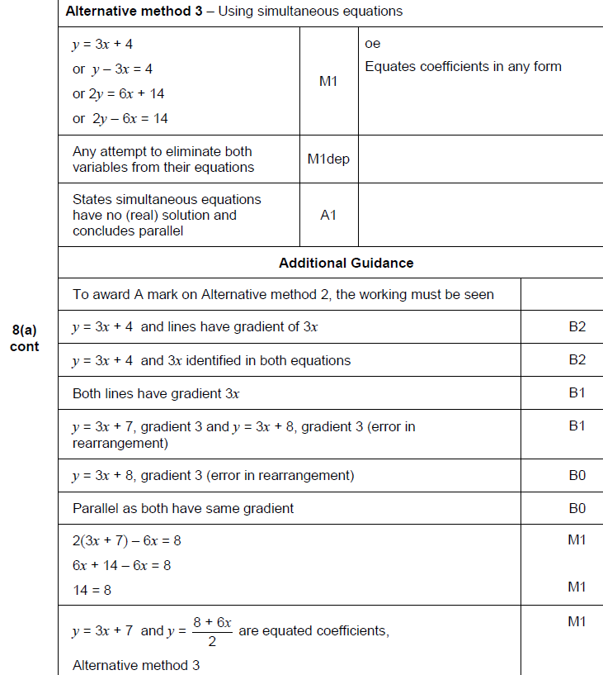
Linear Graphs & Gradients
June 2018 3H Q8
A Alternative & notes

Slide 75
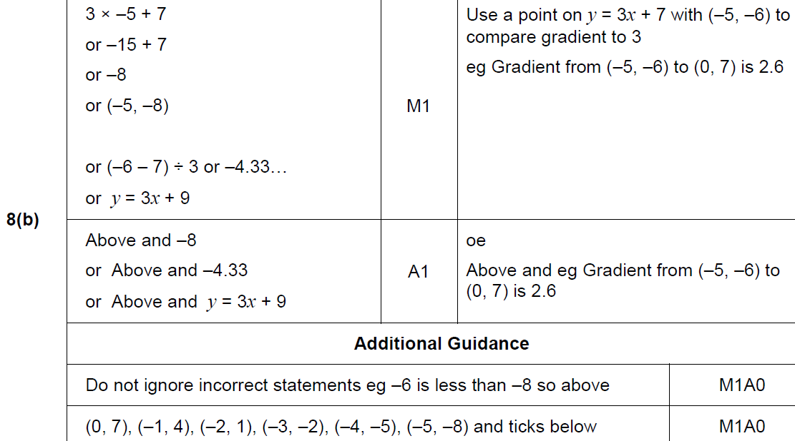
Linear Graphs & Gradients
June 2018 3H Q8
B

Slide 76
Linear Graphs & Gradients
June 2018 3H Q19

Slide 77
Linear Graphs & Gradients
June 2018 3H Q19
A

Slide 78
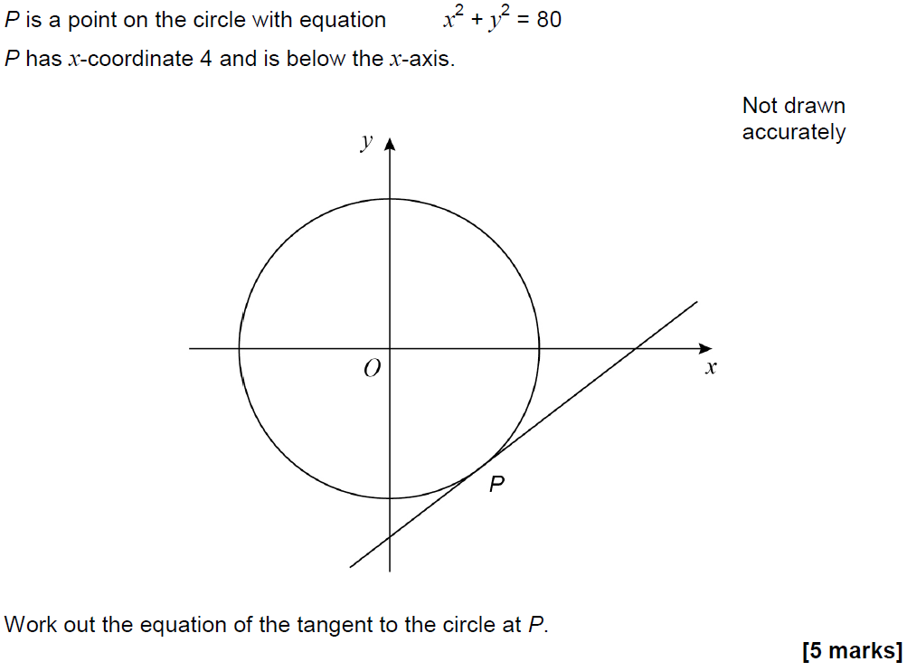
Linear Graphs & Gradients
June 2018 3H Q28

Slide 79
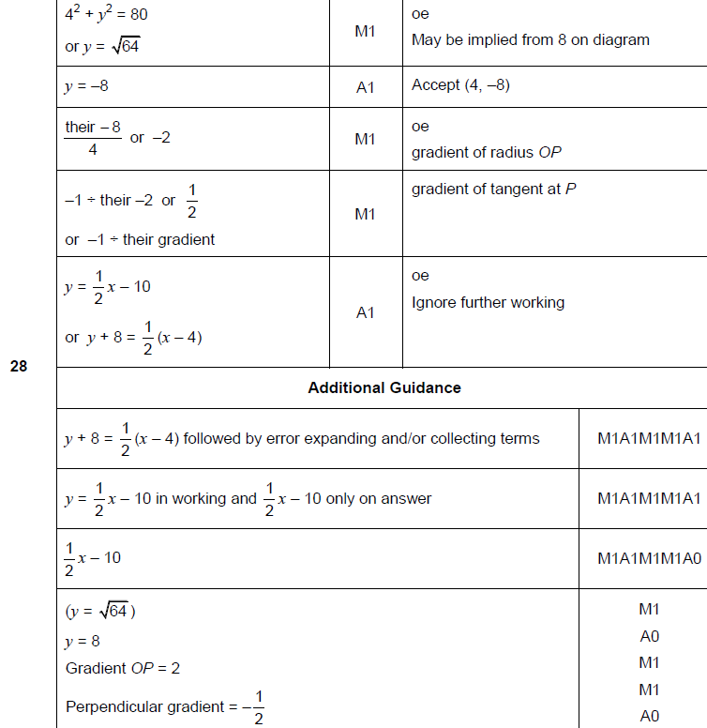
Linear Graphs & Gradients
June 2018 3H Q28
A

Slide 80
Linear Graphs & Gradients
Nov 2018 2H Q2

Slide 81
Linear Graphs & Gradients
Nov 2018 2H Q2
A

Slide 82
Linear Graphs & Gradients
SAM 2H Q14

Slide 83
Linear Graphs & Gradients
SAM 2H Q14
A

Slide 84
Linear Graphs & Gradients
SAM 3H Q14

Slide 85
Linear Graphs & Gradients
SAM 3H Q14
A

Slide 86
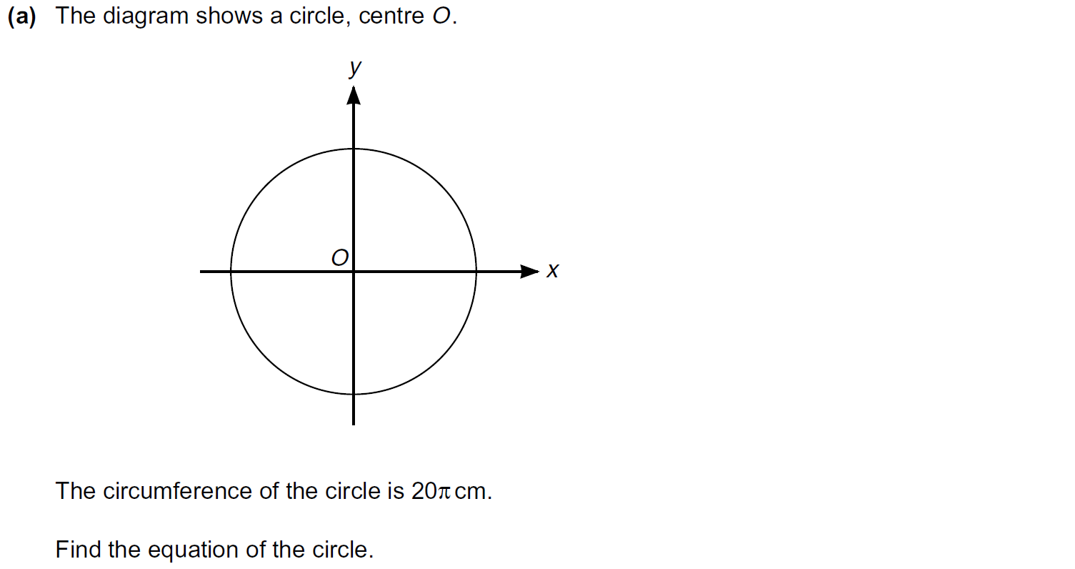
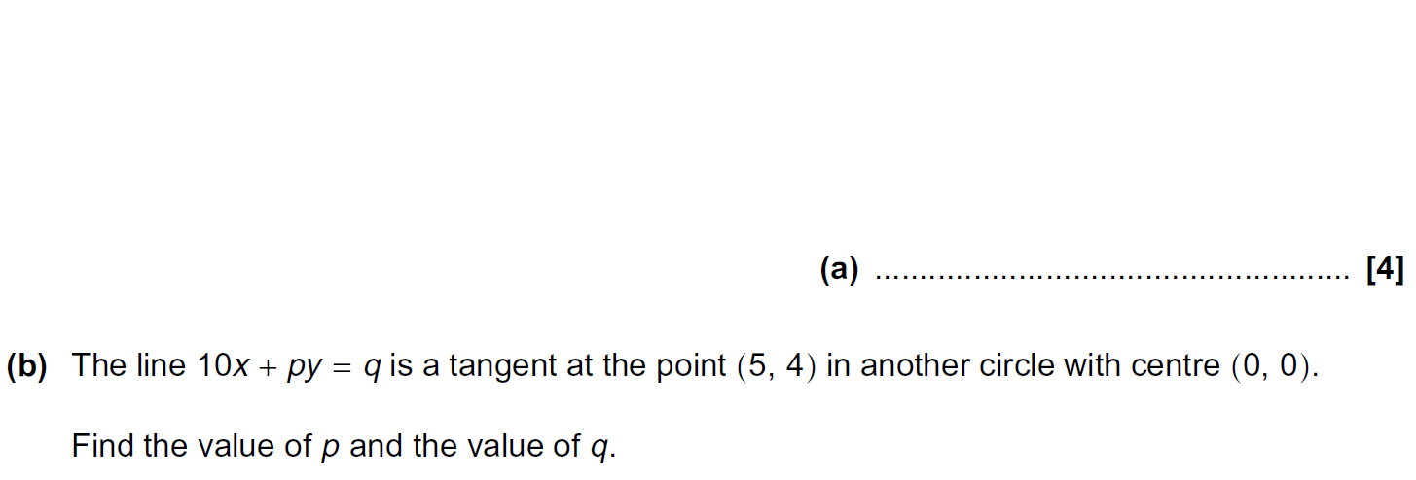
Linear Graphs & Gradients
Practice 2H Q18

Slide 87
Linear Graphs & Gradients
Practice 2H Q18
A
B

Slide 88
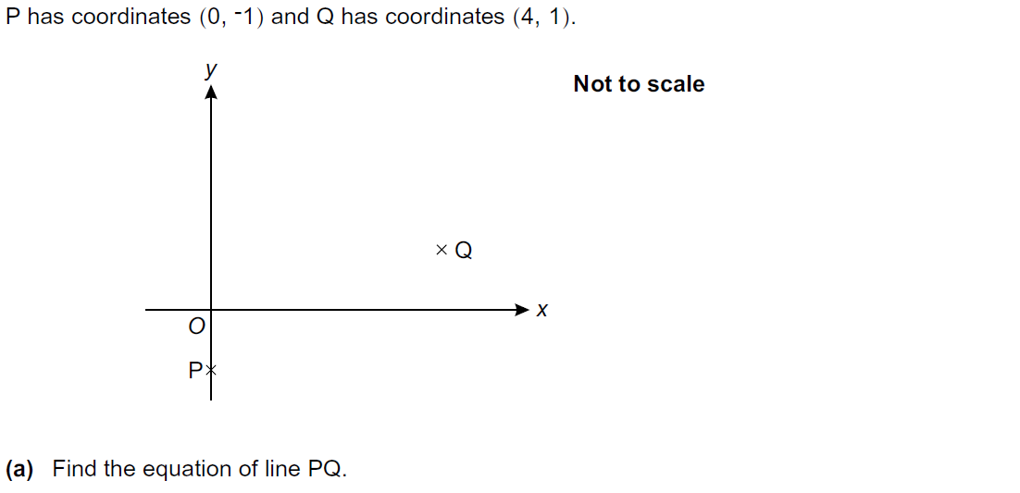
Linear Graphs & Gradients
Practice 3H Q10

Slide 89
Linear Graphs & Gradients
Practice 3H Q10
A
B

Slide 90
Linear Graphs & Gradients
June 2017 3H Q5

Slide 91
Linear Graphs & Gradients
June 2017 3H Q5
A (i)
A (ii)
B

Slide 92
Linear Graphs & Gradients
Nov 2017 3H Q17

Slide 93
Linear Graphs & Gradients
Nov 2017 3H Q17
A
B
C

Slide 94
Linear Graphs & Gradients
June 2018 2H Q18

Slide 95
Linear Graphs & Gradients
June 2018 2H Q18
A
B

Slide 96
Linear Graphs & Gradients
June 2018 3H Q5

Slide 97
Linear Graphs & Gradients
June 2018 3H Q5
A
B

Slide 98
Linear Graphs & Gradients
June 2018 3H Q5
C

Slide 99
Linear Graphs & Gradients
Nov 2018 1H Q18

Slide 100
Linear Graphs & Gradients
Nov 2018 1H Q18
A

