Slide 1
Linear Graphs & Gradients
Old Spec Q’s
Linear Graphs & Gradients
NTSQ
Q1
NTSQ
Q11
Jan 2019
2H Q21
NTSQ
Q2
NTSQ
Q12
Jan 2019
2HR Q11
NTSQ
Q3
NTSQ
Q13
Jan 2019
2HR Q21
NTSQ
Q4
SAM
1H Q13
May 2019
1H Q23
NTSQ
Q6
SAM
2H Q14
June 2019
2H Q10
NTSQ
Q7
May 2018
1H Q12
NTSQ
Q8
May 2018
1H Q20
NTSQ
Q9
June 2018
2HR Q13
NTSQ
Q10
Jan 2019
2H Q10
note. all NTSQ questions involve perpendicular gradients
functions

Slide 2
Linear Graphs & Gradients
NTSQ Q1

Slide 3
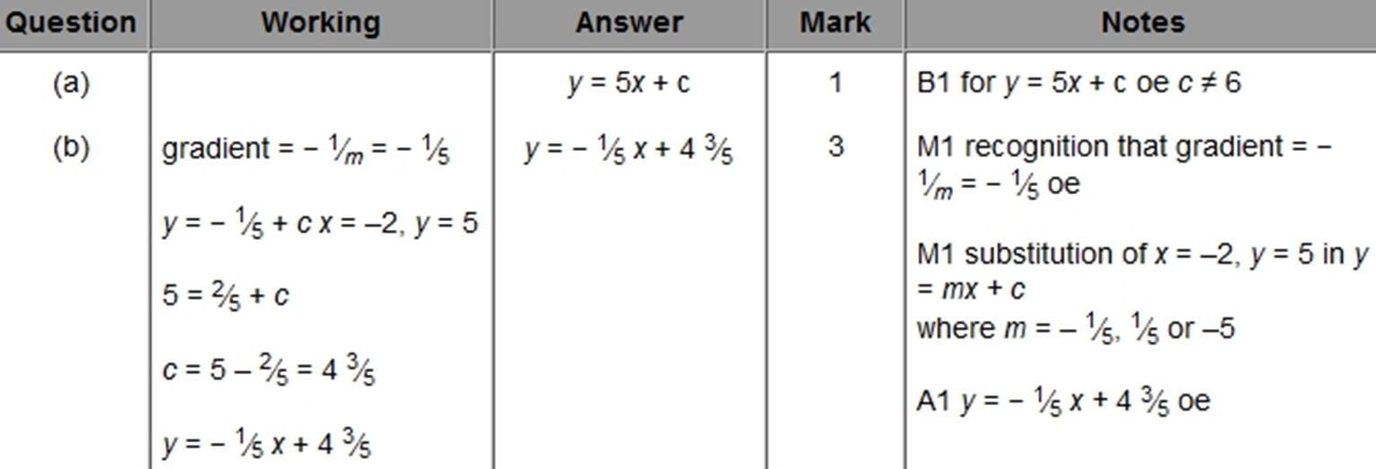
Linear Graphs & Gradients
NTSQ Q1
A
B

Slide 4
Linear Graphs & Gradients
NTSQ Q2

Slide 5
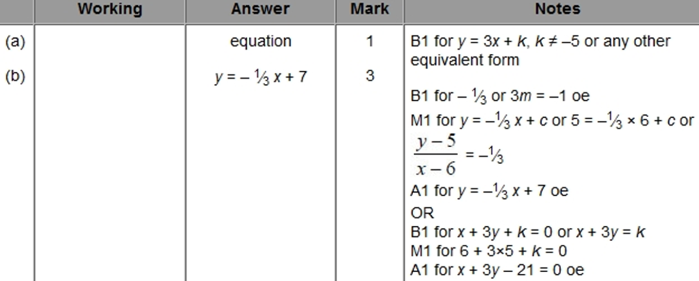
Linear Graphs & Gradients
NTSQ Q2
A
B

Slide 6
Linear Graphs & Gradients
NTSQ Q3

Slide 7
Linear Graphs & Gradients
NTSQ Q3
A
B

Slide 8
Linear Graphs & Gradients
NTSQ Q4

Slide 9
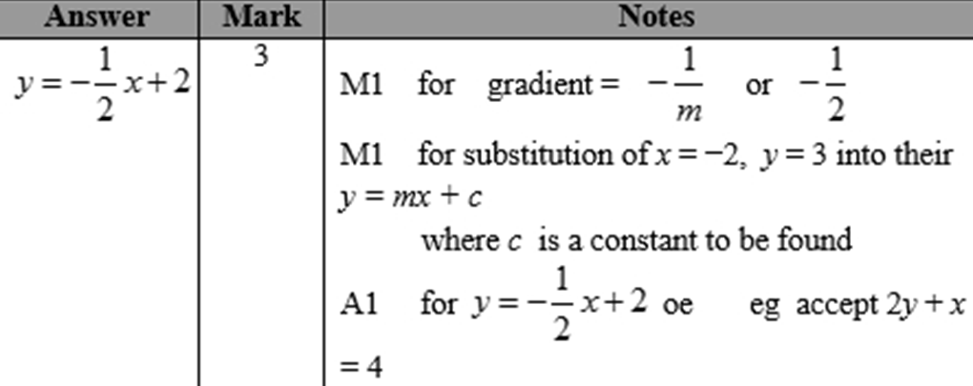
Linear Graphs & Gradients
NTSQ Q4
A

Slide 10
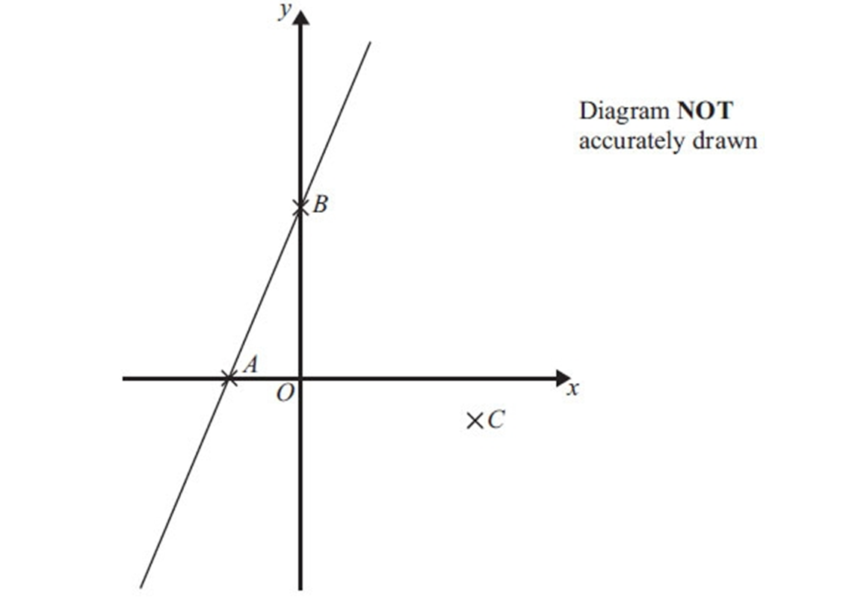
Linear Graphs & Gradients
NTSQ Q6

Slide 11
Linear Graphs & Gradients
NTSQ Q6
A

Slide 12
Linear Graphs & Gradients
NTSQ Q7

Slide 13
Linear Graphs & Gradients
NTSQ Q7
A

Slide 14
Linear Graphs & Gradients
NTSQ Q8

Slide 15
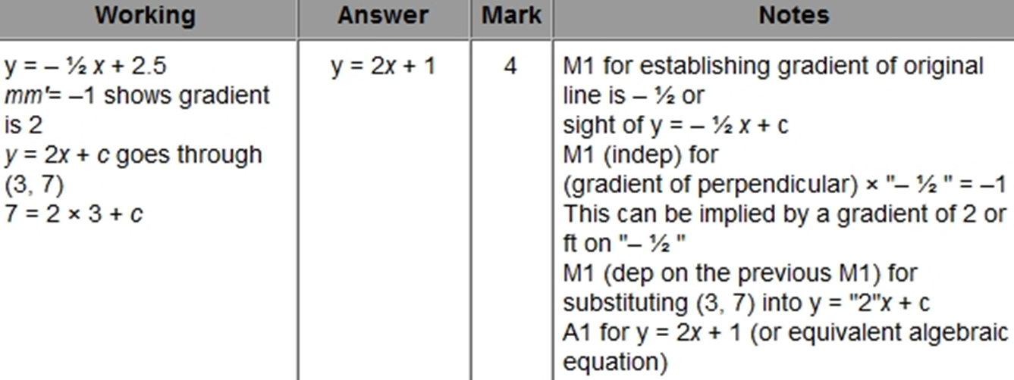
Linear Graphs & Gradients
NTSQ Q8
A

Slide 16
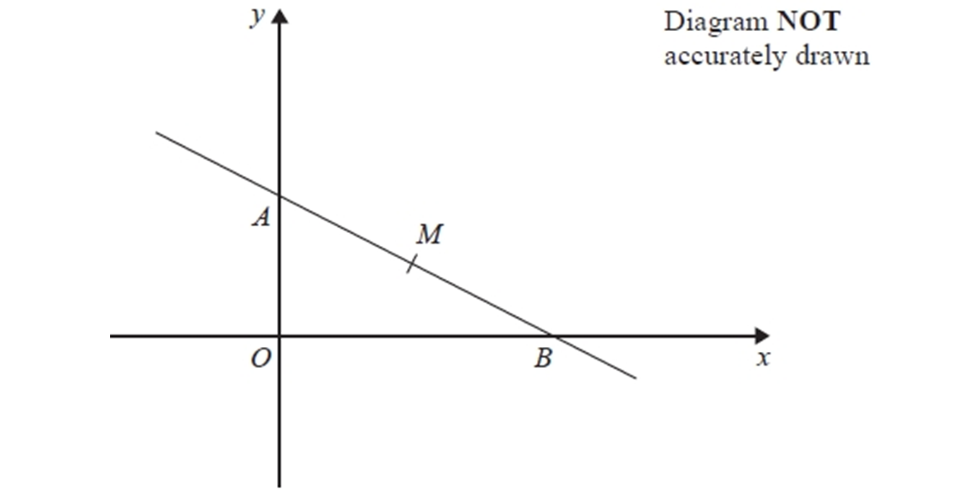
Linear Graphs & Gradients
NTSQ Q9

Slide 17
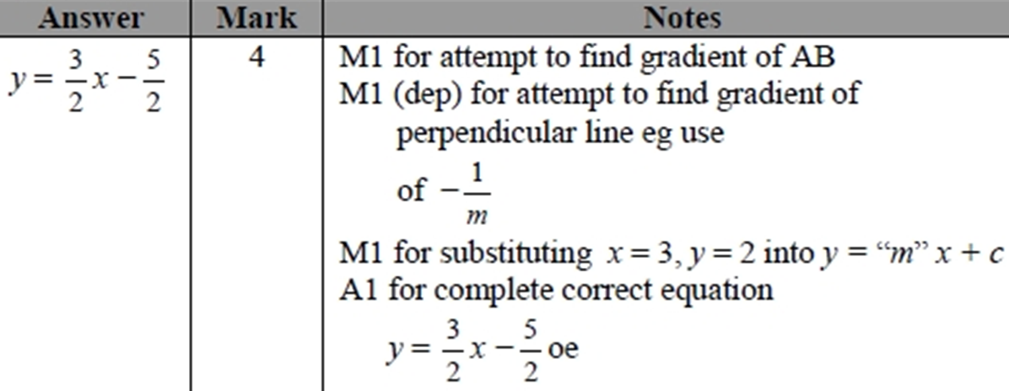
Linear Graphs & Gradients
NTSQ Q9
A

Slide 18
Linear Graphs & Gradients
NTSQ Q10

Slide 19
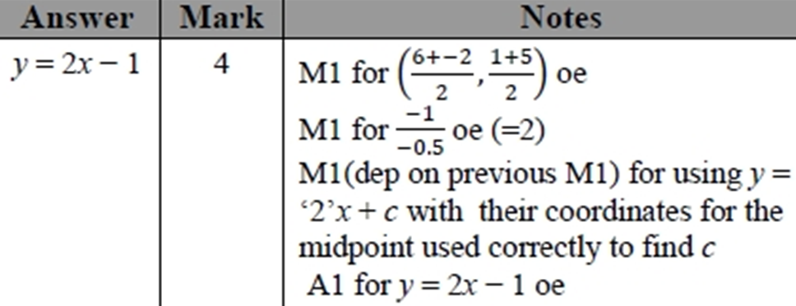
Linear Graphs & Gradients
NTSQ Q10
A

Slide 20
Linear Graphs & Gradients
NTSQ Q11

Slide 21
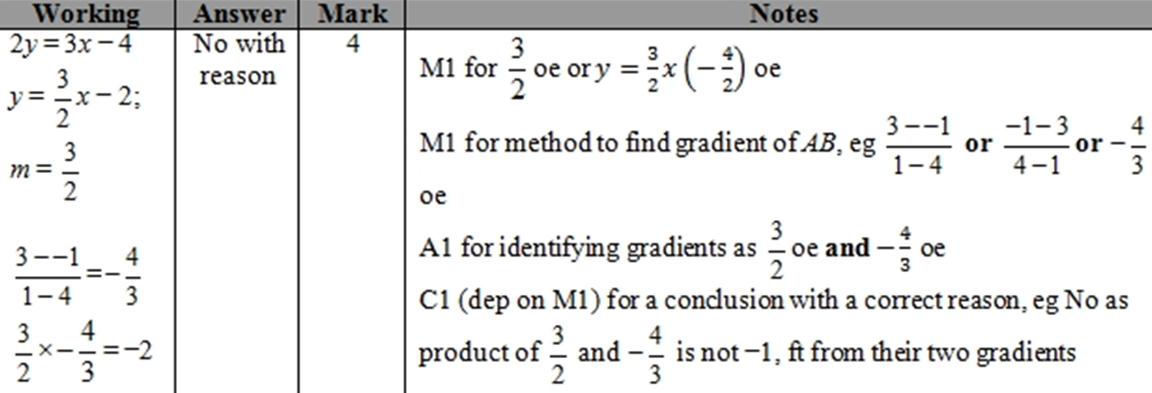
Linear Graphs & Gradients
NTSQ Q11
A

Slide 22
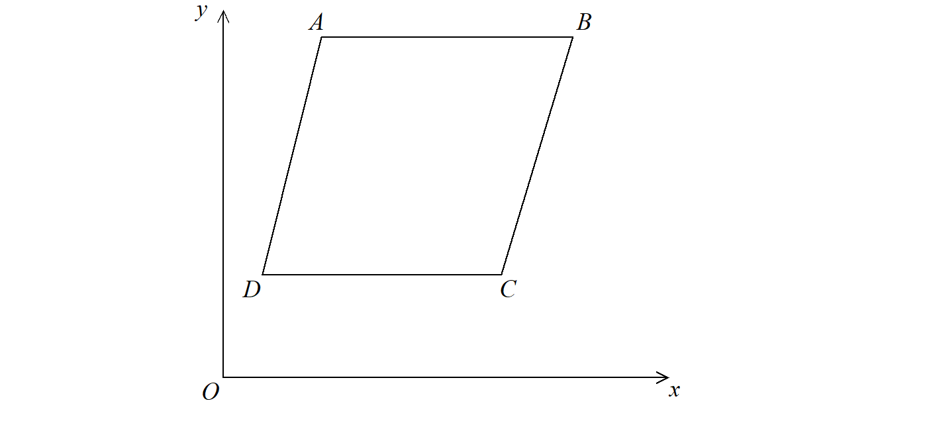
Linear Graphs & Gradients
NTSQ Q12

Slide 23
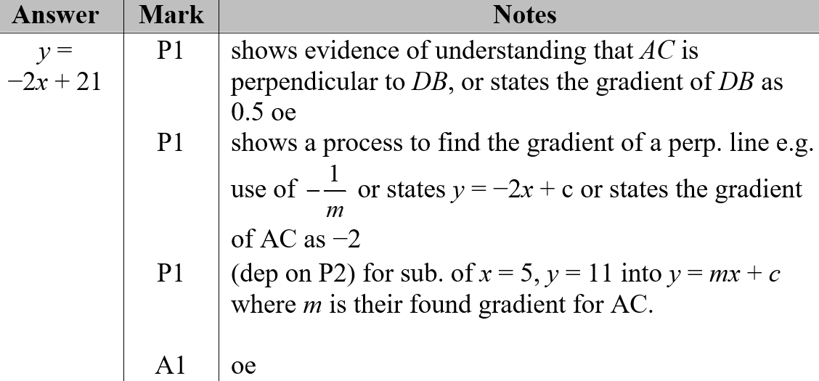
Linear Graphs & Gradients
NTSQ Q12
A

Slide 24
Linear Graphs & Gradients
NTSQ Q13

Slide 25
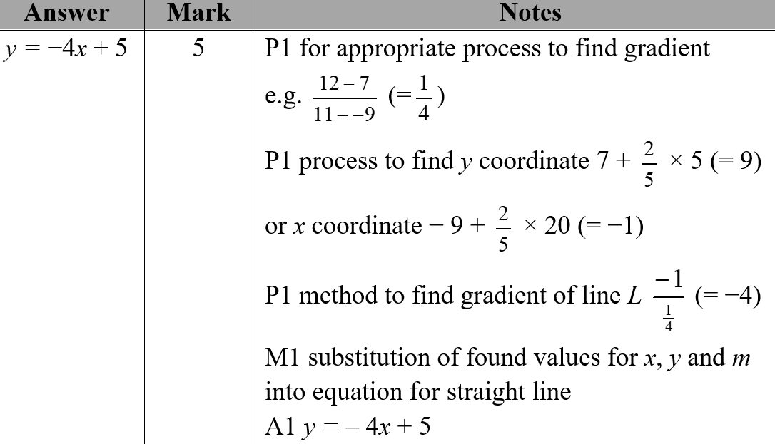
Linear Graphs & Gradients
NTSQ Q13
A

Slide 26
Linear Graphs & Gradients
SAM 1H Q13

Slide 27
Linear Graphs & Gradients
SAM 1H Q13
A
B

Slide 28
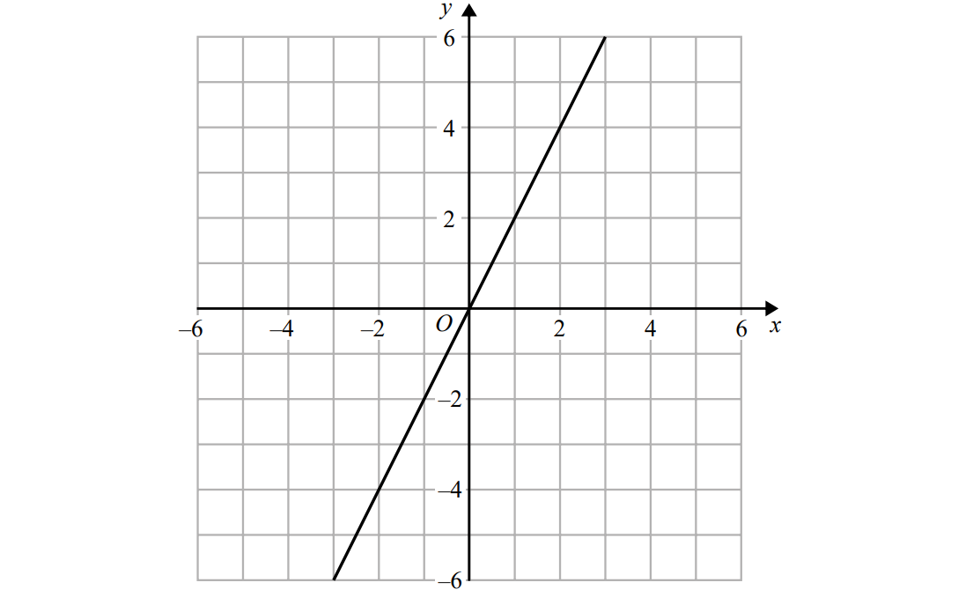
Linear Graphs & Gradients
SAM 2H Q14
Show Graph (a)
Hide Graph (a)
Show
Hide
Show
Hide
Show
Hide
Show
Hide

Slide 29
Linear Graphs & Gradients
SAM 2H Q14
A
B

Slide 30
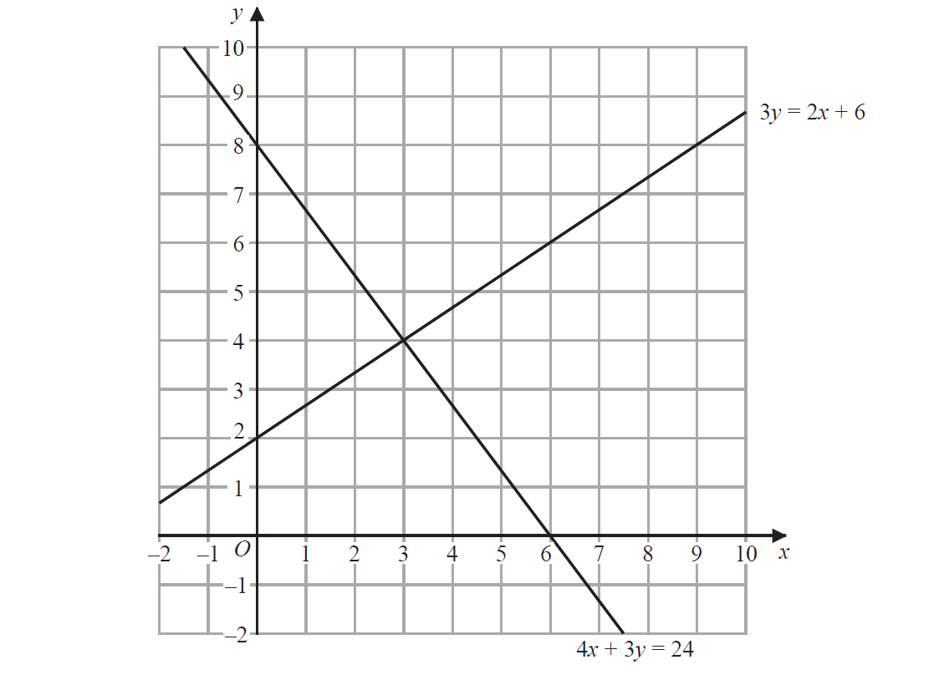
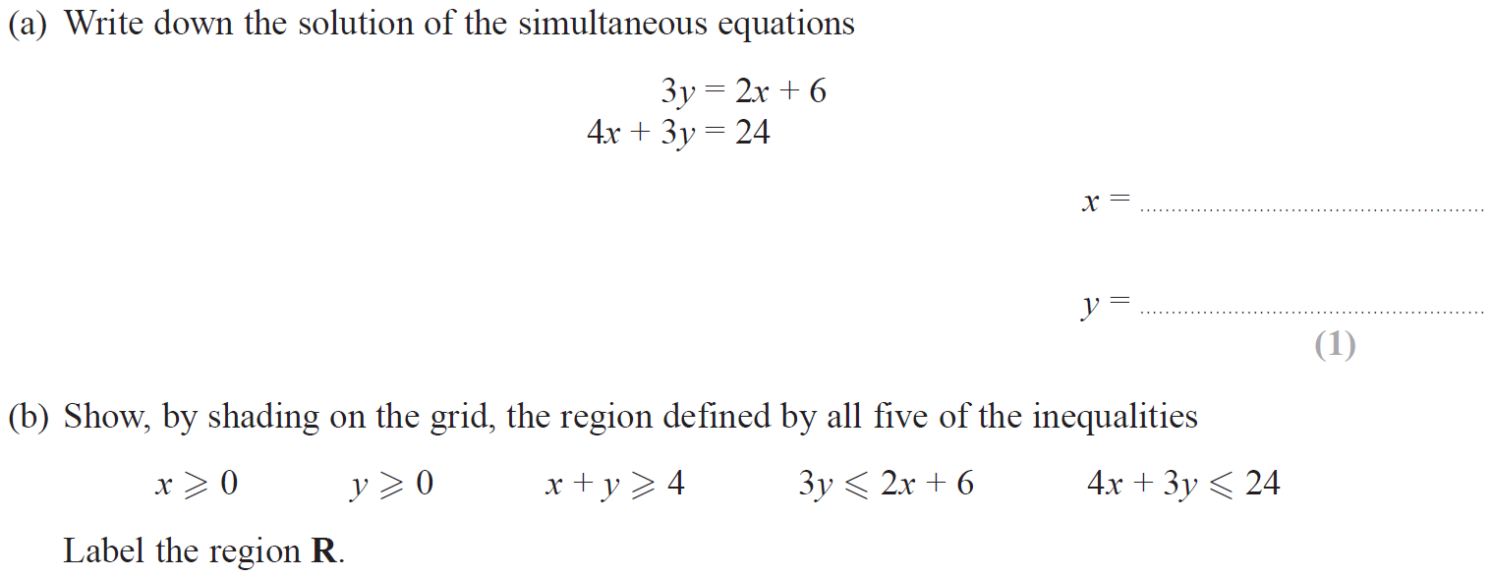
Linear Graphs & Gradients
May 2018 1H Q12

Slide 31
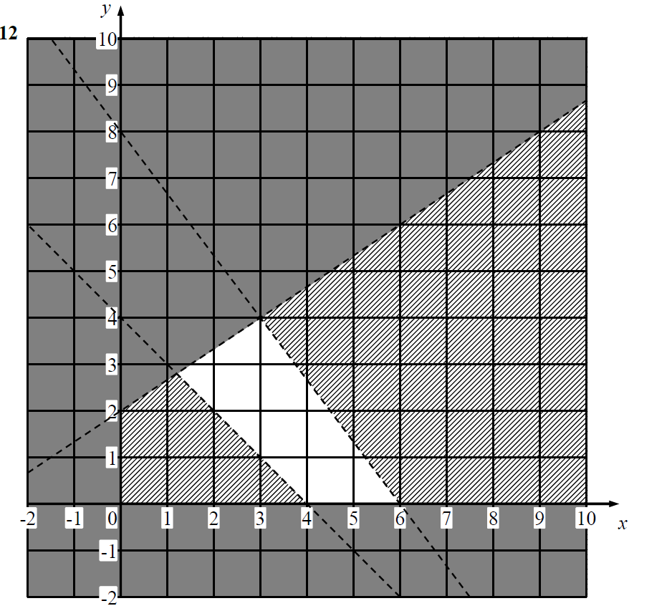
Linear Graphs & Gradients
May 2018 1H Q12
A
B

Slide 32
Linear Graphs & Gradients
May 2018 1H Q20

Slide 33
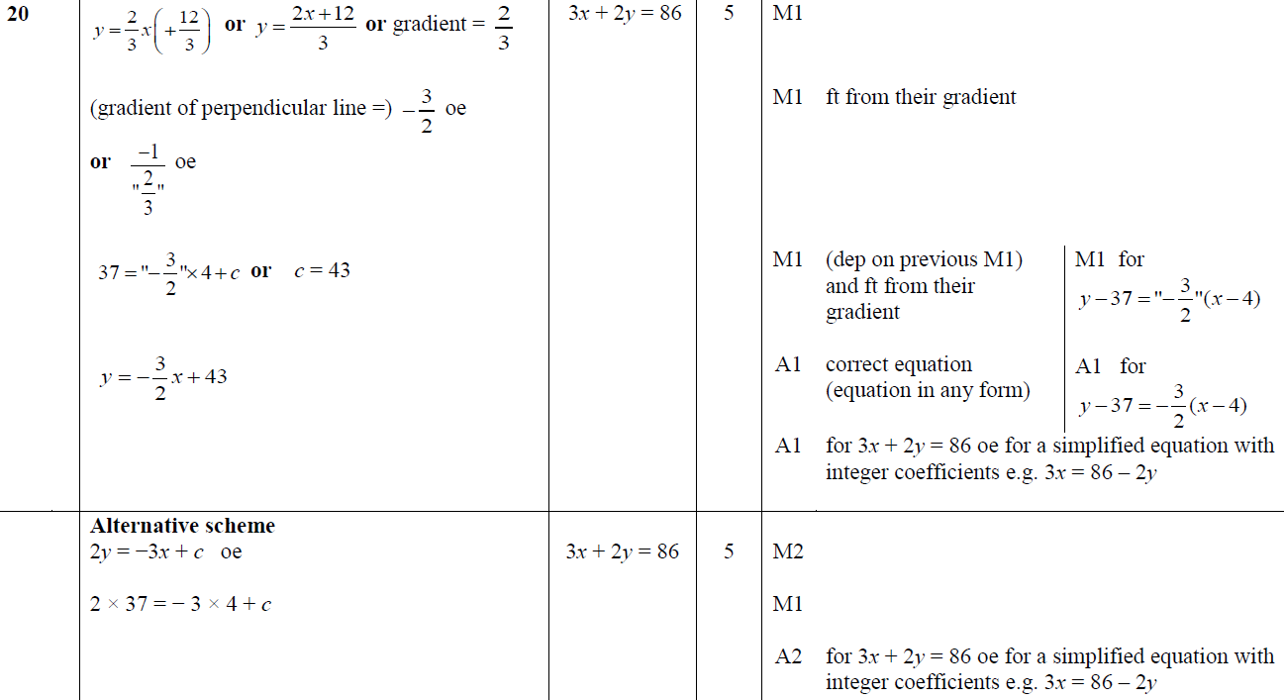
Linear Graphs & Gradients
May 2018 1H Q20
A

Slide 34
Linear Graphs & Gradients
June 2018 2HR Q13

Slide 35
Linear Graphs & Gradients
June 2018 2HR Q13
A

Slide 36
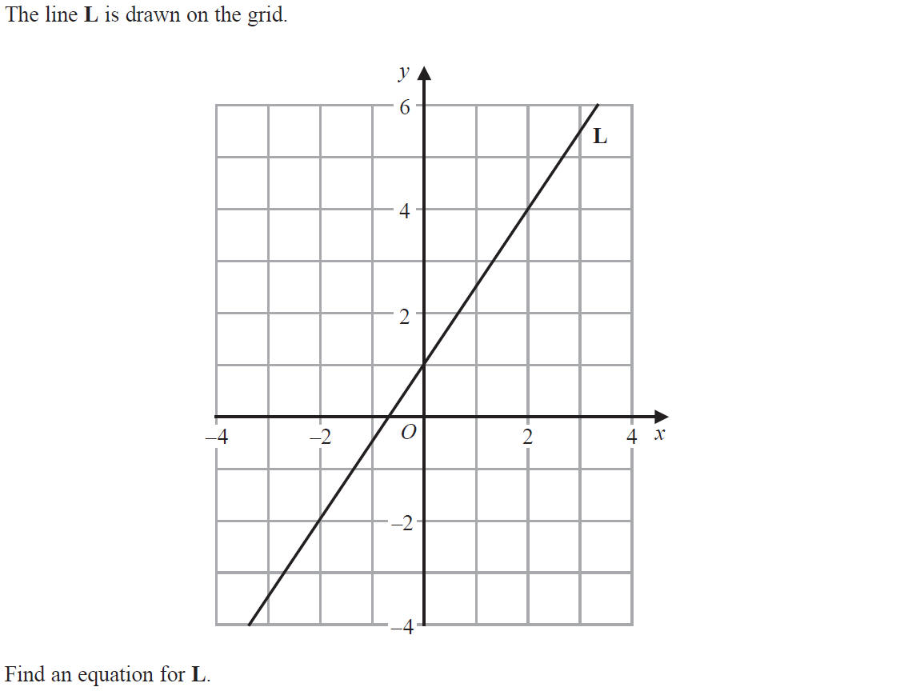
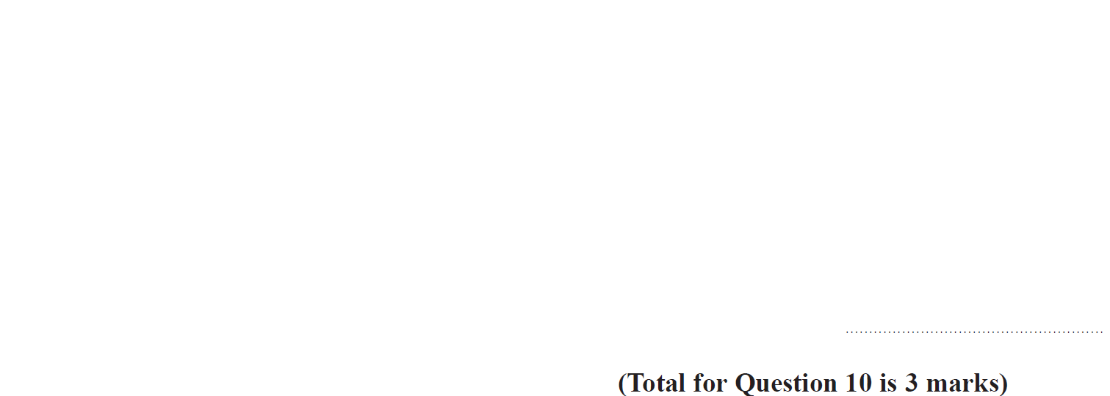
Linear Graphs & Gradients
Jan 2019 2H Q10

Slide 37
Linear Graphs & Gradients
Jan 2019 2H Q10
A

Slide 38
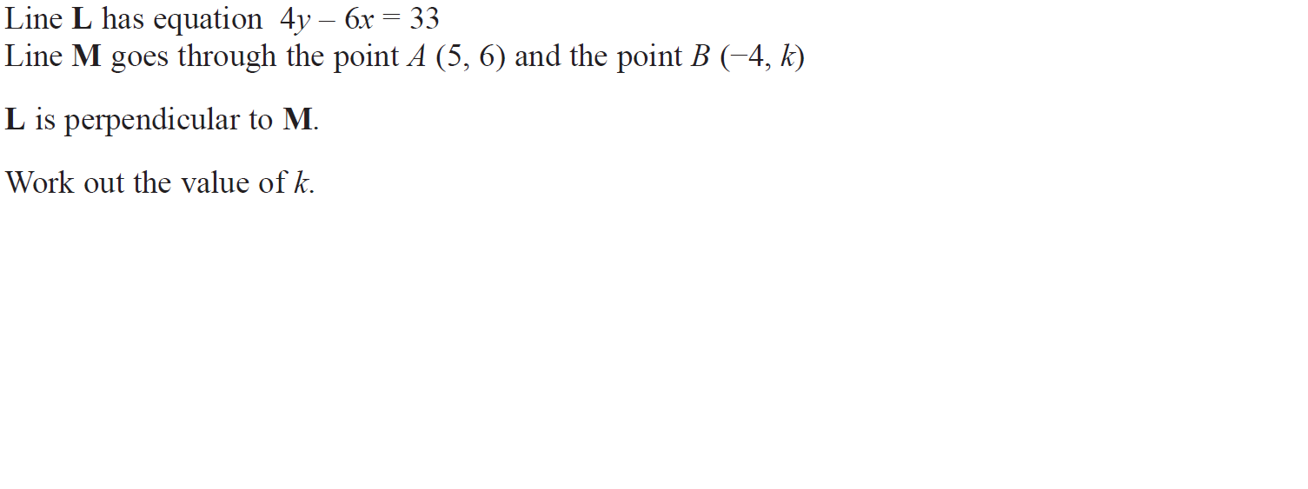
Linear Graphs & Gradients
Jan 2019 2H Q21

Slide 39
Linear Graphs & Gradients
Jan 2019 2H Q21
A

Slide 40
Linear Graphs & Gradients
Jan 2019 2HR Q11

Slide 41
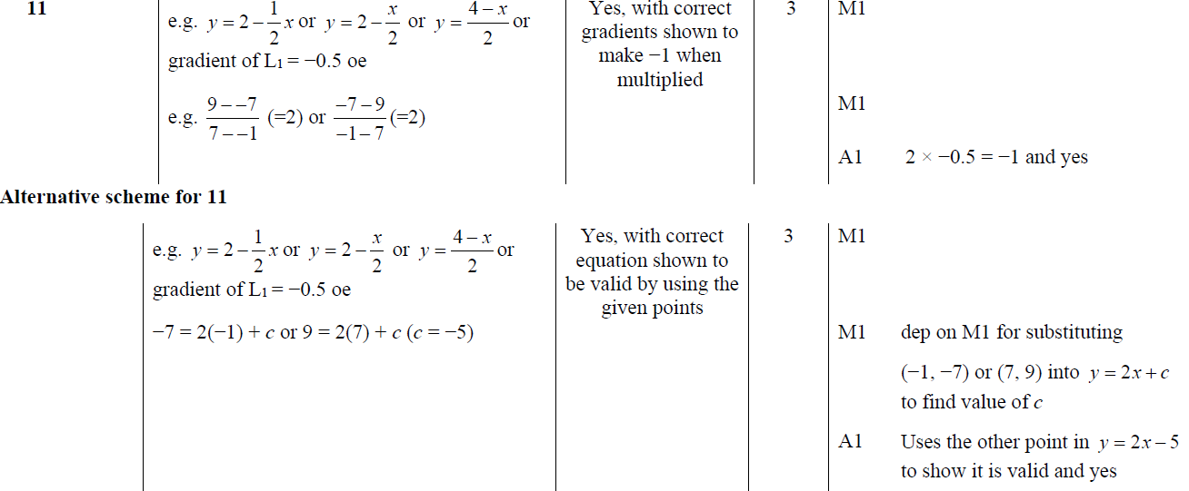
Linear Graphs & Gradients
Jan 2019 2HR Q11
A

Slide 42
Linear Graphs & Gradients
Jan 2019 2HR Q21

Slide 43
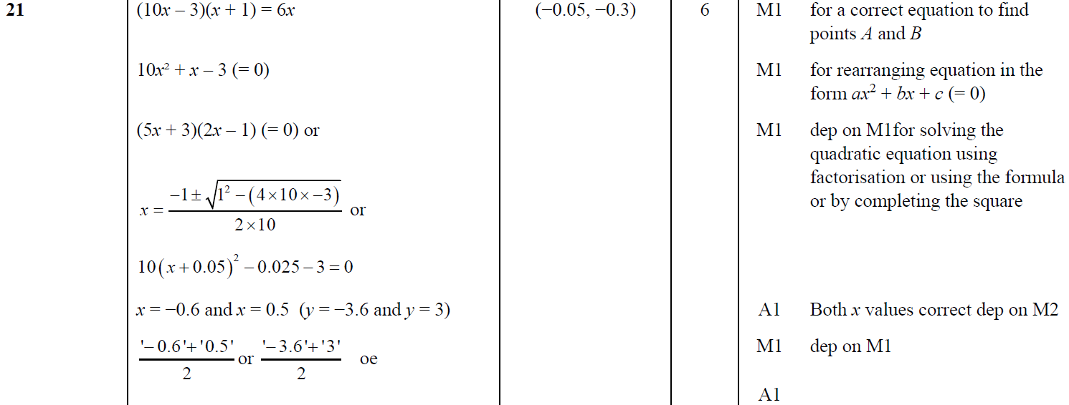
Linear Graphs & Gradients
Jan 2019 2HR Q21
A

Slide 44
Linear Graphs & Gradients
May 2019 1H Q23

Slide 45
Linear Graphs & Gradients
May 2019 1H Q23
A

Slide 46
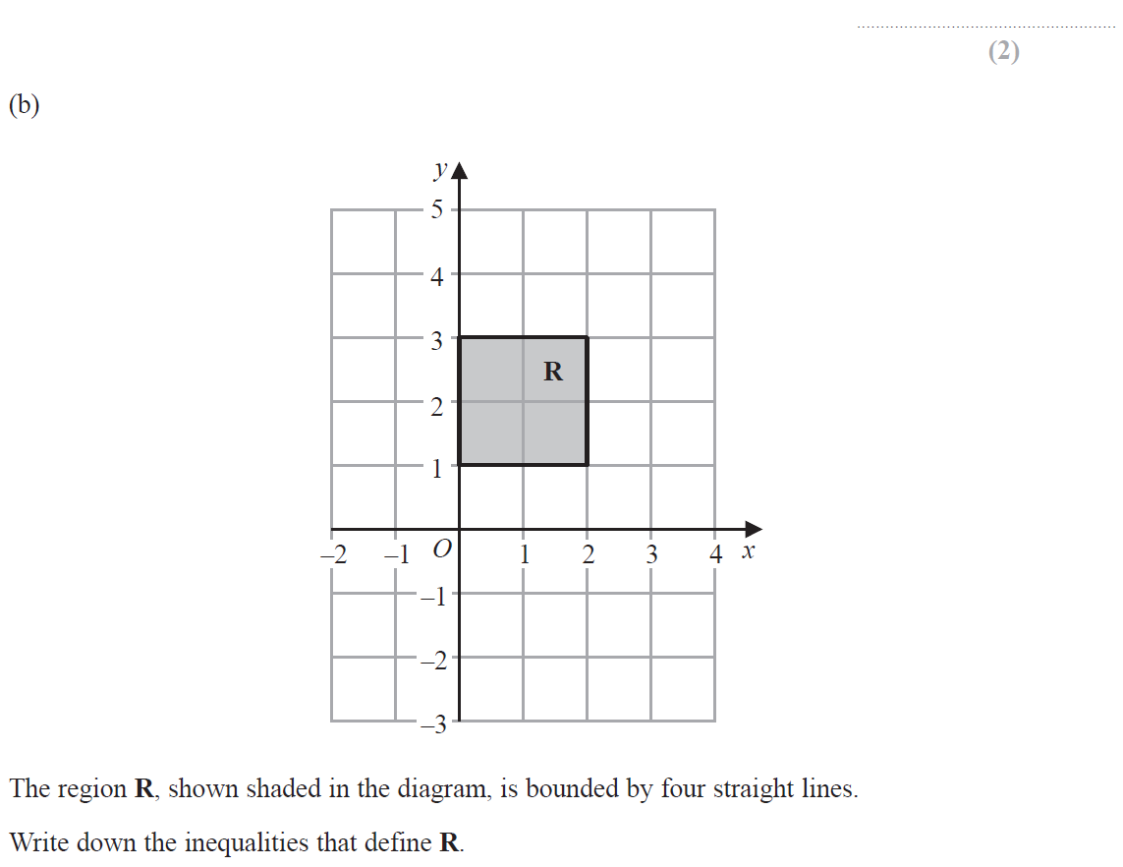
Linear Graphs & Gradients
June 2019 2H Q10

Slide 47
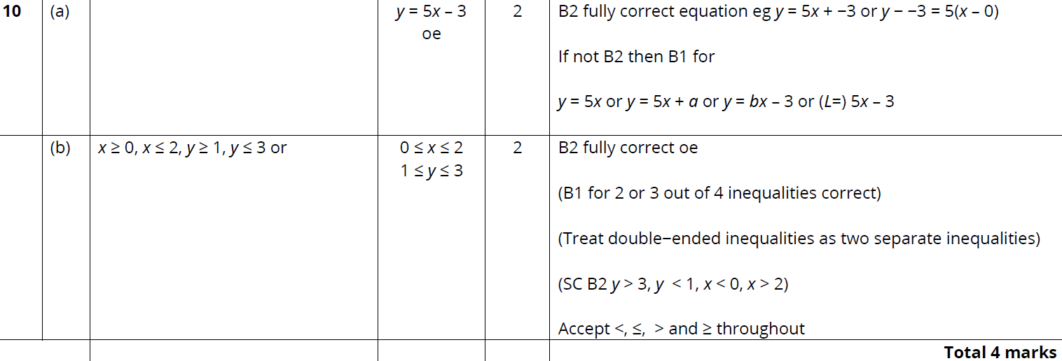
Linear Graphs & Gradients
June 2019 2H Q10
A
B

Slide 48
Linear Graphs & Gradients
New Spec Q’s
Linear Graphs & Gradients
May 2004
3H Q6
Nov 2007
4H Q18
Jan 2012
4H Q5
Jan 2014
4HR Q8
June 2015
4HR Q4
May 2016
3HR Q11
May 2017
3H Q6
May 2018
3HR Q3
May 2004
3H Q12
May 2008
3H Q21
Jan 2012
4H Q13
Jan 2014
4HR Q13
June 2015
4HR Q12
June 2016
4HR Q20
June 2017
4H Q4
May 2018
3HR Q11
Nov 2004
3H Q5
May 2008
4H Q14
Jan 2012
4H Q17
May 2014
3H Q8
Jan 2016
3H Q10
Jan 2017
3H Q8
June 2017
4H Q13
Nov 2004
3H Q6
Nov 2008
3H Q10
May 2012
3H Q14
May 2014
4H Q13
Jan 2016
3H Q15
Jan 2017
4H Q6
May 2017
3HR Q13
Nov 2004
3H Q9
May 2009
3H Q15
Jan 2013
3H Q10
Jan 2015
3H Q10
Jan 2016
3H Q18
Jan 2017
4H Q12
June 2017
4HR Q12
Nov 2005
3H Q2
June 2009
4H Q12
May 2013
3H Q15
Jan 2015
4H Q4
Jan 2016
4H Q6
Jan 2017
4H Q19
Jan 2018
3H Q7
Nov 2005
3H Q17
Nov 2009
4H Q9
May 2013
4H Q7
Jan 2015
3HR Q5
Jan 2016
4H Q12
Jan 2017
3HR Q3
Jan 2018
3H Q10
Nov 2005
4H Q12
June 2010
4H Q4
May 2013
3HR Q13
Jan 2015
3HR Q6
Jan 2016
3HR Q9
Jan 2017
3HR Q7
Jan 2018
3HR Q4
Nov 2006
3H Q12
Nov 2010
4H Q3
May 2013
4HR Q4
May 2015
3H Q13
May 2016
3H Q5
Jan 2017
3HR Q15
Jan 2018
4HR Q3
May 2007
4H Q10
Nov 2010
4H Q12
May 2013
4HR Q20
May 2015
3HR Q20
May 2016
3H Q13
Jan 2017
4HR Q11
June 2018
4H Q14*
functions
*Mainly Differentiation

Slide 49
Linear Graphs & Gradients
May 2004 3H Q6

Slide 50
Linear Graphs & Gradients
May 2004 3H Q6
A
B

Slide 51
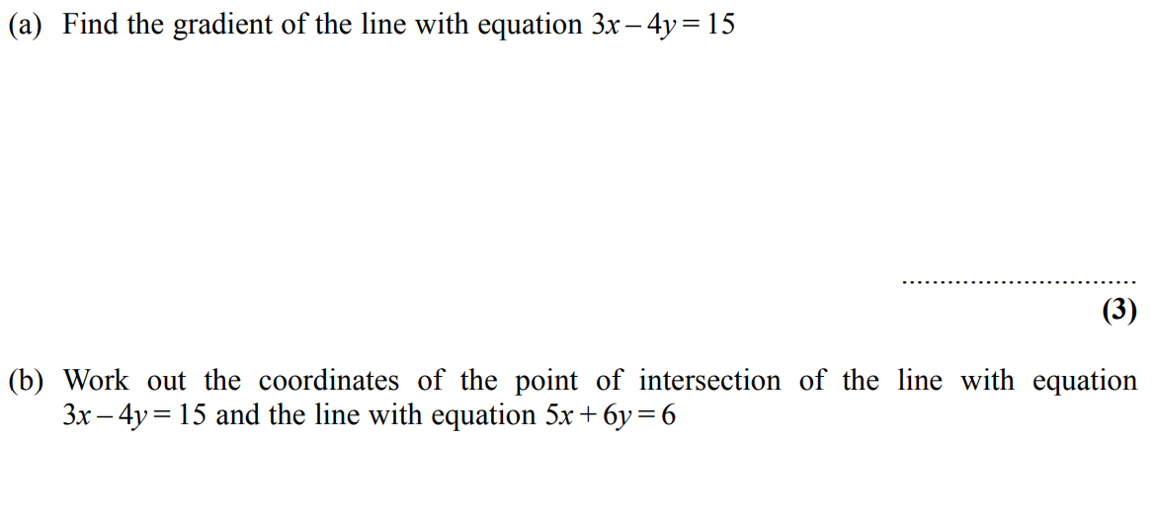
Linear Graphs & Gradients
May 2004 3H Q12

Slide 52
Linear Graphs & Gradients
May 2004 3H Q12
A
B

Slide 53
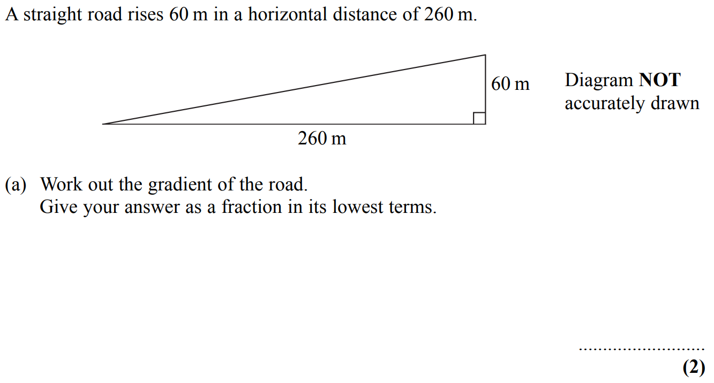
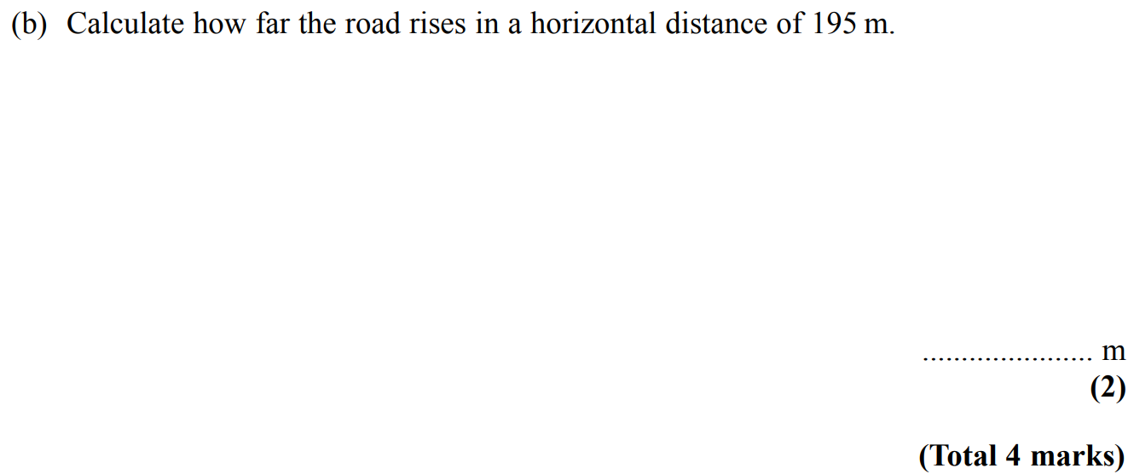
Linear Graphs & Gradients
Nov 2004 3H Q5

Slide 54
Linear Graphs & Gradients
Nov 2004 3H Q5
A
B

Slide 55
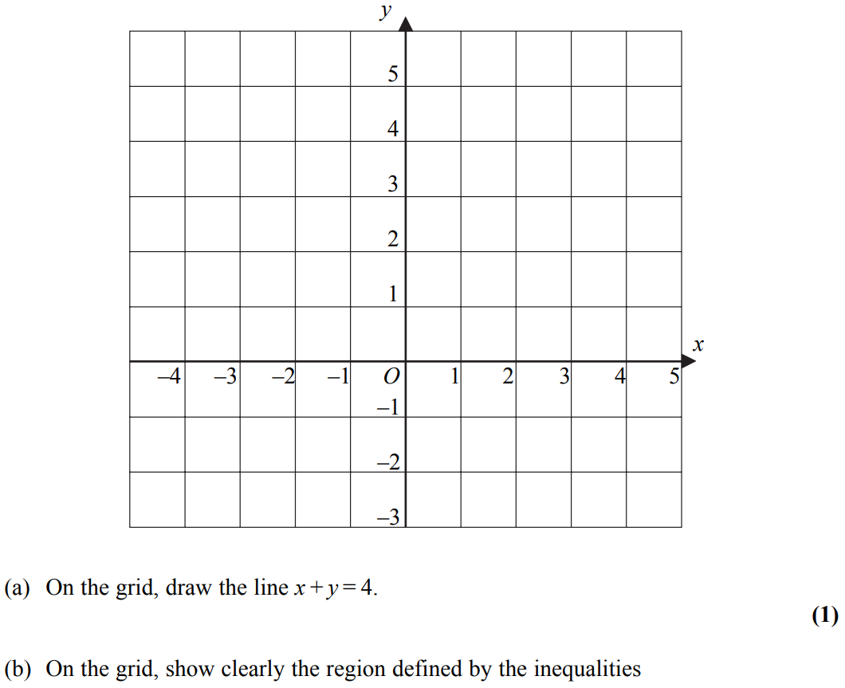
Linear Graphs & Gradients
Nov 2004 3H Q6
Note that in these diagrams I am shading the UNWANTED region
Show
Show
Hide
Show
Hide
Show
Hide

Slide 56
Linear Graphs & Gradients
Nov 2004 3H Q6
A
B

Slide 57
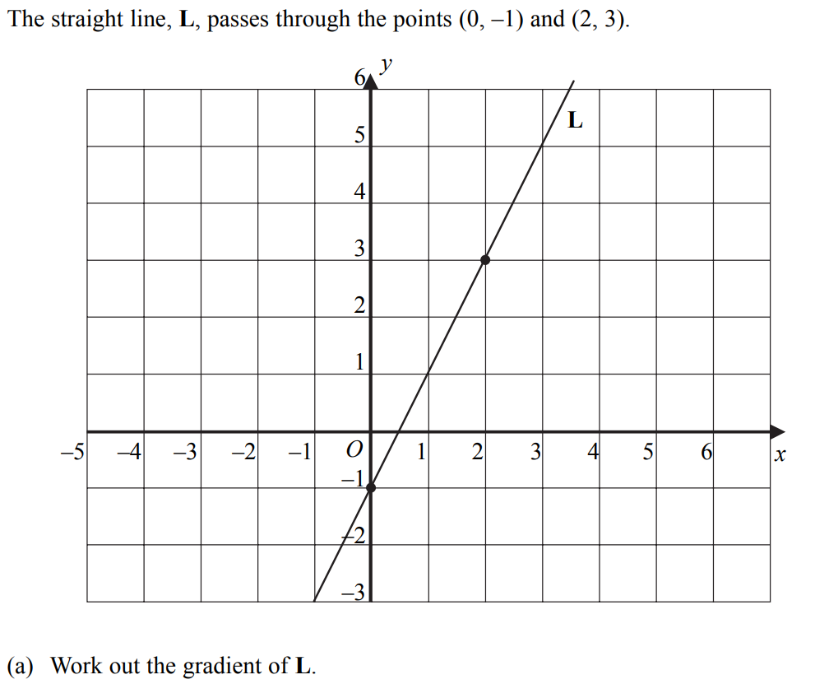
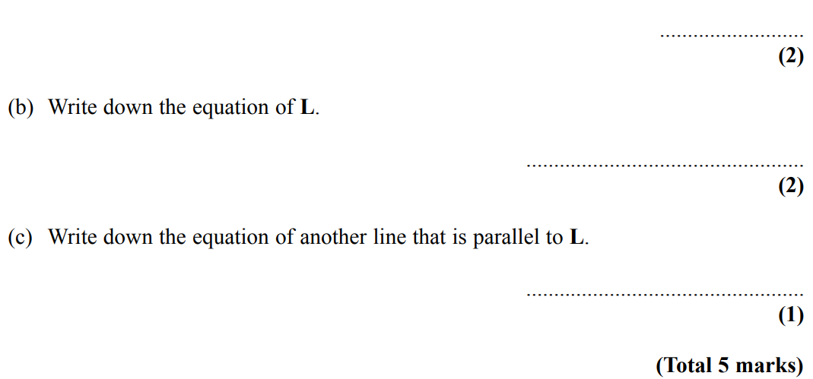
Linear Graphs & Gradients
Nov 2004 3H Q9

Slide 58
Linear Graphs & Gradients
Nov 2004 3H Q9
A
B
C

Slide 59
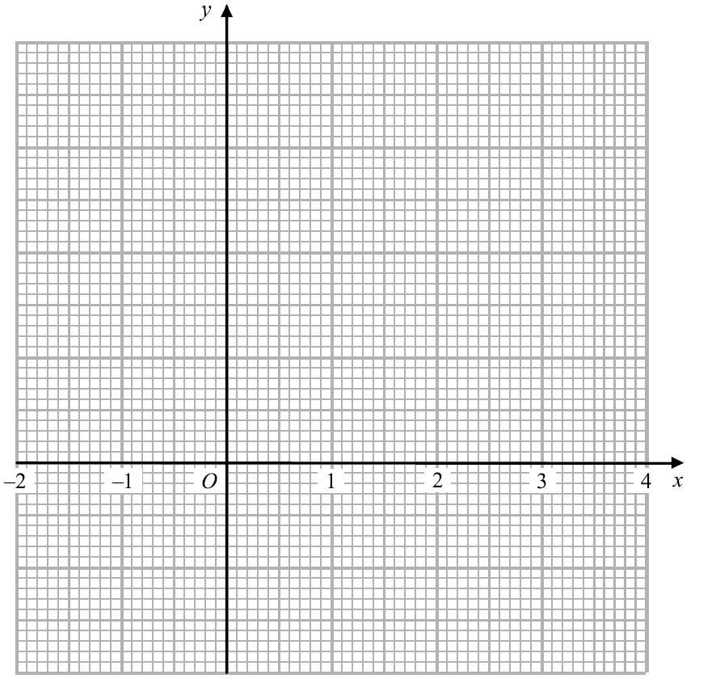
Linear Graphs & Gradients
Nov 2005 3H Q2
20
15
Reveal Graph
10
Hide Graph
5
-5
-10

Slide 60
Linear Graphs & Gradients
Nov 2005 3H Q2
A

Slide 61
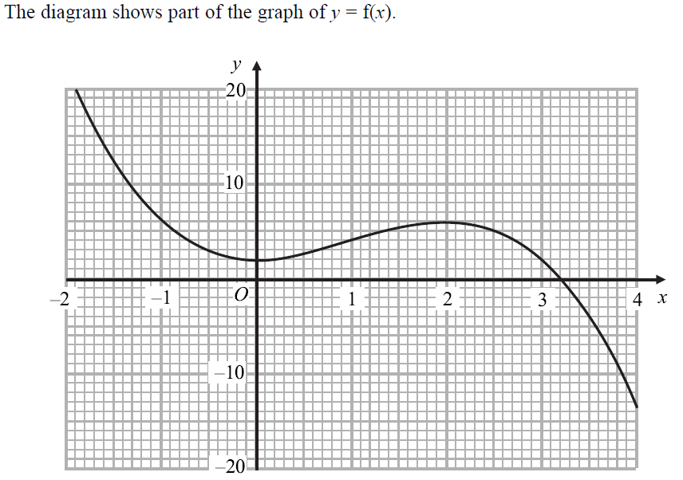
Linear Graphs & Gradients
Nov 2005 3H Q17

Slide 62
Linear Graphs & Gradients
Nov 2005 3H Q17
A
B
C
D
E

Slide 63
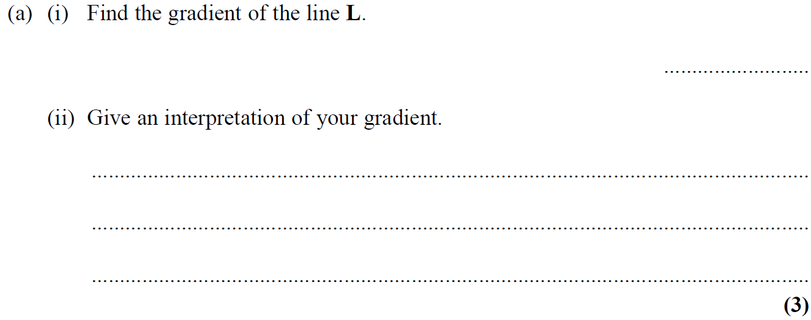
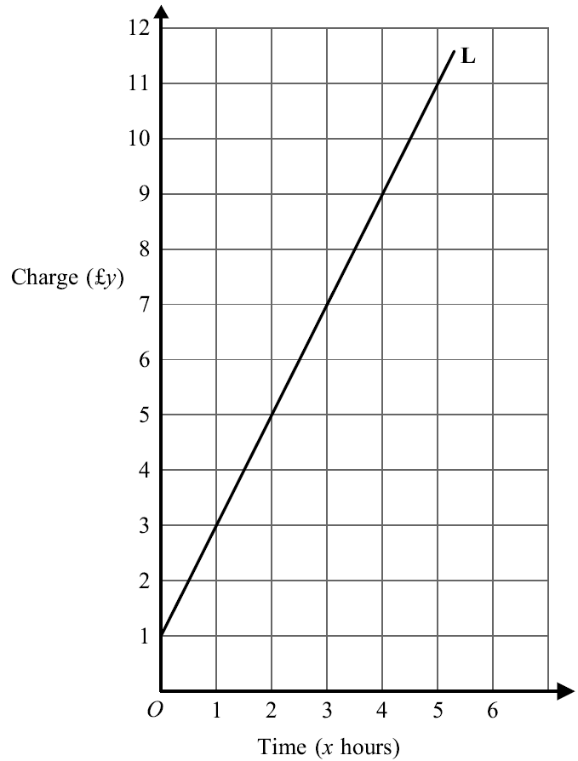
Linear Graphs & Gradients
Nov 2005 4H Q12

Slide 64
Linear Graphs & Gradients
Nov 2005 4H Q12
A
B
C

Slide 65
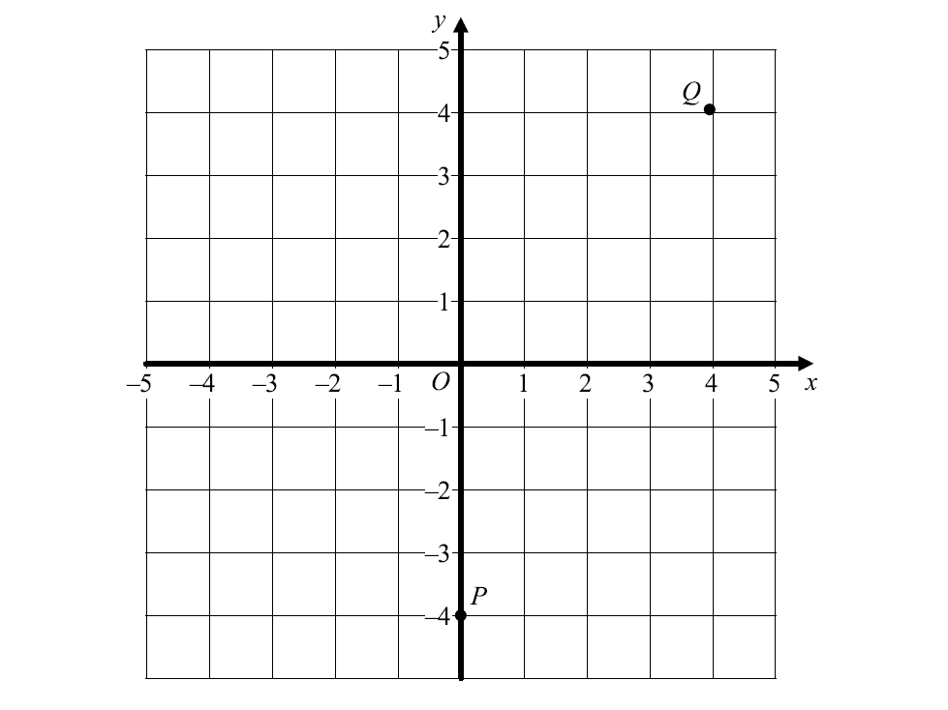
Linear Graphs & Gradients
Nov 2006 3H Q12
Reveal Graph (b)
Hide Graph (b)

Slide 66
Linear Graphs & Gradients
Nov 2006 3H Q12
A
B

Slide 67
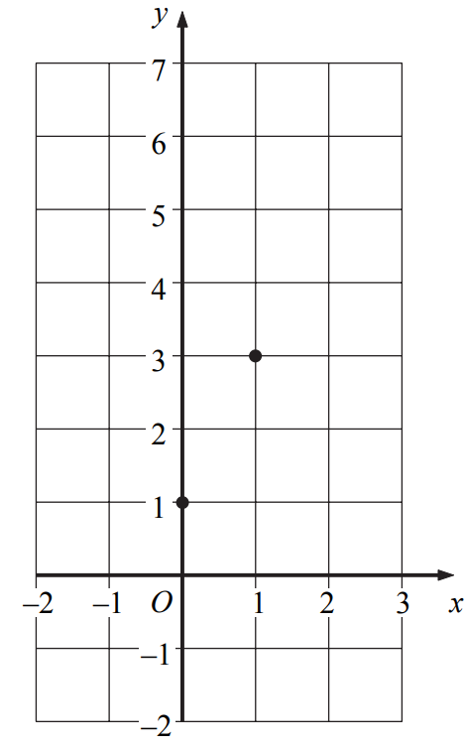
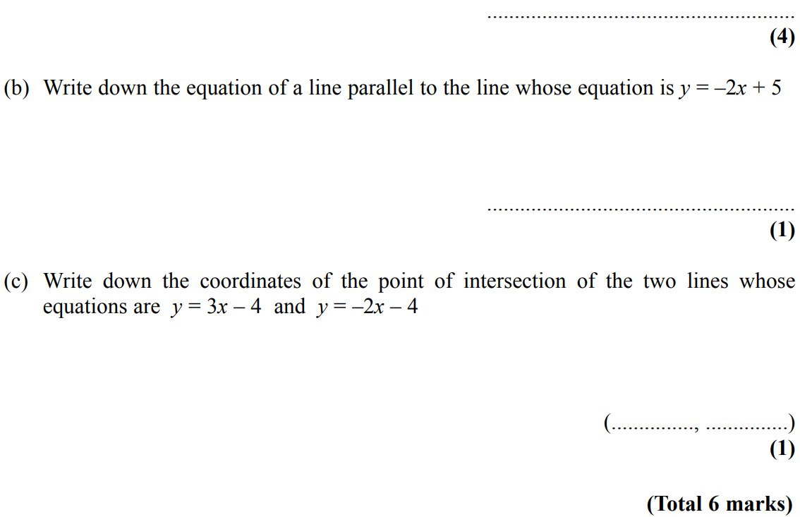
Linear Graphs & Gradients
May 2007 4H Q10

Slide 68
Linear Graphs & Gradients
May 2007 4H Q10
A
B
C

Slide 69
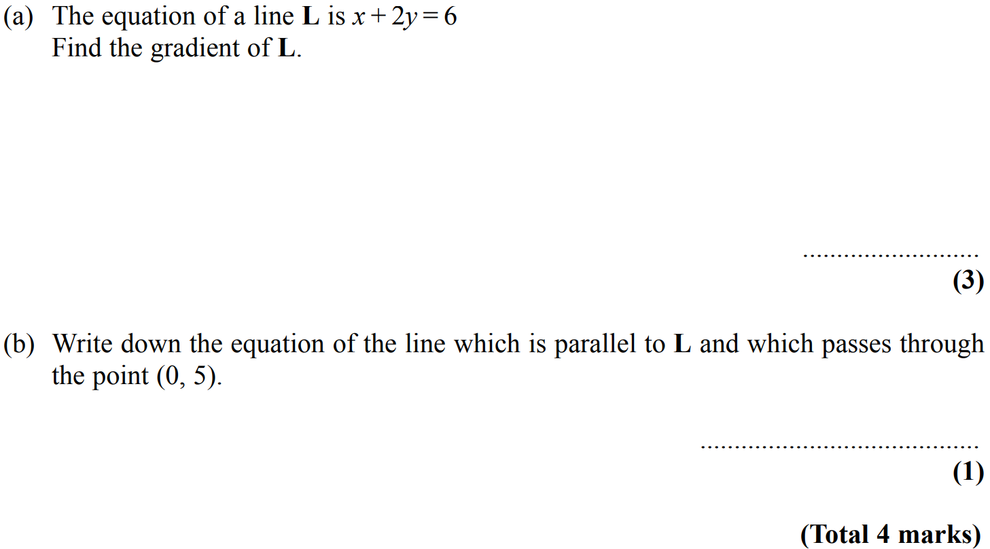
Linear Graphs & Gradients
Nov 2007 4H Q18

Slide 70
Linear Graphs & Gradients
Nov 2007 4H Q18
A
B

Slide 71
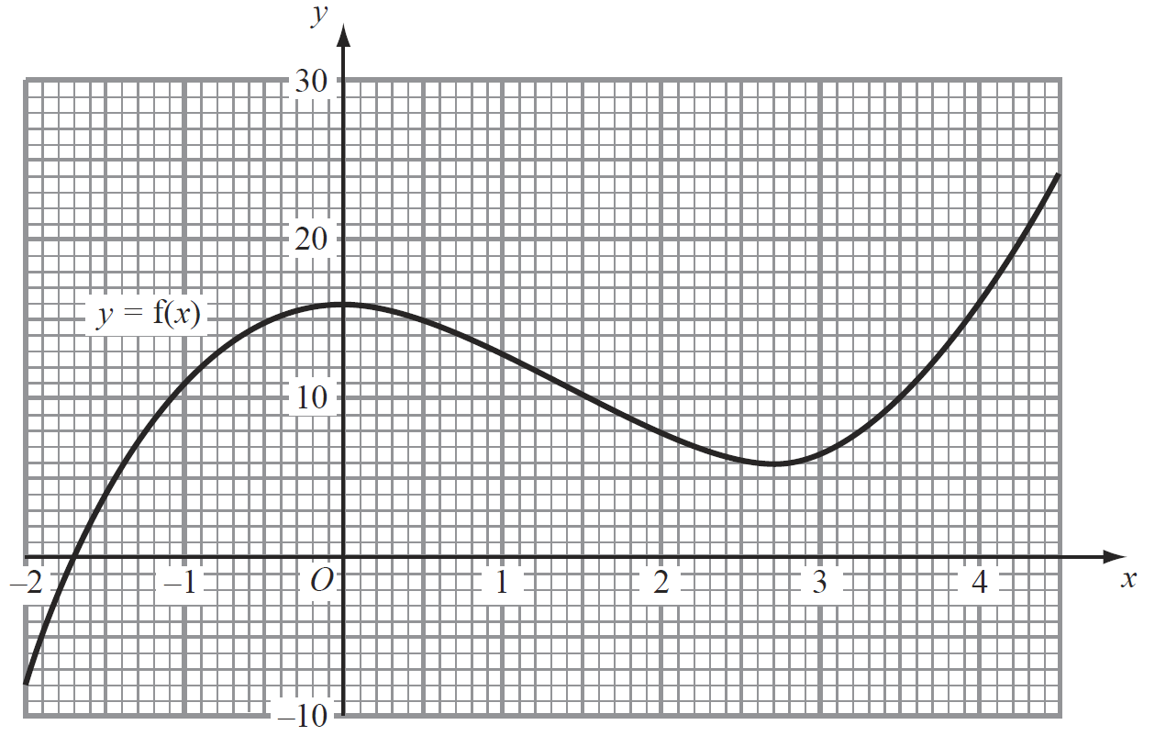
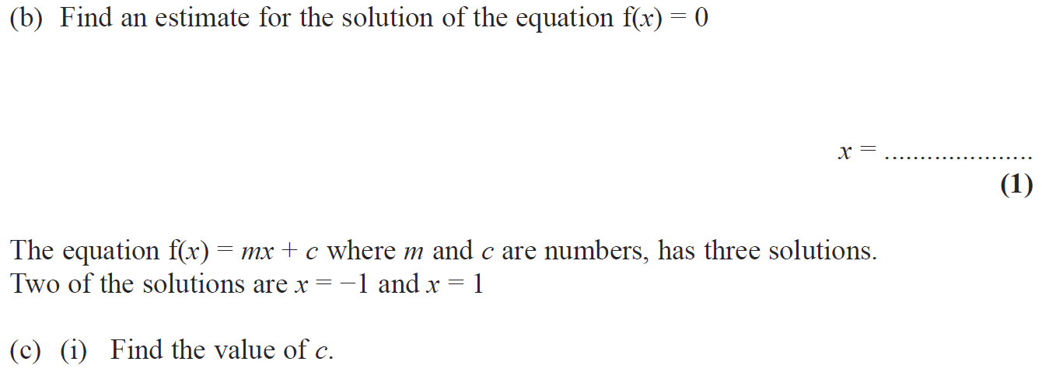
Linear Graphs & Gradients
May 2008 3H Q21

Slide 72
Linear Graphs & Gradients
May 2008 3H Q21
A
B
C (i)
C (ii)

Slide 73
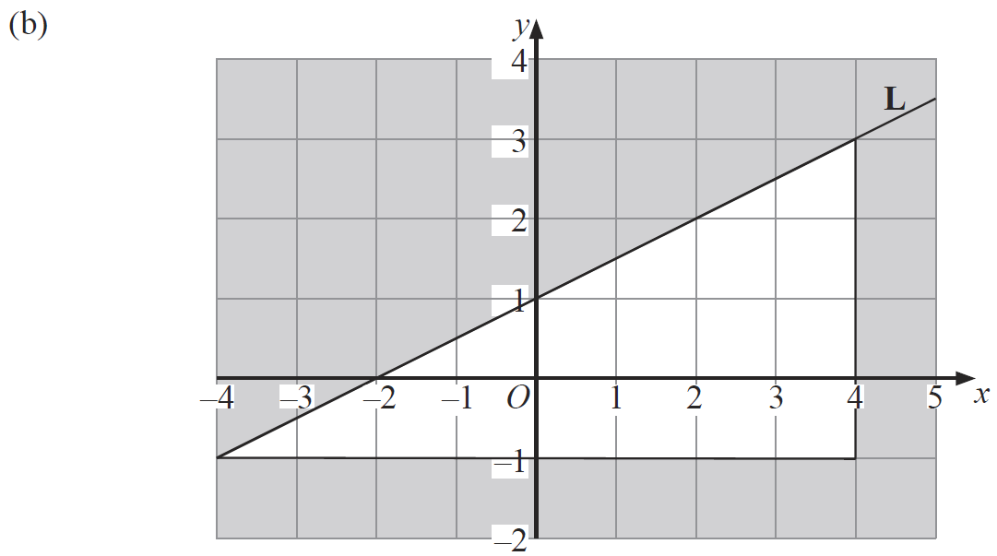
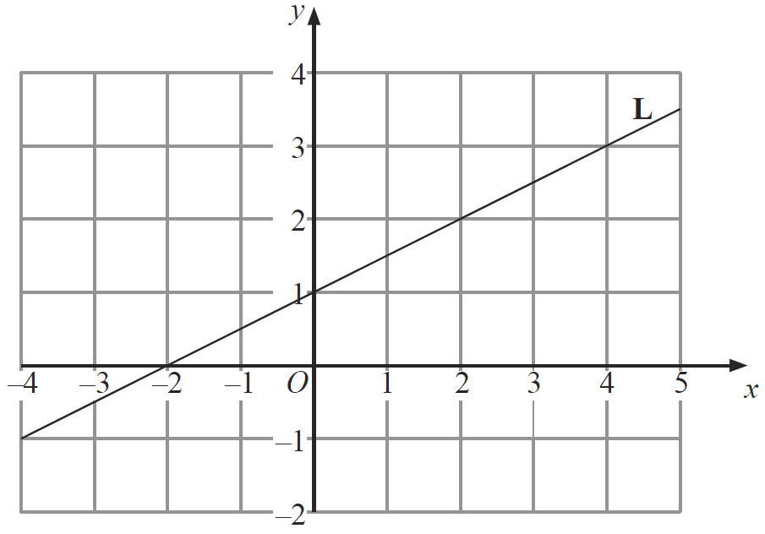
Linear Graphs & Gradients
May 2008 4H Q14

Slide 74
Linear Graphs & Gradients
May 2008 4H Q14
A (i)
A (ii)
B

Slide 75
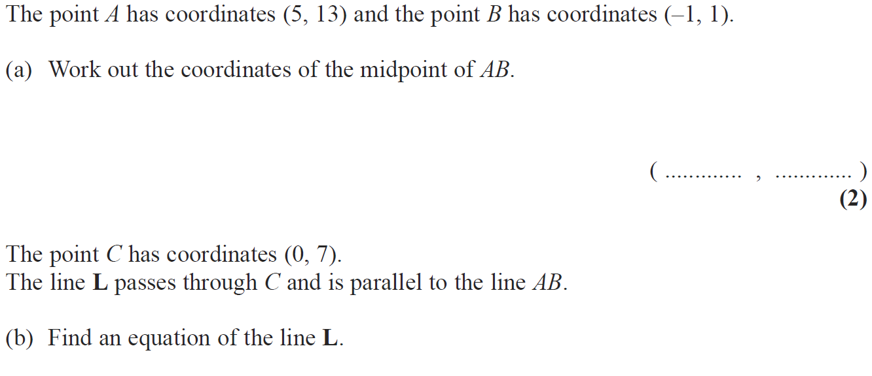
Linear Graphs & Gradients
Nov 2008 3H Q10

Slide 76
Linear Graphs & Gradients
Nov 2008 3H Q10
A
B

Slide 77
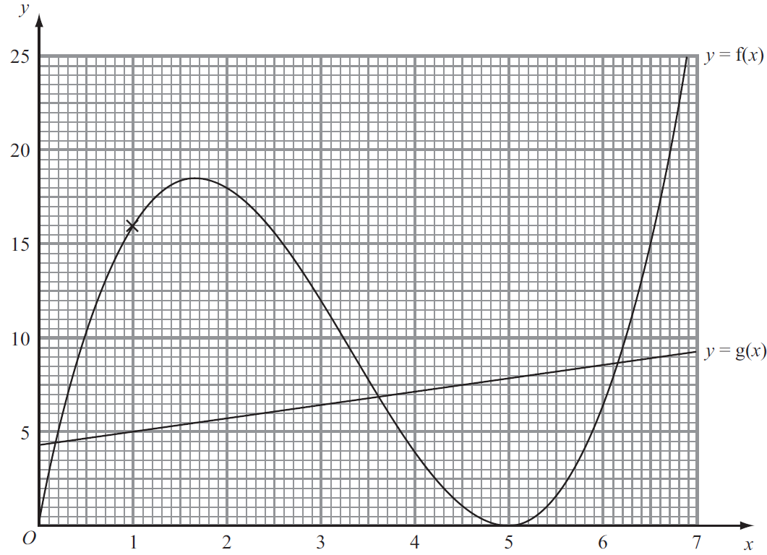
Linear Graphs & Gradients
May 2009 3H Q15

Slide 78
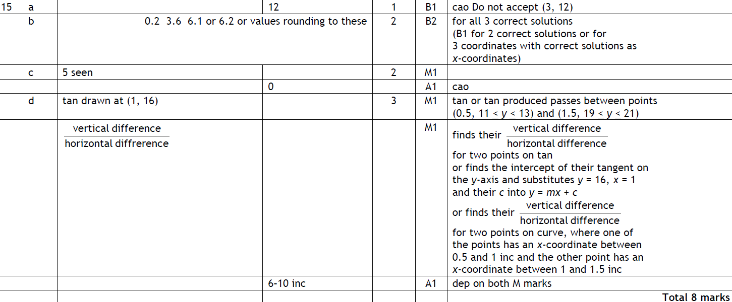
Linear Graphs & Gradients
May 2009 3H Q15
A
B
C
D

Slide 79
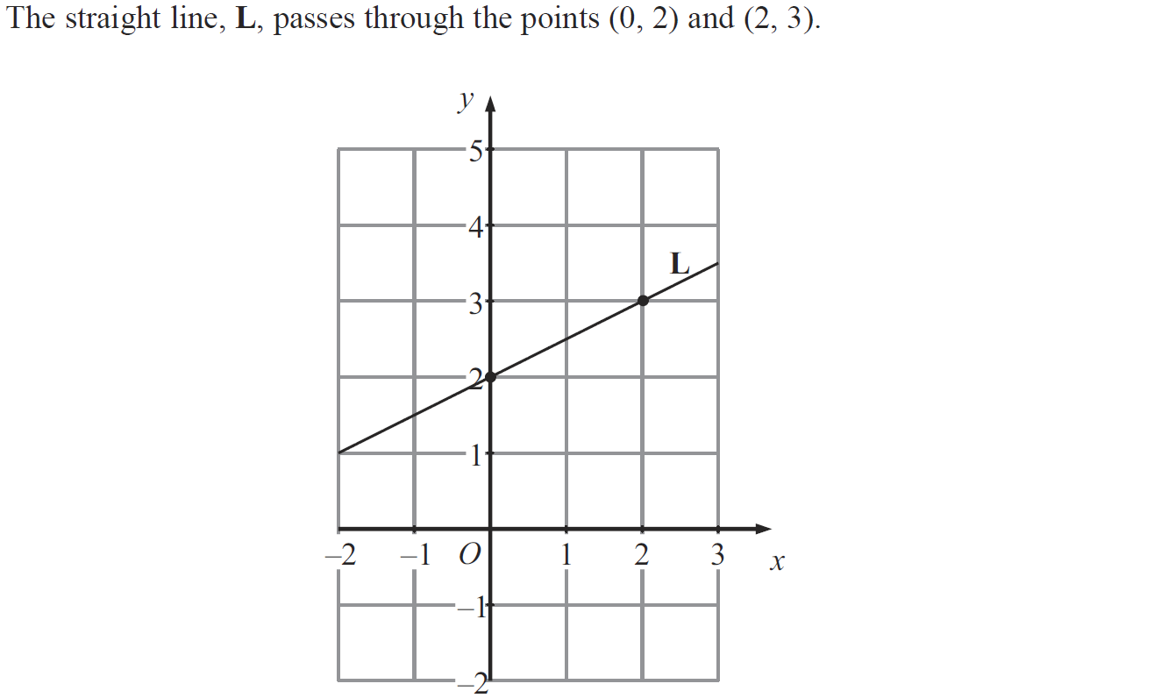
Linear Graphs & Gradients
June 2009 4H Q12

Slide 80
Linear Graphs & Gradients
June 2009 4H Q12
A
B
C

Slide 81
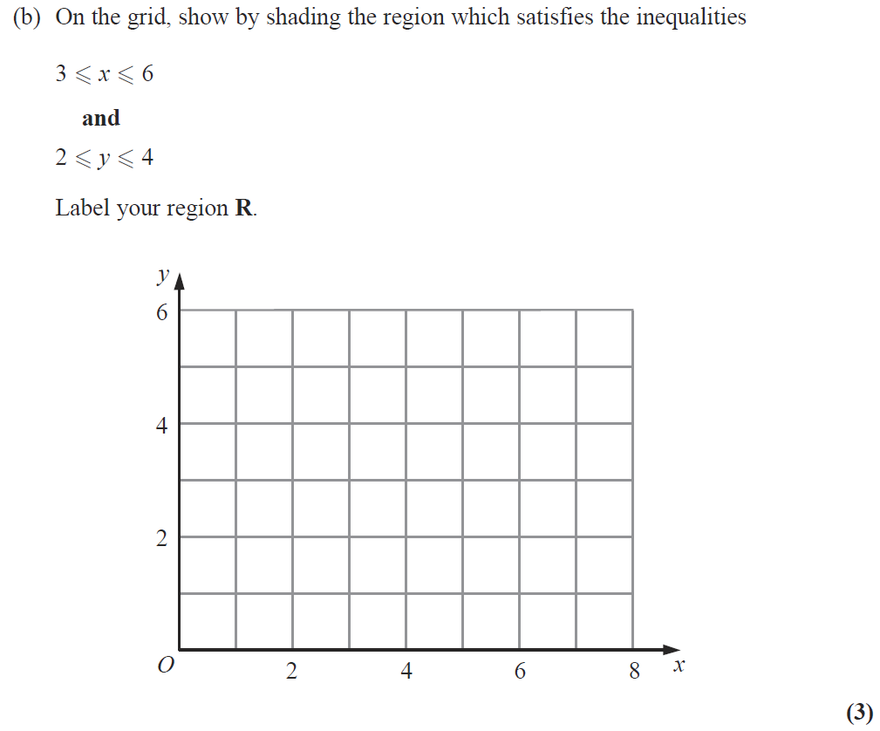
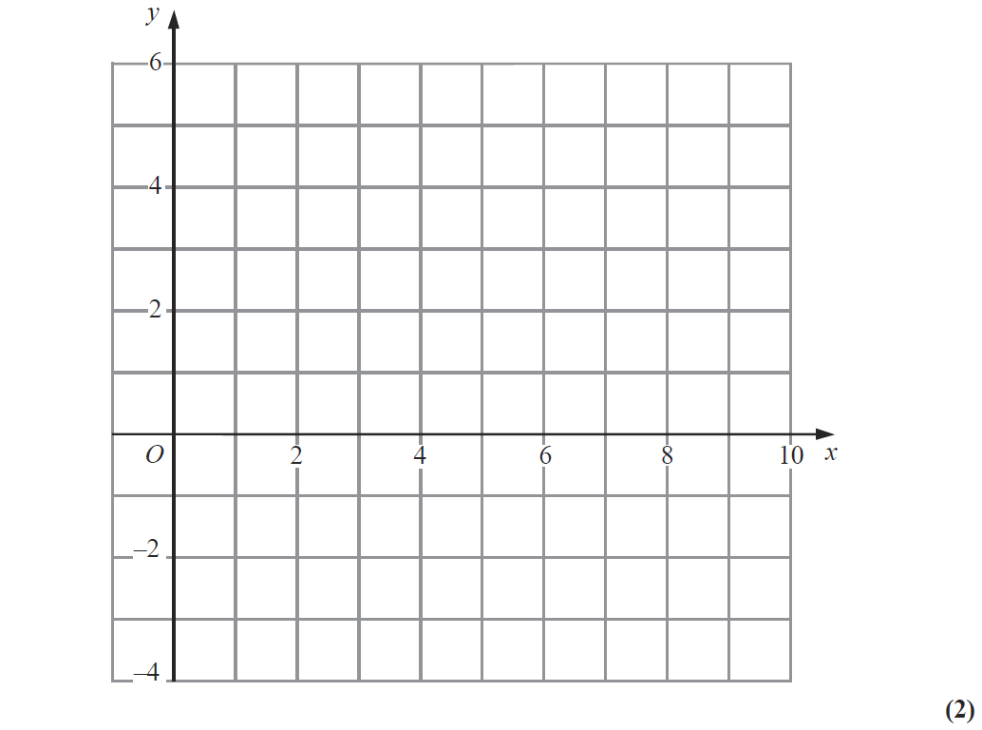
Linear Graphs & Gradients
Nov 2009 4H Q9
Show
Hide
Show
Hide
Show
Hide
R
Reveal Graph (a)
Hide Graph (a)
Note that in these diagrams I am shading the UNWANTED region

Slide 82
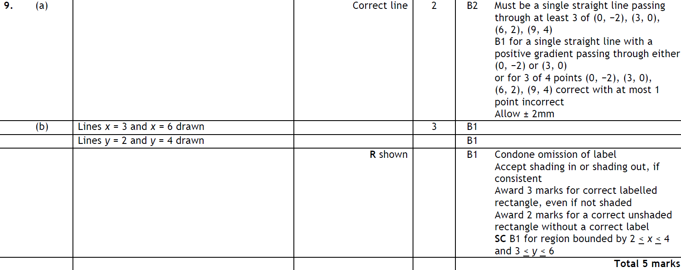
Linear Graphs & Gradients
Nov 2009 4H Q9
A
B

Slide 83
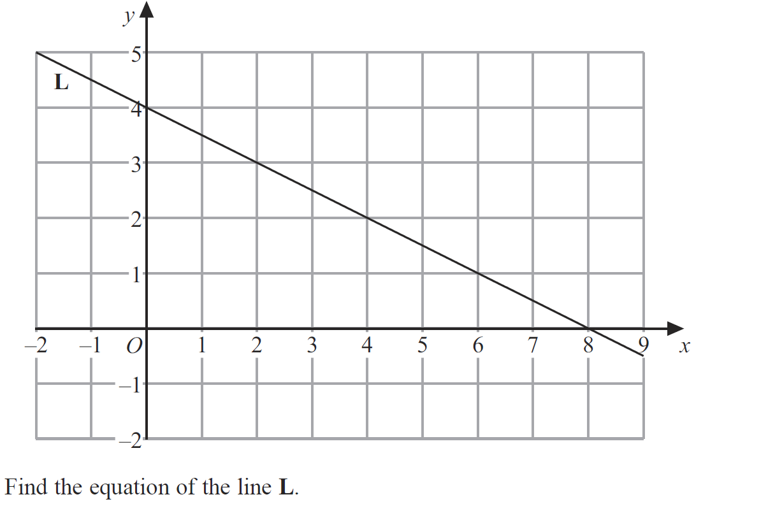
Linear Graphs & Gradients
June 2010 4H Q12

Slide 84
Linear Graphs & Gradients
June 2010 4H Q12
A
B

Slide 85
Linear Graphs & Gradients
Nov 2010 4H Q3

Slide 86
Linear Graphs & Gradients
Nov 2010 4H Q3
A
B

Slide 87
Linear Graphs & Gradients
Nov 2010 4H Q12

Slide 88
Linear Graphs & Gradients
Nov 2010 4H Q12
A
B

Slide 89
Linear Graphs & Gradients
Jan 2012 4H Q5
Reveal Graph
Hide Graph

Slide 90
Linear Graphs & Gradients
Jan 2012 4H Q5
A

Slide 91
Linear Graphs & Gradients
Jan 2012 4H Q13

Slide 92
Linear Graphs & Gradients
Jan 2012 4H Q13
A
B

Slide 93
Linear Graphs & Gradients
Jan 2012 4H Q17

Slide 94
Linear Graphs & Gradients
Jan 2012 4H Q17
A
B
C
D
E
F

Slide 95
Linear Graphs & Gradients
May 2012 3H Q14

Slide 96
Linear Graphs & Gradients
May 2012 3H Q14
A
B

Slide 97
Linear Graphs & Gradients
Jan 2013 3H Q10

Slide 98
Linear Graphs & Gradients
Jan 2013 3H Q10
A
B
C

Slide 99
Linear Graphs & Gradients
May 2013 3H Q15

Slide 100
Linear Graphs & Gradients
May 2013 3H Q15
A
B
C

Slide 101
Linear Graphs & Gradients
May 2013 4H Q7

Slide 102
Linear Graphs & Gradients
May 2013 4H Q7
A
B

Slide 103
Linear Graphs & Gradients
May 2013 3HR Q13

Slide 104
Linear Graphs & Gradients
May 2013 3HR Q13
A
B
C

Slide 105
Linear Graphs & Gradients
May 2013 4HR Q4

Slide 106
Linear Graphs & Gradients
May 2013 4HR Q4
A
B

Slide 107
Linear Graphs & Gradients
May 2013 4HR Q20
Reveal graph (dii)
Reveal graph (b)

Slide 108
Linear Graphs & Gradients
May 2013 4HR Q20
A
B
C
D (i)
D (ii)

Slide 109
Linear Graphs & Gradients
Jan 2014 4HR Q8
Show
R
Note that in these diagrams I am shading the UNWANTED region
Show
Show
Show
Show
Hide
Hide
Hide
Hide

Slide 110
Linear Graphs & Gradients
Jan 2014 4HR Q8
A
B
C

Slide 111
Linear Graphs & Gradients
Jan 2014 4HR Q13

Slide 112
Linear Graphs & Gradients
Jan 2014 4HR Q13
A
B

Slide 113
Linear Graphs & Gradients
May 2014 3H Q8
Show
R
Note that in these diagrams I am shading the UNWANTED region
Show
Hide
Show
Hide
Show
Hide
Show
Hide

Slide 114
Linear Graphs & Gradients
May 2014 3H Q8
A
B

Slide 115
Linear Graphs & Gradients
May 2014 4H Q13

Slide 116
Linear Graphs & Gradients
May 2014 4H Q13
A
B

Slide 117
Linear Graphs & Gradients
Jan 2015 3H Q10

Slide 118
Linear Graphs & Gradients
Jan 2015 3H Q10
A
B

Slide 119
Linear Graphs & Gradients
Jan 2015 4H Q4
Show

Slide 120
Linear Graphs & Gradients
Jan 2015 4H Q4
A

Slide 121
Linear Graphs & Gradients
Jan 2015 3HR Q5
Show

Slide 122
Linear Graphs & Gradients
Jan 2015 3HR Q5
A

Slide 123
Linear Graphs & Gradients
Jan 2015 3HR Q6

Slide 124
Linear Graphs & Gradients
Jan 2015 3HR Q6
A

Slide 125
Linear Graphs & Gradients
May 2015 3H Q13

Slide 126
Linear Graphs & Gradients
May 2015 3H Q13
A
B

Slide 127
Linear Graphs & Gradients
May 2015 3HR Q20

Slide 128
Linear Graphs & Gradients
May 2015 3HR Q20
A
B
C

Slide 129
Linear Graphs & Gradients
June 2015 4HR Q4
Show
Show valid points

Slide 130
Linear Graphs & Gradients
June 2015 4HR Q4
A
B

Slide 131
Linear Graphs & Gradients
June 2015 4HR Q12

Slide 132
Linear Graphs & Gradients
June 2015 4HR Q12
A

Slide 133
Linear Graphs & Gradients
Jan 2016 3H Q10
Show
R
Show
Show
Show
Show
Hide
Hide
Hide
Hide
Note that in these diagrams I am shading the UNWANTED region

Slide 134
Linear Graphs & Gradients
Jan 2016 3H Q10
A
B

Slide 135
Linear Graphs & Gradients
Jan 2016 3H Q15

Slide 136
Linear Graphs & Gradients
Jan 2016 3H Q15
A
B
C
D
E

Slide 137
Linear Graphs & Gradients
Jan 2016 3H Q18

Slide 138
Linear Graphs & Gradients
Jan 2016 3H Q18
A

Slide 139
Linear Graphs & Gradients
Jan 2016 4H Q6

Slide 140
Linear Graphs & Gradients
Jan 2016 4H Q6
A

Slide 141
Linear Graphs & Gradients
Jan 2016 4H Q12

Slide 142
Linear Graphs & Gradients
Jan 2016 4H Q12
A

Slide 143
Linear Graphs & Gradients
Jan 2016 3HR Q9

Slide 144
Linear Graphs & Gradients
Jan 2016 3HR Q9
A
B
C

Slide 145
Linear Graphs & Gradients
May 2016 3H Q5
Show

Slide 146
Linear Graphs & Gradients
May 2016 3H Q5
A

Slide 147
Linear Graphs & Gradients
May 2016 3H Q13

Slide 148
Linear Graphs & Gradients
May 2016 3H Q13
A

Slide 149
Linear Graphs & Gradients
May 2016 3HR Q11

Slide 150
Linear Graphs & Gradients
May 2016 3HR Q11
A

Slide 151
Linear Graphs & Gradients
June 2016 4HR Q20

Slide 152
Linear Graphs & Gradients
June 2016 4HR Q20
A

Slide 153
Linear Graphs & Gradients
Jan 2017 3H Q8
Show
R
Show
Hide
Show
Hide
Show
Hide
Show
Hide

Slide 154
Linear Graphs & Gradients
Jan 2017 3H Q8
A
B

Slide 155
Linear Graphs & Gradients
Jan 2017 4H Q6

Slide 156
Linear Graphs & Gradients
Jan 2017 4H Q6
A
B

Slide 157
Linear Graphs & Gradients
Jan 2017 4H Q12

Slide 158
Linear Graphs & Gradients
Jan 2017 4H Q12
A
B
C

Slide 159
Linear Graphs & Gradients
Jan 2017 4H Q19

Slide 160
Linear Graphs & Gradients
Jan 2017 4H Q19
A
B
C

Slide 161
Linear Graphs & Gradients
Jan 2017 3HR Q3

Slide 162
Linear Graphs & Gradients
Jan 2017 3HR Q3
A

Slide 163
Linear Graphs & Gradients
Jan 2017 3HR Q7
Show

Slide 164
Linear Graphs & Gradients
Jan 2017 3HR Q7
A

Slide 165
Linear Graphs & Gradients
Jan 2017 3HR Q15

Slide 166
Linear Graphs & Gradients
Jan 2017 3HR Q15
A

Slide 167
Linear Graphs & Gradients
Jan 2017 4HR Q11

Slide 168
Linear Graphs & Gradients
Jan 2017 4HR Q11
A

Slide 169
Linear Graphs & Gradients
May 2017 3H Q6
Show

Slide 170
Linear Graphs & Gradients
May 2017 3H Q6
A

Slide 171
Linear Graphs & Gradients
June 2017 4H Q4

Slide 172
Linear Graphs & Gradients
June 2017 4H Q4
A

Slide 173
Linear Graphs & Gradients
June 2017 4H Q13

Slide 174
Linear Graphs & Gradients
June 2017 4H Q13
A
B

Slide 175
Linear Graphs & Gradients
May 2017 3HR Q13
Show
Hide
Show
Hide
Show
Hide
Show
Hide
R

Slide 176
Linear Graphs & Gradients
May 2017 3HR Q13
A

Slide 177
Linear Graphs & Gradients
June 2017 4HR Q12

Slide 178
Linear Graphs & Gradients
June 2017 4HR Q12
A
B

Slide 179
Linear Graphs & Gradients
Jan 2018 3H Q7
Show

Slide 180
Linear Graphs & Gradients
Jan 2018 3H Q7
A

Slide 181
Linear Graphs & Gradients
Jan 2018 3H Q10

Slide 182
Linear Graphs & Gradients
Jan 2018 3H Q10
A

Slide 183
Linear Graphs & Gradients
Jan 2018 3HR Q4
Show (a)

Slide 184
Linear Graphs & Gradients
Jan 2018 3HR Q4
A
B

Slide 185
Linear Graphs & Gradients
Jan 2018 4HR Q3

Slide 186
Linear Graphs & Gradients
Jan 2018 4HR Q3
A

Slide 187
Linear Graphs & Gradients
June 2018 4H Q14

Slide 188
Linear Graphs & Gradients
June 2018 4H Q14
A
B
C

Slide 189
Linear Graphs & Gradients
May 2018 3HR Q3
Show (a)

Slide 190
Linear Graphs & Gradients
May 2018 3HR Q3
A
B

Slide 191
Linear Graphs & Gradients
May 2018 3HR Q11

Slide 192
Linear Graphs & Gradients
May 2018 3HR Q11
A
B

