Slide 1
Indices
Indices
May 2017
1H Q1
Nov 2017
1H Q30
Nov 2018
1H Q1
May 2017
1H Q24
Nov 2017
3H Q21
Nov 2018
1H Q9
SAM
1H Q2
June 2017
3H Q12
Nov 2017
3H Q28
Nov 2018
1H Q16
1 Marker
SAM
3H Q14
Nov 2017
1H Q1
May 2018
1H Q1
Nov 2018
1H Q17
Nov 2017
1H Q3
May 2018
1H Q24
Nov 2018
3H Q17
Nov 2017
1H Q6
June 2018
2H Q18
Rewriting as another power
Negative & fractional

Slide 2
Indices
SAM 1H Q2

Slide 3
Indices
SAM 1H Q2
A

Slide 4
Indices
SAM 3H Q14

Slide 5
Indices
SAM 3H Q14
A
B

Slide 6
Indices
May 2017 1H Q1

Slide 7
Indices
May 2017 1H Q1
A

Slide 8
Indices
May 2017 1H Q24

Slide 9
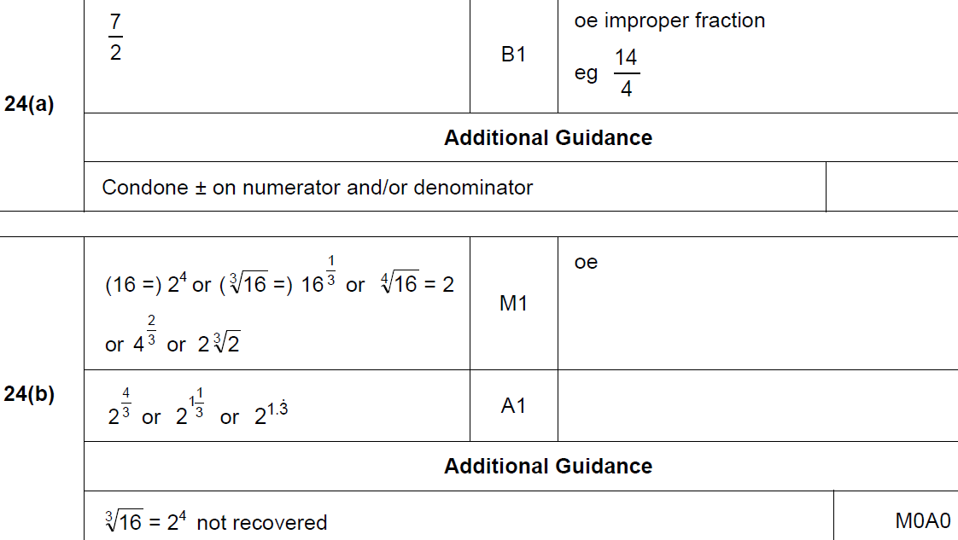
Indices
May 2017 1H Q24
A
B

Slide 10
Indices
June 2017 3H Q12

Slide 11
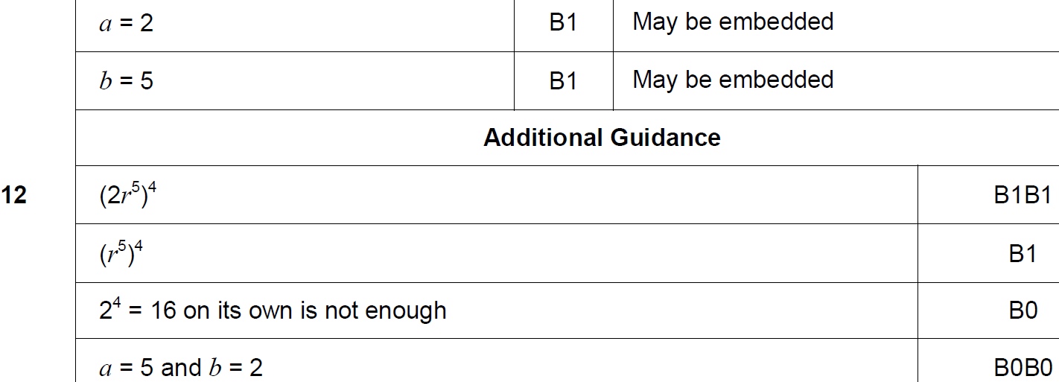
Indices
June 2017 3H Q12
A

Slide 12
Indices
Nov 2017 1H Q1

Slide 13
Indices
Nov 2017 1H Q1
A

Slide 14
Indices
Nov 2017 1H Q3

Slide 15
Indices
Nov 2017 1H Q3
A

Slide 16
Indices
Nov 2017 1H Q6

Slide 17
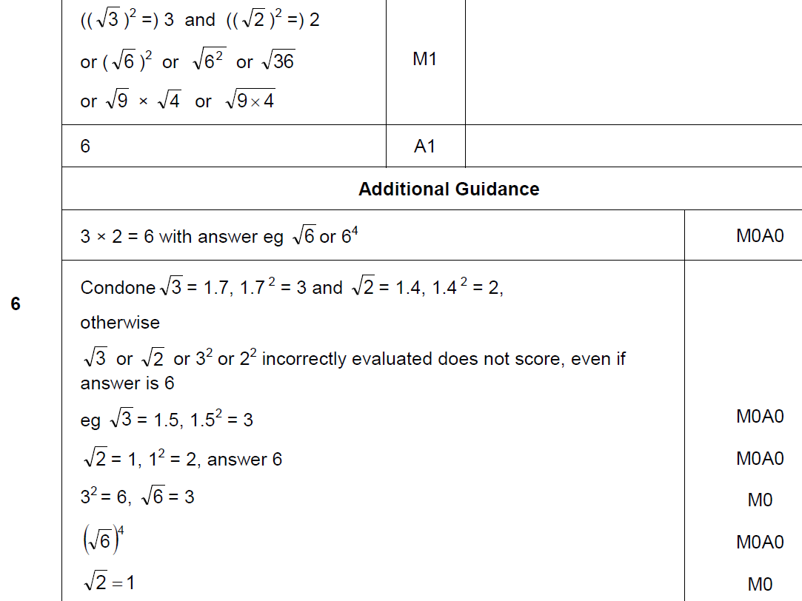
Indices
Nov 2017 1H Q6
A

Slide 18
Indices
Nov 2017 1H Q30

Slide 19
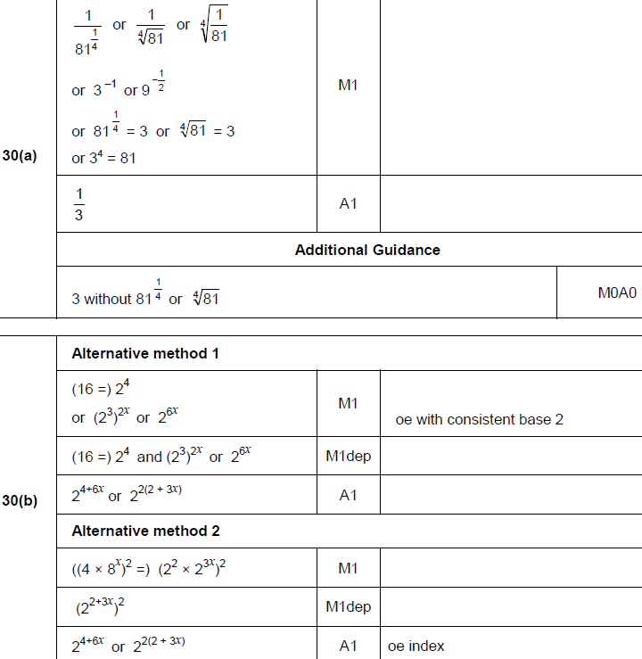
Indices
Nov 2017 1H Q30
A
B

Slide 20
Indices
Nov 2017 3H Q21

Slide 21
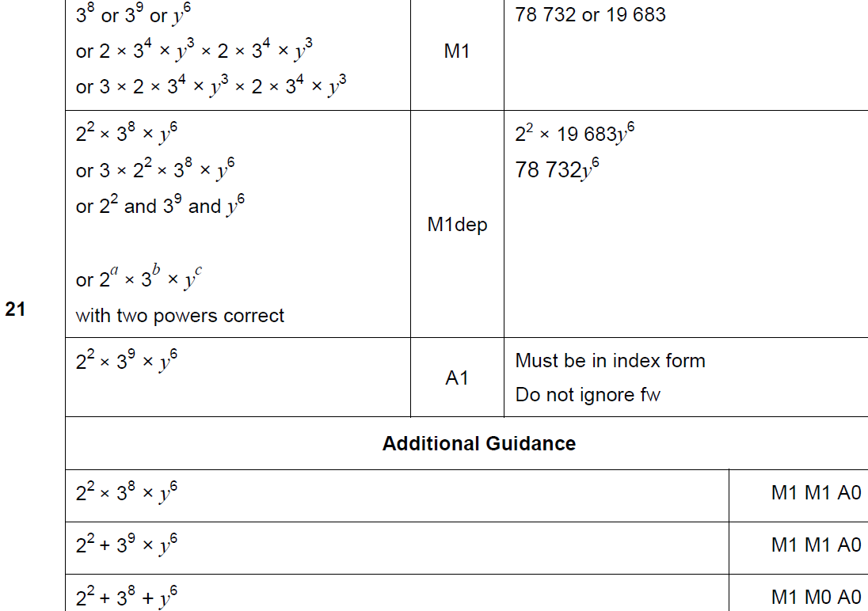
Indices
Nov 2017 3H Q21
A

Slide 22
Indices
Nov 2017 3H Q28

Slide 23
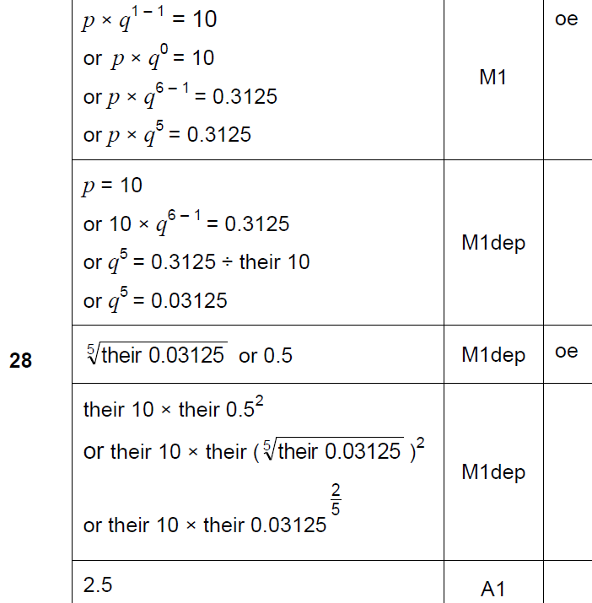
Indices
Nov 2017 3H Q28
A

Slide 24
Indices
May 2018 1H Q1

Slide 25
Indices
May 2018 1H Q1
A

Slide 26
Indices
May 2018 1H Q24

Slide 27
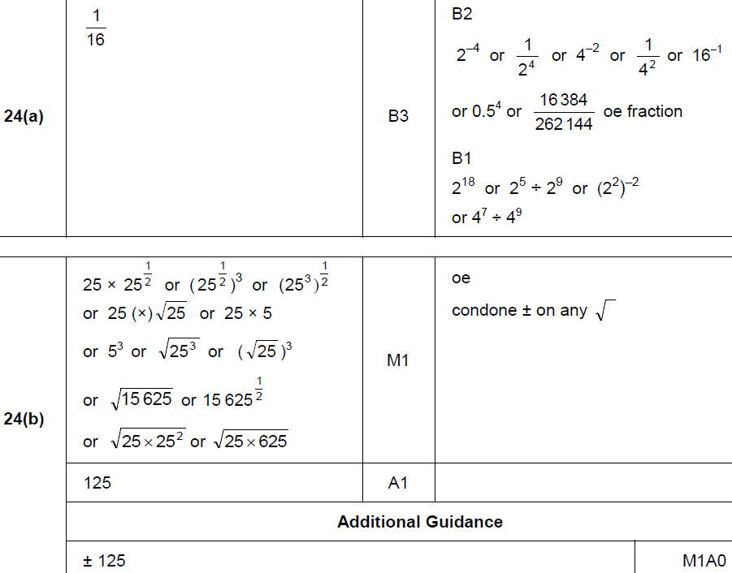
Indices
May 2018 1H Q24
A
B

Slide 28
Indices
June 2018 2H Q18

Slide 29
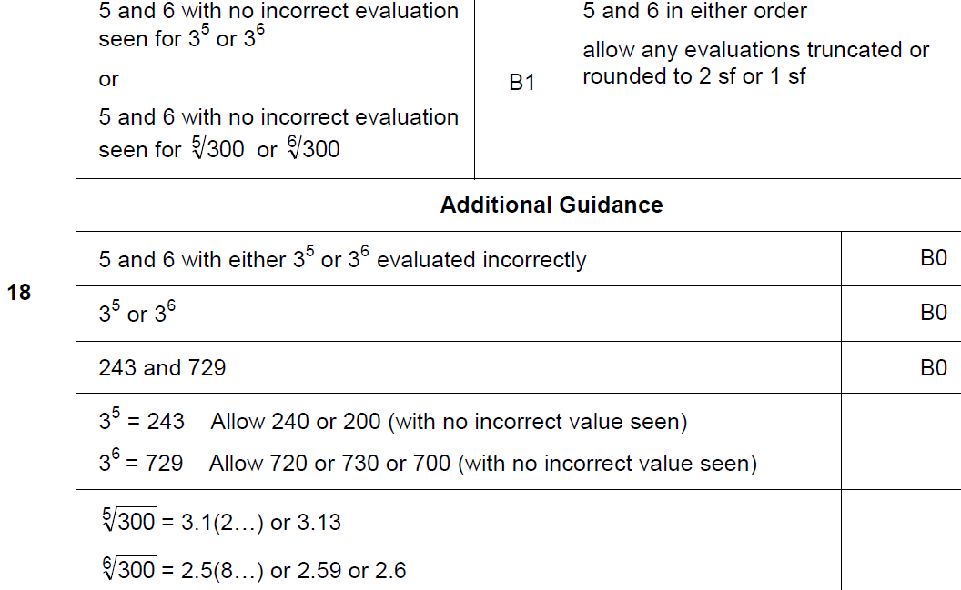
Indices
June 2018 2H Q18
A

Slide 30
Indices
Nov 2018 1H Q1

Slide 31
Indices
Nov 2018 1H Q1
A

Slide 32
Indices
Nov 2018 1H Q9

Slide 33
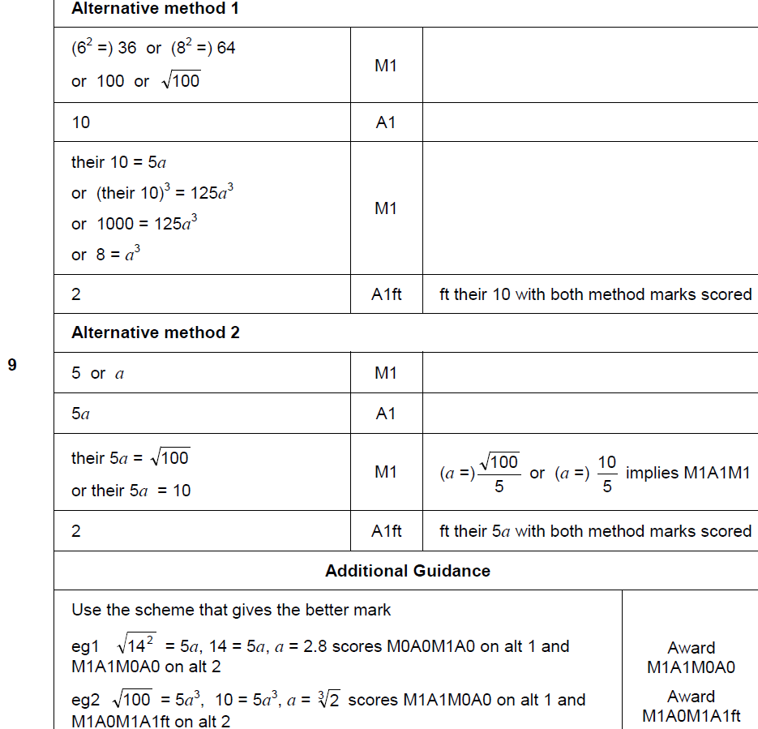
Indices
Nov 2018 1H Q9
A

Slide 34
Indices
Nov 2018 1H Q16

Slide 35
Indices
Nov 2018 1H Q16
A

Slide 36
Indices
Nov 2018 1H Q17

Slide 37
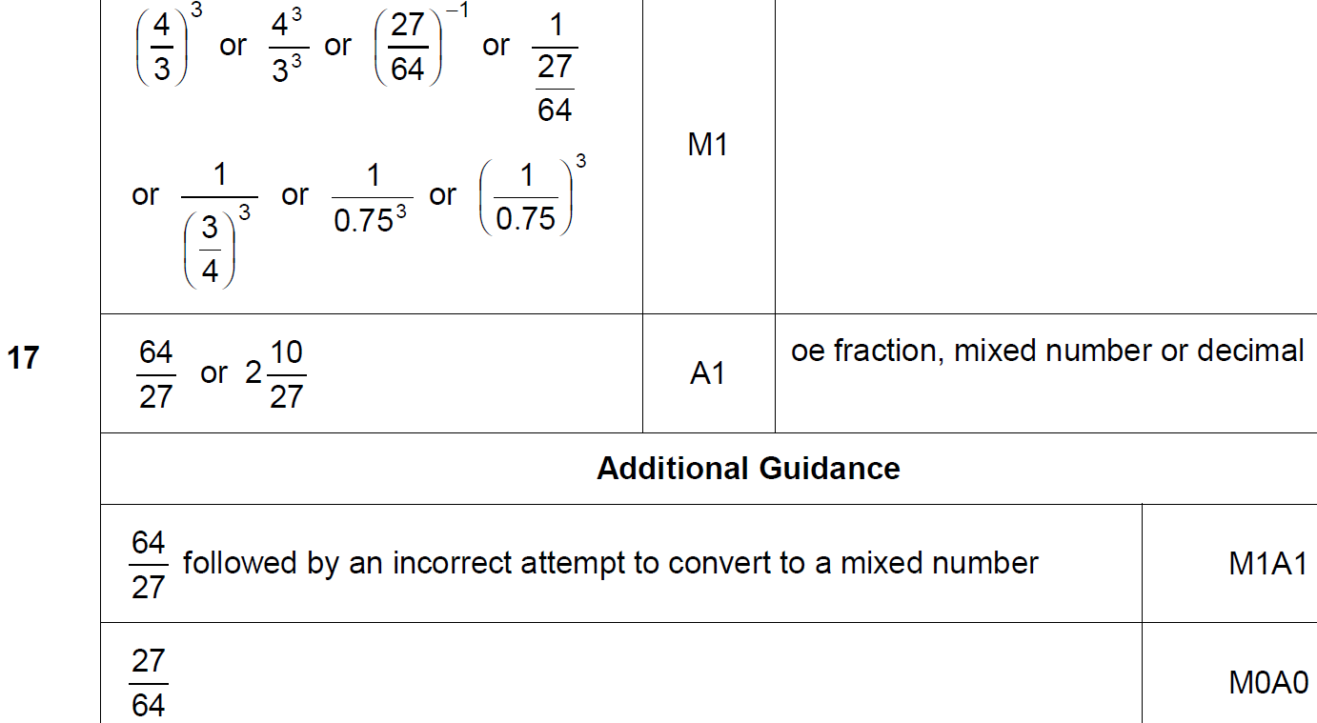
Indices
Nov 2018 1H Q17
A

Slide 38
Indices
Nov 2018 3H Q17

Slide 39
Indices
Nov 2018 3H Q17
A

