Slide 1
Indices
Indices
May 2017
1H Q12
SAM
1H Q10
Nov 2018
1H Q1
June 2017
2H Q18
Edexcel
Spec 1
1H Q10
Nov 2018
1H Q14
Nov 2017
1H Q10
AQA
Spec 2
1H Q1
Nov 2018
3H Q9
Nov 2017
2H Q6
OCR
Spec 2
1H Q15
May 2019
1H Q8
May 2018
1H Q9
Spec 2
2H Q3
June 2019
3H Q12
June 2018
2H Q1
Rewriting as another power
Negative & fractional

Slide 2
Indices
Indices
May 2017
1H Q1
Nov 2017
1H Q30
Nov 2018
1H Q1
May 2017
1H Q24
Nov 2017
3H Q21
Edexcel
Nov 2018
1H Q9
SAM
1H Q2
June 2017
3H Q12
Nov 2017
3H Q28
AQA
Nov 2018
1H Q16
1 Marker
SAM
3H Q14
Nov 2017
1H Q1
May 2018
1H Q1
OCR
Nov 2018
1H Q17
Nov 2017
1H Q3
May 2018
1H Q24
Nov 2018
3H Q17
Nov 2017
1H Q6
June 2018
2H Q18
Rewriting as another power
Negative & fractional

Slide 3
Indices
Indices
June 2017
2H Q15
May 2018
1H Q2
Edexcel
SAM
3H Q7
June 2017
3H Q16
June 2018
2H Q12
AQA
Practice
2H Q11
June 2017
3H Q17
June 2018
2H Q20
OCR
Practice
3H Q8
Nov 2017
1H Q2
June 2018
3H Q4
Nov 2017
2H Q16
Nov 2018
2H Q1
Rewriting as another power
Negative & fractional

Slide 4
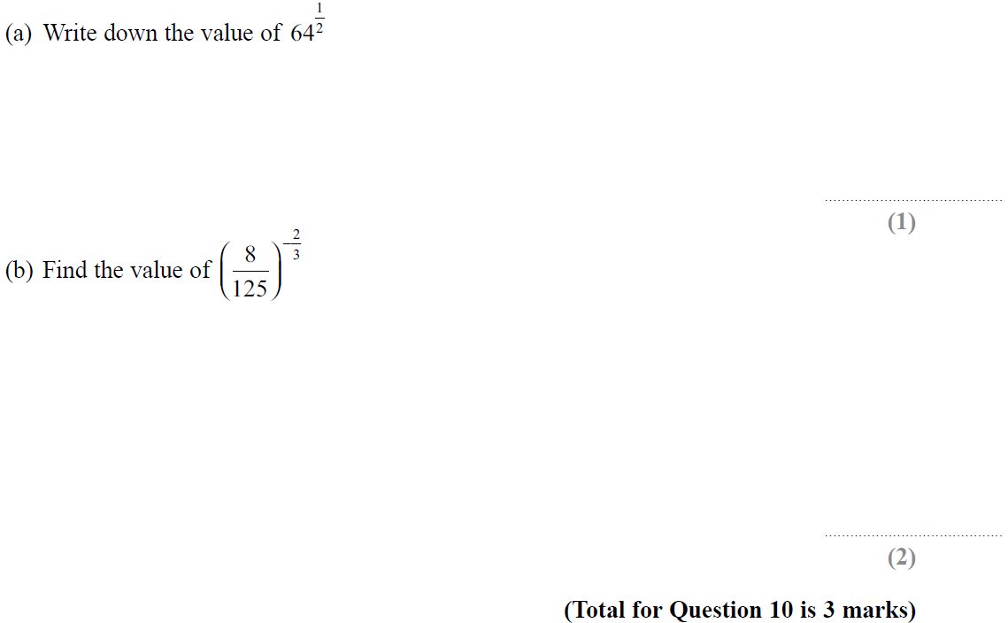
Indices
SAM 1H Q10

Slide 5
Indices
SAM 1H Q10
A
B

Slide 6
Indices
Specimen Set 1 1H Q10

Slide 7
Indices
Specimen Set 1 1H Q10
A

Slide 8
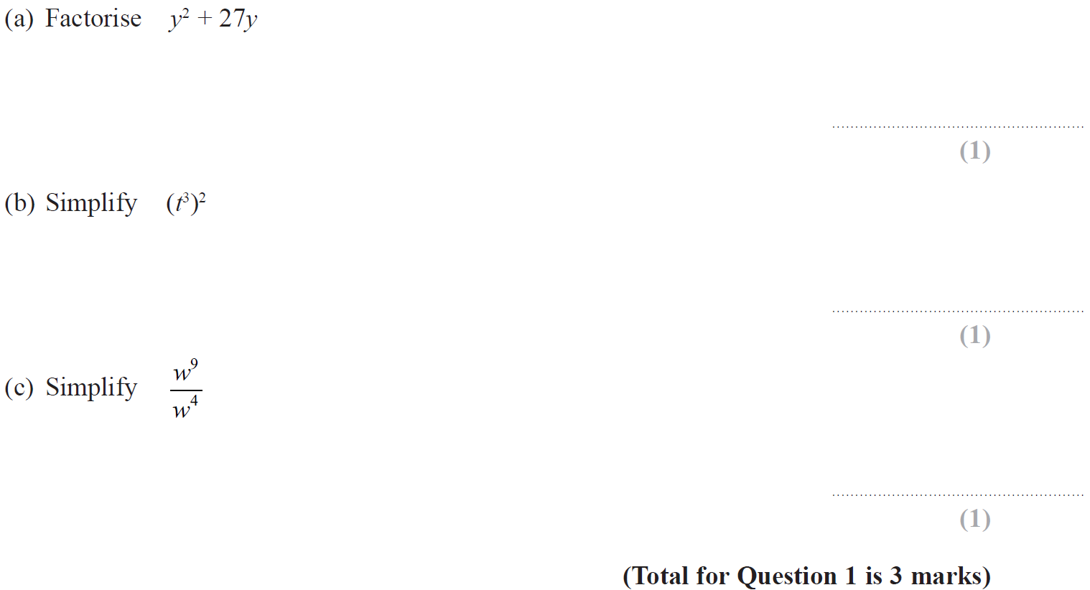
Indices
Specimen Set 2 1H Q1

Slide 9
Indices
Specimen Set 2 1H Q1
A
B
C

Slide 10
Indices
Specimen Set 2 1H Q15

Slide 11
Indices
Specimen Set 2 1H Q15
A
B
C

Slide 12
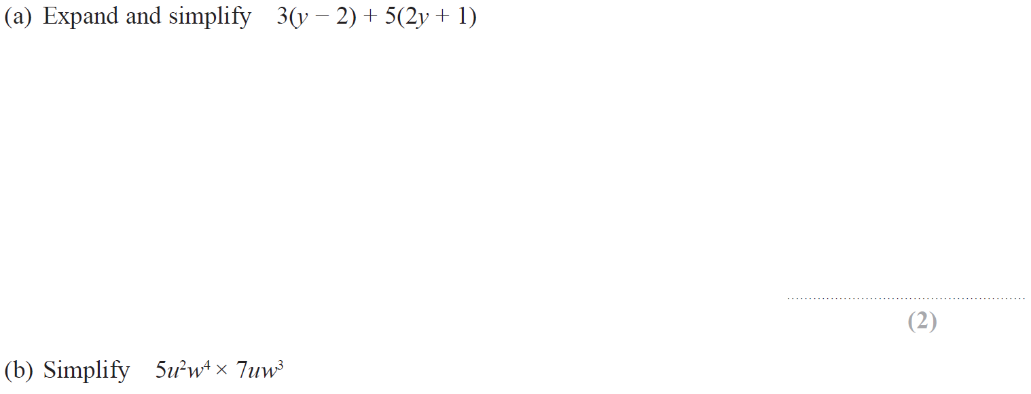
Indices
Specimen Set 2 2H Q3

Slide 13
Indices
Specimen Set 2 2H Q3
A
B

Slide 14
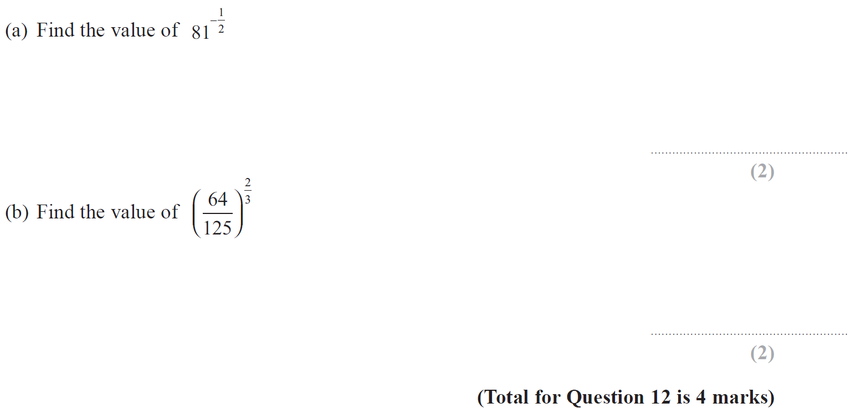
Indices
May 2017 1H Q12

Slide 15
Indices
May 2017 1H Q12
A
B

Slide 16
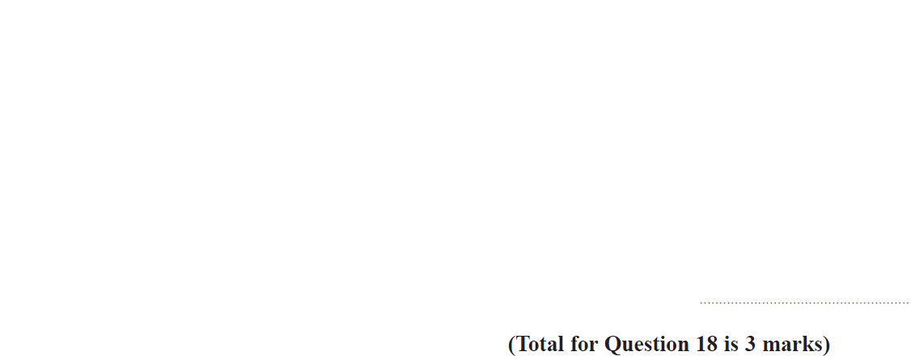
Indices
June 2017 2H Q18

Slide 17
Indices
June 2017 2H Q18
A

Slide 18
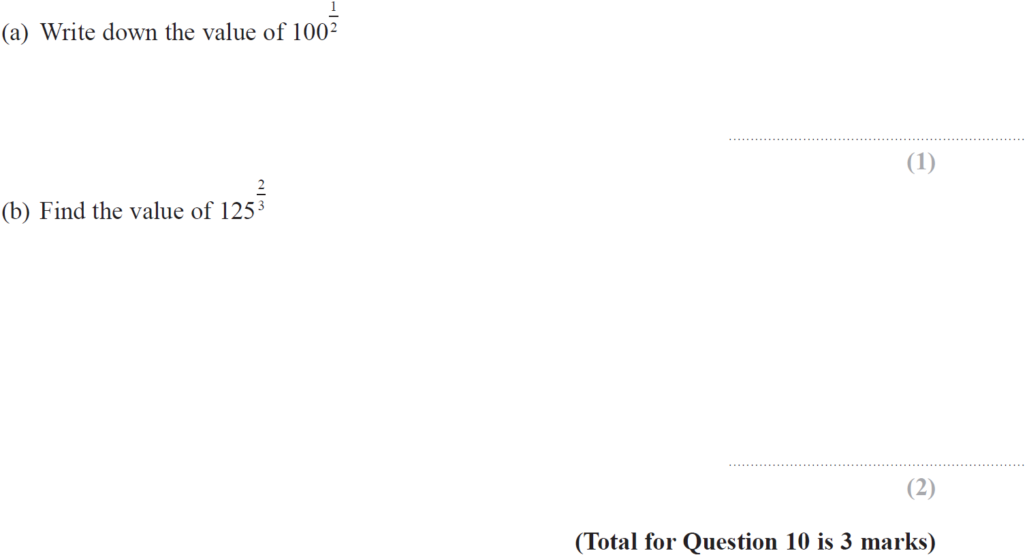
Indices
Nov 2017 1H Q10

Slide 19
Indices
Nov 2017 1H Q10
A
B

Slide 20
Indices
Nov 2017 2H Q6

Slide 21
Indices
Nov 2017 2H Q6
A
B
C

Slide 22
Indices
May 2018 1H Q9

Slide 23
Indices
May 2018 1H Q9
A
B
C

Slide 24
Indices
June 2018 2H Q1

Slide 25
Indices
June 2018 2H Q1
A
B
C

Slide 26
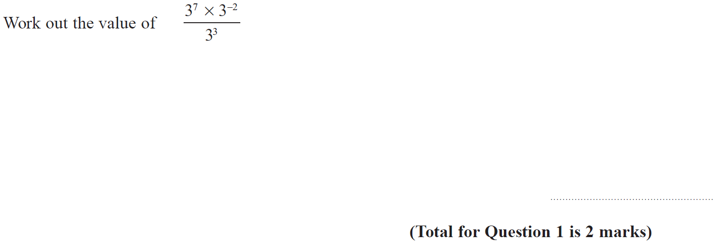
Indices
Nov 2018 1H Q1

Slide 27
Indices
Nov 2018 1H Q1
A

Slide 28
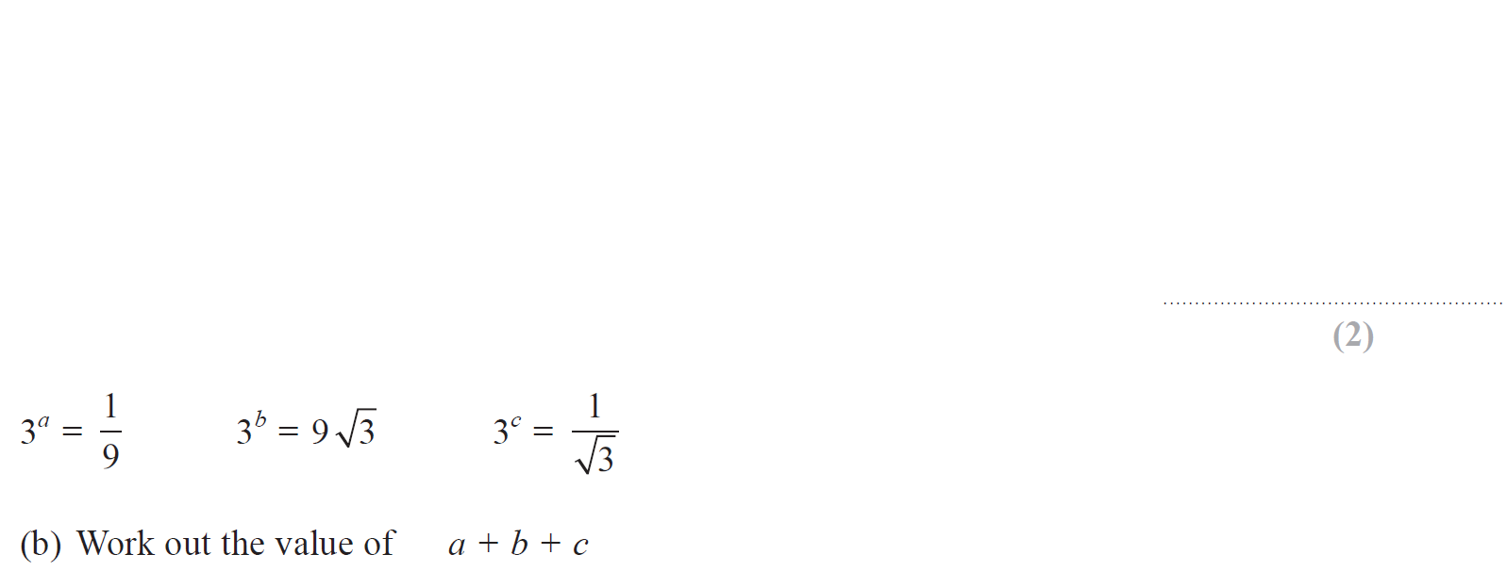
Indices
Nov 2018 1H Q14

Slide 29
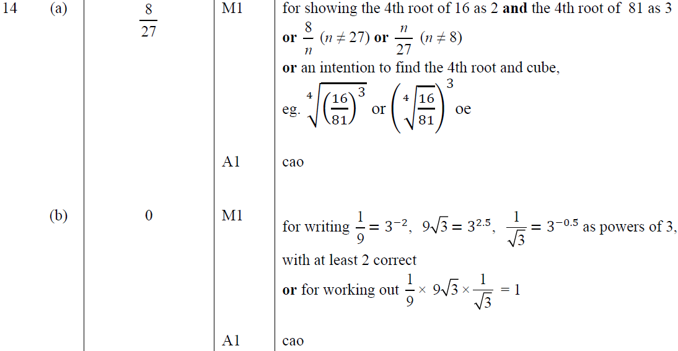
Indices
Nov 2018 1H Q14
A
B

Slide 30
Indices
Nov 2018 3H Q9

Slide 31
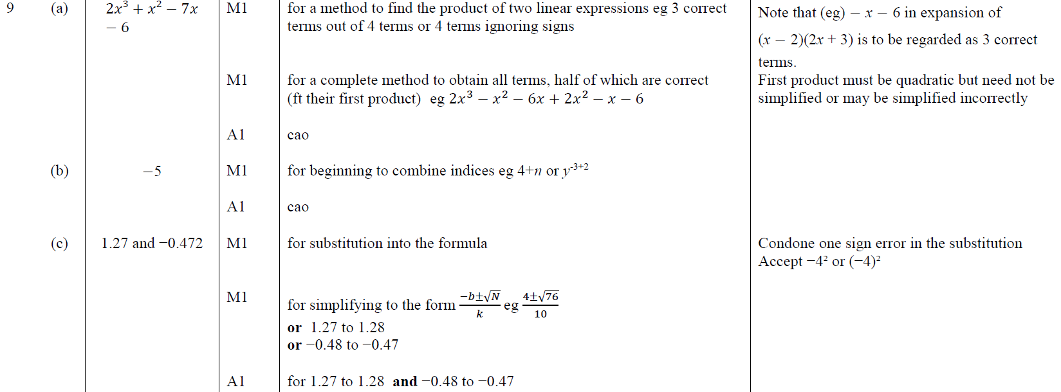
Indices
Nov 2018 3H Q9
A
B
C

Slide 32
Indices
May 2019 1H Q8

Slide 33
Indices
May 2019 1H Q8
A
B
C
A SF
B SF
C SF

Slide 34
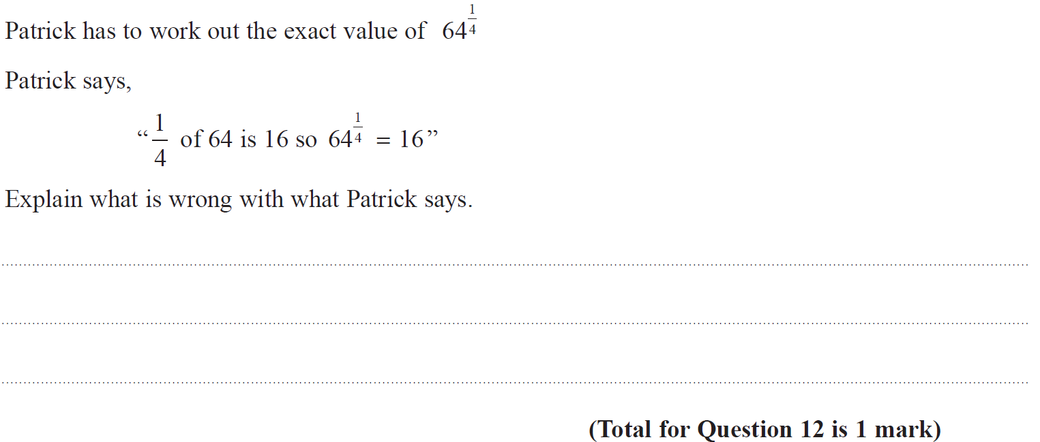
Indices
June 2019 3H Q12

Slide 35
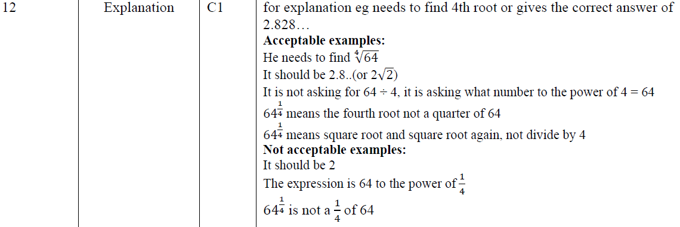
Indices
June 2019 3H Q12
A
A SF

Slide 36
Indices
SAM 1H Q2

Slide 37
Indices
SAM 1H Q2
A

Slide 38
Indices
SAM 3H Q14

Slide 39
Indices
SAM 3H Q14
A
B

Slide 40
Indices
May 2017 1H Q1

Slide 41
Indices
May 2017 1H Q1
A

Slide 42
Indices
May 2017 1H Q24

Slide 43
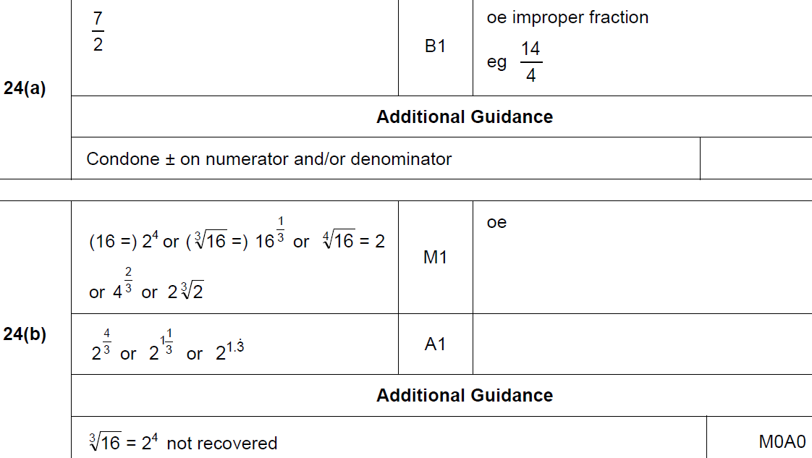
Indices
May 2017 1H Q24
A
B

Slide 44
Indices
June 2017 3H Q12

Slide 45
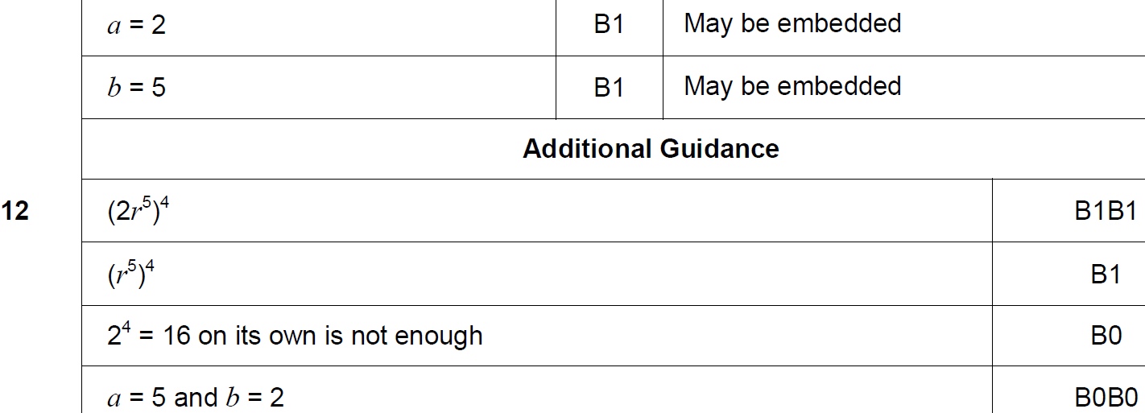
Indices
June 2017 3H Q12
A

Slide 46
Indices
Nov 2017 1H Q1

Slide 47
Indices
Nov 2017 1H Q1
A

Slide 48
Indices
Nov 2017 1H Q3

Slide 49
Indices
Nov 2017 1H Q3
A

Slide 50
Indices
Nov 2017 1H Q6

Slide 51
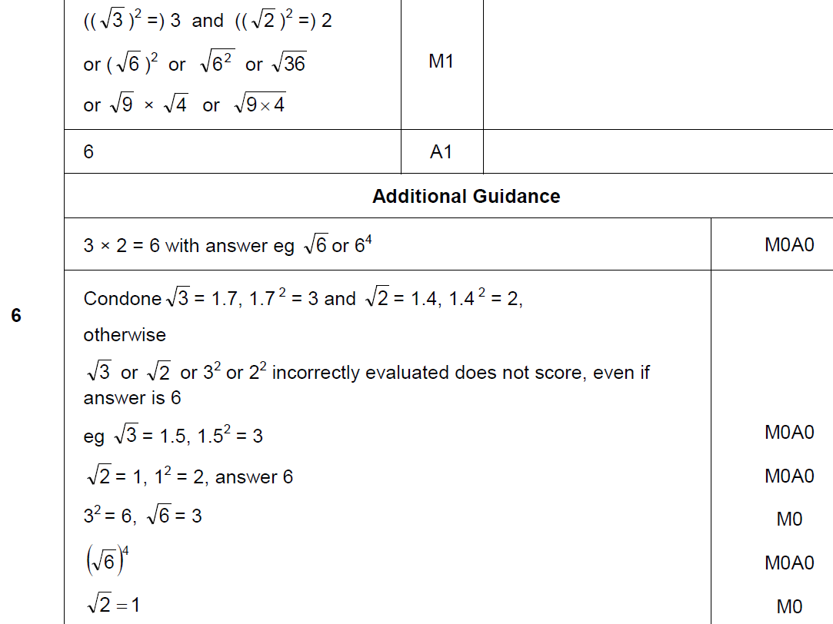
Indices
Nov 2017 1H Q6
A

Slide 52
Indices
Nov 2017 1H Q30

Slide 53
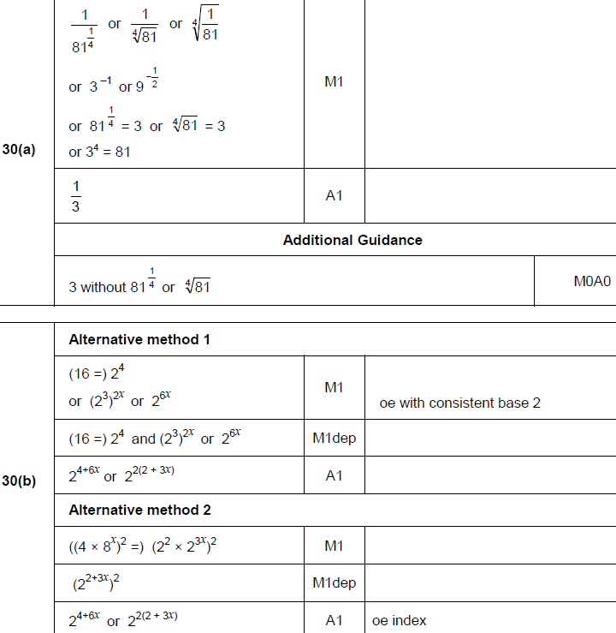
Indices
Nov 2017 1H Q30
A
B

Slide 54
Indices
Nov 2017 3H Q21

Slide 55
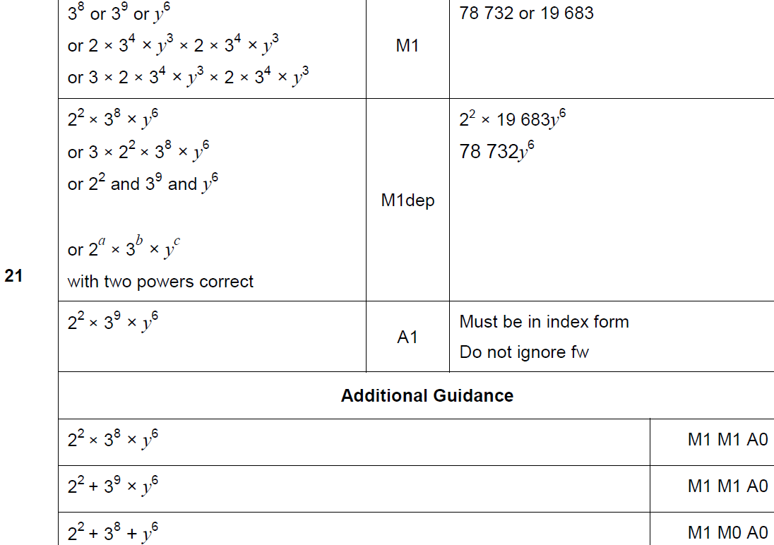
Indices
Nov 2017 3H Q21
A

Slide 56
Indices
Nov 2017 3H Q28

Slide 57
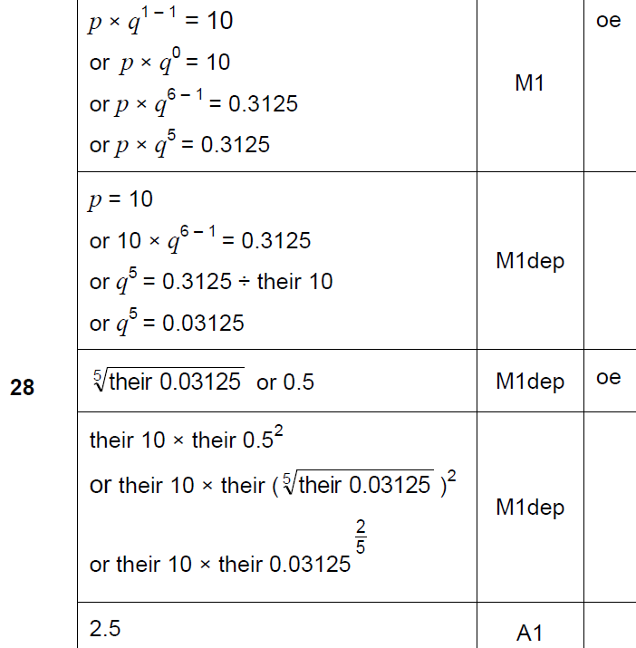
Indices
Nov 2017 3H Q28
A

Slide 58
Indices
May 2018 1H Q1

Slide 59
Indices
May 2018 1H Q1
A

Slide 60
Indices
May 2018 1H Q24

Slide 61
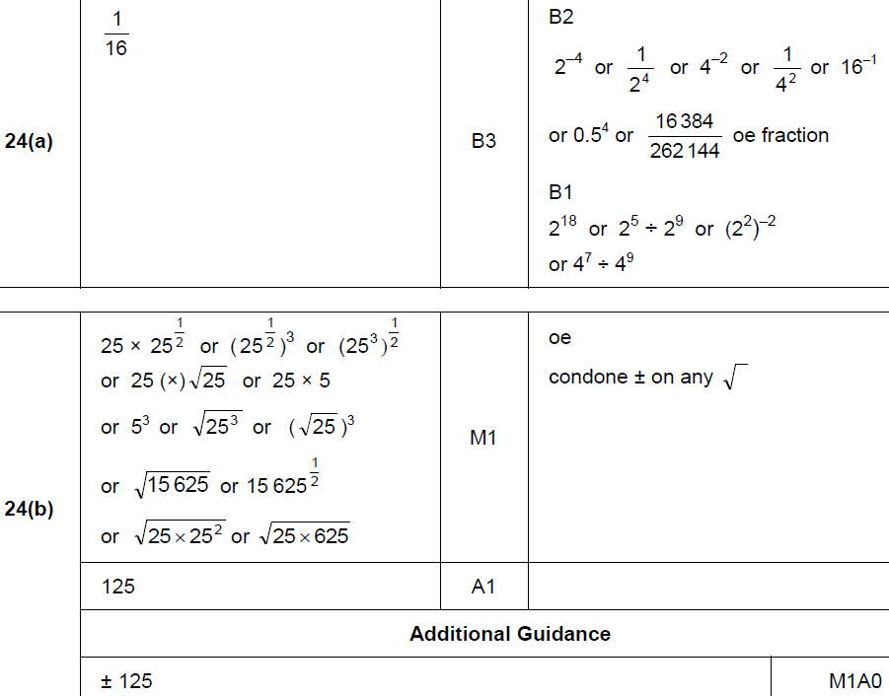
Indices
May 2018 1H Q24
A
B

Slide 62
Indices
June 2018 2H Q18

Slide 63
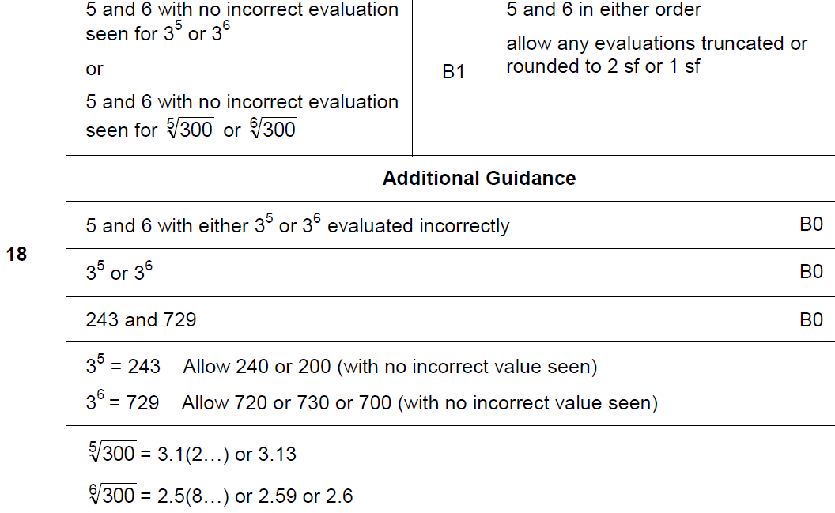
Indices
June 2018 2H Q18
A

Slide 64
Indices
Nov 2018 1H Q1

Slide 65
Indices
Nov 2018 1H Q1
A

Slide 66
Indices
Nov 2018 1H Q9

Slide 67
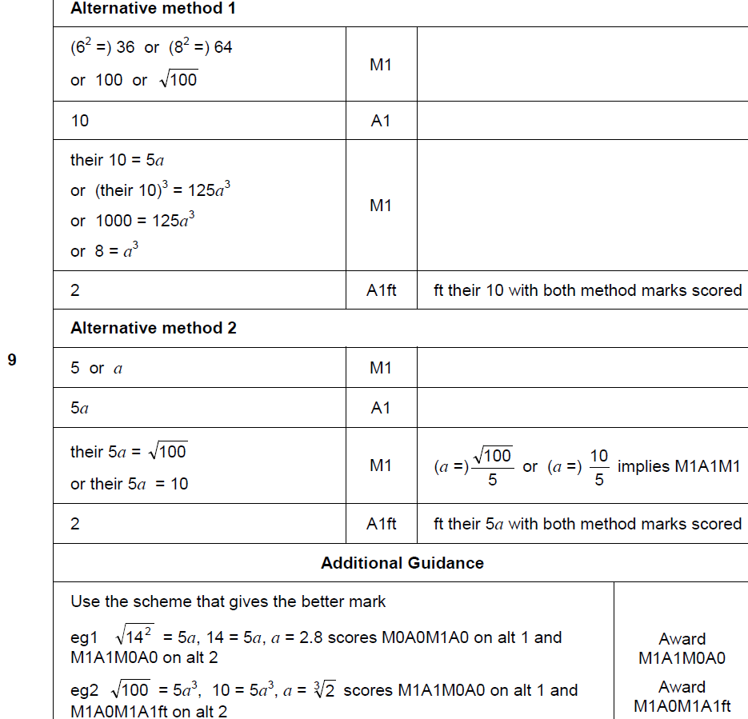
Indices
Nov 2018 1H Q9
A

Slide 68
Indices
Nov 2018 1H Q16

Slide 69
Indices
Nov 2018 1H Q16
A

Slide 70
Indices
Nov 2018 1H Q17

Slide 71
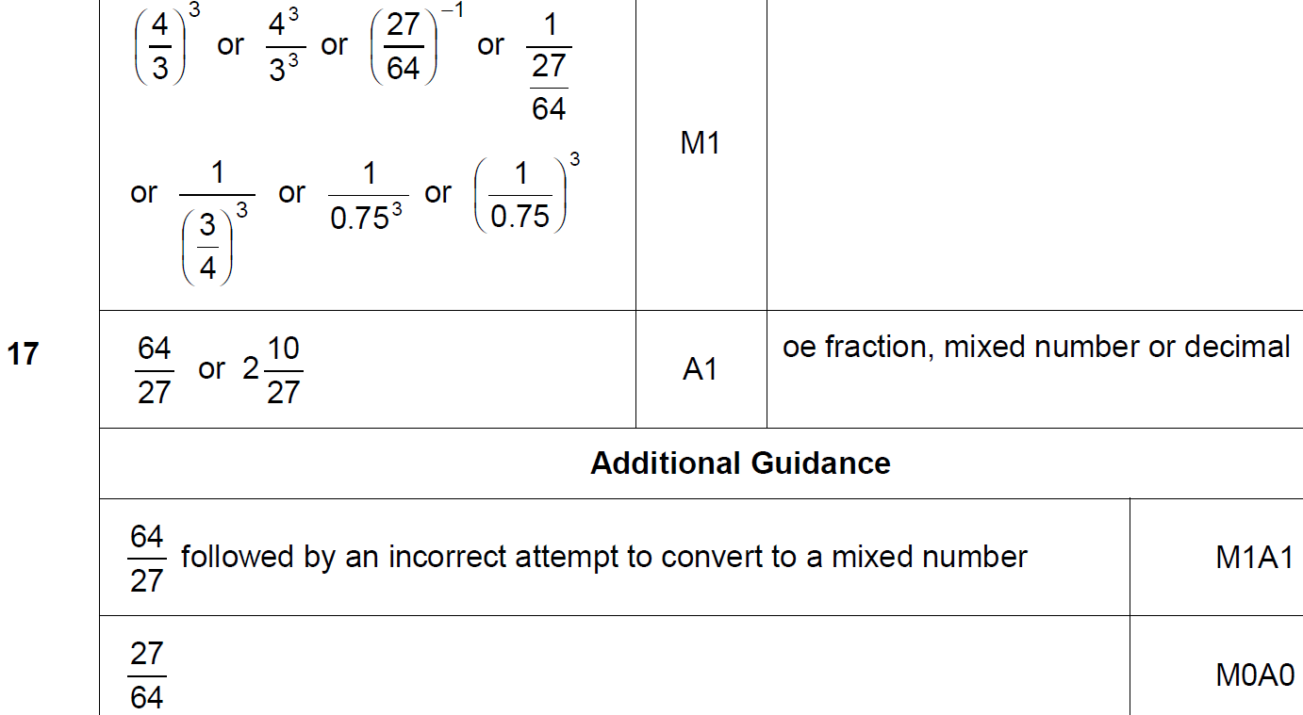
Indices
Nov 2018 1H Q17
A

Slide 72
Indices
Nov 2018 3H Q17

Slide 73
Indices
Nov 2018 3H Q17
A

Slide 74
Indices
SAM 3H Q7

Slide 75
Indices
SAM 3H Q7
A

Slide 76
Indices
Practice 2H Q11

Slide 77
Indices
Practice 2H Q11
A

Slide 78
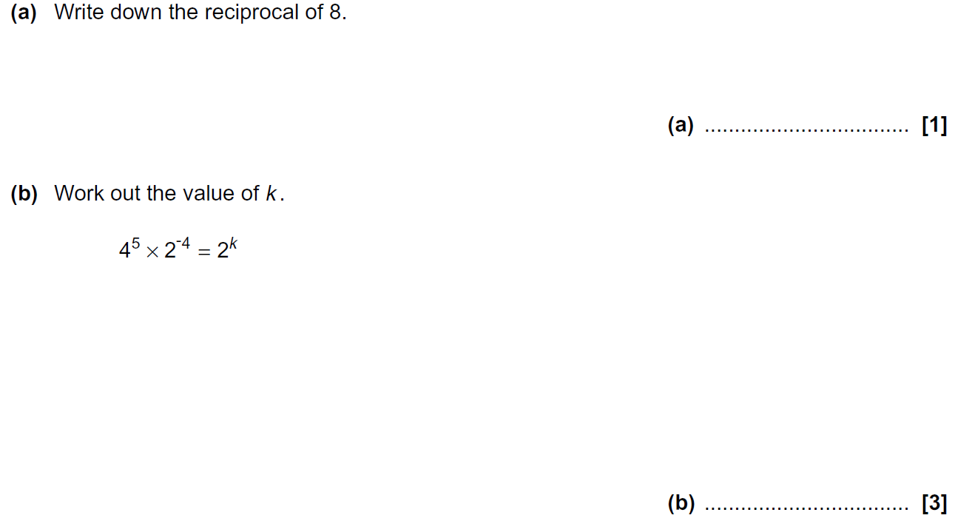
Indices
Practice 3H Q8

Slide 79
Indices
Practice 3H Q8
A
B

Slide 80
Indices
June 2017 2H Q15

Slide 81
Indices
June 2017 2H Q15
A (i)
A (ii)
B

Slide 82
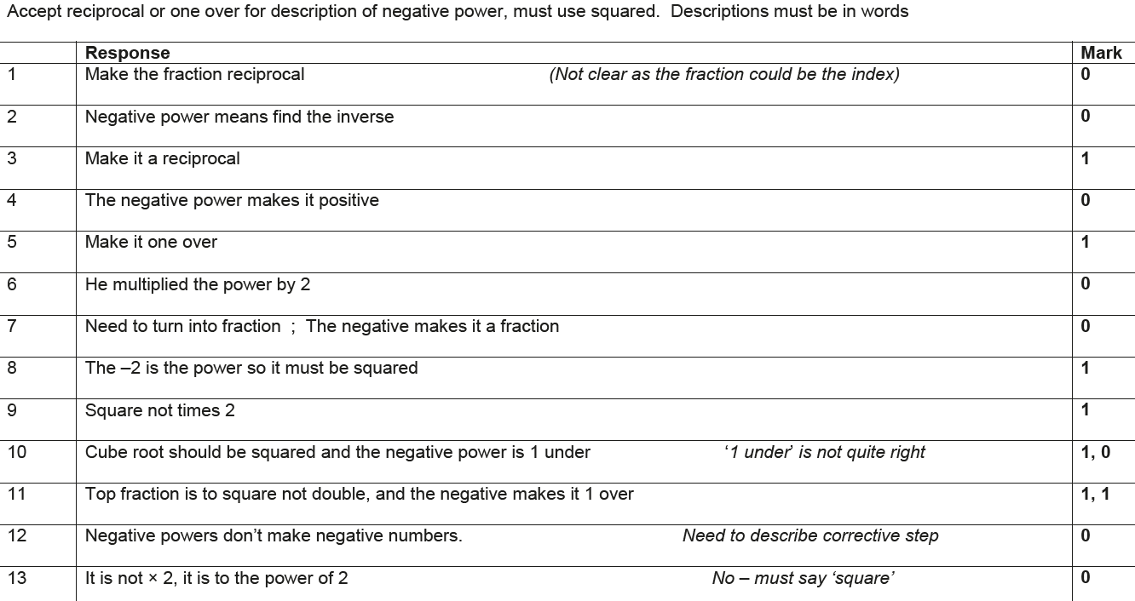
Indices
June 2017 2H Q15
B Exemplar responses

Slide 83
Indices
June 2017 3H Q16

Slide 84
Indices
June 2017 3H Q16
A
B

Slide 85
Indices
June 2017 3H Q17

Slide 86
Indices
June 2017 3H Q17
A

Slide 87
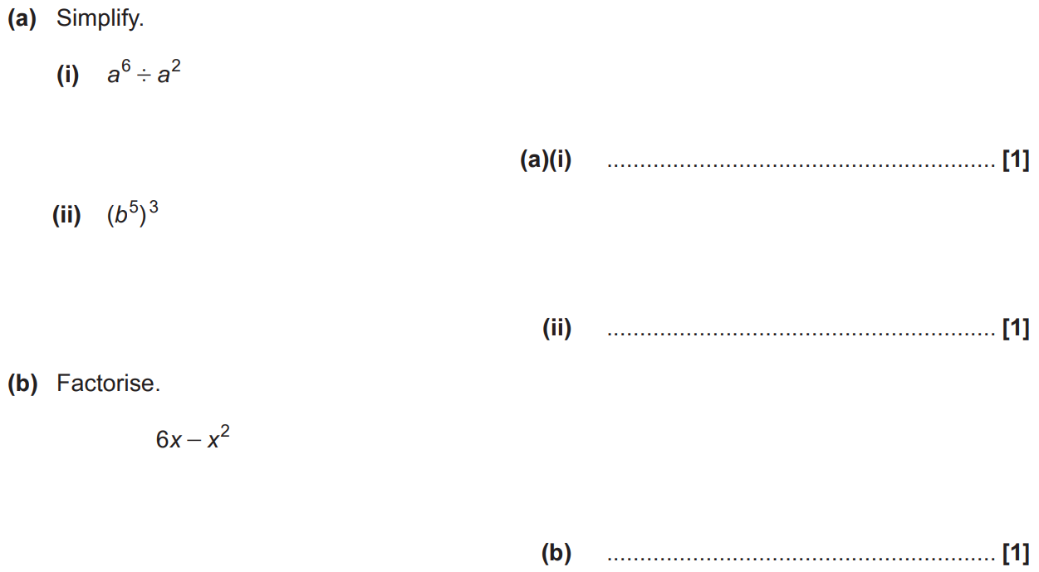
Indices
Nov 2017 1H Q2

Slide 88
Indices
Nov 2017 1H Q2
A (i)
A (ii)
B

Slide 89
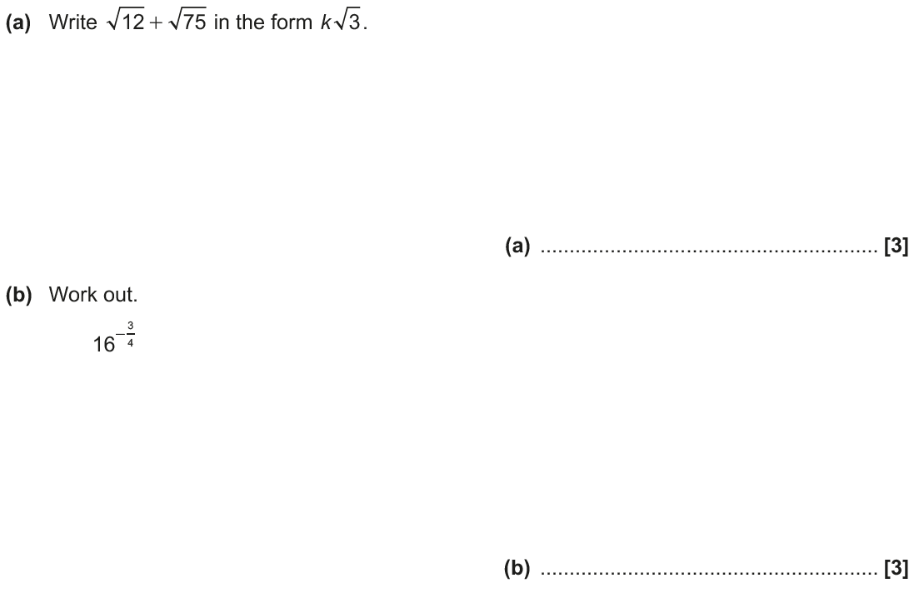
Indices
Nov 2017 2H Q16

Slide 90
Indices
Nov 2017 2H Q16
A
B

Slide 91
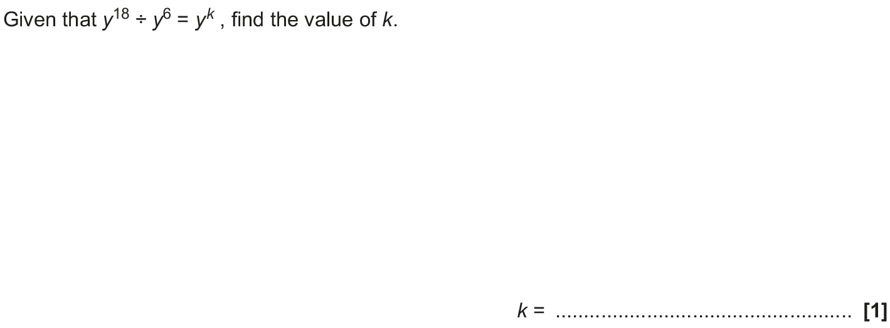
Indices
May 2018 1H Q2

Slide 92
Indices
May 2018 1H Q2
A

Slide 93
Indices
June 2018 2H Q12

Slide 94
Indices
June 2018 2H Q12
A

Slide 95
Indices
June 2018 2H Q20

Slide 96
Indices
June 2018 2H Q20
A (i)
A (ii)
B

Slide 97
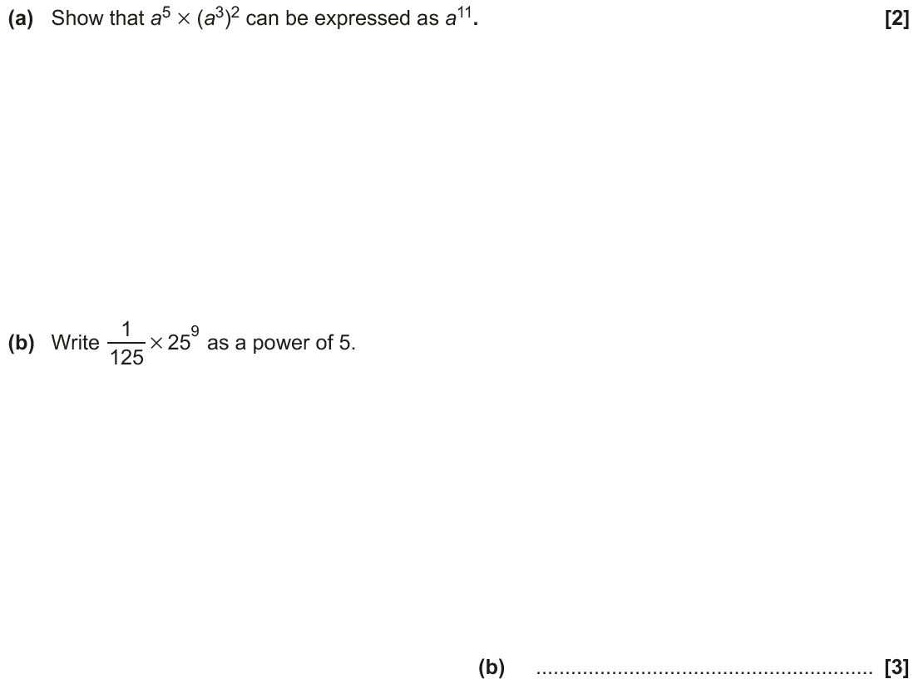
Indices
June 2018 3H Q4

Slide 98
Indices
June 2018 3H Q4
A
B

Slide 99
Indices
Nov 2018 2H Q1

Slide 100
Indices
Nov 2018 2H Q1
A
B

