Slide 1
Indices
Indices
June 2017
2H Q15
May 2018
1H Q2
SAM
3H Q7
June 2017
3H Q16
June 2018
2H Q12
Practice
2H Q11
June 2017
3H Q17
June 2018
2H Q20
Practice
3H Q8
Nov 2017
1H Q2
June 2018
3H Q4
Nov 2017
2H Q16
Nov 2018
2H Q1
Rewriting as another power
Negative & fractional

Slide 2
Indices
SAM 3H Q7

Slide 3
Indices
SAM 3H Q7
A

Slide 4
Indices
Practice 2H Q11

Slide 5
Indices
Practice 2H Q11
A

Slide 6
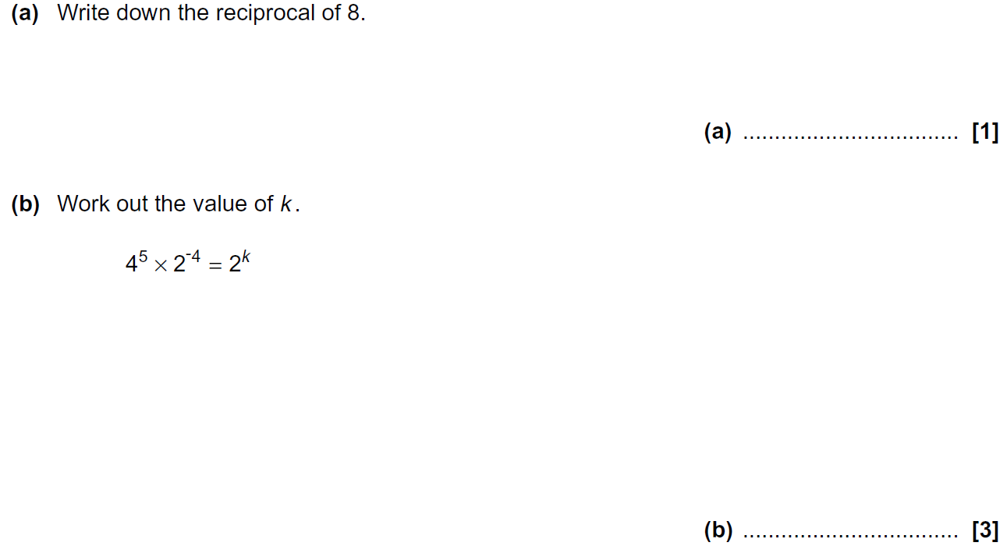
Indices
Practice 3H Q8

Slide 7
Indices
Practice 3H Q8
A
B

Slide 8
Indices
June 2017 2H Q15

Slide 9
Indices
June 2017 2H Q15
A (i)
A (ii)
B

Slide 10
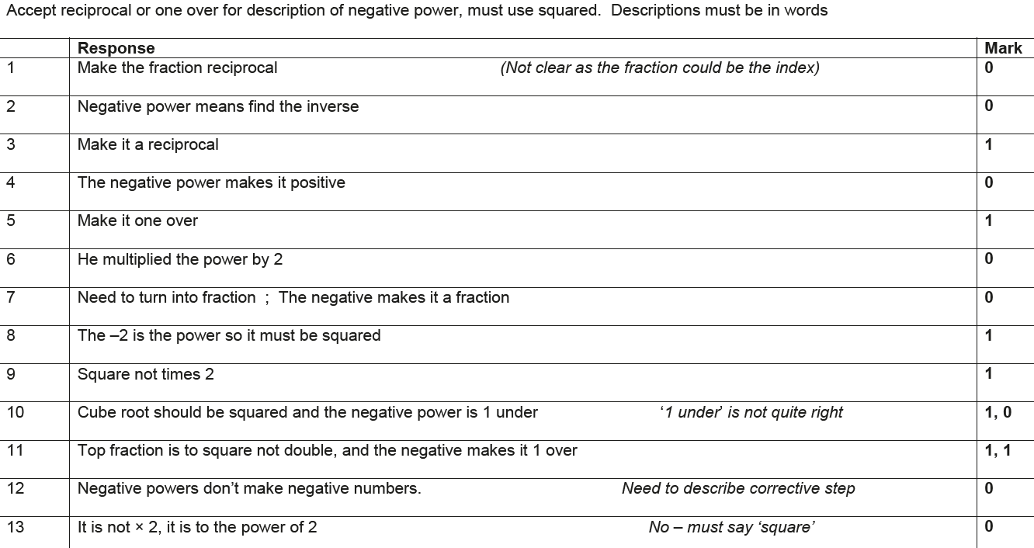
Indices
June 2017 2H Q15
B Exemplar responses

Slide 11
Indices
June 2017 3H Q16

Slide 12
Indices
June 2017 3H Q16
A
B

Slide 13
Indices
June 2017 3H Q17

Slide 14
Indices
June 2017 3H Q17
A

Slide 15
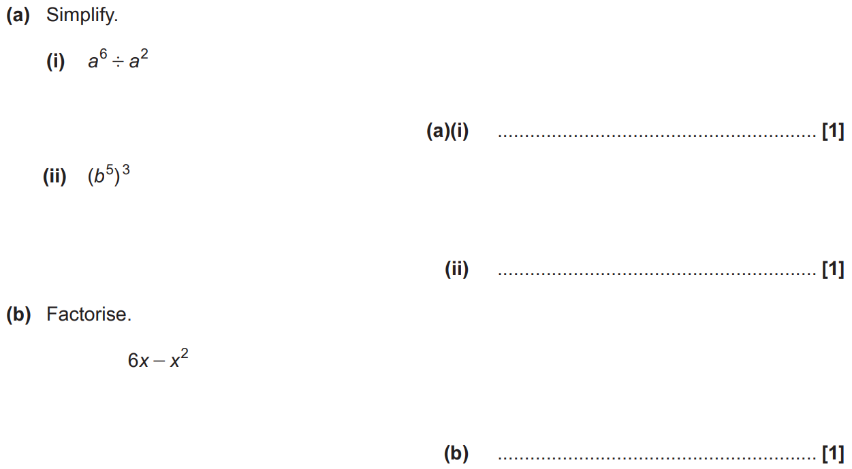
Indices
Nov 2017 1H Q2

Slide 16
Indices
Nov 2017 1H Q2
A (i)
A (ii)
B

Slide 17
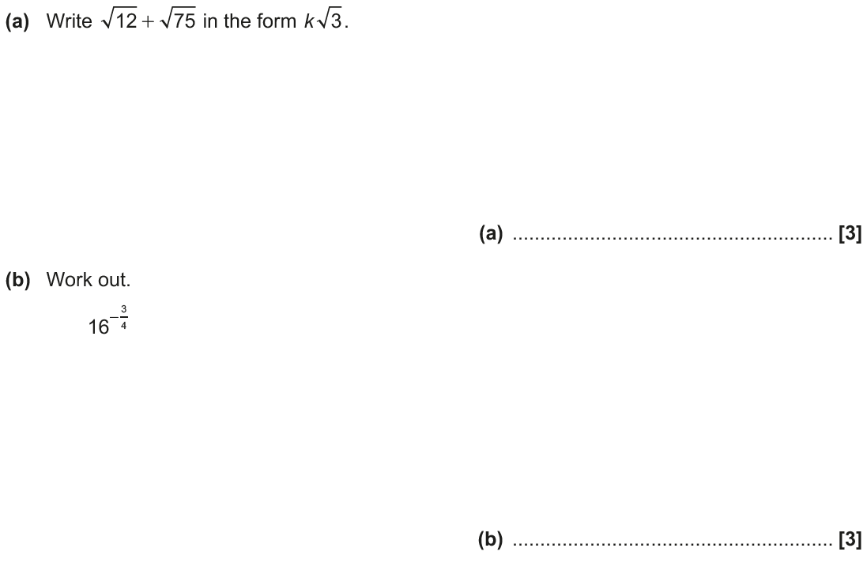
Indices
Nov 2017 2H Q16

Slide 18
Indices
Nov 2017 2H Q16
A
B

Slide 19
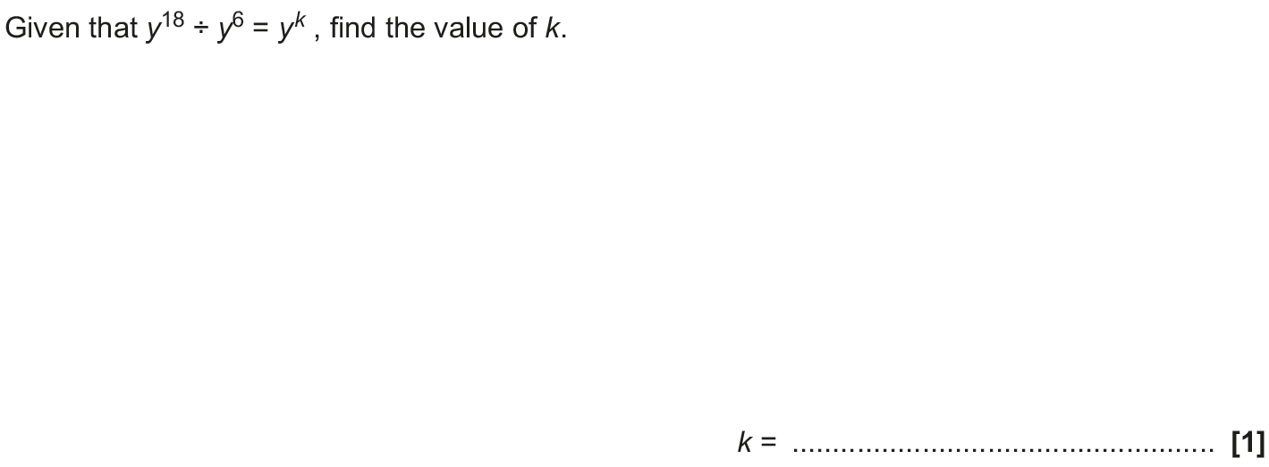
Indices
May 2018 1H Q2

Slide 20
Indices
May 2018 1H Q2
A

Slide 21
Indices
June 2018 2H Q12

Slide 22
Indices
June 2018 2H Q12
A

Slide 23
Indices
June 2018 2H Q20

Slide 24
Indices
June 2018 2H Q20
A (i)
A (ii)
B

Slide 25
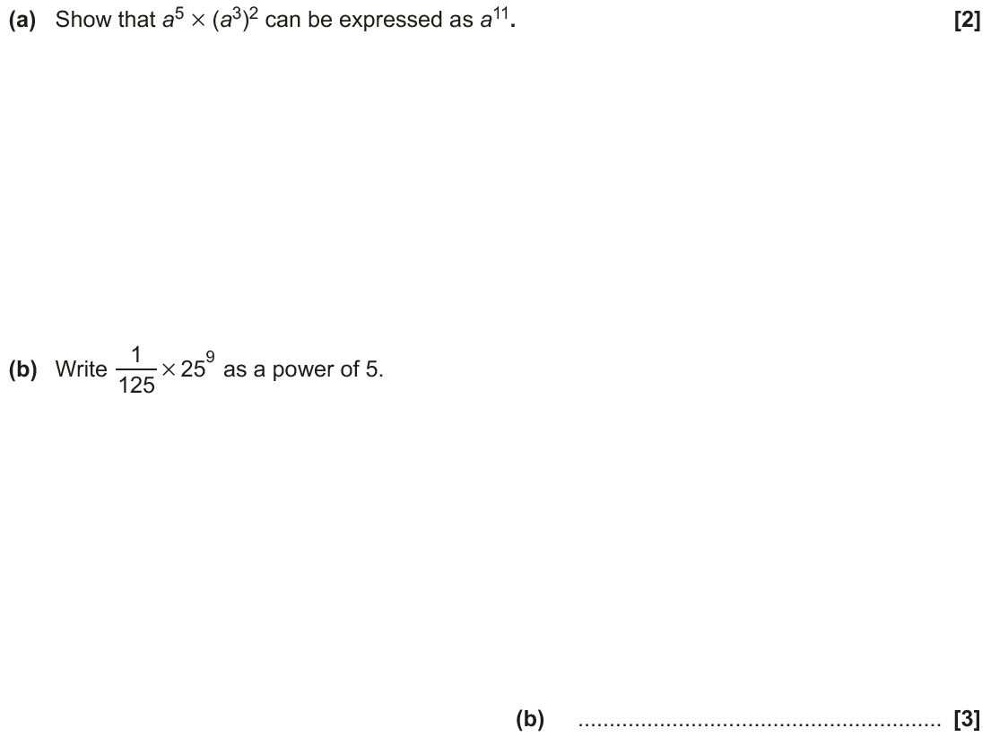
Indices
June 2018 3H Q4

Slide 26
Indices
June 2018 3H Q4
A
B

Slide 27
Indices
Nov 2018 2H Q1

Slide 28
Indices
Nov 2018 2H Q1
A
B

