Slide 1
Indices
Indices
Old Spec Q’s
SAM
2H Q4
Jan 2019
2H Q12
May 2018
1H Q3
Jan 2019
1HR Q15
May 2018
1H Q15
Jan 2019
2HR Q8
June 2018
2H Q10
Jan 2019
2HR Q10
May 2018
1HR Q14
Jan 2019
2HR Q14
June 2018
2HR Q7
May 2019
1H Q3
June 2018
2HR Q14
May 2019
1H Q12
Jan 2019
1H Q16
Negative & fractional

Slide 2
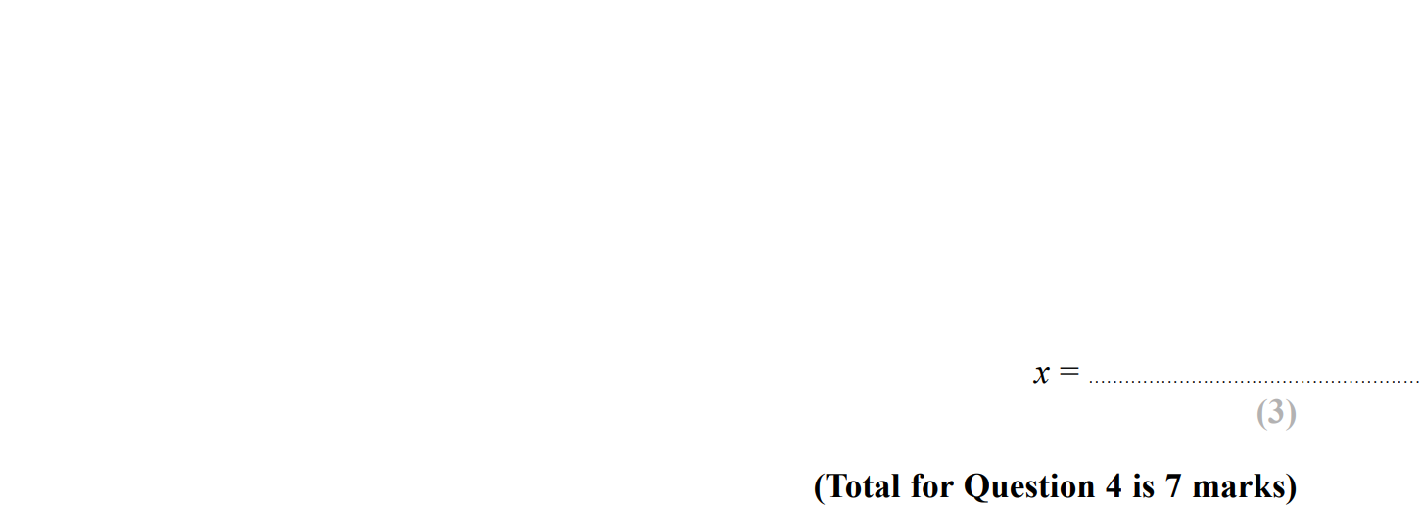
Indices
SAM 2H Q4

Slide 3
Indices
SAM 2H Q4
A
B
C
D
E

Slide 4
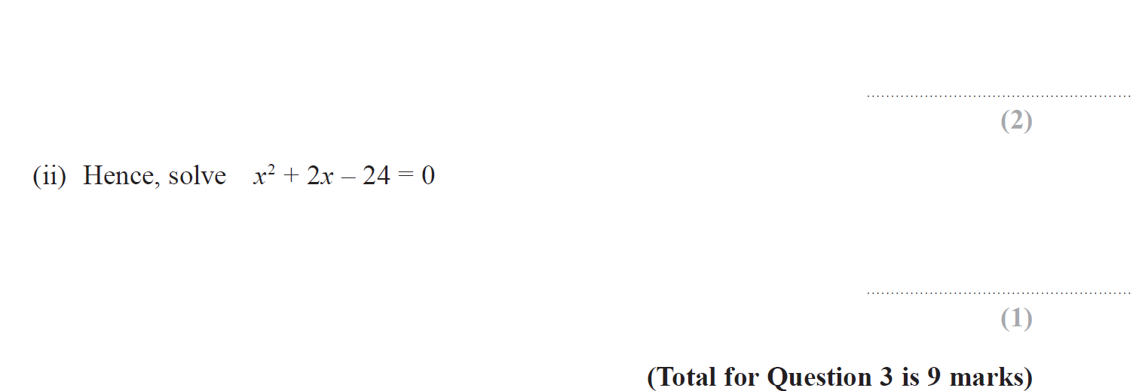
Indices
May 2018 1H Q3

Slide 5
Indices
May 2018 1H Q3
A
B
C
D (i)
D (ii)

Slide 6
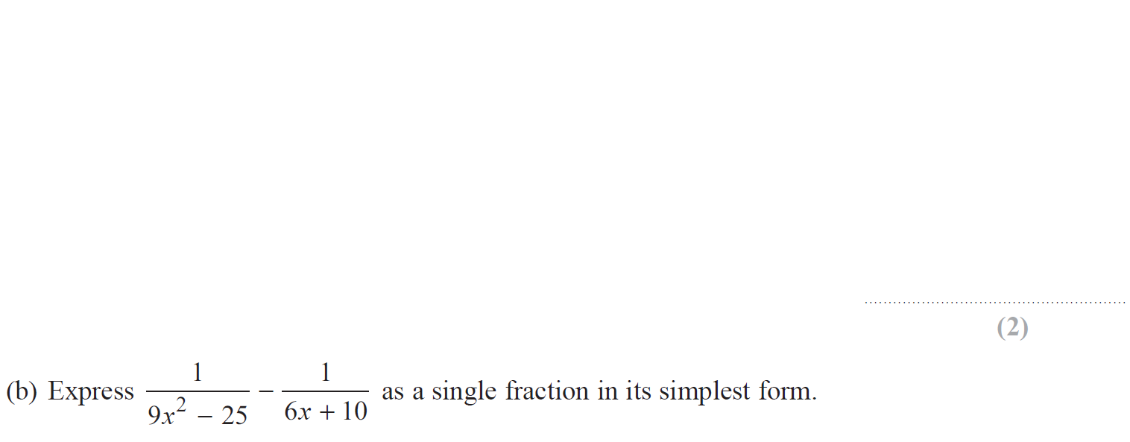
Indices
May 2018 1H Q15

Slide 7
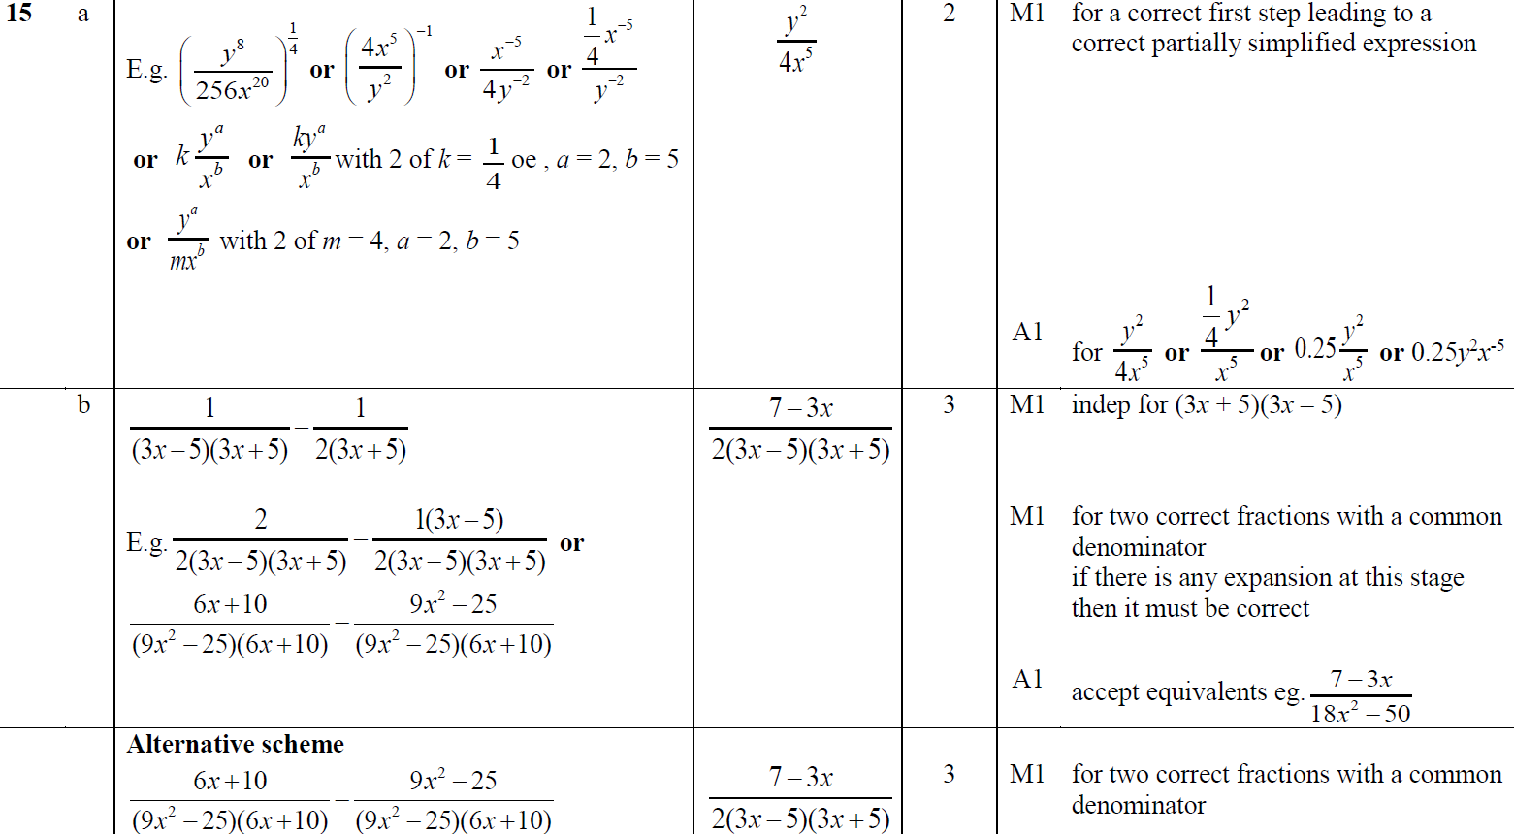
Indices
May 2018 1H Q15
A
B

Slide 8
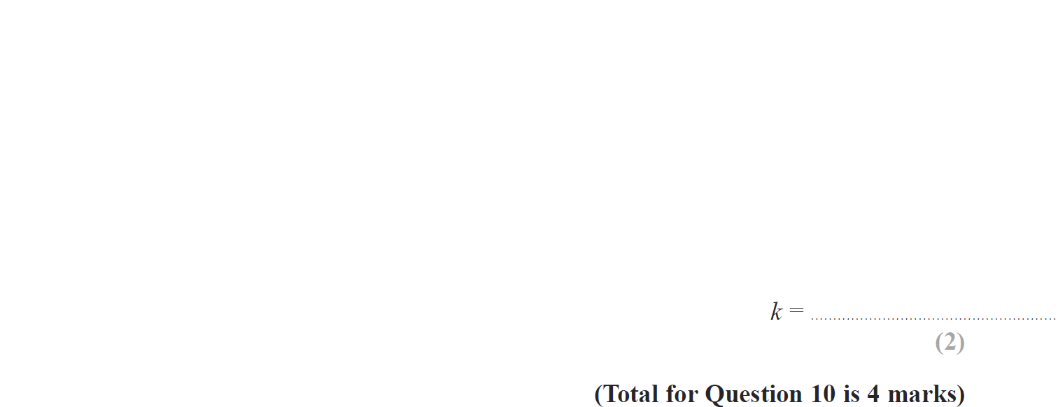
Indices
June 2018 2H Q10

Slide 9
Indices
June 2018 2H Q10
A
B

Slide 10
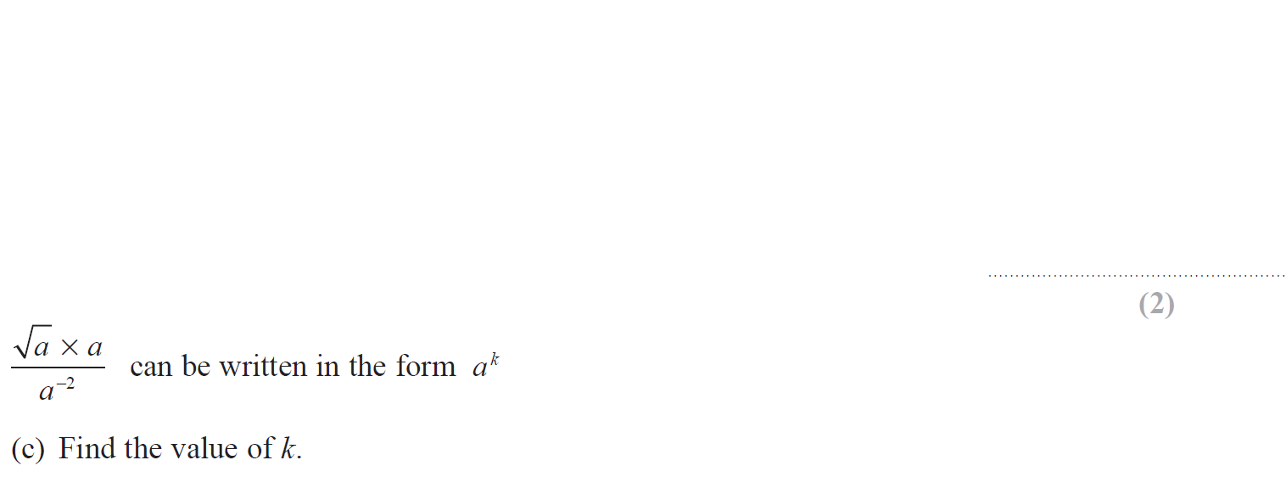
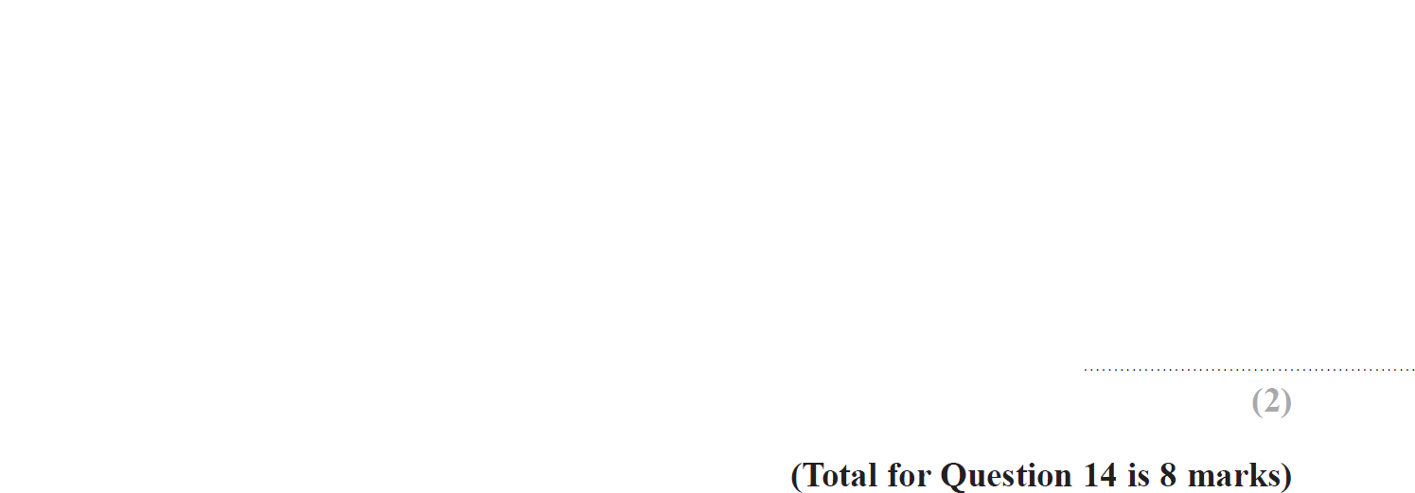
Indices
May 2018 1HR Q14

Slide 11
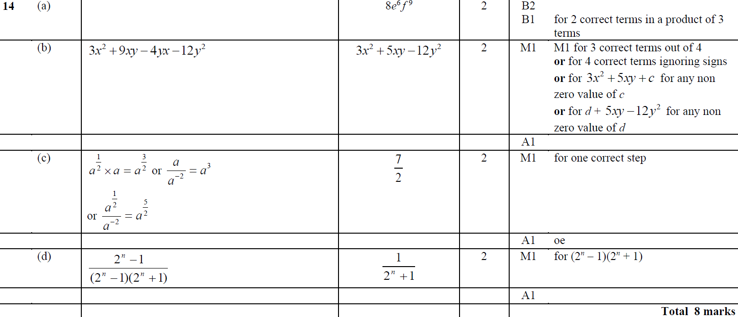
Indices
May 2018 1HR Q14
A
B
C
D

Slide 12
Indices
June 2018 2HR Q7

Slide 13
Indices
June 2018 2HR Q7
A
B

Slide 14
Indices
June 2018 2HR Q14

Slide 15
Indices
June 2018 2HR Q14
A

Slide 16
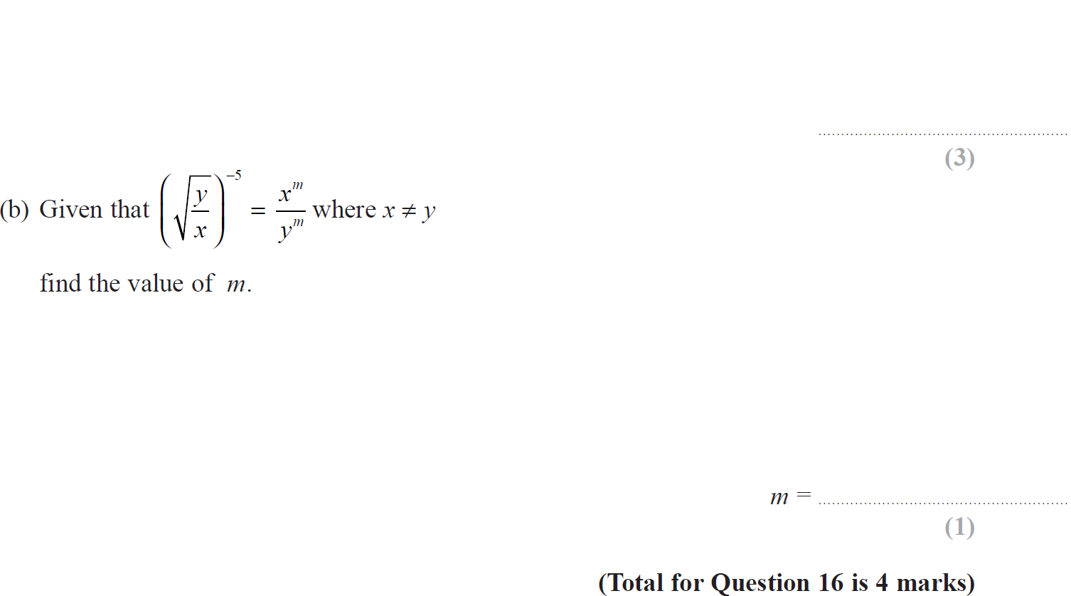
Indices
Jan 2019 1H Q16

Slide 17
Indices
Jan 2019 1H Q16
A
B

Slide 18
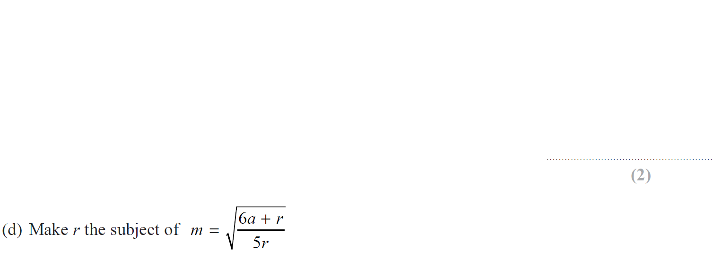
Indices
Jan 2019 2H Q12

Slide 19
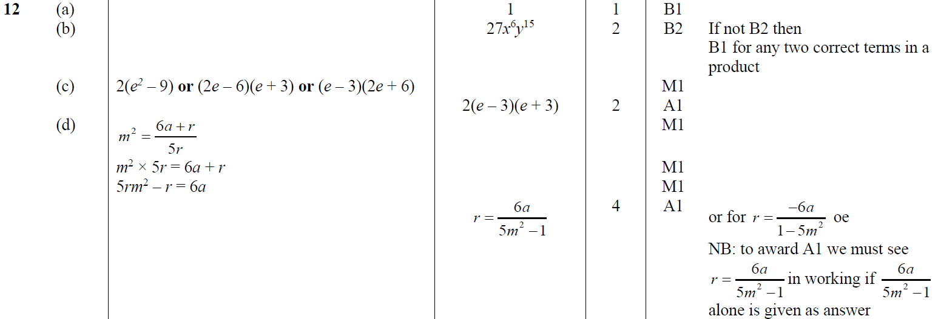
Indices
Jan 2019 2H Q12
A
B
C
D

Slide 20
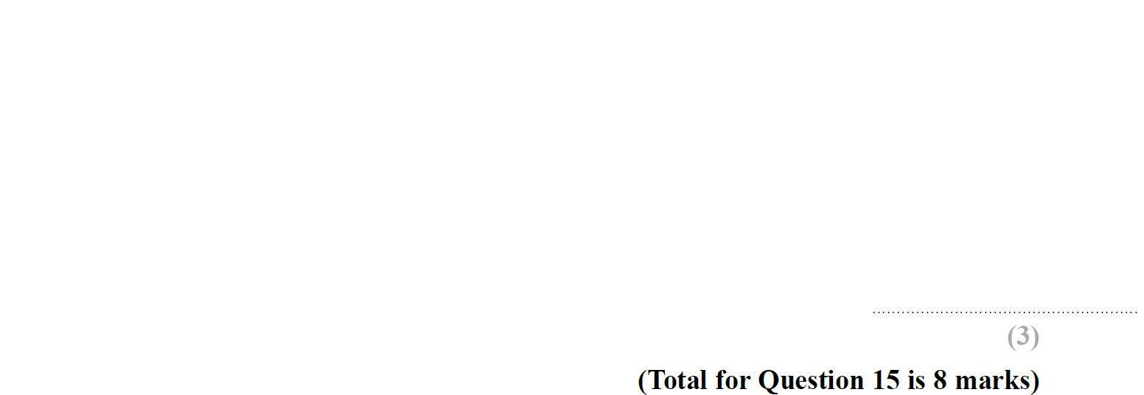
Indices
Jan 2019 1HR Q15

Slide 21
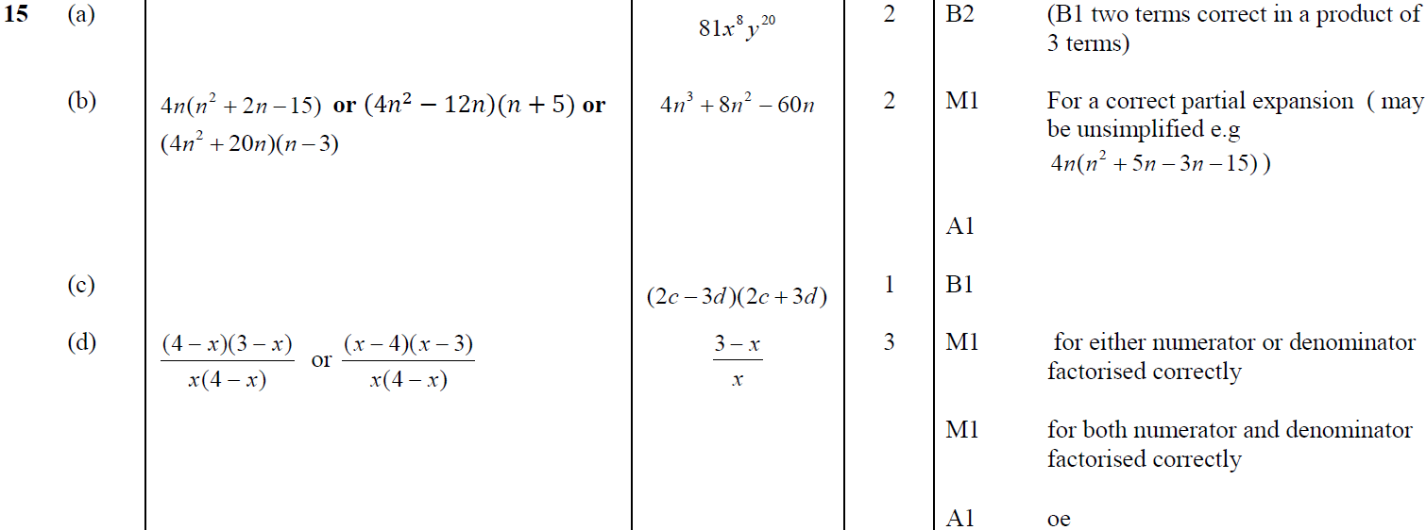
Indices
Jan 2019 1HR Q15
A
B
C
D

Slide 22
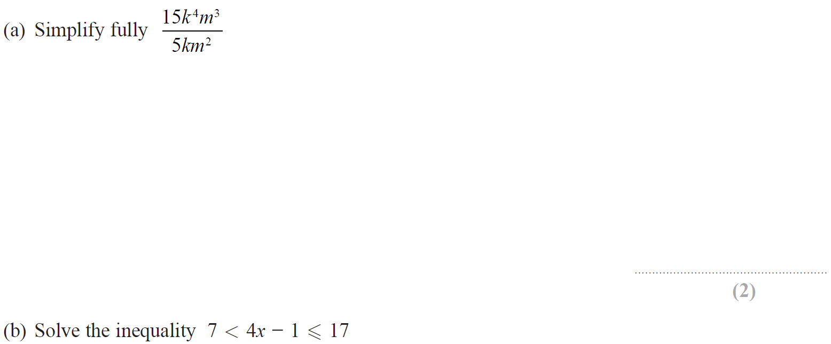
Indices
Jan 2019 2HR Q8

Slide 23
Indices
Jan 2019 2HR Q8
A
B

Slide 24
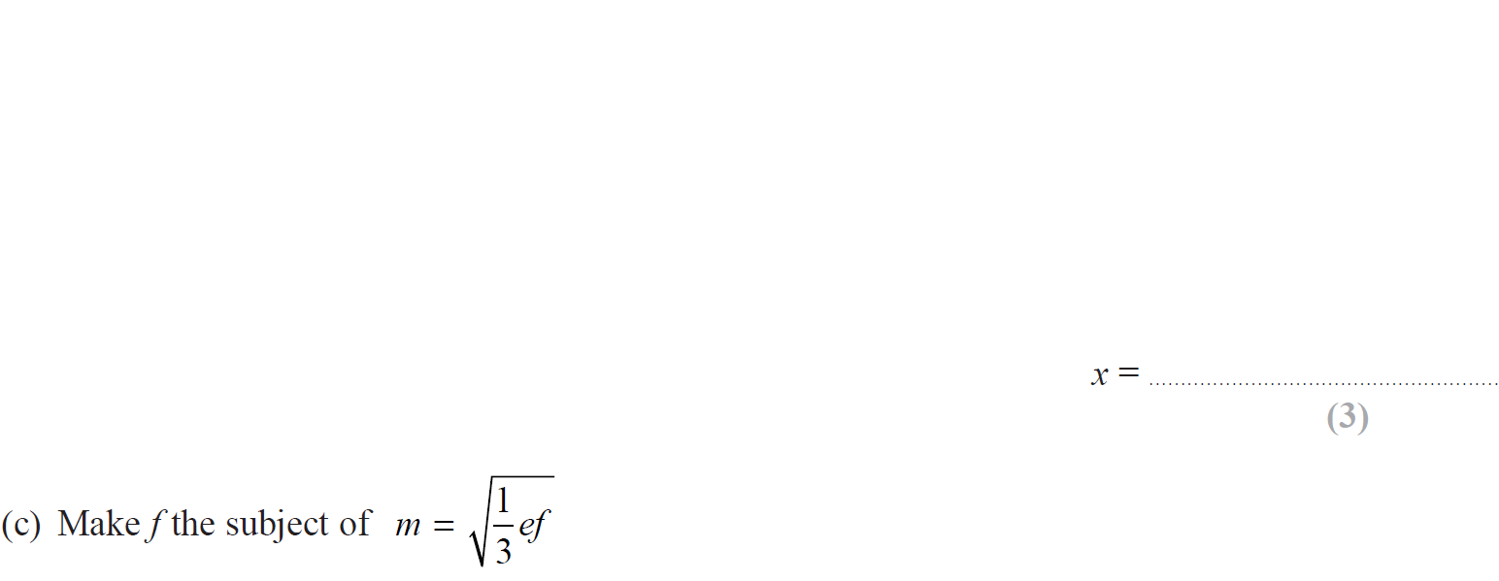
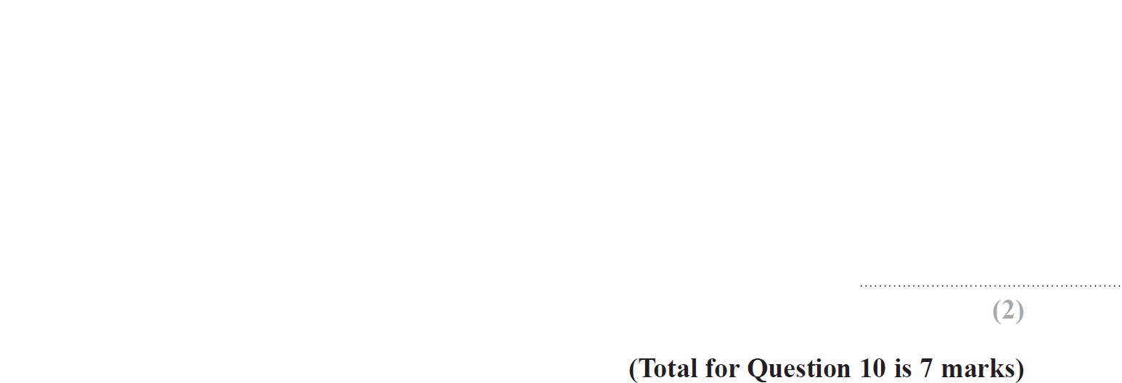
Indices
Jan 2019 2HR Q10

Slide 25
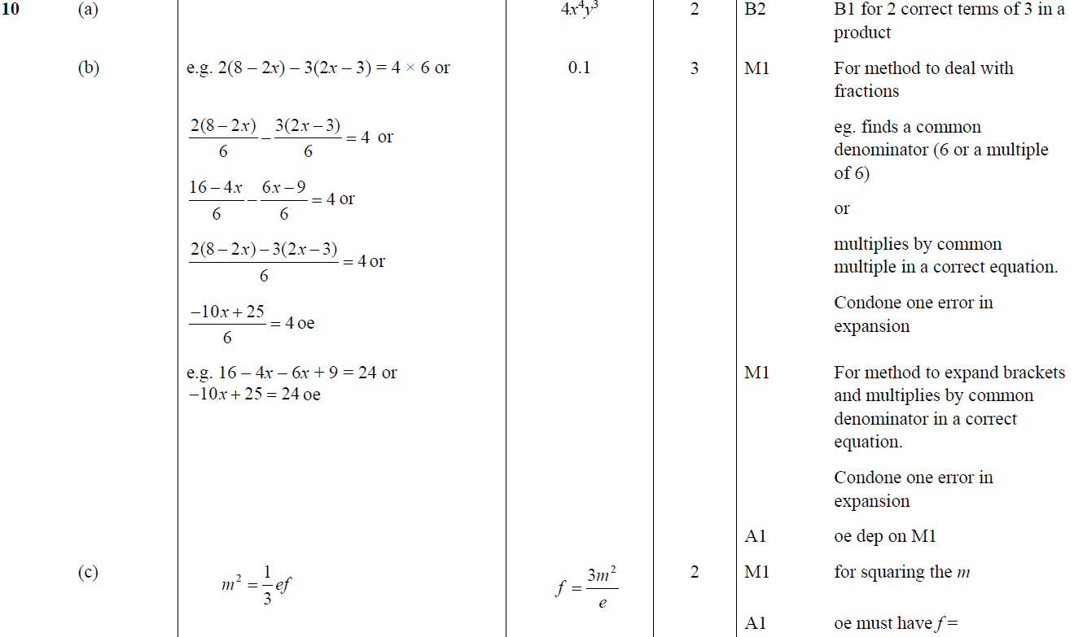
Indices
Jan 2019 2HR Q10
A
B
C

Slide 26
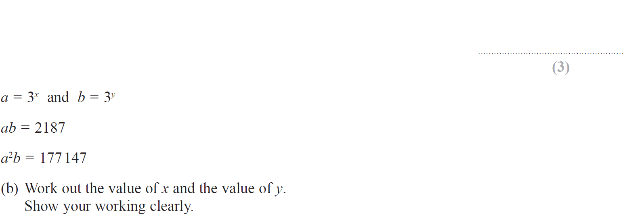
Indices
Jan 2019 2HR Q14

Slide 27
Indices
Jan 2019 2HR Q14
A (i)
A (ii)
A (iii)
B

Slide 28
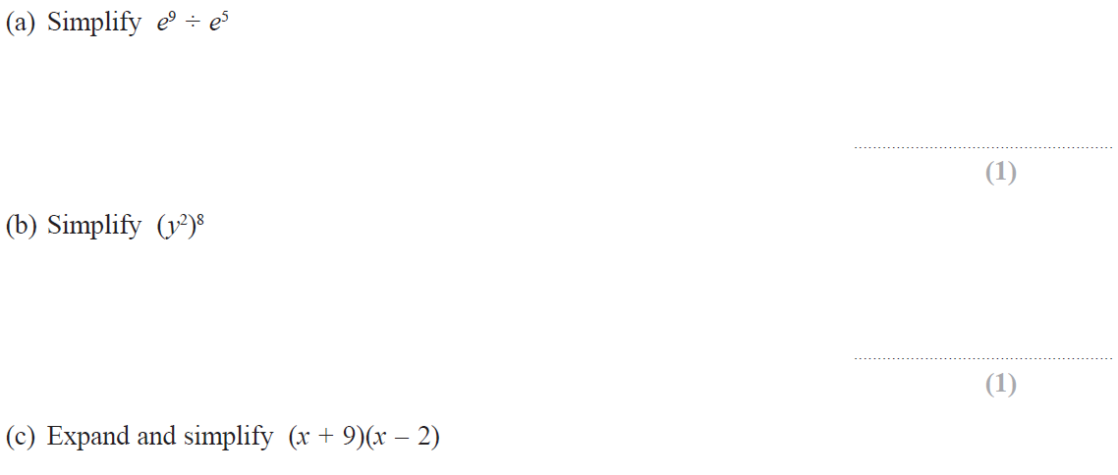
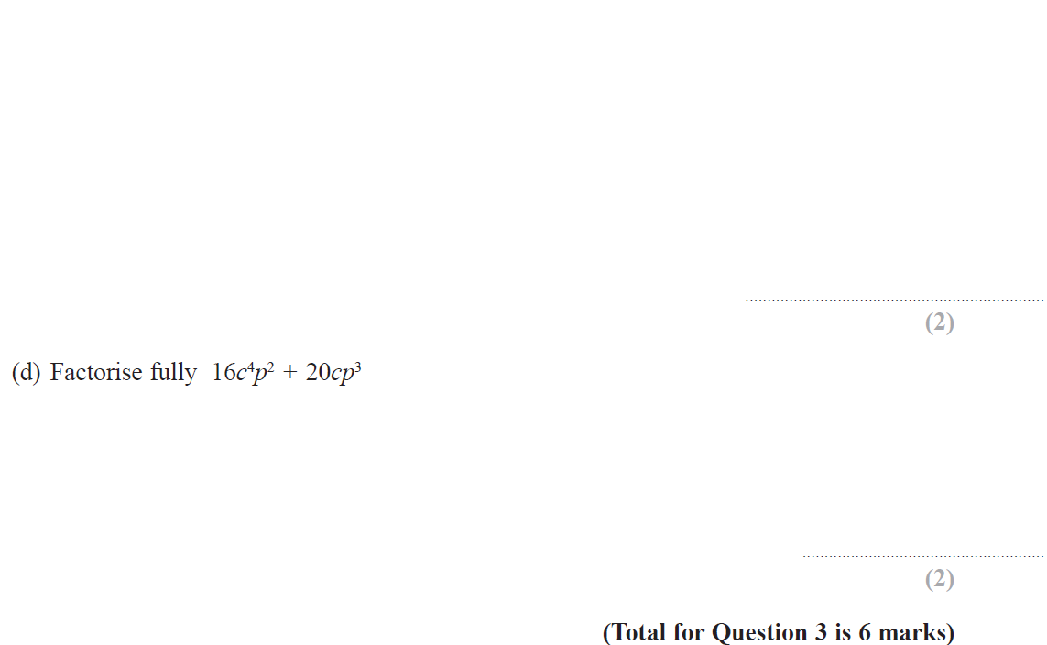
Indices
May 2019 1H Q3

Slide 29
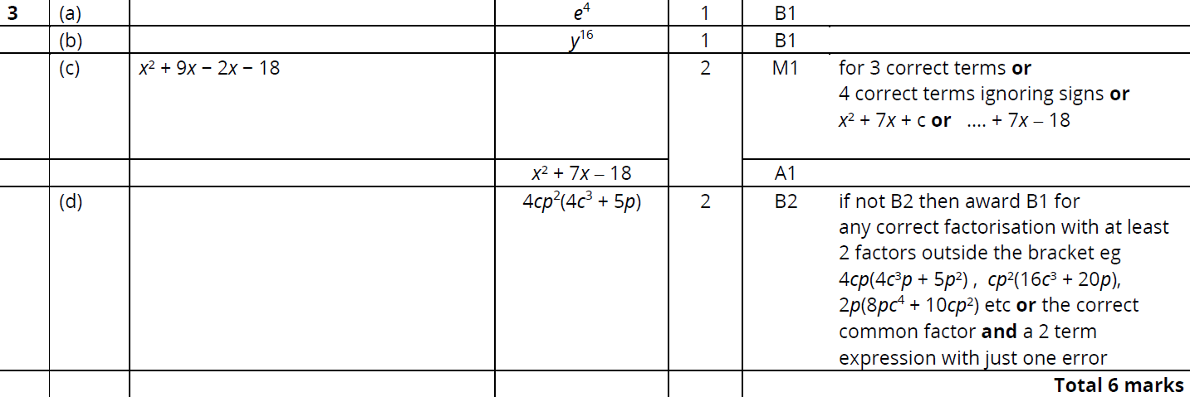
Indices
May 2019 1H Q3
A
B
C
D

Slide 30
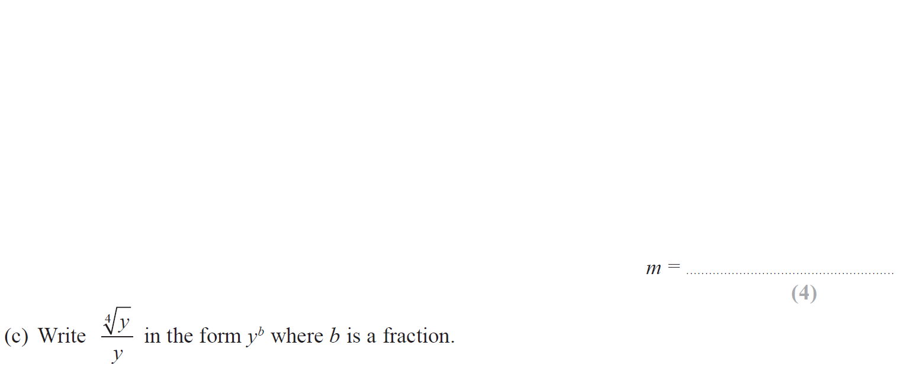
Indices
May 2019 1H Q12

Slide 31
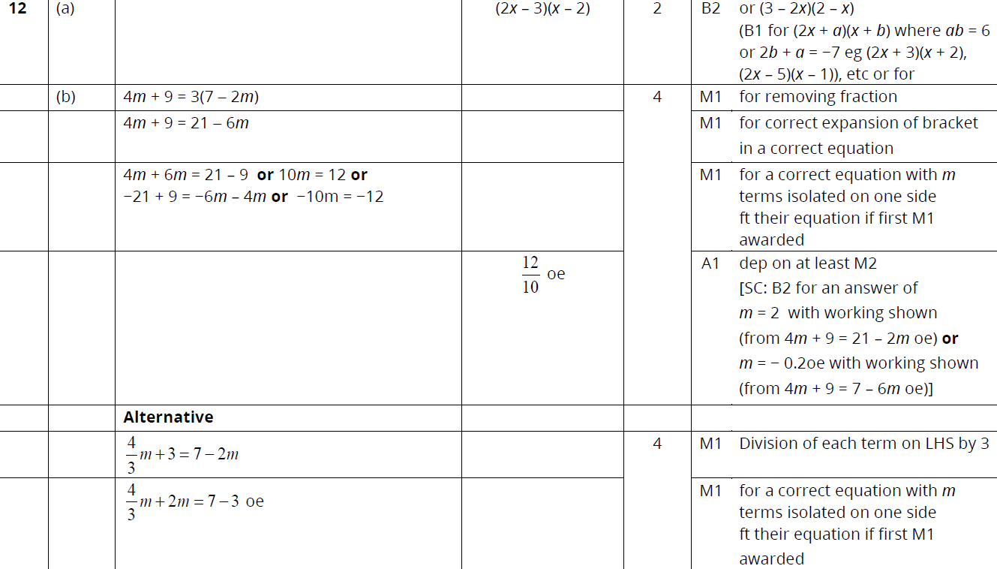
Indices
May 2019 1H Q12
A
B
C

Slide 32
Indices
Indices
New Spec Q’s
May 2004
4H Q9
May 2007
4H Q12
Nov 2009
4H Q12
Jan 2014 3H Q4
Jan 2015 4H Q22
Jan 2016 4HR Q6
June 2017 4H Q10
Jan 2018 4HR Q11
May 2004
4H Q19
Nov 2007
3H Q9
Nov 2010
3H Q20
Jan 2014 3H Q18
Jan 2015 3HR Q15
June 2016 4H Q5
June 2017 4H Q22
May 2018 3H Q6
Nov 2004
4H Q11
Nov 2007
4H Q14
June 2011 4H Q5
Jan 2014 4H Q6
Jan 2015 4HR Q11
June 2016 4H Q15
May 2017 3HR Q9
June 2018 4H Q7
May 2005
4H Q4
May 2008
4H Q7
Jan 2012 4H Q8
Jan 2014 3HR Q9
May 2015 3H Q9
May 2016 3HR Q12
May 2017 3HR Q20
June 2018 4H Q20
May 2006
3H Q4
Nov 2008
3H Q8
Jan 2012 4H Q21
Jan 2014 4HR Q1
May 2015 3HR Q10
May 2016 3HR Q21
June 2017 4HR Q5
June 2018 4HR Q9
May 2006
3H Q13
Nov 2008
3H Q14
May 2012 3H Q3
May 2014 4H Q24
June 2015 4HR Q19
Jan 2017 4H Q16
Jan 2018 4H Q10
June 2018 4HR Q22
May 2006
4H Q13
Nov 2008
4H Q18
May 2012 3H Q17
May 2014 3HR Q20
Jan 2016 4H Q17
Jan 2017 3HR Q11
Jan 2018 4H Q20
Nov 2006
3H Q13
May 2009
3H Q5
Jan 2013 4H Q15
May 2014 4HR Q17
Jan 2016 4H Q25
Jan 2017 4HR Q7
Jan 2018 3HR Q1
Nov 2006
4H Q2
June 2009
4H Q15
May 2013 3H Q14
Jan 2015 3H Q3
Jan 2016 3HR Q6
Jan 2017 4HR Q20
Jan 2018 3HR Q21
May 2007
3H Q5
Nov 2009
3H Q25
May 2013 3HR Q9
Jan 2015 4H Q12
Jan 2016 3HR Q13
May 2017 3H Q14
Jan 2018 4HR Q7
Negative & fractional

Slide 33
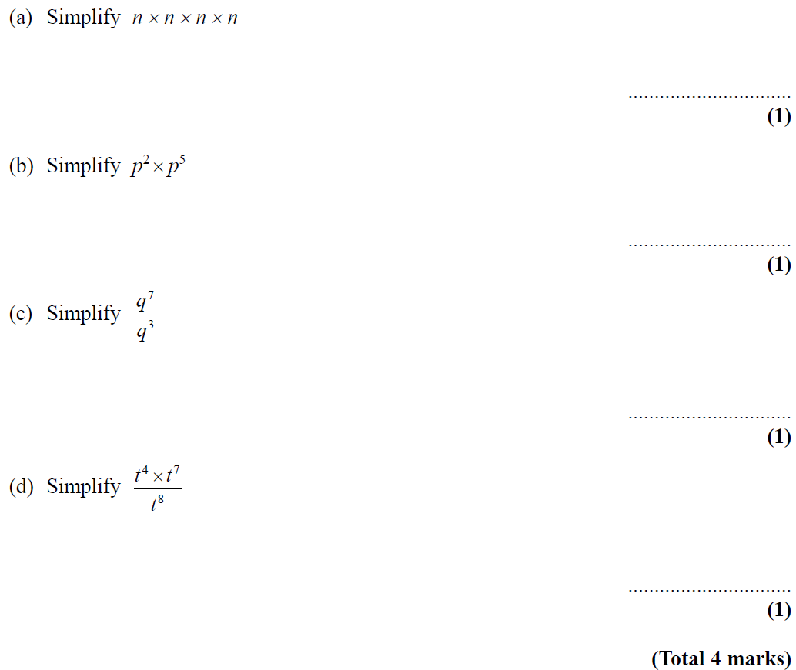
Indices
May 2004 4H Q9

Slide 34
Indices
May 2004 4H Q9
A
B
C
D

Slide 35
Indices
May 2004 4H Q19

Slide 36
Indices
May 2004 4H Q19
A
B
C
D

Slide 37
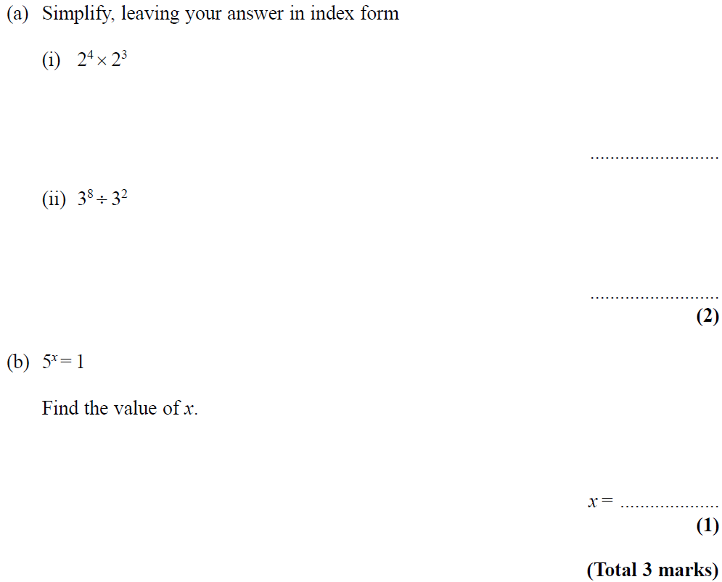
Indices
Nov 2004 4H Q11

Slide 38
Indices
Nov 2004 4H Q11
A (i)
A (ii)
B

Slide 39
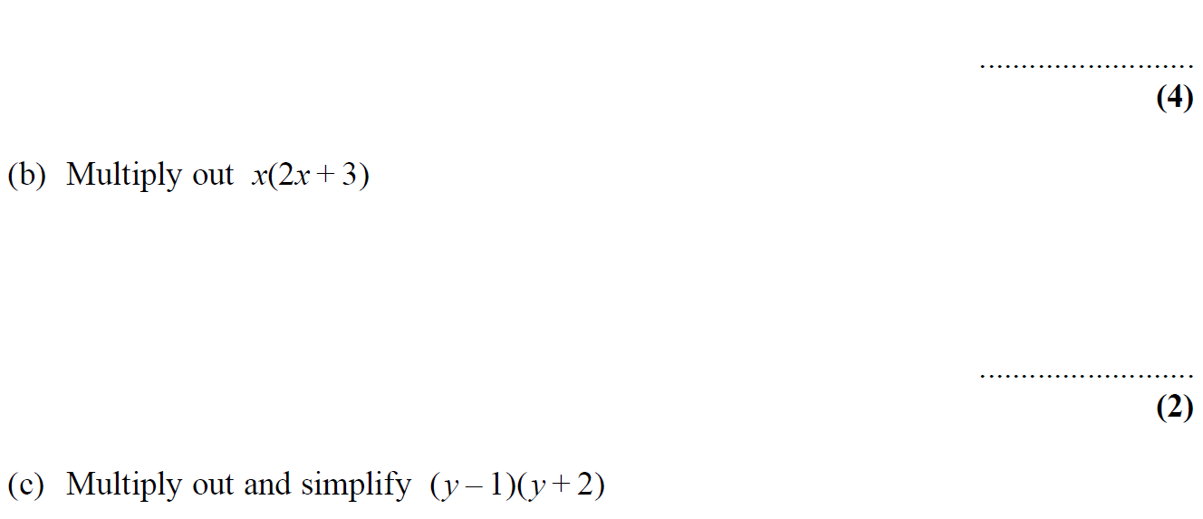
Indices
May 2005 4H Q4

Slide 40
Indices
May 2005 4H Q4
A (i)
A (ii)
A (iii)
B
C

Slide 41
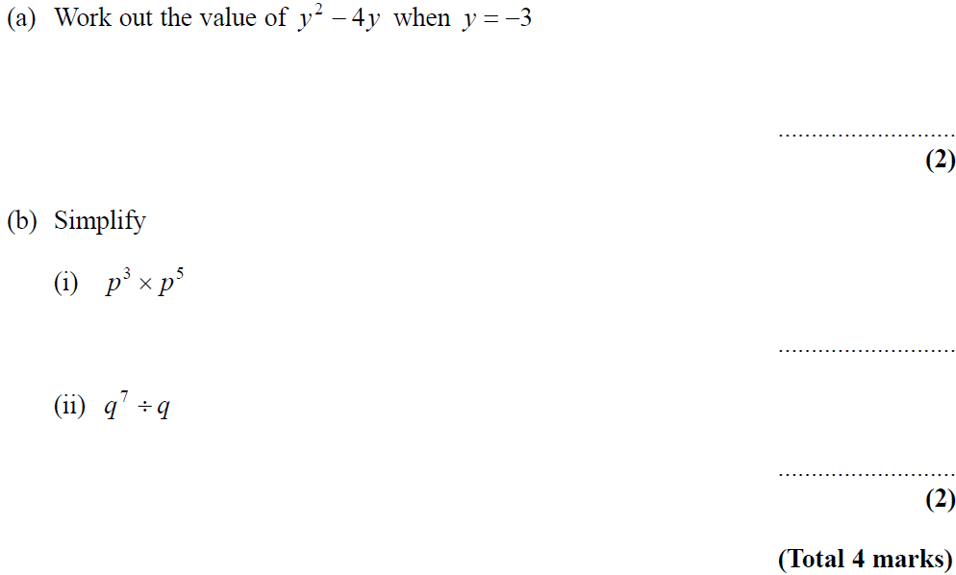
Indices
May 2006 3H Q4

Slide 42
Indices
May 2006 3H Q4
A
B (i)
B (ii)

Slide 43
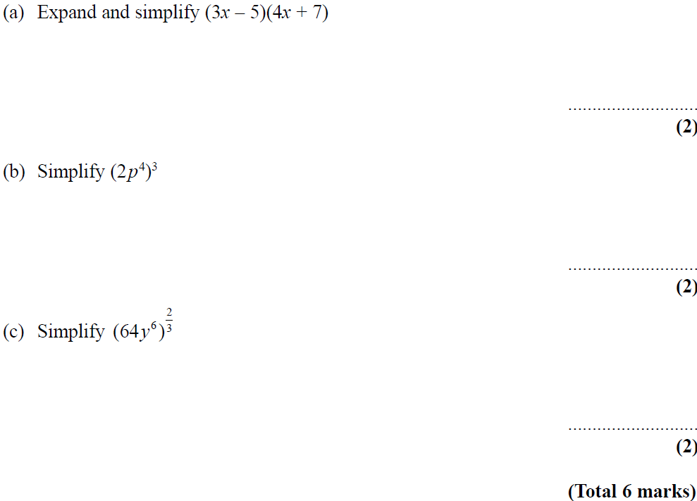
Indices
May 2006 3H Q13

Slide 44
Indices
May 2006 3H Q13
A
B
C

Slide 45
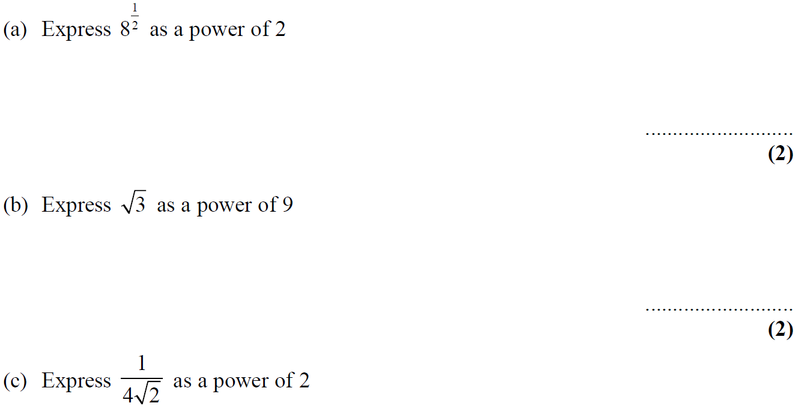
Indices
May 2006 4H Q13

Slide 46
Indices
May 2006 4H Q13
A
B
C

Slide 47
Indices
Nov 2006 3H Q13

Slide 48
Indices
Nov 2006 3H Q13
A
B
C

Slide 49
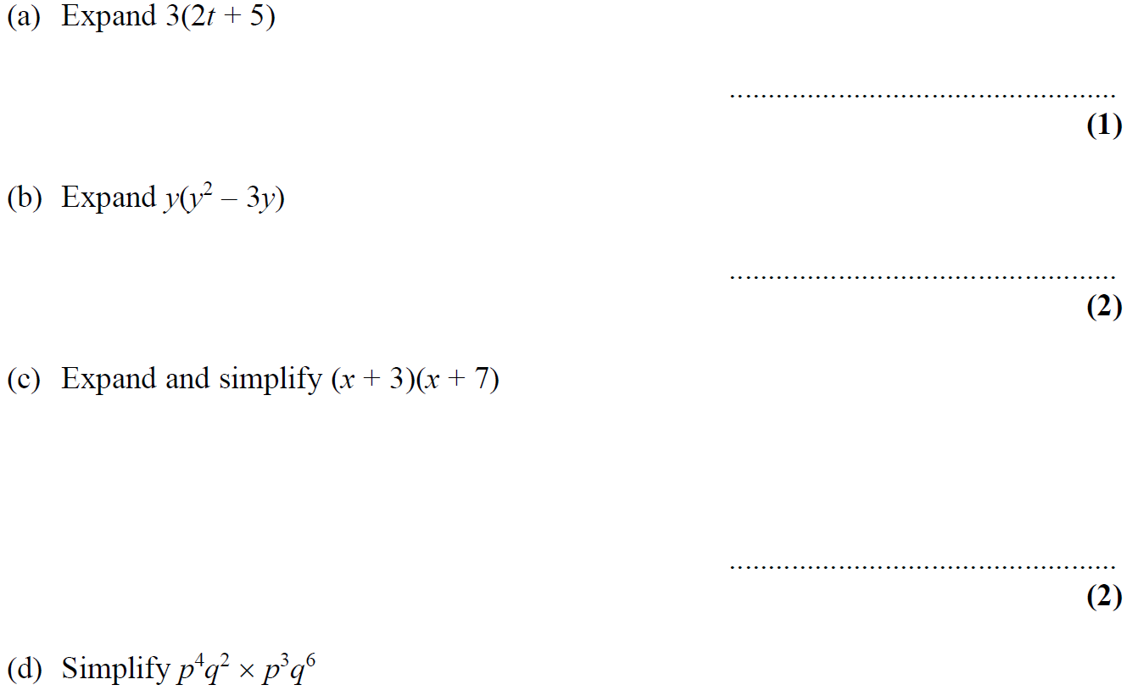
Indices
Nov 2006 4H Q2

Slide 50
Indices
Nov 2006 4H Q2
A
B
C
D

Slide 51
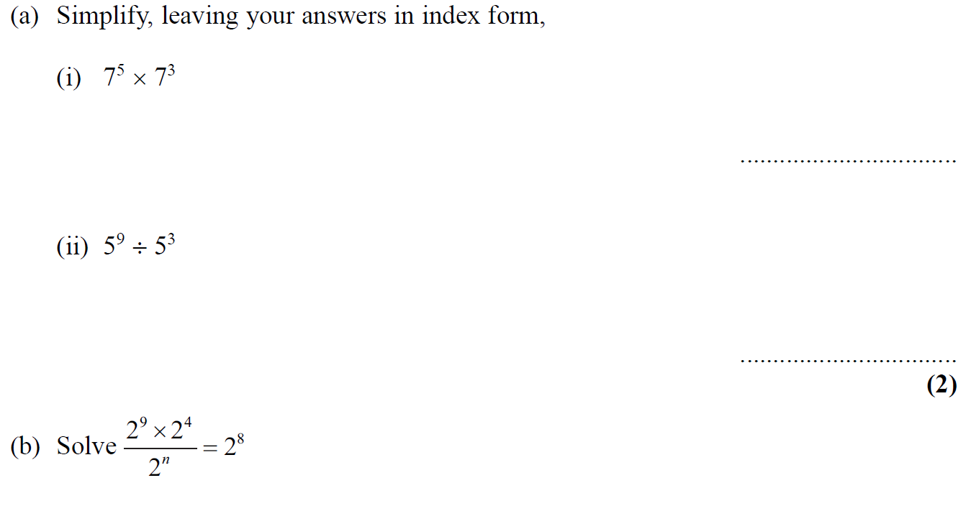
Indices
May 2007 3H Q5

Slide 52
Indices
May 2007 3H Q5
A (i)
A (ii)
B

Slide 53
Indices
May 2007 4H Q12

Slide 54
Indices
May 2007 4H Q12
A
B
C

Slide 55
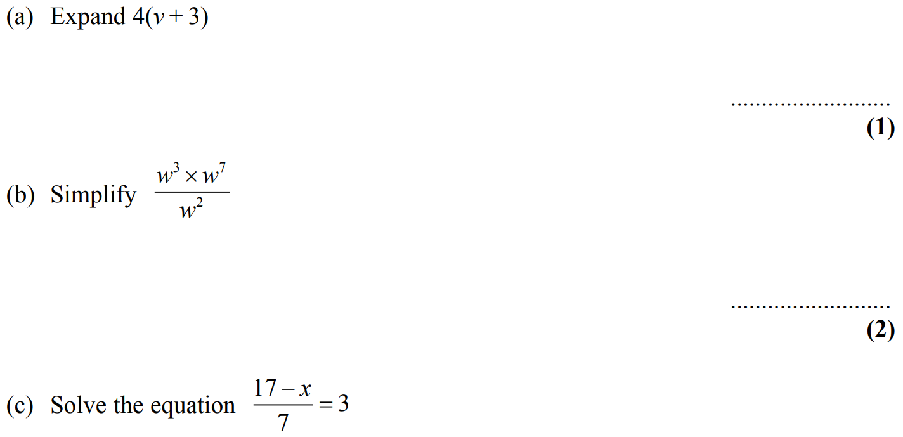
Indices
Nov 2007 3H Q9

Slide 56
Indices
Nov 2007 3H Q9
A
B
C
D

Slide 57
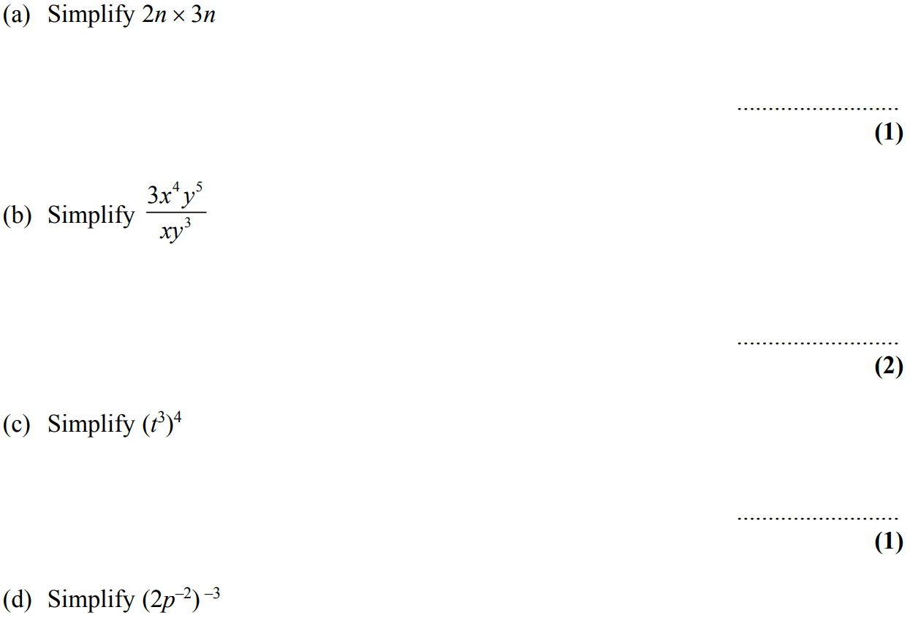
Indices
Nov 2007 4H Q14

Slide 58
Indices
Nov 2007 4H Q14
A
B
C
D

Slide 59
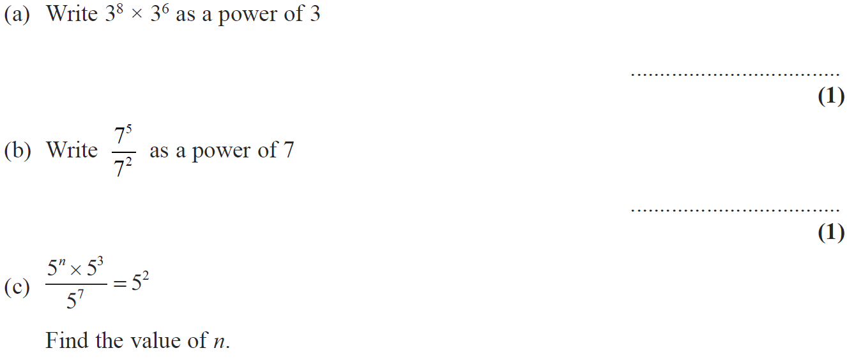
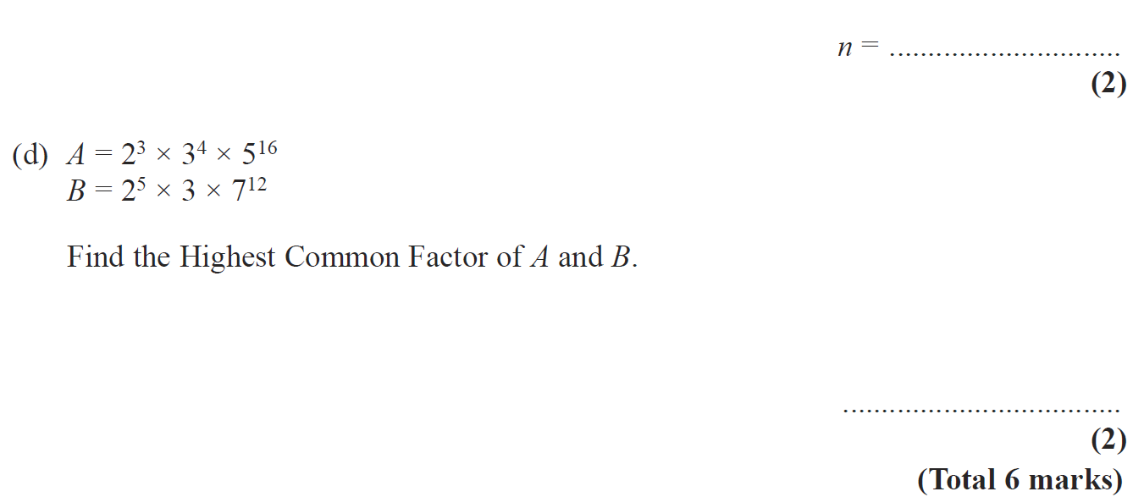
Indices
May 2008 4H Q7

Slide 60
Indices
May 2008 4H Q7
A
B
C
D

Slide 61
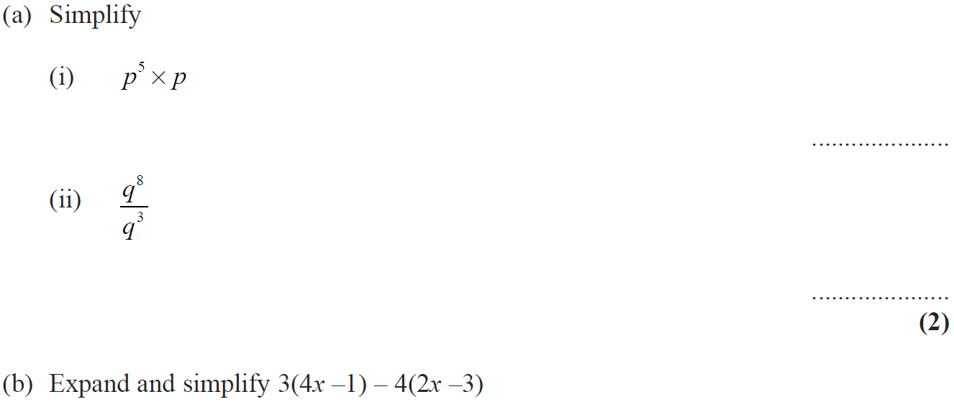
Indices
Nov 2008 3H Q8

Slide 62
Indices
Nov 2008 3H Q8
A (i)
A (ii)
B
C

Slide 63
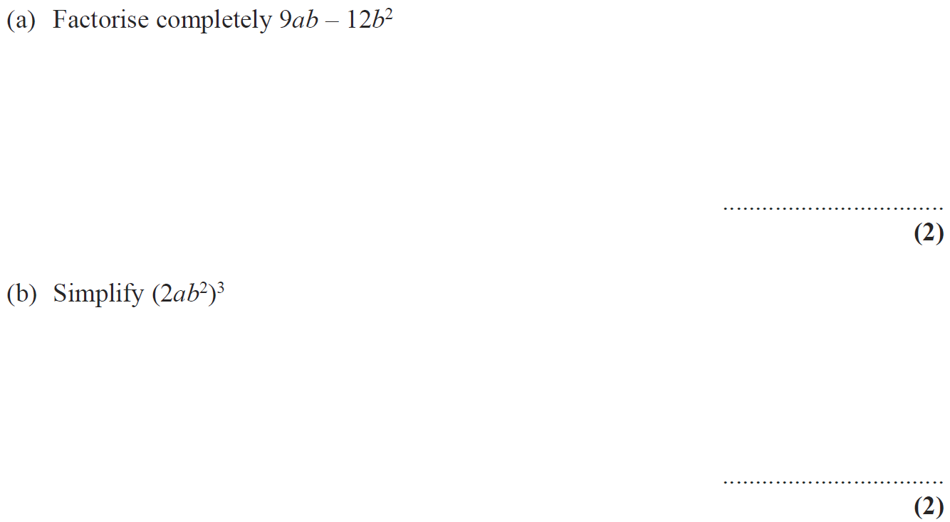
Indices
Nov 2008 3H Q14

Slide 64
Indices
Nov 2008 3H Q14
A
B

Slide 65
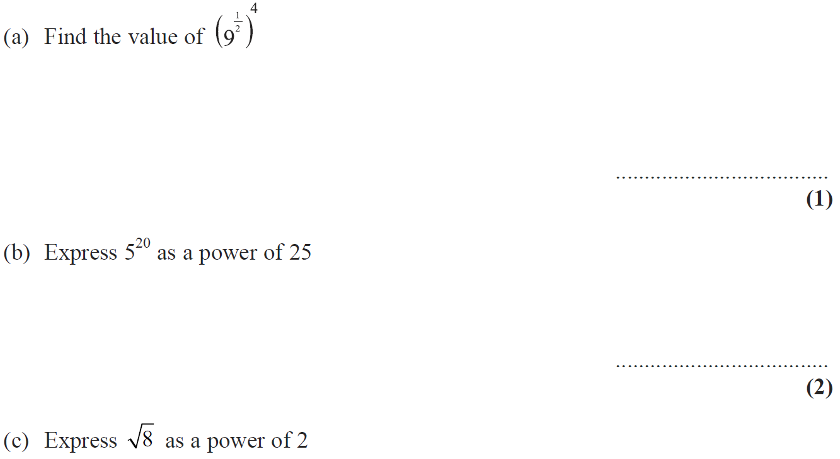
Indices
Nov 2008 4H Q18

Slide 66
Indices
Nov 2008 4H Q18
A
B
C

Slide 67
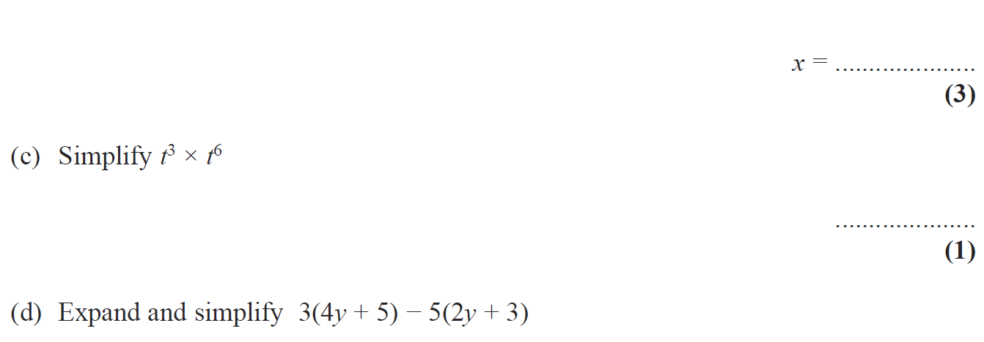
Indices
May 2009 3H Q5

Slide 68
Indices
May 2009 3H Q5
A
B
C
D

Slide 69
Indices
June 2009 4H Q15

Slide 70
Indices
June 2009 4H Q15
A
B
C

Slide 71
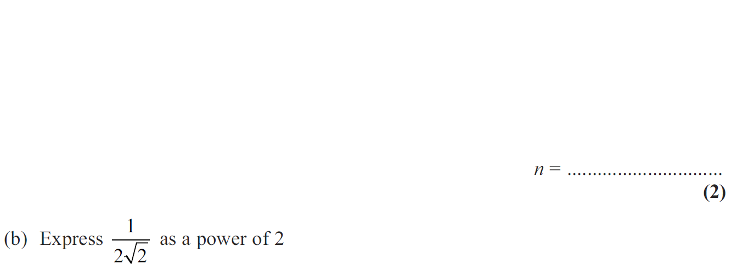
Indices
Nov 2009 3H Q25

Slide 72
Indices
Nov 2009 3H Q25
A
B

Slide 73
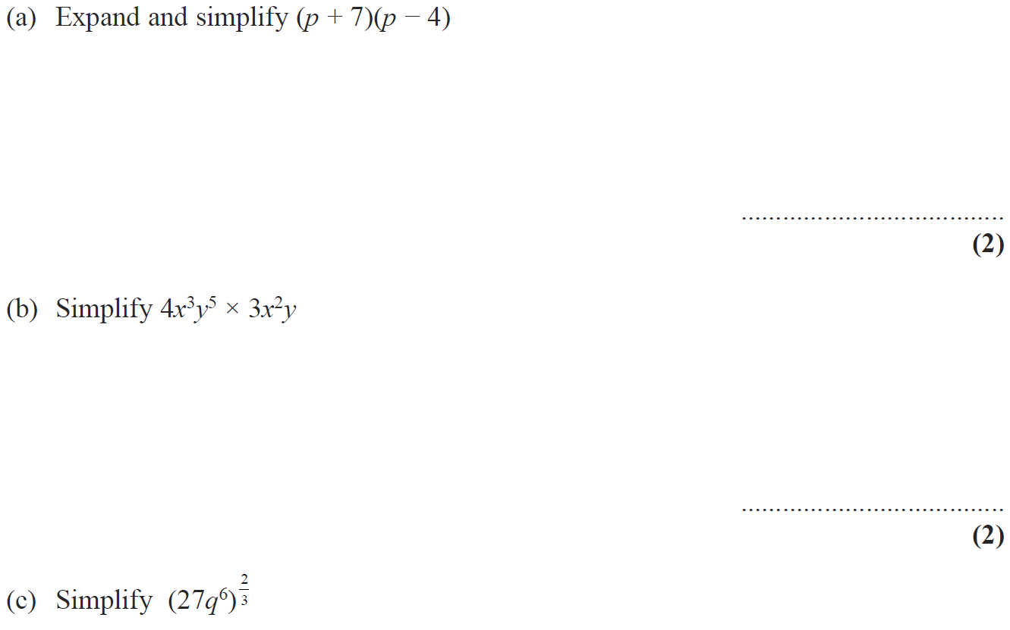
Indices
Nov 2009 4H Q12

Slide 74
Indices
Nov 2009 4H Q12
A
B
C

Slide 75
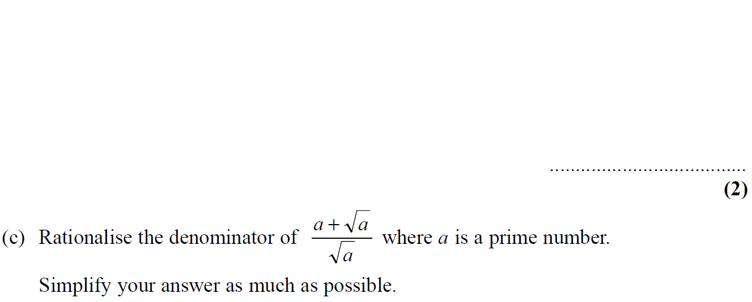
Indices
Nov 2010 3H Q20

Slide 76
Indices
Nov 2010 3H Q20
A
B
C

Slide 77
Indices
June 2011 4H Q5

Slide 78
Indices
June 2011 4H Q5
A (i)
A (ii)
A (iii)
B
C

Slide 79
Indices
Jan 2012 4H Q8

Slide 80
Indices
Jan 2012 4H Q8
A

Slide 81
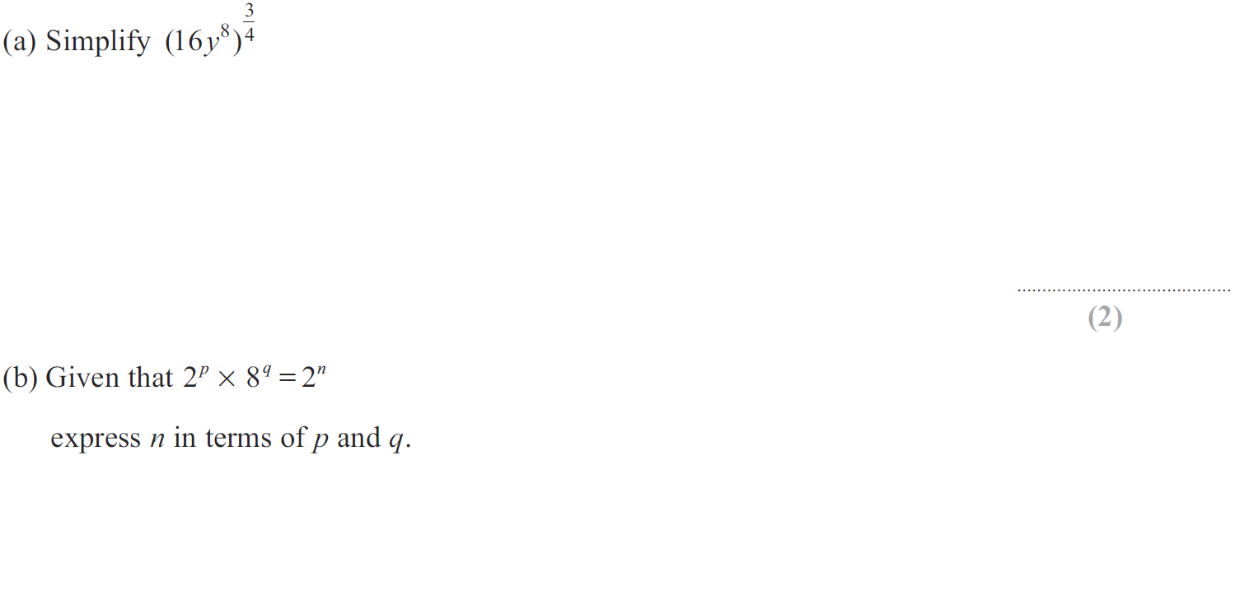
Indices
Jan 2012 4H Q21

Slide 82
Indices
Jan 2012 4H Q21
A
B

Slide 83
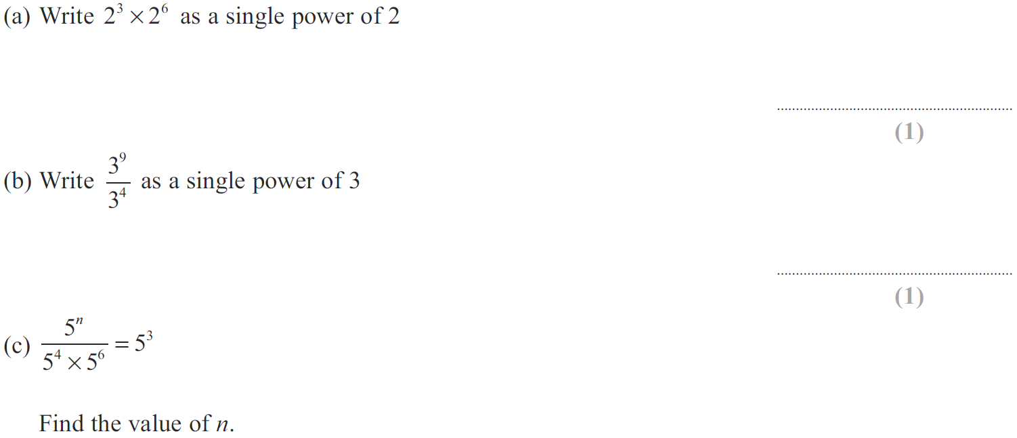
Indices
May 2012 3H Q3

Slide 84
Indices
May 2012 3H Q3
A
B
C

Slide 85
Indices
May 2012 3H Q17

Slide 86
Indices
May 2012 3H Q17
A
B

Slide 87
Indices
Jan 2013 4H Q15

Slide 88
Indices
Jan 2013 4H Q15
A
B

Slide 89
Indices
May 2013 3H Q14

Slide 90
Indices
May 2013 3H Q14
A
B
C

Slide 91
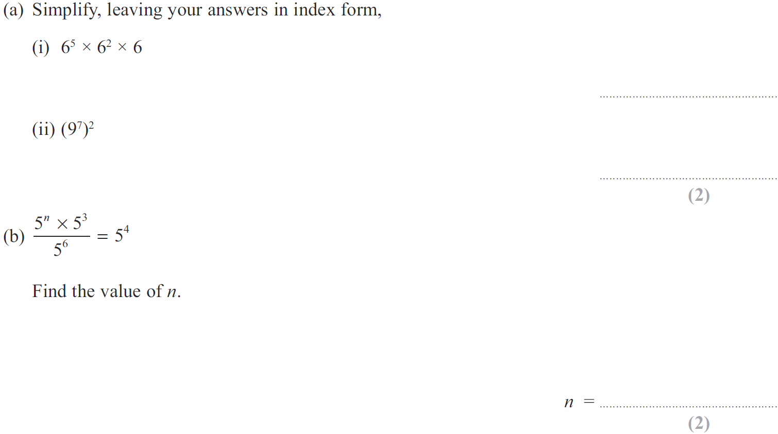
Indices
May 2013 3HR Q9

Slide 92
Indices
May 2013 3HR Q9
A (i)
A (ii)
B

Slide 93
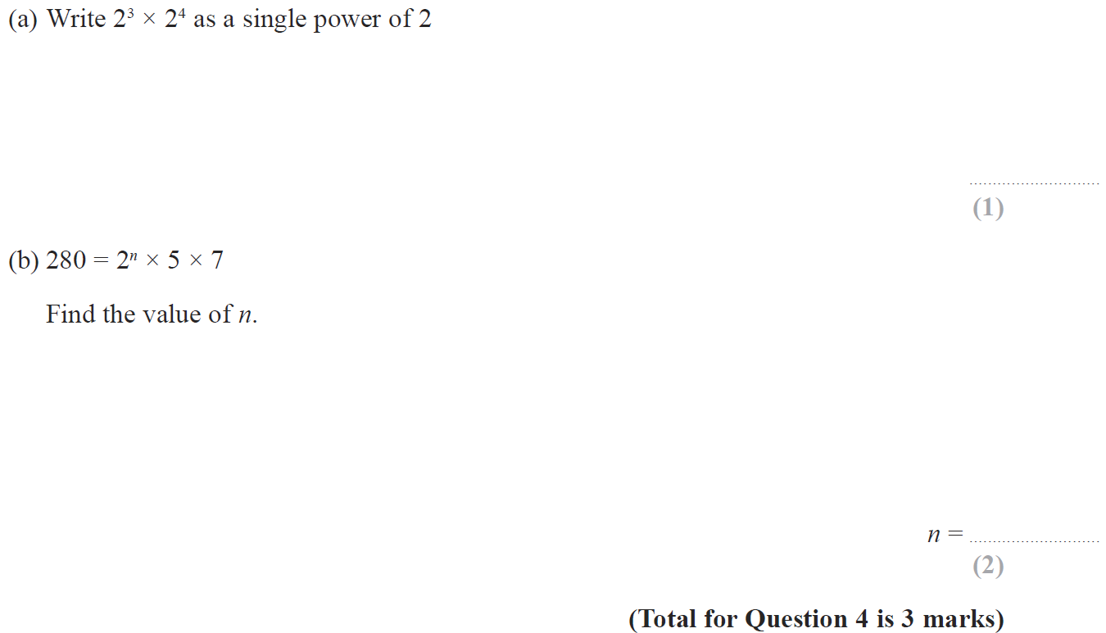
Indices
Jan 2014 3H Q4

Slide 94
Indices
Jan 2014 3H Q4
A
B

Slide 95
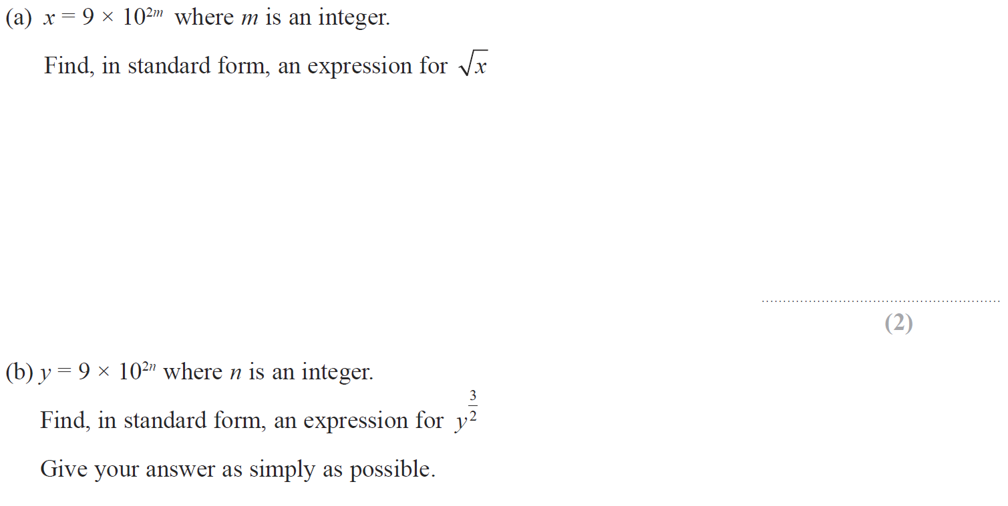
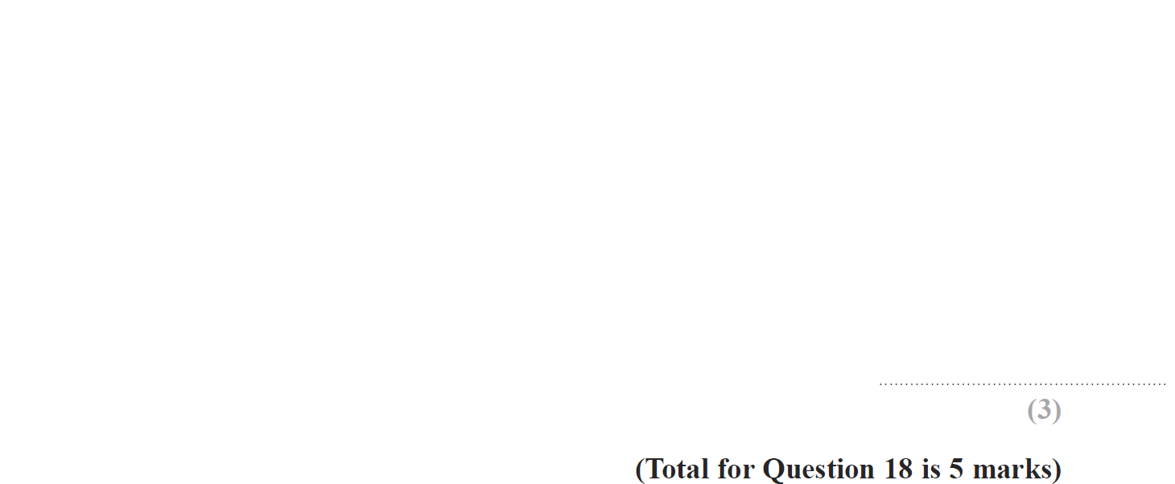
Indices
Jan 2014 3H Q18

Slide 96
Indices
Jan 2014 3H Q18
A
B

Slide 97
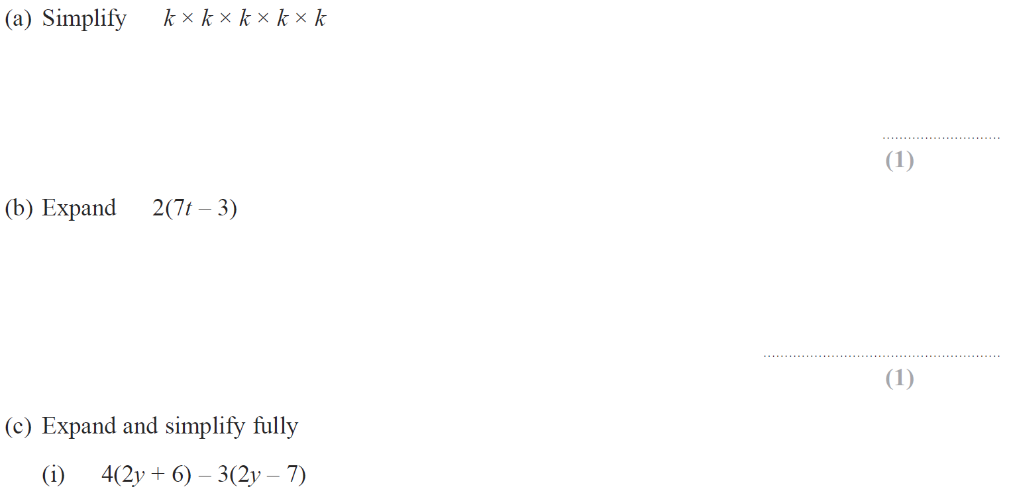
Indices
Jan 2014 4H Q6

Slide 98
Indices
Jan 2014 4H Q6
A
B
C (i)
C (ii)
D

Slide 99
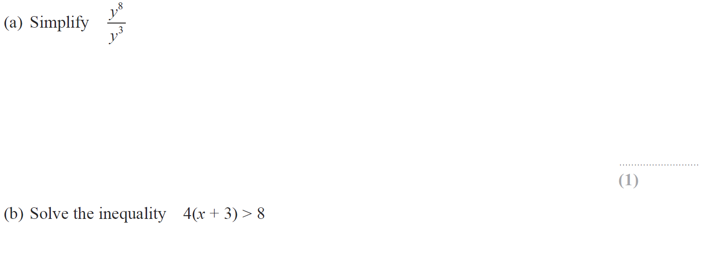
Indices
Jan 2014 3HR Q9

Slide 100
Indices
Jan 2014 3HR Q9
A
B

Slide 101
Indices
Jan 2014 4HR Q1

Slide 102
Indices
Jan 2014 4HR Q1
A
B

Slide 103
Indices
May 2014 4H Q24

Slide 104
Indices
May 2014 4H Q24
A

Slide 105
Indices
May 2014 3HR Q20

Slide 106
Indices
May 2014 3HR Q20
A

Slide 107
Indices
May 2014 4HR Q17

Slide 108
Indices
May 2014 4HR Q17
A
B

Slide 109
Indices
Jan 2015 3H Q3

Slide 110
Indices
Jan 2015 3H Q3
A
B
C
D

Slide 111
Indices
Jan 2015 4H Q12

Slide 112
Indices
Jan 2015 4H Q12
A
B
C
D
E

Slide 113
Indices
Jan 2015 4H Q22

Slide 114
Indices
Jan 2015 4H Q22
A
B

Slide 115
Indices
Jan 2015 3HR Q15

Slide 116
Indices
Jan 2015 3HR Q15
A

Slide 117
Indices
Jan 2015 4HR Q11

Slide 118
Indices
Jan 2015 4HR Q11
A
B
C
D

Slide 119
Indices
May 2015 3H Q9

Slide 120
Indices
May 2015 3H Q9
A
B
C
D

Slide 121
Indices
May 2015 3HR Q10

Slide 122
Indices
May 2015 3HR Q10
A (i)
A (ii)
B

Slide 123
Indices
June 2015 4HR Q19

Slide 124
Indices
June 2015 4HR Q19
A (i)
A (ii)
A (iii)
B
C

Slide 125
Indices
Jan 2016 4H Q17

Slide 126
Indices
Jan 2016 4H Q17
A
B
C

Slide 127
Indices
Jan 2016 4H Q25

Slide 128
Indices
Jan 2016 4H Q25
A

Slide 129
Indices
Jan 2016 3HR Q6

Slide 130
Indices
Jan 2016 3HR Q6
A
B

Slide 131
Indices
Jan 2016 3HR Q13

Slide 132
Indices
Jan 2016 3HR Q13
A
B

Slide 133
Indices
Jan 2016 4HR Q6

Slide 134
Indices
Jan 2016 4HR Q6
A
B
C
D
E

Slide 135
Indices
June 2016 4H Q5

Slide 136
Indices
June 2016 4H Q5
A
B
C
D

Slide 137
Indices
June 2016 4H Q15

Slide 138
Indices
June 2016 4H Q15
A
B
C

Slide 139
Indices
May 2016 3HR Q12

Slide 140
Indices
May 2016 3HR Q12
A
B
C
D

Slide 141
Indices
May 2016 3HR Q21

Slide 142
Indices
May 2016 3HR Q21
A

Slide 143
Indices
Jan 2017 4H Q16

Slide 144
Indices
Jan 2017 4H Q16
A
B
C
D

Slide 145
Indices
Jan 2017 3HR Q11

Slide 146
Indices
Jan 2017 3HR Q11
A
B
C

Slide 147
Indices
Jan 2017 4HR Q7

Slide 148
Indices
Jan 2017 4HR Q7
A
B
C
D
E

Slide 149
Indices
Jan 2017 4HR Q20

Slide 150
Indices
Jan 2017 4HR Q20
A
B

Slide 151
Indices
May 2017 3H Q14

Slide 152
Indices
May 2017 3H Q14
A
B
C

Slide 153
Indices
June 2017 4H Q10

Slide 154
Indices
June 2017 4H Q10
A
B
C
D

Slide 155
Indices
June 2017 4H Q22

Slide 156
Indices
June 2017 4H Q22
A

Slide 157
Indices
May 2017 3HR Q9

Slide 158
Indices
May 2017 3HR Q9
A
B

Slide 159
Indices
May 2017 3HR Q20

Slide 160
Indices
May 2017 3HR Q20
A

Slide 161
Indices
June 2017 4HR Q5

Slide 162
Indices
June 2017 4HR Q5
A
B
C
D
E
F
G

Slide 163
Indices
Jan 2018 4H Q10

Slide 164
Indices
Jan 2018 4H Q10
A
B
C
D
E

Slide 165
Indices
Jan 2018 4H Q20

Slide 166
Indices
Jan 2018 4H Q20
A
B

Slide 167
Indices
Jan 2018 3HR Q1

Slide 168
Indices
Jan 2018 3HR Q1
A
B
C

Slide 169
Indices
Jan 2018 3HR Q21

Slide 170
Indices
Jan 2018 3HR Q21
A (i)
A (ii)
A (i) Alternative
A (ii) Alternative
B

Slide 171
Indices
Jan 2018 4HR Q7

Slide 172
Indices
Jan 2018 4HR Q7
A
B
C
D
E

Slide 173
Indices
Jan 2018 4HR Q11

Slide 174
Indices
Jan 2018 4HR Q11
A
B
C
D

Slide 175
Indices
May 2018 3H Q6

Slide 176
Indices
May 2018 3H Q6
A
B
C
D

Slide 177
Indices
June 2018 4H Q7

Slide 178
Indices
June 2018 4H Q7
A
B (i)
B (ii)
B (iii)
C

Slide 179
Indices
June 2018 4H Q20

Slide 180
Indices
June 2018 4H Q20
A

Slide 181
Indices
June 2018 4HR Q9

Slide 182
Indices
June 2018 4HR Q9
A
B
C
D

Slide 183
Indices
June 2018 4HR Q22

Slide 184
Indices
June 2018 4HR Q22
A

