Slide 1
Histograms
Histograms
June 2017
2H Q24
Nov 2017
2H Q23
SAM
2H Q22
1 Marker
June 2018
3H Q26
Nov 2018
3H Q18
Frequency Diagram*

Slide 2
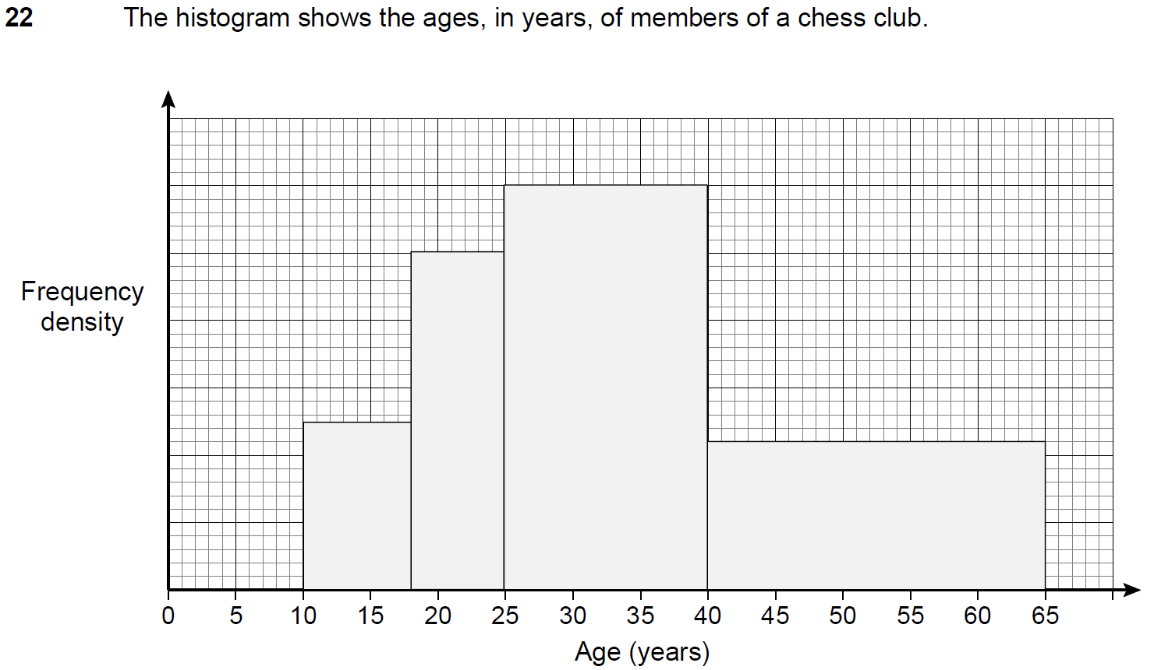
Histograms
SAM 2H Q22

Slide 3
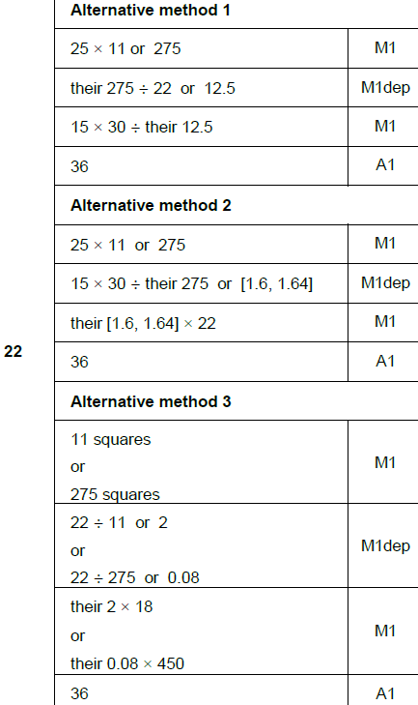
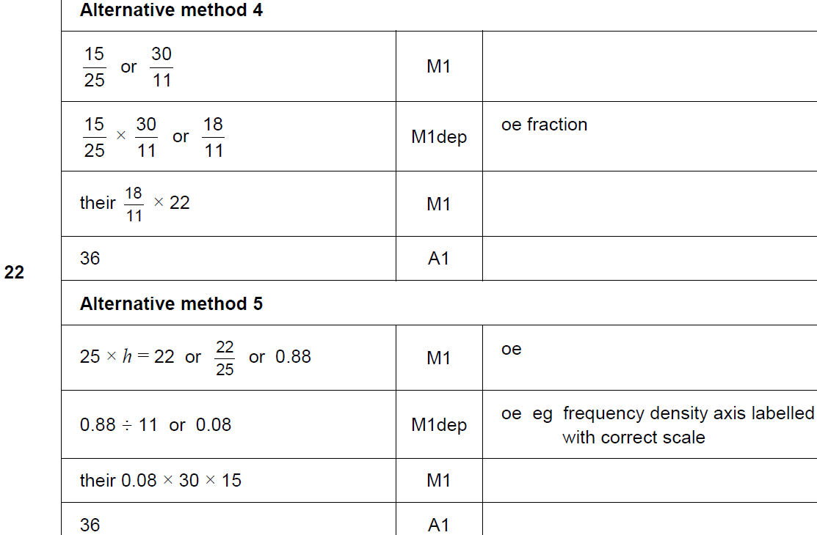
Histograms
SAM 2H Q22
A

Slide 4
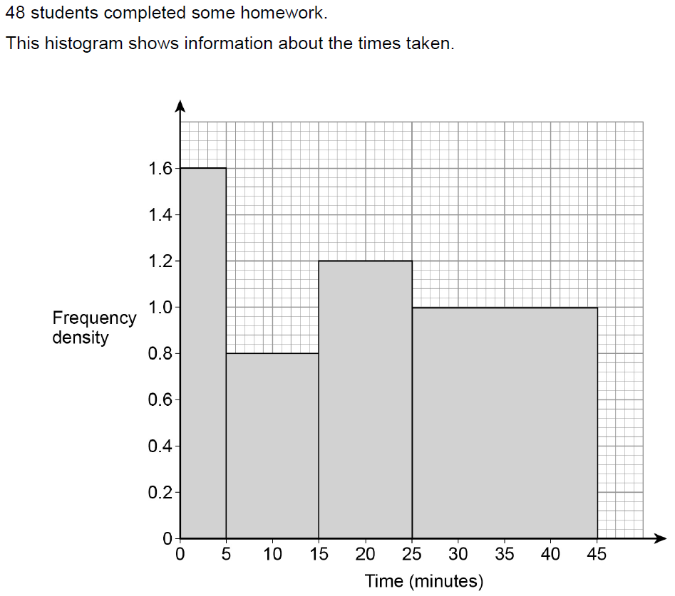
Histograms
June 2017 2H Q24

Slide 5
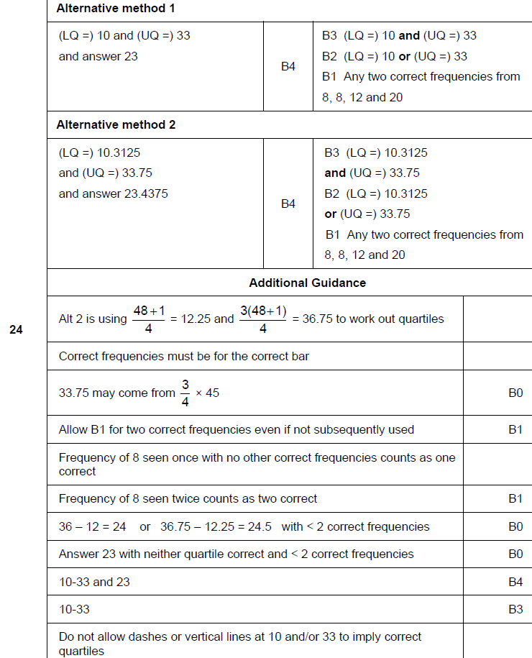
Histograms
June 2017 2H Q24
A

Slide 6
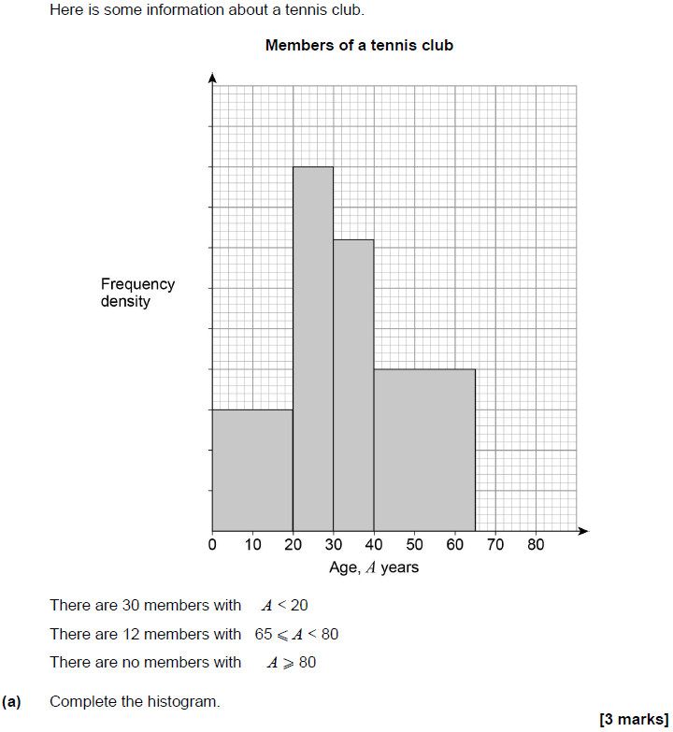
Histograms
Nov 2017 2H Q23

Slide 7
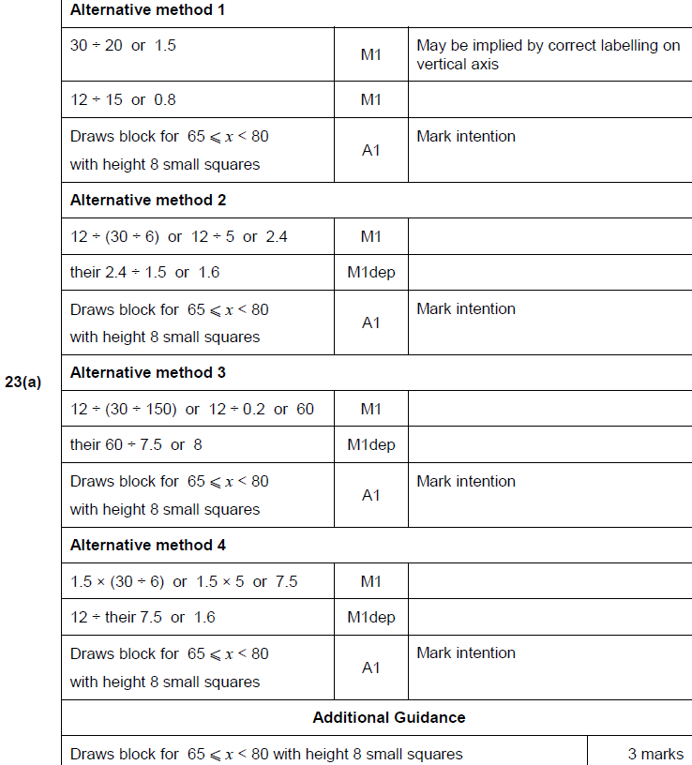
Histograms
Nov 2017 2H Q23
A

Slide 8
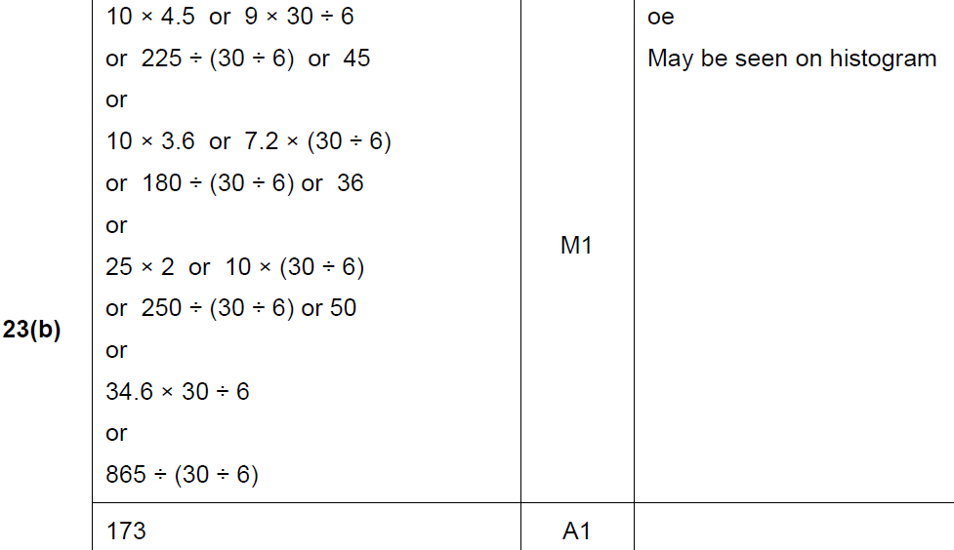
Histograms
Nov 2017 2H Q23
B

Slide 9
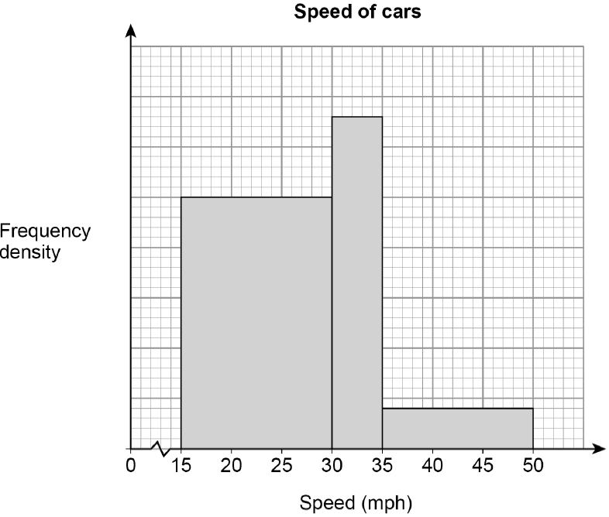
Histograms
June 2018 3H Q26
The histogram shows information about the speed of cars as they pass a checkpoint.
The scale on the frequency density axis is missing.
The histogram shows information about 480 cars.
(a) How many cars does the first bar represent?
[4 marks]
(b) Cars with a speed greater than 40 mph are over the speed limit.
Use the histogram to estimate the number of cars that are over the speed limit.
[2 marks]

Slide 10
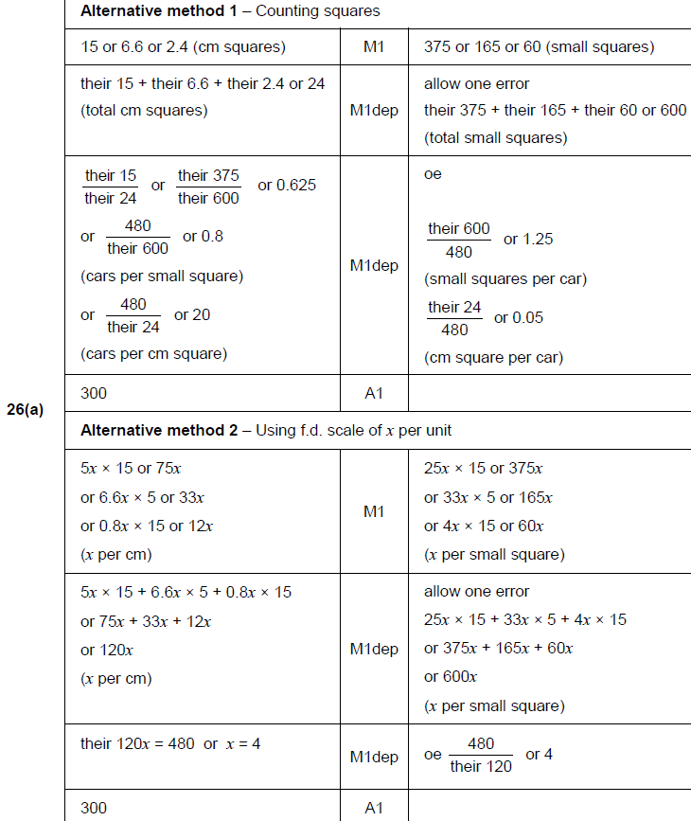
Histograms
June 2018 3H Q26
A

Slide 11
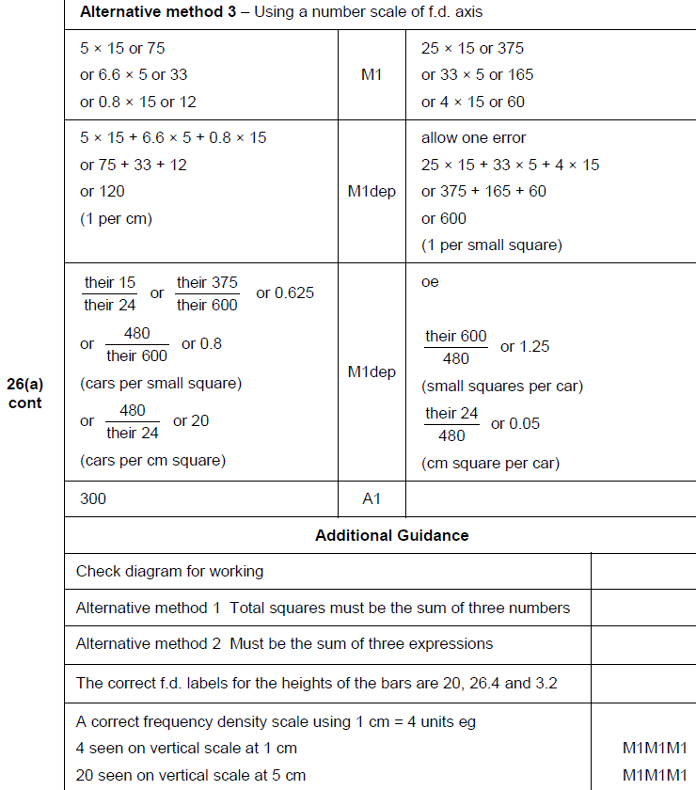
Histograms
June 2018 3H Q26
A

Slide 12
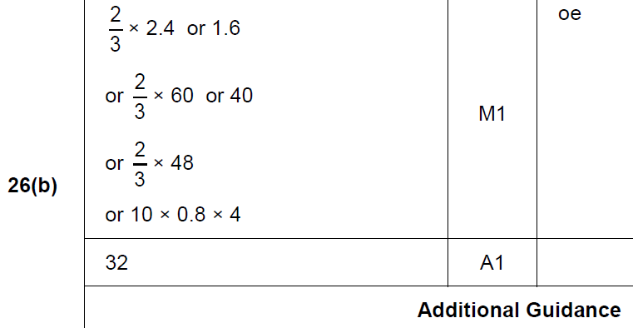
Histograms
June 2018 3H Q26
B

Slide 13
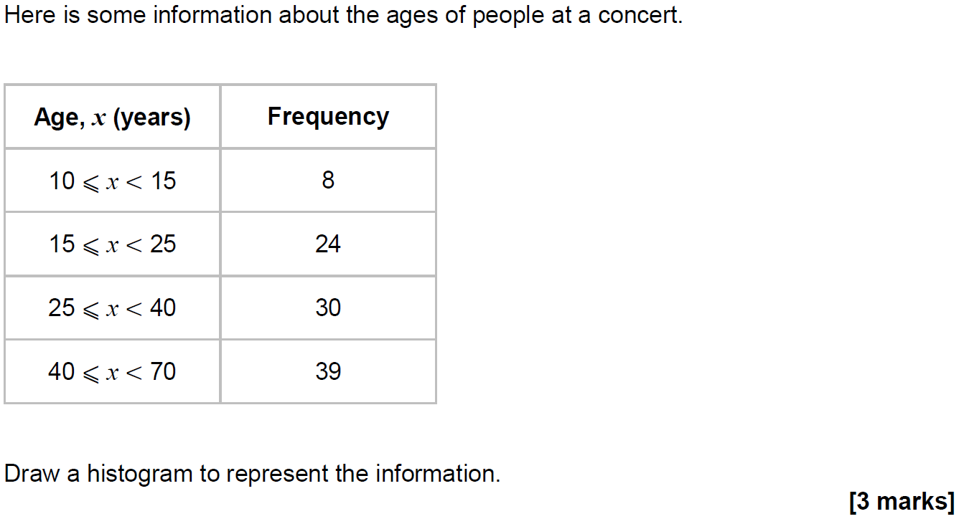
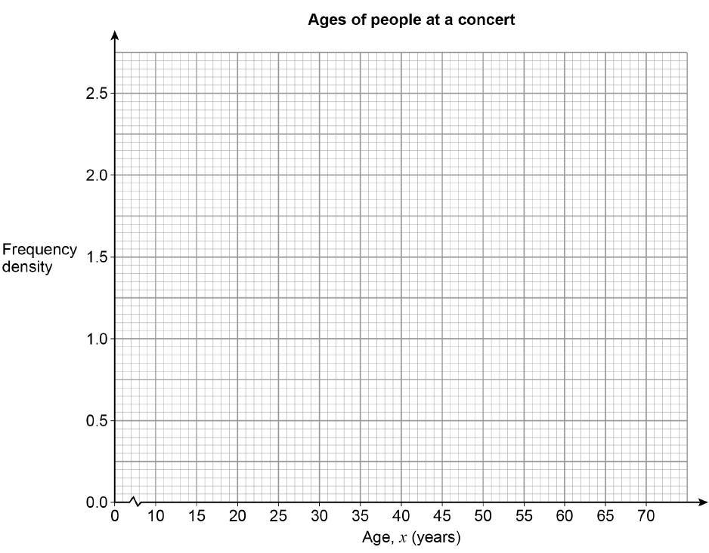
Histograms
Nov 2018 3H Q18

Slide 14
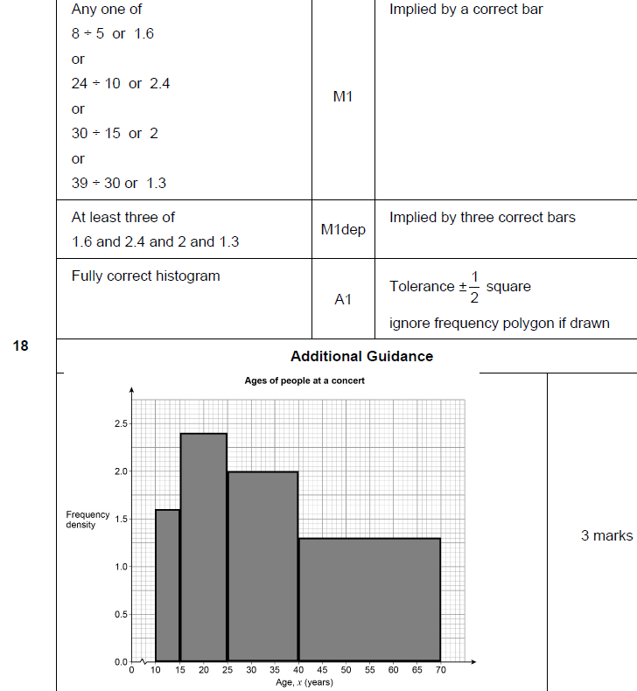
Histograms
Nov 2018 3H Q18
A

