Slide 1
Histograms
Histograms
June 2017 2H Q13
SAM
1H Q22
Nov 2017 2H Q17
Edexcel
Spec 1
2H Q16
June 2018 2H Q17
AQA
Spec 2
1H Q19
Nov 2018 3H Q4*
OCR
Spec 2
3H Q14
Nov 2018 3H Q17
June 2019 3H Q21
Frequency Diagram*

Slide 2
Histograms
Histograms
June 2017
2H Q24
Edexcel
Nov 2017
2H Q23
AQA
SAM
2H Q22
1 Marker
June 2018
3H Q26
OCR
Nov 2018
3H Q18
Frequency Diagram*

Slide 3
Histograms
Histograms
June 2017
3H Q10
Edexcel
SAM
3H Q6
Nov 2017
1H Q10
AQA
Practice
3H Q11
June 2018
2H Q19
OCR
Nov 2018
1H Q12
Frequency Diagram*

Slide 4
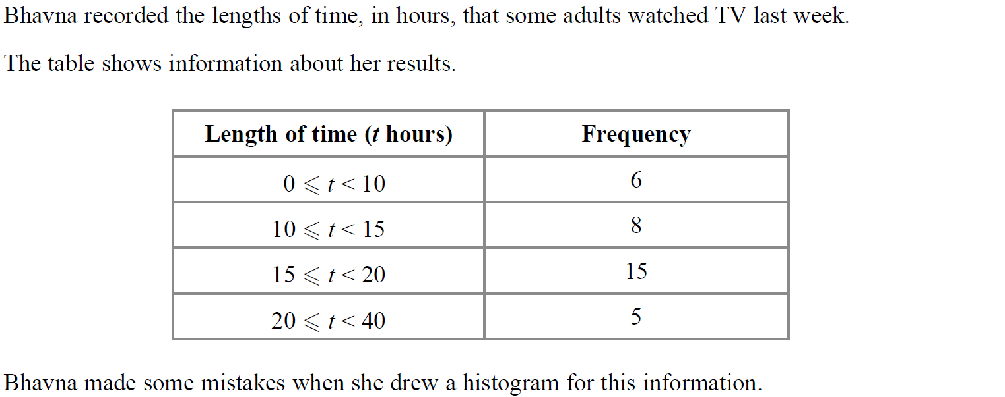
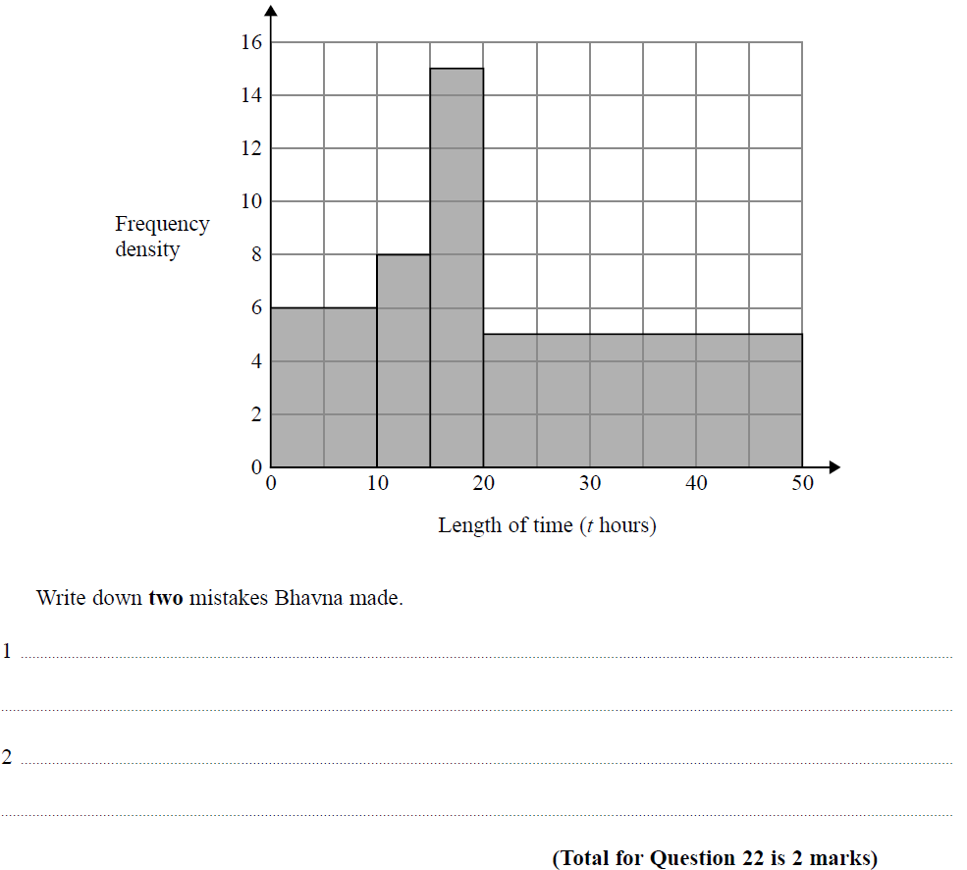
Histograms
SAM 1H Q22

Slide 5
Histograms
SAM 1H Q22
A

Slide 6
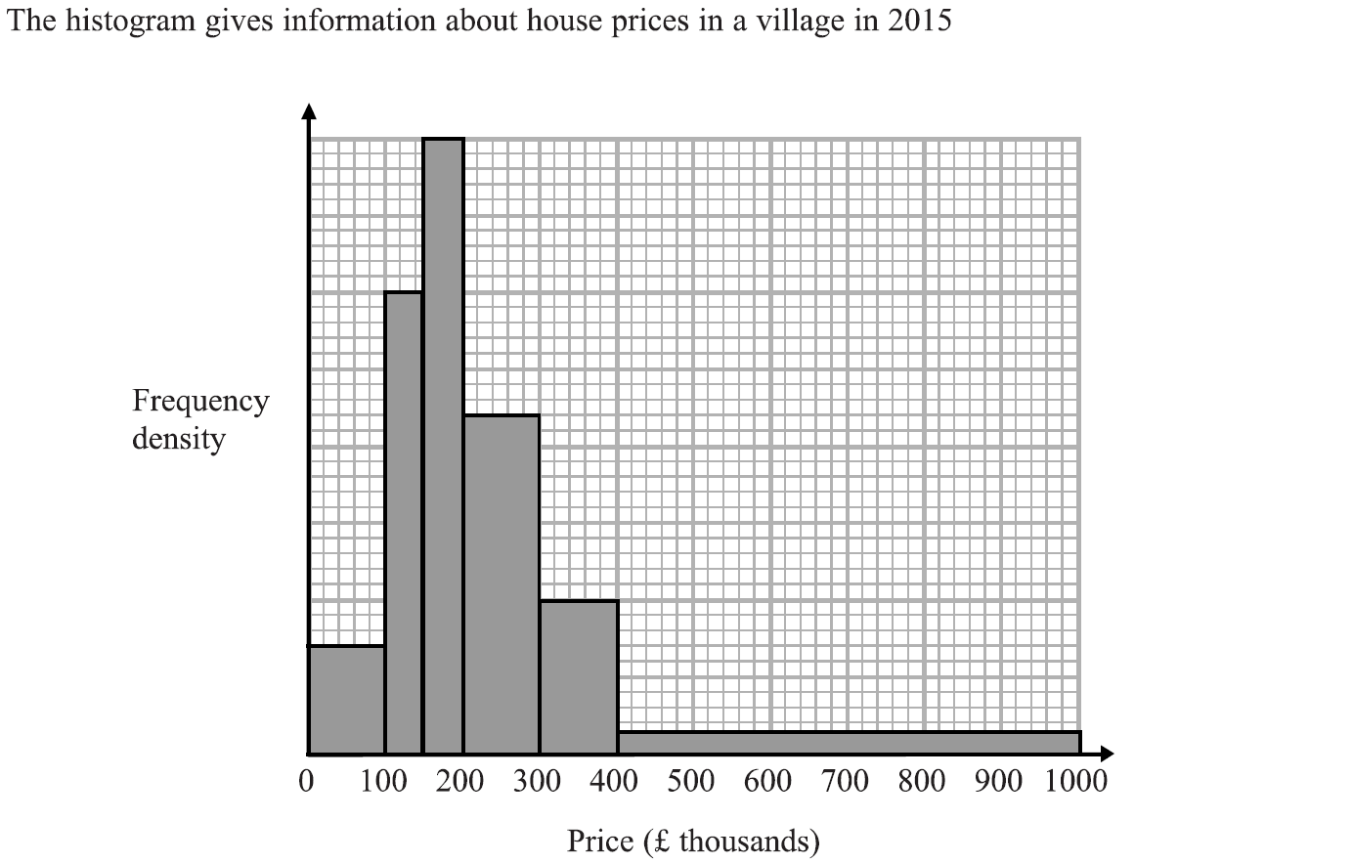
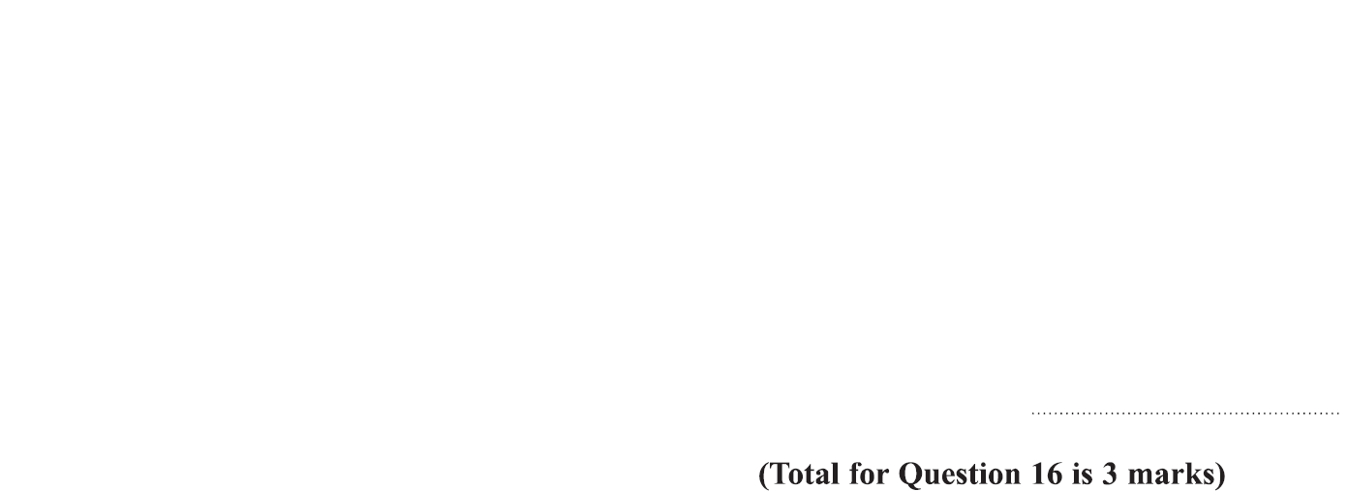
Histograms
Specimen Set 1 2H Q16

Slide 7
Histograms
Specimen Set 1 2H Q16
A

Slide 8
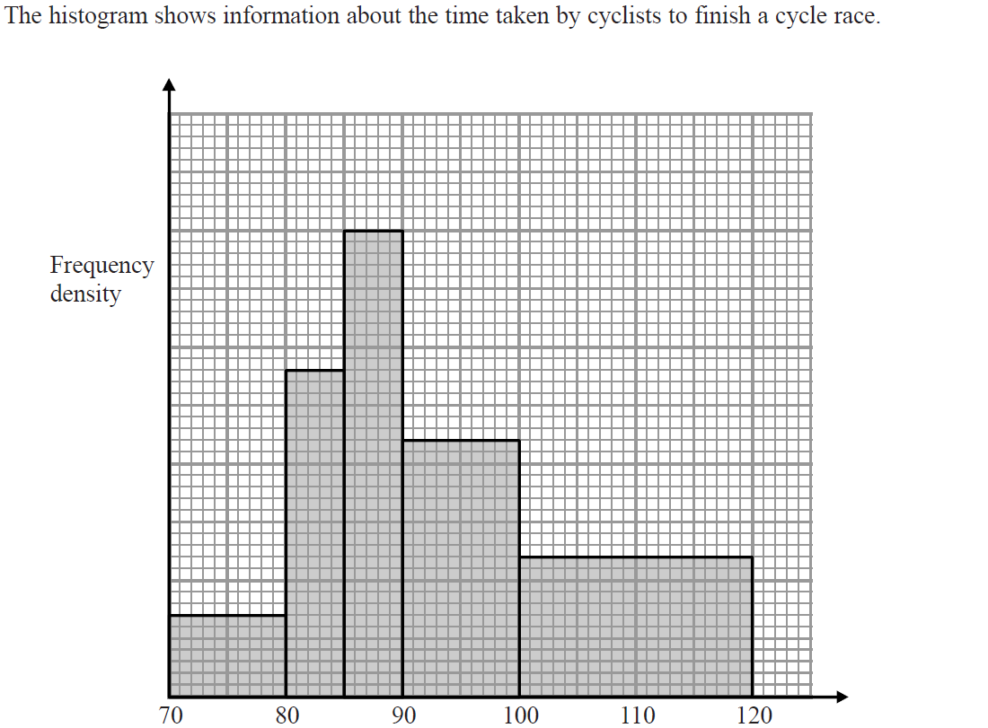
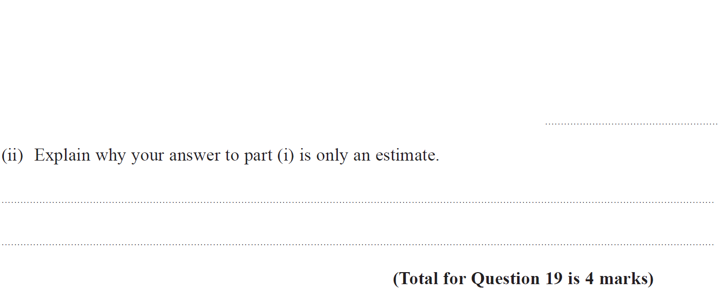
Histograms
Specimen Set 2 1H Q19

Slide 9
Histograms
Specimen Set 2 1H Q19
(i)
(ii)

Slide 10
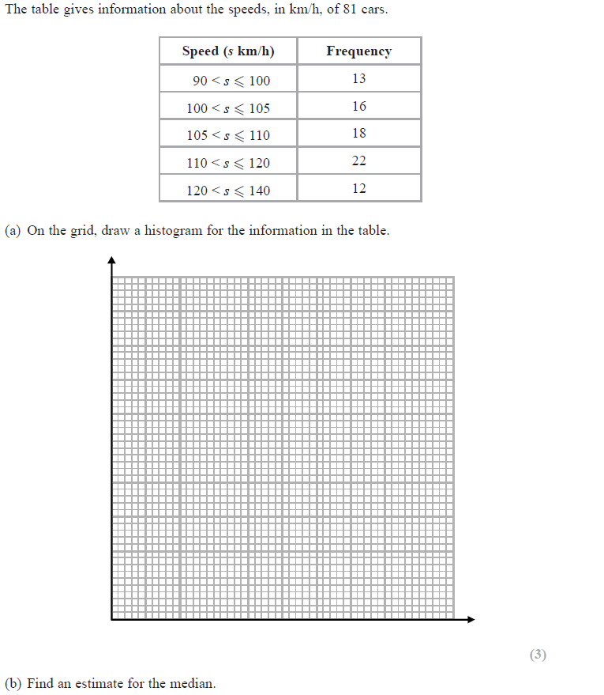
Histograms
Specimen Set 2 3H Q14
Frequency Density
1 2 3 4 5
Reveal Histogram
90 100 110 120 130 140
Speed km/h

Slide 11
Histograms
Specimen Set 2 3H Q14
A
B

Slide 12
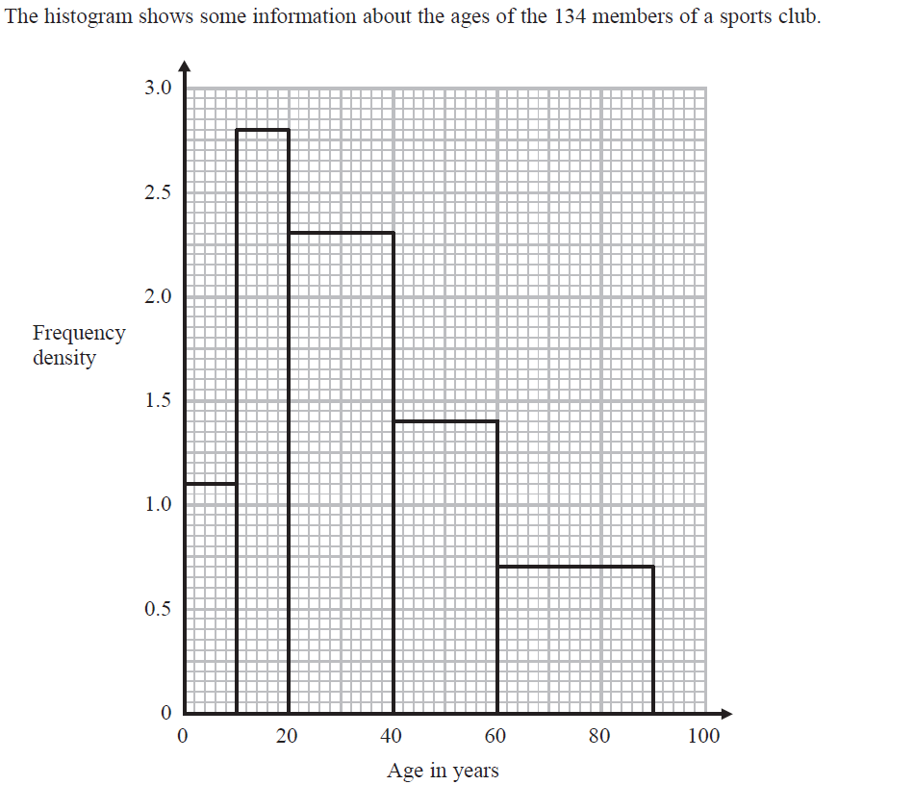
Histograms
June 2017 2H Q13

Slide 13
Histograms
June 2017 2H Q13
A

Slide 14
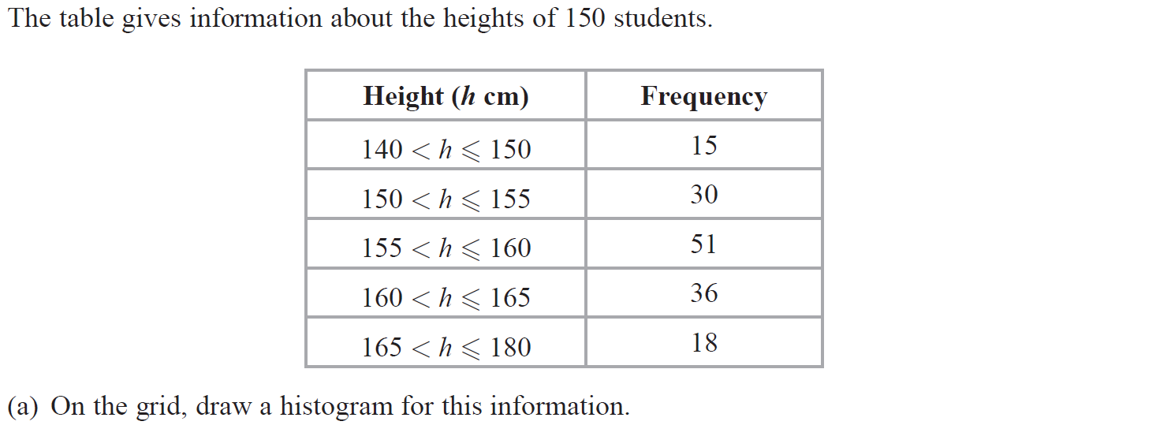
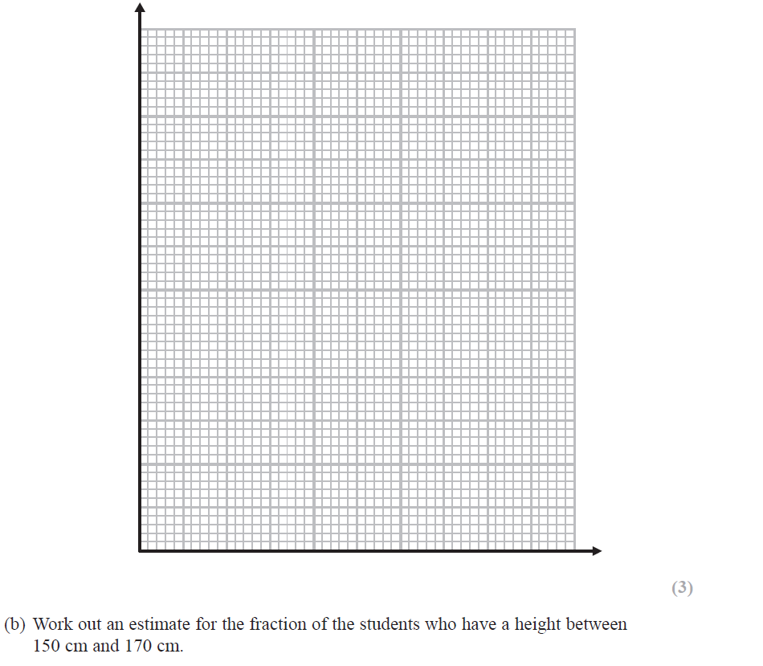
Histograms
Nov 2017 2H Q17
Frequency Density
1 2 3 4 5 6 7 8 9 10 11
Reveal Histogram

Slide 15
Histograms
Nov 2017 2H Q17
A
B

Slide 16
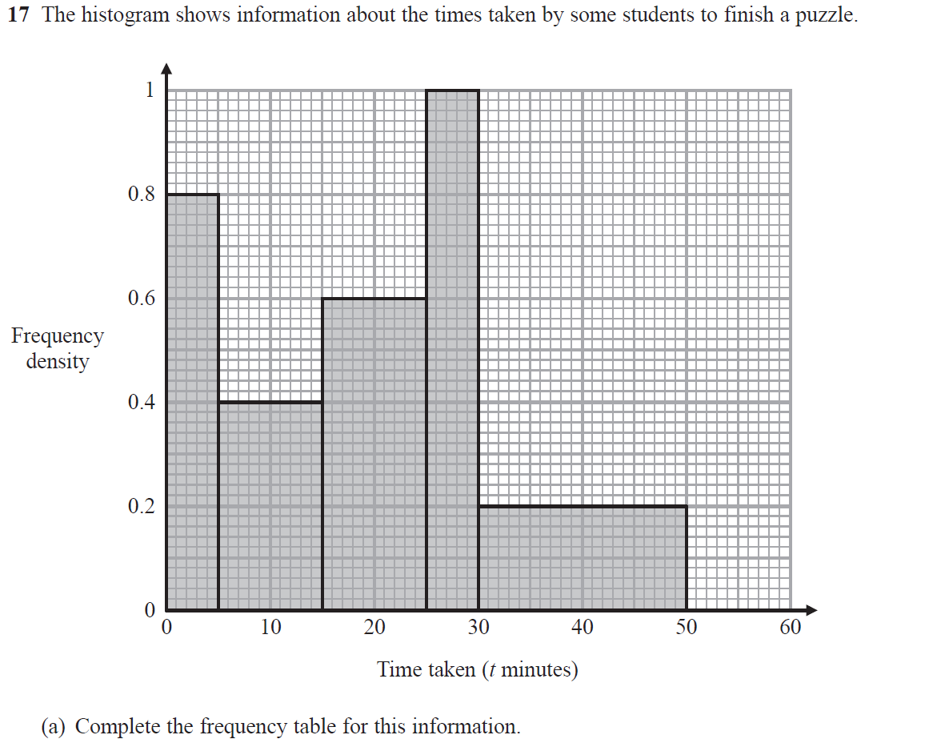
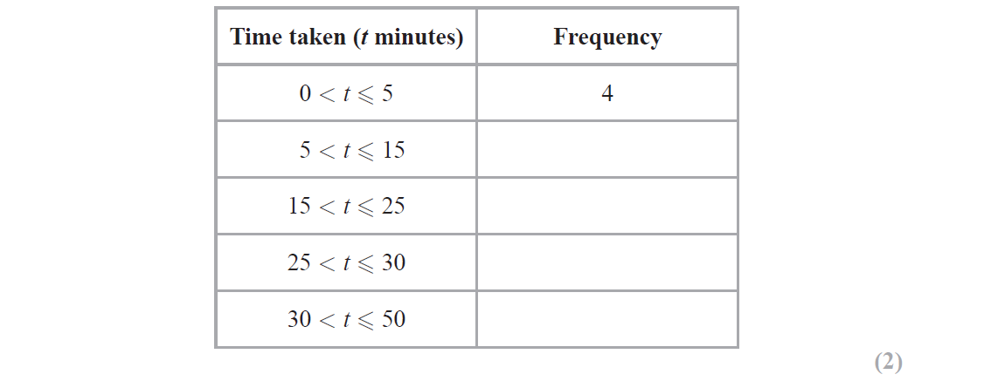
Histograms
June 2018 2H Q17

Slide 17
Histograms
June 2018 2H Q17
A
B

Slide 18
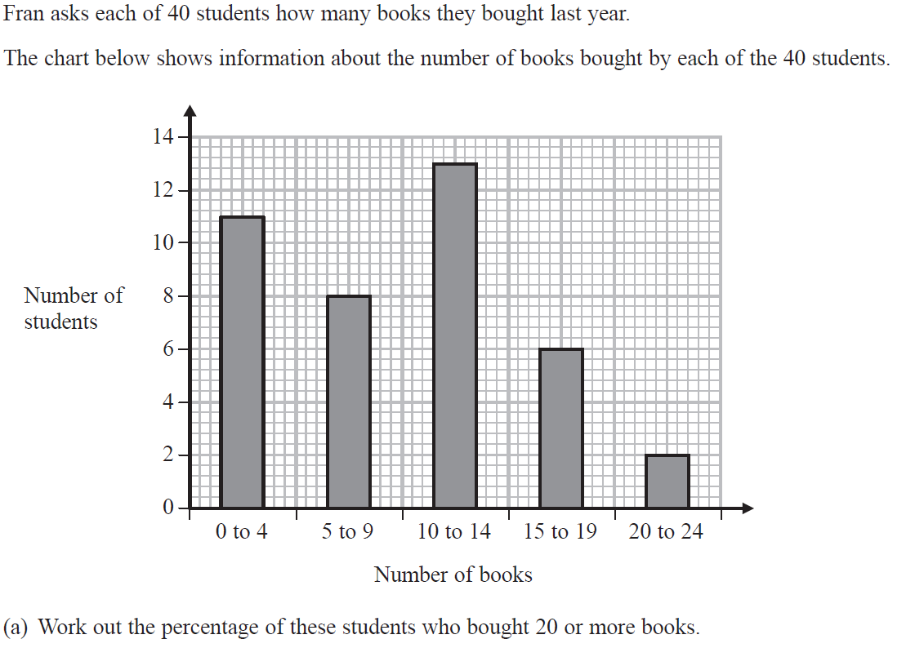
Histograms
Nov 2018 3H Q4

Slide 19
Histograms
Nov 2018 3H Q4
A
B

Slide 20
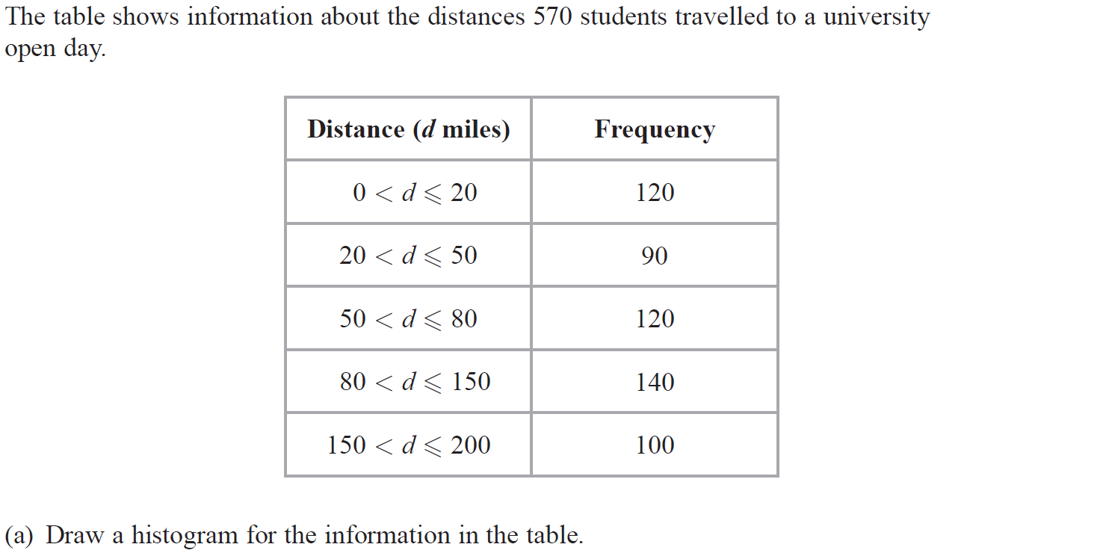
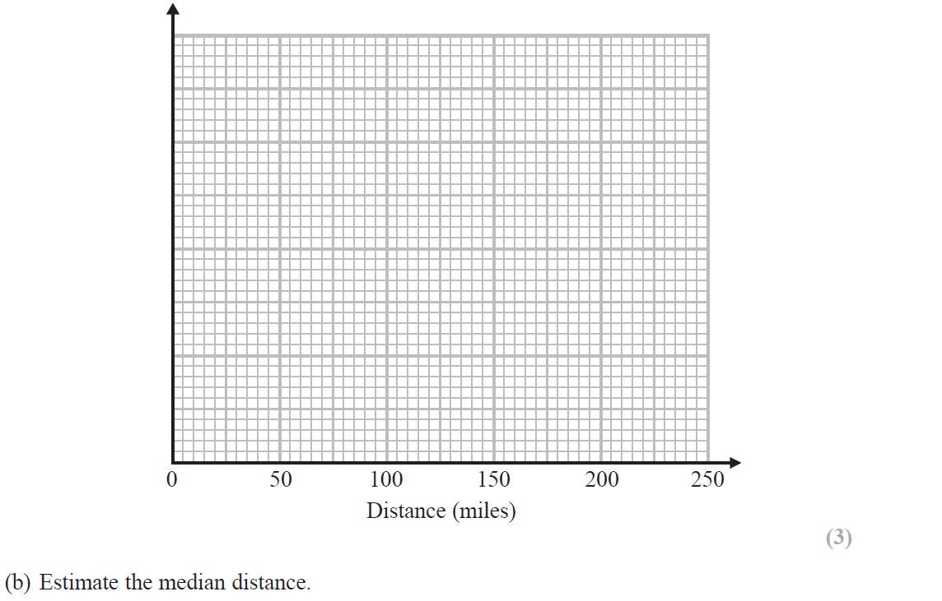
Histograms
Nov 2018 3H Q17
Frequency Density
1 2 3 4 5 6 7
Reveal Histogram

Slide 21
Histograms
Nov 2018 3H Q17
A
B

Slide 22
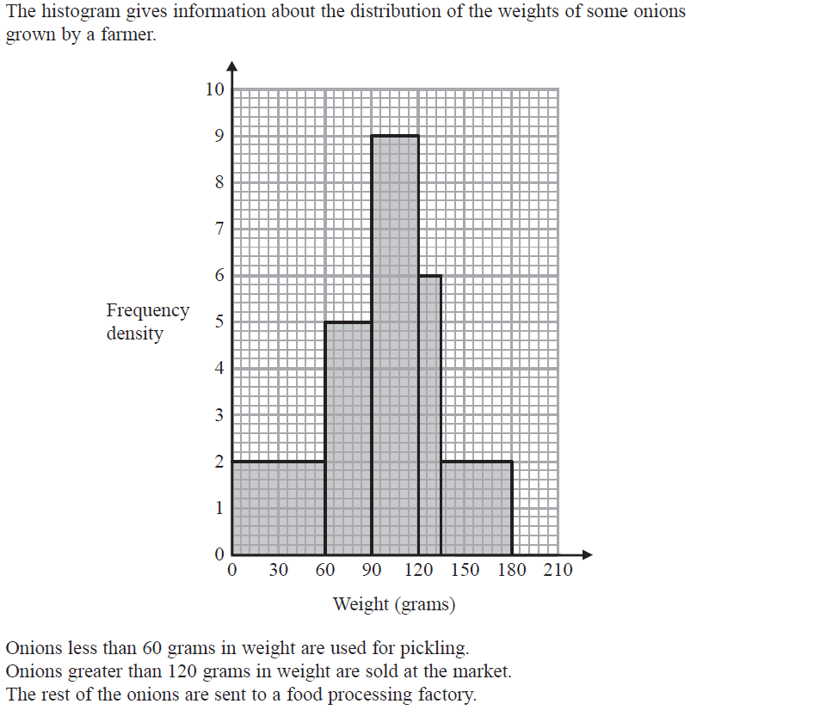
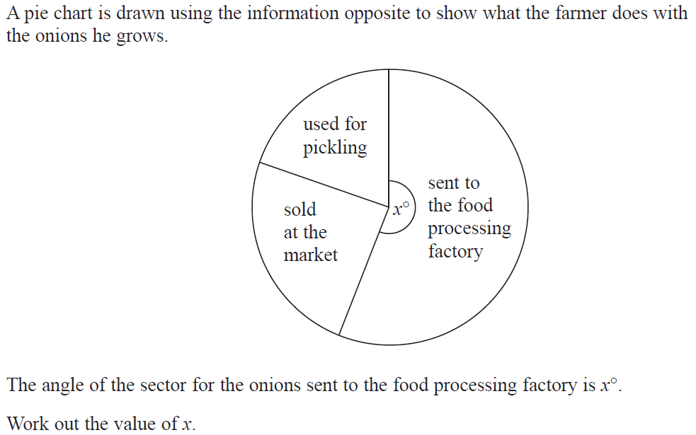
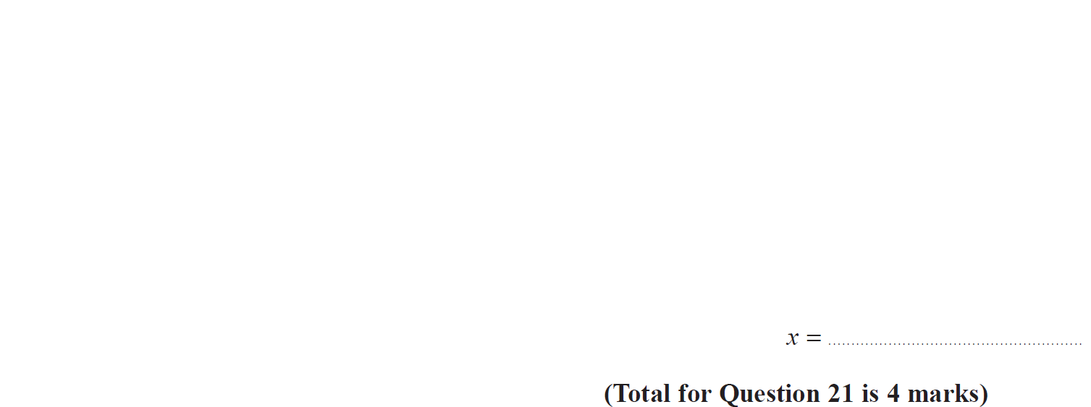
Histograms
June 2019 3H Q21

Slide 23
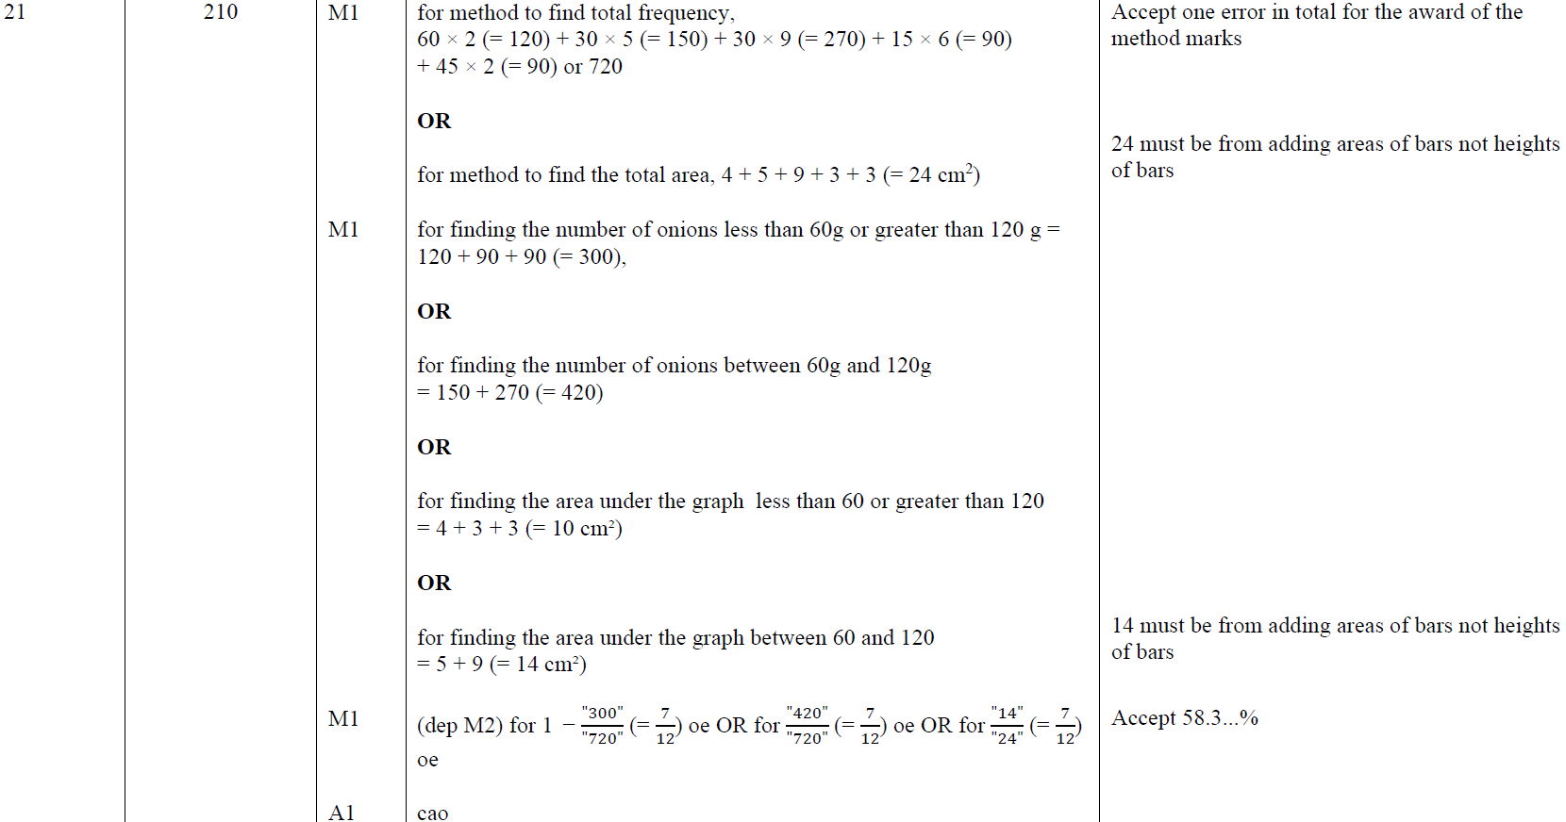
Histograms
June 2019 3H Q21
A

Slide 24
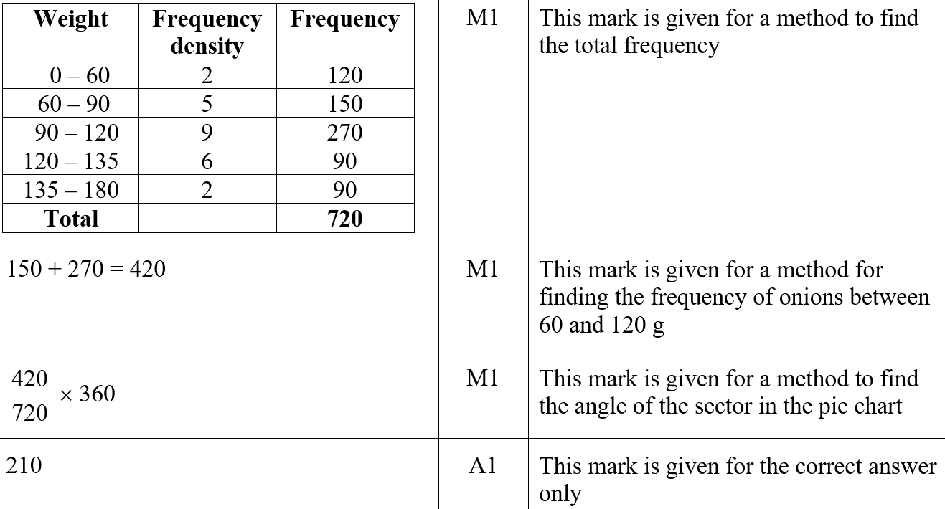
Histograms
June 2019 3H Q21
A SF

Slide 25
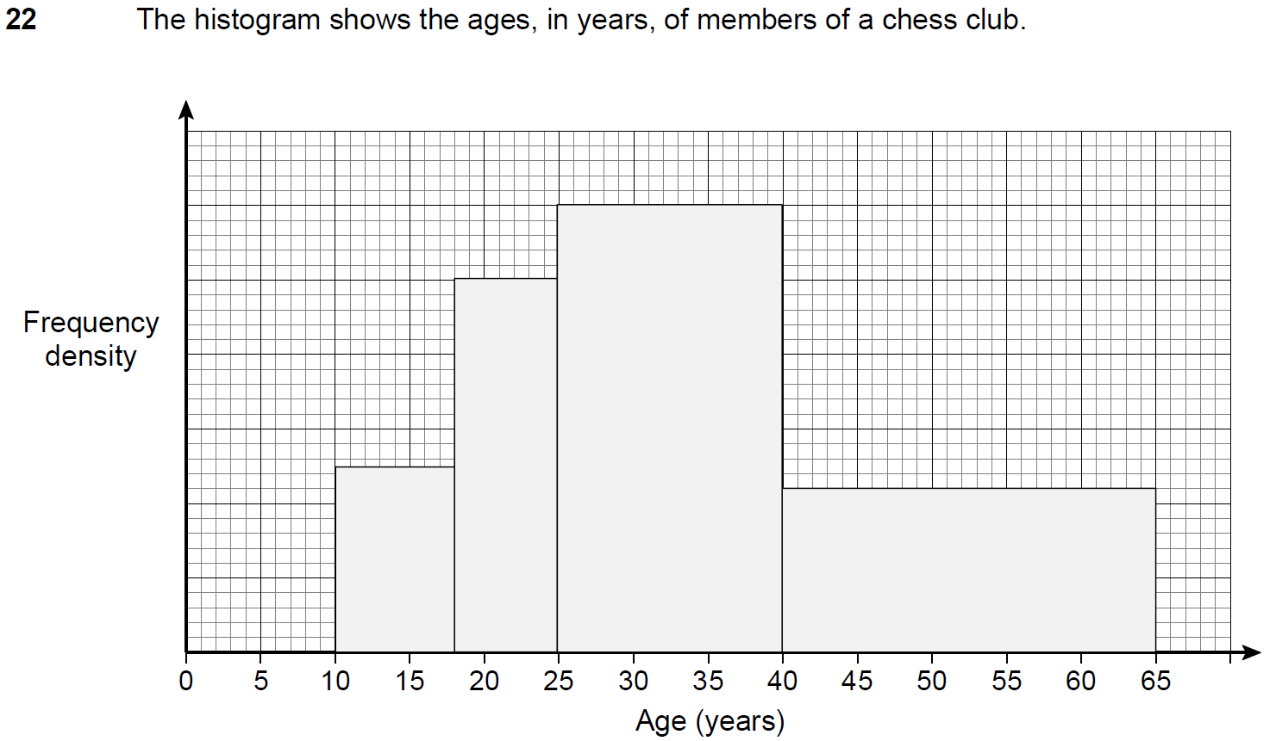
Histograms
SAM 2H Q22

Slide 26
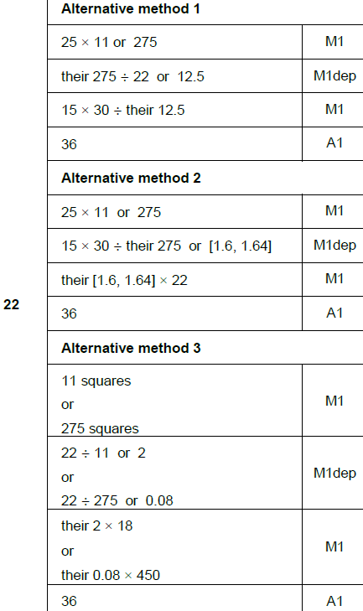
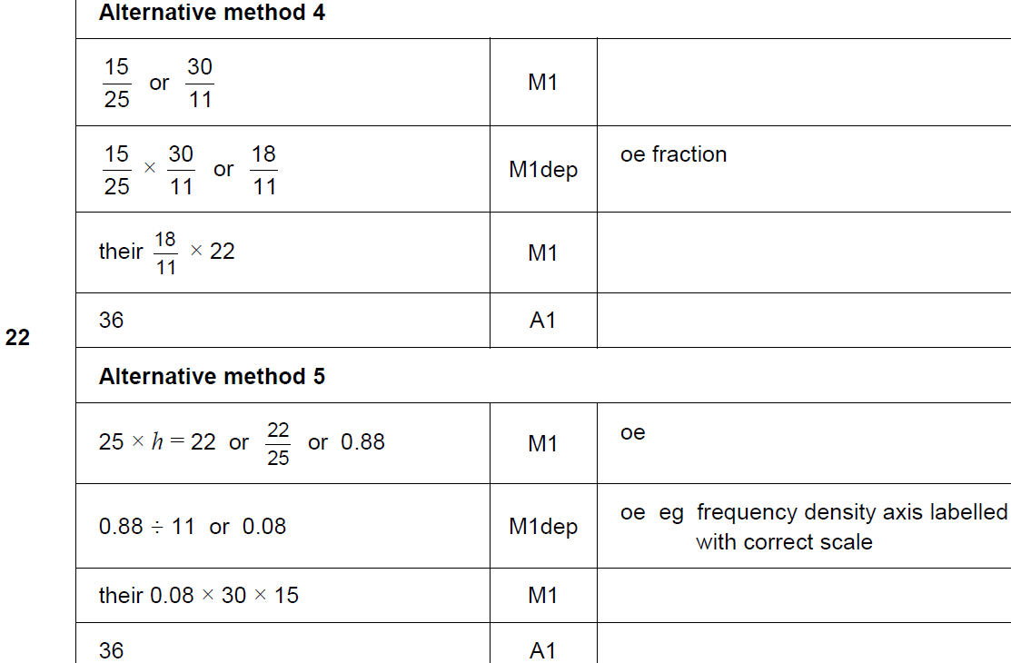
Histograms
SAM 2H Q22
A

Slide 27
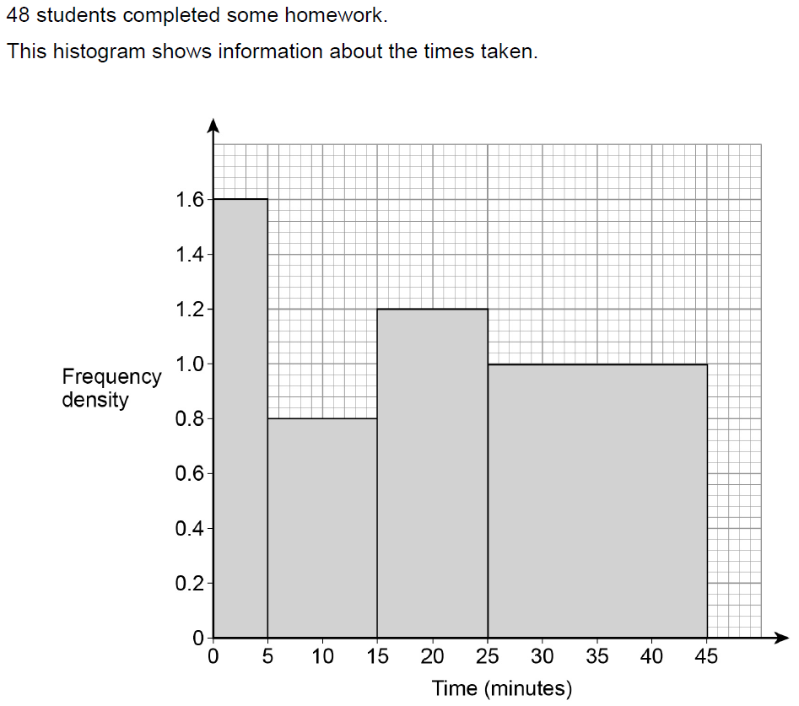
Histograms
June 2017 2H Q24

Slide 28
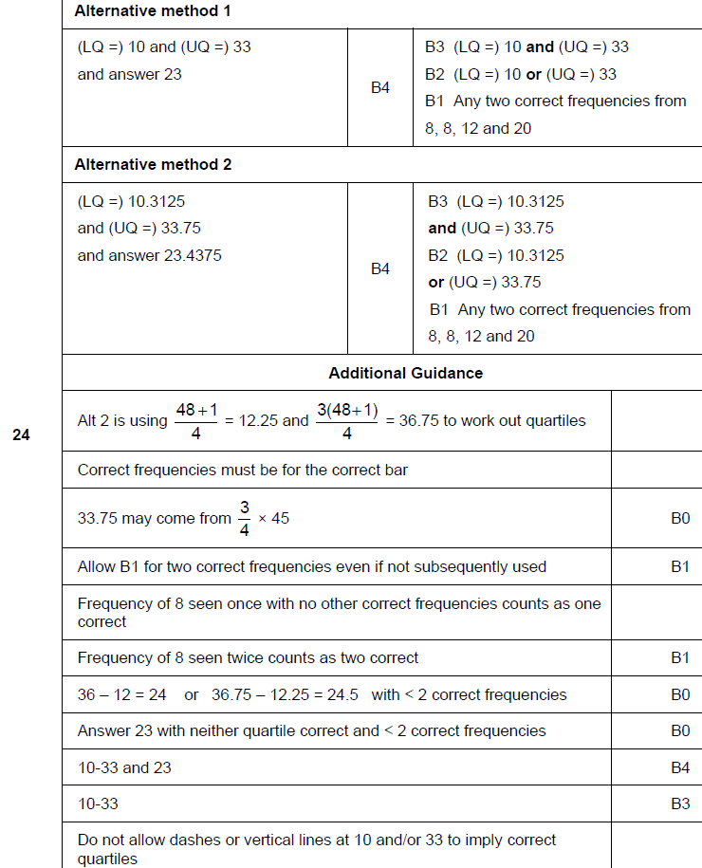
Histograms
June 2017 2H Q24
A

Slide 29
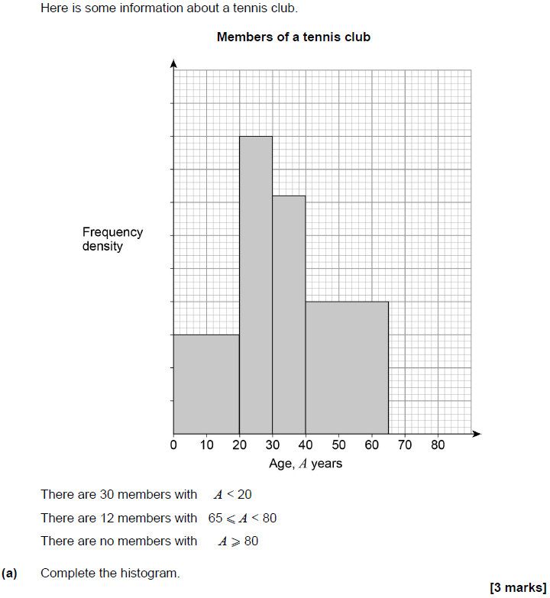
Histograms
Nov 2017 2H Q23

Slide 30
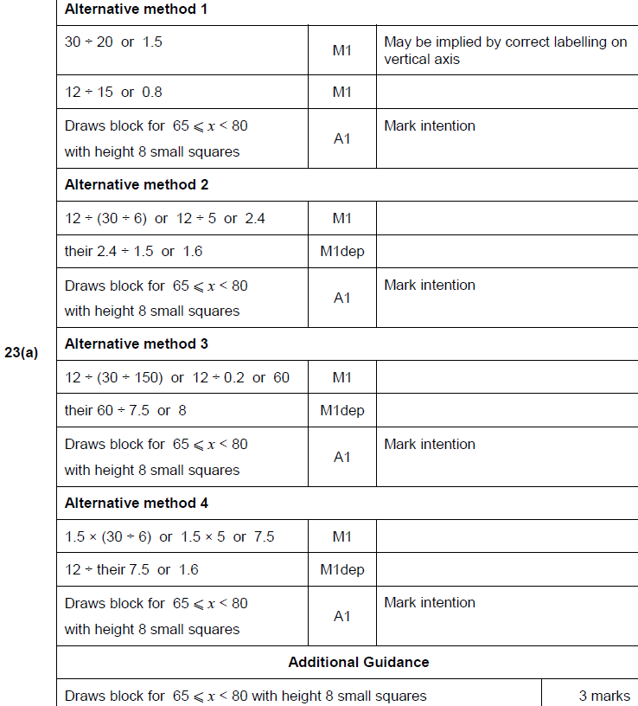
Histograms
Nov 2017 2H Q23
A

Slide 31
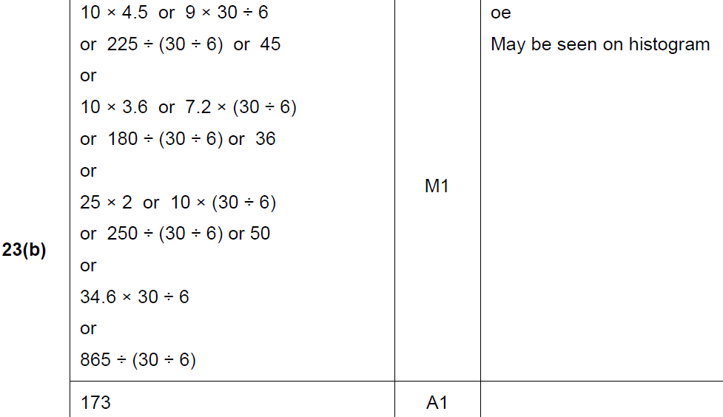
Histograms
Nov 2017 2H Q23
B

Slide 32
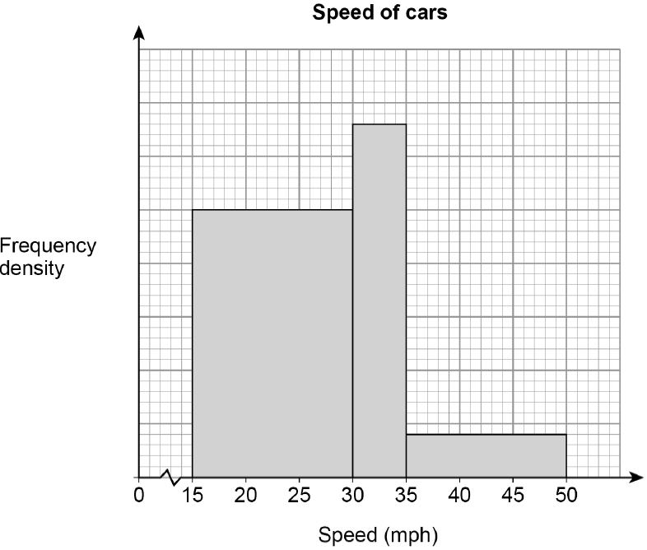
Histograms
June 2018 3H Q26
The histogram shows information about the speed of cars as they pass a checkpoint.
The scale on the frequency density axis is missing.
The histogram shows information about 480 cars.
(a) How many cars does the first bar represent?
[4 marks]
(b) Cars with a speed greater than 40 mph are over the speed limit.
Use the histogram to estimate the number of cars that are over the speed limit.
[2 marks]

Slide 33
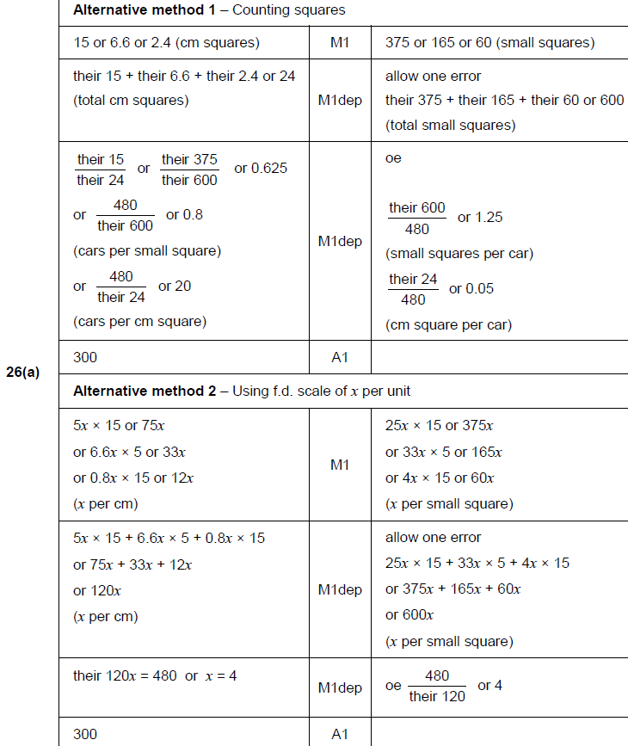
Histograms
June 2018 3H Q26
A

Slide 34
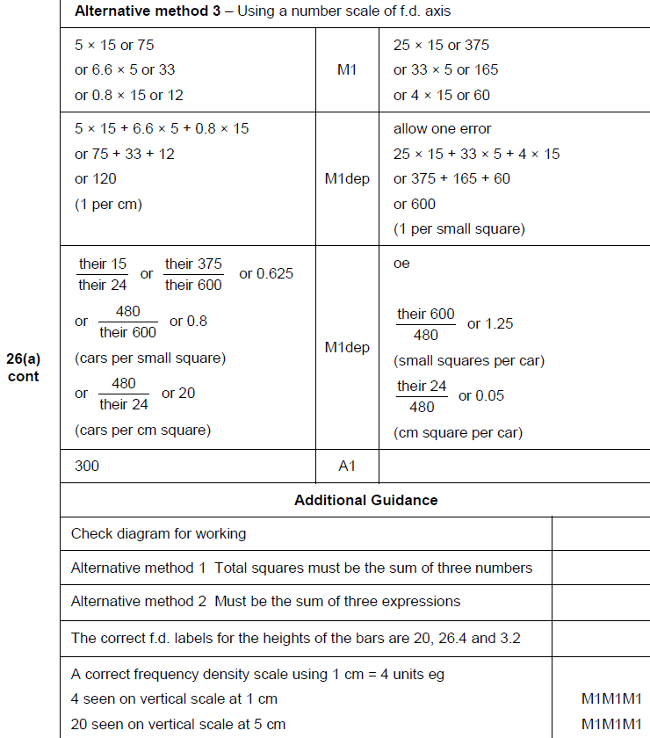
Histograms
June 2018 3H Q26
A

Slide 35
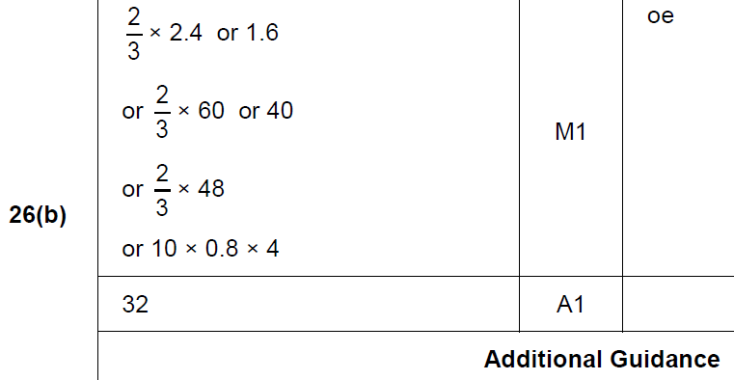
Histograms
June 2018 3H Q26
B

Slide 36
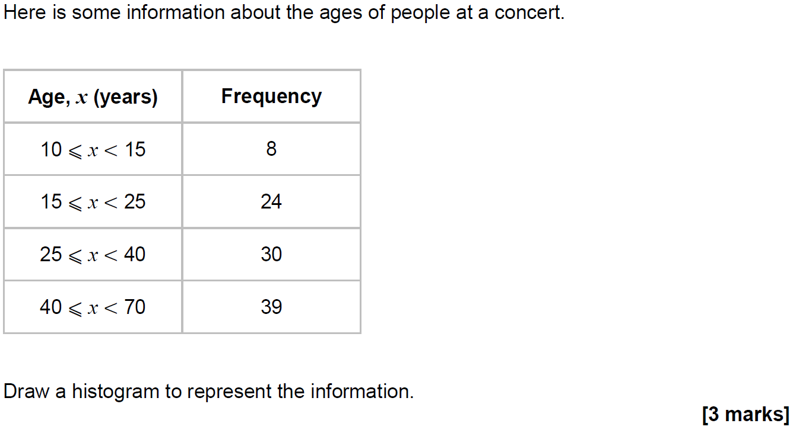
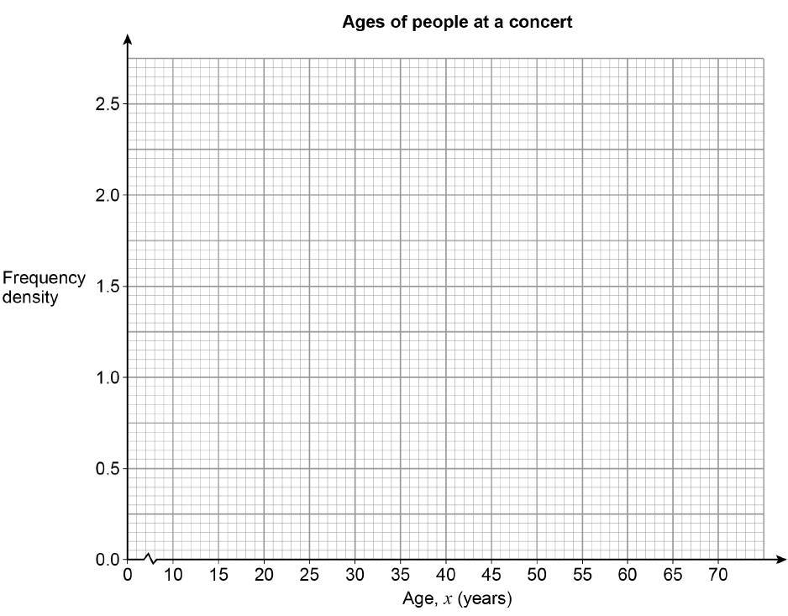
Histograms
Nov 2018 3H Q18

Slide 37
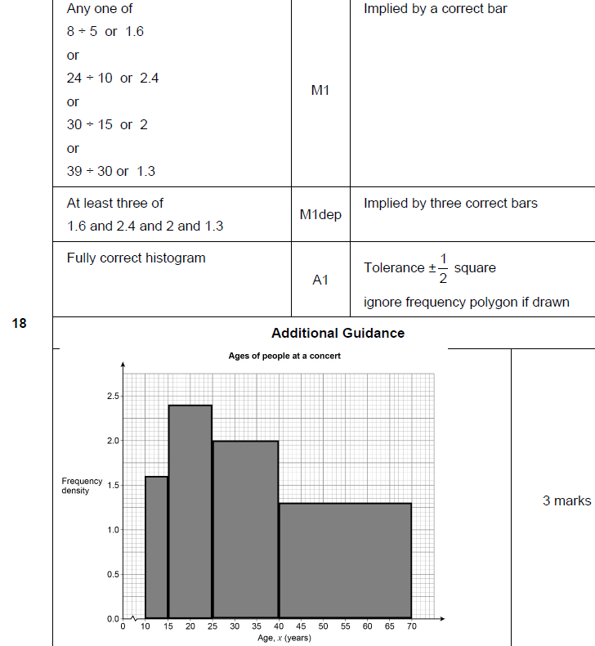
Histograms
Nov 2018 3H Q18
A

Slide 38
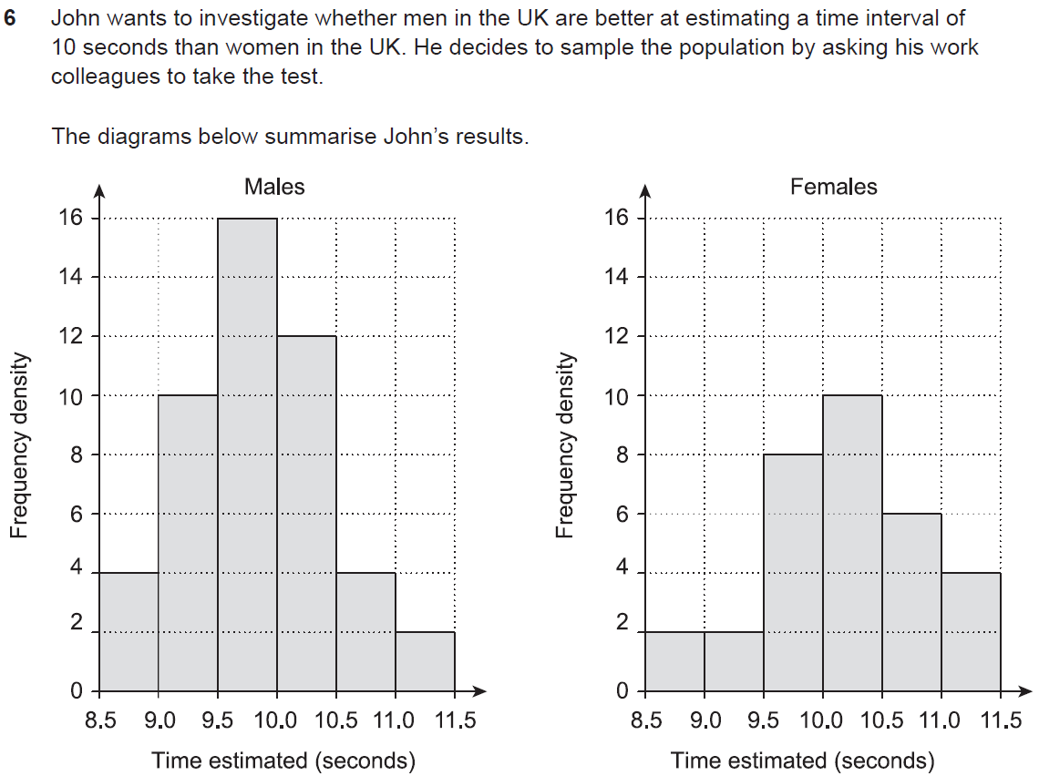
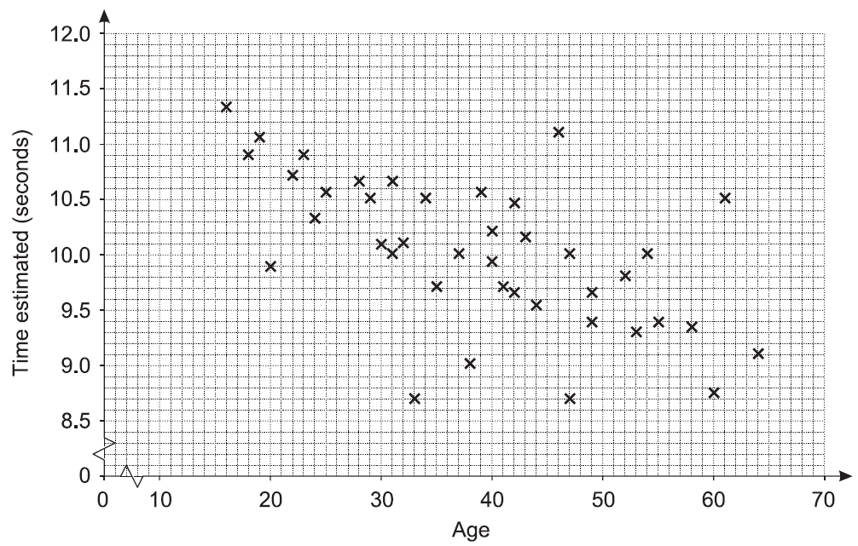
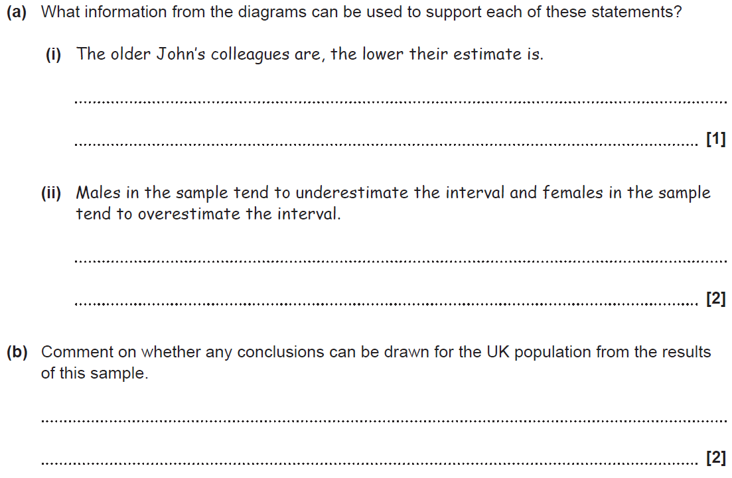
Histograms
SAM 3H Q6

Slide 39
Histograms
SAM 3H Q6
A (i)
A (ii)
B

Slide 40
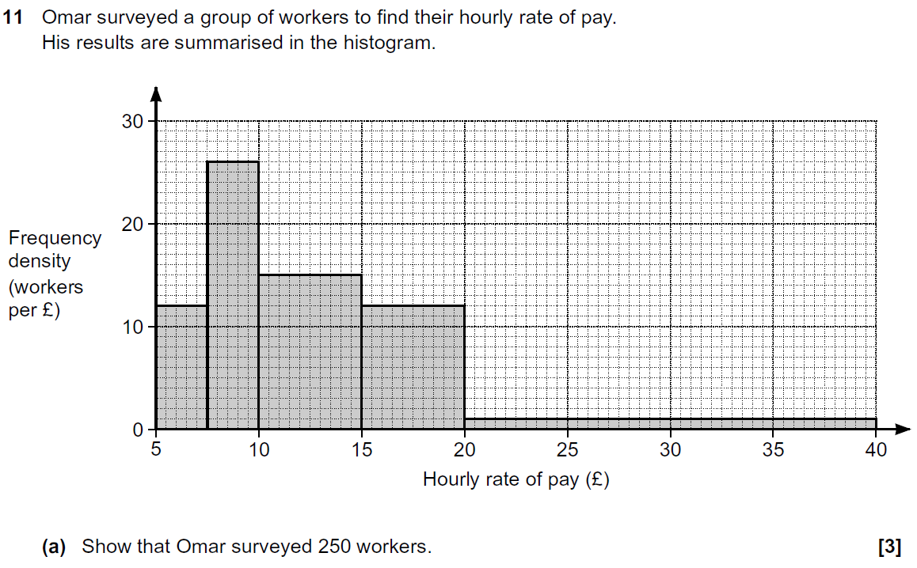
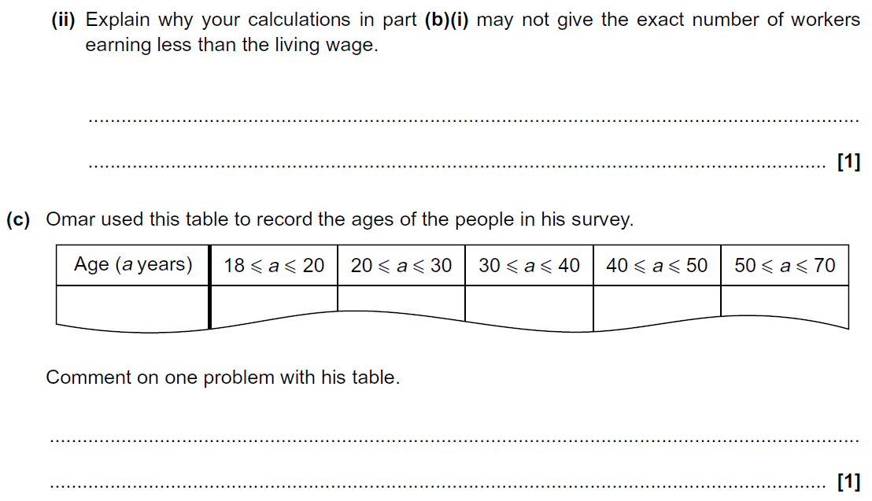
Histograms
Practice 3H Q11

Slide 41
Histograms
Practice 3H Q11
A
B (i)
B (ii)
C

Slide 42
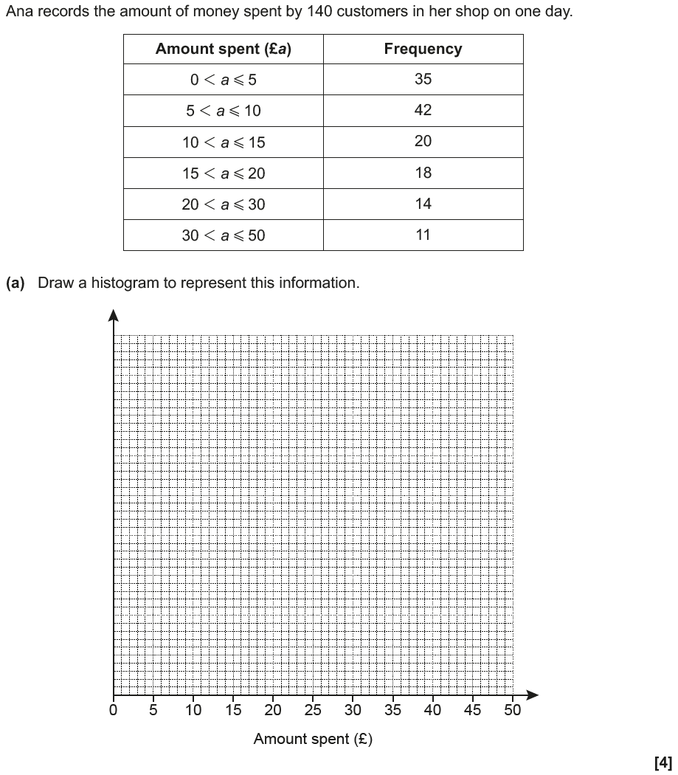
Histograms
June 2017 3H Q10

Slide 43
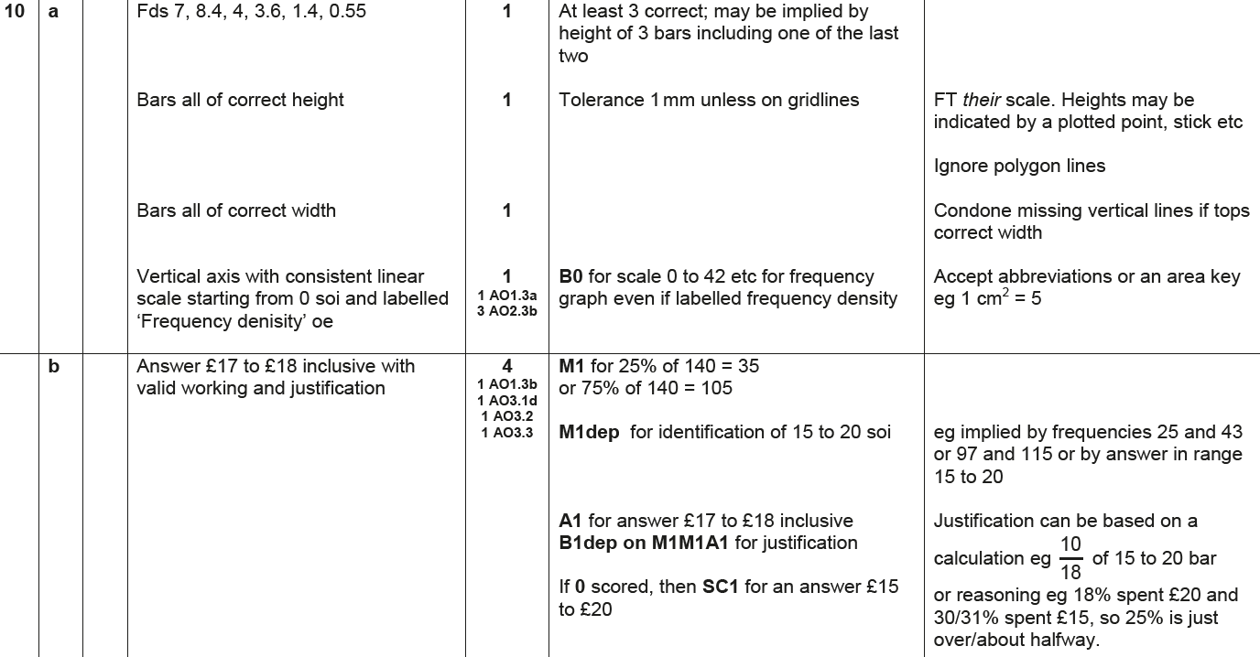
Histograms
June 2017 3H Q10
A
B

Slide 44
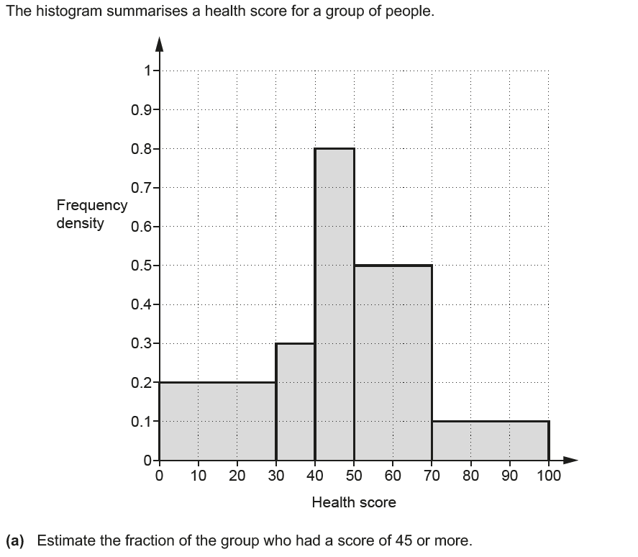
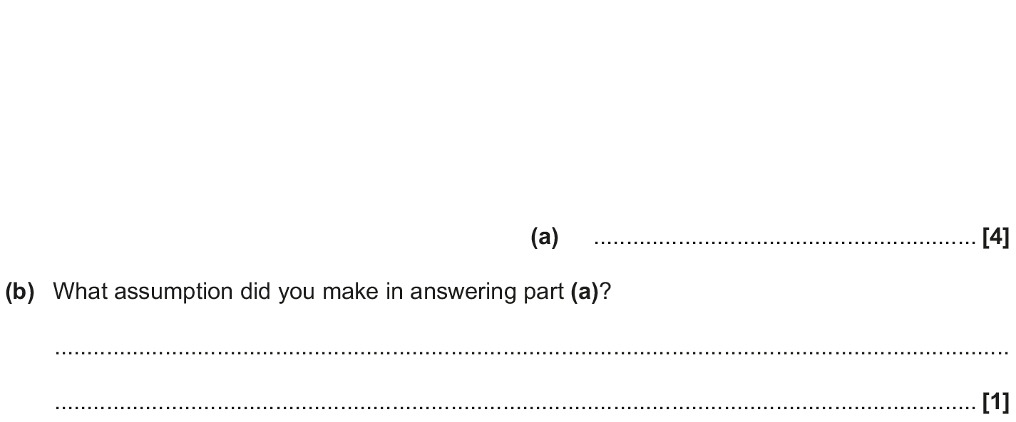
Histograms
Nov 2017 1H Q10

Slide 45
Histograms
Nov 2017 1H Q10
A
B

Slide 46
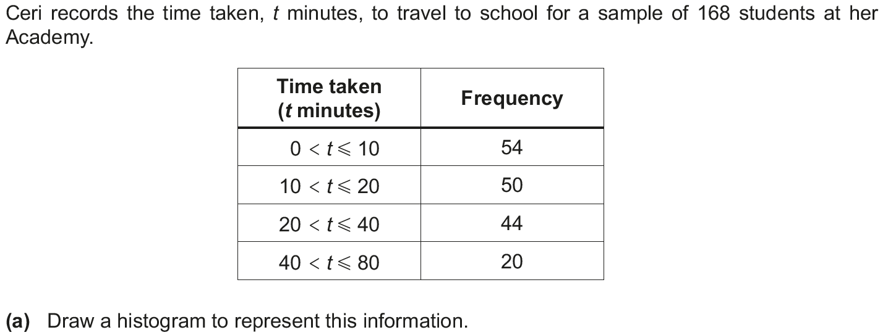
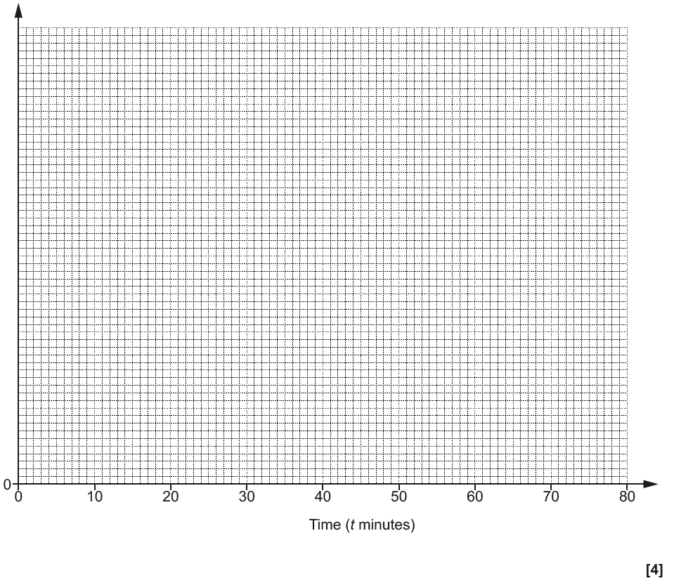
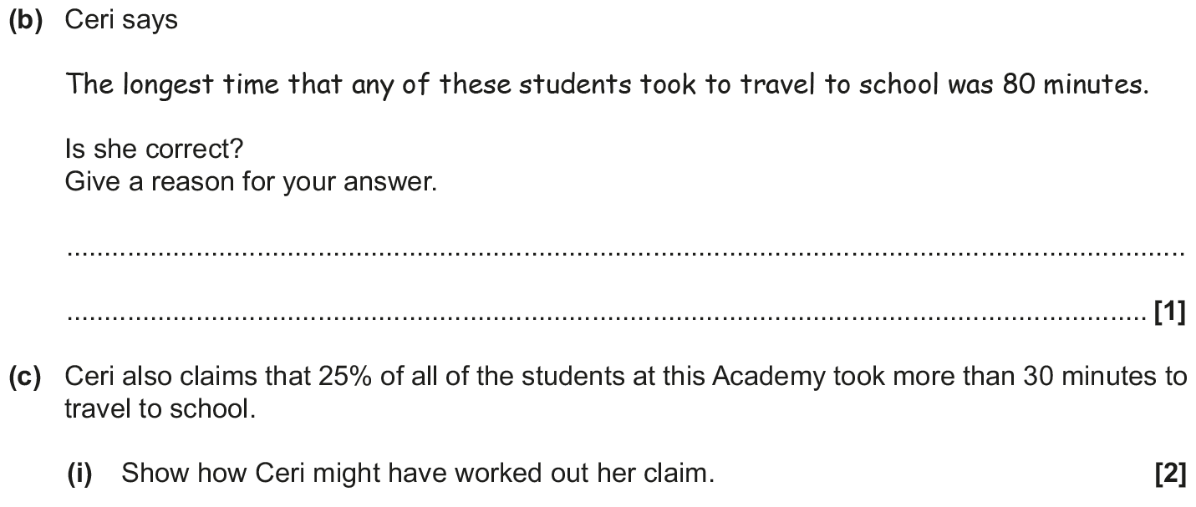
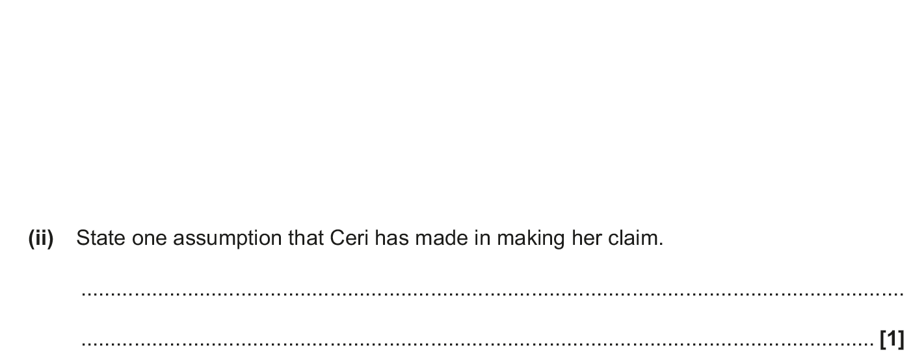
Histograms
June 2018 2H Q19
Reveal Histogram
Frequency Density
1 2 3 4 5 6

Slide 47
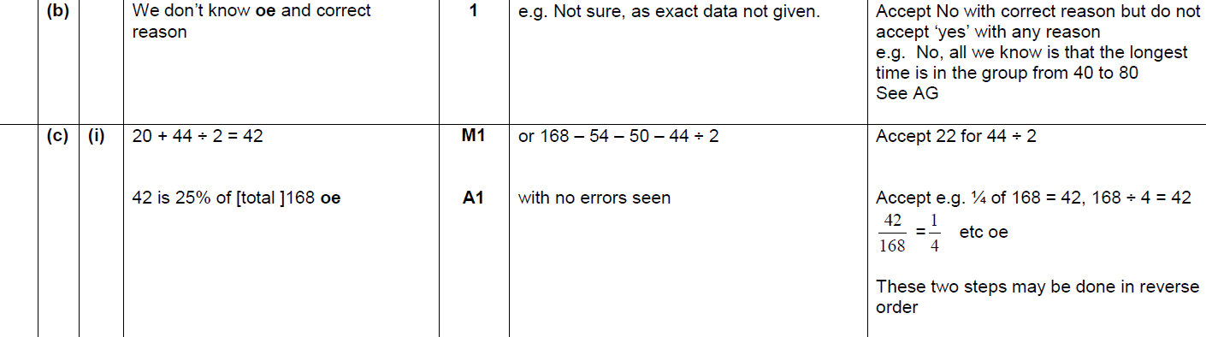
Histograms
June 2018 2H Q19
A
B
C (i)

Slide 48
Histograms
June 2018 2H Q19
C (ii)
B Exemplar responses

Slide 49
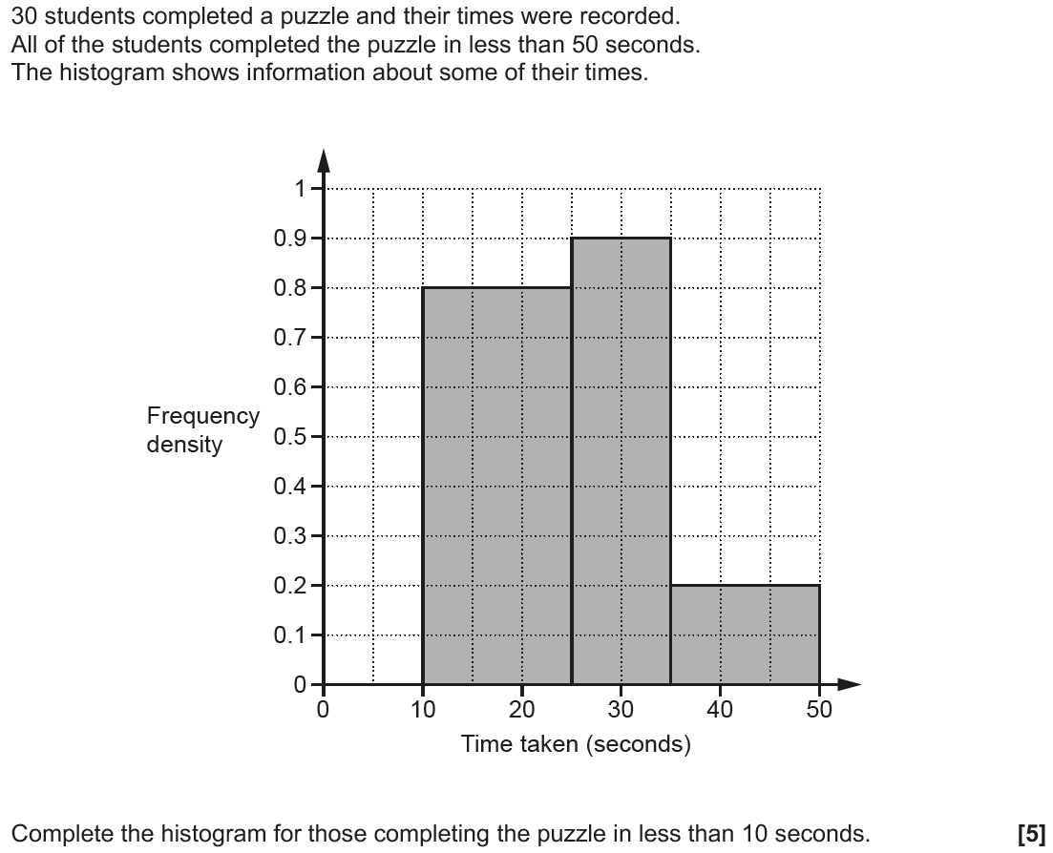
Histograms
Nov 2018 1H Q12
Reveal Histogram

Slide 50
Histograms
Nov 2018 1H Q12
A

