Slide 1
Histograms
Histograms
June 2017 2H Q13
SAM
1H Q22
Nov 2017 2H Q17
Spec 1
2H Q16
June 2018 2H Q17
Spec 2
1H Q19
Nov 2018 3H Q4*
Spec 2
3H Q14
Nov 2018 3H Q17
June 2019 3H Q21
Frequency Diagram*

Slide 2
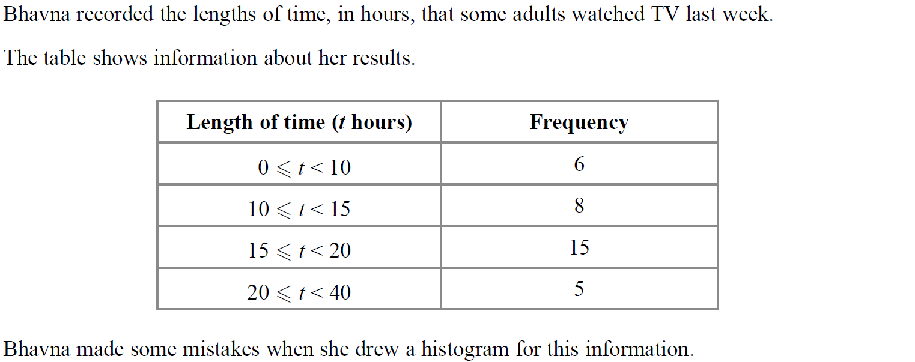
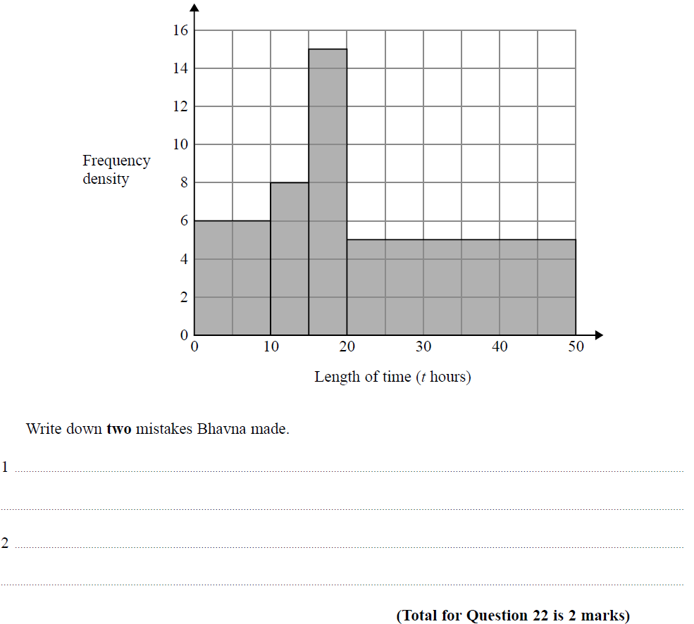
Histograms
SAM 1H Q22

Slide 3
Histograms
SAM 1H Q22
A

Slide 4
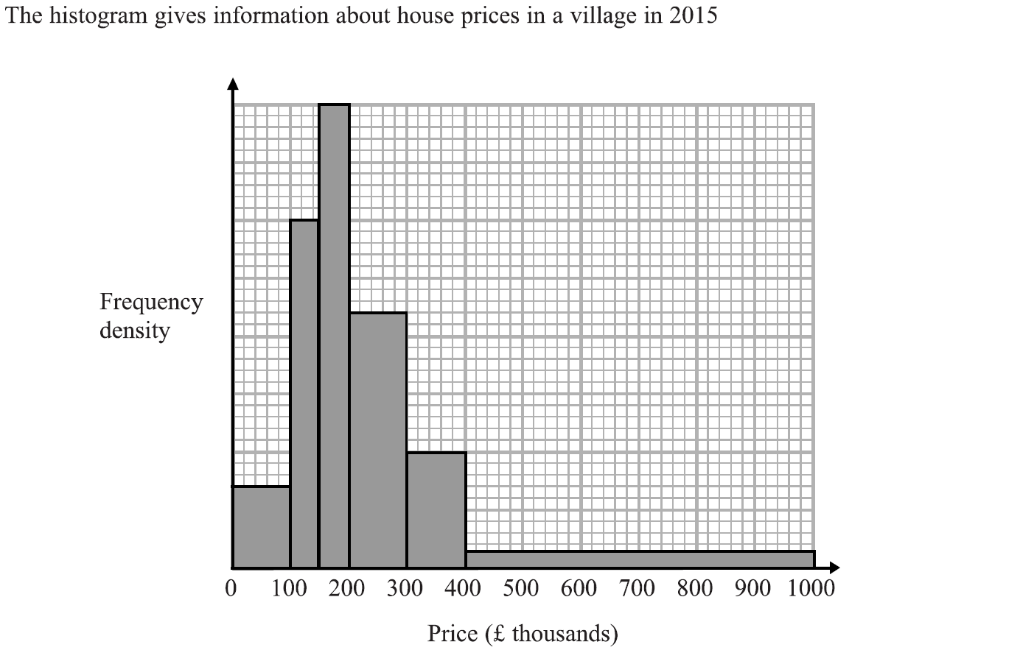
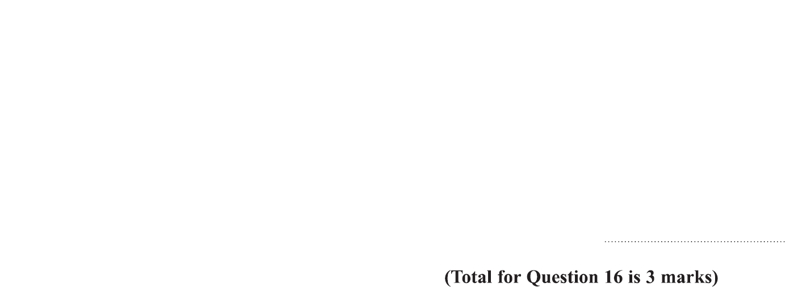
Histograms
Specimen Set 1 2H Q16

Slide 5
Histograms
Specimen Set 1 2H Q16
A

Slide 6
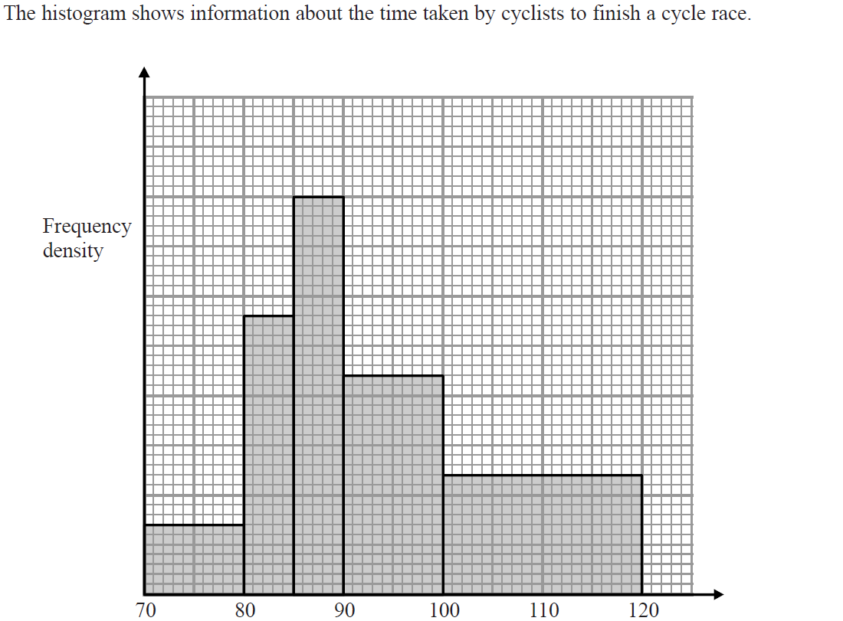
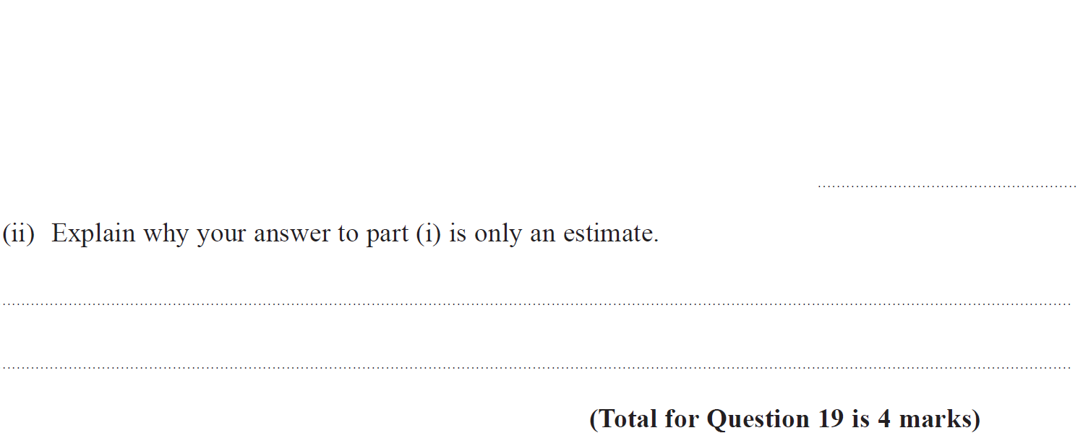
Histograms
Specimen Set 2 1H Q19

Slide 7
Histograms
Specimen Set 2 1H Q19
(i)
(ii)

Slide 8
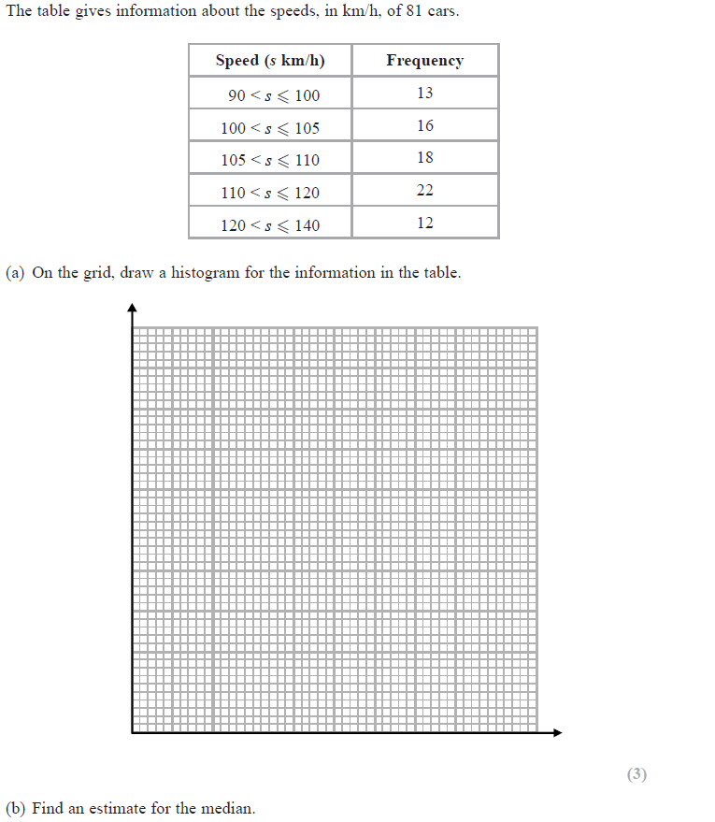
Histograms
Specimen Set 2 3H Q14
Frequency Density
1 2 3 4 5
Reveal Histogram
90 100 110 120 130 140
Speed km/h

Slide 9
Histograms
Specimen Set 2 3H Q14
A
B

Slide 10
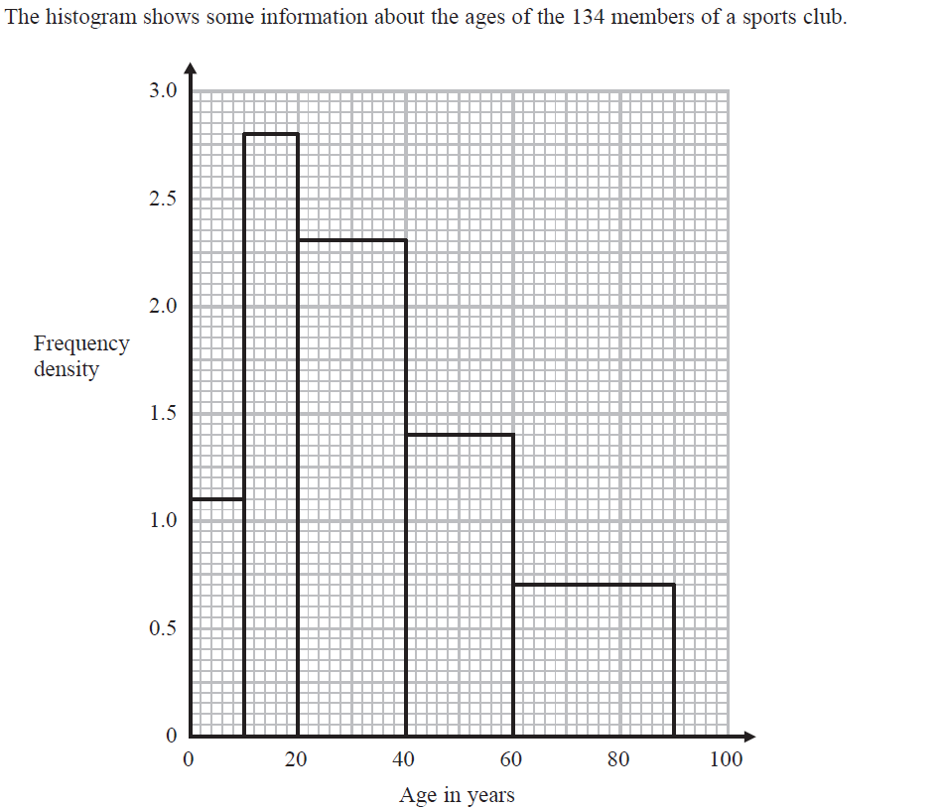
Histograms
June 2017 2H Q13

Slide 11
Histograms
June 2017 2H Q13
A

Slide 12
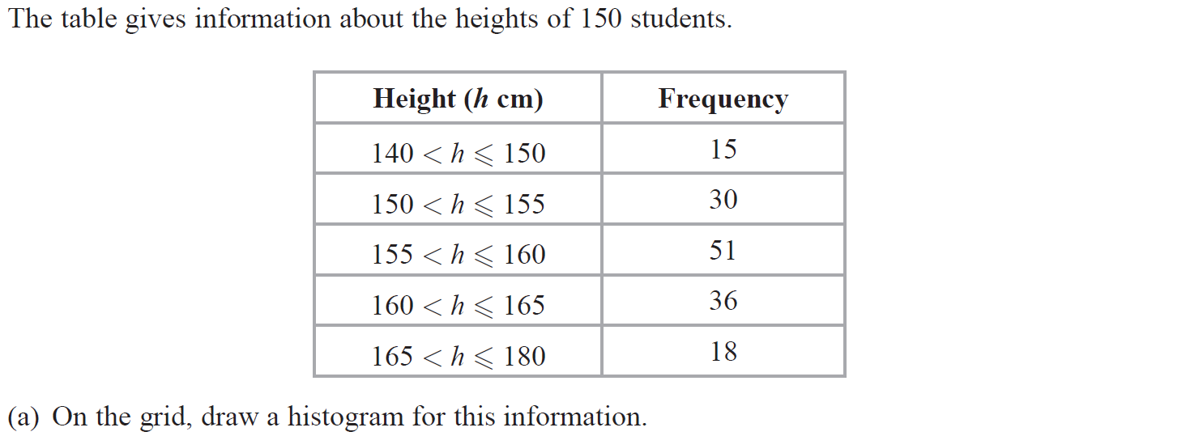
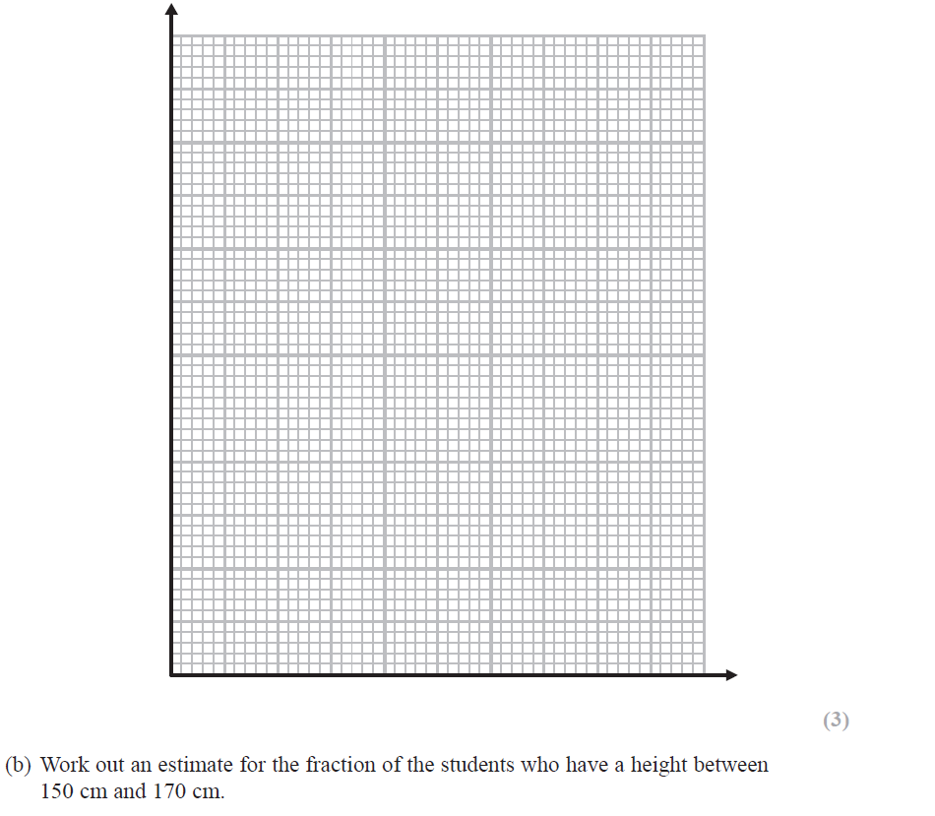
Histograms
Nov 2017 2H Q17
Frequency Density
1 2 3 4 5 6 7 8 9 10 11
Reveal Histogram

Slide 13
Histograms
Nov 2017 2H Q17
A
B

Slide 14
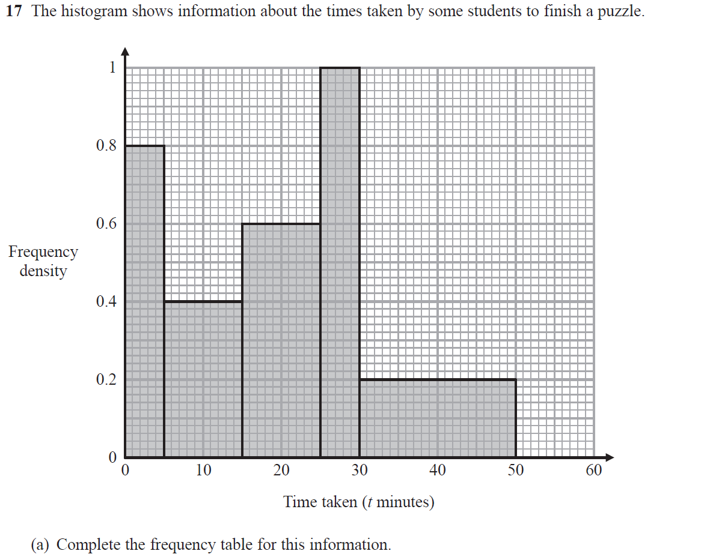
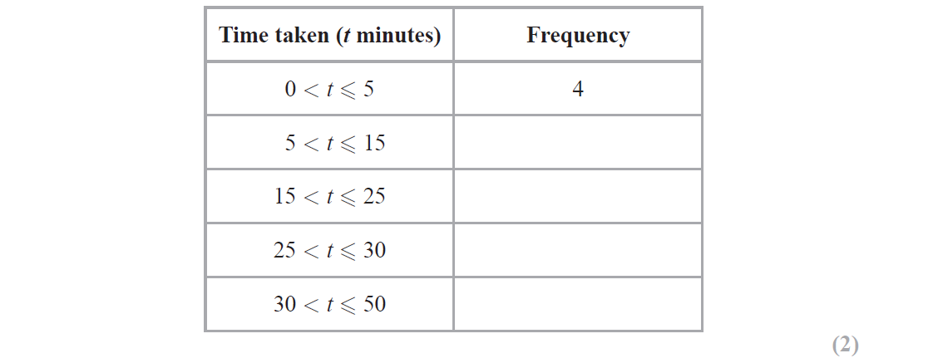
Histograms
June 2018 2H Q17

Slide 15
Histograms
June 2018 2H Q17
A
B

Slide 16
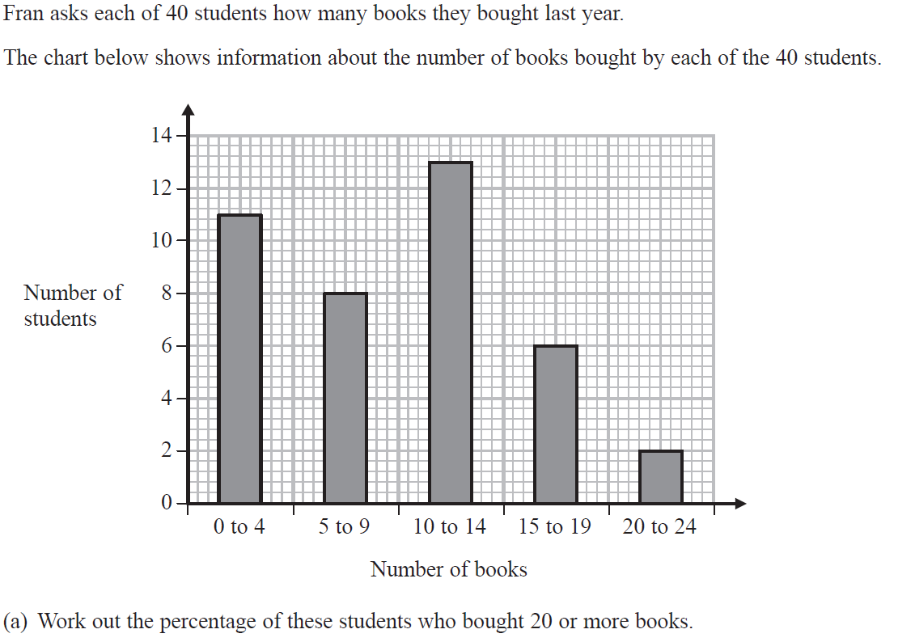
Histograms
Nov 2018 3H Q4

Slide 17
Histograms
Nov 2018 3H Q4
A
B

Slide 18
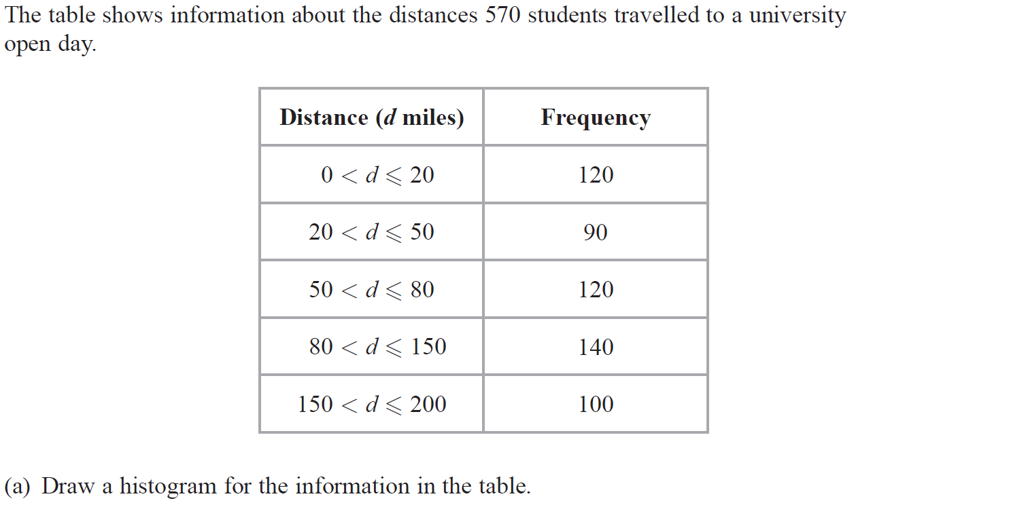
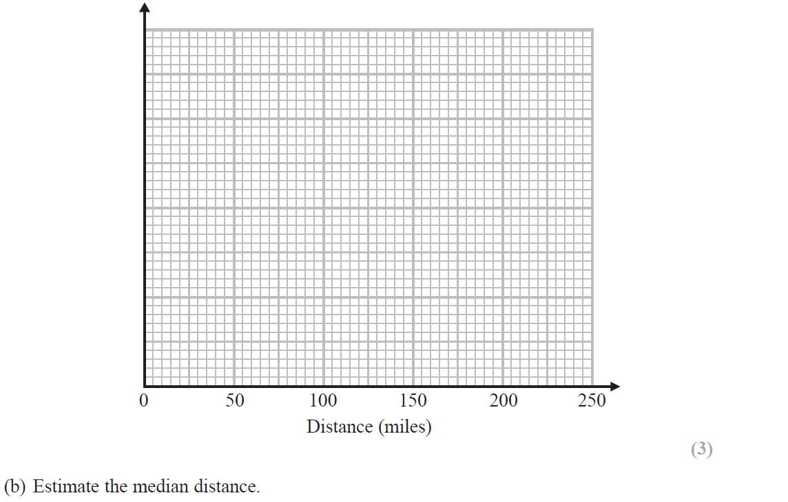
Histograms
Nov 2018 3H Q17
Frequency Density
1 2 3 4 5 6 7
Reveal Histogram

Slide 19
Histograms
Nov 2018 3H Q17
A
B

Slide 20
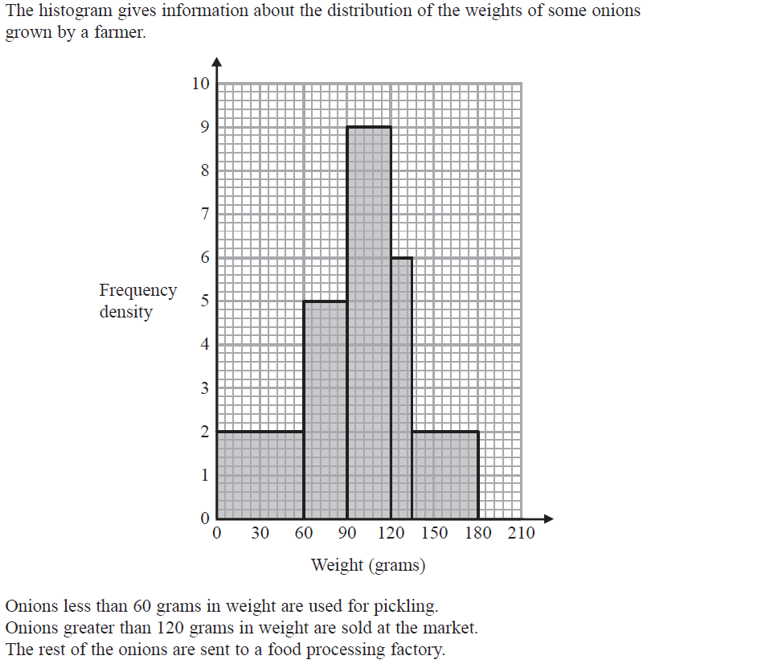
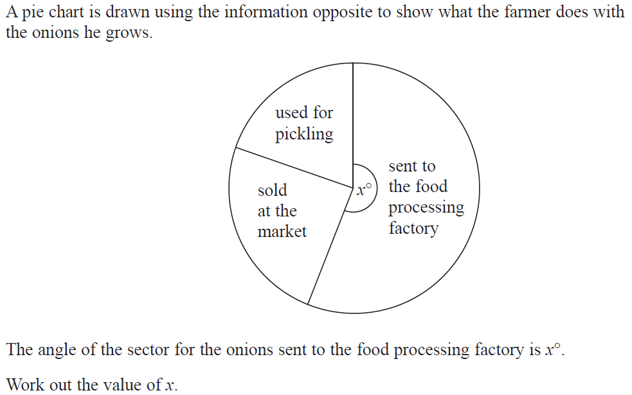
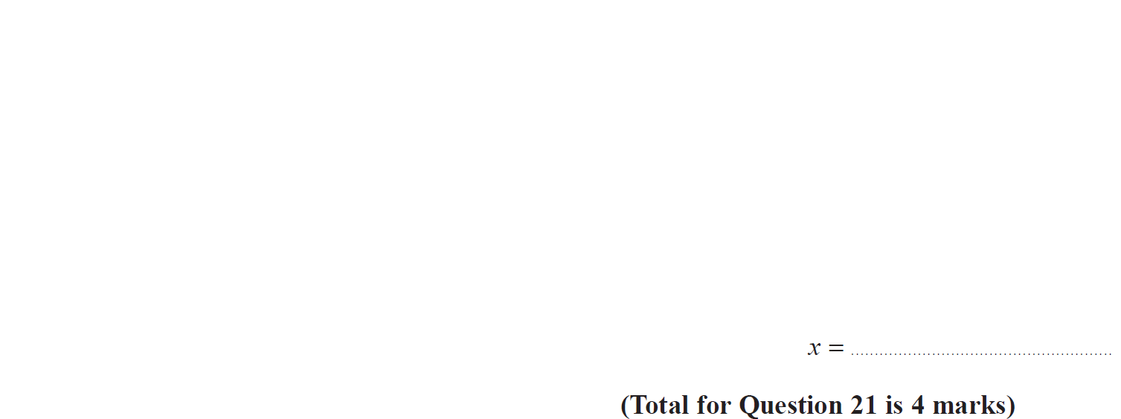
Histograms
June 2019 3H Q21

Slide 21
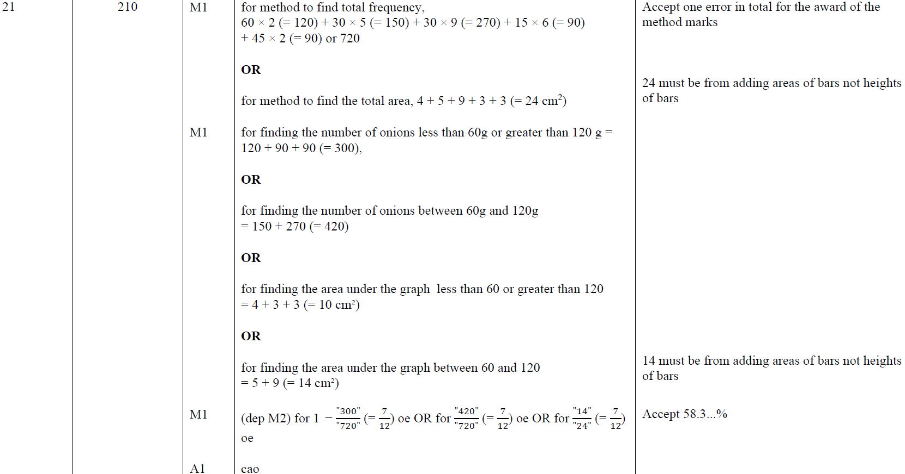
Histograms
June 2019 3H Q21
A

Slide 22
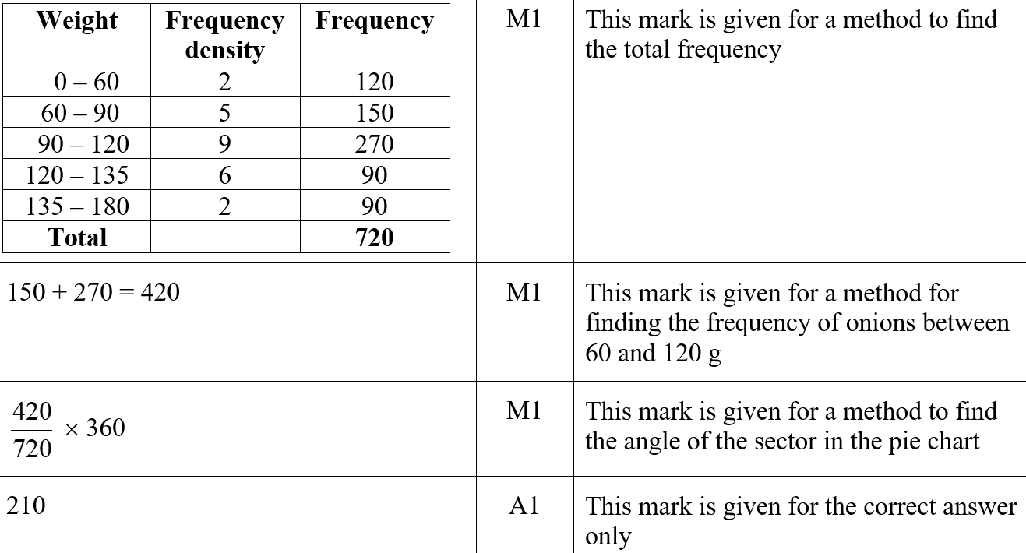
Histograms
June 2019 3H Q21
A SF

