Slide 1
Grouped Data
Grouped Data
June 2017 3H Q3
Nov 2017 1H Q5
SAM
2H Q5
Nov 2017 3H Q1
Spec 1
2H Q4
June 2018 2H Q17
Spec 1
3H Q4
Nov 2018 3H Q4
June 2019 3H Q3
Discrete Data

Slide 2
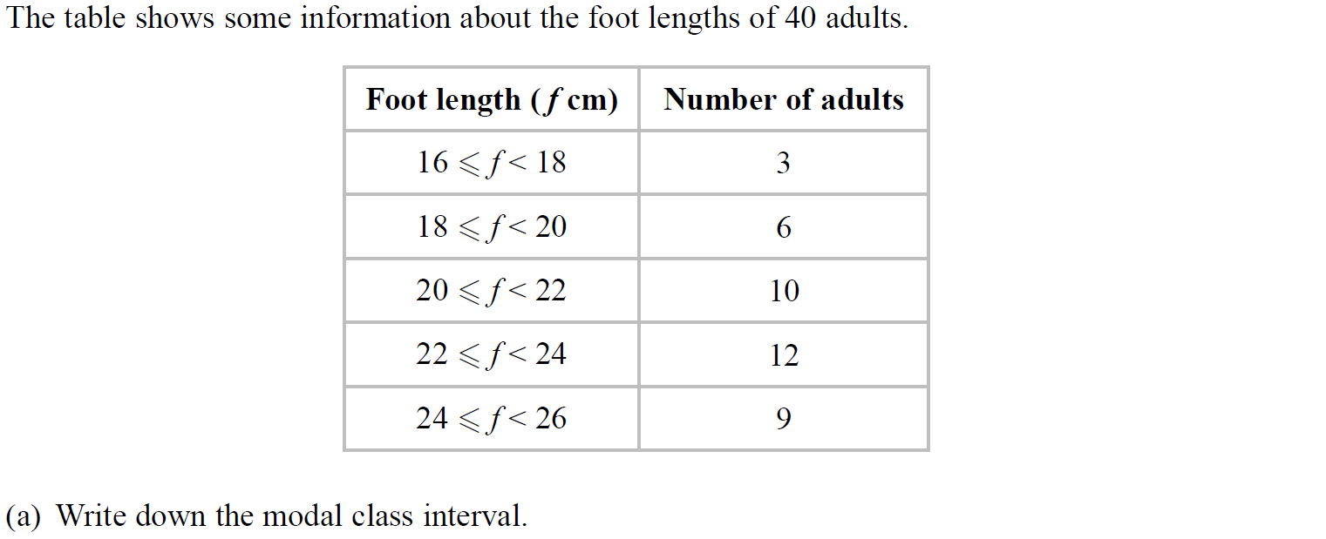
Grouped Data
SAM 2H Q5

Slide 3
Grouped Data
SAM 2H Q5
A
B

Slide 4
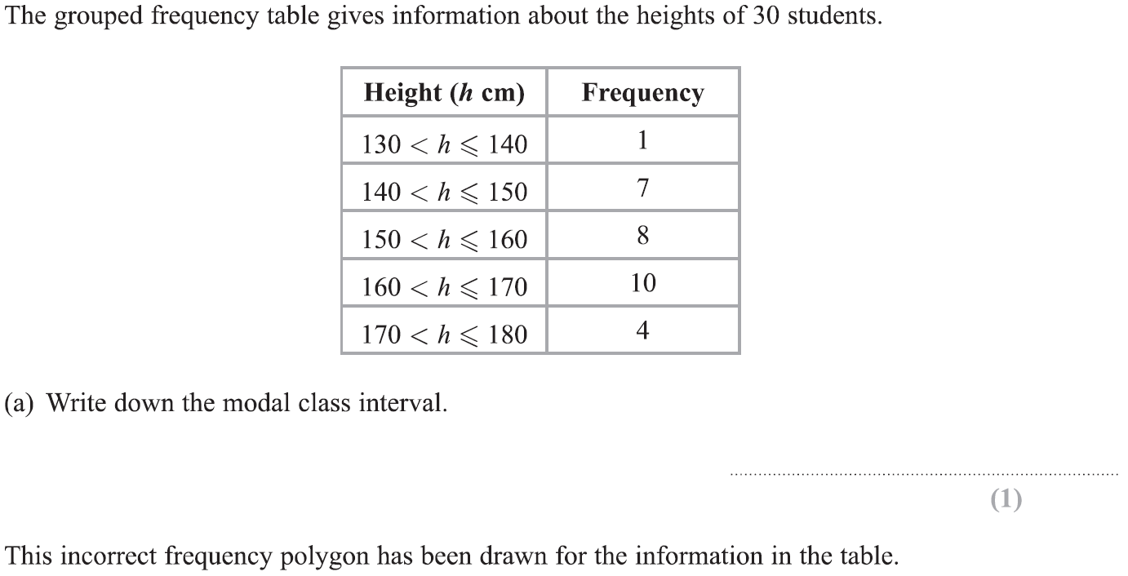
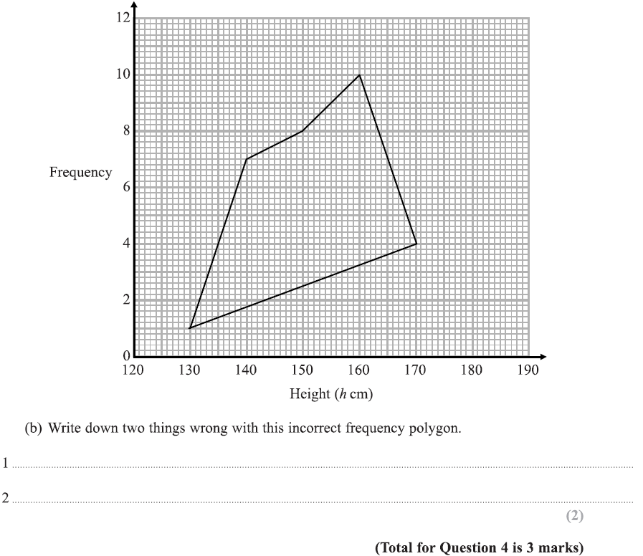
Grouped Data
Specimen Set 1 2H Q4

Slide 5
Grouped Data
Specimen Set 1 2H Q4
A
B

Slide 6
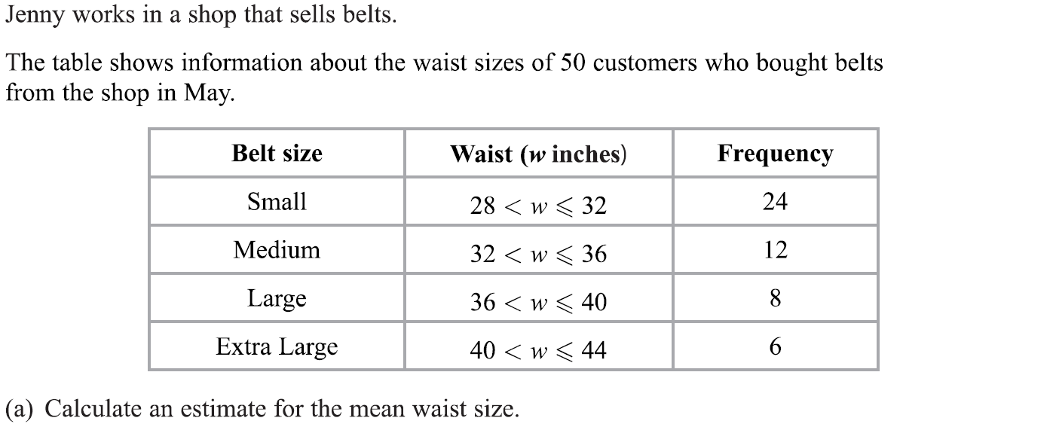
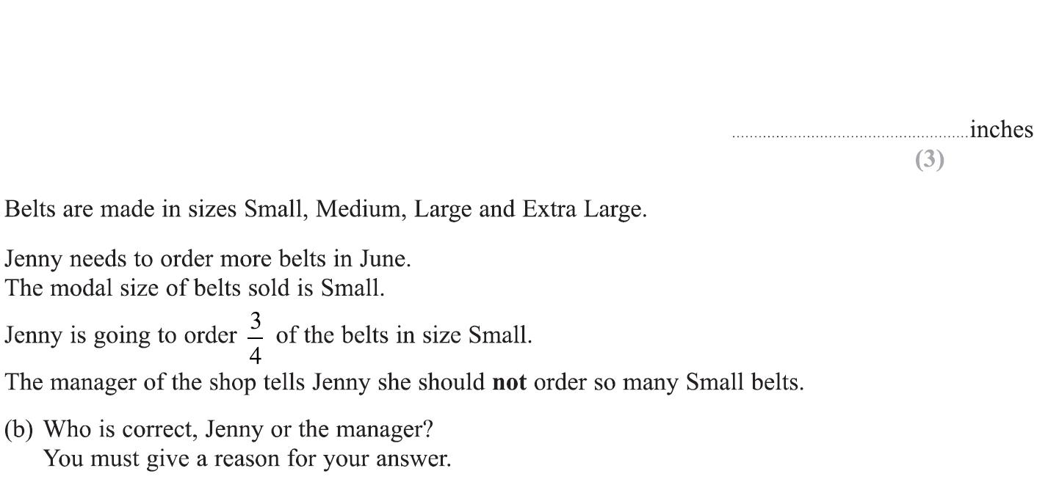
Grouped Data
Specimen Set 1 3H Q4

Slide 7
Grouped Data
Specimen Set 1 3H Q4
A
B

Slide 8
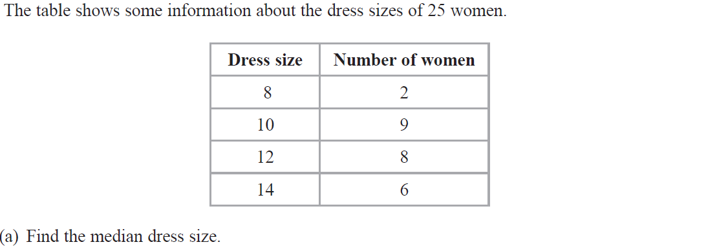
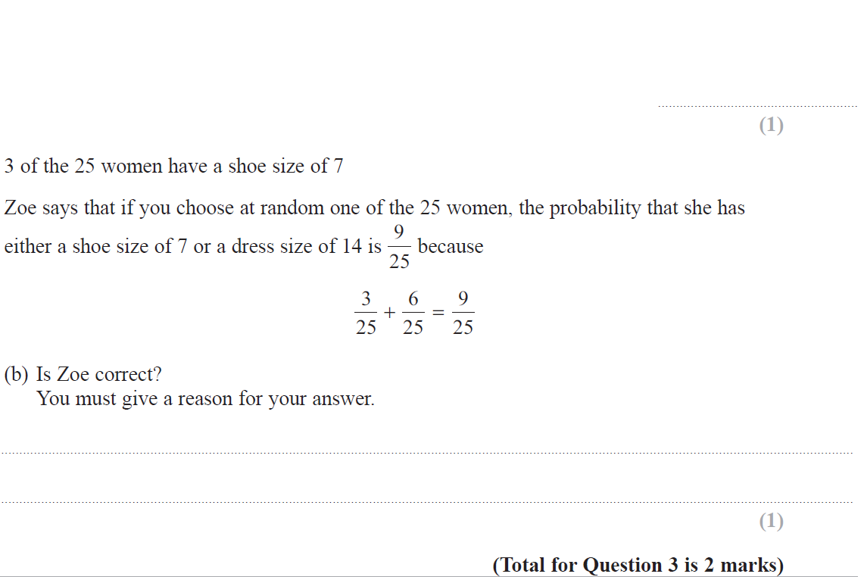
Grouped Data
June 2017 3H Q3

Slide 9
Grouped Data
June 2017 3H Q3
A
B

Slide 10
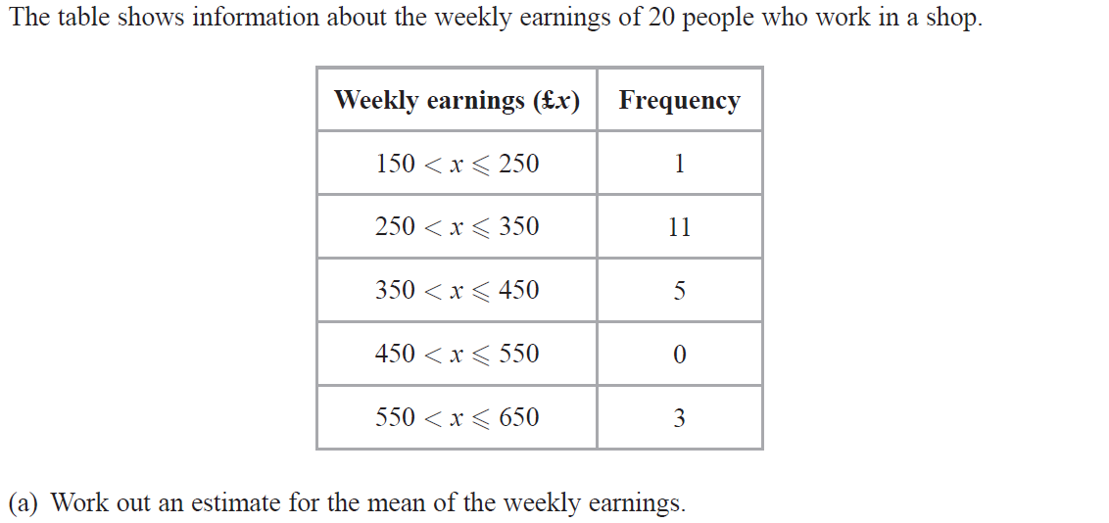
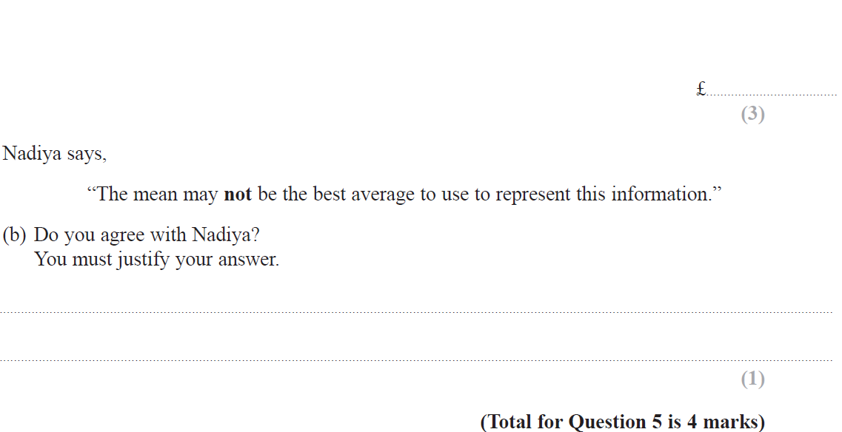
Grouped Data
Nov 2017 1H Q5

Slide 11
Grouped Data
Nov 2017 1H Q5
A
B

Slide 12
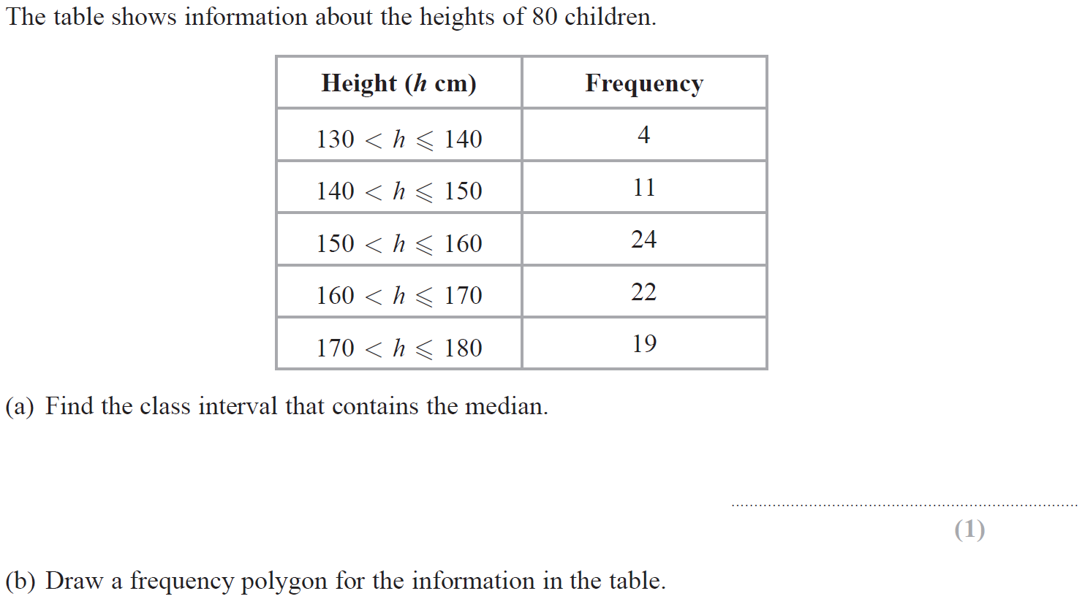
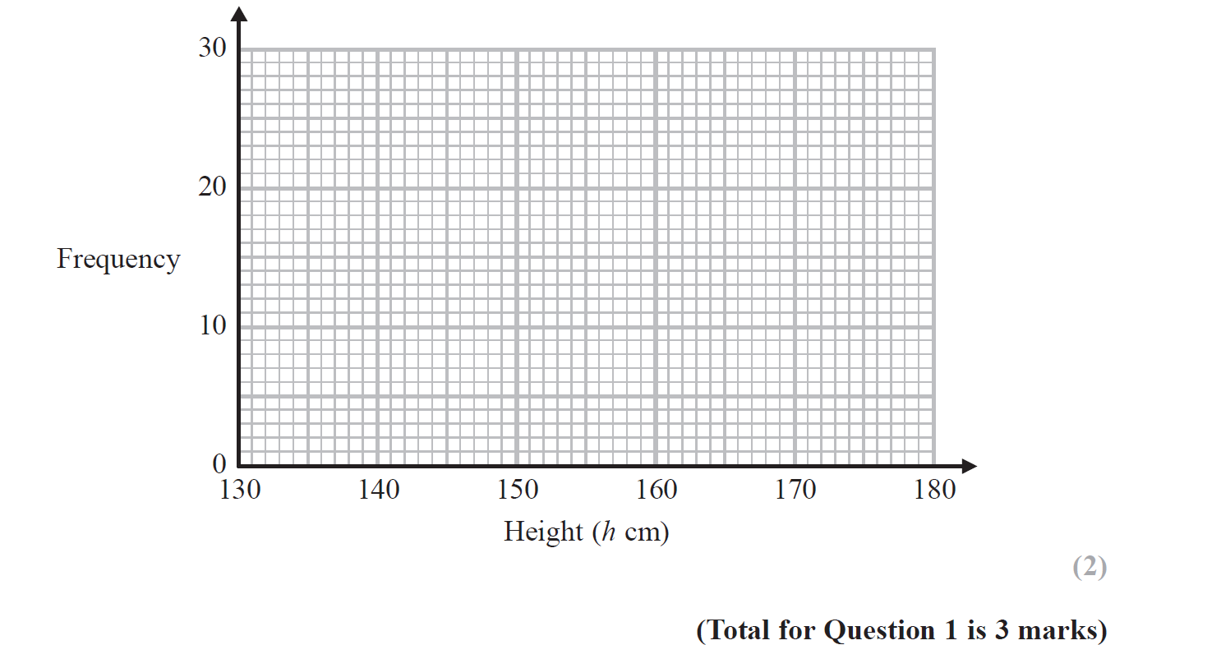
Grouped Data
Nov 2017 3H Q1
Reveal Graph (b)

Slide 13
Grouped Data
Nov 2017 3H Q1
A
B

Slide 14
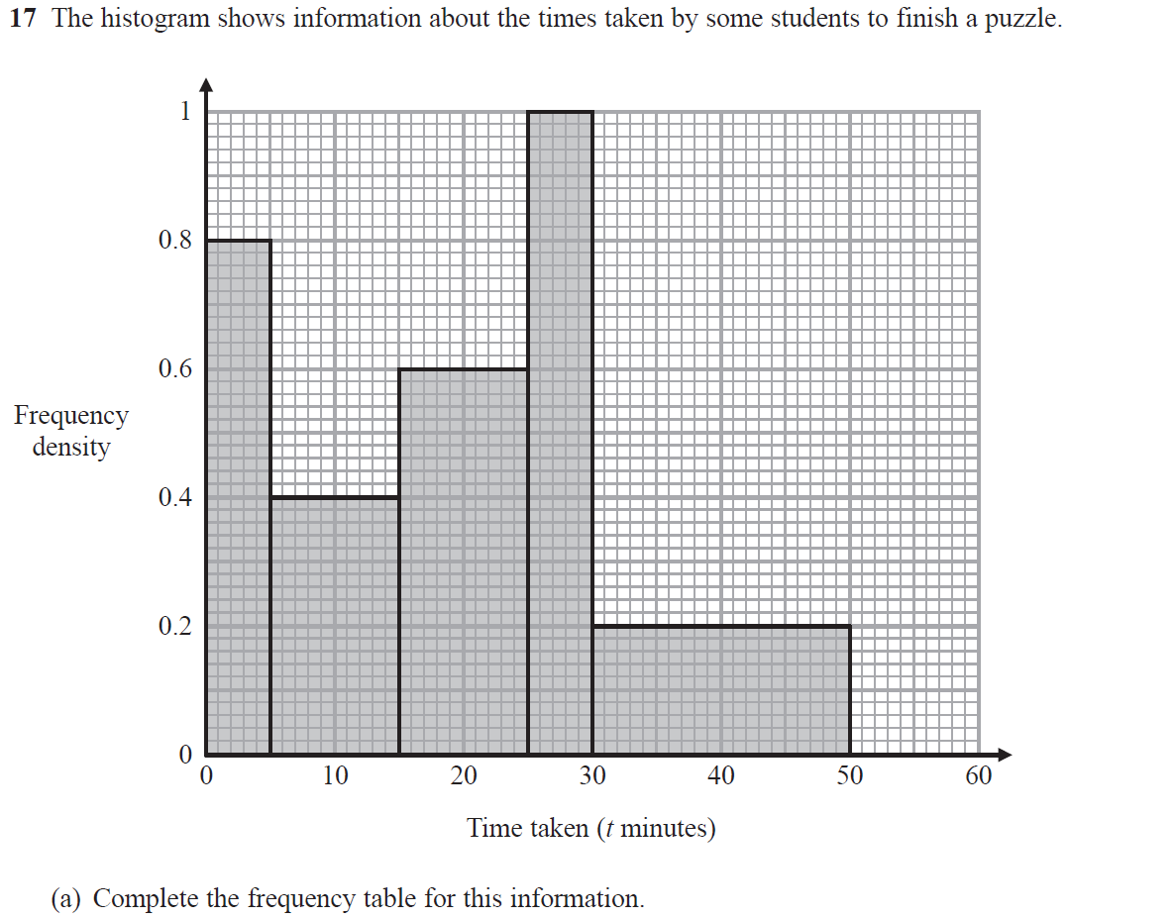
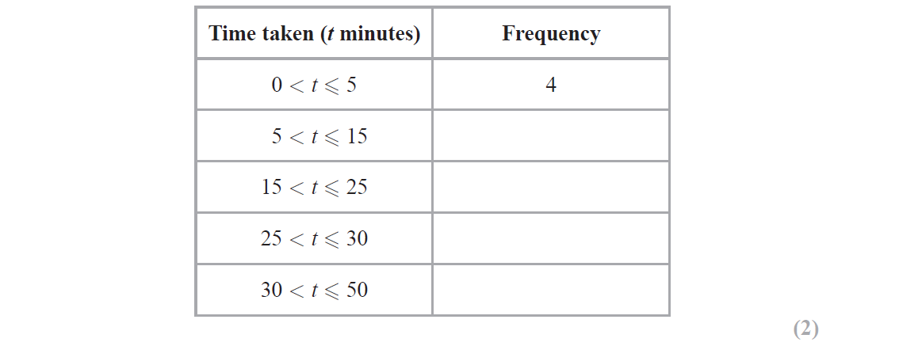
Grouped Data
June 2018 2H Q17

Slide 15
Grouped Data
June 2018 2H Q17
A
B

Slide 16
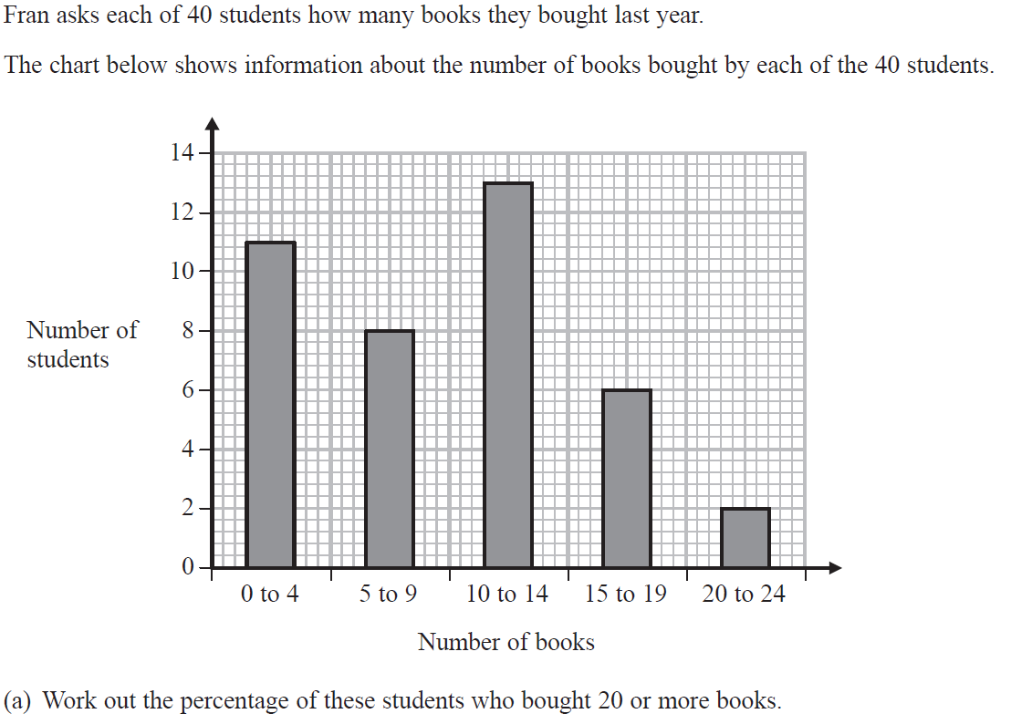
Grouped Data
Nov 2018 3H Q4

Slide 17
Grouped Data
Nov 2018 3H Q4
A
B

Slide 18
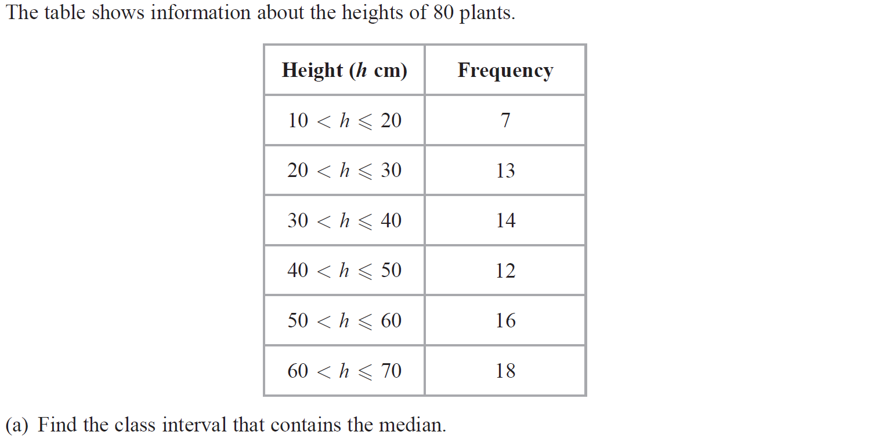
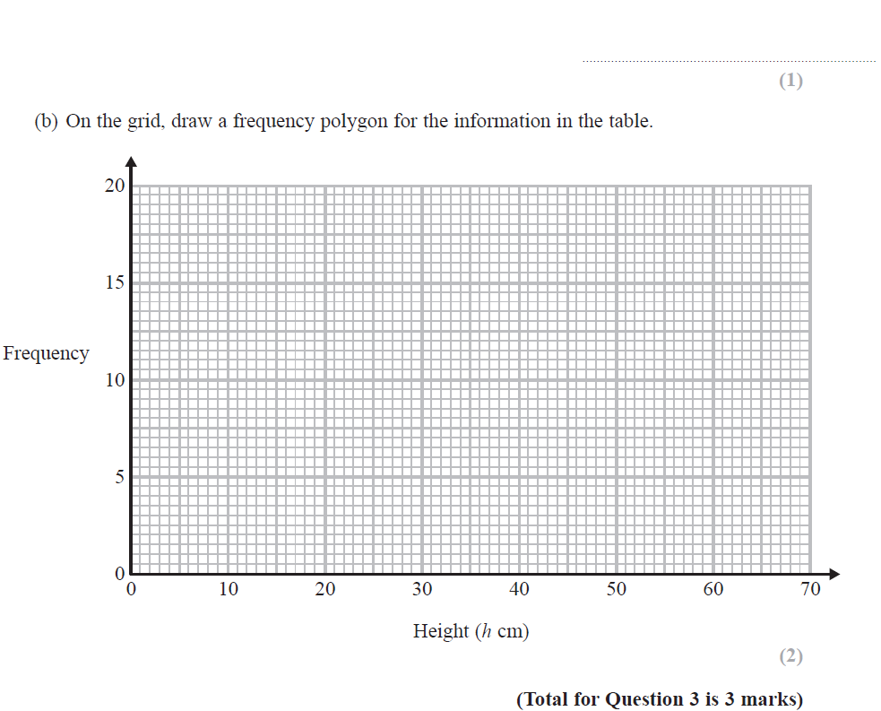
Grouped Data
June 2019 3H Q3

Slide 19
Grouped Data
June 2019 3H Q3
A
B
A SF
B SF

