Slide 1
Grouped Data
Grouped Data
Practice
1H Q9
Nov 2017
3H Q3
Practice
3H Q11
Nov 2018
3H Q2
Discrete Data

Slide 2
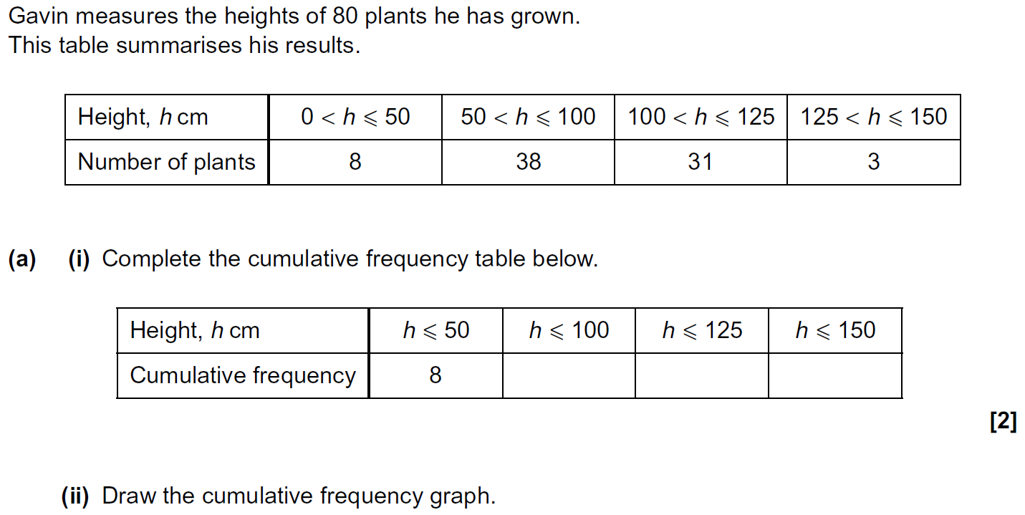
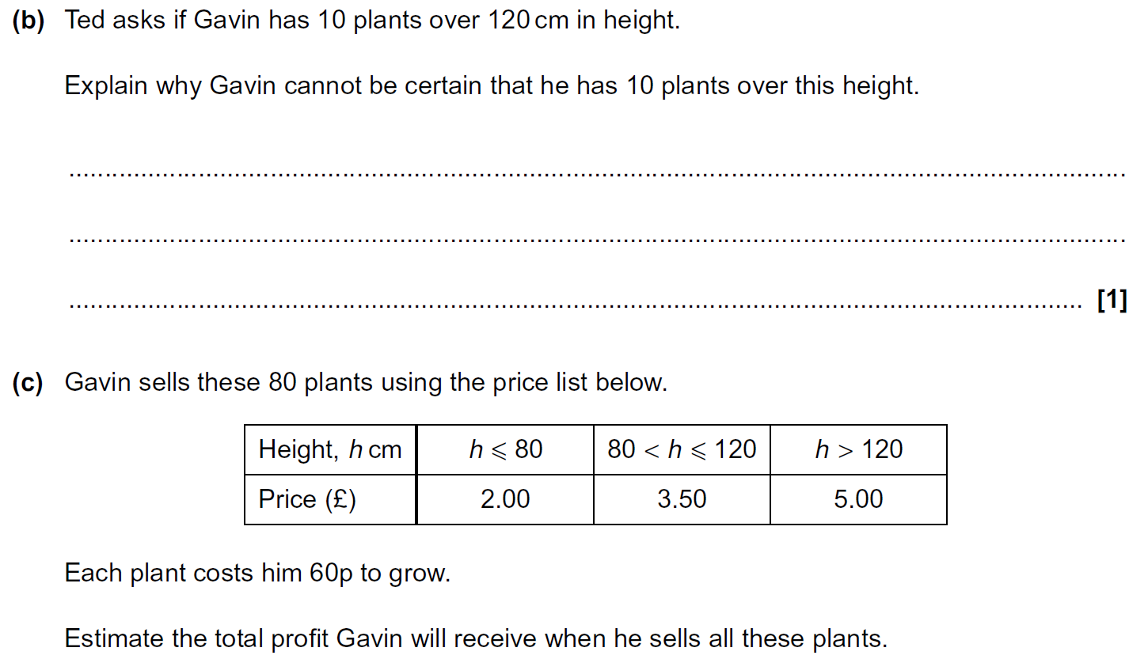
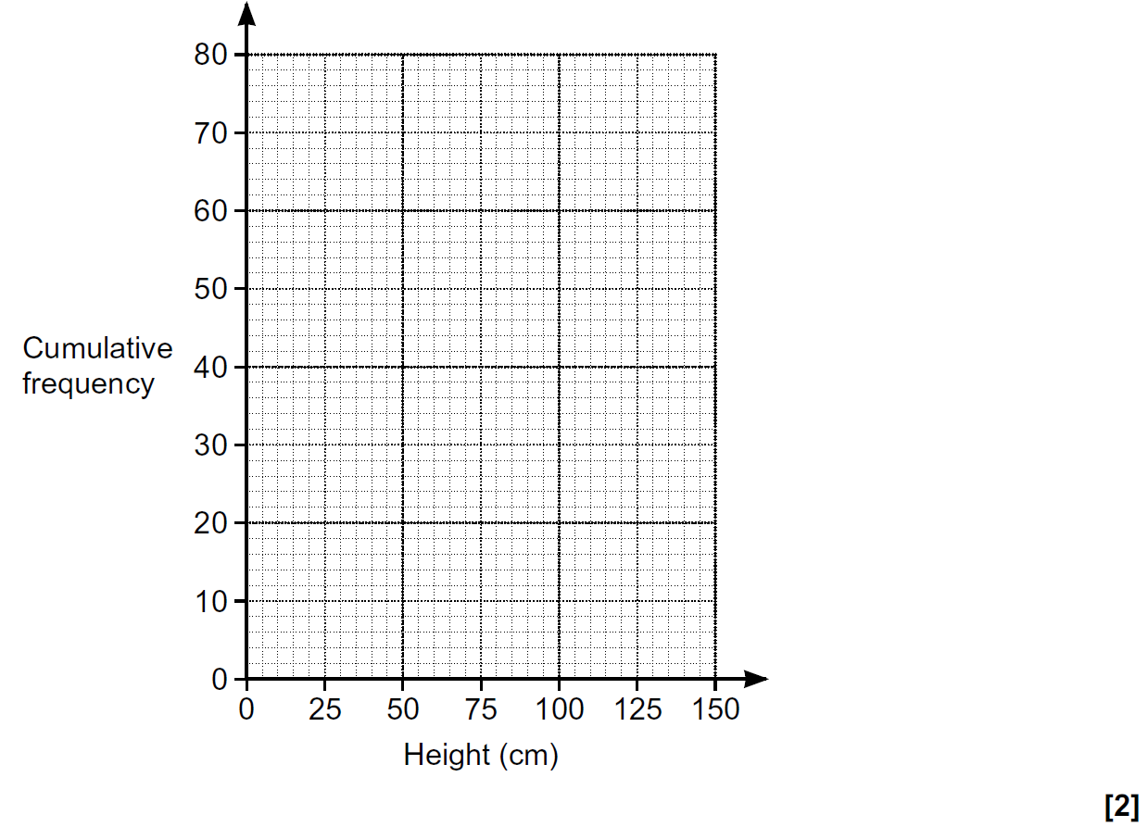
Grouped Data
Practice 1H Q9

Slide 3
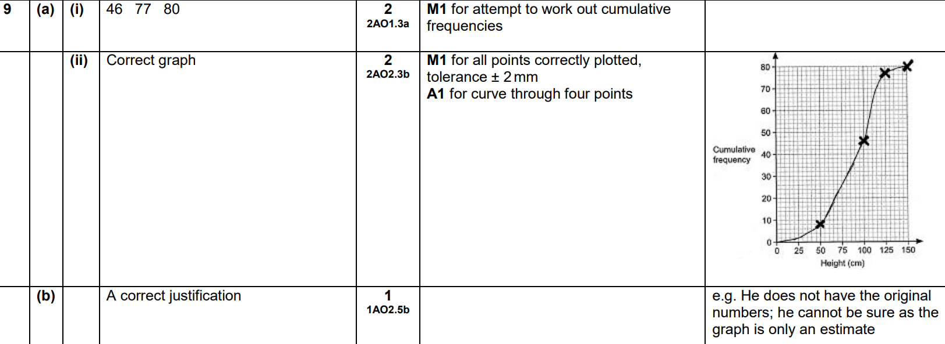
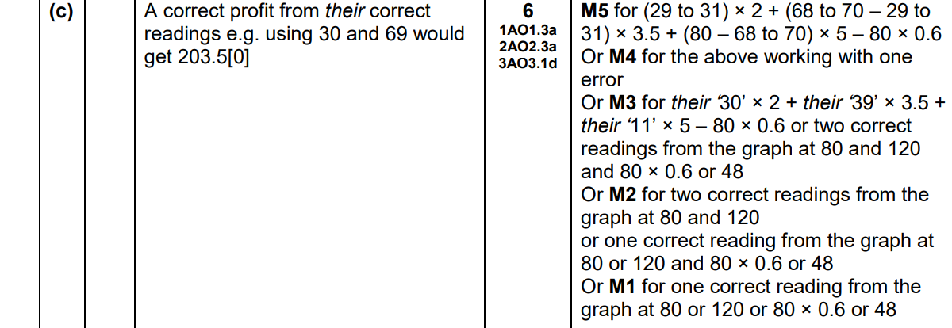
Grouped Data
Practice 1H Q9
A (i)
A (ii)
B
C

Slide 4
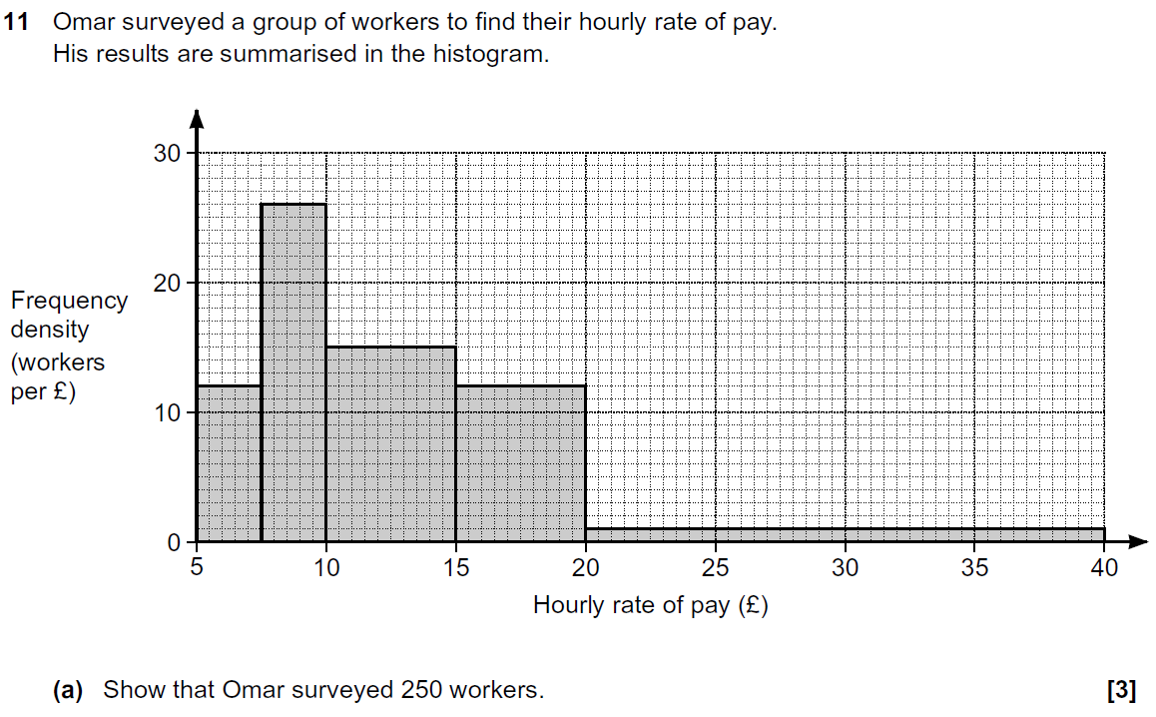
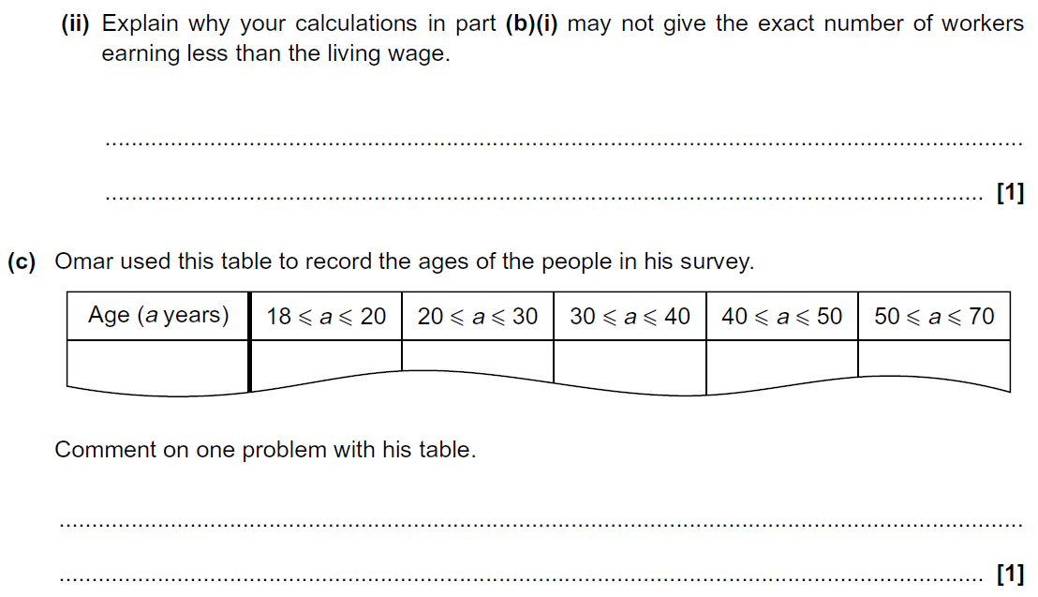
Grouped Data
Practice 3H Q11

Slide 5
Grouped Data
Practice 3H Q11
A
B (i)
B (ii)
C

Slide 6
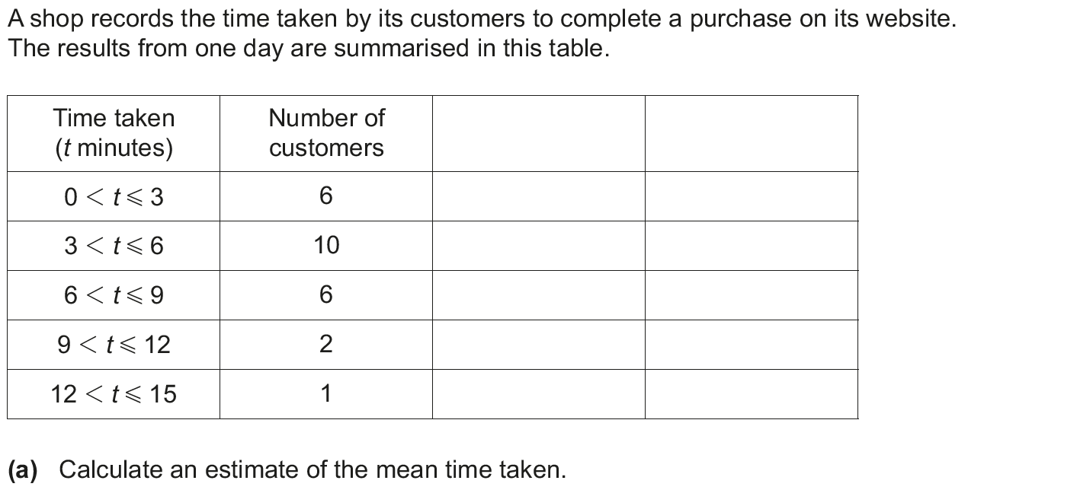
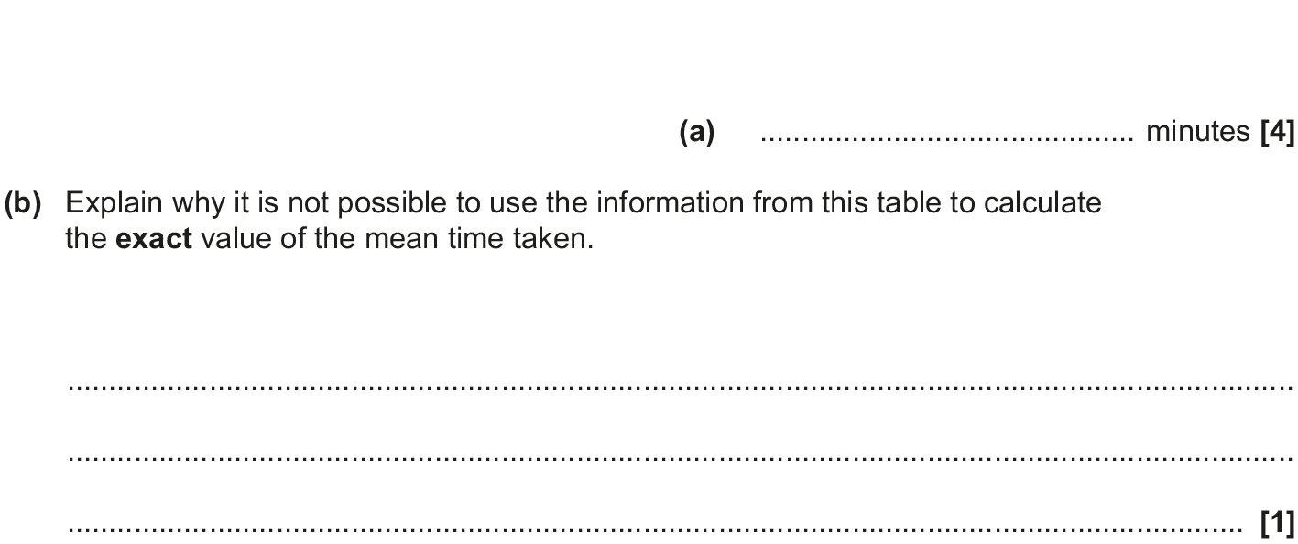
Grouped Data
Nov 2017 3H Q3

Slide 7
Grouped Data
Nov 2017 3H Q3
A
B

Slide 8
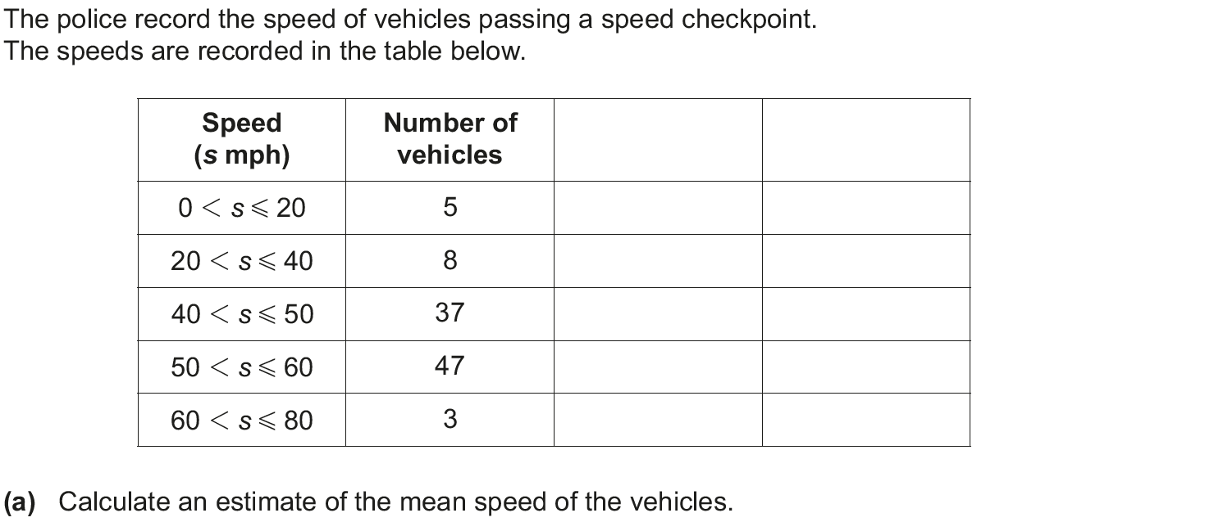
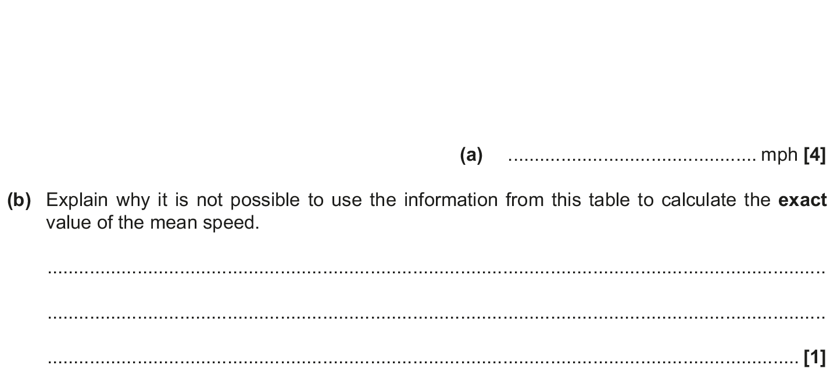
Grouped Data
Nov 2018 3H Q2

Slide 9
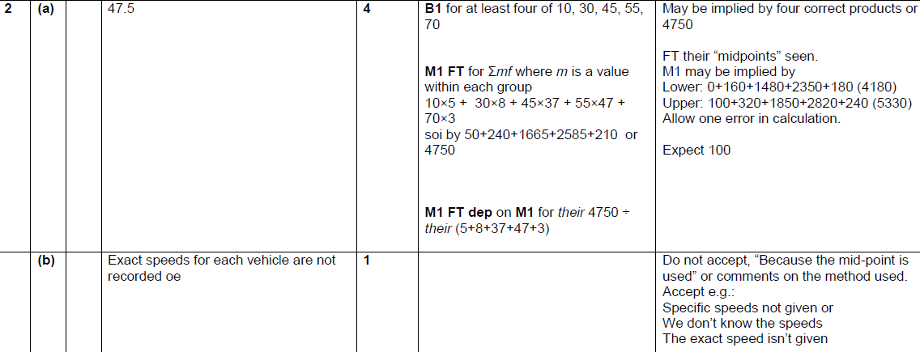
Grouped Data
Nov 2018 3H Q2
A
B

